Slide 1
e-handout
To have these notes
without taking notes
Go to OrHaOlam.com
Click on Messages tab,
2024 Messages

Slide 2
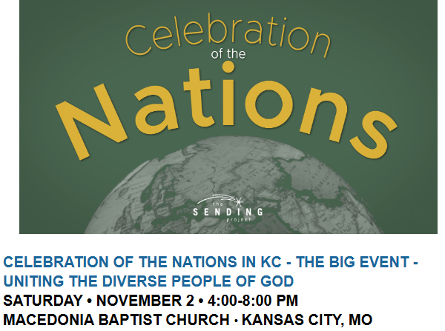
Need a shofarblower!!
1700 Linwood,
KC, MO 64109

Slide 3
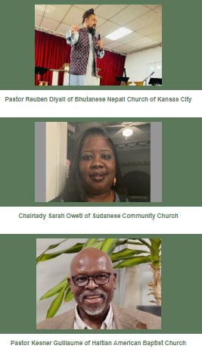
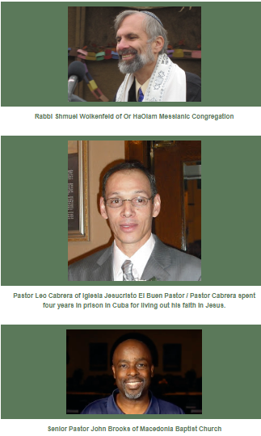

Slide 4
Nations (people groups) of the world have come to the Kansas City metro area! God has blessed the citywide believers of KC with these amazing followers of Messiah. Join us for this BIG EVENT to fellowship with, learn from, celebrate, and hear stories from followers of Yeshua from various people groups (nations) in our city!

Slide 5
The Bible tells us in the book of Revelation that in the future every people group will be gathered around the throne of Jesus and worshiping Him! This will be a heavenly gathering as we celebrate the nations in the Kansas City metro area!

Slide 6
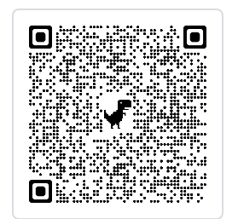
Or HaOlam will have a song time, dance troupe, display table, 4 minute message from Shmuel.
Register free at
Notes:
Or register on site.

Slide 7
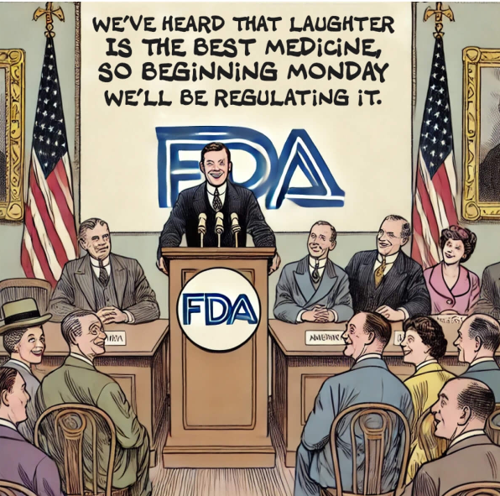
FDA:
We’ve heard that laughter is the best medicine, so beginning Monday, we’ll be regulating it.
Notes:
https://alerts.aflds.org/archive/9z4zaam84ef7c35fmk1mucj5j4ufbsg8575fumur0r8_rp2ach2srat38h1e8he49j4slie4pj5c3h2bs

Slide 8
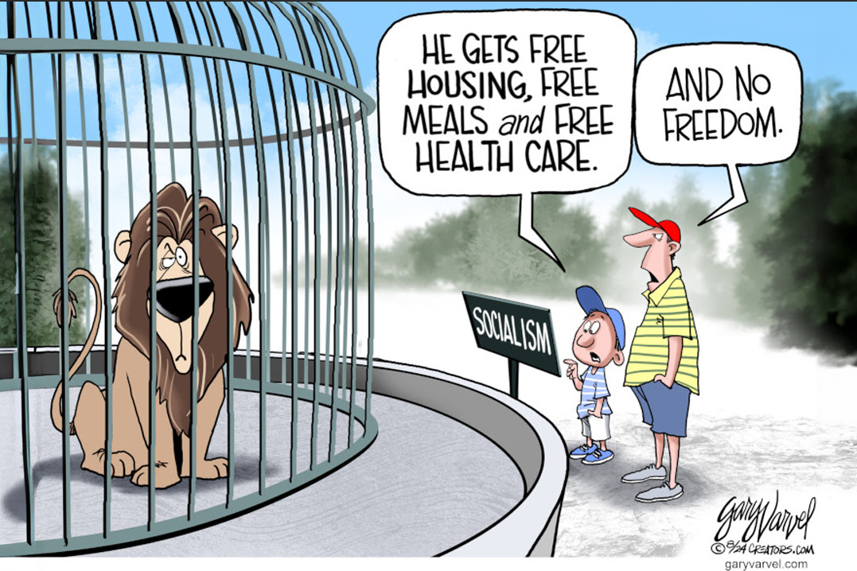
Notes:
AFLDS.org

Slide 9
Notes:
AFLDS.org

Slide 10
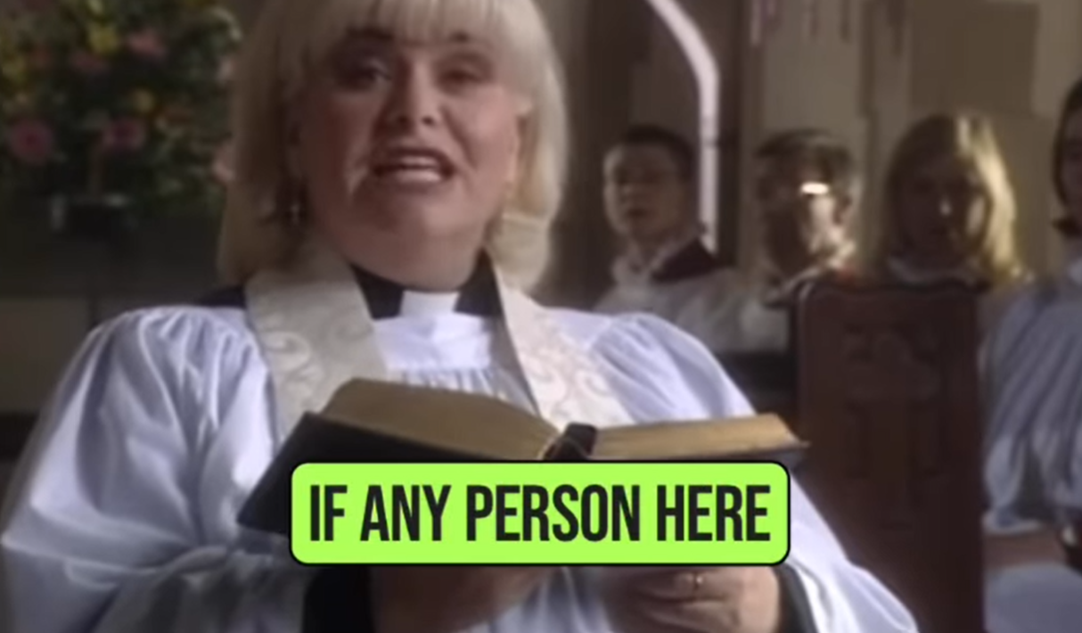
British humor
Notes:
https://www.instagram.com/reel/C_nM_NEs3i0/?igsh=bXMxbWFtajF4dHZk
Continuing in my series in Ephesians.

Slide 11
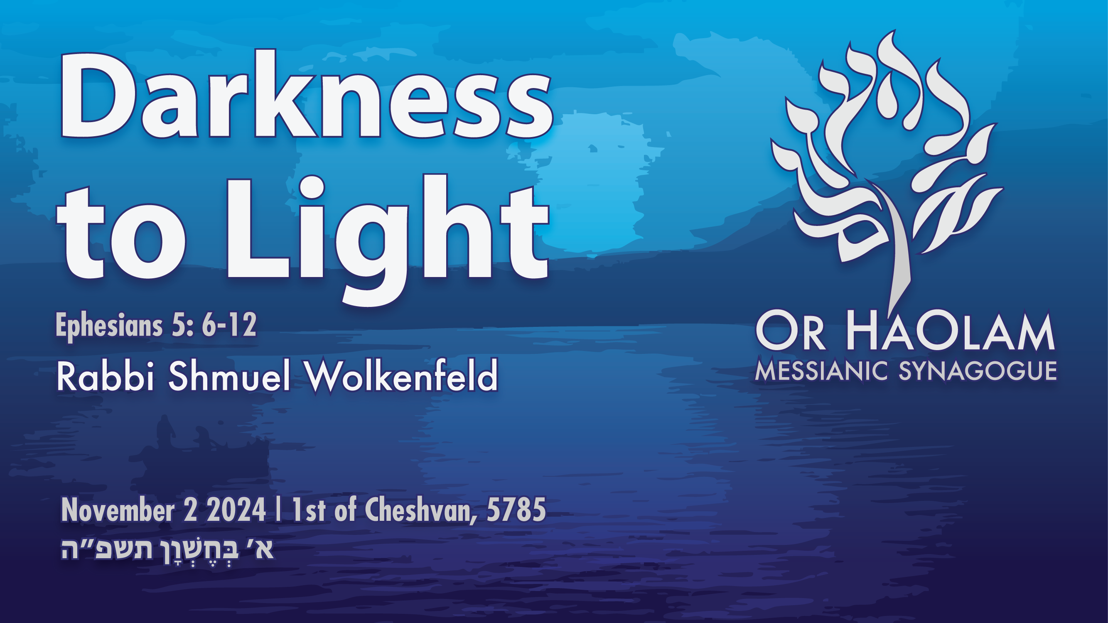

Slide 12

Notes:
Sunrise on Yam Kinerret, Sea of Galilee

Slide 13
^{Eph. 5.6-12} Let no one deceive you with empty words, for because of such things God’s judgment comes on the children of disobedience. Therefore do not be partners with them. For once you were darkness, but now in union with the Lord you are light.
Notes:
Aren’t most people unaware of the reality of holiness?

Slide 14
^{Eph. 5.6-12} Walk as children of light (for the fruit of light is in all goodness and righteousness and truth), trying to learn what is pleasing to the Lord. Take no part in the fruitless deeds of darkness,

Slide 15
^{Eph. 5.6-12} but rather expose them— for it is disgraceful even to mention the things that are done by them in secret.

Slide 16
Or as the prophet Yeshayahu / Isaiah described it:

Slide 17
^{Yeshayahu / Is 60.1-3} Arise, shine, for your light has come! The glory of Adoni has risen on you. For behold, darkness covers the earth, and deep darkness the peoples. But Adoni will arise upon you, and His glory will appear over you. Nations will come to your light, kings to the brilliance of your rising.
Notes:
One of my favorite verses. Hebrew set to music at least twice: Kumi Ori
Deep darkness [pray]

Slide 19
What darkness? What remedy?
Darkness within us
Darkness in our culture, increasingly.
Darkness in Islamic thinking.

Slide 20
What darkness? What remedy?
Darkness within us
Darkness in our culture, increasingly.
Darkness in Islamic thinking.

Slide 21
^{Yermiyahu / Jer 17.9} “The heart is deceitful above all things, and incurable—who can know it? I Adoni search the heart, I try the mind, to give every man according to his ways, according to the fruit of his deeds.
Notes:
We tend to see ourselves as victims, suffering. Not wrongdoers and corrupt.

Slide 22
^{Beresheet/Gen 6.5} Then Adoni saw that the wickedness of humankind was great on the earth, and that every inclination of the thoughts of their heart was only evil all the time.

Slide 23
^{1 Cor. 4.4} I am not aware of anything against me, but this does not make me innocent. The one who is evaluating me is the Lord.
Notes:
We justify ourselves. Excuse ourselves.
EVERYthing that we suffer is a result of some growth G-d want to work in us. Some sin, some weakness.

Slide 24
^{T’hillim/Ps 26.2} Probe me, Adoni, and test me, refine my mind and my heart.
^{T’hillim/Ps 139.23-24} Examine me, God, and know my heart; test me, and know my thoughts. See if there is in me any hurtful way, and lead me along the eternal way.

Slide 25
^{Ephesians 4.17-19} So I tell you this, indeed I insist on it in the Lord—walk no longer as the pagans do, stumbling around in the futility of their thinking. They are darkened in their understanding, alienated from the life of God

Slide 26
^{Ephesians 4.17-19} because of the ignorance in them due to the hardness of their heart. Since they are past feeling, they have turned themselves over to indecency for the practice of every kind of immorality, with greed for more.
Notes:
So, we misread each other, get angry and offended.
So, we are lonely, seduce each other with improper words or gestures.
We feel defrauded, and counterattack

Slide 27
Remedy to the darkness within?
The love and light of Messiah
The death and resurrection of Messiah

Slide 28
^{Mtt.11.28-30} “Come to me, all of you who are struggling and burdened, and I will give you rest. Take my yoke upon you and learn from me, because I am gentle and humble in heart, and you will find rest for your souls. For my yoke is easy, and my burden is light.”
Notes:
It’s life affirming but ego denying to say, “I did wrong.” “I sinned.” “I’m corrupted.”
YK confessional.

Slide 29
^{Gal 2.19-20} For it was through letting the Torah speak for itself that I died to its traditional legalistic misinterpretation, so that I might live in direct relationship with God. When the Messiah was executed on the stake as a criminal, I was too;

Slide 30
^{Gal 2.19-20} so that my proud ego no longer lives. But the Messiah lives in me, and the life I now live in my body I live by the faith in the Son of God had, who loved me and gave himself up for me

Slide 32
What darkness? What remedy?
Darkness within us
Darkness in our culture, increasingly.
Darkness in Islamic thinking.

Slide 33
^{2 Tim 3.1-5} Moreover, understand this: in theאחרית הימים akharit-hayamim [end of days] will come trying times. People will be self-loving, money-loving, proud, arrogant, insulting, disobedient to parents,
Notes:
Cancelling of parents

Slide 34
^{2 Tim 3.1-5} ungrateful, unholy, heartless, unappeasable, slanderous, uncontrolled, brutal, hateful of good, traitorous, headstrong, swollen with conceit, loving pleasure rather than God, as they retain the outer form of religion but deny its power.
Notes:
Matt Staver

Slide 35
Remedy to the increasing darknss of our culture?
Yeshua is the light of world.
^{Mtt 5.14-16} “You are light for the world. A town built on a hill cannot be hidden. Likewise, when people light a lamp,

Slide 36
^{Mtt 5.14-16} they don’t cover it with a bowl but put it on a lampstand, so that it shines for everyone in the house. In the same way, let your light shine before people, so that they may see the good things you do and praise your Father in heaven.
Notes:
Abby Johnson

Slide 37
^{1 Tim 2.1-3} Therefore, first of all I urge that requests, prayers, intercessions, and thanksgiving be made on behalf of all people — for kings and all who are in authority —so we may live a peaceful and quiet life in all godliness and respectfulness.
Notes:
serve the kings and authority… VOTE

Slide 38
^{1 Tim 2.1-3} This is good and pleasing in the sight of God our Savior. He desires all men to be saved and come into the knowledge of the truth.

Slide 39
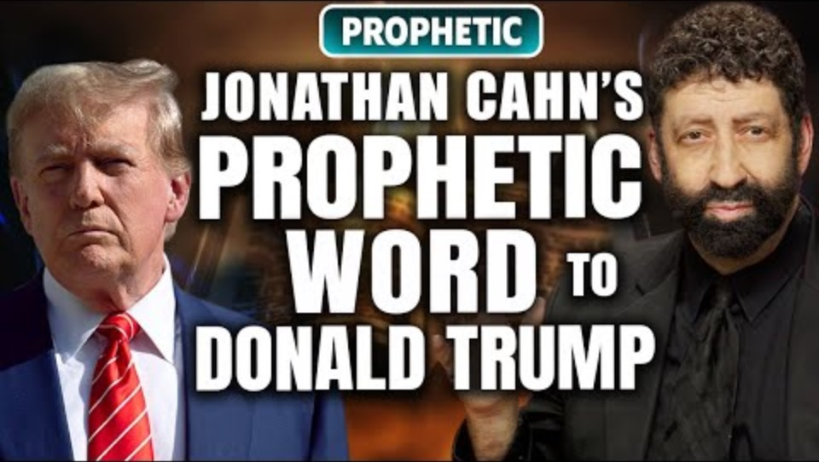
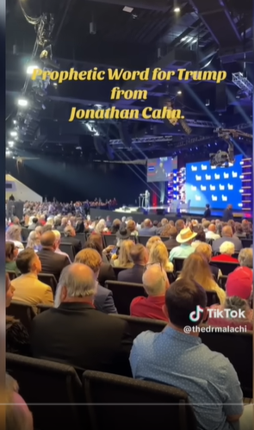
Notes:
https://www.youtube.com/watch?v=6E7P8h2DVus

Slide 40
Shalom from Jonathan Cahn,
This is to thank you for your prayers for the gathering with President Trump at the Inaugural National Faith Summit. There were a lot of chances for the word not to be given (warfare), but at the end, the message I was led to give to Donald Trump came through.

Slide 41
Afterward, I was called up with other faith leaders to pray over Trump. I then met him on stage, we shook hands, and took a picture together. Also, some connections were made that could be very important in the future, especially if the Republicans win on Tuesday.

Slide 42
Of course we need to pray for the election, the future of America, God’s will, encourage our people to vote.
Someone in the gathering recorded the message with the cell phone and posted it online – we reposted it here, if you’d like to see/ share it

Slide 43
https://www.youtube.com/watch?v=6E7P8h2DVus
Again, thank you so much for your prayers and encouragement. I believe it made the difference.
Blessings!
Jonathan Cahn

Slide 44
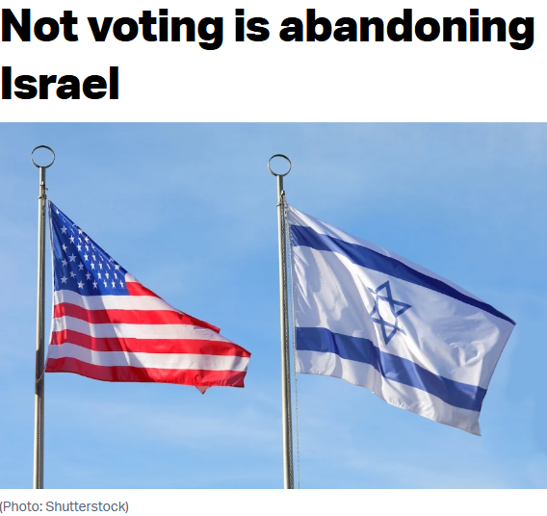
Notes:
https://allisrael.com/blog/not-voting-is-abandoning-israel?utm_source=convertkit&utm_medium=email&utm_campaign=Hezbollah%20struggles%20to%20stop%20%E2%80%98wave%20of%20desertions,%E2%80%99%20ready%20for%20concessions%20to%20bring%20about%20truce%20-%20reports%20%7C%20ANALYSIS%3A%20Momentum%20shifting%20to%20Trump%20-%2015460497

Slide 45
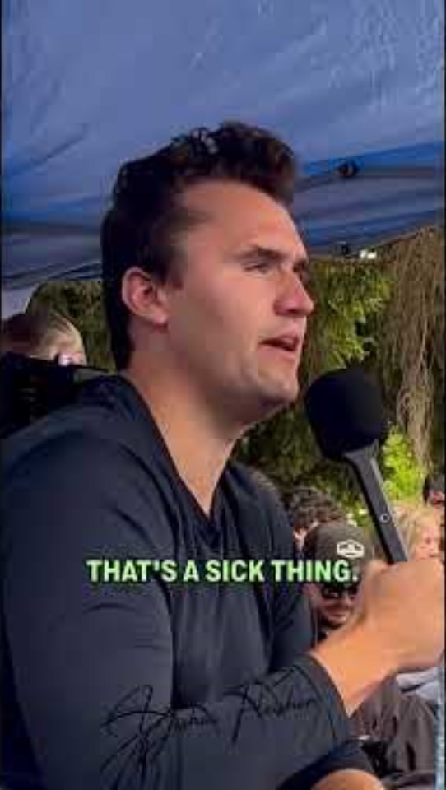
Charlie Kirk gives advice to Israeli student on US campus
Notes:
https://youtube.com/shorts/i27yzCozsOg?si=8PkkhseWPqIr4Zp_

Slide 47
What darkness? What remedy?
Darkness within us
Darkness in our culture, increasingly.
Darkness in Islamic thinking.

Slide 48
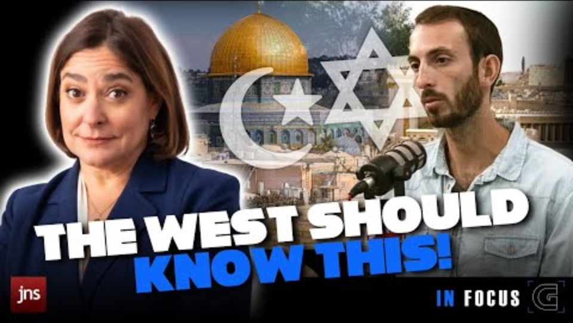
https://youtu.be/OsE5B-9uMYk
Notes:
https://youtu.be/OsE5B-9uMYk
This insight explains why the Oslo Accords never worked at all!

Slide 49
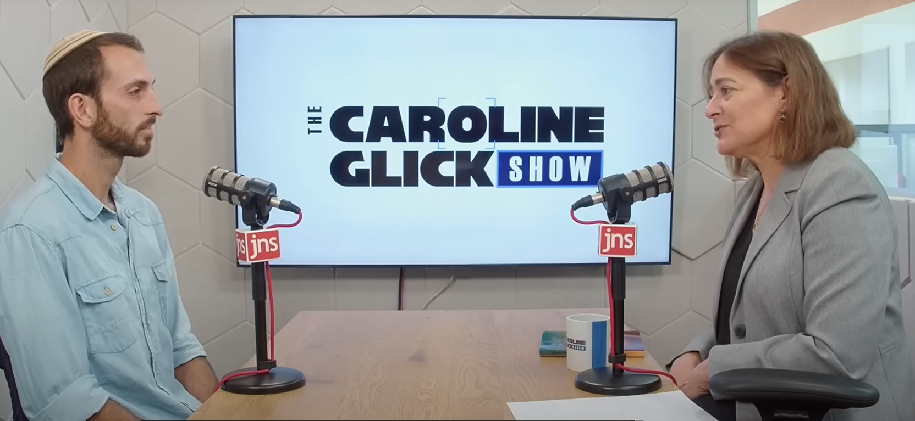
Moriel Bareli
Notes:
He is age 29 father of two daughters originally from Long Island, NY. Far Rockaway [beach I used to go to]

Slide 50
Amazing insight into Islamic understanding of history and reality from Moriel Bareli.
On Oct. 7, invaders considered the leftists communities, Beeri, Kfar Aza, Nir Oz as settlements.
Notes:
“Settlements” has become a dirty word representing Jewish colonizers in Judea / Samaria West
These were in pre-1967 Israel proper, uncontested land. Still considered settlements?

Slide 51
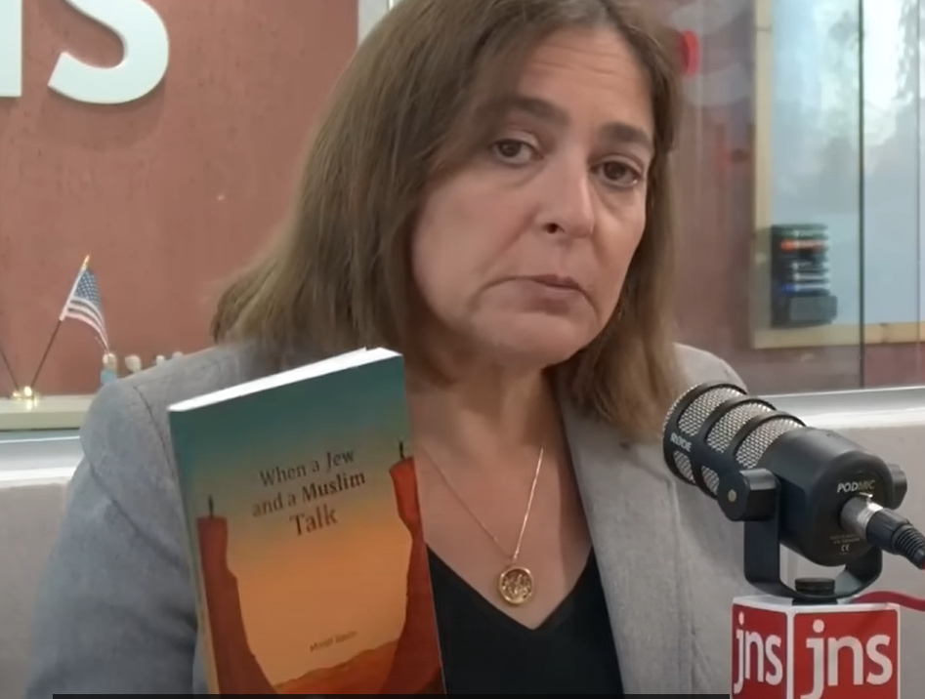
New book:
When a Jew and Muslim Talk

Slide 52
Age 21 Moriel Bareli made aliyah, studying in a yeshiva near Shaar Prakhim [Flowers gate]. Dorms outside the Old City, Yeshiva in Christian Quarter of the Old City.

Slide 53
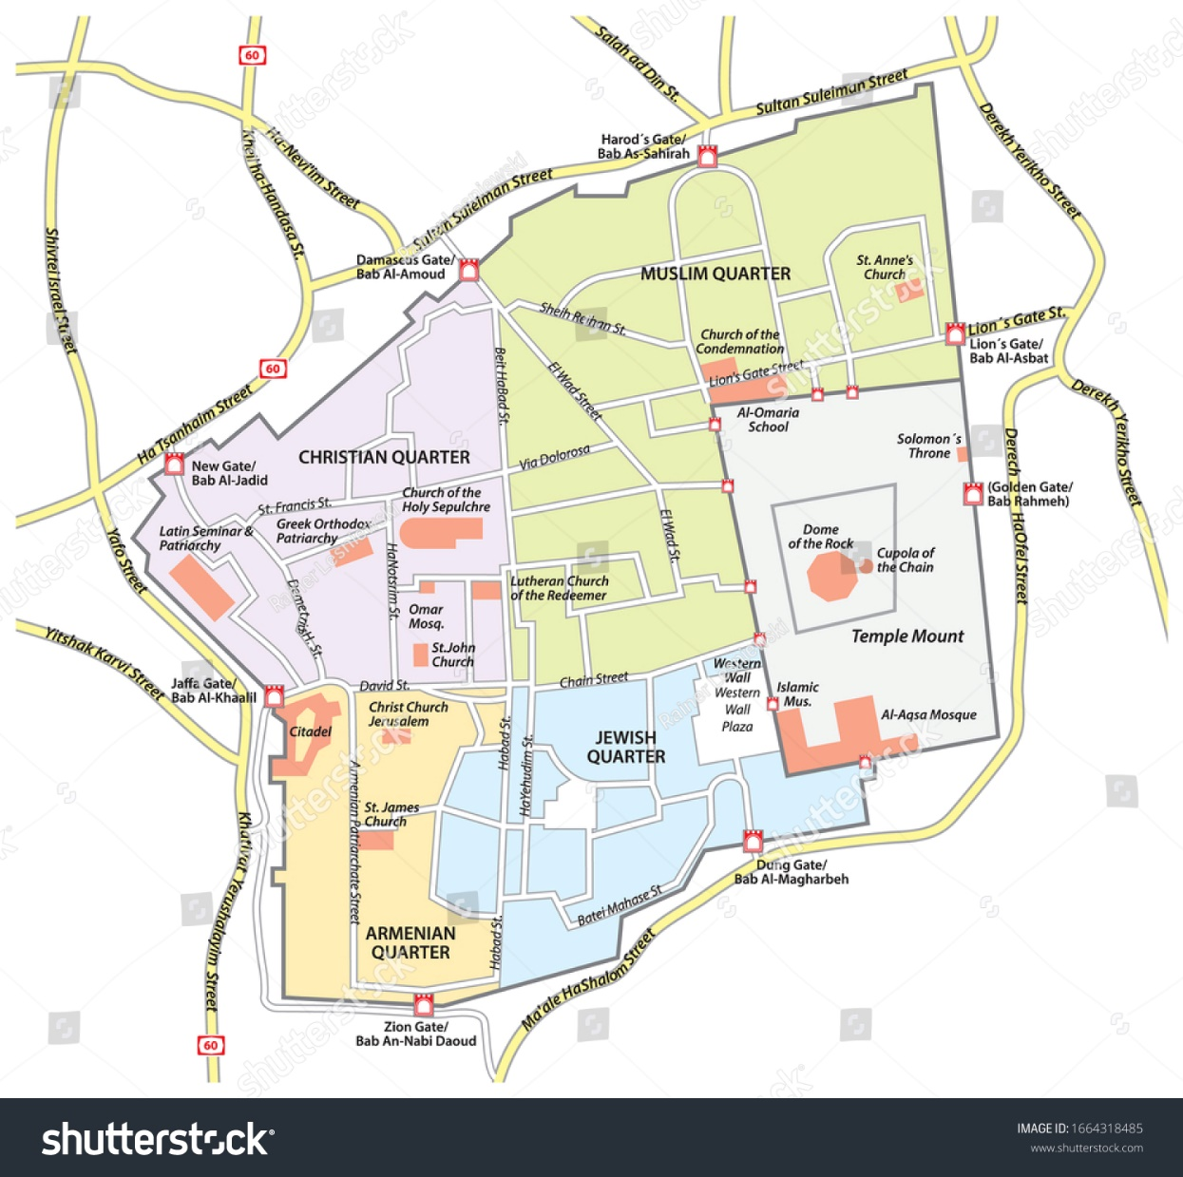
Herod's Gate (Arabic: Bab az Zahra,
שער הפרחים
‎ Sha'ar HaPrakhim
Flowers Gate
Notes:
https://www.shutterstock.com/shutterstock/photos/1664318485/display_1500/stock-vector-map-of-the-old-city-of-jerusalem-1664318485.jpg

Slide 54
2016 time of the Knife Intifada. Wanted to understand Arabic. Now has course. Made profile that he speaks English wants to learn & practice Arabic. Convo with Arabs all over Middle East. Spoke with people in Gaza, Shekhem, Jenin, E. Jerusalem,

Slide 55
Lebanon, Egypt, Syria, Saudi, Morocco. Conversations to practice speaking, writing. Over eight years. Break during his IDF service. Had to delete app and all connections. After army, returned to it. Hundreds of conversations with Muslims.

Slide 56
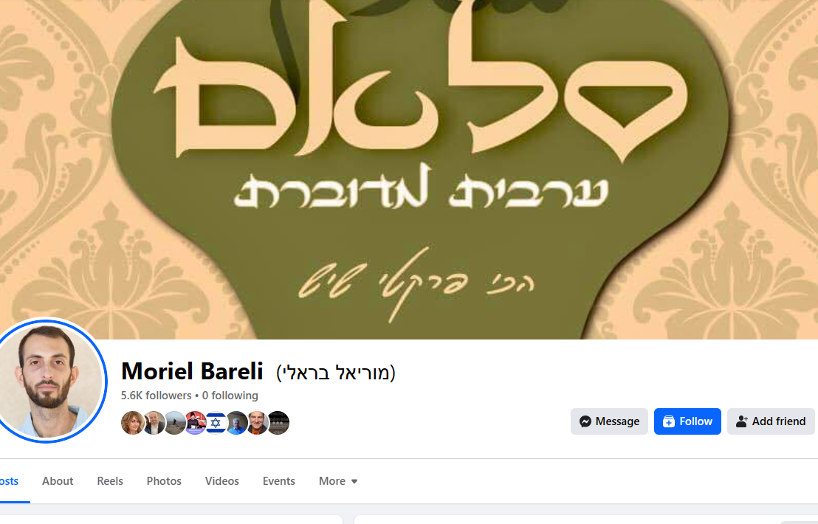

Slide 57
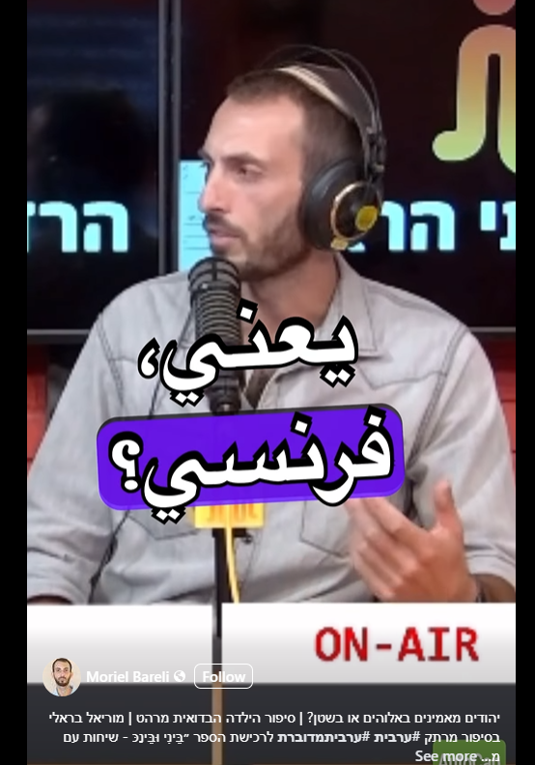

Slide 58
He posted that he was an English speaker wanting to dialogue in Arabic.
Whenever he’d mention that he’s Jewish or Israeli, get reaction, “There is no such thing as Israel, just conquered Palestine. It never existed.”
“What about thousands years history, Kingdom David, Solomon.”

Slide 59
Hearers would laugh. “They were Muslim.” I.e., girl near Haifa, said Al Aksa mosque built by multiple prophets, starting with Adam. Avraham, K. Solomon built Al Aksa.”
“What about Jewish Temple?”
Notes:
Never mind archeology.

Slide 60
“Never was a Jewish Temple. Al Aksa mosque built by Abraham who was a Muslim. Yaakov / Jacob on deathbed called his 12 sons to charge them to continue as Muslims. Bnei Yisrael = sons of Israel.”
Islam = submission = way of life.

Slide 61
Moshe and all 12 tribes believed in One G-d and prophets sent. G-d took them out of Egypt, gave them Torah at Sinai. All Muslim.
Then some of Bnei Yisrael started sinning in idol worship, golden calf. In rebellion, became Jews.
Notes:
Great distinction Bnei Yisrael = Sons of Israel True Israel, and all Muslim.

Slide 62
Yeshua also considered a Muslim Prophet.
Muhammed raised up to restore true faith that Jews had left. Told a girl from Morocco, “Yeshua was a Jew.” She started laughing. “He was a Muslim.”

Slide 63
Revelations to Moses and Yeshua were perverted by Muslims who became “Jews” so final revelation to Muhammed, the Koran, to bring back truth to world. Jews didn’t accept him.

Slide 64
It’s their foundational education. All Muslim people have this view, even if apparently secular. No Enlightenment ~ West. World view even by seculars.

Slide 65
One moved to Germany, yet when told Israel given to Jews by G-d, reacted. Land given to Bnei Yisral = Muslims. Became Jews and departed from faith, 10 of 12 spies didn’t believe. Jews perverted the Bible text and ideas. Avraham

Slide 66
had many sons who were Muslims. Jews went off the path, and Muslims remained. Jews never accepted Muhammed’s correction, so we are cursed. Diaspora, scattered.
Notes:
Leftists Jews have a problem with Chabad Messianic view of religious Jews. Muslims have a problem with all Jews who believe in Jewish sovereignty.

Slide 67
Oct 7 all Jews treated as renegades. Secular Jews think Muslims would be OK with them.
Muslims say, “We don’t have a problem with the Jews, but with the Zionists.” Zionists are Jews who seek sovereignty in Israel.

Slide 68
Jews who live under Muslim reign are OK as dhimmis, special tax. Can’t ride on a horse. Walk in the sewers. Sovereignty is threat to Islam.
MB: Judaisms three pillars: Torah, Land, People
Notes:
Moriel Bareli

Slide 69
Rise of political Zionism was a threat. 250 murdered in Hebron massacre 1929. [in YK Kaddish]
Oslo Accord 1993 implement left wing concept “secular” PLO and Israeli Labor Party Yiskhak Rabin. Charters of PLO and Hamas. Hadith: Jews hide behind tree…
Notes:
We say “Hevron” in YK Kaddish.

Slide 70
All stemming from Islam. Even secular Muslims view Jews NOT in Allah’s covenant. Jews are colonial interlopers sent by Europeans.
Whole idea of partner is antithetical to culture.

Slide 71
Caroline Glick: So, how do we explain Abrahamic Accords. MBS Muhammed bin Salman, expanding the rights of women.
MB: People don’t support agreements. Govt just in treaties. Military expedience against Iran.

Slide 72
One correspondent: Happy Nasrallah killed, but I’m not a Zionist.
Needed: Change the education.
CG: Channel 11 Israeli poll: 18% still atheist 27% say faith strengthened.

Slide 73
CG: Muslim world view expunges me, negates Jews from existence.
MB: We need to prove it to them. We are Bnei Yisrael. Not give Judea Samaria; concedes they are right.
Three things: strength, respect, G-d. Cf weak and no self respect.

Slide 74
Oslo Sept 1993. First suicide bombing March 1994. Oslo accord made Jihad inevitable.
“Why should we believe this land belongs to you if half of you, Neturei Carta [Ultra Orthodox anti Zionist] and seculars don’t believe.

Slide 75
MB: What if we build Temple. We share lamb, prayer.
Muslim Facebooker: We will fight you, but if it happens, must be Insha Allah.
Non religious DON’T prevent war, they incite it.

Slide 76
Remedy to darkness in Islamic thinking: believe in the Covenant and STAND STRONG.

Slide 77
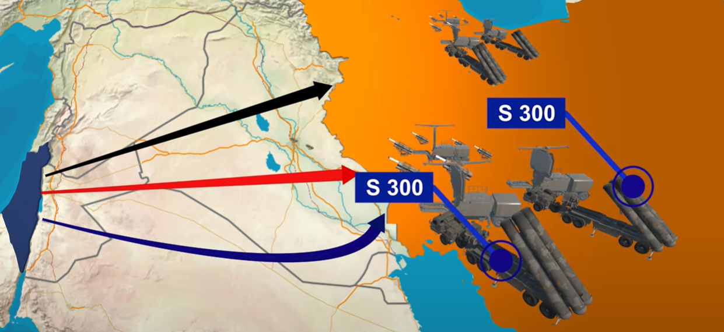
Notes:
https://www.youtube.com/watch?v=SGlkJERPmwo
https://www.youtube.com/watch?v=YeJrC_tBPlA

Slide 78
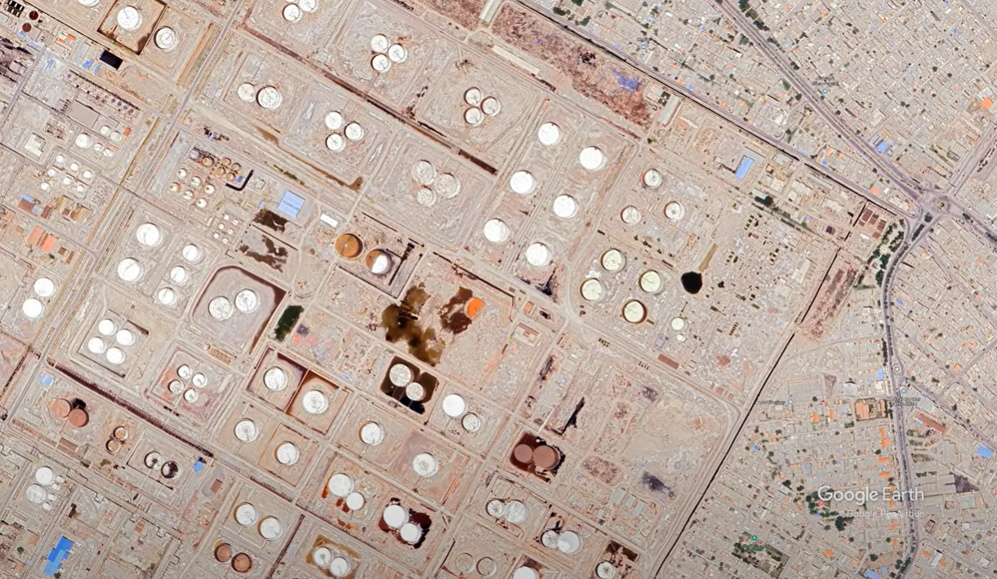

Slide 79
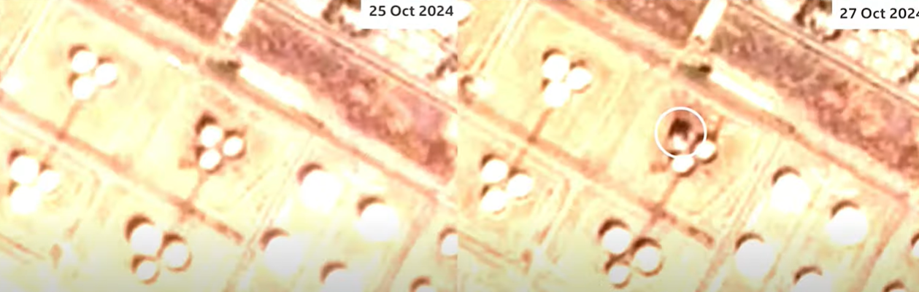

Slide 80
An Israeli source told the Wall Street Journal that Iran had four S-300 air defense batteries, considered the most advanced systems in Iran’s air defense network. During Israel’s strike on Iran over the weekend, all these systems were destroyed.
Notes:
https://x.com/Osint613/status/1850420389597356190

Slide 81
“Israel is sending us a very clear message,” Hamid Hosseini, an expert in Iran’s gas and oil industry, told The New York Times. “This could have very serious economic implications for Iran, and now we understand the risk and that we need to act wisely and not continue with the tension.”
Notes:
https://www.israeltoday.co.il/read/iran-said-fearful-after-israel-hits-missile-program-air-defenses/?mc_cid=251bd78836&mc_eid=9f06d9f262

Slide 82
Ali Vaez, an Iran researcher, told the Times that the attack could set up a much heavier attack on Iran’s nuclear and energy facilities.
“Iran does not have the capability to replace the damaged facilities in the near future,” he said.
Notes:
https://www.israeltoday.co.il/read/iran-said-fearful-after-israel-hits-missile-program-air-defenses/?mc_cid=251bd78836&mc_eid=9f06d9f262

Slide 83
The attack, which Israel named “Operation Days of Repentance,” saw tens of IAF jets, accompanied by refuelers, travel some 1,600 kilometers from Israeli territory. The IAF achieved near uncontested aerial supremacy in Iranian skies.
Notes:
https://www.israeltoday.co.il/read/irans-missile-program-set-back-but-nuclear-threat-remains/?mc_cid=251bd78836&mc_eid=9f06d9f262

Slide 84

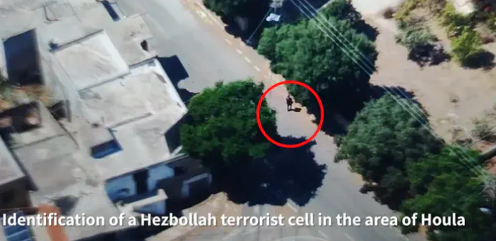
Hezbollah loses popular Lebanese and Shia support. Is this the beginning of the end for Hezbollah?
Notes:
https://www.israelnationalnews.com/news/398350

Slide 85
From the Christians to the Druze, and from the Sunnis to the dominant Shiites, there is a massive revulsion being expressed against the Iranian proxy terrorist group Hezbollah that had bullied its way toward becoming a mafia-like state within a state.
Notes:
https://www.israelnationalnews.com/news/398350

Slide 86
For the first time in over four decades, the Lebanese terrorist group, Hezbollah, appears frail. Following the elimination of the group's leader Hassan Nasrallah by an Israeli airstrike on Beirut on Sep 27, the halo around its invulnerable strength against Israel and other regional rivals faded rapidly.
Notes:
https://www.israelnationalnews.com/news/398350

Slide 87
the open criticism of Hezbollah's reign of terror by leading Lebanese from all religious backgrounds signals the possibility that Iran's chokehold over Lebanon may finally be coming to an end.

Slide 88
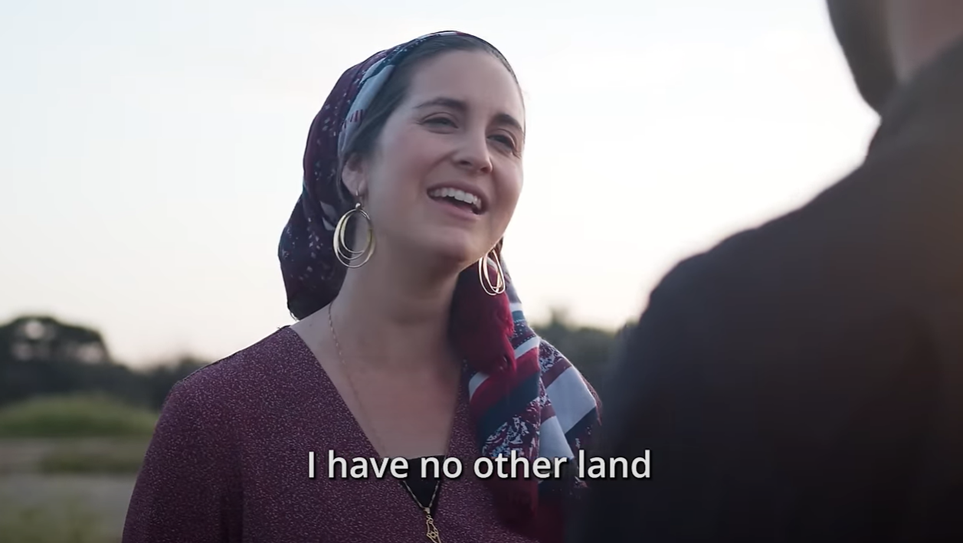
Notes:
https://www.youtube.com/watch?v=rJIXzk4DC9Y

Slide 90
What darkness? What remedy?
Darkness within us
Darkness in our culture, increasingly.
Darkness in Islamic thinking.

Slide 91
Remedy to the darkness within?
The love and light of Messiah
The death and resurrection of Messiah

Slide 92
Remedy to darkness in Islamic thinking: believe in the Covenant and STAND STRONG.

Slide 93
Remedy to the increasing darknss of our culture?
Yeshua is the light of world.
^{Mtt 5.14-16} “You are light for the world. A town built on a hill cannot be hidden. Likewise, when people light a lamp,

Slide 94
^{Mtt 5.14-16} they don’t cover it with a bowl but put it on a lampstand, so that it shines for everyone in the house. In the same way, let your light shine before people, so that they may see the good things you do and praise your Father in heaven.

