Slide 1
e-handout
To have these notes
without taking notes
Go to OrHaOlam.com
Click on Messages tab,
2024 Messages

Slide 2
Or HaOlam is greatly blessed to have an excellent Education Department.
We finessed some policies, particularly on promotion boundaries:
Notes:
Ed and pastoral care!
Angela children, Marcos teens, Jeremy young adults!! Looking to add a singles, and 30-45 parents, and seniors.
Prayerful, skilled, loving.

Slide 3
Promotion from Children’s Ed to Youth Class
  -at age 13 for boys and girls
  -in the Spring [May 31]
  -Bar/Bat Mitzvah bukhurs [kids] immediately after Bar/Bat Mitzvah
Notes:
Choice young person

Slide 4
Promotion from Youth Class to Young Adult / לא קשיש / Lo Kashish and the main adult service upon graduation from High School.
May 31 promotion day.

Slide 5
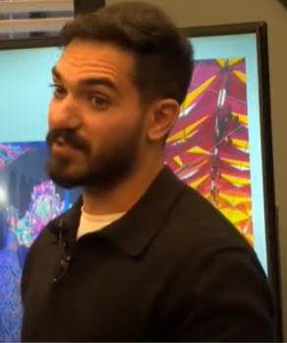
Tues., Dec. 3, Israeli guest speaker, Nova Festival survivor
Rom El-Hai
רום אל חי
Notes:
https://youtu.be/kxTosN92bUs

Slide 6
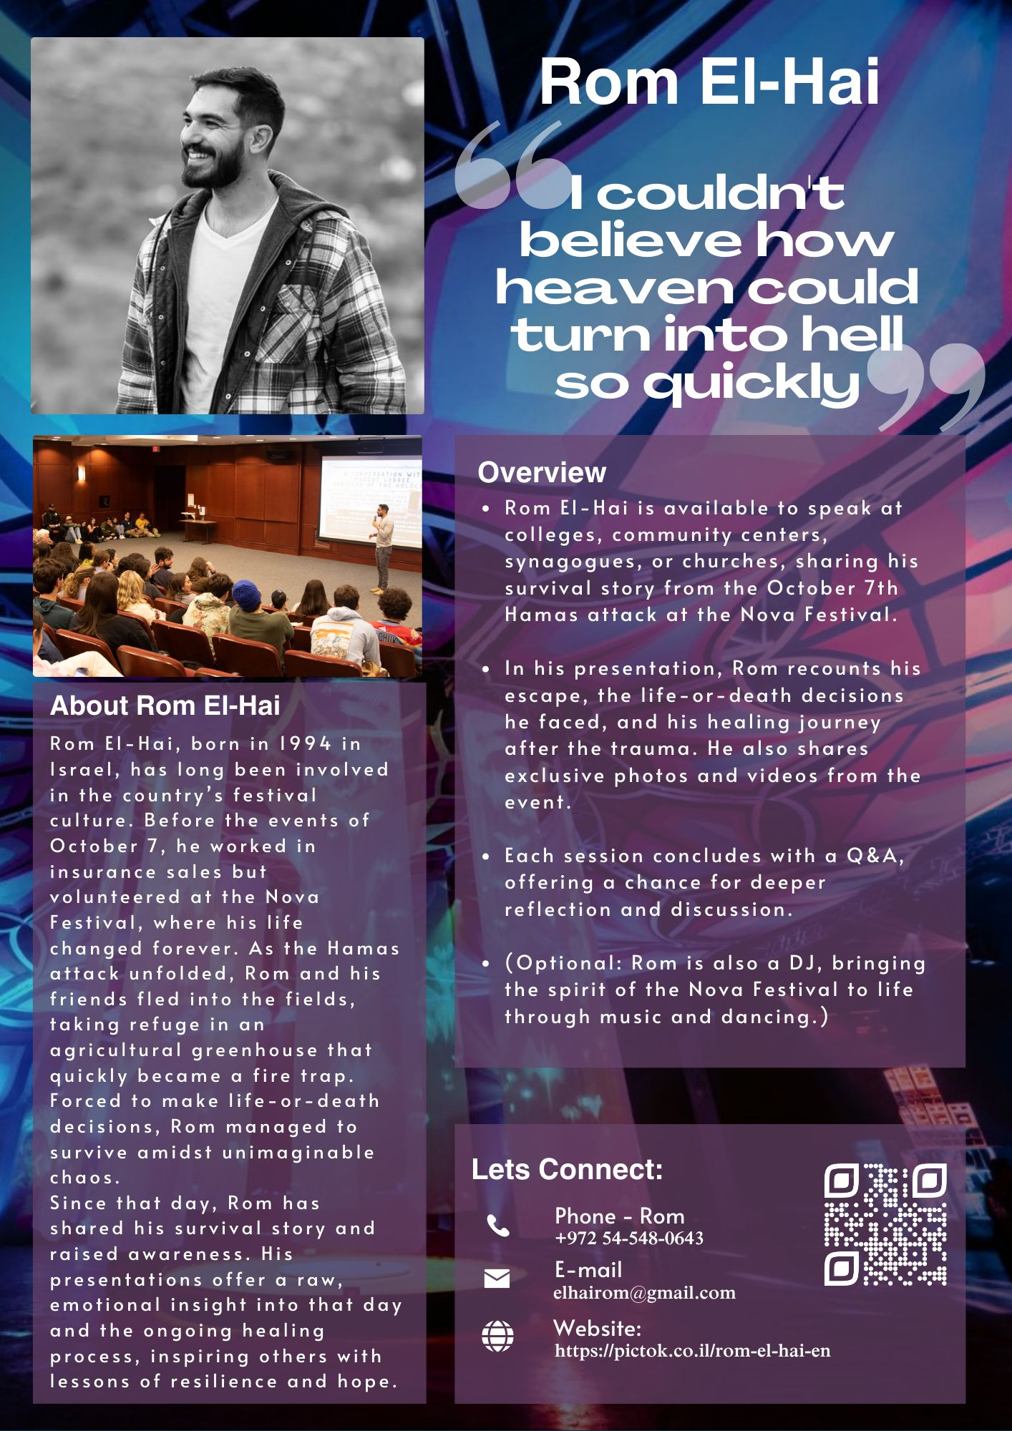

Slide 8
Tues., Dec. 3, Israeli guest speaker, Nova Festival survivor
Rom El-Hai
רום אל חי
Notes:
https://youtu.be/kxTosN92bUs

Slide 9
However, despite the war,
some good news from Israel.

Slide 10

Israeli families defy war with increasing birthrate
Notes:
https://unitedwithisrael.org/watch-israeli-families-defy-war-with-increasing-birth-rate/

Slide 11

Reporter Natasha Kirtchuk is herself eight months pregnant, so wanted to see what awaited her.
Notes:
https://unitedwithisrael.org/watch-israeli-families-defy-war-with-increasing-birth-rate/

Slide 12
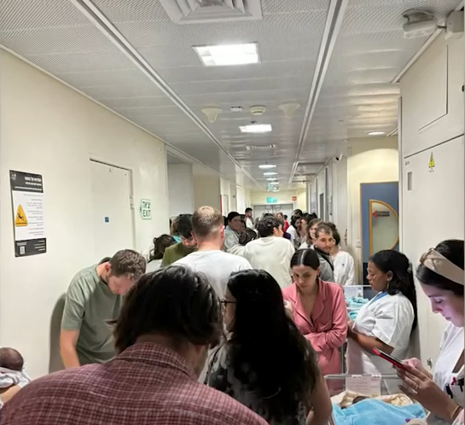
Hospital Bomb shelter during a rocket attack
Notes:
https://unitedwithisrael.org/watch-israeli-families-defy-war-with-increasing-birth-rate/

Slide 13
Hospitals, fortified as bomb shelters, stand as symbols of resilience, where mothers bring new life even while grappling with personal tragedies and ongoing conflict.
Notes:
Some husbands in the military or newly widowed
https://unitedwithisrael.org/watch-israeli-families-defy-war-with-increasing-birth-rate/

Slide 14
Amid the chaos of war, Israeli families are defying the odds with an unprecedented baby boom, marking a 30% rise in births compared to last year.
Notes:
https://unitedwithisrael.org/watch-israeli-families-defy-war-with-increasing-birth-rate/

Slide 15
For Israelis, every birth is more than a moment of joy—it’s a powerful act of defiance and hope, ensuring life thrives despite adversity.
Notes:
https://unitedwithisrael.org/watch-israeli-families-defy-war-with-increasing-birth-rate/

Slide 16
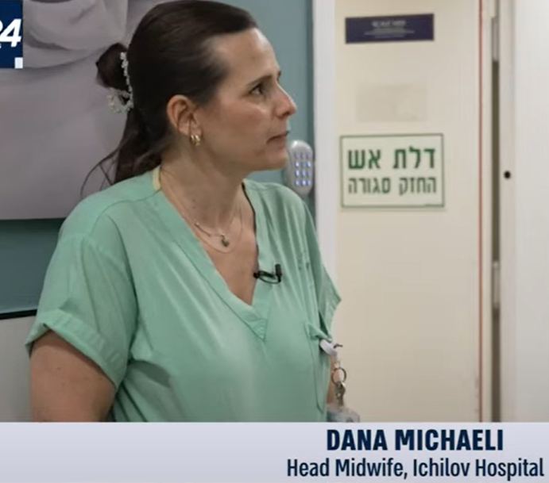
Midwifery culture in the hospitals

Slide 17
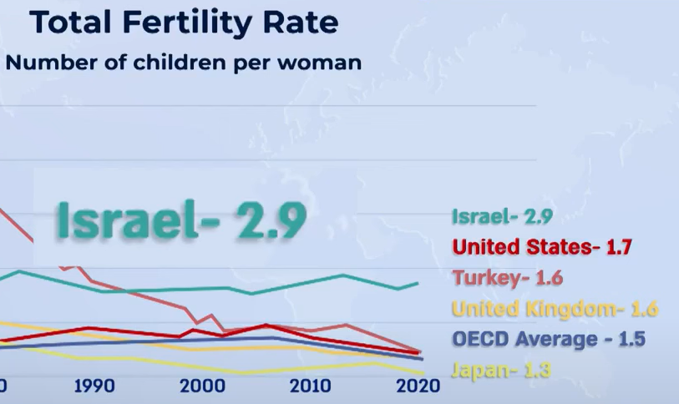
Highest OECD country
Notes:
OECD Organization for Economic Cooperation and Development. 38 member countries describe themselves as committed to democracy and the market economy

Slide 18
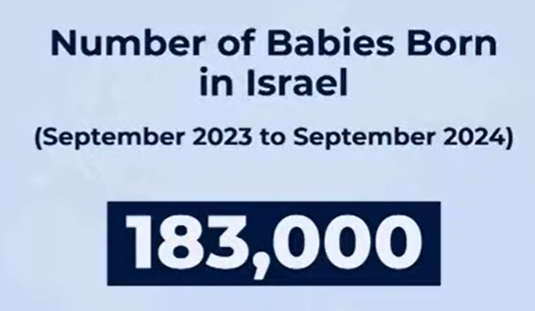
Notes:
https://unitedwithisrael.org/watch-israeli-families-defy-war-with-increasing-birth-rate/
Plus immigrants making aliyah, against war deaths.

Slide 19
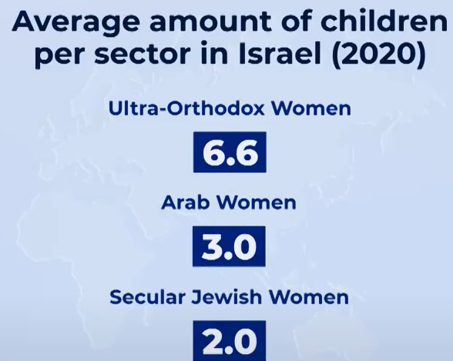

Slide 20
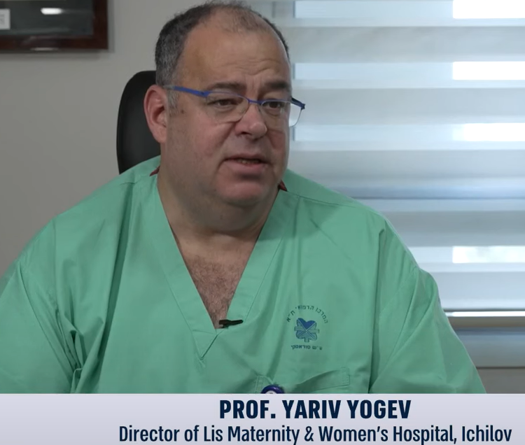
Notes:
Dr. Yariv Yogev was on the phone with his daughter Libi and heard her get shot and killed on Sat. Oct 7 at the Nova festival. Nevertheless, the next day he was called to duty in maternity, delivering babies.
https://unitedwithisrael.org/watch-israeli-families-defy-war-with-increasing-birth-rate/

Slide 21
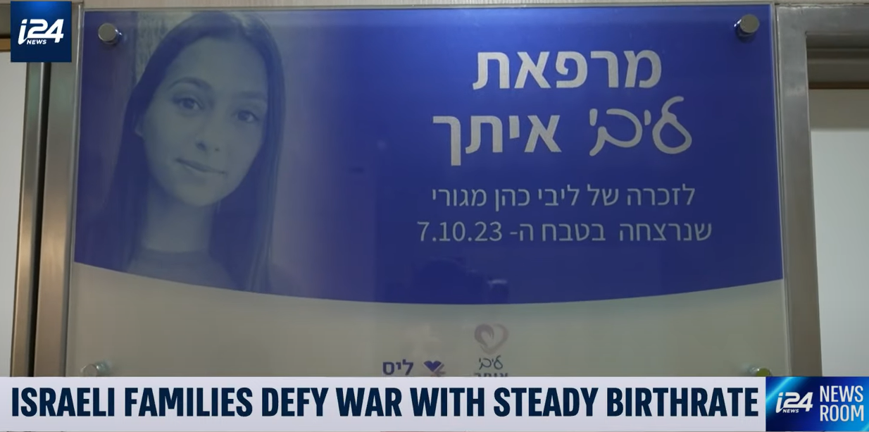

Slide 22
Also, the Israeli economy appears to be gradually recovering from the initial war shock, grew by an annualized rate of 3.8% in the third quarter between July and September. This marks a significant improvement compared to the mere 0.3% growth recorded in the second quarter.
Notes:
https://allisrael.com/israeli-economy-signals-recovery-grows-by-annualized-rate-of-3-8-in-3rd-quarter-despite-multi-front-war?utm_source=convertkit&utm_medium=email&utm_campaign=PM%20Netanyahu%20says%20ICC%20is%20%E2%80%98an%20enemy%20of%20humanity,%E2%80%99%20calls%20its%20decision%20%E2%80%98a%20black%20day%20in%20the%20history%20of%20nations%E2%80%99%20-%2015727946

Slide 23
The Tel Aviv Stock Exchange has been resilient amid the ongoing war and continues to attract funds from international investors. Data released in October revealed that the Tel Aviv Stock Exchange 35 Index, expanded by 14% since the war began on Oct. 7, 2023.
Notes:
https://allisrael.com/israeli-economy-signals-recovery-grows-by-annualized-rate-of-3-8-in-3rd-quarter-despite-multi-front-war?utm_source=convertkit&utm_medium=email&utm_campaign=PM%20Netanyahu%20says%20ICC%20is%20%E2%80%98an%20enemy%20of%20humanity,%E2%80%99%20calls%20its%20decision%20%E2%80%98a%20black%20day%20in%20the%20history%20of%20nations%E2%80%99%20-%2015727946

Slide 24
So, there is good news
in the news in 2024!

Slide 25


Slide 26

Reformation?
Revival vs reformation
Are we in reformation?
How to conserve revival in
reformation

Slide 27
Reformation?
Revival vs reformation
Are we in reformation?
How to conserve revival in
reformation

Slide 28
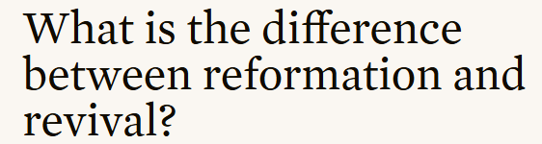

Slide 29
Revival is an inward transformation by an encounter with G-d.
Reformation is a consequent transformation of the religious and moral culture.

Slide 30
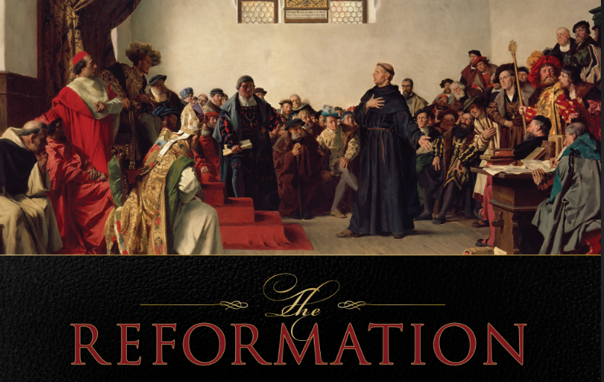
Notes:
https://s3.amazonaws.com/media.cph.org/images/product/xxl/124462.jpg
Martin Luther had an experience with G-d, a new relationship, by which he knew he was forgiven. Eventually he realized that many of the practices of the Roman church were unscriptural.
You may have never heard me honor Martin Luther, since there were some horrific flaws in his life relative to the Jewish people. I have no good explanation for those flaws, except for us to look at our own life and heart and deficiencies.

Slide 31
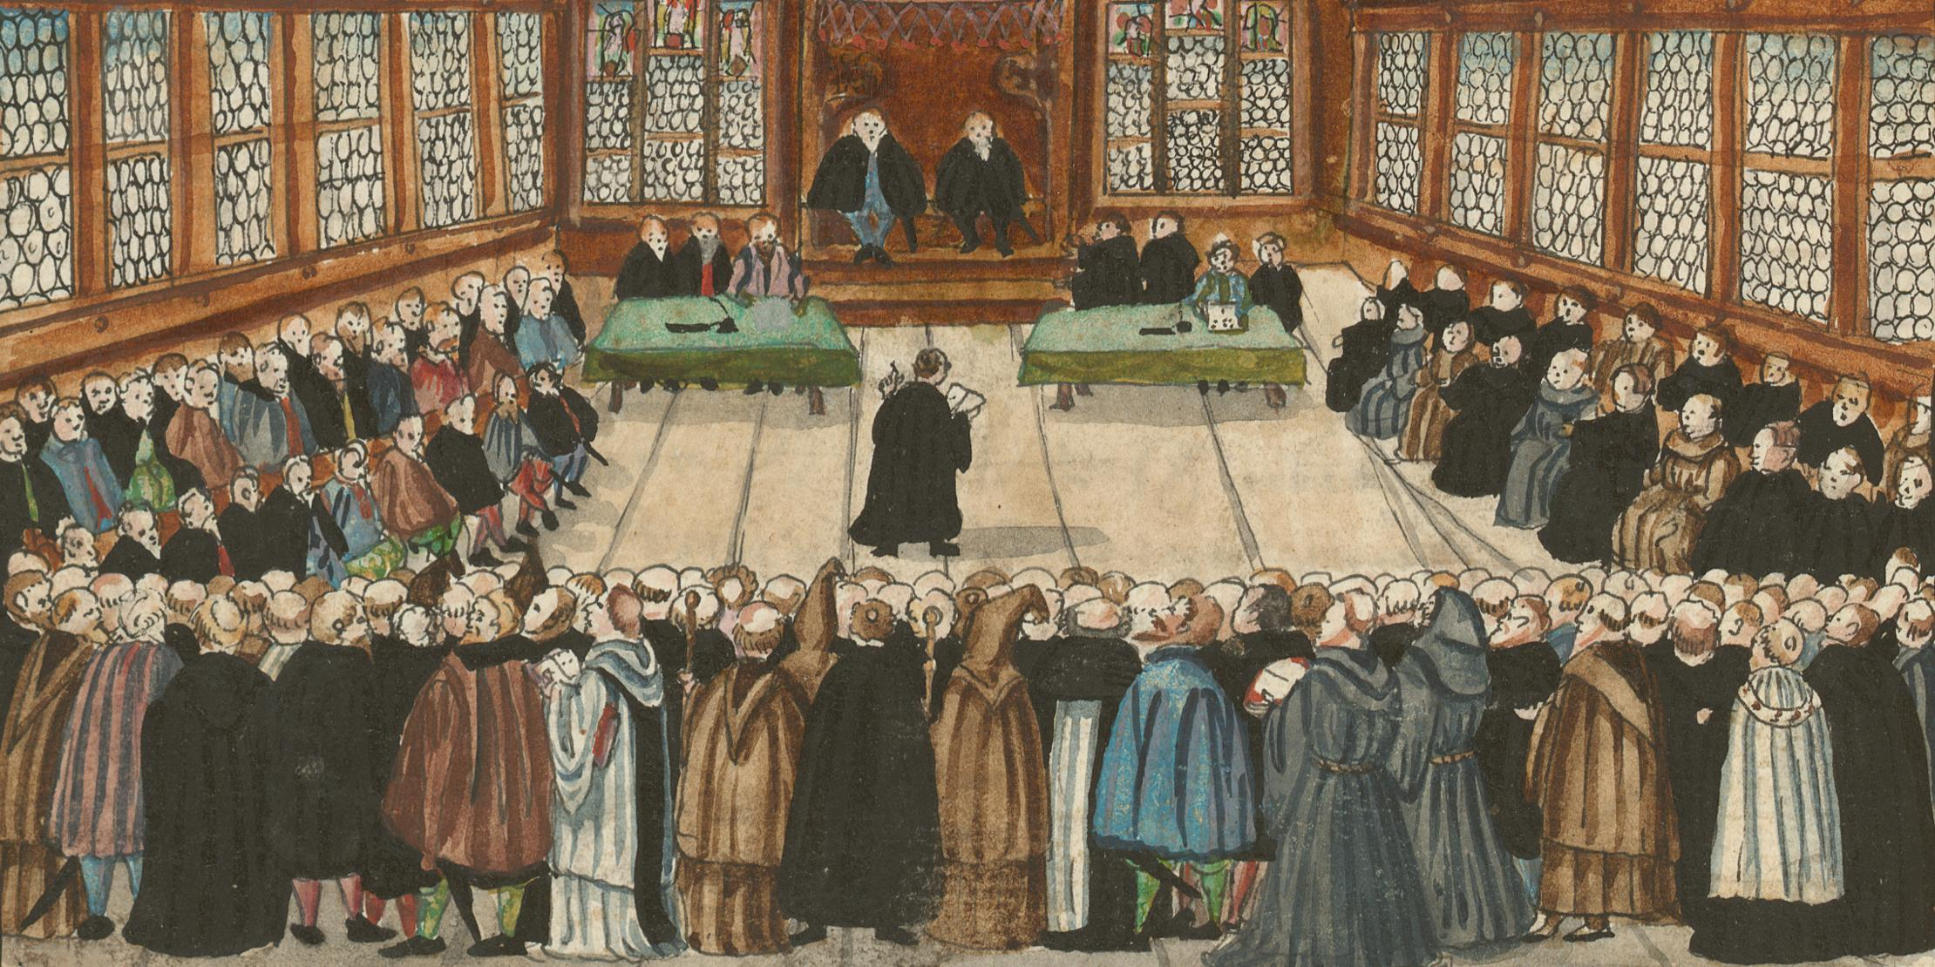
Diet of Worms, Germany,
18 April 1521
Notes:
Unless I can be instructed and convinced with evidence from the Holy Scriptures or with open, clear, and distinct grounds and reasoning…then I cannot and will not recant…Here I stand. I can do no other. God help me! Amen.⁷
https://www.christianstudylibrary.org/article/just-shall-live-faith-conversion-martin-luther

Slide 32
Historically, part of the reason reformation became the label of what happened in the 1500’s is that a great deal of time and energy had to be devoted to reforming the externals of the life of the congregation—how they worshiped,
Notes:
https://learn.ligonier.org/qas/what-is-the-difference-between-reformation-and-revival

Slide 33
how they educated, how they prepared for immersion—almost everything had to be redone.

Slide 34
Revival is generally internal and subjective…revival moves people from a place of religious stagnation [or rebellion SW] —often with the right forms—to a place of personal appropriation of that piety and those convictions.
Notes:
https://learn.ligonier.org/qas/what-is-the-difference-between-reformation-and-revival

Slide 35
Both reformation and revival are necessary in our day, both require a work of the Spirit, and both require the powerful preaching of the Word.
Notes:
https://learn.ligonier.org/qas/what-is-the-difference-between-reformation-and-revival

Slide 36
Revival is an inward transformation by an encounter with G-d.
Reformation is a consequent transformation of the religious and moral culture.

Slide 37
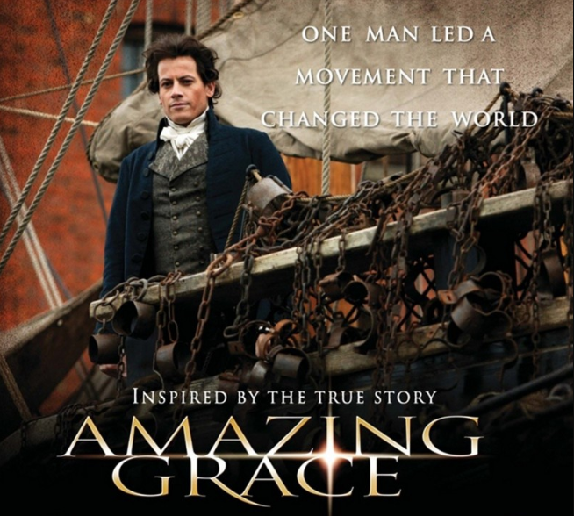
Notes:
http://www.gracehillmedia.com/wp-content/uploads/2015/04/Amazing-Grace-movie-poster.jpg

Slide 38
John Wesley was plagued by his uncertainty of salvation. On May 24th, 1738 he found what he longed for: “In the evening I went very unwillingly to a society in Aldersgate Street, where one was reading Luther’s ‘Preface to the Epistle to the Romans’.
Notes:
https://wesleyscholar.com/wesleys-warmed-heart-at-aldersgate-what-really-happened/

Slide 39
About a quarter before nine, while he was describing the change which God works in the heart through faith in Messiah, I felt my heart strangely warmed. I felt I did trust in Messiah, Messiah alone for salvation, and an assurance was given me that he had taken away my sins, even mine, and saved me from the law of sin and death.”
Notes:
https://wesleyscholar.com/wesleys-warmed-heart-at-aldersgate-what-really-happened/

Slide 40
Wesley shared that message throughout England and America. A great revival resulted, and ultimately there was a great reformation, ending the slave trade in the British Empire through William Wilberforce, a Wesley follower.
Notes:
https://www.historyskills.com/classroom/year-9/william-wilberforce/

Slide 41
In 1807, after nearly two decades of relentless advocacy, Wilberforce's efforts bore fruit. The Abolition Act was passed in the House of Commons with an overwhelming majority. This landmark legislation marked the end of British involvement in the transatlantic slave trade.
Notes:
https://www.historyskills.com/classroom/year-9/william-wilberforce/

Slide 42
Finally, in 1833, the Slavery Abolition Act was passed, ensuring the freedom of all slaves in the British Empire. Wilberforce received the news just days before his death. His life's mission had been accomplished.

Slide 43
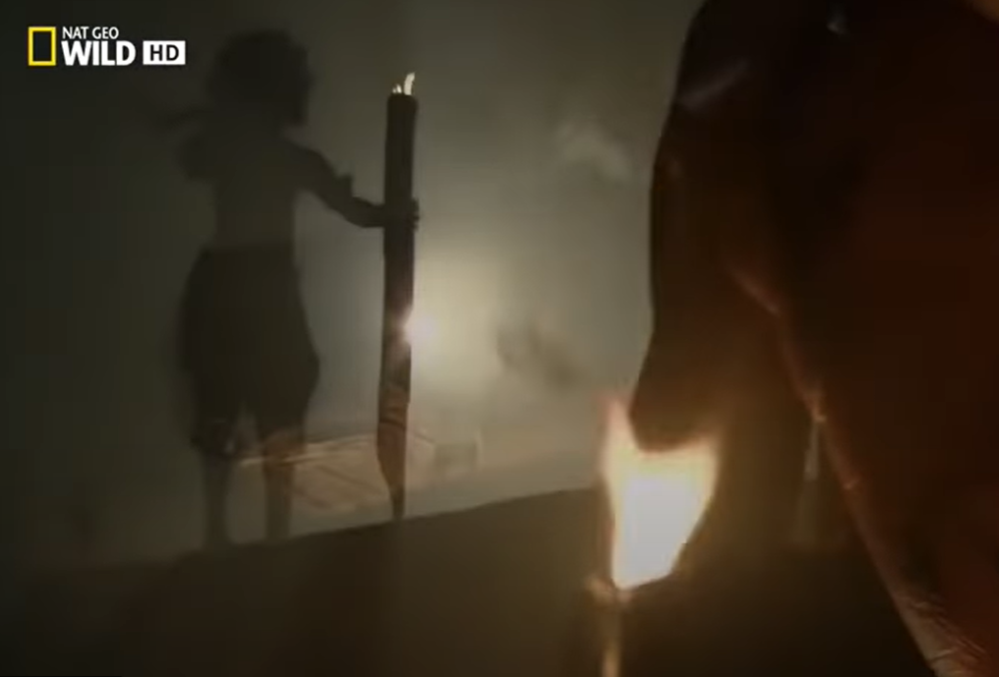
Fiji was once known as the
Cannibal Isles, and is now
known as the Bible Belt of
the Pacific Islands.
Notes:
https://youtu.be/nBQPO1b3nV4

Slide 44
Then later, in the island nation of Fiji, in 2002, Chief Mataitoga of Sabeto village had a dream from the Lord. The village had a lot of social problems as well as enmity and divisions. As a result of the dream, he called his people together to pray and fast to seek God.
Notes:
https://renewaljournal.wordpress.com/2011/08/09/transforming-revivals-bygeoff-waugh/

Slide 45
There was a move of the Holy Spirit with real repen­tance and forgiveness, and unity in the village was restored. The long term results of this action were only revealed with the passing of time.
Notes:
https://renewaljournal.wordpress.com/2011/08/09/transforming-revivals-bygeoff-waugh/

Slide 46
Productivity of the soil increased and long absent fish varieties returned to the reef. Mangroves that had died and disappeared have begun to grow again.
Notes:
https://renewaljournal.wordpress.com/2011/08/09/transforming-revivals-bygeoff-waugh/

Slide 47
The mangroves are very important for the ecology, providing shelter and breeding grounds for all kinds of fish, crabs, etc. all of which were part of the staple diet of these villages.
Supernatural reformation!!
Notes:
https://renewaljournal.wordpress.com/2011/08/09/transforming-revivals-bygeoff-waugh/

Slide 48
^{T’hillim Ps 25.4-5} Make me know your ways, ADONI, teach me your paths. Guide me in your truth, and teach me; for you are the God who saves me, my hope is in you all day long.
Notes:
My truth is to have life easy. YOUR truth is to perfect me through all.

Slide 50
Reformation?
Revival vs reformation
Are we in reformation?
How to conserve revival in
reformation
Notes:
We have had labors for revival: individual salvations. Never enough but to a threshold…

Slide 51
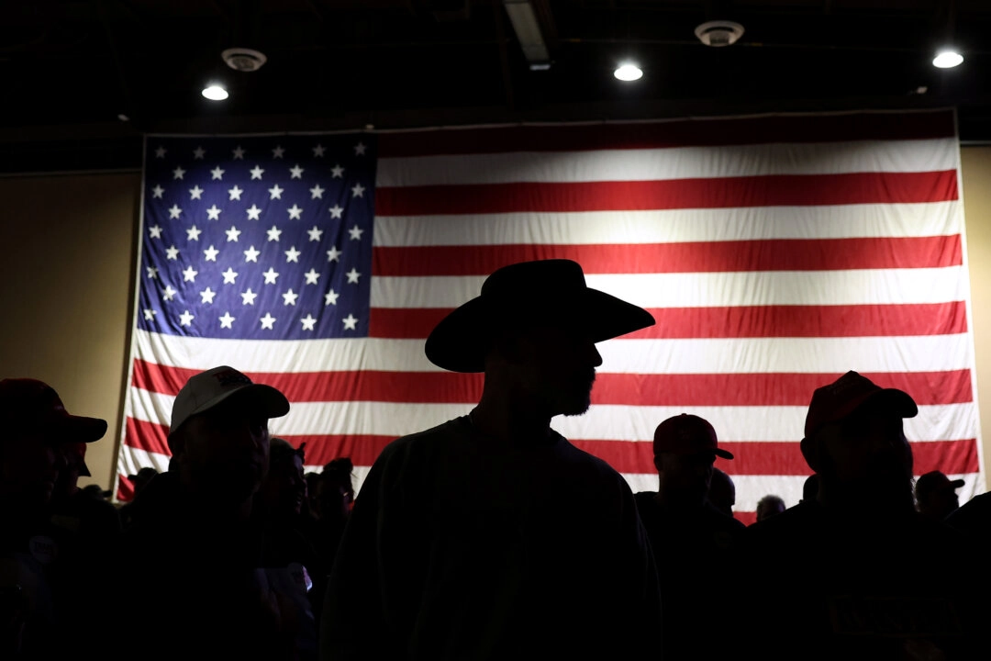
Supporters of then former U.S. President Donald Trump before the start of a campaign rally at the Reno-Sparks
Convention Center in Reno, Nev.,
on Dec. 17, 2023. Justin Sullivan/Getty Images

Slide 52
Epoch Times commentary: In a few years, we could see the return of small farmers, accountability for drug manufacturers, a curbing of agency overreach, and more freedom for enterprise generally speaking.
Notes:
https://www.theepochtimes.com/opinion/how-history-changes-5762242?utm_source=opinionnoe&src_src=opinionnoe&utm_campaign=opinion-2024-11-20&src_cmp=opinion-2024-11-20&utm_medium=email&est=AAAAAAAAAAAAAAAAcuomYBYAh9bH4LguuWhYArg0yEwDi4CakWZxJkVclaEQIH3YkA%3D%3D

Slide 53
Americans are going to be asked to start taking more responsibility for their lives rather than depending on government, which is in so much debt that it can no longer bear its present burdens.
Notes:
https://www.theepochtimes.com/opinion/how-history-changes-5762242?utm_source=opinionnoe&src_src=opinionnoe&utm_campaign=opinion-2024-11-20&src_cmp=opinion-2024-11-20&utm_medium=email&est=AAAAAAAAAAAAAAAAcuomYBYAh9bH4LguuWhYArg0yEwDi4CakWZxJkVclaEQIH3YkA%3D%3D

Slide 54
The Tea Party movement, the health freedom movement, the whole food movement, the homeschooling movement, the free-speech movement — all of them developed in isolation, blinded by fictions of right and left to realize that they had common interests and a common opponent in what is now called the corporatist administrative state.
Notes:
https://www.theepochtimes.com/opinion/how-history-changes-5762242?utm_source=opinionnoe&src_src=opinionnoe&utm_campaign=opinion-2024-11-20&src_cmp=opinion-2024-11-20&utm_medium=email&est=AAAAAAAAAAAAAAAAcuomYBYAh9bH4LguuWhYArg0yEwDi4CakWZxJkVclaEQIH3YkA%3D%3D

Slide 55
The simple idea in our time comes down to one word: freedom. It was the same theme when the Soviet Union fell, and it is the animating spirit behind the election of 2024 which defied the whole of conventional wisdom.
Notes:
https://www.theepochtimes.com/opinion/how-history-changes-5762242?utm_source=opinionnoe&src_src=opinionnoe&utm_campaign=opinion-2024-11-20&src_cmp=opinion-2024-11-20&utm_medium=email&est=AAAAAAAAAAAAAAAAcuomYBYAh9bH4LguuWhYArg0yEwDi4CakWZxJkVclaEQIH3YkA%3D%3D

Slide 56
Getting from the current system to one more in line with what the Founders envisioned is not going to be easy and it will not happen overnight. But change is in the air, and it is a delight to see which way the winds are blowing.
Notes:
https://www.theepochtimes.com/opinion/how-history-changes-5762242?utm_source=opinionnoe&src_src=opinionnoe&utm_campaign=opinion-2024-11-20&src_cmp=opinion-2024-11-20&utm_medium=email&est=AAAAAAAAAAAAAAAAcuomYBYAh9bH4LguuWhYArg0yEwDi4CakWZxJkVclaEQIH3YkA%3D%3D
But change will be attacked, in unexpected ways.
I.e., “Victorian” In the 19th century, Victorian society was marked by an adherence to strict social codes and moral norms. One area where these norms were particularly evident was sexuality, which was often viewed as taboo and repressed.
https://wechronicle.com/victorian-era/examining-victorian-views-on-sexuality-and-repression-taboos-and-double-standards/

Slide 57
According to social researcher Dr. George Barna, 72 percent of Christians voted in this year’s election.
James Dobson’s newsletter:
Mike Huckabee, former Arkansas governor, is the new US ambassador to Israel. His pro-Israel record is second to none.

Slide 58
Congresswoman Elise Stefanik our UN ambassador. Stefanik is a leading congressional critic of universities that fail to protect Jewish students. In hearings, her blistering questioning of the presidents of Ivy League universities led several to resign.

Slide 59
Trump has reiterated his promise that schools not investigating, preventing, and punishing anti-Semitic activity on campuses will be charged with violating civil rights laws. He is open to removing federal funding from such schools.

Slide 60
Concerning the Department of Education considering abolishing it. The department’s budget has exploded from $17 billion in the 1980s to over a current $220 billion while test scores for US students have declined. Big government has proven not to be the answer, and reform is coming!
Notes:
Or beginning to come!

Slide 62
Reformation?
Revival vs reformation
Are we in reformation?
How to conserve revival in
reformation

Slide 63
The Great Wall of China is one of the Seven Wonders of the World. It stretches over 4,000 miles (6,400 KM) and was built to protect China from the barbaric hordes to the north. The designers of the wall made it so high that it could not be scaled, so thick that it could not be penetrated, and so long that no one could go around it.

Slide 64
Yet, during the first hundred years of the wall's existence China was successfully invaded three times, without the wall having been climbed or breached. So how, you ask, did the invaders raid China? Well, the problem wasn't the wall

Slide 65
– it was the gatekeepers! In each of these invasions the barbarians simply bribed the gatekeepers who opened the gates, so the enemies just walked right through.

Slide 66
The protection of the Great Wall of China was only as secure as its gatekeepers. What a lesson, since, don't we all also have "gates to keep"...our eyes, and our ears, and our mouth? No matter how strong we may feel,

Slide 67
we can never forget that these points of entry will be seen by our enemies and there will be attempts to bribe or seduce us so they can break through. We must not allow the "barbaric hordes" to invade our lives by failing to keep careful watch at these entry points –our integrity and our authority depend on the security of our gates! Pray and praise!
Notes:
Revivals in the scriptures were usually one king in duration. Satan will look to corrupt!

Slide 68
Gates of the kingdom:
Prayer: attendance at Teerosh
Praise and faith: below
Service: oneg teams, schmoozers, ushers. This is not a cruise ship, it’s a fishing boat!
Fight: Rep. Nancy Mace
Notes:
Or a warship!
Study, and balance “Victorian”

Slide 69
^{Dvarim 28.45-46} "All these curses will come on you, pursuing you and overtaking you until you are destroyed, because you didn't pay attention to what ADONI your God said, observing his mitzvot and regulations that he gave you. These curses will be on you and your descendants as a sign and a wonder forever. WHY sooo intense??

Slide 70
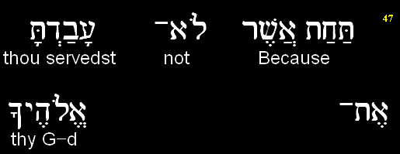
D’varim (Deuteronomy) 28.47a
יְיָ
ADONI

Slide 71
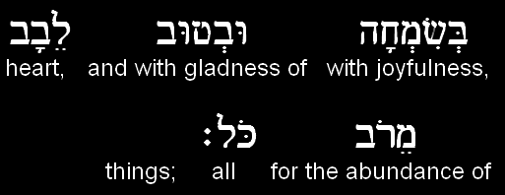
D’varim (Deuteronomy) 28.47b
Notes:
Here it is: it’s not just obeying.
OK, won’t steal, fornicate, pornicate, prevaricate, pontificate (pride), rage, the forbidden ate (all the dietary laws)
It would be nice, but NOT good enough

Slide 72
Levels of living faith & praise.
אֱמוּנָה Emunah
faith, trust, confidence
Active faith.
Notes:
A word of disclaimer on Shalom Arush’s book. His concepts and interp of scripture is EXCELLENT. Some of his illustrations are from Kabbalah, some about reincarnation. I am NOT endorsing those illustrations. Men’s group remember we had to filter some things.
Why use? Marriage book that we did in Men’s Group called men to a deeper level of the crucified life than Dobson, Trent, Smalley, etc. Not use that terminology.
This book calls us to an amazing level of faith. Those who remember David Dreiling, highly endorsed.

Slide 73
Basic level Emuna: firm belief that EVERYTHING comes from Adoni by way of perfect Divine providence. No secondary causes.
Notes:
Like holiness. We accept G-d goodness, and praise. We fall before His Holiness. We praise ALL His works. ALL. Gan Emuna 21, 22
We talk about Sozo ministry, which involves finding the lies about life and G-d that we’ve received, renouncing, and asking G-d for revelation of truth.
This is generalized Sozo, כי the basic lie is that life/G-d is mean, against us.
We commit to praise in everything. Even the consequences of our and others failures. Still in His hands.

Slide 74
Intermediate level: belief that everything that comes from Adoni is for the very best. All troubles have their purpose. Therefore PRAISE. Without understanding the purpose.

Slide 75
Upper level: Belief that our joyful task is to discern the message to us in EVERY trouble.
Notes:
Message NOT = punishment. Iyov/Job was not punished, but called to go higher. Tho He slay me, yet will I trust Him.

Slide 76
^{T’hillim/Ps 32.9-11} Don't be like a horse or mule that has no understanding, that has to be curbed with bit and bridle, or else it won't come near you. Many are the torments of the wicked, but grace surrounds those who trust in ADONI. Be glad in ADONI; rejoice, you righteous! Shout for joy, all you upright in heart!
Notes:
Some of us have bit and bridle religion. Horseback riding is really fun.
What about when we fail, and don’t rejoice, and get angry and depressed, and blow it?
We can still come before Him, repent, and praise Him that He will work even our failure for good. Trust Him in all.

Slide 77
You will preserve and further the Nov., 2024 election victory by prayer, praise, and service!!

Slide 78
Forms of doubt
Doubt that the minutest details of our lives are the providence of a loving G-d and for our redemption.

Slide 79
Doubt that we can speak effectively to G-d about every circumstance, in surrender → praise, and prayer.
Doubt that He loves us, and desires to help us, especially when we talk to Him

Slide 80
Forms of doubt
Doubt that G-d has power, mercy, and compassion that are limitless to work wonders.

Slide 81
^{T’hillim Ps 147.10-12} He takes no delight in the strength of a horse, no pleasure in a runner's speed. ADONI takes pleasure in those who fear him, in those who wait for his grace. Glorify ADONI, Yerushalayim! Praise your God, Tziyon!
Notes:
It’s NOT our abs, or figure, or impressive skills and knowledge, or financial resources that give G-d pleasure. It’s glorifying G-d in all. This is VERY liberating.

Slide 82
^{1 Thes. 5. 16-22} Always be joyful. Pray regularly. In everything give thanks, for this is what God wants from you who are united with the Messiah Yeshua.
Notes:
Weird idea. Always be happy. Only if have active faith, Emuna about life.
NOT talking about Alfred E Newman. What, me worry?

Slide 83
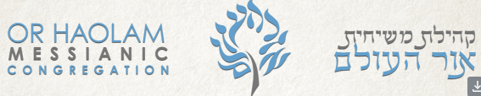
This Shabbat we are inviting 10 people to give 2-minute expressions of praise and Thanksgiving to G-d and to other people.

Slide 84
Or HaOlam now has an AED. Please stay after today’s service for a 10-minute class to learn how to use this device if someone has a sudden cardiac arrest. We strongly recommend attendance. The class will be held between the end of today’s service and before oneg is served. Details are in your bulletin.

Slide 85
Off camera:
Notes:
About to open Zoom room for hour of prayer.

Slide 86
We are hosting a Bring n Share Thanksgiving dinner for Or HaOlamniks who have no family available to be with that day. Singles, empty nesters, families with no extended family. It's not an invitation to the whole city, but so that none of our people should be alone that day.

