Slide 1
e-handout
To have these notes
without taking notes
Go to OrHaOlam.com
Click on Messages tab,
2024 Messages

Slide 2
Financial update
($22,436) year-to-date
adjusted net shortfall as of Thursday evening, Dec. 26, 2024
Notes:
11 people give and extra $2000?
My apologies for not doing this with the several previous babies. I used to, but lost track. Sorry.

Slide 3
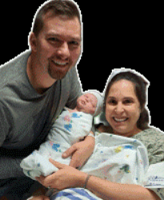
Trudy & Jim Daugherty’s granddaughter Eliana Beth Coulter was born 22 Dec. at 4:56 am, 8 lbs. 15 oz. 20.5 in. to Blake and Sara Coulter.

Slide 4
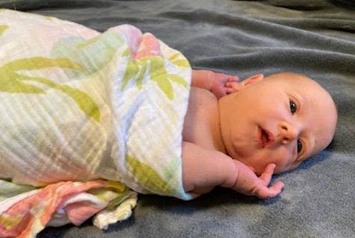
Baby girl Lundquist born Sun Dec 22.
7 lbs.
We are waiting to publicly share name until after personal family naming/blessing time this coming week. Bat Lundquist.
Notes:
Bat Lundquist

Slide 5
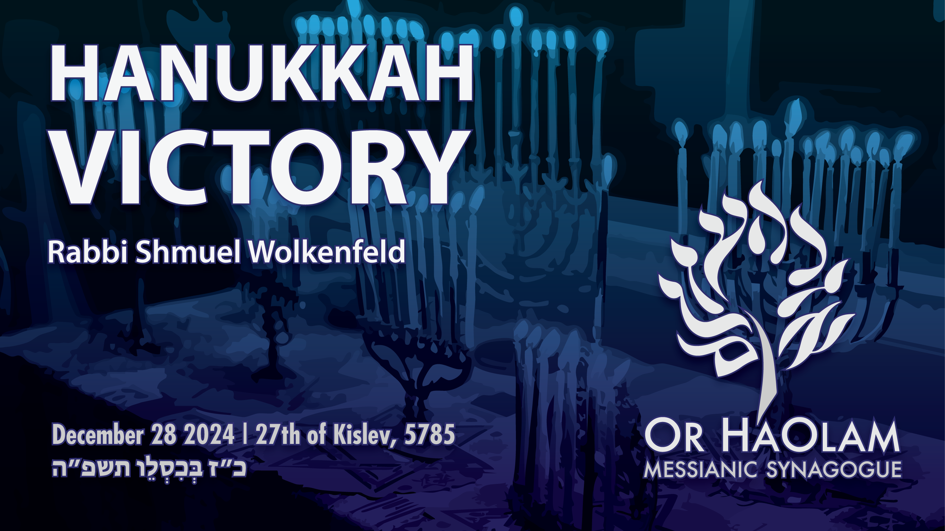

Slide 6
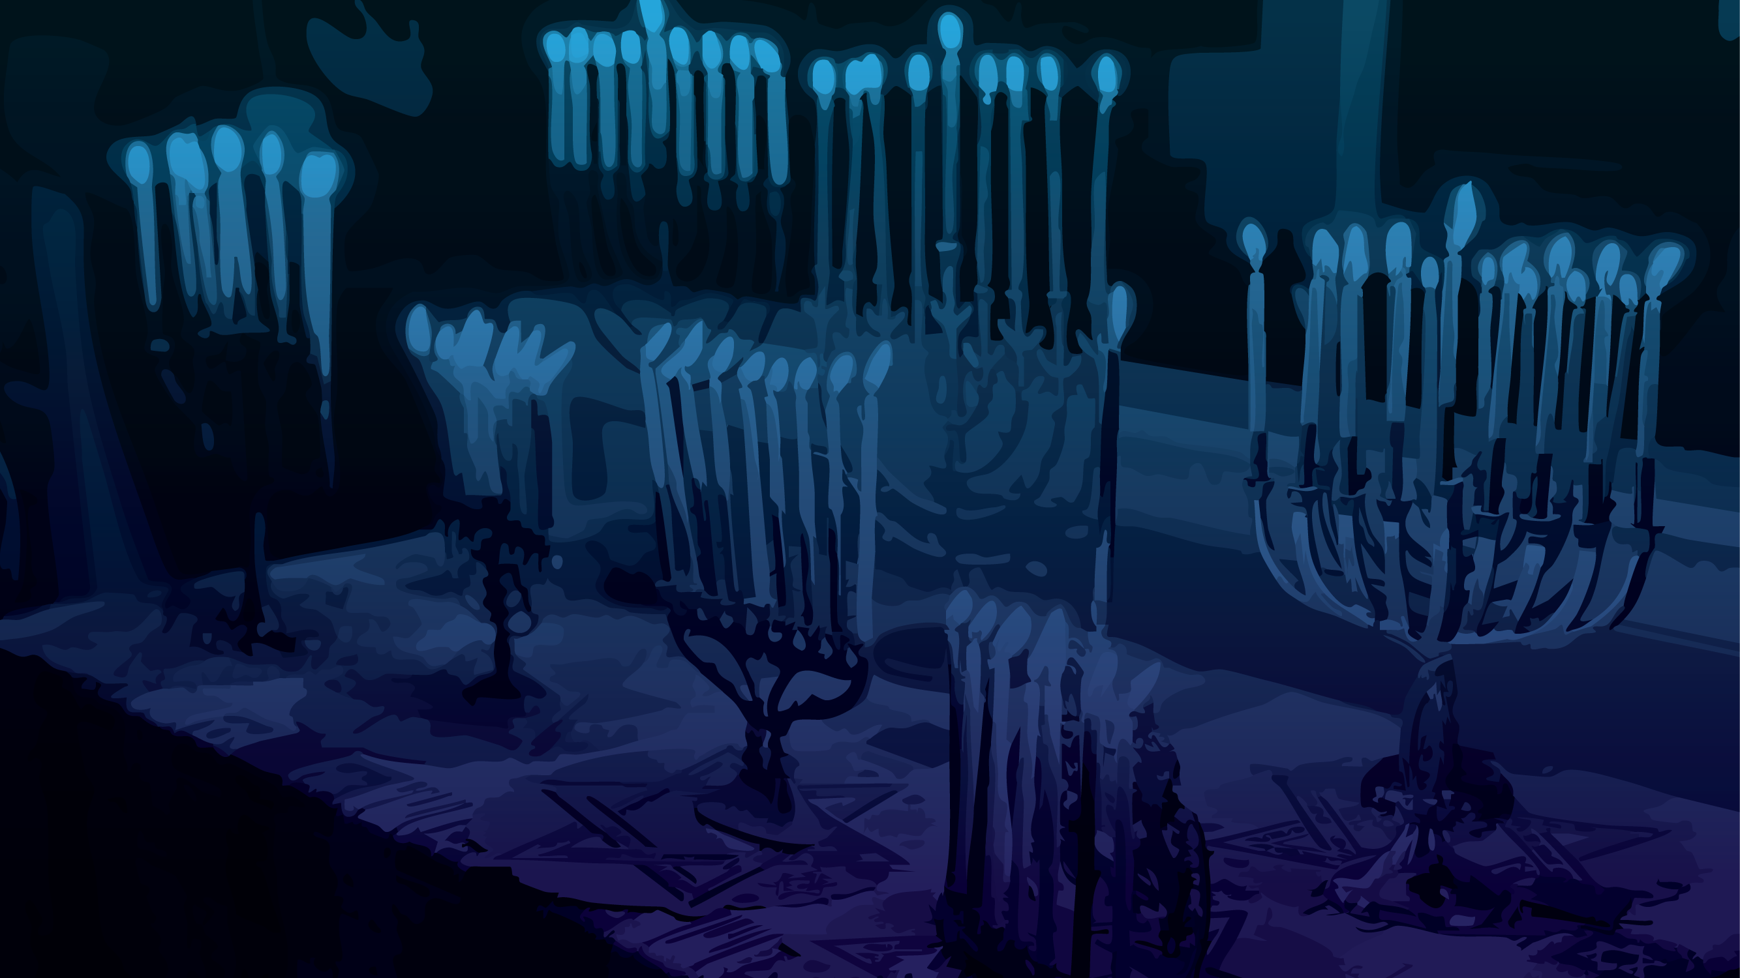
Hanukkah victory
Ancient original Hanukkah
Last year Hanukkah situation
Current Hanukkah situation
Spiritual application

Slide 7
Hanukkah victory
Ancient original Hanukkah
Last year Hanukkah situation
Current Hanukkah situation
Spiritual application

Slide 8
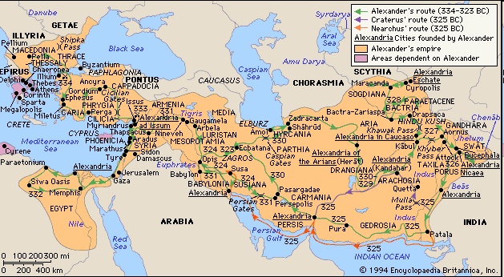
Alexander’s Greek Empire 330 BCE
Notes:
From Macedonia to Egypt to India
When Alexander died at age 33, the empire was divided.

Slide 9
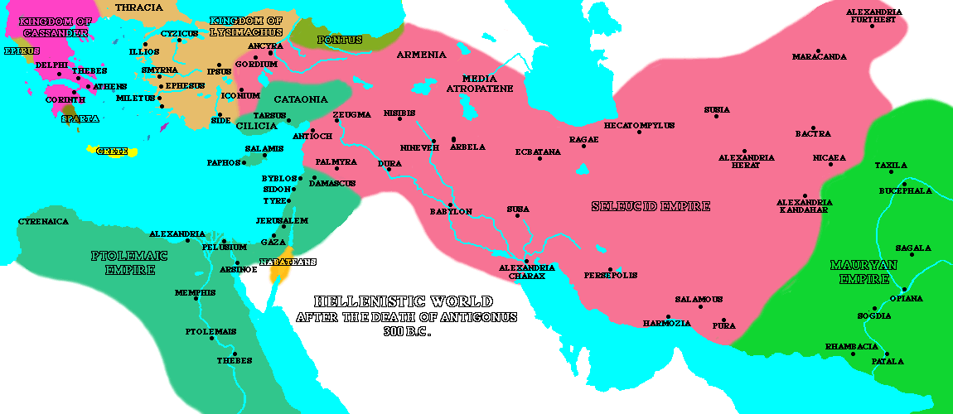
Notes:
Naval interference of Romans → fury of Antiochus the Syrian
In 175 BC, a new king, Antiochus IV (also called "Epihpanes") ascended the throne in Syria. Under the "auspices" of his regime, Jerusalem began to look more and more like a Greek city as Hellenistic culture was officially promoted. Antiochus allowed Hellenistic Jews to have prominent roles in the Holy Temple - so much so that even a non-priest (named Menelaus) was given the role of being the Temple's Kohen Gadol (High Priest). This enraged many Jews, however, who then called for Egyptian rule instead of Syrian (the Egyptians were more tolerant of local customs and did not force Hellenization). Later, when Antiochus returned from an unsuccessful military campaign against Egypt, he decided to quell the Jewish call for Egyptian rule and murdered some 40,000 people in Jerusalem.

Slide 10
The book of Daniel was written about 534 BCE, describing events that happened in the 160’s BCE. Israel was located between the Syrian / Selucids and the Egyptian / Ptolemies. They warred as to who would control it.

Slide 11
^{Daniel 11.29-35} “At the time designated, he will come back to the south. But this time, things will turn out differently than before; because ships from Kittim will come against him, so that his courage will fail him.
Notes:
The army from the Syrian north invaded Israel and Ptolemaic Egypt. Roman ships interfered and defeated the Syrians under Antiochus.

Slide 12
^{Daniel 11.29-35} Then, in retreat, he will take furious action against the holy covenant, again showing favor to those who abandon the holy covenant. Armed forces will come at his order and profane the sanctuary and fortress.
Notes:
Written in the 500’s about events 400 years later. Antiochus was mad!

Slide 13
^{Daniel 11.29-35} They will abolish the daily burnt offering and set up the abomination that causes desolation. Those who act wickedly against the covenant he will corrupt with his blandishments,
Notes:
IE a swine sacrifice.

Slide 14
^{Daniel 11.29-35} but the people who know their God will stand firm and prevail. Those among the people who have discernment will cause the rest of the people to understand

Slide 15
^{Daniel 11.29-35} what is happening; nevertheless, for a while they will fall victim to sword, fire, exile and pillage. When they stumble, they will receive a little help, although many who join them will be insincere.

Slide 16
^{Daniel 11.29-35} Even some of those with discernment will stumble, so that some of them will be refined, purified and cleansed for an end yet to come at the designated time.
Notes:
“We can still be Jews, but embrace new insights, sports, activities, learning…”
Nudity, fighting till death, sensuality, violence, intellectual fads and pride
That was the 400 in advance prophecy. This is the history:

Slide 17
^{1 Macabees 2.15-28} The king's officers, such as compelled the people to revolt, came into the city Modin, to make them sacrifice [a pig]. And when many of Israel came unto them, Mattathias also and his sons came together.
Notes:
ie sacrifice a pig
from Apocrypha: additional ancient Jewish books, NOT Scripture
This one in Heb orig, Greek surviving
Mattathias = Mattityahu = Matisyahu the singer

Slide 18
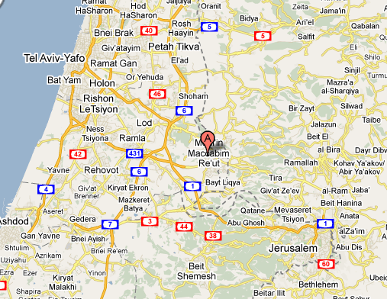
Notes:
Hwy 1 also called Shaar haGai
גַּיְא שער ה‎ or באב אל-ואד Bab El Wad
Matthias family sometimes → Jerus
One day though they were shocked to find that the gold leaf had been ripped from the walls, the tapestries torn down, all plundered and sold for profit by the Syrians. Upon the Jewish altar they had build an altar to the Greek god, Zeus.
Syrian officers came to Modin. 166 BCE

Slide 19
But there was a Hellenized Jew in the town who is willing to do what is unspeakable in Jewish eyes. As he’s about to sacrifice the pig, Mattathias stabs him, also killing the Greek official present. He then turns to the crowd and announces: “Follow me, all of you who are for God’s law and stand by the covenant.” ^{(1 Maccabees 2:27)}
Notes:
You could say that this was a Progressive, a woke Jew
Even if all the nations that live under the rule of the king obey him, and have chosen to do his commandments, departing each one from the religion of his fathers, yet I and my sons and my brothers will live by the covenant of our fathers…We will not obey the king’s word by turning aside from our religion to the right hand or to the left. ^{(I Maccabees 2:19-22)}

Slide 20
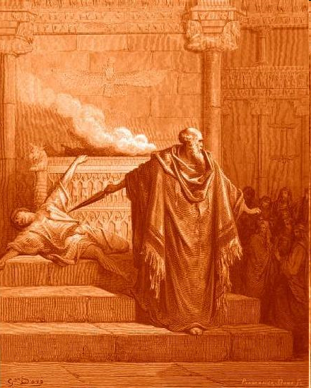
Notes:
Best photo we have sepia
This guy was about to sacrifice a pig on the altar.

Slide 21
The most optimistic estimates put the Maccabee army number at no more than 12,000 men. This tiny force took on the fighting Greek army of up to 40,000 men.
Notes:
Those who join Mattathias and his five sons—named Yohanan, Shimon, Judah, Eleazar, Yonaton—head for the hills, expecting that the Greeks are going to come back and wipe out the whole village as a reprisal. In the hills, they organize a guerilla army, led primarily by the oldest of the sons named Judah, nicknamed Maccabee, which means “the Hammer.” Maccabee is also an acronym for mi komocho ba’alim Hashem, “who is like you among the powers O God,”—the battle cry of the Jewish people.

Slide 22
The Greeks were professional soldiers—they have equipment, they have training, and they have a herd of war elephants, which were the tanks of the ancient world.

Slide 23
The Jews were vastly outnumbered, poorly trained, and poorly equipped (not to mention, they have no elephants), but what they lack in training and equipment they make up in spirit.

Slide 24
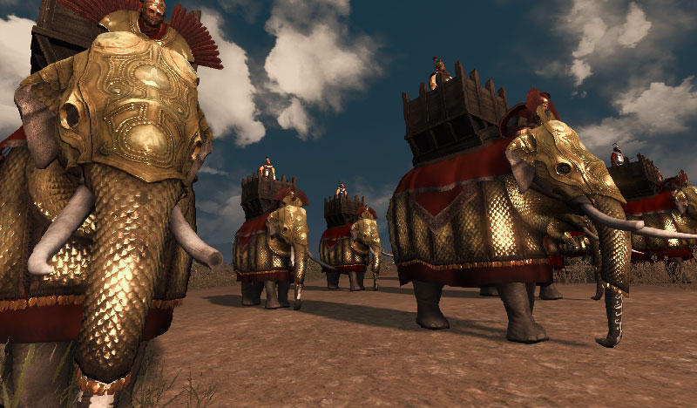
Notes:
https://www.google.com/search?q=syrian+war+elephants&safe=active&sxsrf=ACYBGNQMFeW4Vas2Ouh0iwTBq7gdOjrkmQ:1577477879580&tbm=isch&source=iu&ictx=1&fir=5INhbwabU3XRAM%253A%252C-z0vhSvnp3VZKM%252C_&vet=1&usg=AI4_-kTPVALRwkFcGTAEZYvQ-qUBDrZDcg&sa=X&ved=2ahUKEwjt4ZyF09bmAhUJGc0KHTjGC7QQ9QEwDHoECAoQBg#imgrc=pG9rJFAIudwnnM:&vet=1

Slide 25
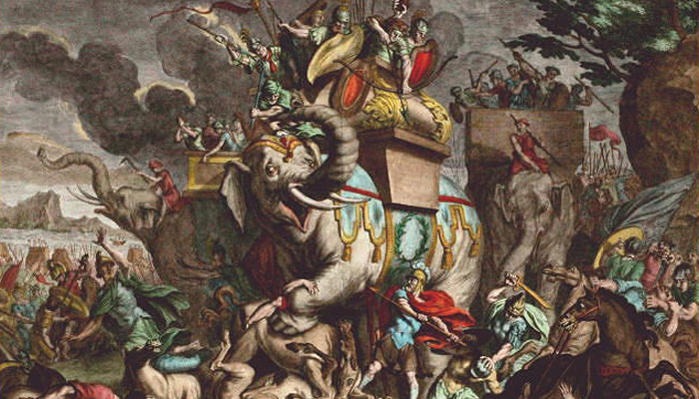
Notes:
https://www.google.com/search?q=maccabees+fight+against+elephants&safe=active&sxsrf=ACYBGNQ8bhxndgWm8e2CtcatfnSln7lumg:1577478621806&source=lnms&tbm=isch&sa=X&ved=2ahUKEwj4zpLn1dbmAhUCac0KHZXjB0QQ_AUoAnoECBEQBA&biw=1280&bih=902#imgrc=clDZthBJLCKWjM:

Slide 26
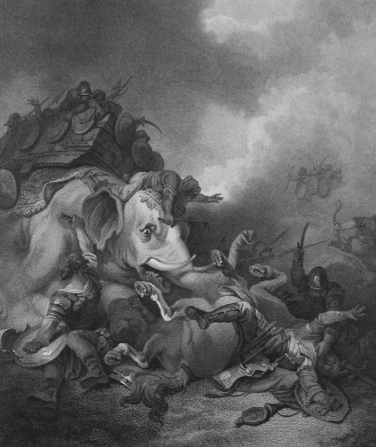
Eleazer (the younger brother of
Judah) died when he single-handedly
attacked a large elephant believed
to be carrying the enemy king I Mac 6:42-46)
Notes:
166 to 164 to liberate Jerusalem
Liberation Jerusalem, cleansed the Temple. Enacted Holiday ~Sukkot

Slide 27
Lysias, the commander-in-chief of the Seleucid Syrian army, along with 60,000 infantrymen and 5000 cavalry, encountered Judah, who had a force of only 3000 poorly equipped rebels, in the town of Emmaus, 7 miles from Jerusalem.
Notes:
Judah then determined to enter Jerusalem and liberate the city, and also to purify the Temple

Slide 28
Judah managed to gather together another 7000 rebels. He prayed to God for strength and deliverance ^{(I Maccabees 4:30-33)}, and God answered!
Notes:
Judah then determined to enter Jerusalem and liberate the city, and also to purify the Temple

Slide 29
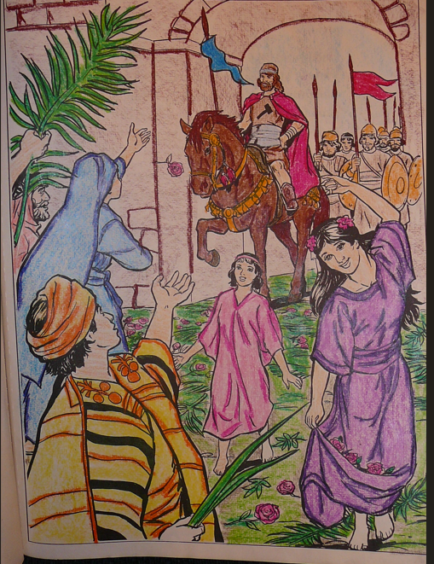
Notes:
Judah then determined to enter Jerusalem and liberate the city, and also to purify the Temple

Slide 30
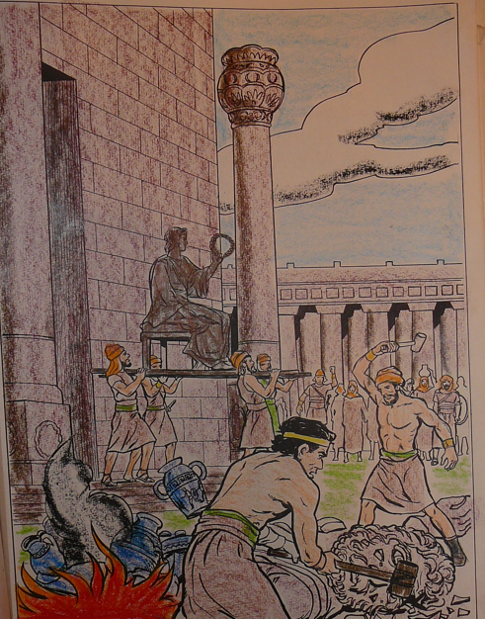
Notes:
Judah then determined to enter Jerusalem and liberate the city, and also to purify the Temple

Slide 31
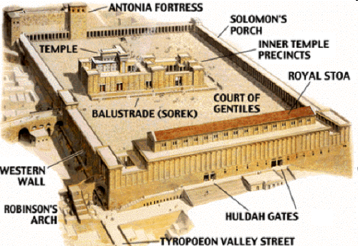
Notes:
We

Slide 32
When the Temple was reconquered in 168 BC, they began the Biblical worship. There was great celebration, and a holiday was proclaimed. There is a legend that there was only enough of the olive oil for the lamp for one day. It takes eight days to prepare from olive leaves, but the light burned 8 days.
Notes:
Or, 8 days to re-enact Sukkot, with celebratory torches. To commemorate the victory, Jewish people light candles, sing songs, eat oily foods for eight days: potato pancakes called Latkes, and jelly donuts.
They tried to kill us, G-d helped us, let’s eat.

Slide 33
But, in fact, it took 25 years of subsequent fighting and a great many casualties on both sides until the Selucid Greeks finally reach a peace agreement with the Jews.

Slide 34
^{John 10.22-23} Then came the Festival of Dedication [that is, Hanukkah] at Jerusalem. It was winter, and Yeshua was in the temple courts walking in Solomon’s Colonnade.
Notes:
Celebrated for the next 160 years, till Yeshua’s day, and till today. 3 candles. Tonight 4.

Slide 36
Hanukkah victory
Ancient original Hanukkah
Last year Hanukkah situation
Current Hanukkah situation
Spiritual application

Slide 37
Hanukkah 2023
Jews facing shock of Oct. 7 slaughter and defilement
“Impossible” tunnel warfare.
Hezbollah HUGE: 10x more powerful than Hamas. 150,000 rockets.
Iranians were strong, racing to get nuclear weapons, proxies.

Slide 38
Iranian rockets: Tehran had thousands of ballistic and cruise missiles with a variety of ranges, according to a 2021 report from the Missile Threat Project at the Center for Strategic and International Studies (CSIS).

Slide 39
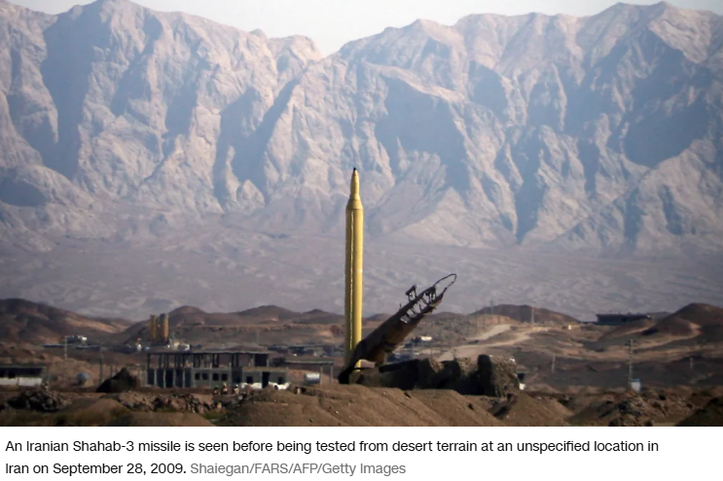

Slide 40
Iranian media reported that Tehran had a new missile, the Fattah-1, in the attacks. Tehran describes the Fattah-1 as a “hypersonic” missile – meaning it travels at Mach 5, or five times the speed of sound (about 3,800 miles per hour).

Slide 41
Houthis in Yemen had great quantities of ballistic missiles.
Syria under Assad had vast supplies of Russian weapons.
Oct. 8 the world erupted in anti-Israel protests!
The U.S. has been duplicitous in sending arms and munitions.

Slide 42
The Israelis have internal judicial action against Netanyahu.
The International Criminal Court rules Netanyahu and Yoav Gallant, the former Minister of Defense of Israel accused of genocide. No action yet on Assad.

Slide 43
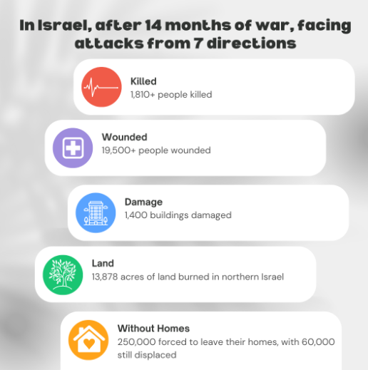

Slide 44
12. Wokeness and cowardice in Israeli and American leadership
Notes:
https://jewishinsider.com/2024/12/elon-musk-praises-tucker-carlson-interview-with-jeffrey-sachs-featuring-antisemitic-conspiracy-theories/

Slide 45

Notes:
https://youtu.be/6QkgDeWen0g

Slide 46
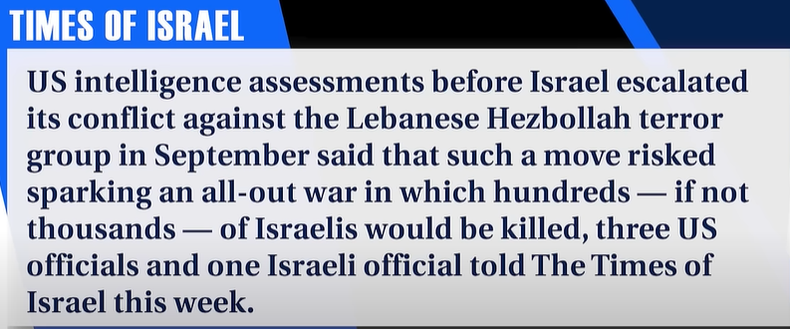
Notes:
https://youtu.be/6QkgDeWen0g?t=178

Slide 47
Herzi Halevi, Chief of the General Staff of Israel Defense Forces
and Yoav Gallant, then Minister of Defense, opposed using the beepers. 5 years developing, but afraid.
Notes:
https://jewishinsider.com/2024/12/elon-musk-praises-tucker-carlson-interview-with-jeffrey-sachs-featuring-antisemitic-conspiracy-theories/

Slide 48
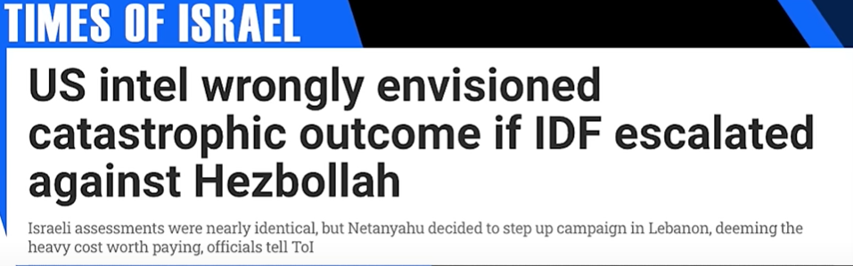
Netanyahu overrode most of Israel’s and America’s intel assessment.
Notes:
https://youtu.be/6QkgDeWen0g?t=93

Slide 49
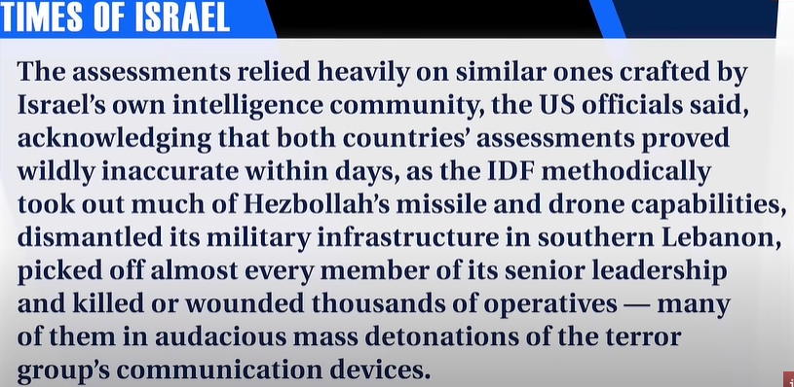
Notes:
https://youtu.be/6QkgDeWen0g?t=195

Slide 50
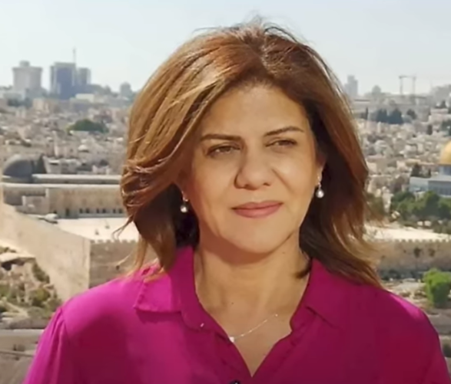
Shiran Abu Akla, journalist embedded with Islamic Jihad, killed in a gunfight with IDF
Notes:
Iranian controlled. May 2022 https://youtu.be/6QkgDeWen0g?t=1153

Slide 51
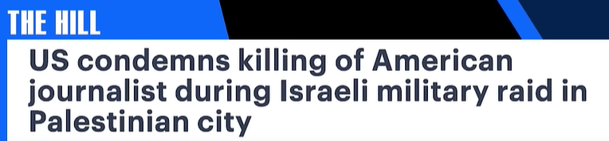
Then launch and investigation into the IDF.
Israeli soldiers on leave in Thailand face a foundation seeking to get them arrested as war criminals.
Notes:
https://www.youtube.com/watch?v=6QkgDeWen0g&t=1153s

Slide 52
Manipulated, coerced,
duplicitous cease fire
arranged by Pres. Biden
Notes:
Avner Boskey

Slide 53
UK Colonel Richard Kemp adds:
“First, if this [Hezbollah] ceasefire had not been secured, it is probable that Joe Biden would have allowed, and even himself orchestrated, a binding UN Security Council Resolution demanding a cessation of hostilities, potentially accompanied by a UN-mandated arms embargo on Israel.
Notes:
Avner Boskey

Slide 54
It would have been his cynical last ditch effort to rescue something at least from his woeful legacy on foreign affairs. Second, as Prime Minister Benjamin Netanyahu alluded to during his speech on the ceasefire,
Notes:
Avner Boskey

Slide 55
the Biden White House has been imposing a partial arms embargo against Israel that included vital munitions and combat equipment including 2,000 pound bombs. After more than a year fighting a war on seven battlefronts that is a significant constraint.”
Notes:
Avner Boskey

Slide 56
13. Slanderous American conservative journalism
Notes:
https://jewishinsider.com/2024/12/elon-musk-praises-tucker-carlson-interview-with-jeffrey-sachs-featuring-antisemitic-conspiracy-theories/

Slide 57
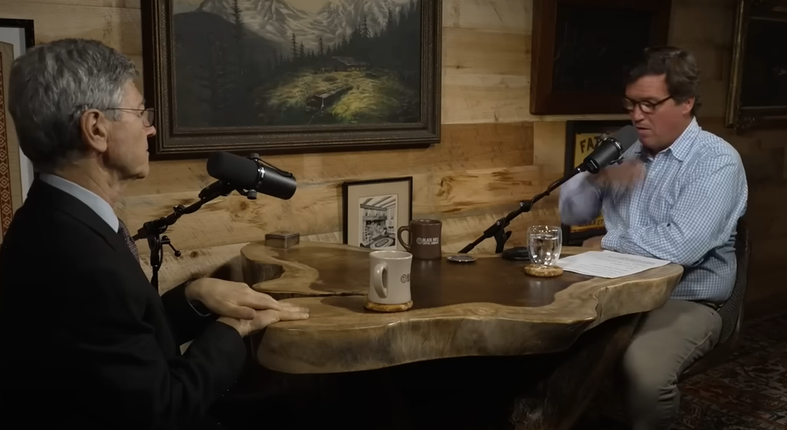
Tucker Carlson and Jeffrey Sachs
Notes:
Some of us may have LOVED Tucker. Rethink that…

Slide 58
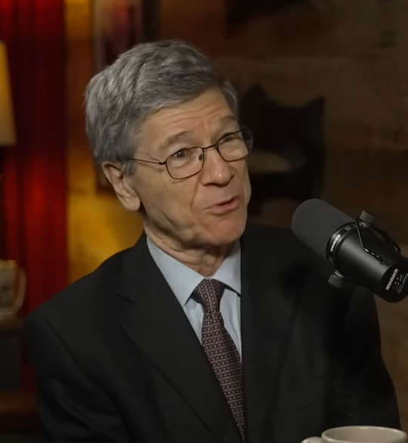
Tucker Carlson’s [had a] controversial interview with Jeffrey Sachs, the Columbia professor who…espouses a litany of conspiracy theories about Israel
Notes:
https://www.realclearpolitics.com/video/2024/12/17/jeffrey_sachs_israel_has_run_american_foreign_policy_in_the_middle_east_for_30_years.html

Slide 59
In the interview, Sachs, who was once a renowned economist but now frequently promotes conspiracy theories on a range of issues, cast the fall of Syria’s authoritarian regime this month as the culmination of a decades-long plot led by Israeli Prime Minister Benjamin Netanyahu.
Notes:
https://jewishinsider.com/2024/12/elon-musk-praises-tucker-carlson-interview-with-jeffrey-sachs-featuring-antisemitic-conspiracy-theories/

Slide 60
“The United States goes to war on his behalf,” he said of Netanyahu, arguing that “Israel has driven so many American wars.”
Notes:
https://jewishinsider.com/2024/12/elon-musk-praises-tucker-carlson-interview-with-jeffrey-sachs-featuring-antisemitic-conspiracy-theories/

Slide 61
Invoking a classic antisemitic trope about Jewish control of American politics, Sachs added that the U.S. “gave over Middle East foreign policy to Israel a long time ago, not to U.S. interest, but to Israel’s interest. That is the Israel lobby, and we don’t hear questioning of this at all.”
Notes:
https://jewishinsider.com/2024/12/elon-musk-praises-tucker-carlson-interview-with-jeffrey-sachs-featuring-antisemitic-conspiracy-theories/
Tucker also had and interview with Darryl Cooper

Slide 62
Dec 18, 2024 · CARLSON: But why would Obama want to overthrow Assad?
SACHS: Because Israel has run American foreign policy in the Middle East for 30 years. That's how it works.

Slide 63
Tucker also interviewed Darryl Cooper, who teaches that Winston Churchill was the villain in WW II, NOT Hitler!

Slide 64

Notes:
Hitler was NOT the bad guy in WW II, but Churchill protecting or advancing the British Empire

Slide 65
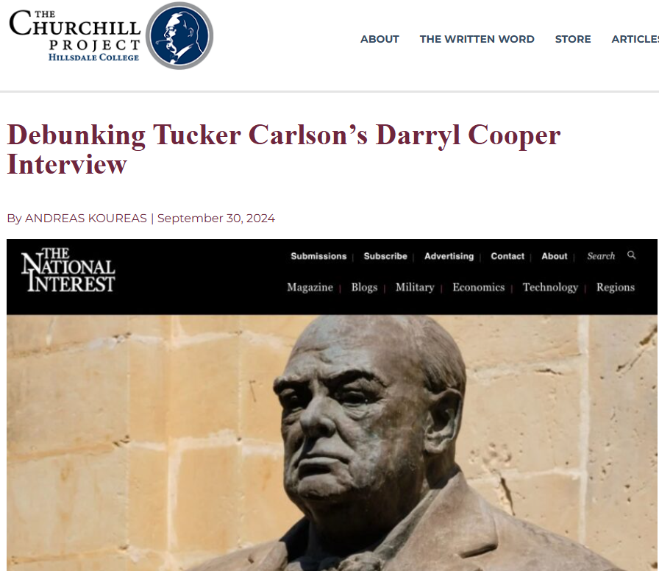
Cooper calls Churchill “the chief villain of the Second World War,”
Notes:
https://winstonchurchill.hillsdale.edu/cooper-koureas/
viewing him as “primarily responsible for that war becoming what it did, becoming something other than an invasion of Poland.”

Slide 66
14. Iranian missile attacks.
Notes:
https://jewishinsider.com/2024/12/elon-musk-praises-tucker-carlson-interview-with-jeffrey-sachs-featuring-antisemitic-conspiracy-theories/

Slide 67
13 April. Iran's attack sent around 170 drones, over 30 cruise missiles, and more than 120 ballistic missiles toward Israel and the Israeli-occupied Golan Heights. Israel said that the coalition, whose defensive efforts were codenamed Iron Shield, destroyed 99 percent of the incoming weapons, most before they reached Israeli airspace.
Notes:
But we didn’t know in advance that Israel would not be destroyed.
https://en.wikipedia.org/wiki/April_2024_Iranian_strikes_against_Israel

Slide 68
On 1 October 2024, Iran launched about 200 ballistic missiles at targets in Israel, in at least two waves in retaliation for Israel's assassinations of Hamas leader Ismail Haniyeh in Tehran, Hezbollah leader Hassan Nasrallah, and IRGC general Abbas Nilforoushan.
Notes:
The two fatalities caused by the attacks were a Palestinian man killed directly by missile debris and an Israeli man indirectly.
https://en.wikipedia.org/wiki/October_2024_Iranian_strikes_against_Israel

Slide 70
Hanukkah victory
Ancient original Hanukkah
Last year Hanukkah situation
Current Hanukkah situation
Spiritual application

Slide 71
Hanukkah 2024
On September 17th, the pagers of thousands of Hezbollah operatives exploded, killing 42 and wounding over 3,000. The following day, the walkie talkies of Hezbollah operatives across Lebanon and Syria exploded,

Slide 72
killing 12 and wounding 2,750. In one fell swoop, the entire Hezbollah communication infrastructure was crippled.

Slide 73
10 days after the pager attack, Israel struck and killed Hezbollah’s supreme leader, Hassan Nasrallah, as he met with top commanders in a Beirut bunker. When Israel’s ground forces entered southern Lebanon, they were surprised to find many Hezbollah command centers unmanned. A captured terrorist told the IDF that after Nasrallah's death most of them fled.
Notes:
https://www.tikkunglobal.org/post/miracles-and-wonders-israel-at-war

Slide 74
On one of Israel’s most viewed primetime news programs, a retired IDF colonel said this:
“As an expert on Hezbollah and Lebanon, I say if you were to put all the heads of Israel’s security agencies here and ask them, ‘Is there a chance that this might happen to Hezbollah in under a month?’
Notes:
https://www.tikkunglobal.org/post/miracles-and-wonders-israel-at-war

Slide 75
There would not be one who would honestly say that they would have imagined even half of what has happened is possible… [It is] not the result of man’s actions but the hand of God.”
Notes:
https://www.tikkunglobal.org/post/miracles-and-wonders-israel-at-war

Slide 76
Hezbollah's massive arsenal exposed – IDF displays over 85,000 weapons confiscated in southern Lebanon
Majority of confiscated weapons were intended to be used in Hezbollah's 'Conquer the Galilee' planned invasion

Slide 77
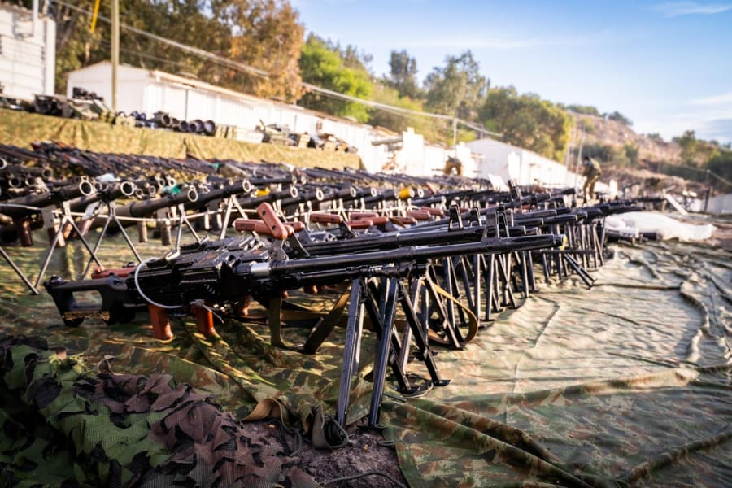
Notes:
https://allisrael.com/idf-displays-over-85-000-items-confiscated-from-hezbollah-in-southern-lebanon?utm_source=convertkit&utm_medium=email&utm_campaign=Israel%20retaliates%20over%20increased%20Houthi%20missile%20attacks,%20strikes%20Sana%E2%80%99a%20airport%20and%20power%20stations%20-%2016093795

Slide 78
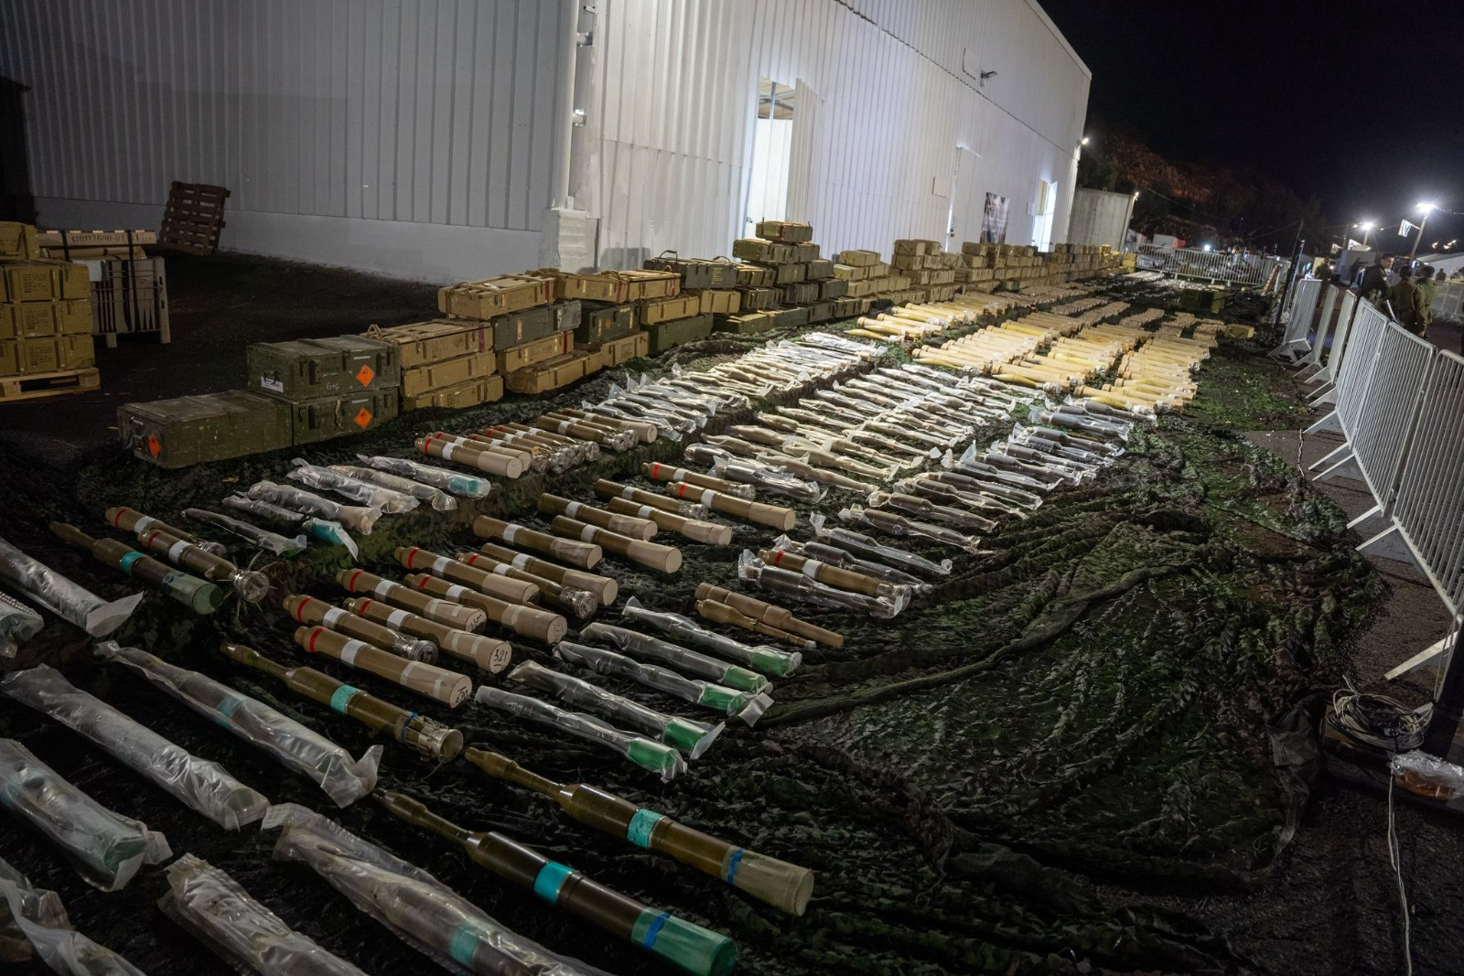
Hezbollah weapons confiscated
by the IDF (Photo: IDF)
Notes:
https://allisrael.com/idf-displays-over-85-000-items-confiscated-from-hezbollah-in-southern-lebanon?utm_source=convertkit&utm_medium=email&utm_campaign=Israel%20retaliates%20over%20increased%20Houthi%20missile%20attacks,%20strikes%20Sana%E2%80%99a%20airport%20and%20power%20stations%20-%2016093795

Slide 79
Yahya Sinwar is dead and also all other Hamas leaders.
Syria’s Assad has fled to Russia and Israel has made 350 airstrikes into Syria destroying their navy, air force, chemical weapons

Slide 80
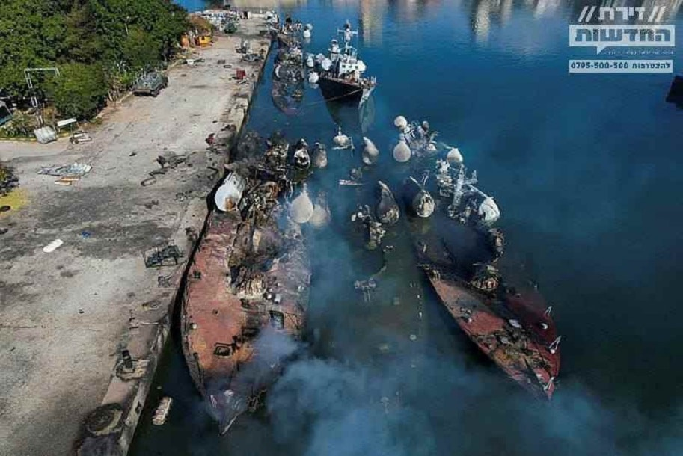
Israeli Navy destroys Syrian
Fleet in Latakia

Slide 81
Russia confirms former Syrian dictator Assad and family are in Russia, apparently per rumors together with over $150 BILLION in Syrian assets.
Notes:
Sally Shiff

Slide 82
Israel destroy Iran’s air defenses.
Change of US administration.

Slide 83
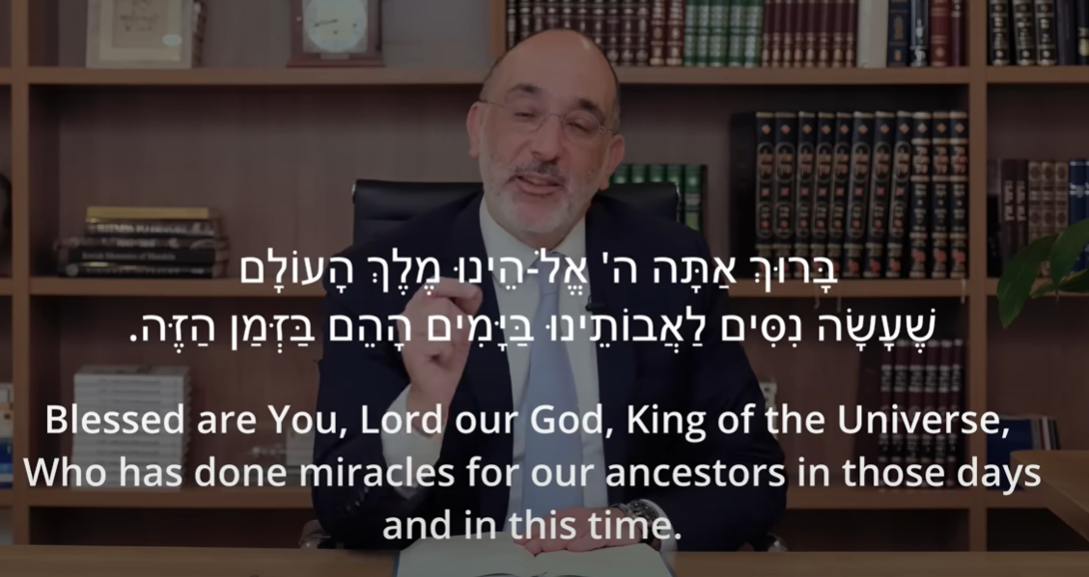
Notes:
https://youtu.be/D2qVIK98oVw
Chief Rabbi of S Africa Warren Goldstein

Slide 85
Hanukkah victory
Ancient original Hanukkah
Last year Hanukkah situation
Current Hanukkah situation
Spiritual application

Slide 86
Believers have experience GREAT opposition in our current culture. A shift seems to be happening.
Chuck Swindol: Victory and success is more dangerous than defeat.
Notes:
Like the change from Hanukkah 2023 to Han 2024, today

Slide 87
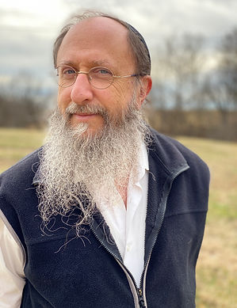
Rabbi Chaim Richman was one of the first onto the Temple Mount in June 1967. Met by a Jordanian.
Notes:
The Jordanian started to show Rabbi Richman that this is where the holy of holies were.
Why are you telling me
You are the Jews, and are back in command. There is a prophecy that the Jews will come and rebuild the Temple. So we are expecting.
Moshe Dayan and Levi Eshkol walked away from it, gave it away.

Slide 88
Israel was at the borders of Beirut in 1982 with Arafat almost defeated, when arrangement was made for him and the PLO to be exiled to Tunisia.
Notes:
https://en.wikipedia.org/wiki/Yasser_Arafat

Slide 89
It’s possible, and historic, to “Snatch defeat out of the jaws of victory.”

Slide 90
We must maintain our passion to have victory over the flesh, the world culture, Satanic influences.
Surrender to Yeshua, purity of mind
Prayer and intercession
Joy and celebration
Service to our community and surroundings.

Slide 91
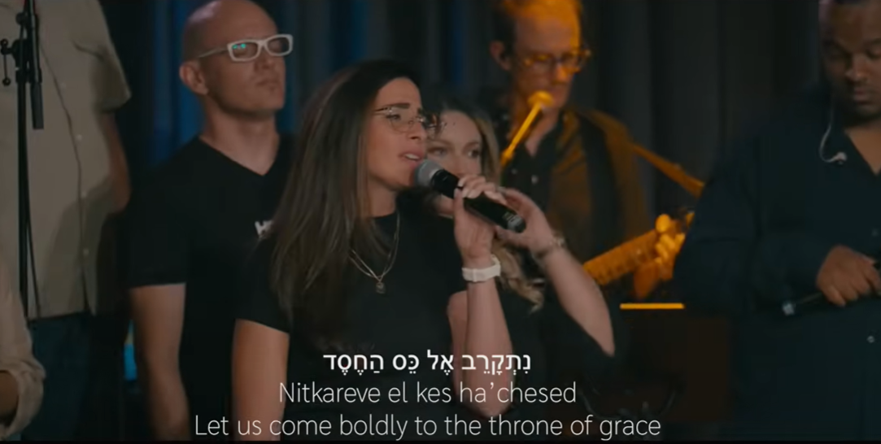
Notes:
https://youtu.be/hBPl2214-jE?t=273

Slide 92
^{Mes Jews/Heb 4.16} Therefore let us draw near to the throne of grace with boldness, so that we may receive mercy and find grace for help in time of need.

Slide 93
^{Mes Jews/Heb 12.1-3} Let us, too, put aside every impediment — that is, the sin which easily hampers our forward movement — and keep running with endurance in the contest set before us, looking away to the Initiator and Completer of that trusting,

Slide 94
^{Mes Jews/Heb 12.1-3} Yeshua — who, in exchange for obtaining the joy set before him, endured execution on a stake as a criminal, scorning the shame, and has sat down at the right hand of the throne of God.

Slide 95
^{Mes Jews/Heb 12.1-3} Yes, think about him who endured such hostility against himself from sinners, so that you won’t grow tired or become despondent.

Slide 96
^{Rev 5.12-13} “Worthy is the Lamb who was slain, to receive power and riches and wisdom and might and honor and glory and blessing!” “To the One seated on the throne and to the Lamb be blessing and honor and glory and power forever and ever!”

Slide 97
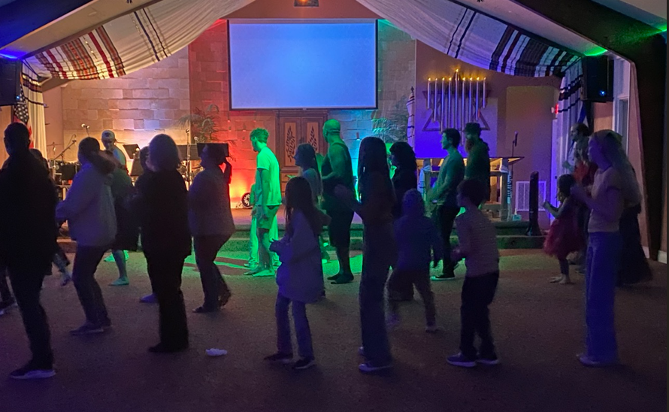

Slide 98
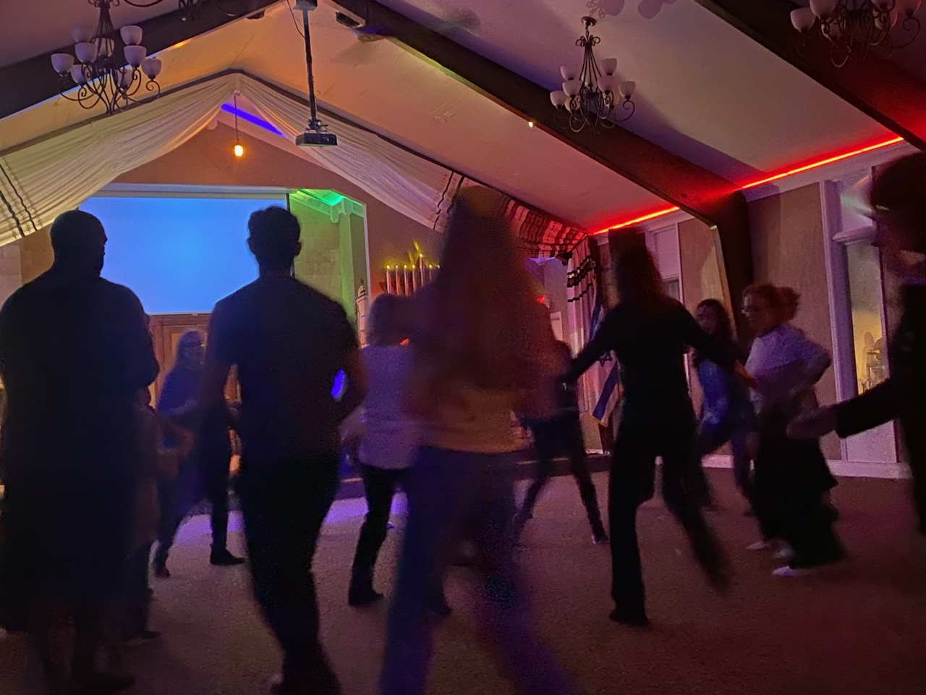

Slide 99
Yermihahu/Jer 31.2-3, 6-7, 9-10, 12-13, 31 From a distance Adonai appeared to me, [saying,] “I love you with an everlasting love; this is why in my grace I draw you to me. Once again, I will build you; you will be rebuilt, virgin of Isra’el.

Slide 100
Yermihahu/Jer 31.2-3, 6-7, 9-10, 12-13, 31 For here is what Adonai says: “Sing with joy for Ya‘akov! shout for the chief of the nations! Proclaim your praise, and say: ‘Adonai! You have saved your people, the remnant of Isra’el!’

Slide 101
Yermihahu/Jer 31.2-3, 6-7, 9-10, 12-13, 31 Look! I am bringing them from the land in the north, gathering them from the far ends of the earth; among them are the blind and lame, women with children, women in labor, all together, a vast throng returning here.

Slide 102
Yermihahu/Jer 31.2-3, 6-7, 9-10, 12-13, 31 Nations, hear the word of Adonai! Proclaim it in the coastlands far away. Say: “He who scattered Isra’el is gathering him,
guarding him like a shepherd his flock.”

Slide 103
Yermihahu/Jer 31.2-3, 6-7, 9-10, 12-13, 31 For Adonai has ransomed Ya‘akov,
redeemed him from hands too strong for him.

Slide 104
Yermihahu/Jer 31.2-3, 6-7, 9-10, 12-13, 31 “Then the virgin will dance for joy, young men and old men together; for I will turn their mourning into joy, comfort and gladden them after their sorrow. I will give the cohanim their fill of rich food, and my people will be satisfied with my bounty,” says

Slide 105
Yermihahu/Jer 31.2-3, 6-7, 9-10, 12-13, 31 “Here, the days are coming,” says Adonai, “when I will make a new covenant with the house of Isra’el and with the house of Y’hudah.

Slide 106
Theology of dance parties:
Not just a tavern.
This is the reconnection of Israel to her Messiah, and so an explosion of joy for Jews and the Nations.

Slide 107
Do you KNOW Yeshua and drinking the water of LIFE?
Are you hearing daily from His Word?
How are you applying what you heard?
Are you offering that water of life to anyone?

