Slide 1
e-handout
To have these notes
without taking notes
Go to OrHaOlam.com
Click on Messages tab,
2024 Messages

Slide 2
During a hike in the Nahal Tabor Nature Reserve in the Lower Galilee, a hiker was on a two-day break from his military reserve duty, seizing the opportunity to enjoy a sunny day after the weeks-long rainy period that Israel experienced recently.

Slide 3
Named Erez Abrahamov (age 45), he stumbled upon a rare scarab amulet dating back to the First Temple period. Scarabs are beetle-shaped amulets or good luck charms.

Slide 4
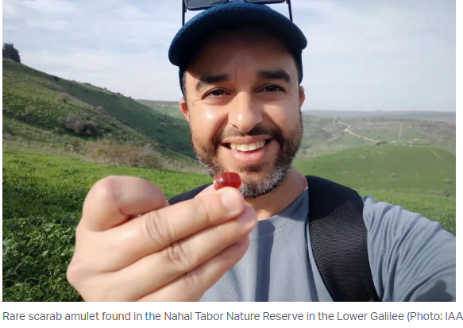
Erez
Abrahamov
Notes:
https://allisrael.com/idf-reservist-finds-2-800-year-old-assyrian-scarab-amulet-while-hiking

Slide 5
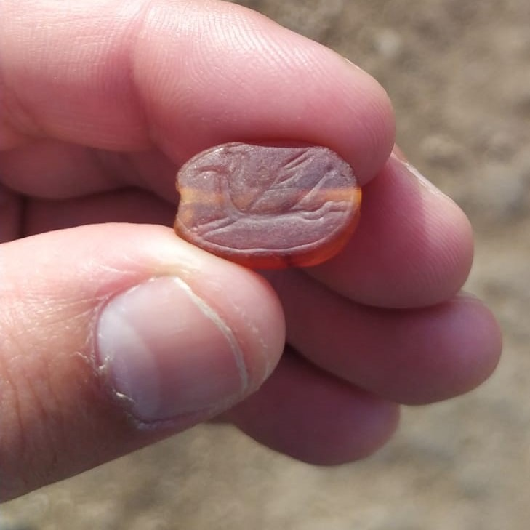
Notes:
https://allisrael.com/idf-reservist-finds-2-800-year-old-assyrian-scarab-amulet-while-hiking

Slide 6
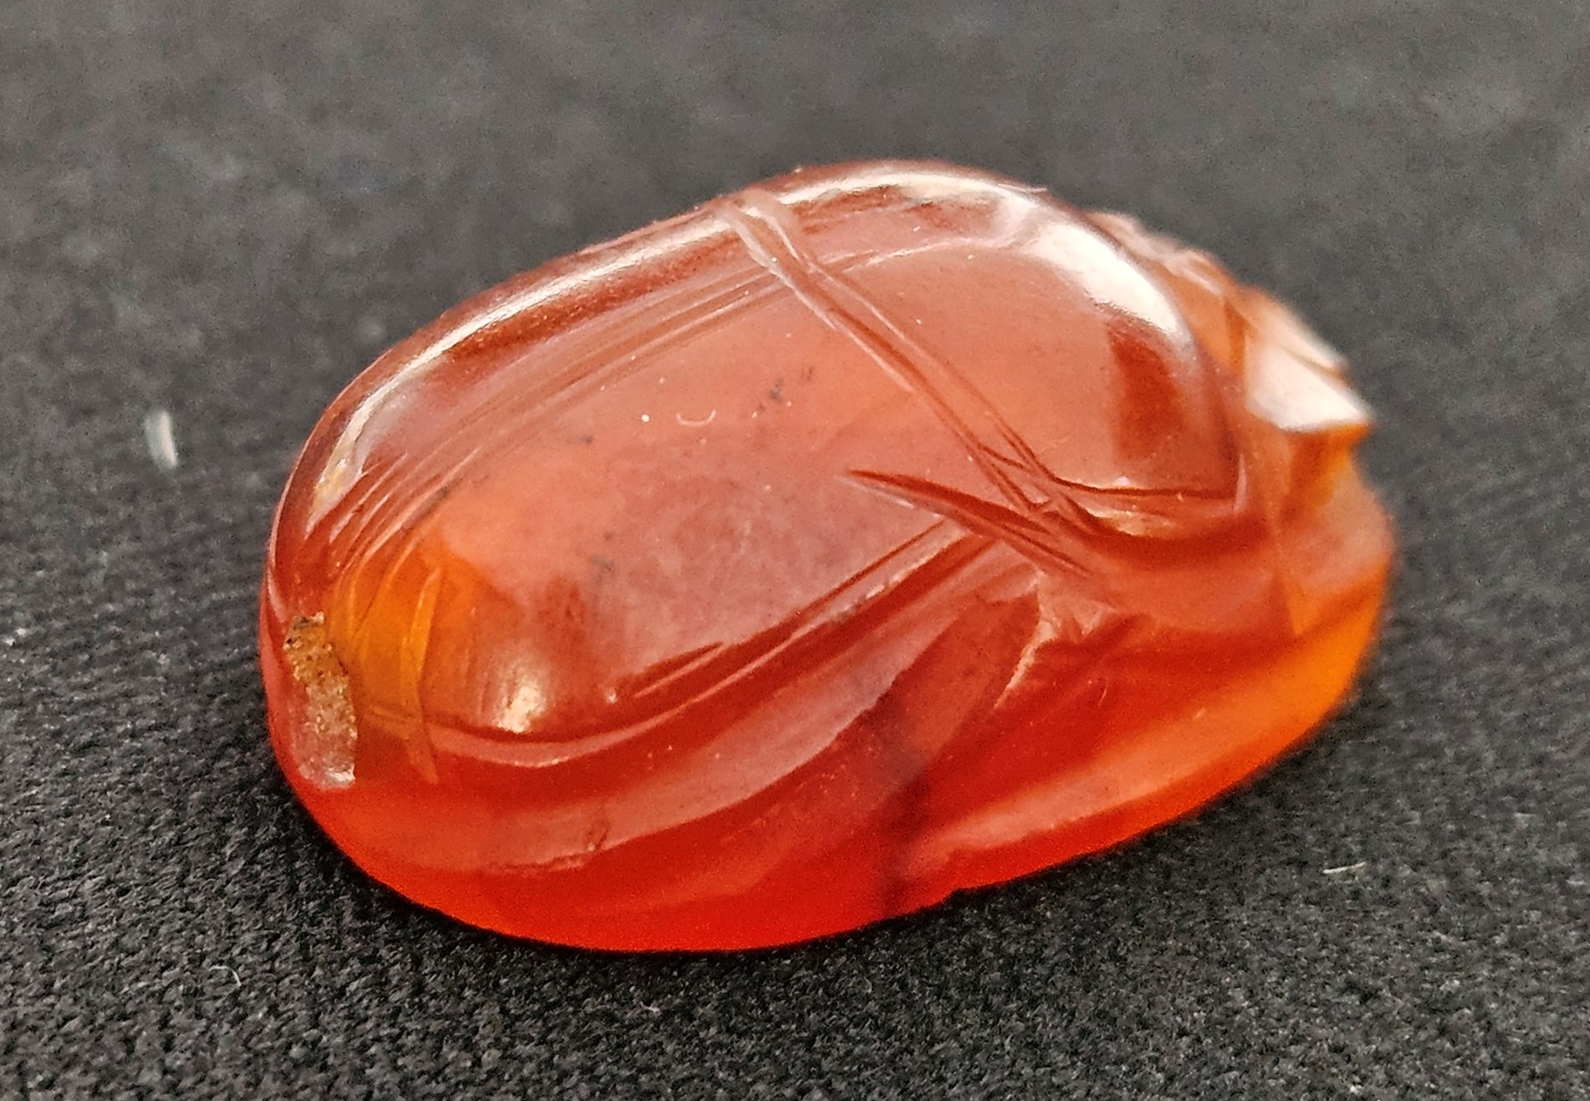
Notes:
https://allisrael.com/idf-reservist-finds-2-800-year-old-assyrian-scarab-amulet-while-hiking

Slide 7
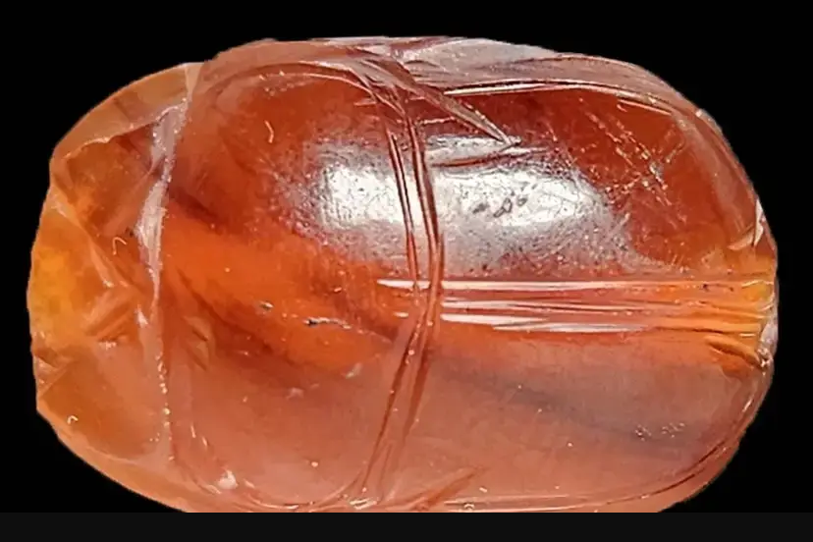
Notes:
https://images.wcdn.co.il/f_auto,q_auto,w_1200,t_54/3/6/6/4/3664235-46.jpg

Slide 8
Where was he?
Just south of the Sea of Galilee, Yam Kinneret.

Slide 9
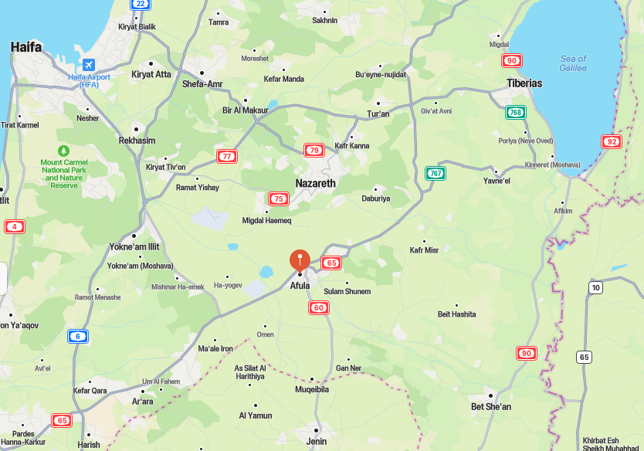

Slide 10
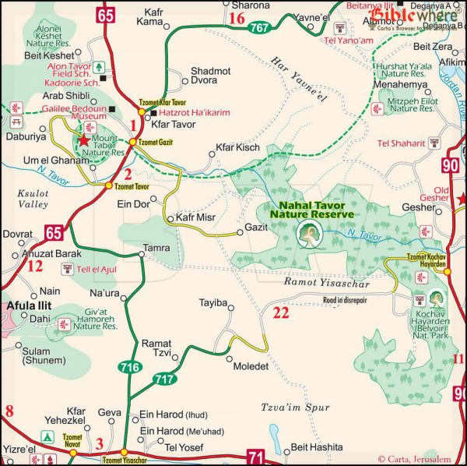

Slide 11
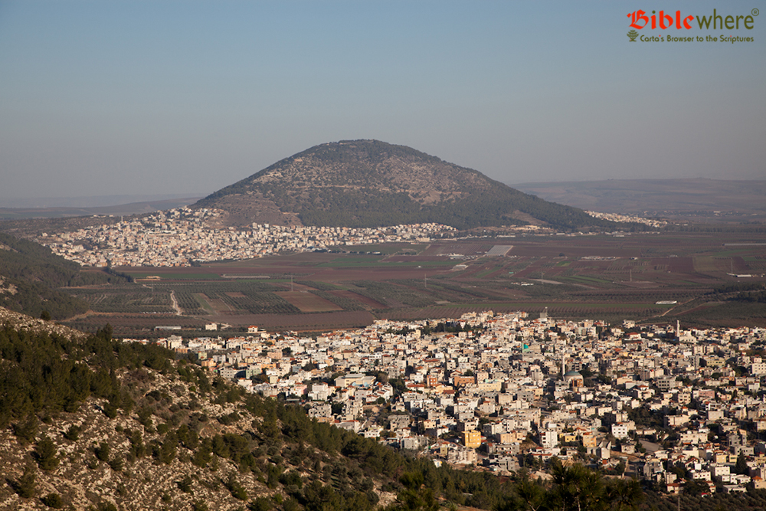
Notes:
Where the story of Devorah and Barak, Ju 4, took place.

Slide 12
Estimated to be around 2,800 years old, the beautiful scarab is crafted from reddish-brown carnelian stone and is believed to have originated either from Assyria or Babylonia.
Notes:
https://allisrael.com/idf-reservist-finds-2-800-year-old-assyrian-scarab-amulet-while-hiking

Slide 13
Itzik Paz, an archaeologist affiliated with the IAA, noted the existence of a large citadel during the Assyrian dominion of the 6th and 7th centuries B.C.
Notes:
https://allisrael.com/idf-reservist-finds-2-800-year-old-assyrian-scarab-amulet-while-hiking

Slide 14
"This Assyrian Empire rule, as we know, was responsible for the destruction of the Kingdom of Israel," Paz added.
Notes:
https://allisrael.com/idf-reservist-finds-2-800-year-old-assyrian-scarab-amulet-while-hiking

Slide 15
The Assyrian Empire is no more to be found, but the Jews that they destroyed and exiled survive, are back in their land, and thriving in many dimensions.

Slide 16
Notes:
Pray about the rich blessings of G-d
https://images.wcdn.co.il/f_auto,q_auto,w_1200,t_54/3/6/6/4/3664235-46.jpg

Slide 17


Slide 18
^{Eph. 3.4-8} If you read what I have written, you will grasp how I understand this secret plan concerning the Messiah. In past generations it was not made known to mankind, as the Spirit is now revealing it to his emissaries and prophets,
Notes:
Secret similar to

Slide 19
^{Eph. 3.4-8} that in union with the Messiah and through the Good News the Nations were to be joint heirs, a joint body and joint sharers with the Jews in what God has promised. I became a servant of this Good News by God’s gracious gift,
Notes:
Not all blessings. Land, antisemitism [Jew lovers]

Slide 20
^{Eph. 3.4-8} which he gave me through the operation of his power. To me, the least important of all God’s holy people, was given this privilege of announcing to the Nations the Good News of the Messiah’s unfathomable riches.

Slide 22

Messiah’s unfathomable riches
The extent of the wealth
The access to the wealth
End times evidence of the wealth
  Victory of Israel over hatred
  Rebuilding of the Temple?!!

Slide 23
^{Eph. 3.8} The Good News of the Messiah’s unfathomable riches.
Notes:
What does that mean?

Slide 24

anexichniaston
that cannot be traced out, that cannot be explored, "not able to trace the steps of") –
Notes:
Follow the money.

Slide 25
properly, impossible to "track“; unable to follow or fully comprehend; inscrutable, past finding out, incomprehensible, beyond research project, lab analysis
Breathtaking
Notes:
Would you like to see breathtaking?

Slide 26
^{Ro 11.33} O the depth of the riches, both of the wisdom and knowledge of God! How unsearchable are His judgments and how incomprehensible
anexichniaston
His ways!
Notes:
In the Septuigint LXX, Greek of the Tanakh…

Slide 28
^{Iyov/Job 5.8-9} I would lay my cause before God. Who does great things beyond comprehension, [Anexichniaston in the LXX]
עֹשֶׂה גְדֹלוֹת וְאֵין חֵקֶר ein khaker

Slide 29
^{Iyov / Job 9.8-10} He alone spreads out the heavens, and treads on the waves of the sea; He makes the Bear, Orion and Pleiades, and the constellations of the south; He does great and unfathomable Anexichniaston things, wonders beyond number. וְאֵין חֵקֶר ein khaker

Slide 30
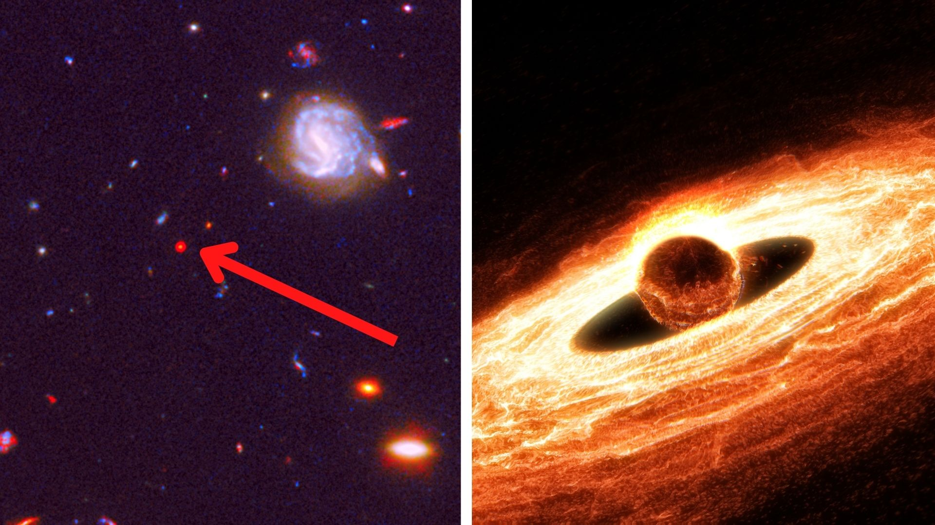
Notes:
Hubble spots a supermassive black hole being born
https://inteng-storage.s3.amazonaws.com/img/iea/Lg6E2B2awN/hubble-supermassive-black-hole-born.jpg

Slide 31
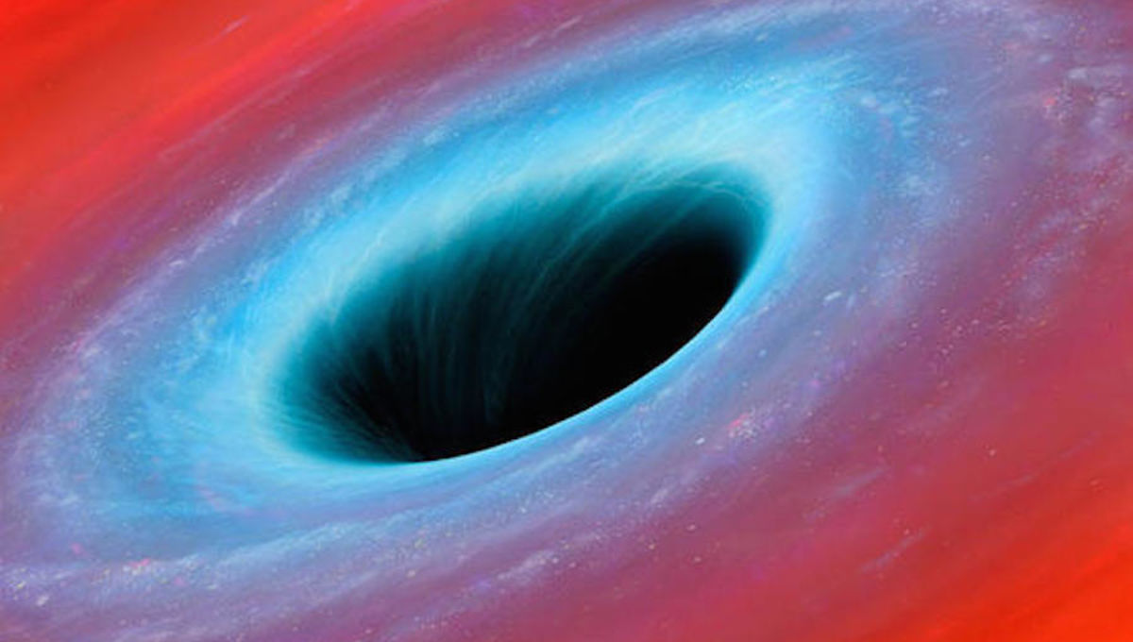
Notes:
Hubble Space Telescope eyes frightening new 'supermassive' black hole ...
https://external-content.duckduckgo.com/iu/?u=https%3A%2F%2Fwww.syfy.com%2Fsites%2Fsyfy%2Ffiles%2Fstyles%2F1200x680_hero%2Fpublic%2Fwire%2Flegacy%2Fblack-hole.jpg&f=1&nofb=1&ipt=73923e0229c1be285bd13189eed38835012061ae56383a3b2dba907c06e8be9d&ipo=images

Slide 32
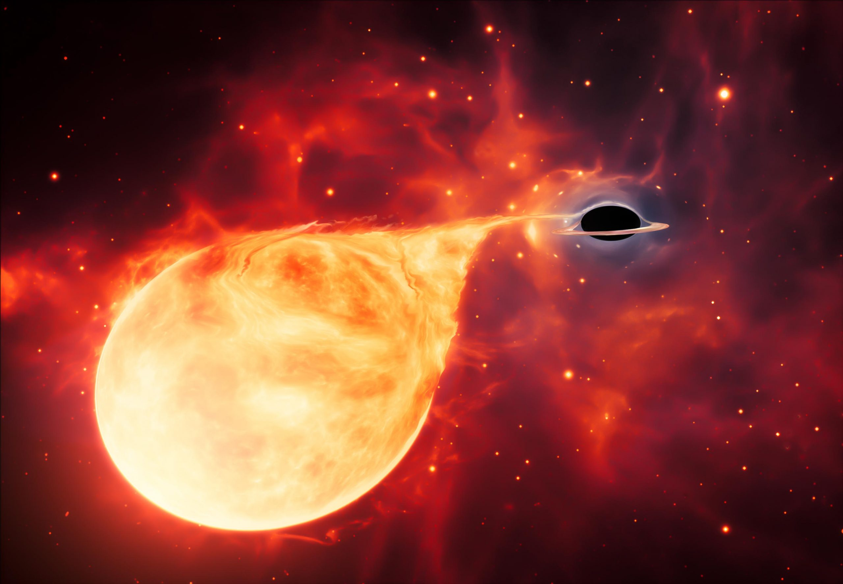
Notes:
Evidence of Elusive “Missing Link” in Black Hole Evolution Found by Hubble Space Telescope
https://scitechdaily.com/images/Intermediate-Mass-Black-Hole-Tearing-Apart-Star-scaled.jpg

Slide 33
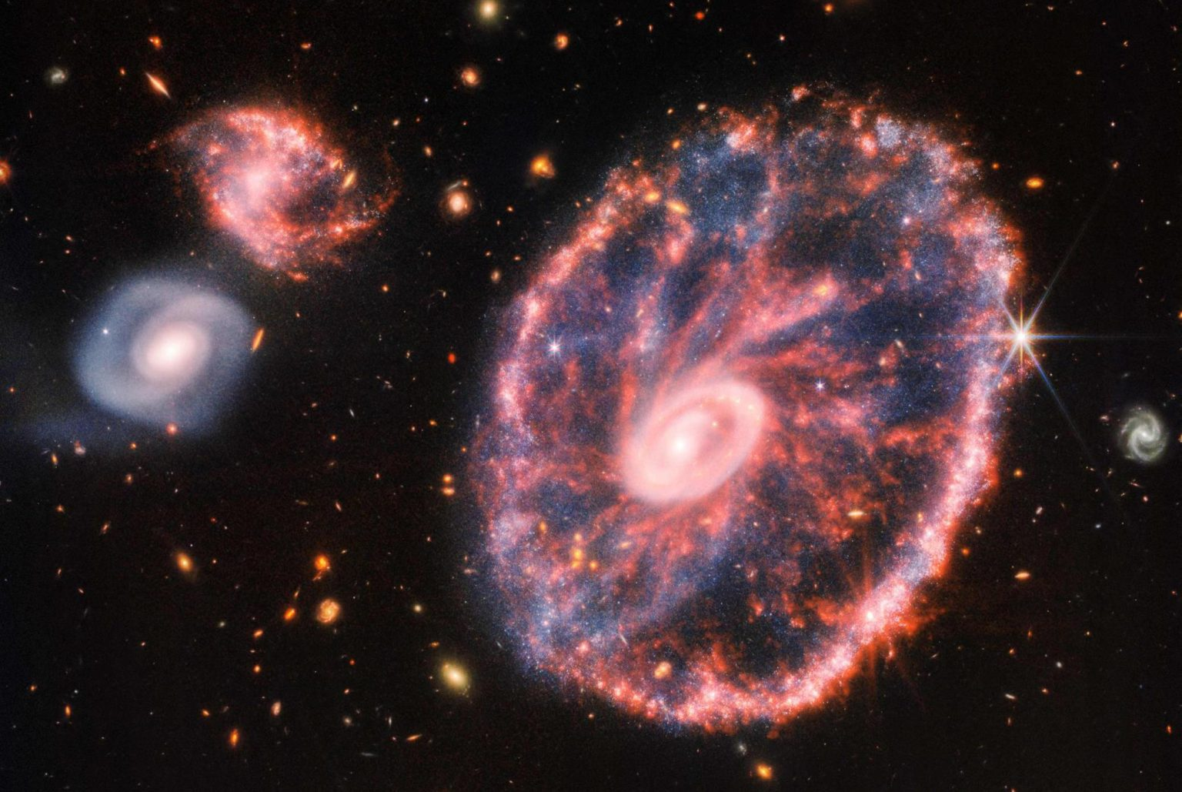
Notes:
James Webb Telescope captures stunning new images of the 'Ring galaxy'
taylordailypress.net
We will explore all this in the next life. Too far to go now.
Don’t really have to go this far…mountains, oceans, lakes. All examples of incomprehensible beauty and glory…
https://www.taylordailypress.net/wp-content/uploads/2022/08/James-Webb-Telescope-captures-stunning-new-images-of-the-Ring-1536x1029.jpg

Slide 34
^{Eph. 3.8} The Good News of the Messiah’s unfathomable riches.
So what exactly is Messiah Yeshua’s wealth for us.

Slide 35
^{Mtt 11.28-30} “Come to me, all of you who are struggling and burdened, and I will give you rest. Take my yoke upon you and learn from me, because I am gentle and humble in heart, and you will find rest for your souls. For my yoke is easy, and my burden is light.”

Slide 36
FIRST WEALTH SET: G-d Himself
^{2 Cor 4.6} The God who once said, “Let light shine out of darkness,” who has made his light shine in our hearts, the light of the knowledge of God’s glory shining in the face of the Messiah Yeshua.
Notes:
What everyone, everyone Jewishly trained, wants.

Slide 37
^{T’hillim/ Ps 27.4} Just one thing have I asked of Adoni; only this will I seek: to live in the house of Adoni all the days of my life, to see the beauty of Adoni and visit in his temple.

Slide 38
^{T’hillim / Ps 103.1-5} Bless Adoni, my soul! Everything in me, bless his holy name! Bless Adoni, my soul, and forget none of his benefits! He forgives all your offenses, he heals all your diseases, he redeems your life from the pit,

Slide 39
^{T’hillim / Ps 103.1-5} he surrounds you with grace and compassion, he contents you with good as long as you live, so that your youth is renewed like an eagle’s.

Slide 40
^{Dvarim/Dt 6.4-5} “Sh’ma, Yisra’el! Adoni Eloheinu, Adoni echad [Hear, Isra’el! Adoni our God, Adoni is one]; and you are to love Adoni your God with all your heart, all your being and all your resources.

Slide 41
SECOND WEALTH SET: People
^{Gal 5.22-24} The fruit of the Ruakh is love, joy, peace, patience, kindness, goodness, faithfulness, gentleness, and self-control. Nothing in the Torah stands against such things.
Notes:
relationships

Slide 42
^{Vayikra/Lev 19.17-18} “‘Do not hate your brother in your heart, but rebuke your neighbor frankly, so that you won’t carry sin because of him. Don’t take vengeance on or bear a grudge against any of your people; rather, love your neighbor as yourself; I am Adoni.

Slide 43
^{Mes Jews/Heb 7.25} He is totally able to deliver those who approach God through him; since he is alive forever and thus forever able to intercede on their behalf.
Notes:
Habits, attitudes, character weakness?

Slide 44
Does anyone really attain to this?
Do even faith leaders attain to this?
Notes:
Lots of leaders failing, bad example in community.

Slide 46
Messiah’s unfathomable riches
The extent of the wealth
The access to the wealth
End times evidence of the wealth
  Victory of Israel over hatred
  Rebuilding of the Temple?!!

Slide 47
^{1 Yn 1.7-9} But if we are walking in the light, as he is in the light, then we have fellowship with each other, and the blood of his Son Yeshua purifies us from all sin. If we claim not to have sin, we are deceiving ourselves,

Slide 48
^{Gal 5.16-18} Run your lives by the Spirit. Then you will not do what your old nature wants. For the old nature wants what is contrary to the Spirit, and the Spirit wants what is contrary to the old nature.

Slide 49
^{Gal 5.16-18} These oppose each other, so that you find yourselves unable to carry out your good intentions. But if you are led by the Spirit, then you are not in subjection to the system that results from perverting the Torah into legalism.

Slide 50
^{1 Yn 1.7-9} and the truth is not in us. If we acknowledge our sins, then, since he is trustworthy and just, he will forgive them and purify us from all wrongdoing.

Slide 51
^{Gal 5.22-24} Now those who belong to Messiah Yeshua have crucified the flesh with its passions and desires.
Notes:
How? Prayer, Scripture, confession to close friends.
Accept some reality…

Slide 52
^{1 Cor 13.4 NKJV} Love suffers long and is kind; love does not envy; love does not parade itself, is not puffed up.
^{CJB} Love is patient and kind, not jealous, not boastful.
Notes:
Last Shabbat message on the pain of spiritual and physical children

Slide 53
^{Gal 5.13-15} Brothers and sisters, you were called to freedom — only do not let your freedom become an opportunity for the flesh, but through love serve one another. For the whole Torah can be summed up in a single saying: “Love your neighbor as yourself.”

Slide 54
^{Gal 5.13-15} But if you bite and devour one another, watch out that you are not destroyed by one another.

Slide 55
^{Mtt 13.44} “The Kingdom of Heaven is like a treasure hidden in a field. A man found it, hid it again, then in great joy went and sold everything he owned, and bought that field.
Notes:
To get the wealth I’m talking about

Slide 56
Another wealth access point.

Slide 57
^{Eph. 3.4-8} If you read what I have written, you will grasp how I understand this secret plan concerning the Messiah. In past generations it was not made known to mankind, as the Spirit is now revealing it to his emissaries and prophets,
Notes:
Secret similar to

Slide 58

“If you read”
Notes:
Implies public reading of scripture.

Slide 59
^{Dt. 31.19} “Therefore, write this song for yourselves, and teach it to the people of Isra’el. Have them learn it by heart, so that this song can be a witness for me
Notes:
^{Col 4.16} After this letter has been read to you, have it read also in the congregation of the Laodiceans; and you, in turn, are to read the letter that will come from Laodicea.
^{1 Tim 4.13.} Until I come, pay attention to the public reading of the Scriptures.

Slide 60
^{Eph. 3.4-8} If you read what I have written, you will grasp how I understand this secret plan concerning the Messiah. In past generations it was not made known to mankind, as the Spirit is now revealing it to his emissaries and prophets,
Notes:
Secret similar to

Slide 61
^{Eph. 3.4-8} that in union with the Messiah and through the Good News the Nations were to be joint heirs, a joint body and joint sharers with the Jews in what God has promised. I became a servant of this Good News by God’s gracious gift, which he gave me through the operation of his power.
Notes:
Not all blessings. Land, antisemitism [Jew lovers]

Slide 62
A third wealth access point.

Slide 63
^{Eph. 3.4-8} To me, the least important of all God’s holy people, was given this privilege of announcing to the Nations the Good News of the Messiah’s unfathomable riches.

Slide 64
^{Eph 3.8} the least important of all God’s holy people
^{Definition:} less than the least
^{Usage:} the smallest, least important.

Slide 65
^{Mtt 18.3-4} “Yes! I tell you that unless you change and become like little children, you won’t even enter the Kingdom of Heaven! So the greatest in the Kingdom is whoever makes himself as humble as this child.

Slide 66
^{1 Tim 1.13-14} I was formerly a blasphemer, a persecutor, and a violent man. Yet I was shown mercy because I had acted ignorantly in unbelief, and the grace of our Lord overflowed with the faith and love that are in Messiah Yeshua.

Slide 67
^{1 Tim 1.15} So here is a statement you can trust, one that fully deserves to be accepted: the Messiah came into the world to save sinners, and I’m the number one sinner!
sinners”—of whom I am foremost.

Slide 68
^{1 Cor 15.8-10} Last of all, as to one untimely born, He also appeared to me. For I am the least of the emissaries, unworthy to be called an emissary because I persecuted God’s community. But by the grace of God I am what I am.

Slide 69
^{1 Cor 15.8-10} His grace toward me was not in vain. No, I worked harder than them all—yet not I, but the grace of God that was with me.

Slide 70
Summary of wealth access points.
Confession of sin
Reading the Word
Humiliy

Slide 72
Messiah’s unfathomable riches
The extent of the wealth
The access to the wealth
End times evidence of the wealth
  Victory of Israel over hatred
  Rebuilding of the Temple?!!

Slide 73
Messiah’s unfathomable riches
The extent of the wealth
The access to the wealth
End times evidence of the wealth
  Victory of Israel over hatred
  Rebuilding of the Temple?!!

Slide 74
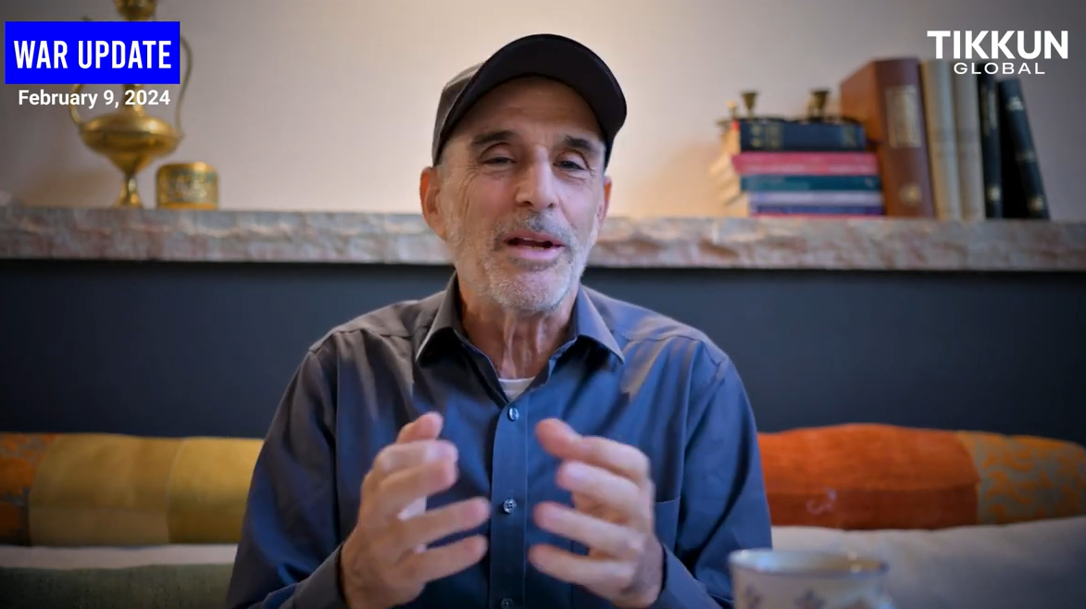
Asher Intrater
Notes:
https://www.tikkunglobal.org/post/israel-at-war-02-09-24-update
War proceeding well but slowly.
~2 million people moved out of the way by Israel so can attack tunnels
Closing in. ~17 out of 24 Hamas brigades dismantled. Found document with list of $154 million support to Yaha Sinwar. Almost caught leadership and hostages. So close that they abandoned ~31 million shekels.
Goal: after Hamas dismantled, demilitarization and deradicalization.

Slide 75
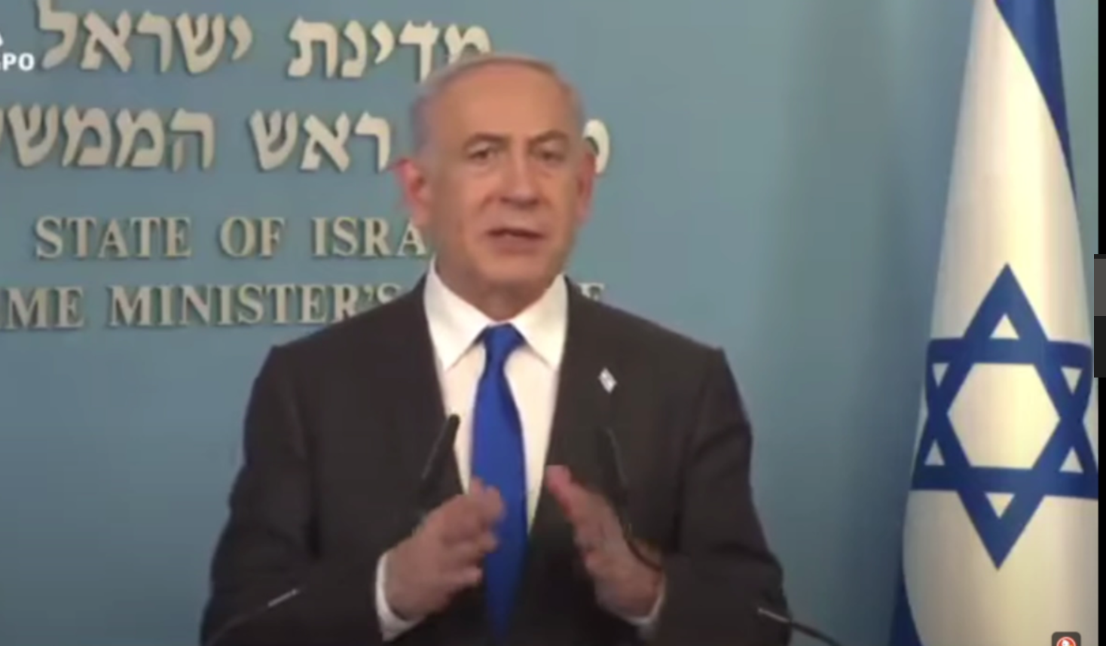
Notes:
https://www.youtube.com/watch?v=GfjKBBz0-Fg

Slide 76
An Israeli women’s basketball team beat Ireland 87 to 57 in the first game of the 2025 Women’s EuroBasket qualifier in Riga on Thursday evening, February 8. However, the Irish team refused to shake hands with their Israeli counterparts.
Notes:
https://vfinews.com/news/idf-believes-32-of-the-136-hostages-are-dead-hamas/israeli-basketball-team-wins-after-irish-team-refuses

Slide 77
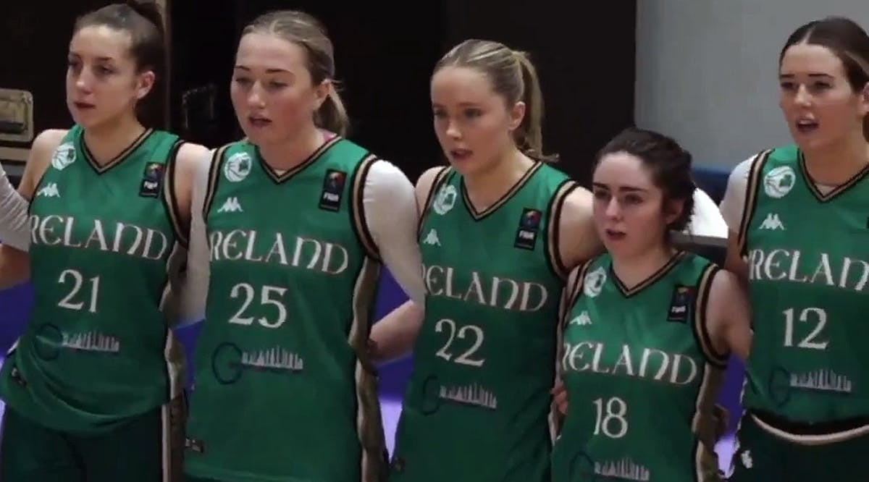
Notes:
https://vfinews.com/news/idf-believes-32-of-the-136-hostages-are-dead-hamas/israeli-basketball-team-wins-after-irish-team-refuses

Slide 78
The Israeli Basketball Association (IBBA) said on social media that the victory came “despite the lack of sportsmanship of the visiting team.”
Notes:
https://vfinews.com/news/idf-believes-32-of-the-136-hostages-are-dead-hamas/israeli-basketball-team-wins-after-irish-team-refuses

Slide 79
The national governing body for basketball in Ireland said in a statement that “Basketball Ireland fully supports our players in their decision.”
Notes:
https://vfinews.com/news/idf-believes-32-of-the-136-hostages-are-dead-hamas/israeli-basketball-team-wins-after-irish-team-refuses

Slide 80
Blue Squares anti-antisemitism presentation will be shown as part of the Superbowl Halftime show.
Or HaOlam still doesn’t endorse rest of the halftime show.

Slide 81
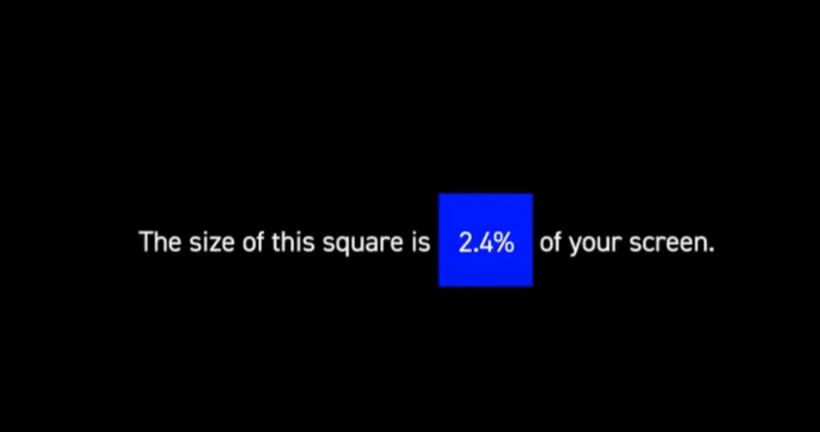

Slide 82
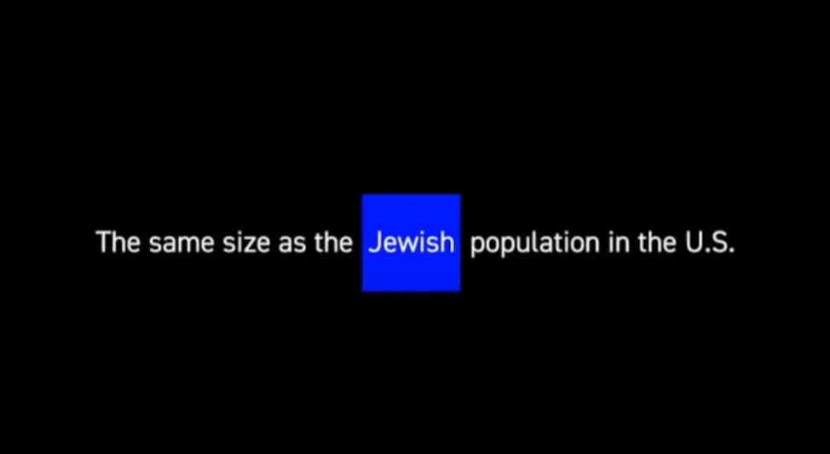
Notes:
Size, that is proportion.

Slide 83
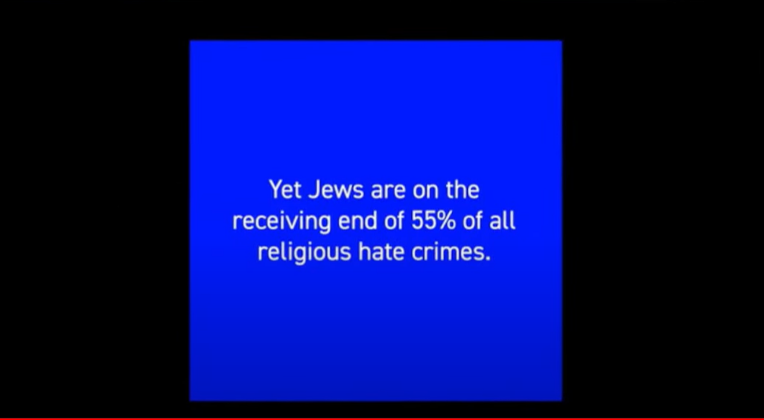

Slide 84
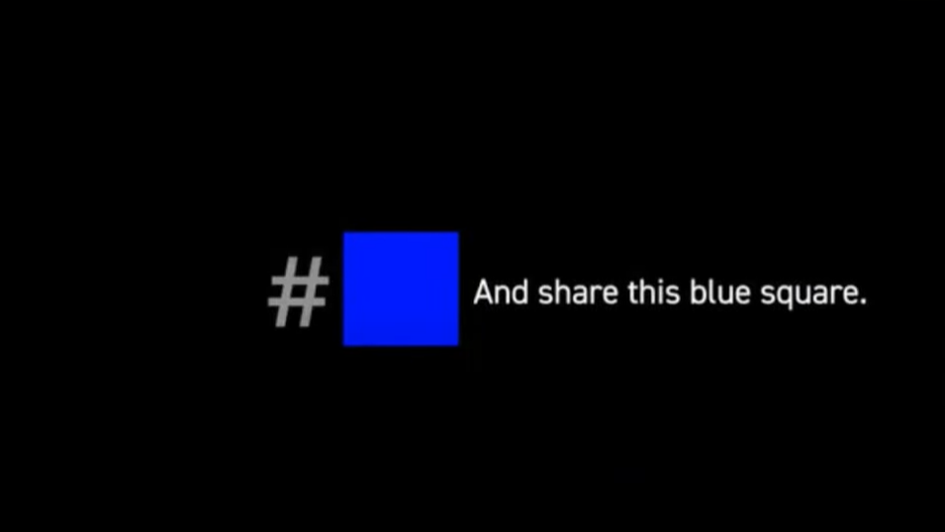
Notes:
Pins on the literature table. Take one and wear it and remember those two numbers. Conversation starter.
2.4% and 55%. Or approximate. 2% and 50% communicates the idea.

Slide 85
https://www.standuptojewishhate.org

Slide 86
An Iran watchdog group says the country has enough weapons-grade uranium to build a nuclear weapon in just one week. The Institute for Science and International Security published the findings in a report on Monday, February 5, saying Tehran could produce a total of six bombs in a month.
Notes:
https://vfinews.com/news/idf-believes-32-of-the-136-hostages-are-dead-hamas/iran-is-capable-of-building-nuclear-bomb-in-one-week

Slide 88
Messiah’s unfathomable riches
The extent of the wealth
The access to the wealth
End times evidence of the wealth
  Victory of Israel over hatred
  Rebuilding of the Temple?!!

Slide 89

Dr. Jim Garlow
CEO/Founder
﻿Well Versed
Rosemary Schindler Garlow
﻿Co-Founder
Well Versed
Notes:
He’s a retired pastor Skyline Nazarene Church. Personal friend of Jeff Seif. Great friend of Israel and the Jewish people.
https://wellversedworld.org/media/hvjtycq/wpn-call-315-part-3-national-gathering-for-prayer-repentance-washington-dc

Slide 90
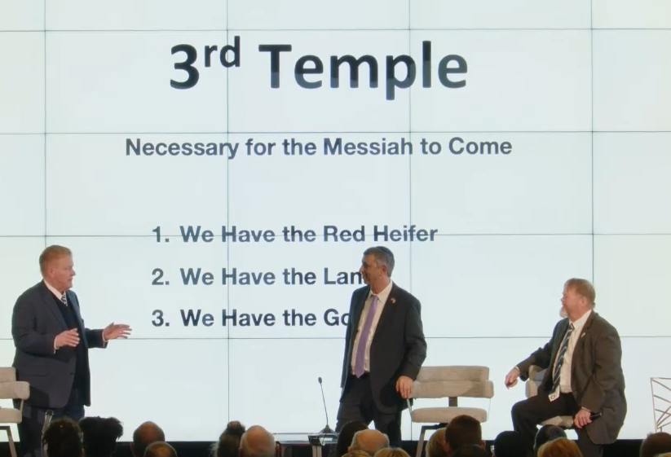

Slide 91
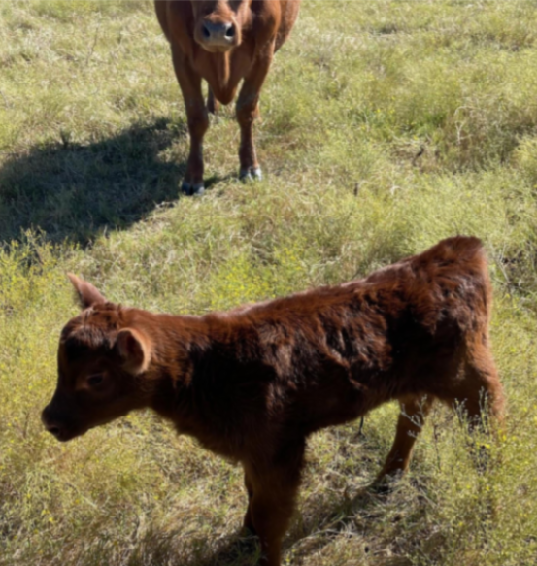
FIRST
100% red
No scars wounds, tags, tattoos, blemishes, brands
Never haltered

Slide 92
The Red Heifer ceremony (from Numbers 19) that is about to take place for the first time in 2,000 years. According to Jewish tradition, the 10th time is supposed to involve the Coming of the Messiah,
Notes:
Jim Garlow
https://wellversedworld.org/media/hvjtycq/wpn-call-315-part-3-national-gathering-for-prayer-repentance-washington-dc

Slide 93
and it is believed that this is will be 10th ceremony. We saw one of the Red Heifers before it was shipped from Texas to Israel.
Notes:
Jim Garlow
https://wellversedworld.org/media/hvjtycq/wpn-call-315-part-3-national-gathering-for-prayer-repentance-washington-dc

Slide 95
SECOND The stunning story of 1 Kings 10, and the gold for Solomon’s Temple which came from “Ophir,” from which a round-trip took three years for Hiram’s ships to make the journey. Hear about the remote tribe
Notes:
https://wellversedworld.org/media/hvjtycq/wpn-call-315-part-3-national-gathering-for-prayer-repentance-washington-dc

Slide 96
in Papua New Guinea named “Ophia” which have a 3,000 year old oral tradition saying that they provided the gold for the First Temple (Solomon).
Notes:
https://wellversedworld.org/media/hvjtycq/wpn-call-315-part-3-national-gathering-for-prayer-repentance-washington-dc

Slide 97
^{1 M’lakhim/Kings 9.26-28} King Solomon also built a fleet of ships in Ezion-geber, which is near Eloth [Modern Eilat] on the shore of the Sea of Reeds in the land of Edom.

Slide 98
^{1 M’lakhim/Kings 9.26-28} Hiram sent his servants with the fleet—sailors who knew the sea—along with Solomon’s servants. So they went to Ophir and took from there 420 talents of gold, and brought it to King Solomon.

Slide 99
^{1 M’lakhim/ Kings 10.21-22} For the king had a Tarshish fleet at sea with Hiram’s fleet; once every three years the Tarshish fleet came, bringing gold, silver, ivory, apes and peacocks.[d]

Slide 100
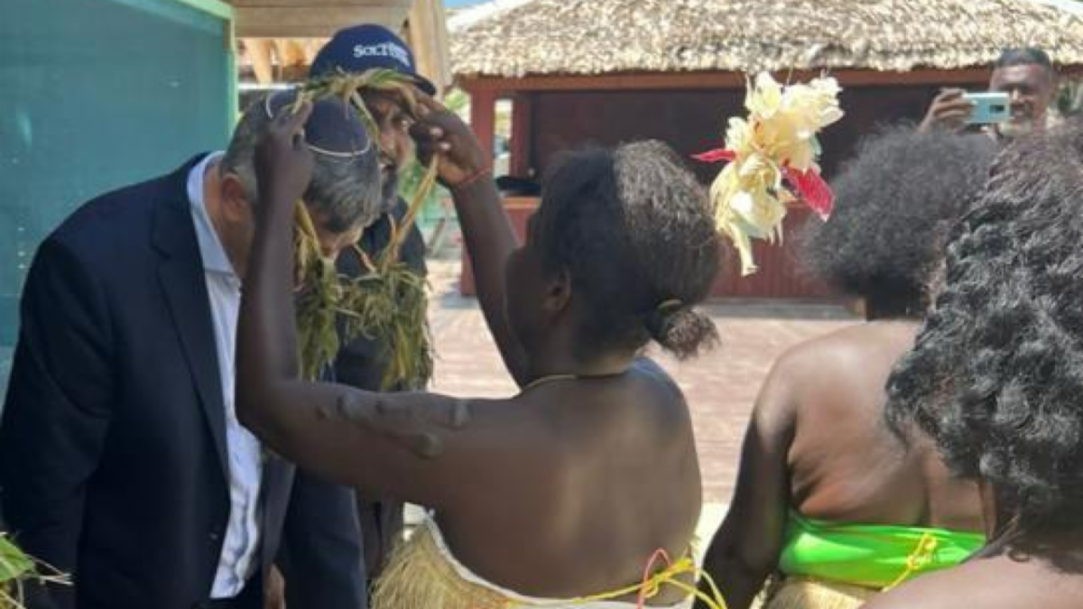

Slide 101
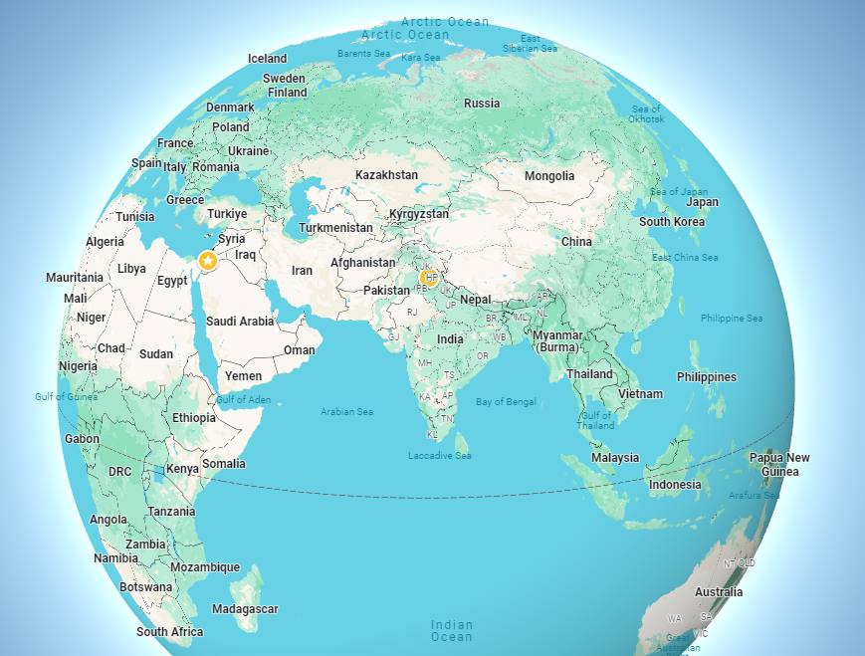

Slide 102
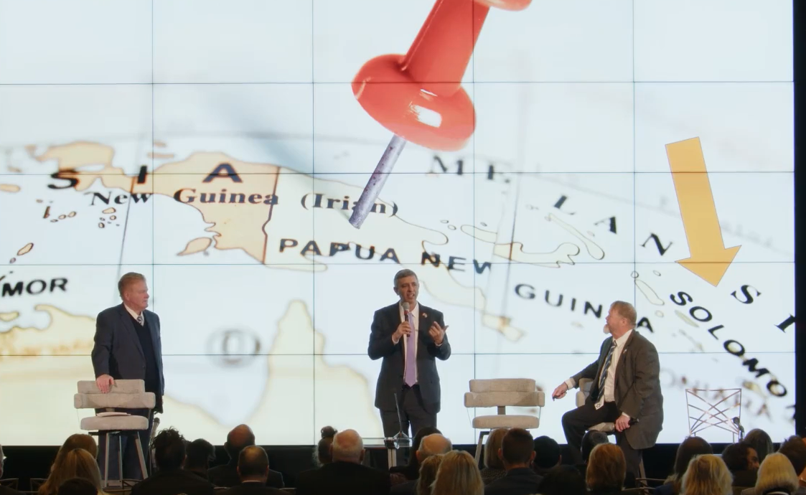

Slide 103
Amazingly, Papua New Guinea has the largest depository of gold, and this tribe is now prepared to give one-third of their mined gold to Israel for the Third Temple.
Notes:
https://wellversedworld.org/media/hvjtycq/wpn-call-315-part-3-national-gathering-for-prayer-repentance-washington-dc

Slide 104
This has all developed in the last year. (And hear about “Solomon Islands”). ONCE AGAIN, THIS IS THE FIRST TIME THIS STORY HAS BEEN TOLD PUBLICALLY.
Notes:
https://wellversedworld.org/media/hvjtycq/wpn-call-315-part-3-national-gathering-for-prayer-repentance-washington-dc

Slide 105
THIRD The miraculous story of obtaining the land (proper elevation in front of the original First – Solomon's – Temple) so the Red Heifer cleansing ceremony can take place. We have visited this site in-person.

Slide 106
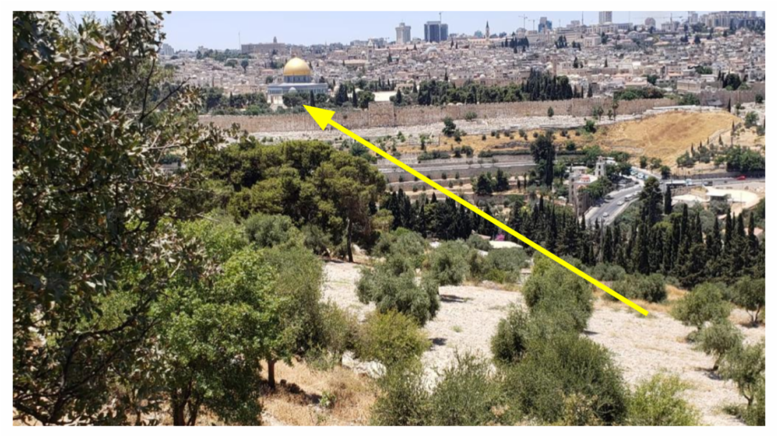

Slide 108
Messiah’s unfathomable riches
The extent of the wealth
The access to the wealth
End times evidence of the wealth
  Victory of Israel over hatred
  Rebuilding of the Temple?!!

Slide 110
Do you KNOW Yeshua and the assurance of sins forgiven?
Are you hearing daily from His Word?
How are you applying what you heard?
Are you asking this of another?
Notes:
Who are you discipling, building up?4

