Slide 1
e-handout
To have these notes
without taking notes
Go to OrHaOlam.com
Click on Messages tab,
2024 Messages

Slide 2
I before E: Except when your
Notes:
English is easy. Rules??
From Lori Wilson, the wordsmith

Slide 3
I before E: Except when your foreign neighbor Keith receives eight counterfeit beige sleighs from feisty caffeinated weightlifters. Weird
Notes:
From Lori Wilson, the wordsmith

Slide 4
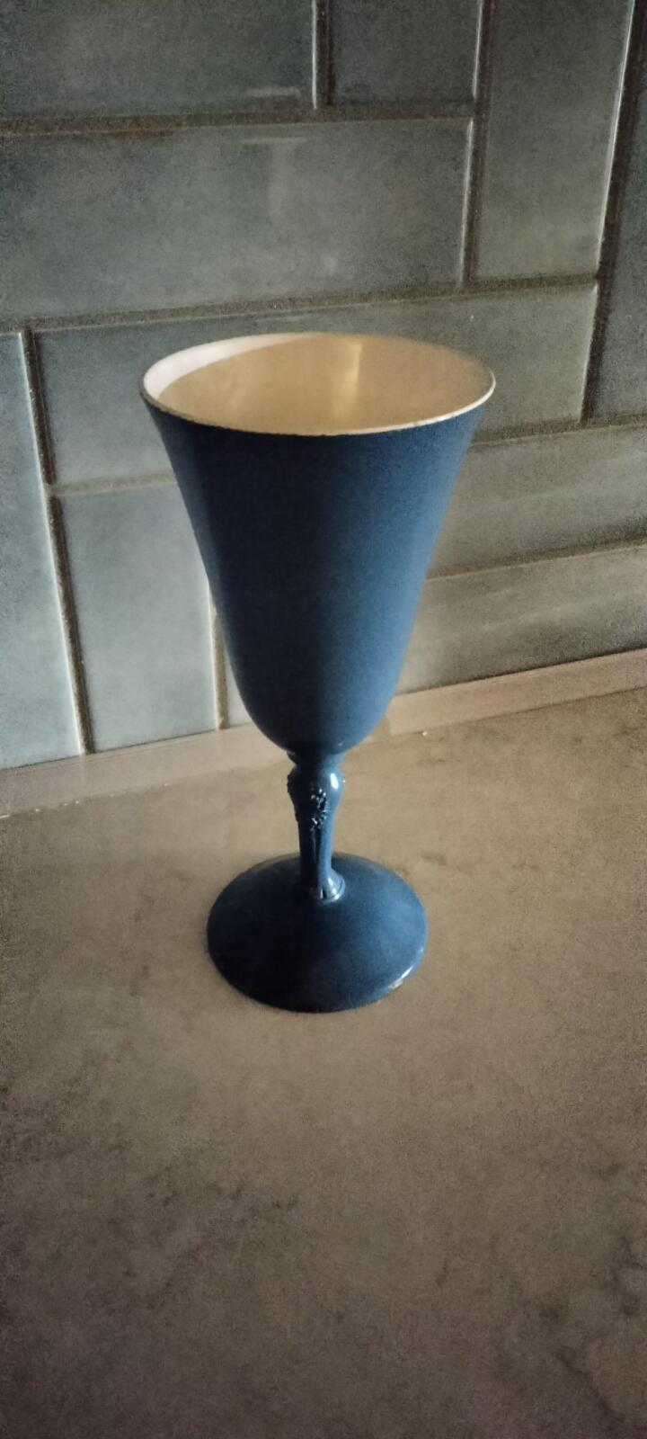
Please help us find: MIA
Notes:
Also, I have a friend who wants to set up a business importing Israeli made art. I can’t remember who it was that told me their daughter was into digital marketing.

Slide 5
Story of Israeli
Dr. Amit Goffer.
He became paralyzed.

Slide 6
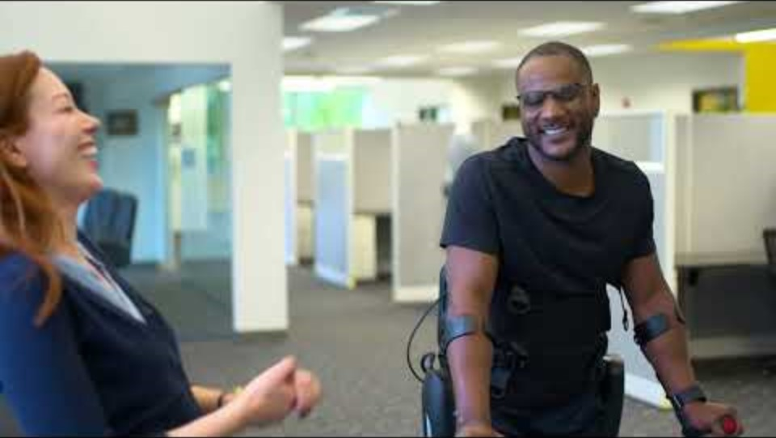
Notes:
1.32 to 2.54
https://www.youtube.com/watch?v=m1b1FSNStbg

Slide 7
What if we are crippled, disabled?

Slide 8


Slide 9
^{Eph. 3.14-21} For this reason, I fall on my knees before the Father, from whom every family in heaven and on earth receives its character. I pray that from the treasures of his glory he will empower you with inner strength by his Spirit,

Slide 10
^{Eph. 3.14-21} so that the Messiah may live in your hearts through your trusting. Also I pray that you will be rooted and founded in love, so that you, with all God’s people, will be given strength to grasp the breadth, length, height and depth of the Messiah’s love, yes, to know it,
Notes:
This may refer back to the unfathomable riches.

Slide 11
^{Eph. 3.14-21} even though it is beyond all knowing, so that you will be filled with all the fullness of God. Now to him who by his power working in us is able to do far beyond anything we can ask or imagine, to him be glory in the Messianic Community and in the Messiah Yeshua from generation to generation forever. Amen.

Slide 13
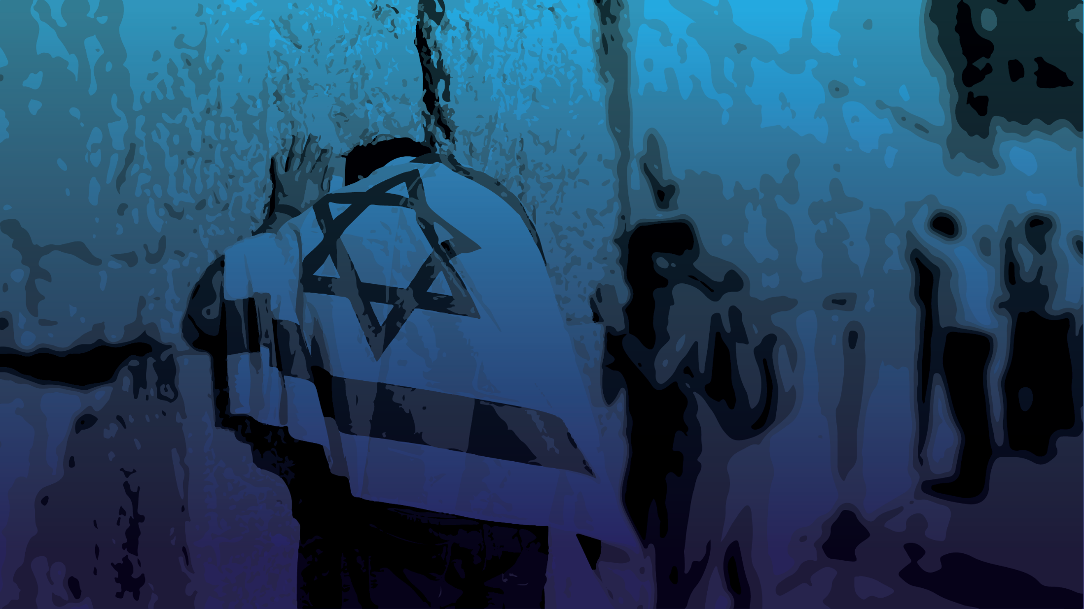
Inner Empowerment of Love in the
Ruakh
In what ways are we crippled,
disabled?

Slide 14
^{Matt 5.22} But I tell you that anyone who nurses anger against his brother will be subject to judgment; that whoever calls his brother, ‘You good-for-nothing!’ will be brought before the Sanhedrin; that whoever says, ‘Fool!’ incurs the penalty of burning in the fire of Gei-Hinnom!
Notes:
First weakness / sin Yeshua called out was settled, unforgiven anger. Nursed anger.
Sonia Warsawski, unsaved Jewish Holocaust survivor, ~99 “I don’t forgive, but I don’t hate.” Amazing. We can do even better.

Slide 15
^{Matt 5.28} I tell you that a man who even [deliberately] looks at a woman with the purpose of lusting after her has already committed adultery with her in his heart.
Notes:
Second weakness/ sin: Lust takes. Love gives. Protects, serves. Are you a protector, or a taker, or a wounded self defender?
You say, “That doesn’t apply to me, I’m a woman.” Just read the reverse. But typically stronger temptation for guys.
You say, “That doesn’t apply to me, I’m same sex attracted.” Nothing new. One of my dorm mates in Union College, Schenectady, NY 1969, said golden rule gave him permission to desire a certain male dorm student. He wanted that guy. Guy no clue.
Are you a giver/ protector, or taker?
Can only give if you have to give, next section.

Slide 16
^{Matt 5.44, 46} I tell you, love your enemies! Pray for those who persecute you!...What reward do you get if you love only those who love you? Why, even tax-collectors do that! And if you are friendly only to your friends, are you doing anything out of the ordinary?
Notes:
Fundamental difference between Yeshua and the Rabbis, according to a Jewish scholar at DSS lectures at Union Station.
Do you wish and pray for repentance for Yaha Sinwar?

Slide 17
^{Mt 5.37} Just let your ‘Yes’ be a simple ‘Yes,’ and your ‘No’ a simple ‘No’; anything more than this has its origin in evil.
Tax time?

Slide 18
^{Gal. 5.19-21} And it is perfectly evident what the old nature does. It expresses itself in sexual immorality, impurity and indecency; involvement with the occult and with drugs; in feuding, fighting, becoming jealous and getting angry; in selfish ambition, factionalism, intrigue and envy; in drunkenness, orgies and things like these.
Notes:
All these disabilities!

Slide 19
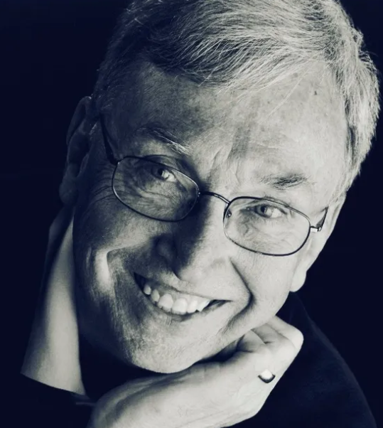

gustafsonconsulting.org/
Notes:
Many of you know Tim.

Slide 20
Gustafson guidelines:
I..…don’t teach, instruct, correct, judge, or define anyone unless God told me to, they’re asking me, or it’s 911. And only out of love.
All come with a great price.

Slide 21
therefore

Slide 22
Gustafson guidelines:
You don’t teach, instruct, correct, judge, or define anyone unless God told you to, they’re asking you, or it’s 911. And only out of love.
All come with a great price.
Notes:
If you make a comment, and the hoped for response is guilt and apology, it’s likely a wrong thing to say.
If you make a comment, and the hoped for response is admiration and praise, it’s likely a wrong thing to say.
What can you say? Appreciation. Praise to G-d and man. Offer suggestions. May I suggest? With love and a smile.

Slide 23
Greatest disability
^{Yaakov/Jas 3.6} And the tongue is a fire. The tongue is a world of evil placed among our body parts. It pollutes the whole body and sets on fire the course of life—and is set on fire by Gehenna.

Slide 24
Definition of gossip:
Spreading negative information about anyone to anyone who is not part of the problem, nor part of the solution.
Notes:
Test: is there anyone’s name in the words you are saying. Then it needs to be positive, with their permission, or direct ministry. Prayer? Make anonymous, unless permission.

Slide 25
Definition of slander:
Telling the truth with the intention to hurts

Slide 26
Inner Empowerment of Love in the
Ruakh
In what ways are we crippled,
disabled?
How to be empowered

Slide 27
Some people do righteousness VERY well.
Some people are nicer by nature than others are by grace.
GREATEST mystery to me is the deep flaws in the ‘righteousness’ of people with Messiah’s grace.
Notes:
3 year old granddaughter Miley ‘I can do it all by myself!’
It seems some people have charming lives without grace of G-d, maybe even antithetical to the idea of grace and salvation.

Slide 28
What I am about to share is the MOST important, life impacting teaching I’ve ever shared. Compared to this, I’ve never preached anything significant before. What makes us who we are. Essence of freedom.

Slide 29
^{Eph. 3.14-21} For this reason, I fall on my knees before the Father, from whom every family in heaven and on earth receives its character.

Slide 30
For what reason?
The preceding chapters
Notes:
Ie Man, this is BIG

Slide 31
For what reason?
The preceding chapters
Revelation of the secret of joint citizenship, Jews and Nations. ^{2.6}
Notes:
Ie Man, this is BIG

Slide 32
For what reason?
The preceding chapters
Revelation of the secret of joint citizenship, Jews and Nations. ^{2.6}
Unfathomable riches ^{2.8}
Notes:
Carried forward.

Slide 33
For what reason?
The preceding chapters
Revelation of the secret of joint citizenship, Jews and Nations. ^{2.6}
Unfathomable riches ^{2.8}
Troubles Shaul is enduring ^{2.13}
Notes:
Ie Man, this is BIG

Slide 34
^{Eph. 3.14-21} For this reason, I fall on my knees
Unusual for modern Jewish prayer
Expression of utter amazement
King Solomon at dedication of the First Temple. Ps 95

Slide 35
^{Eph. 3.14-21} For this reason, I fall on my knees before the Father, from whom every family in heaven and on earth receives its character.
Notes:
Introduces grid of family. Basis of emotional, pyschological health, spiritual understanding. However...

Slide 36
John Bradshaw, a family-systems therapy advocate and family dynamics expert, cites research that found 96 percent of all families to be to some degree ‘dysfunctional’ — that is, distorted by addictions and compulsions... so, ignores the needs of each individual.
Notes:
http://www.thebiganswer.info/Family-Dysfunction.php

Slide 37
96 percent of all families are to some degree emotionally impaired.
Notes:
http://www.thebiganswer.info/Family-Dysfunction.php

Slide 38
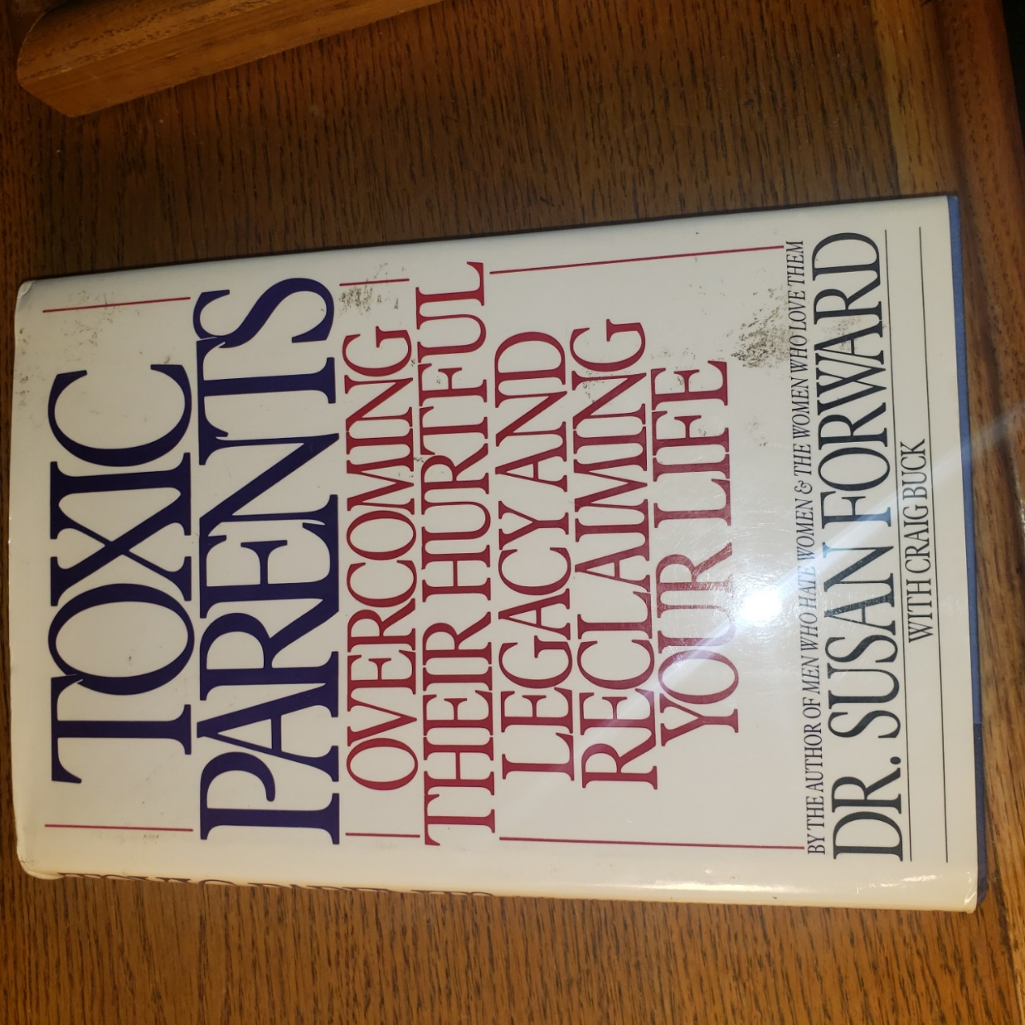
Parents who cause us emotional or physical pain. Parents who ignored our needs or overburdened us with guilt.
Notes:
Given to me by my sister. Our parents.
Just spoke about this two weeks ago? Yes noticed there are still fruit of toxic families.

Slide 39
“Most adult children of toxic parents grow up feeling tremendous confusion about what love means and how it’s supposed to feel. Their parents did extremely unloving things to them in the name of love― Susan Forward, Toxic Parents: Overcoming Their Hurtful Legacy and Reclaiming Your Life

Slide 40
Love doesn’t hurt, it feels good. Loving behavior nourishes your emotional well-being...Genuine love creates feelings of warmth, pleasure, safety, stability, and inner peace.”
― Susan Forward, Toxic Parents: Overcoming Their Hurtful Legacy and Reclaiming Your Life

Slide 41

Classical nuclear family
Notes:
Smiling, eye contact, affirming, body language leaning in 6x/sec exchange of affirmation → oxytocin + dopamine
Most of us don’t understand father allusion, since no experience in healthy families.
Father hunger

Slide 42

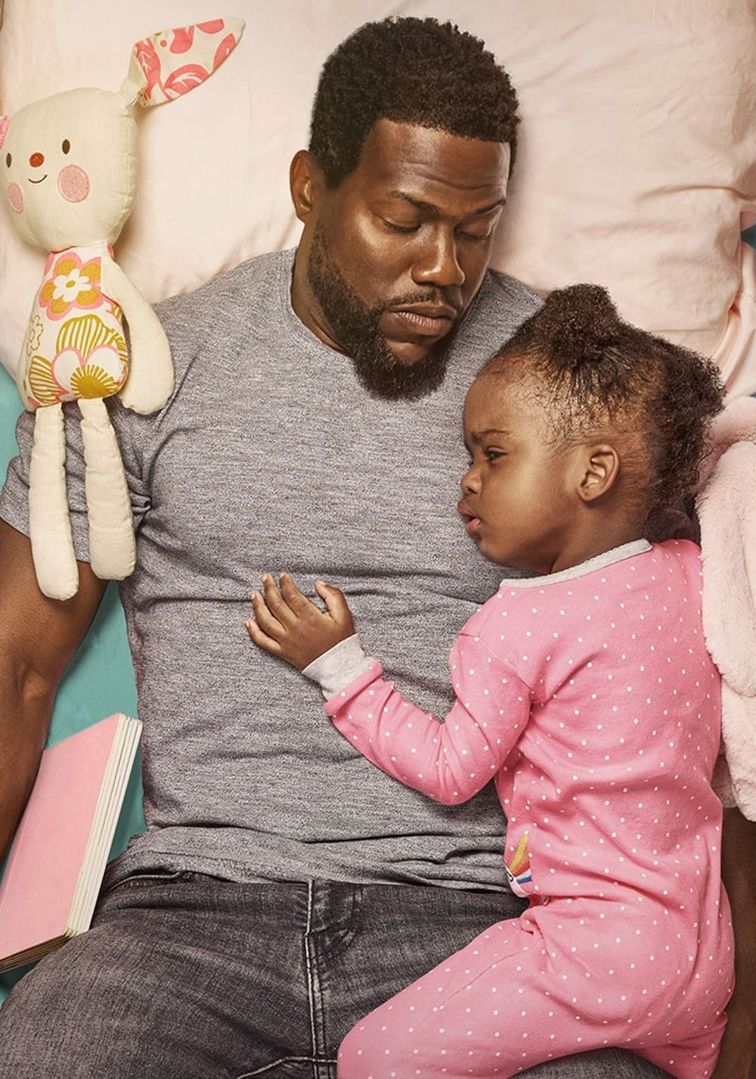
Healthy father figure
Notes:
https://www.focusonthefamily.com/wp-content/uploads/2021/06/fatherhood_1837455628.jpg
https://image.tmdb.org/t/p/original/BnvTMgTZrrgAKaPKNFYyZw3wZF.jpg

Slide 43
^{Eph. 3.14-21} For this reason, I fall on my knees before the Father, from whom every family in heaven and on earth receives its character.
Notes:
Deep breath and cry, “Abba Father!!”
Verse is opaque, no father image for most of us, except for redemptive revelation following.
Need the following to have healthy minds & hearts & families. The following is the healing source of all.
If you have a good father image, count yourself blessed. Among 4%

Slide 44
^{Eph. 3.14-21} I pray that from the treasures of his glory he will empower you with inner strength by his Spirit,
Notes:
Treasures: most treasuries in the world are bankrupt. Word picture of emotional life.
Next slide too small to read, but if get notes, for comparison. Treasuries of the nations of the world. US is 13th wealthiest.

Slide 45
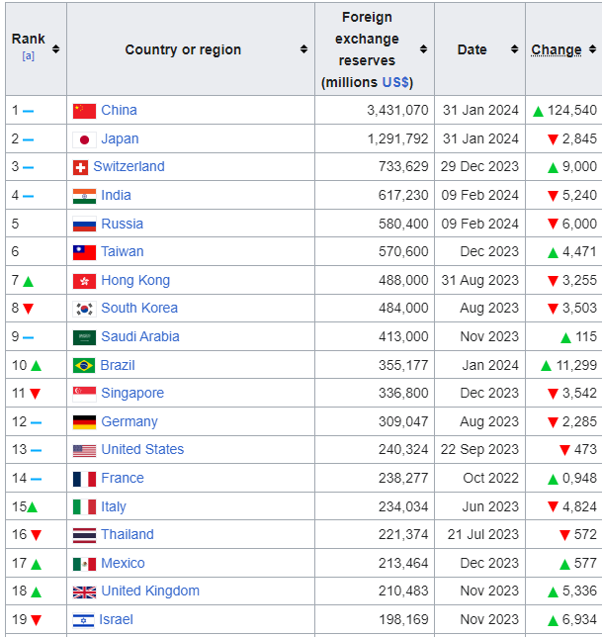
Reserves/
Treasures
Notes:
https://en.wikipedia.org/wiki/List_of_countries_by_foreign-exchange_reserves
Twenty countries with the most treasure = reserves
US 240 billion

Slide 46
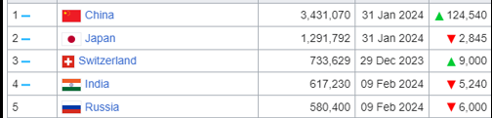
Reserves / Treasures
Notes:
https://en.wikipedia.org/wiki/List_of_countries_by_foreign-exchange_reserves
China has $3.5 trillion treasure = reserves #1

Slide 47
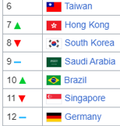
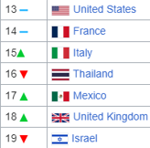
Reserves
Notes:
https://en.wikipedia.org/wiki/List_of_countries_by_foreign-exchange_reserves
Israel #19

Slide 48
Consider debt

Slide 49
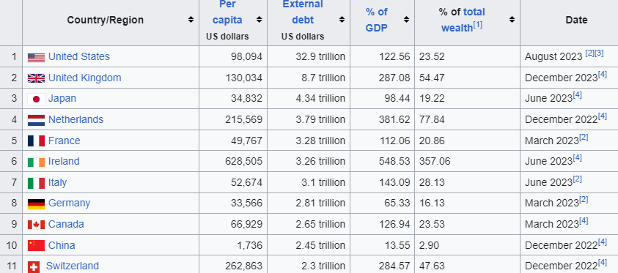
Debt: USA is first in the world
Notes:
https://en.wikipedia.org/wiki/List_of_countries_by_external_debt

Slide 50
Debt
Notes:
https://en.wikipedia.org/wiki/List_of_countries_by_external_debt
Israel #49 on debt chart. Much better debt to asset ratio. Evan Liberman WiseMoney Israel.

Slide 51
United States of America
$33 trillion debt, $240 billion reserves [hard to visualize, so proportionally:]
Like $33 thousand debt, $240 reserves
USA has no treasure, zero reserves in actuality
Notes:
https://en.wikipedia.org/wiki/List_of_countries_by_external_debt
Therefore, we didn’t accept CARES money during COVID China virus lockdown

Slide 52

The average American credit card debt:
Notes:
https://www.usdebtclock.org/#
Plus student loan plus mortgage
We are used to DEBT.

Slide 53
Most of us have zero love reserves.
Maybe a great love deficit.
Wounds
Unresolved conflicts
Settled anger

Slide 54
^{Eph. 3.14-21} I pray that from the treasures of his glory

Slide 55
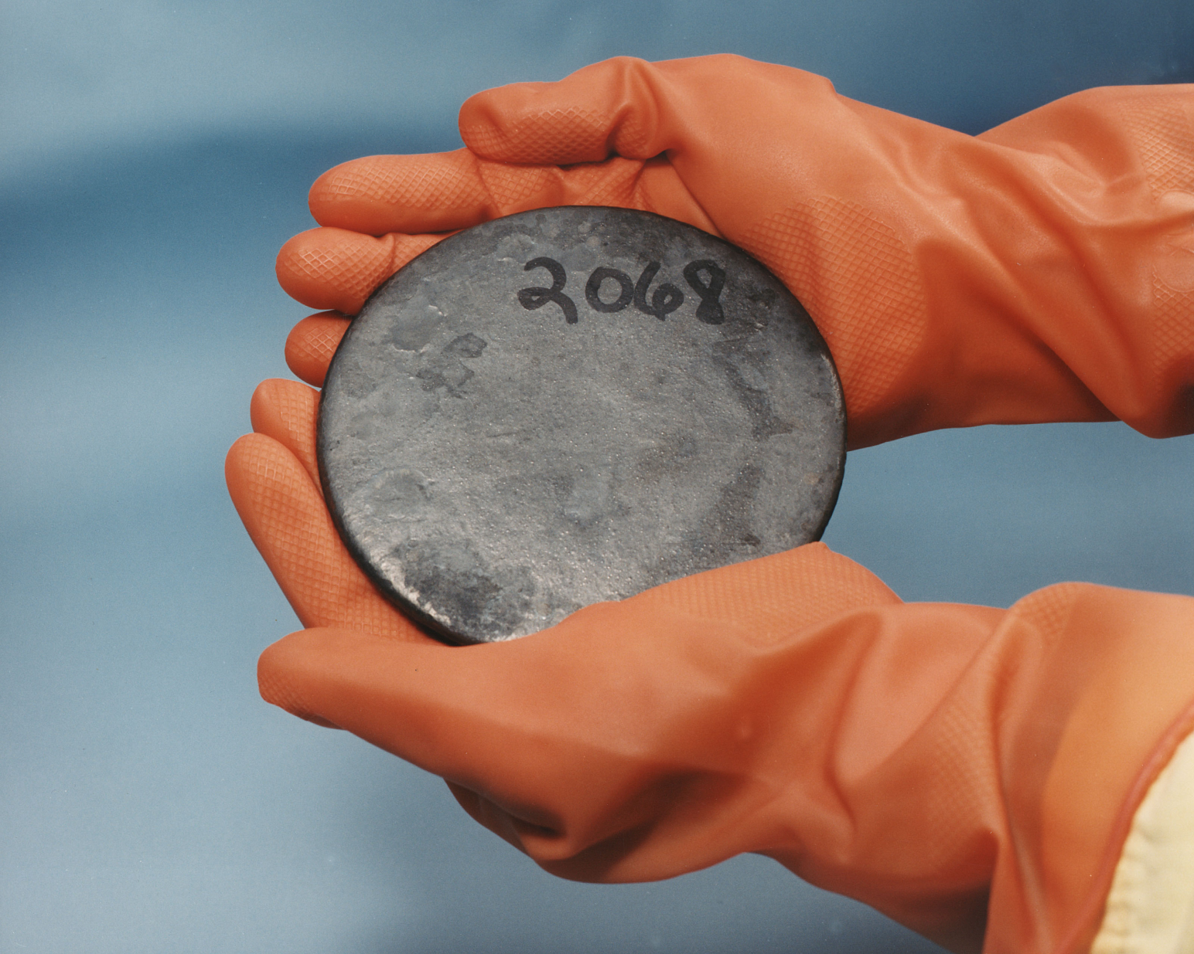
Uranium metal highly
enriched in ²³⁵uranium
2.5 million
times more
than the
energy
released
from
burning
coal
Notes:
https://en.wikipedia.org/wiki/Uranium-235
Heavy gloves
Treasurse of His glory >> valuable, more valuable and energizing than U-235
This is what we’ve been worried the Iranians would manufacture.
There is ENERGY of love from Messiah to forgive, live pure, love enemies, tell truth, control your tongue.

Slide 56
^{Eph. 3.14-21} I pray that from the treasures of his glory he will empower you with inner strength by his Spirit,

Slide 57
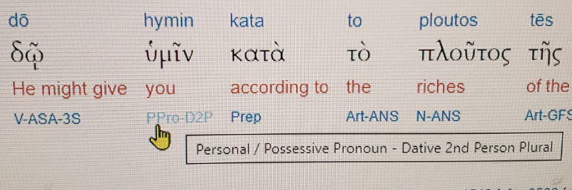
plural
Notes:
‘You’ is plural!! Give you, NOT individually, but in community.

Slide 58
^{Yer. 31.12} “Then the virgin will dance for joy, young men and old men together; for I will turn their mourning into joy, comfort and gladden them after their sorrow.
Notes:
Community joy and dance. Together. Different from charismatic two step, even elegant choreography much or most individual, even if group in unison. Ours in circles, lines. Handholds.

Slide 59
^{Yn 17.20-21} “I pray not only for these, but also for those who will trust in me because of their word, that they may all be one. Just as you, Father, are united with me and I with you, I pray that they may be united with us, so that the world may believe that you sent me.

Slide 61
^{Eph. 3.14-21} I pray that from the treasures of his glory he will empower you with inner strength by his Spirit,
^{NIV} I pray that out of his glorious riches he may strengthen you with power through his Spirit in your inner being,
Notes:
Summarize so far:
1. Treasures: most treasuries in the world are bankrupt. US $33 trillion debt, $240 billion reserves
$33 thousand debt, $240 reserves
2. Of His glory: made of??, no lien: pearls, Au, Ag, ²³⁵U fissile, and it’s empowering!!

Slide 62
^{Eph. 3.14-21} I pray that from the treasures of his glory he will empower you with inner strength by his Spirit,
^{NIV} I pray that out of his glorious riches he may strengthen you with power through his Spirit in your inner being,
Notes:
3. Empower you: give, grant, bestow
4. You in the plural, in community
5. Inner strength: dunamis: (miraculous) power, might, strength, physical power, force, might, ability, efficacy, energy, meaning
Why strength: wealth like that easy to waste.
6. By the Spirit of Him: not impersonal
Yn 16.15 Everything that the Father has is Mine. For this reason I said the Ruach will take from what is Mine and declare it to you.”
Accumulation of descriptions: treasure, glory, empower, you, inner strength, Spirit
This is the righteousness >> our own ability.

Slide 63
^{Eph. 3.14-21} so that the Messiah may live in your hearts through your trusting.
Notes:
Again, not impersonal strength, but Messiah, whom we love, whom we know, who bore our sins, rose from the dead, has no malice, ‘Meek and lowly in heart’ He dwell with/in us, so as to direct His love, humilty, patience to those we deal with.
Yeshua said, ‘You of little faith.’
In our hearts Conscious partnership
Thru trusting: decision of our mind, will, emotions, continuous
Continuous treasured empowering of inner strength by the Ruakh/Spirit
Next illustration some may think irreverent, but hang on...

Slide 64
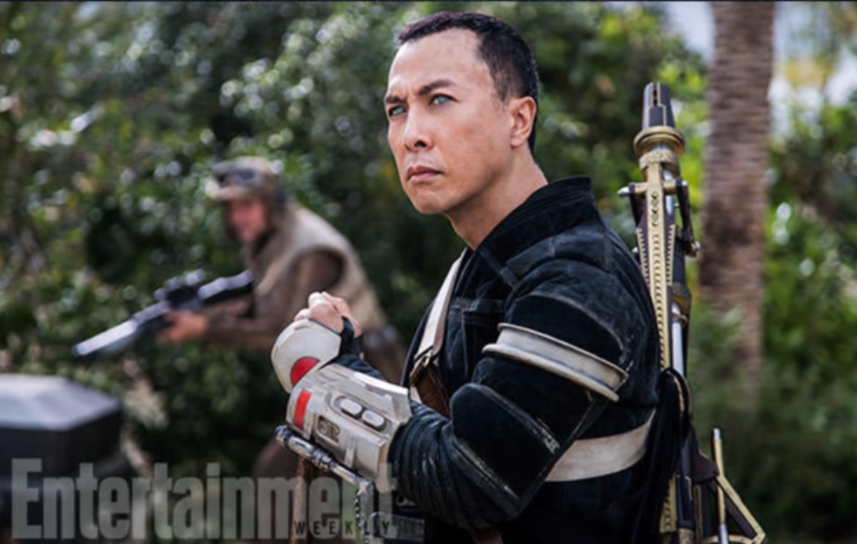
Rogue One
Notes:
Chirrut Inwe. Blind warrior: ‘I am with the force, and the force is with me.’ Great skill in battle.
We can say:
‘I am with Yeshua, and Yeshua is with/in me.’
All say, ‘I am with Yeshua, and Yeshua is with/in me.’

Slide 65
^{Eph. 3.14-21} so that the Messiah may live in your hearts through your trusting. Also I pray that you will be rooted and founded in love,
Notes:
Not just some mystical presence, but LOVE
Examine words:
Rooted: cause to take root; plant, fix firmly, establish

Slide 66
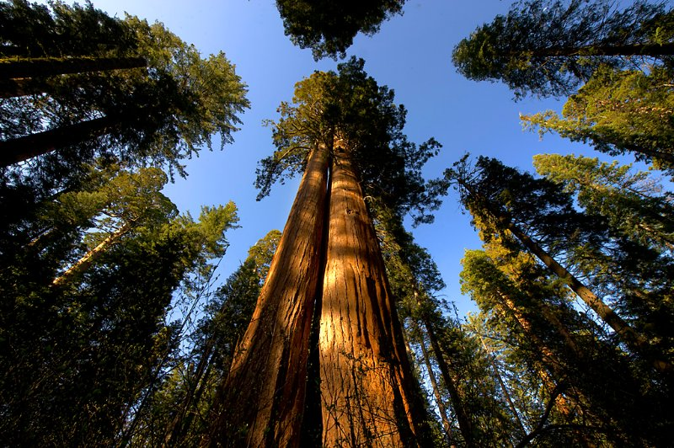

Slide 67
The sequoias have a matting, shallow, and wide spreading root system. There is no taproot. They only root to 12 to 14 feet deep even at maturity. A mature sequoia's roots can occupy over 1 acre of earth and contain over 90,000 cubic feet of soil
Notes:
https://www.giant-sequoia.com/faqs/giant-sequoia-questions/
Word picture: rooted in love

Slide 68
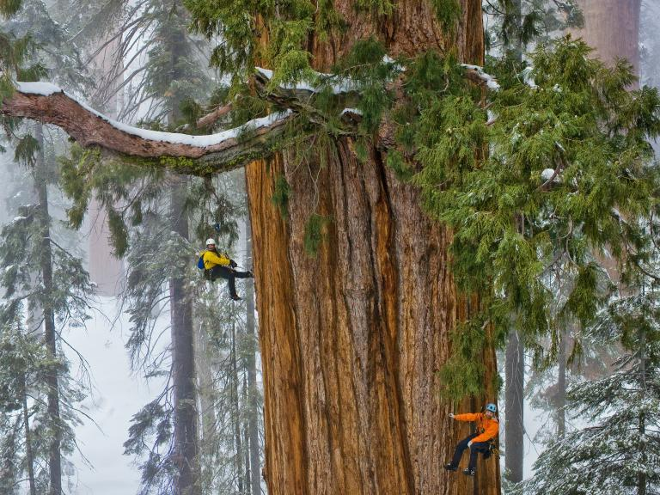
Wide root system: interdependent
with other trees
Notes:
https://www.linkedin.com/pulse/sequoia-tree-dr-tohid-nooralvandi

Slide 69
That mass of matted roots and soil has to maintain the equilibrium of a tree that is nearly 300 feet tall and weighs nearly 2 million pounds
Notes:
https://www.giant-sequoia.com/faqs/giant-sequoia-questions/

Slide 70
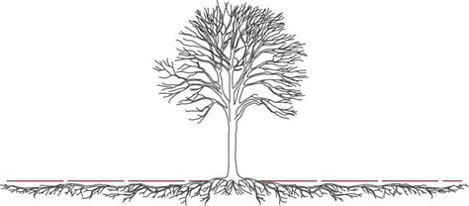
Wide root system
Notes:
https://external-content.duckduckgo.com/iu/?u=https%3A%2F%2Ftse2.mm.bing.net%2Fth%3Fid%3DOIP.0BTrVT2ZS9RpLmZ7TyL-2gHaDQ%26pid%3DApi&f=1&ipt=c0f3f12137b6f6d1a2797bfe039a852cdb5618c835ef67c97f56902ca0015add&ipo=images

Slide 71
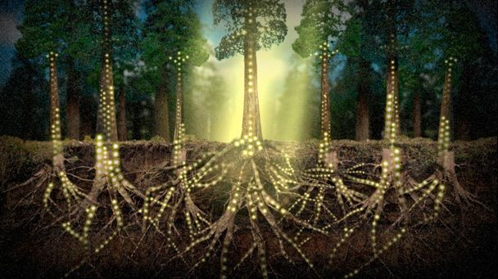
Intertwined roots
Notes:
https://external-content.duckduckgo.com/iu/?u=https%3A%2F%2Fi.pinimg.com%2Foriginals%2Fec%2F8c%2F52%2Fec8c525b4cbd434a4e918dabfff4ac03.jpg&f=1&nofb=1&ipt=0be114f23f60ef1b4bf99bf87120a7a68467722491c1494a57027b669eb6c341&ipo=images

Slide 72
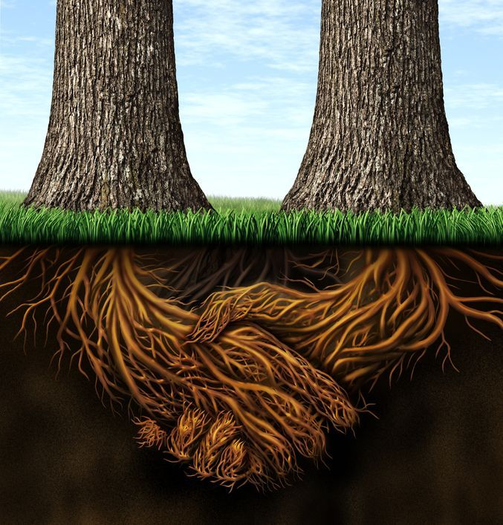
Spirit of Sequoia roots

Slide 73
^{Eph. 3.14-21} so that the Messiah may live in your hearts through your trusting. Also I pray that you will be rooted and founded in love,
Notes:
Rooted: cause to take root; met: I plant, fix firmly, establish
Founded: found, lay the foundation building, structure, World Trade Center.

Slide 74
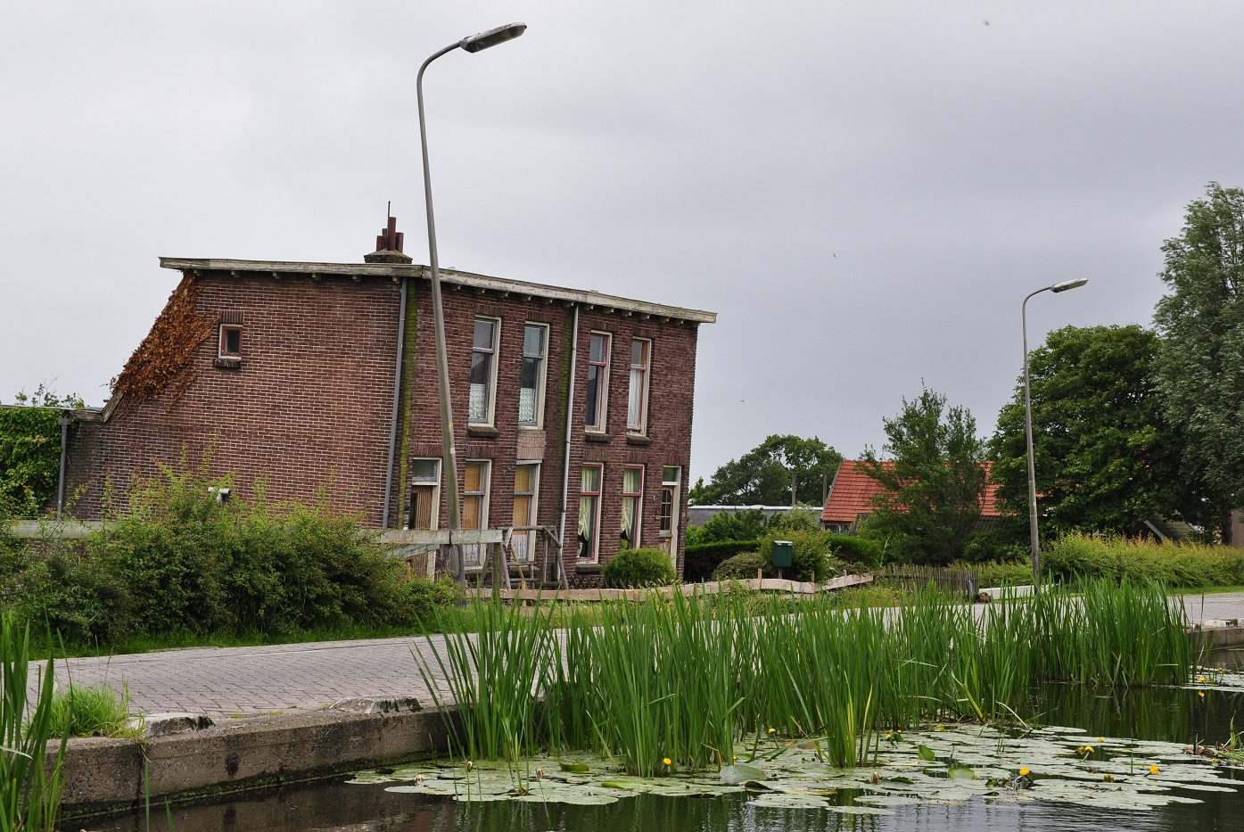
Notes:
Inadequate foundations in muddy soils below sea level caused these houses in the Netherlands to subside
https://en.wikipedia.org/wiki/Foundation_(engineering)#/media/File:Stompwijkseweg_68-70,_Stompwijk,_Netherlands.JPG

Slide 75
The foundation of the Twin Towers rested directly on the rock at a depth of more than 70' below the ground surface. A slurry wall (or diaphragm wall), 3' thick and about 80' deep, was constructed to support the soils surrounding the basements.
Notes:
http://www.columbia.edu/cu/civileng/ling/wtc/

Slide 76
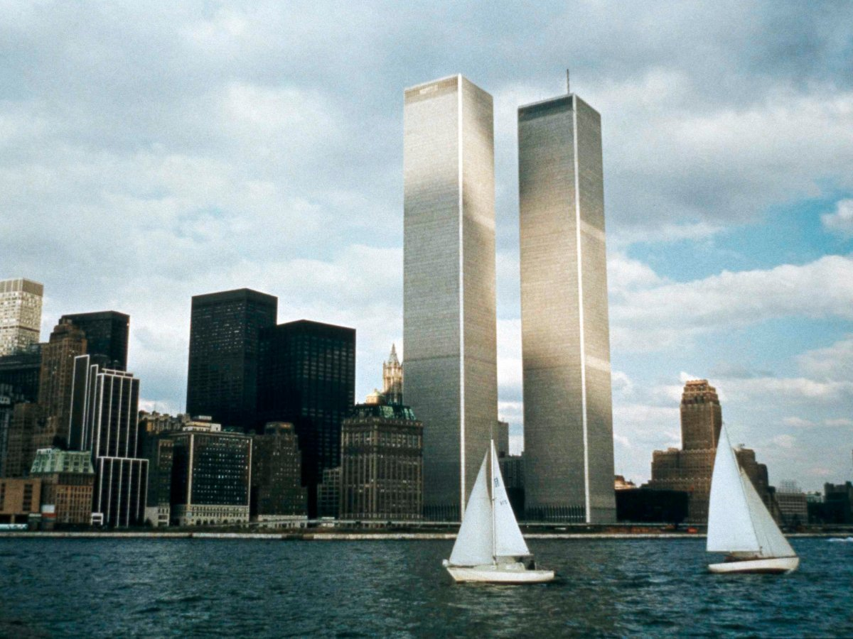

Slide 77
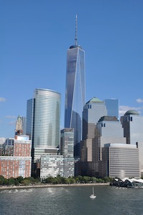
Notes:
On the Rock

Slide 78
^{Eph. 3.14-21} so that you, with all God's people, will be given strength to grasp the breadth, length, height and depth of the Messiah's love, yes, to know it,
[not only private knowledge, community knowledge, ~mat root system of sequoias]
Notes:
Love in community: dance together, eat together, home groups, social intimacy ‘with all G-d’s people’
Strength: ‘have strength for (a difficult task), to be perfectly able.’ Why need strength? Easier to NOT dwell in love. Grumble, complain, see my needs, unfulfilled aspirations, social deficits, family, fanancial, career disappointments. I’m not honored enough. I’m criticized. Love is selfless, outward!
Breadth: inclusive ^{T’hillim/Ps 10312} As far as the east is from the west, so far has He removed our transgressions from us. [north/south 12k miles. E/W unlimited.] All races, all origins Length: ∞ Height: to the very presence of G
Depth: No matter how perverted, debauched, vile, His blood atonement covers!! “Unfathomable”

Slide 79
^{Eph. 3.14-21} even though it is beyond all knowing, so that you will be filled with all the fullness of God.
Now to him who by his power working in us is able to do far beyond anything we can ask
Notes:
^{2 Cor 12.3} And I know that such a man — whether in the body or apart from the body I don’t know, God knows — was snatched into Gan-‘Eden and heard things that cannot be put into words, things unlawful for a human being to utter. Bit like quasars, black holes, pulsars, worm holes: unimaginable. Love of King Messiah Yeshua
^{Yn 14.23} Yeshua answered him, “If someone loves me, he will keep my word; and my Father will love him, and we will come to him and make our home with him.
~jar filled with all the fullness of the ocean: salts, bacteria, seaweed, but only a bit

Slide 80
^{Eph. 3.14-21} or imagine, to him be glory in the Messianic Community and in the Messiah Yeshua from generation to generation forever. Amen.
Notes:
In the community: you and me
In the Messiah: KING
Generation to Generation: Lador vador.
Is this the same G-d who can send people to eternal loss, Gehenna, hell?
We separate ourselves from His love, there is only the opposite. We don’t go out of existence.

Slide 81
^{Ro. 10.3} They are unaware of God’s way of making people righteous and instead seek to set up their own.
So, we need to receive His righteousness, in excellence!
Notes:
I just can’t love everyone: Their ways annoy me. They are irresponsible. They are irritating. I don’t like...
^{1 Kefa/Peter 1.22} Now that you have purified yourselves by obeying the truth, so that you have a sincere love for your brothers, love each other deeply, with all your heart.
Love covers all sins.
[jump to last slide if time short]

Slide 82
Application:
^{2 Kefa/Peter 3.11-14} Since everything is going to be destroyed like this, what kind of people should you be? You should lead holy and godly lives, as you wait for the Day of God and work to hasten its coming.

Slide 83
Application:
^{2 Kefa/Peter 3.11-14} That Day will bring on the destruction of the heavens by fire, and the elements will melt from the heat; but we, following along with his promise, wait for new heavens and a new earth,

Slide 84
Application:
^{2 Kefa/Peter 3.11-14} in which righteousness will be at home. Therefore, dear friends, as you look for these things, do everything you can to be found by him without spot or defect and at peace.

Slide 85
Some people do righteousness VERY well.
Some people are nicer by nature than others are by grace.
GREATEST mystery to me is the deep flaws in some of G-d’s best people.

Slide 86
Dr. Tal Ben Shahar, nicknamed “Professor Happiness,” taught a course at Harvard on positive psychology - known as the most popular course on campus. (He has since returned to Israel where, perhaps, he is happier.)
Notes:
http://www.maozisrael.org/site/News2?abbr=maoz_&page=NewsArticle&id=11171&news_iv_ctrl=-1#top

Slide 87
Dr. Shahar believes the top predictor of happiness is spending time with people we care about and who care about us. In Israel, Friday night Shabbat dinners with extended family are a matter of course,
Notes:
http://www.maozisrael.org/site/News2?abbr=maoz_&page=NewsArticle&id=11171&news_iv_ctrl=-1#top
[RTF the key to all dysfunction and pain is abandonment/isolation, physical or emotional.]

Slide 88
even for the young and hip. After all, isolation is known to be a leading cause of unhappiness. “Loneliness epidemic”
Notes:
http://www.maozisrael.org/site/News2?abbr=maoz_&page=NewsArticle&id=11171&news_iv_ctrl=-1#top
[RTF the key to all dysfunction and pain is abandonment/isolation, physical or emotional.]

Slide 89
“It’s because of our focus on relationships,” the professor notes. “Friends and family are very high up on our value scale, and quality time with them is given a priority. Time we spend with people we care about and who care about us is the number one predictor of happiness.” (www.israel21c.org)
Notes:
http://www.maozisrael.org/site/News2?abbr=maoz_&page=NewsArticle&id=11171&news_iv_ctrl=-1#top

Slide 90
Let’s open our lives, hearts, will power/choice, purpose to RECEIVE:
from the treasures of his glory he will empower you with inner strength by his Spirit, so that the Messiah may live in your hearts through your trusting, that you will be rooted and founded in love.
Notes:
Treasures
Glory
Empower
You
Inner strength
Spirit
Messiah
Your trusting
Roots and foundation in love
Receive it and walk in it with others:

Slide 91
Do you KNOW Yeshua and the assurance of sins forgiven?
Are you hearing daily from His Word?
How are you applying what you heard?
Are you asking this of another?
Notes:
Who are you discipling, building up? #4

Slide 92
Prayer points
Sick among us
A spirit of love in each and all of us. Revival
Hamas War of Iron Swords חרבות ברזל

