Slide 1
The other day she tried to make a chemistry joke,
Notes:
Richard & Luann Ridgeway

Slide 2
The other day she tried to make a chemistry joke,
but got no reaction.
Notes:
Richard & Luann Ridgeway

Slide 3
The UK has no kidney bank...
Notes:
Richard & Luann Ridgeway

Slide 4
The UK has no kidney bank...
But it has a Liverpool.
Notes:
Richard & Luann Ridgeway

Slide 5
And remember,
If you are being chased by a pack of taxidermists,
Notes:
Richard & Luann Ridgeway

Slide 6
And remember,
If you are being chased by a pack of taxidermists,
do not play dead.
Notes:
Richard & Luann Ridgeway

Slide 7
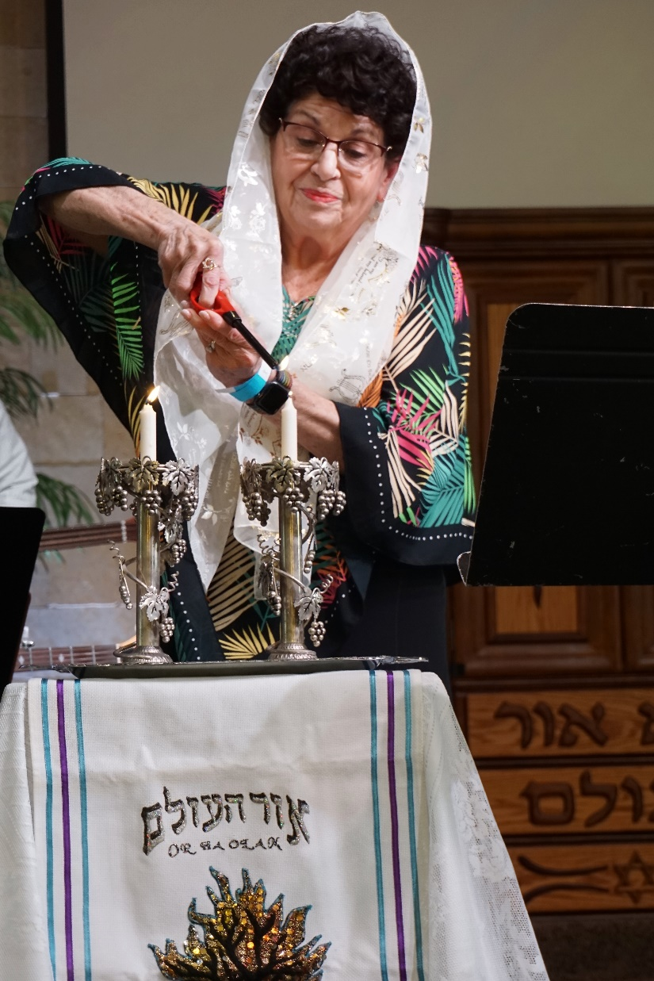
Or HaOlam community Seder, Wed., April 24, 2024
Notes:
Our very menschy Balabuster

Slide 8
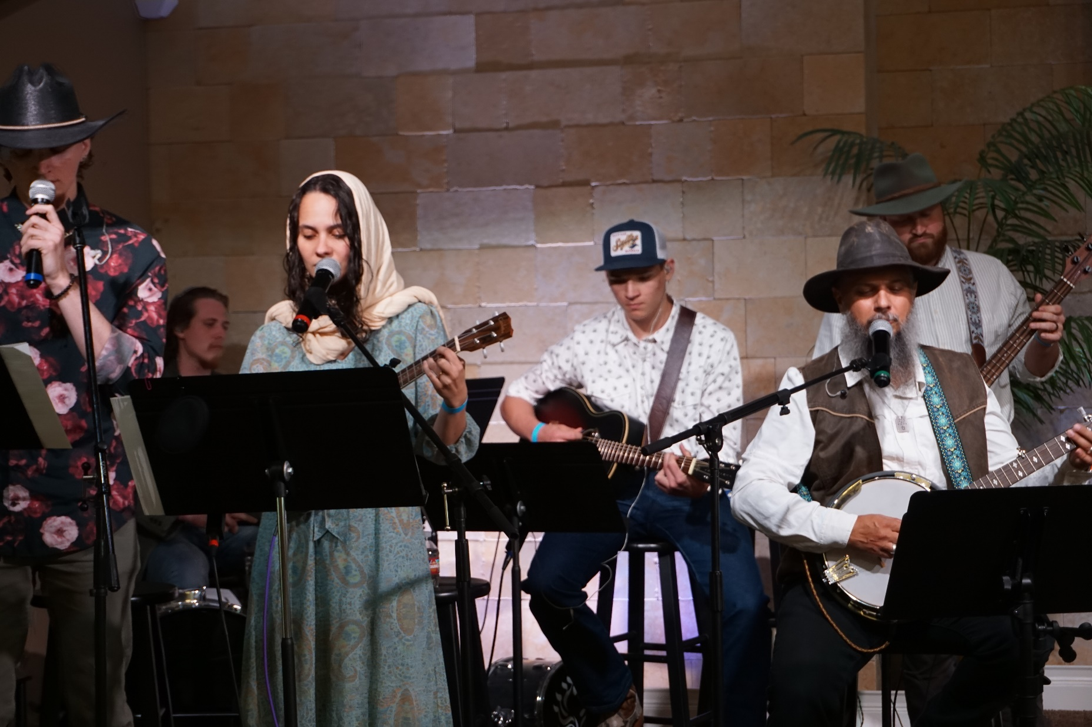

Slide 9
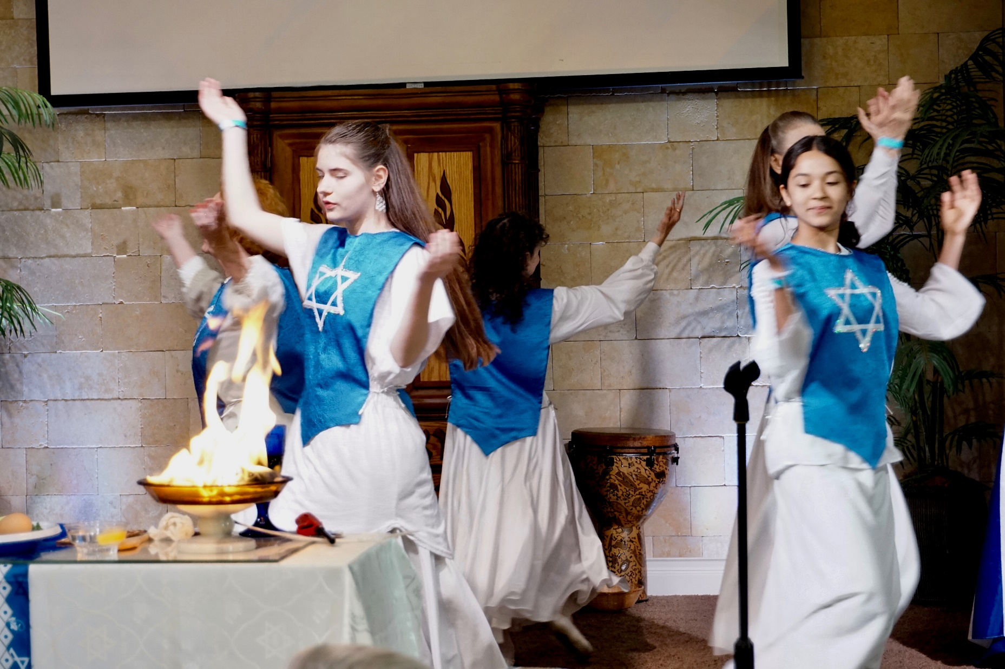

Slide 10
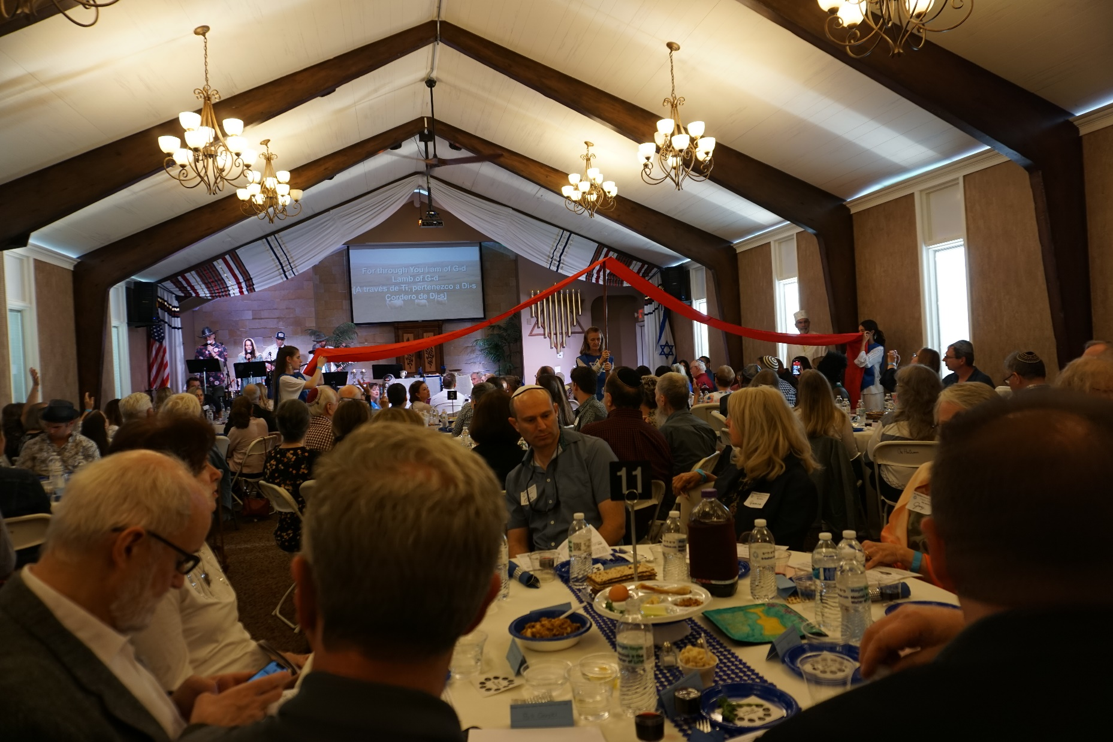

Slide 11
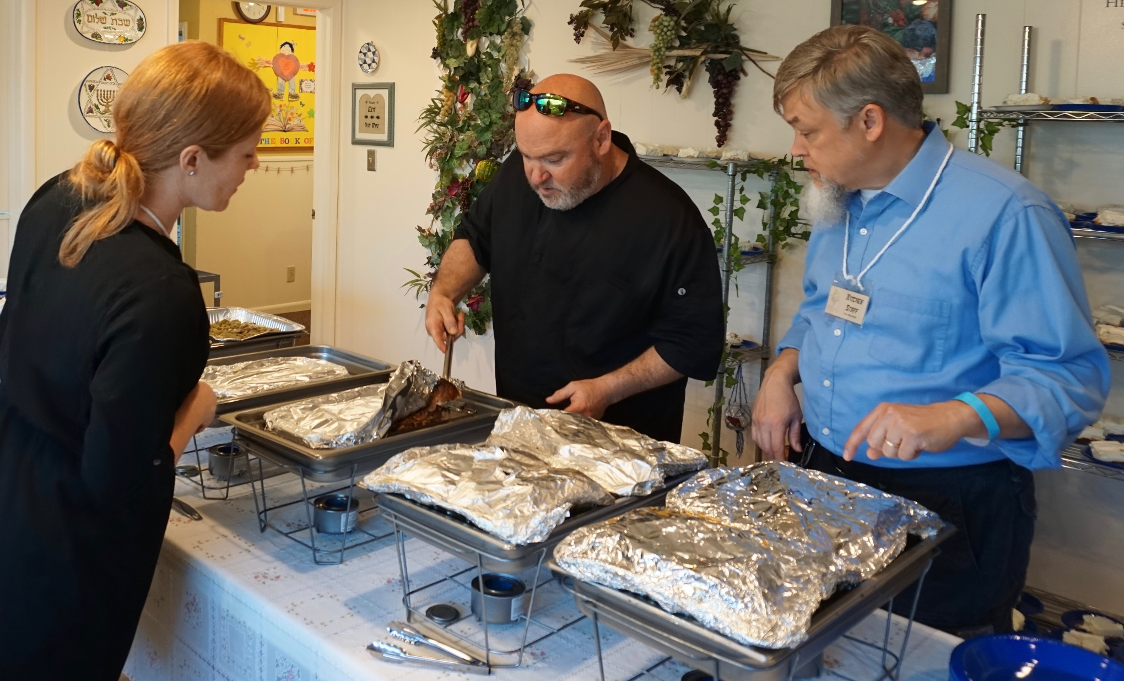

Slide 12
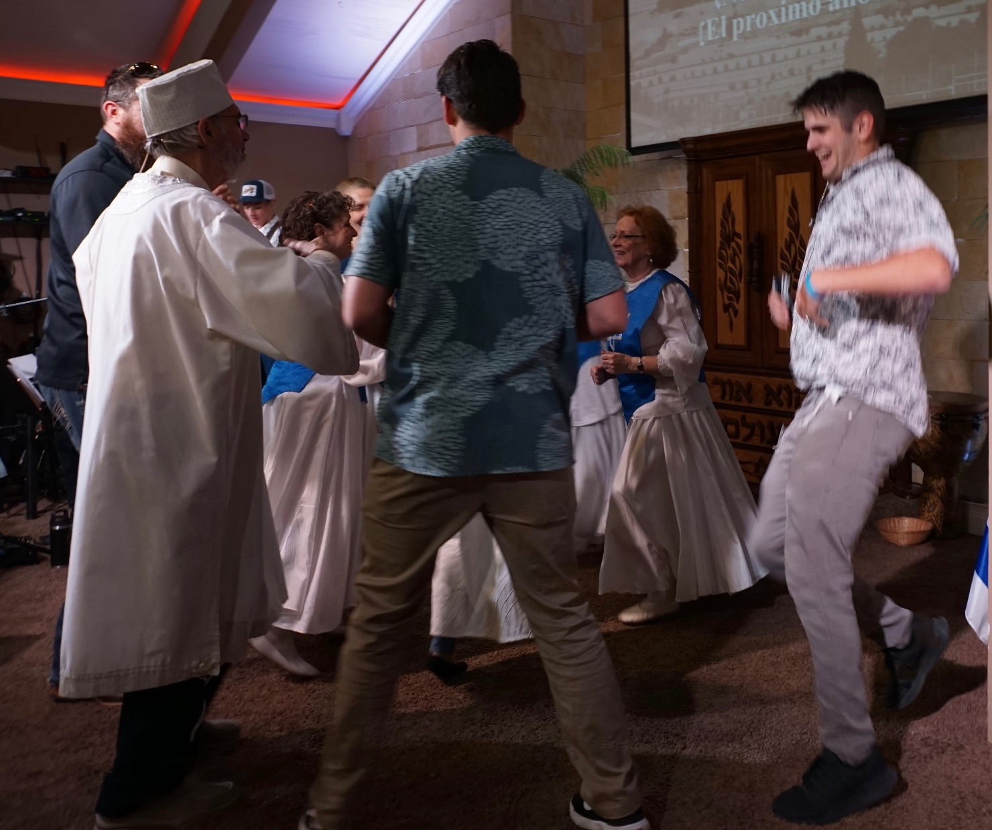

Slide 13
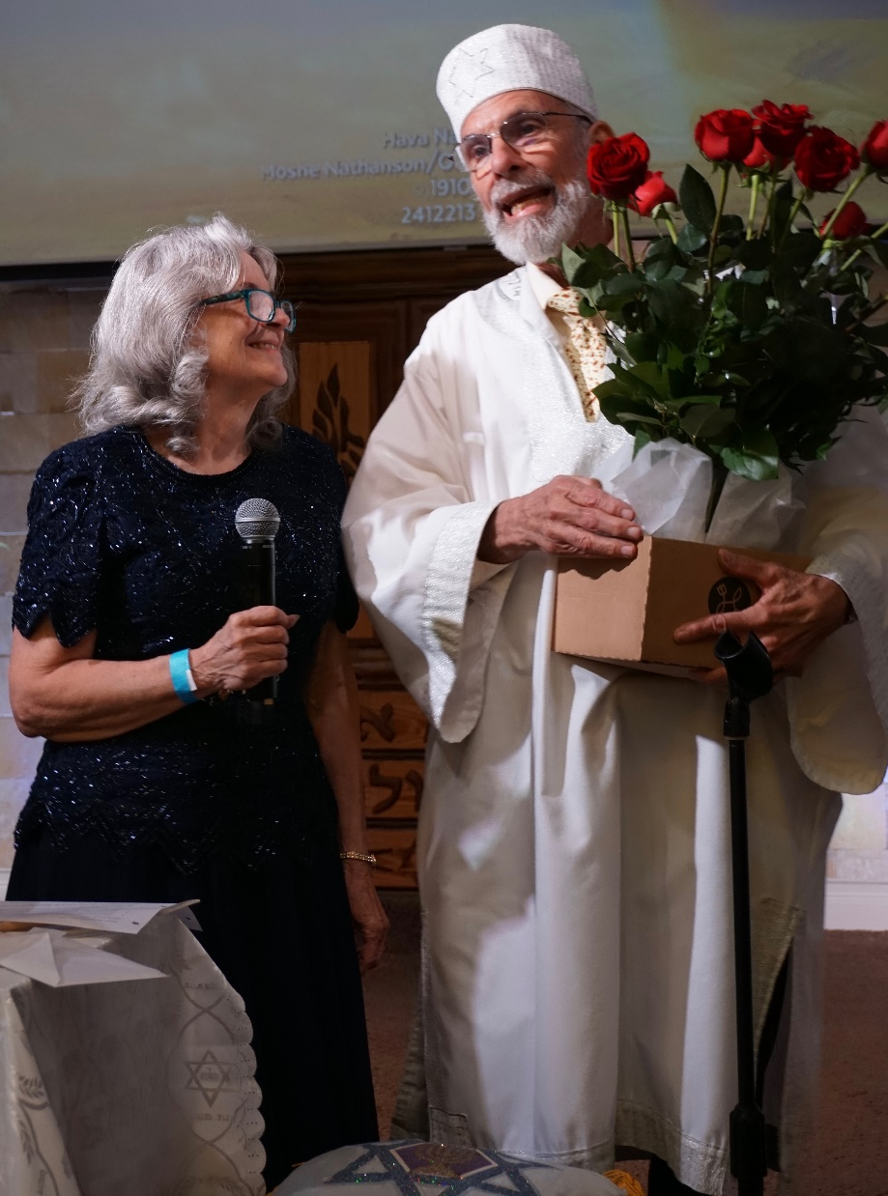

Slide 14
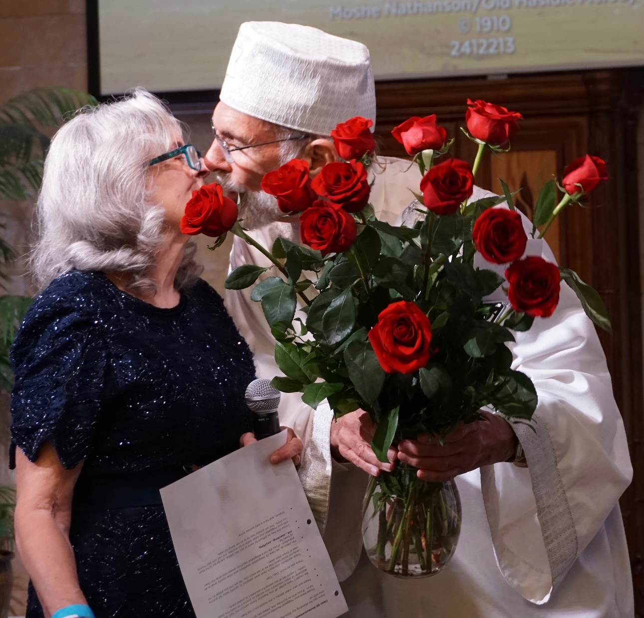

Slide 15
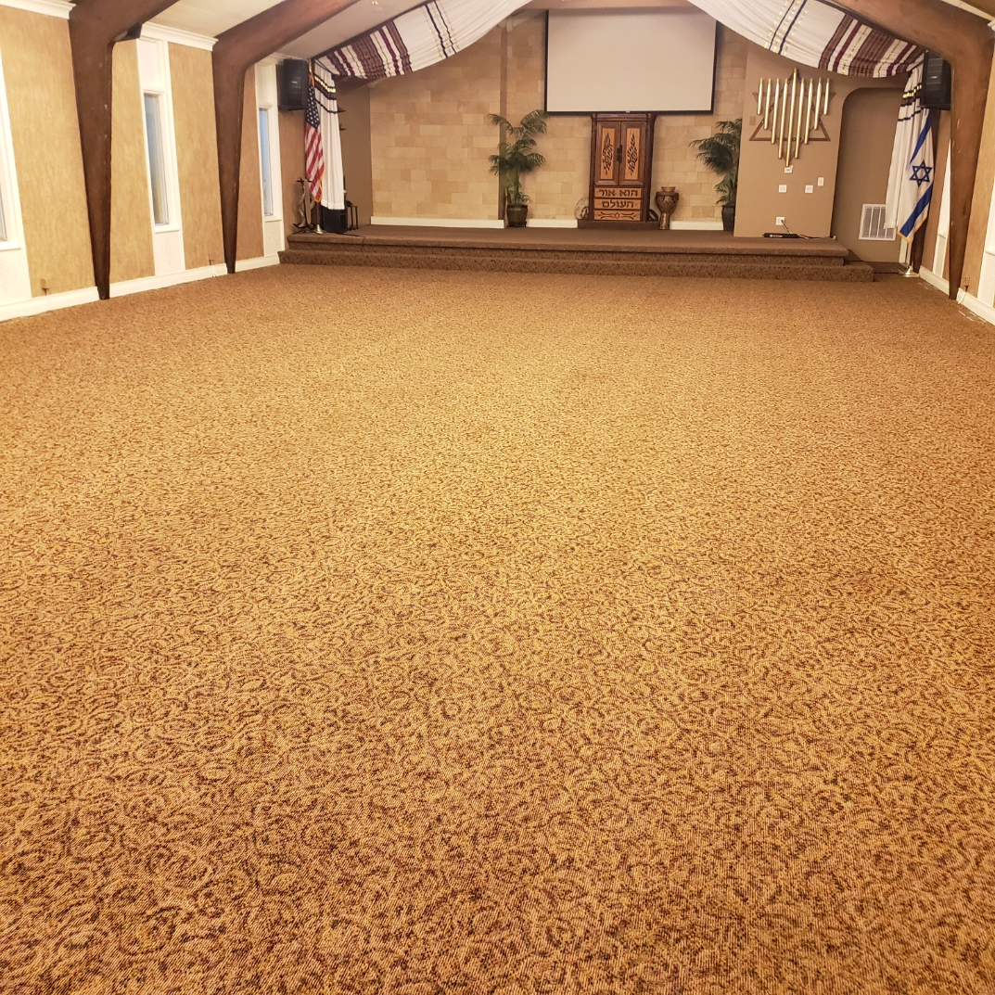
Best cleaned carpet since we bought the place in 2016
By Jonathan Beckman

Slide 16
Friday evening Children’s Seder
Notes:
Richard & Luann Ridgeway

Slide 17
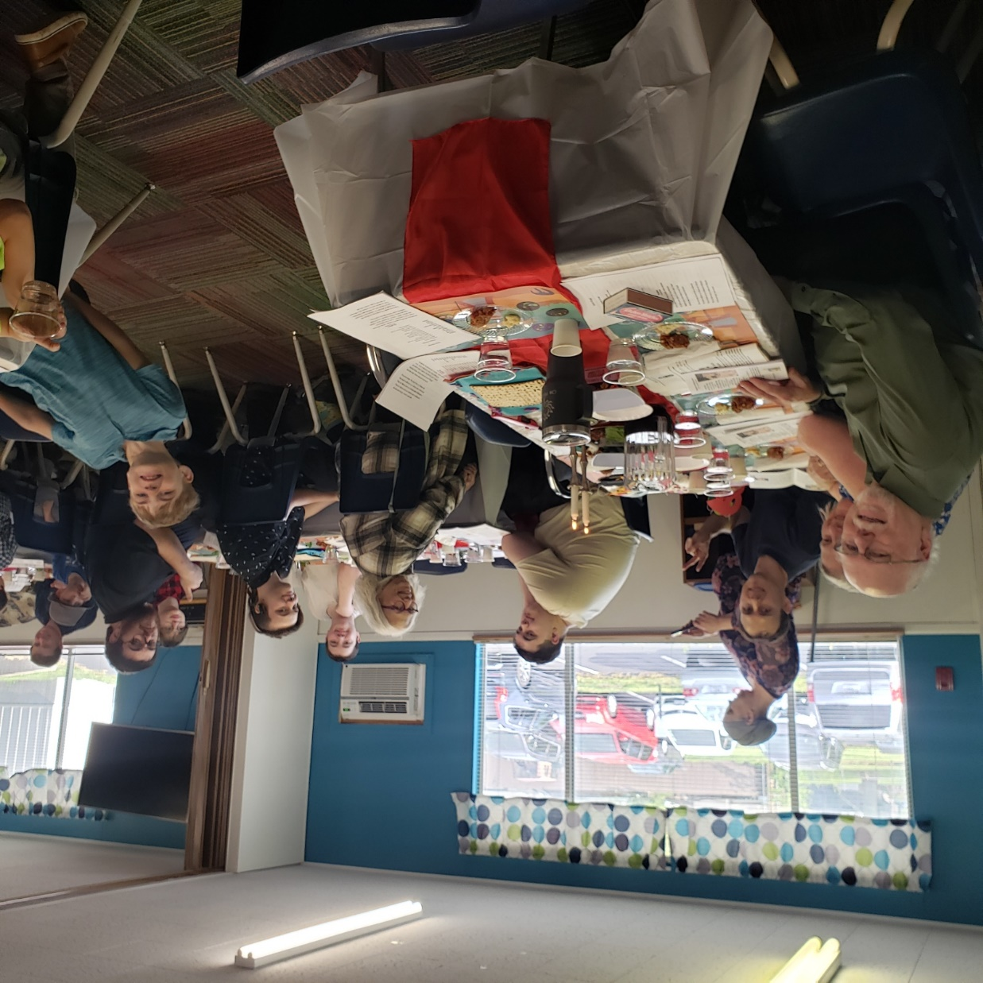
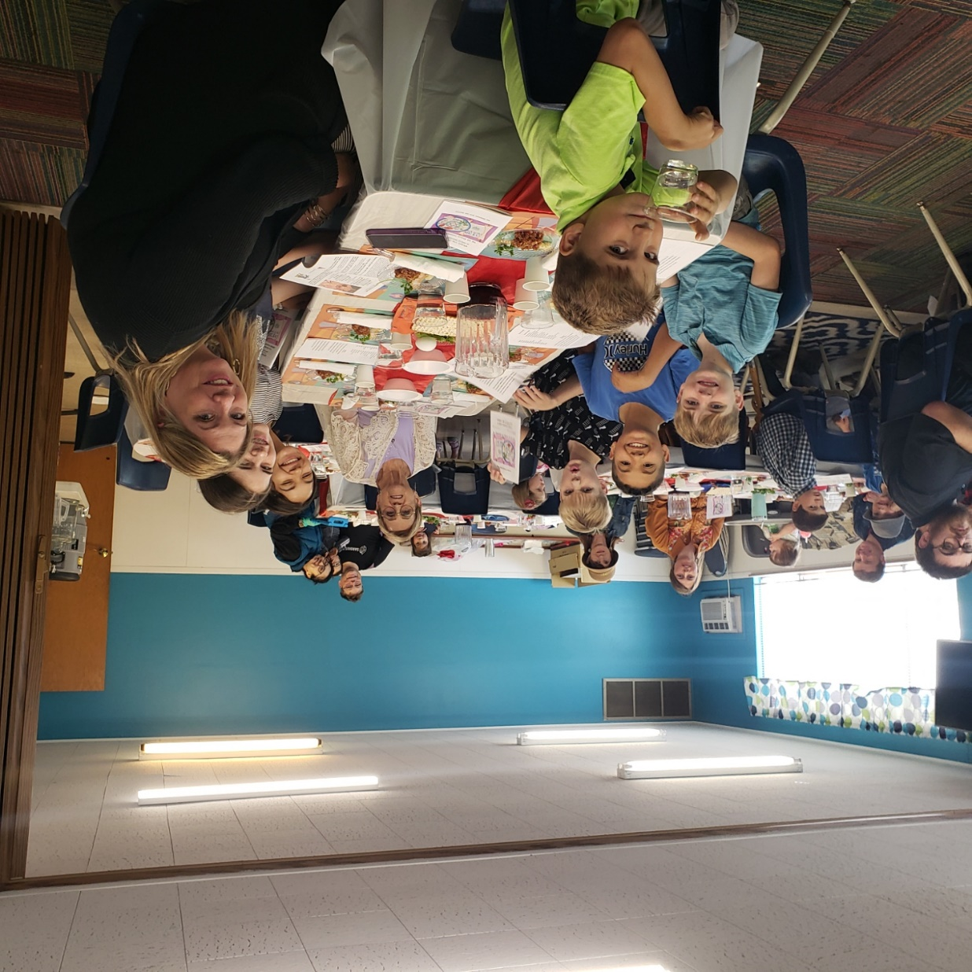

Slide 18
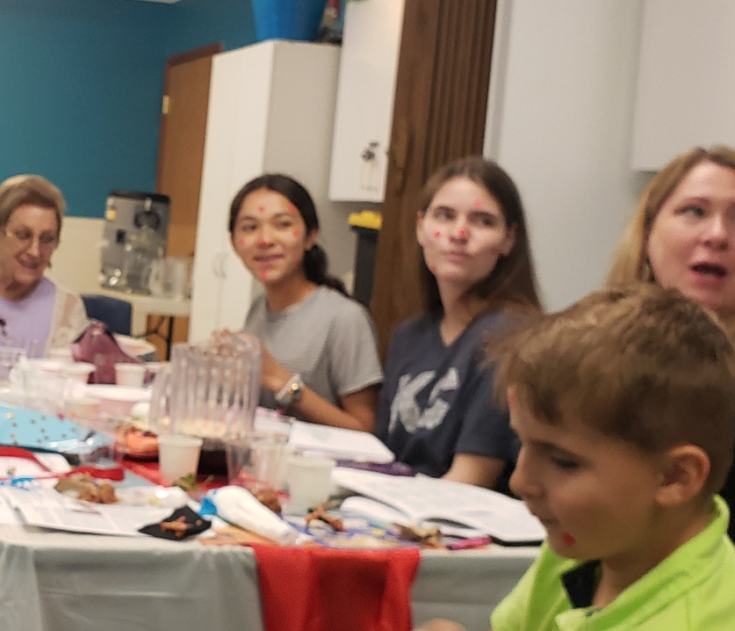
Plague
spots

Slide 19
What is the MOST important
of the Jewish holidays?

Slide 20
Lev 23.9-10 Adonai said to Moshe, "Tell the people of Isra'el, 'After you enter the land I am giving you and harvest its ripe crops, you are to bring a sheaf of the firstfruits of your harvest to the cohen.
Notes:
This is the most important holiday.

Slide 21
Lev 23.11-12 He is to wave the sheaf before Adoni, so that you will be accepted; the cohen is to wave it on the day after the Shabbat. On the day that you wave the sheaf, you are to offer a male lamb without defect, in its first year, as a burnt offering for Adoni.
Notes:
And this is the ceremonial, Temple era object lesson worship
Wave the sheaf
On the day after the Shabbat
Controversy if Pesakh is considered the Shabbat,
Shabbat after Pesakh

Slide 22
^{1 Cor. 15.20-24} But the fact is that the Messiah has been raised from the dead, the first fruits of those who have died. For since death came through a man, also the resurrection of the dead has come through a man.

Slide 23
^{1 Cor 15.20-23} For just as in connection with Adam all die, so in connection with the Messiah all will be made alive. But each in his own order: the Messiah is the firstfruits.

Slide 24
^{1 Cor 15.14,17} If Messiah has not been raised, then our proclaiming is meaningless and your faith also is meaningless… And if Messiah has not been raised, your faith is futile—you are still in your sins.

Slide 25
^{1 Cor 15.20} Messiah has been raised from the dead, the firstfruits of those who have died.
Firstfruits = Resurrection Day

Slide 26
Firstfruits = Resurrection Day
Scriptural symbol of Resurrection is not lilies, bunnies, eggs [chocolate always good], ham
BARLEY is the first of the firstfruits

Slide 27
In Temple times, Yeshua’s time, the barley waving was done shortly after Pesakh.
“The cohen is to wave it on the day after the Shabbat.”
Two possible interpretations:

Slide 28
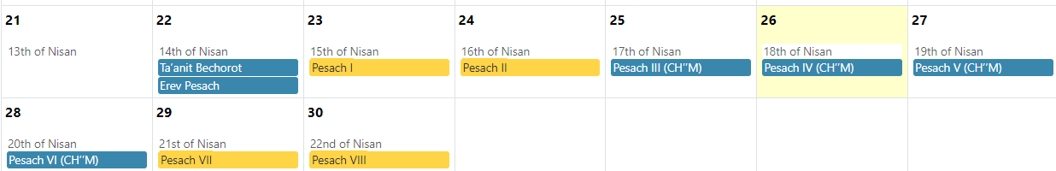
Date of Firstfruits possibilities
#2 #1
Notes:
#1 is Prushim Pharisees
#2 is Zdukhim Saducees
Further complication is Easter, Church’s resurrection day.
It was decided to separate the dating of Easter from the Hebrew calendar, by identifying the first Sunday after the first full moon following the March equinox. Hebrew calendar Passover is Nisan 15, always a full moon.
We are doing firstfruits between the two alternative possibilities.

Slide 29
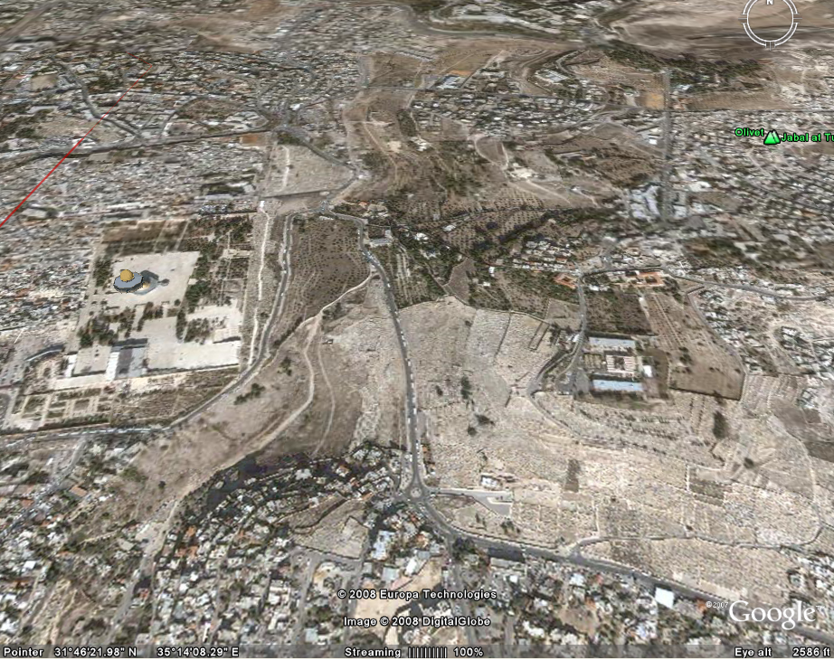
harvest its ripe crops

Slide 30
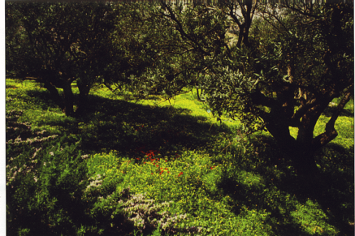
Ashes Valley where the national
firstfruits barley was grown.
Notes:
Called Ashes Valley Feasts of the Lord Kevin Howard, Marv Rosenthal.

Slide 31
Barley is the grain ripening around Passover time
in the Middle East.
Barley is the first of the firstfruits.
Notes:
Wheat comes later, in time for Shavuot. Pentecost
Torah has a firstfruits liturgy…

Slide 32
^{Dvarim Dt 26.1-4} “When you have come to the land Adonai your God is giving you as your inheritance, taken possession of it and settled there; you are to take the firstfruits of all the crops the ground yields, which you will harvest from your land that Adonai your God is giving you,

Slide 33
^{Dvarim Dt 26.1-4} put them in a basket and go to the place where Adonai your God will choose to have his name live. You will approach the cohen holding office at the time and say to him,

Slide 34
^{Dvarim Dt 26.1-4} ‘Today I declare to Adonai your God that I have come to the land Adonai swore to our ancestors that he would give us.’ The cohen will take the basket from your hand and put it down in front of the altar of Adonai your God.

Slide 35
With the destruction of the Temple, the sacrifice of the first fruits was discontinued. The declaration of the first fruits, however, remained alive. With the destruction of the Temple, the sacrifice of the first fruits was discontinued. The declaration of the first fruits, however, remained alive. It was revivified by the sages of the Mishnah, who embedded it in their Seder liturgy (m. Pesahim 10:4):
Notes:
https://thetorah.com/article/a-torah-prescribed-liturgy-the-declaration-of-the-first-fruits
This declaration, with commentary, is in the Or HaOlam Haggadah “Classic Rabbinic Version” which I did for a some Seders, but too long and people complained.
Other than that carryover into the Haggadah, there is NO Jewish celebration of this MOST important holiday.

Slide 36
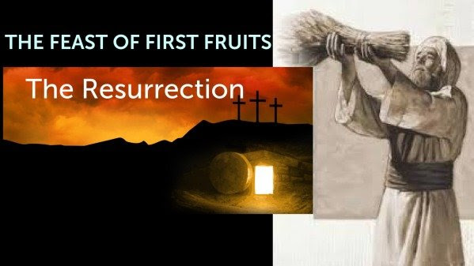
Notes:
Actually two festivals called First Fruits.

Slide 37
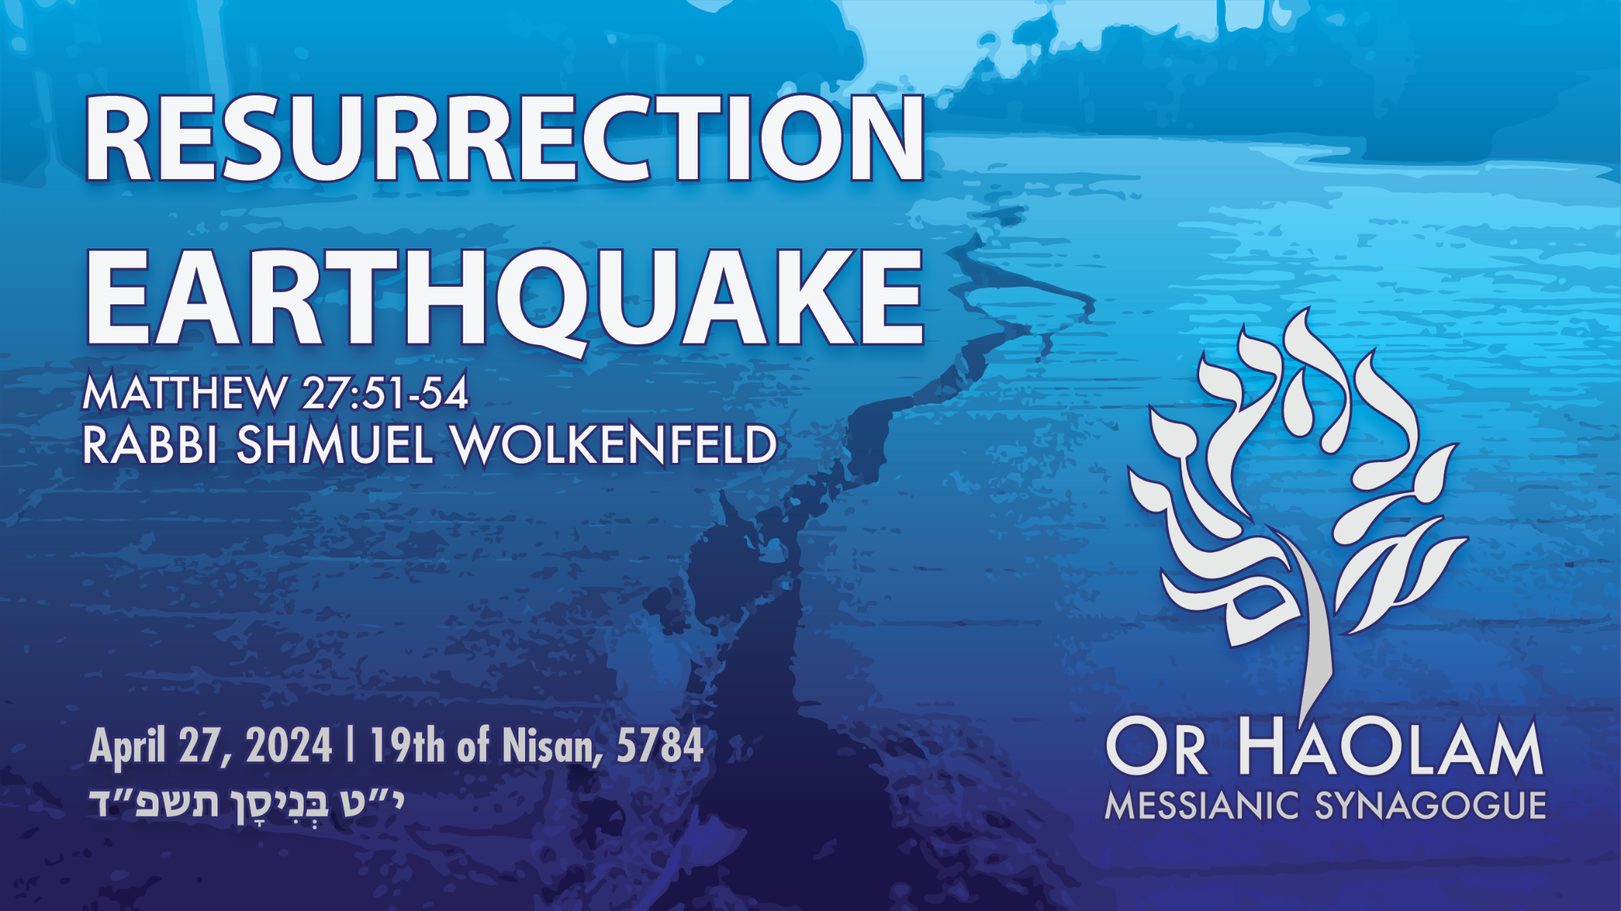

Slide 38

Resurrection Earthquake
Earthquakes were associated
with the resurrection of Yeshua

Slide 39
^{Mtt 27.45-50} From noon until three o’clock in the afternoon, all the Land was covered with darkness. At about three, Yeshua uttered a loud cry, “Eli! Eli! L’mah sh’vaktani? (My God! My God! Why have you deserted me?)” ^{[Ps 22.1]} On hearing this, some of the bystanders said, “He’s calling for Eliyahu.”
Notes:
Not an eclipse. Passover full moon. Only lunar eclipse possible. Plus lasted tooooo long.

Slide 40
^{Mtt 27.45-50} Immediately one of them ran and took a sponge, soaked it in vinegar, put it on a stick and gave it to him to drink. ^{[Ps 69.22]} The rest said, “Wait! Let’s see if Eliyahu comes and rescues him.” But Yeshua, again crying out in a loud voice, yielded up his spirit.

Slide 41
^{Mtt 27.51-54} At that moment the parokhet in the Temple was ripped in two from top to bottom; and there was an earthquake, with rocks splitting apart. Also the graves were opened, and the bodies of many holy people who had died were raised to life; and after Yeshua rose,
Notes:
Selective and strange and safe earthquake. Amy Jill Levine points out no outside historical verification, but no contradiction either.

Slide 42
^{Mtt 27.51-53} they came out of the graves and went into the holy city, where many people saw them.

Slide 43
^{Mtt 27.54} Now the centurion, and those with him keeping guard over Yeshua, when they saw the earthquake and what was happening, they became terribly frightened and said, “This really was the Son of God!”
Notes:
Centurions are officers not easily terrified.

Slide 44
Three days [parts of a day
count as a whole]

Slide 45
^{Mtt 28.1-6} Now after Shabbat, as it began to dawn on the first day of the week, Miriam of Magdala and the other Miriam came to look at the tomb. And suddenly there was a great earthquake, for an angel of Adonai descended from heaven and came and rolled back the stone and sat on it.
Notes:
Selective, strange, safe earthquake.

Slide 46
^{Mtt 28.1-6} His appearance was like lightning, and his clothing as white as snow. And those keeping watch were shaken for fear of him and became like dead men. But the angel answered and said to the women, “Do not be afraid,

Slide 47
^{Mtt 28.1-6} for I know you are looking for Yeshua who was crucified. He is not here; for He is risen, just as He said. Come, see the place where He was lying.

Slide 49
Resurrection Earthquake
Earthquakes were associated
with the resurrection of Yeshua.
2. Earthquakes are G-d’s exclama-
tion points

Slide 50
Sinai revelation

Slide 51
^{Shmot/Ex 19} On the morning of the third day, there was thunder, lightning and a thick cloud on the mountain. Then a shofar blast sounded so loudly that all the people in the camp trembled. Moshe brought the people out of the camp to meet God;

Slide 52
^{Shmot/Ex 19} they stood near the base of the mountain. Mount Sinai was enveloped in smoke, because Adonai descended onto it in fire — its smoke went up like the smoke from a furnace, and the whole mountain shook violently.

Slide 53
Shlikhim/Apostles incarceration

Slide 54
^{Acts 16.22-28} Upon receiving such an order, he threw them into the inner cell and clamped their feet securely between heavy blocks of wood.
Notes:
Great response to a ministry service.
How would you or I respond? Depression, anger at G-d? Anger at authorities? Plotting to escape?

Slide 55
^{Acts 16.22-28} Around midnight, Sha’ul and Sila were praying and singing hymns to God, while the other prisoners listened attentively. Suddenly there was a violent earthquake which shook the prison to its foundations.
Notes:
Two earthquakes.
Praying and singing after being flogged and jailed in stocks! Spiritual earthquake. Therefore others listening, maybe in astonishment.
Controlled geological earthquake, but selectively engineered, that killed no one, but broke all the locks. Miraculous?

Slide 56
^{Acts 16.22-28} All the doors flew open and everyone’s chains came loose. The jailer awoke, and when he saw the doors open he drew his sword and was about to kill himself, for he assumed that the prisoners had escaped. But Sha’ul shouted, “Don’t harm yourself! We’re all here!”
Notes:
Jailer saw the spirit of judgement in the earthquake, apparently.
Judgement: heaven and hell. [Also failure before magistrates.]
We are under the threat of eternal judgement like that. May have to give account at any time to the GREAT Judge of all.

Slide 57
^{Acts 16.29-32} Calling for lights, the jailer ran in, began to tremble and fell down in front of Sha’ul and Sila. Then, leading them outside, he said, “Men, what must I do to be saved?” They said, “Trust in the Lord Yeshua, and you will be saved — you and your household!” Whereupon they told him and everyone in his household the message about the Lord.

Slide 58
Victory of Barak and Devorah

Slide 59
^{Shoftim/ Ju 5.1-5} On that day D’vorah and Barak the son of Avino‘am sang this song: “When leaders in Isra’el dedicate themselves, and the people volunteer, you should all bless Adonai. Hear, kings; listen, princes; I will sing to Adonai! I will sing praise to Adonai the God of Isra’el.

Slide 60
^{Shoftim/ Ju 5.1-5} “Adonai, when you went out from Se‘ir, when you marched out from the field of Edom; the earth quaked, and the sky shook; yes, the clouds poured down torrents. The mountains melted at the presence of Adonai, at Sinai, before Adonai the God of Isra’el.

Slide 61
End of Days apocalypse

Slide 62
^{Yeshayahu/Is 24.19-22} The earth cracks and breaks open, the earth crumbles to pieces, the earth trembles and totters. The earth staggers to and fro like a drunk, sways back and forth like a watchman’s shelter;
Notes:
GBS midnight watch. Watchman’s shelter, one of the cars and someone goes out for MacDonald’s.

Slide 63
^{Yeshayahu/Is 24.19-22} its transgression weighs heavy upon it; it will fall and not rise again. When that day comes, Adonai will punish the armies of the high heaven on high, and the kings of the earth here on earth.

Slide 64
^{Yeshayahu/Is 29.6} Woe to Ari’el [lion of God] — Ari’el, the city where David encamped! Celebrate the feasts for a few more years, but then I will bring trouble to Ari’el…You will be visited by Adonai-Tzva’ot with thunder, earthquakes and loud noises, whirlwinds, tempests, flaming firestorms.

Slide 65
Every answered prayer, in the spirit

Slide 66
^{Thillim Ps 18.7-8} In my distress I called on Adonai, and cried to my God for help. From His Temple He heard my voice, my cry before Him came into His ears. Then the earth rocked and quaked. The foundations of mountains trembled.

Slide 67
End of days

Slide 68
^{Rev 6.12} I saw when the Lamb opened the sixth seal, and there was a great earthquake. The sun became as black as sackcloth made of goat’s hair, and the full moon became like blood.
Notes:
Every lunar eclipse people get excited about the Blood Moon. Nonsense.

Slide 69
^{Rev 6.12} The stars of heaven fell to the earth like a fig tree drops unripe figs when shaken by a great wind. The heaven ripped apart like a scroll being rolled up, and every mountain and island was moved from their places.

Slide 70
^{Rev 8.1-5} Now when the Lamb opened the seventh seal, there was silence in heaven for about half an hour. Then I saw the seven angels who stand before God, and seven trumpets were given to them. Another angel came and stood at the altar,

Slide 71
^{Rev 8.1-5} holding a golden incense burner. He was given much incense to offer up along with the prayers of all the kedoshim upon the golden altar before the throne. And the smoke of the incense, with the prayers of the kedoshim, rose before God from the angel’s hand.

Slide 72
^{Rev 8.1-5} Then the angel took the incense burner and filled it with fire from the altar, and threw it to the earth; and there were clashes of thunder and rumblings and flashes of lightning and earthquakes.

Slide 73
^{Rev 11.13-14} At that hour there was a great earthquake, and a tenth of the city collapsed. Seven thousand people were killed in the earthquake, and the rest were terrified and gave glory to the God of heaven. The second woe is past. The third woe is coming soon.

Slide 75
Resurrection Earthquake
Earthquakes were associated
with the resurrection of Yeshua.
2. Earthquakes are G-d’s exclama-
tion points
3. Resurrection of Messiah is
an intellectual earthquake.

Slide 76
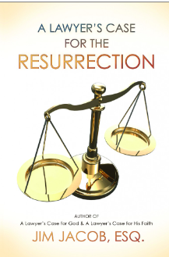
https://www.jimjacobbooks.com/
Jacob has condensed the evidence regarding the resurrection of Yeshua into one easy-to-read booklet

Slide 77
Exhibit A: the Empty tomb
Exhibit B: Witnesses to the Resurrection
Adversarial witnesses—Paul/Saul
500 at once
Exhibit C: Joyful commitment of follower in adversity.
Exhibit D: Silence from the opposition

Slide 79
Resurrection Earthquake
Earthquakes were associated
with the resurrection of Yeshua.
2. Earthquakes are G-d’s exclama-
tion points
3. Resurrection of Messiah is
an intellectual earthquake.
4. Internal earthquake
Notes:
4 too many have not lived up to this
Has there been an earthquake in YOUR life??

Slide 80
Substance Addicts liberated
Profanity addicts transformed
Sexual addictions released, but sometimes accountability needed.
Materialistic mania mollified
Social skills reconstituted.

Slide 81
So, all who really experience resurrection power, forgiveness from a relationship to Messiah Yeshua, have no problems? Easy life?

Slide 82
NO, but we have the amazing beginnings of it, if we walk it out:
disciplines of personal, family, and community worship
Choosing to walk in the joy of His Presence
Accountability and transparency
Growth

Slide 83
^{Rev 1.17-18} He placed his right hand upon me and said, “Don’t be afraid! I am the First and the Last, the Living One. I was dead, but look! — I am alive forever and ever! And I hold the keys to Death and Sh’ol.

Slide 84
April ≈ Nisan
Calendar considerations.

Slide 85
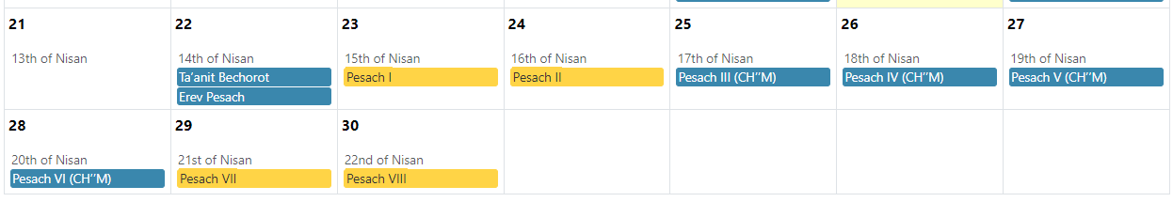
Khamets
burning
2 p.m.
OH
Seder
Reed
Sea
April 23 = Nisan 15 Passover
April 24 = Nisan 16 Firstfruits
April 29 = Nisan 21 Reed Sea crossing: OH service Sunday April 28
Notes:
How do we dare to have it on the 3rd night?
Jews all over the world have a 2nd night Seder. Where they get that authority?

Slide 86
^{Vayikra / Lev 23.8} On the seventh day is a holy convocation, when you are to do no laborious work.”
[Monday April 29, but starting Sunday evening April 28 8:09pm].
That will be the 7 pm to 9pm Teerosh for the week.

Slide 87
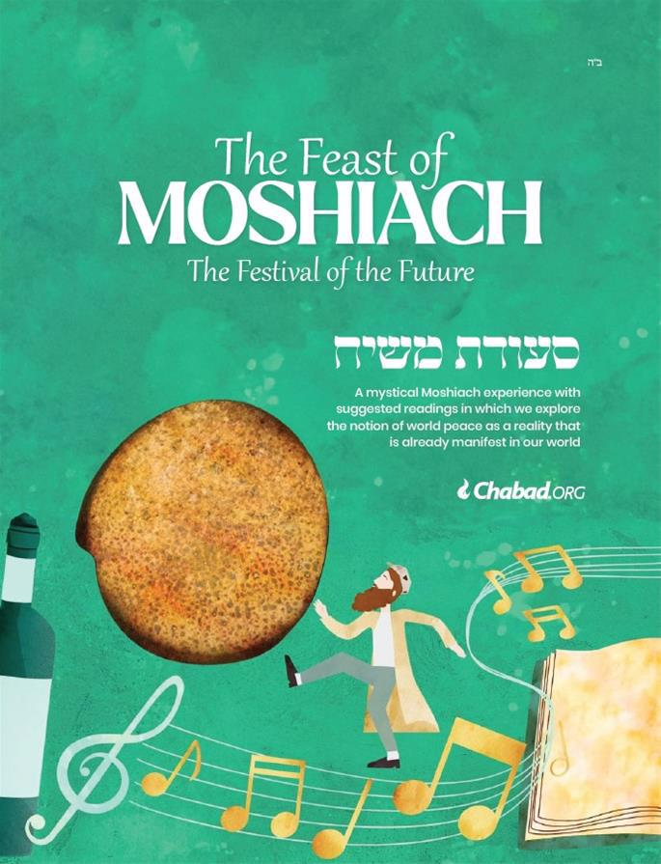
Sunday evening, April 28, 7 pm
Notes:
https://w2.chabad.org/media/images/1273/reDG12734359.jpg?_i=_nF2BB495DED96754E4660F69A3A9F4712

Slide 88
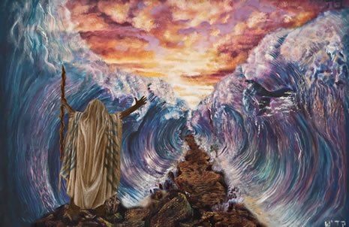
The miracle of the parting of the Red Sea seven days after the Israelites’ Exodus from Egypt.

Slide 89

Notes:
https://www.chabad.org/holidays/passover/pesach_cdo/aid/2748528/jewish/The-Last-Two-Days-of-Passover.htm

Slide 90
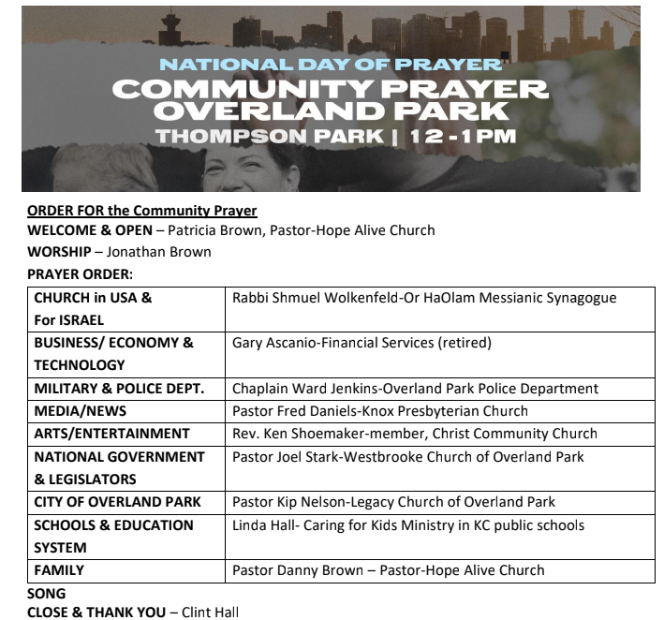
Thursday May 2nd 12-1
Thompson Park
8045 Sante Fe Dr., Overland Park 66204

Slide 91
^{Vayikra/Lev 23.11-16} This is a permanent regulation through all your generations, no matter where you live. “‘From the day after the day of rest — that is, from the day you bring the sheaf for waving — you are to count seven full weeks,

Slide 92
^{Vayikra/Lev 23.11-16} until the day after the seventh week; you are to count fifty days; and then you are to present a new grain offering to Adoni.
Notes:
So, the real emblem of resurrection is not lilies, eggs, bunnies, ham.
It’s barley.

Slide 93


Slide 95
Resurrection Earthquake
Earthquakes were associated
with the resurrection of Yeshua.
2. Earthquakes are G-d’s exclama-
tion points
3. Resurrection of Messiah is
an intellectual earthquake.
4. Internal earthquake
Notes:
4 too many have not lived up to this

Slide 97
Resurrection Earthquake
Earthquakes were associated
with the resurrection of Yeshua.
2. Earthquakes are G-d’s exclama-
tion points
3. Resurrection of Messiah is
an intellectual earthquake.
4. Internal earthquake
Notes:
4 too many have not lived up to this

Slide 98
^{Rev 1.17-18} He placed his right hand upon me and said, “Don’t be afraid! I am the First and the Last, the Living One. I was dead, but look! — I am alive forever and ever! And I hold the keys to Death and Sh’ol.
Notes:
Yeshua and barley: He is the one to conquer death. No one before, or after.
Barley is a simple grain, poor man’s food. Globally 70% of barley production is used as animal fodder, while 30% as a source of fermentable material for beer and certain distilled beverages, and as a component of various foods. It is used in soups and stews, and in barley bread of various cultures. Barley grains are commonly made into malt in a traditional and ancient method of preparation.
In 2017, barley was ranked fourth among grains in quantity produced (149 million tonnes or 330 billion pounds) behind maize, rice and wheat.
John Barleycorn personification of a grain.

Slide 99
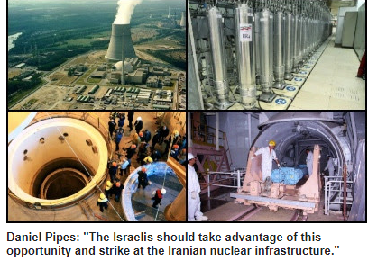
Notes:
https://www.danielpipes.org/22237/will-israel-respond-to-iran-attack?goal=0_086cfd423c-51755d0886-33765913&mc_cid=51755d0886&mc_eid=2515d15785

