Slide 1
e-handout
To have these notes
without taking notes
Go to OrHaOlam.com
Click on Messages tab,
2024 Messages

Slide 2
First, a supernatural praise report

Slide 3
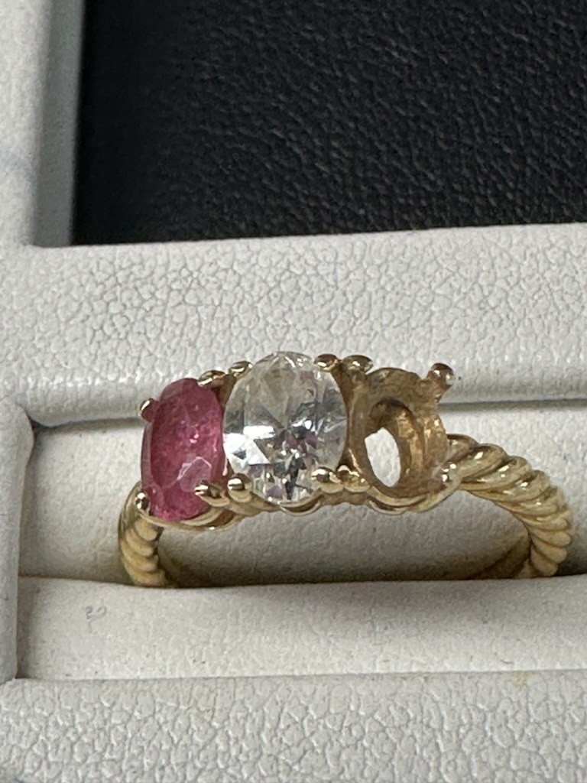

Slide 4
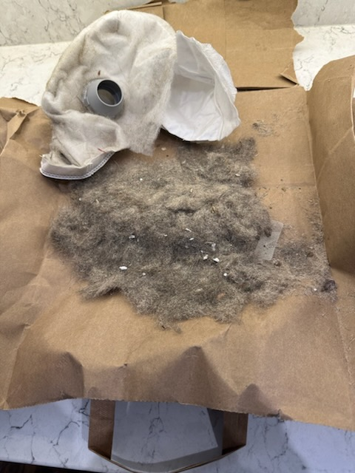

Slide 5
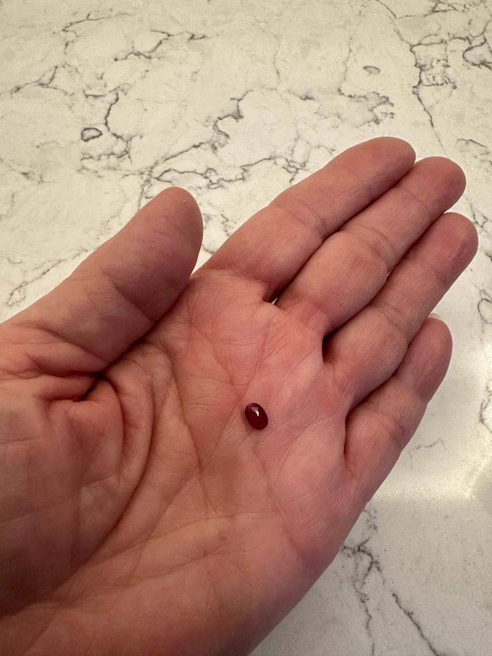

Slide 6
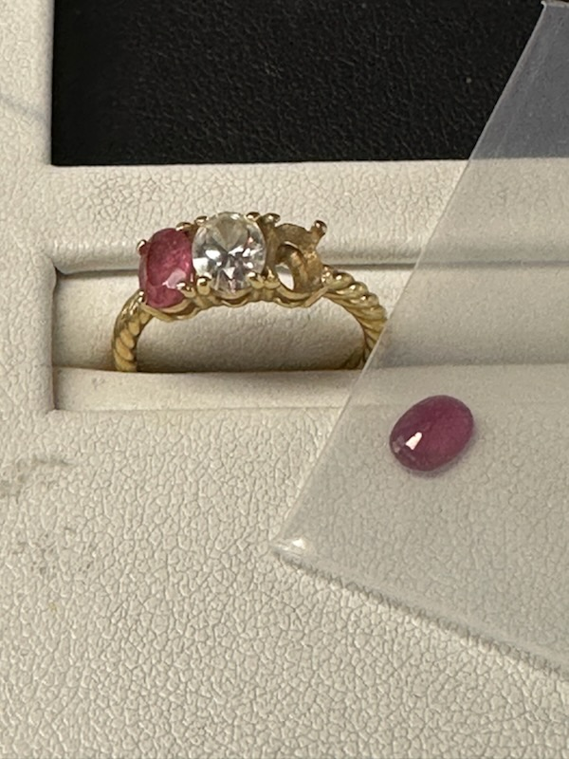

Slide 7
Second, G-d’s
mathematical handiwork.

Slide 9
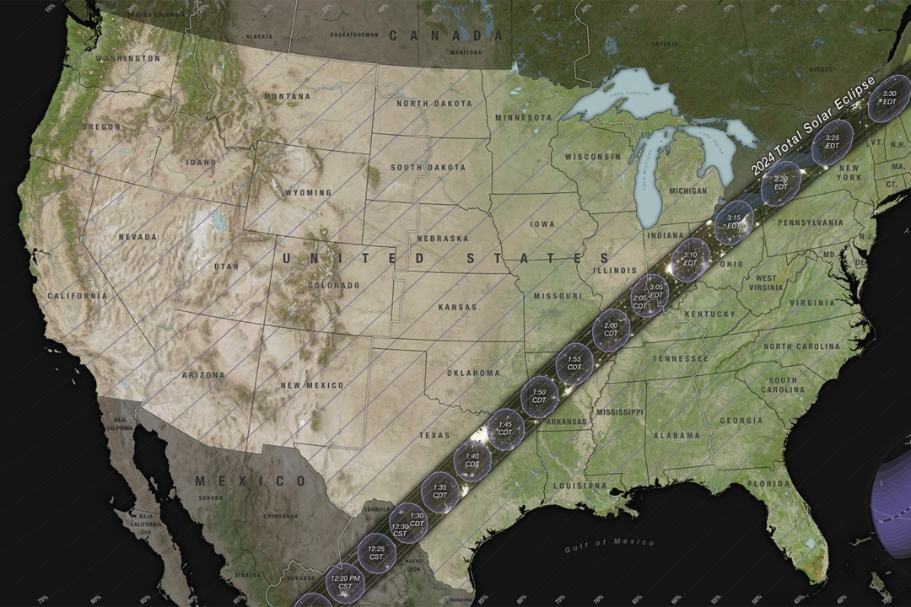
Notes:
Indiana state, Niagara Falls region of Ontario [including Kitchener where Dawn grew up.] National Geographic has said that Niagara Falls is one of the best places to see it.
The regional municipality of Niagara is proactively invoking a state of emergency to prepare for the event, which could involve major traffic jams, heavier demands on emergency services, and cellphone network overloads.

Slide 10
When it gets dark during the day, you'll also see planets aligned in the sky! Mars, Saturn, Neptune, Venus, Mercury, Jupiter and Uranus will be lined up along with the eclipsed Sun, and a comet!
Notes:
https://www.charismanews.com/us/94752-5-jaw-dropping-historic-events-happening-this-april

Slide 11
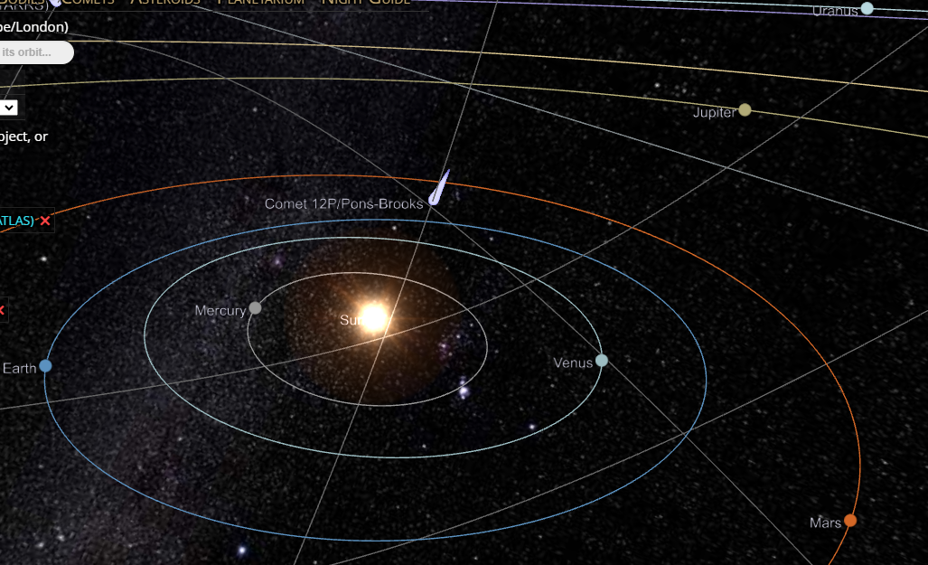
Notes:
https://theskylive.com/3dsolarsystem?objs=c2023a3|13p|12p|c2021s3&date=2024-04-08&h=17&m=12&
You will see The comet, Jupiter, Mercury, Venus, and Mars
Be SURE to wear eclipse or welding lenses.

Slide 12
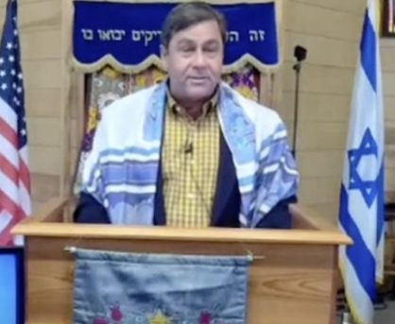
Rabbi Michael Stepakoff, Tampa, FL
Don't know if there is there any prophetic significance to this event, but it's pretty cool in any case.

Slide 13
Hoping it is a sign of revival coming to America and to the world! Either way, surely not long from now, the people of planet earth will drop what they're doing and all the world will see the return of the Son.

Slide 14
Notes:
Or, How do we make mensches?

Slide 15
Mar. 9, 2024
Battlefield Liberation / Rescue
Greatest Rescue in history
Greatest Rescue outside history
Greatest Rescue of our spirits
Are We Rescuers?

Slide 16
To be a rescuer / liberator takes:
Courage to be a rescuer.
Sacrifice to be a rescuer.
Humility to be a rescuer.
Love to be a rescuer.
One who is rescued is then called:
Notes:
Speak the truth in love.
Elevate others.
First to confess.

Slide 18
Summary of maturity menschy:
Not self centered & quarrelling
Focus on love for others
Not showy “spirituality” rather teaching, helpful.
Forgive self & others and reach for Melekh Messiah Yeshua
Notes:
From the various uses of the term “mature” in parallel passages in the Messianic Scriptures.

Slide 19
Summary of maturity menschy:
Kedoshim, the holy people,
The work of service,
Building up the body of Messiah.
Unity of the faith and
Knowledge of Ben-Elohim, the Son of G-d
Notes:
This summary from the context in Ephesians, previous was from parallel passages about maturity.
So, how does G-d do this rescue…

Slide 20
Notes:
Or, How do we make mensches?

Slide 21
The Elite Rescue/ LiberationTeam
Emissaries
Prophets
Proclaimers of the Good News,
Shepherds and
teachers

Slide 22
^{Eph 4.11-12} He Himself gave some to be ₁emissaries, some as ₂prophets, some as ₃proclaimers of the Good News, and some as ₄shepherds and ₅teachers— to equip the kedoshim, the holy people, for the work of service, for building up the body of Messiah.
Notes:
These are described as the leadership gifts. I don’t believe any of the gifts have ceased. “Cessationist” view not mine.
Note the goal. NOT make holy people happy, fulfilled, content in a hotel of bliss.
For the work of the service. Let’s explore that.
First the Greek of the Messianic Scriptures…

Slide 23
Ergon: work, task, employment; a deed, action; that which is wrought or made, a work, a deed (action) that carries out (completes) an inner desire (intension, purpose).
Notes:
I think we can see the root erg, a unit of energy
So…the energizing

Slide 24
Diakonia: waiting at table; in a wider sense: service, ministration, specifically refers to Spirit-empowered service guided by faith
Notes:
Energizing, empowered service. That’s what we are rescued to do. Energized, empowered service. Not drudgery of religious duty. Energized, empowered service.
Hebrew insight…

Slide 25
לַעֲבוֹדַת הַשֵּׁרוּת laAvodat ha-sherut
Notes:
Sherut = service. Taxi is a sherut, a service vehicle. Sherutim are bathrooms. Service rooms.

Slide 26
Avodah?
work, labor, toil, travail; employment, job, service, situation; occupation, trade; worship; paper
Notes:
Milon.co.il

Slide 27
Divrei Hayamim 1 Chron 25.1 TLV
וַיַּבְדֵּ֣ל דָּוִיד֩ וְשָׂרֵ֨י הַצָּבָ֜א לַעֲבֹדָ֗ה
Moreover, David and the commanders of the army, set apart for avodah the sons of Asaph, Heman, and Jeduthun who prophesied with lyres, harps and cymbals.
Avodah?

Slide 28
Avodah?
work, labor, toil, travail; employment, job, service, situation; occupation, trade; worship; paper
Notes:
Milon.co.il

Slide 29
^{Eph 4.11-12} He Himself gave some to be ₁emissaries, some as ₂prophets, some as ₃proclaimers of the Good News, and some as ₄shepherds and ₅teachers— to equip the kedoshim, the holy people, for the work of service, for building up the body of Messiah.
Notes:
Energized, empowered service. Everything? In some sense. Ushering, cleaning, setting up, sermonizing, transporting. Mopping, gardening, mowing has a certain joy in the kingdom. It’s for the King Yeshua!! It’s all romance, ultimately!!

Slide 30
^{Eph 4.11-13} This will continue until we all come to the unity of the faith and of the knowledge of Ben-Elohim, the Son of G-d, to mature adulthood, to the measure of the stature of Messiah’s fullness.

Slide 31
The Elite Rescue/ LiberationTeam
Emissaries
Prophets
Proclaimers of the Good News,
Shepherds and
teachers
Notes:
I believe in education and training. More on that later. However, a great guideline in ministry leadership is that G-d qualifies the called. He doesn’t necessarily call the qualified.
Moreover, my firstborn son served in the Marines. He explained that in Marine training, they break you, your will, your sense of ego and independence. Then they build you up in community.
Remember that in any leadership, you will be called to suffer. Be diminished. If you can’t handle reversals, opposition, distress, don’t consent to responsibility.

Slide 32
The Elite Rescue/ LiberationTeam
Emissaries
Prophets
Proclaimers of the Good News,
Shepherds and
teachers
Notes:
Consider the first one.

Slide 33
^{Ro 15.20-21} ^{Shaul/Paul writes:} I have always made it my ambition to proclaim the Good News where the Messiah was not yet known, so that I would not be building on someone else’s foundation, but rather, as the Tanakh puts it, “Those who have not been told about him will see, and those who have not heard will understand.”

Slide 34
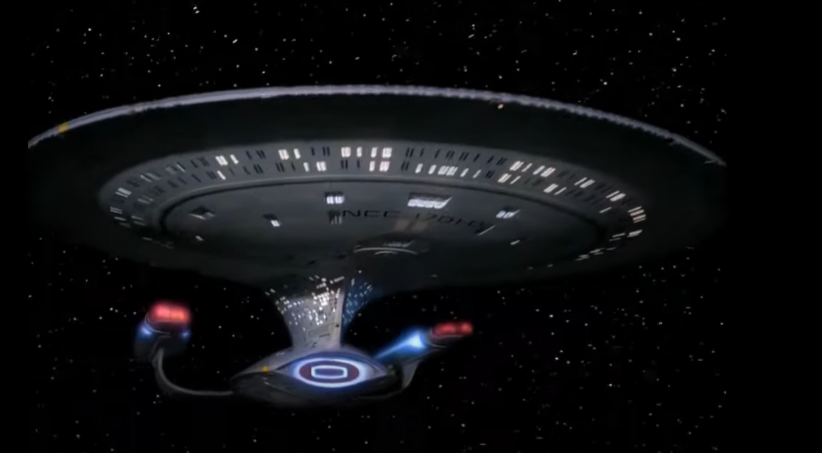
To boldly go where no one has
gone before.
Notes:
not confined to anyone particular place

Slide 35
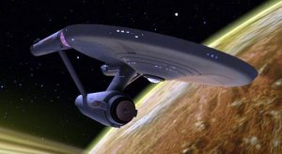
Notes:
https://upload.wikimedia.org/wikipedia/en/1/1a/USS_Enterprise_%28NCC-1701%29%2C_ENT1231.jpg

Slide 36
Breakthrough guys. In our world,
Martin Chernoff, Beth Yeshua Phila
Jonathan Bernis Jewish Voice to the former Soviet Union, Ethiopia, Burma
Stewart Winograd: Minsk, Belarus; India
Dan Juster, Beth Messiah, UMJC, Tikkun
Notes:
First synthesis of Jewish worship for Yeshua. Jewish, Yeshuish. First century.
Joseph Rabinowitz in Kishinev, Moldova in the 1880s
Others people. Key definition is that an Emissary/Apostle is a leader followed by other leaders.

Slide 37
All the founding Messianic rabbis in a measure, though I had about 20 people to help me start in 1995.

Slide 38
^{Talmudic Berakhot 34} A shaliakh [sent one], emissary is the same as the one who sends him.”

Slide 39
Notes:
Or, How do we make mensches?

Slide 40
The Elite Rescue/ LiberationTeam
Emissaries
Prophets
Proclaimers of the Good News,
Shepherds and
teachers

Slide 41
Prophets: foretelling and forthtelling.
Foretelling is risky: ^{Dvarim/Dt 18.20-22} But the prophet who presumes to speak a word in My Name, which I have not commanded him to speak, or who speaks in the name of other gods—that prophet will die.’

Slide 42
^{Dvarim/Dt 18.20-22} “Now should you say in your heart, ‘How would we recognize the word that Adoni has not spoken?’ When a prophet speaks in Adoni’s Name and the word does not happen or come true, that is a word that Adoni has not spoken. The prophet has spoken it presumptuously—do not be afraid of him.”

Slide 43
Nevertheless consider:
^{Acts 21.10-11} While we were staying there, a prophet named Agav came down from Y’hudah to visit us. He took Sha’ul’s belt, tied up his own hands and feet and said,

Slide 44
Nevertheless consider:
^{Acts 21.10-11} “Here is what the Ruach HaKodesh says: the man who owns this belt — the Judeans in Yerushalayim will tie him up just like this and hand him over to the Goyim.”

Slide 45
“just like this?”
Not exactly, but substantially.
Also, forthtelling: declaring G-d’s truth in exhortation, rebuke, encouragement.
Notes:
David Dreiling, now deceased, could read into situations. Had a “government chip.”
Heard personally someone who discerned that a fine, anointed, engaged effective leadership couple was being immoral. Spoke to them privately and discreetly, but powerful.

Slide 46
Several with that gift here. Can be abused and controlling. Whom you will marry, money issues.

Slide 47
In a sense, all musicians prophecy: communicate G-d’s message in the Ruakh.

Slide 48
^{Divrei HaYamin 1 Chron 25.1} For the service, David and the army commanders selected some of the descendants of Asaf, of Heman and of Y’dutun to prophesy with lyres, lutes and cymbals.
Notes:
Strange expression that is! I wondered until about 10 years ago at Messiah conf

Slide 49
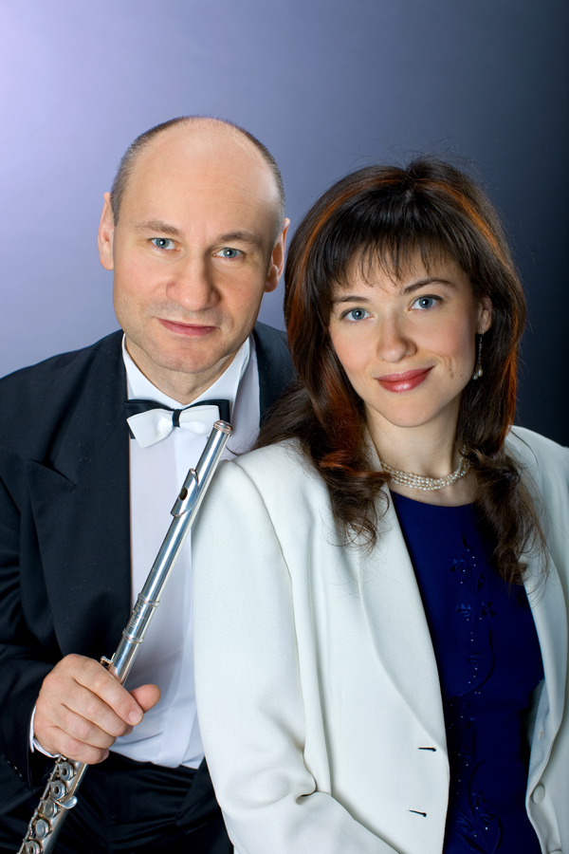
Yulia and Valodia Bouryi from Minsk, Belarus
Classically trained worship leaders.

Slide 50
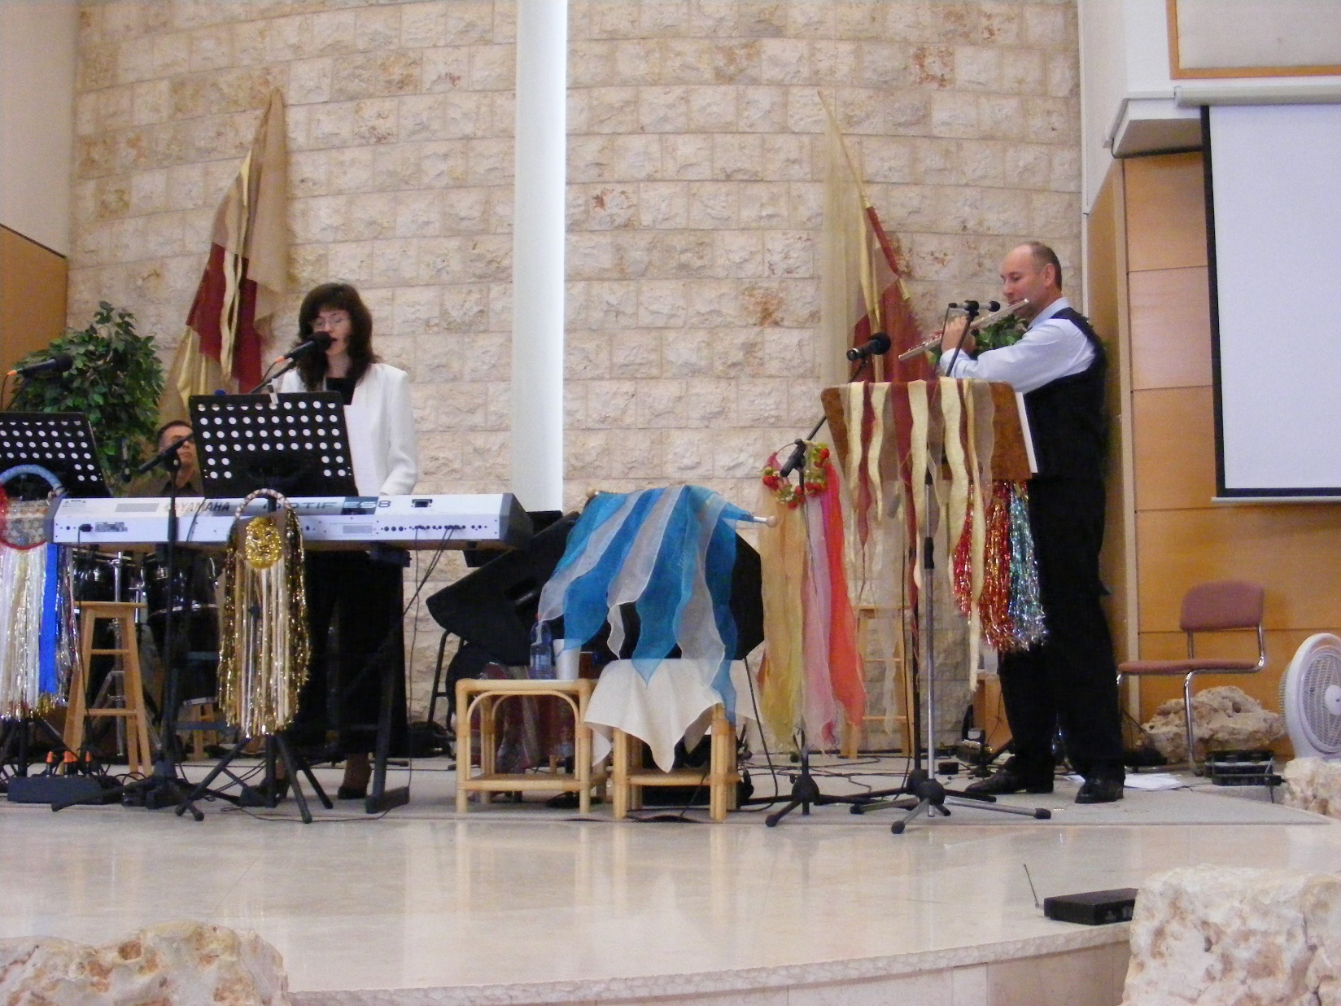
Notes:
At a Messiah Conference afternoon session. He was playing his flute, but tapped it in a rich percussion that was SOOO filled with the Ruakh that I said, this is what that verse means.

Slide 51
^{Divrei HaYamin 1 Chron 25.5-7} God gave Heman fourteen sons and three daughters. They were all with their fathers Asaf, Y’dutun and Heman to sing with cymbals, lutes and lyres in the house of Adoni, serving in the house of God under the direction of the king.
Notes:
Music education and organization does not stifle the Ruakh

Slide 52
^{Divrei HaYamin 1 Chron 25.5-7} Their number, together with their kinsmen who had been instructed in singing to Adoni, was 288, all well trained.
Notes:
We have been greatly blessed over the decades to have great worship directors. Amy is stellar, anointed, organized, teaching.
MANY gifted trained, Ruakh/Spirit filled musicians.
So, during the worship service, don’t just consider it preliminaries. G-d is speaking in prophetic voice. Michael David and his harp teaching.

Slide 53
Notes:
Or, How do we make mensches?

Slide 54
The Elite Rescue/LiberationTeam
Emissaries
Prophets
Proclaimers of the Good News,
Shepherds and
teachers

Slide 55
Evangelists.
People who can seamlessly, winsomely, painlessly turn conversations to the subjects of salvation, sin, judgment, Yeshua, atonement. Sometimes by music outreach at parks. Sometimes at checkout lines.
Notes:
We all should do it, but some people are really gifted Zvi, Jude, Jeff Bernstein,

Slide 56
https://www.foi.org/zvikalisher/
Notes:
https://www.foi.org/zvikalisher/
As a 10-year-old Jewish boy living in Poland in 1939, Zvi Kalisher found himself facing the evils of the Holocaust. Miraculously, he survived and, in 1948, settled in Israel, served in the army as a sapper, defusing landmines in the country he would call his new home. It was there Zvi was introduced to Yeshua the Messiah, whom he loved and served wholeheartedly and spent the rest of his life introducing to others.

Slide 57
But even if you aren’t a called proclaimer, you can share as the Ruakh give you opportunity. Sometimes literature. That’s how Zvi was won. A little black booklet Hebrew Messianic Scriptures by a 60 year old woman to a new arrival in Israel.

Slide 58
Notes:
Or, How do we make mensches?

Slide 59
The Elite Rescue /LiberationTeam
Emissaries
Prophets
Proclaimers of the Good News,
Shepherds and
teachers
Notes:
David Stern: Because the Greek is ambiguous, some take the two terms "shepherds" (pastors) and "teachers" to be speaking of one office — "shepherd-teachers." Pastoring and teaching are overlapping yet distinguishable skills.

Slide 60
Instruction in
The Word
Worship
Community
Mission and vision
Doctrine
Torah Practice

Slide 61
^{T’hillim Ps 23} Adoni is my shepherd; I lack nothing. He has me lie down in grassy pastures, he leads me by quiet water, he restores my inner person. He guides me in right paths for the sake of his own name. Even if I pass through death-dark ravines, I will fear no disaster; for you are with me; your rod and staff reassure me.
Notes:
7 major conflicts 2024. More than ever remember.

Slide 62
Shepherd
The Babylonian Talmud TB Gittin 56a, describes Jerusalem of 68-70 A.D. just before its destruction, when the Romans were besieging the city and various Jewish political-religious parties were fighting amongst each other:
Notes:
Avner Boskey

Slide 63
Rome sent Vespasian Caesar against the Jews. He came and laid siege to Jerusalem for three years. There were at that time in Jerusalem these three wealthy people: Nakdimon [i.e., Nicodemus] ben Gurion, ben Kalba Savua, and ben Tzitzit HaKesat . . .
Notes:
Copyright © 2024 Final Frontier Ministries, All rights reserved.

Slide 64
These three wealthy men had between them enough commodities to sustain the besieged [populace] for twenty-one years. There were certain Zealots among the people of Jerusalem . . . In order to force the residents of the city to engage in battle, the Zealots arose and burned down these storehouses of wheat and barley, and there was a general famine.
Notes:
Copyright © 2024 Final Frontier Ministries, All rights reserved.

Slide 65
Modern Israelis make use of a phrase from that day –
lisrof et ha’asamim
[‘to burn down the warehouses ‘]
לשרוף את האסמים
Are we burning the warehouses?
Notes:
Copyright © 2024 Final Frontier Ministries, All rights reserved.
https://davidstent.org/in-a-wilderness-of-mirrors/
7 major conflicts 2024

Slide 66
Avner Boskey concerning Israel: Our last newsletter went out on March 15, 2023. A lot has happened in the past two weeks. The Saturday night demonstrations in Tel Aviv’s Habimah Square have grown from approximately 100,000 people to close to 200,000 in attendance.
Notes:
Avner Boskey

Slide 67
These have escalated, blocking Tel Aviv’s central freeway for hours, and closing down main municipal arteries. Eventually mounted police, stun grenades and water cannons have been deployed, and multiple arrests followed. Kaplan St. protests
Notes:
Avner Boskey

Slide 68
Jonathan Feldstein President Genesis 123 Foundation
The army has canceled the leave for combat soldiers, more reservists are being called up again, public bomb shelters are open (we have one in our home as do many Israelis), the air force is on high alert,
Notes:
https://genesis123.co/

Slide 69
and GPS is being jammed as far south as Tel Aviv because Hezbollah has many (tens or hundreds of) thousands of precision GPS guided missiles that can hit most everywhere here.
Notes:
https://genesis123.co/

Slide 70
Last week I was driving in northern Israel and my GPS kept saying I was in Beirut. Yesterday, amid rocket fire from Gaza (still) and Lebanon (dozens a day), big news here was the GPS jamming created huge traffic problems.
Notes:
https://genesis123.co/

Slide 71
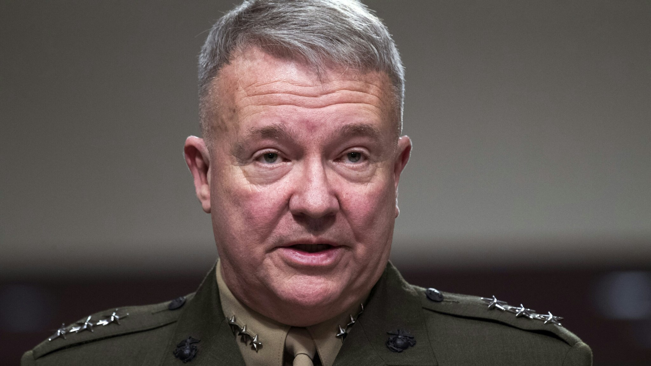
Former U.S. Central Command
Commander Gen. Frank McKenzie
Notes:
just days before the Moscow attack that ISIS-K, ‘retains the capability and will to attack U.S. and Western interests abroad in as little as six months and with little or no warning’,” “In Afghanistan, we have almost no ability to see into that country and almost no ability to strike into that country. And so, ISIS there is able to grow unabated.
https://www.dailywire.com/news/ex-centcom-commander-isis-threat-to-u-s-becoming-serious-because-of-bidens-foreign-policy

Slide 72
^{Yn 17.22-23} The glory which you have given to me, I have given to them; so that they may be one, just as we are one — I united with them and you with me, so that they may be completely one, and the world thus realize that you sent me, and that you have loved them just as you have loved me.

Slide 73
אזור חופשי לשון הרע
Azor khofshi
Lashon HaRa
Defamation free zone

Slide 74
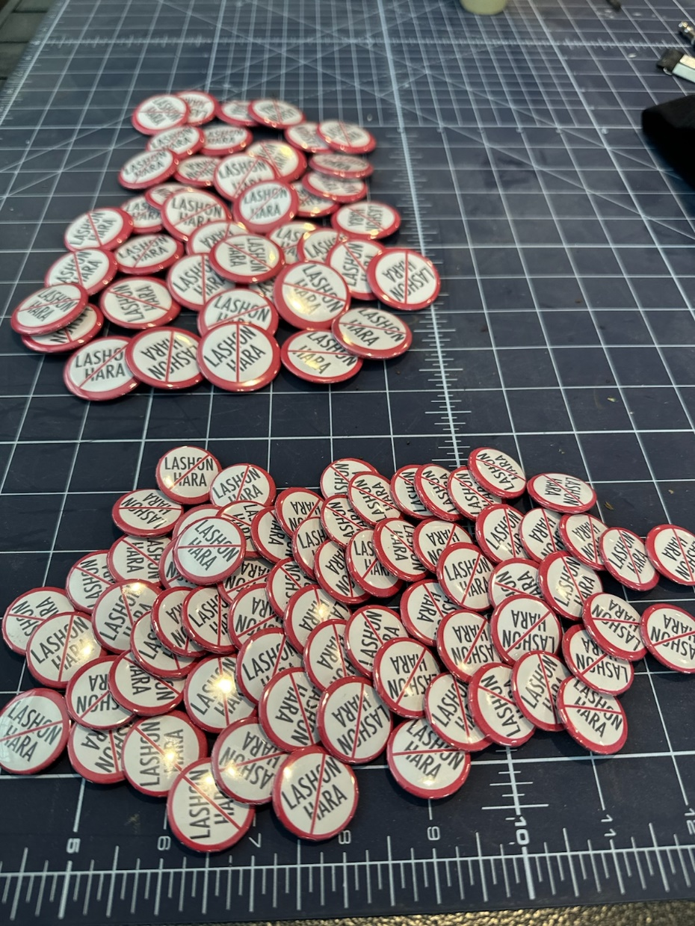

Slide 75
^{2 Cor 4.6} For it is the God who once said, “Let light shine out of darkness,” who has made his light shine in our hearts, the light of the knowledge of God’s glory shining in the face of the Messiah Yeshua.

Slide 76
^{2 Cor 3.18} All of us, with faces unveiled, see as in a mirror the glory of the Lord; and we are being changed into his very image, from one degree of glory to the next, by Adoni the Spirit.

Slide 77
Notes:
Or, How do we make mensches?

Slide 78
The Elite Rescue /LiberationTeam
Emissaries
Prophets
Proclaimers of the Good News,
Shepherds and
teachers

Slide 79
These five types will get it done!

Slide 80
These five types will get it done!
Not at all.
These five types will make us ALL into mensches,
Loving G-d, Messiah like
Loving each other
Lashon hara free.

Slide 81
Do you KNOW Yeshua and drinking the water of LIFE?
Are you hearing daily from His Word?
How are you applying what you heard?
Are you a rescuer?

