Slide 1
e-handout
To have these notes
without taking notes
Go to OrHaOlam.com
Click on Messages tab,
2024 Messages

Slide 2
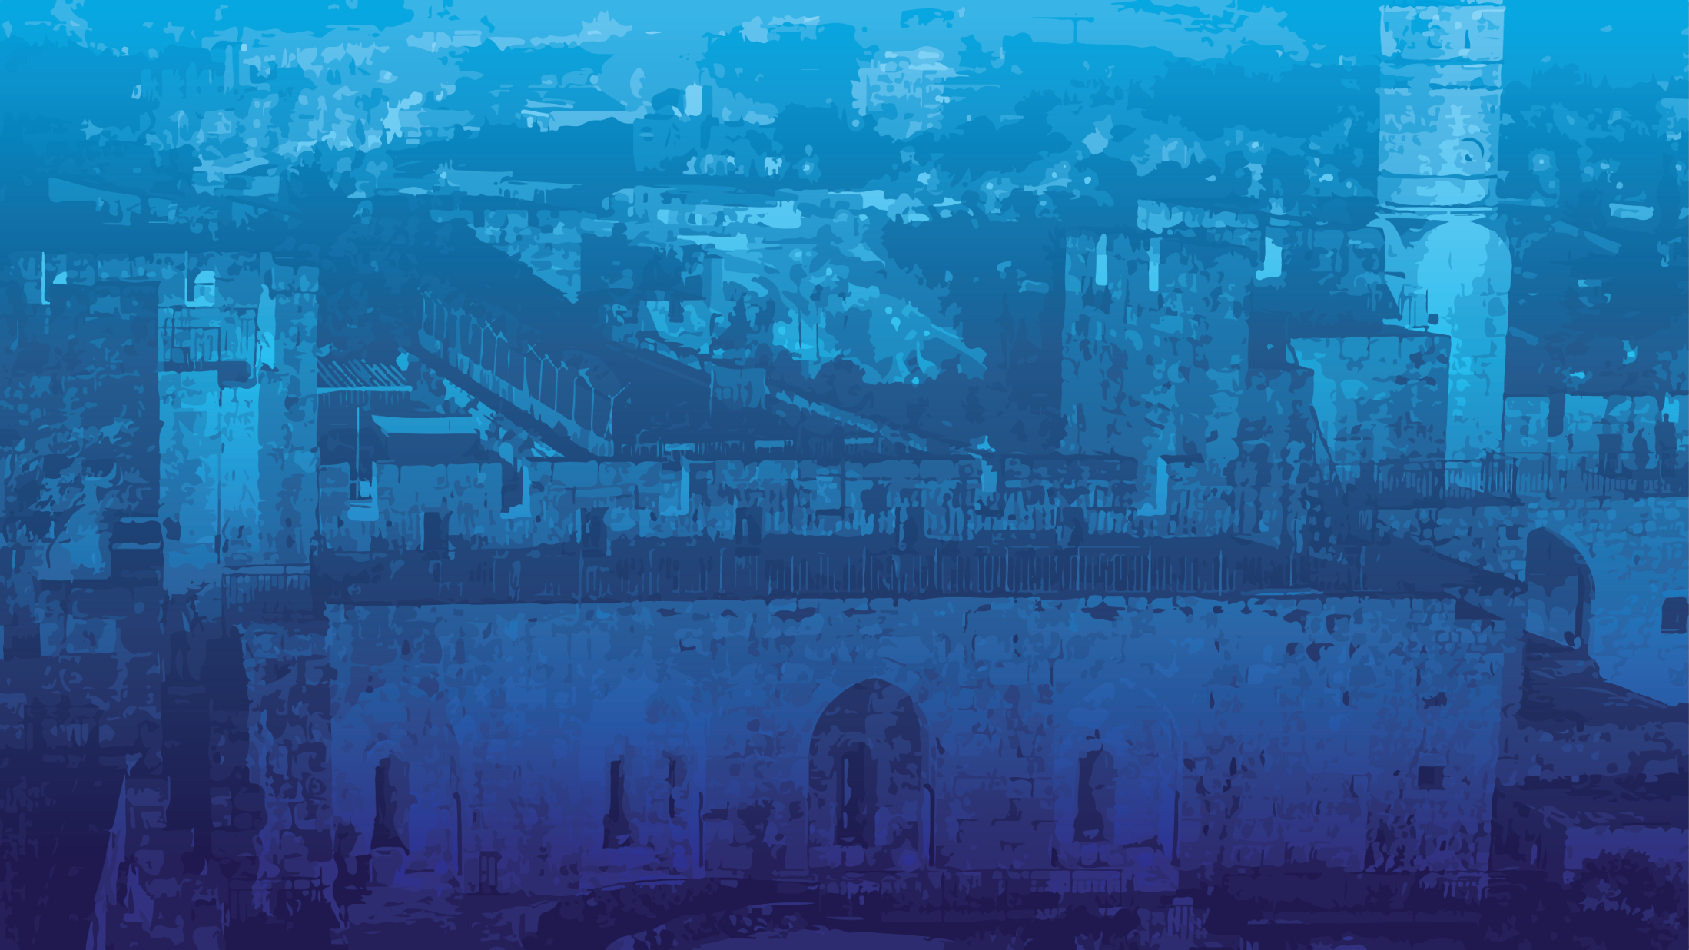
Three calendar themes for today
Mother’s Day
Israel War Dead Memorial Day
Israel Independence Day
But first, a big note of
appreciation

Slide 3
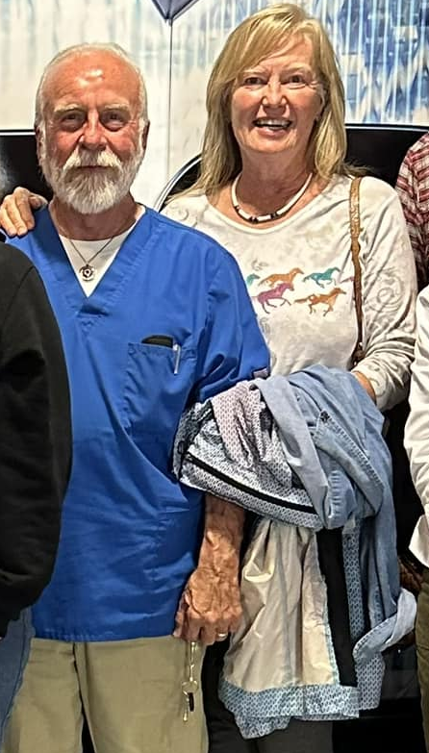
Richard and Luann Ridgeway have had a rough week.

Slide 4
Luann’s Facebook post:
Monday night, May 6, 11:30 pm
“We, along with the flowers and tomatoes are in the basement. Safe and sound! Tornado sirens going off,

Slide 5
which concerns me less than the fact that I've lived in Mo most of my life and I know when conditions are right for tornadoes. Tonight, for maybe the 3rd time in 40 years, I knew we needed to wait it out in the basement.”

Slide 6
Tuesday, May 7, 1:44 am update:
[2 hours later] The … storm has passed us … I'm happy to report that people, cat and both horses are okay. As to property damage – that's another story … Our maple trees have blocked the entrance to our barn

Slide 7
and I can see damage to our barn, though it is standing … There is no doubt in my mind that a tornado passed over us. There are too many twisted limbs to be anything else …
We can't do anything else tonight except offer prayers of thanks that people are okay and animals appear to be fine (but scared) ...”

Slide 8
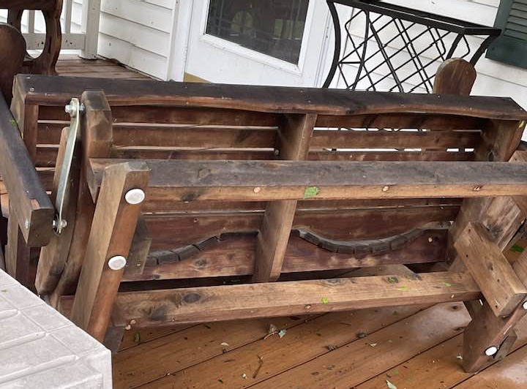
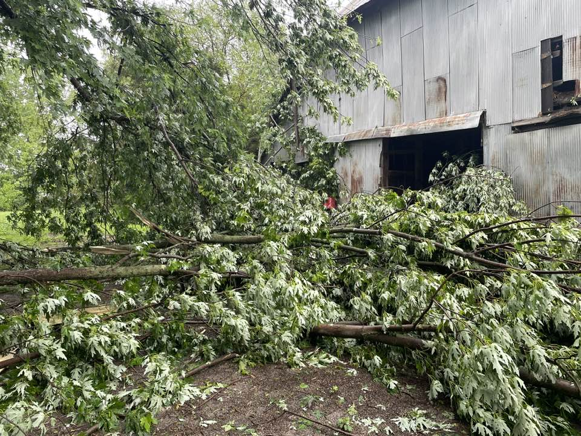
Trees are blocking both entrances to the barn.
This is a very heavy Amish made cedar glider. Storm flipped it over.

Slide 9
“We asked. They supplied. In two days, our congregation at Or HaOlam has volunteered what amounts to a total of around 42 hours of labor (tough, heavy lifting, chainsaw labor) to help us with severe storm/tornado damage.

Slide 10
Our congregation family is amazing. Richard said we have never experienced anything like this – the tornado damage, the support.”

Slide 11
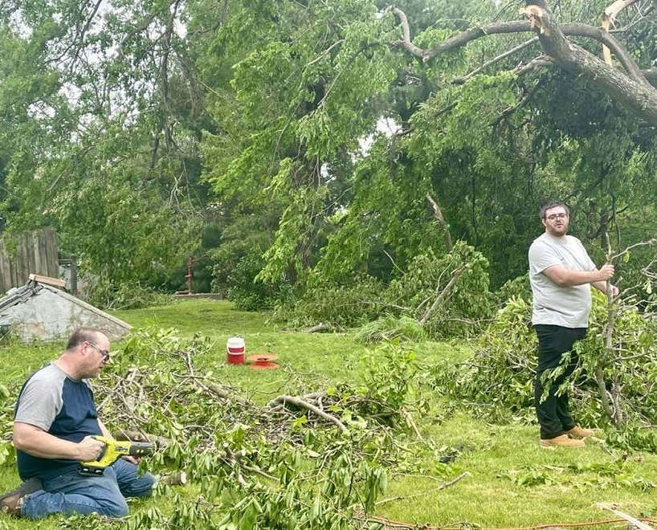
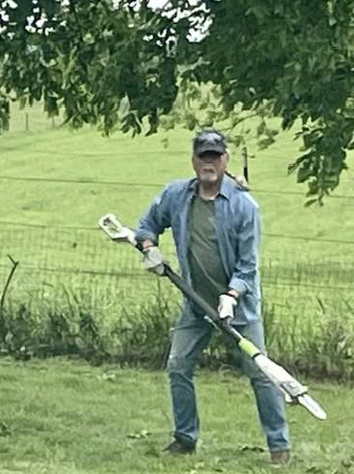
Michael and Yosef Swanson
Jan Fields (Rukhel’s husband)

Slide 12
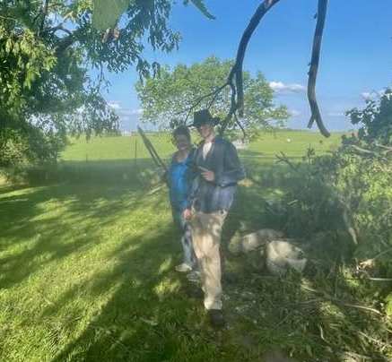
Elizabeth
Schork and
her son
Benjamin

Slide 13
“I missed taking a photo of Eric Miranda who brought his chainsaw and a lot of muscle to help the day after the tornado – because I was still in shock from the enormous damage on the first day after the storm.” (Luann sent a photo that she thought resembles Eric.)

Slide 14
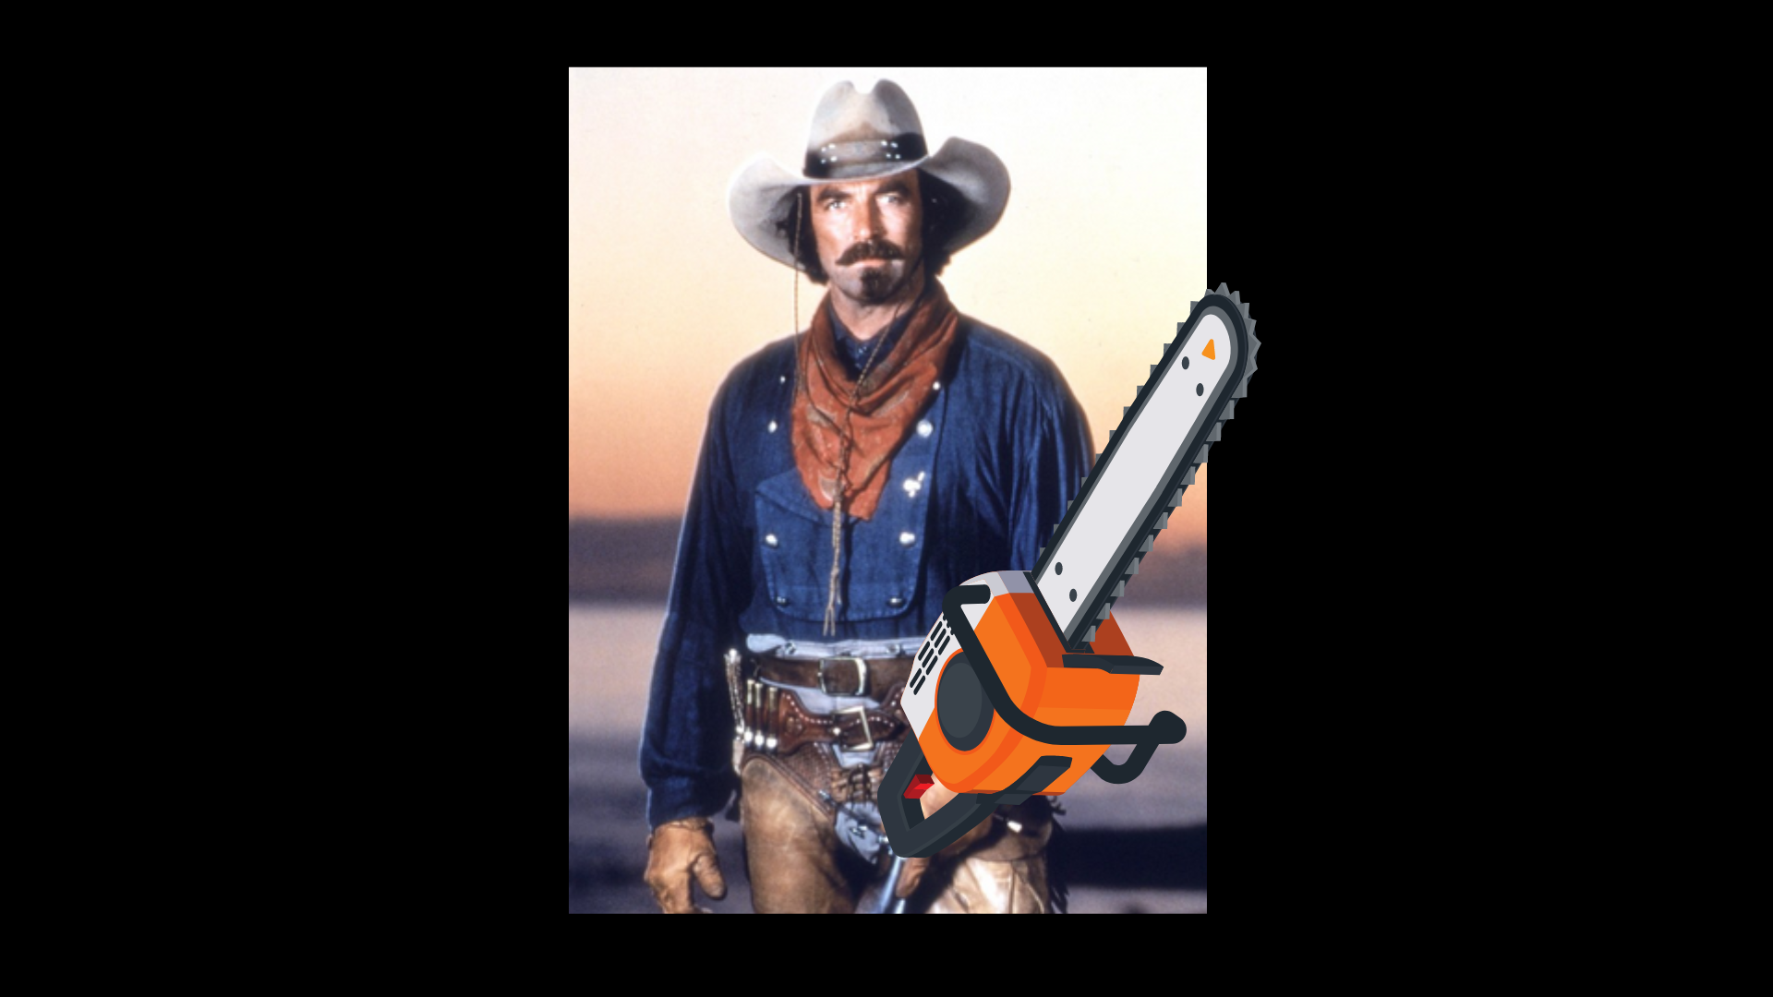
Notes:
Tom Selleck in the movie Quigley Down Under. Nearly any woman over 40 could tell you. There may be swooning. 👀🤣
All those who helped, stand for recognition and appreciation!

Slide 15
Three calendar themes for today
Mother’s Day
Israel War Dead Memorial Day
Israel Independence Day
How to address all…

Slide 16
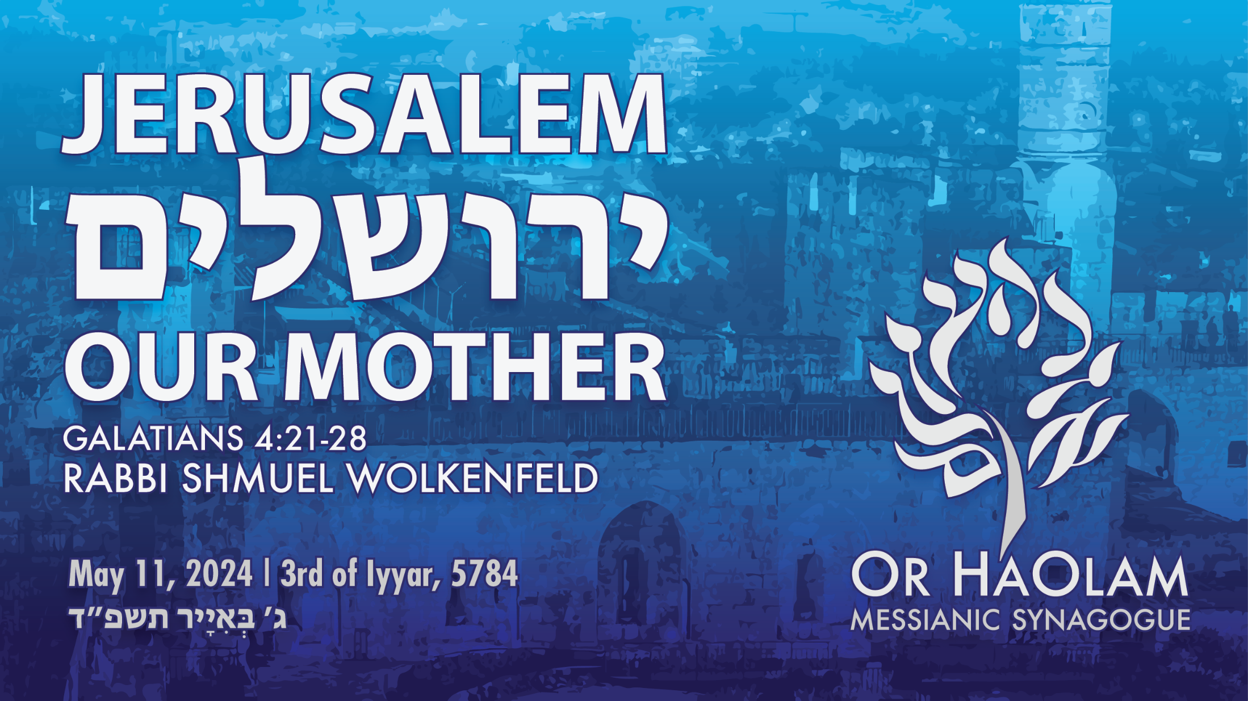

Slide 17
Notes:
Before I show the outline on this background, I’d like to show the background.
Appreciate Jeremy’s weekly creativity.

Slide 18
Jerusalem Our Mother
The scripture
The Analysis [exposition]
Living it for Jerusalem
Living it for Mothers
A final note of victory

Slide 19
Jerusalem Our Mother
The scripture
The Analysis [exposition]
Living it for Jerusalem
Living it for Mothers
A final note of victory

Slide 20
^{Gal 4.21-28} Tell me, you who want to be in subjection to the system that results from perverting the Torah into legalism, don’t you hear what the Torah itself says? It says that Avraham had two sons, one by the slave woman [Hagar] and one by the free woman [Sarah].

Slide 21
^{Gal 4.21-28} The one by the slave woman was born according to the limited capabilities of human beings, but the one by the free woman was born through the miracle-working power of God fulfilling his promise. Now, to make a midrash [allegory] on these things: the two women are two covenants.

Slide 22
^{Gal 4.21-28} One is from Mount Sinai and bears children for slavery — this is Hagar. Hagar is Mount Sinai in Arabia; she corresponds to the present Yerushalayim, for she serves as a slave along with her children. But the Yerushalayim above is free, and she is our mother; for the Tanakh says,

Slide 23
^{Gal 4.21-28} for the Tanakh says,
  “Rejoice, you barren woman who does not bear children! Break forth and shout, you who are not in labor! For the deserted wife will have more children than the one whose husband is with her!” ^{Yeshayahu/Is 54.1}
You, brothers, like Yitz’chak, are children referred to in a promise of God.
Notes:
We are to live in Jerusalem!

Slide 25
Jerusalem Our Mother
The scripture
The Analysis [exposition]
Living it for Jerusalem
Living it for Mothers
A final note of victory

Slide 26
Allegories here
Now, to make a midrash [allegory] on these things: the two women are two covenants.

Slide 27
Allegorical interpretation of scripture has hurt the Jewish people greatly over the centuries!
Church fathers have read “the church” when scripture said “Israel.”
Ezek 37 Dry bones has been read as church Revival, when restoration of Israel to the land is meant.

Slide 28
Allegories = midrashim, can be a legitimate way to interpret scripture.
Notes:
A little theological diversion, Rabbi trail about the limited validity of allegories.

Slide 29
Pardes פרד"סis a theory of Biblical exegesis. It means "orchard" when taken literally, but is used in this context as a Hebrew acronym formed from the initials of the following four approaches:
Notes:
https://en.wikipedia.org/wiki/Pardes_(exegesis) revised slightly

Slide 30
Peshat פְּשָׁט‎ surface, or the literal meaning.
Remez רֶמֶז‎ hints, or the deep meaning beyond just the literal sense.
Notes:
https://en.wikipedia.org/wiki/Pardes_(exegesis) revised slightly
I am basically a Pshat guy. Historical grammatical context. What is the plain contextual sense?

Slide 31
Derash דְּרַשׁ‎ "inquire" ("seek") – the comparative (midrashic) meaning, as given through similar occurrences.
Sod סוֹד‎"secret" ("mystery") or the esoteric/mystical meaning, as given through inspiration or revelation.
Notes:
https://en.wikipedia.org/wiki/Pardes_(exegesis) revised slightly
Allegory in Drash
We avoid Sod. Numerology, Kabbalah. Can be interesting, but hazardous.

Slide 32
Allegory /midrash in the Tanakh
Yeshayahu/ Is 5.1-6 A vineyard is a midrash / allegory
^{Yesh/ Is 5.7} Now the vineyard of Adoni-Tzva’ot is the house of Isra’el.

Slide 33
Allegory in Rabbinic writings
^{Ber. Rabbah 65.21} Conflict between Esav and Yaakov [Esau and Jacob] representing the conflict of Israel [Yaakov] and Rome [Esav]

Slide 34
Allegory in Apocrypha
^{4 Ezra [2 Esdras] 7.26} For behold, the time will come, when the signs which I have foretold to you will come to pass, that the city which now is not seen shall appear, and the land which now is hidden shall be disclosed.
Notes:
Apparently an ancient consolation to Israel that although the earthly Jerusalem was destroyed, there was a heavenly Jerusalem that endured.

Slide 35
Apocrypha (from Ancient Greek ἀπόκρυφος (apókruphos) 'hidden') denotes the collection of ancient books thought to have been written some time between 200 BCE and 100 CE. Denotes material of dubious historicity or orthodoxy.
Notes:
https://en.wikipedia.org/wiki/Biblical_apocrypha

Slide 36
Books of the Apocrypha
1 Esdras
2 Esdras
Tobit
Judith
Additions to Esther
Wisdom of Solomon
Ecclesiasticus
Baruch
Letter of Jeremiah
Prayer of Azariah
Susanna
Bel and the Dragon
Prayer of Manasseh
1 Maccabees
2 Maccabees

Slide 37
Allegories = midrashim, can be a legitimate way to interpret scripture.
Don’t throw out Paul/ Shaul as a legitimate Messianic Jew!

Slide 38
Allegories here
Hagar as covenant of Sinai. Hagar was a slave who bore children into slavery.
Sarah as the covenant of Zion, miracle working power of G-d fulfilling His promises. [Jer 31]
Notes:
Children when childbearing impossible.

Slide 39
Application:
Non-Messianic Jews, are the humanly powered children of Hagar.
We who believe in Messiah, Jewish and Gentile, are the supernaturally empowered children of Sarah.
Notes:
Non Messianic Jews can be noble and meticulous and upright. Beauty in obedience.
Can be joyful, radiant
This is why when we call up women to the Torah service who don’t have a Hebrew name for their mothers, we call them “Bat Sarah” “daughter of Sarah.”

Slide 40
Allegories here
Earthly Jerusalem’s population is in servile mode to G-d
Jerusalem will live on in a heavenly mode of Ruakh freedom!
Notes:
As mentioned above in the apocrypha.

Slide 41
Application: Jerusalem, the physical city, is the failed but future representation of the Kingdom, and subject to destruction. Don’t panic.
There is by midrash/ allegory, a heavenly Jerusalem that retains the comforting power of G-d.

Slide 42
Our hearts are to focus on Jerusalem, the mother ship.
Earthly Jerusalem still represents all that was and will be delightful in the Kingdom and the King. The original and future mother ship.

Slide 43
Our hearts are to focus on Jerusalem, the mother ship.
Heavenly Jerusalem is where we go for those delights today. The current mother ship.

Slide 45
Jerusalem Our Mother
The scripture
The Analysis [exposition]
Living it for Jerusalem
Living it for Mothers
A final note of victory

Slide 46
^{T’hillim Ps 137.5-6} If I forget you, O Jerusalem, let my right hand wither. May my tongue cling to the roof of my mouth if I cease to remember you, if I do not set Jerusalem above my chief joy.

Slide 47
^{T’hillim / Ps 47.1-3, 13-15} Great is Adoni and greatly to be praised, in the city of our God, his holy mountain, beautiful in its elevation, the joy of all the earth, Mount Tziyon, in the far north, the city of the great king.

Slide 48
^{T’hillim / Ps 47.1-3, 12-15} Let Mount Tziyon rejoice, let the daughters of Y’hudah be glad, because of your judgment [on the enemy]. Walk through Tziyon, go all around it; count how many towers it has. Note its ramparts, pass through its citadels, so that you can tell generations to come that such is God, our God forever; he will guide us eternally.

Slide 49
^{Thillim / Ps 147.1-4} Halleluyah! How good it is to sing praises to our God! How sweet, how fitting to praise him! Adoni is rebuilding Yerushalayim, gathering the dispersed of Isra’el. He heals the brokenhearted and binds up their wounds. He determines how many stars there are and calls them all by name.

Slide 50
^{T’hillim / Ps 87.1-3,7} On the holy mountains is [the city’s] foundation. Adonai loves the gates of Tziyon more than all the dwellings in Ya‘akov. Glorious things are said about you, city of God…Singers and dancers alike say, “For me, you are the source of everything.”

Slide 51
^{T’hillim/Ps 78.69} Rejecting the tents of Yosef and passing over the tribe of Efrayim, he chose the tribe of Y’hudah, Mount Tziyon, which he loved. He built his sanctuary like the heights; like the earth, he made it to last forever.

Slide 52
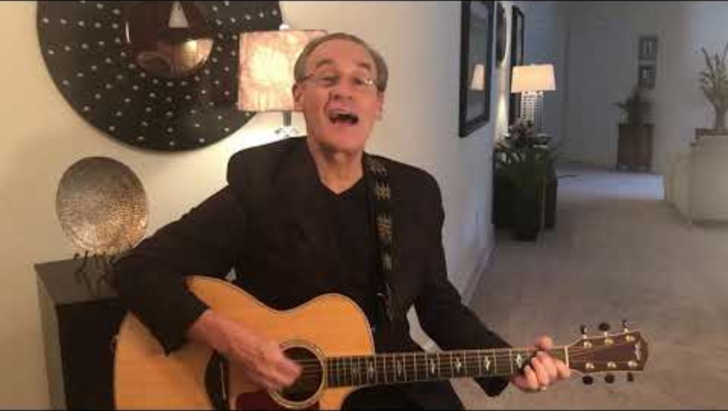
https://youtu.be/7cWpGSfwY1w
Notes:
https://youtu.be/7cWpGSfwY1w

Slide 53
The heart of a Jew is Jerusalem, Messiah his only King.
An when in the soul of the Jew He reigns, peace to the city He brings.
Barukh HaShem HaMashiakh Yeshua.
Barukh HaShem Adoni.

Slide 54
^{Matthew 23.1,37-39} Then Yeshua spoke to the crowds and to His disciples, saying, “Yerushalayim! Yerushalayim! You kill the prophets! You stone those who are sent to you! How often I wanted to gather your children, just as a hen gathers her chickens under her wings,

Slide 55
^{Matthew 23.1,37-39} but you refused! Look! God is abandoning your house to you, leaving it desolate. For I tell you, from now on, you will not see me again until you say,
ברוך הבא בשם די
‘Barukh ha-ba b’shem Adoni ‘Blessed is he who comes in the name of Adoni.’”
Notes:
This is why we turn east during certain prayers. Jerusalem was the place of the Temple, and the place of Messiah’s atonement. Yeshua loves Jerusalem. It’s His home town and future home, and place of redeeming the world.

Slide 56
David Stern: But the Yerushalayim above, corresponding to Sarah, is free; and she is our mother, the mother of all who have the trusting faithfulness that Abraham and Yeshua had, whether Messianic Jews or Messianic Gentiles. ﻿
Notes:
https://kifakz.github.io/eng/bible/stern/stern_galatam_04.html
On the allegorical, midrashic Jerusalem

Slide 57
The freedom which the Messiah has freed us consists in a life of trust, faithfulness and love and it produces good fruit because it is empowered by the indwelling Holy Spirit, with the old nature put to death.

Slide 58
In contrast, the life of legalism produces all kinds of sin, because it is controlled by the old nature. When we live by the Spirit all our circumstances help us and our path continues growing brighter.

Slide 59
Therefore, we are to have a passion for Jerusalem our mother ship, City of the Great King Yeshua.
Go there next November.
Pray for Jerusalem and Israel.
Celebrate Yom HaZikaron Memorial Day, and Israel Independence Day

Slide 60
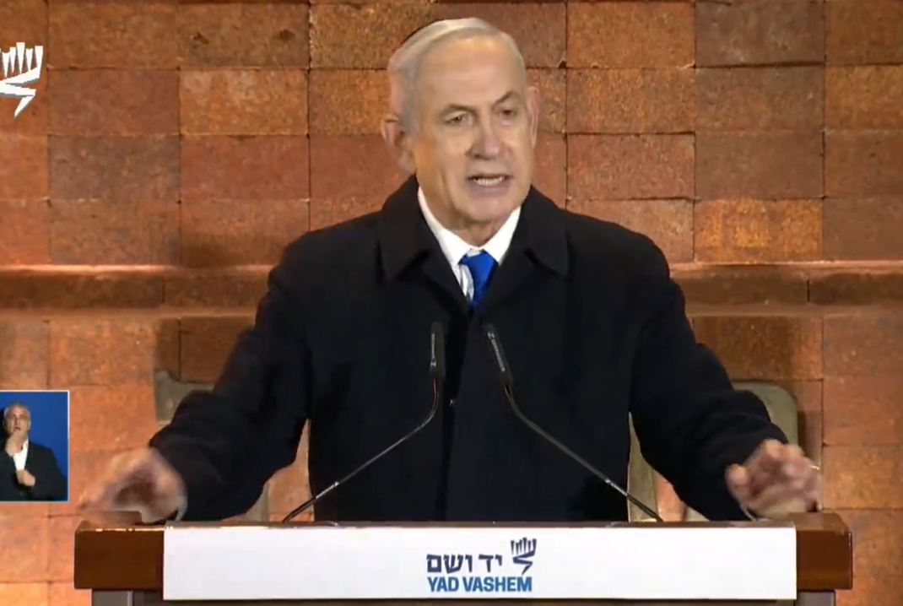
Notes:
https://twitter.com/i/status/1787215056243175779

Slide 61
^{Thillim/Ps 122.6-9} Pray for shalom in Yerushalayim; may those who love you prosper. May shalom be within your ramparts, prosperity in your palaces. For the sake of my family and friends, I say, “Shalom be within you!” For the sake of the house of Adonai our God, I will seek your well-being.

Slide 63
Jerusalem Our Mother
The scripture
The Analysis [exposition]
Living it for Jerusalem
Living it for Mothers
A final note of victory

Slide 64

Dr Dobson’s “Help for Busy Moms”
With Rob and Dianne Parsons
Notes:
UK extension of Focus on the Family

Slide 65
We were sat around a table similar to this and a young lawyer woman said to me, "Hi, Di, how are you? Do you work?" And I just wanted the floor to open up and swallow her. And I can remember thinking, "Well, do I work? I know that I have two children that are totally dependent on me,
Notes:
https://familytalk.widen.net/view/pdf/rjqubivzq9/05092024HELPFORBUSYMOMS1.pdf?t.download=true&u=o5dst7

Slide 66
and I know that the hours I put in are probably a lot longer than the hours that she puts in.” But I can remember muttering back, “I'm just a mum at home with children.”
But somebody gave me something years later, and I have some sympathy with the woman who wrote this:
Notes:
https://familytalk.widen.net/view/pdf/rjqubivzq9/05092024HELPFORBUSYMOMS1.pdf?t.download=true&u=o5dst7

Slide 67
“Yes, I do work. I'm in a Program of Social Development and at present I’m working with three age groups. First with babies and toddlers, that involves a basic grasp of medicine and child psychology. Next, I'm working with teenagers, and I confess the program is not going too well in that area at the moment,
Notes:
https://familytalk.widen.net/view/pdf/rjqubivzq9/05092024HELPFORBUSYMOMS1.pdf?t.download=true&u=o5dst7

Slide 68
and finally, it's evenings and weekends. I work with a man, aged 39, who's exhibiting all the classic symptoms of midlife crisis. That's mainly psychiatric work. The whole job involves planning and a make-it-happen attitude, and the ability to crisis manage. I used to be an international fashion model, but I got bored.
Notes:
https://familytalk.widen.net/view/pdf/rjqubivzq9/05092024HELPFORBUSYMOMS1.pdf?t.download=true&u=o5dst7

Slide 69
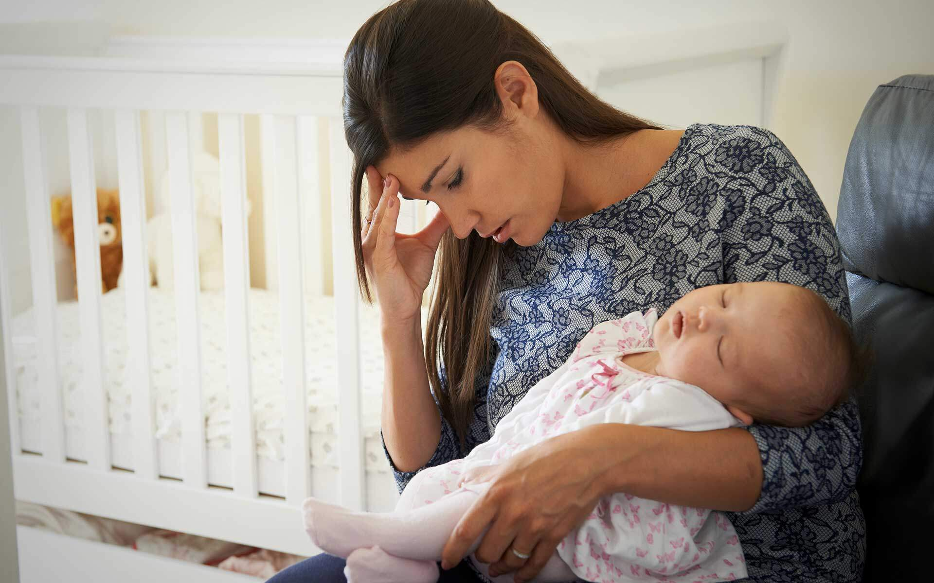

Slide 70
^{Mishlei/Prov 1.7-9} The fear of Adoni is the beginning of knowledge, but fools despise wisdom and discipline. My son, heed the discipline of your father, and do not abandon the teaching [Torah] of your mother; they will be a garland to grace your head,
a medal of honor for your neck.

Slide 71

^{Mishlei/Prov 4.3} I too was a son to my father, still tender, and cherished by my mother.
רַךְ soft; tender, young, immature
Notes:
Stern: and my mother, too, thought of me as her special darling.

Slide 72
^{Mishlei/Prov 6.20-22} Don’t abandon your mother’s teaching. Bind them always on your heart, tie them around your neck. When you walk, they will lead you; when you lie down, they will watch over you; and when you wake up, they will talk with you.

Slide 73
^{Mishlei/Prov 10.1} A wise son is a joy to his father, but a foolish son is a grief to his mother.

Slide 74
^{Mishlei/Prov 15.20} A wise son is a joy to his father, and only a fool despises his mother.

Slide 75
The verse that describes how God took us out of Egypt is in Exodus 19:4:
אַתֶּם רְאִיתֶם, אֲשֶׁר עָשִׂיתִי לְמִצְרָיִם; וָאֶשָּׂא אֶתְכֶם עַל-כַּנְפֵי נְשָׁרִים, וָאָבִא אֶתְכֶם אֵלָי
You have seen what I did unto the Egyptians, and how I bore you on eagles’ wings, and brought you unto Myself.
Notes:
Many ask us for permission to redistribute our newsletters. By all means, please do feel free to forward this newsletter to anyone you wish!
http://www.ulpanor.com/

Slide 76
Each year, we are told to relive the experience of leaving Egypt, being lifted from slavery and oppression “on the wings of eagles”.
Based on the Midrash, Torah commentator Rashi explains that the mother eagle’s wings represent the nature of God’s protection over us.
Notes:
Many ask us for permission to redistribute our newsletters. By all means, please do feel free to forward this newsletter to anyone you wish!
http://www.ulpanor.com/

Slide 77
The eagle is unique.
While other birds carry their young in their talons because they fear of other birds of prey that soar above them, the mother eagle carries its young on its wings.
Notes:
Many ask us for permission to redistribute our newsletters. By all means, please do feel free to forward this newsletter to anyone you wish!
http://www.ulpanor.com/

Slide 78
As the bird that flies higher than any other, it has no fear of attack from above. All it fears are the arrows of man from below. This is how God protects us. We cling to Him, safe in the knowledge that we are protected from above.
As a people, under God’s protection, we have defied all of the laws of history, but our enemies do not stop trying...
Notes:
Many ask us for permission to redistribute our newsletters. By all means, please do feel free to forward this newsletter to anyone you wish!
http://www.ulpanor.com/

Slide 79
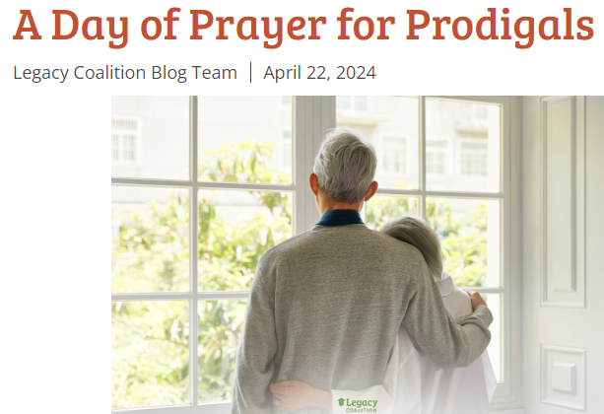

Slide 80
It was June 2nd several years ago.
Eighteen of us made a large circle in our Florida room. We each shared why we had come—a brief overview of our journey with a prodigal.

Slide 81
It was June 2nd several years ago.
Eighteen of us made a large circle in our Florida room. We each shared why we had come—a brief overview of our journey with a prodigal.

Slide 82
We had all come to the only place we thought offered any answers: on our knees. At first, our prayers were tentative—were these people safe? But then honesty, vulnerability, and tears opened our hearts. We connected at that throne of grace, petitioning our God for each other, for the many who requested prayer, for our own loved ones, and for ourselves.

Slide 83
In the end, we recognized that our prayers were as much for ourselves as for our loved wanderers. And we acknowledged that loving a prodigal was indeed a wilderness journey, but each beloved prodigal was a gift, a true treasure to make us more and more like Yeshua. Gratitude filled us even as tears flowed.
And now, June 2nd is coming again: time for the Worldwide Prodigal Prayer Day.

Slide 84
For us, Shabbat, June 1 our afternoon study will be prayer for prodigals.

Slide 86
Jerusalem Our Mother
The scripture
The Analysis [exposition]
Living it for Jerusalem
Living it for Mothers
A final note of victory

Slide 87
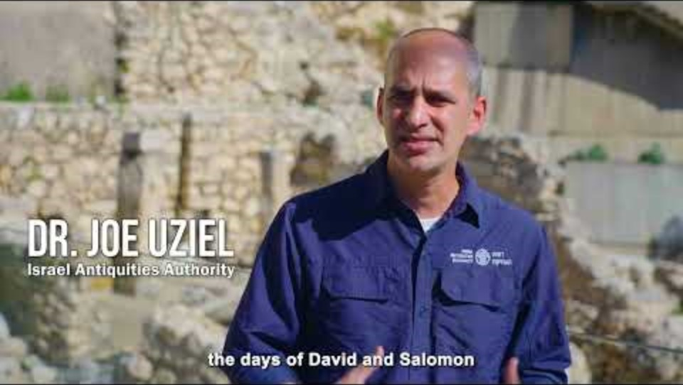
Notes:
https://youtu.be/kZU0H_4cH0k

Slide 88
Do you KNOW Yeshua and drinking the water of LIFE?
Are you hearing daily from His Word?
How are you applying what you heard?
Are you offering that water of life to anyone?

Slide 89
Mothers gather in for a blessing.

