Slide 1
e-handout
To have these notes
without taking notes
Go to OrHaOlam.com
Click on Messages tab,
2024 Messages

Slide 2
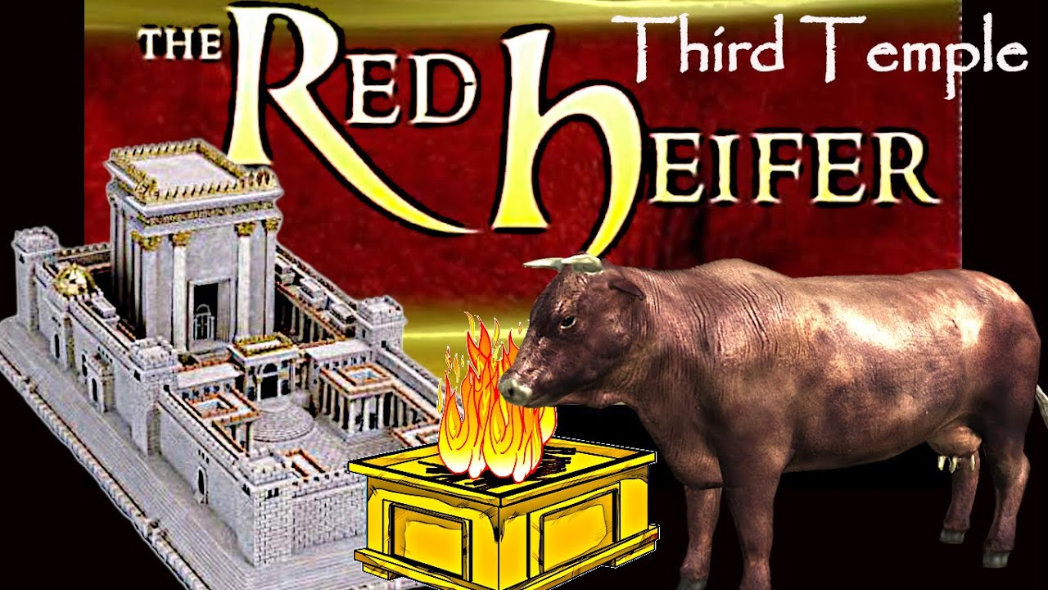
Notes:
https://external-content.duckduckgo.com/iu/?u=https%3A%2F%2Fi.ytimg.com%2Fvi%2FNCM8kuLWd1I%2Fmaxresdefault.jpg&f=1&nofb=1&ipt=9bb81b9a72edff78a39f7185add468ab11524b3f7c6f3823729c0d2ea75dffad&ipo=images

Slide 3
How do you describe a red heifer with three white hairs?

Slide 4
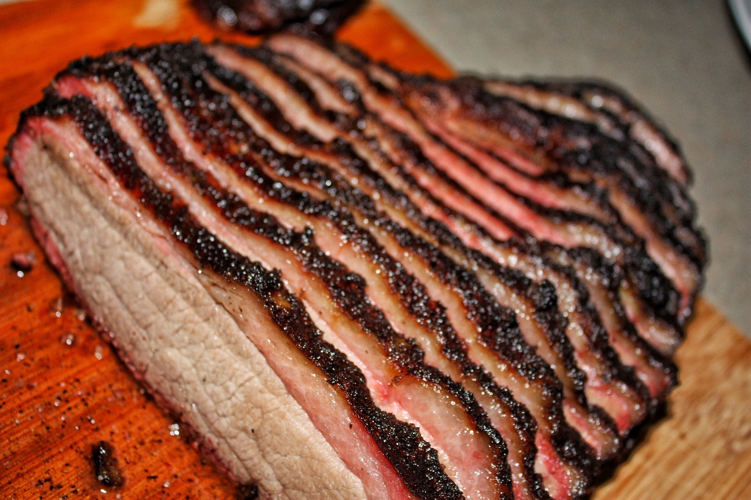
How do you describe a red heifer with three white hairs?
A brisket.

Slide 5
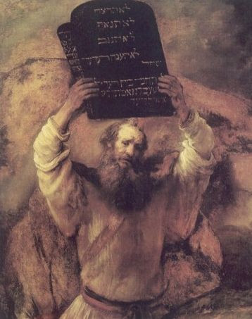
In Rembrandt's painting Moses is depicted holding rounded tablets aloft.
Notes:
https://ci3.googleusercontent.com/meips/ADKq_NaugP9CYeyoRI8MBQ6OgUWImdg04HYRX44I4zHgllXJutm7BtcZmw7436s9y1Kjm5T0a-X2ydG18cL2UYGzAlaIScIDCOLVHFWLUZcyDXedU4obQRX0C6qf3ra2Cnb57InT7k0qwmrpwEC3uBgYkCSmHg=s0-d-e1-ft#http://staticapp.icpsc.com/icp/resources/mogile/113437/952f685b0ba1021768ec133168345a86.jpeg

Slide 6
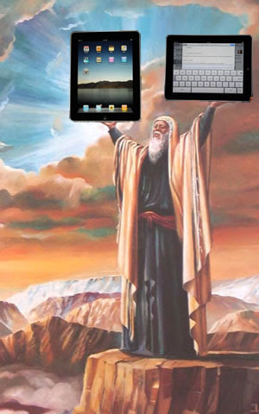
The truth…

Slide 7


Slide 8

Tools for the Trade
What is a father?
What does a father do?
War on masculinity
Tools for the trade

Slide 9
Tools for the Trade
What is a father?
What does a father do?
War on masculinity
Tools for the trade

Slide 11
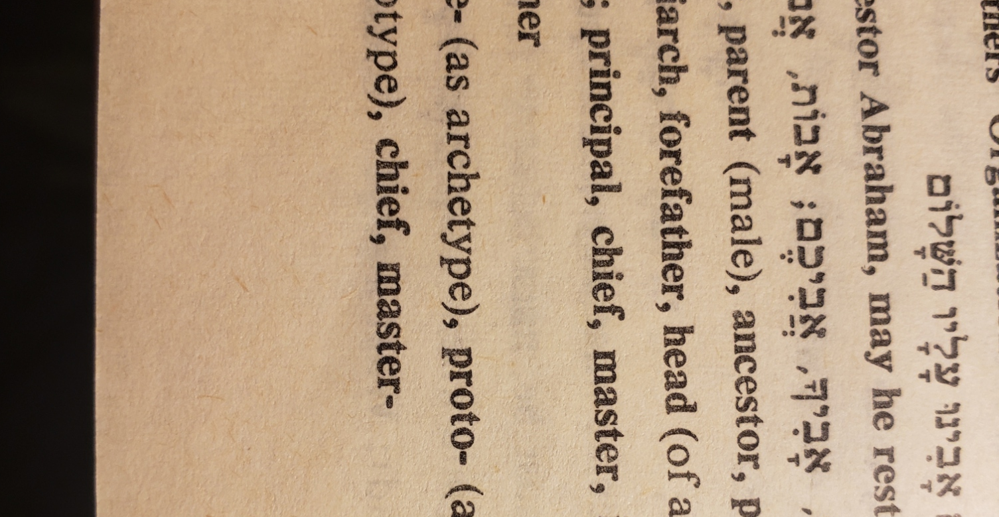
Notes:
a father is the beginning, the source. For example in Hebrew syntax…

Slide 12
אֲבִיגַיִל Avigail Abigail
Source of joy
Notes:
She’s not the father of the joy.

Slide 13
אַבְשָׁלוֹם Avshalom
Source of peace
Notes:
He’s not the father of the shalom.

Slide 14
^{Eph 6.4} Fathers, don’t irritate your children and make them resentful; instead, raise them with the Lord’s kind of discipline and guidance.
Notes:
A father is the source of discipline and guidance

Slide 15
^{2 Cor. 12.14} I will not be a burden to you; for it is not what you own that I want, but you! Children are not supposed to save up for their parents, but parents for their children.
Notes:
A father is the source of financial and other resources.

Slide 16
^{1 Cor 16.13-14} Stay alert, stand firm in the faith, behave like a mentsh, grow strong. Let everything you do be done in love.

Slide 17
Mensch (Yiddish:מענטש mentsh), from Middle High German Mensch, means "a person of integrity and honor". A particularly good person, a person with the qualities one would hope for in a friend or trusted colleague.
Notes:
Wikipedia
Menches, Menchy
https://www.merriam-webster.com/dictionary/mensches
Jonah is a mensch for engaging constructively with his critics.—Ed Yong, Discover Magazine, 31 Mar. 2012
Pray for a menschy congregation.

Slide 18
^{1 Cor 16.13-14} Stay alert, stand firm in the faith, behave like a mentsh, grow strong. Let everything you do be done in love.
Notes:
a father is the source of strength, faith, love.

Slide 19
^{Mishlei/Prov 19.14} House and wealth are an inheritance from fathers, but a prudent wife is from Adoni.

Slide 20
What is a father?
A father is a source

Slide 21
What is a father?
A father is a source
Of life

Slide 22
What is a father?
A father is a source
Of life
Of joy and love
Notes:
Puns, Dad jokes, silly stories. Requested

Slide 23
What is a father?
A father is a source
Of life
Of joy and love
Of money

Slide 24
What is a father?
A father is a source
Of life
Of joy and love
Of money
Of wisdom (+)

Slide 25
What is a father?
A father is a source
Of life
Of joy and love
Of money
Of wisdom (+)
Of correction (-)

Slide 26
The Heavenly Father is the Source of all.
Yeshua restores all that we lose by our sins.

Slide 27
The Heavenly Father is the Source of all.
Yeshua restores all that we lose by our sins.
Dads MUST be richly receiving from the Heavenly Father through the Son and Ruakh.
Notes:
If you don’t have that, you have NOTHING to offer.

Slide 29
Tools for the Trade
What is a father?
What does a father do?
War on masculinity
Tools for the trade

Slide 30
What does a father do?
Meets needs
Solve problems
Fixes everything

Slide 31
We have two things, humanly, in our “spiritual inventory” of tools.
Integrity
Love
Notes:
1. honesty, sexual purity
2. Love means giving
Holy Spirit makes these real to people.
Erwin Lutzer had an amazing message on fatherhood.

Slide 32
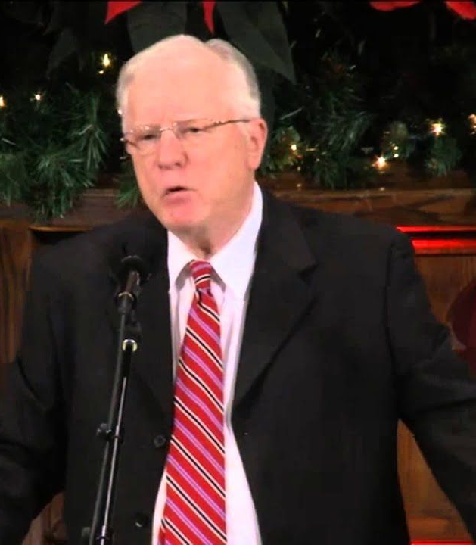
Erwin Lutzer
Pastor Moody Bible Church 1980-2016
Radio speaker
70 books
Notes:
https://external-content.duckduckgo.com/iu/?u=https%3A%2F%2Fi.pinimg.com%2Foriginals%2Fb7%2F61%2F01%2Fb76101b84c1ecb7960f9fa644ac3385b.jpg&f=1&nofb=1&ipt=5ff11aa3df2a97ef06bcf49a02db972c138e9ecce6c813b3b20836c55af20127&ipo=images

Slide 33
Dr. Lutzer, on Focus on the Family radio, was describing talking to his daughter about the MOST important thing to her in his life and ministry.

Slide 34
His daughter said the most significant thing was his practice of apologizing when he was wrong.

Slide 35
We have two things, humanly, in our “inventory” of tools.
Integrity
Love
Notes:
1. honesty, sexual purity
2. Love means giving
Holy Spirit makes these real to people.

Slide 36

Tiger parenting is a form of strict parenting, whereby parents are highly invested in ensuring their children's success, push their children to attain high levels of achievement or success.
Notes:
Several cultures are perfectionist like this. Asians and Jews.
https://external-content.duckduckgo.com/iu/?u=http%3A%2F%2Fwww.8asians.com%2Fwp-content%2Fuploads%2F2011%2F01%2F1.31.11.jpg&f=1&nofb=1&ipt=abea2171279d909d2a15b9a2213dabf9785e3831c6754b0a87dc1466592ba4e4&ipo=images

Slide 37
^{Yn 17.22-23} The glory that You have given to Me I have given to them, that they may be one just as We are one— I in them and You in Me—that they may be perfected in unity, so that the world may know that You sent Me and loved them as You loved Me.
Notes:
Bigger than perfected music, magnificent vocals, instrumentation, technol, sound, lights, dance
Heard of sloppy agape? Shoddy job but love will cover.
I’ve got all the obsessiveness of Tiger Mom. Likely damaged my kids with it.
Nevertheless, this agape is the ONE thing we MUST have.

Slide 38
What if the love and unity breaks?
Notes:
What is a Dad’s responsibility?

Slide 39
^{Gal 6.1-2} Brothers, suppose someone is caught doing something wrong. You who have the Spirit should set him right, but in a spirit of humility, keeping an eye on yourselves so that you won’t be tempted too.

Slide 40
^{Matt 18.15-16} “Moreover, if your brother commits a sin against you, go and show him his fault — but privately, just between the two of you. If he listens to you, you have won back your brother.

Slide 41
^{Matt 18.15-16} If he doesn’t listen, take one or two others with you so that every accusation can be supported by the testimony of two or three witnesses.
Notes:
That has been one of my main roles in the 29 years of Or HaOlam. 1995 till 2024. One of the one or two more. Often G-d breaks through with great reconciliation. Lasting reconciliation.
I’m still available and love it. But there is an attitudinal requirement.

Slide 42
^{1 Cor 13.4-5} Love is patient and kind, not jealous, not boastful, not proud, rude or selfish, not easily angered.

Slide 43

makrothyméō – properly, long-tempered (to defer anger), refusing to retaliate with anger, because of human reasoning.

Slide 44
makrothyméō – [The literal sense if the term is “extending a long time (way).”]
Notes:
https://biblehub.com/greek/3114.htm
Love hurts.

Slide 45
^{Gal 6.1-2} Bear one another’s burdens — in this way you will be fulfilling the Torah’s true meaning, which the Messiah upholds.

Slide 46
Isn’t it painful to do this reconciliation?

Slide 47
Isn’t it painful to do this reconciliation?
Love suffers.
Love suffers long.
Love suffers long, and is kind.
Notes:
A new thing this year more than previously.
We have a Mt 18.16 sweet resolution. Maybe not what we expected going in, but the Ruakh melts and does. Halleluyah. I bask in the glow and gratitude of it. Then some days later I am told…that’s not what I meant. Not happy.
The resolution that was there a day or two later isn’t there. I’ve taken to asking, at the close of reconciliation meetings, when I remember, “now you mean this? You won’t tell me…”

Slide 48
^{Matt 24.10-12} And then many will fall away and will betray one another and hate one other. Many false prophets will arise and lead many astray. Because lawlessness will multiply, the love of many will grow cold.
Notes:
Because the culture is so vile, people more easily offended.
Rise up and love with longsuffering.
“Man up!”

Slide 50
Tools for the Trade
What is a father?
What does a father do?
War on masculinity
Tools for the trade

Slide 51
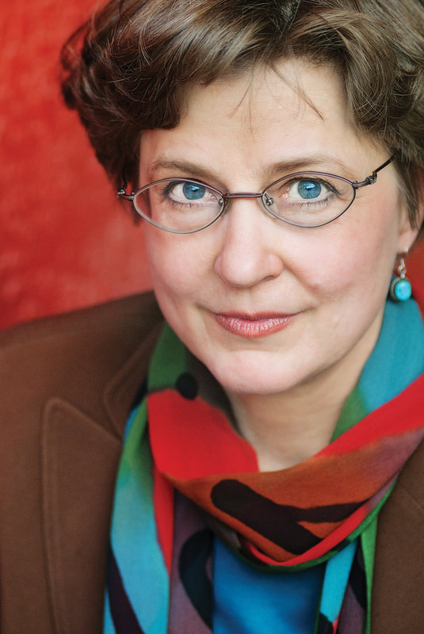
Nancy Pearcey is professor and scholar in residence at Houston Christian University. She has been quoted in The New Yorker and Newsweek, highlighted as one of the five top women apologists by Christianity Today, and hailed in The Economist as "America's pre-eminent evangelical Protestant female intellectual."

Slide 52
Born into a culturally Lutheran family, Nancy Pearcey expected for someone to be able to answer this question of the basis of faith. However, that was not the case. Today on Family Talk, Roger Marsh discusses with Nancy how this deep-seated personal search for truth

Slide 53
set her feet upon a path that would lead her to research that not only proves the Bible faith is true, but that without it, our society spirals out of control. They also discuss Nancy’s latest book, The Toxic War on Masculinity, and the origins of culture’s warped view of men.

Slide 54


Slide 55
She ended up at L’Abri in 1971 with all those hippies, under Francis and Edith Schaeffer in Switzerland. Part of the “Jesus Revolution.”
Found people who could rationally defend the faith and the scriptures.
Notes:
Edith Schaeffer who wrote a book, “Christianity is Jewish.”

Slide 56
In our culture today, it seems like there is and active vendetta against men and masculinity.
Washington Post article: “Why Can’t we Hate Men?”
Book: “Are Men Necessary?”

Slide 57
James Cameron, director of Avatar, wrote, “Talking about healthy masculinity is like talking about healthy cancer.” “Testosterone is a toxin. You have to work it out of your system.”

Slide 58
Betty Friedan, feminist of the 70’s said, “A woman without a man is like a dog without a bicycle.”

Slide 59
Feminism didn’t really start in the 1970’s. Before the Industrial Revolution men worked alongside the wives and children in the farm or trade. Sons were apprentices. “The concept of masculine virtue was duty to God and man,” according to secular writers.

Slide 60
In 1842 an article in a magazine called Parents said, “The greatest cause of domestic sorrow today is father absence. The father’s working late and early.”
Notes:
1842!!

Slide 61
The pandemic was a game changer. Harvard study: 68% of fathers said they got closer to their children, and don’t want to lose that.”
Quotes from CEOs “We did not see any decrease in productivity during the pandemic.”
Notes:
However, lots of initiatives…

Slide 62
1972 Title IX, 1994 Gender Equality Act.
Men are falling behind: higher suicide, drug and alcohol addiction, homelessness, mental illness. Great Depression era levels,

Slide 63
College is now 60% female, 40% male.
Some colleges are starting football teams just to recruit boys.

Slide 64
There was an article in the British newspaper the Guardian “Women are not finding good men.”
Notes:
Marriageable men are scarce.

Slide 65
Secularism has produced a more toxic form of masculinity. Darwinian writers say the men who won out on survival were ruthless, brutal savate, barbarian, and predatory.
A best selling book Moral Animal “Giving men a book on marriage is like giving a booklet to Vikings on how not to pillage.”

Slide 67
The rest of the story…

Slide 68
There have been sociological studies showing that Bible believing men who attend service regularly test out as the best husbands and fathers. I quote some dozen …studies…the most loving, engaged husbands and fathers.

Slide 69
Their wives are tested separately…the happiest the way their husbands treat them. Evangelical men spend more time with their children than any other group. 3.5 hrs/week more than secular men. 35% lower divorce than secular men.

Slide 70
Lowest rate of domestic abuse and violence.
In the NY Times, “The happiest of all wives in America are religious conservatives.” Fully 73% of women who hold conservative gender values and attend services regularly with their husbands have high quality marriages.

Slide 71
Haven’t we all heard that believer’s divorce at the same rate as the Western Culture?
Researchers then separated out the nominal believers. Nominal believers wives report the lowest level of happiness. Higher divorce than seculars.

Slide 72
Nominal believers have 20% higher divorce than seculars, and the highest rate of domestic violence and abuse.

Slide 74
The nominal believer will take religious justification for the mistreatment of their family.
Men are just bigger, stronger, faster, and because of testosterone, they’re more aggressive and risk taking. And…that is good. Creationally.
Notes:
Whenever someone has to quote to his wife, “Submit,” he’s lost it. Public dad and private dad. Knuckle fist.

Slide 75
Nominal believer men are worse than secular men. Often the woman is blamed.
Kindness is weakness to a bully. Consider Hamas.
Loving confrontation. Mat 18
Preach on abuse an perversion. You don’t know who or where.

Slide 76
Tendency is to give roses to the mothers, and exhort / scold the men. Encourage our men!

Slide 77
Nancy Pearcey professor and scholar in residence at Houston Christian University.

Slide 78
^{Gal 6.1-2} Bear one another’s burdens — in this way you will be fulfilling the Torah’s true meaning, which the Messiah upholds.

Slide 79
Isn’t it painful to do this reconciliation?

Slide 80
Isn’t it painful to do this reconciliation?
Love suffers.
Love suffers long.
Love suffers long, and is kind.
Notes:
Men, let’s lead the way.

Slide 81
^{Matt 24.10-12} And then many will fall away and will betray one another and hate one other. Many false prophets will arise and lead many astray. Because lawlessness will multiply, the love of many will grow cold.
But….not us!
Notes:
Because the culture is so vile, people more easily offended.

Slide 83
Tools for the Trade
What is a father?
What does a father do?
War on masculinity
Tools for the trade

Slide 84
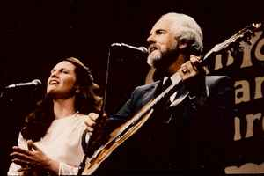
Steve & Annie Chapman
1986

Slide 85
If you are a father, you are a builder
And your children will become what you've made
Please do your best and please don't forget
God gave you the tools for the trade

Slide 86
He gave you eyes to see where your child might go wrong
And feet to lead them safely through
Hands to hold their hands
And lips to say "I love you"

Slide 87
He gave you arms to hold them
When they are afraid
And time to wait until they’re calm
Ears to hear between their lines
And tears to cry when they’re gone

Slide 88
And your knees are for playing
And they're also for praying
That god will watch over the child
And in those times when you can't say it
But they still need to hear it
You can say "I love you" with your smile

Slide 89
If you are a father, you are a builder
And your children will become what you've made
Please do your best
And please don't forget
God gave you the tools for the trade

Slide 91
Tools for the Trade
What is a father?
What does a father do?
War on masculinity
Tools for the trade

Slide 92
Do you KNOW Yeshua and the assurance of sins forgiven?
Are you hearing daily from His Word?
How are you applying what you heard?
Are you asking this of another?
Notes:
Who are you discipling, building up?4

Slide 93
Prayer point 1 Restoration of Fatherhood as promised:
^{Malakhi 3.23-24} Look, I will send to you Eliyahu the prophet before the coming of the great and terrible Day of Adoni.

Slide 94
^{Malakhi 3.23-24} He will turn the hearts of the fathers to the children and the hearts of the children to their fathers; otherwise I will come and strike the land with complete destruction.”

Slide 95
Prayer point 2 Defense of Israel
^{T’hillim/Ps 83.17,19} Fill their faces with shame, so that they will seek your name, Adoni… Let them know that you alone, whose name is Adoni, are the Most High over all the earth.

