Slide 1
e-handout
To have these notes
without taking notes
Go to OrHaOlam.com
Click on Messages tab,
2024 Messages

Slide 2
My three new friends when I was down for several days with viral bronchitis…

Slide 3
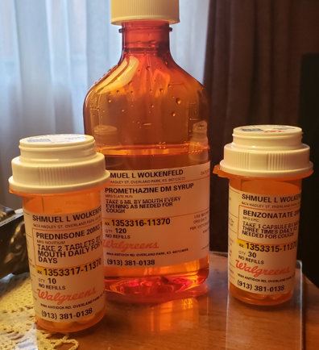
Prednisone, promethazine, benzonatate.
That's the team the doctor said, is really great.
Prednisone, benzonatate, promethazine.
For viral bronchitis, it’s really mean.
Notes:
Thanks for praying for my speedy recovery.

Slide 4
A Shabbat school teacher asked her little children as they were on their way to the service, “Why is it necessary to be quiet in service?”

Slide 5
A Shabbat school teacher asked her little children as they were on their way to the service, “Why is it necessary to be quiet in service?”
One bright little girl replied, ‘Because people are sleeping.’
Notes:
Vicki Kline?

Slide 6
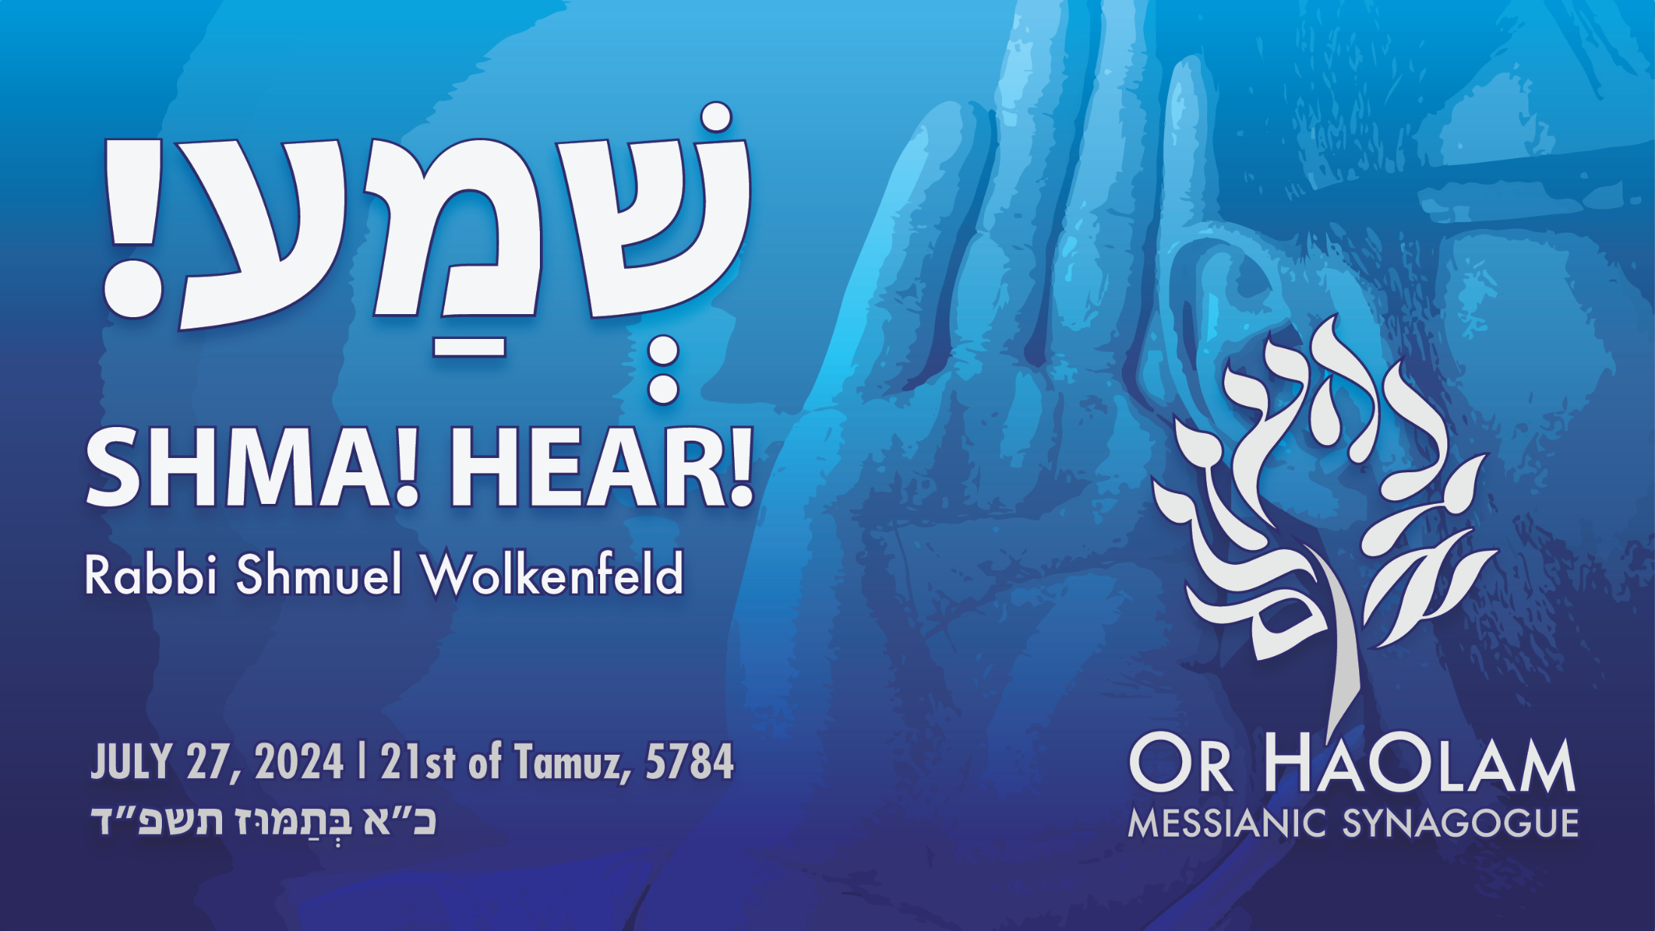

Slide 7
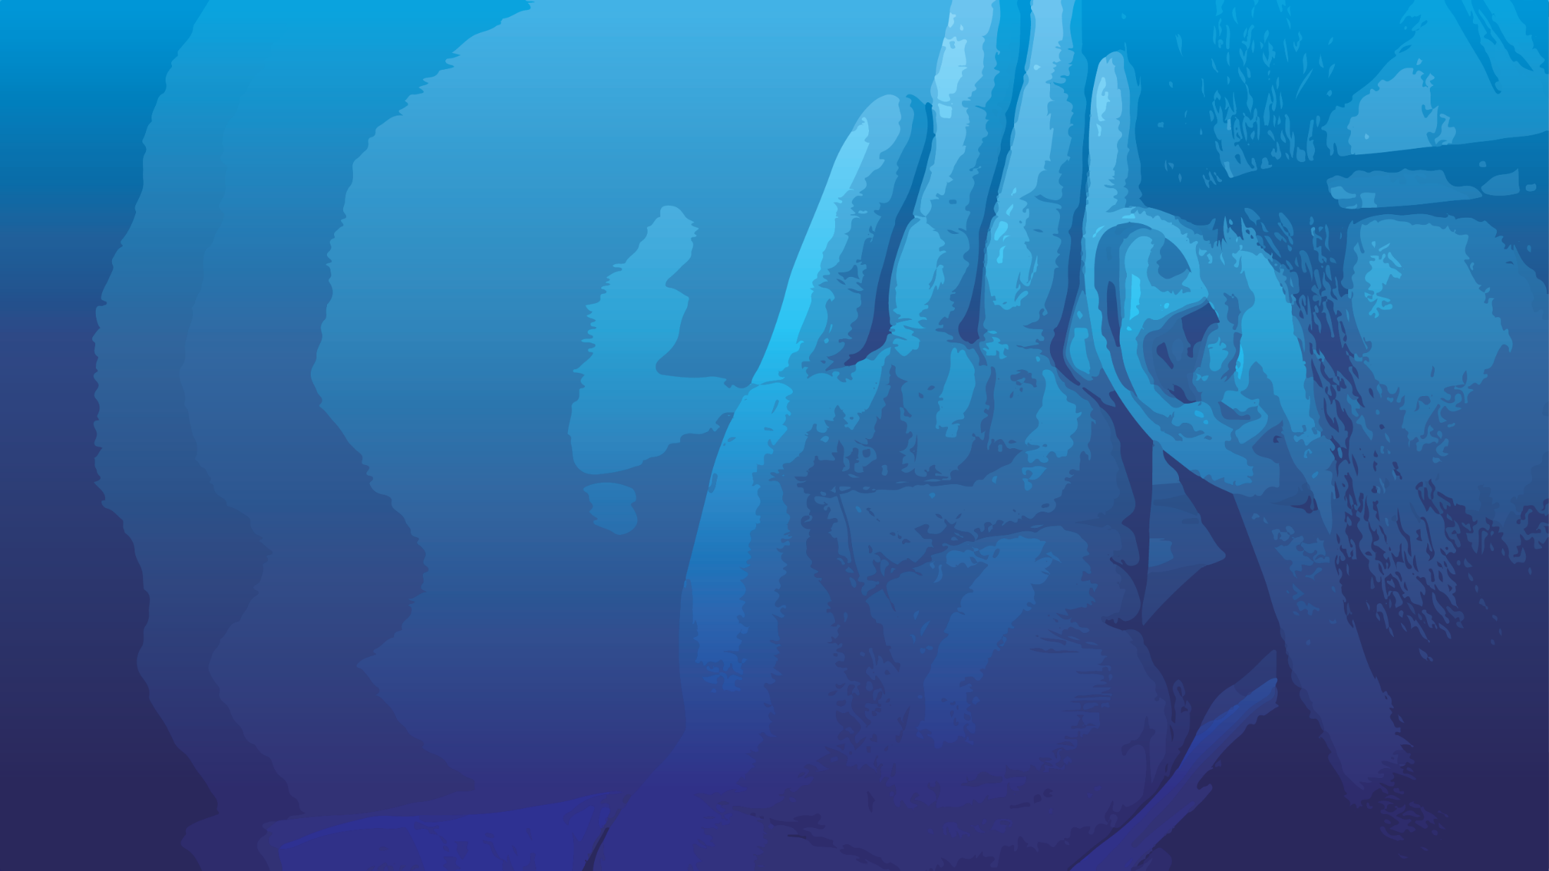
!שְׁמַעShma! Hear!
The command
How to hear G-d: Word, Ruakh
How to hear people
How Israelis and Palestinians can hear each other.
Takeaway: Hear G-d and someone

Slide 8
!שְׁמַעShma! Hear!
The command
How to hear G-d: Word, Ruakh
How to hear people
How Israelis and Palestinians can hear each other.
Takeaway: Hear G-d and someone

Slide 9
^{Mark 12.28-30} One of the Torah-teachers came up and heard them engaged in this discussion. Seeing that Yeshua answered them well, he asked him, “Which is the most important mitzvah of them all?” Yeshua answered, “The most important is

Slide 10
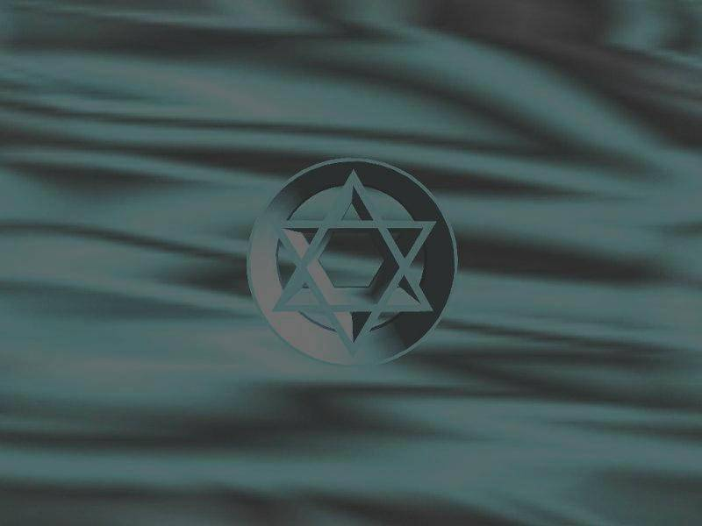
שְׁמַע יִשְׂרָאֵל
יְיָ אֱלהֵינוּ יְיָ אֶחָד
Sh’ma Yees-ra-ayl
Ah-do-ni E-lo-hay-nu
Ah-do-ni eh-khad
בָּרוּךְ שֵׁם כְּבוֹד מַלְכוּתוֹ לְעוֹלָם וָעֶד
Ba-rukh shaym k’vod Mal-khu-to l’o-lam va-ed

Slide 11
^{Mark 12.28-30} Hear, שְׁמַע Shema O Isra’el, Adoni our God, Adoni is one, and you are to love Adoni your God with all your heart, with all your soul, with all your understanding and with all your strength.’ The second is this: ‘You are to love your neighbor as yourself.’ There is no other mitzvah greater than these.”
Notes:
Yeshua was quoting, and slightly augmenting, Dvarim 6.4

Slide 12
Observant Jews consider the Shema to be the most important part of the prayer service in Judaism, and its twice-daily recitation as a mitzvah (religious commandment). Also, it is traditional for Jews to say the Shema as their last words, and for parents to teach their children to say it before they go to sleep at night.
Notes:
https://en.wikipedia.org/wiki/Shema
I personally say the Shema nightly and in the morning. Reciting memorized scripture is the BEST way to overcome sleeplessness.

Slide 13
Literally, reciting the Shema was slated as “receiving the kingdom of heaven.”
Notes:
https://en.wikipedia.org/wiki/Shema

Slide 14
Before going to sleep, the first paragraph of the Shema is recited. This is not only a commandment directly given in the Bible (in Deuteronomy 6:6–7), but is also alluded to from verses such as "Commune with your own heart upon your bed" (Psalms 4:4).
Notes:
https://en.wikipedia.org/wiki/Shema

Slide 15
All flows from the assertion of the oneness of God's kingship. Thus, in the first portion, there is a command to love God with all one's heart, soul, and might, and to remember and teach these very important words to the children throughout the day.
Notes:
https://en.wikipedia.org/wiki/Shema

Slide 16
According to the Talmud, Rabbi Akiva patiently endured while his flesh was being torn with iron combs, and died reciting the Shema. He pronounced the last word of the sentence, Ekhad ("one") with his last breath.
Notes:
https://en.wikipedia.org/wiki/Shema

Slide 17
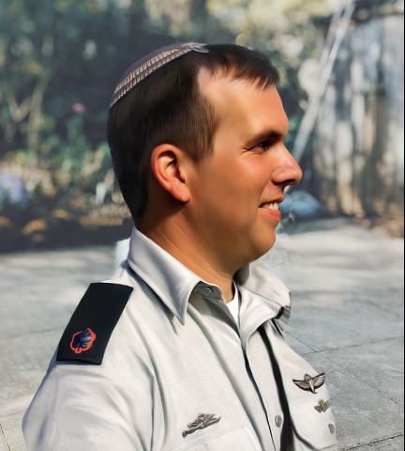
Roi Klein, a major in the Israel Defense Forces
Notes:
https://en.wikipedia.org/wiki/Shema

Slide 18
Since then, it has been traditional for Jews to say the Shema as their last words. In 2006 Roi Klein, a major in the Israel Defense Forces, said the Shema before jumping on a live grenade and dying to save his fellow soldiers.
Notes:
https://en.wikipedia.org/wiki/Shema

Slide 19
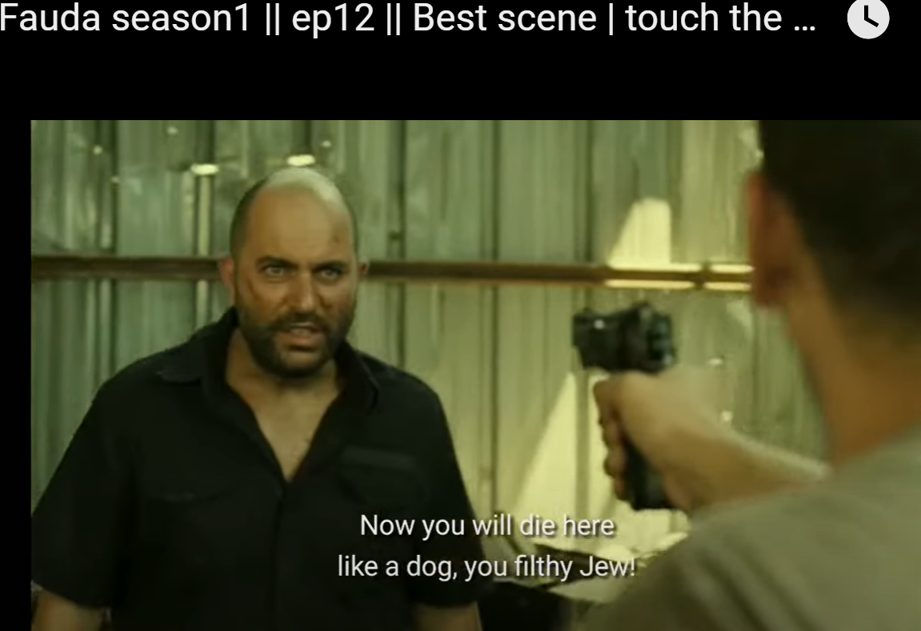
Notes:
https://www.youtube.com/watch?v=Zy6GTQedb9w
Note: the YouTube has more content than I recorded and showed in the synagogue. Violence and taking G-d’s Name in vain. I only showed .03 to .41
It tells the story of Doron, a commander in the Mista'arvim מסתערבים assimilate among the Arabs, in the first season, they pursue a Hamas arch-terrorist known as "The Panther". Doron thought the Panther was eliminated, but found out not. Doron was captured in the undercover operation…

Slide 20
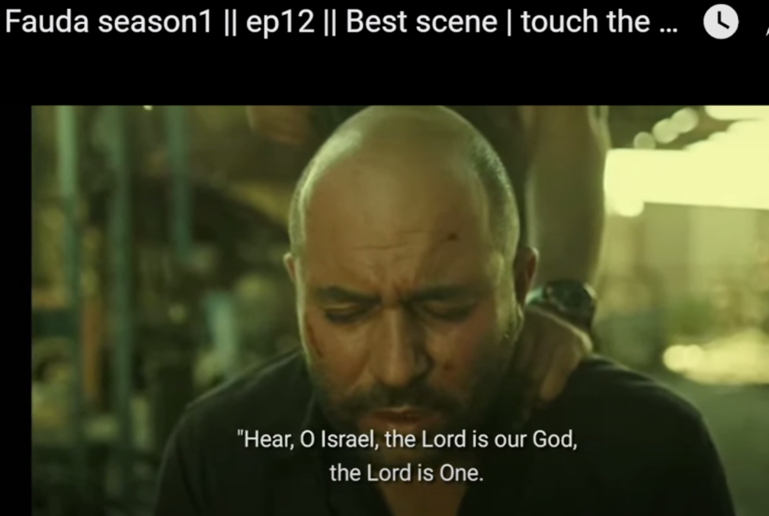

Slide 21
Generally, the Shma is taken as a command to hear and imbibe the concept of the Oneness of G-d. That is the primary interpretation, and the concept of G-d’s being אֶחָד Ekhad One has made the Jewish people the who they are,

Slide 22
the transformative influence in the world, and the culture into which Messiah Yeshua’s message of Divine salvation could be understood and launched. Hence Messiah Yeshua said it was the MOST important.

Slide 23
But there is another expository interpretation that I think the Ruakh has for us today.
Hearing…His Oneness, His nature, His voice.
Hearing…

Slide 25
!שְׁמַעShma! Hear!
The command
How to hear G-d: Word, Ruakh
How to hear people
How Israelis and Palestinians can hear each other.
Takeaway: Hear G-d and someone

Slide 26
Hearing from G-d by
His Word
His Ruakh
Notes:
Scriptural, right, reasonable, providential

Slide 27
^{Mark 12.28-30} Hear, O Isra’el, Adoni our God, Adoni is one.
Hearing Who He is.
Hearing His will.
Hearing His relational love for us.
Hearing other people.
Notes:
Through the Word, and through the Ruakh

Slide 28
^{Yn 14.22-24} Yeshua answered him, “If someone loves me, he will keep my word [all the Tanakh]; and my Father will love him, and we will come to him and make our home with him. Someone who doesn’t love me doesn’t keep my words — and the word you are hearing is not my own but that of the Father who sent me.
Notes:
We hear him, by reading, memorizing, studying, analyzing, loving His Word. All of it. Not just the parasha, not just the B’sorah, New Covenant. All of it!
With the Acts 15 etc. nuances for non-Jews, not excluded but invited, as FFOZ sorts it out.
Are we people of the Book? Title of the Jews. Hearing from His Ruakh while reading and DOING what we hear!

Slide 29
^{Yn 15.7-12} “If you remain united with me, and my words with you, then ask whatever you want, and it will happen for you. This is how my Father is glorified — in your bearing much fruit; this is how you will prove to be my talmidim.

Slide 30
^{Yn 15.7-12} “Just as my Father has loved me, I too have loved you; so stay in my love. If you keep my commands, you will stay in my love — just as I have kept my Father’s commands and stay in his love.

Slide 31
^{Yn 15.7-12} I have said this to you so that my joy may be in you, and your joy be complete. “This is my command: that you keep on loving each other just as I have loved you.

Slide 32
^{T’hillim 1.1-3} How blessed are those who reject the advice of the wicked, don’t stand on the way of sinners or sit where scoffers sit! Their delight is in Adoni’s Torah; in his Torah they meditate day and night.
Notes:
Billy Graham asked what he wished he’d done differently. “Read the Bible more.”

Slide 33
^{T’hillim 1.1-3} They are like trees planted by streams — they bear their fruit in season, their leaves never wither, everything they do succeeds.

Slide 34
^{Ro 10.17-18} So trust comes from what is heard, and what is heard comes by the word of G-d. “But, I say, isn’t it rather that they didn’t hear?” No, they did hear — “Their voice has gone out throughout the whole world and their words to the ends of the earth.”

Slide 35
^{Col 3.15-16} Let the shalom of Messiah rule in your hearts—to this shalom you were surely called in one body. Also be thankful. Let the word of Messiah dwell in you richly, teaching and admonishing one another with all wisdom in psalms and hymns and spiritual songs, singing with gratitude in your hearts to God.
Notes:
By the Word and by the Spirit of shalom as umpire. NEVER do anything, say anything, think anything that disrupts the shalom of Messiah.

Slide 36
^{Mt 13.9} He who has ears to hear, let him hear.
^{Mt. 13.43} Whoever has ears, let him hear!
Notes:
We can hear and not hear.
Sometimes I will re-read a section because I was reading with my eyes, but my heart and brain got distracted.

Slide 37
^{1 K 19.11-12} [Adoni] said [to Eliyahu], “Go outside, and stand on the mountain before Adoni”; and right then and there, Adoni went past. A mighty blast of wind tore the mountains apart and broke the rocks in pieces before Adoni, but Adoni was not in the wind.

Slide 38
^{1 K 19.11-12} After the wind came an earthquake, but Adoni was not in the earthquake. After the earthquake, fire broke out; but Adoni was not in the fire. And after the fire came a quiet, subdued voice.

Slide 39

דְּמָמָה silence, calm, stillness
Thin, lean, fine, delicate, sensitive דַּקָּה
Notes:
not rough, but gentle, more like whispering than roaring; something soft, easy, and musical
That is the kiss of the Ruakh.

Slide 40
^{Song of Songs 2.8} The voice of my lover! Here, he is coming.
Notes:
Do you have a sensitivity for the VOICE of His Love???

Slide 41
^{T’hillim 19. 8-15} The Torah of Adoni is perfect, restoring the soul. The testimony of Adoni is trustworthy, making the simple wise. The precepts of Adoni are right, giving joy to the heart. The mitzvot of Adoni are pure, giving light to the eyes. The fear of Adoni is clean, enduring forever.

Slide 42
^{T’hillim 19. 8-15} The judgments of Adoni are true and altogether righteous. They are more desirable than gold, yes, more than much pure gold!

Slide 43

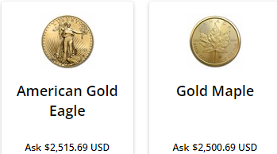

Slide 44
^{T’hillim 19. 8-15} They are sweeter than honey and drippings of the honeycomb. Moreover by them Your servant is warned.
Notes:
Told to have honey when bronchitis.

Slide 45
^{T’hillim 19. 8-15} In keeping them there is great reward. Who can discern his errors? Cleanse me of hidden faults. Also keep Your servant from willful sins. May they not have dominion over me. Then I will be blameless,

Slide 46
^{T’hillim 19. 8-15} free from great transgression. May the words of my mouth and the meditation of my heart be acceptable before You, Adoni, my Rock and my Redeemer.

Slide 47
Hearing from Him, by
His Word
His Ruakh
Notes:
Scriptural, right, reasonable, providential

Slide 48
Hear, then apply what you heard to your life, understanding, practice.
Are we a people who hear from G-d in Messiah Yeshua daily?

Slide 50
!שְׁמַעShma! Hear!
The command
How to hear G-d: Word, Ruakh
How to hear people
How Israelis and Palestinians can hear each other.
Takeaway: Hear G-d and someone
Notes:
Hearing well is the highest form of love. It honors the Oneness of G-d to hear and love people.
Therefore Messiah Yeshua made loving your neighbor ואהבת לרעך כמוך a corollary to loving G-d.

Slide 51
^{Yaakov 1.19-20} Know this, my dear brothers and sisters: let every person be quick to listen, slow to speak, and slow to anger, for human anger doesn’t produce the righteousness of God.
Notes:
I’m from the east coast, where we talk fast and interrupt a LOT. So in Bible school and since, I was convicted of this big time. WAIT and listen.
When I’m doing Mt 18.16 interventions, staying interruptions is a big deal.
That was the chaos of the first Trump Biden debate 4 years ago.
Who have you listened to today?

Slide 52
  ^{Mishlei/ Prov 17.27} One with knowledge restrains his words, and a discerning person stays calm.
  ^{Mishlei/ Prov 10.19} When words are many, sin is not lacking; so he who controls his speech is wise.

Slide 53
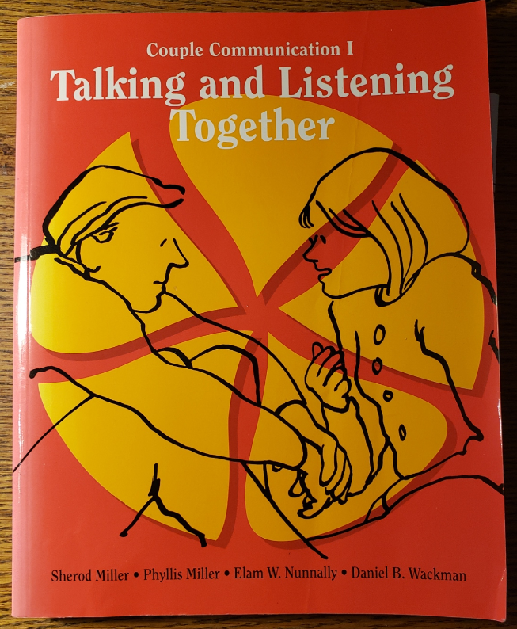

Slide 54
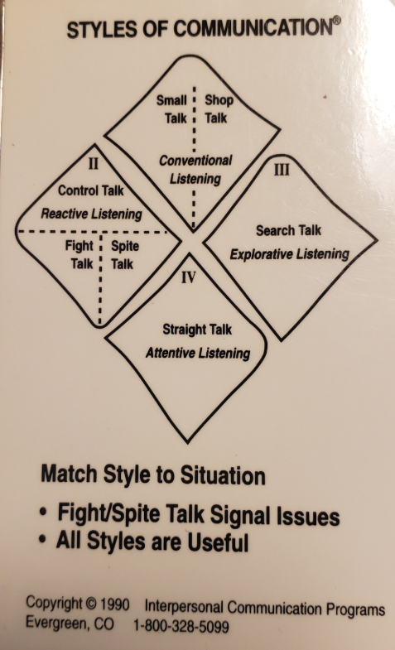

Slide 55
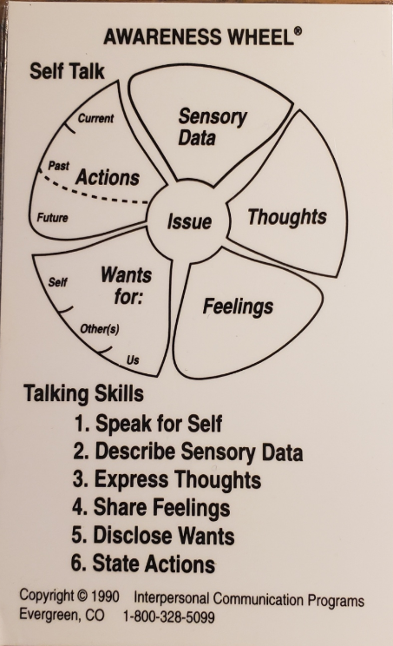
Notes:
I statements >> You statements

Slide 56
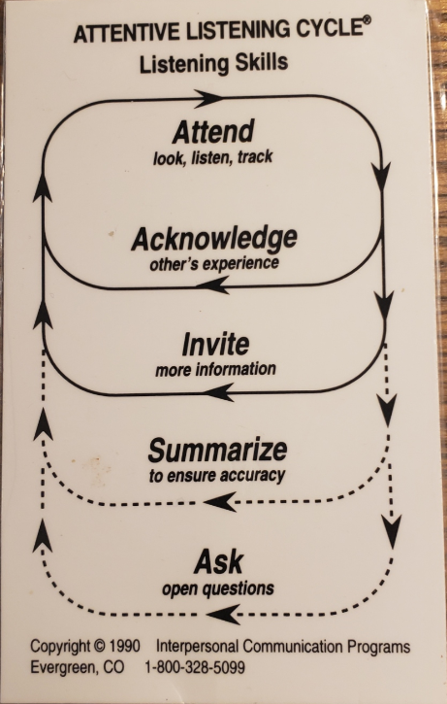

Slide 57
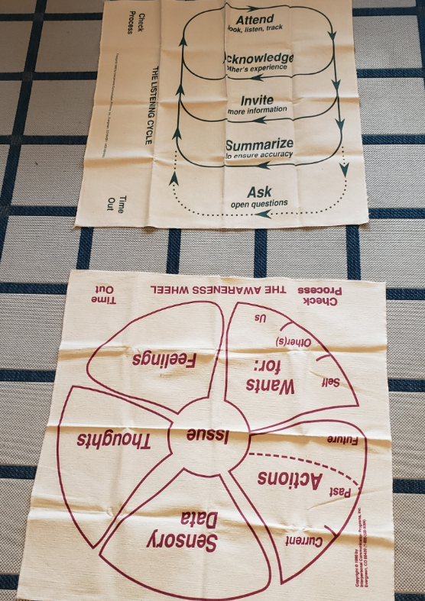

Slide 58
^{1 Cor 13 4-8} Love is patient and kind, not jealous, not boastful, not proud, rude or selfish, not easily angered, and it keeps no record of wrongs. Love does not gloat over other people’s sins but takes its delight in the truth. Love always bears up, always trusts, always hopes, always endures. Love never ends;

Slide 59
Great ideas of outreach/ Ingathering from our wonderful young adults.
Here is a radical idea: outreach by listening.
Disclaimer: Maybe this speaker takes it too far, but good concept.

Slide 60
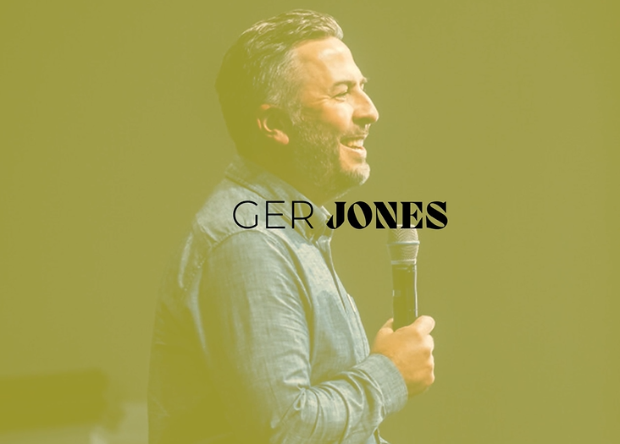
Notes:
https://vimeo.com/842351723/a8d40af5c8
From Barna
https://www.barna.com/about/
In its nearly 40-year history, Barna Group has conducted more than two million interviews over the course of thousands of studies, and has become a go-to source for insights about faith and culture, leadership and vocation, and generations. Barna Group has carefully and strategically tracked the role of faith in America, developing one of the nation’s most comprehensive databases of spiritual indicators.

Slide 61
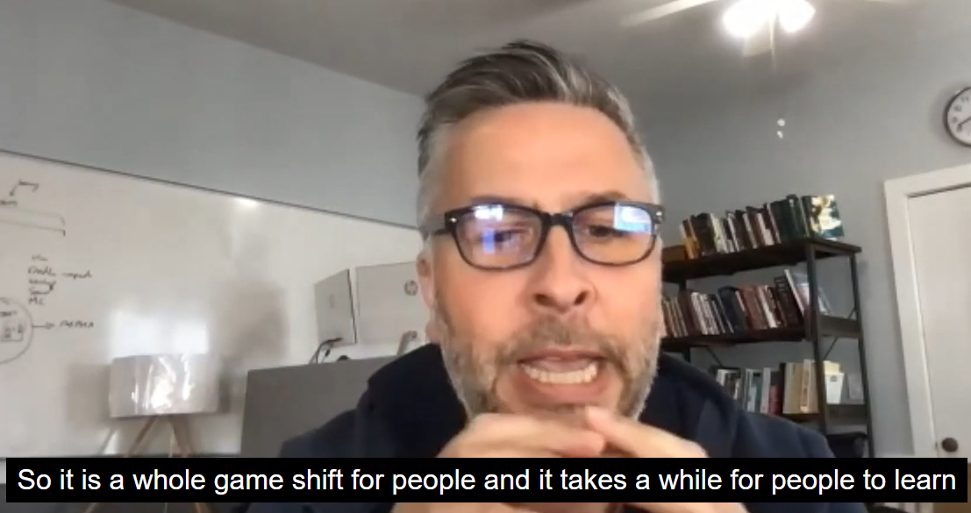

Slide 62
Conclusion: Listen to people. Hear their pain, their story.
Earn the right to speak.

Slide 63
Tim Gustafson, https://gustafsonconsulting.org/
Advises
Don’t teach, instruct, correct, judge, define, even give an opinion unless it’s 911, directly G-d led, or requested.
Notes:
I’m telling you my opinion by your request. Paid request!

Slide 64
^{Yn 17.23} I united with them and you with me, so that they may be completely one, and the world thus realize that you sent me, and that you have loved them just as you have loved me.

Slide 66
!שְׁמַעShma! Hear!
The command
How to hear G-d: Word, Ruakh
How to hear people
How Israelis and Palestinians can hear each other.
Takeaway: Hear G-d and someone

Slide 67
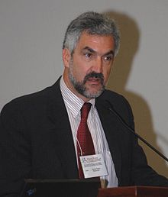
Daniel Pipes
Born 1949
Ph.D Harvard Islamic history
Fluent in Arabic

Slide 68


Slide 69
In the 1880s, the pattern was set, which made sense at the time, which was the people we now call Palestinians said to the Zionists, we hate you, get out of here. We want nothing to do with you, we want to kill you.
Notes:
https://www.meforum.org/65995/the-uniqueness-of-the-palestinian-israeli-conflict?goal=0_086cfd423c-74c0ec8863-33765913&mc_cid=74c0ec8863&mc_eid=2515d15785

Slide 70
And the Zionists, who were few in number and weak, said no, no, no, we have benefits to bring you. We're coming from the modern West. We'll bring clean water and ports and roads, and you'll gain economically.
Notes:
https://www.meforum.org/65995/the-uniqueness-of-the-palestinian-israeli-conflict?goal=0_086cfd423c-74c0ec8863-33765913&mc_cid=74c0ec8863&mc_eid=2515d15785

Slide 71
This made sense at the time when the Palestinians were far more powerful than the Zionists. But the bizarre thing is that 140 years later, this same pattern is still in effect.

Slide 72
The remedy lies, I think, in the Israelis understanding their own mistake and adopting a new policy: not one of conciliation, appeasement, enrichment, placation, but of determining to cause the Palestinians to understand that they are weak and they are defeated.

Slide 73
Israelis and Palestinians have mentalities toward the other that are both weird and unique, wildly out of sync with reality, and equidistant from the norm for parties to a conflict. Rejectionism and conciliation remain basically unchanged.
Notes:
https://www.meforum.org/65995/the-uniqueness-of-the-palestinian-israeli-conflict?goal=0_086cfd423c-74c0ec8863-33765913&mc_cid=74c0ec8863&mc_eid=2515d15785

Slide 74
They are not hearing each other. They are talking past each other.
Israelis [and the West] assume there is a point of conciliation
Islamists [not all Muslims] only think rejection and exclusion.

Slide 75
Zionists purchase land, Palestinians make selling it a capital offense. Zionists build, Palestinians destroy. Zionists ache for acceptance, Palestinians push delegitimization.
Notes:
https://www.meforum.org/65995/the-uniqueness-of-the-palestinian-israeli-conflict?goal=0_086cfd423c-74c0ec8863-33765913&mc_cid=74c0ec8863&mc_eid=2515d15785

Slide 76
Resolution in this case requires either Palestinian acceptance of Israel, or Israel's destruction—not compromise. Martin Sherman correctly notes that, "We are talking about a clash of two collectives with competing and mutually
Notes:
https://www.meforum.org/65995/the-uniqueness-of-the-palestinian-israeli-conflict?goal=0_086cfd423c-74c0ec8863-33765913&mc_cid=74c0ec8863&mc_eid=2515d15785

Slide 77
exclusive narratives that are irreconcilable—and only one side can win." This abnormal conflict cannot be ended through compromise. One side must win, the other must lose.
Notes:
https://www.meforum.org/65995/the-uniqueness-of-the-palestinian-israeli-conflict?goal=0_086cfd423c-74c0ec8863-33765913&mc_cid=74c0ec8863&mc_eid=2515d15785

Slide 78
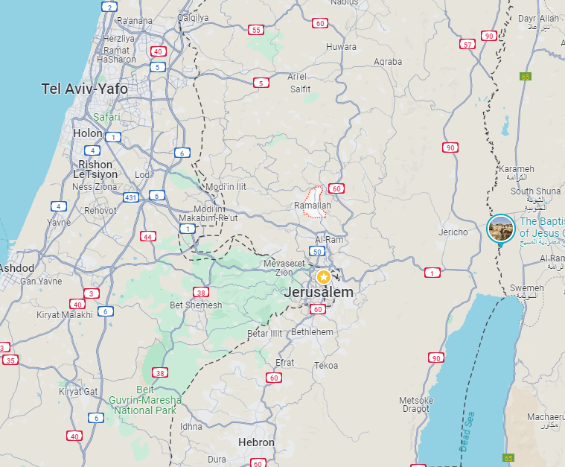
Ramallah, adminis-trative capital of the Palestinian Administration West Bank.

Slide 79
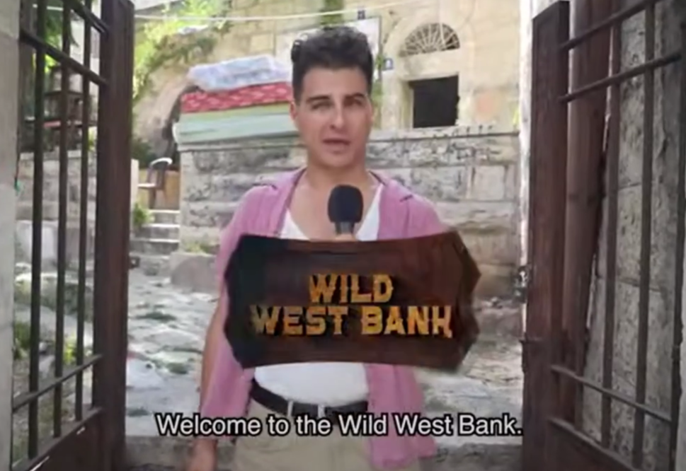
Notes:
https://unitedwithisrael.org/watch-does-anyone-in-ramallah-hate-hamas/?
For much more go to https://twitter.com/VividProwess/status/1810958792315609238

Slide 80
Example of total misunderstanding of the dichotomy: conciliation / rejection.

Slide 81
It turns out it’s very difficult to micromanage a war. Biden told Israel to come up with a mass-evacuation plan for Rafah. Israel did so. He demanded the Israelis expand humanitarian aid. They did so. He demanded the IDF use every piece of technology available to prosecute the Rafah incursion with precision instead of power. The IDF has done so.
Notes:
https://www.commentary.org/seth-mandel/israel-is-doing-what-biden-asked-of-it/
From Ridgeways

Slide 82
The only question left is whether members of the administration, as well as our allies in Europe, really do support Israel’s mission to defeat Hamas. This is no longer an argument over means and methods to reach a shared goal. There are no more nits to pick. Israel has done everything we have asked of it. The president should say so.
Notes:
https://www.commentary.org/seth-mandel/israel-is-doing-what-biden-asked-of-it/
From Ridgeways

Slide 83
Israelis must hear that there is no conciliation with current vast majority Arab mentality.
Arabs must hear that Israel cannot be rejected and destroyed.

Slide 85
!שְׁמַעShma! Hear!
The command
How to hear G-d: Word, Ruakh
How to hear people
How Israelis and Palestinians can hear each other.
Takeaway: Hear G-d and someone

