Slide 1
e-handout
To have these notes
without taking notes
Go to OrHaOlam.com
Click on Messages tab,
2024 Messages
Epigenetic Considerations
and the Truth of Homosexuality
Notes:
So you’ll know I understand science

Slide 2
Engineers' Conversion Table
1. Ratio of an igloo's circumference to its diameter

Slide 3
Engineers' Conversion Table
1. Ratio of an igloo's circumference to its diameter = Eskimo Pi

Slide 4
Engineers' Conversion Table
1. Ratio of an igloo's circumference to its diameter = Eskimo Pi
2. 2000 pounds of Chinese soup =

Slide 5
Engineers' Conversion Table
1. Ratio of an igloo's circumference to its diameter = Eskimo Pi
2. 2000 pounds of Chinese soup = Won ton

Slide 6
Engineers' Conversion Table
1. Ratio of an igloo's circumference to its diameter = Eskimo Pi
2. 2000 pounds of Chinese soup = Won ton
3. 1 millionth of a mouthwash

Slide 7
Engineers' Conversion Table
1. Ratio of an igloo's circumference to its diameter = Eskimo Pi
2. 2000 pounds of Chinese soup = Won ton
3. 1 millionth of a mouthwash = 1 microScope

Slide 8
Engineers' Conversion Table
1. Ratio of an igloo's circumference to its diameter = Eskimo Pi
2. 2000 pounds of Chinese soup = Won ton
3. 1 millionth of a mouthwash = 1 microScope
4. Time between slipping on a peel and smacking the pavement

Slide 9
Engineers' Conversion Table
1. Ratio of an igloo's circumference to its diameter = Eskimo Pi
2. 2000 pounds of Chinese soup = Won ton
3. 1 millionth of a mouthwash = 1 microScope
4. Time between slipping on a peel and smacking the pavement = 1 bananosecond

Slide 10
Engineers' Conversion Table
5. Weight an evangelist carries with God

Slide 11
Engineers' Conversion Table
5. Weight an evangelist carries with God = 1 billigram

Slide 12
Engineers' Conversion Table
5. Weight an evangelist carries with God = 1 billigram
6. 16.5 feet in the Twilight Zone

Slide 13
Engineers' Conversion Table
5. Weight an evangelist carries with God = 1 billigram
6. 16.5 feet in the Twilight Zone = 1 Rod serling

Slide 14

Notes:
https://external-content.duckduckgo.com/iu/?u=https%3A%2F%2Fi.ytimg.com%2Fvi%2FNCM8kuLWd1I%2Fmaxresdefault.jpg&f=1&nofb=1&ipt=9bb81b9a72edff78a39f7185add468ab11524b3f7c6f3823729c0d2ea75dffad&ipo=images

Slide 15
A theological question.
How do you describe a red heifer with three white hairs?

Slide 16
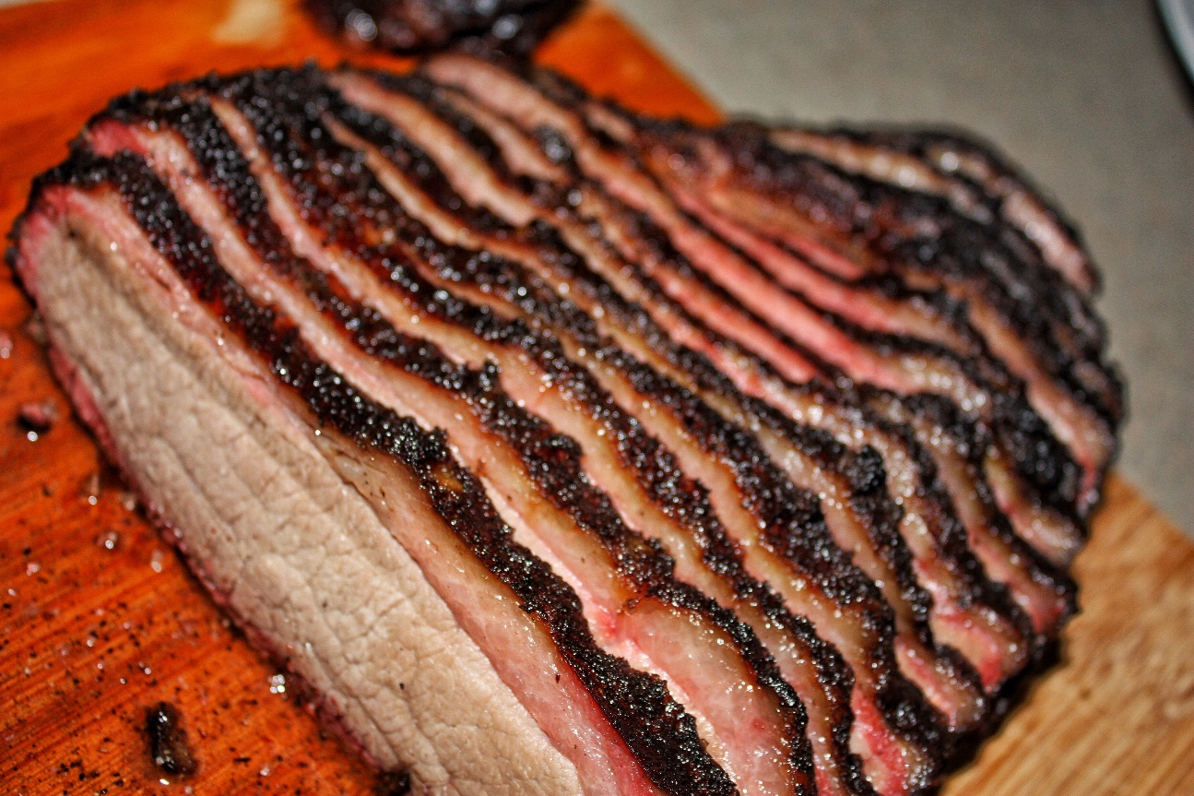
A theological question
How do you describe a red heifer with three white hairs?
A brisket.

Slide 17

Epigenetic Considerations
and the Truth of Homosexuality
Homosexuality is a sin.
Three causes of homosexuality.
  Epigenetics
  Response to pain
  Indulgence
Cure

Slide 18
Epigenetic Considerations
and the Truth of Homosexuality
Homosexuality is a sin.
Three causes of homosexuality.
  Epigenetics
  Response to pain
  Indulgence
Cure

Slide 19
Homosexuality is a sin.
Active practice
Passive tendency
^{Vayikra/Lev 18.22} You are not to go to bed with a man as with a woman; it is an abomination.
וְאֶת-זָכָר לֹא תִשְׁכַּב מִשְׁכְּבֵי אִשָּׁה, תּוֹעֵבָה הִוא.
Cp ^{Vayikra/Lev 11.7} the pig is unclean for you וְאֶת-הַחֲזִיר...טָמֵא הוּא לָכֶם
Notes:
Homosexuality is an abomination to G-d,
unkosher foods are an abomination to us. Actually just says “unclean.” Not as strong a word as “abomination.” Not sin intrinsically, but so designated by G-d in Torah, so a sin to us.
Homosexuality is intrinsically wrong. Abomination to G-d.
Passive tendency, if indulged in fantasy life.

Slide 20
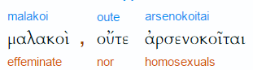
^{1 Cor 6.9-11} People who engage in sex before marriage…who engage in sex after marriage with someone other than their spouse, who engage in active or passive homosexuality…
Notes:
CJB is a bit of a dynamic translation
Thayer
malakos soft, soft to the touch
2) metaphorically in a bad sense
2a) effeminate
2a2) of a boy kept for homosexual relations with a man, as the Roman emperors did
2a3) of a male who submits his body to unnatural lewdness
2a4) of a male prostitute
arsenokoítēs (from 730 /árrhēn, "a male" and 2845 /koítē, "a mat, bed") – properly, a man in bed with another man; a homosexual.
http://biblehub.com/greek/3120.htm

Slide 21
^{1 Cor 6.9-11} none of them will share in the Kingdom of God. Some of you used to do these things. But you have cleansed yourselves, you have been set apart for God, you have come to be counted righteous through the power of the Lord Yeshua the Messiah and the Spirit of our God.
Notes:
Not an irredeemable sin or condition.

Slide 22
Sin is a choice. But some people appear to have a proclivity for a certain sin, a family tendency, easier for them to choose wrong than others.
So these “causes” are not absolute, but increased proclivities.

Slide 23
To many people, it seems that homosexual attraction is their innate proclivity. They were made this way.
It’s only a half truth.
But it is a half truth.
Notes:
This is the key and killer issue.

Slide 24
The underlying
spiritual, scriptural truth:

Slide 25
^{Ex 34.6-7} [ADONI] is God, merciful and compassionate, slow to anger, rich in grace and truth; showing grace to the thousandth generation, forgiving offenses, crimes and sins; yet not exonerating the guilty, but visiting parents' offenses to be experienced by their children and grandchildren, and even by the third and fourth generations.
Notes:
Sin is sort of inherited

Slide 26
Epigenetic Considerations
and the Truth of Homosexuality
Homosexuality is a sin.
Three causes of homosexuality.
  Epigenetics
  Response to pain
  Indulgence
Cure

Slide 27
Genetics and Epigenetics
Genetics is the study of DNA sequences. 4 nucleic acids are the alphabet of life: C A T G
Cytosine, adenine, thyamine, guanine
Four colors of the half rungs of the ladder

Slide 28
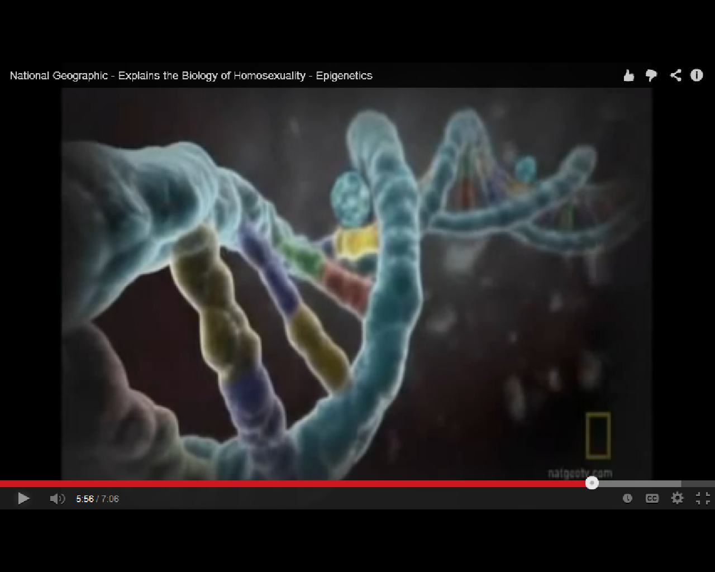
Colors are for illustration:
Olive, gray, green, red
guanine, cytosine, adenine, thiamine
Notes:
Four colors are the four nucleic acids, guanine, cytosine, adenine, thiamine. Controlling components, alphabet of life. Determines if an organism is a fish or an elephant. All have the same DNA alphabet.

Slide 29
Epigenetics is the study of heritable traits, or a stable change of cell function, that happen without changes to the DNA sequence.
The Greek prefix epi- (ἐπι- "over, outside of, around") in epigenetics implies features that are "on top of" or "in addition to" the traditional (DNA sequence based) genetic mechanism of inheritance.
Notes:
https://en.wikipedia.org/wiki/Epigenetics

Slide 30
Two basic types of epigenetic modification to the DNA
DNA methylation
Histone modifications

Slide 31
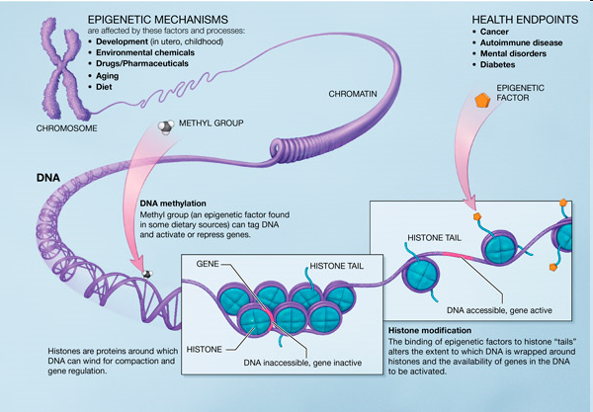
DNA methylation
Notes:
Chromosome is made up of DNA wrapped around spools. Spools are called histone proteins. A methyl radical can attach to the outside of the DNA.

Slide 32
epigentic methyl group
Epigenetics is affected by behavior.

Slide 33
Histone modification

Slide 34
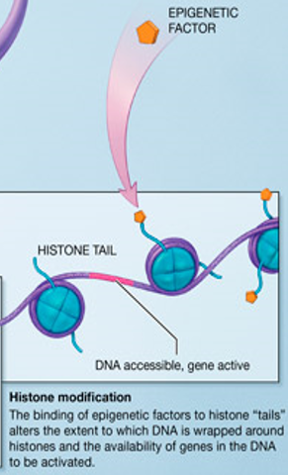
Notes:
https://en.wikipedia.org/wiki/Epigenetics

Slide 35
Environmental stress has been shown to increase the risk of substance use. In an attempt to cope with stress, alcohol and drugs can be used as an escape. Once substance use commences, however, epigenetic alterations may further exacerbate the biological
Notes:
http://en.wikipedia.org/wiki/Behavioral_epigenetics
Once aberrant behavior, hormonal activity occurs, epigenetic alterations may exacerbate the biological.

Slide 36
and behavioral changes associated with addiction.
Even short-term substance use can produce long-lasting epigenetic changes in the brain of rodents, via DNA methylation and histone modification
DNA cannot be changed by behavior. But the molecules surrounding it [epi] can be changed.
Notes:
http://en.wikipedia.org/wiki/Behavioral_epigenetics

Slide 37
Identical twins have identical DNA, which leads to the perceived conclusion that all identical twins are either heterosexual or homosexual. However, it is evident that this is not the case, consequently leaving a gap in the explanation for homosexuality. A "gay" gene does not produce homosexuality, rather, epigenetic modifications act as a temporary "switches" that regulate how the genes are expressed.
Notes:
http://en.wikipedia.org/wiki/Epigenetic_theories_of_homosexuality
Repeat:
A gay gene does not exist that causes homosexuality.
Parental, ancestral behavior [porn, sin, imaginations] give the appearance of genetic proclivity. It’s really epi-genetic proclivity.
Time Mag May 25, 2015, epigenetic pot addiction tendency.

Slide 38
Only twenty percent of identical twins are both homosexual which leads to the hypothesis that even though identical twins share the same DNA, homosexuality is created by something else rather than the genes. Epigenetic transformation allows the on and off switch of certain genes, subsequently shaping how cells respond to androgen signaling, which is critical in sexual development.
Notes:
http://en.wikipedia.org/wiki/Epigenetic_theories_of_homosexuality

Slide 39
Contrary to the fixed sequence of 'letters' in our DNA, epigenetic marks can also change throughout our life and in response to our environment or lifestyle. For example, smoking changes the epigenetic makeup of lung cells, eventually leading to cancer. Other influences of external stimuli like stress, disease or diet are also supposed to be stored in the epigenetic memory of cells.
Notes:
https://www.sciencedaily.com/releases/2017/07/170717100548.htm

Slide 40
It has long been thought that these epigenetic modifications never cross the border of generations. Scientists assumed that epigenetic memory accumulated throughout life is entirely cleared during the development of sperms and egg cells. Just recently a handful of studies stirred the scientific community by showing that epigenetic marks indeed can be transmitted over generations
Notes:
https://www.sciencedaily.com/releases/2017/07/170717100548.htm

Slide 41
The international team in Freiburg is convinced that their findings have far-reaching implications. "Our study indicates that we inherit more than just genes from our parents. It seems to be that we also get a fine-tuned as well as important gene regulation machinery that can be influenced by our environment and individual lifestyle.
Notes:
https://www.sciencedaily.com/releases/2017/07/170717100548.htm

Slide 42
Behavior causes epigenetic changes, behavioral proclivities, that last for three or four generations.
Good choices can overcome the proclivities, shorten, or at least not extend the epigenetic proclivity.
Notes:
I can’t remember where I got the third and fourth generation reference.

Slide 43
There is no gay gene.
There are epigenetic modifications to the function of our DNA that are behavior induced, and make tendencies in the behavior of the next generation. So can be behavior reversed.

Slide 44
Epigenetic Considerations
and the Truth of Homosexuality
Homosexuality is a sin.
Three causes of homosexuality.
  Epigenetics
  Response to pain
  Indulgence
Cure
Notes:
To explain cause, as I understand it, need to introduce some helpful terminology. Joy Starts Here book of the Life Model series, school, combining neuroscience with scripture: neurotheology. P. 13

Slide 45
Predator: exploits others for his own comfort/pleasure
Possum: hides or is compliant to avoid pain of confrontation
Protector: gives comfort, gently deals with the weak
Notes:
From Joy Starts Here book of the Life Model school. P. 13

Slide 46
Abuse or Emotional devastation and false comfort. Lack of healthy love. [Typically domineering mothers and passive / aggressive, absent, or abusive fathers. Wounds, that’s why Joy in Yeshua ישוע building is so vital. Wounds from predators.
Possum behavior → predator [Hurt people hurt people]
Abandonment is the ultimate source of shame, wounding.
Notes:
Combined with lies of the culture, movies, Netflix
Abuse: SRA = Satanic ritual abuse → imprinting, Meant to imprint on your wedding night, so your definition of sexuality is your lifelong spouse.
The global prevalence of child sexual abuse has been estimated at 19.7% for females and 7.9% for males, according to a 2009
If a person doesn’t have a good role model in their parent of the same gender, or particularly an abusive parent, they will have a weakness, a tendency, proclivity to find comfort in a sexual partner of the same gender.
Or if the opposite gender seems unsafe כי wounds.

Slide 47
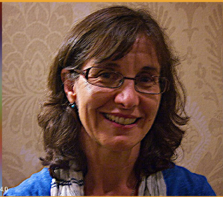
Rosaria Butterfield, who lived as a practicing lesbian for 10 years before finding Yeshua /Jesus,
Notes:
https://washingtonstand.com/podcast/ep-56-rosaria-butterfield-an-unlikely-convert

Slide 48
is adamant that most people who adopt this kind of lifestyle have been traumatized or abused in some way.
That hidden hurt is exactly what Pullman zeroed in on when she talked with “Outstanding” podcast host Joseph Backholm.
Notes:
https://washingtonstand.com/commentary/the-hidden-hurt-behind-pride-month-and-sexual-rebellion-

Slide 49
Like a lot of adults her age, The Federalist’s Joy Pullman grew up as a child of separated parents. It’s an experience that she’s carried with her into her research and writing about the LGBT movement. In her new book, “False Flag: Why Queer Politics Means the End of America,”

Slide 50
she talks about how this instability at home is creating entire generations of hurting kids. And it’s that family chaos and dysfunction, she insists, that makes it more likely that someone will identify as homosexual or transgender.
Notes:
So, do everything you can to ensure that your home is a place of joy!

Slide 51
When you have family separation], when you have divorce … if that’s not addressed,” Joy warns, “if you don’t have a way of healing and reconciling that, then people are scared of being in those intimate relationships because they’ve been hurt in intimate relationships before.”
Notes:
https://washingtonstand.com/commentary/the-hidden-hurt-behind-pride-month-and-sexual-rebellion-

Slide 52
Sometimes that shows up in the millennial and Gen Z reluctance to marry and have families, she points out. “Many young people’s home lives have not been happy. … They’ve been a source of pain, alienation, and conflict. And so I think there’s a lot of unaddressed anguish.
Notes:
https://washingtonstand.com/commentary/the-hidden-hurt-behind-pride-month-and-sexual-rebellion-

Slide 53
Epigenetic Considerations
and the Truth of Homosexuality
Homosexuality is a sin.
Three causes of homosexuality.
  Epigenetics
  Response to pain
  Indulgence
Cure

Slide 54
Indulgence ^{Ro 1.27} The men, giving up natural relations with the opposite sex, burn with passion for one another, men committing shameful acts with other men.
Even fantasy indulgence. Heterosexuality will get boring → weird and wild stuff for new delights. 67% of children admit to clearing their Internet history to hide their online activity
Notes:
Theodore Robert "Ted" Bundy (born Theodore Robert Cowell; was a famous American killer, rapist, kidnapperand necrophile who assaulted and killed numerous young women and girls (from ages 15 - 25) during the 1970s and possibly earlier.
Those of use who are, who have been so much influenced by violence in the media, in particular pornographic violence, are not some kinds of inherent monsters. We are your sons and we are your husbands. And we grew up in regular families. And pornography can reach out and snatch a kid out of any house today. It snatched me out of my home twenty, thirty years ago.

Slide 55
^{Ro 1.24-28} God has given them up to the vileness of their hearts’ lusts, to the shameful misuse of each other’s bodies. They have exchanged the truth of God for falsehood, by worshipping and serving created things, rather than the Creator — praised be he for ever. Amen. This is why God has given them up to degrading passions;

Slide 56
^{Ro 1.24-28} so that their women exchange natural sexual relations for unnatural; and likewise the men, giving up natural relations with the opposite sex, burn with passion for one another, men committing shameful acts with other men and receiving in their own persons the penalty appropriate to their perversion. In other words, since they have not considered God worth knowing, God has given them up to worthless ways of thinking; so that they do improper things

Slide 57
79% of accidental exposures to Internet porn among kids take place in the home
56% of divorce cases involve one party having an obsessive interest in online porn
29% of working adults accessed explicit websites on work computers
Notes:
[Motivation of porn isn’t initially to be a predator, it’s to find a safe woman. Possum. Paper or pixel woman.
Filters: covenant eyes software, others.
Pornography wrong? Self abuse? Messiah: But I tell you that a man who even looks at a woman with the purpose of lusting after her has already committed adultery with her in his heart.
Eyes, and summer, ladies, legs, midriffs, cleavage. PLEASE.
Inner attitudes about people.
Indulgence → deviant behavior various kinds.

Slide 58
Everyone is a [potential] homosexual if we just indulge enough, get bored, look for more bizarre adventures.
Notes:
Sometimes I am approached by parents in panic that their kid things he or she is gay. My answer is that everyone is gay, potentially. My own story.
Jewish boy NYC, 2nd gen American. Parents Am dream house and 2 cars. Mom Dad, abuser. Me no father no elder. Loved Jewishness but no clue meaning. Darkness. Roam streets Greenwich Village, Where is truth? Realty business. Marxism no love. Eastern Meditation no truth. No idea what was right or wrong or even real. Reading explicit obscene novels, could identify either way. Am I?
Physics of the brain as answer. Two years as physics major intention to be a neurophysicist.
Wendy. 10 days.

Slide 59
Summary of Causes
Epigenetics [sins of the fathers and mothers]
Wounding, especially by parental models, abuse, lies of the culture, wrong imprinting. Predators causing predation or false comfort [possums]
Satiation
Notes:
Root cure
#2 first: REPENT, accountability, good friends
Next generation: protect, shelter, legislate
Legislate morality?? What else
Ravi Zach: no moral absolutes? Can I have your wallet?
Protect, shelter, imprint on holy sexuality
#1 and #3 somewhat combined. Wounds from bad role models → wrong imprinting. SEEM inborn

Slide 60
Epigenetic Considerations
and the Truth of Homosexuality
Homosexuality is a sin.
Three causes of homosexuality.
  Epigenetics
  Response to pain
  Indulgence
Cure

Slide 62
Cure
I’m no “reparative therapist”
  I do know the plague of my own heart,
  and sins of my youth.
Want to deal with underlying issues
http://www.heritagehouseministries.com
Notes:
Can’t do 4 days ~20 hours of RTF in ½ hour. Recommend Ira & Gloria Brawer Restoring the Foundations. Summary.
http://www.heritagehouseministries.com
Lean Payne
http://www.leannepayne.org/home/index.php
The best.

Slide 63
Sins of the Fathers and Resulting Curses
  Gay parent
  Habits and tendencies.
  Abandonment
  Effect your epigenetics, make it seem inborn. Partially is, but reversible.
Notes:
So renounce inheritance, take G-d as father.

Slide 64
2. Ungodly beliefs
Something wrong with me.
Must be in control to be safe
I’m garbage, when by myself.
I have no value
I am a homosexual. I have innate same sex attraction.
Notes:
Women are unsafe.
Men are unsafe.
So, renounce lies. Affirm truth.

Slide 65
3. Soul spirit hurt
Being ok by myself, aloneness,
Parents, left in incubator/ hospital 1 year weeks at a time w/o Mom Dad. No conscious memory, asked his Mom in 2007 why I can’t be alone. She told him hospital story.

Slide 66
Soul spirit hurt
Being ok by myself, aloneness,
3 years old began separation, age 5 divorce. How felt: disconnect. Numb and dissociation. Specific: void, כי hatred of father by mother.

Slide 67
Soul spirit hurt
Father kidnapped כי she had custody. Father had a gun. His mother pleading, “Don’t”
Dad gone from his life till age 16.
Half brother 6 years younger.
Bonefish incident
Own divorce.

Slide 68
Soul spirit hurt
Ask the Ruakh to reveal the one or several men/women who hurt you, engendered the bitterness → continual anger at that gender.
Express to Adoni your frustration, hurt, pain [release it]
Invite Yeshua ישוע into this memory.

Slide 69
4. Demonic Oppression

Slide 70
Terminology
Ancient Greek word δαίμων daimōn denotes a spirit or divine power
Demon = evil spirit = unclean spirit
Some translations
Demon possessed. Better from Gk: daimon-izomai demon + passive = demonized
How can a true, new born believer be demon possessed? Not possible.
Notes:
What does it mean?

Slide 71
^{Eph 4. 25-27} Therefore, stripping off falsehood, let everyone speak truth with his neighbor, because we are intimately related to each other as parts of a body. Be angry, but don't sin - don't let the sun go down before you have dealt with the cause of your anger; otherwise you leave room for the Adversary.
Notes:
Consider that phrase

Slide 72
you leave room for the Adversary.
Other translations:
and do not give the devil a foothold. NIV
Neither give place to the devil. KJV
for anger gives a mighty foothold to the Devil. NLT

Slide 73
Any areas in our lives that are not fully in control by ourselves, or by G-d may be areas in your life that are demonized.
^{Ro 6.19-20} For I don't do the good I want; instead, the evil that I don't want is what I do! But if I am doing what "the real me" doesn't want, it is no longer "the real me" doing it but the sin housed inside me.
Notes:
Filling of the Spirit, will address most of this, but this is another arsenal in the weapons of warfare. Might be controversial, but I think reasonable and helpful.

Slide 74
Some translations:
“cast out demons” better: expel
Less religious, like smoke: inhale, exhale; poison in, poison out
^{Mark 1.39} So he traveled all through the Galil, preaching in their synagogues and expelling demons.
Seems pretty common.
Good, respectable people with some area NOT in control
Notes:
Usually a bit of coughing כי poison
Synagogues. Typical populationl not just jail or psyche ward. Not criminal or maniacal. Do you have any are NOT in control. Tried confessing, filling, dying to self, fasting.

Slide 75
Areas of residence, “room for the Adversary”
Emotional:
  rejection → loneliness, misery, depression, self pity, despair → death
  Rebellion: anger, hostility
  Often combined: rejection therefore rebellion.
Notes:
Rejection is a choice to believe or not. That is, we are rejected by people, but doesn’t classify us.
They don’t love me. Why should I obey.

Slide 76
Areas of residence, “room for the Adversary”
Tongue: lying spirit, talking spirit
Sex:
  sexuality is NOT evil
  Every form of compulsive sexuality
  Looking at women
Lusts: perverted appetites
Notes:
President FBM. Talk would get really interesting then improbable. He was adopted son of wealthy parents. High expectations. Lied to cover their disappointment. Didn’t realize lying. Flowed. Can pass lie detector.
masturbation, lesbianism, homosexuality
Demon in eyes, can’t stop. Women have told me.
gluttony

Slide 77
Areas of residence, “room for the Adversary”
Occult: even respectable Horoscopes, yoga, fortune tellers, horseshoes, hamsa
False religions: Islam, Mormonism, Freemasons

Slide 78
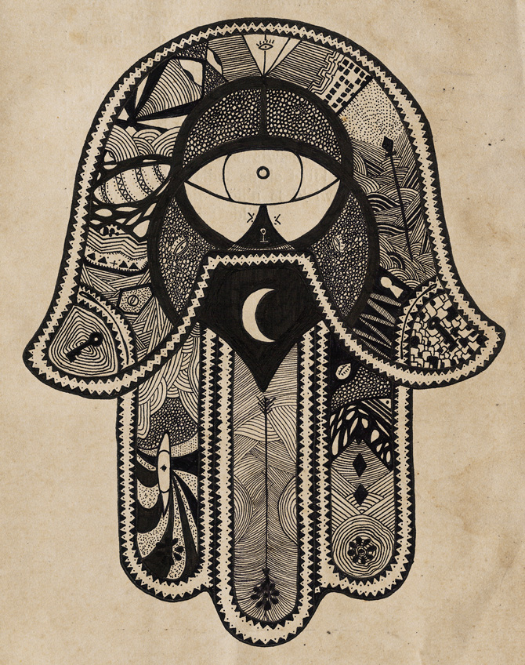

Notes:
One paper notes, if time: p 3 how enter
I prayed the prayer to follow about some emotional issues, and it really liberated me. Yeshua ישוע really liberated me.

Slide 79
Expelling:
L-rd Yeshua ישוע I believe you are the Son of G-d, and the only way to G-d. That You died for my sins, and rose again from the dead. I come to you now for mercy, and for forgiveness. I believe you do forgive me and receive me as your child. And because You receive me, I receive myself as a child of G-d. And now L-rd you know the special problem that I have.
Notes:
Think about the problem

Slide 80
Expelling:
The demonic influences that torment me. I want to meet your conditions, and receive your deliverance.

Slide 81
Expelling:
First of all I forgive whoever harmed me or wronged me. I forgive them all now. [Name the persons to yourself.] Adoni, I have forgiven all these and laid down all bitterness, all hatred, all resentment and all rebellion. And I believe you’ve forgiven me. I thank you for it.

Slide 82
Expelling:
I renounce every contact with Satan, with occult power, with secret societies. Anything in Satan’s territory.
Notes:
Pause for people to consider

Slide 83
Expelling:
Also Adoni, if there is a curse over my life, I thank you that on the execution stake You were made a curse that I might be redeemed from the curse and receive the blessing. I claim that now to release from the curse and entering into the blessing.

Slide 84
And now I come against every evil spirit that has a hold on me. That occupies any area of my personality. I hate them. They are my enemies. I will not compromise with them. I will not make peace with them. They will have no more place in me. I turn against them now. In the authority of your name Yeshua ישוע I command them to leave me. I expel them right now in the Name of Yeshua ישוע. Amen.
Notes:
No more praying. Begin to expel in faith.
DP prayer: Now L as your servant and representative here, I take dominion in Yeshua ישוע Name over every spirit that has been renounced, and I command them to go, now, in Yeshua ישוע name. Release these people in the almighty name of Yeshua ישוע. I affirm that Yeshua ישוע is Lord over this gathering. That He has defeated Satan. That He holds the keys of death and hades. All authority has been given to Him in heaven and in earth. Satan you are subject to us in the Name of Yeshua ישוע. You have to obey us. You have to go from these people. You have no options. The Bible says you must leave. Leave you must, Satan. In the Name of Yeshua ישוע. Amen.
Release yourself from everything. Don’t bother about other people, and your dignity. It will come back in a few minutes.

Slide 85
A word of hope

Slide 86
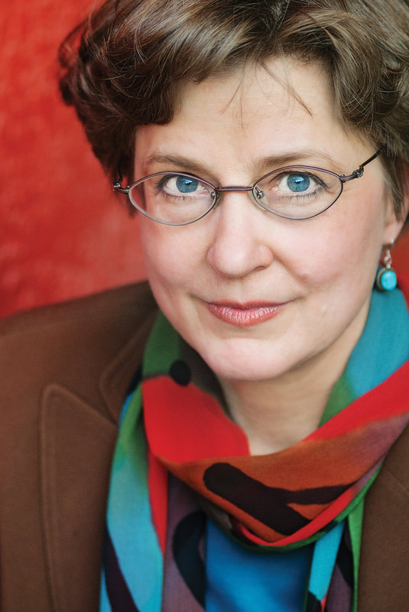
Nancy Pearcey is professor and scholar in residence at Houston Christian University. She has been quoted in The New Yorker and Newsweek, highlighted as one of the five top women apologists by Christianity Today, and hailed in The Economist as "America's pre-eminent evangelical Protestant female intellectual."

Slide 87
Born into a culturally Lutheran family, Nancy Pearcey expected for someone to be able to answer this question of the basis of faith. However, that was not the case. Today on Family Talk, Roger Marsh discusses with Nancy how this deep-seated personal search for truth

Slide 88
set her feet upon a path that would lead her to research that not only proves the Bible faith is true, but that without it, our society spirals out of control. They also discuss Nancy’s latest book, The Toxic War on Masculinity, and the origins of culture’s warped view of men.

Slide 89


Slide 90
She ended up at L’Abri in 1971 with all those hippies, under Francis and Edith Schaeffer in Switzerland. Part of the “Jesus Revolution.”
Found people who could rationally defend the faith and the scriptures.
Notes:
Edith Schaeffer who wrote a book, “Christianity is Jewish.”

Slide 91
There have been sociological studies showing that Bible believing men who attend service regularly test out as the best husbands and fathers. I quote some dozen …studies…the most loving, engaged husbands and fathers.

Slide 92
Their wives are tested separately…the happiest the way their husbands treat them. Evangelical men spend more time with their children than any other group. 3.5 hrs/week more than secular men. 35% lower divorce than secular men.

Slide 93
Lowest rate of domestic abuse and violence.
In the NY Times, “The happiest of all wives in America are religious conservatives.” Fully 73% of women who hold conservative gender values and attend services regularly with their husbands have high quality marriages.

Slide 94
Haven’t we all heard that believer’s divorce at the same rate as the Western Culture?
Researchers then separated out the nominal believers. Nominal believers wives report the lowest level of happiness. Higher divorce than seculars.

Slide 95
Nominal believers have 20% higher divorce than seculars, and the highest rate of domestic violence and abuse.

Slide 97
The nominal believer will take religious justification for the mistreatment of their family.
Men are just bigger, stronger, faster, and because of testosterone, they’re more aggressive and risk taking. And…that is good. Creationally.
Notes:
Whenever someone has to quote to his wife, “Submit,” he’s lost it. Public dad and private dad. Knuckle fist.

Slide 98
Nominal believer men are worse than secular men. Often the woman is blamed.
Kindness is weakness to a bully. Consider Hamas.
Loving confrontation. Mat 18
Preach on abuse an perversion. You don’t know who or where.

Slide 99
Tendency is to give roses to the mothers, and exhort / scold the men. Encourage our men!

Slide 100
Nancy Pearcey professor and scholar in residence at Houston Christian University.

Slide 101
Epigenetic Considerations
and the Truth of Homosexuality
Homosexuality is a sin.
Three causes of homosexuality.
  Epigenetics
  Response to pain
  Indulgence
Cure

Slide 102
^{Matt 24.10-12} And then many will fall away and will betray one another and hate one other. Many false prophets will arise and lead many astray. Because lawlessness will multiply, the love of many will grow cold.
But….not us!
Notes:
Because the culture is so vile, people more easily offended.

Slide 103
^{Gal 6.1-2} Bear one another’s burdens — in this way you will be fulfilling the Torah’s true meaning, which the Messiah upholds.

Slide 104
Isn’t it painful to do this reconciliation?

Slide 105
Isn’t it painful to do this reconciliation?
Love suffers.
Love suffers long.
Love suffers long, and is kind.
Notes:
Men, let’s lead the way.

