Slide 1
e-handout
To have these notes
without taking notes
Go to OrHaOlam.com
Click on Messages tab,
2024 Messages

Slide 2

Notes:
https://www.thejkc.org/index.php

Slide 3
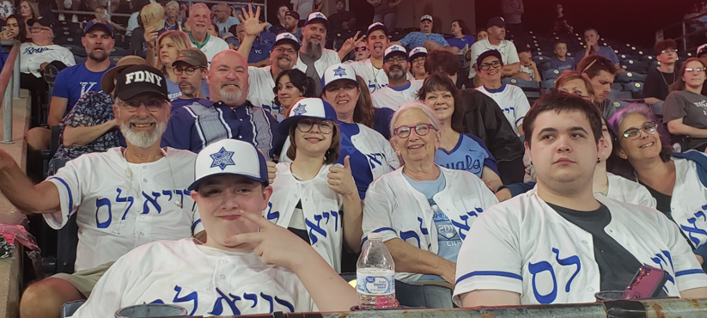
Notes:
https://www.youtube.com/watch?v=PFR3S6jN0Ng
Event was VERY….American no other way to describe.
Soccer…often a brawl.
Hockey often a brawl.
I apologize… some got missed.
Football IS a controlled brawl…quintessentially American
No brawls, not hostility to the umpires, no protests outside, no obscenity.
Seats great, no scorching sun.
Food great at Jewish tailgate
Candid zoom Kiss cam, muscle cam, dance cam
Great clean family friendly fun.
I’m proud to be an American, where at least I know I’m free.

Slide 4
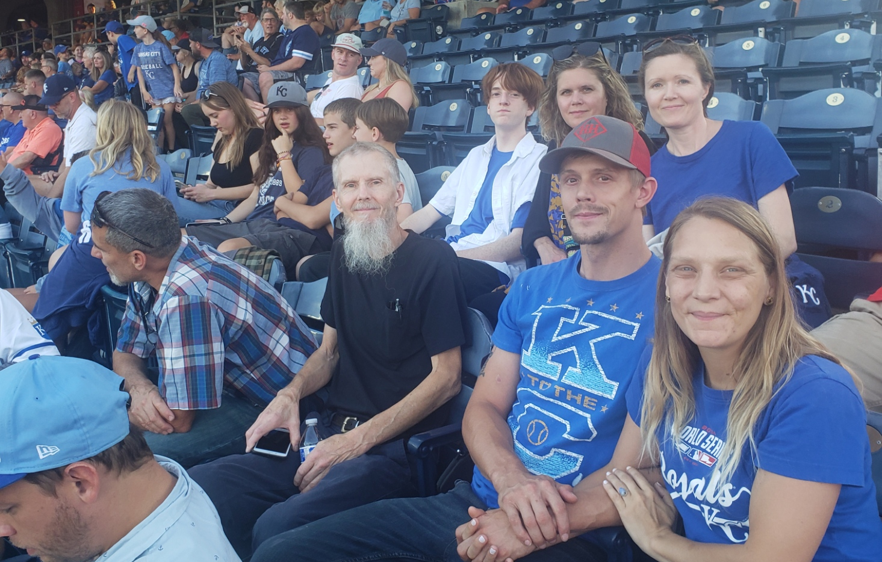
Notes:
Kallevig Patriarchy

Slide 5
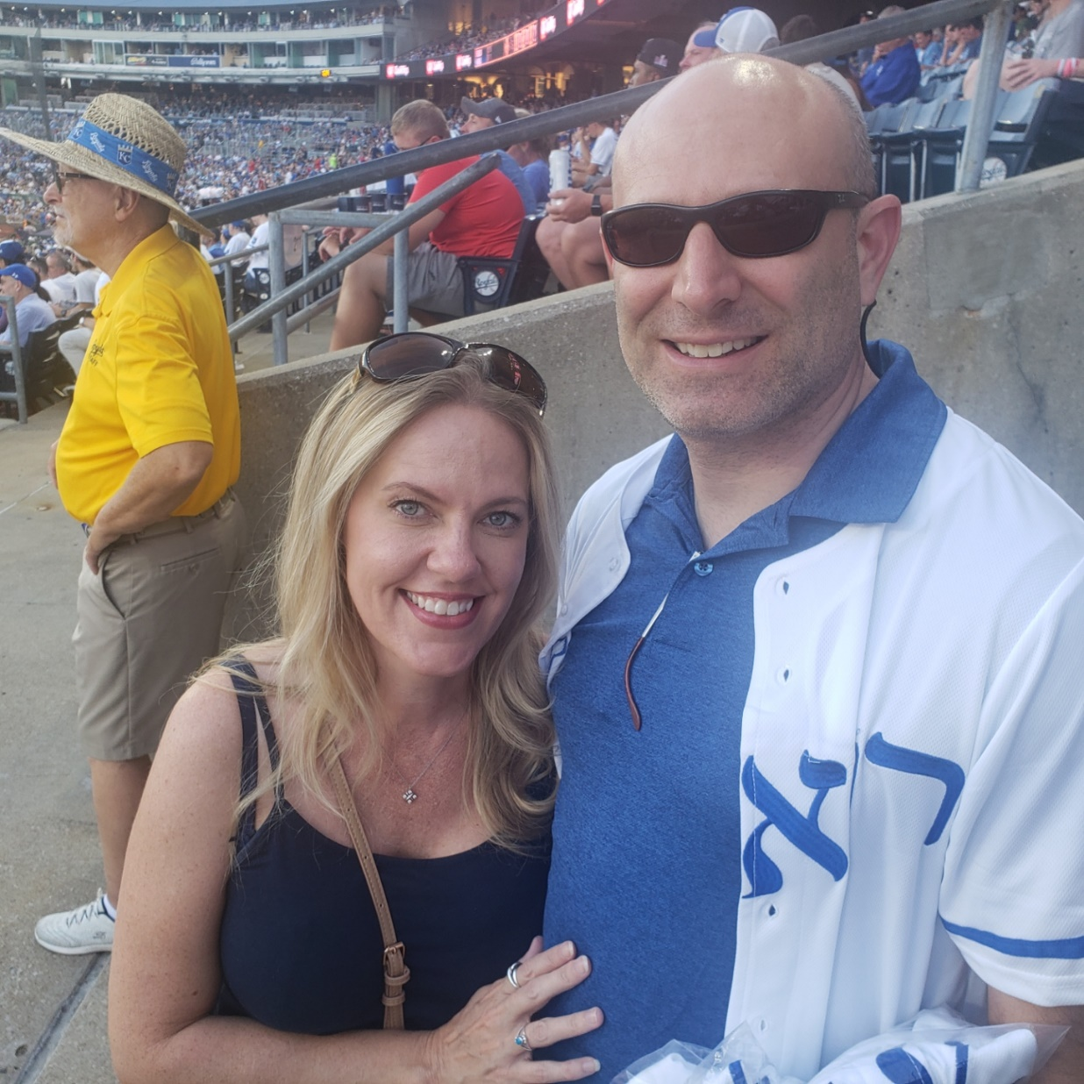
Notes:
Brian Kaufman and Savannah

Slide 6
Surprising Israel War Update

Slide 7
Iran's Supreme Leader Ayatollah Ali Khamenei on July 28, 2024, delivering a speech during the official presidential endorsement ceremony of

Slide 8
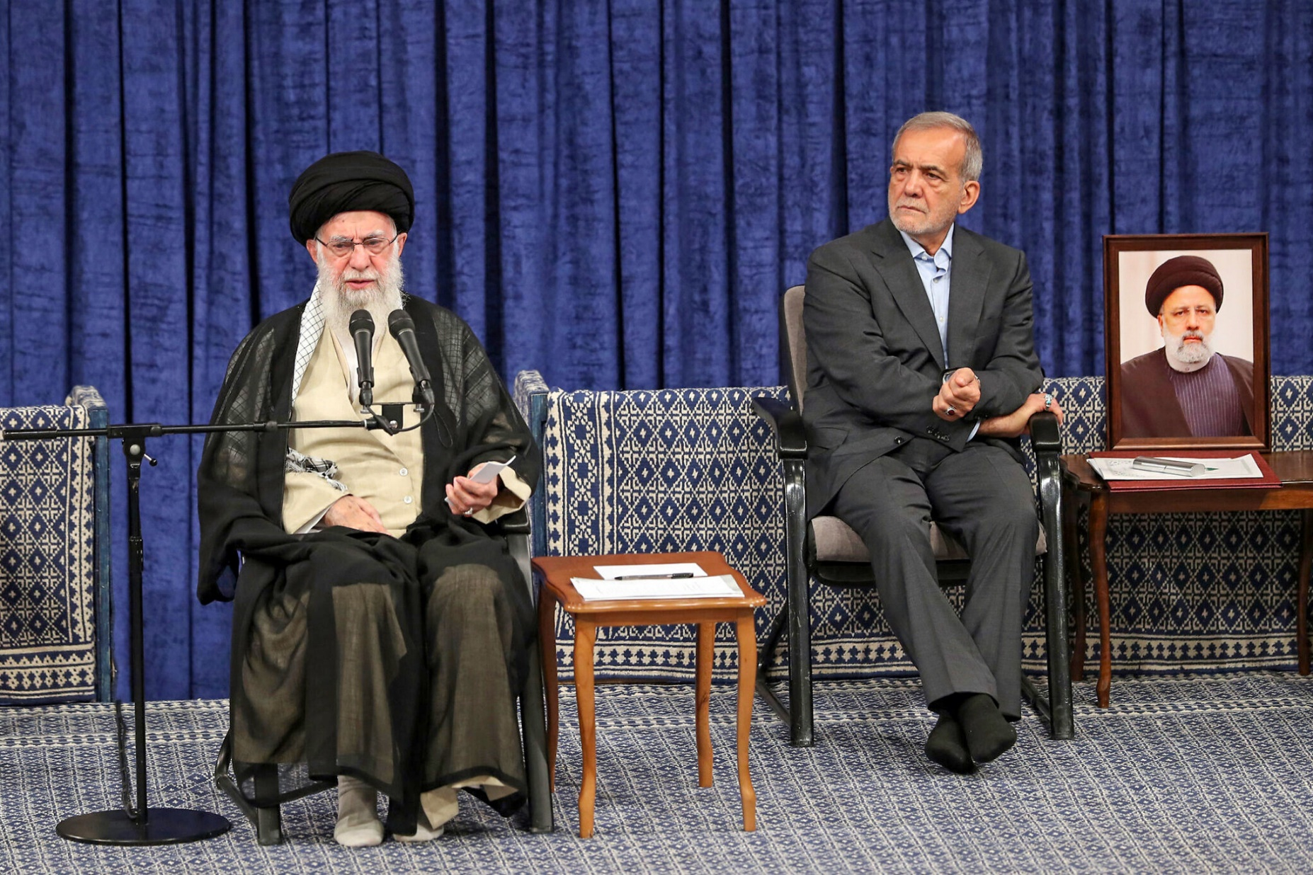
Pres-elect Masoud Pezeshkian (R).
Notes:
https://static.timesofisrael.com/www/uploads/2024/07/AFP__20240728__366F8Q8__v1__HighRes__IranPoliticsPezeshkian.jpg

Slide 9
Iranian President Masoud Pezeshkian has implored the country’s supreme leader to avoid a direct attack on Israel, warning an escalation could lead Israel to devastate infrastructure and energy targets and cripple the economy, according to a report in Iran International.
Notes:
https://www.timesofisrael.com/liveblog_entry/report-irans-president-pezeshkian-urges-khamenei-to-avoid-attack-on-israel/

Slide 10
The report, which cited anonymous sources with knowledge of the matter and which could not be independently confirmed, said Pezeshkian told Ali Khamenei that a war could deepen citizens’ discontent with the regime and even bring about Iran’s collapse.
Notes:
https://www.timesofisrael.com/liveblog_entry/report-irans-president-pezeshkian-urges-khamenei-to-avoid-attack-on-israel/

Slide 11
According to several sources within Iran, there is widespread support for Israel from among the Iranian people themselves.
Notes:
https://allisrael.com/growing-support-for-israel-from-within-iran

Slide 12
People from different cities in Iran are reportedly voicing their belief that the vast majority of citizens oppose the Islamic Revolutionary Guard Corps (IRGC) and are hoping Israel will bring down the regime, according to Ynet News reporter Emily Schrader.
Notes:
https://allisrael.com/growing-support-for-israel-from-within-iran

Slide 13
So, there is a mixture of sentiments in Israel.
A sense of dread that Iran and/ or Hezbollah may devastatingly attack.
A sense that the enemies may be cowering, like July 1967.
Notes:
So, we are going to address something else today, that hasn’t gotten enough attention.

Slide 14


Slide 15

Where Your Treasure Is Mt.6.21
The significance of money.
Money Management: tithe
Money Management: Terumah
Money Management: Half shekel
Personal stories.

Slide 16
Where Your Treasure Is Mt.6.21
The significance of money.
Money Management: tithe
Money Management: Terumah
Money Management: Half shekel
Personal stories.

Slide 17
^{Mtt 6.21} The place where your treasure is, is the place you will most want to be, and end up being.
Notes:
Evan Liberman Wise Money Israel.
If you invested $50,000 min, or $100k better rate, all in Israeli companies, Elbit, Rafael, Bank Leumi, do you think you might pray more earnestly, passionately for Israel?

Slide 18
2,084 verses in Mes Scrip/NT about money
10x as many verses as on faith and salvation
16 of Yeshua’s 38 parables are about $
Notes:
So, it’s all supernatural, and starts with the receiving of LIFE that is eternal, in quality and in duration, from the Messiah, by repentance and faith. Don’t want to skip this perspective.

Slide 19
^{U.S. Dept of Labor} Of every 100 people who reach age 65
2 are financially independent
23 must continue working
75 must depend on friends relatives, or charity
96 of the 100 are flat broke!

Slide 20
40% of older Americans rely solely on social security for retirement income.
Only 7% of retirees have ideal situation of income from three sources: social security, a pension and savings.
Notes:
https://www.nirsonline.org/2020/01/new-report-40-of-older-americans-rely-solely-on-social-security-for-retirement-income/

Slide 21

Published Wed, May 8 2024
Notes:
https://www.cnbc.com/2024/05/08/as-social-security-faces-insolvency-these-are-key-factors-to-watch.html
Reduced benefits, not stop entirely.

Slide 22
1929 2% of American homes mortgaged
1962 2% of American homes not mortgaged

Slide 23
^{Mishlay/Prov. 21.20} In the home of the wise are fine treasures and oil, but a fool quickly devours it.
In the house of the wise are stores of choice food and oil, but a foolish man devours all he has. ^{NIV}
אוֹצָר נֶחְמָד וָשֶׁמֶן בִּנְוֵה חָכָם, וּכְסִיל אָדָם יְבַלְּעֶנּוּ.

Slide 24
^{Mishlay/Prov. 28.20} A trustworthy person will receive many blessings, but one rushing to get rich will not go unpunished.
אִישׁ אֱמוּנוֹת רַב בְּרָכוֹת וְאָץ לְהַעֲשִׁיר לֹא יִנָּקֶה:
Notes:
Get rich quick scheme too good to be true, probably is.

Slide 25
^{Mtt 6. 24} "You can't worship two gods at once. Loving one god, you'll end up hating the other. Adoration of one feeds contempt for the other. You can't worship God and Money both.
Notes:
Money has no intrinsic value.
Start with basic principles.

Slide 26
Money is meant to be a servant. Can be a master. Driving. What is your vision??

Slide 27
^{2 Cor. 9,8-11} God has the power to provide you with every gracious gift in abundance, so that always in every way you will have all you need yourselves

Slide 28
^{2 Cor. 9,8-11} and be able to provide abundantly for every good cause - as the Tanakh says, "He gave generously to the poor; his tzedakah lasts forever."
Notes:
Psalm 112

Slide 29
^{2 Cor. 9,8-11} He who provides both seed for the planter and bread for food will supply and multiply your seed and increase the harvest of your tzedakah.
Notes:
Great trial in Medieval famines.
Seed is the tithe. Statement that the money isn’t ours, any of it. Trust G-d to balance out all the details.
First scriptural reference to tithe.

Slide 30
^{2 Cor. 9,8-11} You will be enriched in every way, so that you can be generous in everything. And through us your generosity will cause people to thank God

Slide 31
^{Mishlei/Prov 11.1} False scales are an abomination to Adoni, but accurate weights please him.
INTEGRITY

Slide 32
Bad choices,
adverse circumstances?
A loving G-d in Messiah and a loving community will walk us through recovery.

Slide 34
Where Your Treasure Is Mt.6.21
The significance of money.
Money Management: tithe
Money Management: Terumah
Money Management: Half shekel
Personal stories.

Slide 35
^{B’raysheet/Gen 14.18-20} Malki-Tzedek king of Shalem brought out bread and wine. He was cohen of El 'Elyon [God Most High], so he blessed him with these words:

Slide 36
^{B’raysheet/Gen 14.18-20} "Blessed be Avram by El 'Elyon, maker of heaven of earth, and blessed be El 'Elyon, who handed your enemies over to you." Avram gave him a tenth of everything.
Notes:
Where did Abe get that idea? Seems like it wasn’t a brilliant innovation. Described as if expected.
Abraham was the first in the world that began to offer tithes; according to Pirke Eliezer, c. 27.
Maybe. Maybe understood from beginning of time in Gan Eden. What did G-d communicate in Eden?

Slide 37
Below are some specific instances of the Mesopotamian tithe,
taken from The Assyrian Dictionary of the Oriental Institute of the University of Chicago, Vol. 4 "E":
  [Referring to a ten per cent tax levied on garments by the local ruler:] "the palace has taken eight garments as your tithe (on 85 garments)"

Slide 38
"...eleven garments as tithe
(on 112 garments)"
  "...(the sun-god) Shamash demands the tithe..."

Slide 39
  "four minas of silver, the tithe of [the gods] Bel, Nabu, and Nergal..."
  "...he has paid, in addition to the tithe for Ninurta, the tax of the gardiner"

Slide 40
  "...the tithe of the chief accountant, he has delivered it to [the sun-god] Shamash"
  "...why do you not pay the tithe to the Lady-of-Uruk?"
Notes:
Pagan sources above.
Next Biblical source: Yaakov.

Slide 41
^{Ber./Gen2820-22} Ya'akov took this vow: "If God will be with me and will guard me on this road that I am traveling, giving me bread to eat and clothes to wear, so that I return to my father's house in peace,

Slide 42
^{Ber./Gen2820-22} then ADONI will be my God; and this stone, which I have set up as a standing-stone, will be God's house; and of everything you give me, I will faithfully return one-tenth to you."
Notes:
That was his vow, and again, didn’t seem to be couched as an innovation. Normal godliness.
Torah commands to Israel next.

Slide 43
^{Vayikra/Lev 27.31-34} All the tenth given from the land, whether from planted seed or fruit from trees, belongs to ADONI; it is holy to ADONI.
Notes:
It’s not really my tithe. Holy: separate, pure, bright.
Faithfulness in this qualifies us to administer more.

Slide 44
^{Vayikra/Lev 27.31-34} If someone wants to redeem any of his tenth, he must add to it one-fifth. All the tenth from the herd or the flock, whatever passes under the shepherd's crook,

Slide 45
^{Vayikra/Lev 27.31-34} the tenth one will be holy to ADONI. The owner is not to inquire whether the animal is good or bad, and he cannot exchange it;

Slide 46
^{Vayikra/Lev 27.31-34} if he does exchange it, both it and the one he substituted for it will be holy; it cannot be redeemed. These are the mitzvot which ADONI gave to Moshe for the people of Isra'el on Mount Sinai.
Notes:
Animals by counting every tenth one, grain by firstfuits guess

Slide 47
^{Bamidbar/Nu 18.20-21} ADONI said to Aharon, "You are not to have any inheritance or portion in their land; I am your portion and inheritance among the people of Isra'el.

Slide 48
^{Bamidbar/Nu 18.20-21} "To the descendants of Levi I have given the entire tenth of the produce collected in Isra'el. It is their inheritance in payment for the service they render in the tent of meeting.
Notes:
Source of life for Levi-im, and they tithed to subdivision of tribe of Levi: Priests/Cohenim

Slide 49
^{Dvarim/Dt. 12.17-18} "You are not to eat on your own property the tenth of your grain, new wine or olive oil [that you set aside for ADONI],

Slide 50
^{Dvarim/Dt. 12.17-18} or the firstborn of your cattle or sheep, or any offering you have vowed, or your voluntary offering, or the offering from your hand. No, you are to eat these in the presence of ADONI your God in the place ADONI your God will choose
Notes:
Tithe of the grain was eaten on the holiday of firstfruits: barley on Firstfruits, Wheat on Shavuot. However, don’t know it’s a tithe till crop finished. Approx.
Voluntary offerings, above tithes.

Slide 51
^{Dvarim/Dt. 12.17-18} -you and your sons, daughters, male and female slaves, and the Levi who is your guest; and you are to rejoice before ADONI your God in everything you undertake to do.
Notes:
What? Thought the tithe was given to the Leviim. Contradiction? Ever panic when an apparent contradiction?

Slide 52
^{Dvarim 14.22-26} "Every year you must take one tenth of everything your seed produces in the field, and eat it in the presence of ADONI your God.
Notes:
the second tithe

Slide 53
^{Dvarim 14.22-26} In the place where he chooses to have his name live you will eat the tenth of your grain, new wine and olive oil, and the firstborn of your cattle and sheep, so that you will learn to fear ADONI your God always.
Notes:
the second tithe could be brought to Jerusalem any time of the year and there was no specific obligation to bring the second tithe to Jerusalem for the Festival of Sukkot. The only time restriction was a commandment to remove all the tithes from one's house in the end of the third year. Deuteronomy 14:28

Slide 54
^{Dvarim 14.22-26} "But if the distance is too great for you, so that you are unable to transport it, because the place where ADONI chooses to put his name is too far away from you;

Slide 55
^{Dvarim 14.22-26} then, when ADONI your God prospers you, you are to convert it into money, take the money with you, go to the place which ADONI your God will choose, and exchange the money for anything you want -

Slide 56
^{Dvarim 14.22-26} - cattle, sheep, wine, other intoxicating liquor, or anything you please - and you are to eat there in the presence of ADONI your God, and enjoy yourselves, you and your household.
Notes:
Intoxicating liquor!??
Marguerita

Slide 57
^{Dvarim 26.12} "After you have separated a tenth of the crops yielded in the third year, the year of separating a tenth, and have given it to the Levi,

Slide 58
^{Dvarim 26.12} the foreigner, the orphan and the widow, so that they can have enough food to satisfy them while staying with you;
Notes:
Every year a tithe was paid to the Levites; and besides that a second tithe, which was carried to Jerusalem and eaten there; and every third year it was eaten at home, in their towns and cities in the country instead of it, with the Levite, poor and stranger, and was called the poor's tithe; and hence the Targum of Jonathan here calls this year the year of the poor's tithe, as was also the sixth year, and was reckoned not complete till the passover in the following year, as the Jewish writers Misn. ib. & Maimon. & Bartenora in ib.

Slide 59
^{Neh 13.4-5} Elyashiv the cohen, who had been put in charge of the storage rooms in the house of our God…had…a large room where…they had stored the grain offerings,

Slide 60
^{Neh 13.4-5} frankincense, equipment and the tenths of grain, wine and olive oil ordered to be given to the L'vi'im, singers and gatekeepers, and the contributions for the cohanim.

Slide 61
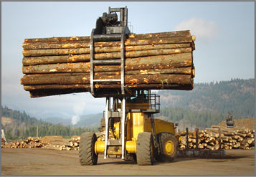
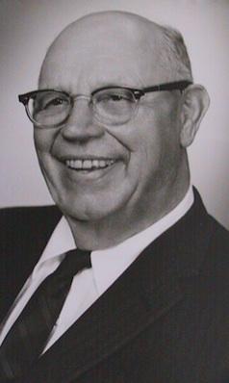
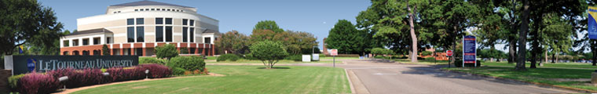
Robert G LeTourneau
(Nov 30, 1888 – June 1, 1969)
Notes:
Robert Gilmour LeTourneau (November 30, 1888 – June 1, 1969), born in Richford, Vermont, was a prolific inventor of earthmoving machinery. His machines represented nearly 70 percent of the earthmoving equipment and Engineering vehicles used during World War II, and he was responsible for nearly 300 patents. Mining, forestry, steel.
With the help of his wife, the former Evelyn Peterson (1900-1987), he founded what became a private, Christian university, LeTourneau University, in Longview, Texas, and was known as a devoted Christian and generous philanthropist to Christian causes, including to a camp and conference grounds that carry his name, “LeTourneau Christian Center.”

Slide 62
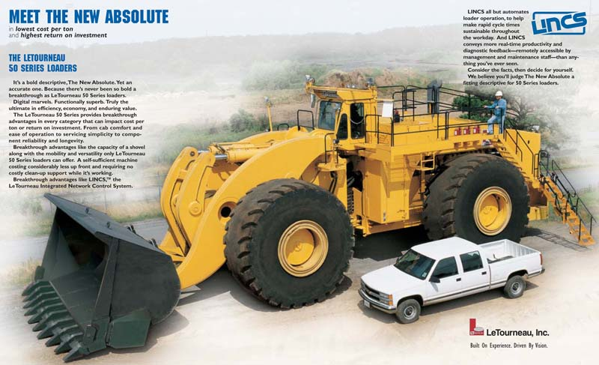
Notes:
He was sometimes called, “God’s businessman.” Most famous, when I heard about him, as the man who reverse tithed. Gave 90%, lived on 10%

Slide 63
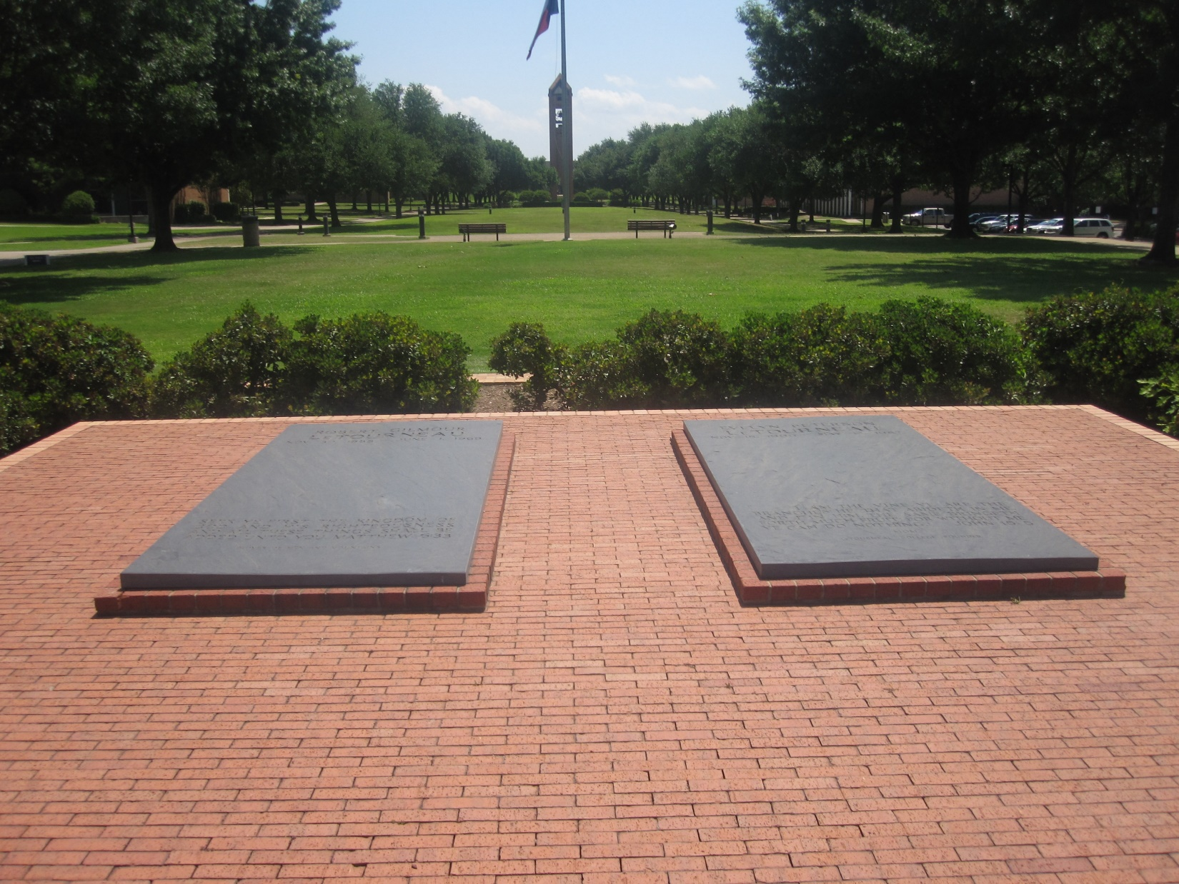
Graves of R.G. and Evelyn Peterson
LeTourneau on the LeTourneau U
campus in Longview, Texas

Slide 64
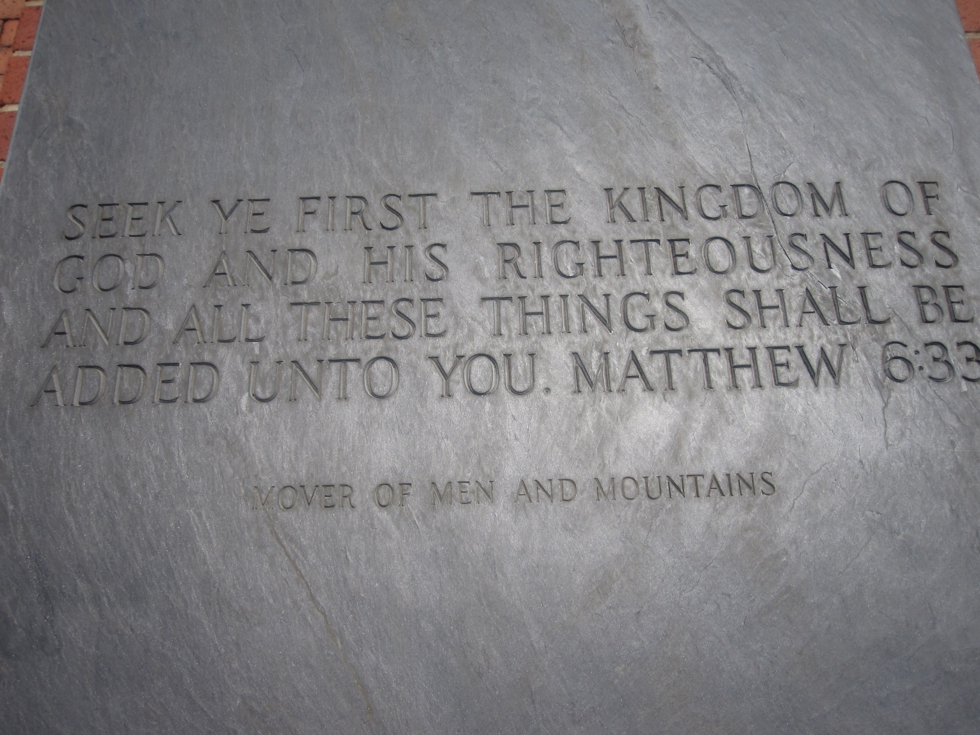
Matthew 6:33, inscribed at the
foot of R.G. LeTourneau's grave
Notes:
But is tithing really carried over to Messianic Scriptures/ NT?
We believe all Torah is, but some, associated with the Temple, obviously can’t be done. So is this Temple related and on hold? Letourneau just did above and beyond?

Slide 65
^{Mtt. 23.23} "Woe to you hypocritical Torah - teachers and P'rushim! You pay your tithes of mint, dill and cumin;

Slide 66
^{Mtt. 23.23} but you have neglected the weightier matters of the Torah -- justice, mercy, trust. These are the things you should have attended to -- without neglecting the others!
Notes:
Words Yeshua. BUT, Temple still standing then.

Slide 67
^{1 Cor. 9.13-14} Those who work in the Temple get their food from the Temple, and those who serve at the altar get a share of the sacrifices offered there?

Slide 68
^{1 Cor. 9.13-14} In the same way, the Lord directed that those who proclaim the Good News should get their living from the Good News.
Even so ^{NKJV}
Along the same lines ^{Message}
Notes:
This is a חידוש khiddush, and innovation by Shaul. Applied specific Temple regulation to ministers of B’sorah/Good News of Yeshua.

Slide 69
First tithe to the Leviim, Cohenim
Second tithe for family celebration in Yerushaliyim except third and sixth year given to poor.
What maintains the sanctuary?

Slide 71
Where Your Treasure Is Mt.6.21
The significance of money.
Money Management: tithe
Money Management: Terumah
Money Management: Half shekel
Personal stories.

Slide 72
^{Shmot/Ex 25.1-2} Adoni said to Moshe, “Tell the people of Isra’el to take up a collection for me — accept a contribution from anyone who wholeheartedly wants to give.

Slide 73
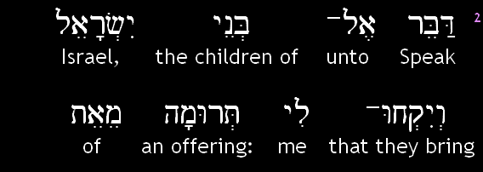
Sh’mot (Exodus) 25.2a

Slide 74
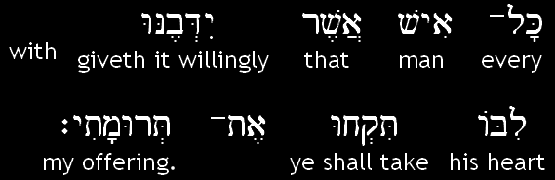
Sh’mot (Exodus) 25.2b
Notes:
Two key words, phrases
Terumah, תרומה
ידבנו לבו yibenu libo

Slide 75
תְּרוּמָה שֵם נdonation ; (Jewish law)
Terumah (priestly tithe on produce) contribution

Slide 76
יִדְּבֶנּוּ לִבּוֹ Yid-veh-nu libo
נָדַב
to donate, to contribute, to promise to donate ; (talmudic) to dedicate a sacrifice as a donation to the Temple
נִדְבַת לֵבgenerosity

Slide 77
heart prompts him to give. ^{NIV}
everyone who wants ^{TLB}
gives it willingly ^{NKJV}
whose heart moves him ^{NASU}
everyone who wants ^{TLB}

Slide 78
^{Exodus 36:3-7} They received from Moshe all the offering which the people of Israel had brought for the work of building the sanctuary...For what they had already was not only sufficient for doing all the work, but too much!

Slide 79
Terumah was
in addition to the tithe.

Slide 80
^{Nu 31.48-50} The officers in charge of the thousands who fought … approached Moshe and said to him, “Your servants have counted all the soldiers under our command, and not one of us is missing. We have brought an offering for Adoni

Slide 81
^{Nu 31.48-50} what every man has obtained in the way of gold jewelry — armlets, bracelets, signet rings, earrings and belts — to make atonement for ourselves before Adoni.”
לְכַפֵּר עַל-נַפְשֹׁתֵינוּ,
Notes:
Restitutionary atonement for the depredations and corruptions of war. Who knows what happened in the rage of battle and siege.

Slide 82
^{2 Cor.8.1-2} Now, brothers, we must tell you about the grace God has given the congregations in Macedonia. Despite severe trials, and even though they are desperately poor,

Slide 83
^{2 Cor.8.1-2} their joy has overflowed in a wealth of generosity…first they gave themselves to the Lord.
Spirit of poverty vs. poverty of spirit
Love, safety, value, purpose
Adoni is a giver

Slide 86
Where Your Treasure Is Mt.6.21
The significance of money.
Money Management: tithe
Money Management: Terumah
Money Management: Half shekel
Personal stories.

Slide 87
^{Shmot/Ex 30.12-15} "When you take a census of the people of Isra'el and register them, each, upon registration, is to pay a ransom for his life to ADONI,

Slide 88
^{Shmot/Ex 30.12-15} to avoid any breakout of plague among them during the time of the census. Everyone subject to the census is to pay as an offering to ADONI half a shekel [one-fifth of an ounce of silver]-
Notes:
in the Misnah is a whole treatise called "Shekalim", in which an account is given of the time and manner of collecting this ransom money, and for what uses, and who were obliged to pay it, and who not; on the first of Adar (or February) they proclaimed concerning the payment of it, on the fifteenth the tables were set for that purpose, and on the twenty fifth the proper persons sat in the sanctuary to receive it
After Temple destroyed, the Romans claimed this.

Slide 89
^{Shmot/Ex 30.12-15} by the standard of the sanctuary shekel (a shekel equals twenty gerahs). Everyone over twenty years of age who is subject to the census is to give this offering to ADONI -
Notes:
Remember Daveed’s census and the plague.
The Syriac version renders the word here used, "two zuzim of head money": now a "zuz" with the Jews, answered to a Roman penny, four of which made a "shekel"

Slide 90
^{Shmot/Ex 30.12-15} the rich is not to give more or the poor less than the half-shekel when giving ADONI's offering to atone for your lives.

Slide 91

Sh’mot (Exodus) 30:11
יְיָ
Adoni
Notes:
Likely most common Hebrew phrase in Torah.

Slide 92
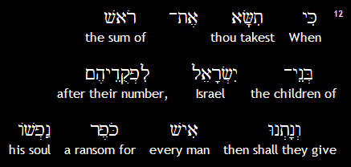
Sh’mot (Exodus) 30:12a
Notes:
Same root as
כִּפֵּר פ' פיעל to grant atonement, to forgive
An atonement!!????
The anti-Messianic teachers, Tovia Singer, Michael Skobac, etc., say there are many forms of atonement. Blood sacrifice not essential. Yeshua not needed. Consider the basis of their argument, starting above.

Slide 93
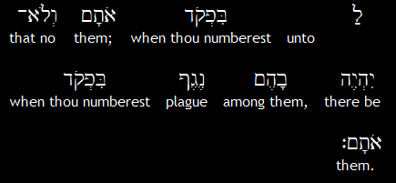
Sh’mot (Exodus) 30:12b
יְיָ
Adoni,
Notes:
Ever happen?

Slide 94
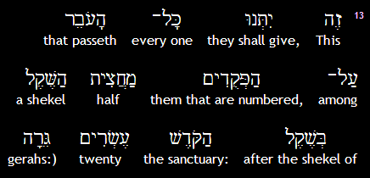
Sh’mot (Exodus) 30:13a

Slide 95
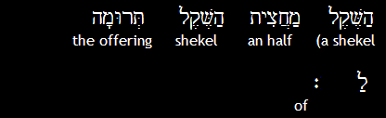
Sh’mot (Exodus) 30:13b
יְיָ
Adoni.

Slide 96
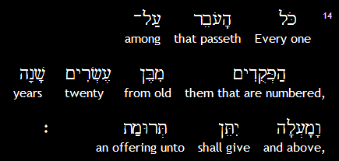
Sh’mot (Exodus) 30:14
יְיָ
Adoni.
Notes:
Rest of section…

Slide 97
^{2 Sam 24.1-15} The anger of ADONI blazed up against Isra'el, so he moved David to act against them by saying, "Go, take a census of Isra'el and Y'hudah." The king said to Yo'av the commander of the army, who was with him, "Go systematically through all the tribes of Isra'el,
Notes:
Anger of Adoni? Apparently saw something in King David’s, Daveed HaMelekh’s, heart, needed to be tested, and Daveed failed the temptation.

Slide 98
^{2 Sam 24.1-15} from Dan to Be'er-Sheva; and take a census of the population; so that I can know how many people there are." Yo'av said to the king,

Slide 99
^{2 Sam 24.1-15} "May ADONI your God add to the people a hundredfold, no matter how many there are; and may the eyes of my lord the king see it. But why does my lord the king take pleasure in doing this?"

Slide 100
^{2 Sam 24.1-15} However, the king's word prevailed against Yo'av and the army officers. So Yo'av and the army officers went out from the king's presence to take a census of the people of Isra'el… But after he had taken the census, David was conscience-stricken.
Notes:
Why conscience stricken?
Half shekel not collected
1,570,000 people x $3.85/half shekel = $6,500,000
Previously taught on this in March 16, 2001. No commentator got it then.
Best commentator now [John Gill] “he began to see the pride and haughtiness of his heart; his vanity and confidence in the creature, which led him to it; aggravated by doing it without seeking to know the mind of God, and without giving him his due, the half shekel, according to the law”

Slide 101
^{2 Sam 24.1-15} David said to ADONI, "I have greatly sinned in what I have done. But now, ADONI, please! Put aside your servant's sin, for I have done a very foolish thing." When David got up in the morning, this word of ADONI came to the prophet Gad,

Slide 102
^{2 Sam 24.1-15} David's seer: "Go and say to David that this is what ADONI says: 'I am giving you a choice of three punishments. Choose one of them, and I will execute it against you." Gad came to David and told him; he said: "Do you want seven years

Slide 103
^{2 Sam 24.1-15} of famine in your land? or do you want to flee before your enemies for three months while they pursue you? or do you want three days of plague in your land? Think about it, and tell me what to answer the one who sent me."

Slide 104
^{2 Sam 24.1-15} David said to Gad, "This is very hard for me. Let us fall into the hand of ADONI, because his mercies are great, rather than have me fall into the hand of man."

Slide 105
^{2 Sam 24.1-15} So ADONI sent a plague on Isra'el from that morning until the end of the specified time; 70,000 of the people died between Dan and Be'er-Sheva.
Notes:
Rest of the story…angel of death over Jerusalem, Ornan’s threshing floor. Purchased it and animals for sacrifice, and became the Temple mount.
Apparently because half shekel not collected as evidence of dependence on G-d.

Slide 106
^{2 K 12.4-5} Y'ho'ash said to the cohanim, "All the funds for sacred purposes which are brought to the house of ADONI - the half-shekel tax,

Slide 107
^{2 K 12.4-5} the taxes on persons in a man's household, and all the offerings anyone voluntarily brings to the house of ADONI - the cohanim are to receive from whoever personally makes contributions to them;

Slide 108
^{2 K 12.4-5} and they are to use these funds to repair the damaged parts of the house, wherever damage is found.

Slide 109
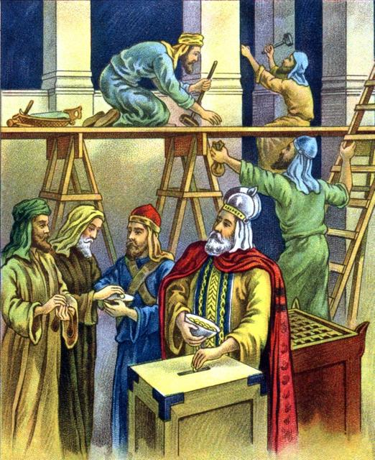

Slide 110
After the return under Nehemiah, Jews [all throughout] the Diaspora continued to pay the Temple tax. Josephus reports that at the end of the 30s CE "many tens of thousands" of Babylonian Jews guarded the convoy taking the tax to Jerusalem ^{(Ant. 18.313).}
Notes:
https://en.wikipedia.org/wiki/Temple_tax
Continued in Yeshua’s day, into Roman times. You may have thought this was an obscure Torah command, became a key to Jewish identity.

Slide 111
^{Nekhemiah 10.33-34} “We will impose on ourselves a yearly tax of one-third of a shekel [one-seventh of an ounce of silver] for the service of the house of our God, for the showbread, for the regular grain offering,
Notes:
Who gave Nekhemiah authority to change scripture? Not a census, so Shmot/Ex 30 didn’t exactly apply.

Slide 112
^{Nekhemiah 10.33-34} for the regular burnt offering, for [the offerings] on Shabbat, on Rosh-Hodesh, at the designated times and at other holy times, for the sin offerings to make atonement for Israel, and for all the work connected with the house of our God.”
Notes:
Carried down to Yeshua’s time…

Slide 113
^{Mtt 17.24-27} When they came to K'far-Nachum, the collectors of the half-shekel came to Kefa and said, "Doesn't your rabbi pay the Temple tax?"
Notes:
Not the Roman tribute, with the image of Caesar on it. Different tax, different story
Israeli half shekel

Slide 114
^{Mtt 17.24-27} "Of course he does," said Kefa.
When he arrived home, Yeshua spoke first.
"Shim`on, what's your opinion? The kings of the earth -- from whom do they collect duties and taxes?

Slide 115
^{Mtt 17.24-27} From their sons or from others?" "From others," he answered. "Then," said Yeshua, "The sons are exempt. But to avoid offending them -- go to the lake,

Slide 116
^{Mtt 17.24-27} throw out a line, and take the first fish you catch. Open its mouth, and you will find a shekel. Take it and give it to them for me and for you."
I.e., two half shekels, on for Kefa/Peter, one for Yeshua.
Notes:
Archeology about the significance of this…

Slide 117
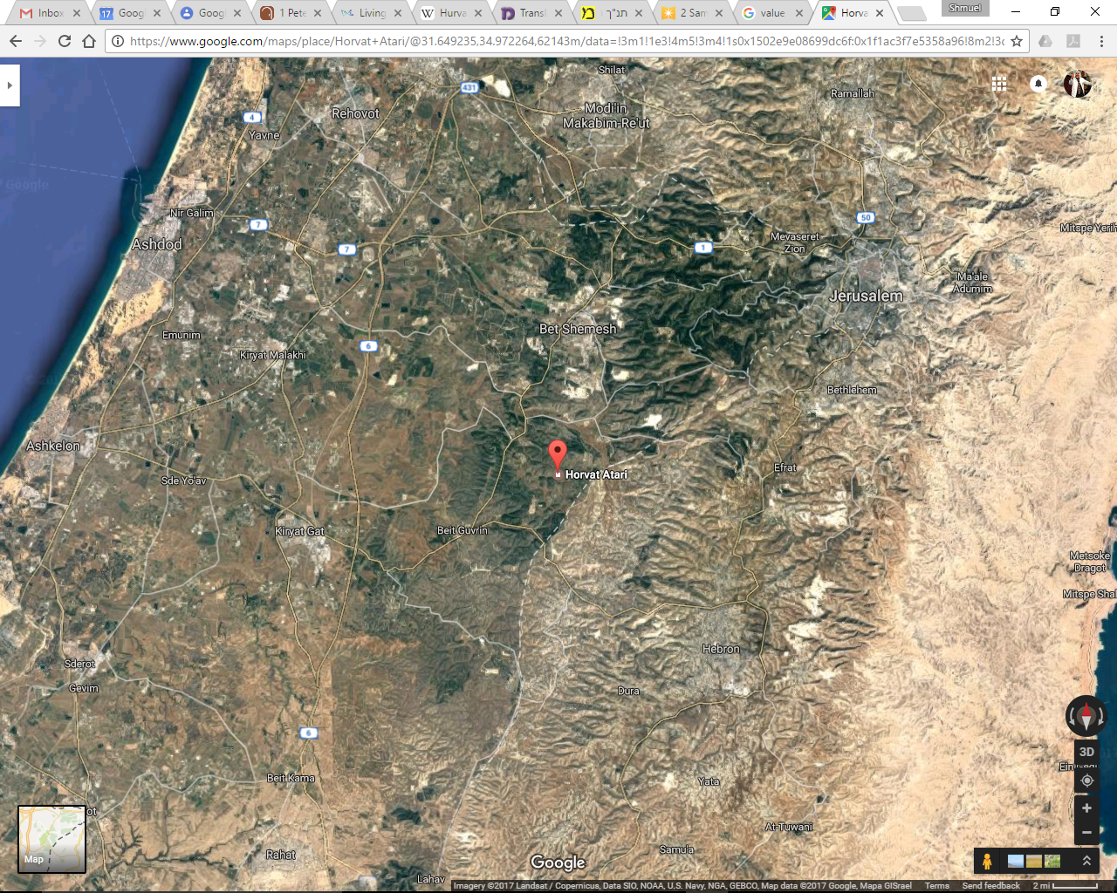
Hurvat Itri
Notes:
Middle of Judean hills, southwest of Jerusalem

Slide 118
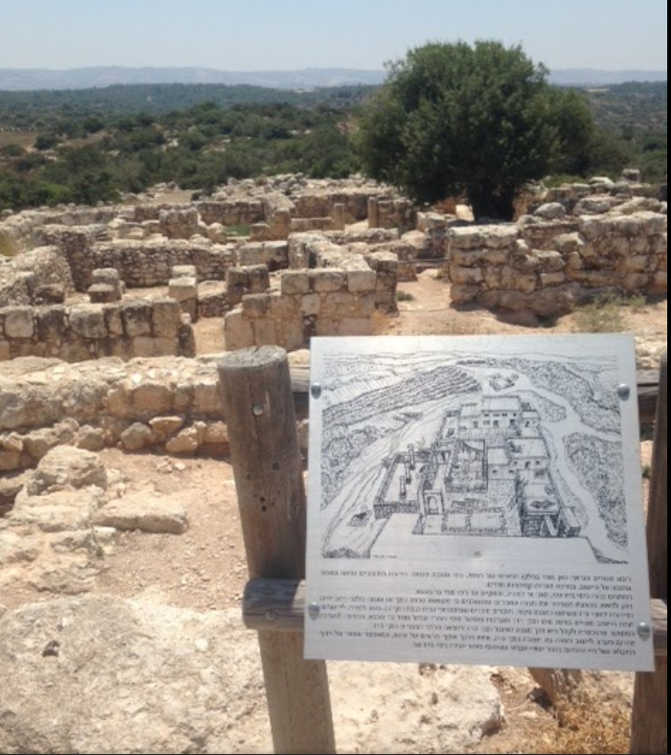
Hurvat Itri, ruins of Itri,
From 135 CE Second revolt
Notes:
Apparently from 135 CE: formidable wall formations, with massive stones, which led Israeli archaeologist, Boaz Zissu, to believe that it may have been one of the fifty strongholds in Judea destroyed by Hadrian during the second Jewish revolt (the Great Revolt).
https://en.wikipedia.org/wiki/Hurvat_Itri

Slide 119
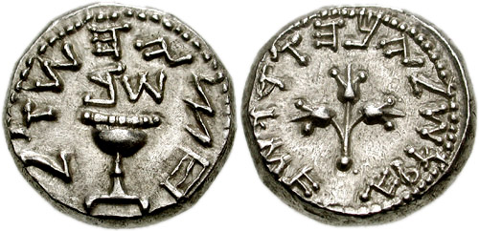
The half-Shekel coin discovered
in Hurvat Itri $3.85 Ag
Notes:
Archaeological excavations conducted at Hurvat Itri in Israel from 1999 to 2001 by Boaz Zissu and Amir Ganor of the Israeli Antiquities Authority (IAA) have yielded important finds, the most-prized of which being a half-Shekel coin minted in the 2nd century CE, upon which are embossed the words "Half-Shekel" in paleo-Hebrew (Hebrew: חצי השקל‎), and which same coin possesses a silver content of 6.87 grams [$3.85] https://en.wikipedia.org/wiki/Shekel#Collection_of_the_half-Shekel and a bronze coin with a date-palm tree and the inscription, "El'azar the Priest," on its obverse side, and a cluster of grapes with the inscription, "Year One of the Freedom of Israel," on its reverse side
https://en.wikipedia.org/wiki/Hurvat_Itri

Slide 120
^{1Kefa/Peter 1.18-19} You should be aware that the ransom paid to free you from the worthless way of life which your fathers passed on to you did not consist of anything perishable like silver or gold; on the contrary,

Slide 121
^{1Kefa/Peter 1.18-19} it was the costly bloody sacrificial death of the Messiah, as of a lamb without defect or spot

Slide 122
The first Roman attempt to halt payments of the tax was made long before the Jewish War on account of customs controls. The Senate had forbidden the export of gold and silver, but the Jews of Italy continued to pay the Temple tax.
Notes:
https://en.wikipedia.org/wiki/Temple_tax

Slide 123
In 62 BCE L. Valerius Flaccus, governor of the province of Asia, issued an edict forbidding the Jews of his province from sending the tax to Jerusalem. After the destruction of the Temple in Jerusalem in CE 70,
Notes:
https://en.wikipedia.org/wiki/Temple_tax

Slide 124
new Roman tax was imposed for taxation of the Jews, the Fiscus Judaicus diverted into imperial coffers.
Notes:
https://en.wikipedia.org/wiki/Temple_tax

Slide 125
The tax was initially imposed by Roman Emperor Vespasian as one of the measures against Jews as a result of the First Roman-Jewish War of 66–73 AD (first Jewish revolt) (Josephus BJ 7. 218; Dio Cassius 66.7.2).
Notes:
https://en.wikipedia.org/wiki/Fiscus_Judaicus

Slide 126
The tax was imposed on all Jews throughout the empire, not just on those who took part in the revolt against Rome. The tax was imposed after the destruction of the Second Temple in 70 AD in place of the levy (or Tithe) payable by Jews towards the upkeep of the Temple.
Notes:
https://en.wikipedia.org/wiki/Fiscus_Judaicus

Slide 127
The amount levied was two denarii, equivalent to the one-half of a shekel that observant Jews had previously paid for the upkeep of the Temple of Jerusalem (Exodus 30:13). The tax was to go instead to the Temple of Capitoline Jupiter, the major center of ancient Roman religion.
Notes:
https://en.wikipedia.org/wiki/Fiscus_Judaicus

Slide 128
The fiscus Iudaicus was a humiliation for the Jews. In Rome, a special procurator known as procurator ad capitularia Iudaeorum was responsible for the collection of the tax. Only those who had abandoned Judaism were exempt from paying it.
Notes:
https://en.wikipedia.org/wiki/Fiscus_Judaicus

Slide 129
While the tax paid for the Temple of Jerusalem was payable only by adult men between the ages of 20 and 50, the fiscus Iudaicus was imposed on all Jews, including women, children, and elderly—and even Jewish slaves.
Notes:
https://en.wikipedia.org/wiki/Fiscus_Judaicus

Slide 130
The tax was continued even after the completion of the reconstruction of the Capitoline temple for its upkeep.
Notes:
https://en.wikipedia.org/wiki/Fiscus_Judaicus

Slide 131
Domitian, who ruled between 81 and 96 AD, expanded the fiscus Iudaicus to include not only born Jews and converts to Judaism, but also on those who concealed the fact that they were Jews or observed Jewish customs. Suetonius relates that
Notes:
https://en.wikipedia.org/wiki/Fiscus_Judaicus

Slide 132
when he was young an old man of 90 was examined to see whether he was circumcised.
Domitian applied the tax even to those who merely "lived like Jews.“
De-incentivize Torah observance!
Notes:
https://en.wikipedia.org/wiki/Fiscus_Judaicus

Slide 133
It did not take long for Christians to petition the Emperor to distinguish the Christians for the purpose of the payment of the fiscus Iudaicus. As the tax only applied to practising Jews, if they could be recognised as a separate religion, they would escape the impost.
Notes:
https://en.wikipedia.org/wiki/Fiscus_Judaicus
So, if you ever wondered what happened to the Ancient Messianic Jewish movement, taxation was another stroke against us!

Slide 134
The tax was revived in the Middle Ages in 1342 under the name of Opferpfennig by the [German] Holy Roman Emperors.
Notes:
https://en.wikipedia.org/wiki/Fiscus_Judaicus

Slide 135
The Opferpfennig tax was introduced in 1342 by Emperor Louis IV the Bavarian, who ordered all Jews above the age of 12 and possessing 20 gulden to pay one gulden annually for protection.
Notes:
https://en.wikipedia.org/wiki/Fiscus_Judaicus
Thought “protection” tax was a Mafia idea.

Slide 136
The practice was justified on the grounds that the Germanic Holy Roman Emperor, as the legal successor of the [Italian] Roman emperors,
Notes:
https://en.wikipedia.org/wiki/Fiscus_Judaicus

Slide 137
was the rightful recipient of the Temple tax which Jews paid to the Romans after the destruction of the Second Temple. The Opferpfennig was collected on Christmas day.
Notes:
https://en.wikipedia.org/wiki/Fiscus_Judaicus
Shmot/Ex 30 in force till 1300’s, but as a mockery!
Replacement theology to the extreme.

Slide 139
Where Your Treasure Is Mt.6.21
The significance of money.
Money Management: tithe
Money Management: Terumah
Money Management: Half shekel
Personal stories.

Slide 140
1969 I came to faith. Went to Bible College in Cincinnati + Univ Cinti. to learn Hebrew, Jewish studies. Worked as a janitor in the Cincinnati Public Schools.
1973 Education tax voted down; school Board layed off workers.
Notes:
Starting tithing and offering right away. Calhoun St was the Haight Ashbury, Greenwich Village of Cincinnati.

Slide 141
I got notice from U.C. that I was reclassified as an out of state student. Double tuition plus back tuition.
Ps 112 + Phil 4
Last week as janitor told AAA hiring phone sales.
Notes:
Didn’t have time for job hunting, except found something as a dishwasher. Lost employment plus tuition hike.
Ps 112 Phil 4

Slide 142
2015
Jim Adler and I invited to Bible College Pres office. Told repurposing of our worship room since 1996. July “eviction”
March of Remembrance rental of OP Convention Center.

Slide 143
2020 COVID shutdown
10 in house
CARES offer declined: better bankrupt than government $. [not for everyone]
Donations never failed.
Back wall, mortgage paid off.

Slide 145
Where Your Treasure Is Mt.6.21
The significance of money.
Money Management: tithe
Money Management: Terumah
Money Management: Half shekel
Personal stories.

Slide 146
^{Mtt 6.21} The place where your treasure is, is the place you will most want to be, and end up being.

Slide 147
Do you KNOW Yeshua and drinking the water of LIFE?
Are you hearing daily from His Word?
How are you applying what you heard?
Are you offering that water of life to anyone?

