Slide 1
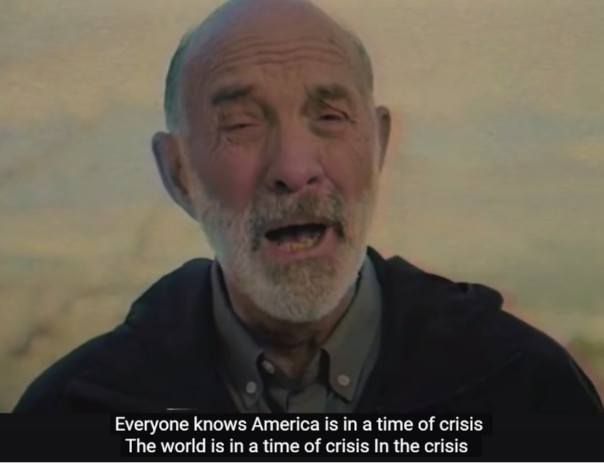
Lou Engle calling a million women to DC Oct 12
YK

Slide 2
e-handout
To have these notes
without taking notes
Go to OrHaOlam.com
Click on Messages tab,
2024 Messages

Slide 3
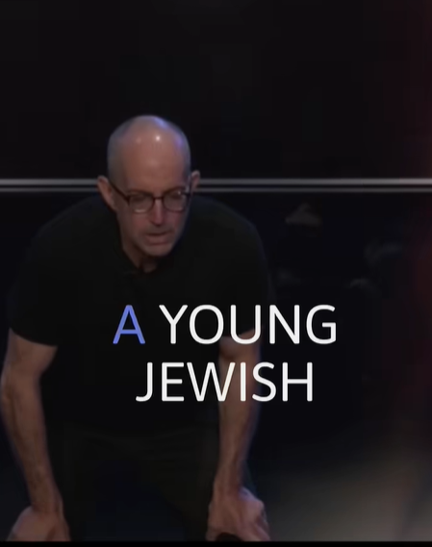
Brad Zimmerman
woman brings her
fiancé home to
meet her parents
Notes:
Brad Zimmerman
https://www.facebook.com/reel/819868282906677

Slide 4
I would like to address a question.
I’m not asking the cosmological deep question:

Slide 5
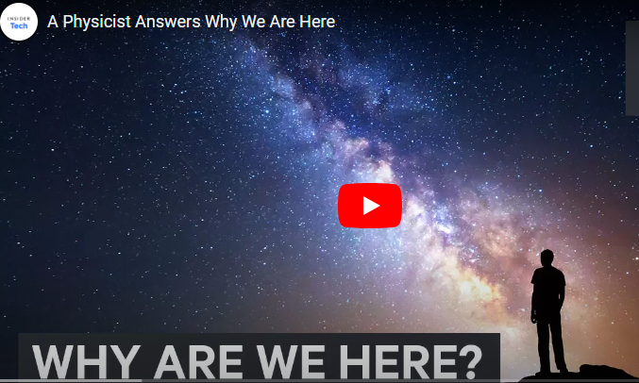
Notes:
https://youtu.be/A6UsE-zVCEE
That has already been answered.

Slide 6

The answer to the "Ultimate Question of Life, the Universe, and Everything"
Notes:
Hitchhiker’s Guide to the Galaxy
Douglas Adams

Slide 7
The answer to the "Ultimate Question of Life, the Universe, and Everything"
Notes:
42 is the answer.
What??!
You have to watch the movie, and love science fiction, or the dry British humor spoof of science fiction.
I am asking a much lesser, but still important question.

Slide 8
Why are we here
in this particular congregation?
What is our purpose?

Slide 9
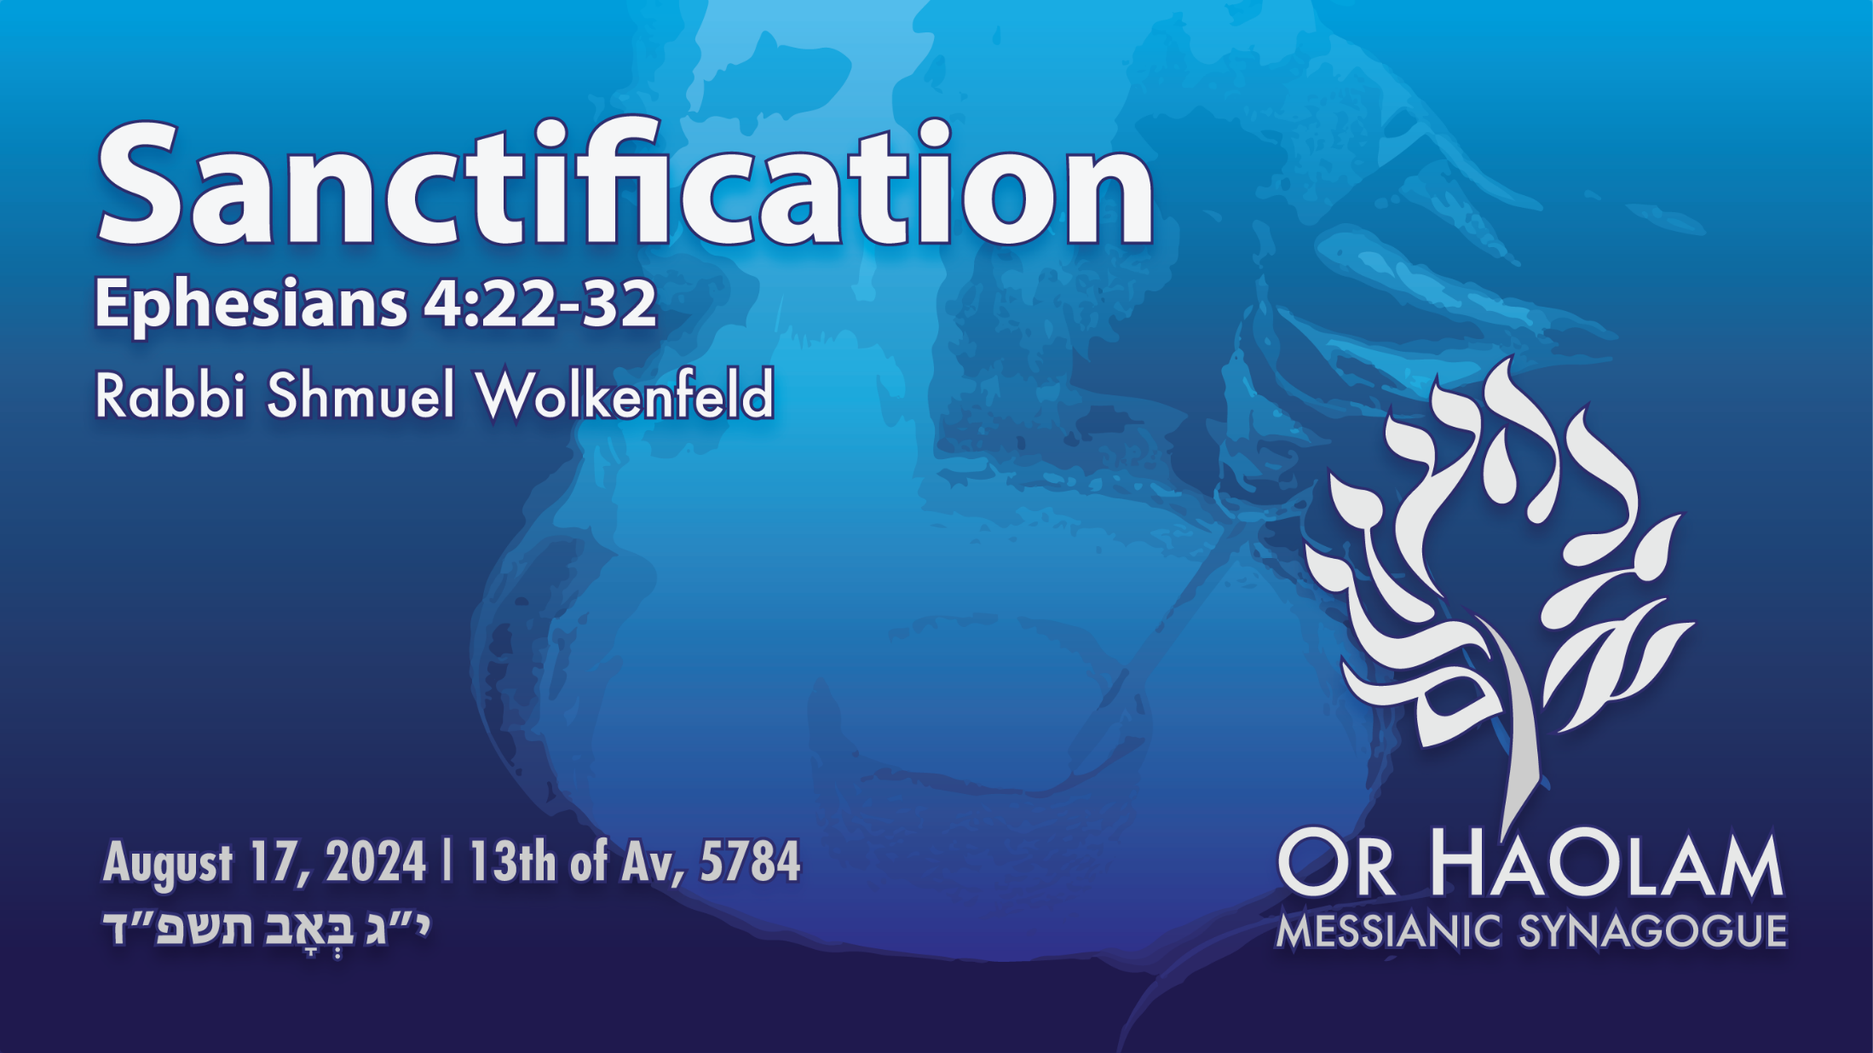
Notes:
graphic of refining fire.

Slide 10

Sanctification
The need
Seek Him for filling NOW
Practical applications

Slide 11
Sanctification
The need
Seek Him for filling NOW
Practical applications

Slide 12

The Vision of Or HaOlam:
Working to bring Jewish people, and those grafted in, to their covenantal identity in Messiah. Implies:

Slide 13
1.) Salvation through the Atonement of the Messiah; personal faith in the atoning death and resurrection of Yeshua; it's all about the King.
But, what is salvation?
Notes:
There are three more major implications, but this is the one we’ll explore today.

Slide 14
From our Statement of Faith

Slide 15
I am enjoying or seeking the indwelling of the Holy Spirit, empowering me to live a holy and effective life.
^{Yeer-m’ya-hu (Jeremiah) 31: 32} “I will put My Torah within them. Yes, I will write it on their heart. I will be their God
and they will be My people.
Notes:
What does that mean? Self evident?

Slide 16
Hebrew thinking underlying this.
Sanctification קִדּוּשׁ Kiddush noun
Holiness קְדֻשָּׁה K’dusha noun
Holy קָדוֹשׁ Kadosh adj
separate, morally pure, bright
Notes:
All these terms are related in the thinking of the authors. Don’t sound alike in English.
Sanctification the noun describing the action, the transformation.
Holiness is the condition we are aim to attain.
Holy is the adjective describing people or things which have been sanctified, make holy.

Slide 17
Hebrew thinking underlying this.
Sanctification קִדּוּשׁ Kiddush noun
Holiness קְדֻשָּׁה K’dusha noun
Holy קָדוֹשׁ Kadosh adj
separate, morally pure, bright
This is our purpose, our goal. To be holy, to share holiness.

Slide 18
What does it mean to become Holy by the power of the Ruakh HaKodesh, the Holy Spirit?

Slide 19
Is that a crisis or a process?
Notes:
Continuing the series in the Book of Ephesians.
As a new believer in Bible College, it was a big deal to get sanctified, get filled with the Spirit, get renewed, get your heart purified.

Slide 20
Why is this important?

Slide 21
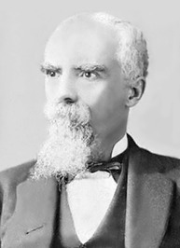
“The believers are looking for better methods; God is looking for better men [and women].”
― E.M. Bounds, Power Through Prayer
Notes:
https://www.goodreads.com/author/show/942850.E_M_Bounds

Slide 22
“What the Congregations need to-day is not more machinery or better, not new organizations or more and novel methods, but men and women whom the Holy Spirit can use -- men and women of prayer, mighty in prayer.”
Notes:
https://www.goodreads.com/author/quotes/942850.E_M_Bounds

Slide 23
The Holy Spirit does not flow through methods, but through men and women. He does not come on machinery, but on men and women. He does not anoint plans, but men and women -- of prayer.” E.M. Bounds, Power Through Prayer
Notes:
https://www.goodreads.com/author/quotes/942850.E_M_Bounds

Slide 24
Ephesians 4.22-32

Slide 25
^{Eph. 4.22-32} With respect to your former lifestyle, you are to lay aside the old self corrupted by its deceitful desires, be renewed in the spirit of your mind, and put on the new self—created to be like God in true righteousness and holiness.
Notes:
Note, Shaul/Paul is writing to believers. This NOT about getting to first know the L-rd. This is about the rest of the story, as Paul Harvey used to say.

Slide 26
^{Eph. 4.22-32} So lay aside lying and “each one of you speak truth with his neighbor,” for we are members of one another. “Be angry, yet do not sin.” Do not let the sun go down on your anger, nor give the devil a foothold.

Slide 27
^{Eph. 4.22-32} The one who steals must steal no longer—instead he must work, doing something useful with his own hands, so he may have something to share with the one who has need. Let no harmful word come out of your mouth, but only what is beneficial for building others up according to the need,

Slide 28
^{Eph. 4.22-32} so that it gives grace to those who hear it. Do not grieve the Ruach ha-Kodesh of God, by whom you were sealed for the day of redemption. Get rid of all bitterness and rage and anger and quarreling and slander, along with all malice.

Slide 29
^{Eph. 4.22-32} Instead, be kind to one another, compassionate, forgiving each other just as God in Messiah also forgave you.

Slide 31
Sanctification
The need
Seek Him for filling NOW
Practical applications

Slide 32
^{Eph. 4.22-32} With respect to your former lifestyle, you are to lay aside the old self corrupted by its deceitful desires,
Notes:
Consider the word picture.
How long can it take to remove a garment?

Slide 33
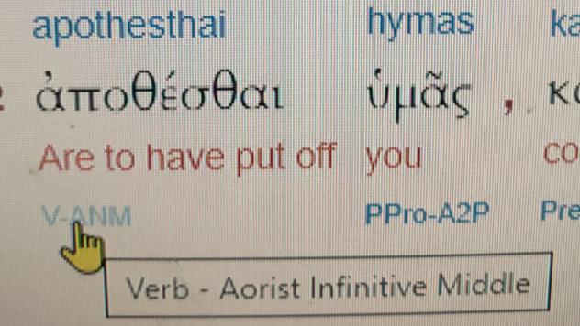
Notes:
Aorist tense means a definite, completed action. A crisis point.

Slide 34
The aorist describes an event as a complete action rather than one that was ongoing, unfolding, repeated, or habitual.
Notes:
https://en.wikipedia.org/wiki/Aorist_(Ancient_Greek)

Slide 35
An English speaker might say either "The tree died" or "The tree was dying," which communicate similar things about the tree but differ in aspect. In ancient Greek, these would be stated, respectively, in the aorist and imperfect.
Notes:
https://en.wikipedia.org/wiki/Aorist_(Ancient_Greek)
A definite event.

Slide 36
Completed Action
^{Ro 6.6-7} We know that our old self was put to death on the execution-stake with him, so that the entire body of our sinful propensities might be destroyed, and we might no longer be enslaved to sin. For someone who has died has been cleared from sin.
Notes:
Death is complete

Slide 37
^{Eph. 4.22-32} With respect to your former lifestyle, you are to lay aside the old self corrupted by its deceitful desires,
Notes:
How long can it take to remove a garment?
But I put it off, an it comes back!
True, but there is a decision point, a crisis point.

Slide 38
Some compare this to the Gan Eden replacement of the fig leaves with the animal skins.
^{Ber/Gen 3.21} Adoni Elohim made Adam and his wife tunics of skin and He clothed them.
Notes:
False, debauched covering with garments of redemption

Slide 39
So there is a crisis, a point in time putting off of the old life, a specific decision point.
But it’s not a stand alone operation.

Slide 40
^{Eph. 4.22-32} be renewed in the spirit of your mind, and put on the new self—created to be like God in true righteousness and holiness.
Notes:
Crisis and process.
Barney Kasdan: not merely laundering the old clothes. Not self improvement. Death to self. Writing to believers, so this was more than initial salvation.
Yetzer hara → Yetzer hatov
יצר הרע --> יצר הטוב

Slide 41
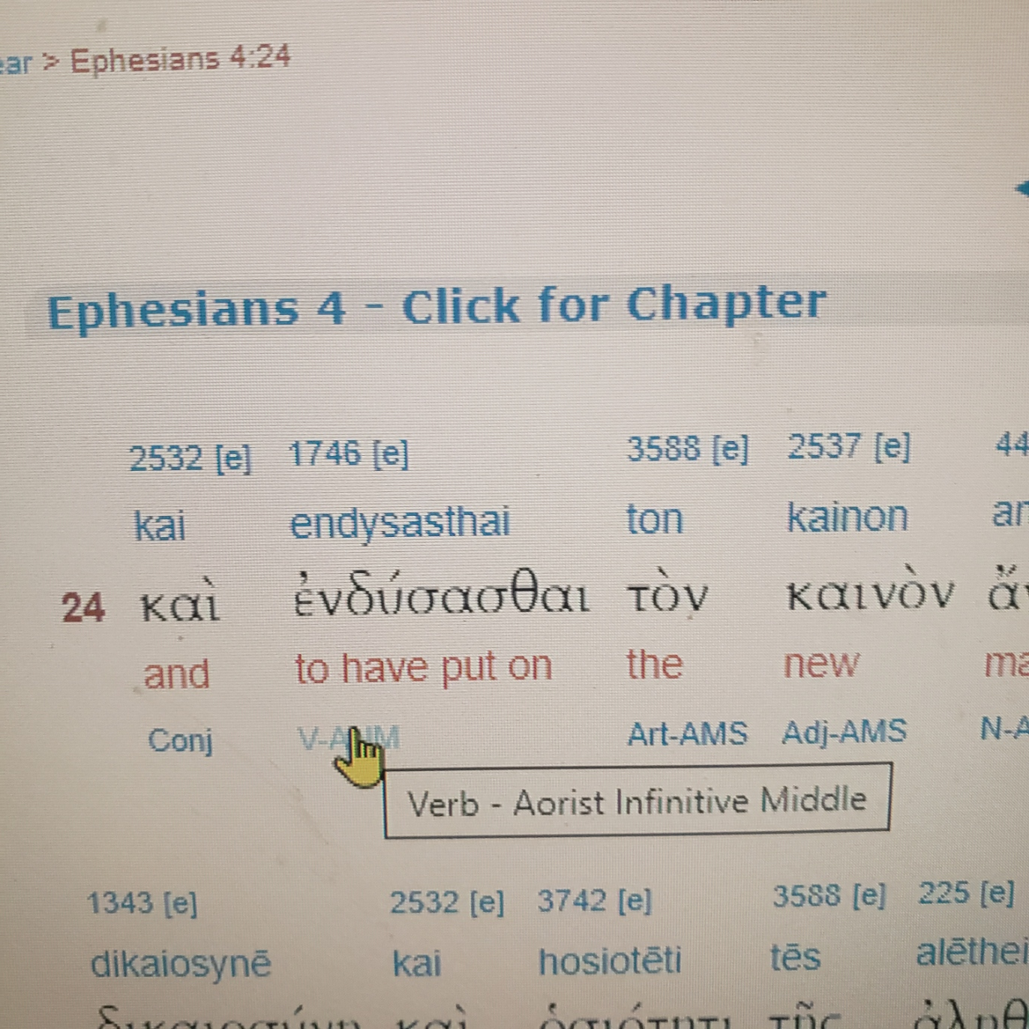

Slide 42
The Tanakh is full of examples of G-dly clothing: strength
^{Yeshayahu 52.1} Awake, awake! Clothe yourself in your strength, Zion! Clothe yourself in beautiful glorious garments, Yerushalayim, the holy city!

Slide 43
^{Ps 132.9} May your cohanim be clothed with righteousness; may those loyal to you shout for joy.
G-d is clothed with majesty and honor.
Notes:
Perkins p 32 Marine

Slide 44
^{Yeshayahu/Is 61.10} I am so joyful in Adoni! My soul rejoices in my God, for he has clothed me in salvation, dressed me with a robe of triumph, like a bridegroom wearing a festive turban, like a bride adorned with her jewels.

Slide 45
There is a distinct change point in a believers life, of putting off the old corrupted self, and putting on the new self.
It may need to be repeated, but there IS a growth point.

Slide 46
^{Acts 19.2-7} [Shaul] said to them, “Did you receive the Ruach ha-Kodesh since you believed?” They replied to him, “No, we’ve never even heard that there is a Ruach ha-Kodesh. He said, “Into what were you immersed?”
Notes:
They were believers, but hadn’t gone through the second change point.

Slide 47
^{Acts 19.2-7} They said, “Into John’s immersion.” Paul said, “John immersed with an immersion of repentance, telling the people that they should believe in the One coming after him—that is, in Yeshua.”

Slide 48
^{Acts 19.2-7} When they heard this, they were immersed in the name of the Lord Yeshua. And when Paul laid hands upon them, the Ruach ha-Kodesh came upon them, and they began speaking in tongues and prophesying. In all, there were about twelve men.
Notes:
There is the key thing, the Ruakh coming upon them. Speaking in tongues is an ancillary blessing, doesn’t always happen.

Slide 49
^{Yekhez 36. 24-28} For I will take you from among the nations, gather you from all the countries, and return you to your own soil. Then I will sprinkle clean water on you, and you will be clean; I will cleanse you from all your uncleanness and from all your idols. I will give you a new heart and put a new spirit inside you;

Slide 50
^{Yekhez 36. 24-28} I will take the stony heart out of your flesh and give you a heart of flesh. I will put my Spirit inside you and cause you to live by my laws, respect my rulings and obey them. You will live in the land I gave to your ancestors.You will be my people, and I will be your God.

Slide 51
So, seek NOW, today
Take off old nature, put on new
Be filled with the Ruakh
Be sanctified [made holy] wholly 1 Thes 5.23-24
Notes:
Are you ready?
Have you already?
Did you lose that filling. Redo!

Slide 53
Sanctification
The need
Seek Him for filling NOW
Practical applications
Notes:
Things to commit to for filling

Slide 54
^{Eph. 4.22-32} So lay aside lying and “each one of you speak truth with his neighbor,” for we are members of one another.
Notes:
Implication here and re stealing that Shaul was addressing former slaves.
All speech was now Kiddush HaShem
קידוש השם " sanctification of the Name") is a precept of Judaism. In rabbinic sources and modern parlance, it refers to private and communal conduct that reflects well, instead of poorly, on the G-d and His people.
Reflecting prophetic vision of Zekhariah.

Slide 55
^{Zekh 8.16} These are the things that you are to do: speak the truth one to another; administer the judgment of truth and shalom in your gates.

Slide 56
^{Eph. 4.22-32} “Be angry, yet do not sin.” Do not let the sun go down on your anger, nor give the devil a foothold.
Notes:
another thing to commit to if seeking the filling: put off/ put on

Slide 57

^{T’hillim/ Ps 4.4} Tremble, but do not sin!
רָגַז ragaz
quake, be excited, perturbed
to be agitated, quiver
Notes:
Shaking with rage, but not sin !?

Slide 58
It is possible to be angry
and NOT sin.

Slide 59
^{Yokhanan 2. 13-17} It was almost time for the festival of Pesach in Y’hudah, so Yeshua went up to Yerushalayim. In the Temple grounds he found those who were selling cattle, sheep and pigeons, and others who were sitting at tables exchanging money.

Slide 60
In the Temple were the bazaars pf the sons of Annas which corrupted the Temple and “beat the people with staves.”
^{Tractate Pesakhim 57a}
Notes:
Barney Kasdan Ephesians p 76

Slide 61
^{Yokhanan 2. 13-17} He made a whip from cords and drove them all out of the Temple grounds, the sheep and cattle as well. He knocked over the money-changers’ tables, scattering their coins; and to the pigeon-sellers he said,

Slide 62
^{Yokhanan 2. 13-17} “Get these things out of here! How dare you turn my Father’s house into a market?” (His talmidim later recalled that the Tanakh says, “Zeal for your house will devour me.”) Ps 69.10

Slide 63
But if we mess up,
and get into sinful anger,
sunset, or at least bedtime
is the deadline to fix it!

Slide 64
^{Dvarim/Dt 24.14-15} “You are not to oppress a hired servant who is poor and needy, whether he is from your brothers or the outsiders in your land within your town gates.

Slide 65
^{Dvarim/Dt 24.14-15} On that day you are to give him his wages—the sun is not to set on it—for he is poor and sets his heart on it. Otherwise he will cry out against you to Adoni, and you will have sin on you.

Slide 66
The Greek Pythagoreans had a rule, “If at any time in a passion they broke out into opprobrious language, before the sun set they gave one another their hands, and with them a discharge from all injuries…concluded as friends.”
Notes:
Plutarch, as quoted by JK McKee p 168.

Slide 67
^{Eph. 4.22-32} “Be angry, yet do not sin.” Do not let the sun go down on your anger, nor give the devil a foothold.
Unforgiven offense, and stewing anger, is a GREAT avenue for satanic entrance and stronghold. It’s like taking a poison pill and waiting for the other person to die!
Notes:
Barney Kasdan p 77

Slide 68
^{Eph. 4.22-32} The one who steals must steal no longer—instead he must work, doing something useful with his own hands, so he may have something to share with the one who has need.
Notes:
Another thing to commit to relative to putting off/ putting on

Slide 69

Notes:
We have this mentality, almost idolatry, of the 4 year degree. My family, children of immigrants did.
mikeroweworks.org/

Slide 70
mikeroweworks.org/
Notes:
https://youtu.be/JxTBJDCK_eg
https://youtu.be/hkFpsILh3pc

Slide 71


Slide 72
^{Eph. 4.22-32} Let no harmful word come out of your mouth, but only what is beneficial for building others up according to the need,
Notes:
Working definition of evil, harmful speaking: Sharing negative information with people who are not part of the problem, nor part of the solution. Need to know.

Slide 73
^{Eph. 4.22-32} so that it gives grace to those who hear it. Do not grieve the Ruach ha-Kodesh of God, by whom you were sealed for the day of redemption. Get rid of all bitterness and rage and anger and quarreling and slander, along with all malice.

Slide 74
^{Eph. 4.22-32} Instead, be kind to one another, compassionate, forgiving each other just as God in Messiah also forgave you.

Slide 76
Sanctification
The need
Seek Him for filling NOW
Practical applications

Slide 78
Prayer points
Our filling with the Ruakh
Destruction of Hamas
Spiritual liberation in Messiah
Liberation of the captives
Destruction of the Iranian regime by revival

Slide 79
Since the start of the Israel-Hamas war, some 10,056 wounded soldiers and security organization members have been absorbed by the Defense Ministry's Rehabilitation Department, the department said Wednesday.
Notes:
https://www.jpost.com/breaking-news/article-814696?
From GK, a founding congregant now in Israel

Slide 80
The department predicted that by 2030, there would be 100,000 IDF disabled cared for by the department, 50% of whom would be facing mental health injuries.
Notes:
https://www.jpost.com/breaking-news/article-814696?
From GK, a founding congregant now in Israel

Slide 81
Military historian Uri Milstein called Sagi “one of those exceptional individuals in human history who can intellectualize the battlefield without any prior experience or training. Napoleon was one such individual.”
Notes:
https://www.israeltoday.co.il/read/legendary-israeli-general-time-to-take-out-irans-leadership/?mc_cid=9e5e6865e3&mc_eid=9f06d9f262

Slide 82
Talking about today’s war on Israel’s borders, he said that Jerusalem needs to stop fearing the Islamic Republic and hit it where it hurts: Kharg Island, south of Khuzestan. “That’s all,” he added.
Notes:
https://www.israeltoday.co.il/read/legendary-israeli-general-time-to-take-out-irans-leadership/?mc_cid=9e5e6865e3&mc_eid=9f06d9f262

Slide 83
Kharg Island is a small island (12.3 square miles), situated 16 miles off the coast of Iran in the Persian Gulf. The island’s oil terminal accounts for more than 90% of Iran’s crude exports.
Notes:
https://www.israeltoday.co.il/read/legendary-israeli-general-time-to-take-out-irans-leadership/?mc_cid=9e5e6865e3&mc_eid=9f06d9f262

Slide 84
“All Israel has to do is send a few drones over the island. This will send the Iranians a clear message. If they don’t get it—escalate the situation. First mildly, then severely if we must. They will order their proxies to stop firing at us.
Notes:
https://www.israeltoday.co.il/read/legendary-israeli-general-time-to-take-out-irans-leadership/?mc_cid=9e5e6865e3&mc_eid=9f06d9f262

Slide 85
By killing Hezbollah's Fuad Shukr in Beirut and Hamas's Ismail Haniyeh in Tehran within a 24-hour span, Israel demonstrated a commitment to total victory over its enemies. But the rest of the world, from the least free nations (China) to the freest nations (the U.S.), seems committed to saving Hamas. Jerusalem must resist these efforts.
Notes:
https://www.meforum.org/66027/israel-must-not-allow-hamas-to-survive-gaza-war?goal=0_086cfd423c-57442d49ff-33765913&mc_cid=57442d49ff&mc_eid=2515d15785

Slide 86
Chinese support for Hamas is no surprise. In December, the IDF discovered massive caches of Chinese weapons in Gaza. In 2014, the IDF disclosed that an enormous Chinese-made tunneling machine with 40 inch blades was used to dig Hamas's underground city.
Notes:
https://www.meforum.org/66027/israel-must-not-allow-hamas-to-survive-gaza-war?goal=0_086cfd423c-57442d49ff-33765913&mc_cid=57442d49ff&mc_eid=2515d15785

Slide 87
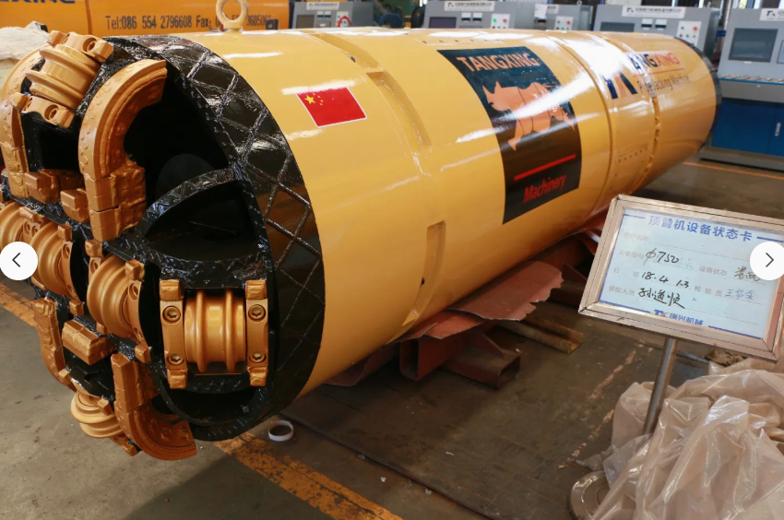
Notes:
I can’t say for sure if this was the machine used in Gaza, but it is one of the Chinese made augers.
https://tangxingglobal.en.made-in-china.com/product/WxJUyjXTgtko/China-HRC870mm-Rock-Auger-Boring-Machine-Tbm-Pipe-Jacking-Tunnel-Boring-Machine.html

Slide 88
Christian ministry leaders believe a revival is taking place in the Islamic Middle East, with more than one million leaving Islam for Christianity in Iran alone, CBN News reports.
Notes:
https://www.worthynews.com/97729-christian-ministries-report-revival-in-the-islamic-world-one-million-iranians-have-turned-to-christ

Slide 89
Prayer points
Our filling with the Ruakh
Destruction of Hamas
Spiritual liberation in Messiah
Liberation of the captives
Destruction of the Iranian regime by revival

