Slide 1
e-handout
To have these notes
without taking notes
Go to OrHaOlam.com
Click on Messages tab,
2024 Messages

Slide 2
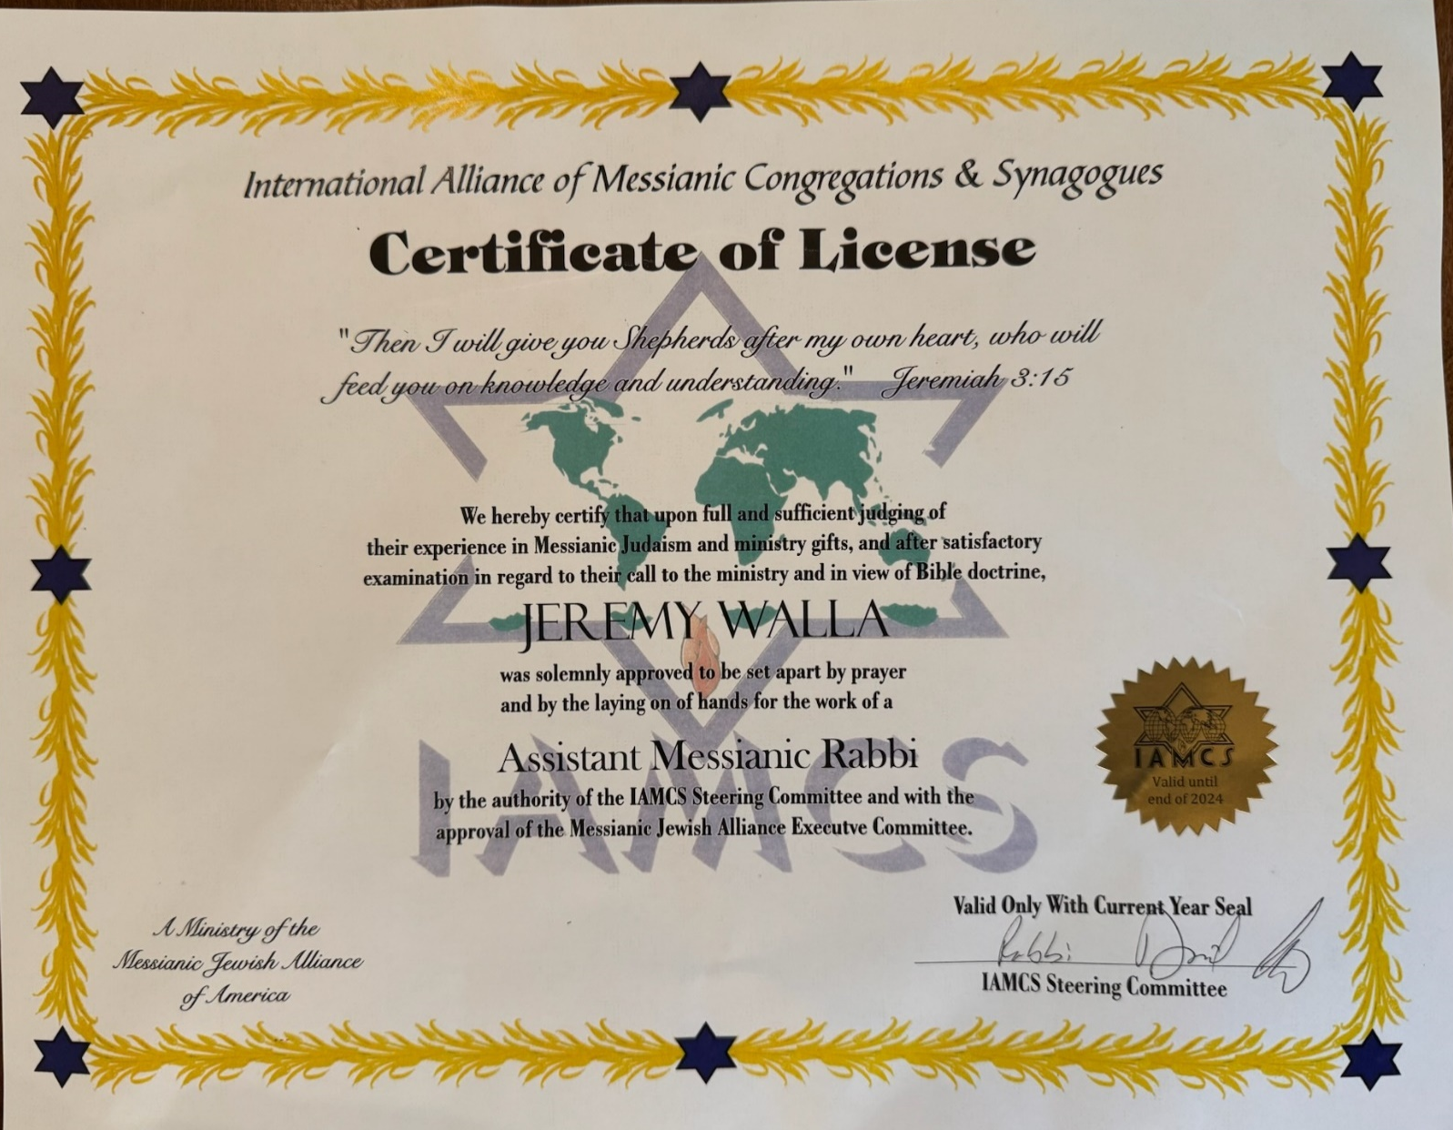

Slide 3
Last Shabbat I spoke on sanctification of believers.
Aorist Gk tense so definite change
Co-commitments with the change: truth, temper, theft, work, words.
I never really spoke of HOW it happens.
Notes:
Making us holy, significantly more Messiah like.
It may be obvious, and some prayed into it in the Third Hour of Prayer opening, but I think I should enlarge.

Slide 4
^{Eph. 4.22-32} With respect to your former lifestyle, you are to lay aside the old self corrupted by its deceitful desires, be renewed in the spirit of your mind, and put on the new self—created to be like God in true righteousness and holiness.
Notes:
How exactly do we take off the corrupted self, AND put on the new self?

Slide 5
Both
Definite point change
AND
Process change

Slide 6

Notes:
consider great artwork: refining fire!

Slide 7
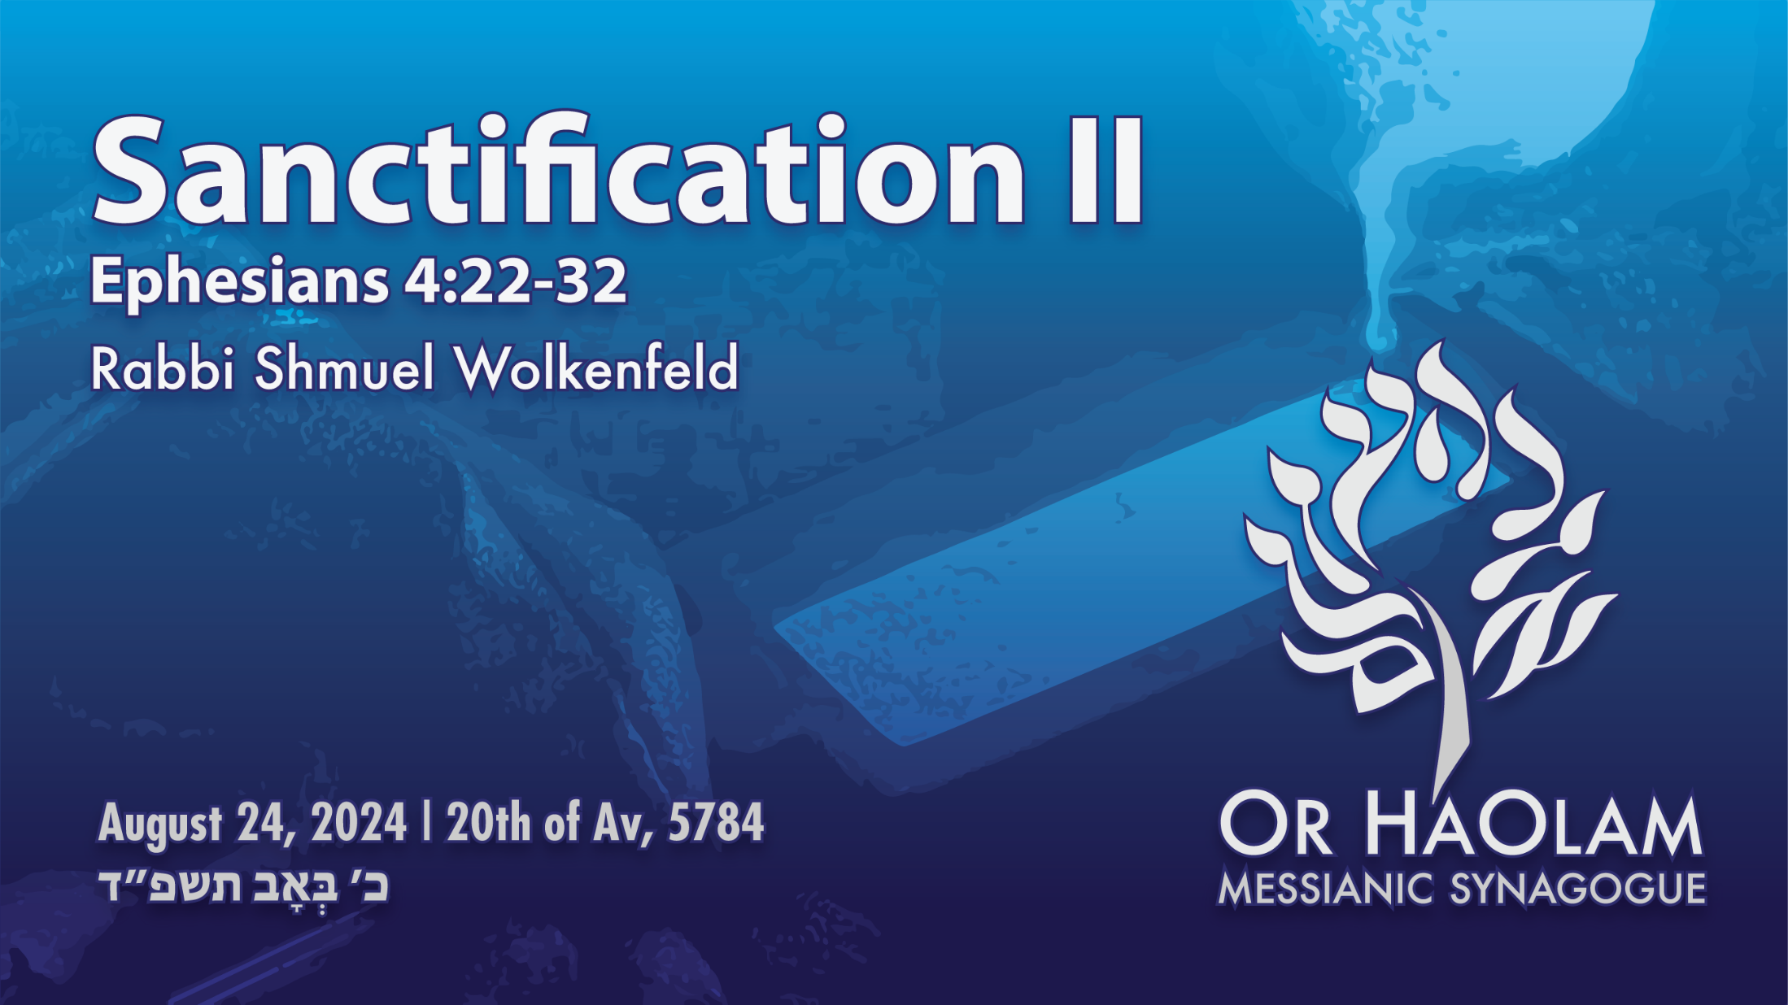

Slide 8
Sanctification Part 2 “How To”
Starters: Life change disciplines: prayer and the Word. [P]
Confess [D]
Repent / renounce. [D]
Receive the Ruakh/ Holy Spirit [D]
Set up accountability as needed. [P]
Notes:
[D] means definite point in time change.
The rest is process change..
#5 and on, “What if it doesn’t work? I am NOT changed? Still raging temper, wild lusts, hopeless depression, cringing fears, grasping jealousy and covetousness. More than temptation, I am still ruled by these things.”

Slide 9
Scripture Memorization with faith
Pursue deep healing ministries
Financial faithfulness
Immersion
Commit to Servant spirit: Work, Mike Rowe
Submission to Adversity
Notes:
I know you are thinking, “Rabbi, 11 points! We’ll never get out of here, to lunch.”

Slide 10
Sanctification Part 2 “How To”
Starters: Life change disciplines: prayer and the Word. [P]
Confess [D]
Repent / renounce. [D]
Receive the Ruakh/ Holy Spirit [D]
Set up accountability as needed. [P]

Slide 11

Notes:
First Messianic Cong I ever walked into. Spring, 1970 or 1971. I had thought I was the only Jewish believer in Messiah since Paul.
I knew it was the way Jews should worship. And welcome the Nations.

Slide 12

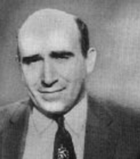
Notes:
Marty Chernoff, founder and father of David and Joel Chernoff.
https://external-content.duckduckgo.com/iu/?u=https%3A%2F%2Ftse1.mm.bing.net%2Fth%3Fid%3DOIP.ms6Md8caiUg6RJQrq1OYvgAAAA%26pid%3DApi&f=1&ipt=beaaf9402ae6f5e0b48ab19058f310f1e0eb11e56829c30140799e552895df59&ipo=images

Slide 13
from: Rabbi Shmuel Wolkenfeld via Rabbis Forum iamcsrabbisforum@gaggle.email Aug 23, 2024, 9:48 AM
I barely knew Marty in Cincinnati. But he was legendary in leadership. One thing I heard was that he required, or at least instilled in his people, was a discipline of prayer…
Notes:
Email from me Friday, yesterday morning.

Slide 14
A half hour per day maybe? If anyone can help me with the particulars of that, I would greatly appreciate it.
Shmuel
Orhaolam.com

Slide 15
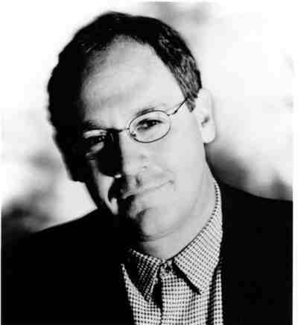
Shalom Shmuel,
My father used to preach “if you are not spending at least one hour per day (30 min. prayer/30 min. in word) you are a weak believer.”
Blessings, Joel Chernoff
Notes:
Think about that. An hour alone with the heavenly King, the Heavenly Bridegroom and King. Martin Chernoff at Beth Yeshua had doctors, lawyers, all kinds of professionals and tradesmen. Were they too busy to spend that hour? Apparently not.
Bottom line. Life process.
But, you may say, “No way I can do 30/30.”
Start with 15/15, or 10/10, or 5/5.
Your own written prayers, siddur prayers, spontaneous prayers.
You can wear t’fillin; you can pray in tongues. I usually read from my prayer list on the recliner, with coffee.
This is a basic matter of life in Messiah.

Slide 16
On to the specifics of the putting on / putting off…
Notes:
Assuming you have a daily prayer life.

Slide 17
Sanctification Part 2 “How To”
Life change disciplines: prayer and the Word. [P]
Confess [D]
Repent / renounce. [D]
Receive the Ruakh/ Holy Spirit [D]
Set up accountability as needed. [P]
Notes:
I heard beautiful confessions of failures in the inner life last Shabbat.
Examine your heart. Better yet, let the Ruakh examine your heart. Examine your youth, your favorite mental pastimes.

Slide 18
^{1 Yn 1.9} If we confess our sins, He is faithful and righteous to forgive our sins and purify us from all unrighteousness.
^{Mishlei Prov 28.13} He who conceals his sins will not succeed; he who confesses and abandons them will gain mercy.
Notes:
May take some time. Prayer here or at home.

Slide 19
^{Yaakov/Jas 5.16} Therefore, openly acknowledge your sins to one another, and pray for each other, so that you may be healed.
Notes:
Therefore we have prayer ministers.
Similar to how Amber has corrected me repeatedly that she, the midwife, doesn’t deliver babies. The mother delivers the baby. She “just” catches, assists, midwifes [vb] the baby.
Prayer ministers just guide YOU in prayer. Maybe pray for you, but you have to do most of the praying. At least in terms of agreeing with the prayer minister in your heart.
Come up after the message with an open heart to confess. All confidential. Mute that mike!! Confession as the first step to deep change, sanctification.

Slide 20
Sanctification Part 2 “How To”
Life change disciplines: prayer and the Word. [P]
Confess [D]
Repent / renounce. [D]
Receive the Ruakh/ Holy Spirit [D]
Set up accountability as needed. [P]
Notes:
Can’t just confess to brag, confess to renounce!

Slide 21
^{Mes Jews/Heb 12.1-2} Let us, too, put aside every impediment [aorist] — that is, the sin which easily hampers our forward movement — and keep running with endurance in the contest set before us, focusing on Yeshua, the initiator and perfecter of faith.
Notes:
That sense of superiority, or the flip side, a sense of inferiority that makes you suspicions of all, looking down on me. Rather, gratefulness and joy.

Slide 22
^{Mishlei Prov 28.13} He who conceals his sins will not succeed; he who confesses and abandons them will gain mercy.

Slide 23
^{1 Yn 1.6-7} If we claim to have fellowship with him while we are walking in the darkness, we are lying and not living out the truth. But if we are walking in the light, as he is in the light, then we have fellowship with each other, and the blood of his Son Yeshua purifies us from all sin.

Slide 24
^{Ro 8.13} For if you live according to the old nature, you must die; but if by the Ruakh you put to death the deeds of the body, you shall live.

Slide 25
^{Ro 6.13-14} Do not offer any part of yourselves to sin as an instrument for wickedness. On the contrary, offer yourselves [aorist] to God as people alive from the dead, and your various parts to God as instruments for righteousness. For sin will not have authority over you.

Slide 26
^{Col. 3.5-8}Therefore, put to death the earthly parts of your nature — sexual immorality, impurity, lust, evil desires and greed (which is a form of idolatry); for it is because of these things that God’s anger is coming on those who disobey him.

Slide 27
^{Col. 3.5-8} True enough, you used to practice these things in the life you once lived; but now, put them all away — anger, exasperation, meanness, slander and obscene talk.

Slide 28
^{Gal 5.24} Those who belong to the Messiah Yeshua have put their old nature to death on the stake, along with its passions and desires.

Slide 29
^{Gal 5. 19-21} And it is perfectly evident what the old nature does. It expresses itself in sexual immorality, impurity and indecency; involvement with the occult and with drugs; in feuding, fighting, becoming jealous and getting angry; in selfish ambition, factionalism, intrigue and envy; in drunkenness, orgies and things like these

Slide 30
^{Mtt 16.24-25} Then Yeshua told his talmidim [followers], “If anyone wants to come after me, let him say ‘No’ to himself, take up his execution-stake, and keep following me. For whoever wants to save his own life will destroy it, but whoever destroys his life for my sake will find it.

Slide 31
^{T’hillim / Ps 51.7-9} Behold, I was born in iniquity and in sin when my mother conceived me. Surely You desire truth in the inner being. Make me know wisdom inwardly. Cleanse me with hyssop and I will be clean. Wash me, and I will be whiter than snow.

Slide 32
^{Gal.2.19-20} I have been executed on the tree with Messiah; and it is no longer I who live, but Messiah lives in me. And the life I now live in the body, I live by trusting in Ben-Elohim [the Son of G-d] —who loved me and gave Himself up for me.

Slide 34
Sanctification Part 2 “How To”
Life change disciplines: prayer and the Word. [P]
Confess [D]
Repent / renounce. [D]
Receive the Ruakh/ Holy Spirit [D]
Set up accountability as needed. [P]

Slide 35
^{Yn 14.15-17} “If you love me, you will keep my commands; and I will ask the Father, and he will give you another comforting Counselor like me, the Spirit of Truth, to be with you forever. The world cannot receive him, because it neither sees nor knows him

Slide 36
^{Lk 11.13} So if you, even though you are bad, know how to give your children gifts that are good, how much more will the Father keep giving the Ruach HaKodesh from heaven to those who keep asking him!”

Slide 37
^{Ro 8.5-6} For those who identify with their old nature set their minds on the things of the old nature, but those who identify with the Spirit set their minds on the things of the Spirit. Having one’s mind controlled by the old nature is death, but having one’s mind controlled by the Spirit is life and shalom.

Slide 38
^{Acts 19.2-7} [Shaul] said to them, “Did you receive the Ruach ha-Kodesh since you believed?” They replied to him, “No, we’ve never even heard that there is a Ruach ha-Kodesh. He said, “Into what were you immersed?”
Notes:
They were believers, but hadn’t gone through the second change point.

Slide 39
^{Acts 19.2-7} They said, “Into John’s immersion.” Paul said, “John immersed with an immersion of repentance, telling the people that they should believe in the One coming after him—that is, in Yeshua.”

Slide 40
^{Acts 19.2-7} When they heard this, they were immersed in the name of the Lord Yeshua. And when Paul laid hands upon them, the Ruach ha-Kodesh came upon them, and they began speaking in tongues and prophesying. In all, there were about twelve men.
Notes:
There is the key thing, the Ruakh coming upon them. Speaking in tongues is an ancillary blessing, doesn’t always happen.

Slide 41
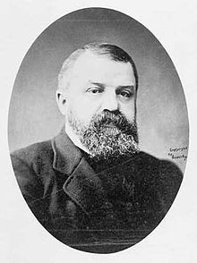
Dwight Lyman Moody (1837-1899), the greatest evangelist of the 19th century, drawing crowd of up to 30,000.

Slide 42
D.L. Moody has been influential in my personal life as I study and read about his life and ministry in the 1800's. I remember reading a story about how D.L. Moody was preparing to lead a revival throughout England to which an elderly pastor protested and said,
Notes:
George Whitten

Slide 43
"Why do we need this 'Mr. Moody'? He's uneducated, inexperienced, etc. Who does he think he is anyway? Does he think he has a monopoly on the Holy Spirit?"
Notes:
George Whitten

Slide 44
A younger, yet wiser pastor stood up and responded, "No, but the Holy Spirit has a monopoly on Mr. Moody."
Notes:
George Whitten

Slide 45
Sanctification Part 2 “How To”
Life change disciplines: prayer and the Word. [P]
Confess [D]
Repent / renounce. [D]
Receive the Ruakh/ Holy Spirit [D]
Review and meditate
Notes:
I pray and hope that there are a LOT of people seeking, at the close.

Slide 46
#5 and on, “What if it doesn’t work?
I am NOT changed? Still raging temper, wild lusts, hopeless depression, cringing fears, grasping jealousy and covetousness. More than temptation, I am still ruled by these things.”
Back to life processes

Slide 47
Sanctification Part 2 “How To”
Life change disciplines: prayer and the Word. [P]
Confess [D]
Repent / renounce. [D]
Receive the Ruakh/ Holy Spirit [D]
Set up accountability as needed. [P]
Notes:
There are some deep issues of sin, porn, addictions, that need intervention.

Slide 48
I had a personal mentor, now deceased, Gary Kivelowitz, who promoted the idea of a personal partner. Anytime a partner is tempted, he can phone or text, even at 4 a.m. Even if the partner doesn’t answer immediately, the confession has been entered. There is power.
Notes:
If you have a secret sin, establish an accountability partner. Part of process sanctification.

Slide 49
John Wesley (1703-1791) is generally considered the founder of the Methodist movement--a branch of protestant Christianity that changed British and world history, and ended the slave trade in the British Empire. [Wilberforce]
Notes:
Movie: Amazing Grace
https://www.umc.org/en/content/john-wesleys-22-questions-of-self-examination

Slide 50
In 1738 he had an intense religious experience at a meeting on Aldersgate Street in London. Following this experience, he began preaching throughout the country and forming "classes" and "bands".
Notes:
https://www.umc.org/en/content/john-wesleys-22-questions-of-self-examination
A personal mentor to me, lunchtime 1969-71.

Slide 51
In these classes and bands, members met regularly for learning and personal accountability. The following questions were used by Wesley for self-examination.
Notes:
https://www.umc.org/en/content/john-wesleys-22-questions-of-self-examination
I think that these are a bit lighter than the original

Slide 52
Am I consciously or unconsciously creating the impression that I am better than I really am? In other words, am I a hypocrite?
Am I honest in all my acts and words, or do I exaggerate?
Do I confidentially pass on to another what was told to me in confidence?
Can I be trusted?
Notes:
https://www.edtaylor.org/2016/07/27/john-wesleys-accountability-questions/
Home group curriculum?

Slide 53
Am I a slave to dress, friends, work, or habits?
Am I self-conscious, self-pitying, or self-justifying?
Did the Bible live in me today?
Do I give the Bible time to speak to me everyday?
Am I enjoying prayer?
When did I last speak to someone else about my faith?
Notes:
https://www.edtaylor.org/2016/07/27/john-wesleys-accountability-questions/

Slide 54
Do I pray about the money I spend?
Do I get to bed on time and get up on time?
Do I disobey God in anything?
Do I insist upon doing something about which my conscience is uneasy?
Am I defeated in any part of my life?

Slide 55
Am I jealous, impure, critical, irritable, touchy, or distrustful?
How do I spend my spare time?
Am I proud?
Do I thank God that I am not as other people, especially as the Pharisees who despised the publican?

Slide 56
Is there anyone whom I fear, dislike, disown, criticize, hold a resentment toward or disregard? If so, what am I doing about it?
Do I grumble or complain constantly?
Is Messiah real to me?

Slide 57
Scripture Memorization with faith
Pursue deep healing ministries
Financial faithfulness
Immersion
Commit to Servant spirit: Work, Mike Rowe
Submission to Adversity
Notes:
Ira Brawer RTF taught us.

Slide 58
^{T’hillim / Ps 1.1-3} Happy is the one who has not walked in the advice of the wicked, nor stood in the way of sinners, nor sat in the seat of scoffers. But his delight is in the Torah of Adoni, and on His Torah he meditates day and night.

Slide 59

הָגָה verb moan, growl, utter, speak, muse (only poetry) (onomatopoetic)
Notes:
Onomatopoetic the word sounds like the thing that it is. Like a fly in Hebrew is zvuv. זבוב
Hagah: muttering like repeating when memorizing.
Chewing on it.

Slide 60
^{T’hillim / Ps 1.1-3} He will be like a planted tree over streams of water, producing its fruit during its season. Its leaf never droops— but in all he does, he succeeds.

Slide 61
^{Ro 12.1} Do not be conformed to this world but be transformed by the renewing of your mind, so that you may discern what is the will of God—what is good and acceptable and perfect.

Slide 62
^{T’hillim / Ps 119.11} I treasure your word in my heart, so that I won’t sin against you.

Slide 63
^{T’hillim / Ps 119.15-16} I will meditate on your precepts and keep my eyes on your ways. I will find my delight in your regulations. I will not forget your word.

Slide 64

שִׂיחַ siakh: to muse, complain, talk (of)

Slide 65
Memorize the word
and recite to yourself in faith.
Notes:
focused on your besetting sin, weakness.

Slide 66
Scripture Memorization with faith
Pursue deep healing ministries
Financial faithfulness
Immersion
Commit to Servant spirit: Work, Mike Rowe
Submission to Adversity
Notes:
Sometimes it seems all the above inadequate. Deep wounds. Parental scars.

Slide 67


Slide 69
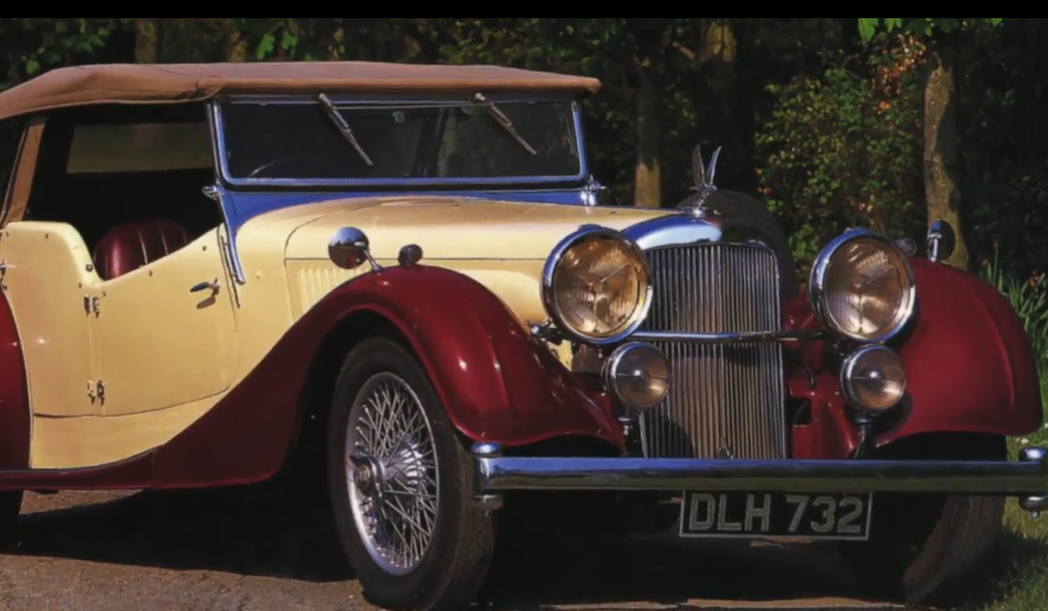


Slide 70
Alvis Car and Engineering Company Ltd was a British manufacturing company in Coventry from 1919 to 1967. In addition to automobiles designed for the civilian market, the company also produced racing cars, aircraft engines, armoured cars and other armoured fighting vehicles

Slide 71
Scripture Memorization with faith
Pursue deep healing ministries
Financial faithfulness
Immersion
Commit to Servant spirit: Work, Mike Rowe
Submission to Adversity
Notes:
I spoke at length about tithe and offerings of terumah and half shekel a few weeks ago. Not going to enlarge now. Except to say that

Slide 72
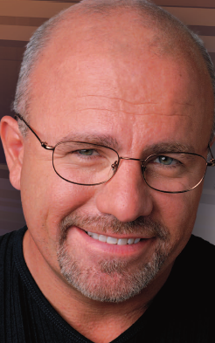

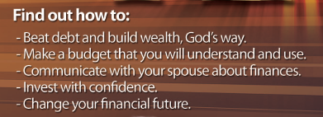
Dave
Ramsey
10/26 to 12/21

Slide 73
Scripture Memorization with faith
Pursue deep healing ministries
Financial faithfulness
Immersion: Class 1.30 today
Commit to Servant spirit: Work, Mike Rowe
Submission to Adversity
Notes:
I spoke at length about tithe and offerings of terumah and half shekel a few weeks ago. Not going to enlarge now. Except to say that

Slide 74
Class is in the doctrines of Or HaOlam. So, if you aren’t needing immersion, but want to learn, come.
Immersion service 4 p.m. tomorrow Gardner (KS) Lake, 15628 Lake Rd. 8, Gardner, KS.

Slide 75
^{Ro. 6.3-4} Don’t you know that those of us who have been immersed into the Messiah Yeshua have been immersed into his death? Through immersion into his death we were buried with him; so that just as, through the glory of the Father, the Messiah was raised from the dead, likewise we too might live a new life.
Notes:
Great celebration of music, testimony, 3 self immersion.

Slide 76
Scripture Memorization with faith
Pursue deep healing ministries
Financial faithfulness
Immersion: Class 1.30 today
Commit to Servant spirit: Work, Mike Rowe
Submission to Adversity

Slide 77
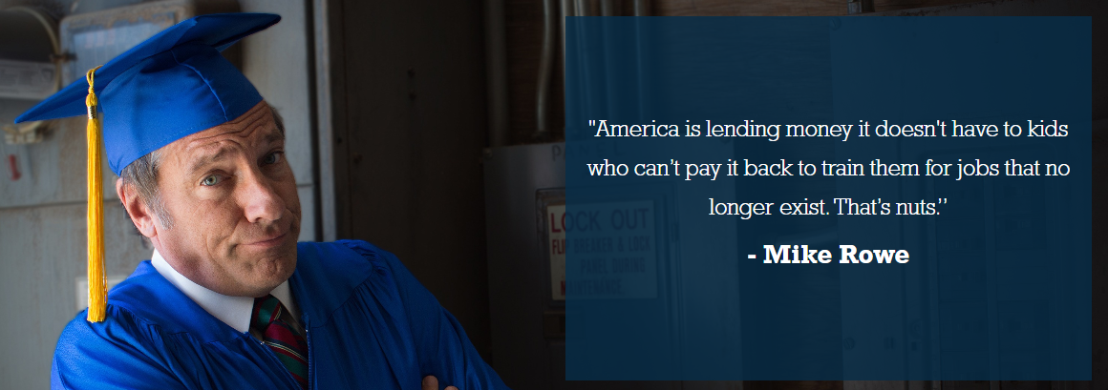
Notes:
We have this mentality, almost idolatry, of the 4 year degree. My family, children of immigrants did.
mikeroweworks.org/

Slide 78
mikeroweworks.org/
Notes:
https://youtu.be/JxTBJDCK_eg
https://youtu.be/hkFpsILh3pc

Slide 79
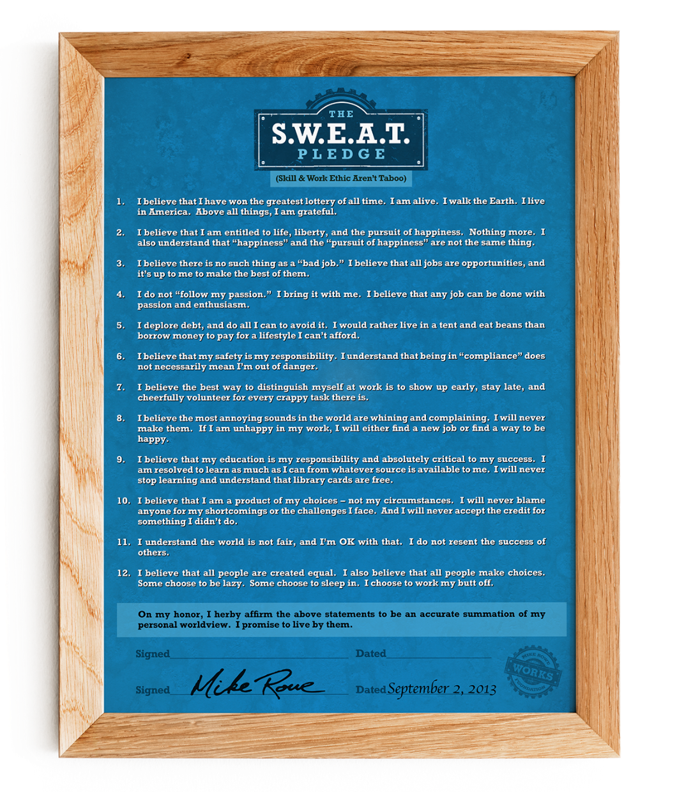
Skills and Work Ethic Aren’t Taboo.

Slide 80
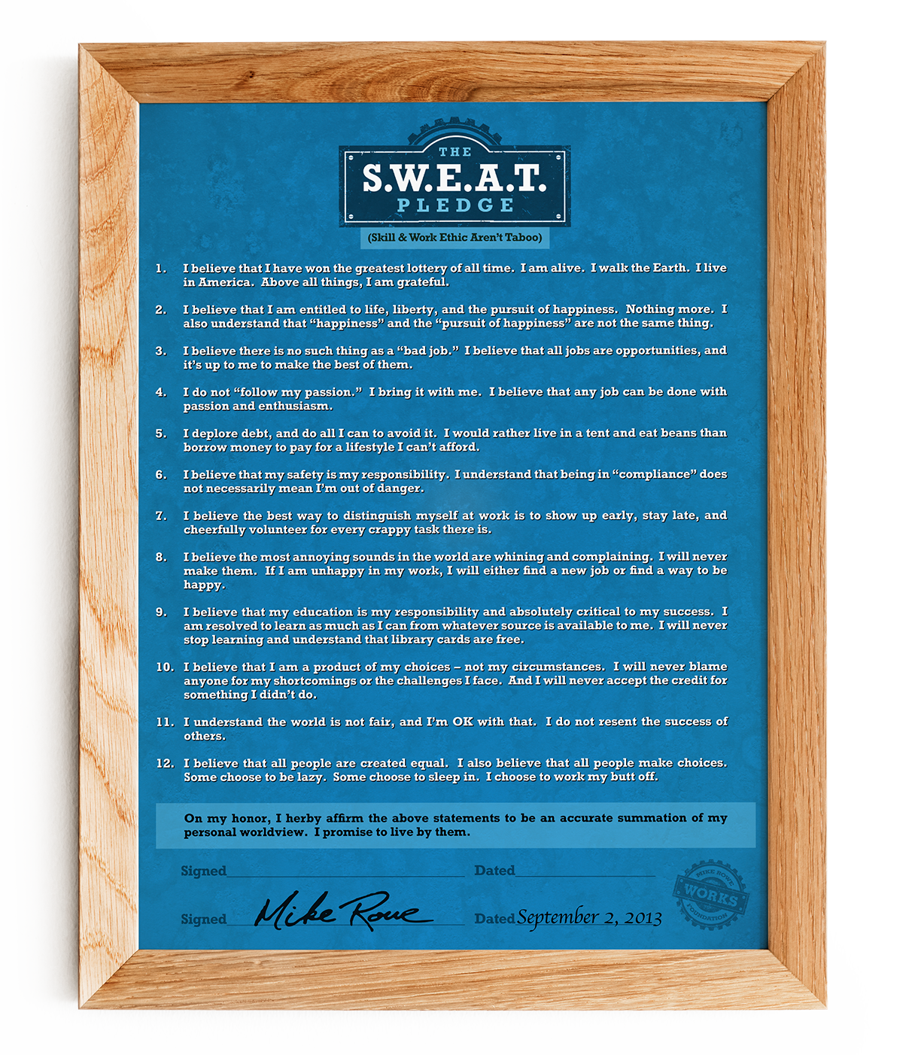
Notes:
Don’t count on the lottery to save you. If you win the lottery, and bring Or HaOlam the tithe, we will NOT accept it!
No entitlements to healthcare, housing, salary. We do LOTS of benevolence to help people in need. But no entitlements.
Smile and do it.

Slide 81
Notes:
4. Work with what you can.
5. Dave Ramsey coming up re debt. Dawn and I buy cars for cash. Making payments to the bank now for the NEXT one. Savings payments.
6. Litigious culture. Some bona fide. Not every hot cup of coffee.

Slide 82
Notes:
Rabbi Robert Solomon the flagship Messianic synagogue of Beth Hallel, Atlanta area, GE, said that the distinguishing mark of a true leader is willingness to clean toilets.
Never stop learning. I go to the Yeshiva at MJAA, even though I have taught the Yeshiva some years.

Slide 84
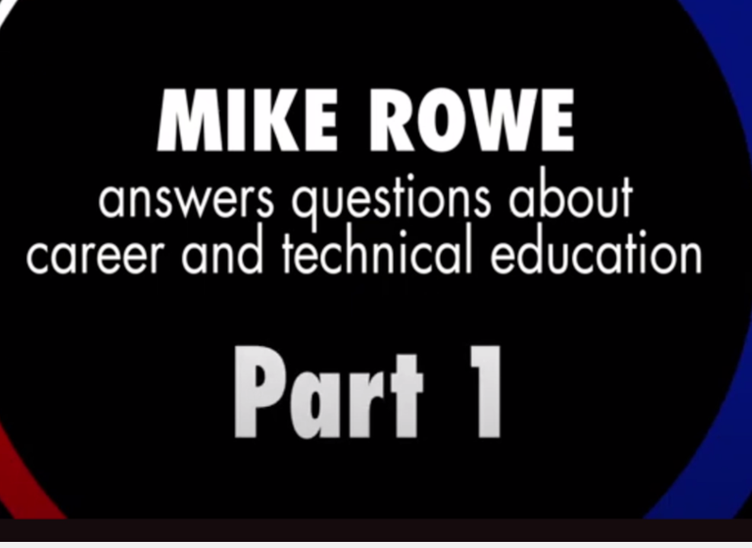

Slide 85
Scripture Memorization with faith
Pursue deep healing ministries
Financial faithfulness
Immersion: Class 1.30 today
Commit to Servant spirit: Work, Mike Rowe
Submission to Adversity
Notes:
I

Slide 86
It is good for me that I was afflicted, that I might learn your statutes. (ESV) Psalms 119:71
Nosh: David came to the uncomfortable understanding that there are some life lessons obtained only after negative and painful experiences. God truly works all things together for our good. (Romans 8:28)/
Notes:
Chuck Swindol quoted another speaker saying a man was 100x more likely to withstand affliction that to stand in prosperity. For every 1 that’s gone down in affliction, 100 have fallen to temptation in time of prosperity.

Slide 88
Sanctification Part 2 “How To”
Starters: Life change disciplines: prayer and the Word. [P]
Confess [D]
Repent / renounce. [D]
Receive the Ruakh/ Holy Spirit [D]
Set up accountability as needed. [P]
Notes:
[D] means definite point in time change.
The rest is process change..

Slide 89
Scripture Memorization with faith
Pursue deep healing ministries
Financial faithfulness
Immersion
Commit to Servant spirit: Work, Mike Rowe
Submission to Adversity

