Slide 1
e-handout
To have these notes
without taking notes
Go to OrHaOlam.com
Click on Messages tab,
2024 Messages

Slide 2
There has been a lot of political satire. Consider this…

Slide 3
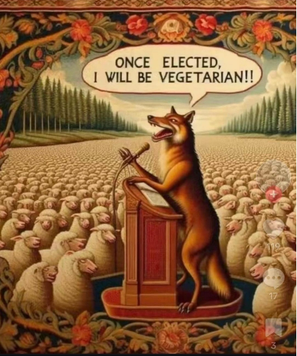

Slide 4
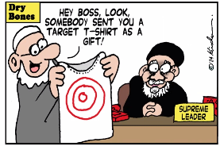
Notes:
Dave Hunt

Slide 5
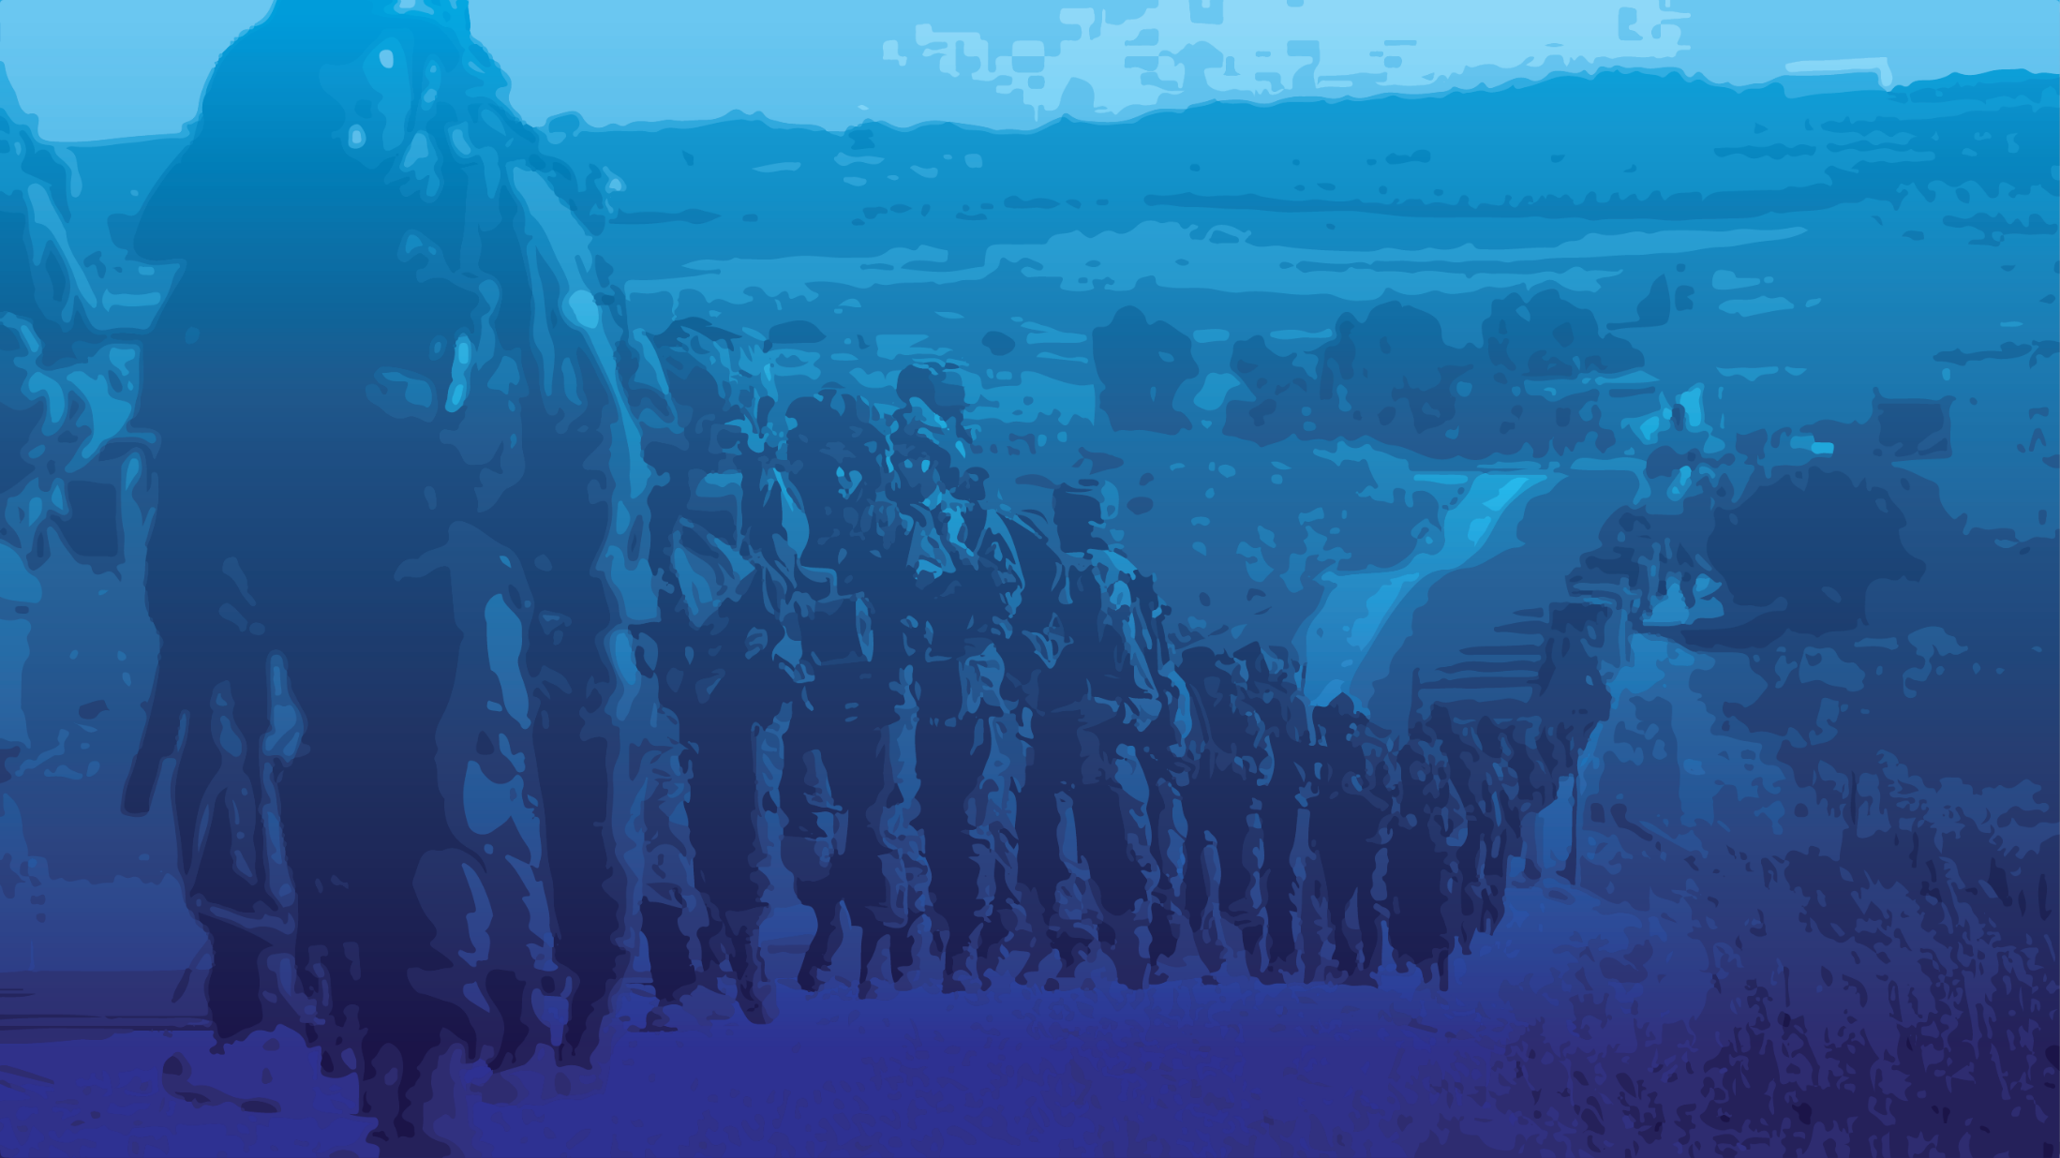

Slide 6
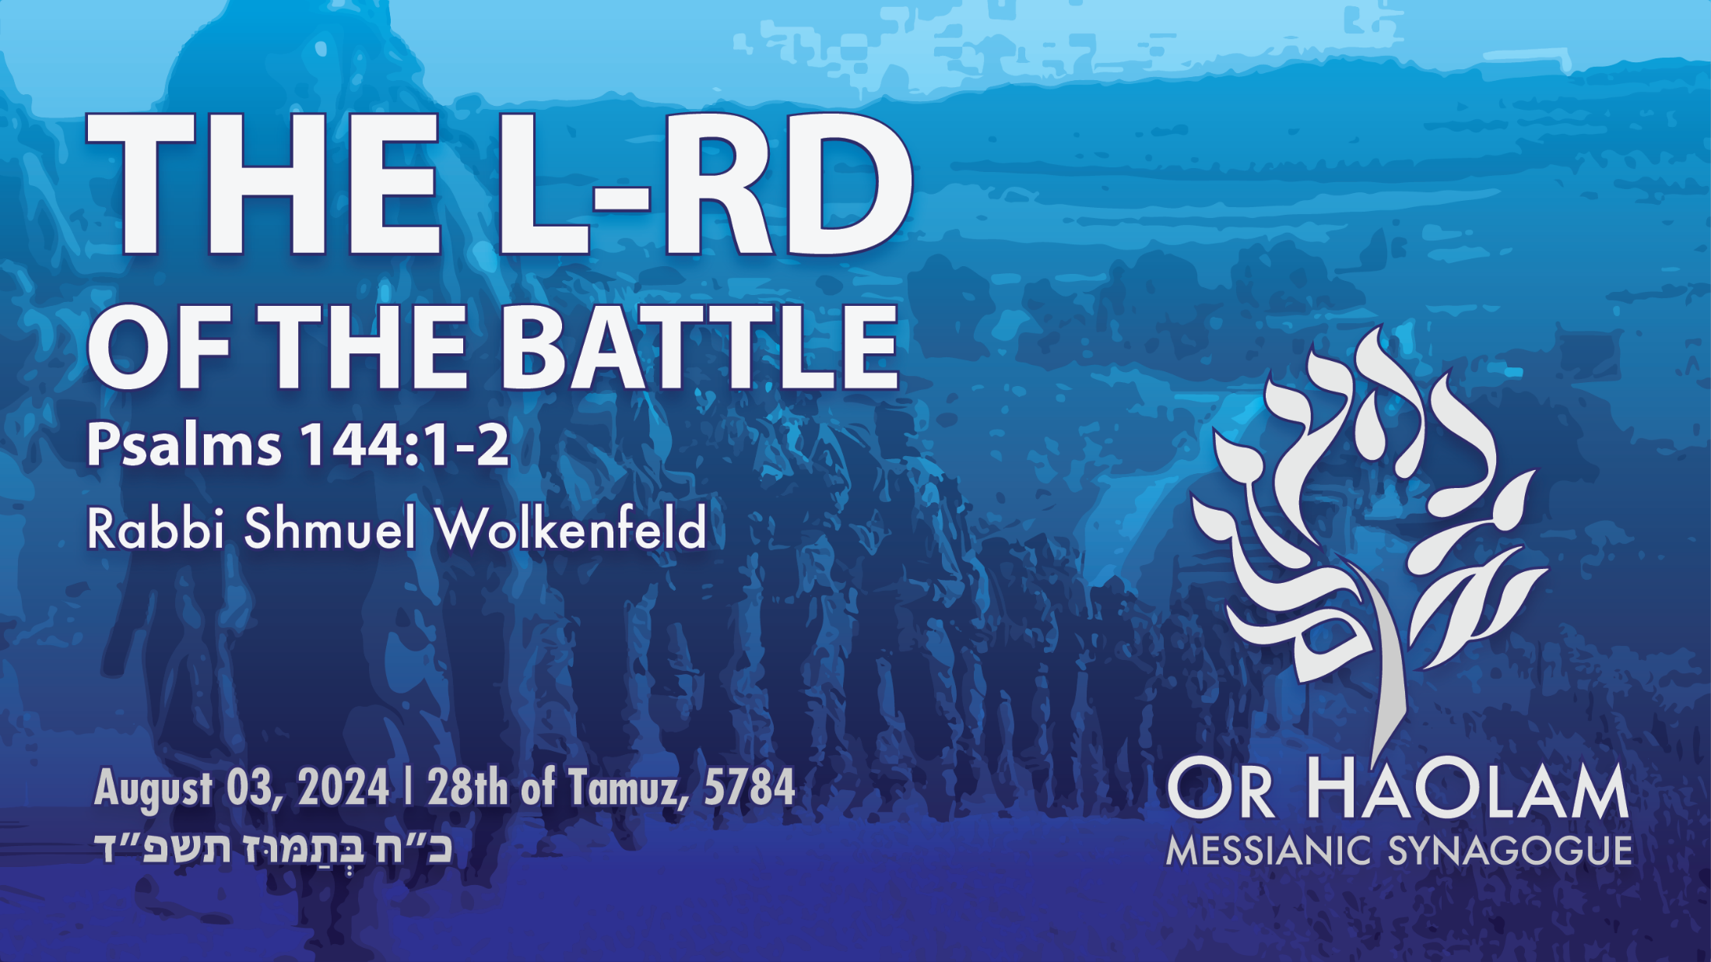

Slide 7
The L-rd of the Battle Ps 144.1-2
The words
The Seriousness of Attack
The Way of Victory

Slide 8
The L-rd of the Battle Ps 144.1-2
The words
The Seriousness of Attack
The Way of Victory

Slide 9
תְּהִילִים Psalm 144: 1,2
בָּרוּךְ יְיָ צוּרִי הַמְלַמֵּד יָדַי לַקְרַב
Barukh Adoni tsu-ree,
Ha-m'la-mayd ya-dai la-krav [repeat]
[Blessed be the LORD my Rock,
Who trains my hands for war,]

Slide 10
אֶצְבְּעוֹתַי לַמִּלְחָמָה: בָּרוּךְ יְיָ צוּרִי
Ets-b'o-ti la-meel-kha-ma,
Barukh Adoni tsu-ree.
[And my fingers for battle,
Blessed be the LORD my Rock]

Slide 11
חַסְדִי וּמְצוּדָתִי מִשְׂגַבִּי וּמְפָלְטִי לִי
Khas-dee oo-m'tsoo-da-tee,
Mees-ga-be oo-m'fal-tee lee
[My lovingkindness and my fortress,
My high tower and my deliverer]

Slide 12
מָגִנִי וּבוֹ חָסִיתִי הָרוֹדֵד עָמִי תַחְתָֽי:
Ma-gee-nee u-vo kha-see-tee,
Ha-ro-dayd amee takhtai
[My shield and the One in whom I take refuge,
Who subdues my people
under me.]

Slide 13
תְּהִילִים Psalm 144: 1,2
Phrase by phrase
בָּרוּךְ יְיָ צוּרִי
Barukh Adoni tsu-ree,
[Blessed be the LORD my Rock,

Slide 14
צָוּר tsur rock cliff, flinty rock, fortress, Gibraltar
Same word as ^{Mt 16.18} I also tell you this: you are Kefa,” [which means ‘Rock,’] “and on this rock I will build my Community, and the gates of Sh’ol will not overcome it.
Notes:
We are in a Kingdom at war.
Gates of Sh’ol, of Hell, of the enemy. Not a defensive. Gates are the enemies defenses.
“Hold the fort for I am coming” atrocious song.

Slide 15

Petros: a stone or a boulder the masculine form) however is a stone…such as a man might throw
petra: a huge mass of rock, such as a projecting cliff, Gibraltar.
Notes:
Peter, Kefa, is NOT the rock. This rock…Yeshua, His deity just confessed at Banias.

Slide 16
הַמְלַמֵּד יָדַי לַקְרַב
Ha-m'la-mayd ya-dai la-krav
Who trains my hands for war

Slide 17
מְלַמֵד m'la-mayd teaches (present tense)
קְרַב krav battle, combat
קָרַב karav come, draw near, approach
קְרוֹבים relatives 🤔
Notes:
Teaches, continually, through victories and defeats. Present tense. Ongoing learning.
We battle with our close relatives? Apparently Hebraic culture.

Slide 18
אֶצְבְּעוֹתַי לַמִּלְחָמָה
Ets-b'o-ti la-meel-kha-ma,
And my fingers for battle,
Notes:
Details. Strategies. Devices.
We tend to think of David the shepherd boy as near defenseless against the armed giant Golyat, Goliath. Not really so.

Slide 19
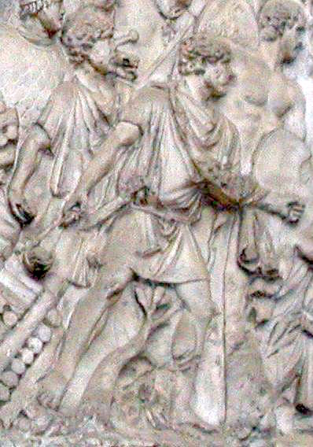
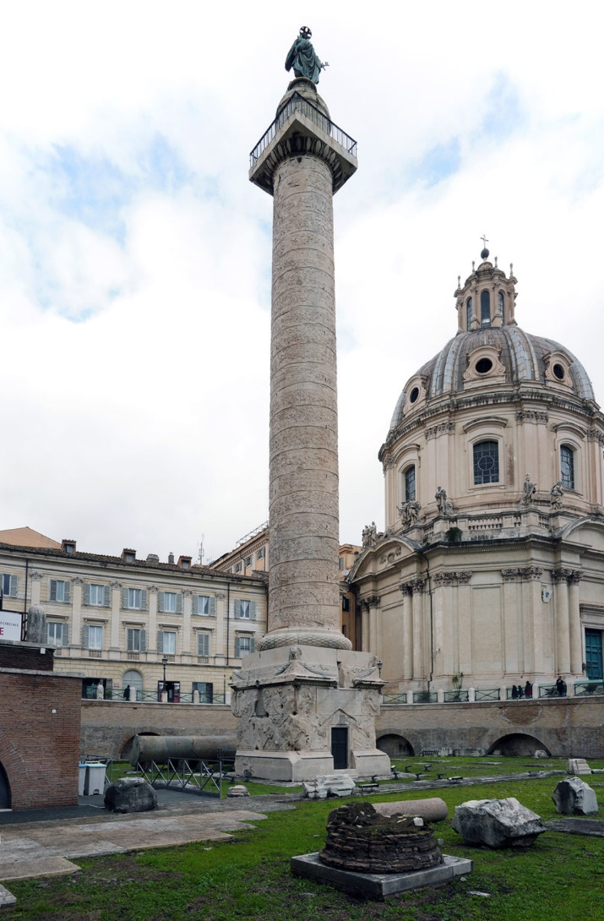
Slingers on Trajan's Column CE 113 Rome.
Notes:
https://en.wikipedia.org/wiki/Sling_(weapon)

Slide 20
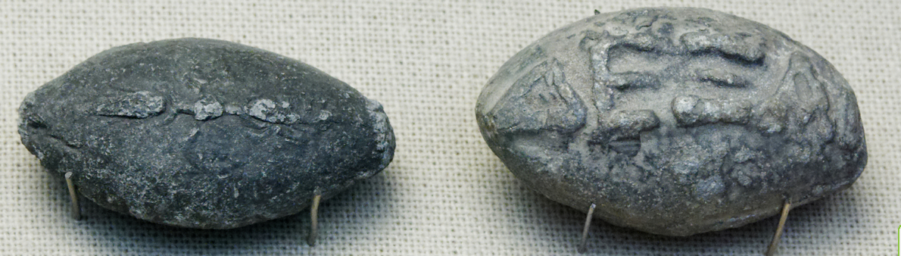
Ancient Greek lead sling bullets with a winged thunderbolt molded on one side and the inscription "ΔΕΞΑΙ" (Dexai) meaning 'take that' on the other side, 4th century BCE, from Athens, British Museum.
Notes:
https://en.wikipedia.org/wiki/Sling_(weapon)

Slide 21
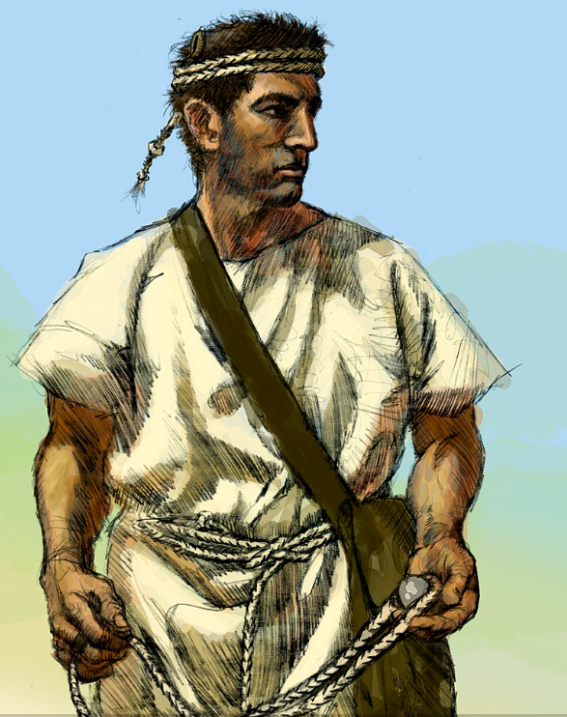
Artistic depiction of a slinger from the Balearic Islands, famous for the skill of its slingers.
Notes:
https://en.wikipedia.org/wiki/Sling_(weapon)

Slide 22
The sling could hurl a stone of 1 oz. at 62 mph to hit something 656 ft. or more away. In some battles, the weapon proved more valuable than bow and arrow, for even if an enemy soldier wore leather armor, a stone could inflict lethal internal damage.
Notes:
https://www.deseret.com/2007/7/19/20030276/strange-but-true-physics-explains-how-david-slew-goliath/

Slide 23
A sling was also more accurate and its projectile could travel farther than an arrow. So the slingers were often grouped behind the archers, who needed to be closer to the enemy to be effective.
Notes:
https://www.deseret.com/2007/7/19/20030276/strange-but-true-physics-explains-how-david-slew-goliath/

Slide 24
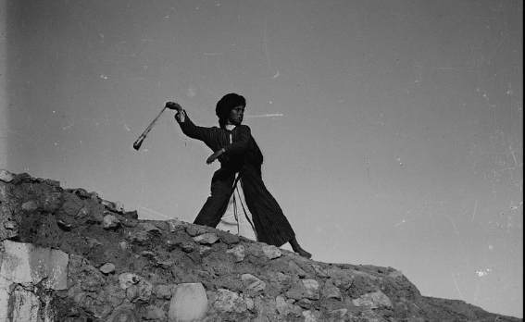
Arab shepherd boy using a sling,
c. 1900–1920, Jerusalem
Notes:
https://en.wikipedia.org/wiki/Sling_(weapon)

Slide 25
הַמְלַמֵּד יָדַי לַקְרַב
Ha-m'la-mayd ya-dai la-krav
Who trains my hands for war
So G-d expedites expert military skills.

Slide 26
Israeli forces killed Hezbollah leader Fouad Shukur in Beirut on Tuesday, while Hamas leader Ismail Haniyeh died Wednesday from an Israeli strike in Tehran. Both men caused the deaths of innocent civilians as well as Israeli and American soldiers.
Notes:
https://mailchi.mp/meforum/mef-experts-assassination-of-terrorist-leaders-means-israel-intends-to-crush-hamas?e=2515d15785

Slide 27
The New York Times reported – and other outlets like The Jerusalem Post confirmed – that Haniyeh was killed by a bomb that had been hidden, several weeks earlier, inside the room where the senior Hamas leader was staying, and that the bomb was activated remotely by Israeli Mossad agents who were on Iranian soil at the time.
Notes:
https://allisrael.com/like-spy-thriller-amazing-details-about-assassination-of-hamas-leader-haniyeh-in-tehran-start-to-emerge?

Slide 28
According to sources of the Jerusalem Post , the bomb had been smuggled into Iran and hidden in the guest house as far back as June. The house is located in an IRGC compound in a high-end suburb of northern Tehran.
During his frequent visits to Tehran over the past decade, the Hamas leader often stayed at this exact guest house, providing a clear target location for his assassination.
Notes:
https://allisrael.com/like-spy-thriller-amazing-details-about-assassination-of-hamas-leader-haniyeh-in-tehran-start-to-emerge?

Slide 29
Fuad Shukr was also behind the 1983 bombing of the US Marine barracks in Beirut that killed 241 Americans. The US had offered a $5 million bounty for him since, but it was Israel that took him out, days after he helped kill 12 Druze children in Israel.
Notes:
Will the American government pay, and thank the Israelis?

Slide 30
הַמְלַמֵּד יָדַי לַקְרַב
Ha-m'la-mayd ya-dai la-krav
Who trains my hands for war
So G-d expedites expert military skills.

Slide 31
חַסְדִי וּמְצוּדָתִי
Khas-dee oo-m'tsoo-da-tee,
[My lovingkindness and my fortress,

Slide 32
חַסְדִי khas-dee my kheh-sed, my lovingkindness
kindness, benevolence; goodness, charity, grace; (flowery) favor, grace;
מְצוּדָתִי m'tsoo-da fortress, stronghold
Notes:
seems an anomaly, lovingkindness. G-d’s soldiers have grace. Soldiers need lovingkindness in the hell of war. Stewart through reach, Avi Mizrachi, Joseph Project doing.
Soldiers give lovingkindness as well. You’ve heard of the amazing Israeli efforts to spare civilians: texts, phone calls, leaflets. Number of 30k from the Gaza Health Admin totally bogus. Like the hospital attack.

Slide 33
מִשְׂגַבִּי וּמְפָלְטִי לִי
Mees-ga-be oo-m'fal-tee lee
My high tower and my deliverer]
מִשְׂגַבִּי mees-ga-bee fortress, high place
מְפָלְטִי m'fal-tee refuge, escape. haven
Notes:
“Look, today I have set you up as a fortified city – an iron pillar and bronze walls – against the whole land, against the kings of Judah, its princes, against its kohanim (priests) and against the people of the land. Though they will fight against you, they will not win, for I am with you, to deliver you.” (TLV) Jeremiah 1:18-19

Slide 34
מָגִנִי וּבוֹ חָסִיתִי
Ma-gee-nee u-vo kha-see-tee,
My shield and the One in whom I take refuge,
Notes:
Shield of faith.

Slide 35
מָגִנִי ma-gee-nee shield, guard

Slide 36
הָרוֹדֵד עָמִי תַחְתָֽי:
Ha-ro-dayd amee takhtai
Who subdues my people
under me.
Notes:
G-d causes the people to be willing followers, not imposed and heartless like Putin. Waves of Russians to their death.
Hamas human shields.

Slide 39
The L-rd of the Battle Ps 144.1-2
The words
The Seriousness of Attack
The Way of Victory
Notes:
the attack that we are facing, although it looks so peaceful here. In a bubble.

Slide 40
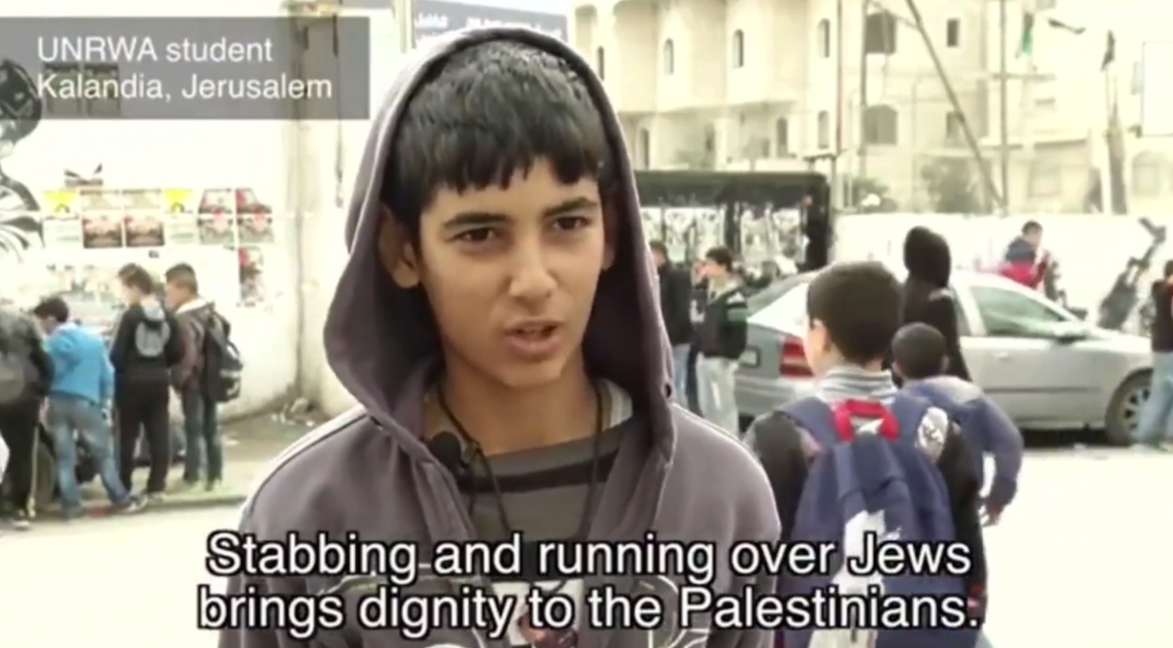
Notes:
https://x.com/VividProwess/status/1810958792315609238

Slide 41
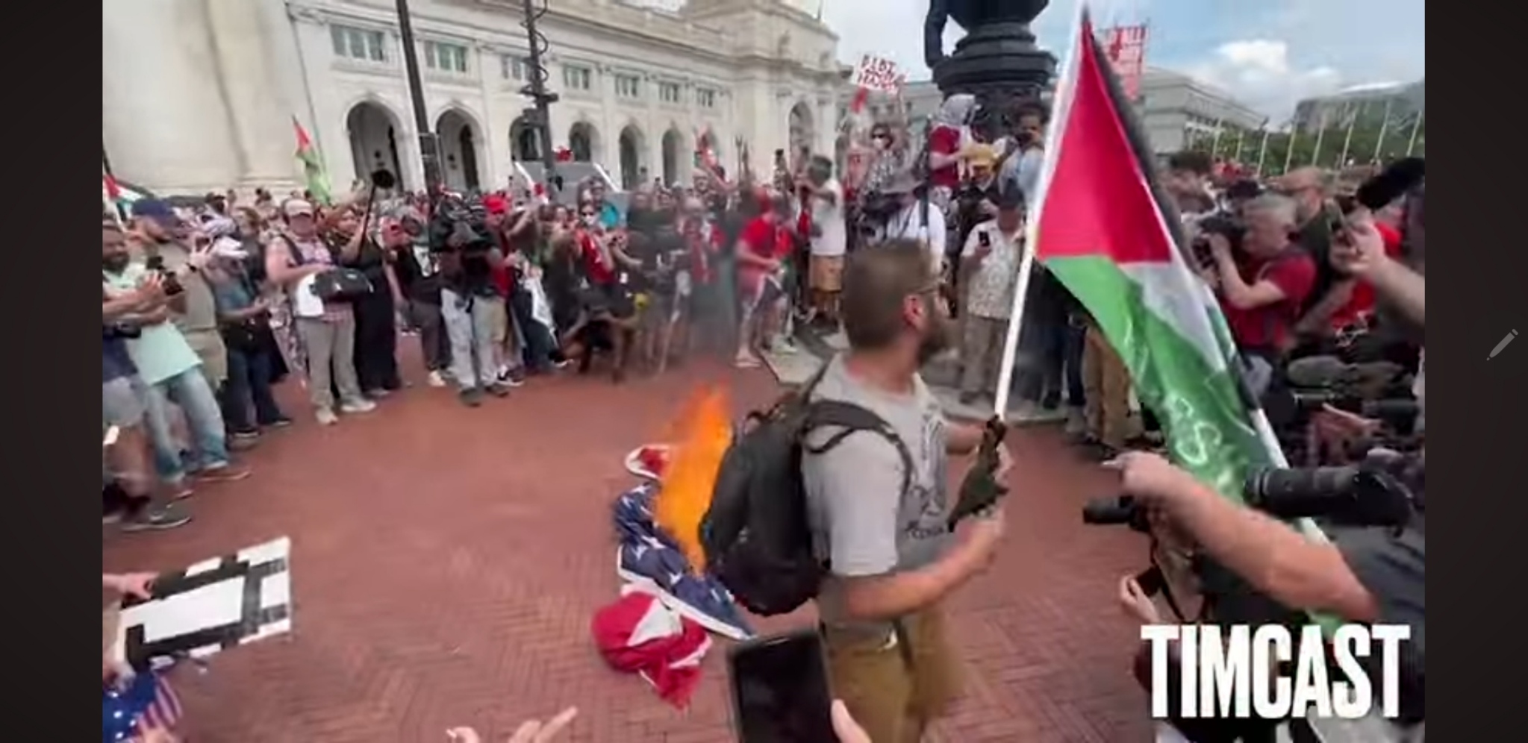

Slide 42
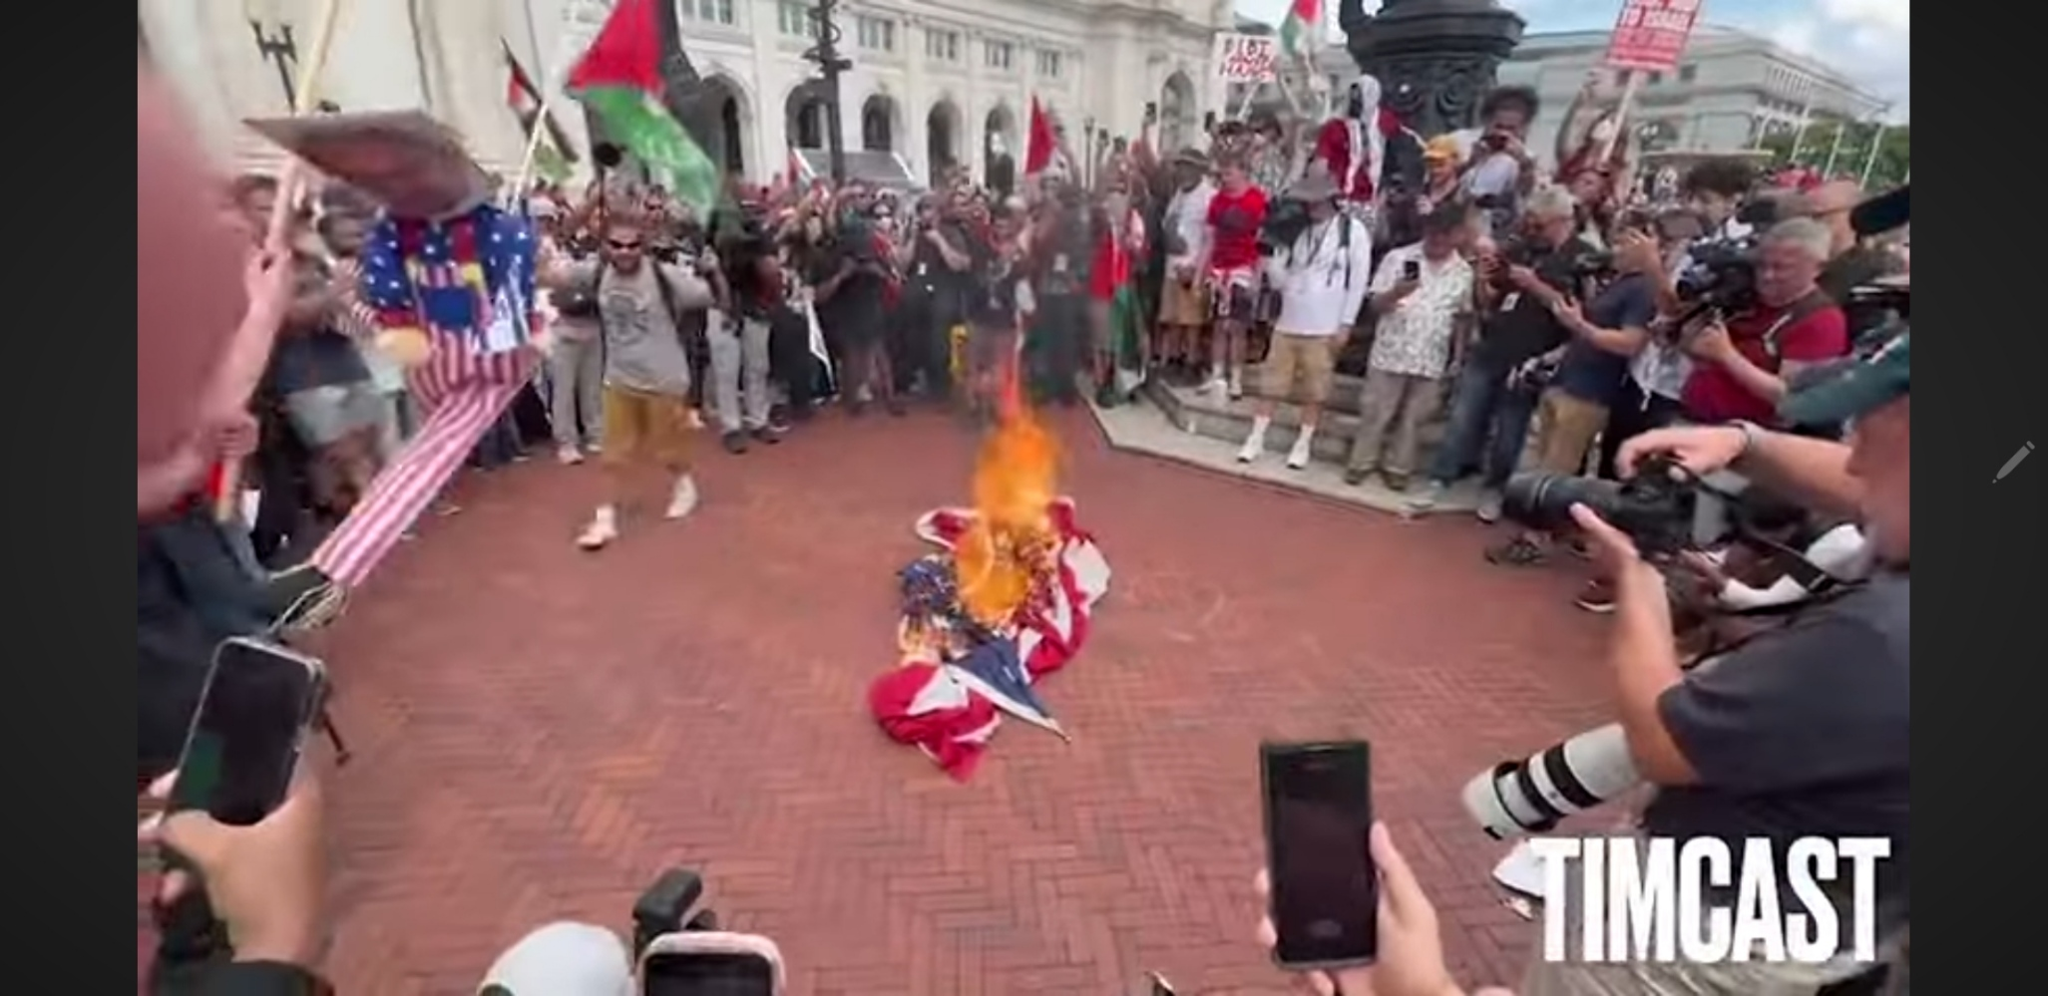
Notes:
Little media coverage. Spray paint on limestone there forever. A builder’s analysis. Trump.

Slide 43
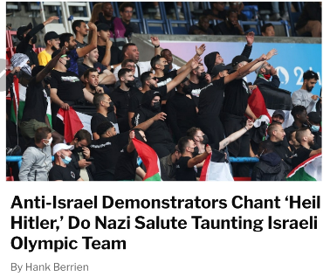

Slide 44
Four horses of Rev 6
I looked, and there in front of me was a white horse;
Another horse went out, a red one;
There…was a black horse
I saw a horse, pale greenish gray
Notes:
A really simple exposition… white, red, black, green

Slide 45
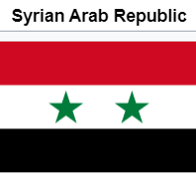
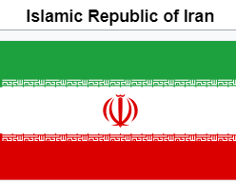
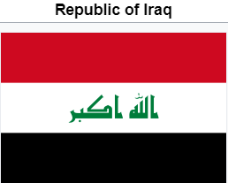
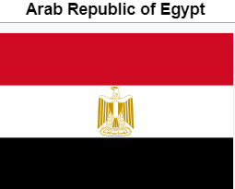
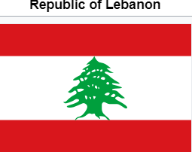
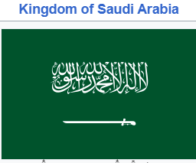
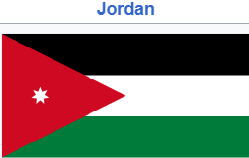

Slide 46
The pan-Arab colors are black, white, green and red. Individually, each of the four pan-Arab colors were intended to represent a certain aspect of the Arab people and their history.
Notes:
https://en.wikipedia.org/wiki/Pan-Arab_colors

Slide 47
Olympics return to Greek rank paganism and hedonism.

Slide 48
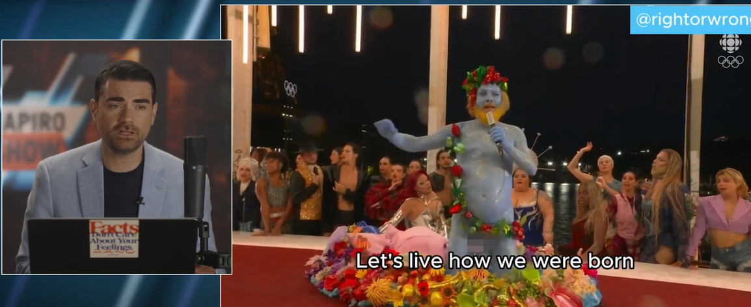
naked
Notes:
https://www.dailywire.com/episode/ep-2014

Slide 49
Performers in drag staged a blasphemous mockery of “The Last Supper,” as depicted in Leonardo Da Vinci’s iconic painting. Defenders of the performance claimed it recreated a different painting,
Notes:
https://washingtonstand.com/commentary/discipline-and-debauchery-from-the-2024-olympics-to-the-christian-walk

Slide 50
“The Feast of the Gods” by Jan Hermansz van Bijlert, which itself mimics Da Vinci’s Last Supper. They pointed to one actor depicting the Greco-Roman god of fertility, wine, and revelry, Dionysus/Bacchus.
Notes:
https://washingtonstand.com/commentary/discipline-and-debauchery-from-the-2024-olympics-to-the-christian-walk

Slide 51
It’s a deeper dilemma than a current war. There is a real cosmic war on humanity.
^{Yn 10.10} The thief comes only to steal, slaughter, and destroy. I have come that they might have life, and have it abundantly!

Slide 52


Slide 53
In a wide ranging almost 2 hour discussion of everything from AI to the future of humanity, Musk discussed his own spiritual search at age 11. [!] Musk considered the popular anti-Natalist view, and rejected it. He has 12 children. Says children are a delight.
Notes:
Genius boy: read Bible, Koran,

Slide 54
Anti-natalism is a family of philosophical views that are critical of reproduction — they consider coming into existence as it exists presently is immoral. Anti-natalists thus argue that humans should abstain from having children.
Notes:
https://en.wikipedia.org/wiki/Antinatalism

Slide 55
Anti-natalist views are not necessarily limited only to humans but may encompass all sentient creatures, arguing that coming into existence is a harm for sentient beings in general.
Notes:
https://en.wikipedia.org/wiki/Antinatalism

Slide 56
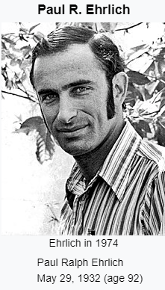
Ehrlich became well known for the controversial 1968 book The Population Bomb, which he co-authored with his wife Anne H. Ehrlich, in which they famously stated that "[i]n the 1970s hundreds of millions of people will starve to death in spite of any crash programs embarked upon now.
Notes:
https://en.wikipedia.org/wiki/Paul_R._Ehrlich

Slide 57
Erlich was wrong there, but the anti-life message continues..
Marx was a follower of anti-natalism.
Even a Talmudic debate.
Eruvin 13b as taught by R. Moshe Grussgott, Day of Discovery, 2023

Slide 58
Depopulation. Lower birth rate Abortion. Border chaos. Uncontrolled debt → bankruptcy Life destruction in Border Chaos and defilement of humanity.
We are in a war of Life and Death.

Slide 59
Tuesday evening we had Special Guest Speaker JJ Carrell, a recently retired agent for Homeland Security.
498 views on our YouTube channel!

Slide 60
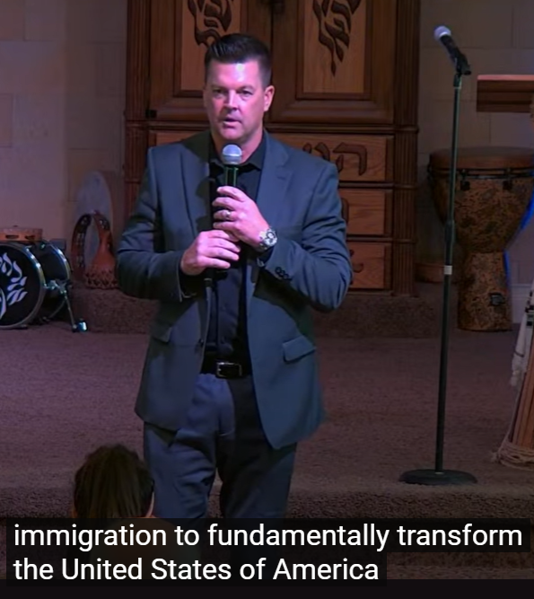
“A strategic decision was made in the current administration:
We are going to use the vehicle of illegal
Notes:
https://www.youtube.com/watch?v=C70A3tUCpac&t=2840s

Slide 61
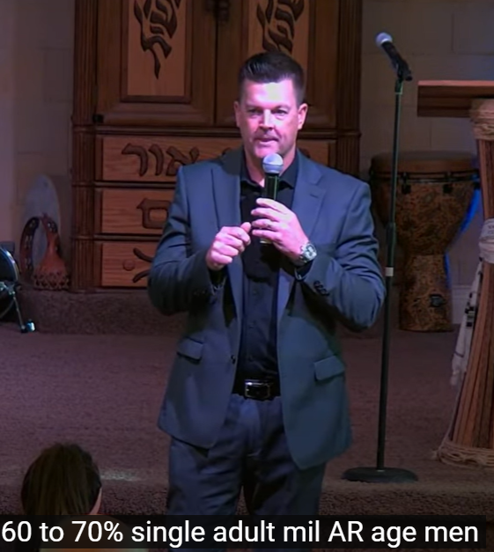
12 million illegal entrants into the United States.
Systematic sex trafficking by the US government!
Notes:
These guys are sleepers, primed for attack!
https://www.youtube.com/watch?v=C70A3tUCpac&t=2840s
Incredible numbers of sex trafficked individuals. US government

Slide 62
Secular resolution of problems…

Slide 63
What America’s Jews passionately care about is “social justice.” In terms of helping the sick and the poor, social justice is deeply embedded in Judaism.
Notes:
Its self salvation, as in Romans 10 Brothers and sisters, my heart’s desire and my prayer to God for Israel is for their salvation. ² For I testify about them that they have zeal for God—but not based on knowledge. ³ For being ignorant of God’s righteousness and seeking to establish their own, they did not submit themselves to the righteousness of God.
https://www.americanthinker.com/articles/2024/08/even_if_moses_endorsed_donald_trump_jews_would_not_vote_for_him.html

Slide 64
The old saw, “There are two types of Jews: those who believe that Judaism is about social justice and those who know Hebrew,” contains more than a kernel of truth. By and large, orthodox Jews voted for Trump in 2016 and 2020.
Notes:
https://www.americanthinker.com/articles/2024/08/even_if_moses_endorsed_donald_trump_jews_would_not_vote_for_him.html

Slide 65
Death spending…

Slide 66
Spending on net interest hit $514 billion in the first seven months of fiscal year 2024. That’s more than spending on both national defense ($498 billion) and Medicare ($465 billion).
Notes:
https://www.worthynews.com/95369-u-s-spending-on-interest-tops-national-defense-medicare

Slide 67
At the start of the year, U.S. household debt reached a record high of $17.3 trillion, according to data from the Federal Reserve Bank of New York (NYFRB).
Divide by 337 million US population = $51,000 per capita
Notes:
https://www.marketwatch.com/guides/banking/american-debt-2024/

Slide 68
Plus Federal debt of $35 trillion divided by US population
= $104,000 per capita portion of the Federal debt.
Notes:
That’s why babies cry.

Slide 70
The L-rd of the Battle Ps 144.1-2
The words
The Seriousness of Attack
The Way of Victory

Slide 71
Victory in Israel
and the Jewish world
And all the world…
Notes:
https://www.youtube.com/watch?v=8hJfkZ38KYs

Slide 72
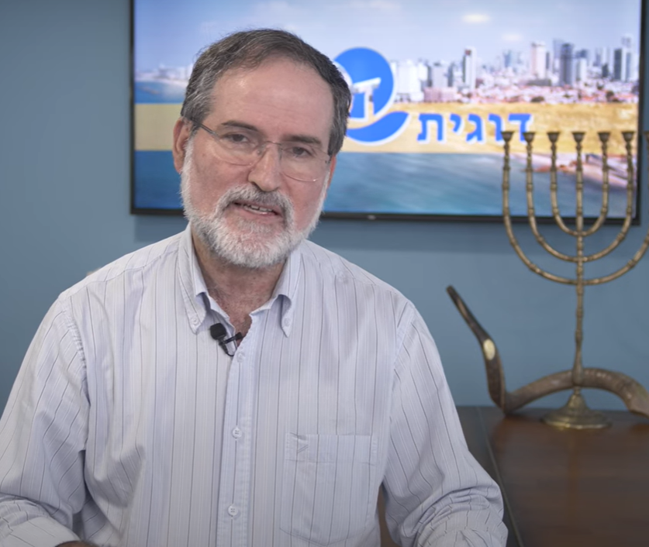
Avi Mizrachi of the Dugit Coffee house outreach.

Slide 73
Dvorah Mizrachi told us the story of how in about the summer of 2023 a women’s group wanted to have a retreat away from Tel Aviv. Only kibbutz Nir Am would allow them as Messianic women. Dvorah said that they prayed protection over the kibbutz, north, south, east, west.

Slide 74
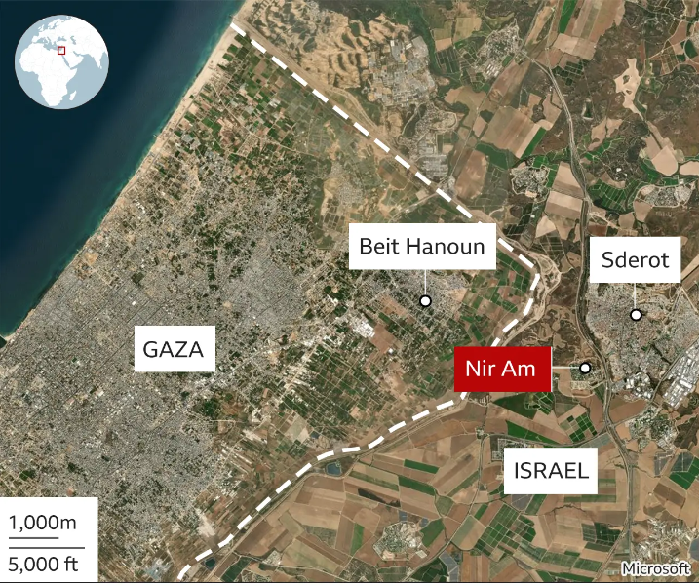

Slide 75
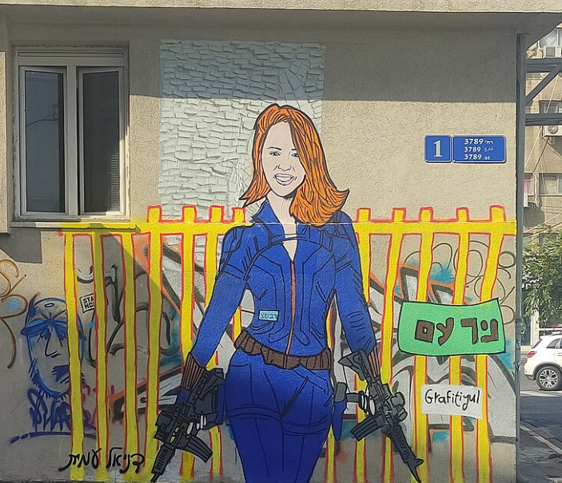
Graffiti of Inbal Liberman (26) head of security in Kibbutz Nir Am. She led protection of the Kibbutz.
Notes:
https://en.wikipedia.org/wiki/Inbal_Rabin-Lieberman

Slide 76
On October 7, 2023, Rabin-Lieberman heard unusual noises near the kibbutz. She assessed the significance of the threat and quickly distributed weapons among the 12 members of the quick response group manned by residents of the kibbutz, including her uncle.
Notes:
https://en.wikipedia.org/wiki/Inbal_Rabin-Lieberman

Slide 77
She ran between houses, organizing men in different ambushes around the perimeter of the kibbutz and developed a plan to protect the settlement. Rabin-Lieberman and her fellow citizens held off the attackers for three hours, killing 25 militants before the IDF arrived.
Notes:
One person from Nir Am was killed, who left the kibbutz for the Nova festival
https://en.wikipedia.org/wiki/Inbal_Rabin-Lieberman
https://www.bbc.com/news/world-middle-east-67089113

Slide 78
Nir-Am was one of only two communities bordering the Gaza Strip that did not suffer Israeli casualties during the Hamas-led attack on Israel on October 7, 2023 (alongside Ein HaBesor).
Notes:
The only casualty was one kibbutznik who left the kibbutz for the Nova Festival

Slide 79
So was there a connection between the Messianic women’s retreat and prayer, and Nir Am kibbutz survival?

Slide 80
A story of awakening Jewish identity in the Land…

Slide 81
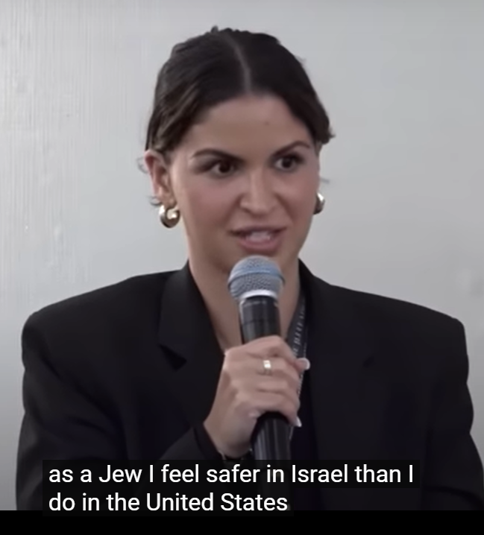
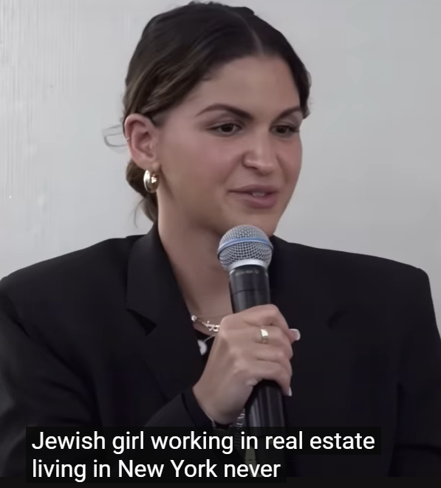
Natalie from New York
Notes:
https://www.youtube.com/watch?v=g0N7wLY5VGk
As a Jew I feel safer in Israel than in the United States, even during times of war.
First ever anti-Semitism was visiting relatives in France they told her to hide her Jewish jewelry.
Hunters and fishers.

Slide 82

Israeli Olympic team representing the hostages.
Notes:
https://unitedwithisrael.org/watch-israeli-athletes-defiantly-bring-awareness-of-hostages-to-the-olympics/?

Slide 83
Writing today for the Wall Street Journal, MEF president Daniel Pipes argued that since Hamas's Oct. 7 attacks, Israel has unfortunately followed "two opposite policies" simultaneously: "destroy the organization and make a deal with it." Pipes's main points:
Notes:
https://mailchi.mp/meforum/mef-experts-assassination-of-terrorist-leaders-means-israel-intends-to-crush-hamas?e=2515d15785

Slide 84
Israeli Prime Minister Bibi Netanyahu has on the one hand made victory a central goal of his campaign against Hamas, mentioning the word 182 times since Oct. 7. Yet to assuage both foreign and domestic critics, he negotiated with Hamas to permit its survival and win the release of Israeli hostages.
Notes:
https://mailchi.mp/meforum/mef-experts-assassination-of-terrorist-leaders-means-israel-intends-to-crush-hamas?e=2515d15785

Slide 85
This indecision failed to free the hostages, exacerbated dissension in Israel, and damaged Israelis' security.
The "drama and hutzpah of killing Haniyeh on a ceremonial visit to Iran appears to end the indecision" and shows that "Israel intends to crush Hamas and win."
Notes:
https://mailchi.mp/meforum/mef-experts-assassination-of-terrorist-leaders-means-israel-intends-to-crush-hamas?e=2515d15785

Slide 86
Victory in the Muslim world.

Slide 87
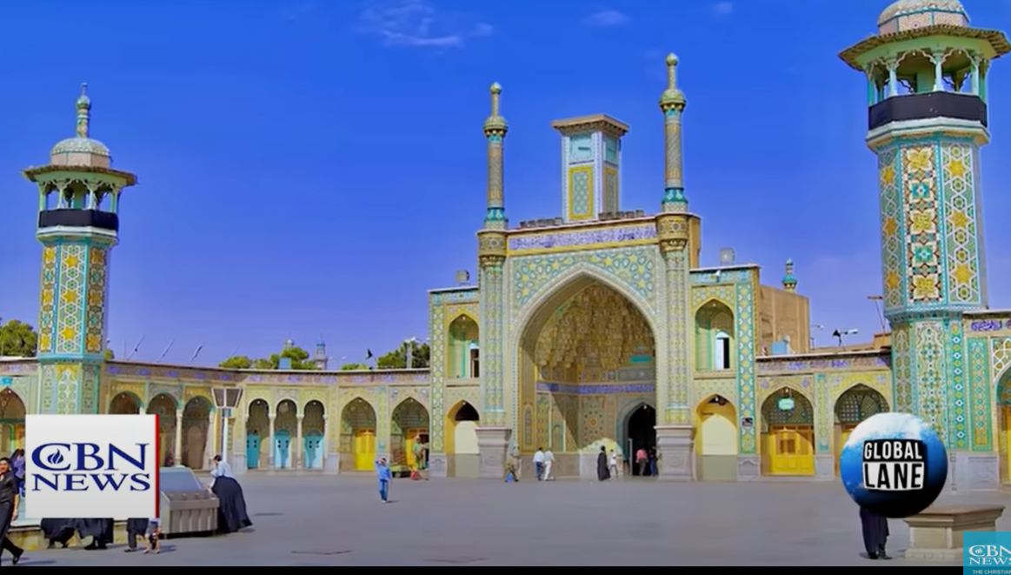
50,000 of 75,000 mosques have
closed in the Iranian Islamic State.

Slide 88
Jul 28, 2024
Is Yeshua more popular than the Ayatollah? More than a million Muslims have come to Messiah. Don Shenk of The Tide Ministry says, “What is happening there is actually representative of what is happening in the Islamic world."
Notes:
Not the old news of Sheep Among Wolves, which was great. But it still happening.
https://www.youtube.com/watch?v=OFAa5XWClqI

Slide 89

Shabbat afternoons
Oct 26- Dec 21

Slide 90
Victory in our health and fitness.
Notes:
Epoch Times article that reinforced something that the Ruakh has been saying to me. Pay now or pay later. You’ve heard me talk about my morning calisthenics.

Slide 91
Muscle Mass — The Key to Longevity
“Of particular interest is the role of skeletal muscle as a reservoir of amino acids needed by other tissues such as skin, brain, and heart for the synthesis of organ-specific proteins,” he said.
Notes:
not about weight loss, diet, appearance. About building up muscle.

Slide 92
Muscle Mass — The Key to Longevity
Mounting evidence suggests that muscles have more roles than previously assumed. “It is, perhaps, the most important organ system for combating our current health crisis,
Notes:
not about weight loss, diet, appearance. About building up muscle.

Slide 93
Muscles Endocrine Organs
Muscles for Blood Sugar Levels
Muscles Improve Cardio Health
Muscles Boost Immune Function
Muscles Strengthen the Brain
Notes:
https://www.theepochtimes.com/health/muscle-your-bodys-largest-organ-5662072

Slide 94
Victory in the joy of the Lord, expressing salvation of Yeshua and worship.

Slide 95
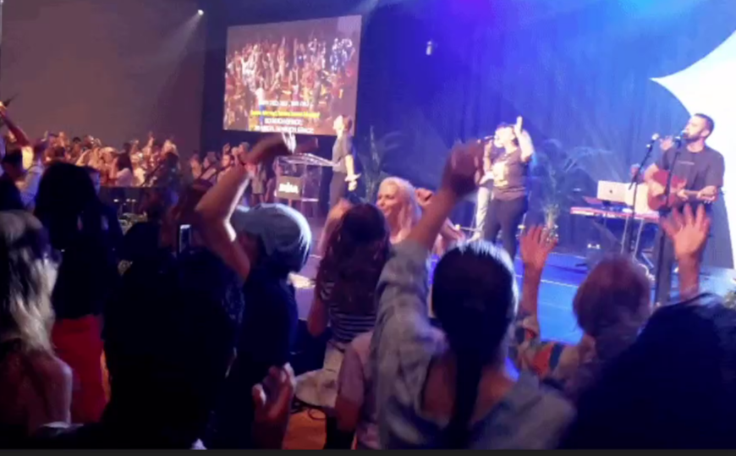
Messiah Conference Solu
Worship and dance response
Notes:
They also do a Wednesday night dance party till midnight.

Slide 96
Saturday evenings third Shabbat of Noneg [no oneg] we will have a youth outreach Dance Party!
First run Aug. 17.
Pull back sanctuary chairs.
Taco bar?

Slide 97
תְּהִילִים Psalm 144: 1,2
בָּרוּךְ יְיָ צוּרִי הַמְלַמֵּד יָדַי לַקְרַב
Barukh Adoni tsu-ree,
Ha-m'la-mayd ya-dai la-krav [repeat]
[Blessed be the LORD my Rock,
Who trains my hands for war,]

Slide 98
אֶצְבְּעוֹתַי לַמִּלְחָמָה: בָּרוּךְ יְיָ צוּרִי
Ets-b'o-ti la-meel-kha-ma,
Barukh Adoni tsu-ree.
[And my fingers for battle,
Blessed be the LORD my Rock]

Slide 99
חַסְדִי וּמְצוּדָתִי מִשְׂגַבִּי וּמְפָלְטִי לִי
Khas-dee oo-m'tsoo-da-tee,
Mees-ga-be oo-m'fal-tee lee
[My lovingkindness and my fortress,
My high tower and my deliverer]

Slide 100
מָגִנִי וּבוֹ חָסִיתִי הָרוֹדֵד עָמִי תַחְתָֽי:
Ma-gee-nee u-vo kha-see-tee,
Ha-ro-dayd amee takhtai
[My shield and the One in whom I take refuge,
Who subdues my people
under me.]

Slide 101
תְּהִילִים Psalm 144: 1,2
בָּרוּךְ יְיָ צוּרִי
Barukh Adoni tsu-ree,
[Blessed be the LORD my Rock,

