Slide 1
e-handout
To have these notes
without taking notes
Go to OrHaOlam.com
Click on Messages tab,
2024 Messages

Slide 2
Wedding in Berkeley

Slide 3
Siddur [Jewish prayer book] prayer is very beautiful.
80% scripture, plus poetry
Third Wednesday each month we have a Shakharit [morning] siddur service, with tallit and tefillin.
Notes:
At the wedding, I discovered a whole new [to me] branch of Judaism called Open Orthodox, or Traditional Egalitarian.
I want to be careful to honor my family, but there is a lesson for us.
Erev Shabbat Friday night ~6-8 Service all Hebrew Siddur prayer book, acapella, enthusiastic, knowledgeable. Up to 200 people, mostly age 20-40, no phones, no driving if possible
Shabbat morning aufruf [Torah aliyah] 9 till noon, Torah reading same style
Wedding Sunday 3 p.m. to 9.30 same
Tischen, Bedeken, Huppah, Dance, Meal, More Dance!
How “Open Orthodox”? LGBTQ+ inclusive, pro Palestinian rights, very woke, not Presence

Slide 4
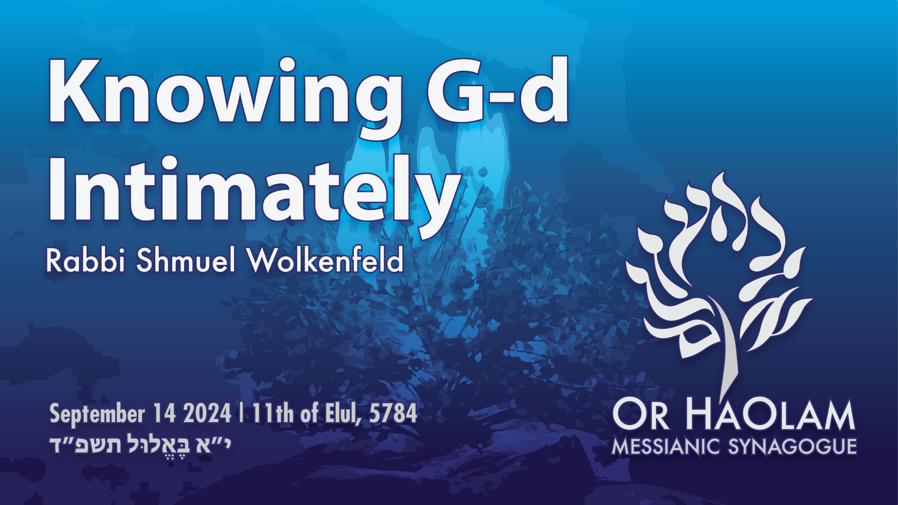

Slide 5

Knowing G-d Intimately
Benefits of knowing G-d
External hazards of knowing G-d
Internal hazards of knowing G-d
Fail Safe

Slide 6
Knowing G-d Intimately
Benefits of knowing G-d
External hazards of knowing G-d
Internal hazards of knowing G-d
Fail Safe

Slide 7
^{Ro 10.1-4} Brothers and sisters, my heart’s desire and my prayer to God for Israel is for their salvation. For I testify about them that they have zeal for God — but not based on knowledge.

Slide 8
^{Ro 10.1-4} For being ignorant of God’s righteousness and seeking to establish their own, they did not submit themselves to the righteousness of God. For Messiah is the goal of the Torah as a means to righteousness for everyone who keeps trusting.
Notes:
In the 29 years of Or HaOlam, we have lost individuals and families who have LOVED the beauty of the Torah, Siddur and Orthodoxy. Left Yeshua. But this is the key. Knowing Messiah!

Slide 9
^{Yn 17.3} Eternal life is this: to know you, the one true God, and him whom you sent, Yeshua the Messiah.
Notes:
Know Him as the SENT one: atoning, forgiving, redeeming Lord!
Does that concept warm your heart as your reality?

Slide 10
^{Yn 17.22-23} The glory which you have given to me, I have given to them; so that they may be one, just as we are one — I united with them and you with me, so that they may be completely one, and the world thus realize that you sent me, and that you have loved them just as you have loved me.
Notes:
You have heard me talk about my sense of G-d’s Glory in the liquid love that I sort of experienced in the church where I was introduced to Messiah.

Slide 11
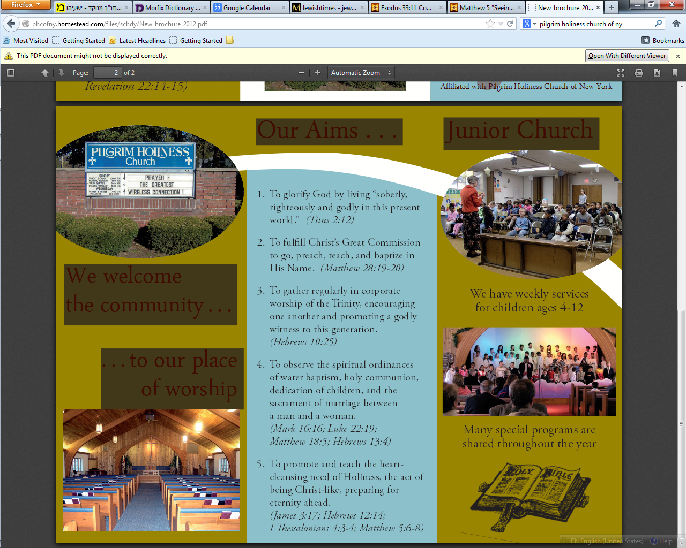
Pilgrim Holiness Church
Notes:
Golden glow up in the laminated rafters. “Cloud of liquid love.” My first exposure. Repentance and faith about a month later. April 13, 1969 I experienced New Birth. Many young people similarly seeking from Union College, Schenectady, NY. I have never gotten over that revelation.
Went home few weeks later. “Mom, Dad, I’ve found the answer to life’s problems. It’s not in drugs, or revolution, but in the love of Jesus Christ.”
Sent me to psychiatrist.
“You’re worse than Hitler. He destroyed our bodies. You are destroying our souls.”
I was talking to a woman had an experience with G-d at age 4. Never could walk away from it.

Slide 12
^{T’hillim / Ps 16.8-11} I have set Adoni always before me. Since He is at my right hand, I will not be shaken. So my heart is glad and my soul rejoices. My body also rests secure. For You will not abandon my soul to Sheol nor let Your faithful one see the Pit.
Notes:
Knowing G-d is joy.
Knowing G-d is assurance of NOT going to the pit, to hell.

Slide 13
^{T’hillim / Ps 16.8-11} You make known to me the path of life. Abundance of joys are in Your presence, eternal pleasures at Your right hand.
Notes:
Moshe said, Show me your glory.
This is the month of Shabbats of consolation.

Slide 14
Benefit #1 Relationships
^{Yn 17.22-23} The glory which you have given to me, I have given to them; so that they may be one, just as we are one — I united with them and you with me, so that they may be completely one, and the world thus realize that you sent me, and that you have loved them just as you have loved me.
Notes:
Unity and love among brothers. At His feet, repenting, surrendering. Splits and problems? Resolvable in the love of Messiah. Theoretically.

Slide 15
^{Eph 4. 30-32} Don’t cause grief to God’s Ruakh HaKodesh, for he has stamped you as his property until the day of final redemption. Get rid of all bitterness, rage, anger, violent assertiveness and slander, along with all spitefulness.

Slide 16
^{Eph 4. 30-32} Instead, be kind to each other, tenderhearted; and forgive each other, just as in the Messiah God has also forgiven you.
Notes:
What if it doesn’t work? We’ll get to that later.

Slide 17
^{Ro. 8.15-17} You did not receive a spirit of slavery to bring you back again into fear; on the contrary, you received the Spirit, who makes us sons and by whose power we cry out, “Abba!” (that is, “Dear Father!”).
Notes:
Assurance of salvation through relationship with Him!

Slide 18
^{Ro. 8.15-17} The Spirit himself bears witness with our own spirits that we are children of God; and if we are children, then we are also heirs, heirs of God and joint-heirs with the Messiah — provided we are suffering with him in order also to be glorified with him.
Notes:
Benefit #1 Relationships with G-d and people.

Slide 19
Benefit #2 Suffering is purposeful
^{Phil. 3.10} I gave it all up in order to know him, that is, to know the power of his resurrection and the fellowship of his sufferings as I am being conformed to his death.
Sufferings for a purpose!
Notes:
Messiah likeness is the purpose of sufferings! I strongly believe in solving all problems. But in the process, there is suffering. And sometimes not resolved like we would like.
Gave up what?

Slide 20
^{Phil 3.4-8} If anyone else thinks he has grounds for putting confidence in human qualifications, I have better grounds:
b’rit-milah on the eighth day, by birth belonging to the people of Isra’el, from the tribe of Binyamin, a Hebrew-speaker, with Hebrew-speaking parents, in regard to the Torah, a Parush,
Notes:
All of us gave up our ethnic royalty, of sorts. Surrender all to the supremacy of Messiah.

Slide 21
^{Phil 3.4-8} in regard to zeal, a persecutor of the Messianic Community, in regard to the righteousness demanded by legalism, blameless. But the things that used to be advantages for me, I have, because of the Messiah,
Notes:
My family

Slide 22
^{Phil 3.4-8} come to consider a disadvantage. Not only that, but I consider everything a disadvantage in comparison with the supreme value of knowing the Messiah Yeshua as my Lord.
Notes:
Do you know Him?
Spirit bear witness with your spirit, that you are a child of G-d. Not to be too mystical, but a sense. Can have such!

Slide 23
Benefit #3 Hard to leave
^{Yn 6.67-69} So Yeshua said to the Twelve, “Don’t you want to leave too?” Shim‘on Kefa answered him, “Lord, to whom would we go? You have the word of eternal life. We have trusted, and we know that you are the Holy One of God.”
Notes:
I’ve asked people who have walked away:. Doesn’t life feel empty without HIM?
“I don't feel empty. I don't really fell any more or less happy than I did before. For the most part, I feel fulfilled, happy, and content with my life.”
“I never had a G-d shaped vacuum in my heart.”

Slide 24
Bene #4 Character transformation
^{Yeshayahu/Isaiah 6.1-6} In the year of King Uzziah’s death, I saw Adoni sitting on a throne, high and lifted up,[a] and the train of His robe filled the Temple. Seraphim were standing above Him.

Slide 25
Bene #4 Character transformation
^{Yeshayahu/Isaiah 6.1-6} Each had six wings: with two he covered his face and with two he covered his feet, and with two he flew.

Slide 26
Benefit #4 Character transformation Yeshayahu/Isaiah 6.1-6 One called out to another, and said: “Holy, holy, holy, is Adoni-Tzva’ot! The whole earth is full of His glory.” Then the posts of the door trembled at the voice of those who called, and the House was filled with smoke.

Slide 27
Benefit #4 Character transformation
^{Yeshayahu/Isaiah 6.1-6} Then I said: “Oy to me! For I am ruined! For I am a man of unclean lips, and I am dwelling among a people of unclean lips. For my eyes have seen the King, [Messiah] Adoni-Tzva’ot!”
Notes:
Knowledge of Yeshua, whom this was a vision of, according to Yn 12, convicts us. Uncleaned speech,

Slide 28
Benefit #4 Character transformation
^{Yeshayahu/Isaiah 6.1-6} Then one of the seraphim flew to me, with a glowing coal in his hand, which he had taken with tongs from the altar. He touched my mouth with it and said: “Behold, this has touched your lips. Your iniquity is taken away, and your sins atoned for.”
Notes:
Upon acknowledging his sinfulness [>>sins, but inner uncleanness] he had supernatural transformation.
Supernatural, instantaneous. Sometimes gradual.
Ellel next week!
Are we more Messiah like in character, attitudes, than this time last year?
Some of the sweetest, most sacrificial, servant hearted people on earth are the transformed believers!!

Slide 29
Benefit #5 Calling, with opposition
Then I heard the voice of Adonai saying: “Whom should I send, and who will go for Us?” So I said, “Hineni. Send me.” Then He said: “Go! Tell this people: ‘Hear without understanding, and see without perceiving.’
Notes:
Before G-d can use a man or woman, He has to bring him through affliction. “Love suffers LONG”

Slide 30
Benefit #5 Calling with opposition
Make the heart of this people fat, their ears heavy, and their eyes blind. Else they would see with their eyes, and hear with their ears, and understand with their heart, and return, and be healed.”
Notes:
I was a hippy wannabe, when came to Yeshua thought lots of people would want this! Some did then on my campus. Some did in the hood in Cincinnati, neighborhood of the Bible College. Some always do.
Most like the above.
But, I’m called to present Him!

Slide 31
Benefit #6: With a Person not an experience
^{Yn 15.12-15} “This is my command: that you keep on loving each other just as I have loved you. No one has greater love than a person who lays down his life for his friends. You are my friends, if you do what I command you.
Notes:
Personal love.
I was told by a rabbi in Jerusalem that he would write a letter for me to the Israeli immigration officials, Misrad HaPanim, מסרד הפנים and I could have Israeli citizenship and keep my faith
I could pray to the Father in His Name.
IF I consented to NOT pray to Yeshua. That to the Jerusalem rabbi would be idolatry.
I love to talk / pray to Yeshua. I visualize worshiping Him as we do the Men’s dance.

Slide 32
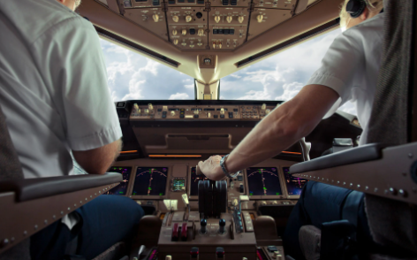
Notes:
https://cdn.bfldr.com/FK28HSHN/at/r4wkfc5fkg2n9ksm29jcrks/09112024APILOTSCLOSECALLON911docx.pdf

Slide 33
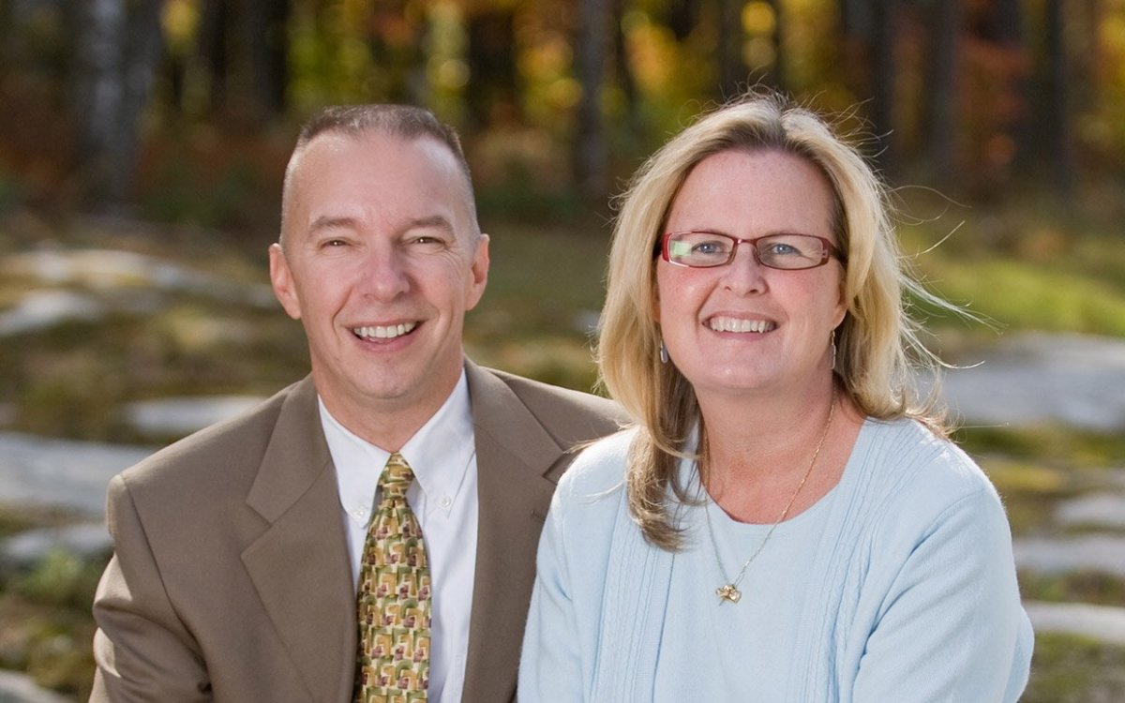
Steve and Megan Scheibner
Notes:
https://external-content.duckduckgo.com/iu/?u=https%3A%2F%2Fparade.com%2F.image%2Ft_share%2FMTkwNTgwODgxMjUzNzM4MzY0%2Fmegan-ann-scheibner-ftr.jpg&f=1&nofb=1&ipt=8117c8afb7d7b2194360a7e99cdab385307a399da8e6a4db6893c82ceba55896&ipo=images

Slide 34
Dr. Steve and Megan Scheibner report:
On September 11th, 2001, I was an active pilot for American Airlines, a first officer on the 767 out of Boston.
Dr. James Dobson: Logan?
Dr. Steve Scheibner: Logan Airport, right.
Notes:
https://cdn.bfldr.com/FK28HSHN/at/r4wkfc5fkg2n9ksm29jcrks/09112024APILOTSCLOSECALLON911docx.pdf

Slide 35
On September 11th, Boston was one of the airports of choice, and the 767 was the airplane that the terrorists had trained on. The first airplane that was hijacked American Airlines Flight 11 was a flight that I was actually scheduled to be the co-pilot on.
Notes:
https://cdn.bfldr.com/FK28HSHN/at/r4wkfc5fkg2n9ksm29jcrks/09112024APILOTSCLOSECALLON911docx.pdf

Slide 36
On September 10th, 2001, about three o'clock in the afternoon is when American Airlines would normally call and fill the trips. I went into my computer, I logged in to see if there was any unassigned flying for the next day.
Notes:
https://cdn.bfldr.com/FK28HSHN/at/r4wkfc5fkg2n9ksm29jcrks/09112024APILOTSCLOSECALLON911docx.pdf

Slide 37
And as I looked, there was one flight that hadn't been assigned a co-pilot yet, and that was Flight 11 out of Logan to Los Angeles. It just so happened on September 11th, 2001, there was only one guy available to fill in the co-pilot slot, and that was me.
Notes:
https://cdn.bfldr.com/FK28HSHN/at/r4wkfc5fkg2n9ksm29jcrks/09112024APILOTSCLOSECALLON911docx.pdf

Slide 38
Usually within two or three minutes after seeing your name assigned by the computer, somebody at American Airlines will call to confirm that assignment, so it's not a done deal until a phone call gets made.
Notes:
https://cdn.bfldr.com/FK28HSHN/at/r4wkfc5fkg2n9ksm29jcrks/09112024APILOTSCLOSECALLON911docx.pdf

Slide 39
And I waited for the phone to ring and the phone never rang, which is not completely unusual, but I can tell you in 23 years of being an American, I've been bumped off a trip three times under that same set of circumstances.
Notes:
https://cdn.bfldr.com/FK28HSHN/at/r4wkfc5fkg2n9ksm29jcrks/09112024APILOTSCLOSECALLON911docx.pdf

Slide 40
A fellow by the name of Tom McGinnis was a co-pilot at American Airlines, a little bit senior to me. He was a regular line holder, so he had some privileges that I didn't have as a reserve pilot.
Notes:
https://cdn.bfldr.com/FK28HSHN/at/r4wkfc5fkg2n9ksm29jcrks/09112024APILOTSCLOSECALLON911docx.pdf

Slide 41
About three o'clock in the afternoon, he went over to the computer to see if there was any unassigned flying. He saw that my name had been assigned to that trip, but he saw a little code next to my name that said I hadn't been called yet.
Notes:
https://cdn.bfldr.com/FK28HSHN/at/r4wkfc5fkg2n9ksm29jcrks/09112024APILOTSCLOSECALLON911docx.pdf

Slide 42
He called down to American in a hurry and said, "Is it too late for me to have that trip?" They said, "No, you can still have it.”
Notes:
https://cdn.bfldr.com/FK28HSHN/at/r4wkfc5fkg2n9ksm29jcrks/09112024APILOTSCLOSECALLON911docx.pdf

Slide 43
Well, in the morning of September 11th, I got up, and since I hadn't been assigned a flight by American Airlines, I put on my Navy uniform that day. I was doing some work as a Navy Reserve officer on the local base, and I went in on the Navy base that day and was meeting with a guy in the morning.

Slide 44
And I had to go over and get something off my desk, so I went over to the other building where I normally worked. And then of course, as I walked in, all the televisions were on and the first airplane had hit the first building, the airplane that I should have been on.

Slide 45
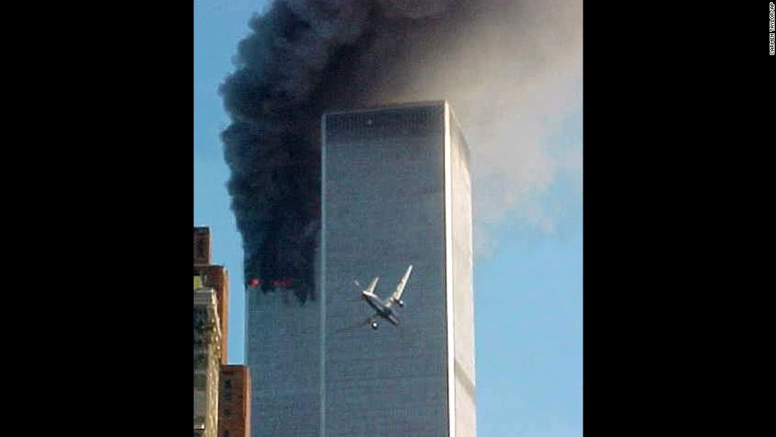
Notes:
https://external-content.duckduckgo.com/iu/?u=https%3A%2F%2Fcdn.cnn.com%2Fcnnnext%2Fdam%2Fassets%2F160815132201-07-sept-11-timeline-super-169.jpg&f=1&nofb=1&ipt=ce0d7e3ae20c5403a7dc478357fc653f94b846463dc0017366e17bd60c2832ba&ipo=images

Slide 46
As we're standing there watching the TV, trying to figure out what was going on, we all watched the second airplane hit the second building

Slide 47
And as we're doing that, my cell phone rings and I pick it up and I answer it, and it's a secretary from my seminary, a beautiful lady by the name of Evie. And as soon as Evie heard my voice, she started crying. And when she started crying, I started crying.
Notes:
https://cdn.bfldr.com/FK28HSHN/at/r4wkfc5fkg2n9ksm29jcrks/09112024APILOTSCLOSECALLON911docx.pdf

Slide 48
Megan Scheibner: Somebody else lost a husband for me to keep mine.
Notes:
https://cdn.bfldr.com/FK28HSHN/at/r4wkfc5fkg2n9ksm29jcrks/09112024APILOTSCLOSECALLON911docx.pdf

Slide 49
Tom McGinnis, the pilot who bumped me off the flight that day, he'd be the first guy to tell you that he did not die for Steve's sins. The silver lining on this little dark story is that Tom had a solid testimony of faith in Messiah Yeshua.
Notes:
https://cdn.bfldr.com/FK28HSHN/at/bk289rgk6r7g3c7bfrznz8m/09122024APILOTSCLOSECALLON911docx.pdf

Slide 50
The real connection is this, I know what it's like personally to have somebody die in my place. Not once, but twice and once was enough. You see, Tom didn't die for my sins. The other who died in my place, the other who died in Tom's place, the other who died in your place, is the Lord Yeshua.
Notes:
https://cdn.bfldr.com/FK28HSHN/at/bk289rgk6r7g3c7bfrznz8m/09122024APILOTSCLOSECALLON911docx.pdf

Slide 51
^{Ro 5.7-8} Now it is a rare event when someone gives up his life even for the sake of somebody righteous, although possibly for a truly good person one might have the courage to die.

Slide 52
^{Ro 5.7-8} But God demonstrates his own love for us in that the Messiah died on our behalf while we were still sinners.
Benefit #6: With a Person not an experience
Notes:
Pause for prayer.

Slide 54
Knowing G-d Intimately
Benefits of knowing G-d
External hazards of knowing G-d
Internal hazards of knowing G-d
Fail Safe
Notes:
Hazards?

Slide 55
^{1 Cor 8.1-3} “We all have knowledge.” Yes, that is so, but “knowledge” puffs a person up with pride; whereas love builds up. The person who thinks he “knows” something doesn’t yet know in the way he ought to know. However, if someone loves God, God knows him.

Slide 56
If you know G-d intimately and transformatively, that is a challenge to human /rabbinic consensus and knowledge, and can surprisingly became a source of great rage.

Slide 57
^{Acts 8.3} But Sha’ul set out to destroy the Messianic Community — entering house after house, he dragged off both men and women and handed them over to be put in prison.

Slide 58
^{Acts 26.11} Often I went from one synagogue to another, punishing them and trying to make them blaspheme; and in my wild fury against them, I even went so far as to persecute them in cities outside the country.
Notes:
I have faced some of this. “One local rabbi: I have great respect for pastors. I have no respect for you. You are a fraud.”

Slide 59
^{Acts 7.56-58a} “I see heaven opened and the Son of Man standing at the right hand of God!” At this, they began yelling at the top of their voices, so that they wouldn’t have to hear him; and with one accord, they rushed at him, threw him outside the city and began stoning him.

Slide 60
^{Acts 22.1, 6, 8, 21-23} “Brothers and fathers! Listen to me as I make my defense before you now!”... I was a zealot for God, as all of you are today. I persecuted to death the followers of this Way, arresting both men and women and throwing them in prison…
Notes:
One of my favorite Bible events. Paul is on the steps of the Antonia Fortress explaining his faith in Yeshua to the people in the Temple courtyard.

Slide 61
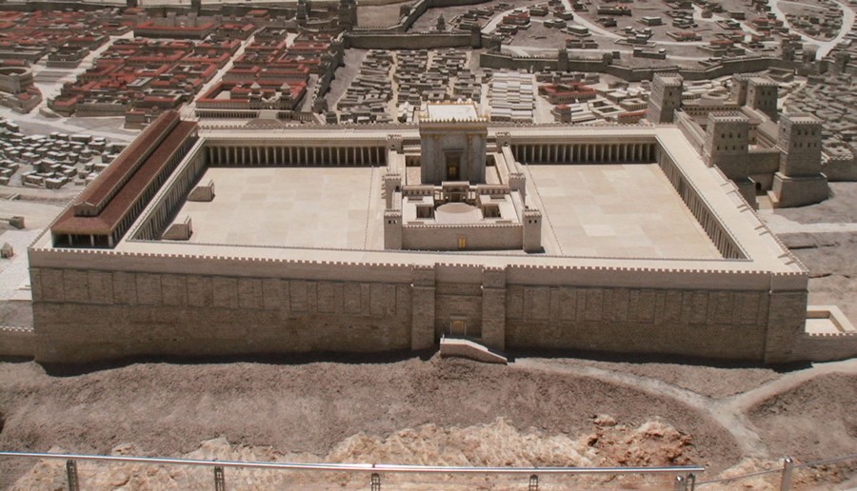
Notes:
https://external-content.duckduckgo.com/iu/?u=https%3A%2F%2Fwww.generationword.com%2Fjerusalem101-photos%2Ftemple_mount%2Fherod%2Fview-from-east.JPG&f=1&nofb=1&ipt=6618a99b9400bfeb8c7ffe321bfba3a0009a45b43550f01694445d29e1c62106&ipo=images

Slide 62
^{Acts 22.1, 6, 8, 21-23} “As I was traveling and approaching Dammesek, around noon, suddenly a brilliant light from heaven flashed all around me!... I answered, ‘Sir, who are you?’ ‘I am Yeshua from Natzeret,’ he said to me, ‘and you are persecuting me! He said,

Slide 63
^{Acts 22.1, 21-23} ‘Get going! For I am going to send you far away — to the Goyim!’” They had been listening to him up to this point; but now they shouted at the top of their lungs, “Rid the earth of such a man! He’s not fit to live!” They were screaming, waving their clothes and throwing dust into the air.

Slide 64
Why the rage?
^{Ro 10.1-4} Brothers and sisters, my heart’s desire and my prayer to God for Israel is for their salvation. For I testify about them that they have zeal for God — but not based on knowledge.

Slide 65
^{Ro 10.1-4} For being ignorant of God’s righteousness and seeking to establish their own, they did not submit themselves to the righteousness of God. For Messiah is the goal of the Torah as a means to righteousness for everyone who keeps trusting.
Notes:
In the 29 years of Or HaOlam, we have lost individuals and families who have LOVED the beauty of the Siddur and Orthodoxy. Left Yeshua. But this is the key. Knowing Messiah!

Slide 66
We encourage our people to participate in activities in the wider Jewish community.
Just know that your joy in Messiah
Can be attractive
Can be enraging

Slide 68
Knowing G-d Intimately
Benefits of knowing G-d
External hazards of knowing G-d
Internal hazards of knowing G-d
Fail Safe
Notes:
Hazards? You may disagree with the following…

Slide 69
The bliss and warmth of fellowship in the Spirit is somewhat akin to romantic bliss and warmth. If not guarded, can cross over from healthy friendship to romantic and then sexual warmth.
Notes:
I know of a couple that were singles alone in an apartment, interceding passionately. The passion got out of hand.
Alone in an apartment.

Slide 70
Knowing G-d together can lead to too much sharing and emotional infidelity. “Soul tie.”
I always cc my wife on emails to a lady.
Never be alone in a building, or a car, with a member of the opposite gender.
Notes:
How the mighty have fallen!
Bill Gothard, Ravi Zacharias, Mike Bickle, Robert Morris, Tony Evans, Jack Hyles. Ravi may not be so.

Slide 71
The bliss and warmth of the Spirit can be mistaken for reinforcing of erroneous opinions.
Martin Luther, leader of the Reformation.
John Calvin.

Slide 72
Chrysostom: c. 349 – 407, Archbishop of Constantinople, “Golden tongue” revivalist.
G-d hates the Jews.
Notes:
http://www.azquotes.com/author/31916-Hilary_of_Poitiers
These men are heros of church history!
See Michael Brown’s Our Hands are Stained with Blood

Slide 73
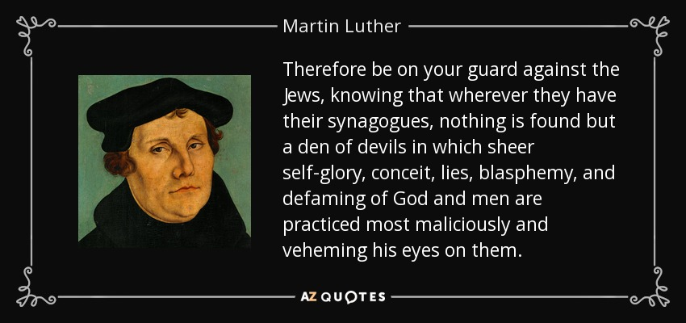
Notes:
My mother phoned to tell me about this one. I was a believer for a few months. I had thought all the anti-Semitism by supposed Christians was among the Catholics.

Slide 74
John Calvin 1509, Noyon, France
didn't allow Jews to live in the city of Geneva. Toll for daily admission.
All covenants to church.
All curses in Bible to Jews.

Slide 75
Were Chrysostom, Luther, Calvin not saved? Will we see them in eternity in G-d’s presence?
Mystery bag
Love “suffers long…bears all things, it believes all things, it hopes all things, it endures all things.”

Slide 77
Knowing G-d Intimately
Benefits of knowing G-d
External hazards of knowing G-d
Internal hazards of knowing G-d
Fail Safe

Slide 78


Slide 79
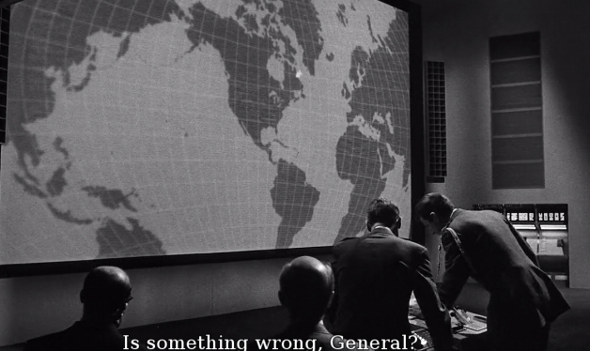
Notes:
https://external-content.duckduckgo.com/iu/?u=https%3A%2F%2Fm.media-amazon.com%2Fimages%2FM%2FMV5BN2Y3ZTZiNmYtZTU4Yi00YWEzLWFlMjQtYjBiZDU2NmNjYzlmXkEyXkFqcGdeQXVyNzk5MDQ0NA%40%40._V1_.jpg&f=1&nofb=1&ipt=b38d280ca7e8f0a63049ed68924ff5a9d4aac3d54bf83113c23931c1d6315243&ipo=images

Slide 80
In the Failsafe novel the USAF early warning radar indicates that an unidentified aircraft has intruded into U.S. airspace. Shortly after, the intruder is identified as an off-course civilian airliner.
Notes:
https://en.wikipedia.org/wiki/Fail_Safe_(1964_film)

Slide 81
However, a computer error causes one U.S. bomber group, Group 6, to erroneously receive apparently valid orders for a nuclear attack on Moscow. Attempts to rescind this order fail.
Ultimately, nuclear exchange of Moscow for New York.
Notes:
Hence the term “Failsafe”
https://en.wikipedia.org/wiki/Fail_Safe_(1964_film)

Slide 82
Spiritual Failsafe: accountability
“Where do rabbis / pastors go when they need help?” Over 70% of clergy report not having a close friend.
Who knows you? Fears, weaknesses, temptations?

Slide 83
^{1 Yn 4.1} Loved ones, do not believe every spirit, but test the spirits to see if they are from God.

Slide 84
This applies to our children
as well:

Slide 85
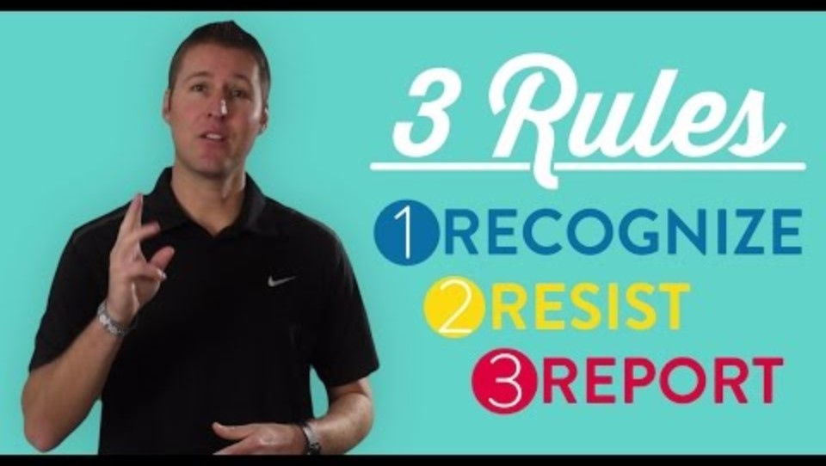
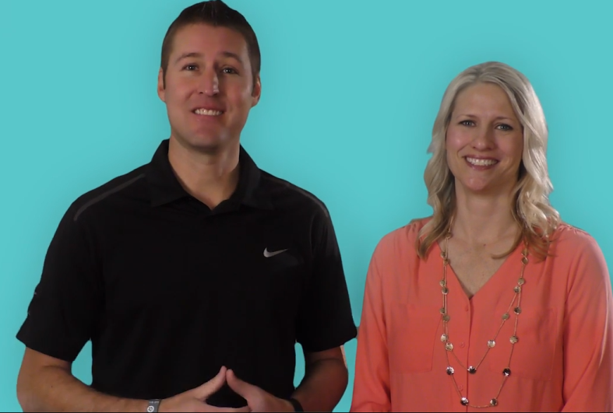
This applies to our kids as well: accountability
Notes:
https://youtu.be/gm4Wh16twhw

Slide 87
Knowing G-d Intimately
Benefits of knowing G-d
External hazards of knowing G-d
Internal hazards of knowing G-d
Fail Safe
Notes:
Hazards? You may disagree with the following…

Slide 88
^{Yn 17.3} Eternal life is this: to know you, the one true God, and him whom you sent, Yeshua the Messiah.

Slide 89
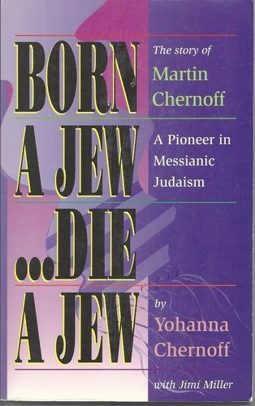
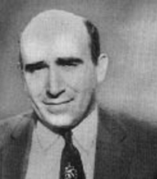
Notes:
Marty Chernoff, founder and father of David and Joel Chernoff.
https://external-content.duckduckgo.com/iu/?u=https%3A%2F%2Ftse1.mm.bing.net%2Fth%3Fid%3DOIP.ms6Md8caiUg6RJQrq1OYvgAAAA%26pid%3DApi&f=1&ipt=beaaf9402ae6f5e0b48ab19058f310f1e0eb11e56829c30140799e552895df59&ipo=images

Slide 90
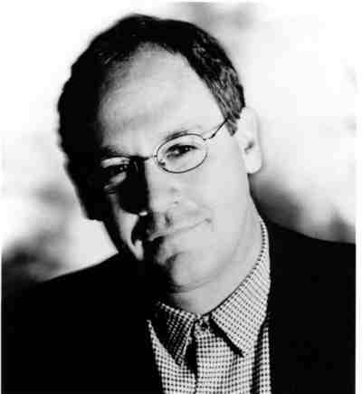
Shalom Shmuel,
My father used to preach “if you are not spending at least one hour per day (30 min. prayer/30 min. in word) you are a weak believer.”
Blessings, Joel Chernoff
Notes:
Think about that. An hour alone with the heavenly King, the Heavenly Bridegroom and King. Martin Chernoff at Beth Yeshua had doctors, lawyers, all kinds of professionals and tradesmen. Were they too busy to spend that hour? Apparently not.
Bottom line. Life process.
But, you may say, “No way I can do 30/30.”
Start with 15/15, or 10/10, or 5/5.
Your own written prayers, siddur prayers, spontaneous prayers.
You can wear t’fillin; you can pray in tongues. I usually read from my prayer list on the recliner, with coffee.
This is a basic matter of life in Messiah.

