Slide 1
e-handout
To have these notes
without taking notes
Go to OrHaOlam.com
Click on Messages tab,
2024 Messages

Slide 2
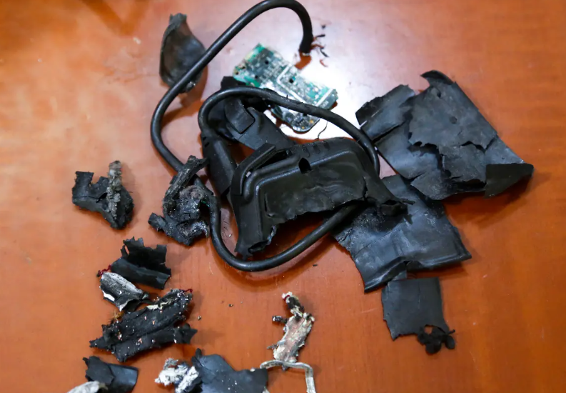
remains of exploded pagers
Notes:
TOPSHOT - A photo taken on September 18, 2024, in Beirut's southern suburbs shows the remains of exploded pagers on display at an undisclosed location. (Photo by AFP) Photo by -/AFP via Getty Images

Slide 3
Avner Boskey: On Tuesday, September 17, 2024, at 3:30 pm, over 4,000 Motorola beepers (Gold Apollo Rugged Pagers – model AR924) simultaneously exploded across Lebanon in the hands and pant pockets of Hezbollah and Iranian Revolutionary Guards Corps terrorists.
Notes:
Avner Boskey

Slide 4
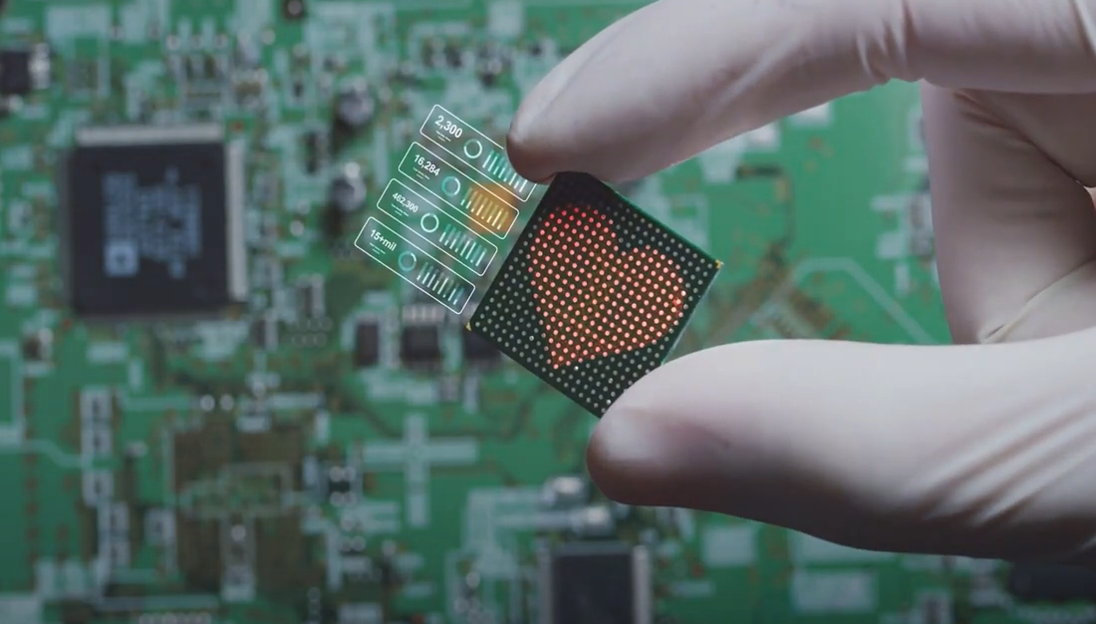
Explosives inserted into pagers

Slide 5
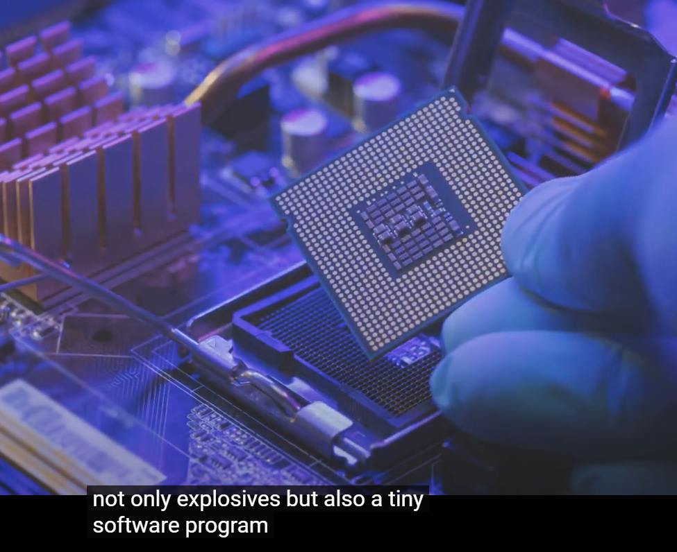
Notes:
https://duckduckgo.com/?q=how+did+Israel+arm+the+pagers&atb=v349-1&iax=videos&ia=videos&iai=https%3A%2F%2Fwww.youtube.com%2Fwatch%3Fv%3D5wazkT6Lxi0
There are various theories about the arming of the devices
Taiwanese manufacturer subcontracted to Hungarian company https://www.cbsnews.com/news/hezbollah-pagers-explode-israel-taiwan-hungary-gold-apollo-bac-consulting/
Israel interdicted the shipment and modified them
There was no Hungarian company. Actually made in Israel, Hungarian shell company.
Exploded Tuesday since two Hezbollah operatives seemed to be on to the plot, otherwise were to be part of an invasion.

Slide 6
Exclusive Hylan Slobodkin [not confirmed]:
An internal Hezbollah document from the office of the head of the organization's military intelligence division was leaked.

Slide 7
Hezbollah reports 879 deaths as a result of the infiltration and explosion of its internal communication network.
Of these - 131 Iranians, 79 Yemenis, of which 291 senior officials were killed.

Slide 8
As a result of the explosions, 509 of them were blinded, the vast majority of them (491 completely blind) and 602 were seriously injured, of which 84 were senior citizens.

Slide 9
Additional injuries, of which 1735 were damaged in their reproductive organs, of which 905 were irreversibly damaged.

Slide 10
The number of non-involved casualties is 40, of which 39 are dead and one is seriously or seriously injured.
Retired Messianic Rabbi
Hylan Slobodkin

Slide 11
Sally Shiff
According to reports in Lebanon, Kornet anti-tank missile guidance systems also exploded.
Explosions at Hezbollah solar farms in Sidon Tzur and al-Baqaa? One of the Lebanese says that solar energy systems also exploded...all the systems that contain lithium batteries exploded.
Notes:
Sally Shiff

Slide 12
Lt. Gen. Herzi Halevi, the Israeli military’s chief of staff, said on Wednesday that Israel’s military has “many capabilities that we have not yet activated.”
Notes:
https://www.theepochtimes.com/world/second-wave-of-explosions-hits-communications-devices-across-lebanon-5726302?src_src=RTNews&src_cmp=rtbreaking-2024-09-18-2&est=AAAAAAAAAAAAAAAAcuomYBYAh9bH4LguuWhYArg0yEwDi4CakWZxJkVclaEQIH3YkA%3D%3D

Slide 13
“The rule is that every time we work on a certain stage, the next two stages are already ready to advance,” Halevi said. “At each stage, the price for Hezbollah must be high.”
Notes:
https://www.theepochtimes.com/world/second-wave-of-explosions-hits-communications-devices-across-lebanon-5726302?src_src=RTNews&src_cmp=rtbreaking-2024-09-18-2&est=AAAAAAAAAAAAAAAAcuomYBYAh9bH4LguuWhYArg0yEwDi4CakWZxJkVclaEQIH3YkA%3D%3D

Slide 14
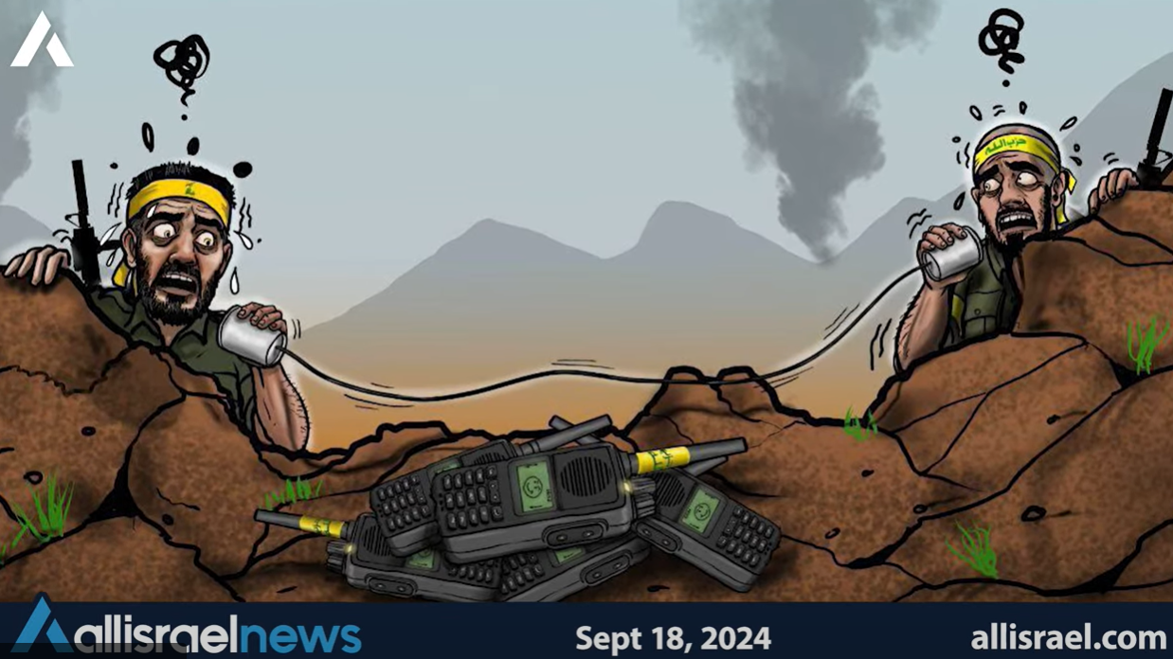

Slide 15
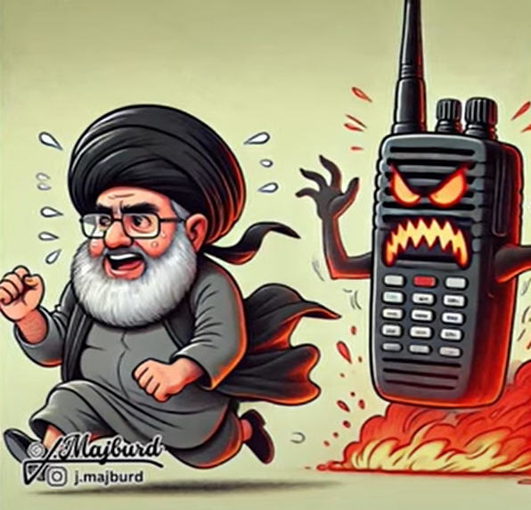
Notes:
My understanding is that a new holy day has been added to the Jewish calendar for future celebration. It is called: Yom Beepur. Mike Stepakoff
However, consider…

Slide 16
As recited in the Passover Haggadah
^{Prov. 24. 17 – 18} Do not rejoice when your enemy falls, and do not let your heart be glad when he stumbles; lest Adoni sees it, and it displease Him, and He turn away His wrath from him.
Notes:
on the other hand…

Slide 17
^{T’hillim Ps 83 17-19} Cover their faces with shame, so they may seek Your Name—Adoni. Let them be ashamed and dismayed forever. Let them be humiliated and perish. Let them know that You alone —whose Name is Adoni— are El Elyon over all the earth.

Slide 18
The world is filled with warfare, strife and trauma

Slide 20
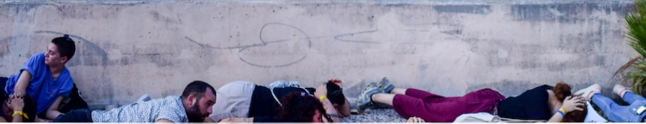
A new academic study warns that around half a million Israelis could potentially develop post-traumatic stress disorder (PTSD) as a consequence of the Hamas Oct. 7 massacres and ongoing war.
Notes:
https://firmisrael.org/learn/news/half-a-million-israelis-could-develop-ptsd-new-research/

Slide 21
23.1% of U.S. adults experienced a mental health condition in 2022
In 2022, 32.9% of U.S. adults experienced both a mental health condition and substance abuse
As of 2020, suicide is the second leading cause of death for U.S. children ages 10 to 14
Notes:
https://www.forbes.com/health/mind/mental-health-statistics/

Slide 22
Young adults ages 18 to 25 in the U.S have the highest rate of experiencing any mental health concerns (33.7%)
Notes:
Used to be the prime of life: athletes, creativity. Einstein was 26 years old when he discovered E=mc² in 1905
https://www.forbes.com/health/mind/mental-health-statistics/

Slide 23
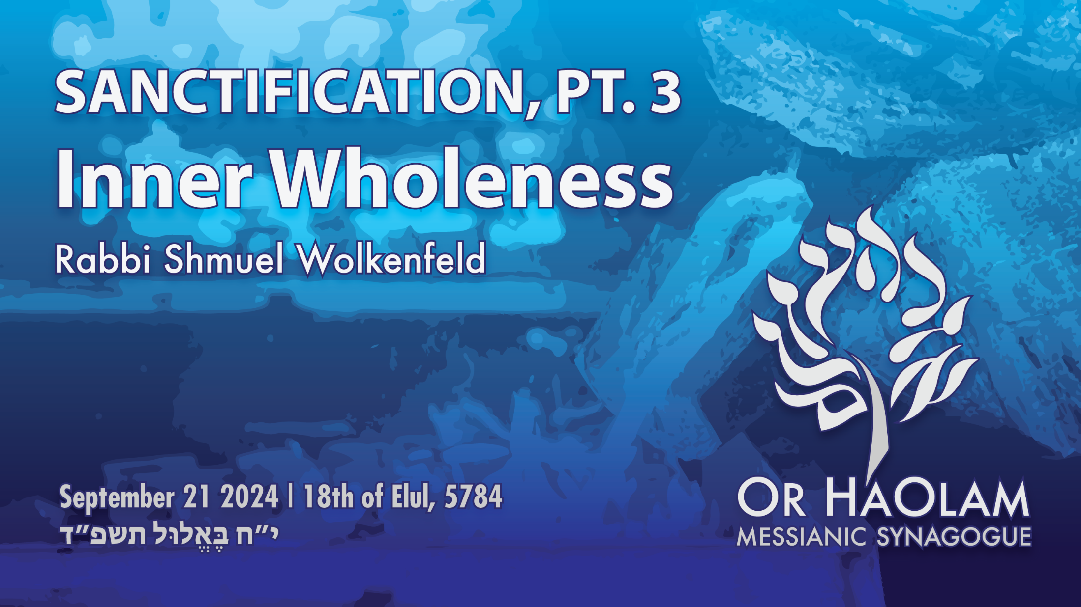
Notes:
Take a deep breath. A topic of Shalom. Enough about the problem. Let’s explore the cure.

Slide 24

Sanctification: Inner Wholeness
The world in trauma
Word analysis of sanctification
Ellel’s approach
Ephesians 5.1-5

Slide 25
Sanctification: Inner Wholeness
The world in trauma
Word analysis of holiness
Ellel’s approach
Ephesians 1-5

Slide 26
The world is in Trauma
Trauma in the Middle East: sons of Isaac and sons of Ishmael
Trauma in the West: Gen Z

Slide 29
Sanctification: Inner Wholeness
The world in trauma
Word analysis of sanctification
Ellel’s approach
Ephesians 5.1-5

Slide 30
Sanctification sounds like a medieval monastic religious term. How is that the answer to all this turmoil and anguish?
Why do I need that?
Notes:
Review:

Slide 31
Conclusion of word analysis:
Holiness, health, wholeness are deeply related.
Notes:
Word analysis is NOT a word salad

Slide 32
Sanctifi-cation | קִדּוּשׁ | kiddush | the process
Holiness | קְדֻשָּׁה | k’dusha | the quality
Holy | קָדוֹשׁ | kadosh | adjective
Notes:
These are all terms of bliss and PRESENCE
All these terms are related in the thinking of the scripture authors. Don’t sound alike in English.
Sanctification the noun describing the action, the process, the transformation, becoming holy.
Holiness is the quality of life we are aim to attain.
Holy is the adjective describing people or things which have been sanctified, made holy.

Slide 33
Holy means
separate, morally pure, bright
This is our purpose, our goal. To be holy, to share in G-d’s holiness through Messiah Yeshua.

Slide 34
English Word History
holy
Middle English, from Old English hālig; akin to Old English hāl whole
Notes:
Before we explore the word “whole” consider “health”
https://www.merriam-webster.com/dictionary/holy

Slide 35
Health
Middle English helthe, from Old English hǣlth, from hāl
Notes:
Same root word
https://www.merriam-webster.com/dictionary/health#word-history

Slide 36
whole
A (1) free of wound or injury : unhurt
(2) recovered from a wound or injury : restored
(3) being healed “whole of an ancient evil, I sleep sound” —
A.E. Housman
Notes:
https://www.merriam-webster.com/dictionary/whole

Slide 37
whole
B free of defect or impairment: intact
C physically sound and healthy : free of disease or deformity
D mentally or emotionally sound
Notes:
https://www.merriam-webster.com/dictionary/whole

Slide 38
Conclusion of word analysis:
Holiness, health, wholeness are deeply related.

Slide 40
Notes:
Take a deep breath. A topic of Shalom. Enough about the problem. Let’s explore the cure.

Slide 41
Sanctification: Inner Wholeness
The world in trauma
Word analysis of sanctification
Ellel’s approach
Ephesians 5.1-5

Slide 42

From the Ellel Website ellel.org/
The sad truth is that many believers feel that there is no real answer to the problems they face on a daily basis –
Notes:
https://ellel.org/usa/about/
Where the rubber meets the road.

Slide 43
– problems such as fear and anxiety, addictions and anger outbursts, long-term consequences of trauma or abuse and relationship dysfunction... to name but a few. The list is endless!
Notes:
https://ellel.org/usa/about/

Slide 44
Our definition of healing is simple. We believe healing is God's supernatural work of bringing order into a person's life where there has been disorder! It includes looking at the root problems that may be the cause of a person's struggle -
Notes:
https://ellel.org/usa/about/

Slide 45
dealing with any unforgiveness, sin, wounding, or hold of the enemy. As we help a person do their business with God in forgiving, repenting and making godly choices, we then pray for the Lord to bring His healing. It's not the weird or wacky picture of healing that some people have - just basic discipleship.
Notes:
https://ellel.org/usa/about/

Slide 47
Sanctification: Inner Wholeness
The world in trauma
Word analysis of sanctification
Ellel’s approach
Ephesians 5.1-5

Slide 48
^{Eph. 4.22-32} With respect to your former lifestyle, you are to lay aside the old self corrupted by its deceitful desires,

Slide 49
^{Eph. 4.22-32} be renewed in the spirit of your mind, and put on the new self—created to be like God in true righteousness and holiness.

Slide 50
One commentator noted that from 4:25 on to the end of the book, the instructions all have to do with application of 4:22-24 , i.e. putting off the old man and putting on the new man.

Slide 51
^{Eph 5.1-5} Therefore be imitators of God, as dearly loved children; and walk in love, just as Messiah also loved us and gave Himself up for us as an offering and sacrifice to God for a fragrant aroma. But sexual immorality and any impurity or greed—
Notes:
putting on, putting off

Slide 52
^{Eph 5.1-5} don’t even let these be mentioned among you, as is proper for קדושים kedoshim [holy people]. Obscene, coarse, and stupid talk are also out of place, but instead let there be thanksgiving. Know for certain that no immoral,
Notes:
putting off, putting on

Slide 53
^{Eph 5.1-5} indecent, or greedy person—who is really an idol worshipper at heart—has any inheritance in the kingdom of Messiah and God.
Notes:
Back through the Eph 5.1-5 text

Slide 54

Therefore be imitators of God
What does that mean?

Slide 55
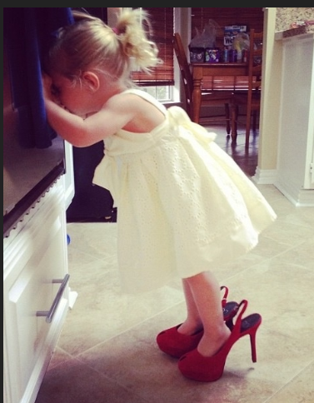
Children love to imitate their parents.
Notes:
Except when they become teenagers, if there are wounds and/ or problems and /or rebellion, they will do the OPPOSITE of their parents.
https://external-content.duckduckgo.com/iu/?u=https%3A%2F%2Fi.pinimg.com%2F736x%2F1f%2Ff9%2F51%2F1ff951a94990e162940aa0d1c67b3022--mom-and-dad-little-girls.jpg&f=1&nofb=1&ipt=3daf03cdecbfb347e27ea6c35bfd9e5f563df5b9bd7026887c0245c61501cf4b&ipo=images

Slide 56
God Is Infinite – He is Self-Existing, Without Origin
God Is Immutable – He Never Changes
3.God Is Self-Sufficient – He Has No Needs
4. God is Omnipotent – He Is All Powerful
Notes:
https://www.biblestudytools.com/bible-study/topical-studies/15-amazing-attributes-of-god-what-they-mean-and-why-they-matter.html

Slide 57
5. God Is Omniscient – He Is All-Knowing
6. God Is Omnipresent – He Is Always Everywhere
7. God Is Wise – He Is Full of Perfect, Unchanging Wisdom
8. God Is Faithful – He Is Infinitely, Unchangingly True
Notes:
https://www.biblestudytools.com/bible-study/topical-studies/15-amazing-attributes-of-god-what-they-mean-and-why-they-matter.html

Slide 58
9. God Is Good – He Is Infinitely, Unchangingly Kind and Full of Good Will
10. God Is Just – He Is Infinitely, Unchangeably Right and Perfect in All He Does
11. God Is Merciful – He is Infinitely, Unchangeably Compassionate and Kind
Notes:
https://www.biblestudytools.com/bible-study/topical-studies/15-amazing-attributes-of-god-what-they-mean-and-why-they-matter.html

Slide 59
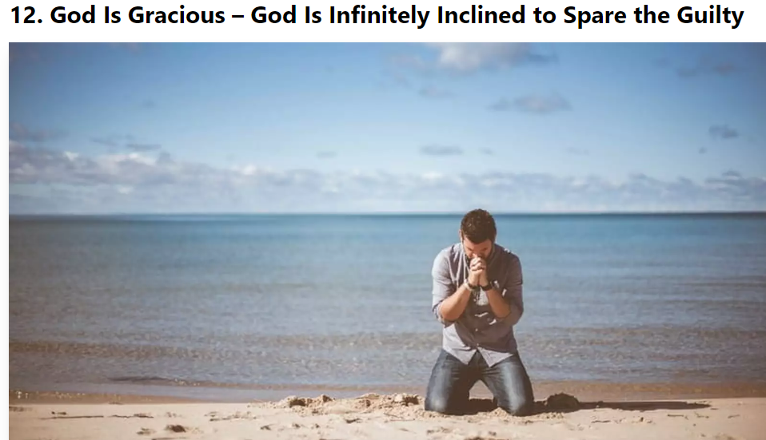
Notes:
https://www.biblestudytools.com/bible-study/topical-studies/15-amazing-attributes-of-god-what-they-mean-and-why-they-matter.html

Slide 60
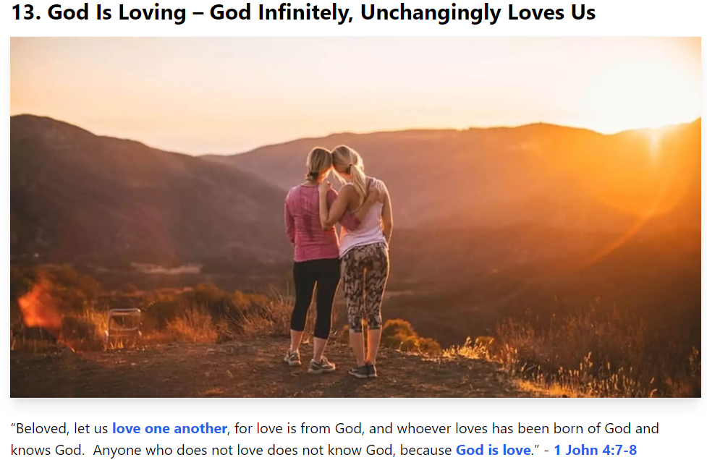
Notes:
https://www.biblestudytools.com/bible-study/topical-studies/15-amazing-attributes-of-god-what-they-mean-and-why-they-matter.html

Slide 61
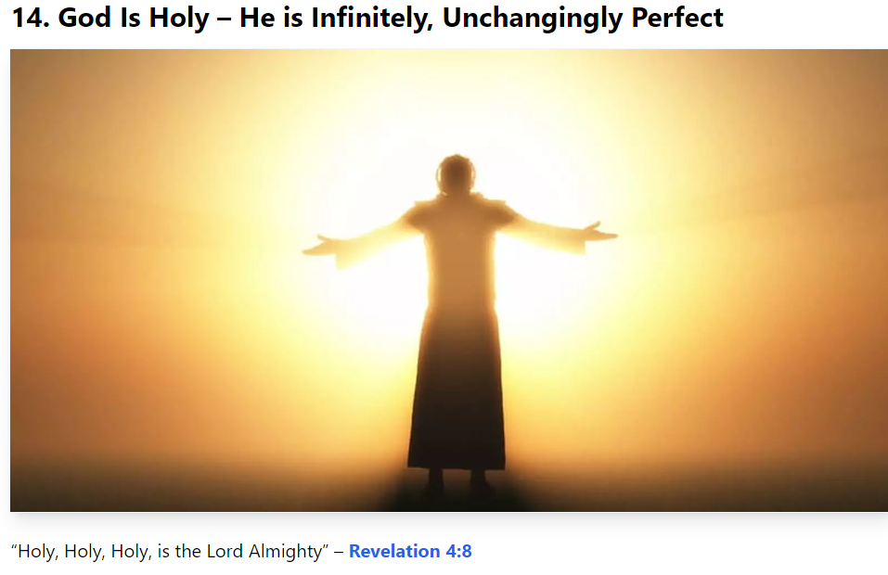
Notes:
https://www.biblestudytools.com/bible-study/topical-studies/15-amazing-attributes-of-god-what-they-mean-and-why-they-matter.html

Slide 62
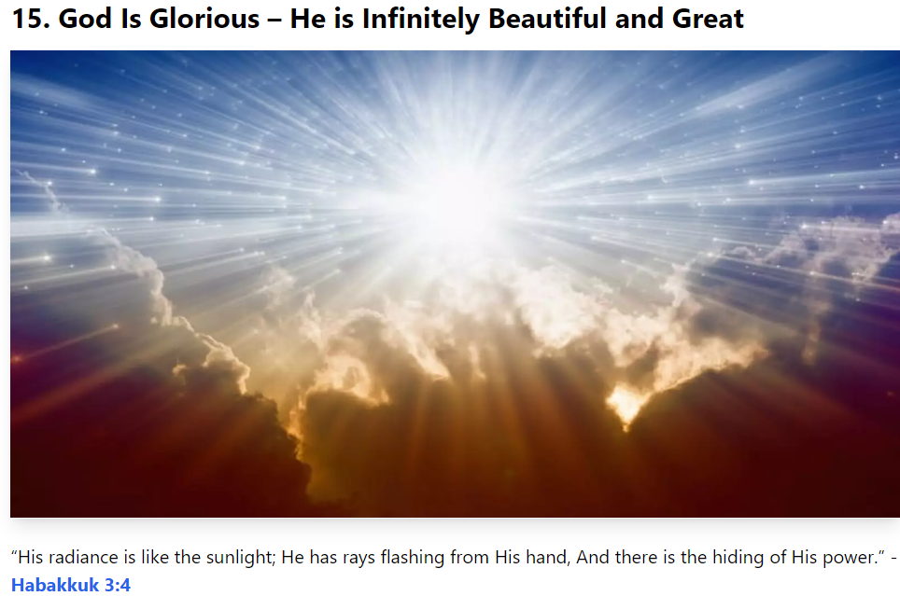
Notes:
https://www.biblestudytools.com/bible-study/topical-studies/15-amazing-attributes-of-god-what-they-mean-and-why-they-matter.html

Slide 63
We obviously can’t do most of those so the text specifies

Slide 64
^{Eph 5.1-5} as dearly loved children
Many have NO idea what it is to be have loving parental role models.
Notes:
I spent 3 weeks at a Jack Frost “Imparting the Father’s Heart” conference. Special private session as well. I was advised to do a study on a mother’s love. Had a revelation of my mom, as heir to WW II Nazism, grandpa her dad fled from pogroms in Russia, Belarus. Scratching and clawing for some dignity. Took it out on her husband and us kids
I never saw a healthy marriage until I met believers in 1969 age 19.

Slide 65
^{Eph 5.1-5} and walk in love
Notes:
We may not know all the 613 mitzvot, although we can be learning, but this is the central mitzvah, that is the context of ALL the others. Without this one, all fails.
But, what is love? I was sharing with a gay dorm mate in 1969 who then said love is “do unto others as you would have them do to you.”

Slide 66
^{Eph 5.1-5} and walk in love just as Messiah also loved us and gave Himself up for us as an offering and sacrifice to God for a fragrant aroma.
Notes:
Why fragrant? Sacrificial love hurts. Love suffers long. The Temple sacrificial animals are a fragrant aroma: burned meat?
So the first thing to take off / put on is the idea that I will be comforted and blessed. Rather, serve, give comfort and blessing. Even if you have to rebuke, correct. Sandwich model? Positive negative positive.
Messiah like love

Slide 67
Sacrificial love which deals with offenses, forgives.
Importance of forgiveness
C.S. Lewis: Everyone thinks forgiveness is a great idea until he has something to forgive.
Notes:
Next several slides directly from Lambert Bariho’s Ellel teaching last night. Prep you who are going only this afternoon.

Slide 68
^{Mt 5.23-26} So if you are offering your gift at the Temple altar and you remember there that your brother has something against you, leave your gift where it is by the altar, and go, make peace with your brother. Then come back and offer your gift.
Notes:
They walked with the offering many miles, especially if from Galil. Yeshua is saying, “Go back.”
Imagine if we had a screener at the pushka, the offering box, or on the Giving Fire website form, asking you if you were at odds with anyone?
“No, can’t accept your donation.”

Slide 69
^{Mt. 6.12} Forgive us what we have done wrong, as we too have forgiven those who have wronged us.
^{Mark 11.25} And when you stand praying, if you have anything against anyone, forgive him; so that your Father in heaven may also forgive your offenses.

Slide 70
Forgiveness is NOT
Forgetting: Rwanda 1 million people murdered in 100 days
Minimizing wrongs. Yosef w bros
Deny our anger
Declare them not guilty
Notes:
Takes much psycholological energy to suppress a memory.
You meant it for evil
Gets them off your hook, not G-d’s hook.

Slide 71
Not that they get away with it
Forgiveness is NOT reconciliation. Need both parties humbling
Forgiveness is NOT restoration of trust. Must be earned.
Notes:
7 Ekkehart Hoeffing

Slide 72
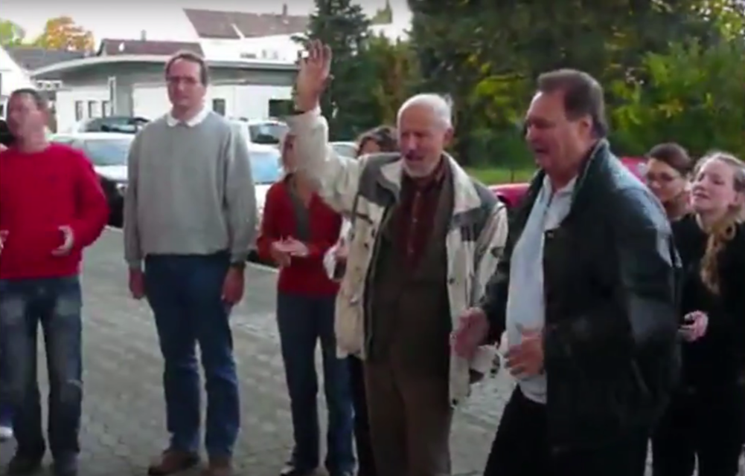
Immanuel Geminde burning
Mein Kampf
Notes:
Everything German to me was sinister, pernicious, insidious. Seeing the signs, the Teutonic architecture, hearing the language, looking at the cold faced people.
Singing Am Yisrael Khi, the People of Israel live, in Nuremberg!!

Slide 73
Forgiveness does mean
Healing of memories
Surrender to G-d desire for retaliation David & K. Saul
Surrendering my right to judge
Choosing mercy when not deserved, before the time
Notes:
4. Y died before we were worthy.

Slide 74
5. Acknowledge what is really in my heart vs “spiritual terminology”

Slide 75
How do we forgive
Separate the sin from the sinner.
Making a choice >> feeling.
Forgiveness is a process. 70x7
Be specific: people and events
Bring it to the Execution Stake.
Surrender the pain
Repeat
Notes:
The person’s identity is not = the sin.
Lambert and Catherine had an individual hurt them. They made great efforts, prayer retreat. Approached in individual who had no idea. He was free from the poison. Not forgiving is allowing someone to live in your heart without paying rent. Unforgiveness is like drinking rat poison and expecting the rat to die.

Slide 77
^{Eph 5.1.5} But sexual immorality and any impurity or greed—
Notes:
Could be talking about sensuality and avaricious materialism or the concept that sexual immorality = greed. “Love can wait to give, lust cannot wait to get.”

Slide 78
^{Eph 5.1-5} don’t even let these be mentioned among you, as is proper for קדושים kedoshim [holy people]. Obscene, coarse, and stupid talk are also out of place.
Notes:
I love good humor. When we got our Volvo, it had a one year subscription to satellite radio. Among the categories of stations was comedy. I was happy to try them. But all of them were the likes of Sarah Silverman, a nice Jewish girl? No a foul mouthed stand up comedienne.
Hard when you are in a circle of people, all being chummy, then you have be the religious grinch.

Slide 79
^{Eph 5.1-5} Instead let there be thanksgiving.
Notes:
Best way to overcome jealousy of those who have it better, and pride over those who have it worse.

Slide 80
^{Eph 5.1-5} Know for certain that no immoral, indecent, or greedy person—who is really an idol worshipper at heart—has any inheritance in the kingdom of Messiah and God.
Notes:
^{Mt 16.26} For what will it profit a man if he gains the whole world but forfeits his soul? Or what will a man give in exchange for his soul?

Slide 82
Sanctification: Inner Wholeness
The world in trauma
Word analysis of sanctification
Ellel’s approach
Ephesians 5.1-5

Slide 83
Epitome of holiness = health = wholeness
^{Gal 5. 22-23} But the fruit of the Spirit is love, joy, peace, patience, kindness, goodness, faithfulness, humility, self control. Nothing in the Torah stands against such things.

Slide 85
Prayer points:

Slide 86
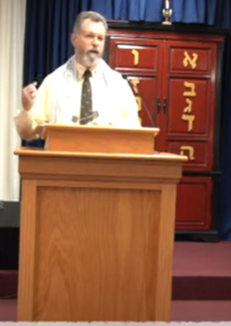
From Rabbi Todd Lesser
We are already seeing Jewish salvations through our new building before we are officially in it. I have met with 4 people at the new building (they preferred to meet there) while it was undergoing renovation,

Slide 87
3 of them were Jewish, 2 of them have since been immersed into new faith in Yeshua as their Jewish Messiah -- a 98-year old Jewish woman and her son, who was greatly influenced by Jonathan Cahn YouTube videos.

Slide 88
The 3rd Jewish person I met with is the longest living member of the conservative synagogue in town. This 95-year old Jewish lady said she would like to attend our services once we got into the new building.

Slide 89
If this is how the Lord is using our new building before we get into it, we can't wait to see what He is going to do once we are actually holding services there! Baruch HaShem!

Slide 90
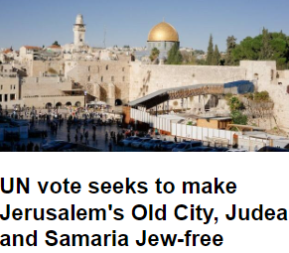

Slide 91
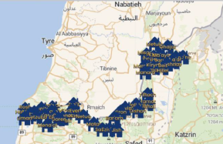
Notes:
Note 44 communities in northern Israel near Lebanon where families were evacuated to be safe from Hezbollah rockets. These families remain displaced from homes and jobs.

Slide 92
If there was any doubt that the ground war is coming – this week should put those doubts to rest. Israel is moving forces up North, including the elite 98th Brigade. This moves means the IDF is serious in invading and holding Southern Lebanon.
Notes:
https://www.israelunwired.com/israel-strikes-southern-lebanon-100s-of-times-assassinates-head-of-radwan-force-readies-for-ground-war/

Slide 93
With Hezbollah’s high command in disarray, the IDF has no choice but to launch a ground invasion now. If they wait too long, Iran will move over its Shiite Militias to bolster Hezbollah’s weakened hand. Expect a few more days of targeted killings and intense bombings in both Lebanon and perhaps Syria before the first stage of the invasion begins.
Notes:
https://www.israelunwired.com/israel-strikes-southern-lebanon-100s-of-times-assassinates-head-of-radwan-force-readies-for-ground-war/

Slide 94
During the eight years from 2016, when MAiD (medical assistance in dying) was legalized in Canada, through 2023, over sixty-thousand people were killed by doctors.
Notes:
https://www.thegoldreport.com/news/euthanasia-by-the-numbers-canadian-doctors-have-already-killed-the-equivalent-of-a-small-city

Slide 95
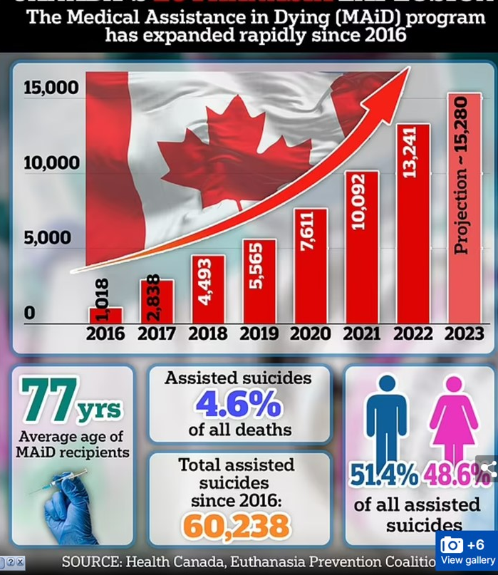

Slide 96
