Slide 1
e-handout
To have these notes
without taking notes
Go to OrHaOlam.com
Click on Messages tab,
2024 Messages
Notes:
I don’t think I can improve on the wonderful drash that Naomi gave. Nevertheless, a few remarks from a Bar Mitzvah bukhur [choice young man] of 1962.

Slide 2
When Louis was younger, he just hated going to Bar Mitzvahs. All of his uncles and aunts used to come up to him, poke him in the ribs, and say to him, "You're next, Louis."

Slide 3
But they stopped doing that after Louis started doing the same thing to them at funerals.

Slide 4
One day, two bees are buzzing around what's left of a rose bush.
"How's your summer been?" asks bee number one.
"Not too good," says bee two. "Lotta rain, lotta cold. There aren't enough flowers, therefore not enough pollen."
Notes:
source: http://www.jokebuddha.com/Mitzvah#ixzz3CV2cuktD

Slide 5
The first bee has an idea. "Hey, why don't you go down to the corner and hang a left? There's a Bar Mitzvah going on. Plenty of flowers and fruit."
Bee two buzzes, "Thanks!" and takes off.
Notes:
source: http://www.jokebuddha.com/Mitzvah#ixzz3CV2cuktD

Slide 6
An hour later, the bees bump into each other again.
"How was the Bar Mitzvah?" asks the first bee.
"Great!" replies the second.
The first bee, however, notices a small circle on his friend's head, and inquires, "What's that on your head?"
Notes:
source: http://www.jokebuddha.com/Mitzvah#ixzz3CV2cuktD

Slide 7
"A yarmulke," is the answer. "I didn't want them to think I was a Wasp."
Notes:
source: http://www.jokebuddha.com/Mitzvah#ixzz3CV2cuktD

Slide 8
TORAHFIED
Notes:
source: http://www.jokebuddha.com/Mitzvah#ixzz3CV2cuktD

Slide 9
TORAHFIED n. Inability to remember one's lines at one's Bar Mitzvah.
Notes:
source: http://www.jokebuddha.com/Mitzvah#ixzz3CV2cuktD

Slide 10


Slide 11
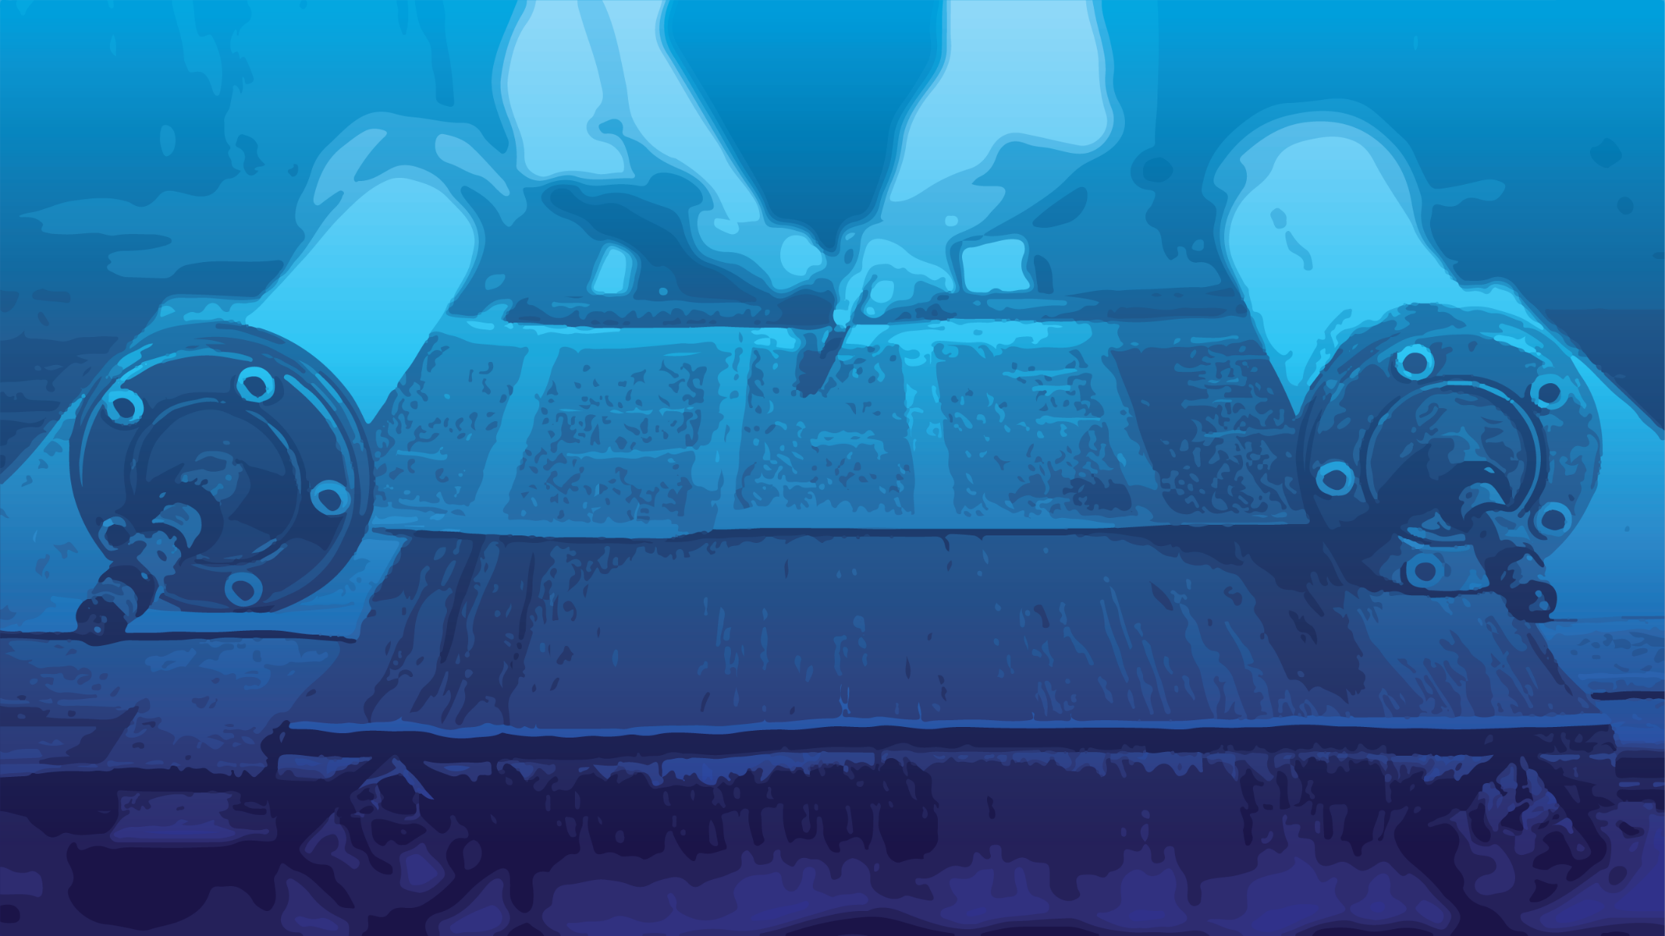

Slide 12
Bat Mitzvah: Daughter of the Covenant
Brief history
Purpose
Hazards

Slide 13
Bat Mitzvah: Daughter of the Covenant
Brief history
Purpose
Hazards

Slide 14
How did it start? Origins of Bar Mitzvah
The Great Synagogue in Rome records the custom of a young woman [!] being called up in synagogue before the entire community
Notes:
Continued as practice in the Roman synagogue.
http://en.wikipedia.org/wiki/Bar_and_Bat_Mitzvah#History

Slide 15
dates back to the early years of the Roman Jewish community approximately 2,300 years ago. 200 BCE
Notes:
Continued as practice in the Roman synagogue.
http://en.wikipedia.org/wiki/Bar_and_Bat_Mitzvah#History

Slide 16
Pirkei Avot consists of the Mishnaic tractate of Avot, the second-to-last tractate in the order of Nezikin in the Mishnah, plus one additional chapter.
Notes:
Tractate = subsection
Order = major section

Slide 17
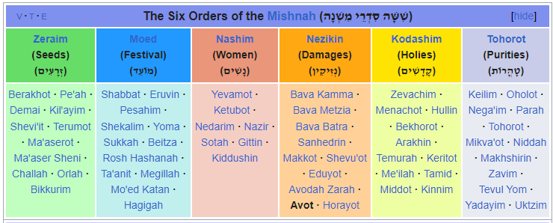

Slide 18
Pirkei Avot/Ethics of the Fathers 5.22 [~200 CE]
Five years is the age for the study of Scripture. [Leviticus]
Ten, for the study of Mishnah.
Thirteen, for the obligation to observe the mitzvot.
Notes:
Old enough to fast on YK.

Slide 19
Fifteen, for the study of Talmud.
Eighteen, for marriage.
Twenty, to pursue [a livelihood].
Thirty, for strength.

Slide 20
American rabbi Mordecai M. Kaplan, who held the first public celebration of a bat mitzvah in the United States, for his daughter Judith, on March 18, 1922, at the Society for the Advancement of Judaism, his synagogue in New York City.
Notes:
Quite shocking to observers.
In my day, Bat Mitzvahs were less common than Bar Mitzvahs. My sister’s Jewish education was just skipped. She never had a Bat Mitzvah.

Slide 21
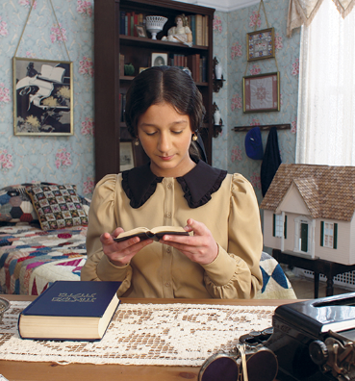
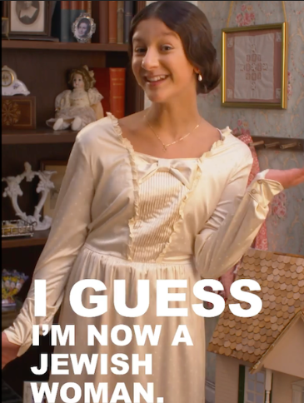
Judith Kaplan,
1922

Slide 22
Judith Kaplan recited the preliminary blessing, read a portion of that week's Torah portion in Hebrew and English, and then intoned the closing blessing
Notes:
Next innovation I don’t approve of at all. NEVER be done at Or HaOlam.

Slide 23
On July 10th, 1977 the first Bark Mitzvah took place in West Orange New Jersey. Marvin and Thebe Drazin held a Bark Mitzvah for their dog Schnoppsie-Lewis Drazin in their backyard.

Slide 24
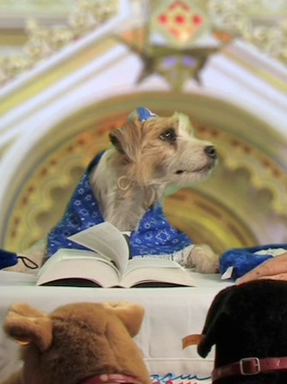
Schnoppsie
July 10, 1977
Notes:
70’s Height of the hippy era

Slide 26
Bat Mitzvah: Daughter of the Covenant
Brief history
Purpose
Hazards

Slide 27
What is a Bar/Bat Mitzvah?
בַּת מִצְוָה
בַּת daughter
מִצְוָה (religion) commandment, precept; decree, edict; good deed, act of kindness
Notes:
Daughter and commandment seem opposite.
Daughter is the epitome of beloved and precious.
Commandment sound legal, military.
It’s being engaged, involved, enamored with the TRUTH of the Word. The daughterhood dimension is because the Word is a love letter of family identity. Covenantal family identity. Covenant is the key word.
Shortly Naomi’s parents, Michael & Tova, will recite the following over her.

Slide 28
בָּרוּךְ שֶׁפְּטָרַנִי מֵעָנְשׁוֹ שֶׁלָזֶה.
Ba-rukh sheh-p'ta-ra-nee
may-an-sho sheh-lah-zeh.
Blessed is He Who has released
me from full responsibility
for the character and deeds of
my daughter.
Notes:
She will bear the full responsibility of her own actions, words, thoughts. Somewhat.
So lets explore the tie between Daughter of Commandments, and the covenant.

Slide 29
^{Yermiyahu 31.31-33} “Hey! the days are coming,” says Adoni, “when I will make a new covenant with the house of Isra’el and with the house of Y’hudah…“For this is the covenant I will make with the house of Isra’el after those days,” says Adoni: “I will put my Torah within them and write it on their hearts;

Slide 30
^{Yermiyahu 31.31-33} I will be their God, and they will be my people. No longer will any of them teach his fellow community member or his brother, ‘Know Adoni’; for all will know me, from the least of them to the greatest; because I will forgive their wickednesses and remember their sins no more.”

Slide 31
The covenant is expressed in the Torah teachings and commandments.
Daughter of the Commandments =
[Bat Mitzvah]
Daughter of the Covenant

Slide 32
^{Yn 14.15-19} "If you love me, you will keep my commands; and I will ask the Father, and he will give you another comforting Counselor like me, the Spirit of Truth, to be with you forever…I will not leave you orphans -- I am coming to you…

Slide 33
^{Yn 14.15-19} In just a little while, the world will no longer see me; but you will see me. Because I live, you too will live.
Notes:
You will see Him if you are regularly in the Word.

Slide 34
^{Thillim/Ps 112.1} Halleluyah! How happy is anyone who fears ADONI, who greatly delights in his mitzvot.

Slide 35
^{Thillim/Ps 119.30-32} I choose the way of trust; I set your rulings [before me]. I cling to your instruction; ADONI, don't let me be put to shame! I will run the way of your mitzvot, for you have broadened my understanding.

Slide 36
So, it’s a big step, committing to love Him and His mitzvot and walk in His covenant.

Slide 37
God meets us at transition points, so we have ceremonies.
Birth: Brit Milah/circumcision
Puberty
Marriage
Death
Notes:
Celebrate transitions. Honor the budding womanhood of Naomi Swanson

Slide 38
בָּרוּךְ אַתָּה בְּבֹאֶךָ; וּבָרוּךְ אַתָּה בְּצֵאתֶךָ
Barukh atah b'voekha, barukh atah btseitkha
^{Dt. 28.6} “A blessing on you when you go out, and a blessing on you when you come in.”

Slide 40
Bat Mitzvah: Daughter of the Covenant
Brief history
Purpose
Hazards

Slide 41
Naomi’s wonderful drash starts with “You are standing before the Lord. Chazak! Be Courageous.”
Notes:
Dennis Prager
https://www.prageru.com/video/the-void-finding-happiness-in-a-world-of-escapism
throws out the question: Why is Gen Z 1997-2012 12-27 years old the most depressed, anxious, and overly medicated generation in America? Detached and lonely, millions of young people are plunging into the void of escapism and social media addiction, only to find themselves more isolated and alone. Screens and drugs.
Solutions to Gen Z and their families for overcoming this mental health crisis by taking on responsibilities and finding purpose.
Purpose in Yeshua, responsibilities in community, with people, not just with screens.

Slide 42
So adult responsibilities:
Handling disagreements

Slide 43

Notes:
From Dr Henry Cloud
https://www.boundaries.me/e/BAh7BjoWZW1haWxfZGVsaXZlcnlfaWRsKwhwhwzrBQA%3D--baf37135647cb00a613159326d79b34cd2cdd9ad?skip_click_tracking=true
Face your fearsome adversaries. Don’t run or rage in conflict.

Slide 44
The most important benefit of a good confrontation is that it preserves love in a relationship. This may seem counterintuitive to you. You may think, “This doesn't make sense.
Notes:
https://www.boundaries.me/e/BAh7BjoWZW1haWxfZGVsaXZlcnlfaWRsKwhwhwzrBQA%3D--baf37135647cb00a613159326d79b34cd2cdd9ad?skip_click_tracking=true

Slide 45
When I confront someone, they will either get mad or leave the relationship.” This can and does happen. But confrontation was not designed to make someone angry or chase him or her away. In fact, it was designed to do the opposite.
Notes:
https://www.boundaries.me/e/BAh7BjoWZW1haWxfZGVsaXZlcnlfaWRsKwhwhwzrBQA%3D--baf37135647cb00a613159326d79b34cd2cdd9ad?skip_click_tracking=true

Slide 46
The Latin term for confrontation means "to turn your face toward, to look at frontally." It merely indicates that you are turning toward the relationship and the person. You are face-to-face, so to speak. So, face your fearsome people.
Notes:
https://www.boundaries.me/e/BAh7BjoWZW1haWxfZGVsaXZlcnlfaWRsKwhwhwzrBQA%3D--baf37135647cb00a613159326d79b34cd2cdd9ad?skip_click_tracking=true

Slide 47
In confrontation, people simply face the relationship and deal with an aspect of the connection that needs to be addressed. The intent is to make the relationship better, to deepen the intimacy, and to create more love and respect between two people.
Notes:
https://www.boundaries.me/e/BAh7BjoWZW1haWxfZGVsaXZlcnlfaWRsKwhwhwzrBQA%3D--baf37135647cb00a613159326d79b34cd2cdd9ad?skip_click_tracking=true

Slide 48
That is why, to be an effective confronter, you need to understand that confrontation works best when it serves love. Boundary conversations are motivated and driven by love. They promote the purposes of love. They enhance a relationship, not end it.
Notes:
https://www.boundaries.me/e/BAh7BjoWZW1haWxfZGVsaXZlcnlfaWRsKwhwhwzrBQA%3D--baf37135647cb00a613159326d79b34cd2cdd9ad?skip_click_tracking=true

Slide 49
Notes:
From Dr Henry Cloud
https://www.boundaries.me/e/BAh7BjoWZW1haWxfZGVsaXZlcnlfaWRsKwhwhwzrBQA%3D--baf37135647cb00a613159326d79b34cd2cdd9ad?skip_click_tracking=true

Slide 50
2. Facing opposition.
Anti-Semitism
Notes:
As this congregation represents Jewish people and those identifying with them…

Slide 51
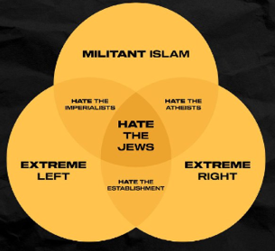
Amir Tsarfati
Notes:
Amir Tsarfati https://beholdisrael.org/
t.me/beholdisraelchannel/40128
Christ the King sounds good, underlying insidious

Slide 52
Last week, the UN General Assembly approved a resolution calling for a global arms and trade embargo against Israel. The resolution also demanded that Israel should unilaterally withdraw from East Jerusalem, Gaza, and the “West Bank” (Judea & Samaria) with a deadline of 12 months.
Notes:
https://honestreporting.com/what-does-the-un-resolution-of-a-unilateral-withdrawal-mean-for-israel/

Slide 53
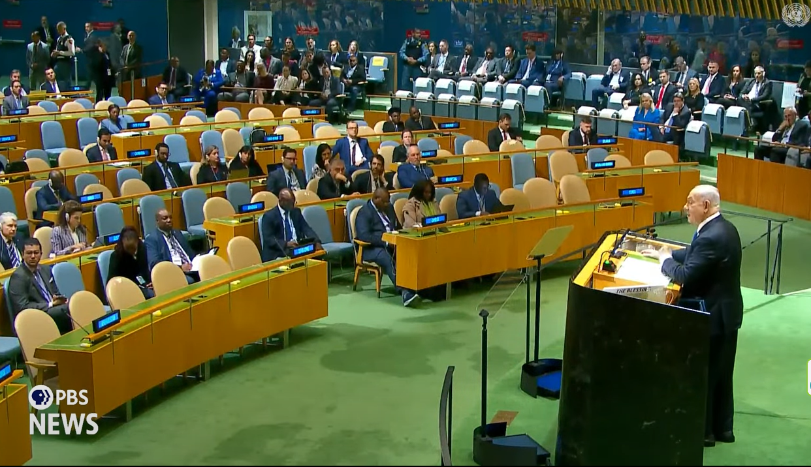
Benjamin Netanyahu addressing
the UN, Sept.26, 2024
Notes:
https://youtu.be/MV8U3l_ECC4
Note the empty seats.

Slide 54
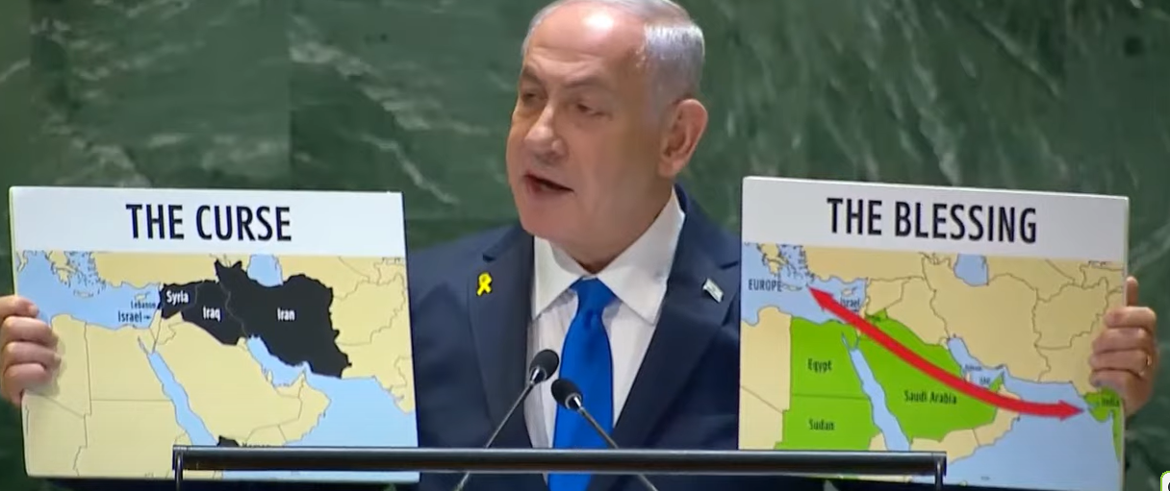

Slide 55
Every Arab nation that has made peace with Israel is being blessed and flourishing, like Egypt, Jordan, Sudan, the United Arab Emirates, Morrocco, and Chad. However, those nations that have not made peace with Israel are starving and suffering from poverty like Yemen, Iraq, Iran, Syria, and Lebanon.
Notes:
Barry Segal

Slide 56
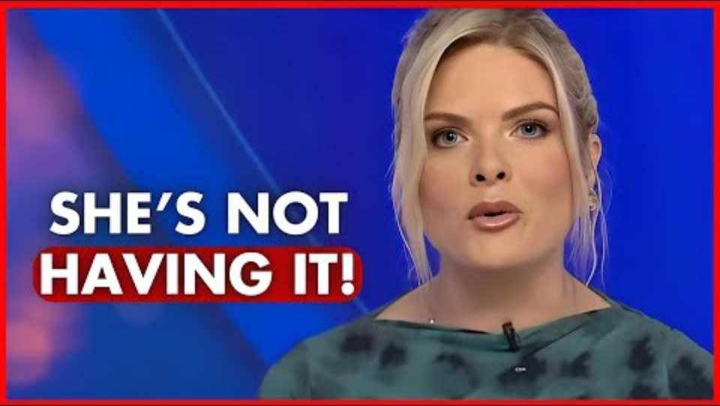
Erin Moran Sky-news
Aus-
tralia
Notes:
https://youtu.be/rLBdehdPQuM?t=85
2.26 to 3.53 in particular

Slide 57
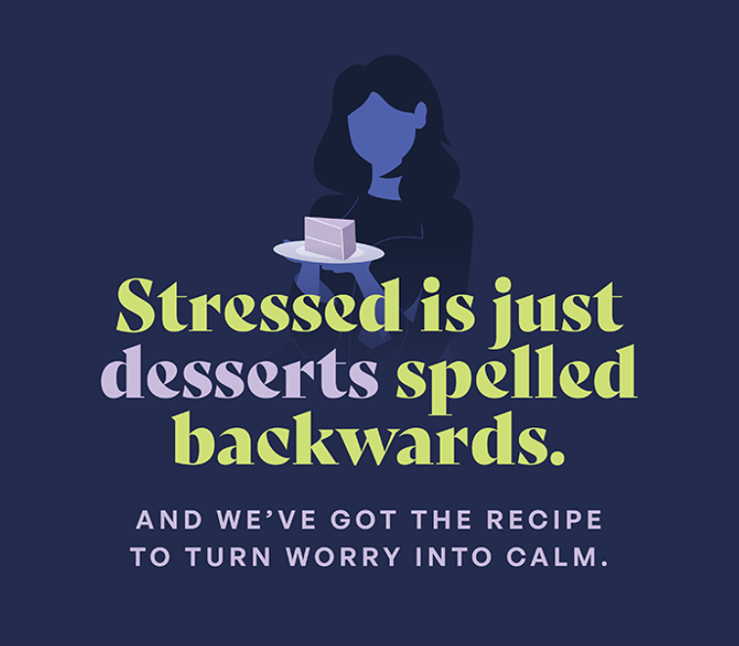
Notes:
https://www.chabad.org/multimedia/course_cdo/aid/6496251/jewish/StressRX-Summit.htm

Slide 58
2. Be strong and courageous facing opposition.
Anti-Semitism
Opposition to you as a Jew, opposition to you as a Yeshua believer and follower.

Slide 59
3. Listening, learning, and leading

Slide 60
^{Deut. 31:7} "Moses called Yehoshua and said to him before the eyes of all Israel: Be strong and courageous for you will come with (et) this nation to the land that God promised to their forefathers to give to them and you will bequeath it to them."
כִּי אַתָּה תָּבוֹא אֶת הָעָם הַזֶּה
Notes:
http://www.ulpanor.com/

Slide 61
In another verse, G-d says to Yehoshua:
^{Deut. 31:23} "He commanded Yehoshua the son of Nun and said: Be strong and courageous for you will bring the Children of Israel to the land that I promised to them and I will be with you."
כִּי אַתָּה תָּבִיא אֶת בְּנֵי יִשְׂרָאֵל
Notes:
http://www.ulpanor.com/

Slide 62
In the first verse, Moses says to Yehoshua "you will come", while G-d says to Yehoshua "you will bring."
In Hebrew there is a slight difference in the spelling and pronunciation of these two verbs.
תָּבִיא and תָּבוֹא
TAVEE TAVO
Notes:
Why is there a difference in the usage of this verb between the two verses?
http://www.ulpanor.com/

Slide 63
The Sages state: When Moshe said to Yehoshua -
...כִּי אַתָּה תָּבוֹא אֶת הָעָם הַזֶּה
"For you will come (et) this nation" – the meaning is:
"For you will come with this nation" (together with this nation).
Here Moshe intended that Yehoshua would take counsel with the elders of the nation, and act according to their opinion.
Notes:
http://www.ulpanor.com/

Slide 64
But, when G-d told Yehoshua:
"For you will bring (et) this nation"
Here the verb תָּבִיא is an active verb (Binyan Hif'eel) and the intention is that Yehoshua would actively lead the Children of Israel even against their will – the decision is his.
Notes:
http://www.ulpanor.com/

Slide 65
Rabbi Elchanan Wasserman:
In the beginning, the leader cannot rely just on his own opinion. He first needs to hear out the opinions and the advice of the elders and the sages.
But after hearing out all the opinions, the leader needs to demonstrate leadership and to decide by himself how to act.
Notes:
http://www.ulpanor.com/

Slide 66
So listen, learn, and lead in whatever life, and G-d, calls you to.

Slide 67
Adult responsibilities:
Handling disagreements
2. Facing opposition.
3. Listening, learning, and leading
Notes:
Conflict is never fun, DON’T withdraw to screens or meds!
Opposition can be quite hateful, especially to you as a Messianic Jewish girl and all those here who affiliate with the Jews.
You will have opportunity and calling to lead. Do it with humility and courage.

Slide 69
Bat Mitzvah: Daughter of the Covenant
Brief history
Purpose
Hazards

