Slide 1


Slide 2
Moshe lived by the Word, spent his life teaching it. So, he is called “Moshe Rabenu.”
Died also according to the Word of Adoni, as G-d appointed it.
Place of death not known or likely would have become a shrine.

Slide 3
Each year, around Rosh Hashanah, the Jewish New Year, tens of thousands of Jewish people make a pilgrimage to Uman, a city in central Ukraine. Despite the Russian attacks, the city streets are jam-packed.
Notes:
https://united24media.com/life-in-ukraine/why-thousands-of-hasidic-jews-make-a-pilgrimage-to-ukraine-2798

Slide 4
Their destination? The gravesite of Rabbi Nachman, who, 200 years ago, promised to intercede on behalf of anyone who visited him on Rosh Hashanah.
Notes:
https://united24media.com/life-in-ukraine/why-thousands-of-hasidic-jews-make-a-pilgrimage-to-ukraine-2798

Slide 5
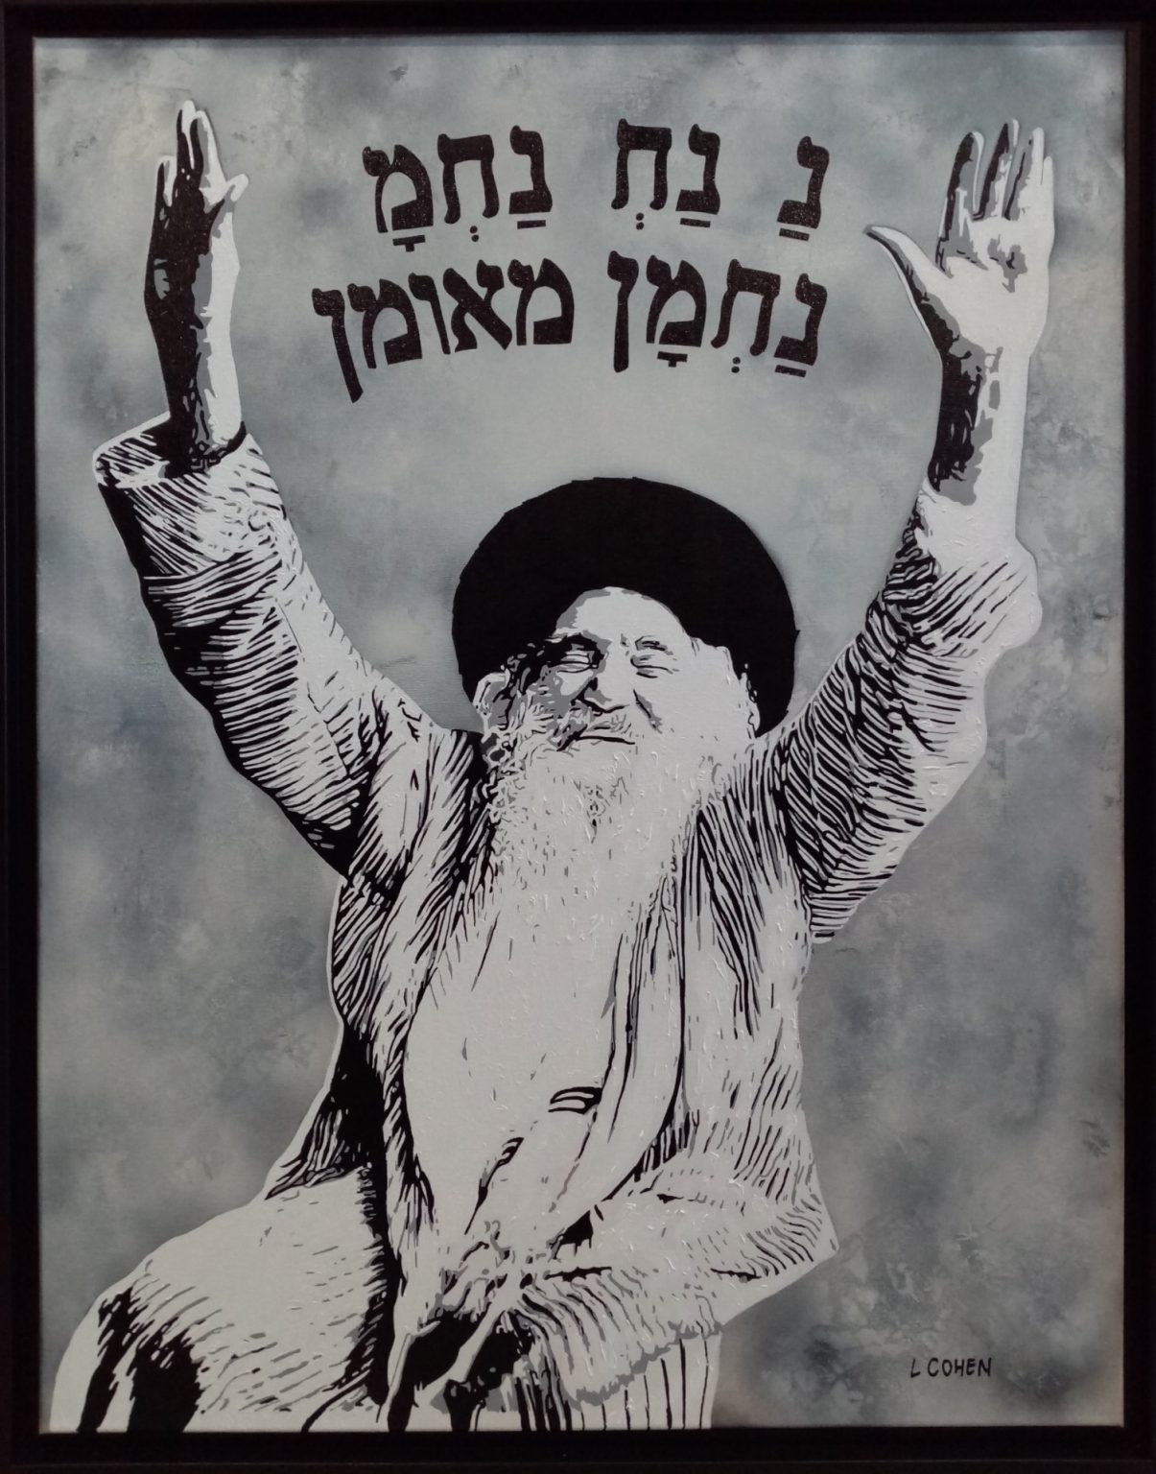
Rabbi Nachman of Breslov
Notes:
https://cohenlionel.fr/wp-content/uploads/2021/02/galerie-lionel-cohen-rav-nahman-de-breslev-acrylique-toile-peinture-portrait-hebraique-1-1205x1536.jpg
Rabbi Nachman, a great-grandson of the Baal Shem Tov, revived the Hasidic movement by combining the Kabbalah with in-depth Torah scholarship. And stories

Slide 6
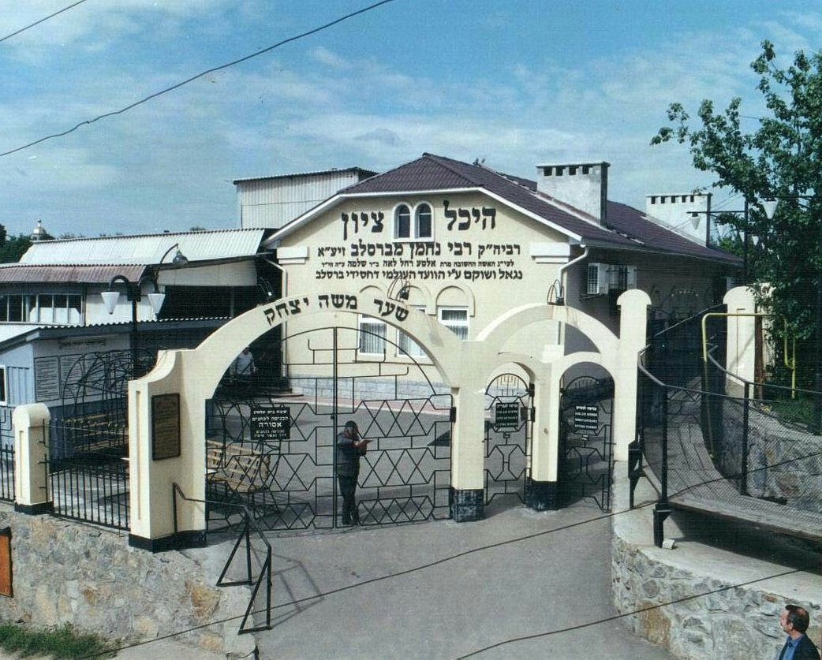
Tomb of Rabbi Nachman in Uman, Ukraine

Slide 7
Old Jewish Cemetery, Prague - A historic site with graves dating back to the 15th century.
Cemetery of the Great Synagogue, Vilnius - Home to many notable rabbis and scholars.
Westwood Village Memorial Park, Los Angeles - Final resting place of famous Jewish personalities like Marilyn Monroe.
Notes:
https://search.yahoo.com/yhs/search?p=famous%20Jewish%20graves&hspart=fc&hsimp=yhs-90&type=fc_AC22890F0FA_s69_g_e_d_n1_c999&param1=7&param2=eJwtjstuwyAURH%2BFZSIBvoAhvWGVOs4HVF0VsXAc6iA%2F5Ydc9esrqmg2o5k50jTx4az%2FuAoArZRy1A%2FOeuGoT7mjvnbWI6KjPk6pMciFBi51zt9yR30TRmf9tjjqt8pZ34%2B%2FseuqTHMghz0Oj3FfyLASARws2eNgckt%2BTH4k1TR1YQ%2F3Nq6ZVieuDDm0z7XvKOliG0gT6nY8kvo5j33IRC44JJGl%2Bq7m%2BELSryW%2Bvm5LmP99WWgp8QoMTydkQtyAoXkvmcHicimxkDdM5FansQSpGSCT8hPMGdRZGw5Cff0ByxlRgg%3D%3D

Slide 8
Moshe died in strength
“eyes undimmed and vigor undiminished”
Theme: Living in the Word Brings Life. Sometimes challenges, but LIFE even in challenges.
Notes:
No glasses or contacts or Lasik surgery. Virile. At 120 years.
Mourned 30 days. Became traditional practice:
7 days sitting at home. Visits. Home services.
30 days
1 year say Kaddish, stone set year end. Yearly commemoration Yahrzeit

Slide 10
Welcome home Alon, Ariel, Avinatan, Bar, David, Eitan M., Eitan H., Elkana, Evyatar, Gali, Guy, Matan A., Matan Z., Maxim, Nimrod, Omni, Rom, Segev, Yosef, & Ziv!

Slide 11
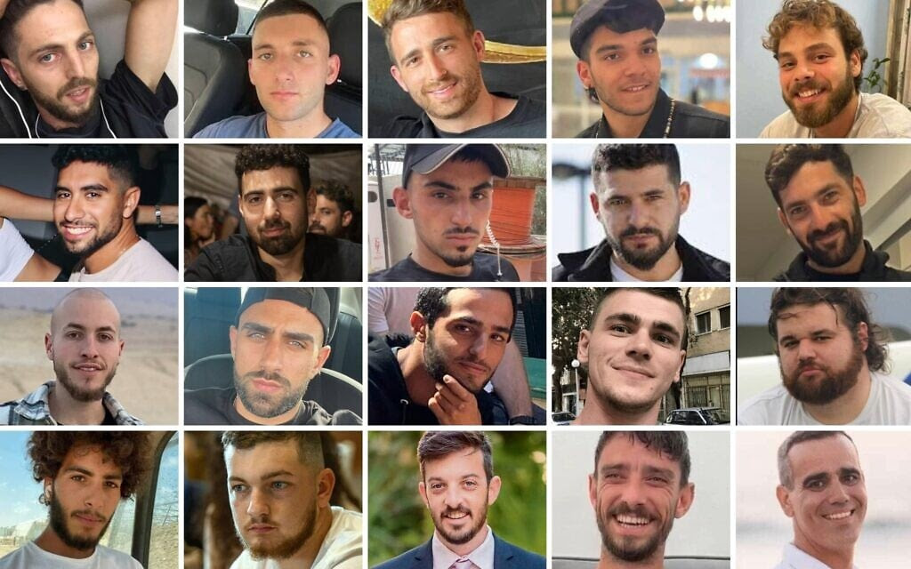

Slide 12
“When Adoni brought back the captives of Zion we were like men who dreamed...Adoni has done great things for us and we are filled with joy."(Psalm 126:1,3)

Slide 13
The twenty released include 11 men kidnapped from the Nova Music Festival: Elkana Bohbot, 35; Rom Braslavski, 22; Evyatar David, 24; Guy Gilboa-Dalal, 23; Maxim Herkin, 35; Segev Kalfon, 27; Bar Abraham Kupershtein, 22; Eitan Abraham Mor, 23; Yosef-Chaim Ohana, 25; Alon Ohel, 24; and Avinatan Or, 32.

Slide 14
From Kibbutz Kfar Aza, Gali Berman, 27, and Ziv Berman, 27, were freed. From Kibbutz Nir Oz, the released include David Cunio, 35; Ariel Cunio, 28; Eitan Horn, 38; and Matan Zangauker, 25.

Slide 15
Also released were Omri Miran, 47, who was kidnapped from Kibbutz Nahal Oz, Matan Angrest, 22, who was kidnapped from the Nahal Oz outpost, and Nimrod Cohen, 21, who was kidnapped near the Gaza border.

Slide 16
Many of the hostages who have returned have testified that they were held for long periods in dark tunnels and subjected to torture, severe starvation, and physical and sexual abuse.
Notes:
https://www.dailywire.com/news/sadistic-humiliation-mutilation-and-gang-rape-were-part-of-hamas-strategy-israeli-report-shows
https://www.dailywire.com/news/israeli-hostages-reveal-harrowing-conditions-of-starvation-and-exploitation-upon-return-home

Slide 17
It remains to be seen IF Hamas will follow through on their commitment to disarm and disband.
Notes:
Daniel Pipes news: “The war will only end when Hamas surrenders unconditionally. Anything else only condemns future generations to even greater conflict.”

Slide 18
Yasser Abu Shabab is a prominent anti-Hamas figure in Rafah. However, Hama confirmed that one of his senior aides had been “liquidated” as part of the operation. “The campaign will continue until no one violates the law,” a Hamas security official said.
Notes:
George Whitten

Slide 19
The bloody effort to consolidate control highlights both Hamas’s fragility and its determination to reimpose order amid Gaza’s ruins—underscoring the deep volatility surrounding efforts to secure lasting peace in the enclave.
Notes:
George Whitten

Slide 20
HOWEVER, step 1 and 2 were successful!!
Let us rejoice.

Slide 21
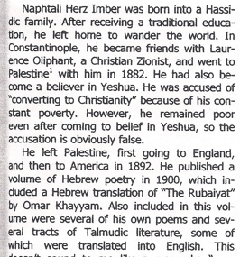

Slide 22
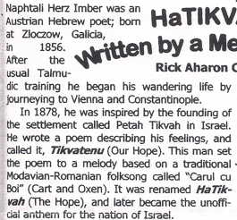

Slide 24

Fruitful LIFE from the Word
Life is in the Word
We get family reality
We get cosmic reality
We get hope in impossibilities

Slide 25
^{John 1.1-3} In the beginning was the Word, and the Word was with God, and the Word was God. He was with God in the beginning. All things came to be through him, and without him nothing made had being.
The Word, the Son, is the Logos, the logic of creation
Notes:
Quantum mechanics and general and special relativity.

Slide 26
^{Yn 8.31-32} So, Yeshua said to the Judeans who had trusted him, “If you obey what I say, then you are really my talmidim, you will know the truth, and the truth will set you free.”

Slide 27
“If you remain united with me, and my words with you, then ask whatever you want, and it will happen for you.
If our minds and hearts are in scripture, we will understand life and love.

Slide 28
Theme: Living in the Word Brings Life. Sometimes challenges, but LIFE even in challenges.
^{2 Cor 5.7} For we walk by faith, not by sight.

Slide 30
Fruitful LIFE from the Word
Life is in the Word
We get family reality
We get cosmic reality
We get hope in impossibilities

Slide 31
B’resheet (Genesis) 1:26
ג כִּי שֵׁם יְהוָה אֶקְרָא ס הָבוּ גֹדֶל לֵאלֹהֵינוּ׃
ג כִּי שֵׁם יְהוָה אֶקְרָא ס הָבוּ גֹדֶל לֵאלֹהֵינוּ׃
וַיֹּ֣אמֶר אֱלֹהִ֔ים נַֽעֲשֶׂ֥ה אָדָ֛ם בְּצַלְמֵ֖נוּ כִּדְמוּתֵ֑נוּ וְיִרְדּוּ֩ בִדְגַ֨ת הַיָּ֜ם וּבְע֣וֹף הַשָּׁמַ֗יִם וּבַבְּהֵמָה֙ וּבְכׇל־הָאָ֔רֶץ וּבְכׇל־הָרֶ֖מֶשׂ הָֽרֹמֵ֥שׂ עַל־הָאָֽרֶץ׃
Then G-d said, “Let us make humankind in our image, in the likeness of ourselves; and let them rule over the fish in the sea, the birds in the air, the animals, and over all the earth, and over every crawling creature that crawls on the earth.”

Slide 32
ג כִּי שֵׁם יְהוָה אֶקְרָא ס הָבוּ גֹדֶל לֵאלֹהֵינוּ׃
ג כִּי שֵׁם יְהוָה אֶקְרָא ס הָבוּ גֹדֶל לֵאלֹהֵינוּ׃
Then G-d said, “Let us make humankind in our image, in the likeness of ourselves; and let them rule over the fish in the sea, the birds in the air, the animals, and over all the earth, and over every crawling creature that crawls on the earth.”

Slide 33
בְּרֵאשִׁית Genesis 1.26-28
Let us נַֽעֲשֶׂ֥ה
In His image [first song?]
Rule over creation
Notes:
נַֽעֲשֶׂ֥ה could be the plural of royalty, but not likely. Speaks of “uniplurality” in אֱלֹהִ֔ים

Slide 34
B’resheet (Genesis) 1:27
ג כִּי שֵׁם יְהוָה אֶקְרָא ס הָבוּ גֹדֶל לֵאלֹהֵינוּ׃
ג כִּי שֵׁם יְהוָה אֶקְרָא ס הָבוּ גֹדֶל לֵאלֹהֵינוּ׃
וַיִּבְרָ֨א אֱלֹהִ֤ים אֶת־הָֽאָדָם֙ בְּצַלְמ֔וֹ בְּצֶ֥לֶם אֱלֹהִ֖ים בָּרָ֣א אֹת֑וֹ זָכָ֥ר וּנְקֵבָ֖ה בָּרָ֥א אֹתָֽם׃
So G-d created humankind in his own image; in the image of G-d he created him: male and female he created them.
Notes:
First song in history, celebrating humankind in his image, male and female

Slide 35
B’resheet (Genesis) 1:28
ג כִּי שֵׁם יְהוָה אֶקְרָא ס הָבוּ גֹדֶל לֵאלֹהֵינוּ׃
ג כִּי שֵׁם יְהוָה אֶקְרָא ס הָבוּ גֹדֶל לֵאלֹהֵינוּ׃
וַיְבָ֣רֶךְ אֹתָם֮ אֱלֹהִים֒ וַיֹּ֨אמֶר לָהֶ֜ם אֱלֹהִ֗ים פְּר֥וּ וּרְב֛וּ וּמִלְא֥וּ אֶת־הָאָ֖רֶץ וְכִבְשֻׁ֑הָ וּרְד֞וּ בִּדְגַ֤ת הַיָּם֙ וּבְע֣וֹף הַשָּׁמַ֔יִם וּבְכָל־חַיָּ֖ה הָֽרֹמֶ֥שֶׂת עַל־הָאָֽרֶץ׃
G-d blessed them: G-d said to them, “Be fruitful, multiply, fill the earth and subdue it.
Notes:
G-d was celebrating LIFE.
Fruitful and multiply.
Rule over the fish in the sea, the birds in the air and every living creature that crawls on the earth.”
Overpop and Elon Musk

Slide 36
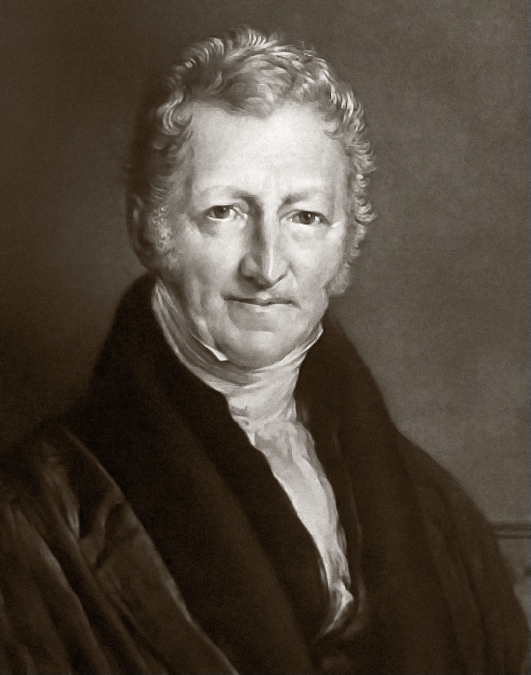
Reverend Thomas Robert Malthus laid out in his 1798 writings, An Essay on the Principle of Population, a theory called
Malthusianism.

Slide 37
Malthusianism is a theory that population growth is potentially exponential, according to the Malthusian growth model, while the growth of the food supply or other resources is linear,
Notes:
https://en.wikipedia.org/wiki/Malthusianism
It was commonly taught when I was in HS.

Slide 38
which eventually reduces living standards to the point of triggering a population decline. This event is called a Malthusian catastrophe.
Notes:
https://en.wikipedia.org/wiki/Malthusianism
It was commonly taught when I was in HS. Global overpopulation.
Similar book called “The Biological Time Bomb”

Slide 39
China's family planning policies began to be shaped by fears of overpopulation in the 1970s, and officials raised the age of marriage and called for fewer and more broadly spaced births. A near-universal one-child limit was imposed in 1980 and written into the country's constitution in 1982
Notes:
https://en.wikipedia.org/wiki/One-child_policy

Slide 40
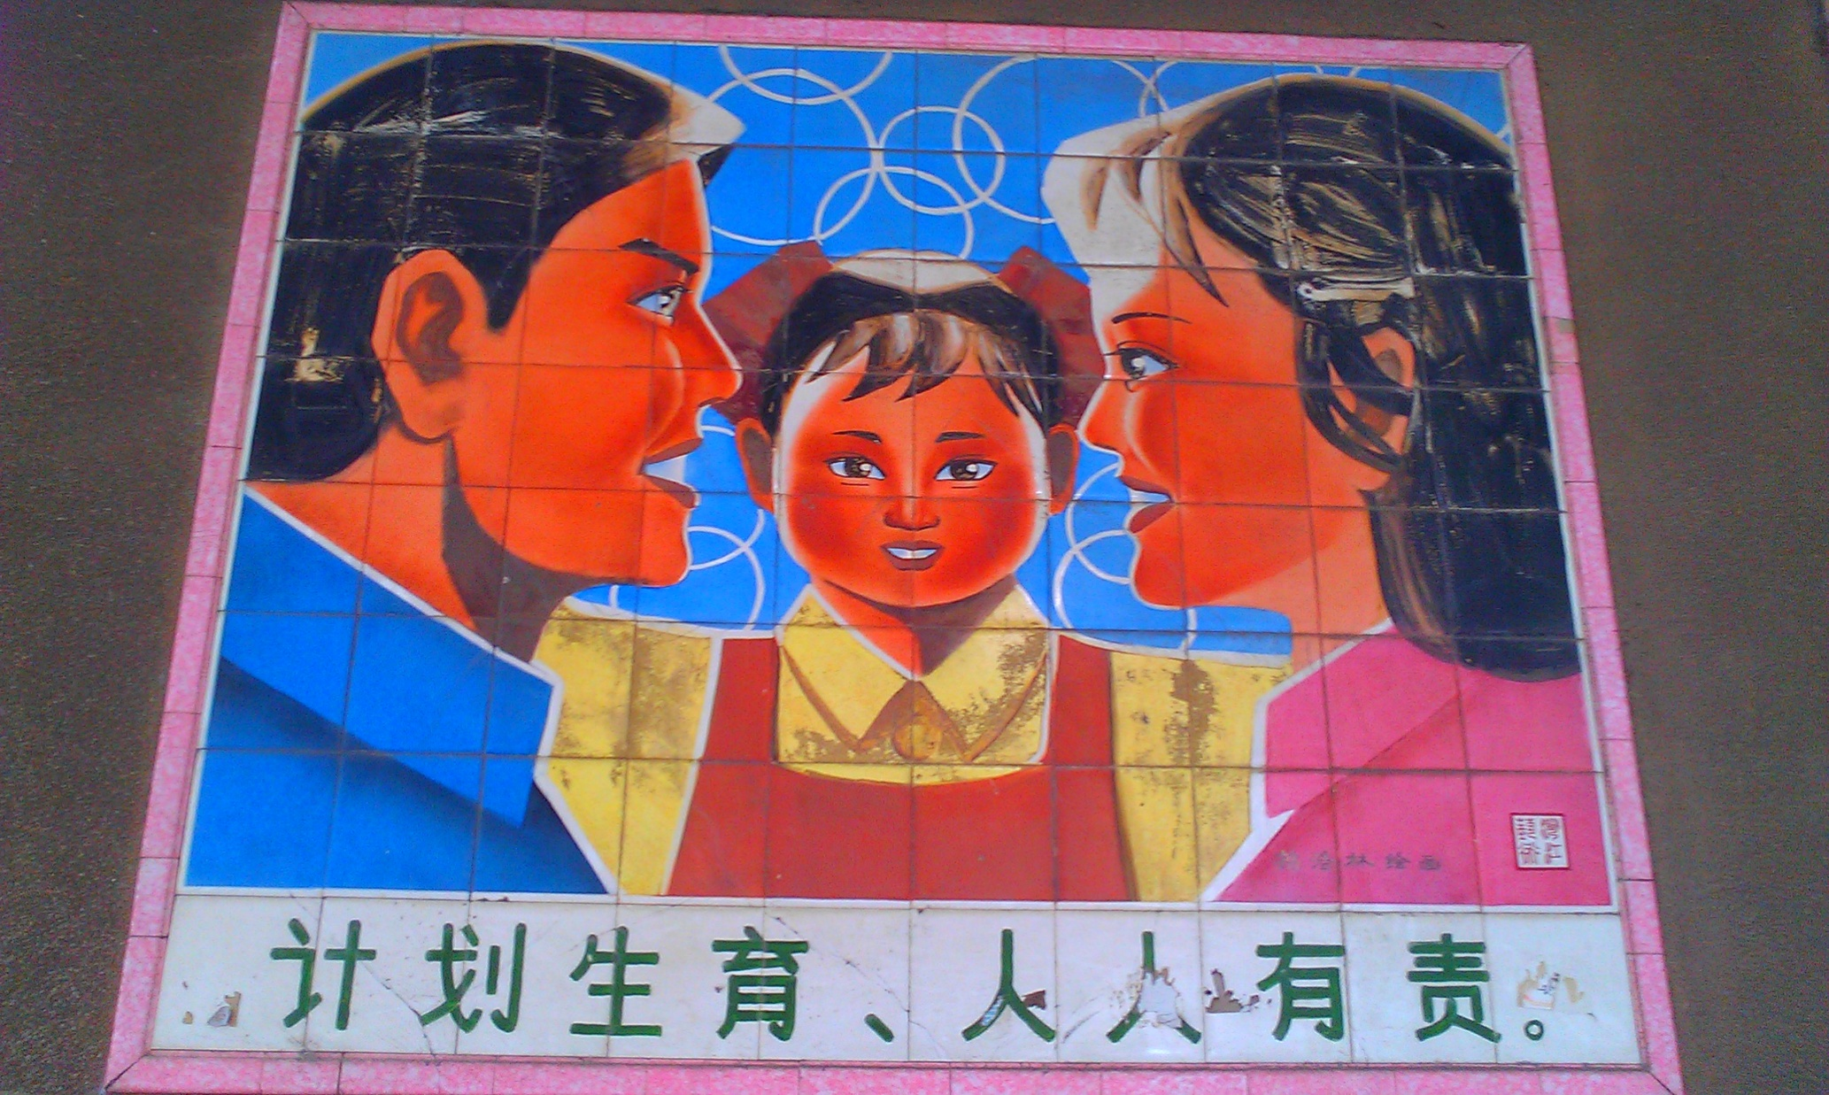
Notes:
A propaganda painting in Guangdong promotes the idea of a nuclear family with a single child. The text reads "Planned child birth is everyone's responsibility."

Slide 41
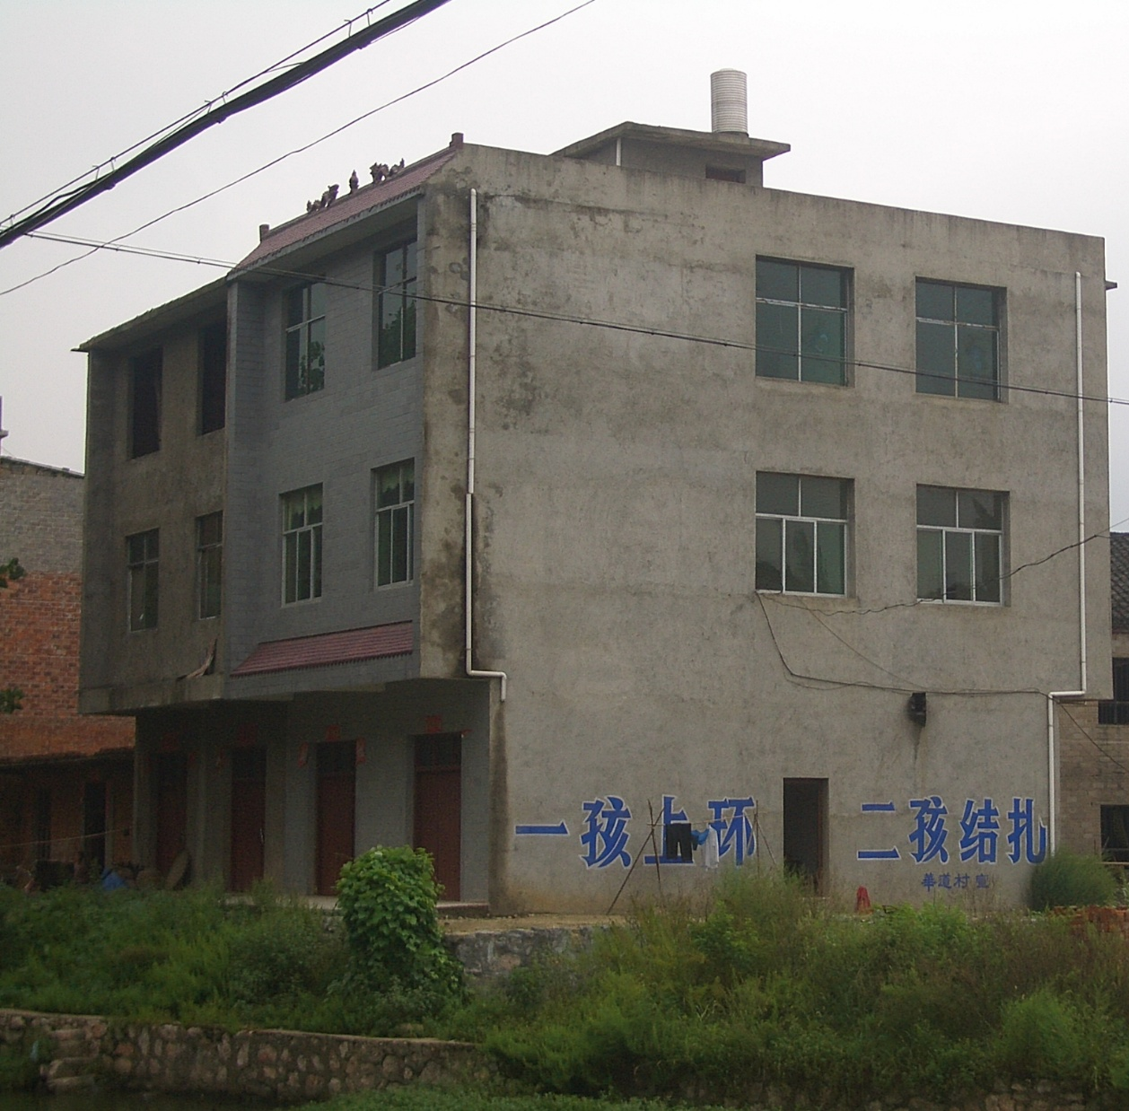
Propaganda slogan on a building at Yangxin County, Hubei, reading “an IUD after the first, tubal ligation after the second.”
Notes:
The CCP was actually quite brutal in enforcing this policy, with arrest seizures of unauthorized pregnant women and forced abortions.

Slide 42
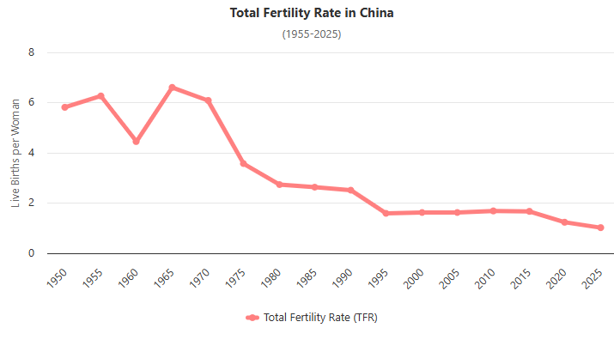
Notes:
https://www.worldometers.info/demographics/china-demographics/

Slide 43
This fear of life grew worse, in a movement called Anti-natalism

Slide 44
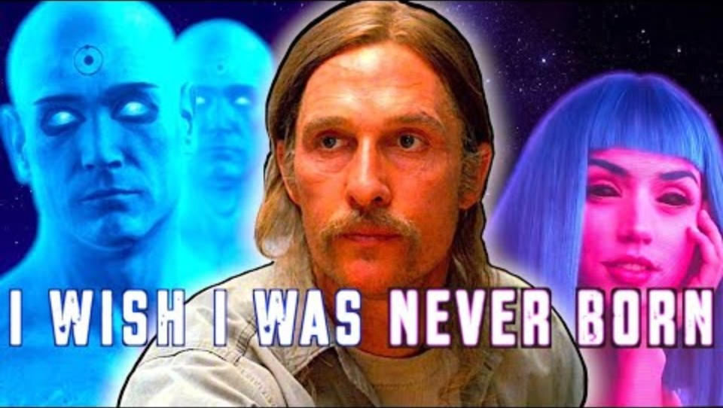
Notes:
https://youtu.be/yqMtAQEU2SA

Slide 45
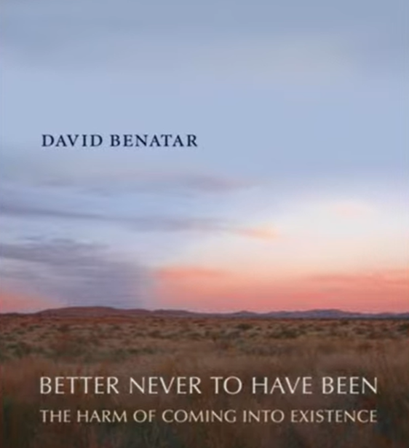
Notes:
Yet, it didn’t begin with David Bentar in the 20th C.

Slide 46
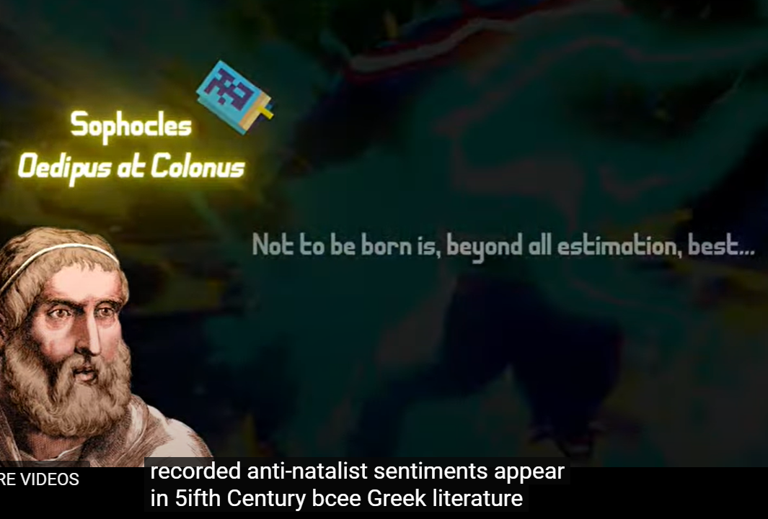

Slide 47
In July 2021, the Chinese Communist government removed all limits, shortly after implementing financial incentives to encourage individuals to have additional children.
Notes:
https://en.wikipedia.org/wiki/One-child_policy

Slide 48
The rationale for the reversal / abolition was summarized by former Wall Street Journal reporter Mei Fong: "The reason China is doing this right now is because they have too many men, too many old people, and too few young people.
Notes:
https://en.wikipedia.org/wiki/One-child_policy

Slide 49
They have this huge crushing demographic crisis as a result of the one-child policy. And if people don't start having more children, they're going to have a vastly diminished workforce to support a huge aging population."
Notes:
https://en.wikipedia.org/wiki/One-child_policy
The CCP had tried to re-engineer the growth of the human race with restraining, and their plans woefully backfired on them.

Slide 50
A similar population issue,
but worse.

Slide 51
A landmark study published in the journal Human Reproduction Update analyzed data from over 40,000 men across North America, Europe, Australia, and New Zealand. The results were staggering – a 52.4% decline in sperm concentration between 1973 and 2011.
Notes:
https://holisticfertilityinstitute.com/fertilityarticles/the-truth-about-male-fertility-what-s-really-causing-the-global-decline#:~:text=Did%20you%20know%20that%20sperm%20counts%20have%20dropped,position%20doubles%20the%20risk%20of%20sperm%20DNA%20damage.

Slide 52
The authors warn that the mean sperm count has now dropped dangerously close to the threshold that makes conception more difficult, meaning couples around the world may encounter problems having a baby without medical assistance.
Notes:
https://www.euronews.com/health/2022/11/15/sperm-count-drop-is-accelerating-worldwide-and-threatens-the-future-of-mankind-study-warns

Slide 53
And the decline isn't slowing down. More recent data suggests the trend is continuing and possibly accelerating. But why? What's causing this dramatic shift in just a few decades?
Notes:
https://holisticfertilityinstitute.com/fertilityarticles/the-truth-about-male-fertility-what-s-really-causing-the-global-decline#:~:text=Did%20you%20know%20that%20sperm%20counts%20have%20dropped,position%20doubles%20the%20risk%20of%20sperm%20DNA%20damage.

Slide 54
The findings, published on Tuesday in the journal Human Reproduction Update, serve as "a canary in a coal mine," said Professor Hagai Levine, the study’s lead author from the Hebrew University of Jerusalem’s Hadassah Braun School of Public Health.
Notes:
https://www.euronews.com/health/2022/11/15/sperm-count-drop-is-accelerating-worldwide-and-threatens-the-future-of-mankind-study-warns

Slide 55
"We have a serious problem on our hands that, if not mitigated, could threaten mankind’s survival," he said in a statement.
Notes:
https://www.euronews.com/health/2022/11/15/sperm-count-drop-is-accelerating-worldwide-and-threatens-the-future-of-mankind-study-warns

Slide 56
The Sedentary Lifestyle Crisis
Environmental Toxins
Nutritional Deficiencies
Stress and Sleep Disruption
Electromagnetic Radiation
Some Prescription Medications
Notes:
https://holisticfertilityinstitute.com/fertilityarticles/the-truth-about-male-fertility-what-s-really-causing-the-global-decline#:~:text=Did%20you%20know%20that%20sperm%20counts%20have%20dropped,position%20doubles%20the%20risk%20of%20sperm%20DNA%20damage
Tight clothes
BPA and phtalates, pesticides, flame retardants
Food lots E, low nutrients: Zn
Cortisol
Laptop

Slide 57
The study, commissioned by the nonprofit organization The Club of Rome, predicts that if current trends continue, the world's population, which is currently 7.96 billion, will peak at 8.6 billion in the middle of the century before declining by nearly 2 billion before the century's end.
Notes:
https://www.livescience.com/worlds-population-could-plummet-to-six-billion-by-the-end-of-the-century-new-study-suggests

Slide 58
Japan’s population is projected to lose 18.7 million people between 2024 and 2050. The population is expected to shrink from 123.8 million to 105.1 million, a 15.1% decline. Japan’s population has been falling since 2011 due to very low fertility rates (1.42 births per woman) and an aging population.
Notes:
https://worldpopulationreview.com/country-rankings/countries-with-declining-population

Slide 59
The population of Greece is expected to shrink from 10 million to 8.8 million, a loss of more than 12%, over the next 26 years. Greece’s population began declining in 2011 when the first negative birth rate was recorded. Greece’s population could decline by up to 50% over the next 50 years if nothing is done to combat it.

Slide 60
So, the secular world
was panicked about overpopulation,
and is now panicked
about depopulation.

Slide 61
Theme: Living in the Word Brings Life. Sometimes challenges, but LIFE even in challenges.

Slide 62
B’resheet (Genesis) 1:28
וַיְבָ֣רֶךְ אֹתָם֮ אֱלֹהִים֒ וַיֹּ֨אמֶר לָהֶ֜ם אֱלֹהִ֗ים פְּר֥וּ וּרְב֛וּ וּמִלְא֥וּ אֶת־הָאָ֖רֶץ וְכִבְשֻׁ֑הָ וּרְד֞וּ בִּדְגַ֤ת הַיָּם֙ וּבְע֣וֹף הַשָּׁמַ֔יִם וּבְכָל־חַיָּ֖ה הָֽרֹמֶ֥שֶׂת עַל־הָאָֽרֶץ׃
G-d blessed them: G-d said to them, “Be fruitful, multiply, fill the earth and subdue it.
Notes:
G-d was celebrating LIFE.
Fruitful and multiply.
Rule over the fish in the sea, the birds in the air and every living creature that crawls on the earth.”
Overpop and Elon Musk

Slide 63
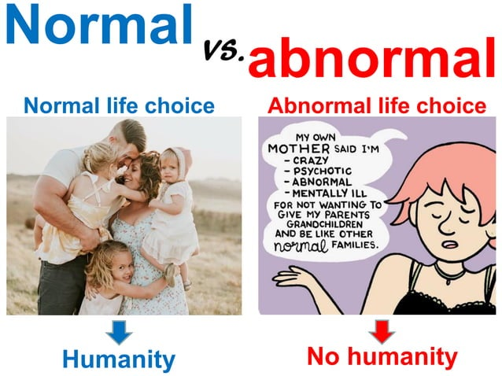

Slide 64

Notes:
https://upload.wikimedia.org/wikipedia/commons/6/6b/Parents_and_their_baby.jpg

Slide 65
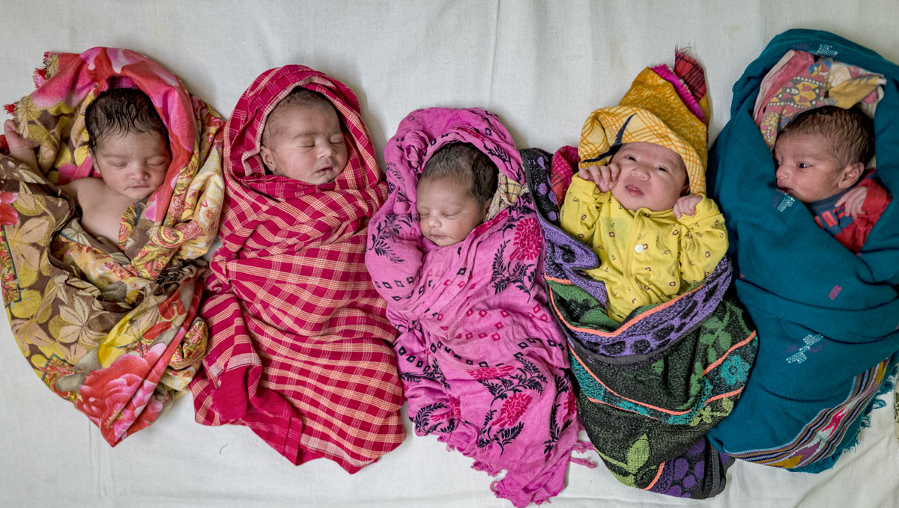
Notes:
https://www.science.org/do/10.1126/science.ze0x33r/full/_20240401_on_fertilityrate-1712071489863.jpg

Slide 66

Today is a day that the United States Senate has declared Charlie Kirk Remembrance Day on what would’ve been his 32nd birthday.
Notes:
https://cdn.bfldr.com/FK28HSHN/at/2smkhq3sc99cbpf6c89bjcg/10142025WHYYOUNGPEOPLEMATTERENCOURAGECULTURETOREACHTHENEXTGENERATIONFORTHEGOSPEL.pdf

Slide 67
President Donald Trump plans to give the slain conservative activist the Medal of Freedom at a White House ceremony.
Notes:
https://cdn.bfldr.com/FK28HSHN/at/2smkhq3sc99cbpf6c89bjcg/10142025WHYYOUNGPEOPLEMATTERENCOURAGECULTURETOREACHTHENEXTGENERATIONFORTHEGOSPEL.pdf

Slide 68
Dobson: Where do you get the guts to do that?
Charlie Kirk: So, I grew up in Chicago, which is… the fun thing about being from Illinois as a sidebar is we have term limits. That's one term in office, one term in jail for all of our leaders. But look, I’m a Scot and it's kind of in my blood to love a good fight.
Notes:
https://cdn.bfldr.com/FK28HSHN/at/2smkhq3sc99cbpf6c89bjcg/10142025WHYYOUNGPEOPLEMATTERENCOURAGECULTURETOREACHTHENEXTGENERATIONFORTHEGOSPEL.pdf

Slide 69
I'm also just not comfortable only talking to people that agree with me all the time. I find such invigoration and excitement and energy to go to places where not a soul agrees with me. That is the coolest thing in the world
Notes:
https://cdn.bfldr.com/FK28HSHN/at/2smkhq3sc99cbpf6c89bjcg/10142025WHYYOUNGPEOPLEMATTERENCOURAGECULTURETOREACHTHENEXTGENERATIONFORTHEGOSPEL.pdf

Slide 70
If you go to the early speeches of Turning Point USA in ‘13, ‘14, ‘15, ‘16, and some people in the line were remarking on this, and they're totally right, which is Charlie, I didn't know you were a Christian. [This is] because even I was raised in a church community where I was told you do not talk about these two things together ever.
Notes:
https://cdn.bfldr.com/FK28HSHN/at/2smkhq3sc99cbpf6c89bjcg/10142025WHYYOUNGPEOPLEMATTERENCOURAGECULTURETOREACHTHENEXTGENERATIONFORTHEGOSPEL.pdf

Slide 71
I go as far to say that if someone is thinking that they're transgender, that they are participating in an equivalent of gender blackface, that they are trying to pretend something that they are not to appropriate an identity to try to blur right and wrong.
Notes:
https://cdn.bfldr.com/FK28HSHN/at/2smkhq3sc99cbpf6c89bjcg/10142025WHYYOUNGPEOPLEMATTERENCOURAGECULTURETOREACHTHENEXTGENERATIONFORTHEGOSPEL.pdf

Slide 72
Just to give you an idea of a flavor of how blunt I am on these campuses. And most kids are kind of in shock and in silence when I say this, but honestly, a lot of kids that will find that to be oppositional, we have a way we run our events,
Notes:
https://cdn.bfldr.com/FK28HSHN/at/2smkhq3sc99cbpf6c89bjcg/10142025WHYYOUNGPEOPLEMATTERENCOURAGECULTURETOREACHTHENEXTGENERATIONFORTHEGOSPEL.pdf

Slide 73
and anyone who's been at a Turning Point USA campus event will tell you that we do this every time. If you disagree, you get to ask the first question.
Notes:
https://cdn.bfldr.com/FK28HSHN/at/2smkhq3sc99cbpf6c89bjcg/10142025WHYYOUNGPEOPLEMATTERENCOURAGECULTURETOREACHTHENEXTGENERATIONFORTHEGOSPEL.pdf

Slide 74
I think we're one of the few organizations and Dr. Dobson, I think you could be one of the others that can get swinging from the chandelier Pentecostals and Five Point Calvinists and Episcopalians all in the same room to agree that we need to do something about liberty and to destroy the woke.
Notes:
https://cdn.bfldr.com/FK28HSHN/at/2smkhq3sc99cbpf6c89bjcg/10142025WHYYOUNGPEOPLEMATTERENCOURAGECULTURETOREACHTHENEXTGENERATIONFORTHEGOSPEL.pdf

Slide 75
Theme: Living in the Word Brings Life. Sometimes challenges, but LIFE even in challenges.

Slide 77
Fruitful LIFE from the Word
Life is in the Word
We get family reality
We get cosmic reality
We get hope in impossibilities

Slide 78
^{Yn 8.31-32} So, Yeshua said to the Judeans who had trusted him, “If you obey what I say, then you are really my talmidim, you will know the truth, and the truth will set you free.”
Notes:
I grew up secular. No sense of absolutes. Disoriented, plus some intoxicants → no sense of time and space. Sitting in a Greyhound bus wondering, how do I know I’m in Albany, not in NYC?

Slide 79
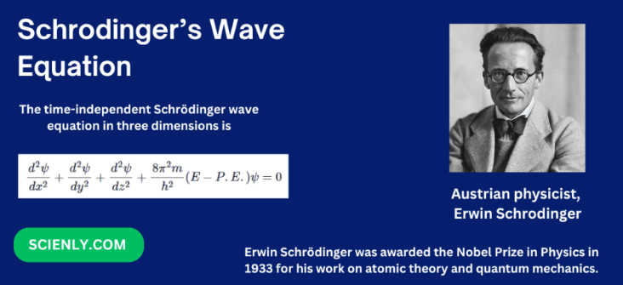
Notes:
https://scienly.com/wp-content/uploads/2025/01/schrodinger-wave-equation-1024x512.png
This was the closest thing to a revelation of TRUTH. Guys at CERN, Large Hadron Collider and Hindu and Buddha all since no sense of TRUTH.

Slide 80
Theme: Living in the Word Brings Life. Sometimes challenges, but LIFE even in challenges.

Slide 82
Fruitful LIFE from the Word
Life is in the Word
We get family reality
We get cosmic reality
We get hope in impossibilities

Slide 83
^{Malachi 4:6} He will turn the hearts of the fathers to their children, and the hearts of the children to their fathers; or else I will come and strike the land with a curse.

Slide 84
^{Yeshayahu/Is 44.3-4} I will pour water on the thirsty land and streams on the dry ground; I will pour my Spirit on your descendants, my blessing on your offspring. They will spring up among the grass like willows on the riverbanks.

Slide 85
^{Yeshayahu/Is 44.3-4} One will say, ‘I belong to Adoni.’ Another will be called by the name of Ya‘akov. Yet another will write that he belongs to Adoni and adopt the surname Isra’el.”

Slide 86
^{Isaiah 60.4} Lift up your eyes and look all around: they all gather—they come to you— your sons will come from far away, your daughters carried on the hip.

Slide 87
^{Ps 90.16-17} Let Your work appear to Your servants, and Your splendor on their children. Let the favor of the Lord our God be upon us. Establish the work of our hands for us— yes, establish the work of our hands.

Slide 88
^{Psalm 145:4,13} One generation will commend your works to another; they will tell of your mighty acts.
Your kingdom is an everlasting kingdom, And Your dominion endures throughout all generations.

Slide 89
^{Psalm 100:5} For Adoni is good and his love endures forever; his faithfulness continues through all generations.

Slide 90
^{2 Cor 5.7} For we walk by faith, not by sight.
^{2 Cor 4.18} We look not at what can be seen but at what cannot be seen. For what can be seen is temporary, but what cannot be seen is eternal.
Notes:
How we built Or HaOlam. A whole lot of impossibilities, people, $, expertise, resources, building…
How are you building your life.

Slide 92
Fruitful LIFE from the Word
Life is in the Word
We get family reality
We get cosmic reality
We get hope in impossibilities

Slide 93
Notes:
https://cdn.bfldr.com/FK28HSHN/at/2smkhq3sc99cbpf6c89bjcg/10142025WHYYOUNGPEOPLEMATTERENCOURAGECULTURETOREACHTHENEXTGENERATIONFORTHEGOSPEL.pdf

