Slide 1
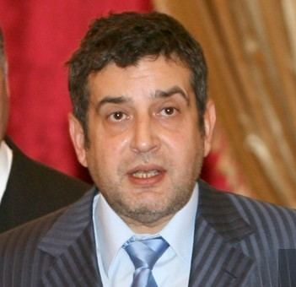
Eduard Shyfrin, PhD, Vice President of the World Jewish Congress
___________________________________
Alexander is the only name of non-Jewish origin
Notes:
.

Slide 2
which has been accepted by the Jews.
Alexander defeated the Persians (modern Iran) and conquered Judea. He treated Judaism and Jewish sages with great respect.

Slide 3
In his honor the High Priest Shimon HaTzaddik decreed that all male priests born that year had to bear the name Alexander.
And as Alexander saved the Jews, President Trump is a Savior of Israel. Therefore, from now on the name Donald must be accepted as a Jewish name.

Slide 4


Slide 5
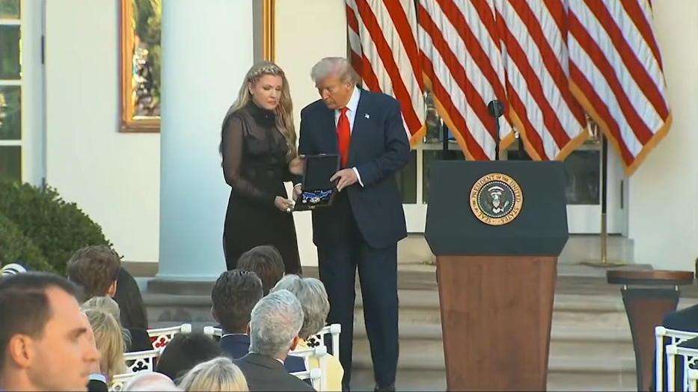
President Donald Trump posthumously awarded the
Presidential Medal of Freedom to Charlie Kirk in
the Rose Garden of the White House, Tuesday, Oct. 14, 2025

Slide 6
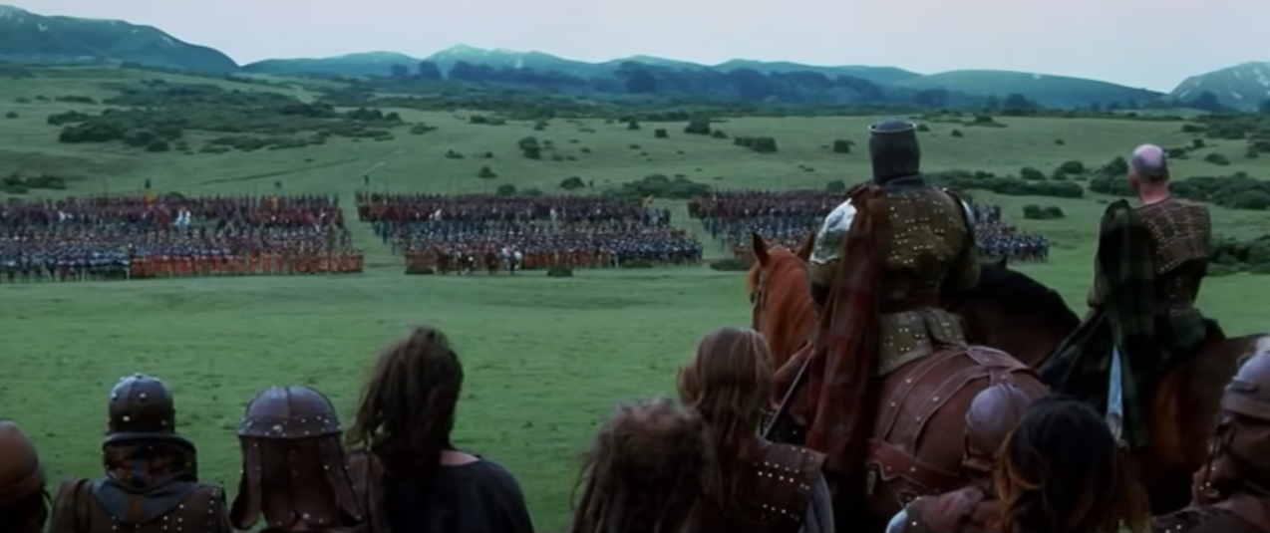
Freedom cry of William Wallace
Notes:
https://youtu.be/kNsK5BKVbw0
Charlie Kirk said of himself that he’s a Scot, and fighting is in his blood.

Slide 7
Notes:
https://youtu.be/giLrq1ufU4M

Slide 8
Notes:
.

Slide 9

FREEDOM
Scriptural meaning
US History of Freedom
Application to us: Knowing truth
  About Life and Abortion
  Siege of Druze Sweida
  Continuance of Hamas
4. Freedom and Hope in Messiah

Slide 10
^{Yn 8.31-36} Then Yeshua said to the Judeans who had trusted Him, “If you abide in My word, then you are truly My disciples. You will know the truth, and the truth will set you free!” They answered Him, “We are Abraham’s children and have never been slaves to anyone!
Notes:
Focus on that: truth → freedom
Living in truth: cosmically, relationally, politically, every dimension. Pilate asked, “What is truth?”

Slide 11
^{Yn 8.31-36} How can you say, ‘You will become free’?” Yeshua answered them, “Amen, amen I tell you, everyone who sins is a slave to sin. Now the slave does not remain in the household forever; the son abides forever. So if the Son sets you free, you will be free indeed!
Notes:
Radical statement: internal bondage
Sin is slavery
Language: profanity, even sissy swearing: Gosh
Anger and rage, unresolved hurts.
Lust → pornography
Materialism: “must have” cf GRATEFULNESS
Belittling people as self defense, maybe imaginary

Slide 12
^{T’hillim/Ps 102.20-23} Since you are my rock and fortress, lead me and guide me for your name’s sake. Free me from the net they have hidden to catch me, because you are my strength.
Notes:
External bondages

Slide 13
^{T’hillim/Ps 129.1-5} Since I was young they have often attacked me — let Isra’el repeat it — since I was young they have often attacked me, but they haven’t overcome me. The plowmen plowed on my back; wounding me with long furrows.

Slide 14
^{T’hillim/Ps 129.1-5} But Adoni is righteous; he cuts me free from the yoke of the wicked. Let all who hate Tziyon be thrown back in confusion.
Notes:
External bondages

Slide 15
^{T’hillim/Ps 146.7-9} He secures justice for the oppressed, he gives food to the hungry. Adoni sets prisoners free, Adoni opens the eyes of the blind, Adoni lifts up those who are bent over.

Slide 16
^{T’hillim/Ps 146.7-9} Adoni loves the righteous. Adoni watches over strangers, he sustains the fatherless and widows; but the way of the wicked he twists.

Slide 17
^{Eph 1.7-8} In union with him, through the shedding of his blood, we are set free — our sins are forgiven; this accords with the wealth of the grace he has lavished on us. In all his wisdom and insight
Notes:
Internal bondage: guilt, regret.

Slide 18
^{Mes Jews/Heb 2.14-15} By his death he might render ineffective the one who had power over death (that is, the Adversary) and thus set free those who had been in bondage all their lives because of their fear of death.
Notes:
I know a friend whose wife may or may not be close to death. But he said there is no loss for the patient.

Slide 19
^{Mes Jews/Heb 13.5-6} Keep your lives free from the love of money; and be satisfied with what you have; for God himself has said, “I will never fail you or abandon you.” Therefore, we say with confidence, “Adonai is my helper; I will not be afraid — what can a human being do to me?”
Notes:
Gratefulness is the only way to freedom over depressed jealousy AND arrogant pride
Rachel Cruze, daughter of Dave Ramsey said that.

Slide 20
Notes:
Especially at the end.

Slide 21
FREEDOM
Scriptural meaning
US History of Freedom
Application to us: Knowing truth
  About Life and Abortion
  Siege of Druze Sweida
  Continuance of Hamas
4. Freedom and Hope in Messiah
Notes:
Especially at the end.

Slide 22
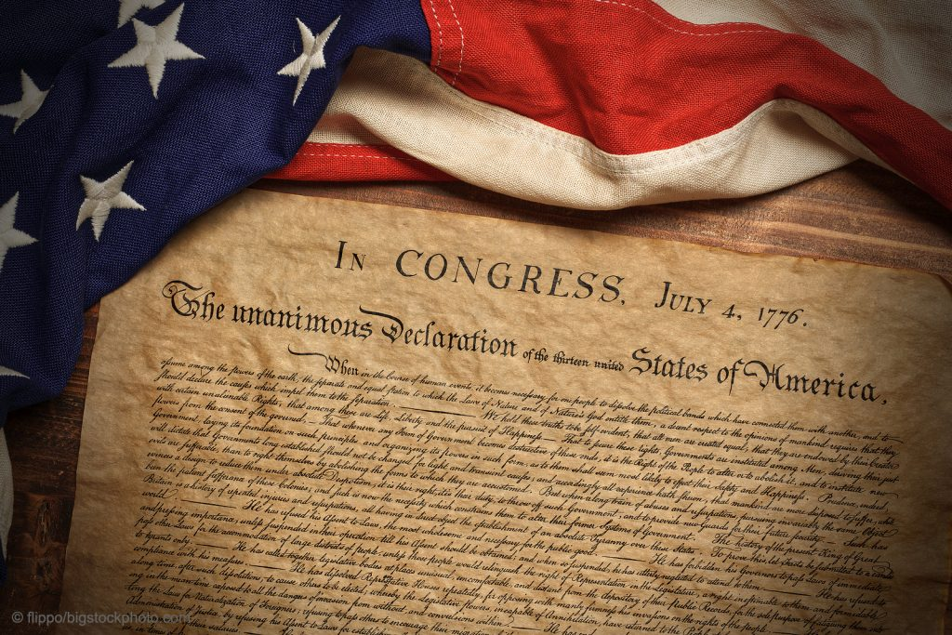
Notes:
https://doesgodexist.today/wp-content/uploads/2023/07/Declaration-of-Independence-with-Historic-Flag-1024x683.jpg

Slide 23
We hold these Truths to be self-evident, that all Men are created equal, that they are endowed by their Creator with certain unalienable Rights, that among these are Life, Liberty, and the Pursuit of Happiness
Notes:
https://declaration.fas.harvard.edu/resources/text
DNA of our national identity

Slide 24
-That to secure these Rights, Governments are instituted among Men, deriving their just Powers from the Consent of the Governed, that whenever any Form of Government becomes destructive of these Ends, it is the Right of the People to alter or to abolish it.
Notes:
https://declaration.fas.harvard.edu/resources/text

Slide 25
The History of the present King of Great-Britain is a History of repeated Injuries and Usurpations, all having in direct Object the Establishment of an absolute Tyranny over these States. To prove this, let Facts be submitted to a candid World.
Notes:
https://declaration.fas.harvard.edu/resources/text

Slide 26
What were the grievances of the Americans?
There are 26 enumerated grievances!

Slide 27
We, therefore, the Representatives of the united States of America, in General Congress, Assembled, appealing to the Supreme Judge of the world for the rectitude of our intentions, do, in the Name,
Notes:
https://declaration.fas.harvard.edu/resources/text
United is an adjective, not a proper noun.
separation

Slide 28
and by Authority of the good People of these Colonies, solemnly publish and declare, That these United Colonies are, and of Right ought to be Free and Independent States;
Notes:
Separation
https://declaration.fas.harvard.edu/resources/text

Slide 29
that they are Absolved from all Allegiance to the British Crown… And for the support of this Declaration, with a firm reliance on the protection of divine Providence, we mutually pledge to each other our Lives, our Fortunes and our sacred Honor.
Notes:
https://declaration.fas.harvard.edu/resources/text
William Wallace’ cry also against a tyrannical British crown

Slide 30
Advocates for freedom of speech, religion, and assembly.
Supports the right to pursue happiness and personal fulfillment.
Encourages civic participation and democratic governance.

Slide 31
One dimension revolves around an individual’s right to chart their path without excessive government oversight. Many define personal liberty as the power to choose healthcare options, raise children based on personal values, and conduct daily affairs without undue intervention.
Notes:
https://freedomforallamericans.org/freedom-mean-in-america-today/

Slide 32
Engagement in elections, freedom of speech, and the right to assemble have always held a prominent place in American civic life. A 2024 Pew Research Center report stated that nearly three-quarters of U.S. adults regard press freedom as extremely important.

Slide 33
41% expressed concern about possible restrictions placed on media outlets. The significance of open discourse and journalistic independence remains clear, but many worry about manipulation or censorship behind the scenes.

Slide 34
The US is now enslaved to a culture of sin:
On line internet sexting and seduction
No Kings mentality : Sat., Oct 18th 10:00am 7500 Metcalf Av, Overland Park
LGBTQ normalization, not just compassion, but locker room
Anti-Semitism and Jew hatred. One of my former students is on Facebook virulently anti-Israel.
Abortion
Charlie Kirk was successfully working for FREEDOM from all the above.
Notes:
Republican officials in New York unanimously voted to suspend the state's Young Republicans after racist and antisemitic messages sent by chapter leaders surfaced Tuesday. The leaked chat also included Kansas, Arizona, and Vermont chapter leaders. The Kansas Young Republicans dissolved earlier this week

Slide 36
FREEDOM
Scriptural meaning
US History of Freedom
Application to us: Knowing truth
  About Life and Abortion
  Siege of Druze Sweida
  Continuance of Hamas
4. Freedom and Hope in Messiah

Slide 37

Annie Fowler
KC Coalition for Life

Slide 38
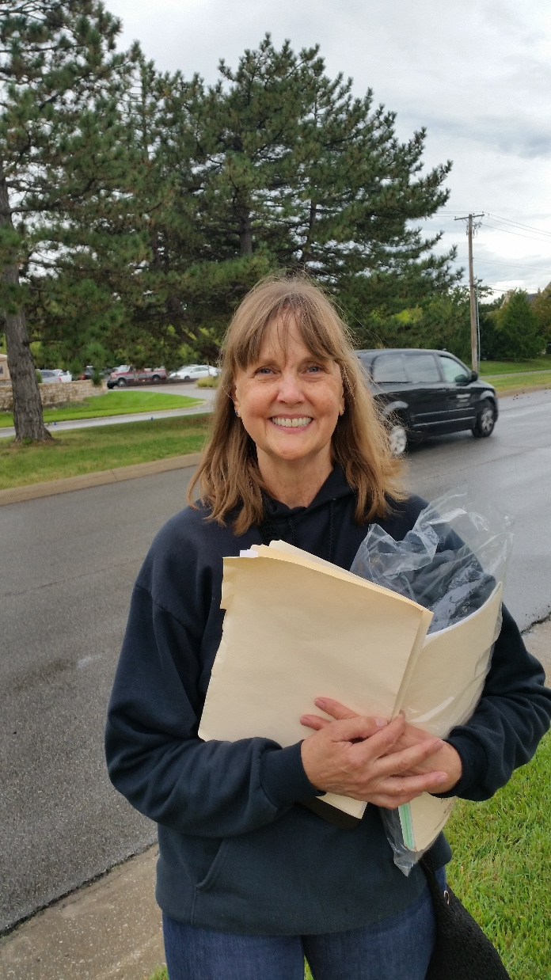
Annie Fowler
KC Director
Or HaOlam
Day
Oct. 21,
2025
Notes:
Truth will set you free…

Slide 39
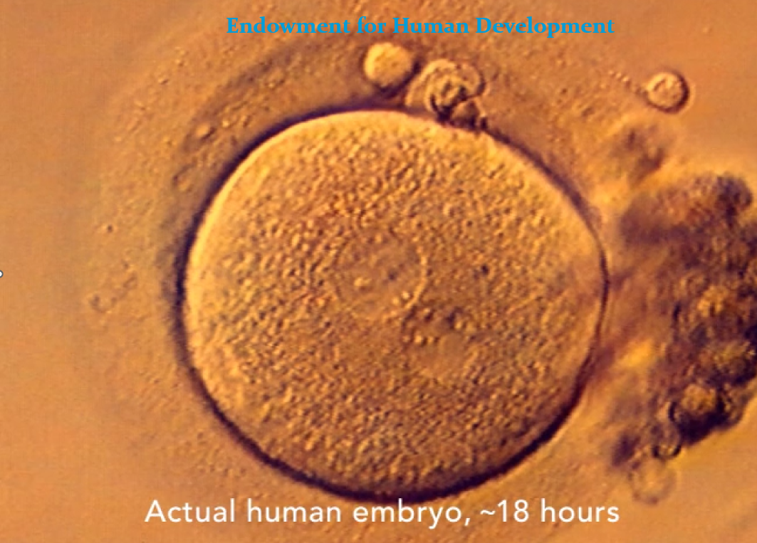
Notes:
We all started as a fertilized egg. One sperm enters the egg and a sort of flash of light accompanies the rapid closure of the egg membrane.
How they got these photos without destroying a life, I don’t know, but I trust the sources.

Slide 40
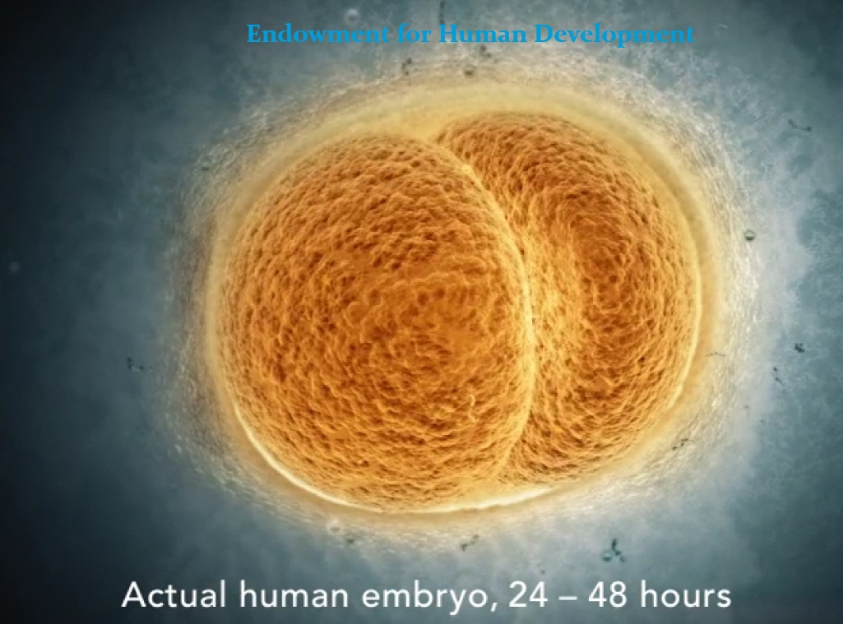
Notes:
OK to kill?

Slide 41
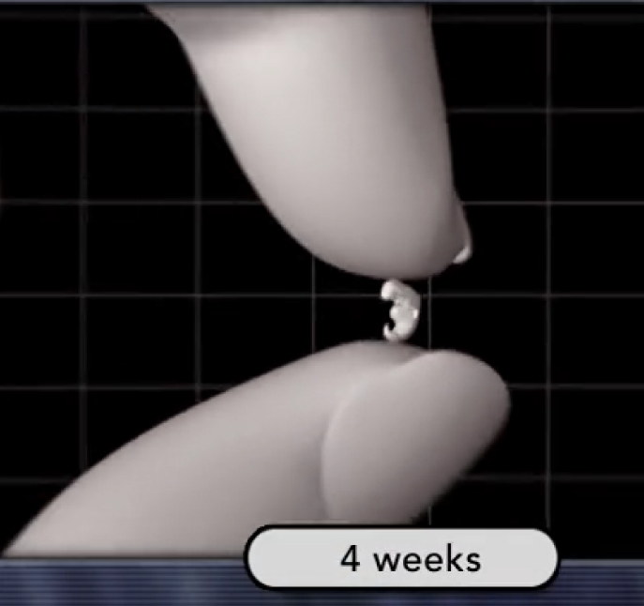

Slide 42
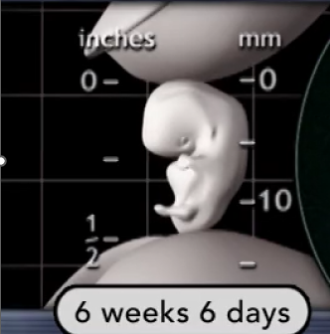

Slide 43
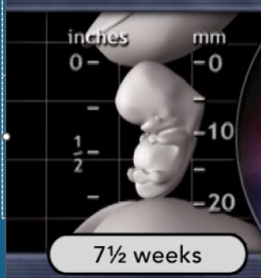

Slide 44
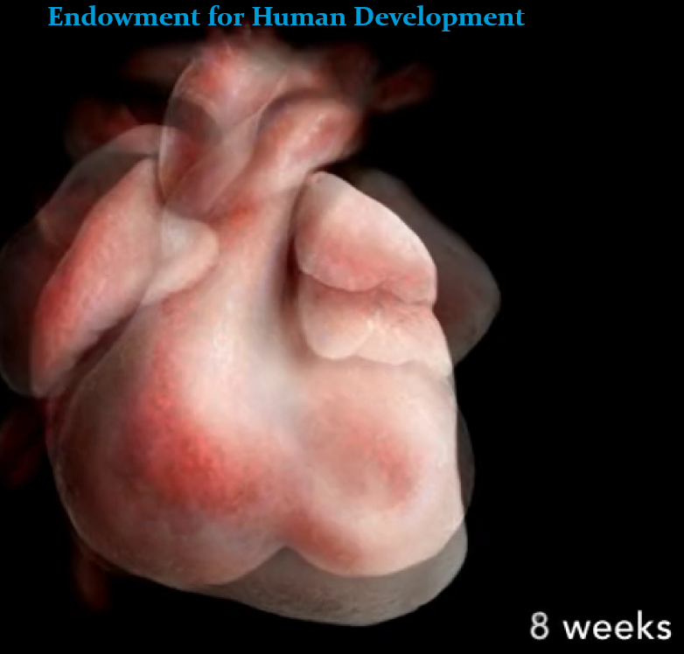
Notes:
2 months

Slide 45
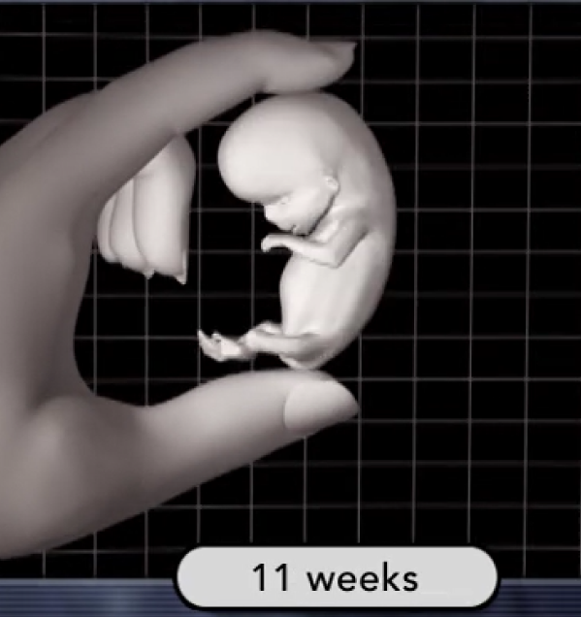
Notes:
< 3 months

Slide 46
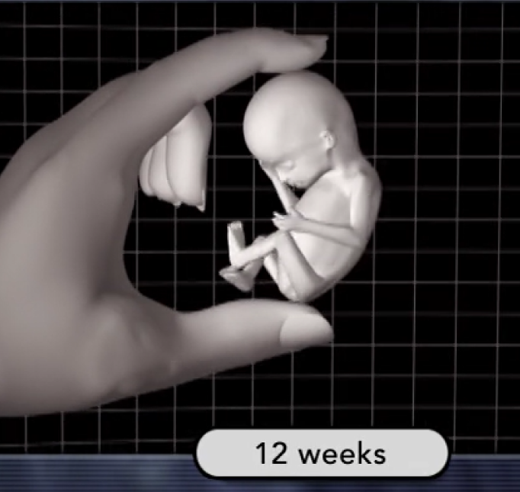
Notes:
3 months

Slide 47
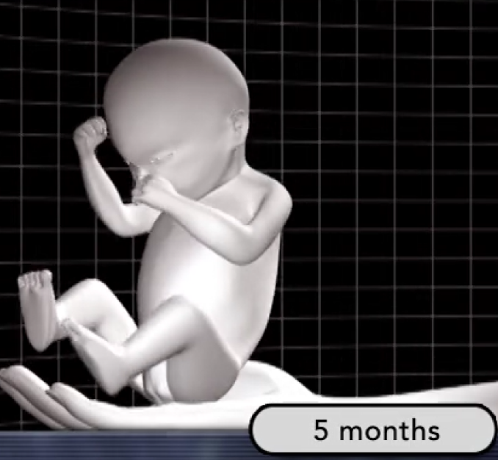

Slide 48
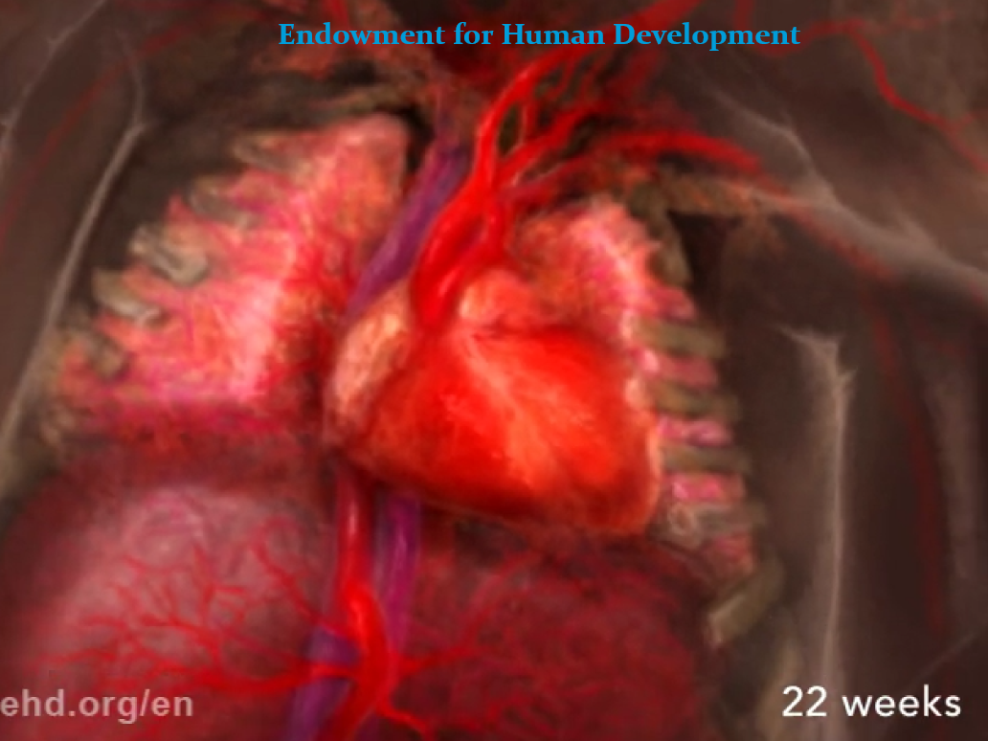
Notes:
5.5 months 2nd trimester

Slide 49
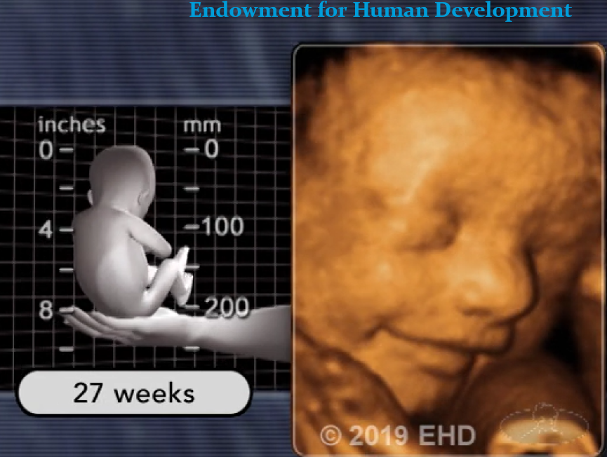
Notes:
<7 months

Slide 50
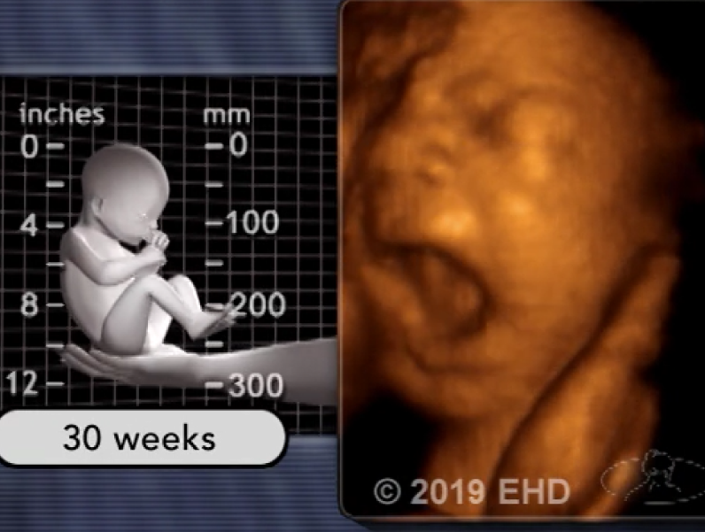
Notes:
7.5 months

Slide 51

ehd.org/en
Notes:
So, what can we do??

Slide 52
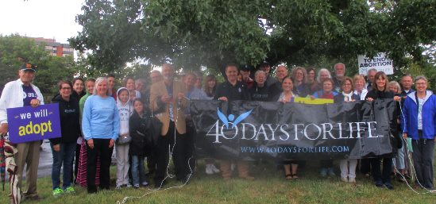

Slide 53
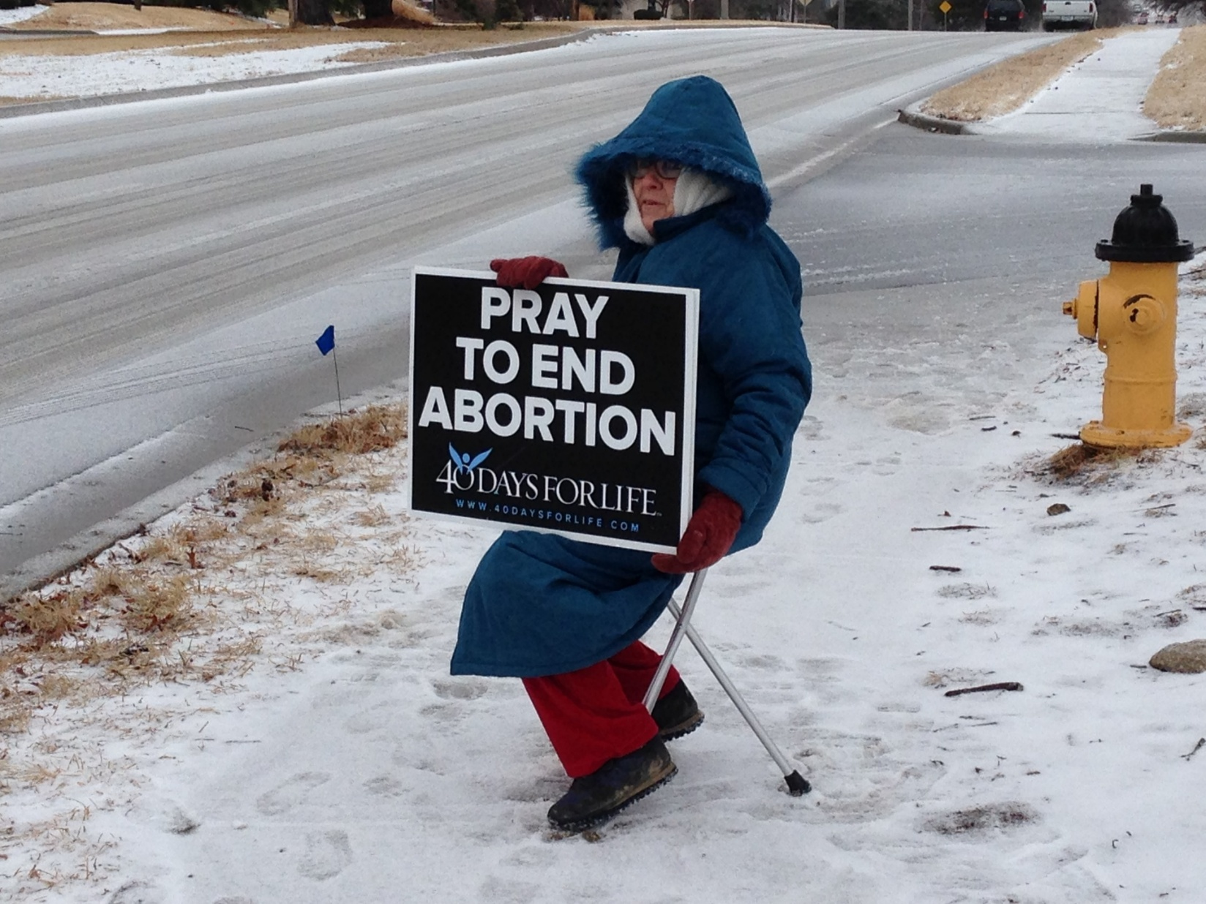

Slide 54
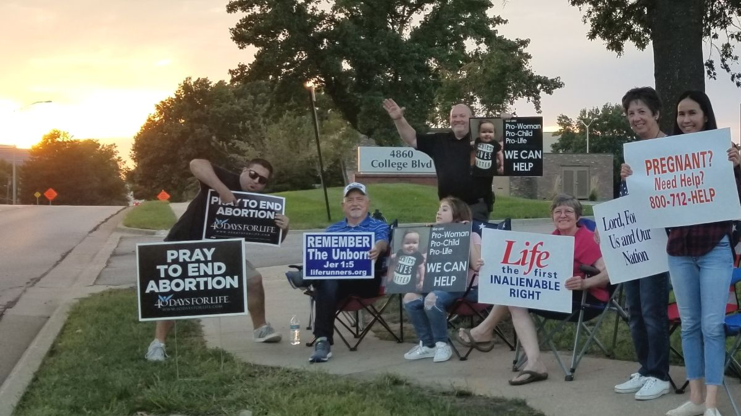

Slide 55
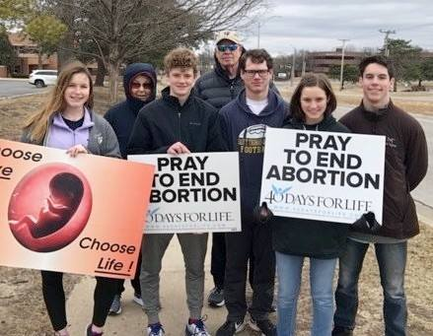

Slide 56


Slide 57
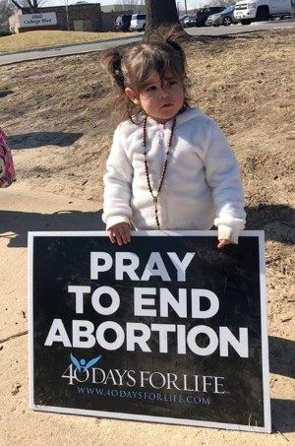

Slide 58
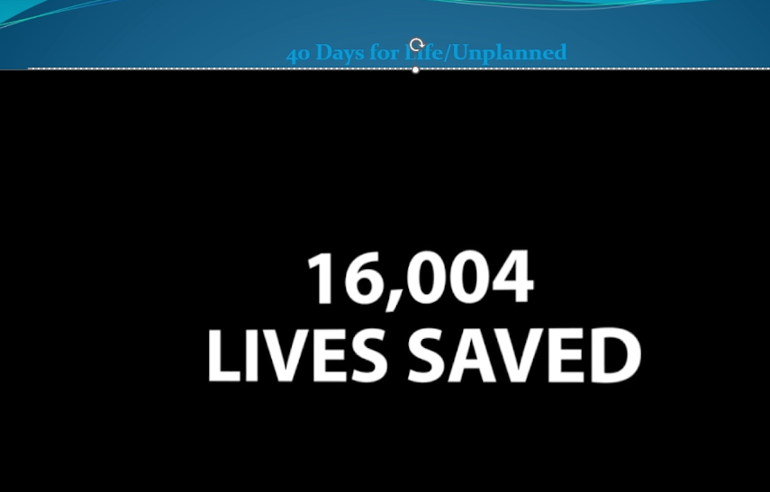
Forty Days for Life
Notes:
Play movie

Slide 59
Or HaOlam Day
Oct. 21, 2025

Slide 60
Notes:
Know the truth

Slide 61
FREEDOM
Scriptural meaning
US History of Freedom
Application to us: Knowing truth
  About Life and Abortion
  Siege of Druze Sweida
  Continuance of Hamas
4. Freedom and Hope in Messiah

Slide 62
Siege of the Druze,
Massacre in Sweida

Slide 63
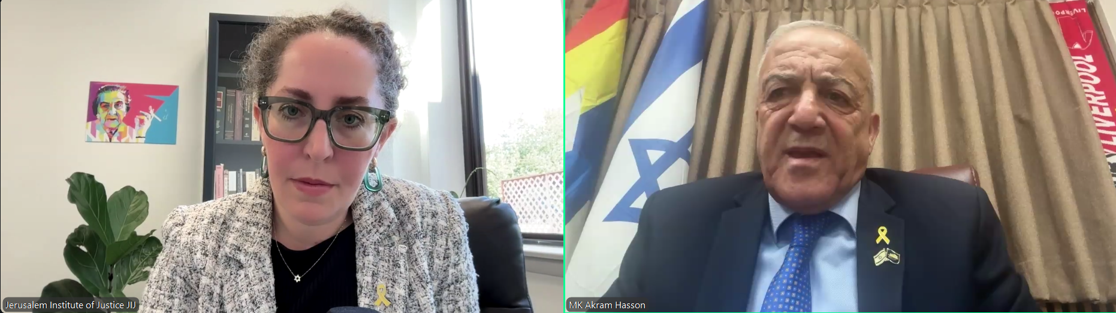
Monique Beadle
Brumbach, former
UMJC Pres. Now
Attorney for JIJ
Israeli Druze
MK Akram
Hasson
Notes:
She grew up at Messiah Conf with one of my sons. Heard her interview the Israeli Druze MK Thursday, Oct. 16, 2025
I was on a Zoom call with the Jerusalem Institute of Justice, founded by a Messianic Jewish attorney Calev Myers, husband of notable Messianic songwriter Shelly Myers: Kumi Ori

Slide 64
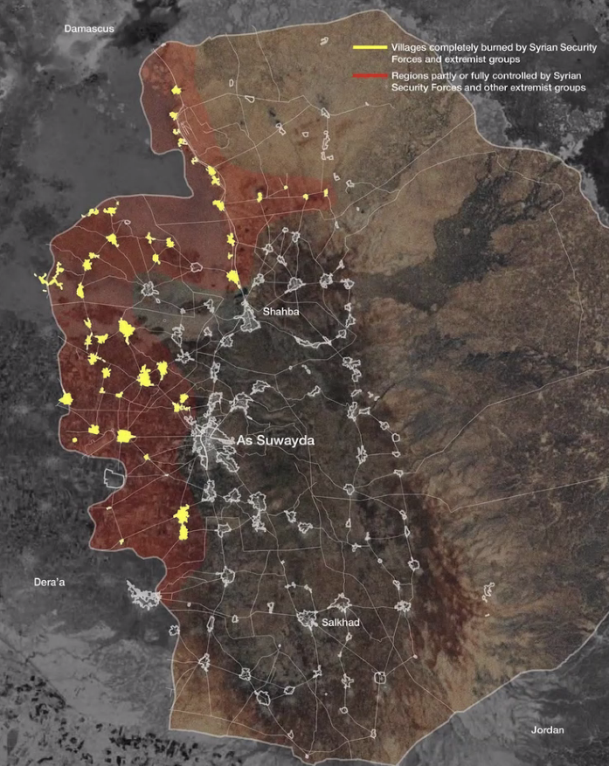
1300 murdered
36 Druze villages destroyed
Siege

Slide 65
The bodies of victims of the recent clashes between local Druze fighters and Bedouin tribes, are laid out for identification in the yard of a hospital in Syria’s southern city of Sweida on July 17, 2025.
(Photo by Shadi AL-DUBAISI / AFP)

Slide 66
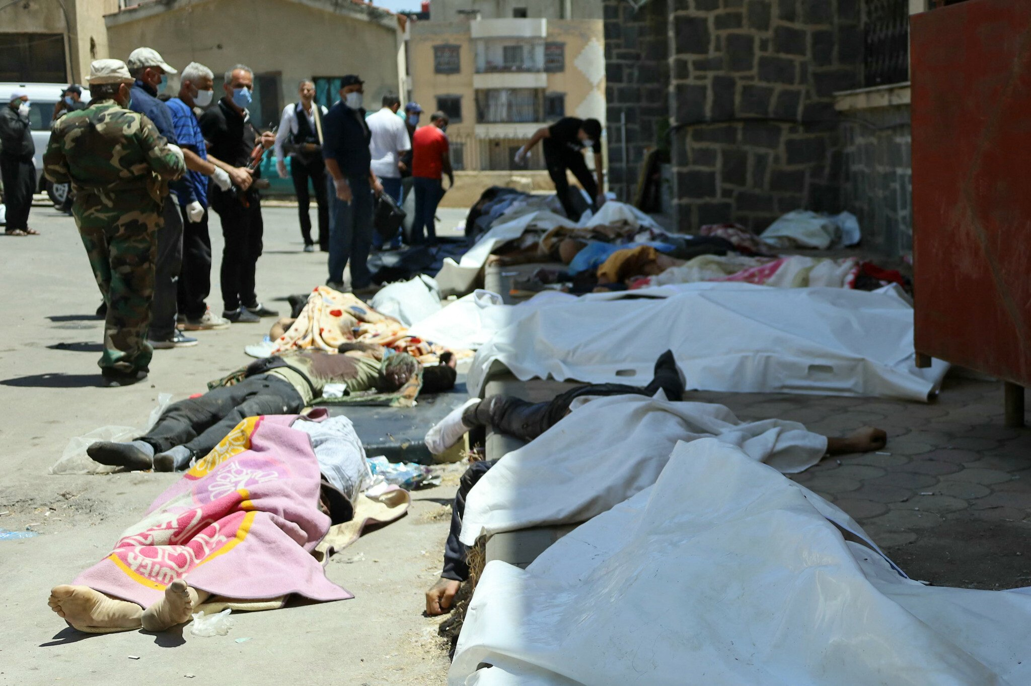

Slide 67
Syrian Druze grapple with death and destruction in Sweida after fighting ended
About 500 people killed in clashes, according to UK war monitor; AFP photographer counts 15 bodies strewn in city center amid looted shops and burned cars and houses
By Shadi al-Dubaisi and Layal Abou Rahal
17 July 2025, 7:16 pm
Notes:
https://www.timesofisrael.com/syrian-druze-grapple-with-death-and-destruction-in-sweida-after-fighting-ends/

Slide 68
Water and electricity services remained cut off in the city, and most shops have closed their doors pending the completion of search operations by local fighters securing the area.
Notes:
https://www.timesofisrael.com/syrian-druze-grapple-with-death-and-destruction-in-sweida-after-fighting-ends/

Slide 69
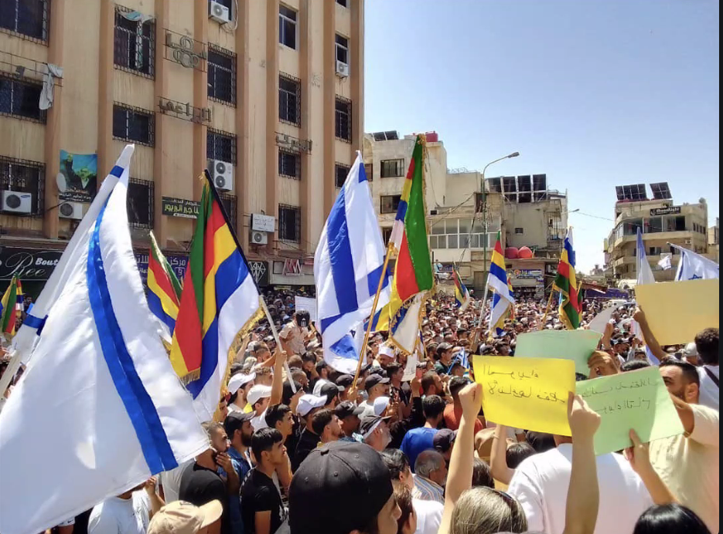
Notes:
Only the Israeli drones stopped the Syrian tanks. Druze had no weapons to stop a tank.

Slide 70
Hossam Saraya, a Syrian-American Druze from Oklahoma, was shown in another video, kneeling with his brother, father, and at least three other relatives, before a group of men in military garb sprayed them with automatic fire and celebrated.
Notes:
https://apnews.com/article/syria-druze-clashes-bedouins-650975a2909a934544a5e86fd5929350

Slide 71
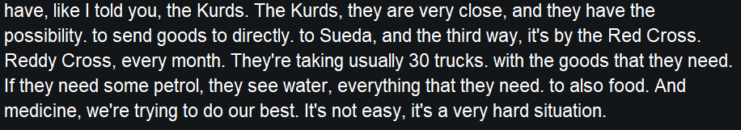
Israeli sends one helicopter every two days.
Notes:
Voice transcription during Zoom call screenshot

Slide 72
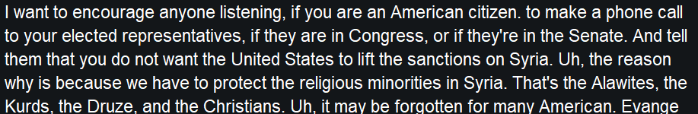
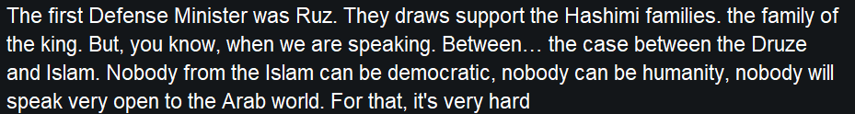
Jordan does not help them
80 km to Israel

Slide 73
Notes:
Especially at the end.

Slide 74
FREEDOM
Scriptural meaning
US History of Freedom
Application to us: Knowing truth
  About Life and Abortion
  Siege of Druze Sweida
  Continuance of Hamas
4. Freedom and Hope in Messiah
Notes:
Especially at the end.

Slide 75
As difficult as it is to acknowledge, what remains of Hamas has yet to accept its defeat. For now, it still controls the weapons necessary to regain power in Gaza.
More importantly, it continues to cling to the belief that its sole mission is to destroy the State of Israel.
Notes:
https://middle-east-forum.read.axioshq.com/p/mef-dispatch/f6a3501d-cd28-47c1-a990-2c976dd17703?utm_source=email&utm_medium=email&utm_location=email_view_in_browser

Slide 76
The October 13, 2025, announcement that Hamas has received American approval to conduct security operations in Gaza represents a catastrophic strategic error that undermines the long-term objective of excising the terrorist organization from Gaza’s governance. President Trump’s statement that “we gave them approval for a period of time”
Notes:
https://www.meforum.org/mef-online/gazas-clan-architecture-the-only-alternative-to-hamass-resurgence?utm_campaign=MEFO%20Articles&utm_medium=email&_hsenc=p2ANqtz-_SOob8W4jhRSKKCnQhkgv5juBY4zenMaDlXkN1N3b7CKw7JWzG52cBaMS0V7CAgKNAP70uesMkE4EUA4NBsGXpzwVtMg&_hsmi=385316391&utm_content=385316391&utm_source=hs_email

Slide 77
to address lawlessness fundamentally contradicts his own 20-point peace plan’s core principle: Hamas must have no role—direct, indirect, or in any form—in Gaza’s future governance.
Notes:
https://www.meforum.org/mef-online/gazas-clan-architecture-the-only-alternative-to-hamass-resurgence?utm_campaign=MEFO%20Articles&utm_medium=email&_hsenc=p2ANqtz-_SOob8W4jhRSKKCnQhkgv5juBY4zenMaDlXkN1N3b7CKw7JWzG52cBaMS0V7CAgKNAP70uesMkE4EUA4NBsGXpzwVtMg&_hsmi=385316391&utm_content=385316391&utm_source=hs_email

Slide 78
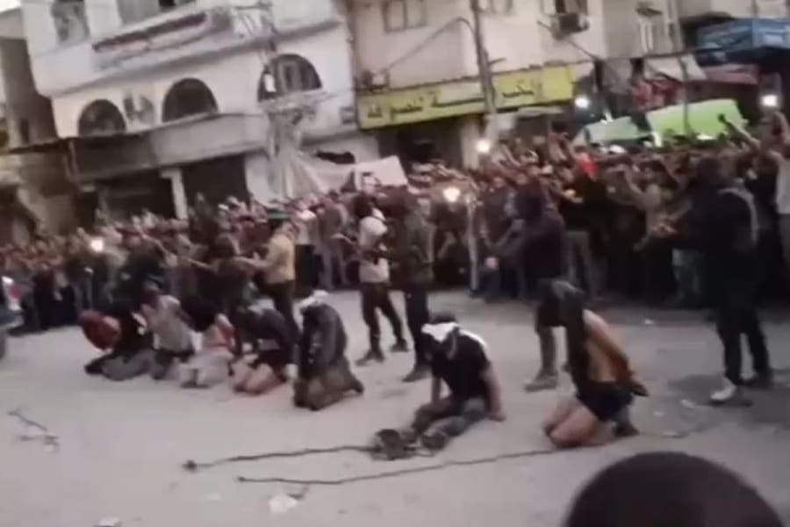
Notes:
Hamas militants execute Palestinian opponents to their rule in Gaza (Photo: Screenshot/Social media)

Slide 79
While the remaining 19 points of the framework continue to be negotiated and implemented, this premature legitimization of Hamas’s security role virtually guarantees its complete reconstitution.
Notes:
https://www.meforum.org/mef-online/gazas-clan-architecture-the-only-alternative-to-hamass-resurgence?utm_campaign=MEFO%20Articles&utm_medium=email&_hsenc=p2ANqtz-_SOob8W4jhRSKKCnQhkgv5juBY4zenMaDlXkN1N3b7CKw7JWzG52cBaMS0V7CAgKNAP70uesMkE4EUA4NBsGXpzwVtMg&_hsmi=385316391&utm_content=385316391&utm_source=hs_email

Slide 80
The strategic imperative remains unchanged: empowering Gaza’s clan structures, which represent 72 percent of Gaza’s 2.3 million residents through 608 registered mukhtars and six major Bedouin confederations, to fill the governance vacuum as Hamas is systematically removed.
Notes:
https://www.meforum.org/mef-online/gazas-clan-architecture-the-only-alternative-to-hamass-resurgence?utm_campaign=MEFO%20Articles&utm_medium=email&_hsenc=p2ANqtz-_SOob8W4jhRSKKCnQhkgv5juBY4zenMaDlXkN1N3b7CKw7JWzG52cBaMS0V7CAgKNAP70uesMkE4EUA4NBsGXpzwVtMg&_hsmi=385316391&utm_content=385316391&utm_source=hs_email

Slide 81
The sister of murdered hostage Shiri Bibas offered scathing criticism of the recently implemented ceasefire and hostage deal with Hamas, writing that while she was happy to see the living hostages reunited with their families, Israel had not achieved a decisive victory over Hamas and the Jewish state remains in grave danger.
Notes:
https://worldisraelnews.com/shiri-bibas-sister-the-war-isnt-over-israel-has-a-lot-to-fear/

Slide 82
“We did not achieve peace at the end of this war — we achieved defeat,” said Dana Silverman-Setton, whose parents, sister and nephews were murdered by terrorists.
By World Israel News Staff
Notes:
https://worldisraelnews.com/shiri-bibas-sister-the-war-isnt-over-israel-has-a-lot-to-fear/

Slide 83
The October 2023 Hamas attack on Israel exposed a fundamental truth about Gaza’s social architecture: Hamas’s control masked but never eliminated deeper tribal loyalties. When Israeli forces offered partnership opportunities to 12 major clans in early 2024,
Notes:
https://www.meforum.org/mef-online/gazas-clan-architecture-the-only-alternative-to-hamass-resurgence?utm_campaign=MEFO%20Articles&utm_medium=email&_hsenc=p2ANqtz-_SOob8W4jhRSKKCnQhkgv5juBY4zenMaDlXkN1N3b7CKw7JWzG52cBaMS0V7CAgKNAP70uesMkE4EUA4NBsGXpzwVtMg&_hsmi=385316391&utm_content=385316391&utm_source=hs_email

Slide 84
11 rejected collaboration not from ideological commitment to Hamas, but from calculated self-preservation against an uncertain future. This demonstrates both the clans’ strategic autonomy and their potential as rational actors capable of pragmatic decision-making based on shifting incentives.
Notes:
https://www.meforum.org/mef-online/gazas-clan-architecture-the-only-alternative-to-hamass-resurgence?utm_campaign=MEFO%20Articles&utm_medium=email&_hsenc=p2ANqtz-_SOob8W4jhRSKKCnQhkgv5juBY4zenMaDlXkN1N3b7CKw7JWzG52cBaMS0V7CAgKNAP70uesMkE4EUA4NBsGXpzwVtMg&_hsmi=385316391&utm_content=385316391&utm_source=hs_email

Slide 85
The clans’ control of Gaza’s economic activity through established commercial networks, agricultural holdings, and trade relationships positions them as indispensable stakeholders in reconstruction. The Tarabin confederation’s members across Gaza, Egypt, and Jordan provide cross-border commercial networks essential for economic recovery.

Slide 86
The Tayaha confederation’s clans controlling eastern territories offer agricultural expertise crucial for food security. The Barbakh clan’s members engaged in commerce represent an entrepreneurial capacity that no technocratic committee could replicate.

Slide 87
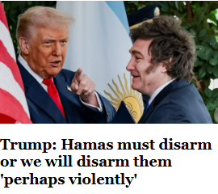

Slide 88
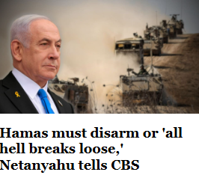

Slide 89
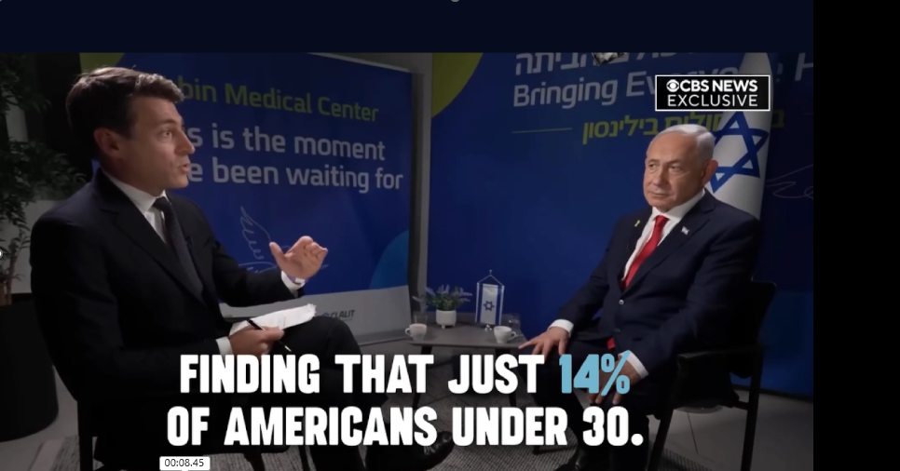
Notes:
“We need to be more verbal and take a more open stand against antisemitism, shutting down people like Candace Owens and Tucker Carlson who call themselves Christians and whose strategy is to divide the Christian community from standing with Israel,” Pastor Larry Huch, founder and senior pastor of the Dallas-based New Beginnings Church, told JNS in an interview in Jerusalem. “This avalanche of antisemitism has to be stopped now.”
https://www.jns.org/us-evangelical-leader-calls-to-shut-down-owens-and-carlson/?utm_campaign=Daily%20Syndicate%20Emails&utm_medium=email&_hsenc=p2ANqtz-8DHTcRadKzZ_E7a_yU9Z-jVPrvMXqM-ikPqS68Mg2OgjGaMN1Dol_QctKEUrbpx40IJNPuhcYnAhqtvGtFXC60O0aylw&_hsmi=119842586&utm_content=119842586&utm_source=hs_email

Slide 90
Notes:
Especially at the end.

Slide 91
FREEDOM
Scriptural meaning
US History of Freedom
Application to us: Knowing truth
  About Life and Abortion
  Siege of Druze Sweida
  Continuance of Hamas
4. Freedom and Hope in Messiah
Notes:
Especially at the end.

Slide 92
Elkana Bohbot, 36, one of the organizers of the Supernova music festival, now reunited with his wife, Rivka, and five-year-old son Re’em, was chained in a deep tunnel for nearly two years, losing all sense of time and space.
Notes:
https://www.israeltoday.co.il/read/hostages-describe-torture-and-torment-in-gaza/?mc_cid=584b5c1147&mc_eid=9f06d9f262

Slide 93
Over the two years in captivity, he was able to see images of his family at rallies, appealing for his release, his wife recounted. In the days before his release, his Hamas captors overfed Bohbot, despite clear Israeli warnings that this could prove fatal after prolonged starvation.
Notes:
https://www.israeltoday.co.il/read/hostages-describe-torture-and-torment-in-gaza/?mc_cid=584b5c1147&mc_eid=9f06d9f262

Slide 94
“Yesterday was more emotional than our wedding day or even Re’em’s birth,” Rivka Bohbot said on Tuesday. “I saw them reborn. Elkana couldn’t stop hugging Re’em
Notes:
https://www.israeltoday.co.il/read/hostages-describe-torture-and-torment-in-gaza/?mc_cid=584b5c1147&mc_eid=9f06d9f262

Slide 95
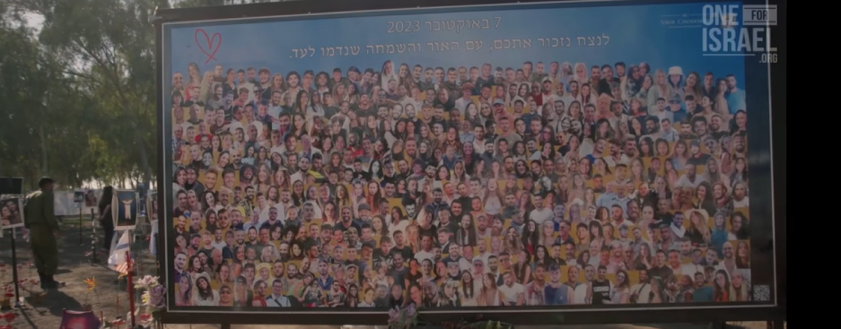
Oh, Daugher of Zion…

Slide 96
Notes:
Especially at the end.

Slide 97
FREEDOM
Scriptural meaning
US History of Freedom
Application to us: Knowing truth
  About Life and Abortion
  Siege of Druze Sweida
  Continuance of Hamas
4. Freedom and Hope in Messiah
Notes:
Especially at the end.

