Slide 1
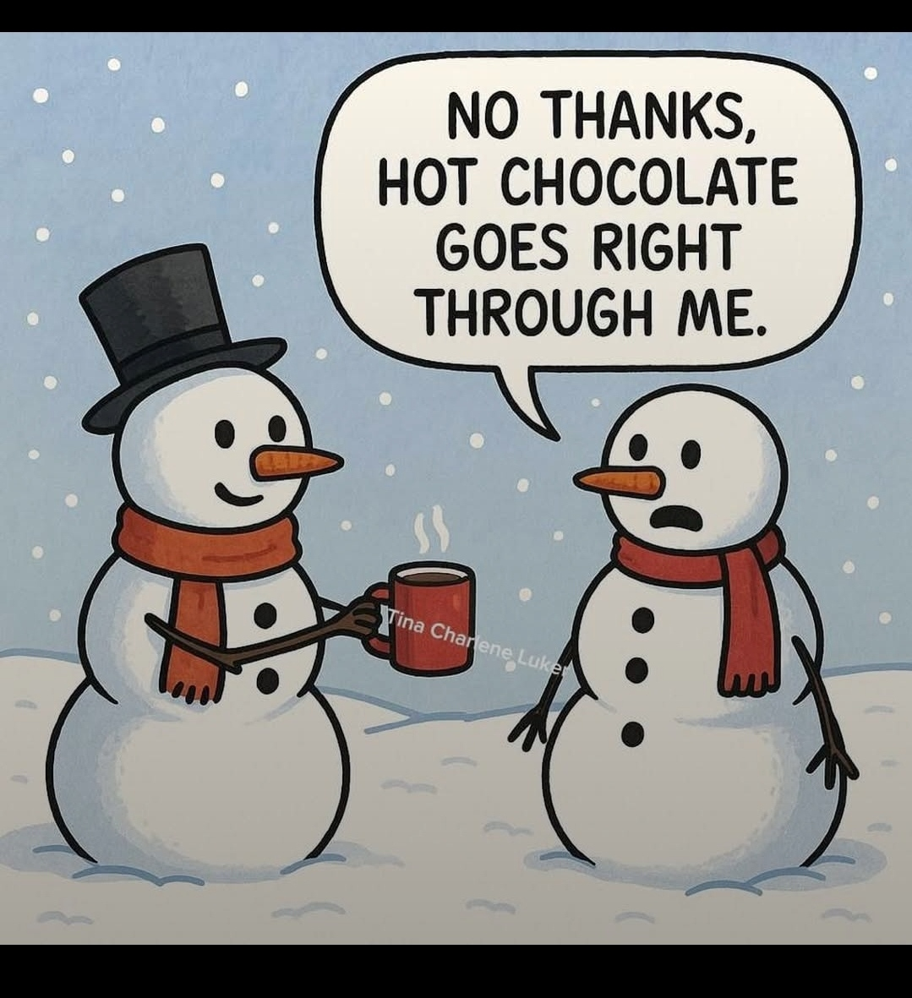
A friendly but unwise gesture, yummy hot chocolate:

Slide 2
Notes:
Hanukkah is about victory over impossible odds.
A military victory story.

Slide 3
Why did the Jewish people win gloriously in 168 CE Hanukkah? But lost catastrophically in
70 CE Great Revolt
116 CE Diaspora War
135 CE Bar Kokhba
Why do the Jews win NOW, against all odds?
Notes:
Jeremiah gave Israel a prophetic claim, that Daniel prayed into.

Slide 4
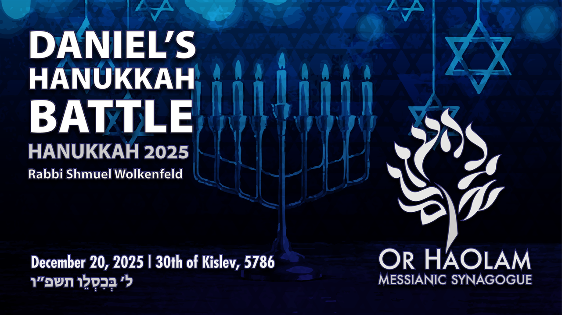

Slide 5
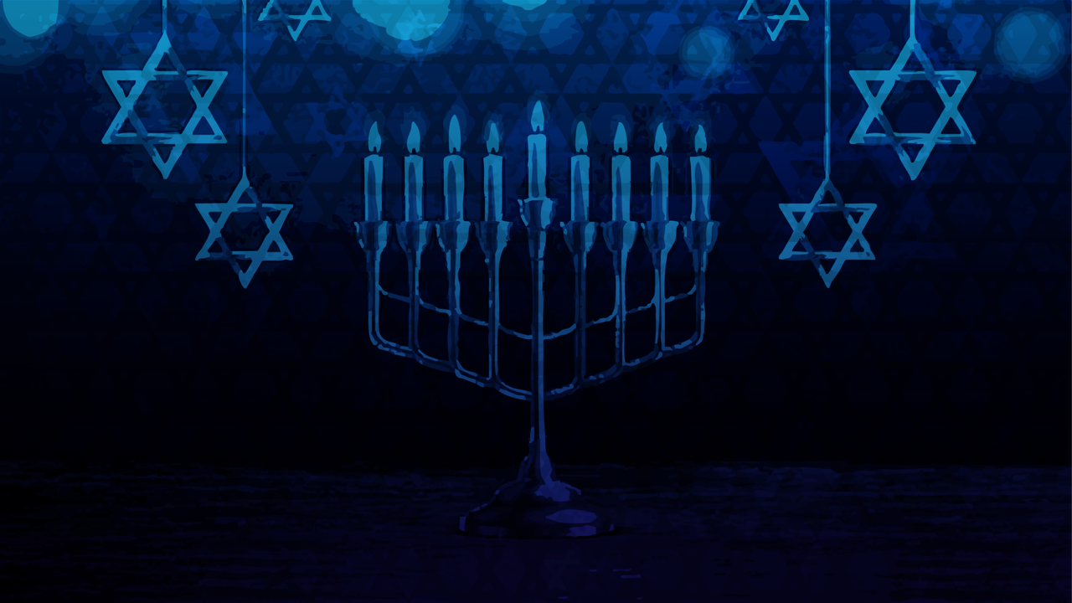
Daniel’s Hanukkah Battle
Historical Context: Hanukkah War,
the Great Revolt, Diaspora War,
Bar Kokhba

Slide 6
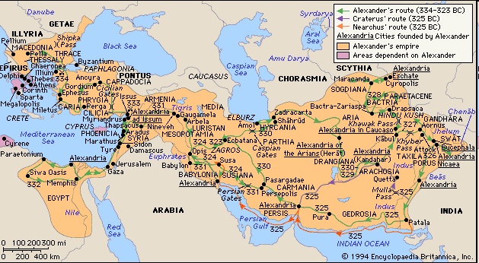
Alexander’s Empire
Notes:
Alexander’s Greek/Macedonian Empire 330 CoBCE
Alexander’s Empire was different than all previously. He wanted to spread culture and religion, Greek enlightenment, as well as take territory.

Slide 7
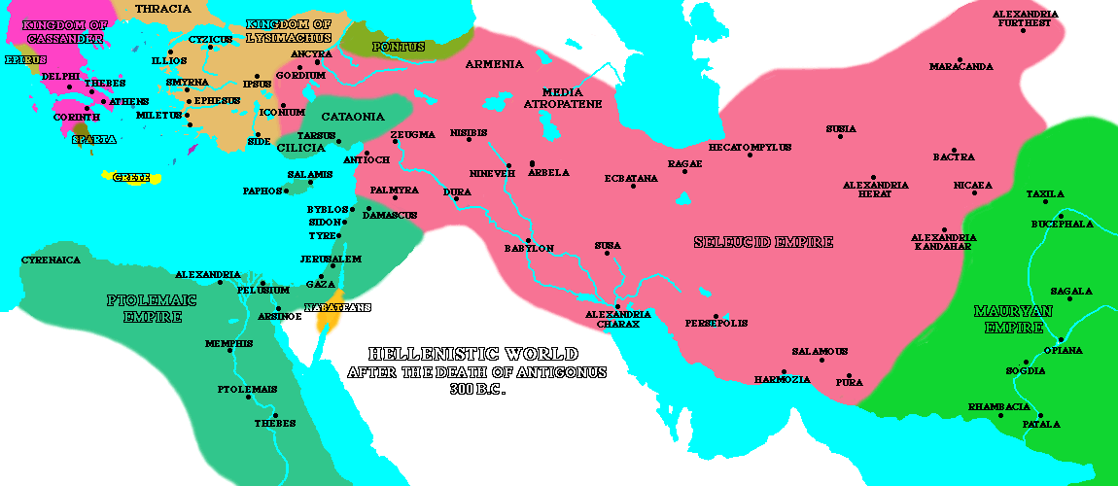
Notes:
Naval interference of Romans → fury of Antiochus the Syrian
In 175 BC, a new king, Antiochus IV (also called "Epiphanes") ascended the throne in Syria. Under the "auspices" of his regime, Jerusalem began to look more and more like a Greek city as Hellenistic culture was officially promoted. Antiochus allowed Hellenistic Jews to have prominent roles in the Holy Temple - so much so that even a non-priest (named Menelaus) was given the role of being the Temple's Kohen Gadol (High Priest). This enraged many Jews, however, who then called for Egyptian rule instead of Syrian (the Egyptians were more tolerant of local customs and did not force Hellenization). Later, when Antiochus returned from an unsuccessful military campaign against Egypt, he decided to quell the Jewish call for Egyptian rule and murdered some 40,000 people in Jerusalem.

Slide 8
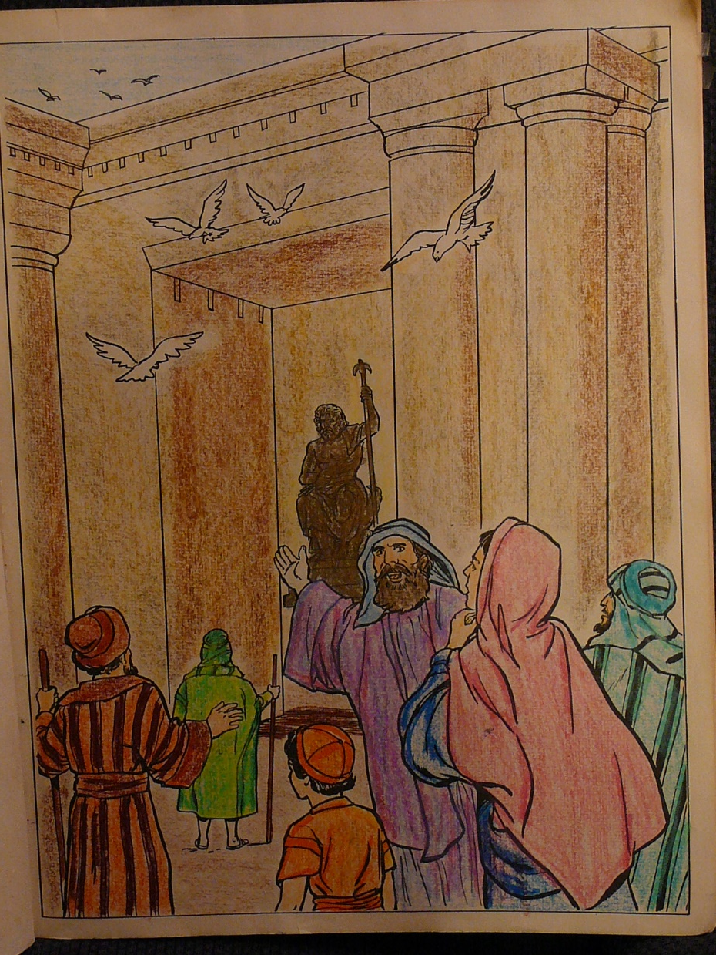
The Greek Syrians putting idols into the Temple of God.

Slide 9
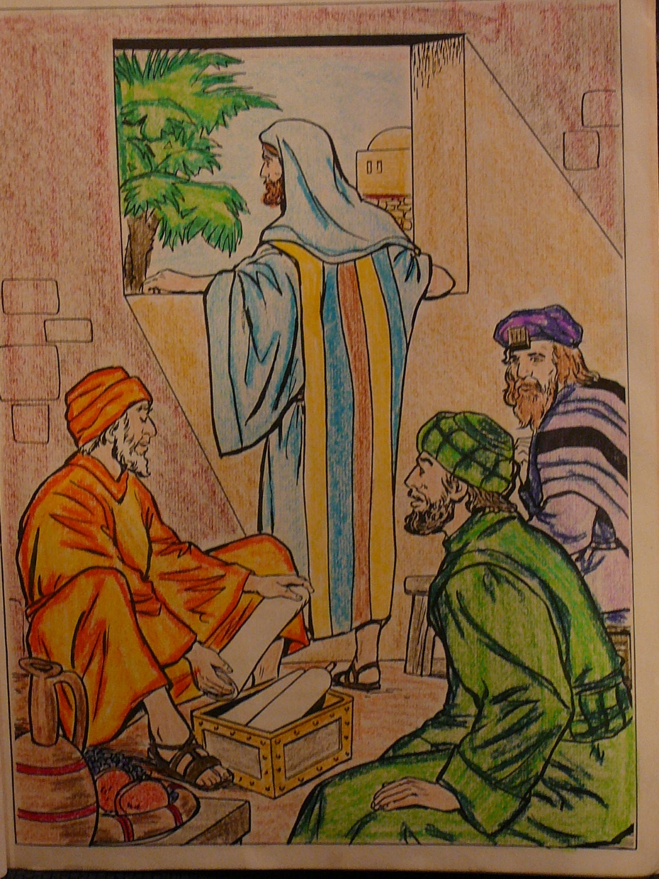
Study of scripture was forbidden, so a game was invented to be done if the Greek soldiers came.

Slide 10
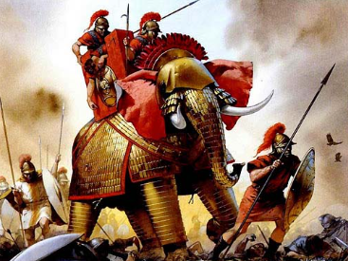
Hanukkah Revolt 168-142 VICTORY against overwhelming forces
Notes:
Syrian war elephants, Jewish Maccabees underneath

Slide 11
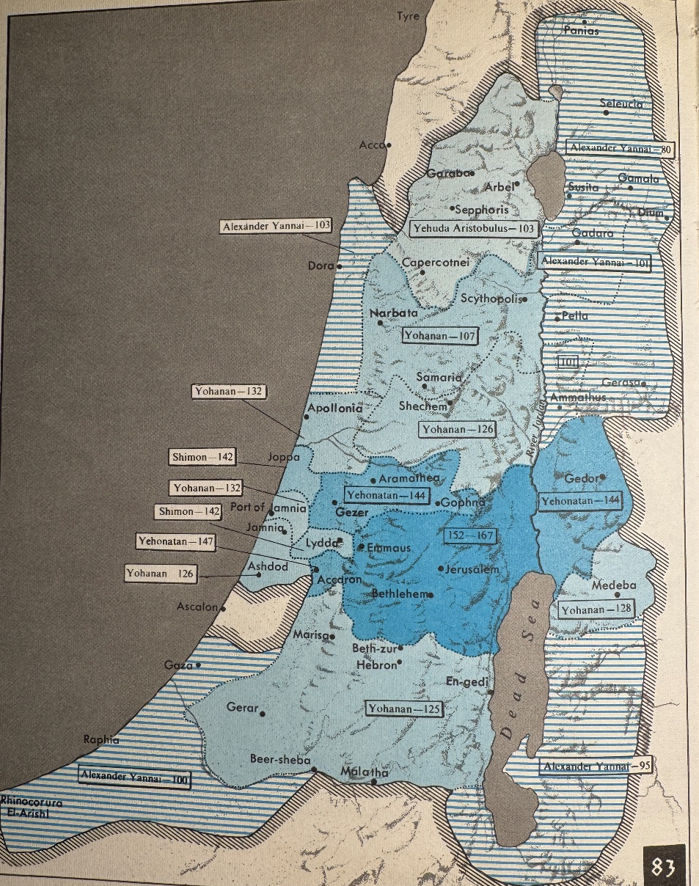
The Hasmonean Maccabean Kingdom
167-142 BCE
But compare other Jewish revolts:

Slide 12
Great Revolt 70 CE Titus
-shocking destruction of the Temple,
-one million Jews killed,
-100,000 captive

Slide 13
What about Messianic Jews at that time?
^{Lk 21.20-22} However, when you see Yerushalayim surrounded by armies, then you are to understand that she is about to be destroyed. Those in Y’hudah must escape to the hills,

Slide 14
^{Lk 21.20-22} those inside the city must get out, and those in the country must not enter it. For these are the days of vengeance, when everything that has been written in the Tanakh will come true.
Fled to Pella
Notes:
Most Jewish people know this history sort of subconsciously. Messianics fled in the wars. Why IDF service is SO important for Jewish believer kids. Chaim Malespin, some from Or HaOlam.

Slide 15
“Diaspora Revolt” = “Kitos War” = Second Jewish–Roman War"
115-118 much less known
Destruction and displacement of Jewish communities in North Africa, Cyrenaica, Cyprus, and Alexandria, Egypt
Notes:
Less known
Jewish population of Alexandria ~100,000
Translation of LXX there. Born or studied there: Philo, Ben Sira, Josephus.

Slide 16
Bar Kokhba Revolt 135 CE
-100,000s Jews slaughtered
-nation renamed Palestina
-city renamed Aelia Capitolina
-Jews banned from entering Jerusalem

Slide 17
Why did the Jewish people win gloriously in 168 CE Hanukkah? But lost catastrophically in
70 CE Great Revolt
116 CE Diaspora War
135 CE Bar Kokhba
Why do the Jews win NOW, against all odds?
Notes:
Jeremiah gave Israel a prophetic claim, that Daniel prayed into.

Slide 19
Daniel’s Hanukkah Battle
Historical Context: four wars
Prophetic Context

Slide 20
When the Babylonian army carried the Jewish population to Babylon in 597 BCE, and later destroyed the first Temple in 586 BCE, the prophet Yermiyahu had this message for the captives:

Slide 21
^{Yer 29.10-14} For thus says Adoni: “After 70 years for Babylon are complete, I will visit you, and fulfill My good word toward you—to bring you back to this place. For I know the plans that I have in mind for you,” declares Adoni,
Notes:
Note: 70 years

Slide 22
^{Yer 29.10-14} “plans for shalom and not calamity—to give you a future and a hope. “Then you will call on Me, and come and pray to Me, and I will listen to you.

Slide 23
^{Yer 29.10-14} You will seek Me and find Me, when you will search for Me with all your heart. Then I will be found by you,” says Adoni, “and I will return you from exile,

Slide 24
^{Yer 29.10-14} and gather you from all the nations and from all the places where I have driven you,” says Adoni, “and I will bring you back to the place from which I removed you as captives into exile.”

Slide 25
^{Matt 7.7-8} “Ask, and it shall be given to you. Seek, and you shall find. Knock, and it shall be opened to you. For everyone who asks receives, and the one who seeks finds, and to the one who knocks it shall be opened.

Slide 26
Daniel read this

Slide 27
^{Daniel 9.1-3} In the first year of Darius the son of Akhashverosh, a Mede by birth who was made king over the kingdom of the Chaldeans…I, Dani’el, was reading the Scriptures and thinking about the number of years
Notes:
538 BCE

Slide 28
^{Daniel 9.1-3} which Adoni had told Yirmeyahu the prophet would be the period of Yerushalayim’s desolation, seventy years. I turned to Adoni, God, to seek an answer, pleading with him in prayer, with fasting, sackcloth and ashes.

Slide 29
Daniel’s prayer
as musically presented
Notes:
Our prayer pattern and prototype.
Heart of the message…

Slide 30
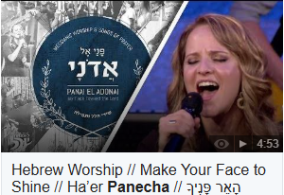
Notes:
https://youtu.be/IkiH0pXekj4

Slide 31
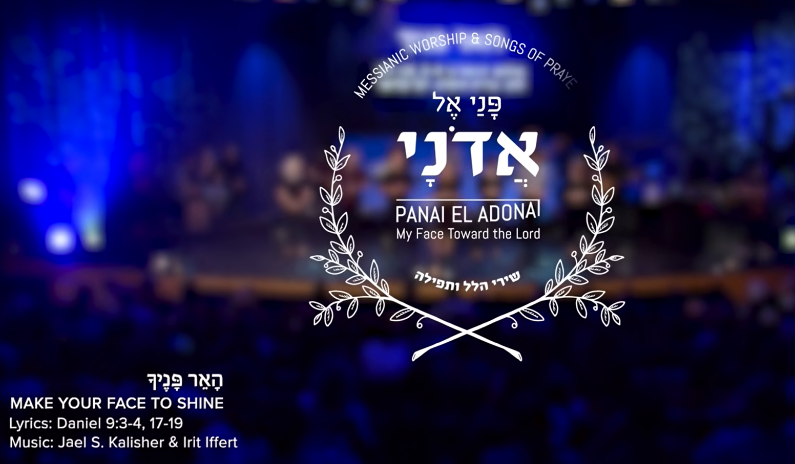
Daniel’s prayer
as musically presented

Slide 32
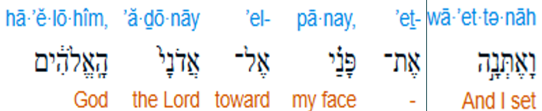
^{Dan 9.3} So I set my face to the Lord God
Notes:
Set my face = deliberate time and place

Slide 33

^{Dan 9.3} to seek Him by prayer and supplications
Notes:
To beg and plead

Slide 34

^{Dan 9.18} Give ear, my God, and hear!
Notes:
G-d is always hearing, but we are desperate for Him to respond, hear and receive

Slide 35

^{Dan 9.18} Open Your eyes and see
Notes:
His eyes always open, but focus

Slide 36

^{Dan 9.17} Cause Your face to shine
Notes:
Title phrase, Divine intervention, neg and pos
^{Rev 20.11 KJV} And I saw a great white throne, and him that sat on it, from whose face the earth and the heaven fled away;
Shmot / Ex 34 “No one can see my face and live.”
Also, beauty of His face Just one thing have I asked of Adonai; only this will I seek: to live in the house of Adonai all the days of my life, to see the beauty of Adonai and visit in his temple.
^{2 Cor 4.6} For it is the God who once said, “Let light shine out of darkness,” who has made his light shine in our hearts, the light of the knowledge of God’s glory shining in the face of the Messiah Yeshua.

Slide 37
^{Dan 9.17} Cause Your face to shine

Slide 38

^{Dan 9.19} For Your city and Your people are called by Your name.’
Notes:
Our Father in heaven! May your Name be kept holy. Be recognized as holy.
We are the representatives of Your Name!!

Slide 39

^{Dan 9.19} For Your city and Your people are called by Your name.’
Notes:
Your city…by covenant
His covenant:
our marriages,
Our other social relationships
our contract agreements,
our tax return,
our tithe and offerings
Our words Lashon hara
We are the only Yeshua some people will ever see!

Slide 40
^{Dan 9.17} Cause Your face to shine

Slide 41
^{Dan 9.17} Cause Your face to shine

Slide 42
^{Dan 9.19} For Your city and Your people are called by Your name.’

Slide 43
^{Dan 9.19} For Your city and Your people are called by Your name.’

Slide 44
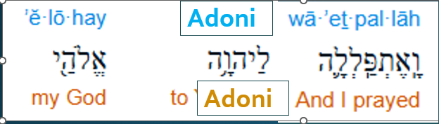
^{Dan 9.4} I prayed to Adoni my God
Notes:
I prayed to Adoni MY G-d

Slide 45
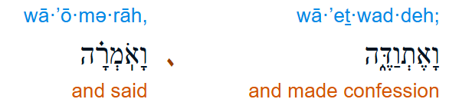
^{Dan 9.4} and confessed, saying:

Slide 46
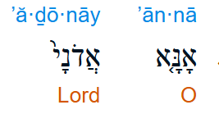
^{Dan 9.4} Please, Adoni,
Notes:
Wording on Sukkot, while waving…Desperate

Slide 47
^{Dan 9.18} Give ear, my God, and hear!

Slide 48
^{Dan 9.18} Open Your eyes and see

Slide 49
^{Dan 9.17} Cause Your face to shine

Slide 50
^{Dan 9.17} Cause Your face to shine

Slide 51
^{Dan 9.19} For Your city and Your people are called by Your name.’

Slide 52
^{Dan 9.19} For Your city and Your people are called by Your name.’

Slide 53

^{Dan 9.19} Adoni, hear! Adoni, forgive!
Notes:
These next two slides are the whole message, the download.
Please hear, and please forgive, we are not pretending to be super spiritual because we are praying. Forgive all our wandering, distracted, sometimes sinful thoughts of pride, jealousy, passion, even right during prayer.

Slide 54

^{Dan 9.19} Adoni, pay attention and act!
Notes:
Hear and DO
This is how Daniel fought the Maccabee battles. This is how we can do the same.

Slide 55
^{Dan 9.19} Adoni, hear! Adoni, forgive!

Slide 56
^{Dan 9.19} Adoni, pay attention and act!

Slide 57
^{Dan 9.17} Cause Your face to shine

Slide 58
^{Dan 9.19} For Your city and Your people are called by Your name.’

Slide 59
^{Dan 9.19} For Your city and Your people are called by Your name.’

Slide 60
^{Dan 9.17} Cause Your face to shine

Slide 61
^{Dan 9.17} Cause Your face to shine

Slide 62
^{Dan 9.19} For Your city and Your people are called by Your name.’

Slide 63
^{Dan 9.19} For Your city and Your people are called by Your name.’

Slide 64
Daniel prayed desperately, earnestly, extensively, repetitively for the restoration of the Jews to the Land based on the promises in Yermiyahu.
Did the Maccabees have to fight bravely and brilliantly?
Did they have supernatural help?
Notes:
Do we pray desperately, earnestly, extensively, repetitively for our hearts and conduct, our families, our community, our nation, Am Yisrael??

Slide 65
Daniel the seer, nearly 400 years prior to the clash of Jews and Greeks. In Daniel 11:31-32 a prophetic word is given: Greek forces led by a future king (Antiochus IV Epiphanes) would try to commit genocide against the entire Jewish people, but would be successfully resisted by stalwart Jewish warriors, the Maccabees:
Notes:
https://davidstent.org/hanukkah-the-clash-between-the-maccabees-and-the-armies-of-woke/

Slide 66
“The people who know their God will be strong and take action. And those who have insight among the people will give understanding to the many; yet they will fall by sword and by flame, by captivity and by plunder for many days. Now when they fall, they will be granted a little help . . . And some of those who have insight will fall” ^{(Daniel 11:32-35)}
Notes:
https://davidstent.org/hanukkah-the-clash-between-the-maccabees-and-the-armies-of-woke/

Slide 68
Daniel’s Hanukkah Battle
Historical Context: 4 wars
Prophetic Context
Current context

Slide 69
^{Yeshayahu 11. 11-12} On that day Adoni will raise his hand again, a second time, to reclaim the remnant of his people who remain from Ashur, Egypt, Patros, Ethiopia, ‘Eilam, Shin‘ar, Hamat and the islands in the sea. He will hoist a banner for the Goyim, assemble the dispersed of Isra’el, and gather the scattered of Y’hudah from the four corners of the earth.
Notes:
Second time means NOT the return from Babylon. Return from second expulsion…happening last two centuries

Slide 70
“I will plant Israel in their own land, never again to be uprooted from the land I have given them, says the LORD your God” (Amos 9:15).
Notes:
We were uprooted twice

Slide 71
“Judah will be inhabited forever and Jerusalem through all generations. Their bloodguilt, which I have not pardoned, I will pardon. The LORD dwells in Zion” (Joel 3:20-21).
Notes:
Dan Juster: This passage comes after the description of a severe world judgment of nations that are described as invading Israel. It is hard to see how this would be the Church.

Slide 72
“Can a mother forget her nursing child and have no compassion on the child she has borne? Though she may forget, I will not forget you. See, I have engraved you on the palms of my hands; your walls are ever before me. Your sons hasten back and those who laid you waste depart from you. Lift up your eyes and look around; all your sons gather and come to you. . .

Slide 73
Though you were ruined and laid waste, now you will be too small for your people, and those who devoured you will be far away. The children born during your bereavement will yet say in your hearing, ‘This place is too small for us; give us more space to live in’” (Isaiah 49:15-20).
Notes:
the first return was a small minority. The Jewish people of the first century were a minority, less than 1/3 of those alive at the time. Israel remained under foreign domination except for one brief and corrupt period.

Slide 74
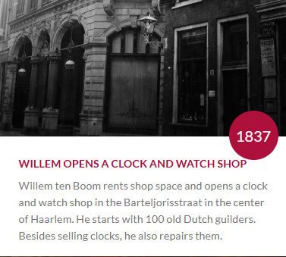
Notes:
https://www.corrietenboom.com/en/family-ten-boom
He read all these scriptures…

Slide 75
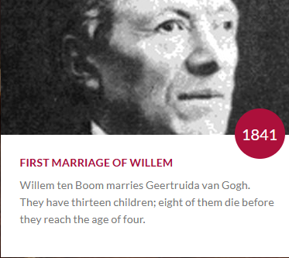
Notes:
https://www.corrietenboom.com/en/family-ten-boom

Slide 76
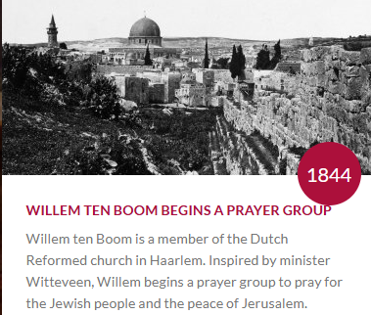
Notes:
https://www.corrietenboom.com/en/family-ten-boom
Note: 1844

Slide 77
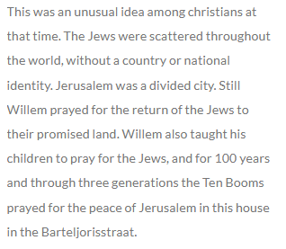
Notes:
https://www.corrietenboom.com/en/family-ten-boom
This is why the Jews win the wars now! Ten boom family generations praying since 1844!!

Slide 78
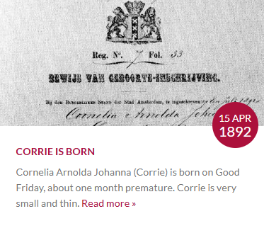
Notes:
https://www.corrietenboom.com/en/family-ten-boom

Slide 79
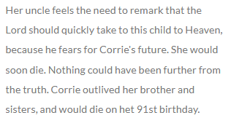

Slide 80
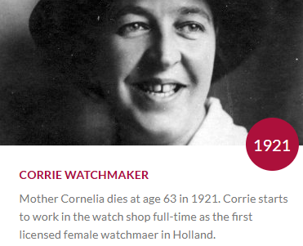
Notes:
https://www.corrietenboom.com/en/family-ten-boom

Slide 81
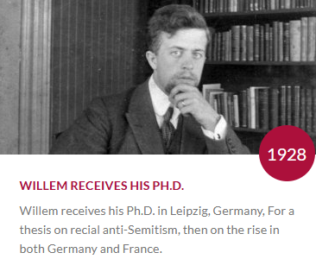
Notes:
Great heritage of prayer and study of Israel

Slide 82
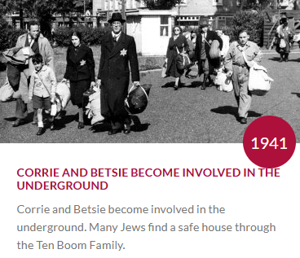
Notes:
https://www.corrietenboom.com/en/family-ten-boom

Slide 83
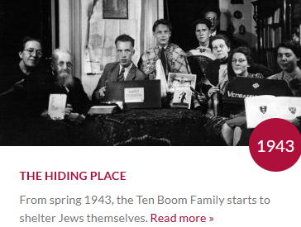
Notes:
https://www.corrietenboom.com/en/family-ten-boom

Slide 84
Several of the Jewish people spent extended time with the Ten Booms; others just two days. Despite all the horrors going on in the outside world, the atmosphere in the house is happy. A lot of music is made; even a play is rehearsed and performed.

Slide 85
On 28 February 1944, a Dutch informant, Jan Vogel, told the Nazis about the Ten Booms' work; at around 12:30 p.m. of that day, the Nazis arrested the entire Ten Boom family. The group of six people hidden by the Ten Booms, made up of both Jews and resistance workers, remained undiscovered.
Notes:
https://en.wikipedia.org/wiki/Corrie_ten_Boom

Slide 86
Ten Boom received a letter one day in prison, "All the watches in your cabinet are safe."
Notes:
Got out despite surveillance.
Altogether rescued ~800 Jews

Slide 87
Notes:
https://www.corrietenboom.com/en/family-ten-boom
From 1844

Slide 88
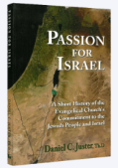
Dan Juster: The doctrine of the restoration of Israel has a long and revered place in the history of Protestant theology.

Slide 89
Its roots go back to the Puritans. From there it passed to the Lutheran Pietists in Germany and Scandinavia. By the mid-19th century, it was the consensus doctrine of British and American Christianity.
Notes:
https://www.jewishvoice.org/read/article/restoration-israel

Slide 90
The ten Booms and these others and more prayed for the restoration of the Jews to the Land based on the many promises.
Did the IDF have to fight bravely and brilliantly?
Did they have supernatural help?
Notes:
What impossible issues do you face?
G-d specializes in the impossible. Ester saw her condition concerning her people, her position, and her husband the Persian Emperor as IMPOSSIBLE.

Slide 91
^{Ester 4.14} For if you fail to speak up now, relief and deliverance will come to the Jews from a different direction; but you and your father’s family will perish. Who knows whether you didn’t come into your royal position precisely for such a time as this.”

Slide 92
Bondi Beach attack: The police’s handling of the attack itself has also come under criticism as footage emerged of police officers taking cover for long minutes as the perpetrators took aim and delivered rapid fire at participants in the Chanukah party.
Notes:
https://www.jns.org/seven-men-detained-near-bondi-beach-after-tip-report/?utm_campaign=Daily%20Syndicate%20Emails&utm_medium=email&_hsenc=p2ANqtz-8VRyLiroAC7cm-uxdS69ZqBcE9Zxwx9sAZDE9Q0xcZQC-ludtHB8bxg4qZMSsxsRVrWYuHbU1Dy1gqtukFUl9pDy2uBQ&_hsmi=124308917&utm_content=124308917&utm_source=hs_email

Slide 93
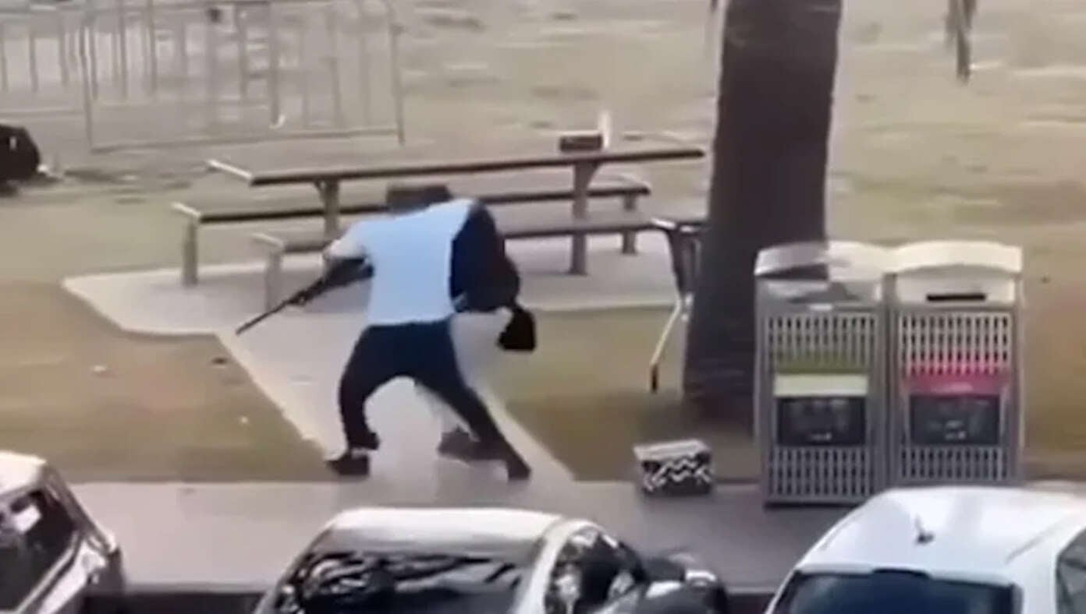
Ahmed Al Ahmed, a Syrian fruit
shop owner
Notes:
Who would have expected?
Your deliverance will come from unexpected sources!!

Slide 94
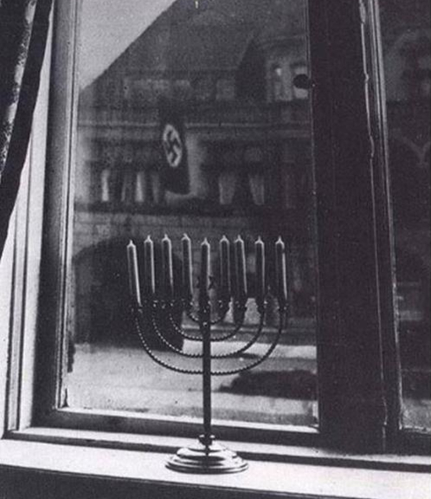
The photograph was taken by Rachel Posner on the last day of Hanukkah in Kiel, Germany. She wrote these words on the back of the picture in German: “Chanukah 5692 (1932). ‘Death to Judah,’ so the flag says. ‘Judah will live forever,’ so the light answers.”
Notes:
https://allisraelnews.com/edu/hanukkahs-enduring-message-of-courage?utm_source=convertkit&utm_medium=email&utm_campaign=At%20least%2012%20dead%20in%20shooting%20attack%20at%20Hanukkah%20celebration%20in%20Bondi%20Beach,%20Australia%20-%2020061411

Slide 95
What are the apparently impossible challenges in your life?
Overcoming inner darkness
Family salvation
Successful outreach to Jewish people and the nations?
Extended, passionate prayer, repentance and worship are the keys.
Notes:
Israel survival. Your ID with Israel and Torah and how to work that out with your family.

Slide 97
Daniel’s Hanukkah Battle
Historical Context
Prophetic Context
Current context

Slide 98
^{Dan 9.19} Adoni, hear! Adoni, forgive!

Slide 99
^{Dan 9.19} Adoni, pay attention and act!

Slide 100
^{Dan 9.17} Cause Your face to shine

Slide 101
^{Dan 9.19} For Your city and Your people are called by Your name.’

Slide 102
^{Dan 9.19} For Your city and Your people are called by Your name.’

