Slide 1
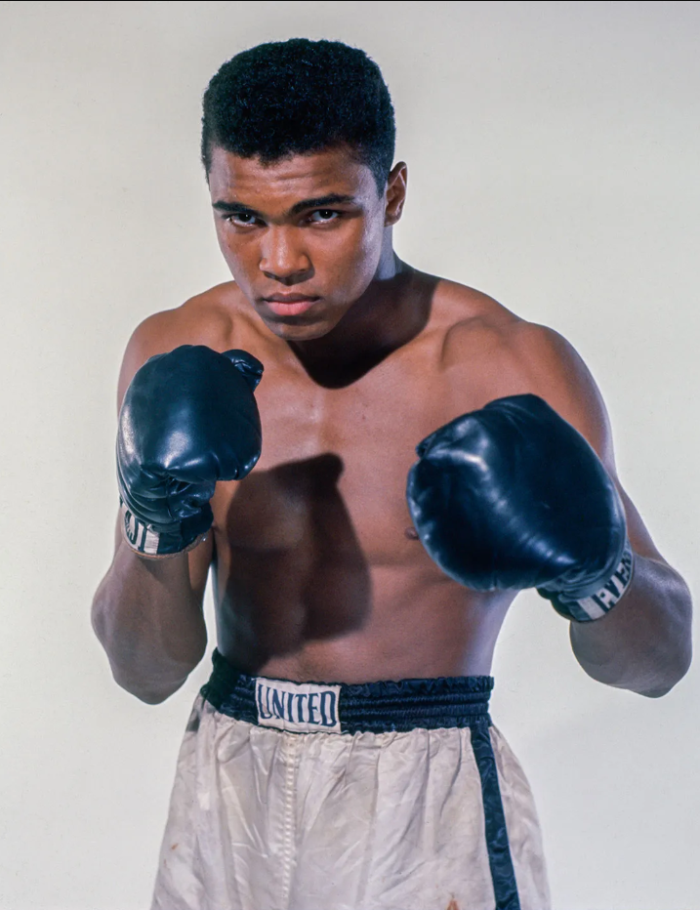
Muhammad Ali born
Cassius Clay Jr.; 1942 –2016) was an American professional boxer and activist. A global cultural icon, widely known by the nickname "the Greatest", he is often regarded as the greatest heavyweight
boxer of all time.

Slide 2
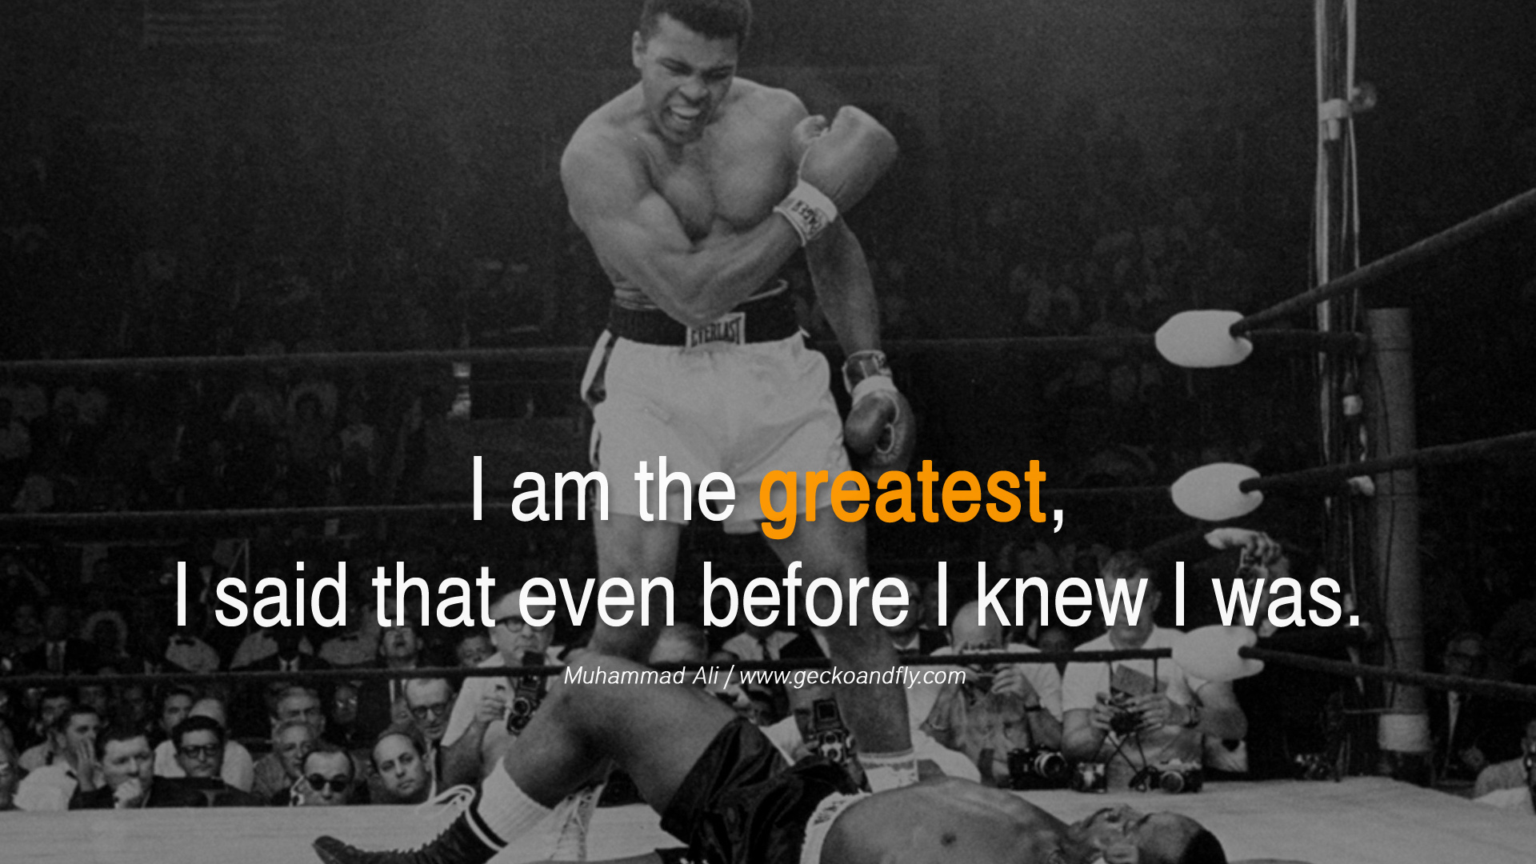
Notes:
https://cdn.quotesgram.com/img/1/12/2012853608-muhammad-ali-quotes-winning14.jpg

Slide 3
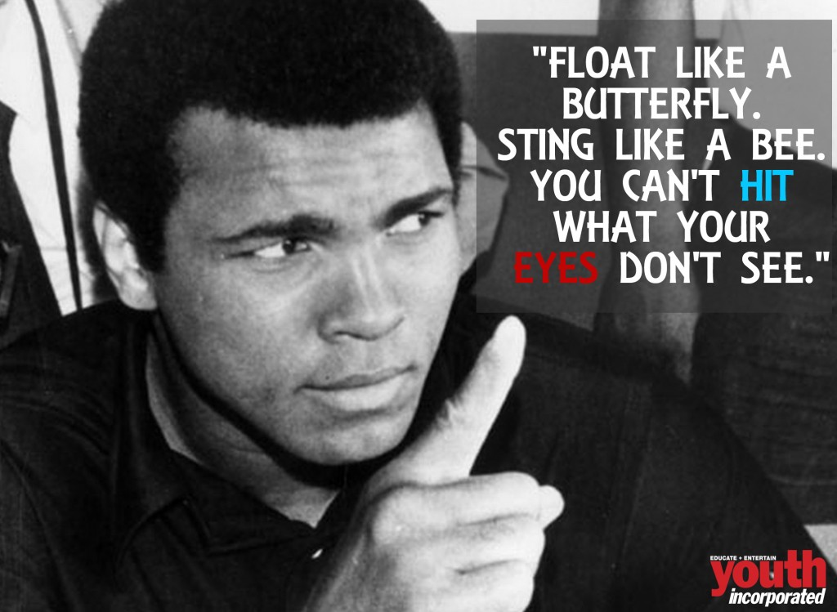
Notes:
https://youthincmag.com/wp-content/uploads/2016/06/MD-ALI-6-1024x749.jpg

Slide 4
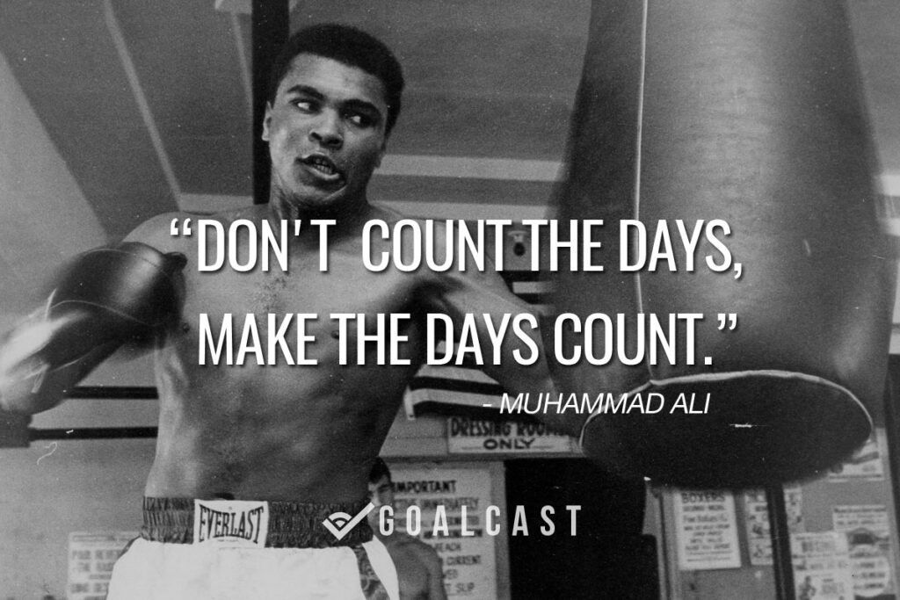
Notes:
https://www.goalcast.com/media-library/don-t-count-the-days-make-the-days-count-muhammad-ali-quote.jpg?id=51632447
Scripture has another way to greatness, different from self proclamation

Slide 5


Slide 6

The Way to Greatness Lk 14.11
Yeshua on humility
Other scriptures on humility
Lying to cover defects
Membership accountability
Aspects of Humility

Slide 7
The Way to Greatness Lk 14.11
Yeshua on humility
Other scriptures on humility
Lying to cover defects
Membership accountability
Aspects of Humility

Slide 8
^{Luke 14.11} Everyone who exalts himself will be humbled, and the one who humbles himself will be exalted.
Notes:
This is the verse in the parasha of Dec 20 that struck me as my download.

Slide 9
^{Mtt 11.28-29} “Come to me, all of you who are struggling and burdened, and I will give you rest. Take my yoke upon you and learn from me, because I am gentle and humble in heart, and you will find rest for your souls.
Notes:
His claim to our allegiance, His authority, is His humility and gentleness.

Slide 10
^{Matt 23.11-12} But the greatest among you shall be your servant. Whoever exalts himself shall be humbled, and whoever humbles himself shall be exalted.
Notes:
Definition of greatness…serving others.
Rabbi Robt Solomon zl of Beth Hallel Atlanta, flagship cong, said that if you want to find a great leader, find someone who cleans toilets.
Me, I take out the trash. Been doing since age 8 or so.

Slide 11
^{Lk 22.24-27} An argument arose among them as to which of them should be considered the greatest. But Yeshua said to them, “The kings of the Goyim lord it over them; and those in authority over them are given the title, ‘Benefactor.’ But not so with you!

Slide 12
^{Lk 22.24-27} On the contrary, let the greater among you become like the younger, and one who rules like one who serves. For who is greater? The one reclining at the table? or the one who serves? It’s the one reclining at the table, isn’t it? But I myself am among you like one who serves.

Slide 13
^{Lk 11.7-11} When Yeshua noticed how the guests were choosing for themselves the best seats at the table, he told them this parable: “When you are invited by someone to a wedding feast, don’t sit down in the best seat; because if there is someone more important than you who has been invited,
Notes:
The context of my “download” scripture

Slide 14
^{Lk 11.7-11} the person who invited both of you might come and say to you, ‘Give this man your place.’ Then you will be humiliated as you go to take the least important place. Instead, when you are invited, go and sit in the least important place; so that when the one who invited you comes,

Slide 15
^{Lk 11.7-11} he will say to you, ‘Go on up to a better seat.’ Then you will be honored in front of everyone sitting with you. Because everyone who exalts himself will be humbled, but everyone who humbles himself will be exalted.”

Slide 16
^{Mt 18.1-6} At that hour the disciples came to Yeshua, saying, “Who then is greatest in the kingdom of heaven?” And He called a child to Himself, set him in the midst of them, and said, “Amen, I tell you, unless you turn and become like children, you shall never enter the kingdom of heaven.

Slide 17
^{Mt 18.1-6} Whoever then shall humble himself like this child, this one is the greatest in the kingdom of heaven. And whoever welcomes one such child in My name, welcomes Me. “But whoever causes one of these little ones who trust in Me to stumble,

Slide 18
^{Mt 18.1-6} it would be better for him to have a heavy millstone hung around his neck and to be sunk in the depth of the sea!
Notes:
Treasuring defenseless little ones is a mandate, kingdom of heaven citizens…unborn

Slide 19
In Israel, the 2025 statistic is 20,000 abortions to 120 adoptions.
Why? It’s less dishonorable to lose your baby to death than to have other parents raise them.
Both Jewish and Arab cultures.

Slide 20
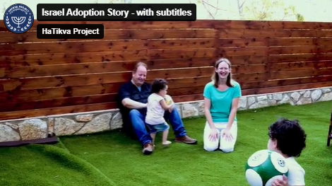
Notes:
https://vimeo.com/300737883?fl=pl&fe=cm

Slide 22
The Way to Greatness Lk 14.11
Yeshua on humility
Other scriptures on humility
Lying to cover defects
Membership accountability
Aspects of Humility

Slide 23
^{T’hillim 18.26-27} With the pure, you are pure; but with the crooked you are cunning. People afflicted, you save; but haughty eyes, you humble.

Slide 24
^{T’hillim 20.8} Some trust in chariots and some in horses, but we praise the name of Adoni our God. They will crumple and fall, but we will arise and stand erect.
Notes:
David movie re Golyat, Goliath

Slide 25
^{T’hillim /Ps 106.43} Many times [God] rescued them, but they kept making plans to rebel. Thus, they were brought low by their own wrongdoing. Still, he took pity on their distress whenever he heard their cry.

Slide 26
^{T’hillim / Ps 119.165} Those who love your Torah have great peace;
nothing makes them stumble.
Notes:
Torah is a key element in our identity as Messianic Jew and Gentile. Walking in the mitzvot brings great peace. If it brings a spirit of condemnation to others less observant, you are not really in Torah.
Peace and joy and humility.

Slide 27
^{Mishlei /Prov 3.34} Adoni’s curse is in the house of the wicked, but he blesses the home of the righteous. The scornful he scorns, but gives grace to the humble.
Notes:
Are you or I scornful to those we disagree with. Roll your eyes in contempt?

Slide 28
^{Mishlei /Prov 16.18-19} Pride goes before destruction, and arrogance before failure. Better to be humble among the poor than share the spoil with the proud.

Slide 29
^{Mishlei/Prov 29.23} A man’s pride will bring him low, but a humble spirit will gain honor.

Slide 30
^{Yeshayanu 23.9} Adoni-Tzva’ot planned it to break the pride of all the arrogant, to humiliate all those who are honored everywhere on earth.

Slide 31
^{Yeshayahu/Is 57.15} For thus says the High and Exalted One who inhabits eternity, whose Name is Holy: “I dwell in a high and holy place, yet also with a contrite and humble spirit, to revive the spirit of the humble, and revive the heart of the contrite.
Notes:
One of my favorite scriptures…liquid love.

Slide 32
^{Daniel 9.3} So I set my face to the Lord God to seek Him by prayer and supplications, with fasting, sackcloth and ashes.
Notes:
Not extravagance and comfort. Self denial

Slide 33
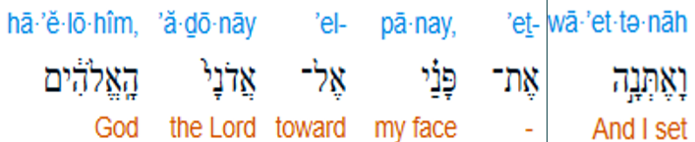
^{Dan 9.3} So I set my face to the Lord God
Notes:
Set my face = deliberate time and place

Slide 34

^{Dan 9.3} to seek Him by prayer and supplications
Notes:
To beg and plead

Slide 35
^{Mes Jews/ Heb 7.7} It is beyond all dispute that the one who blesses has higher status than the one who receives the blessing.
Notes:
If you want to get a leg up on someone, give them a blessing.

Slide 37
The Way to Greatness Lk 14.11
Yeshua on humility
Other scriptures on humility
Lying to cover defects
Membership accountability
Aspects of Humility
Notes:
How does this fit in? Sometimes, to defend our honor, we have nothing truthful to brag about, or some failure to cover up, so we’ll embellish something, or make something up. If we are content with humility, all will be ok however it plays out.

Slide 38
^{Rev 21.18} But as for the cowardly, the untrustworthy, the vile, the murderers, the sexually immoral, those involved with the occult and with drugs, idol-worshippers, and all liars — their destiny is the lake burning with fire and sulfur, the second death.”
Notes:
Me and lying and 1040 form and even if telling anecdotes and jokes. I’ll ruin the flow of a joke if I don’t have the facts correct.
Isn’t every believer terrified of telling false statements?

Slide 39

Notes:
https://m.media-amazon.com/images/I/61akf-INL4L._SL1022_.jpg

Slide 40
Is it always wrong to lie? What if it’s for a good reason? What if telling the truth put you or others in danger?
Hiding Jews in Nazi occupied Holland was a dangerous task and the ten Booms,
Notes:
https://www.writtenlives.ca/better-to-lie-what-to-do-when-gods-commands-conflict/

Slide 41
who had always believed it was wrong to lie, found themselves wondering if they might have to. Corrie argued it wasn’t wrong to lie if it meant saving someone’s life.
Notes:
https://www.writtenlives.ca/better-to-lie-what-to-do-when-gods-commands-conflict/

Slide 42
Her sister, Nollie disagreed. “We are to keep God’s commandment. If we do, He will honour that obedience.”
It would soon be put to the test.
Men and boys, from sixteen to thirty, were being rounded up by the Nazis and taken to work in the munition factories. It was called the Razzia and such seizures could happen at any time of day or night.
Notes:
https://www.writtenlives.ca/better-to-lie-what-to-do-when-gods-commands-conflict/

Slide 43
Nollie and her husband, Flip von Woerden, had three boys and the entire family feared they’d soon be taken. As a precaution, the von Woerdens hid the entrance to their cellar — a makeshift hiding place — and the boys stayed as near to home as possible.
Notes:
https://www.writtenlives.ca/better-to-lie-what-to-do-when-gods-commands-conflict/

Slide 44
One afternoon, while the family was preparing to celebrate Flip’s birthday, a group of soldiers appeared at the end of the street. Peter and Bob came flying into the kitchen.
Notes:
https://www.writtenlives.ca/better-to-lie-what-to-do-when-gods-commands-conflict/

Slide 45
It took only moments for them to get into the secret room and the mat to be replaced. The ladies in the kitchen — the van Woerden’s youngest daughter, Cocky and their Aunts, Corrie and Betsie heard the front door slam open and soldiers run up the stair. One came into the kitchen waving his rifle as he shouted for the women to move against the wall.
Notes:
https://www.writtenlives.ca/better-to-lie-what-to-do-when-gods-commands-conflict/

Slide 46
“Do you have brothers?” One of the men asked, singling Cocky out. The soldiers had already made an unsuccessful search of the house.
Notes:
https://www.writtenlives.ca/better-to-lie-what-to-do-when-gods-commands-conflict/

Slide 47
Cocky glanced nervously at her aunts, wishing they could tell her what to say. All her life she had been told not to lie, but what about now? She tried to guess what her parents would say.
“Well?”
Cocky nodded. “Yes. Three.”
Notes:
https://www.writtenlives.ca/better-to-lie-what-to-do-when-gods-commands-conflict/

Slide 48
The man grinned, “And how old are your brothers?”
She wondered how long could she continue to tell the truth. “The oldest is twenty-one. The others are nineteen and eighteen.”
Notes:
https://www.writtenlives.ca/better-to-lie-what-to-do-when-gods-commands-conflict/

Slide 49
“Good answer. Where are they?”
“The oldest is at Theological College. He doesn’t get home most nights because–“
“And the other two?”
Notes:
https://www.writtenlives.ca/better-to-lie-what-to-do-when-gods-commands-conflict/

Slide 50
Cocky knew her answer could put her brothers into jeopardy. She couldn’t do that, not when they were so close to escaping, not for such a silly conviction. Surely, when her parents had told her she must never lie
Notes:
https://www.writtenlives.ca/better-to-lie-what-to-do-when-gods-commands-conflict/

Slide 51
they hadn’t realized she would have to face a circumstance like this.
She didn’t know what to do. She was so nervous she began to laugh. She couldn’t help it.
Notes:
https://www.writtenlives.ca/better-to-lie-what-to-do-when-gods-commands-conflict/

Slide 52
“They are under the table.” She said, laughing still.
The officer walked over to the table and lifted the overhanging cloth. When he turned back to look at Cocky his expression had darkened. He slapped her across the face. “Don’t take us for fools!” He shouted. Motioning for his companion to follow, the young man stormed out of the house.
Notes:
https://www.writtenlives.ca/better-to-lie-what-to-do-when-gods-commands-conflict/

Slide 53
Cocky hadn’t lied. Her brothers were under the table. It was there, under the mat that the trap door to the cellar was hidden.
That evening, the family had a discussion about whether or not Cocky had done the right thing.
Notes:
https://www.writtenlives.ca/better-to-lie-what-to-do-when-gods-commands-conflict/

Slide 54
I am personally an absolutist when it comes to truth telling.
Aren’t all believers terrified to lie?
You can’t make up for your deficits by lying. Humility is painful, but it is RIGHT.
Notes:
“I have read…”

Slide 55

For forty years You sustained them in the desert: they lacked nothing, their garments did not wear out, and their feet did not swell. ^{Neh 9:21}
Notes:
Joel Chernoff Daily Nosh

Slide 56
Joel Chernoff’s “Nosh”: Those who are called by His name can trust that even in seasons of divine discipline and correction (as with Israel, 40 years in the wilderness), God will sustain us and not abandon us to destruction.
Notes:
G-d will be with us, if we are always truth tellers.

Slide 58
The Way to Greatness Lk 14.11
Yeshua on humility
Other scriptures on humility
Lying to cover defects
Membership accountability
Aspects of Humility
Notes:
In the 32 years of Or HaOlam there is a provision in our By Laws that we have never followed up on. It is membership renewal. Sort of an exercise in humility in accountability. I have to give account?
Here is the letter coming to all members, and some others.

Slide 59
In the spirit of 1 Kefa (Peter) 5.1-3 we’d like to invite you to renew your membership covenant by answering the following accountability questions.

Slide 60
Therefore, I urge the congregation leaders among you, as a fellow-leader and witness to the Messiah's sufferings, as well as a sharer in the glory to be revealed: shepherd the flock of God that is in your care, exercising oversight not out of constraint, but willingly, as G-d wants; and not out of a desire for dishonest gain, but with enthusiasm.

Slide 61
Personally, Jeremy, the Assistant Rabbi, and I get asked similar and even more detailed questions by our ordaining body, the IAMCS, about our life, ministry, and the conduct of the congregation, in order to maintain our ordination status and participation in the Bi-yearly IAMCS business meeting.

Slide 62
Our Congregational Business meeting will be on February 8, 2026 for current members. Answering this form will renew your membership. You don’t need to give the right answer. That is, filling out the form can be taken as a request for help and growth as a part of the community. Alternatively, you can express your desire to withdraw, if needed, but let us know the reason.

Slide 63
1. Are you walking wholeheartedly with Yeshua, and have a clear assurance from the Ruakh/the Spirit that you are forgiven and ready to meet Him any time?

Slide 64
2. Do you believe in our statements of faith and vision?
https://orhaolam.com/uploads/Statement_of_Faith.pdf https://orhaolam.com/uploads/Congregational_Vision_and_Concept.pdf

Slide 65
3. Are there any prayer requests related to your walk, family, health, finances?

Slide 66
4. Are you tithing to Or HaOlam? G-d promises to “open…the floodgates of heaven and pour out for you a blessing” to those who give Him their tithe faithfully.
Notes:
We are not asking to see your 1040 form. Some traditional synagogues do that.

Slide 67
5. Do you have a 10-10-10 or more devotional life? Ten minutes reading the Word, ten minutes in prayer, and 10 minutes in worship and listening? Maybe you have some creative variation?

Slide 68
6. Are you an active attendee and participant at Or HaOlam?

Slide 69
7. Have you sought Adoni and found a specific place to regularly serve? (This may be an obvious issue for most of you.)

Slide 70
8. If you are not an active attendee/participant, do you have any questions or issues we can help you with?

Slide 71
9. If you are not an active attendee/participant, would you like us to remove your name from the membership roll and cease pursuing you?

Slide 72
10. Have you ever contemplated stepping away from synagogue? Anything we should consider changing?

Slide 74
The Way to Greatness Lk 14.11
Yeshua on humility
Other scriptures on humility
Lying to cover defects
Membership accountability
Aspects of Humility

Slide 75
A humble mindset has significant positive effects on our cognitive, interpersonal, and decision-making skills. Humility is directly related to our ability and willingness to learn. Humble people are better learners and problem solvers.
Notes:
https://positivepsychology.com/humility/#5-real-life-examples

Slide 76
Humble students who are genuinely open to feedback often overtake their naturally more talented peers who think so highly of their own abilities that they reject all advice. Some studies have found that humility is more important as a predictive performance indicator than IQ

Slide 77
Humility in our leaders, moreover, fosters trust, engagement, creative strategic thinking, and generally boosts performance
Notes:
https://positivepsychology.com/humility/#5-real-life-examples

Slide 78
Those of us who lack cultural humility are more prone to make assumptions about others, feel superior to them, and dramatically overvalue our knowledge and talents in comparison to others
Notes:
https://positivepsychology.com/humility/#5-real-life-examples

Slide 79
An example is Joffrey Baratheon from Game of Thrones. The character of Joffrey is known for his narcissistic entitlement, vastly inflated sense of his talents, and desire to dominate–all traits negatively correlated with humility
Notes:
https://positivepsychology.com/humility/#5-real-life-examples

Slide 80
Joffrey shows little sympathy or concern for other characters throughout the story, including his own wife, Sansa, whom he treats with severe cruelty. It is little wonder audiences around the world celebrated when he was poisoned and died in Season 4, putting an end to his reign of tyranny.
Notes:
https://positivepsychology.com/humility/#5-real-life-examples

Slide 81
Humor is a powerful tool. We can all benefit from laughing more about ourselves and our imperfections.
Notes:
https://positivepsychology.com/humility/#5-real-life-examples
Very Jewish self effacing humor.

Slide 82
Exercises that hone gratitude and appreciation can boost a humble state of mind. A great starting point is expressing gratitude to others. This invites us to value our important relationships with others.
Notes:
Adapted from
https://positivepsychology.com/humility/#5-real-life-examples

Slide 83
Think about the people who have influenced us most positively in our lives, truly appreciate their contribution, and demonstrate our gratitude.
Notes:
Adapted from
https://positivepsychology.com/humility/#5-real-life-examples

Slide 85
The Way to Greatness Lk 14.11
Yeshua on humility
Other scriptures on humility
Lying to cover defects
Membership accountability
Aspects of Humility
Humility of a dog

Slide 86
What is more humble than a dog, of certain breeds?

Slide 87
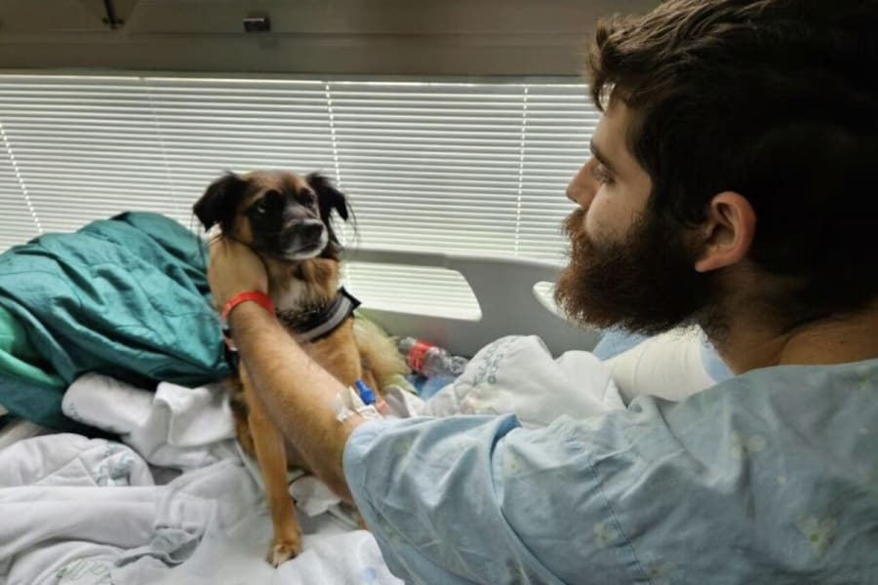
Notes:
https://allisraelnews.com/hospital-therapy-dogs-help-rehabilitate-traumatized-patients-in-israel?utm_source=convertkit&utm_medium=email&utm_campaign=%E2%80%98Forget%20it%E2%80%99%3A%20PM%20Netanyahu%20slams%20%E2%80%98fantasies%20of%20re-establishing%20empires%E2%80%99%20in%20message%20to%20Turkey%20after%20summit%20with%20Greece%20and%20Cyprus%20-%2020157538

Slide 88
The cute canines have brought significant breakthroughs in the lives of several patients, helping a soldier so traumatized by the violence that left him blind in one eye after witnessing the death of his friend that he wouldn’t speak,
Notes:
https://allisraelnews.com/hospital-therapy-dogs-help-rehabilitate-traumatized-patients-in-israel?utm_source=convertkit&utm_medium=email&utm_campaign=%E2%80%98Forget%20it%E2%80%99%3A%20PM%20Netanyahu%20slams%20%E2%80%98fantasies%20of%20re-establishing%20empires%E2%80%99%20in%20message%20to%20Turkey%20after%20summit%20with%20Greece%20and%20Cyprus%20-%2020157538

Slide 89
finally starting to talk again… to little Teddy, one of the therapy dogs. Matry told The Media Line that “something shifted,” and the soldier opened up, began to cry and also began speaking to the dog.
Notes:
https://allisraelnews.com/hospital-therapy-dogs-help-rehabilitate-traumatized-patients-in-israel?utm_source=convertkit&utm_medium=email&utm_campaign=%E2%80%98Forget%20it%E2%80%99%3A%20PM%20Netanyahu%20slams%20%E2%80%98fantasies%20of%20re-establishing%20empires%E2%80%99%20in%20message%20to%20Turkey%20after%20summit%20with%20Greece%20and%20Cyprus%20-%2020157538

Slide 90
She gave other examples of how therapy dogs have helped to bring unresponsive patients back into action, and others with mental blocks and fears, including Nova survivors, find breakthroughs.
Notes:
https://allisraelnews.com/hospital-therapy-dogs-help-rehabilitate-traumatized-patients-in-israel?utm_source=convertkit&utm_medium=email&utm_campaign=%E2%80%98Forget%20it%E2%80%99%3A%20PM%20Netanyahu%20slams%20%E2%80%98fantasies%20of%20re-establishing%20empires%E2%80%99%20in%20message%20to%20Turkey%20after%20summit%20with%20Greece%20and%20Cyprus%20-%2020157538

Slide 91
“After a traumatic event, a soldier could be in acute stress, and doctors or nurses may not be able to read him. Somehow, when the dog is there, you ask the soldier not to speak to the nurse or doctors, but speak to the dog,” Hellmann said. “Just looking into the dog’s eyes, there’s something in the chemistry that happens between a human and a dog that can break that threshold and let things come out.”

Slide 93
The Way to Greatness Lk 14.11
Yeshua on humility
Other scriptures on humility
Lying to cover defects
Membership accountability
Aspects of Humility
Humility of a dog

