Slide 1
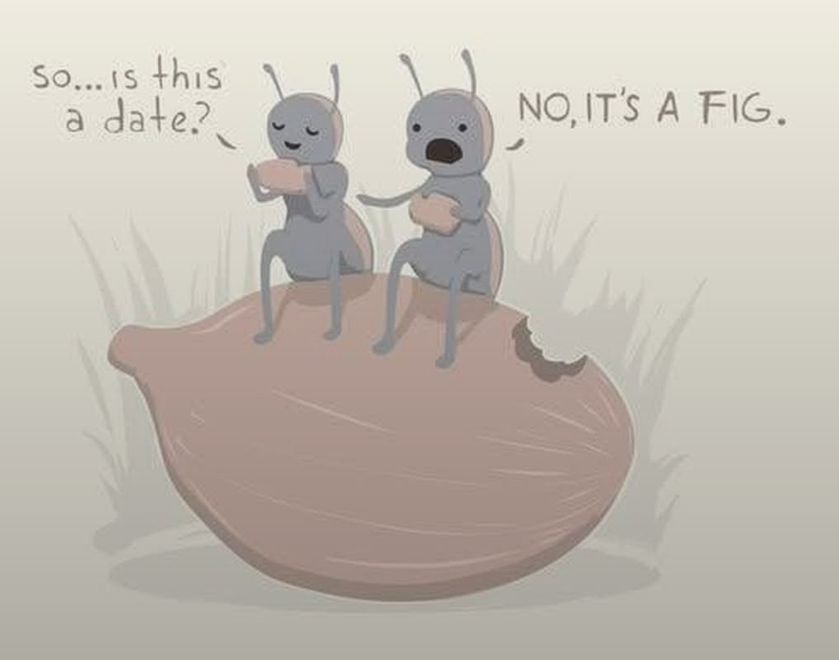

Slide 2
Notes:
Ben Troyer, tree guy

Slide 3
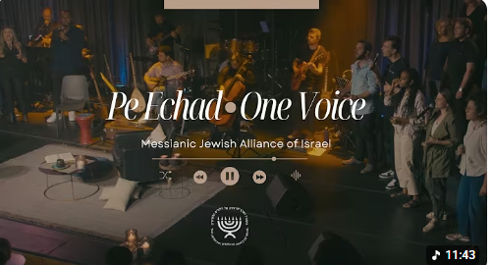
Notes:
I have shared that I generally start my daily personal devotions with a song, usually scripture in Hebrew from Israelis. G-d always speaks to me through the music, and sometimes I get what my friend David Dreiling referred to as “downloads” for messages.
This medley has given me three messages already, and this is the fourth. This theme today is getting rid of every weight. From 4 minutes in. We have a WONDERFUL worship team who could do this, but this is an isolated and short clip that was just easier to grab.

Slide 4
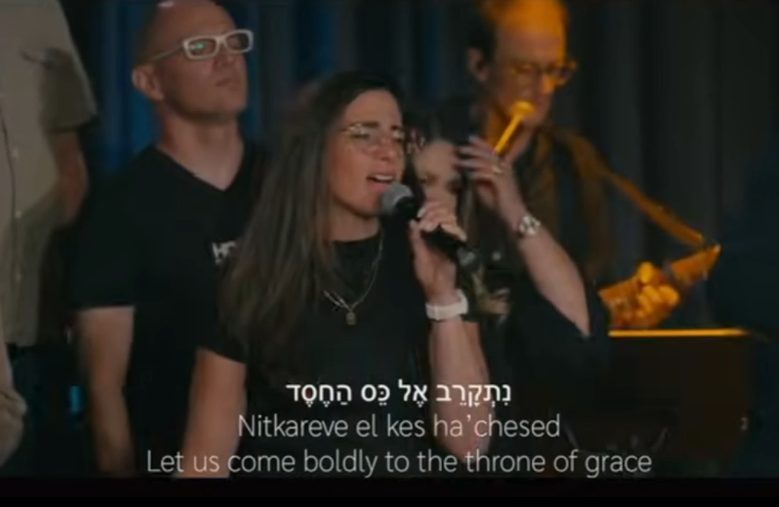
Notes:
https://youtu.be/hBPl2214-jE?t=266
Habitu Elav (Look upon him) Words adapted from Hebrews 12:1-3, music by David Sagin
Vocalist: ‪@KerenSilverMusic‬

Slide 5
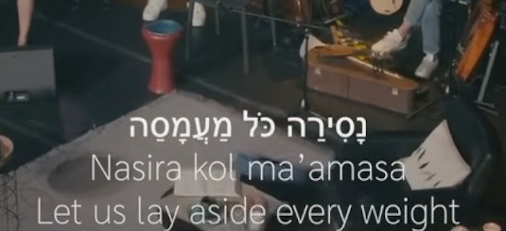
Notes:
Same root as the word Yeshua uses when He says

Slide 6
^{Mtt 11.28-30} Come to Me, all who are weary and burdened, and I will give you rest. Take My yoke upon you and learn from Me, for I am gentle and humble in heart, and ‘you will find rest for your souls.’ For My yoke is easy and My burden is light.”
Notes:
And, the name of the prophet Amos

Slide 7
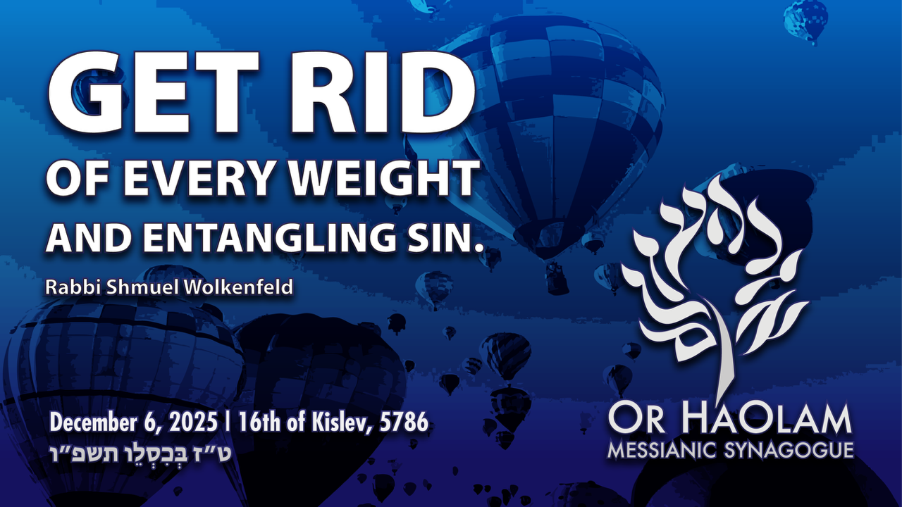

Slide 8

Get Rid of every weight
and entanglement MJ 12.1-2
Unpacking the word pictures
Applying the word pictures.

Slide 9
Get Rid of every weight
and entanglement MJ 12.1-2
Unpacking the word pictures
Applying the word pictures.
What are the weights?

Slide 10
^{Mes Jews/Heb 12.1-2} Therefore, since we have such a great cloud of witnesses surrounding us, let us also get rid of every weight and entangling sin. Let us run with endurance the race set before us, focusing on Yeshua, the initiator and perfecter of faith.

Slide 11
^{Mes Jews/Heb 12.1-2} For the joy set before Him, He endured the cross, disregarding its shame; and He has taken His seat at the right hand of the throne of God.
Notes:
Let’s explore the word definitions, three phrases in particular…

Slide 12
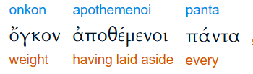
whatever is prominent, protuberance, bulk, mass, hence), a burden, weight, encumbrance
Notes:
https://biblehub.com/greek/3591.htm

Slide 13
that hinders movement, anything that impedes the believer’s progress in the life of faith. Not only overt transgression but also morally neutral pursuits, habits, or relationships can weigh down spiritual momentum.

Slide 14
Readers in the first century were familiar with athletic contests held in Greek and Roman arenas. Runners stripped down to the lightest garments to achieve maximum speed. Any extra mass, however small, threatened victory.
Notes:
Or nothing

Slide 15
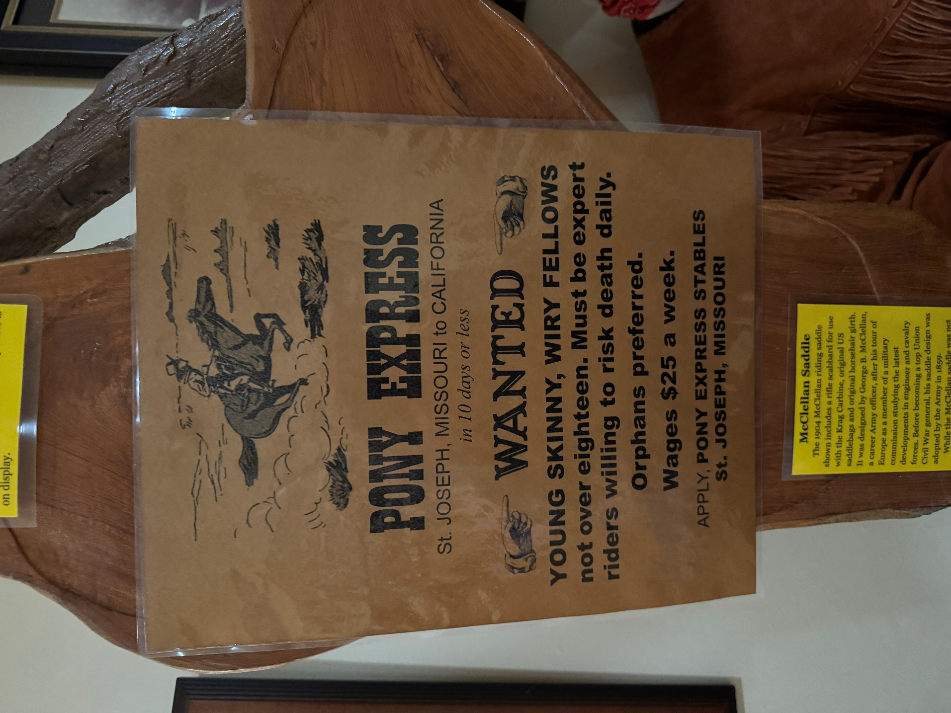
Notes:
From local American history

Slide 17
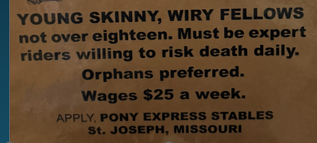

Slide 18
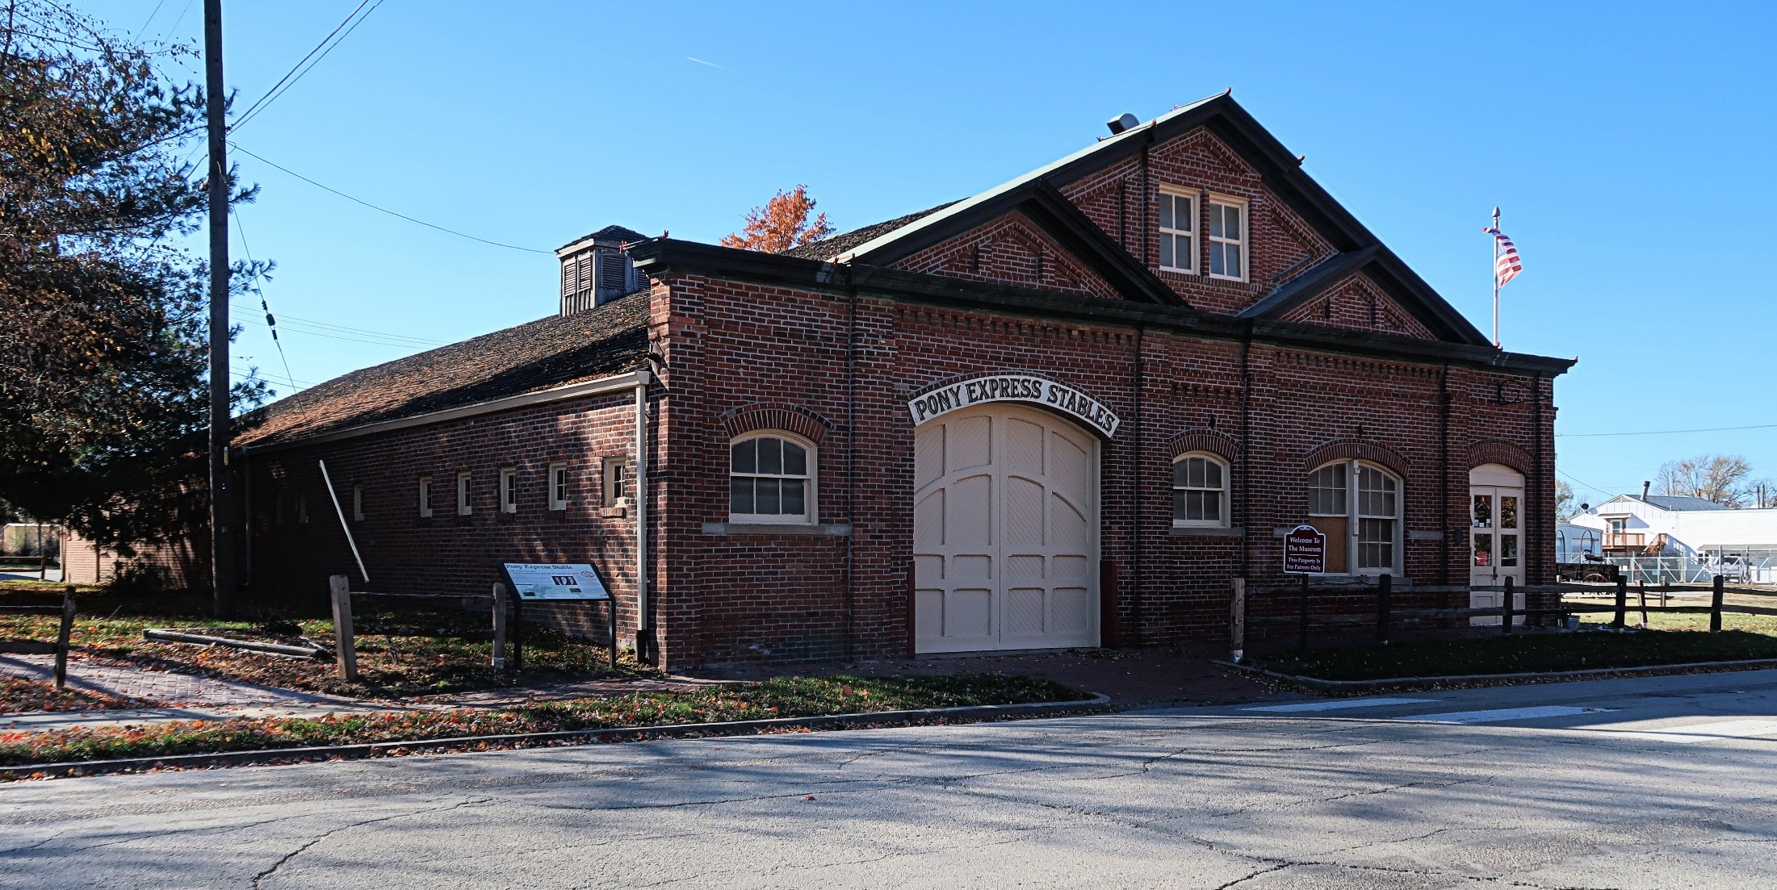
914 Penn St Saint Joseph, MO

Slide 19
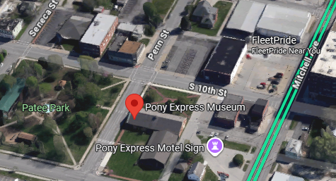

Slide 20
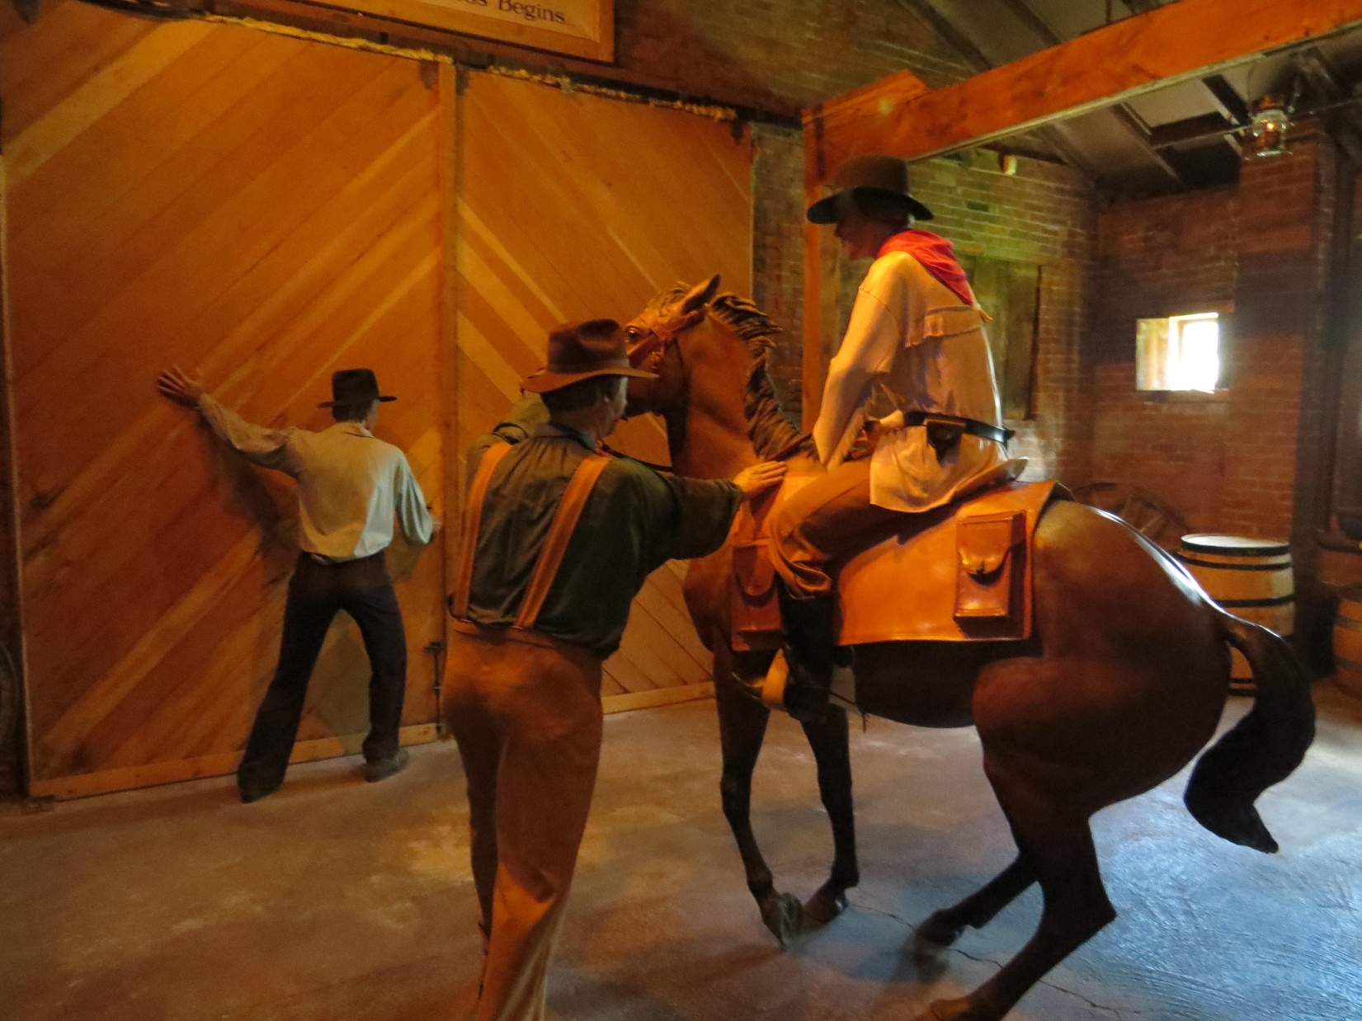

Slide 22
Some observe, that the word here used signifies a tumor or swelling; and so may design the tumor of pride and vanity, in outward privileges, and in a man's own righteousness.

Slide 23
Everything that might slow you or me down, hinder you or me in the Kingdom race, fruitfulness for Messiah. Character flaws.
Is _____ a weight, or a wing?
Notes:
The first word picture that came to mind was of a hot air balloon in distress, and the riders throwing weights overboard to stay afloat. Jeremy got the same image as you see in the wonderful background he made. I tried to find a clip of that. How many saw Around the World in 80 Days? I thought there was a desperation scene. But there is a scene.

Slide 25
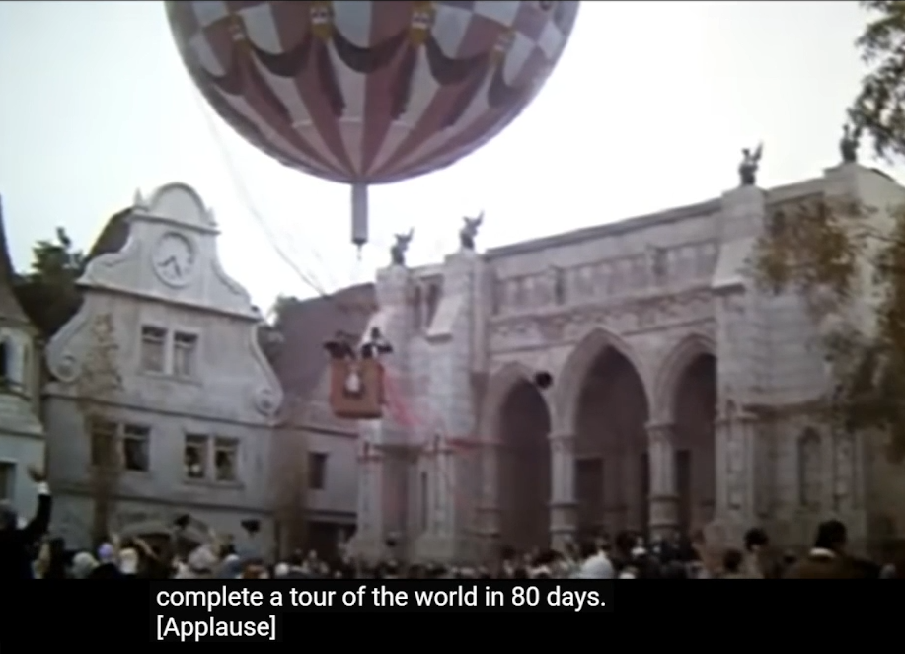
Around the World in 80 Days
1954 movie set in 1872
Notes:
https://video.search.yahoo.com/yhs/search?fr=yhs-trp-044c&hsimp=yhs-044c&hspart=trp&p=around+the+world+in+80+days+movie+1956&type=Y273_F573969_237869_111125#id=13&vid=fa2693fd60c72fc7033c6126e5266551&action=view

Slide 26
Similar to what Yeshua says:
^{Mtt 13.22} The seed sown among thorns stands for someone who hears the message, but it is choked by the worries of the world and the deceitful glamor of wealth, so that it produces nothing.

Slide 27
^{Mes Jews/Heb 12.1-2} Therefore, since we have such a great cloud of witnesses surrounding us, let us also get rid of every weight and entangling sin. Let us run with endurance the race set before us, focusing on Yeshua, the initiator and perfecter of faith.
Notes:
Second phrase in this passage to consider…

Slide 28

1. well-surrounded

Slide 29
2. (of a competitor) thwarting a runner in every direction well-planted all-around, describing what is encompassing (encircling), i.e. surrounding, "wholly around"; (figuratively) a serious hindrance that "encircles" (hampers) someone who desperately needs to advance.

Slide 30
^{Mishlei / Prov 29.5} A man who flatters his neighbor spreads a net for his feet.
Distractions
Notes:
Like a weight…
Flattery engages pride.
Seduction.
I get texts: Is this Abigail. Is this Amy?
Oh, you sound like a nice person. Can I meet you? Occasionally with a photo.

Slide 31
^{Mes Jews/Heb 12.1-2} Therefore, since we have such a great cloud of witnesses surrounding us, let us also get rid of every weight and entangling sin. Let us run with endurance the race set before us, focusing on Yeshua, the initiator and perfecter of faith.
Notes:
Third word picture in these verses

Slide 32
“cloud of witnesses” implies communal accountability. Believers run in view of previous generations and alongside present companions, so tolerating weights affects the whole body
Cheerleaders help you run harder.
Accountability. Celebrate Recovery

Slide 33
Weight that hinders
Entanglements
Community accountibility

Slide 35
Accountability
As a rabbi, I have a yearly renewal I have to sign to the IAMCS about my doctrine, my lifestyle, my liturgical leading of the congregation.
Jeremy does too.
Shouldn’t members have similar?

Slide 36
Membership
Or HaOlam has a yearly membership renewal that I have failed to maintain.
However, Feb. 8, 2026 we will a Membership meeting, have full reports and celebration. Yearly renewal forms coming to members shortly.
Notes:
Community accountability
Membership class for newbies, in Jan
Help us get rid of weights.

Slide 38
Get Rid of every weight
and entanglement MJ 12.1-2
Unpacking the word pictures
Applying the word pictures.
What are the weights?
Notes:
What are the weights

Slide 39
What are the weights?
^{T’hillim/Ps 38.4} For my iniquities are on my head—like a burden too heavy for me.
In Pilgrim’s Progress, author John Bunyan depicts our iniquities as a GREAT burden that can only be loosed by Messiah Yeshua!

Slide 40
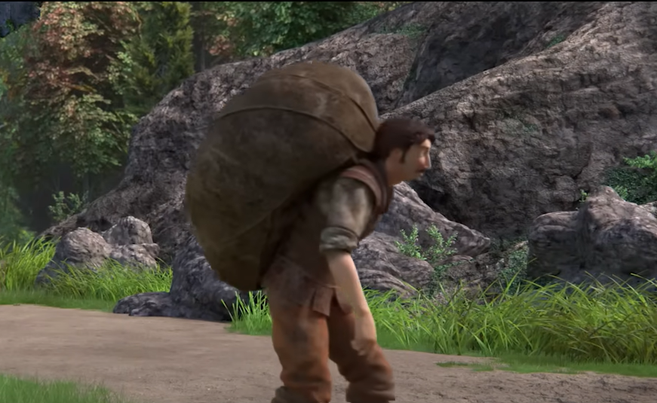
Notes:
https://youtu.be/ksu-zTG9HHg
Note the absurdly heavy burden of sin and guilt and separation from G-d. Maybe some here?

Slide 41
Pilgrim was gloriously FREE. Do you remember?
Me: April 13, 1969 Still today!
Nevertheless, even born again believers can have some weights, some burdens.

Slide 42
^{1 Yn 2.15-17} Do not love the world or the things in the world. If anyone loves the world, the love of the Father is not in him. For everything in the world—the desire of the flesh, the desire of the eyes, and the boasting of life—is not from the Father but from the world.
Notes:
This is it. If you deal with these three, you continue in Messiah’s freedom!!

Slide 43
^{1 Yn 2.15-17} The world is passing away along with its desire, but the one who does the will of God abides forever.
Notes:
Let’s examine these three weights.

Slide 44
The desire of the flesh.
ἐπιθυμία eh-pee-thoo-MEE-ah a longing (especially for what is forbidden) -- concupiscence, desire, lust (after). properly, passion built on strong feelings (urges). These can be positive or negative, depending on whether the desire is inspired by faith (God's inbirthed persuasion)
Notes:
Sexual desire is good . In marriage it is good. Procreation is good. We LOVE babies. The human race is NOT reproducing enough people currently. 2.4 babies per woman. The .4 is the hardest.

Slide 45
Pornography, sexually explicit speech or text, sexting, inappropriate touching.
DON’T click on it! Genesis 3:6: "When the woman saw that the tree was good for food" (the desires of the old nature or "flesh”
Notes:
Raging desire for anything. Food, drink, sex.

Slide 46
B. the desire of the eyes "and that it was a delight to the eyes" (the desires of the eyes), to possess
Materialism; worldly cares, riches, and honors, luxuries when immoderately pursued.
We all love beauty and comfort.

Slide 47
I grew up in Jamaica, NY. Middle Class ~Mission, KS
Donald Trump grew up in Jamaica Estates, NY. ~Mission Hills, KS
I was affluent adjacent.

Slide 48
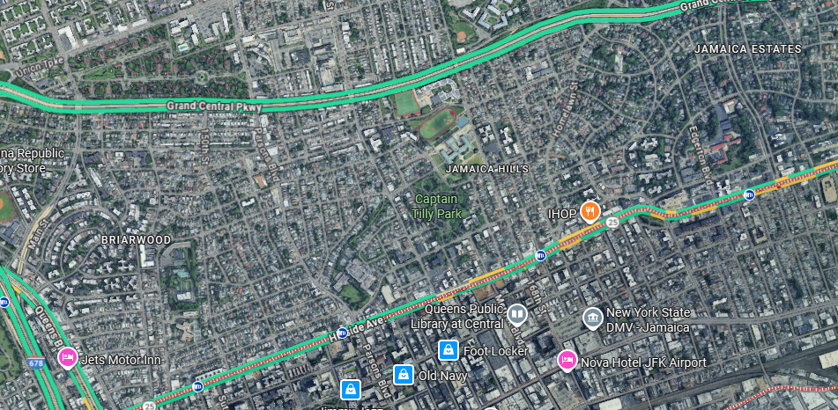

Slide 49
Nevertheless, became indigent obsessive. “Romance of Poverty.”
But if you are blessed with wealth, rejoice.
Notes:
Hippy non-materialist world. Very toxic. My kids may have forgiven me. Told Dawn, if you ever see me in a nice house in the suburbs, consider me backslidden.
But if you are blessed with wealth, rejoice.

Slide 50
^{1 Tim 6.9-10} Those who want to get rich fall into temptation and a trap and into many foolish and harmful desires that plunge people into ruin and destruction. For the love of money is a root of all kinds of evil. Some people, eager for money, have wandered from the faith and pierced themselves with many griefs.

Slide 51
^{1 Tim 6.17-19} Direct those who are rich in this present age not to be proud or to fix their hope on the uncertainty of riches but rather on God—who richly provides us with everything to enjoy. Direct them to do good, to be rich in good deeds, to be generous, sharing, storing up for themselves a good foundation for the future, so they might take hold of the true life.,
Notes:
It DOESN’T say “Those who are rich sell all and give to charity.” Yeshua did say that once.
However, we are taught, all of us, to tithe on the firstfruits, before expenses, and give.
So, here is a December invitation. How many were inundated on Giving Tuesday? I aways felt that that was too much hype and fad and high pressure. So, this a notification. Last year we recovered similarly in December. Pray about it!

Slide 52
Financial report as of October 31, 2025
donations: $ 21,645 tithes
1,264 designated
expenses: $ 29,701
net: $ ( 6,792) Oct.
YTD adj. net $ (45,352)
Notes:
We are considering some ways to limit spending.
Nevertheless, our confidence is NOT in our $, although it’s nice. Our confidence is…

Slide 53
C. The boasting of life
^{Gal 2.19-20} I have been executed on the stake with Messiah; and it is no longer I who live, but Messiah lives in me. And the life I now live in the body, I live by trusting in Ben-Elohim—who loved me and gave Himself up for me

Slide 54
^{Eph 2.10} For we are His workmanship—created in Messiah Yeshua for good deeds, which God prepared beforehand so we might walk in them.

Slide 55
^{Eph 3-16-19} I pray that from His glorious riches He would grant you to be strengthened in your inner being with power through His Ruach, so that Messiah may dwell in your hearts through faith. I pray that you, being rooted and grounded in love,

Slide 56
^{Eph 3-16-19} may have strength to grasp with all the kedoshim / holy people what is the width and length and height and depth, and to know the love of Messiah which surpasses knowledge, so you may be filled up with all the fullness of God.

Slide 57
Otherwise, a litany of fears, insecurities, phobias, anxieties, panics, aggression, despair as a Jew or for the Jews.
I had certain internal issues [weights] that were greatly alleviated by Be In Health / Brian and Sue Samuel Nov 22.

Slide 58
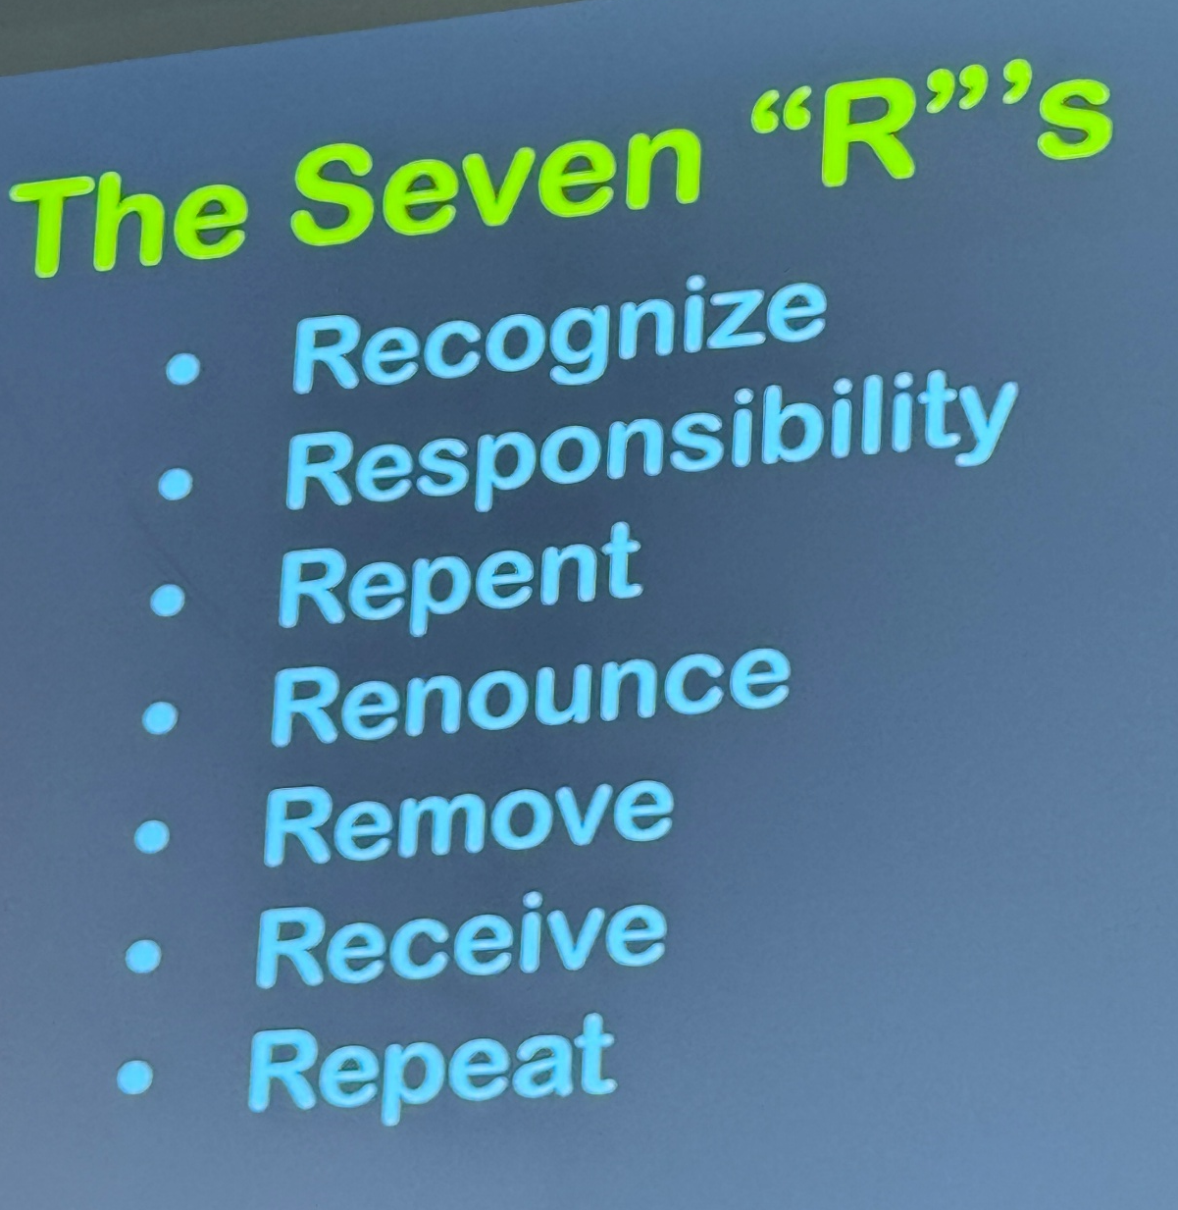
Notes:
Get rid of GREAT emotional weights by just taking responsibility for them. The fears are internal. My own.
PAUSE

Slide 59
Without faith, there are many things to rage or panic and despair about. Great weights in the daily news and culture…

Slide 60
On October 31, 2025, during a Friday sermon at the Islamic Center of Kansas (Olathe, KS), Muhammad Tarife proclaimed that ‘Gaza has begun a new page of Jihad and sacrifice,’ and prayed for Allah to ‘destroy the criminal Zionists… kill them one by one, do not spare a single one of them.’
Notes:
https://alford.house.gov/news/documentsingle.aspx?DocumentID=1399
That was in Minneapolis or Detroit, or Qatar? OLATHE

Slide 61
However, G-d specializes in surprises.

Slide 62
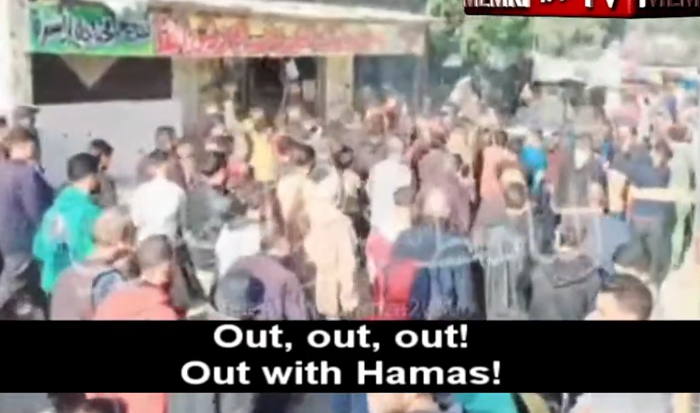
https://youtu.be/3mrGLm9vID8
Notes:
https://youtu.be/3mrGLm9vID8

Slide 63
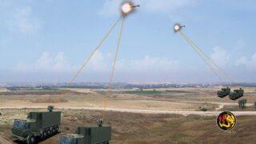
Israel’s Defense Ministry will deliver its first full Iron Beam
high-energy laser battery to the IDF
on December 30.
Notes:
https://www.worthynews.com/110534-israel-enters-the-laser-era-as-iron-beam-deploys-on-dec-30
can target drones, rockets, missiles, and mortar rounds at distances of roughly 10 kilometers. The system works alongside Iron Dome, David’s Sling, and Arrow, not as a replacement but as a new layer in Israel’s air-defense network. One of Iron Beam’s biggest advantages is cost. Arrow interceptors can cost millions of shekels, and each Iron Dome missile tens of thousands. By comparison, a laser shot costs only the electricity required–often described as “as cheap as turning on a light.”

Slide 64
In the two-year sessions since 2000, an average of just under 4,800 pages per session were added by the Congress itself, and just over 150,000 pages per session were added by the bureaucracy. Nobody elected the bureaucracy to do that. Until a year ago, no one could even dismiss bureaucrats from office.
Notes:
https://imprimis.hillsdale.edu/todays-firestorm-and-the-declaration/?utm_campaign=imprimis&utm_medium=email&_hsenc=p2ANqtz-_Dmru2lCRQiHsNREqYyF5dZ3bPoyYZrtP2NC1W6oGgbOHVjWftZxQVFwtIyYenoiyp8JrI4-bRtsOH4NhBZmI3cno5aQ&_hsmi=391122438&utm_content=391122438&utm_source=hs_email

Slide 65
An illustration in weight dropping/ transformation in today’s parasha.

Slide 66
One of the most mysterious episodes in the entire Torah occurs in this week’s portion ‘Vayishlakh’.
Yaakov, alone at night on the banks of the Yabbok River, suddenly finds himself wrestling with a strange “ish”—a man, an angel, or perhaps a divine being. The struggle lasts until dawn.
Notes:
https://www.ulpanor.com/2025/12/04/wrestling-toward-the-name-israel/

Slide 67
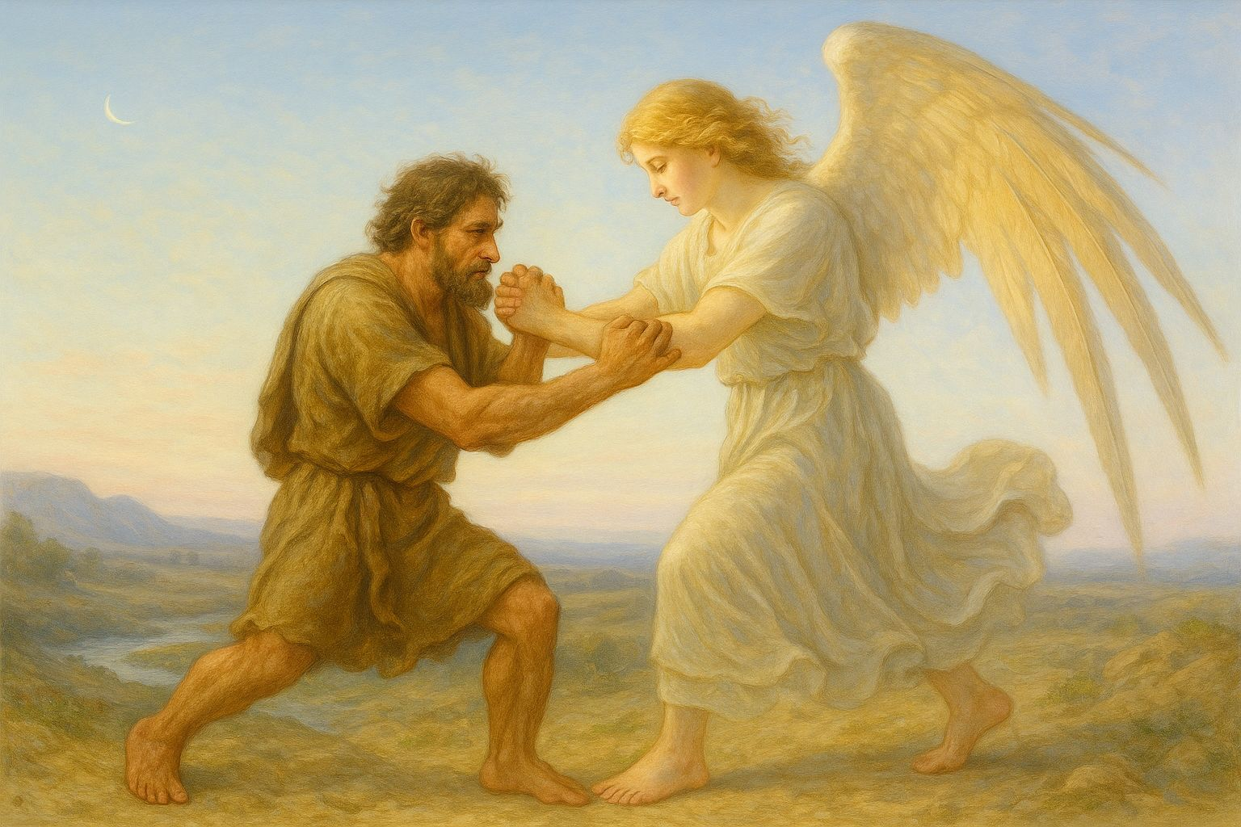
Notes:
https://www.ulpanor.com/2025/12/04/wrestling-toward-the-name-israel/

Slide 68
The being wounds Yaakov, blesses him, and renames him Yisrael, “one who wrestles with God and prevails.”
Notes:
https://www.ulpanor.com/2025/12/04/wrestling-toward-the-name-israel/

Slide 69
This nocturnal encounter becomes the turning point of Yaakov’s life—the moment when struggle itself becomes destiny. A contemporary psychologist might say: Yaakov is the first biblical figure who chooses his own identity rather than merely receiving it.
Notes:
https://www.ulpanor.com/2025/12/04/wrestling-toward-the-name-israel/

Slide 70
Avraham is called.
Yitzḥak is chosen.
Moshe is drafted.
But Yaakov decides—again and again—who he must become.
Notes:
https://www.ulpanor.com/2025/12/04/wrestling-toward-the-name-israel/

Slide 71
A life of wrestling does not indicate spiritual failure; it is the crucible in which authenticity is forged.
Yaakov teaches that faith is not the absence of struggle; faith is the willingness to struggle toward blessing.
Rabbi Jonathan Sacks speaks of Mozart-souls and Beethoven-souls.
Notes:
https://www.ulpanor.com/2025/12/04/wrestling-toward-the-name-israel/

Slide 72
Some people move through the world like Mozart composed: effortlessly. Their creativity flows like a spring—clear, smooth, unlabored.
You listen to Mozart and feel as though the music simply appeared, as if he touched heaven without struggle.
Notes:
https://www.ulpanor.com/2025/12/04/wrestling-toward-the-name-israel/

Slide 73
Beethoven was the opposite. His genius required battle. Manuscripts full of scratch-outs, drafts piled on drafts, ideas hammered into being.
The result is breathtaking—but you feel the fire, the wrestling, the inner storms. The sublime serenity of his late works is the hard-earned peace of one who confronted both angels and demons.
Notes:
https://www.ulpanor.com/2025/12/04/wrestling-toward-the-name-israel/

Slide 74
This is the perfect metaphor for Yaakov, the man who becomes Yisrael.
Yaakov is not the obvious religious hero. He lacks the bold hospitality of Avraham, the disciplined faith of Yitzḥak, the burning charisma of Moshe, or the poetic radiance of David.
Notes:
https://www.ulpanor.com/2025/12/04/wrestling-toward-the-name-israel/

Slide 75
His life—at least on the surface—seems like a sequence of entanglements: rivalry with Esav, tension with Lavan, friction between his wives, strife among his sons. His path is not a straight line but a field of struggles.
Notes:
https://www.ulpanor.com/2025/12/04/wrestling-toward-the-name-israel/

Slide 76
And yet—it is Yaakov whom the Torah elevates as the father of Israel, the man whose children all remain within the covenant.
He is Beethoven, not Mozart.
Notes:
https://www.ulpanor.com/2025/12/04/wrestling-toward-the-name-israel/

Slide 78
Get Rid of every weight
and entanglement MJ 12.1-2
Unpacking the word pictures
Applying the word pictures.

Slide 79
Weights carried by believers:
The desires of the flesh
The desires of the eyes
The pride of life

Slide 80
^{Mes Jews/Heb 12.1-2} Therefore, since we have such a great cloud of witnesses surrounding us, let us also get rid of every weight and entangling sin. Let us run with endurance the race set before us, focusing on Yeshua, the initiator and perfecter of faith.

Slide 81
^{Mes Jews/Heb 12.1-2} For the joy set before Him, He endured the cross, disregarding its shame; and He has taken His seat at the right hand of the throne of God.

