Slide 1
e-handout
To have these notes
without taking notes
Go to OrHaOlam.com
Click on Messages tab,
2025 Messages

Slide 2
Financial update
as of Thursday evening,
Dec. 26, 2024
($22,436) year-to-date
adjusted net shortfall

Slide 3
Financial update
2024 end, Or HaOlam was
~$10,000 in the black!
surplus for 2024
Halleluyah ! הללויה
Notes:
And Thank YOU for believing in G-d’s work here!

Slide 4
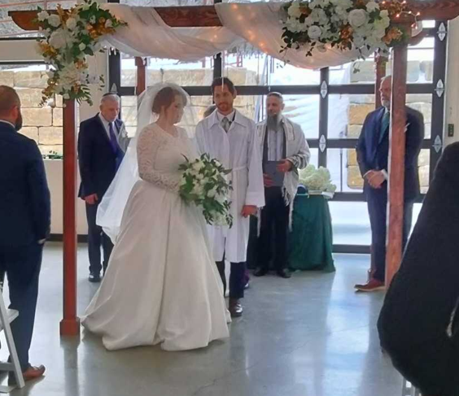
Welcome to newlyweds
Christopher and Kate Carrol!
Notes:
Circling the groom

Slide 5
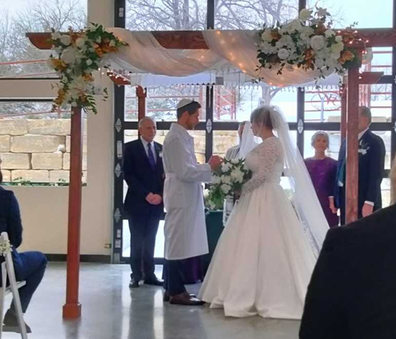
Notes:
ring

Slide 6
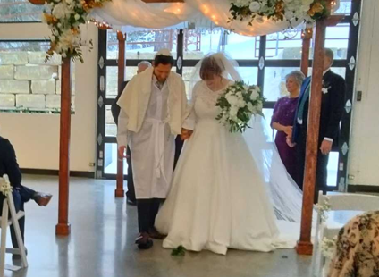
Notes:
Breaking the glass.

Slide 7

Notes:
#27

Slide 8
Jan. 21, 2025 night sky snapshot Six planets in an approximate line across the evening sky. Three are very bright, (Venus, Jupiter, Mars), and four are easily visible with just your eyes (add Saturn)
Notes:
Jan. 13: Full Moon

Slide 9
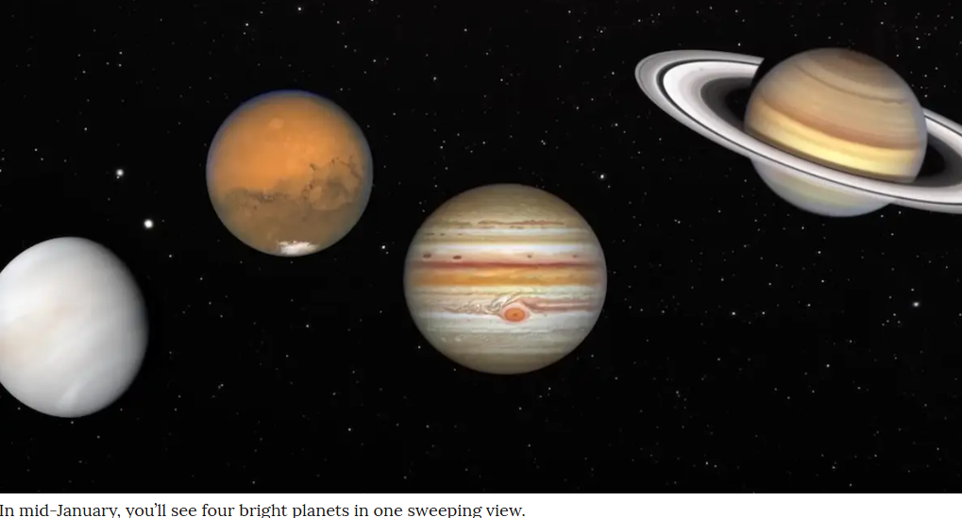
Late January
Four bright planets in one sweeping view.
Notes:
In mid to late January, 2025, you’ll see four bright planets in one sweeping view.
Jan. 13: Full Moon
Won’t look like the above, rather:

Slide 10
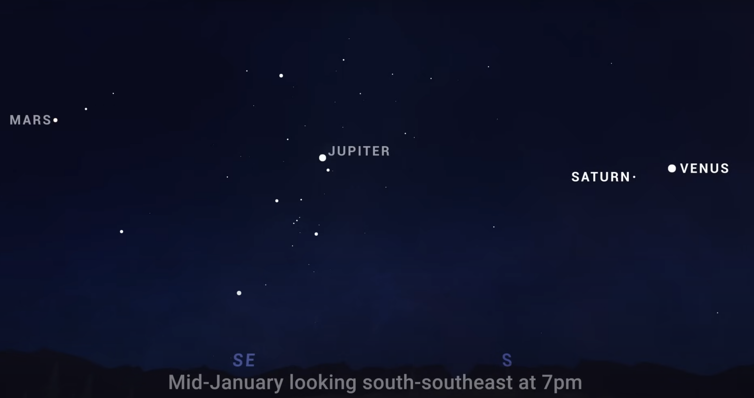

Slide 11
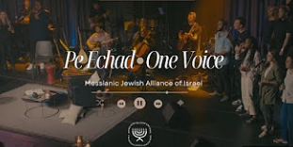
Notes:
I have taken to having several parts to my devotions.
Inspiring music, usually young Israeli Hebrew musicians. [I likely should have made Aliyah in my 20s, so my kids could have been some of these. I have a flautist, violinist, keyboardist, and trumpet player]
Confession
Reading 2 chapters Brit, 2 chapters Tanakh
Prayer list
One song I’ve been recently really enamored with, Pe Echad, has a section:

Slide 12
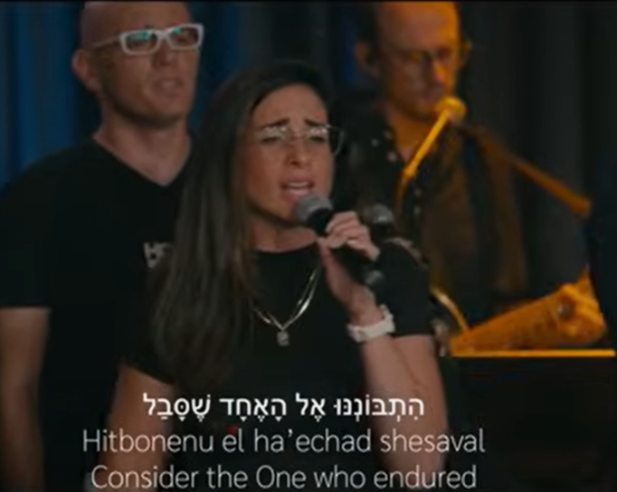
Notes:
https://www.youtube.com/watch?v=hBPl2214-jE
Rich resonant anointed contralto voice of Keren Silver.
Consider the One who endured, MJ 12.1

Slide 13
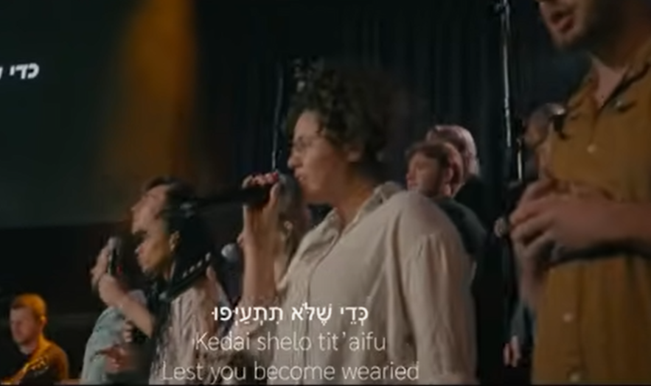
Notes:
https://www.youtube.com/watch?v=hBPl2214-jE
Lest you become wearied

Slide 14
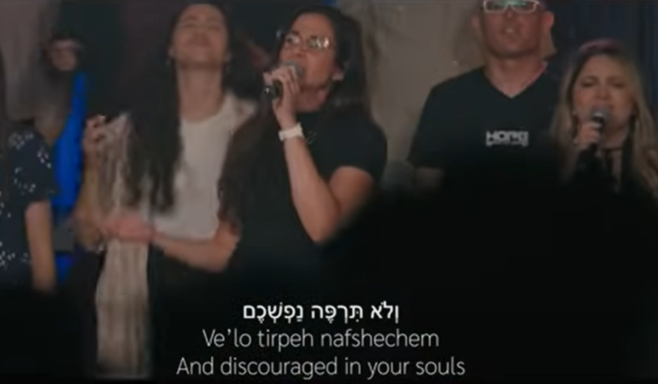
Notes:
https://www.youtube.com/watch?v=hBPl2214-jE
And discouraged in your souls.
The Ruakh seemed to be downloading that theme.

Slide 15
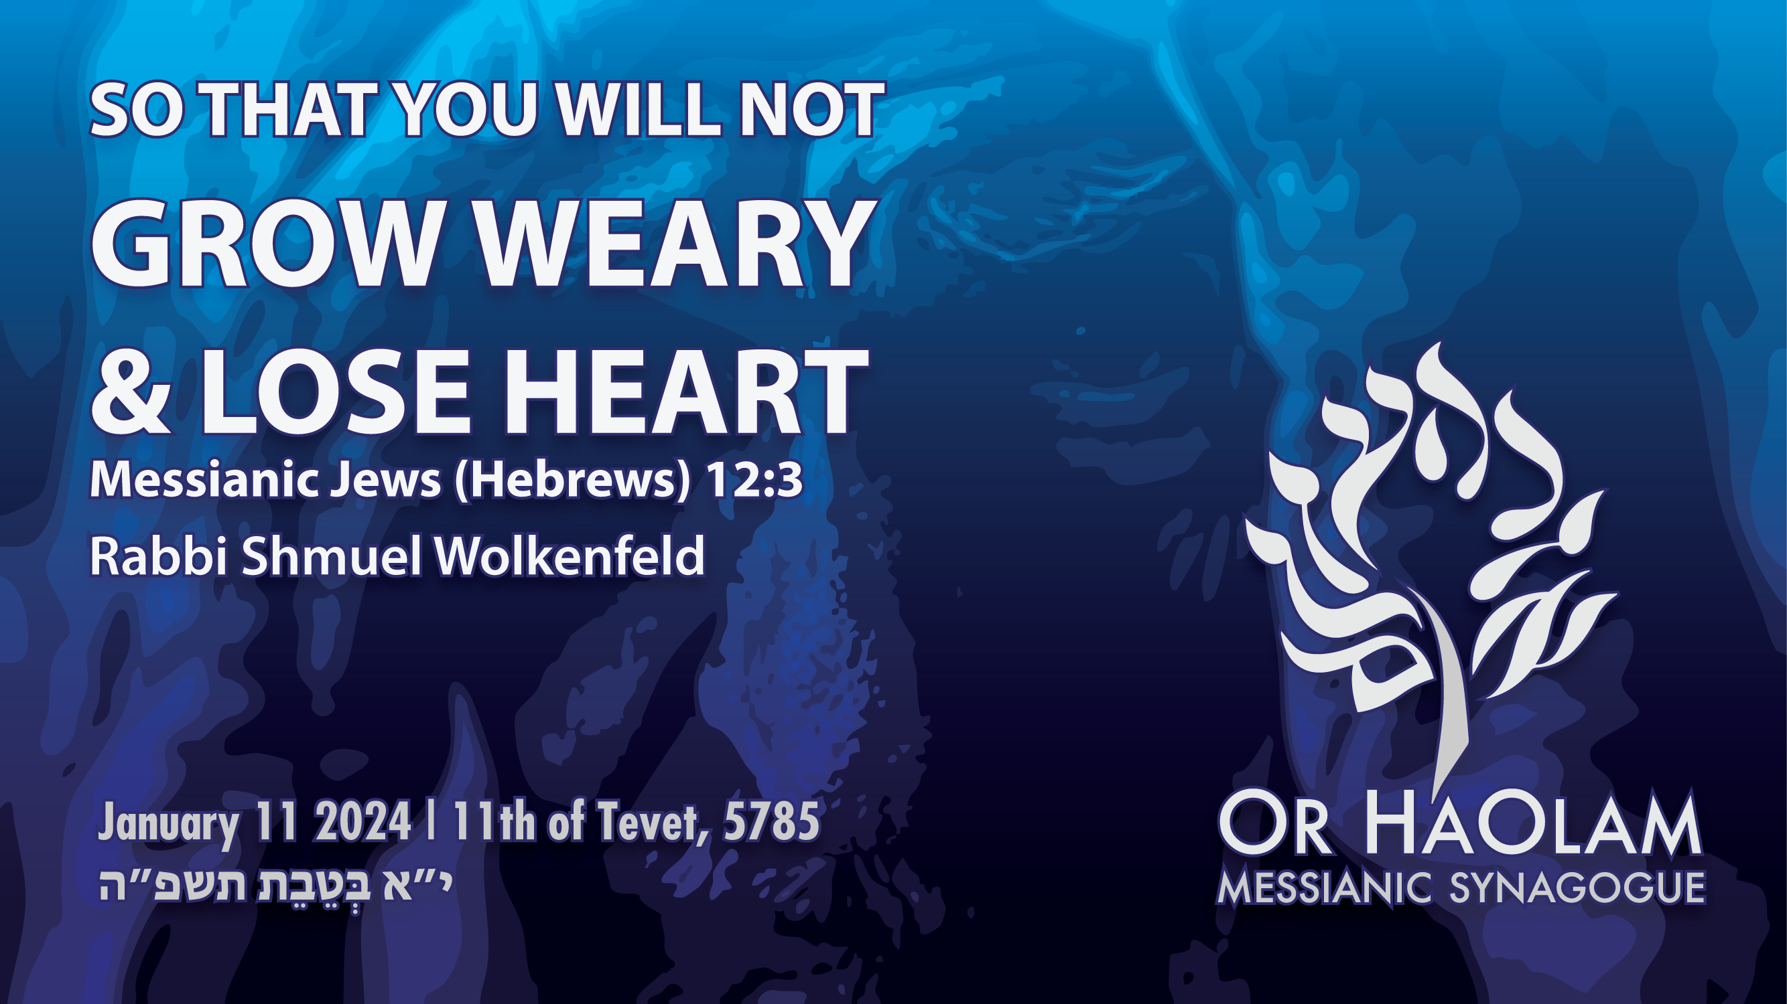

Slide 16
^{Mes Jews/Heb 12.1-3} Let us, too, put aside every impediment — that is, the sin which easily hampers our forward movement — and keep running with endurance in the contest set before us, looking away to the Initiator and Completer of that trusting,

Slide 17
^{Mes Jews/Heb 12.1-3} Yeshua — who, in exchange for obtaining the joy set before him, endured execution on a stake as a criminal, scorning the shame, and has sat down at the right hand of the throne of God.

Slide 18
^{Mes Jews/Heb 12.1-3} Yes, think about him who endured such hostility against himself from sinners, so that you won’t grow tired or become despondent.

Slide 19
^{Gal.6.9 CJB} So let us not grow weary of doing what is good; for if we don’t give up, we will in due time reap the harvest.
^{TLV} So let us not lose heart in doing good, for in due time we will reap if we don’t give up.

Slide 21

Not Grow Tired Or Despondent
Causes of despondency
Victory over despondency
Notes:
David Stern’s wording.

Slide 22
Not Grow Tired Or Despondent
Causes of despondency
Victory over despondency

Slide 23
despondent (adjective)
disheartened, discouraged, dispirited, downhearted, low-spirited, hopeless, downcast, cast down, crestfallen, down, low, disconsolate,

Slide 24
despondent (adjective)
despairing, wretched, oppressed, melancholy, gloomy, glum, morose, Eeyorish, doleful, dismal, woebegone, miserable, depressed, dejected, distressed
Notes:
Puddleglum Narnia Chronicles The Silver Chair
I felt the Ruakh wanted me to address anyone fighting with this.

Slide 25
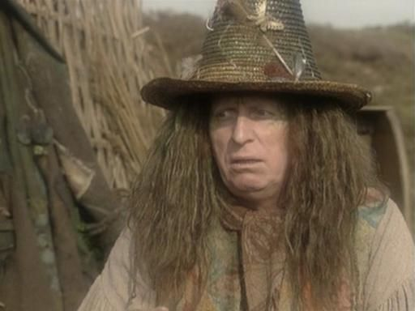
Notes:
Puddleglum Narnia Chronicles The Silver Chair

Slide 26
Theme of the Rabbi’s Conf that we just attended:
^{Yn 15.16} “You did not choose Me, but I chose you. I selected you so that you would go and produce fruit, and your fruit would remain.”
Notes:
What fruit?
Heart of despondence

Slide 27
“My fruit…!”
Children: unsaved, estranged
New births, new believers
Healing
Marriage distress
Other relational distress
Unanswered prayer
Notes:
Legacy children, leadership children here, many wonderful, but some wayward.
Last time we had a totally secular or rebellious person REPENT.
We’ve had wonderful healings, but some maybe not.
OH marriage failures. After a time, in the humdrum of life, he turns out to be less than the prince you thought. She…always is the Queen.
Family fractures, congregational fractures

Slide 28
Suffering abuse or pain
Loss of Loved One
Financial difficulty
Devastating storms
Violence in the land
Political unrest
Wars, Israeli wars: this one
Notes:
[Rabbi, you are making me discouraged.]

Slide 29
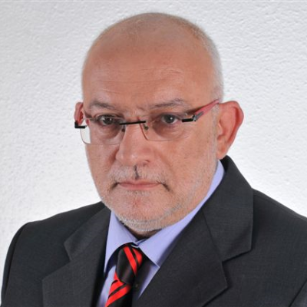
Yoni Ben Menachem a veteran Arab affairs and diplomatic commentator for Israel Radio and Television. He served as director general and chief editor of the Israel Broadcasting Authority.
Notes:
https://www.jns.org/hamas-recruits-thousands-of-fighters-in-gaza/?utm_campaign=Daily%20Syndicate%20Emails&utm_medium=email&_hsenc=p2ANqtz-8C7xTRVCyViBkY7cKZR55LMXmho85-bIisY3TxREH_EHbwz526Uf451KEFBGJs3xtR5u86y7cfLJqcl6I9o5Pd6wUOyw&_hsmi=102395356&utm_content=102395356&utm_source=hs_email

Slide 30
^{(Jan. 10, 2025 / JNS)} According to Israeli security officials, Hamas has recruited approximately 4,000 fighters over the past month. Currently, Hamas is estimated to have about 20,000 armed fighters in Gaza, along with a stockpile of
Notes:
https://www.jns.org/hamas-recruits-thousands-of-fighters-in-gaza/?utm_campaign=Daily%20Syndicate%20Emails&utm_medium=email&_hsenc=p2ANqtz-8C7xTRVCyViBkY7cKZR55LMXmho85-bIisY3TxREH_EHbwz526Uf451KEFBGJs3xtR5u86y7cfLJqcl6I9o5Pd6wUOyw&_hsmi=102395356&utm_content=102395356&utm_source=hs_email

Slide 31
scores of rockets that it sporadically launches into Israeli territory.
The Palestinian Islamic Jihad organization also retains about 4,000 armed fighters in the Strip.
Notes:
https://www.jns.org/hamas-recruits-thousands-of-fighters-in-gaza/?utm_campaign=Daily%20Syndicate%20Emails&utm_medium=email&_hsenc=p2ANqtz-8C7xTRVCyViBkY7cKZR55LMXmho85-bIisY3TxREH_EHbwz526Uf451KEFBGJs3xtR5u86y7cfLJqcl6I9o5Pd6wUOyw&_hsmi=102395356&utm_content=102395356&utm_source=hs_email

Slide 32
Hamas’s military recovery has allowed it to prolong its war of attrition against the IDF and adopt tougher stances in hostage negotiations.
The funds for this recruitment effort reportedly come from the sale of humanitarian aid packages, which Hamas seizes and resells in Gaza’s markets.

Slide 33
^{T’hillim/Ps 13} How long, Adoni? Will you forget me forever? How long will you hide your face from me? How long must I keep asking myself what to do, with sorrow in my heart every day? How long must my enemy dominate me?

Slide 34
^{T’hillim/Ps 13} Look, and answer me, Adoni my God! Give light to my eyes, or I will sleep the sleep of death. Then my enemy would say, “I was able to beat him”; and my adversaries would rejoice at my downfall.

Slide 35
^{2 Kefa/Pet 3.3-4} First, understand this: during the Last Days, scoffers will come, following their own desires and asking, “Where is this promised ‘coming’ of his? For our fathers have died, and everything goes on just as it has since the beginning of creation.”
Notes:
In the 70’s, I could scare people saying that now I’m driving this car, but could disappear any moment. Not so sure it would work now.

Slide 36
^{Mtt 25.5} “Now while the bridegroom was taking a long time, they all got drowsy and started falling asleep.
Notes:
Are we getting drowsy?

Slide 38
Not Grow Tired Or Despondent
Causes of despondency
Victory over despondency

Slide 39
Not Grow Tired Or Despondent
Causes of despondency
Victory over despondency
  Submit to pruning

Slide 40
^{Yn 15.2} Every branch that does bear fruit, he prunes, so that it may bear more fruit.
Tree weeps after pruning.
Next year 10x fruit
Notes:
Embrace whatever is being honed in your life whatever unsolvable difficulty. Rather than being discouraged, despondent, embrace it.
“ fixing our eyes on Yeshua, the pioneer and perfecter of faith.”

Slide 41

Notes:
https://www.drjamesdobson.org/marriage-parenting/finding-joy-in-the-cold-and-dark-times-episode-8-b
Similar to one I showed prev, but not the same.

Slide 42
Not Grow Tired Or Despondent
Causes of despondency
Victory over despondency
  Submit to pruning
  Seek divine heart burn
Notes:
David Levine at Rabbis Conf

Slide 43
^{Lk 24. 13-17} That same day, two of them were going toward a village about seven miles from Yerushalayim called Amma’us, and they were talking with each other about all the things that had happened. As they talked and discussed,

Slide 44
^{Lk 24. 14-17} Yeshua himself came up and walked along with them, but something kept them from recognizing him. He asked them, “What are you talking about with each other as you walk along?” They stopped short, their faces downcast…

Slide 45
^{Lk 24. 25-27} He said to them, “Foolish people! So unwilling to put your trust in everything the prophets spoke! 26 Didn’t the Messiah have to die like this before entering his glory?” 27 Then, starting with Moshe and all the prophets, he explained to them the things that can be found throughout the Tanakh concerning himself.

Slide 46
^{Lk 24. 30-32} As he was reclining with them at the table, he took the matzah, made the b’rakhah, broke it and handed it to them. Then their eyes were opened, and they recognized him.

Slide 47
^{Lk 24. 30-32}. But he became invisible to them. They said to each other, “Didn’t our hearts burn inside us as he spoke to us on the road, opening up the Tanakh to us?”

Slide 48
Daily HEARING,
שמע → heartburn, burning heart.
Notes:
“ fixing our eyes on Yeshua, the pioneer and perfecter of faith.”
Time and intimacy with the Bridegroom and Master.

Slide 50
Not Grow Tired Or Despondent
Causes of despondency
Victory over despondency
  Submit to pruning
  Seek divine heart burn
  Trust the Word

Slide 51
The Prophetic Word
This past summer there was an overwhelming feeling of heaviness and dread as we waited for the inevitable war with Hezbollah in Lebanon.
Notes:
https://www.tikkunglobal.org/post/miracles-and-wonders-israel-at-war
150,000 missiles 10x power of Hamas

Slide 52
The Prophetic Word
Israeli experts warned it would be incredibly difficult. Then in August, Oren, a teacher from Tiferet Yeshua, shared a prophetic word with the congregation’s leadership. Our elders prayed and felt it was from the Lord.
Notes:
https://www.tikkunglobal.org/post/miracles-and-wonders-israel-at-war

Slide 53
The Prophetic Word
“Do not fear war in the north. A great miracle is at hand that will strike the world with amazement…
Notes:
https://www.tikkunglobal.org/post/miracles-and-wonders-israel-at-war

Slide 54
The Prophetic Word
Do not be impressed by the balance of military might. Cease counting cannons, rocket launchers and armed fighters… My name will be on everyone’s lips when the overwhelming victory against all odds comes.”
Notes:
https://www.tikkunglobal.org/post/miracles-and-wonders-israel-at-war

Slide 55
September 17th Pagers, Sept 18 Cell phones; the entire Hezbollah communication infrastructure was crippled.
Sept 27 Nasrallah eliminated
Oct 17 Yahyah Sinwar eliminated.
Notes:
https://www.tikkunglobal.org/post/miracles-and-wonders-israel-at-war

Slide 56
When Israel’s ground forces entered southern Lebanon, they were surprised to find many Hezbollah command centers unmanned. A captured terrorist told the IDF that after Nasrallah's death most of them fled.
Notes:
https://www.tikkunglobal.org/post/miracles-and-wonders-israel-at-war

Slide 57
On one of Israel’s most viewed primetime news programs, a retired IDF colonel said this:
“As an expert on Hezbollah and Lebanon, I say if you were to put all the heads of Israel’s security agencies here and ask them, ‘Is there a chance that this might happen to Hezbollah in under a month?’
Notes:
https://www.tikkunglobal.org/post/miracles-and-wonders-israel-at-war

Slide 58
There would not be one who would honestly say that they would have imagined even half of what has happened is possible… [It is] not the result of man’s actions but the hand of God.”
Notes:
https://www.tikkunglobal.org/post/miracles-and-wonders-israel-at-war
“ fixing our eyes on Yeshua, the pioneer and perfecter of faith.”
Jackie Santoro newsletter:

Slide 59
Rachel Boskey reports: Nothing moves my heart as much as speaking to my friends about Yeshua, those who don't yet know Him personally. Some months ago I was walking in our town and met a lady I've known for 27 years.

Slide 60
She is not a Messianic believer. Her son and one of our sons were in the same class in their childhood. I asked her how she is handling the stress and emotional pain of our Israeli reality.

Slide 61
She said she's in a lot of pain, and I told her I am too. I then felt free and was urged to tell her that Messiah Yeshua is coming back to help Israel in the coming times of great trouble. She said immediately "He is? Then we have hope!" I was amazed by her response, as she is a very liberal Israeli ideologically.

Slide 62
She and I are most likely on opposite ends of the political spectrum. Yet her heart responded immediately to the name of Yeshua. She went on to say that she has always looked up to Yeshua, since her Holocaust survivor grandmother, who was an atheist, always told her that Yeshua was a good Jew.

Slide 63
Another remarkable event took place in the home of a close friend in our town. She asked Avner and I to lead a singalong concert in her home for a group of about 30 of her friends and family, ages 92 to 15 years old. She chose 14 well-known Israeli folk songs, all of them about the Negev. I spent a good bit of time learning and practicing those songs in preparation.

Slide 64
The long-time mayor of our town and his wife were there for the concert. My friend, totally on her own initiative, said she wanted to tell all of her guests about what we believe, and she asked us to help her explain to everyone who Messianic Jews are.

Slide 65
So I wrote five simple points about what we believe as Messianics in Israel. She read those five points to everyone who came to the gathering in her home -- among them were God's prophetic promises to Israel, salvation through faith in the Messiah's sacrifice, the Second Coming of Yeshua to Israel.

Slide 66
Israelis and Jews are People of the Book. [As national literature, Ben Gurion] About half of this nation would consider themselves conservative politically and living according to some measure of respect for religious tradition. The latest traumas have polarized the secular and conservative wings here more sharply.

Slide 67
Among more conservative Israelis, the terms 'Gog and Magog' and 'footsteps of the Messiah' are heard often in public media spheres. There is awareness here that we are witnessing unprecedented developments leading to events prophesied in the Hebrew scriptures.

Slide 69
Not Grow Tired Or Despondent
Causes of despondency
Victory over despondency
  Submit to pruning
  Seek divine heart burn
  Trust the Word
  Jonathan Cahn’s closing word
  at the Rabbi’s Conf

Slide 70
^{Rev 12.1-2} Now a great sign was seen in heaven — a woman clothed with the sun, under her feet the moon, and on her head a crown of twelve stars. She was pregnant and about to give birth, and she screamed in the agony of labor.

Slide 71
^{Rev 12.5-6} She gave birth to a son, a male child, the one who will rule all the nations with a staff of iron.[a] But her child was snatched up to God and his throne; and she fled into the desert, where she has a place prepared by God so that she can be taken care of for 1,260 days.

Slide 72
^{Rev 12.7-10} Next there was a battle in heaven — Mikha’el and his angels fought against the dragon, and the dragon and his angels fought back. But it was not strong enough to win, so that there was no longer any place for them in heaven.

Slide 73
^{Rev 12.7-10} The great dragon was thrown out, that ancient serpent, also known as the Devil and Satan [the Adversary], the deceiver of the whole world. He was hurled down to the earth, and his angels were hurled down with him.

Slide 74
^{Rev 12.10-11} Then I heard a loud voice in heaven saying, “Now have come the salvation and the power and the kingdom of our God and the authority of His Anointed One, for the accuser of our brothers and sisters—

Slide 75
^{Rev 12.10-11} the one who accuses them before our God day and night—has been thrown out. They overcame him by the blood of the Lamb and by the word of their testimony, and they did not love their lives even in the face of death.

Slide 76
Israel exists to give birth
To the Messiah, the Scriptures
To new life. First command, “Be fruitful and multiply.”
Only by intimacy with the Bridegroom, Moshe, David, Shaul
Love of Yeshua >> love of life
Notes:
Israel is pictured as a pregnant woman.

Slide 78
Not Grow Tired Or Despondent
Causes of despondency
Victory over despondency
  Submit to pruning
  Seek divine heart burn
  Trust the Word
  Jonathan Cahn’s closing word
  at the Rabbi’s Conf

Slide 79
^{Mes Jews/Heb 12.1-3} Let us run with endurance the race set before us, focusing on Yeshua, the initiator and perfecter of faith.

Slide 80
^{Mes Jews/Heb 12.1-3} Yeshua — who, in exchange for obtaining the joy set before him, endured execution on a stake as a criminal, scorning the shame, and has sat down at the right hand of the throne of God.

Slide 81
^{Mes Jews/Heb 12.1-3} Yes, think about him who endured such hostility against himself from sinners, so that you won’t grow tired or become despondent.
Notes:
“ fixing our eyes on Yeshua, the pioneer and perfecter of faith.”

