Slide 1
e-handout
To have these notes
without taking notes
Go to OrHaOlam.com
Click on Messages tab,
2024 Messages

Slide 2
Jan. 21, 2025 night sky snapshot Six planets in an approximate line across the evening sky. Three are very bright, (Venus, Jupiter, Mars), and four are easily visible with just your eyes (add Saturn)

Slide 3
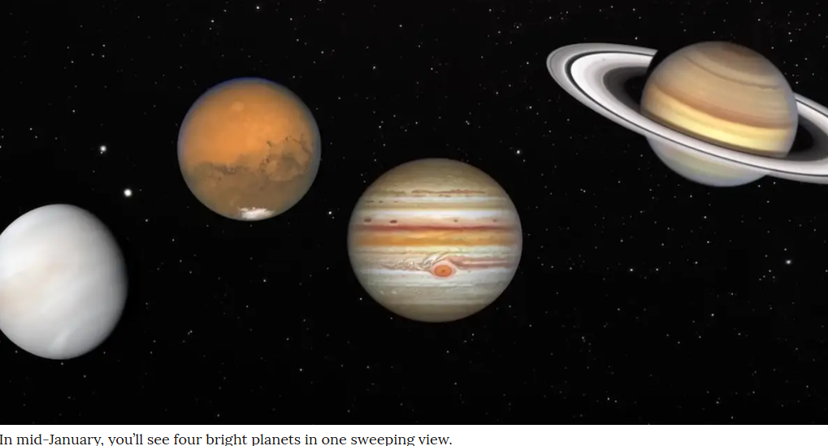
Late January
Four bright planets in one sweeping view.
Notes:
In mid to late January, 2025, you’ll see four bright planets in one sweeping view.
Jan. 13: Full Moon
Won’t look like the above, rather:

Slide 4
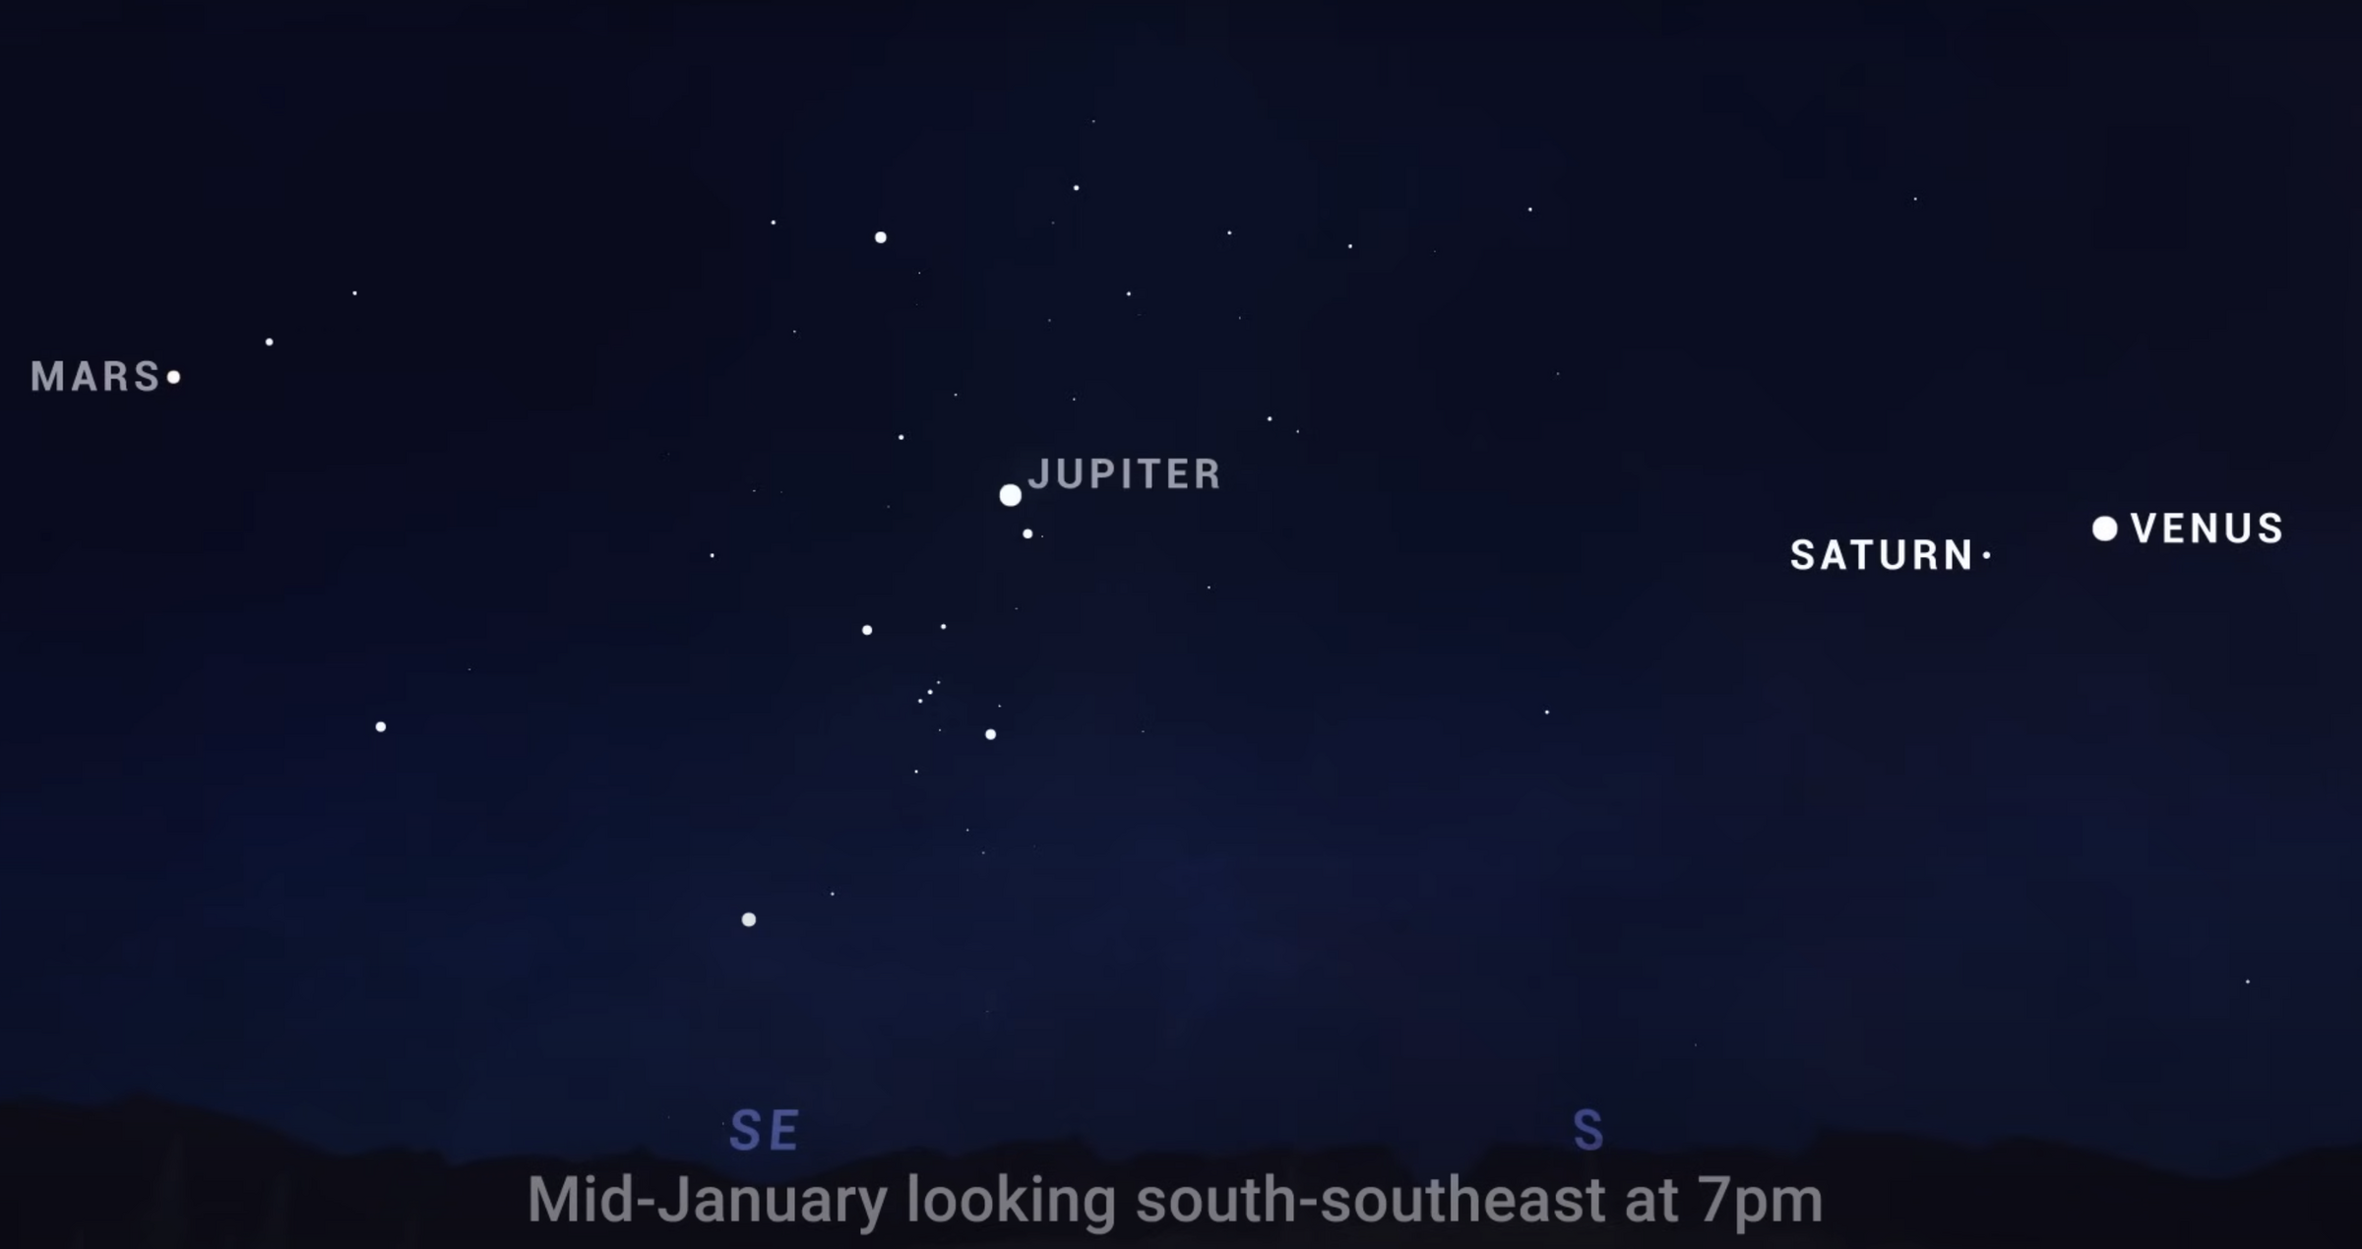
Notes:
Go outside and see and worship: “When I consider the heavens…”

Slide 5
I realize many of our congregants are single, and this next video may be a weird message. But count it as training for the future, or a prayer request for our couples.

Slide 6
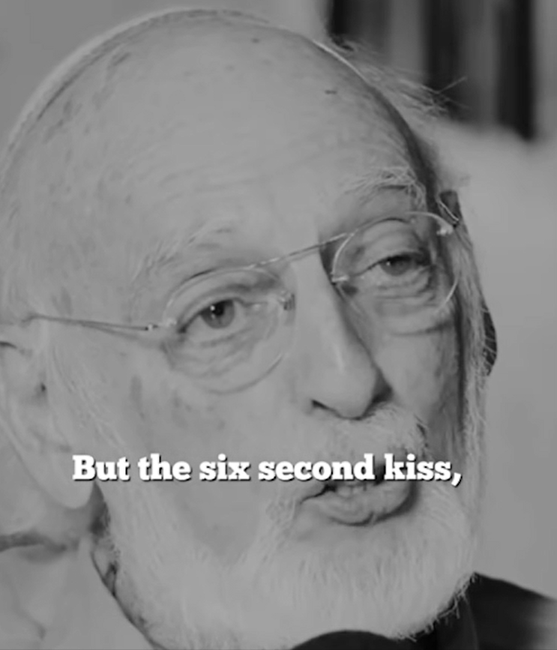
Dr. John Gottman teaches on the six second kiss.
Notes:
https://www.instagram.com/reel/DDpqHk6T0sT/?igsh=b3l6ZW9tOXQwbjBy

Slide 7
Intimacy with G-d

Slide 8
^{T’hillim / Ps 27.4} One thing have I asked of Adoni, that will I seek: to dwell in the House of Adoni all the days of my life, to behold the beauty of Adoni, and to meditate in His Temple.

Slide 9
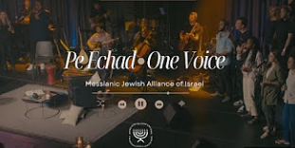
Notes:
https://youtu.be/hBPl2214-jE
One song I’ve been recently really enamored with, mentioned last week: Pe Echad, has another section:

Slide 10
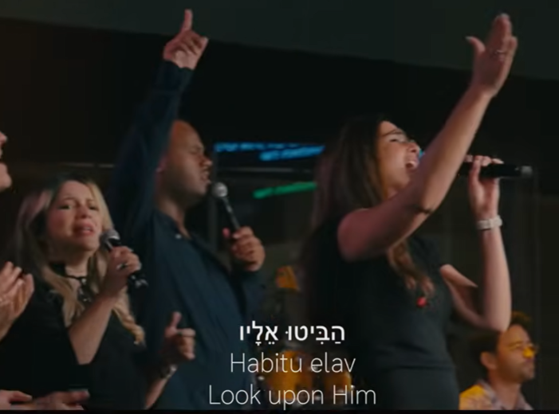
Look upon Him
הביטו אליו
Habitu elav
Notes:
https://www.youtube.com/watch?v=hBPl2214-jE
Keren Silver is the wife of Stefan Silver, who has spoken at Or HaOlam, who works for Evan Liberman Wise Money Israel

Slide 11
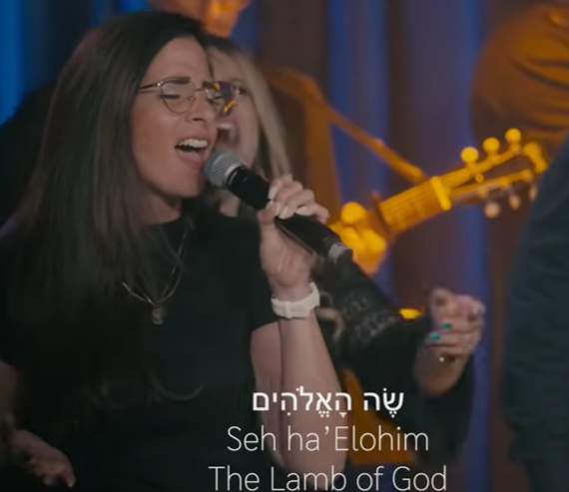
The Lamb of G-d
Notes:
https://www.youtube.com/watch?v=hBPl2214-jE

Slide 12
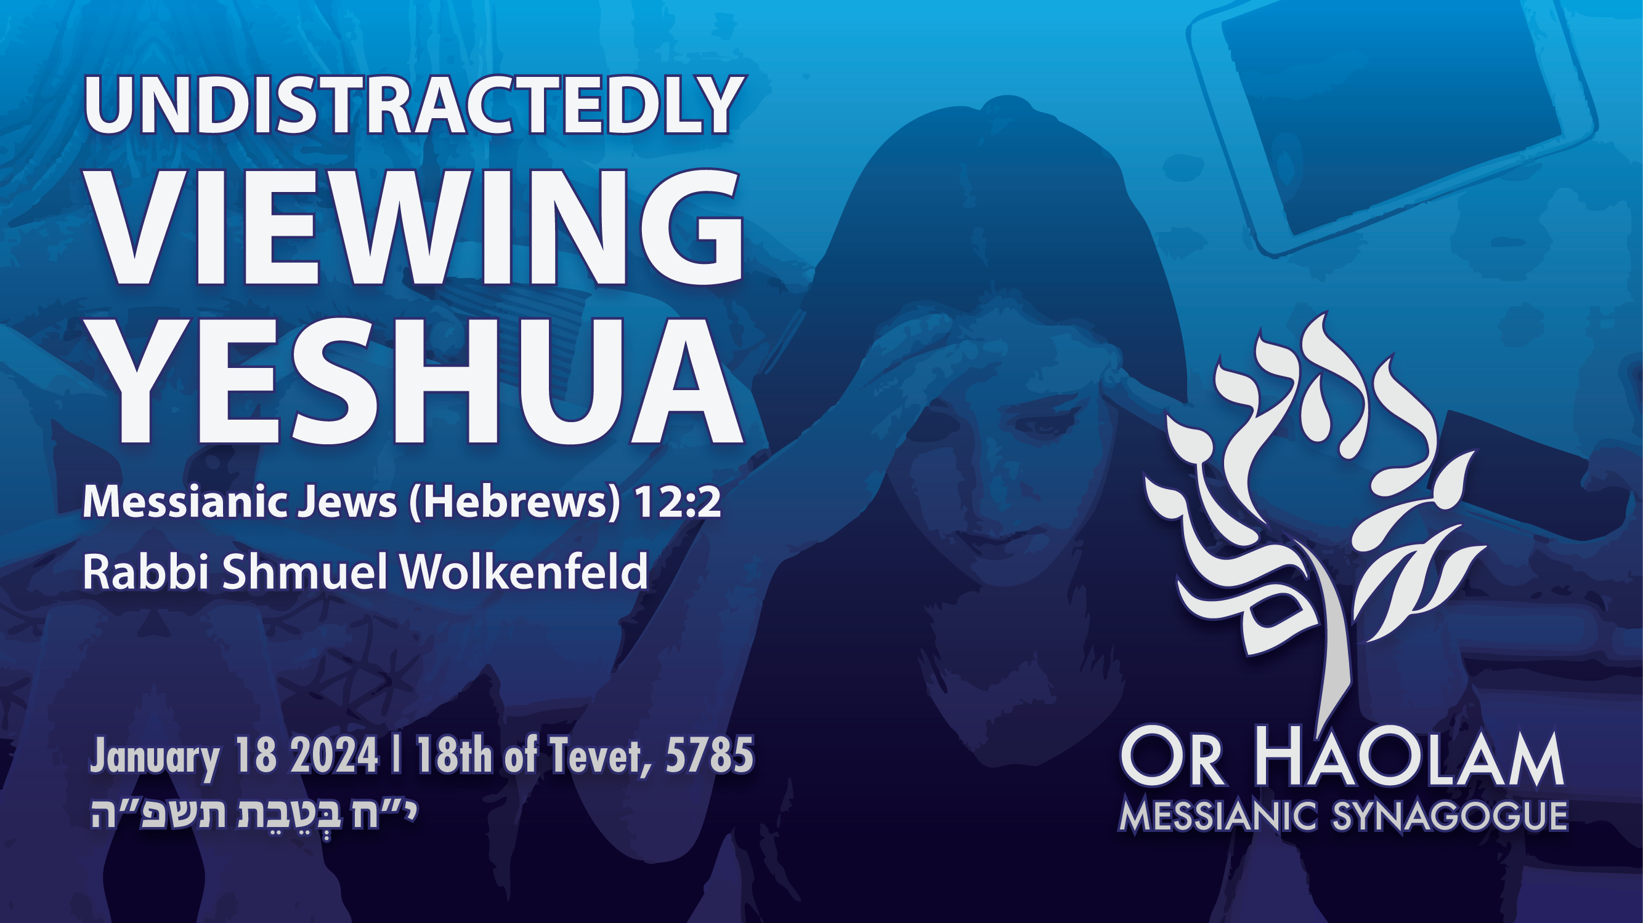

Slide 13

Undistactedly Viewing Yeshua
Mes Jews 12.2
Importance of Looking to Him
Word study
Context
What we see
Effect

Slide 14
Undistactedly Viewing Yeshua
Mes Jews 12.2
Importance of Looking to Him
Word study
Context
What we see
Effect

Slide 15
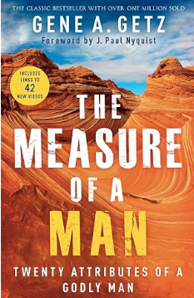
Gene Getz was interviewed on James Dobson Family Talk recently on his classic book on
re-parenting adult men.
Notes:
Many men have no idea of fatherhood. Many women too!
Who do we rely on, look to, if no father?

Slide 17
Undistactedly Viewing Yeshua
Mes Jews 12.2
Importance of Looking to Him
Word study
Context
What we see
Effect

Slide 18
^{Messianic Jews/Heb 12.2} Looking away ἀφορῶντες (aphorōntes) to Yeshua, the Initiator and Completer of that trusting, — who, in exchange for obtaining the joy set before him, endured execution on a stake as a criminal, scorning the shame, and has sat down at the right hand of the throne of God

Slide 19

ἀφορῶντες (aphorōntes)

Slide 20
Yeshua

Slide 21
ἀφορῶντες (aphorōntes)
To look away from all else at one object, to fix one's eyes upon.
Meaning: I look away from (something else) to, see distinctly.
Word Origin: From the Greek preposition ἀπό (apo, meaning "from") and the verb ὁράω (horao, meaning "to see" or "to look").
Notes:
https://biblehub.com/greek/872.htm

Slide 22
Usage: The verb ἀφοράω (aphoraó) is used in the Messianic Scriptures to describe the act of focusing one's attention or gaze exclusively on a particular object or person,
Notes:
https://biblehub.com/greek/872.htm

Slide 23
often implying a deliberate turning away from other distractions. It conveys a sense of concentration and intent focus, often in a spiritual or moral context.
Notes:
https://biblehub.com/greek/872.htm

Slide 24
Cultural and Historical Background: ἀφορῶντες (aphorōntes)
The concept of focusing one's gaze or attention was often associated with discipline and purpose. Philosophers and teachers would encourage students to concentrate on virtuous living and the pursuit of wisdom.
Notes:
https://biblehub.com/greek/872.htm

Slide 25
Cultural and Historical Background: In the context of the Messianic Scriptures, this term is used to encourage believers to maintain their focus on Messiah, amidst the distractions and challenges of life.
Notes:
https://biblehub.com/greek/872.htm

Slide 26
^{Amp} [looking away from all that will distract us and] focusing our eyes on Yeshua
^{CSB} keeping our eyes on Yeshua,
^{CEB} and fix our eyes on Yeshua,
^{DARBY} looking stedfastly on Yeshua

Slide 27
^{EASY} As we run, we must always look towards Yeshua
^{MOUNCE} fixing our gaze upon Yeshua

Slide 28
^{Messianic Jews/Heb 12.2} Looking away ἀφορῶντες (aphorōntes) to Yeshua, the Initiator and Completer of that trusting, — who, in exchange for obtaining the joy set before him, endured execution on a stake as a criminal, scorning the shame, and has sat down at the right hand of the throne of God
Notes:
His initiative, redemption of us, in our quagmire.
Finisher: He won’t forsake us, despite our imperfections.
Joy? Of our redeemed company with Him.
Embarrassed?
Right hand, from Ps 110, divine royalty.
Dr. Stuart Sacks Hebrews thru a Hebrew’s Eyes p 93
Newell 402

Slide 30
Undistactedly Viewing Yeshua
Mes Jews 12.2
Importance of Looking to Him
Word study
Context
What we see
Effect

Slide 31
^{Yeshayahu/Is 6.1-6} In the year of King Uzziah’s death, I saw Adoni sitting on a throne, high and lifted up, and the train of His robe filled the Temple. Seraphim were standing above Him. Each had six wings: with two he covered his face and with two he covered his feet, and with two he flew.

Slide 32
^{Yeshayahu/Is 6.1-6} One called out to another, and said:
“Holy, holy, holy, is Adoni -Tzva’ot! The whole earth is full of His glory.” Then the posts of the door trembled at the voice of those who called, and the House was filled with smoke.
Notes:
This is Yeshua, according to Yn 12

Slide 33
^{Yeshayahu/Is 6.1-6} Then I said: “Oy to me! For I am ruined! For I am a man of unclean lips, and I am dwelling among a people of unclean lips. For my eyes have seen the King, Adonai-Tzva’ot!”
Notes:
Effect on us!

Slide 34
^{Yeshayahu/Is 6.1-6} Then one of the seraphim flew to me, with a glowing coal in his hand, which he had taken with tongs from the altar. He touched my mouth with it and said: “Behold, this has touched your lips. Your iniquity is taken away, and your sins atoned for.”
Notes:
Go!!

Slide 35
^{T’hillim / Ps 27.4} One thing have I asked of Adoni, that will I seek: to dwell in the House of Adoni all the days of my life, to behold the beauty of Adoni, and to meditate in His Temple…In His Tabernacle I will offer sacrifices with shouts of joy. I will sing, yes, sing praises to Adoni.
Notes:
Beauty and joy!!

Slide 36
^{Revelation 1.12-16} When I had turned, I saw seven gold menorahs; and among the menorahs was someone like a Son of Man, wearing a robe down to his feet and a gold band around his chest. His head and hair were as white as snow-white wool,

Slide 37
^{Revelation 1.12-16} his eyes like a fiery flame, his feet like burnished brass refined in a furnace, and his voice like the sound of rushing waters. In his right hand he held seven stars, out of his mouth went a sharp double-edged sword, and his face was like the sun shining in full strength.

Slide 38
^{Song of Songs 5.10-16} The man I love is radiant and ruddy; he stands out among ten thousand.
His head is like the finest gold;
his locks are wavy and black as a raven.
His eyes are like doves by running streams, bathed in milk and set just right.

Slide 39
^{Song of Songs 5.10-16} His cheeks are like beds of spices, like banks of fragrant herbs.
His lips are like lilies dripping with sweet myrrh.
His arms are rods of gold set with beryl,
his body polished ivory adorned with sapphires.

Slide 40
^{Song of Songs 5.10-16}
His legs are like pillars of marble
set on bases of pure gold.
His appearance is like the L’vanon,
as imposing as the cedars.

Slide 41
^{Song of Songs 5.10-16}
His words are sweetness itself; he is altogether desirable.
This is my darling, and this is my friend, daughters of Yerushalayim.

Slide 42
^{Mes Jews /Heb 12.2} Looking away to the Initiator and Completer of that trusting, Yeshua — who, in exchange for obtaining the joy set before him, endured execution on a stake as a criminal, scorning the shame, and has sat down at the right hand of the throne of God.

Slide 44
Undistactedly Viewing Yeshua
Mes Jews 12.2
Importance of Looking to Him
Word study
Context
What we see
Effect

Slide 45
^{2 Cor 4.6} For it is the God who once said, “Let light shine out of darkness,” who has made his light shine in our hearts, the light of the knowledge of God’s glory shining in the face of the Messiah Yeshua.

Slide 46
^{2 Cor 3.18} So all of us, with faces unveiled, see as in a mirror the glory of the Lord; and we are being changed into his very image, from one degree of glory to the next, by Adoni the Spirit.

Slide 47
Some Or HaOlamniks
Expression of
ἀφορῶντες (aphorōntes)
Looking away to Yeshua

Slide 48
From Joy Burlison Looking to Yeshua, focusing on Yeshua; it's such a simple concept yet one that everyday I find I must remind myself.. in all situations, He is enough; anything more can become an idol. In the past, when I was worried about my son, I looked outside of Yeshua.

Slide 49
From Joy Burlison Later I confessed to my son I had acted outside of faith; that started healing the past. I daily face a medical diagnosis I was given years ago & the potential outcome. Every time I think about the possibilities, I realize I need to look to Yeshua in trust & that brings me back to shalom;

Slide 50
From Joy Burlison He is the highest authority over my health ups & downs. I love that He is the initiator & perfecter of faith, giving me hope as I intercede with Him for others, which is my greatest desire for humanity.. to look to Yeshua. May we live in a way that points to our Beloved.

Slide 51
From Ulises Acosta Yeshua is the one we must follow and imitate because HE is not only the way to end our pilgrimage but our example on how to get there. Just as our heroes in chapter 11 suffered and saw miracles, He suffered and did miracles. Just as they lived, we must live also.

Slide 52
From Ulises Acosta. It is not an easy race, perseverance, endurance in trust is required, and that is why we need to consider Yeshua’s example, his humility endurance of the cross. That is why we must keep our eyes on Him, He is our example, the only one we must follow in this race, till we leave these temporary tents.

Slide 53
From Ulises Acosta. Yeshua Mashiach overcame depravity, weakness, illness, all the consequences of death, the victory that enables us to reach what was promised depends on following Him with close attention, this requires our effort and concentration.

Slide 54
From Jim Adler
The TLV refers to it as “focusing on Yeshua,” as we “run the race set before us.”
To me that means that as we endure the hurdles and obstacles and challenges in our life, we should always keep our gaze on Yeshua the perfector of our faith.

Slide 55
Jim Adler
We should put our trust in Him when we are enduring a financial hardship, an emotional hardship, a physical hardship, or any challenge.

Slide 56
Jim Adler
I have found it when I am experiencing such a challenge that my first look is not always to Him, but my eventual look is and when I do, He gives me peace amidst the storms of life and often times removes the challenge or works it for good. It may not happen as quick as I would like, but it does happen God‘s perfect timing.

Slide 57
Jim Adler
You have all heard me speak of my back going out so I couldn’t go hiking in Yosemite in the redwood forest and when I came back, I realized I had pretty bad coronary artery disease and needed six

Slide 58
heart bypasses. If my back not gone out and I’ve gone hiking. I probably would’ve died. Similarly, recently when I needed lower back surgery, I needed cardiac clearance so they did a CAT scan on my carotid arteries and found that one of them was severely narrowed and needed surgery.

Slide 59
Jim Adler
Had my back not gone out the narrowed carotid artery would not have been diagnosed, and I might’ve had a stroke. More recently, I was experiencing some pain after the back surgery and we were going to the ER at the suggestion of the

Slide 60
Jim Adler
on-call physician’s assistant, and when I went to get a jacket out of the closet, I found that the ice on the roof was melting in a peculiar way and dripping on our clothes. Fortunately, we caught it soon and our clothes barely got damp.

Slide 61
Jim Adler In these instances, I did not always have my gaze on Him, but He let me know He was watching over me. These serve as reminders to trust Him.

Slide 62
Other testimonies

Slide 63
"Revival, above everything else, is a glorification of the Lord Yeshua the Messiah, the Son of God. It is the restoration of Him to the centre of the life of the congregation. . . It leads to our hymns, our anthems of praise: Messiah the centre." (D. Martyn Lloyd-Jones)
Notes:
FROM THE LINE OF FIRE: here is an excerpt from Dr. Brown's 1995 book, From Holy Laughter to Holy Fire: America on the Edge of Revival, from the chapter, “Jesus, the Pearl of Great Price, the Center of Revival”. . .

Slide 64
More than 100 years ago, a couple went to hear a famous preacher in London one Sunday morning. As they left the building, the husband exclaimed, “Oh, what a wonderful preacher!”

Slide 65
That night, they went to hear Spurgeon. When they left that service, the husband exclaimed, “Oh, what a wonderful Savior!” May all our teaching and preaching and living and giving and serving and doing draw people’s attention to Him.

Slide 66
"Revival is a new discovery of Yeshua." (James S. Stewart)

Slide 67
I now have the privilege and joy of boasting about Yeshua, my best Friend, my Savior and Lord, my Master and King, the Messiah, the Anointed One, the Messiah, the Son of the living God, the Alpha and the Omega, the Beginning and the End, the Author and Finisher of our faith,

Slide 68
the Vine, the Bread of Life, the Water of Life, the Way, the Truth, and the Life, the only Gate, the Good Shepherd, the Great Shepherd, the Chief Shepherd, the Lily of the Valley, the Fairest of Ten Thousand, the Word of God, the I Am. There is none like my Lord!

Slide 69
He is the Image of the invisible God, the Ruler of all Creation, the Firstborn from the dead, the King of kings and the Lord of lords, the One who holds all things together by His powerful word. He is Yeshua, my closest and most wonderful Friend. He alone is worthy of praise!

Slide 70
To this day, men and women gladly suffer for Him, surrender all for Him, even die for Him— joyfully!— because in Him, they have everything they need; in Him, they have discovered perfect Love; in Him, they have found what their souls longed for; in Him, they have met God! Why shouldn’t they gladly leave homes,

Slide 71
jobs, possessions, riches, and reputation in exchange for fellowship with Him? Why shouldn’t they say with Paul, “I consider everything a loss compared to the surpassing greatness of knowing Messiah Yeshau my Lord, for whose sake I have lost all things. I consider them rubbish, that I may gain Messiah.” ^{Phil 3:8.}

Slide 72
Why shouldn’t they follow the example of Moshe, “[who] regarded disgrace for the sake of Messiah as of greater value than the treasures of Egypt, . . . [who] persevered because he saw Him who is invisible” ^{(Mes Jews/Heb. 11:25-26)}?

Slide 73
In the diary of 21 year old Robert Murray M’Cheyne, this entry is found, dated February 23, 1834: “Rose early to seek God, and found Him whom my soul loveth. Who would not rise early to meet such company?”

Slide 74
Would you rise early if you were sure would find Him too? Can you live without His presence and smile?
The seventeenth century Puritan, Samuel Rutherford, could not: “A long time out of Messiah’s glorious presence is two deaths and two hells for me. We must meet. I am not able to do without Him.”

Slide 75
A radical, sold-out missionary to the Mexican Indians told this story in April of 1993. An Indian came home one day after working in the fields. When his wife offered him dinner, he told her he wasn’t feeling well. Then he collapsed in a chair and died.

Slide 76
His wife rushed out and gathered together some other believers— including one of the town leaders, who was also a believer. When they prayed for her husband, he was raised back to life. The missionary, who has seen others raised from the dead, went to talk with him about his experience.

Slide 77
The little Indian sat and quietly related what happened. Then my friend asked him— as he asks everyone who has been resurrected, “What did you see?” Suddenly the man sprang to his feet and began to jump up and down exclaiming over and over and over:

Slide 78
“I saw the I Am! I saw the I Am! I saw the I Am!” He is the Resurrection and the Life!

Slide 79
When you see the I AM— in all His glory and splendor and beauty and power— you will never be the same. When you come into intimate, personal contact with Him, you will be changed. He is YESHUA. He wants to be your Friend! He is a Lord like no other lord and a Master like no other master.

Slide 80
Those who know Him love to do His will. They count suffering for Him to be a privilege, sacrificing for Him to be a joy, and dying for Him to be an honor. His yoke is easy and His burden is light. His smile is better than a billion dollars. His favor is worth more than all the praises human lips can offer.

Slide 81
Press in to Him, experience Him, embrace Him.
He is your life and the very substance of your being.

Slide 82
^{Messianic Jews/Heb 12.2} Looking away ἀφορῶντες (aphorōntes) to Yeshua, the Initiator and Completer of that trusting, — who, in exchange for obtaining the joy set before him, endured execution on a stake as a criminal, scorning the shame, and has sat down at the right hand of the throne of God

Slide 83
When we dance…look to Him.
Notes:
Envision Him in the midst…dancing with us. I’m not just clumsy at dance, I’m focusing on the words and offering them to G-d for myself and my children. Like David, dancing before Adoni.
Accuser will bring distractions. Who is absent. What problem to solve…
Focus, look away from distraction, receive the Blood atonement covering.

Slide 84
When we dance…look to Him.
When we sing…look to Him.
Notes:
Therefore raise hands…engage with Him when singing.
Focus, look away from distraction, receive the Blood atonement covering.

Slide 85
When we dance…look to Him.
When we sing…look to Him.
When we drive…look at the road, and Him.

Slide 86
When we dance…look to Him.
When we sing…look to Him.
When we drive…look at the road, and Him.
When we interact with people… look to Him for love and wisdom.
Notes:
Focus, look away from distraction, receive the Blood atonement covering.

Slide 87
When we dance…look to Him.
When we sing…look to Him.
When we drive…look at the road, and Him.
When we interact with people… look to Him for love and wisdom.
When we work…look to the work, and Him.

Slide 88
When you are lonely, look to Him.

Slide 89
When you are lonely, look to Him.
When you are depressed, look to Him.

Slide 90
When you are lonely, look to Him.
When you are depressed, look to Him.
When you sin, look to Him.

Slide 91
When you are lonely, look to Him.
When you are depressed, look to Him.
When you sin, look to Him.
When you are doing your taxes, look to Him.

Slide 92
When you are lonely, look to Him.
When you are depressed, look to Him.
When you sin, look to Him.
When you are doing your taxes, look to Him.
When facing war, look to Him.
Notes:
Daniel Pipes: Trump dispatched private citizen and future presidential envoy Steven Witcoff to read Netanyahu the riot act. A report in Ha'aretz tells how Witcoff compelled Netanyahu to break the Sabbath for a meeting in which he was forced "to accept a plan that [he] had repeatedly rejected over the past half year."
This new, aggressive approach, Ran Porat of Monash University explains, obliged Netanyahu "to recalculate his positions, seeking to appease Trump." In an unexpected irony, Sanam Vakil of Chatham House notes "the Biden administration proved unwilling to exert adequate pressure over Israel's leadership" but Trump did. Netanyahu stood up to timid President Joe Biden but acquiesced to cowboy Donald Trump.

Slide 93
^{Messianic Jews/Heb 12.2} Looking away ἀφορῶντες (aphorōntes) to Yeshua, the Initiator and Completer of that trusting, — who, in exchange for obtaining the joy set before him, endured execution on a stake as a criminal, scorning the shame, and has sat down at the right hand of the throne of God

Slide 95
Undistactedly Viewing Yeshua
Mes Jews 12.2
Importance of Looking to Him
Word study
Context
What we see
Effect

