Slide 1
e-handout
To have these notes
without taking notes
Go to OrHaOlam.com
Click on Messages tab,
2025 Messages

Slide 2
Many of you have hear of my intense dissatisfaction with the current Hamas ceasefire: For each female civilian hostage released, the deal stipulates that Israel will free 30 Palestinian prisoners, while 50 prisoners are to be released for each female IDF soldier. But here is a very workable idea:
Notes:
https://worldisraelnews.com/israel-accepts-4-hostages-despite-hamas-violating-deal/
Hamas released four Israeli hostages in Gaza early Saturday in exchange for 200 Palestinian prisoners to be released later in the day.

Slide 3
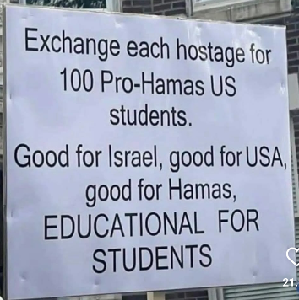

Slide 5
December & end of 2024 financial news:
donations:
$ 74,759 tithes for December
$ 4,741 designated offerings & misc/less reserves
less expenses:
$ 36,057

Slide 6
$43,443 December adjusted net surplus
$16,621 2024 adjusted net surplus

Slide 7
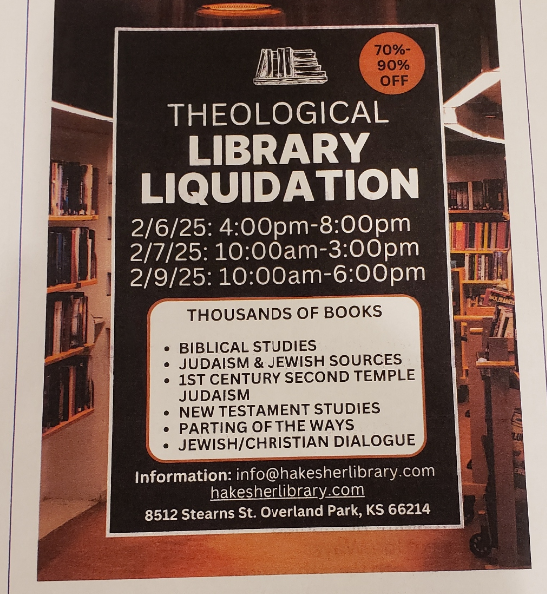

Slide 8
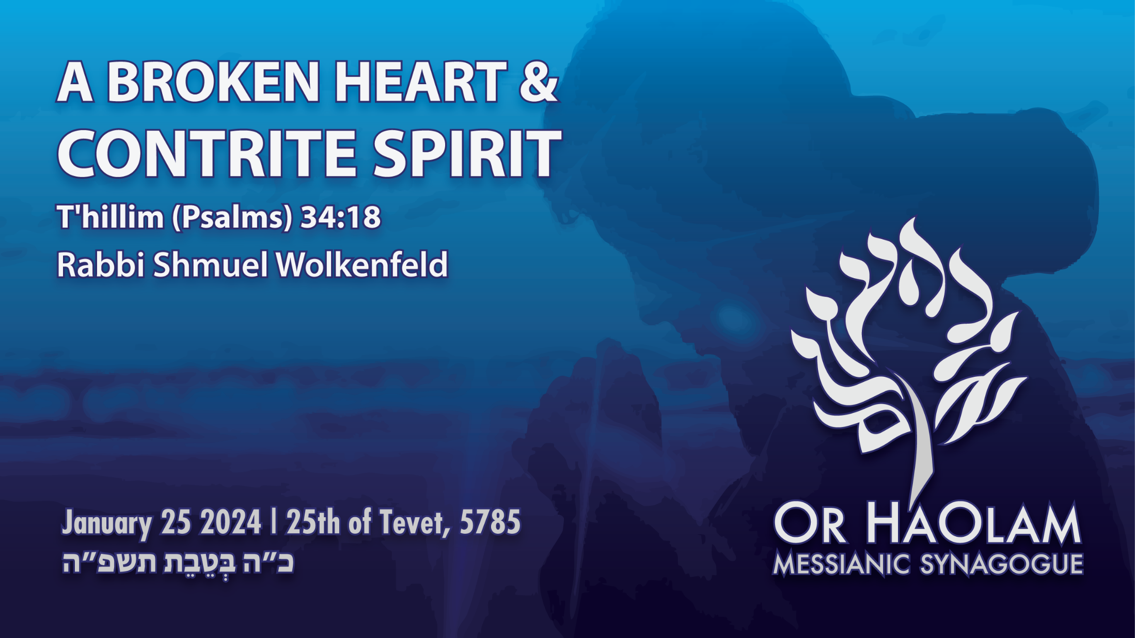

Slide 9

T'hillim-Ps 34.18 A broken heart
and contrite spirit
Int. Holocaust Remembrance Day
Tubingen MoR Response
Broken Heart, Contrite Spirit
Conditions today
Our Calling

Slide 10
T'hillim-Ps 34.18 A broken heart
and contrite spirit
Int. Holocaust Remembrance Day
Tubingen MoR Response
Broken Heart, Contrite Spirit
Conditions today
Our Calling

Slide 11
^{T’hillim/Ps 34.18} Adoni is near those with broken hearts; he saves those whose spirit is crushed.

Slide 12
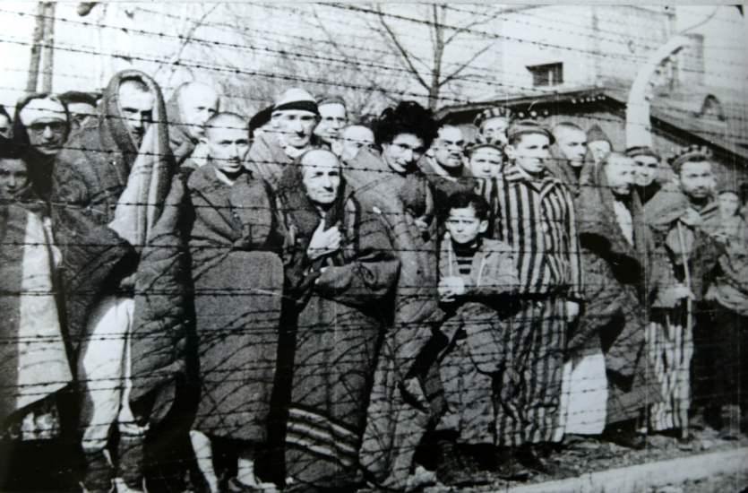
Newly liberated prisoners at
Auschwitz, 1945
Notes:
https://en.wikipedia.org/wiki/Liberation_of_Auschwitz_concentration_camp

Slide 13
On 27 January 1945, Auschwitz — a Nazi concentration camp and extermination camp in occupied Poland where more than a million people were murdered — was liberated by the Soviet Red Army. Most of the prisoners had been forced onto a death march, about 7,000 had been left behind.
Notes:
https://en.wikipedia.org/wiki/Liberation_of_Auschwitz_concentration_camp

Slide 14
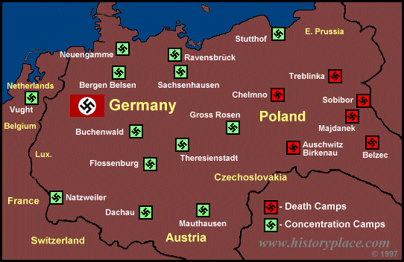

Slide 15
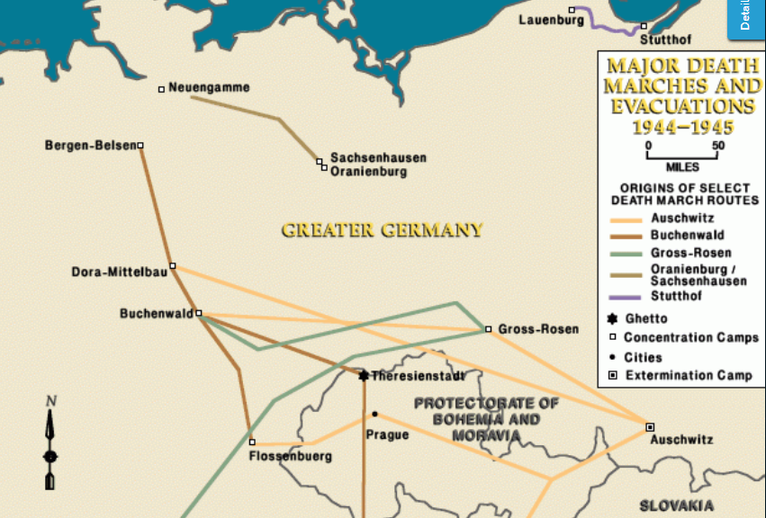
Notes:
Peter Loth was at Stuttof

Slide 16
The majority of those left behind were middle-aged adults or children younger than 15. Red Army soldiers also found 600 corpses, 370,000 men's suits, 837,000 articles of women's clothing, and 7.7 tons of human hair.

Slide 17
Red Army general Vasily Petrenko, commander of the 107th Infantry Division, remarked, “I who saw people dying every day was shocked by the Nazis’ indescribable hatred toward the inmates who had turned into living skeletons.

Slide 18
The battle hardened Soviet soldiers attempted to help the survivors and were shocked at the scale of Nazi crimes. The date is now recognized as International Holocaust Remembrance Day.
Notes:
https://en.wikipedia.org/wiki/Liberation_of_Auschwitz_concentration_camp

Slide 19
The anniversary of the date of the liberation, Jan. 27, 1945, is recognized by the United Nations and the European Union as International Holocaust Remembrance Day.

Slide 20

Notes:
https://th.bing.com/th/id/OIP.ZUoG59u5ZyL1KmsG_AajVAHaHa?rs=1&pid=ImgDetMain

Slide 21
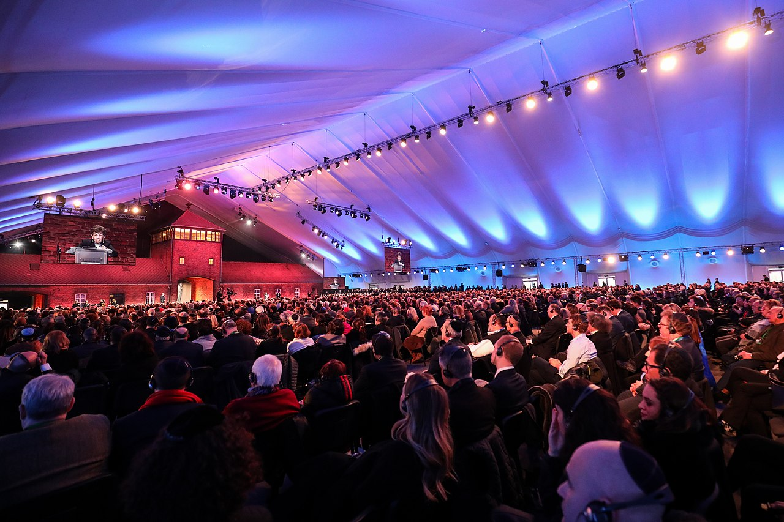
January 27, 2020, over 200
Auschwitz and Holocaust
Survivors at the Death Gate
Notes:
On January 27, 2020, over 200 Auschwitz and Holocaust Survivors met in front of the Death Gate at the former Auschwitz II-Birkenau camp to commemorate the 75th anniversary of the liberation.

Slide 22
Three events are available for the commemoration of
International Holocaust Remembrance Day.

Slide 23
Auschwitz-Birkenau Memorial and Museum will have a 9 am CST event at https://www.youtube.com/auschwitzmemorial
All events detailed our bulletin

Slide 24
US Holocaust Memorial Museum will show a video of three teens who survived the camp. It will be shown at noon CST here: https://www.youtube.com/playlist?list=PLWQC3P4psZP6Mh45x yYa2QepIMgkKD4BA

Slide 25
Midwest Center for Holocaust Education will hold a local, live event at Regnier Hall at the KU Edwards Campus (12610 Quivira Rd., Overland Park) at 6:30 pm. The program will also be available over Zoom.
Notes:
Details in the bulletin

Slide 27
T'hillim-Ps 34.18 A broken heart
and contrite spirit
Int. Holocaust Remembrance Day
Tubingen MoR Response
Broken Heart, Contrite Spirit
Conditions today
Our Calling

Slide 28
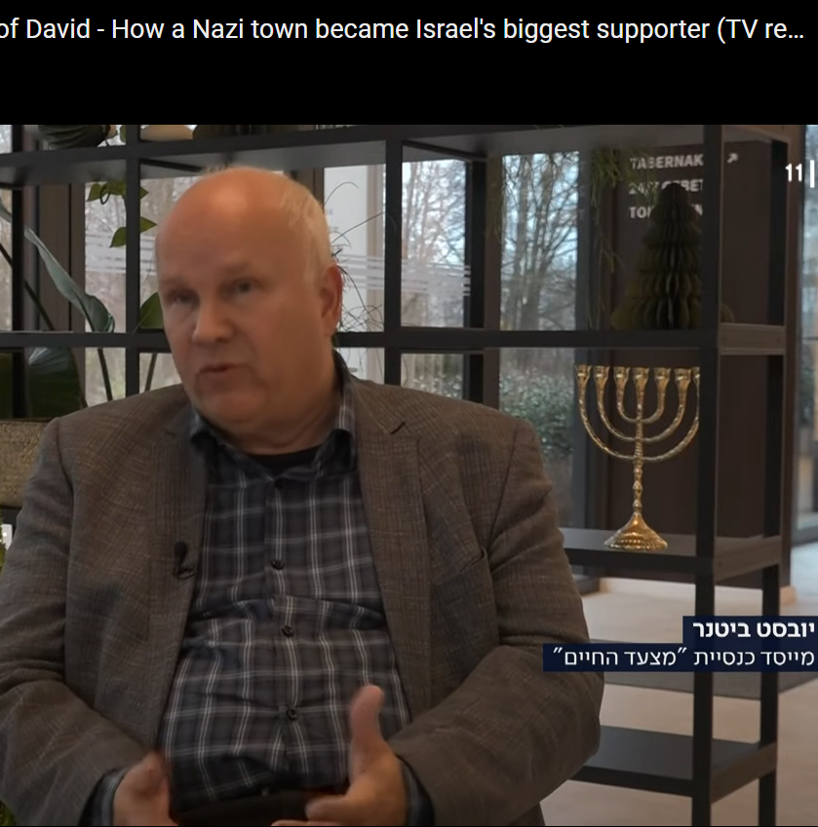
TOS Church Tübingen founded 1987 by
Jobst and Charlotte Bittner as a result of a prayer fellowship with other married couples.
Notes:
Tübinger Offensive Stadtmission City mission, street children, drug rehab, humanitarian aid

Slide 29
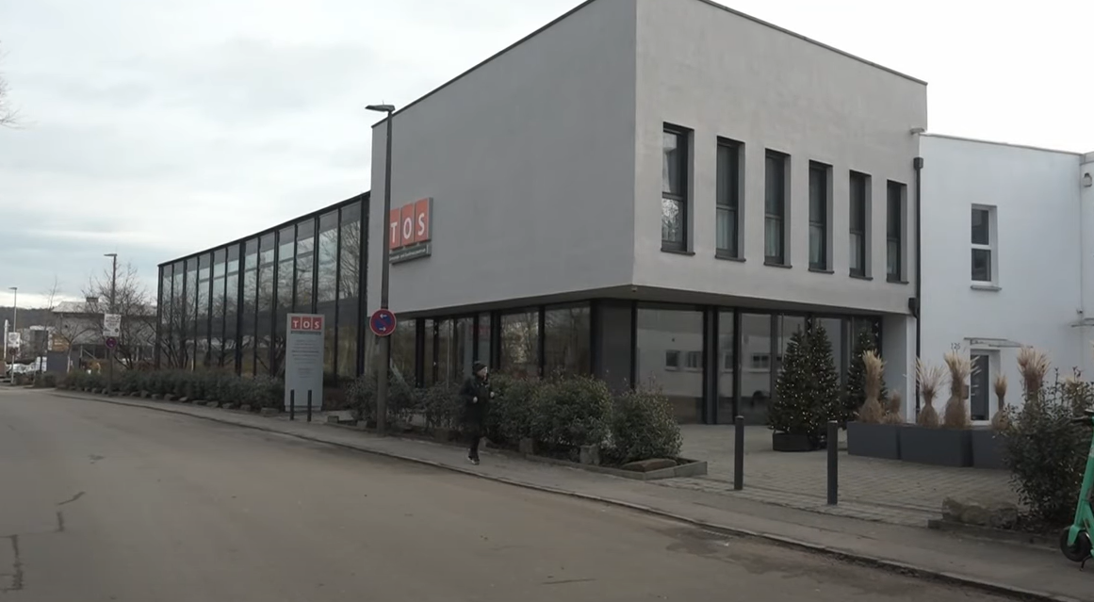

Slide 30
However, at first the congregation was not effective and growing. They found out the
They were in the midst of Nazi force labor camps
Tubingen Hospital had specimens from Mengele’s work

Slide 31
Tubingen is the birthplace of murderers like Martin Sandberger, who are responsible for death of about 600,000 European Jews.
Notes:
https://marchoflife.org/permanent-exhibition/

Slide 32
Many of SS leaders studied at the University of Tübingen and then became leaders of Einsatzgruppen in Eastern Europe and lived on after 1945, largely without any consequences.
Notes:
https://marchoflife.org/permanent-exhibition/

Slide 33
Through various institutes whose research “scientifically” substantiated the ideology of the National Socialists, Tübingen had a decisive influence in the German Reich.
Notes:
https://marchoflife.org/permanent-exhibition/

Slide 34
Jobst organized a repentance march through the location of the labor camps. He called it the March of Life. What began in 2007 with a one-time commemoration and reconciliation march has grown

Slide 35
into a worldwide movement that motivates tens of thousands of people to take to the streets against antisemitism today and to stand with Israel. The March of Life has changed the lives of many Holocaust survivors and their families forever.
Notes:
https://marchoflife.org/permanent-exhibition/

Slide 36
A display shows how long it took for society to reach a general recognition of the Holocaust. Nevertheless, family history was overlooked, and although antisemitic and racist prejudices were no longer expressed publicly,
Notes:
https://marchoflife.org/permanent-exhibition/

Slide 37
they continued to simmer below the surface. The exhibition seeks to encourage visitors to break this silence within their own families.
Notes:
https://marchoflife.org/permanent-exhibition/

Slide 38
Together with descendants of German Wehrmacht, police and SS members, they organize memorial and reconciliation marches at Holocaust sites in Europe and around the world, starting in 2007.

Slide 39
The core and distinguishing feature of the March of Life movement from other commemorative events is the willingness of participants to work through their own family history in relation to involvement in National Socialism , sometimes through extensive research , and to take responsibility for it as far as they are able.

Slide 40
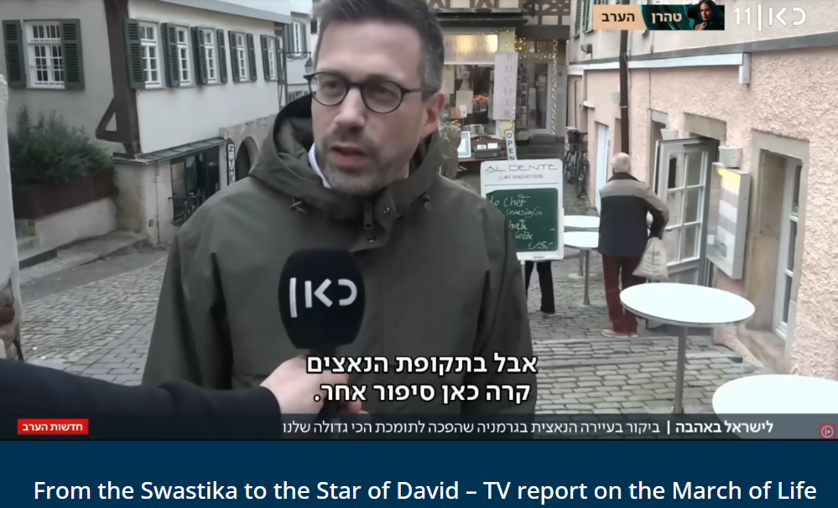
Israeli journalist
Dov Gil-Har
Notes:
https://marschdeslebens.org/vom-hakenkreuz-zum-davidstern-tv-bericht-ueber-den-marsch-des-lebens/

Slide 41
Shortly before the end of 2024, the renowned Israeli journalist Dov Gil-Har visited the TOS Community and Conference Center in Tübingen, where the March of Life is based.
Notes:
https://marschdeslebens.org/vom-hakenkreuz-zum-davidstern-tv-bericht-ueber-den-marsch-des-lebens/

Slide 42
As part of the German premiere of the musical "Exodus 1947 - A Ship Writes History", he interviewed the young actors of the musical, the international director Heinz Reuss and the founder and president of the March of Life movement Jobst Bittner.
Notes:
https://marschdeslebens.org/vom-hakenkreuz-zum-davidstern-tv-bericht-ueber-den-marsch-des-lebens/
A good movie for us to show.

Slide 43
The interviews resulted in a 15-minute report that was broadcast on January 6th at prime time in the evening news on the Israeli Channel 11.
Notes:
https://marschdeslebens.org/vom-hakenkreuz-zum-davidstern-tv-bericht-ueber-den-marsch-des-lebens/

Slide 44
" From the Swastika to the Star of David - How a Nazi town became Israel's biggest supporter"
What led a community of Nazi descendants in a small German town to take responsibility for the actions of their ancestors?
Notes:
https://marschdeslebens.org/vom-hakenkreuz-zum-davidstern-tv-bericht-ueber-den-marsch-des-lebens/

Slide 45
The community from which the murderers of seven hundred thousand Jews came decided to investigate the crimes of that generation and dedicate its activities to the Jewish people - and those abducted.
Notes:
https://marschdeslebens.org/vom-hakenkreuz-zum-davidstern-tv-bericht-ueber-den-marsch-des-lebens/

Slide 46
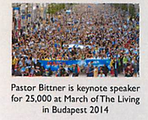

Slide 47
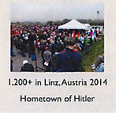

Slide 48
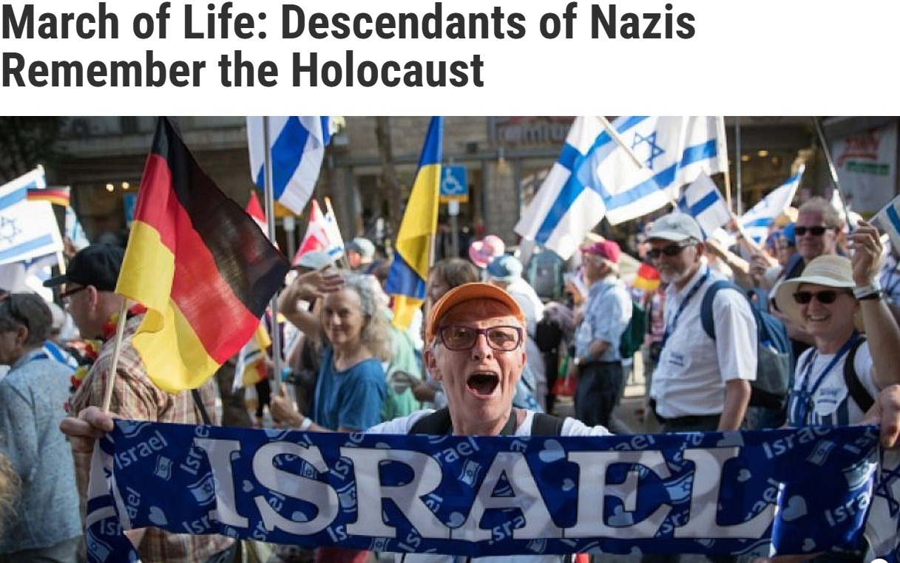
Notes:
https://aish.com/march-of-life-descendants-of-nazis-remember-the-holocaust/
Barbel Pfeiffer, a congregant, had been unaware of any personal connection to the Holocaust. Although she had seen photos of her maternal grandfather in his army uniform, she assumed it was a closed chapter in Germany’s history. When encouraged to explore their families’ hidden past, she began asking questions.
Pfeiffer was shocked to discover the terrible family secret that her paternal grandfather, an engineer, helped build the Auschwitz gas chambers. It took weeks for her to come to terms with that horrific realization. Then in 2012 she traveled to Auschwitz with her church and addressed a group of Holocaust survivors.

Slide 50
T'hillim-Ps 34.18 A broken heart
and contrite spirit
Int. Holocaust Remembrance Day
Tubingen MoR Response
Broken Heart, Contrite Spirit
Conditions today
Our Calling

Slide 51
^{Nekhemyah 9.1-3} Now on the twenty-fourth day of this same month, Bnei-Yisrael gathered together, fasting and wearing sackcloth and putting dust on their heads. The offspring of Israel separated themselves from all foreigners, standing and confessing their sins and the iniquities of their fathers.

Slide 52
^{Nekhemyah 9.1-3} They stood in their place and read in the scroll of the Torah of Adonai their God for a quarter of the day; and for another quarter they were confessing and prostrating themselves before Adonai their God.

Slide 53
^{Daniel 9.15-17} “Now, Adoni our God, who brought your people out of the land of Egypt with a strong hand, thereby winning renown for yourself, as is the case today — we sinned, we acted wickedly. Adoni, in keeping with all your justice, please allow your anger and fury to be turned away from your city Yerushalayim, your holy mountain;

Slide 54
^{Daniel 9.15-17} because it is due to our sins and the wrongdoings of our ancestors that Yerushalayim and your people have become objects of scorn among everyone around us.

Slide 55
^{Daniel 9.15-17} Therefore, our God, listen to the prayer and pleadings of your servant; and cause your face to shine on your desolated sanctuary, for your own sake.

Slide 56
^{Ezra 9.6-7} “My God, I am ashamed. I blush to lift my face to you, my God! For our sins tower over our heads; our guilt reaches up to heaven. Since the times of our ancestors, we have been deeply guilty;

Slide 57
^{Ezra 9.6-7} and because of our sins, we, our kings and our cohanim have been handed over to the kings of the lands, to the sword, to exile, to pillage and to disgrace, as is the case today

Slide 58
^{T’hillim Ps 51.3-9} God, in your grace, have mercy on me; in your great compassion, blot out my crimes. Wash me completely from my guilt, and cleanse me from my sin. For I know my crimes, my sin confronts me all the time. Against you, you only,

Slide 59
^{T’hillim Ps 51.3-9} have I sinned and done what is evil from your perspective; so that you are right in accusing me and justified in passing sentence. True, I was born guilty, was a sinner from the moment my mother conceived me. Still, you want truth in the inner person;

Slide 60
^{T’hillim Ps 51.3-9} so make me know wisdom in my inmost heart. Sprinkle me with hyssop, and I will be clean; wash me, and I will be whiter than snow.

Slide 61
^{Yeshayahu Is 57.15} For thus says the High, Exalted One who lives forever, whose name is Holy: “I live in the high and holy place but also with the broken and humble, in order to revive the spirit of the humble and revive the hearts of the broken ones.

Slide 62
^{Phil 2.5-8} Have this attitude in yourselves, which also was in Messiah Yeshua, Who, though existing in the form of God, did not consider being equal to God a thing to be grasped. But He emptied Himself—

Slide 63
^{Phil 2.5-8} taking on the form of a slave, becoming the likeness of men and being found in appearance as a man. He humbled Himself—becoming obedient to the point of death, even death on a cross.

Slide 64
This is the way we seek the favor of G-d and man.
Notes:
You might say, “Why preach this here?”
America refused the mercy ship St. Louis.
America refused to bomb the gas chambers of Auschwitz.
America sold no weapons to Israel until John Kennedy’s presidency.

Slide 66
T'hillim-Ps 34.18 A broken heart
and contrite spirit
Int. Holocaust Remembrance Day
Tubingen MoR Response
Broken Heart, Contrite Spirit
Conditions today
Our Calling

Slide 67
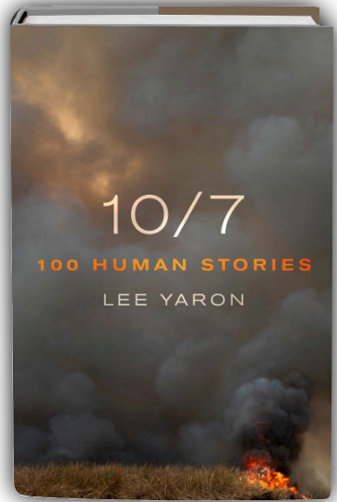
Jan. 15, 2025 I attended an interview with author Lee Yaron interviewed by Meta Meltzer at the Jewish Community Center.

Slide 68

Lee Yaron Meta Meltzer
Notes:
Acclaimed Author Series: Lee Yaron לי ירון
https://static.macmillan.com/static/smp/100-human-stories-9781250366283/

Slide 69
She wrote a compiled bio of Oct 7 victims: including left-wing kibbutzniks, Burning Man-esque partiers, radical right-wingers, Bedouins, Israeli Arabs, Thai and Nepalese guest workers, peace activists, and elderly Holocaust survivors.

Slide 70
She realized that this wasn’t an Israeli story, but an ongoing part of the Jewish story from the time of Avraham.
Is there a safe place in the world for Jews?

Slide 71
Yaron noted that there are two forms of anti-Semitism.
Megaphone: BDS, from an ideology.
Whisper: after Jan. 2024 EVERY publisher cancelled Israeli authors; from FEAR
Notes:
That is part of why I wear a kippah. Not be ashamed, live in fear. Do you dissociate from that Jewish place?

Slide 72
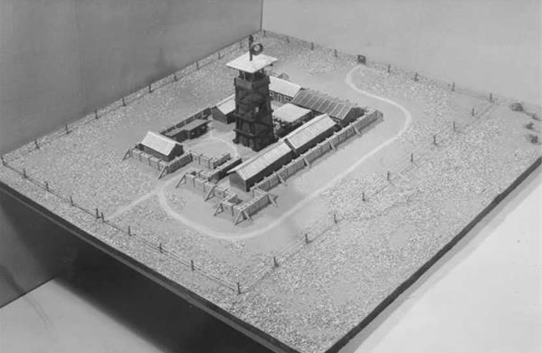
Stockade and Tower
Notes:
https://en.wikipedia.org/wiki/Tower_and_Stockade

Slide 73
Part of the curse on Israel in exile is
^{Viyikra Lev 26.36-37} “As for those who remain, I will bring weakness into their hearts in the lands of their enemies, so that the sound of a driven leaf will put them to flight, and they will flee as one flees from the sword and fall,

Slide 74
^{Viyikra Lev 26.36-37} even when no one is pursuing. They will stumble over one another, as if before the sword, when no one pursues, and you will have no strength to stand before your enemies.
Notes:
Fearful Jews became a stereotype. “As lambs to the slaughter” in the camps in Germany.

Slide 75
Tower and Stockade
חוֹמָה וּמִגְדָּל, lit. 'wall and tower') was a settlement method used by Zionist settlers in Mandatory Palestine.

Slide 76
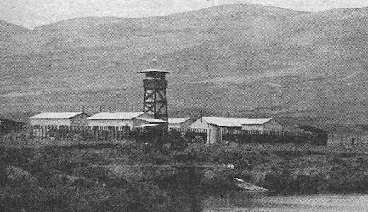
Notes:
https://www.jonathan-cook.net/blog/2020-07-07/jnf-history-forests-vetting/

Slide 77
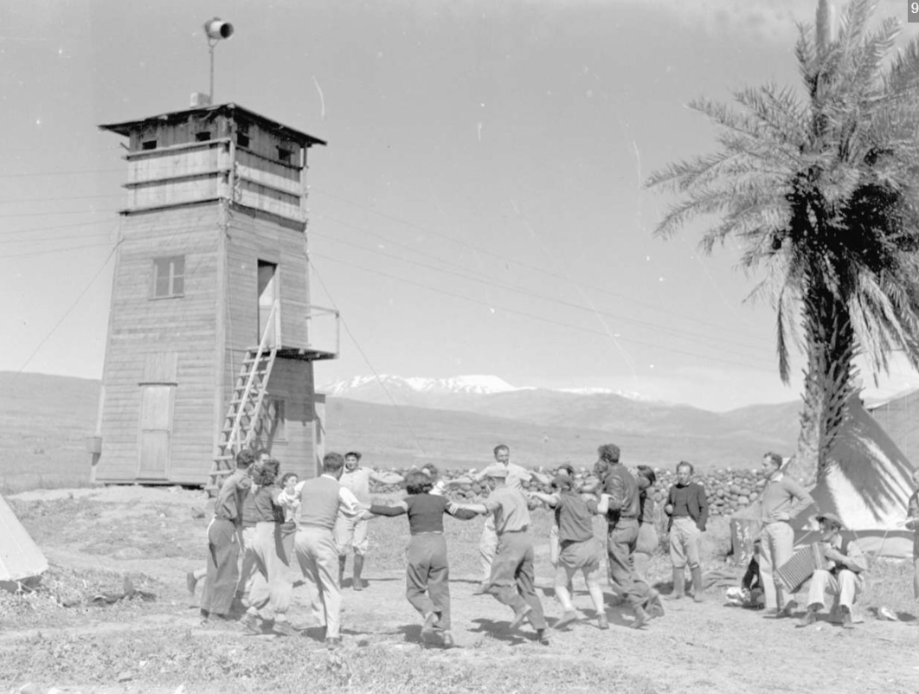
Notes:
https://en.wikipedia.org/wiki/Tower_and_Stockade#/media/File:%D7%97%D7%99%D7%90%D7%9D_%D7%90%D7%9C-%D7%95%D7%90%D7%9C%D7%99%D7%93_(%D7%97%D7%95%D7%9E%D7%94_%D7%95%D7%9E%D7%92%D7%93%D7%9C_-_%D7%A7%D7%99%D7%91%D7%95%D7%A5_%D7%A2%D7%9E%D7%99%D7%A8)-ZKlugerPhotos-00132ft-09071706851215a0.jpg

Slide 78
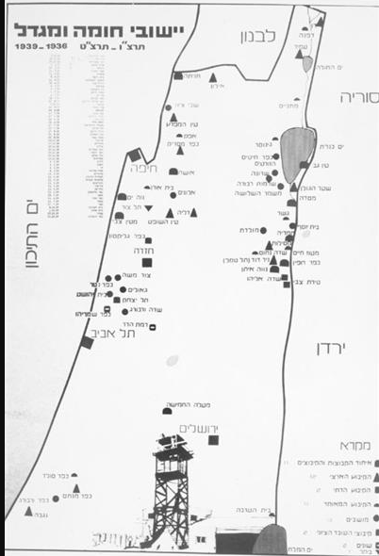
Map of “Stockade and Tower” settlements.

Slide 79
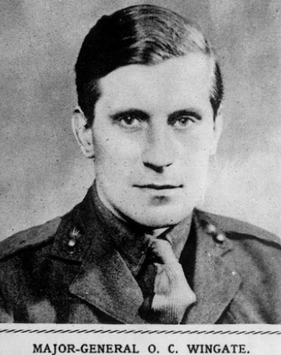
Orde Wingate was a Plymouth Brethren revivalist Christian. He embraced the 1917 British Balfour Declaration which promised the Jewish people a national homeland.
Notes:
https://www.c4israel.org/news/gideon-of-the-20th-century/

Slide 80
In 1936 he was stationed in then British Mandatory Palestine and was puzzled by his fellow Brits in the land who were now overtly anti-Jewish. Deployed to British intelligence, he shut himself away in a hotel room in Haifa for months, trying to work things out.
Notes:
https://www.c4israel.org/news/gideon-of-the-20th-century/

Slide 81
He studied the origins of the Jewish-Arab conflict, the Hebrew Bible and also Hebrew – which within a few years he would be speaking fluently. He came out of the hotel room an undying Zionist convinced that the times he was living in were of Biblical proportion and God was about to act: and Wingate, was here to be part of that plan.
Notes:
https://www.c4israel.org/news/gideon-of-the-20th-century/

Slide 82
At the time Arab gangs were murdering defenseless farmers and families on kibbutzim in the Jezreel valley. The British refused to get involved so as not to jeopardize the flow of Arab oil running through their pipeline in the heart of the Jezreel valley.
Notes:
https://www.c4israel.org/news/gideon-of-the-20th-century/

Slide 83
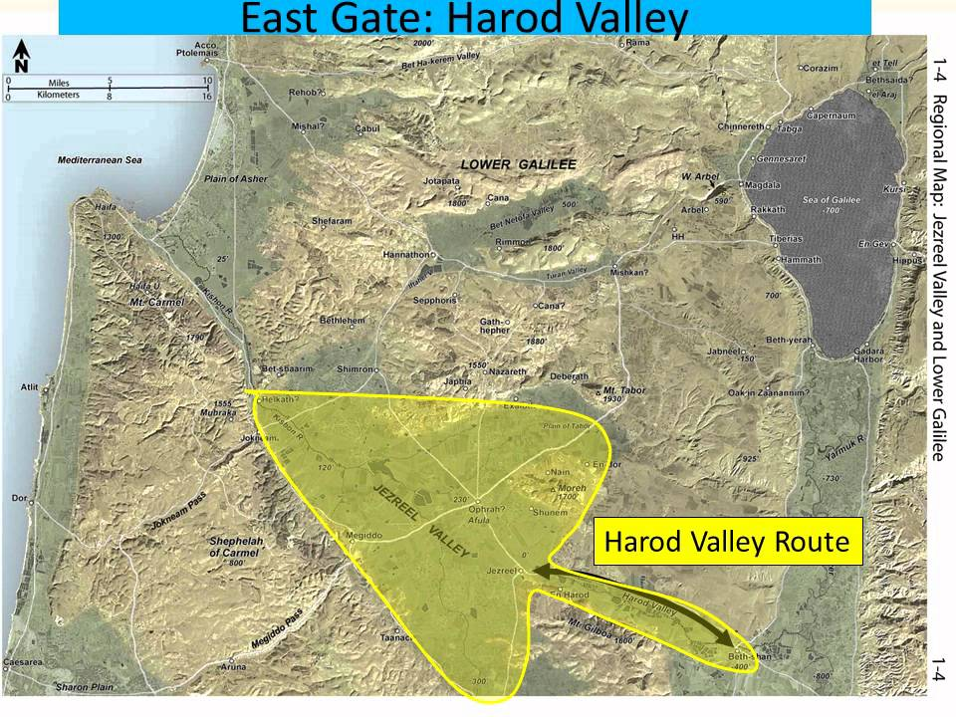

Slide 84
Formally, he was charged by the British to protect the pipeline. In setting up the Special Night Squads of Jewish Fighters Wingate believed he had finally discovered why God had put him on earth.
Notes:
https://www.c4israel.org/news/gideon-of-the-20th-century/

Slide 85
He used the Israelite battles of the Bible as a blueprint for success: but not just any battle. He turned to the battle between Gideon and the Midianites which took place in the exact same Jezreel Valley,

Slide 86
and studied their art of war. Seeing himself as a Gideon, he was commanding a small group of soldiers to defeat the Arab “Midianites,”

Slide 87
Wingate trained the small groups of lightly equipped men to move silently under the cover of darkness, gather intelligence and attack an enemy where the enemy least expected it – in their own backyard.

Slide 88
There had not been a Jewish military operation like this in over two thousand years. The Special Night Squads succeeded all expectations. Attack was the form of defense. Sabotage ceased, the pipeline was kept safe and the Arab marauders were defeated.

Slide 89
“Orde Wingate will be forever remembered for laying the foundation of the first Jewish army in two thousand years”
Notes:
“Everything we know about warfare, we learned from Orde Wingate.”

Slide 90
Israel’s first Prime Minister David Ben Gurion famously became known simply as HaZaken, “the old man.” הזקן
Notes:
https://www.c4israel.org/news/gideon-of-the-20th-century/

Slide 91
Baron Edmond de Rothschild, a philanthropist, gave millions of his own money to help the 19th century struggling Jewish community and was accordingly bestowed the title, HaNadiv HaYadua, “the generous one.” הנדיב הידוע
Notes:
https://www.c4israel.org/news/gideon-of-the-20th-century/

Slide 92
Orde Wingate was also given a name. In Hebrew, he is affectionally known as HaYadid, or simply, “the friend.” הידיד
Are we willing to stand with Israel and the Jew?
~Marco Rubio, Elise Stefanik
Notes:
https://www.c4israel.org/news/gideon-of-the-20th-century/

Slide 93
Subtle anti-Semitism

Slide 94
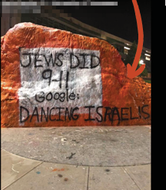
conspiracy theory

Slide 95
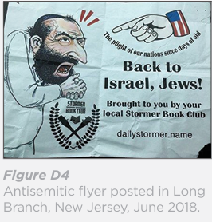
dual loyalty

Slide 96
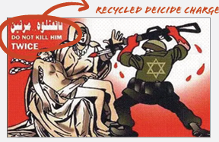
deicide

Slide 97

From the River to the Sea

Slide 98
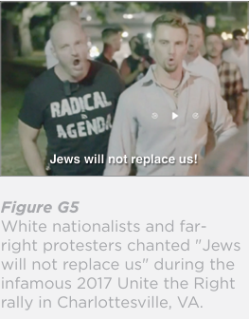
Great Replacement

Slide 99
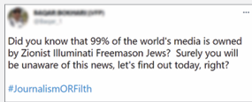
Illuminati
Jew down
Jewish lightning

Slide 100
Jew down
Jewish lightning

Slide 101
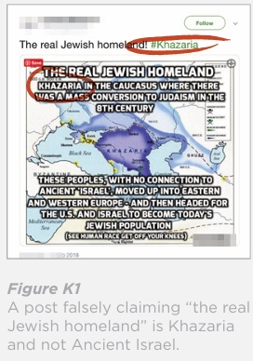
Khazars

Slide 102
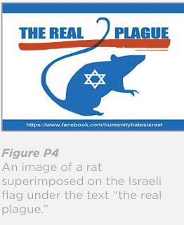
Kike
poisoning the well

Slide 103
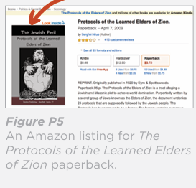
Protocols of the Elders of Zion

Slide 104
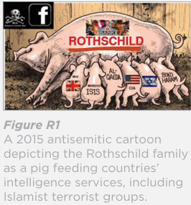
Rothschild
Notes:
Do we make “Rothschild” as a conspiracy word?

Slide 105
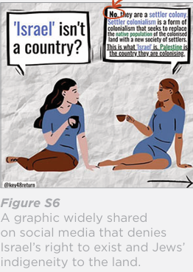
settler colonialist

Slide 106
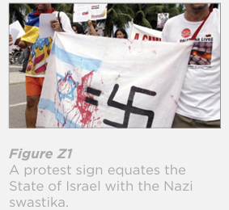
“Zionism is racism”

Slide 108
T'hillim-Ps 34.18 A broken heart
and contrite spirit
Int. Holocaust Remembrance Day
Tubingen MoR Response
Broken Heart, Contrite Spirit
Conditions today
Our Calling

Slide 109
^{Revelation 5:4f} “Do not weep! See, the Lion of the tribe of Judah, the Root of David, has triumphed. He is able to open the scroll and its seven seals.”

Slide 110
Benjamin Netanyahu quoted Jeremiah 31:17:
There is hope for your latter end, says Adoni, and your children will return to their borders.

Slide 112
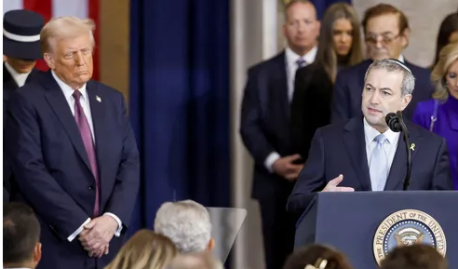

Slide 113
^{Yeshayahu Is 66.2}“But on this one will I look, one humble and of a contrite spirit, who trembles at My word.”

