Slide 1
e-handout
To have these notes
without taking notes
Go to OrHaOlam.com
Click on Messages tab,
2025 Messages

Slide 2
From the Zakenim [Elders meetng minutes]
We had a $16,621 surplus: Give praise offerings to organizations?

Slide 3
From the Zakenim [Elders meetng minutes]
We had a $16,621 surplus: Give praise offerings to organizations?
Joseph Project –– $1,600 ~tithe

Slide 4
From the Zakenim [Elders meetng minutes]
We had a $16,621 surplus: Give praise offerings to organizations?
Joseph Project –– $1,600
HaTikva –– $1,000

Slide 5
From the Zakenim [Elders meetng minutes]
We had a $16,621 surplus: Give praise offerings to organizations?
Joseph Project –– $1,600.
HaTikva –– $1,000
Jewish Federation (local) –– $500

Slide 6
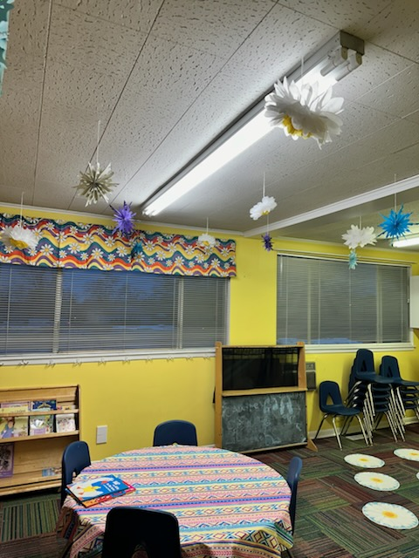
Maintenance Director Steve Kline fixed the light in the Torah Tots room [southwest classroom]

Slide 7
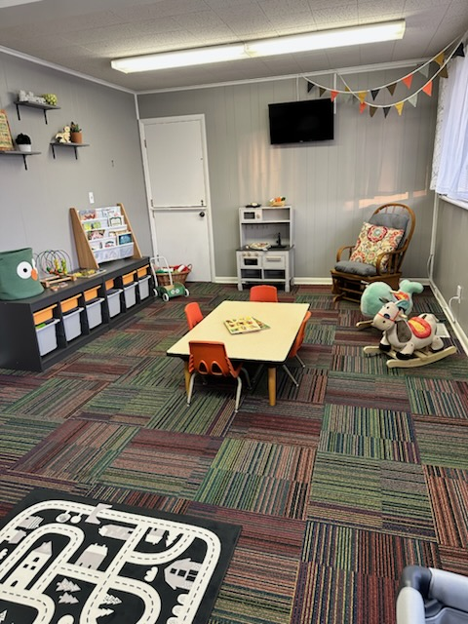
Children’s Ed. Director Angela Stobbe remodeled, reorganized, restocked, revitalized the Besorah Babies’ room!
[Southeast room]

Slide 8
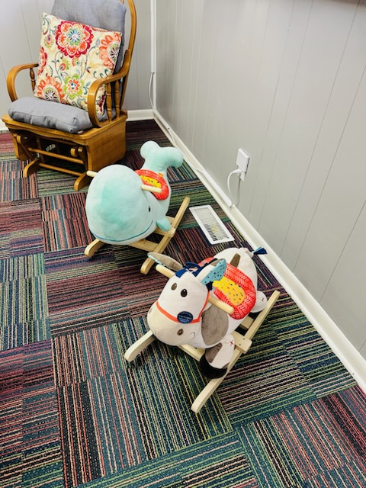
Besorah Babies’ room Ages 0-2

Slide 9
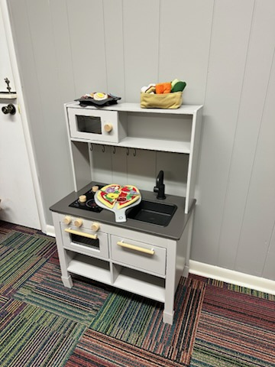
Besorah Babies’ room Ages 0-2

Slide 10

Besorah Babies’ room Ages 0-2

Slide 11
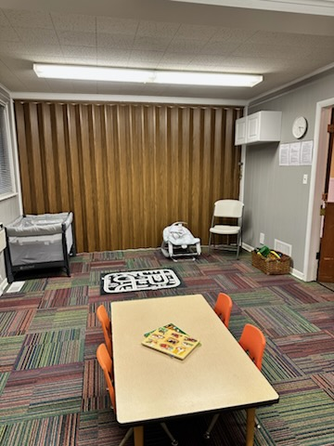
Besorah Babies’ room
Notes:
Halleluyah. Gave her a hand!!

Slide 12
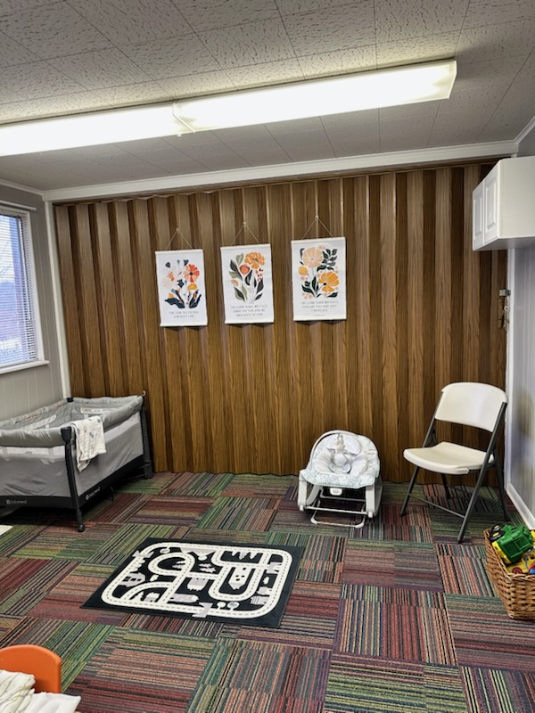
Besorah Babies’ room
Notes:
Halleluyah. Gave her a hand!!

Slide 13

Besorah Babies’ room
Notes:
Halleluyah. Gave her a hand!!

Slide 14
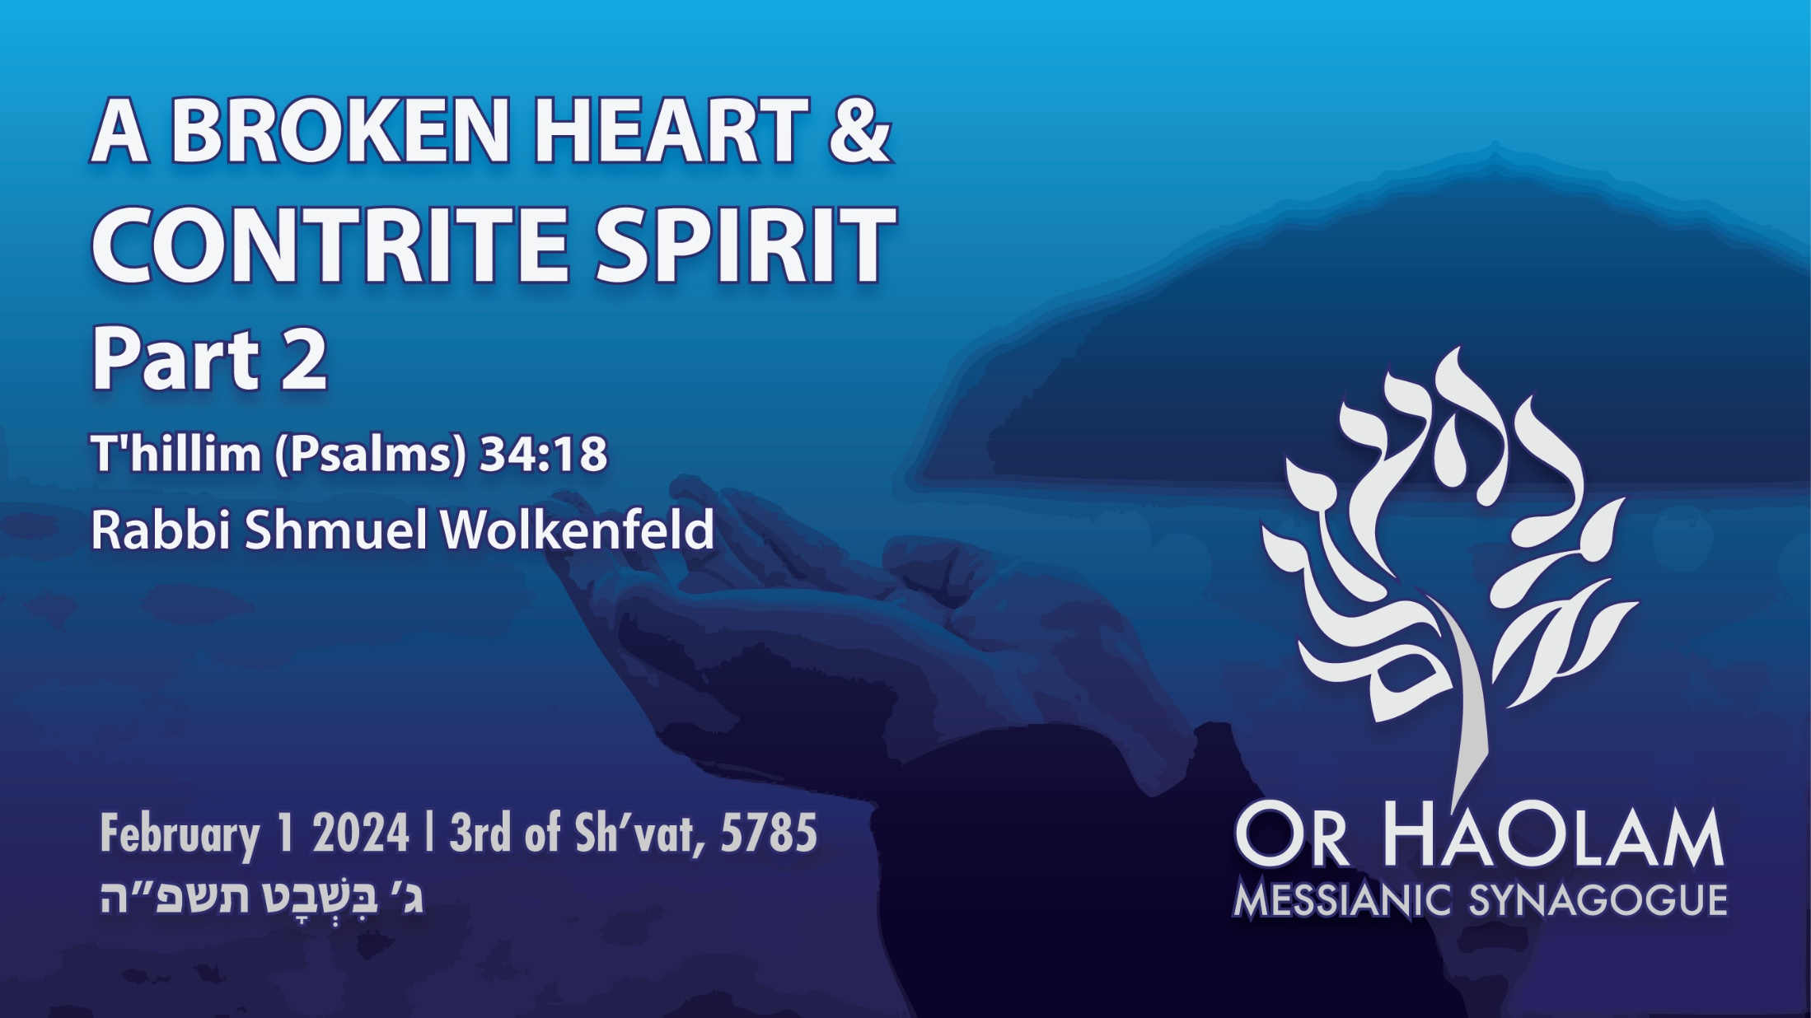

Slide 15

^{T'hillim-Ps 34.18} A broken heart and
contrite spirit. Part 2
Prophetic End time danger
Prophetic End time resolution

Slide 16
^{T’hillim/Ps 34.18} Adoni is near those with broken hearts; he saves those whose spirit is crushed.

Slide 17
^{T'hillim-Ps 34.18} A broken heart and
contrite spirit. Part 2
Prophetic End time danger
Prophetic End time resolution
Notes:
Are we in this time, or it’s precursor?

Slide 18
^{Zekh 12.3} Moreover, in that day I will make Jerusalem a massive stone for all the people. All who try to lift it will be cut to pieces. Nevertheless, all the nations of the earth will be gathered together against her.

Slide 19
^{Zekh 14.1-4} Look, a day is coming for Adoni when your plunder, [Yerushalayim], will be divided right there within you. “For I will gather all the nations against Yerushalayim for war.

Slide 20
^{Zekh 14.1-4} The city will be taken, the houses will be rifled, the women will be raped, and half the city will go into exile; but the rest of the people will not be cut off from the city.”
Notes:
This time it’s going to happen in Jerusalem, not the Gaza envelope. Are we heading toward this? In a foretaste? Maybe a Trump pause?

Slide 21
^{Yeshayahu 3.1-4} For see! The Lord, Adonai-Tzva’ot, will remove from Yerushalayim and Y’hudah every kind of support — all reserves of food and water; heroes and warriors, judges and prophets, diviners and leaders,

Slide 22
^{Yeshayahu 3.1-4} captains of fifty, men of rank and advisers, skillful magicians and expert enchanters. I will put children in authority; capriciousness will govern them.
Notes:
Are we in the pre-cursor to these times?

Slide 23
Global Antisemitism Surges to Record 46% in Latest ADL Survey
January 22, 2025
Notes:
https://metrovoicenews.com/global-antisemitism-surges-to-record-46-in-latest-adl-survey/

Slide 24


Slide 25
Global antisemitism has reached unprecedented levels, with nearly half of the world’s population harboring deeply entrenched antisemitic attitudes.
Notes:
https://metrovoicenews.com/global-antisemitism-surges-to-record-46-in-latest-adl-survey/

Slide 26
What is anti-Semitism?

Slide 27
Anti-Semitism, sometimes called history’s oldest hatred, is hostility or prejudice against Jewish people.
In much of Europe throughout the Middle Ages, Jewish people were denied citizenship and forced to live in ghettos.
Notes:
https://www.history.com/topics/holocaust/anti-semitism
Ghetto is not and American racist slum word for the ‘hood.’ It originally was the limited quarters of the Jewish people in Europe.

Slide 28
With the rise of Christianity, anti-Semitism spread throughout much of Europe. Early Christians vilified Judaism in a bid to gain more converts. They accused Jews of outlandish acts such as “blood libel”—the kidnapping and murder of Christian children to use their blood to make Passover bread.
Notes:
https://www.history.com/topics/holocaust/anti-semitism

Slide 29
In the wake of the Russian Revolution, an estimated 1,326 pogroms are thought to have taken place across Ukraine alone, leaving nearly half a million Ukrainian Jews homeless and killing an estimated 30,000 to 70,000 people between 1918 and 1921.
Notes:
https://www.history.com/topics/holocaust/anti-semitism

Slide 30
More than 58,000 adults from 103 countries and territories were surveyed, representing 94 percent of the global adult population ethnicities.
Notes:
https://metrovoicenews.com/global-antisemitism-surges-to-record-46-in-latest-adl-survey/

Slide 31
The survey also found that 20 percent of respondents worldwide have not heard about the Holocaust. Less than half recognize the Holocaust’s historical accuracy, which falls to 39 percent among 18- to 34-year-olds,
Notes:
https://metrovoicenews.com/global-antisemitism-surges-to-record-46-in-latest-adl-survey/

Slide 32
Respondents younger than 35 also have elevated levels of antisemitic sentiments (50 percent), 13 percentage points higher than respondents older than 50.
Notes:
https://metrovoicenews.com/global-antisemitism-surges-to-record-46-in-latest-adl-survey/
Nations against Israel

Slide 33
The countries and territories with the highest antisemitism index scores include the West Bank and Gaza (97 percent), Kuwait (97 percent) and Indonesia (96 percent), while those with the lowest scores are Sweden (5 percent), Norway (8 percent), Canada (8 percent) and the Netherlands (8 percent).
Notes:
https://metrovoicenews.com/global-antisemitism-surges-to-record-46-in-latest-adl-survey/

Slide 34
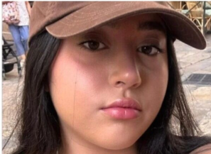
Israel Defense Forces soldier Liri Albag, who was released on Saturday after 477 days in captivity in Gaza.

Slide 35
“Dad, there are two million terrorists there, make no mistake. I sat with children aged 8 and 4 who were cursing ‘the Jews,’”
Notes:
Nations against Israel

Slide 36
Daniel Pipes
Unfortunately for Gazans and Israelis alike, the Israeli priority of releasing hostages and the distraction of taking on Hamas' allies meant Israeli forces did not destroy Hamas, did not liberate Gazans from oppression and extremism.

Slide 37
Daniel Pipes
and did not free Israel from a murderous jihadist group. What once appeared to be likely now looks forlorn. Once again, Israel's over-rated security establishment has managed to clutch defeat from the jaws of victory.
Notes:
Nations against Israel succeeding?

Slide 38
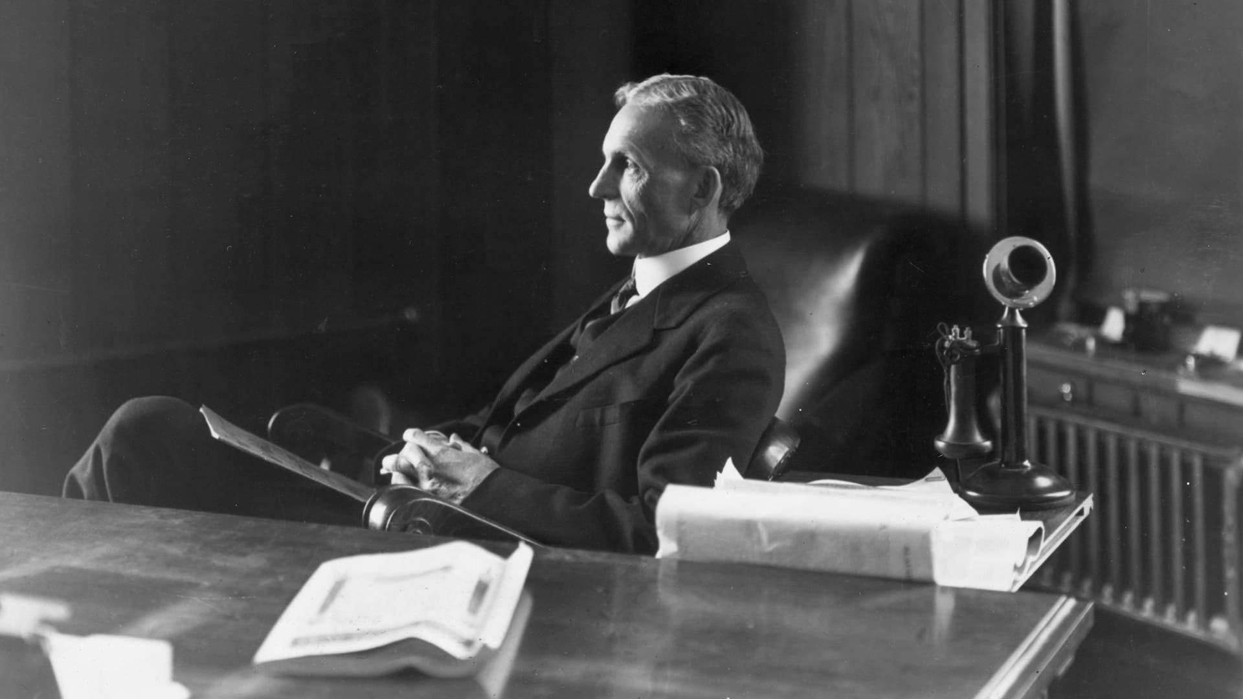
Henry Ford
Notes:
https://www.history.com/topics/holocaust/anti-semitism

Slide 39
American Icon Henry Ford Fostered Anti‑Semitism
The man known for changing the auto industry also used his immense power and influence to… vilify Jewish people.

Slide 40
He used his status as one of America's most well-known and trusted business leaders to systematically spread conspiracy theories about Jews. His screeds against Jewish people became so well-known at home and abroad that he, Henry Ford, is the only American whom Adolf Hitler compliments by name in Mein Kampf.
Notes:
Published Protocols of the Elders of Zion.

Slide 41
“Antisemitic tropes and beliefs are becoming alarmingly normalized across societies worldwide,” said Marina Rosenberg, the ADL’s senior vice president for international affairs. “This dangerous trend is not just a threat to Jewish communities; it’s a warning to us all.
Notes:
https://metrovoicenews.com/global-antisemitism-surges-to-record-46-in-latest-adl-survey/
They will destroy the Little Satan first [Israel] then the Great Satan [the USA]

Slide 42

From the River to the Sea

Slide 43
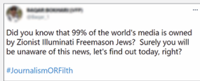
Illuminati
Jew down
Jewish lightning

Slide 44
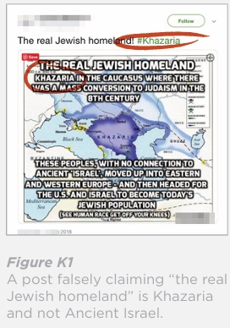
Khazars

Slide 45
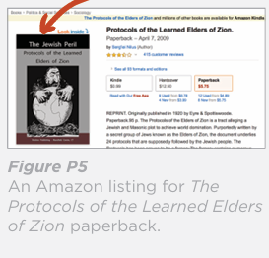
Protocols of the Elders of Zion

Slide 46
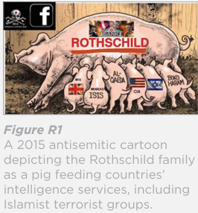
Rothschild
Notes:
Do we make “Rothschild” as a conspiracy word?

Slide 47
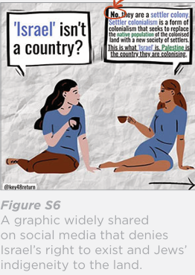
settler colonialist

Slide 48
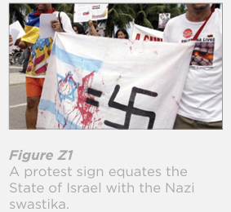
“Zionism is racism”
Notes:
United Nations General Assembly Resolution 3379, adopted on 10 November 1975, "Determines that Zionism is a form of racism and racial discrimination
It was revoked by Resolution 46/86, adopted on
16 December 1991

Slide 49
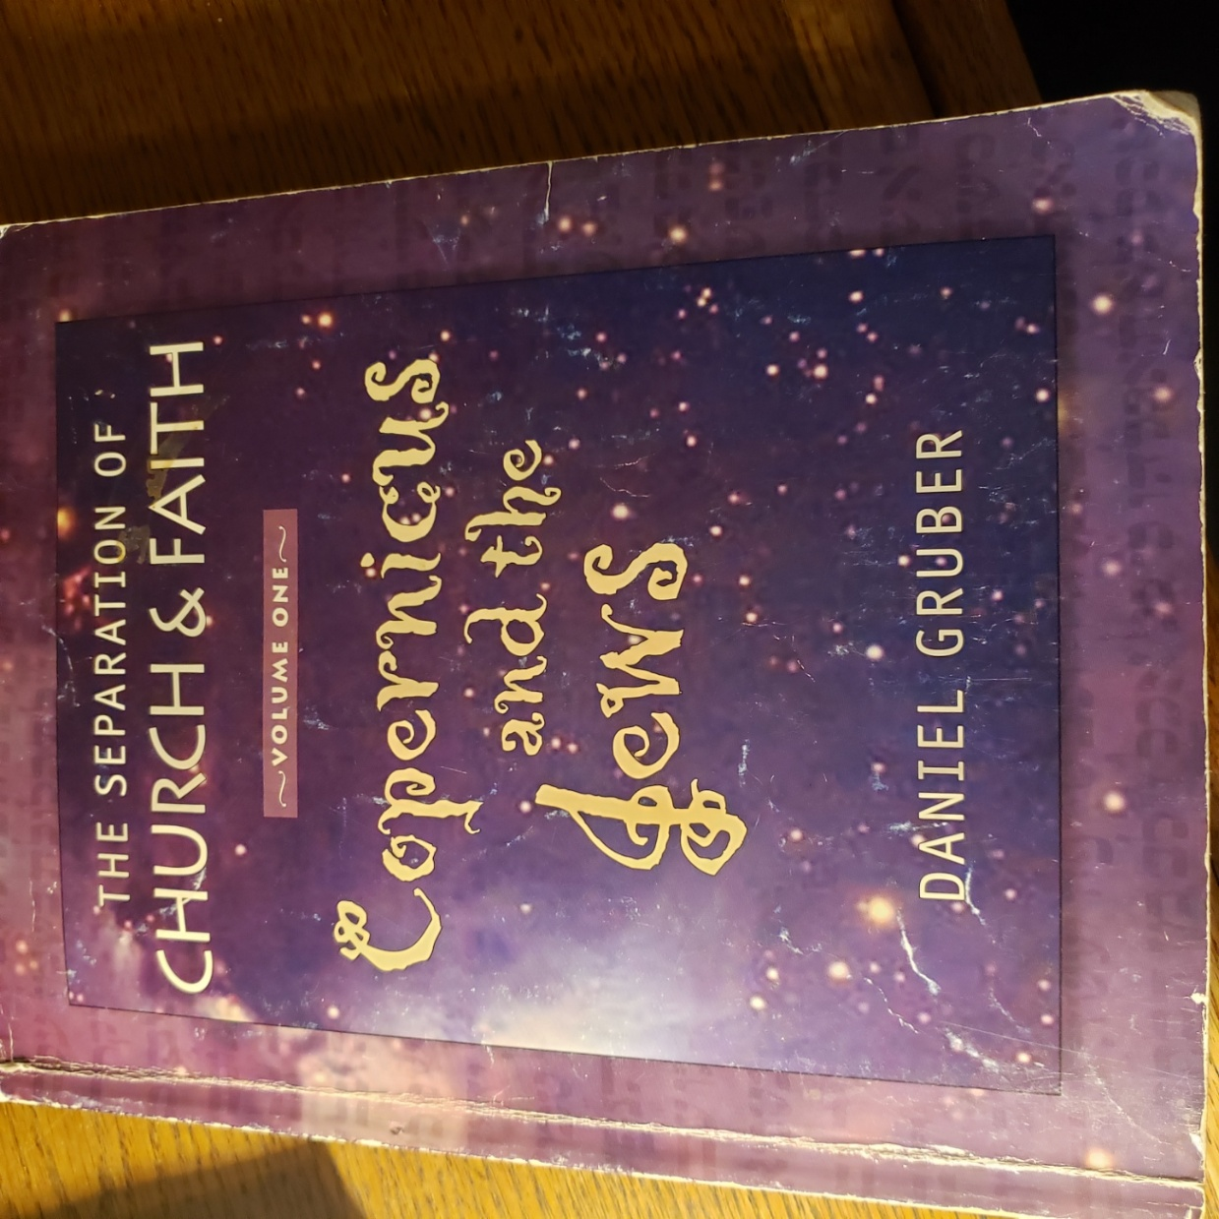
  Dan Gruber is the source of the concepts following…

Slide 50
Why we don’t call
our synagogue a church…
It’s one of those words.
Notes:
Some people will say to me “I like your church.”
“I can’t make it to church today.”
You will see me smile and squirm a bit.
Here’s why.

Slide 51
Two Hebrew words for community or gathering, or us, here in this room, and universally:
עֵדָה Edah
קָהָל Kahal

Slide 52
into LXX Greek Septuagint: Hebrew content in Greek packaging
עֵדָה Edah is usually translated sunagoge [synagogue]
קָהָל Kahal usually ekklesia [congregation, community, church?]

Slide 53
no major difference in the words
no particularly Jewish connotation to sunagoge עֵדָה Edah
no particularly non-Jewish connotaion to קָהָל Kahal usually ekklesia [congregation, community, church?]

Slide 54
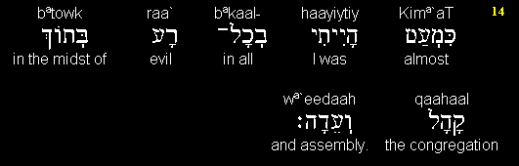
Prov 5.14
I was almost in all evil in the midst of the congregation and assembly.

Slide 55

Nu 1.18

Slide 56
^{Beresheet/Gen 1.9} Let the waters below the heaven be gathered /sunagogen
^{Matityahu 13.47} The Kingdom of Heaven is like a net thrown into the lake, that gathered/sunagogen all kinds of fish.

Slide 57
^{Acts 7.38} the assembly/ekklesia in the wilderness, accompanied by the angel that had spoken to him at Mount Sinai

Slide 58
English packaging of Greek rendering of Hebrew thought:
1525
William Tyndale translates ekklesia as “community”
never uses the word “church”

Slide 59
English packaging of Greek rendering of Hebrew thought:
1535
Luther’s German translation never used the word “church”
rather “gemeinde” community
Notes:
I don’t often speak favorably of Martin Luther.

Slide 60
1611 KJV King James of England
head of the Church of England
divine right of kings to rule

Slide 61
1611 KJV King James of England
gave rules to KJV translators
rule #3 “Ecclesiastical Words to be kept” in stead of the “scrupulosity of the Puritans” [Tyndale]
mandated “church” for ekklesia
validates James’ rule over church
Notes:
“Yaakov” supplanted by “James”

Slide 62
Implications of the word “church”
Is it still just “assembly?”
cf “mosque” substituted ~ alien and foreign concept to Israel

Slide 63
  It would seem very foreign to say “I am attending a mosque,” if meaning a place where Messiah is worshiped.

Slide 64
  mosque (n.)
  "Islamic place of worship and the ecclesiastical organization connected with it," 1717, earlier moseak (c. 1400), also mosquee (16c.), probably in part from French mosquée

Slide 65
  from Arabic masjid "temple, place of worship," from sajada "he worshipped" + prefix ma- denoting "place." Mangled in Middle English as muskey, moseache, etc.

Slide 66
Implications of the word “church”
Church Age theology
possibly from Greek
  “kuriakon” house of the L-rd
  not the sense of ekklesia קָהָל Kahal / community or gathering

Slide 67
possibly from Latin kirk / circle, circus, not the sense of ekklesia קָהָל Kahal / community or gathering
concept

Slide 68
scriptures speak of body of Messiah, commonwealth of Israel, community of believers in the Jewish Messiah and King
“church” is a group disconnected from the Jewish people
Notes:
To make matters worse…

Slide 69
^{Rev. 3.9} . . .the synagogue of Satan, those who call themselves Jews but aren’t–on the contrary, they are lying – see, I will cause them to come and prostrate themselves at your feet, and they will know that I have loved you.

Slide 70
^{Rev 2.9} To the angel of the Messianic Community in Smyrna, write: ‘Here is the message from the First and the Last, who died and came alive again: I know how you are suffering and how poor you are (though in fact you are rich!),

Slide 71
^{Rev 2.9} and I know the insults of those who call themselves Jews but aren’t – on the contrary, they are a synagogue of the Adversary.

Slide 72
common, metaphorical interpretation: that Yokhanan / John is talking about Jews who reject Yeshua as the Messiah
literal understanding that these are non-Jews who lie and say they are Jews but in fact are Gentiles.

Slide 73
Metaphorical interpretation gave this verse a virulently anti-Semitic significance.
over the centuries Jews have had the epithet “synagogue of Satan” hurled at them by Christians who thought they understood the Bible.

Slide 74
Conclusion:
the kingdom of Messiah is made up of the assembly of
  Jews who’ve received the New Covenant G-d made with Israel and Judah in Jer 31

Slide 75
Conclusion:
  non-Jews grafted into this covenant with Israel Ro 11
  word ‘church’ is not a translation of anything in scripture

Slide 76
  word “church” has implications of the government of European kings and bishops, without Jews
Notes:
So, the enemies of Israel have another angle. Here’s one more..

Slide 77
Simultaneously, and more dangerously, we, Jews and those affiliated, have lost some of our main allies.
Understanding this loss may be the key to Jewish deliverance.
Notes:
Worthy News · P.O. Box 78758 · Nashville, Tennessee 37207 · USA

Slide 78

From George Whitten

Slide 79
In April 2023, Mike Bickle, leader of the International House of Prayer, led a massive, unprecedented global prayer effort to mobilize MILLIONS worldwide to pray for Israel (specifically pray for their salvation).

Slide 80
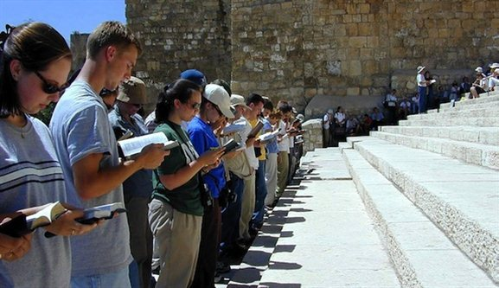
Notes:
https://bible.org/assets/images/Stiles_SouthernStepsPsalmsofAscent.001.jpg

Slide 81
On 28 October 2023, three former senior IHOPKC executives published an open letter revealing they had passed on allegations against Bickle to the church’s current leaders.
Notes:
Just three weeks after the Oct 7, 2023 attack.

Slide 82
At a time when Israel needed intercessory prayer the most, a scandal erupted with him that left thousands of his ministry’s young intercessors and those committed to joining in prayer worldwide shocked and discouraged.

Slide 83
Bickle has since admitted some “moral failures” but denied “more intense sexual activities”. After months of delay, just before Christmas IHOPKC announced it had received new information which confirmed the allegations.

Slide 84
There have been ongoing investigations, accusations, but no clear confession and repentance.
There may be a report coming out this Monday.

Slide 85
^{T’hillim/Ps 34.18} Adoni is near those with broken hearts; he saves those whose spirit is crushed.
Notes:
My letter to Mike Bickle.

Slide 86
  Gateway Church in Dallas, one of Israel’s biggest financial supporters, was caught in controversy when its lead pastor, Robert Morris, had to step down. As a result, millions of donor dollars that were helping Israel spiritually and providing aid for Israelis in need were cut off.

Slide 87
^{T’hillim/Ps 34.18} Adoni is near those with broken hearts; he saves those whose spirit is crushed.

Slide 88
DayStar Television, the first Christian broadcasting network to ever bring the gospel into Israel— and a generous source of provision for Israel was also hit with controversy and cover up.
https://julieroys.com/former-daystar-tv-executive-wife-accuse-joni-lamb-covering-up-daughters-sexual-abuse/

Slide 89
Most recently, Dr. Michael Brown, a well-respected theologian and host of In the Line of Fire, also found himself facing allegations.

Slide 90
I have two situations where there was deep moral failure, and a “sort of apology” was given.
If there was real confession and repentance, the situation could have been restored. Half repentance.

Slide 91
^{T’hillim/Ps 34.18} Adoni is near those with broken hearts; he saves those whose spirit is crushed.

Slide 93
^{T'hillim-Ps 34.18} A broken heart and
contrite spirit. Part 2
Prophetic End time danger
Prophetic End time resolution

Slide 94
^{T’hillim/Ps 34.18} Adoni is near those with broken hearts; he saves those whose spirit is crushed.

Slide 95
We only have one asset to “market” to the world.
INTEGRITY
^{2 Cor 8.21} We take pains to do what is right not only in the sight of God but also in the sight of other people.
Notes:
Never be in a car with the opposite gender, in a room with door closed.
We have procedures for counting money. I voluntarily do NOT know who the donors are.

Slide 96
Corollaries:
Humility, servant spirit, love
Notes:
Schmoozers.
Oneg team. Take out the garbage.

Slide 97
^{Yeshayahu / Is 66.2} Didn’t I myself make all these things? This is how they all came to be,” says Adonai. “The kind of person on whom I look with favor is one with a poor and humble spirit, who trembles at my word.

Slide 98
^{T’hillim/ Ps 138.6} For though Adoni is exalted, yet He looks upon the lowly, but the haughty He knows from afar.

Slide 99
^{Mishlei/Prov 11.1-3} Dishonest scales are an abomination to Adoni, but an accurate weight is His delight. When pride comes, then comes disgrace, but with the humble is wisdom. The integrity of the upright guides them, but the crookedness of the treacherous will destroy them.

Slide 100
National Gathering for Prayer and Repentance
2025 NGPR, hosted jointly by FRC and Well Versed, is set to take place on Wednesday, February 5, beginning at 7:00 a.m. at the Museum of the Bible in Washington, D.C. House Speaker Mike Johnson (R-La.),

Slide 101
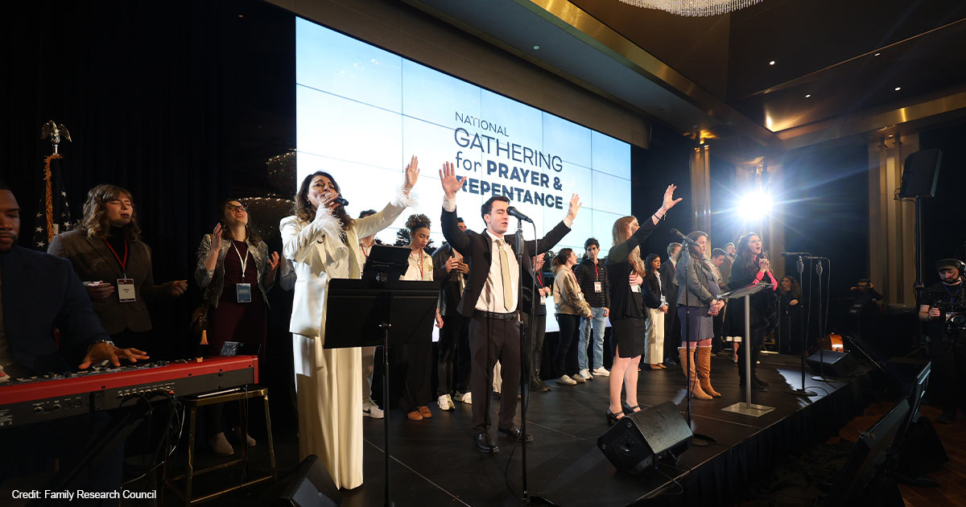

Slide 102
FRC Board Chair and Dean of Regent University’s School of Government Michele Bachmann, Rabbi Jonathan Cahn, author Nick Vujicic.

Slide 103
^{Zekhariah 12.10-14} “Then I will pour out on the house of David and the inhabitants of Jerusalem a spirit of grace and supplication, when they will look toward Me whom they pierced. They will mourn for him as one mourns for an only son and grieve bitterly for him, as one grieves for a firstborn.

Slide 104
^{Zekhariah 12.10-14} In that day there will be a great mourning in Jerusalem, mourning like Hadad-rimmon in the valley of Megiddo. The land will mourn clan by clan. The clan of the house of David by itself and their wives by themselves, the clan of the house of Nathan by itself, and their wives by themselves,

Slide 105
^{Zekhariah 12.10-14} the clan of the house of Levi by itself and their wives by themselves, the clan of the Shimeites by itself and their wives by themselves. Each of the remaining clans will mourn by itself and their wives by themselves.”

Slide 106
^{Zekh 14.1-4} Look, a day is coming for Adoni when your plunder, [Yerushalayim], will be divided right there within you. “For I will gather all the nations against Yerushalayim for war.

Slide 107
^{Zekh 14.1-4} The city will be taken, the houses will be rifled, the women will be raped, and half the city will go into exile; but the rest of the people will not be cut off from the city.”

Slide 108
^{Zekh 14.1-4} Then Adoni will go out and fight against those nations, fighting as on a day of battle. On that day his feet will stand on the Mount of Olives, which lies to the east of Yerushalayim;

Slide 109
^{Zekh 14.1-4} and the Mount of Olives will be split in half from east to west, to make a huge valley. Half of the mountain will move toward the north, and half of it toward the south.

Slide 110
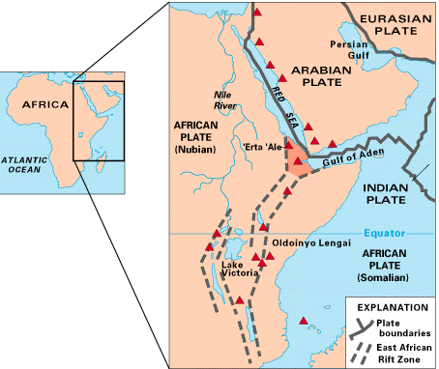
Great Rift Valley

Slide 111
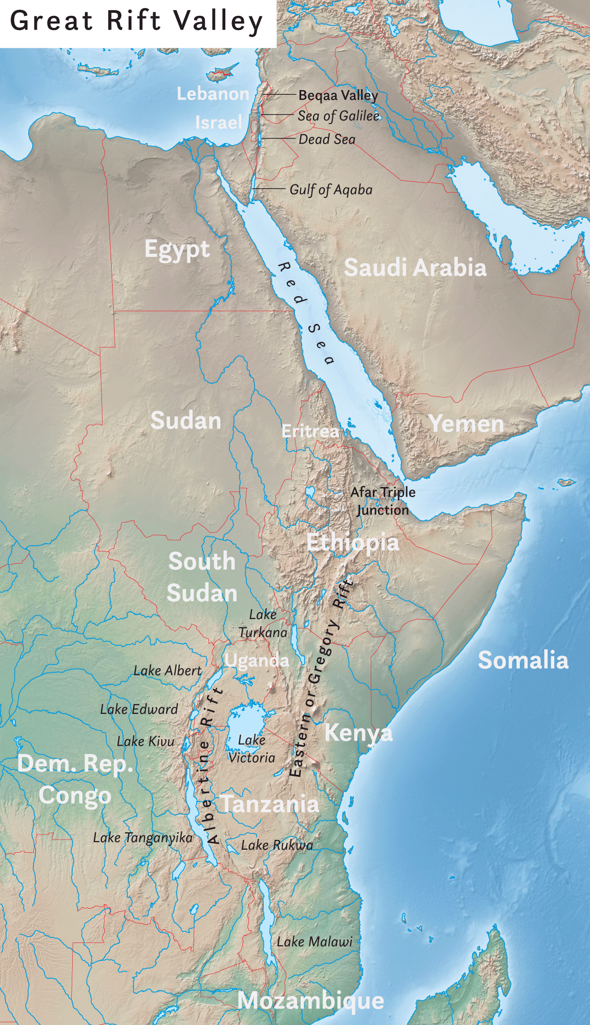
Great Rift Valley

Slide 114
^{Zekh 14.1-4} and the Mount of Olives will be split in half from east to west, to make a huge valley. Half of the mountain will move toward the north, and half of it toward the south.

Slide 116
^{T'hillim-Ps 34.18} A broken heart and
contrite spirit. Part 2
Prophetic End time danger
Prophetic End time resolution

