Slide 1
e-handout
To have these notes
without taking notes
Go to OrHaOlam.com
Click on Messages tab,
2025 Messages

Slide 2

John & Josie Two weeks ago, still dancing.
Notes:
Mother and son healthy9 lbs 5 oz 23 in

Slide 3
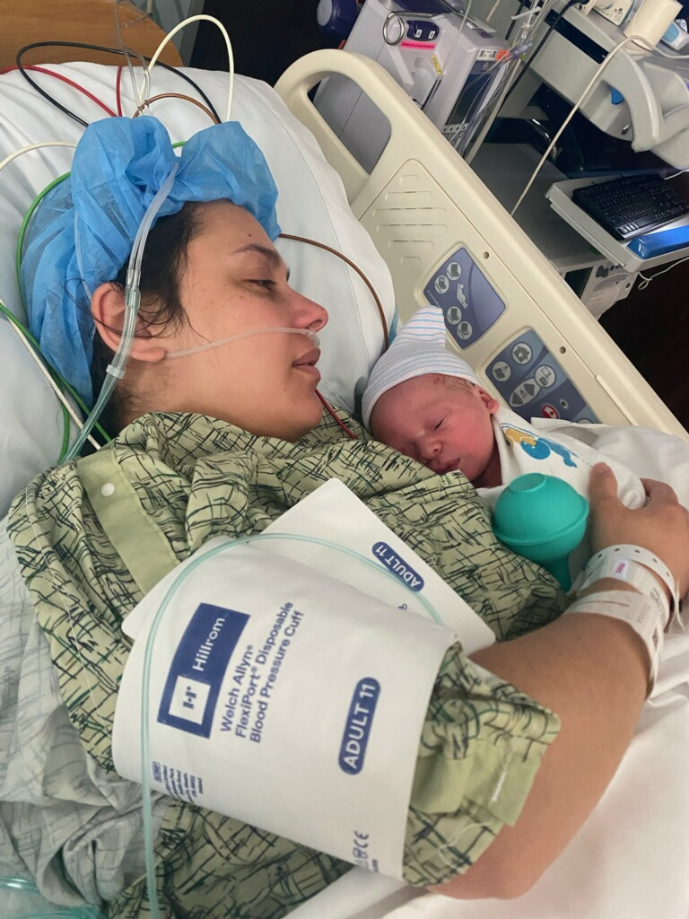
Monday, Feb. 10, 2025
Mother and son healthy
9 lbs. 5 oz, 23 in.
Azariah Bower

Slide 4
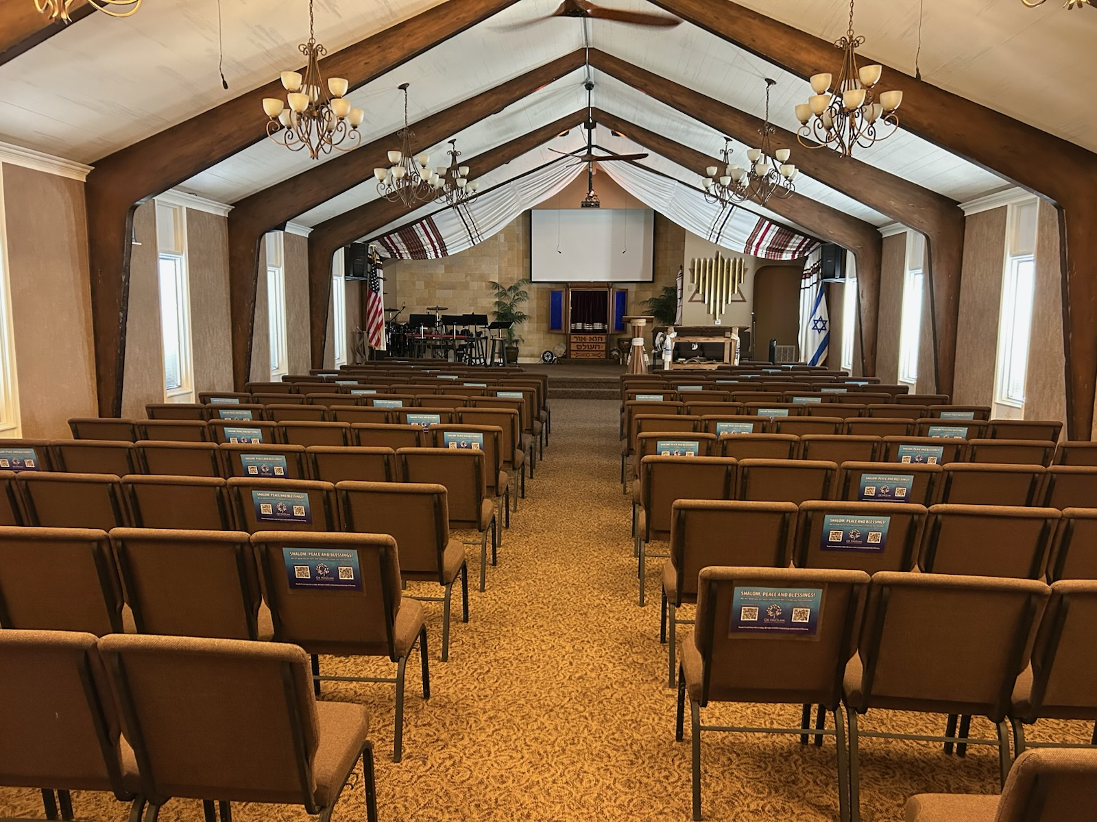
Notes:
If you aren’t quick on the draw to capture the QR code during our quick opening, you have all morning to get it. This will be a legitimate use of cell phones, not emails, texting, or gaming.
BTW, Or Ha guest now. No PW needed.

Slide 5
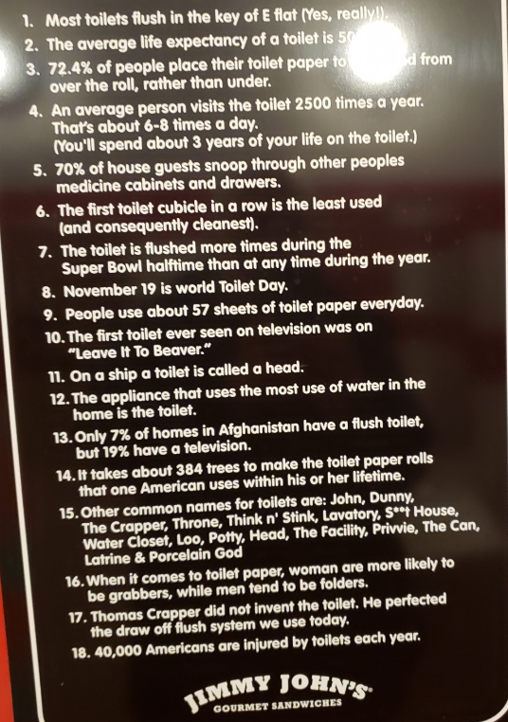
Posted in Jimmy John’s restaurant bathroom

Slide 6

Men’s Meeting curriculum

Slide 7

Testimony of Tommy Cox with the Texas High School Coaches Association re Measure of a Man study
Notes:
clip

Slide 8


Slide 9
^{Shmot / Ex 14.10-15} As Pharaoh approached, the people of Isra’el looked up and saw the Egyptians right there, coming after them. In great fear the people of Isra’el cried out to Adoni and said to Moshe, “Was it because there weren’t enough graves in Egypt that you brought us out to die in the desert?

Slide 10
^{Shmot / Ex 14.10-15} Why have you done this to us, bringing us out of Egypt? Didn’t we tell you in Egypt to let us alone, we’ll just go on being slaves for the Egyptians? It would be better for us to be the Egyptians’ slaves than to die in the desert!” [Go back!]

Slide 11
^{Shmot / Ex 14.10-15} Moshe answered the people, “Stop being so fearful! Remain steady, and you will see how Adoni is going to save you. He will do it today — today you have seen the Egyptians, but you will never see them again! Adoni will do battle for you. Just calm yourselves down!” [Stand still]

Slide 12
^{Shmot / Ex 14.10-15} Adoni asked Moshe, “Why are you crying to me? Tell the people of Isra’el to go forward! Lift your staff, reach out with your hand over the sea, and divide it in two. The people of Isra’el will advance into the sea on dry ground.
Notes:
Prayer
First of all, where was this?

Slide 13
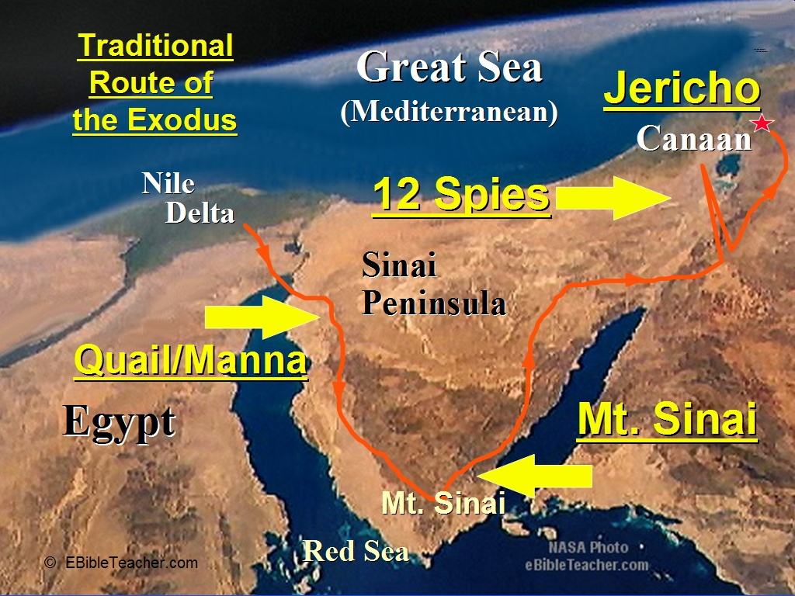
Reed Sea ים סוף
-----------------
Notes:
Backstory: people of Israel left Goshen/Nile Delta and camped at Reed Sea [NOT Red Sea ים סוף]
Panic from Pharoah’s army. Traditional location. Somewhere, between a hostile army and an ocean. PANIC.
People: Go back
Moshe: stand still
G-d: go forward.
Drying out sea, took a little while, even for G-d

Slide 14
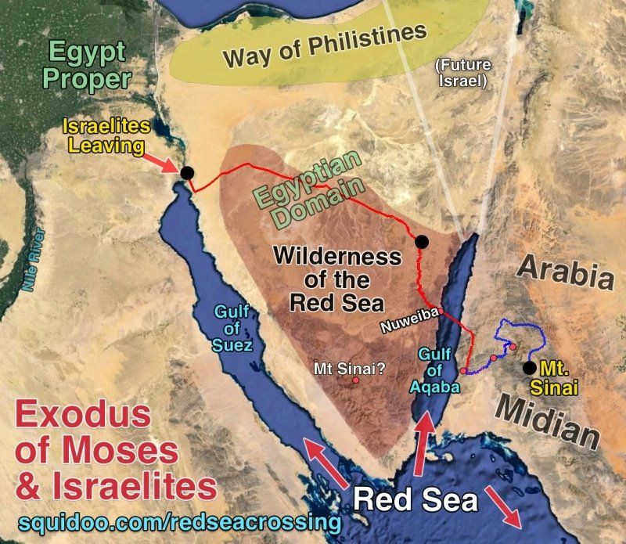
Alternative
Reed Sea [NOT
Red Sea
ים סוף
Yam Suf] crossing.
Notes:
Tim Mahoney supports. Allows 7 days.
We’ll do an archeology study on this.

Slide 16
^{Shmot / Ex 14.10-15} As Pharaoh approached, the people of Isra’el looked up and saw the Egyptians right there, coming after them. In great fear the people of Isra’el cried out to Adoni and said to Moshe, “Was it because there weren’t enough graves in Egypt that you brought us out to die in the desert?

Slide 17
^{Shmot / Ex 14.10-15} Why have you done this to us, bringing us out of Egypt? Didn’t we tell you in Egypt to let us alone, we’ll just go on being slaves for the Egyptians? It would be better for us to be the Egyptians’ slaves than to die in the desert!” [Go back!]

Slide 18
Go Back:
Fear motivated
  FOMO: Fear Of Missing Out
Notes:
Panic mode. Death by Egyptian swords!
Abandon ship.

Slide 19
^{2 Tim 4.10} For Demas, because he has fallen in love with this present world, has deserted me and gone off to Thessalonica; Crescens has gone to Galatia; Titus has gone to Dalmatia
Notes:
Fear apparently, of losing benefits in the material world

Slide 20
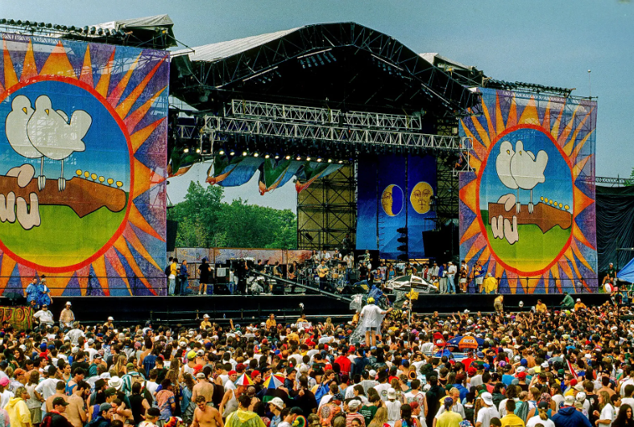
Woodstock music Festival
Aug.15 -18, 1969
Notes:
https://www.worldatlas.com/r/w2000-h1125-q90/upload/0f/03/92/shutterstock-1084821599.jpg

Slide 21
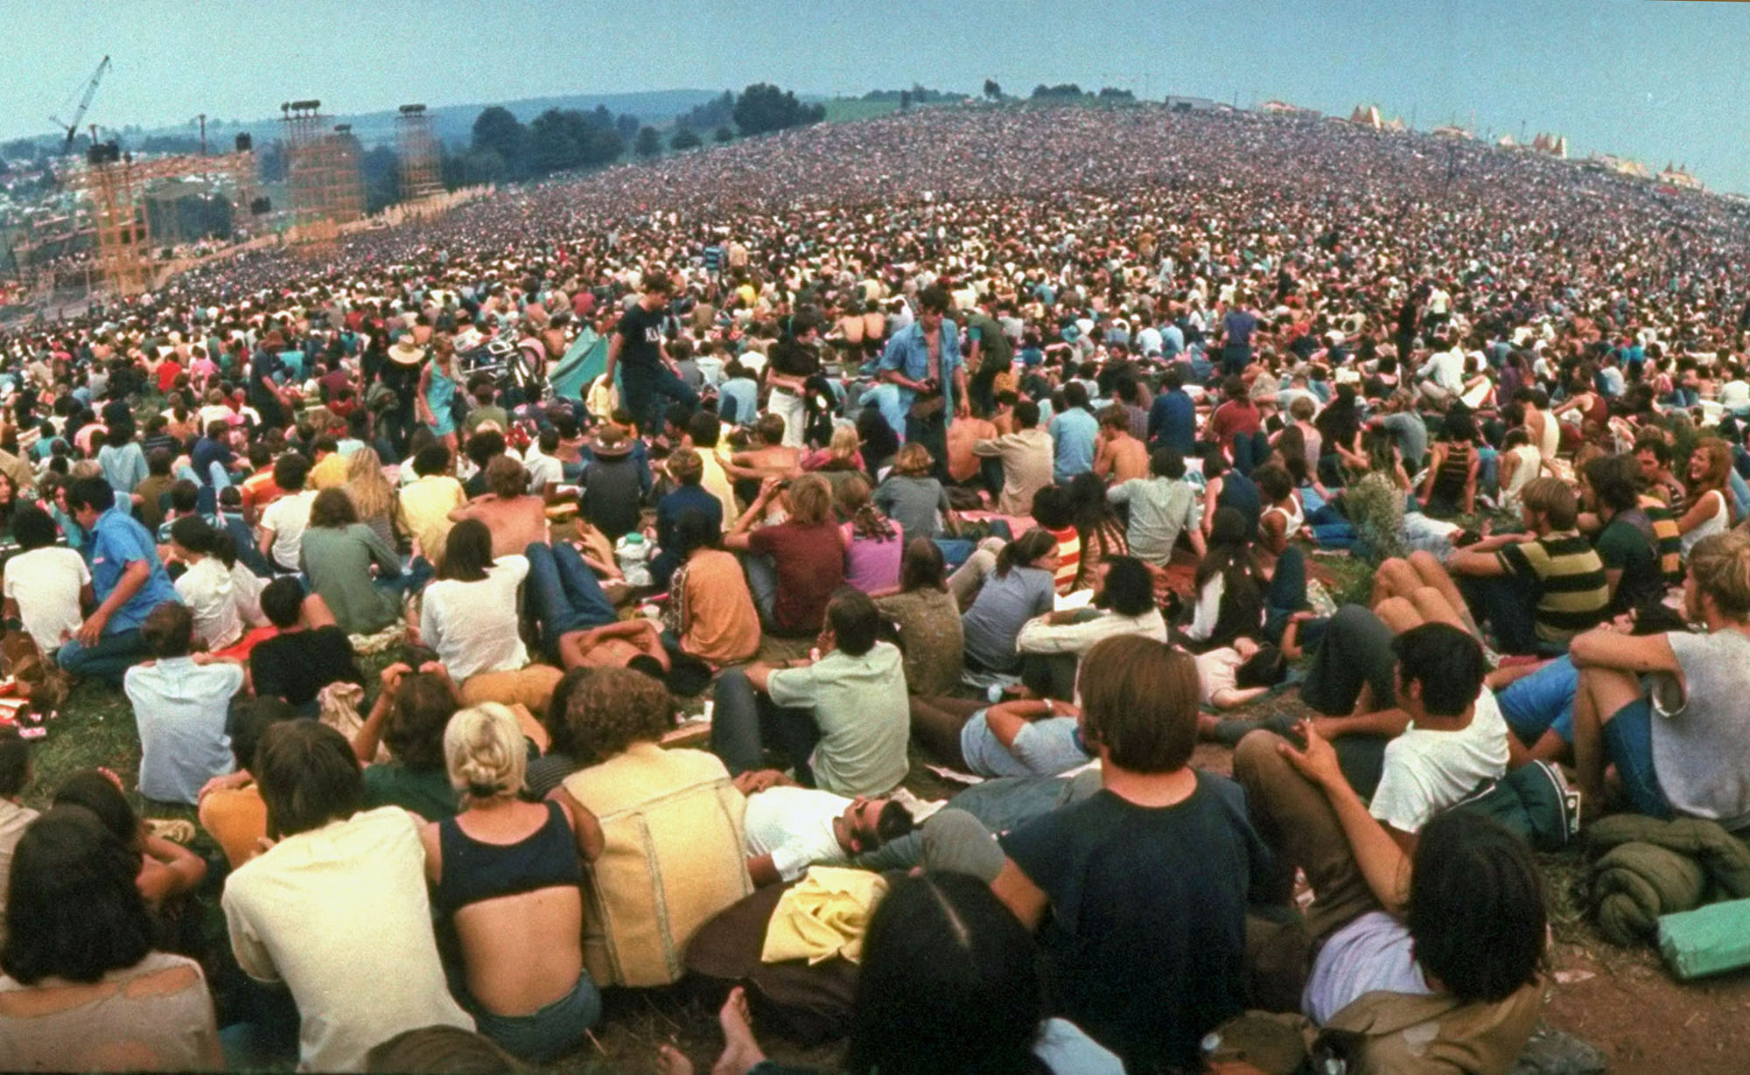
Woodstock music Festival
Aug.15 -18, 1969
Notes:
I came to faith in Messiah in April 1969, glorious revelation. But new enough to the Kingdom when I heard about Woodstock, sort of longing. FOMO music, people, drugs, sex. BUT, glad I didn’t go. Party. Similarly when offered Israel summer 1969 on Kibbutz, kibbutz goddess girls…trouble.
Went in 1971 to Heb U Jerus study program.
It’s sometimes very tempting to go back
There are somethings you have to miss out on.
“Learn more”
https://cdn.theatlantic.com/media/img/photo/2019/08/woodstock/w01_50461159-1/original.jpg

Slide 22
^{Mtt 13.6-7} Other seeds fell among the thorns, and the thorns grew and choked them out

Slide 23
^{Mt 13.18-22} Now the seed sown among thorns stands for someone who hears the message, but it is choked by the cares of the world and the deceitful glamor of wealth, so that it produces nothing.
Notes:
Cares, glamour and glitz

Slide 24
^{Ro 13.13} Let us walk properly as in the day—not in orgies and drunkenness, not in sexual liaisons and sensuality, not in strife and envy.

Slide 25
Go Back:
Fear motivated
  FOMO: Fear Of Missing Out
  Rejection

Slide 26
^{Mtt 13.5-7} Other seeds fell on rocky ground, where they didn’t have much soil. They sprang up immediately, because the soil wasn’t deep. But when the sun came up, they were scorched; and because they had no roots, they withered away.

Slide 27
^{Mt 13.18-22} “So listen to what the parable of the sower means...The seed sown on rocky ground is like a person who hears the message and accepts it with joy at once, but has no root in himself.
Notes:
What does that mean “root in himself”?

Slide 28
^{Mt 13.18-22} So he stays on for a while; but as soon as some trouble or persecution arises on account of the message, he immediately falls away.

Slide 29
^{Mtt 5.1-10} “How blessed are those who are persecuted because they pursue righteousness! for the Kingdom of Heaven is theirs.

Slide 30
^{Mtt 5.11-12} “How blessed you are when people insult you and persecute you and tell all kinds of vicious lies about you because you follow me! Rejoice, be glad, because your reward in heaven is great — they persecuted the prophets before you in the same way.

Slide 31
^{Yn 6.58} So this is the bread that has come down from heaven — it is not like the bread the fathers ate; they’re dead, but whoever eats this bread will live forever!

Slide 32
^{Yn 6.60, 66} On hearing it, many of his talmidim said, “This is a hard word — who can bear to listen to it?”… From this time on, many of his talmidim turned back and no longer traveled around with him.

Slide 33
^{Yn 6.67-69} So Yeshua said to the Twelve, “Don’t you want to leave too?”
Notes:
Leaving the Kingdom and the King because of social pressure, legitimate weirdness [there is illegitimate]

Slide 34


Slide 35
Nosh: We all have known people who are hyper-spiritual about everything. You can’t have a normal conversation with them because all discussion, no matter what the subject, is cloaked in spiritual jargon.

Slide 36
Fear of hostility from Jewish association

Slide 37
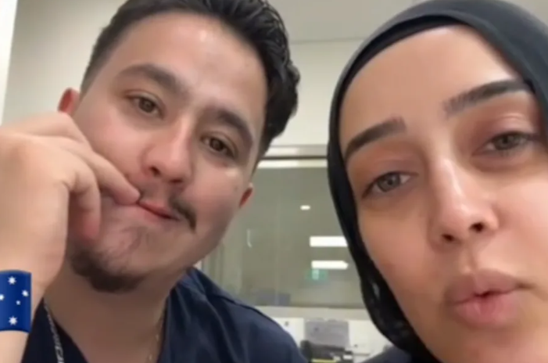
Notes:
https://allisrael.com/antisemitic-healthcare-workers-in-australia-threaten-to-kill-israelis-saying-i-won-t-treat-them-i-ll-kill-them?utm_source=convertkit&utm_medium=email&utm_campaign=Breakthrough%20on%20hostage%20release%20as%20Hamas%20announces%20commitment%20to%20resume%20deal%20-%2016600997

Slide 38
An Afghan-born Sydney nurse, Ahmad Rashad Nadir, and his female colleague Sarah Abu Lebdeh boasted they would not treat Israeli patients and would kill Israelis
Associate with Jews…
Notes:
https://allisrael.com/antisemitic-healthcare-workers-in-australia-threaten-to-kill-israelis-saying-i-won-t-treat-them-i-ll-kill-them?utm_source=convertkit&utm_medium=email&utm_campaign=Breakthrough%20on%20hostage%20release%20as%20Hamas%20announces%20commitment%20to%20resume%20deal%20-%2016600997

Slide 39
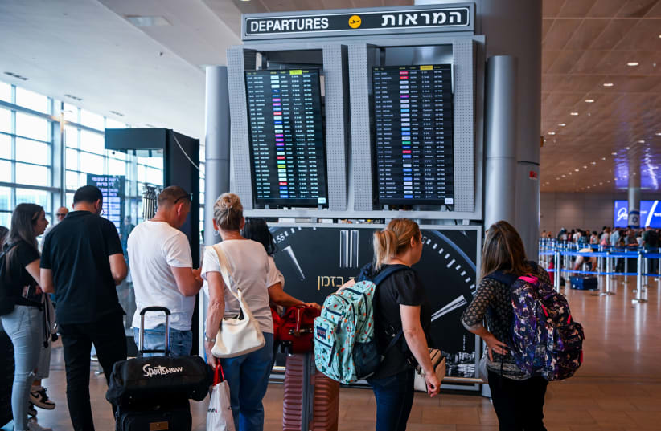
Passengers at the Ben Gurion
International airport near
Tel Aviv on June 9, 2024
Notes:
(photo credit: ARIE LIEB ABRAMS/FLASH90)

Slide 40
Israelis are emigrating abroad in numbers the country has never seen before – taking with them their money, education, and professional skills. The numbers behind this movement indicate long-term harm to Israel, even far from the conflict zones in the North and South.
Notes:
https://www.jpost.com/israel-news/article-824369

Slide 41
In the first seven months of this year, 40,600 people left the country, an average of 2,200 more each month than in 2023.
Notes:
https://www.jpost.com/israel-news/article-824369

Slide 42
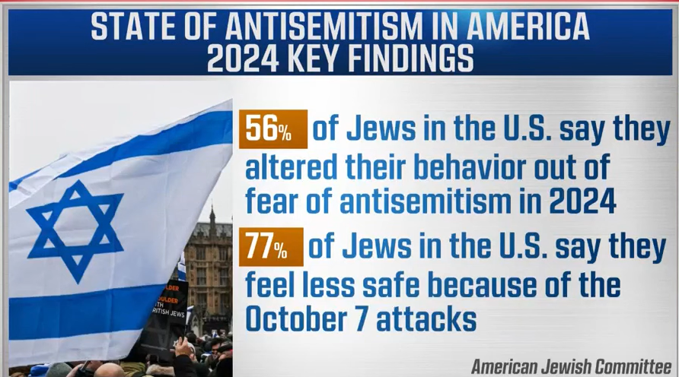
Notes:
Love Jewish things, heritage cf love Jewish people and Israel. I can’t turn it off. Name. Face, kippah, job. Some of you can.
https://www.ajc.org/AntisemitismReport2024/Ted-on-CNN-Feb12?_hsenc=p2ANqtz--p-Im18V8H6ErACVR1rBasv69nl00L4hWQaphBSvXcnjB1DKaBQf5wkBpbANihic04VyazfTT-kpEcPpb-TIF3QagVYA&_hsmi=347105623&utm_campaign=SOAR%202024&utm_medium=email&utm_content=347105623&utm_source=hs_email

Slide 43
As AJC CEO Ted Deutch said, “Antisemitism has reached a tipping point in America… That one-third of American Jews have been the target of antisemitism in the past year should raise red flags for every American and our leaders.”

Slide 44
Similar in 1967
Nasser’s incendiary speech
Levi Eshkol trembling, intimidated speech
UN withdrew

Slide 45
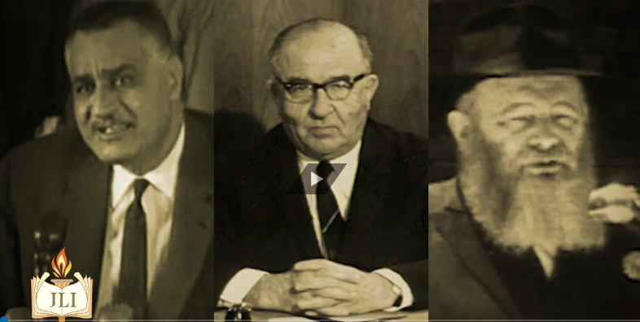
Gamal Abdel Nasser
& Levi Eshkol

Slide 46
In November 2022, for instance, USAID awarded $100,000 to a Palestinian activist group whose leaders hailed the Popular Front for the Liberation of Palestine, a designated terror group.
Notes:
https://unitedwithisrael.org/at-usaid-funding-for-terror-tied-groups-and-internal-hostility-toward-israel-goes-back-years/

Slide 47
Just six days before Hamas’s Oct. 7 assault on Israel, USAID handed $900,000 “to a terror charity in Gaza involved with the son of Hamas leader Ismail Haniyeh.”
Notes:
https://unitedwithisrael.org/at-usaid-funding-for-terror-tied-groups-and-internal-hostility-toward-israel-goes-back-years/

Slide 48
A February report from the Middle East Forum think tank found that USAID had awarded “millions of federal dollars” to “organizations directly in Gaza controlled by Hamas.”

Slide 49
Go Back:
Fear motivated
  FOMO: Fear Of Missing Out
  Rejection
  Life failure

Slide 50
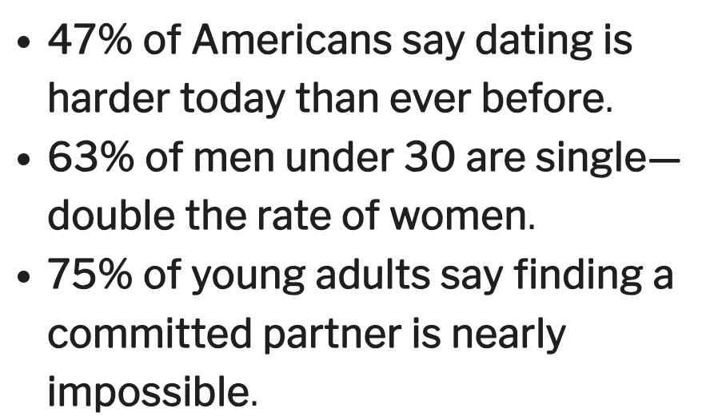

Slide 51
Go Back:
Fear motivated
  FOMO: Fear Of Missing Out
  Rejection
  Life failure
  Sinful failure Anger/bitterness

Slide 52
^{Ro 7.22-24} For in my inner self I completely agree with God’s Torah; but in my various parts, I see a different “torah,” one that battles with the Torah in my mind and makes me a prisoner of sin’s “torah,”

Slide 53
^{Ro 7.22-24} which is operating in my various parts. What a miserable creature I am! Who will rescue me from this body bound for death?

Slide 54
Notes:
Standing still is a GREAT thing to do, in most cases.

Slide 55
^{Shmot / Ex 14.10-15} Moshe answered the people, “Stop being so fearful! Remain steady, and you will see how Adoni is going to save you. He will do it today — today you have seen the Egyptians, but you will never see them again! Adoni will do battle for you. Just calm yourselves down!” [Stand stil]

Slide 56
^{T’hillim Ps 46.11-12} “Be still, and know that I am God. I am exalted among the nations. I am exalted in the earth.” Adoni-Tzva’ot is with us.
The God of Jacob is our strong tower.

Slide 57
^{Iyov / Job 37.14} “Listen to this, Iyov/Job: stand and consider God’s wonders. Do you know how God orders them, and makes the lightning flash in His cloud?

Slide 58
^{T’hillim / Ps 37.7-8} Be still before Adoni; wait patiently till he comes. Don’t be upset by those whose way succeeds because of their wicked plans. Stop being angry, put aside rage, and don’t be upset — it leads to evil.

Slide 59
^{Hab 2.20} Adoni is in his holy temple;
let all the earth be silent before him.
^{Zekh 2.17} Be silent before Adonai, all flesh, for He has aroused Himself from His holy dwelling.”

Slide 61
^{Shmot / Ex 14.10-15} Adoni asked Moshe, “Why are you crying to me? Tell the people of Isra’el to go forward! Lift your staff, reach out with your hand over the sea, and divide it in two. The people of Isra’el will advance into the sea on dry ground.

Slide 62
^{Yn 6.67-69} So Yeshua said to the Twelve, “Don’t you want to leave too?” Peter Shim‘on Kefa answered him, “Lord, to whom would we go? You have the word of eternal life. We have trusted, and we know that you are the Holy One of God.”
Notes:
No where else to go

Slide 63
^{Mtt 6.12-13} Forgive us what we have done wrong, as we too have forgiven those who have wronged us. And do not lead us into hard testing, but keep us safe from the Evil One.
Notes:
So, normative in the Kingdom to be addressing weakness, even failure. BUT address it.

Slide 64
^{Ro 6.12-14} Therefore, do not let sin rule in your mortal bodies, so that it makes you obey its desires; and do not offer any part of yourselves to sin as an instrument for wickedness. On the contrary, offer yourselves to God as people alive from the dead,

Slide 65
^{Ro 6.12-14} and your various parts to God as instruments for righteousness. For sin will not have authority over you; because you are not under legalism but under grace.
Notes:
We are all a mess at times, deep down. But His grace is sufficient. Seek Him, Love Him, worship Him, T’shuvah / Repentance

Slide 66
Go forward in prayer

Slide 67
Notes:
Nasser, Eshkol, Schneerson

Slide 68
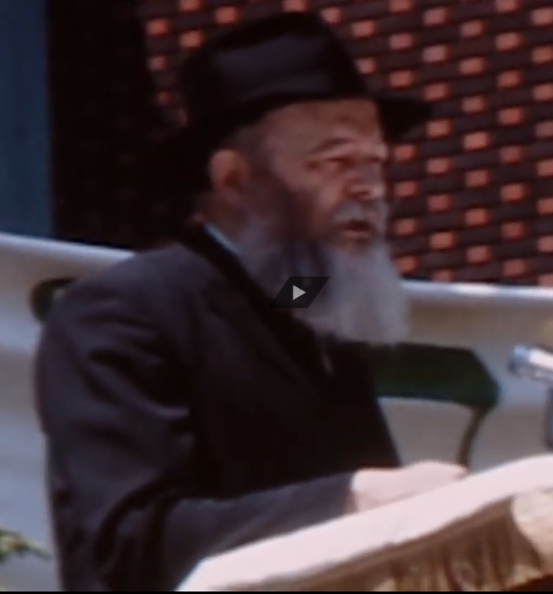
On June 3, 1967 – two days before fighting began – the Lubavitcher Rebbe Rabbi Menachem M. Schneerson
Notes:
https://youtu.be/zQ8gS0zw7rE

Slide 69
announced what was regarded as a radical step: Every Jewish man – no matter where he was, no matter his level of religious observance – should help safeguard Israel by putting on Tefillin.
Notes:
First day Israel destroyed entire Egyptian and Syrian air forces. Took Sinai, Judea Samaria, Jerusalem, Golan.

Slide 70
Go forward in
community ingathering
Notes:
Stuck 1970s Reese Howells?

Slide 71
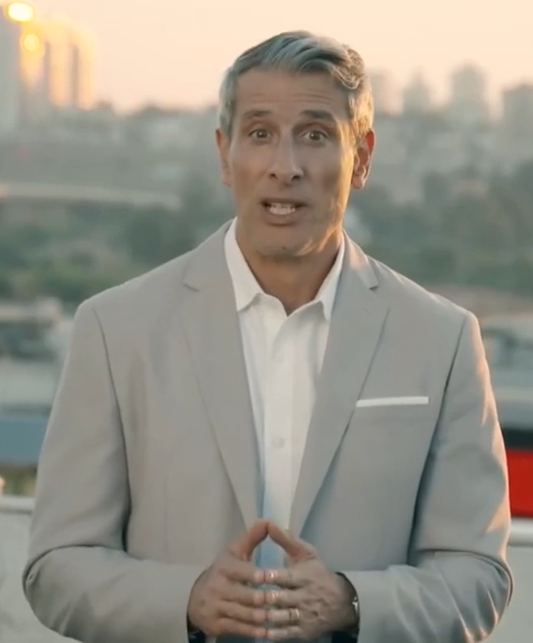
Erez Soref, founder of OneforIsrael

Slide 72
We have our own OneForIsrael digital outreach / Ingathering strategy. 5 testimonies soon to be published on our website.

Slide 73
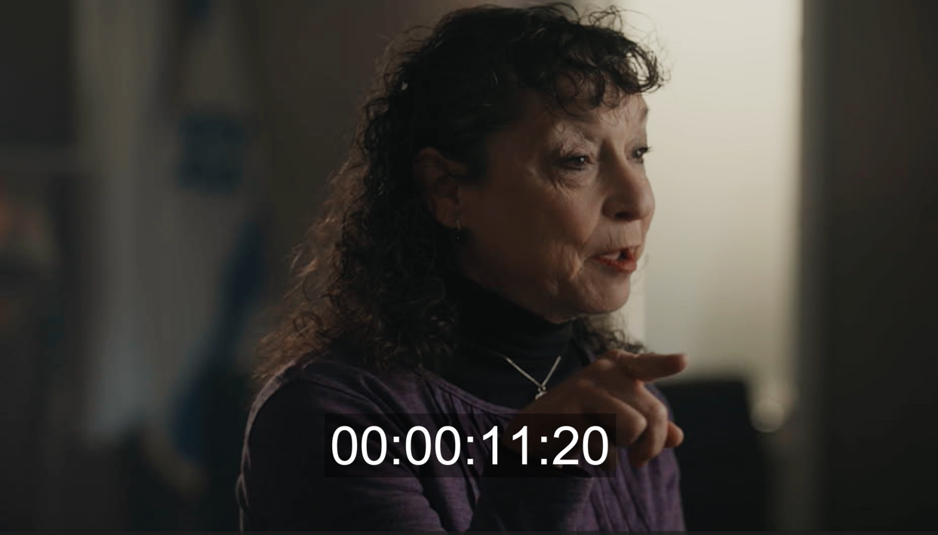

Slide 74
Forward: Kingdom inward and outward
Plus Speak direct: me at J
Invite to in person and webstream
Servants here.
Schmoozers here.
Notes:
We could change third hour of prayer to a third Shabbat oneg, but we need a lot more oneg workers. Speak to Dawn

Slide 75
Forward: Kingdom inward and outward
Plus Speak direct: me at J
Invite to in person and webstream
Servants here.
Schmoozers here.
Mental health strategy

Slide 76

Laughter is the Best Medicine
Notes:
.Halfpoint/Shutterstock https://www.theepochtimes.com/health/laughter-is-the-best-medicine-1412645?ea_src=author_manual&ea_med=related_stories

Slide 77
^{Mishlei/ Prov 17.22 TLV} A cheerful heart is good medicine, but a crushed spirit dries up the bones.
^{DARBY} A joyful heart promotes healing; but a broken spirit dries up the bones.
Notes:
https://www.theepochtimes.com/health/laughter-can-reverse-disease-and-help-you-live-longer-heres-how-5801771?utm_source=Health&src_src=Health&utm_medium=email&utm_campaign=health-2025-02-11&src_cmp=health-2025-02-11&est=AAAAAAAAAAAAAAAAcuomYBYAh9bH4LguuWhYArg0yEwDi4CakWZxJkVclaEQIH3YkA%3D%3D

Slide 78
^{AMP} A happy heart is good medicine and a joyful mind causes healing, But a broken spirit dries up the bones.

Slide 79
For starters, laughter has been shown to decrease pro-inflammatory cytokines, making it an ally in lowering persistent inflammation—a factor involved in every chronic health condition from diabetes and arthritis
Notes:
https://www.theepochtimes.com/health/laughter-can-reverse-disease-and-help-you-live-longer-heres-how-5801771?utm_source=Health&src_src=Health&utm_medium=email&utm_campaign=health-2025-02-11&src_cmp=health-2025-02-11&est=AAAAAAAAAAAAAAAAcuomYBYAh9bH4LguuWhYArg0yEwDi4CakWZxJkVclaEQIH3YkA%3D%3D

Slide 80
to heart disease and metabolic syndrome. With each laugh, you’re dialing down inflammation, an essential step in disease prevention and reversal.
Notes:
https://www.theepochtimes.com/health/laughter-can-reverse-disease-and-help-you-live-longer-heres-how-5801771?utm_source=Health&src_src=Health&utm_medium=email&utm_campaign=health-2025-02-11&src_cmp=health-2025-02-11&est=AAAAAAAAAAAAAAAAcuomYBYAh9bH4LguuWhYArg0yEwDi4CakWZxJkVclaEQIH3YkA%3D%3D

Slide 81
Type 2 diabetes, laughter can lower blood glucose levels and delay cardiovascular complications.

Slide 82
A good laugh also works wonders for lowering blood pressure and elevating mood by reducing stress hormones such as cortisol and adrenaline.

Slide 83
Laughter can kill cancer cells. A hearty chortle boosts the activity of specific immune cells that target and destroy cancer cells.

Slide 84
Laughing enhances memory, especially in older adults. Among adults aged 65 and older, sharing laughter—whether with friends, children, or grandchildren or even while listening to the radio—has been associated with a lower risk of dementia, according to a 2022 study.

Slide 85
Laughter strengthens immunity. A 2001 study in Alternative Therapies in Health and Medicine showed that watching a humorous video for an hour improved immune markers, including T and B cells.

Slide 86
A 2020 study found that among people aged 40 and older, those who laughed less than once a month had a significantly higher risk of all-cause mortality than those who laughed at least once a week.
Notes:
So, how do we do this?

Slide 87
Why did the mushroom get invited to all the parties?

Slide 88
Why did the mushroom get invited to all the parties?
Because he’s a fungi!

Slide 89
What do you get when you pamper a cow?

Slide 90
What do you get when you pamper a cow?
Spoiled milk!

Slide 92
^{Shmot / Ex 14.10-15} As Pharaoh approached, the people of Isra’el looked up and saw the Egyptians right there, coming after them. In great fear the people of Isra’el cried out to Adoni and said to Moshe, “Was it because there weren’t enough graves in Egypt that you brought us out to die in the desert?

Slide 93
^{Shmot / Ex 14.10-15} Why have you done this to us, bringing us out of Egypt? Didn’t we tell you in Egypt to let us alone, we’ll just go on being slaves for the Egyptians? It would be better for us to be the Egyptians’ slaves than to die in the desert!” [Go back!]

Slide 94
^{Shmot / Ex 14.10-15} Moshe answered the people, “Stop being so fearful! Remain steady, and you will see how Adoni is going to save you. He will do it today — today you have seen the Egyptians, but you will never see them again! Adoni will do battle for you. Just calm yourselves down!” [Stand still]

Slide 95
^{Shmot / Ex 14.10-15} Adoni asked Moshe, “Why are you crying to me? Tell the people of Isra’el to go forward! Lift your staff, reach out with your hand over the sea, and divide it in two. The people of Isra’el will advance into the sea on dry ground.
Notes:
First of all, where was this?

Slide 96
Go forward
Spiritually by repenting entering into Yeshua’s life
Prayer and intercession
Outreach Ingathering: Schmoozers, oneg helper
Laughing: sharing joy.
Notes:
Stay for the third hour. Come up to pray or tell a joke?!

