Slide 1
e-handout
To have these notes
without taking notes
Go to OrHaOlam.com
Click on Messages tab,
2025 Messages

Slide 2

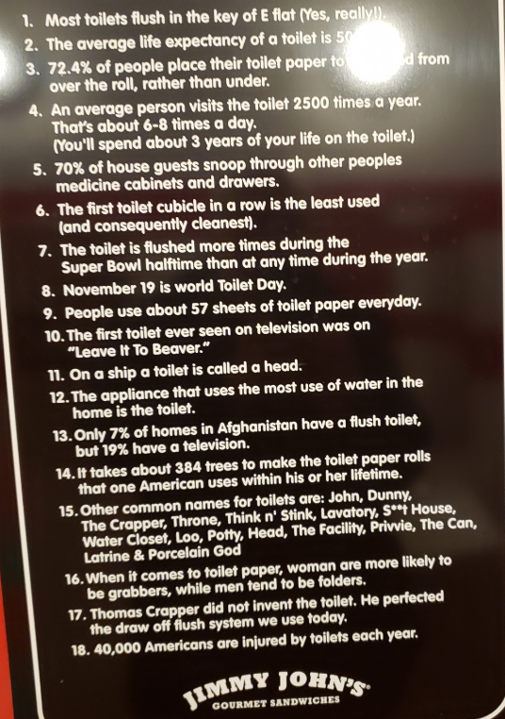
From Jimmy Johns

Slide 3
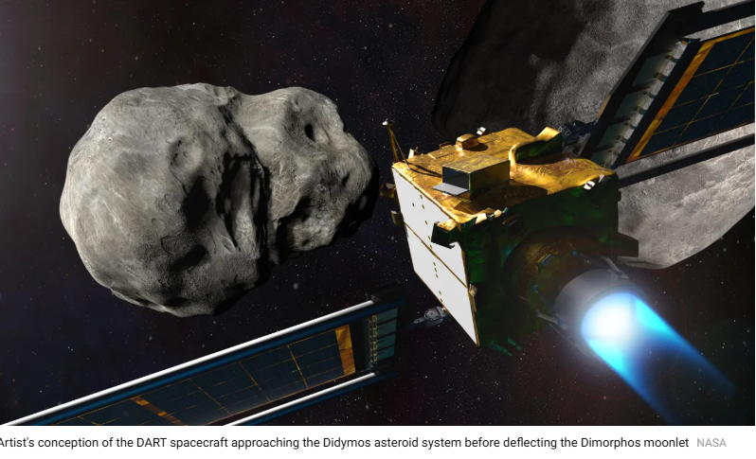
Impending calamity

Slide 4
It’s only recently that we became aware of 2024 YR4 at all. The rock was discovered on Dec. 27, 2024, by the NASA-funded Asteroid Terrestrial-Impact Last Alert System (ATLAS) telescope in Chile. [Viewable in S Hemisphere due to curvature of the earth.]
Notes:
https://time.com/7225374/do-you-need-to-worry-about-asteroid-2024-yr4-hitting-earth/?utm_source=beehiiv&utm_medium=email&utm_campaign=newsletter-the-brief&_bhlid=2dc81d40346cec6b218623d20c7ffe784f45f0b1

Slide 5

It is moving fast—about 38,000 mph, according to NASA’s calculations, or more than twice the velocity of an Earth-orbiting satellite. It’s that screaming speed that causes even a relatively small asteroid to pack such a destructive wallop.
Notes:
https://time.com/7225374/do-you-need-to-worry-about-asteroid-2024-yr4-hitting-earth/?utm_source=beehiiv&utm_medium=email&utm_campaign=newsletter-the-brief&_bhlid=2dc81d40346cec6b218623d20c7ffe784f45f0b1
17,000 mph is the speed of low earth orbit, like the ISS

Slide 6
Dec. 22, 2032. That’s the day the asteroid dubbed 2024 YR4 may strike our planet. According to NASA, the odds of a collision are just 2.3%.

Slide 7
But that nearly doubles the 1.2% risk the U.S. space agency and the European Space Agency (ESA) calculated in late January.
Dec. 22, 2032
Notes:
Only 7 years away!

Slide 8

Facts are funnier than fiction
Notes:
More hilarious than fiction

Slide 9
Musk’s Department of Government Efficiency, or DOGE, discovered the data while reviewing SSA records for potential waste or fraud.
Notes:
https://www.theepochtimes.com/us/database-lists-12-million-people-older-than-120-eligible-for-social-security-musk-5811532?utm_source=Morningbrief&src_src=Morningbrief&utm_campaign=mb-2025-02-18&src_cmp=mb-2025-02-18&utm_medium=email&est=AAAAAAAAAAAAAAAAcuomYBYAh9bH4LguuWhYArg0yEwDi4CakWZxJkVclaEQIH3YkA%3D%3D
Disputed at
https://www.marketbeat.com/articles/tens-of-millions-of-dead-people-arent-getting-social-security-checks-despite-trump-and-musk-claims-2025-02-18/?utm_source=miximedia&utm_medium=miximedia

Slide 10
120-129-year-olds are getting 3.5 million checks each month from Social Security.
130-139-year-olds are getting 3.9 million monthly checks.
140-149-year-olds are getting 3.5 million monthly checks.
Notes:
Liberty Counsel Action is a 501(c)(4) tax-exempt non-profit organization. Donations are not tax-deductible.

Slide 11
150-159-year-olds are getting 1.3 million monthly checks.
160-169-year-olds are getting 121,807 monthly checks.
170-179-year-olds, are getting 6,087 monthly checks.
180–189-year-olds are getting 695 monthly checks.
Notes:
Liberty Counsel Action is a 501(c)(4) tax-exempt non-profit organization. Donations are not tax-deductible.

Slide 12
190-199-year-olds are getting 448 monthly checks.
200-209-year-olds are getting 879 monthly checks.
210-219-year-olds are getting 866 monthly checks.
Notes:
Liberty Counsel Action is a 501(c)(4) tax-exempt non-profit organization. Donations are not tax-deductible.

Slide 13
220-229-year-olds are getting 1,039 monthly checks.
And there are checks being mailed to one person recorded as between 240-249 years old and the other as 360-369 years old!
Notes:
Liberty Counsel Action is a 501(c)(4) tax-exempt non-profit organization. Donations are not tax-deductible.

Slide 14
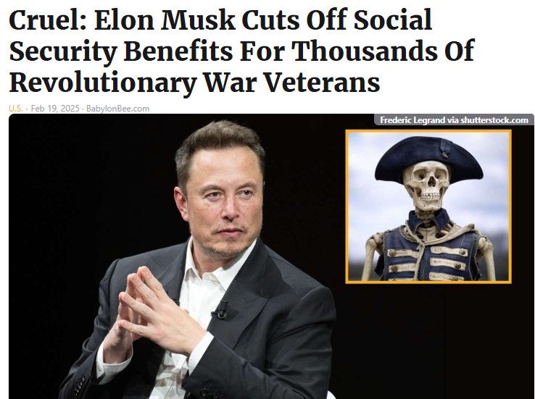
Notes:
You can’t make this stuff up! Truth is funnier than fiction!!

Slide 15
There are 12.4 million monthly Social Security checks being issued to “people” who, according to records, are 120 or more years old!
Notes:
Liberty Counsel Action is a 501(c)(4) tax-exempt non-profit organization. Donations are not tax-deductible.

Slide 16
Furthermore, if we total up the number of people listed as “eligible” for Social Security, which is 398.4 million people — then compare that total to the U.S. population of 341 million, there are 57 million MORE people “eligible” than the total U.S. population!
Notes:
Liberty Counsel Action is a 501(c)(4) tax-exempt non-profit organization. Donations are not tax-deductible.

Slide 17
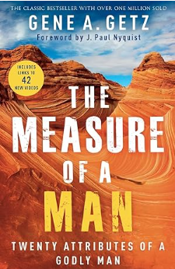
Men’s Meeting curriculum
Notes:
An issue spoke to my heart that was my “download” for the message.

Slide 18
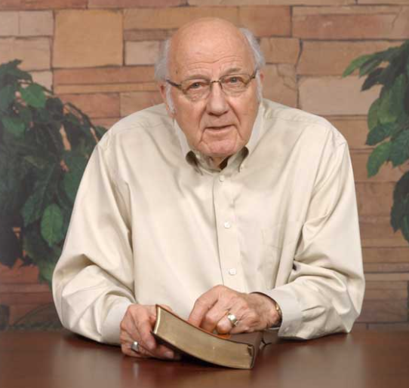
Gene Getz
Notes:
Story p 26-27
SW story re monthly lunches with my 4 kids

Slide 19
^{Yaakov 1.19} Know this, my dear brothers and sisters: let every person be quick to listen, slow to speak, and slow to anger.

Slide 20


Slide 21

Notes:
Note Jeremy’s artwork, much appreciated.

Slide 22
^{Yaakov/James 1.19} Let every person be
quick to listen, slow to speak
Listening to G-d
Listening to people
When truth is utterly violated.
Rebuke

Slide 23
^{Yaakov/James 1.19} Let every person be
quick to listen, slow to speak
Listening to G-d
Listening to people
When truth is utterly violated.
Rebuke

Slide 24
Greatest commandment according to Messiah and to midrash?
^{Dt. 6.4} שְׁמַע, יִשְׂרָאֵל יְיָ אֱלֹהֵינוּ, יְיָ אֶחָד.
Sh’ma, Yisra’el! Adoni Eloheinu, Adoni ekhad. Hear,Israel! Adoni our God, Adoni is one.
Notes:
Many times in Revelation: He that has ears to hear, let him hear.
Also, an apocalyptic sense to the parable use. Hear the end.

Slide 25
Mattityahu (Matthew) 13:1
בַּיּוֹם הַהוּא יָצָא יֵשׁוּעַ מִן הַבַּיִת וְיָשַׁב עַל-יַד הַיָּם.
That same day, Yeshua went out of the house and sat down by the lake;

Slide 26
Mattityahu (Matthew) 13:2
כֵּיוָן שֶׁנִּקְהֲלוּ אֵלָיו הֲמוֹן עַם רַב יָרַד לַסִּירָה לָשֶׁבֶת בָּהּ וְכָל הֶהָמוֹן עָמַד עַל הַחוֹף.
but such a large crowd gathered around him that he got into a boat and sat there while the crowd stood on the shore.

Slide 27
Mattityahu (Matthew) 13:3a
אָז דִּבֵּר אֲלֵיהֶם רַבּוֹת בִּמְשָׁלִים
He told them many things in parables:
מָשָׁל שֵם ז'proverb, fable, allegory
Notes:
Several types of parables in Tanakh/Heb scrip
Stories: Yekhez Ezk 24 Jerusalem like a cauldron boiled dry, ~in judgement
Ju 9.7 contention among the sons of Gideon parable of the trees.
Is 5 vineyard like Israel
Rabbinic style also
Greeks used fables but different.

Slide 28
^{Psalm 78.0-2} Listen, my people, to my teaching; turn your ears to the words from my mouth. I will speak to you in parables and explain mysteries from days of old.
Hidden truth?
Notes:
a short allegorical story designed to illustrate or teach some truth, religious principle, or moral lesson.
a statement or comment that conveys a meaning indirectly by the use of comparison, analogy, or the like.

Slide 29
^{Mattityahu 13.10-17} Then the talmidim came and asked Yeshua, "Why are you speaking to them in parables?“ He answered, "Because it has been given to you to know the secrets of the Kingdom of Heaven, but it has not been given to them.

Slide 30
^{Mattityahu 13.10-17} For anyone who has something will be given more, so that he will have plenty; but from anyone who has nothing, even what he does have will be taken away. Here is why I speak to them in parables:

Slide 31
^{Mattityahu 13.10-17} they look without seeing and listen without hearing or understanding. That is, in them is fulfilled the prophecy of Yesha`yahu [Isaiah] which says, `You will keep on hearing but never understand, and keep on seeing but never perceive,

Slide 32
^{Mattityahu 13.10-17} because the heart of this people has become dull -- with their ears they barely hear, and their eyes they have closed, so as not to see with their eyes, hear with their ears, understand with their heart, and do t'shuvah, so that I could heal them.'
Notes:
So, the question to ask ourselves is, are we hearing from G-d? Time in His word with obedient ears. Do, and obey, do and repent, do and allow the Spirit to work!!
It’s NOT a given that reading = receiving unless we have a yielded heart.

Slide 33
^{Mattityahu 13.10-17} But you, how blessed are your eyes, because they see, and your ears, because they hear! Yes indeed! I tell you that many a prophet and many a tzaddik longed to see the things you are seeing but did not see them, and to hear the things you are hearing but did not hear them.
Notes:
Mystery to me since 1969 when I came to faith.

Slide 34
Why are some people’s eyes open, other closed?
~Karate lessons?: 6 different katas

Slide 35
^{Eph 5.13-14} But everything exposed to the light is revealed clearly for what it is, since anything revealed is a light. This is why it says, "Get up, sleeper! Arise from the dead, and the Messiah will shine on you!"
Notes:
Why do some people get the light, the revelation, some don’t. Just don’t have karate minds??

Slide 36
Sovereign choice
^{Acts 9.15} “This man is my chosen instrument to carry my name to the Goyim, even to their kings, and to the sons of Isra’el as well.”
Notes:
G-d’s description to Hananyah/Ananias about rebirth of Shaul.
Absolute choice? Just way easier. Shaul still could have resisted.

Slide 37
Selective Sealing ^{2 Cor. 4.2-4} We refuse to make use of shameful underhanded methods, employing deception or distorting God’s message. On the contrary, by making very clear what the truth is, we commend ourselves to everyone’s conscience in the sight of God.
Notes:
This is a reason why some don’t, or why it’s harder.

Slide 38
^{2 Cor. 4.2-4} So if indeed our Good News is veiled, it is veiled only to those in the process of being lost. They do not come to trust because the god of the ‘olam hazeh has blinded their minds, in order to prevent them from seeing the light shining from

Slide 39
^{2 Cor. 4.2-4} the Good News about the glory of the Messiah, who is the image of God.
Notes:
Pharaoh hardened his heart.
Absolute veiling, or just way more difficult?
We need to pray for those around us to have “hearing ears.” “No one can come to me except my father draw him.”

Slide 40
Are you hearing daily from G-d’s Word?
How are you applying what you heard?
Are you sharing that insight with anyone?

Slide 42
^{Yaakov/James 1.19} Let every person be
quick to listen, slow to speak
Listening to G-d
Listening to people
When truth is utterly violated.
Rebuke

Slide 43
We have TWO ears and one mouth. Is there a lesson?

Slide 44
We have TWO ears and one mouth. Is there a lesson?
Hear twice as much as we speak!

Slide 45

Notes:
https://www.bing.com/videos/riverview/relatedvideo?q=How+to+Resolve+Conflict+Resolution&&mid=65B2A8B64E06DA0639AF65B2A8B64E06DA0639AF&FORM=VCGVRP

Slide 46
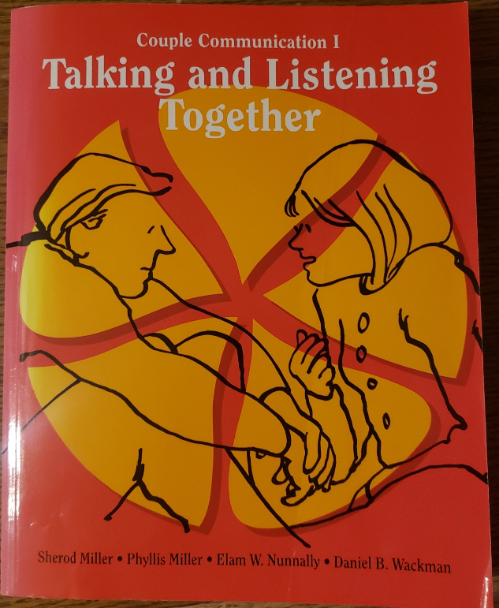
Notes:
Dawn and I took a class in communication. For marriage, but not only for marriage. Any relational dynamic, friend, family, co-worker.

Slide 47
How to hear someone:

Slide 48
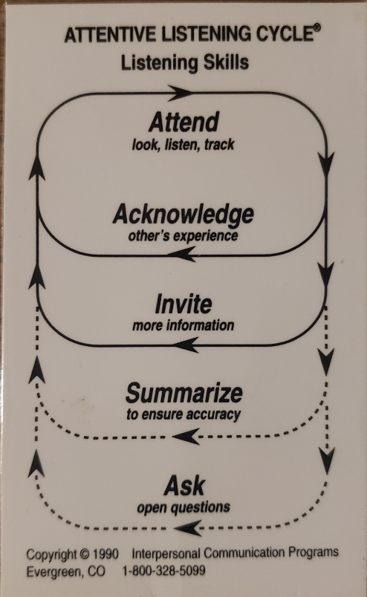
Notes:
Attend: eye contact. Put your phone away. Hands OFF keyboard. Don’t focus on your response. Make brief notes, but focus on the one you are hearing!
Acknowledge: nod, uh-huh, yes, indeed!
Invite: Tell me more about that. Please give me an illustration of that concept.
Summarize: briefly, without comment or evaluation or negation or agreement, restate what you heard. Without sarcasm!
Ask: Open questions, not yes or no questions.
Only when you can acceptable summarize do you get your turn to speak.

Slide 49
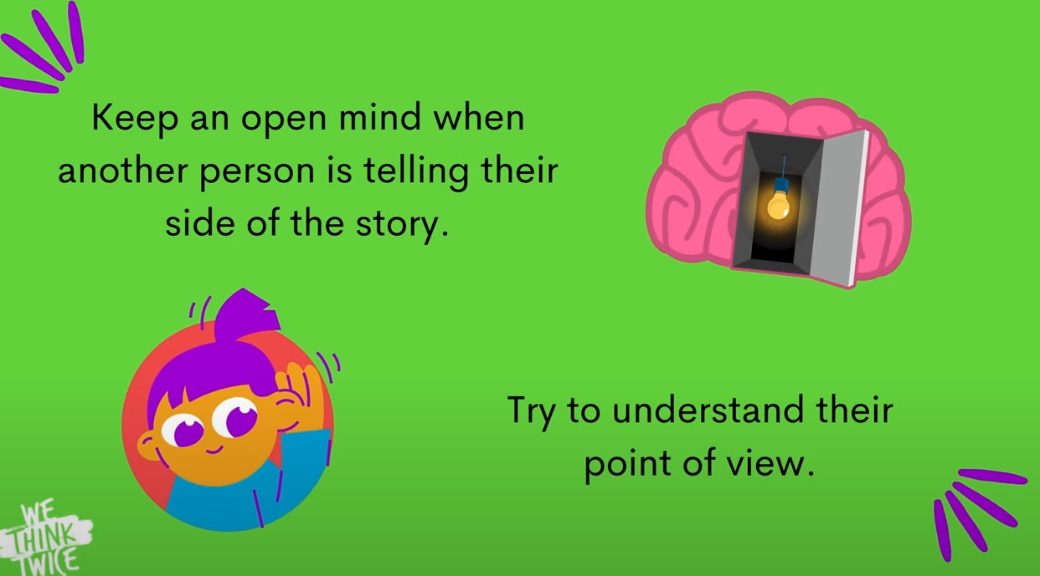
Notes:
https://www.bing.com/videos/riverview/relatedvideo?q=How+to+Resolve+Conflict+Resolution&&mid=65B2A8B64E06DA0639AF65B2A8B64E06DA0639AF&FORM=VCGVRP

Slide 50
Don’t interrupt.
to stop or hinder by breaking in
to cause a disruption in a conversation or discussion

Slide 51


Slide 52

Notes:
Very hard for a New Yorker. If you just can’t wait, Golden words, “Excuse me.”

Slide 53
When I was a science & math teacher, the key to the success I had is when I could discern where a student was stuck in understanding something.
“Mr. Wolkenfeld, this makes no sense at all!”
Notes:
I had slides and illustrations then, just like now. The truth of chemistry is not different from the truth of theology.
The speed of sound affected by temperature is LIKE the openness of heart affected by the Ruakh.
“No sense at all,” seems really negating my whole presentation.

Slide 54
“Can you be a little more specific?”
Unlock the key disconnect.
Notes:
Two students in 11 years who would frequently reverse some concept which would undermine the whole dynamic. Listen over and over and get it.
Listen. Think how they are thinking.
Applies to our communication of Yeshua. Sometimes people may see flaws in our lives.

Slide 55
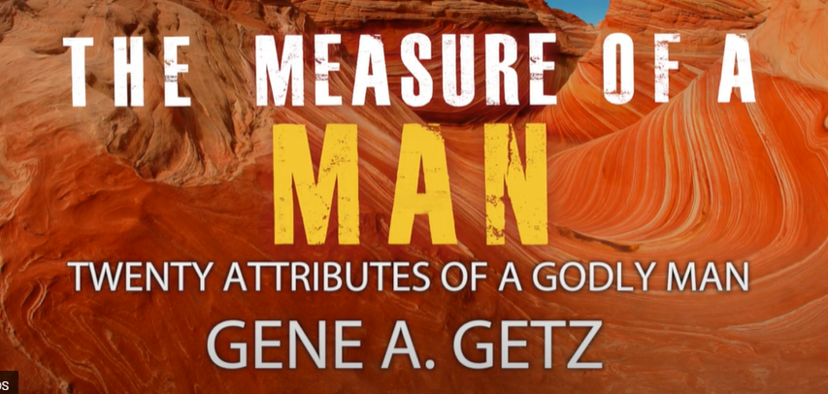

Slide 56
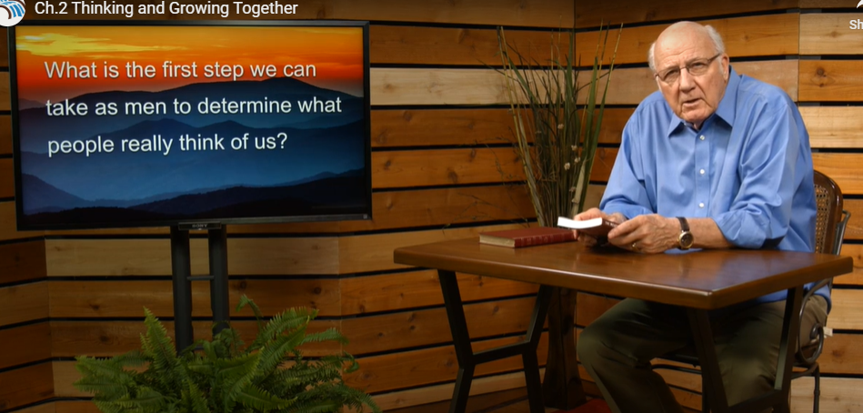

Slide 57
^{Eph 4.16} From Him the whole body is fitted and held together by every supporting ligament. The proper working of each individual part produces the body’s growth, for building itself up in love.

Slide 58
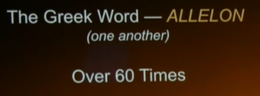

Slide 59
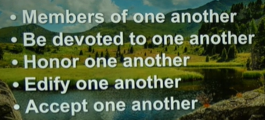

Slide 60
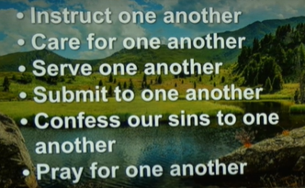

Slide 61
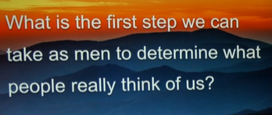

Slide 62
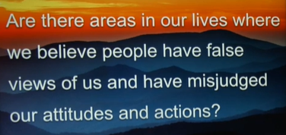

Slide 63
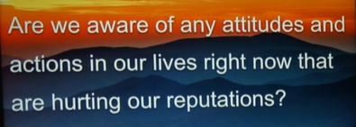

Slide 64
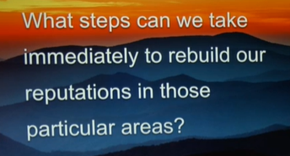

Slide 65
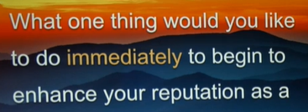
talmid / follower of Messiah?

Slide 66
Give permission to a friend, confidant, to ask about your thought life.
Notes:
Yeshua was exemplary in HEARING us!!

Slide 67
^{Yeshayahu/ Is 42.1-3} Behold My servant[a], whom I uphold. My Chosen One, in whom My soul delights. I have put My Ruakh on Him, He will bring justice to the nations. He will not cry out or raise His voice, or make His voice heard in the street. A bruised reed He will not break. A smoldering wick He will not snuff out.
Notes:
He will not disrupt or crush those reaching out to Him. Not interrupt, but hear OUR hearts!

Slide 68
^{Mishlei/ Prov 12.17-19} A fool shows his irritation immediately,
but a prudent person overlooks an insult.
He who tells the truth tells what is right, but a false witness, deceit.
Notes:
“Let it fly” “If I think it or feel it, I say it.”
Tells the truth יפיח yafeakh breathes אמונה Emunah faithfulness That is, if you live in the truth, there is no web of lies to maintain.
‘Oh, what a tangled web we weave
When first we practice to deceive,’
from an early nineteenth century Scottish author, Sir Walter Scott, best selling writer of novels, plays, and poems.

Slide 69
^{Mishlei/ Prov 12.17-19} Reckless speech is like the thrusts of a sword,
but the tongue of the wise brings healing.
Notes:
Rash speech, let it flow.

Slide 70
Why is this important?
^{Vayikra/Lev 19.17-18} “‘Do not hate your brother in your heart, but rebuke your neighbor frankly, so that you won’t carry sin because of him. Don’t take vengeance on or bear a grudge against any of your people; rather, love your neighbor as yourself; I am Adoni.
Notes:
Rebuke is intrinsic to love.

Slide 71
^{Mark 12.28-31} One of the Torah-teachers came up and heard them engaged in this discussion. Seeing that Yeshua answered them well, he asked him, “Which is the most important mitzvah of them all?” Yeshua answered, “The most important is,‘Sh’ma Yisra’el, Adonai Eloheinu, Adonai ekhad

Slide 72
^{Mark 12.28-31} [Hear, O Isra’el, the Lord our God, the Lord is one], and you are to love Adonai your God with all your heart, with all your soul, with all your understanding and with all your strength.’
The second is this: ‘You are to love your neighbor as yourself.’
Notes:
Implies the rebuking part.

Slide 74
^{Yaakov/James 1.19} Let every person be
quick to listen, slow to speak
Listening to G-d
Listening to people
When truth is utterly violated.
Rebuke
Notes:
Nothing to hear. Just the rebuking aspect

Slide 75
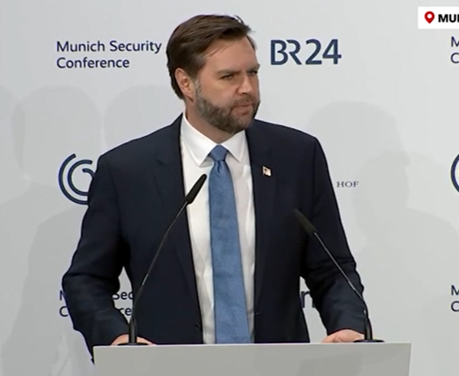
JD Vance at the Munich, Germany, Security Conf.

Slide 76
JD Vance gave specific examples of the erosion of fundamental liberties in countries whose leaders were in the room. One of the most disturbing cases took place in Britain, where a 51-year-old veteran was arrested for silently praying within 200 meters of an abortion facility.
Notes:
https://www.drjamesdobson.org/articles/the-attack-on-our-fundamental-liberties?utm_campaign=6458768-2025%20Public%20Policy&utm_medium=email&_hsenc=p2ANqtz--gXRuztA9EHOWAMzkif87oc1ArioGAwLhk2J-z1JSgH2TtYXocMKYcr5bYLckaGuFUCoXXy0LYwsXn2gAwOCr0a7XXbQ&_hsmi=348269053&utm_content=348269051&utm_source=hs_email

Slide 77
He wasn’t obstructing or interacting with anyone; he only stood there with his head bowed. When a police officer asked him if he was praying, he said, “Yes.” He was charged with a crime and fined thousands of dollars.
Notes:
https://www.drjamesdobson.org/articles/the-attack-on-our-fundamental-liberties?utm_campaign=6458768-2025%20Public%20Policy&utm_medium=email&_hsenc=p2ANqtz--gXRuztA9EHOWAMzkif87oc1ArioGAwLhk2J-z1JSgH2TtYXocMKYcr5bYLckaGuFUCoXXy0LYwsXn2gAwOCr0a7XXbQ&_hsmi=348269053&utm_content=348269051&utm_source=hs_email

Slide 78
As Ronald Reagan famously said, “If we ever forget that we’re one nation under God, then we will be a nation gone under.”
Notes:
https://www.drjamesdobson.org/articles/the-attack-on-our-fundamental-liberties?utm_campaign=6458768-2025%20Public%20Policy&utm_medium=email&_hsenc=p2ANqtz--gXRuztA9EHOWAMzkif87oc1ArioGAwLhk2J-z1JSgH2TtYXocMKYcr5bYLckaGuFUCoXXy0LYwsXn2gAwOCr0a7XXbQ&_hsmi=348269053&utm_content=348269051&utm_source=hs_email

Slide 80
Current Hamas travesties

Slide 81
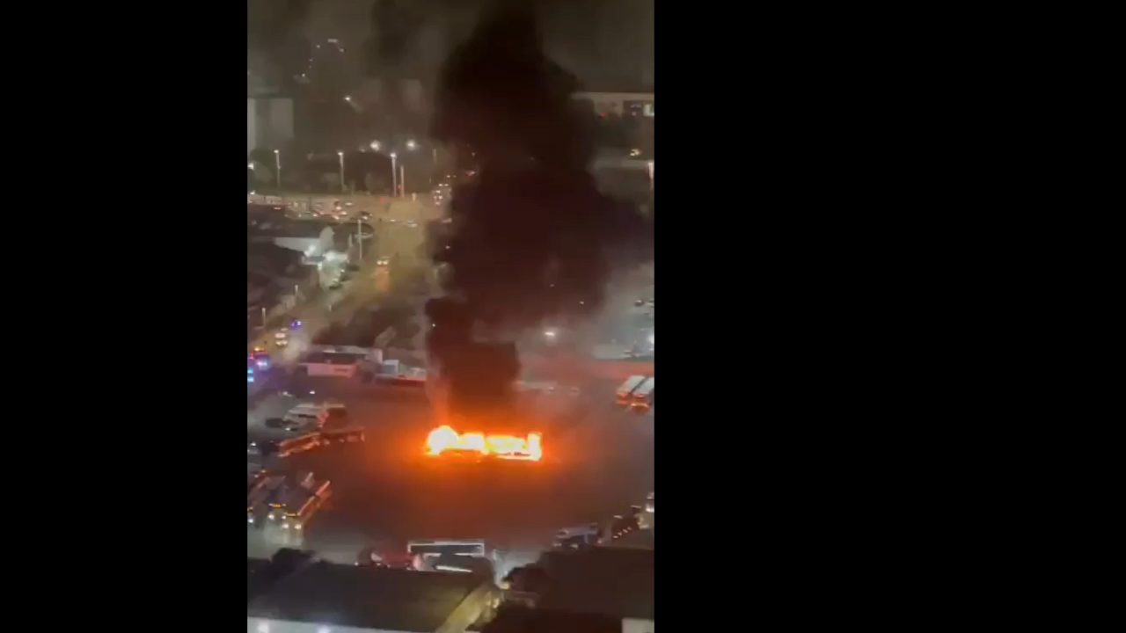
15 bombs were found in buses that were intended to go off at 9 am during peak hours of commute. Thankfully (aka miracle), the terrorist set the timer wrong and no one was hurt. Only losing a few buses in Bat Yam [Tel Aviv].
Hamas claimed the buses.
Notes:
Sally Shiff

Slide 82
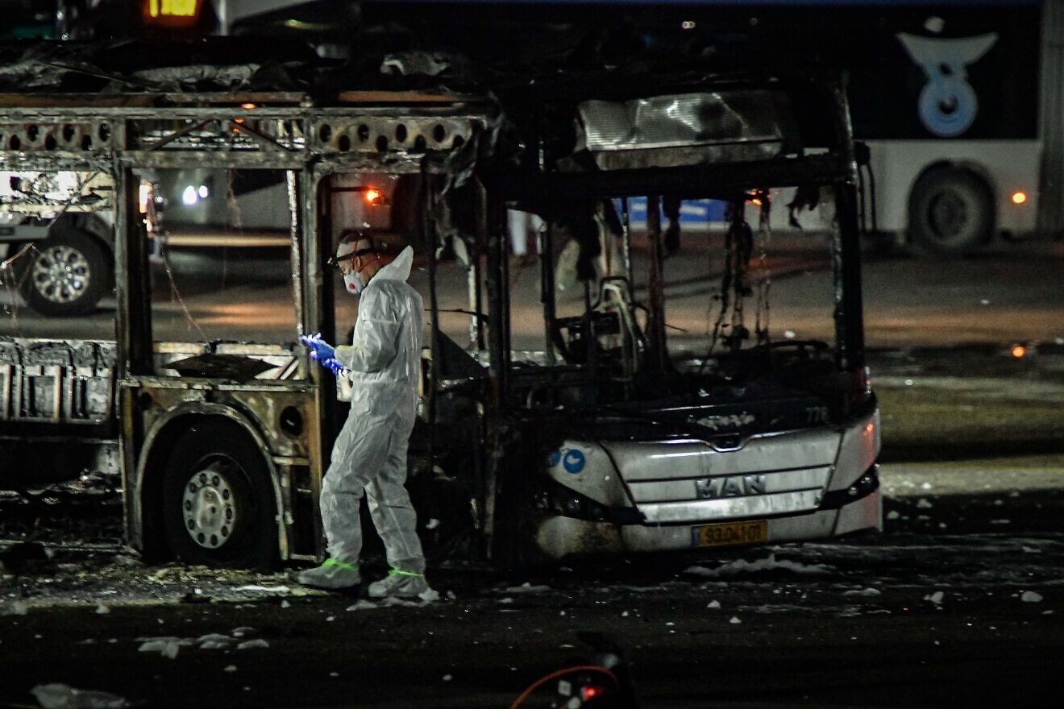
Notes:
https://www.israeltoday.co.il/read/netanyahu-orders-massive-counter-terror-op-after-bus-bombings/#google_vignette
All of the explosions on Thursday occurred in parked, empty buses across the central city of Bat Yam, located just south of Tel Aviv. There were no injuries in the attack.

Slide 83
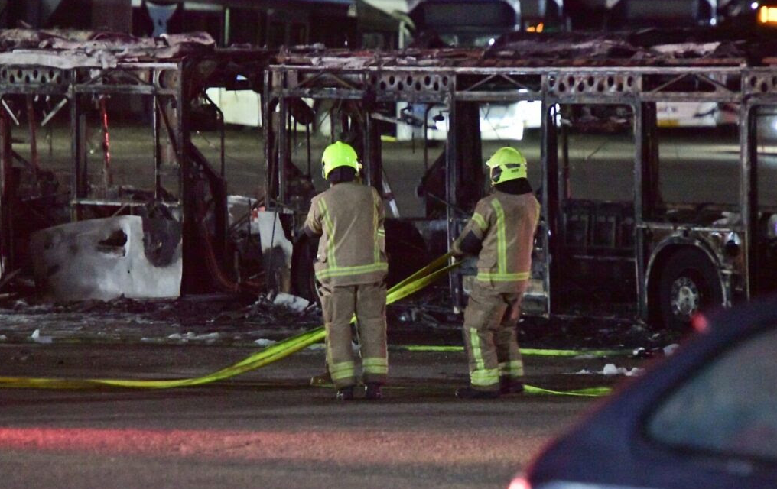
Notes:
https://www.israeltoday.co.il/read/netanyahu-orders-massive-counter-terror-op-after-bus-bombings/#google_vignette

Slide 84
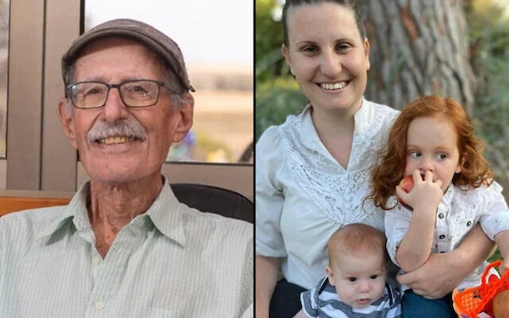
Notes:
Shiri Bibas, her little boys Ariel and Kfir, and Oded Lifshitz

Slide 85
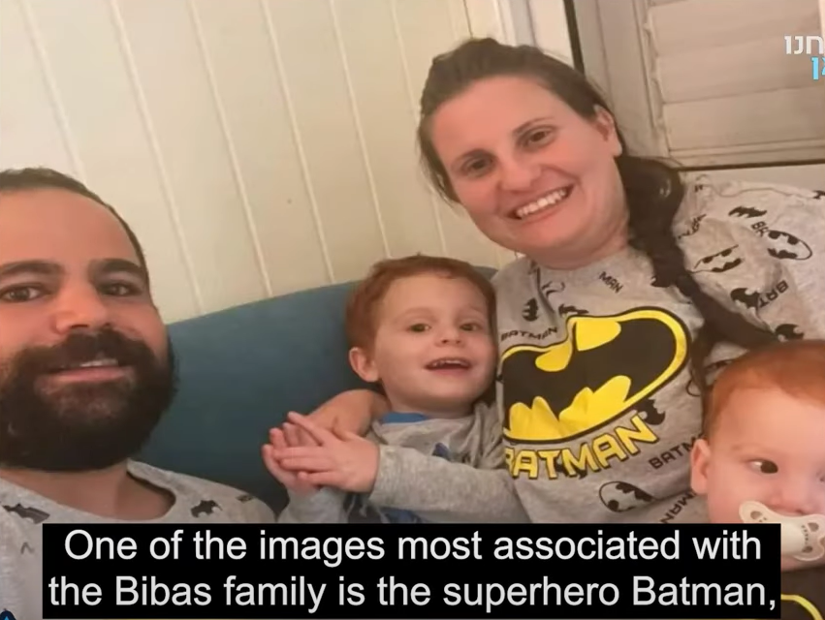

Slide 86
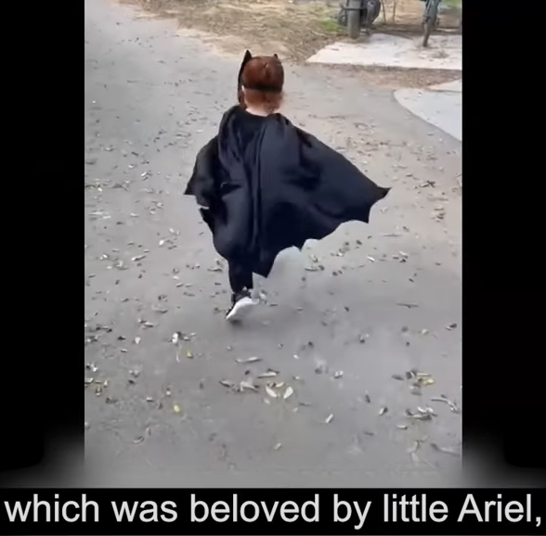

Slide 87
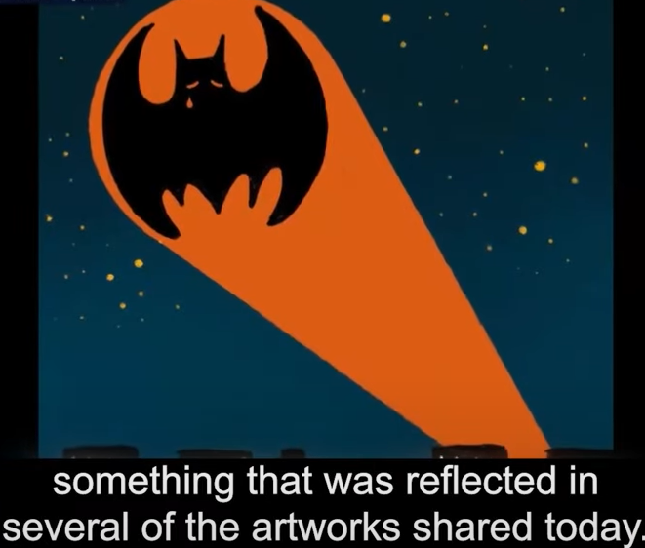

Slide 88
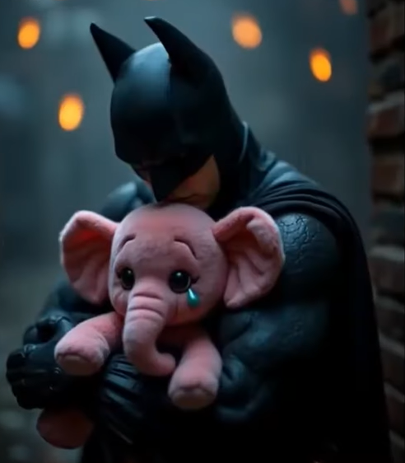

Slide 89
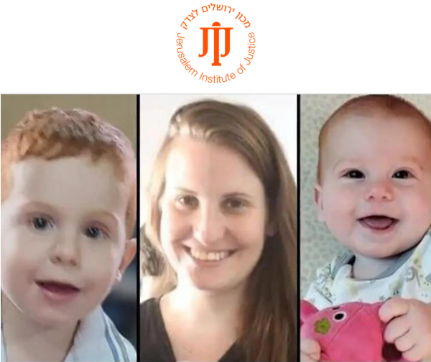
Mom Shiri and
Ariel and Kfir Bibas.
Notes:
In better days.

Slide 90
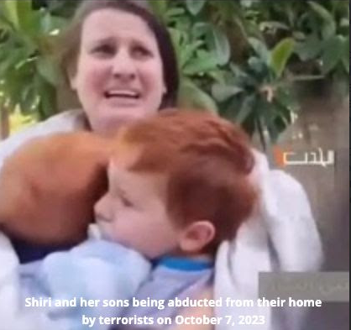
Shiri and sons being abducted from their home on
Oct. 7, 2023

Slide 91
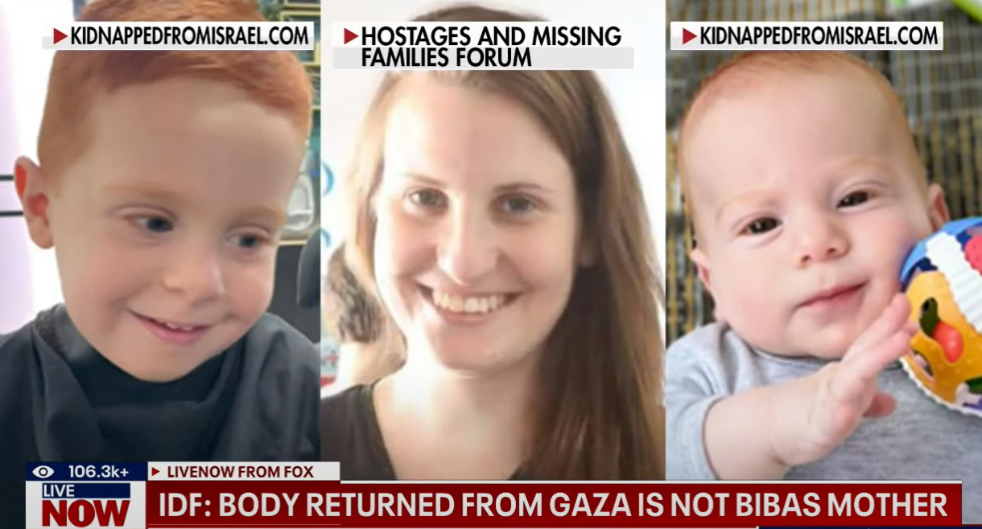
Notes:
https://www.youtube.com/watch?v=sNLnOr6z_as

Slide 92
According to the assessment of professional officials, based on the intelligence available to us and forensic findings from the identification process, Ariel and Kfir Bibas were brutally murdered by terrorists in captivity in November 2023.
Notes:
Sally Shiff

Slide 93
The babies’ captors murdered them with their bare hands, then mutilated their bodies in an attempt to conceal their crimes. An Israeli military spokesman said Friday that the two Bibas children were savagely beaten to death by the terror group and didn’t die in an IDF bombing as had been claimed.
Notes:
Copyright © 2025 The Jerusalem Institute of Justice, All rights reserved.
https://mailchi.mp/jij/shiri-bibas?e=5b00c6e90f
https://www.nysun.com/article/may-god-avenge-their-blood-netanyahu-expresses-outrage-after-hamas-fails-to-return-the-body-of-shiri-bibas

Slide 94
During the identification process, it was determined that the additional body received is not that of Shiri Bibas, and no match was found for any other hostage. This is an anonymous, unidentified body.
Notes:
Sally Shiff

Slide 95
By JERUSALEM POST STAFF
Updated: FEB 22, 2025 08:13
The body of Shiri Bibas was returned to Israel from Gaza on Friday night, the Hostage and Missing Families Forum announced Saturday.

Slide 96
Oded Lifshitz, 83, a lifelong peace activist and one of the founders of Kibbutz Nir Oz, was murdered in captivity as well.

Slide 97
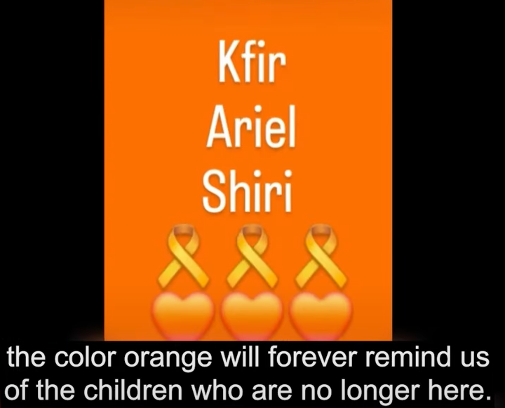

Slide 98
Our response to total falsehood:
Stand strong, rebuke, “fight, fight, fight!”
Notes:
A MOST politically incorrect cartoon. Maybe less so now…

Slide 99
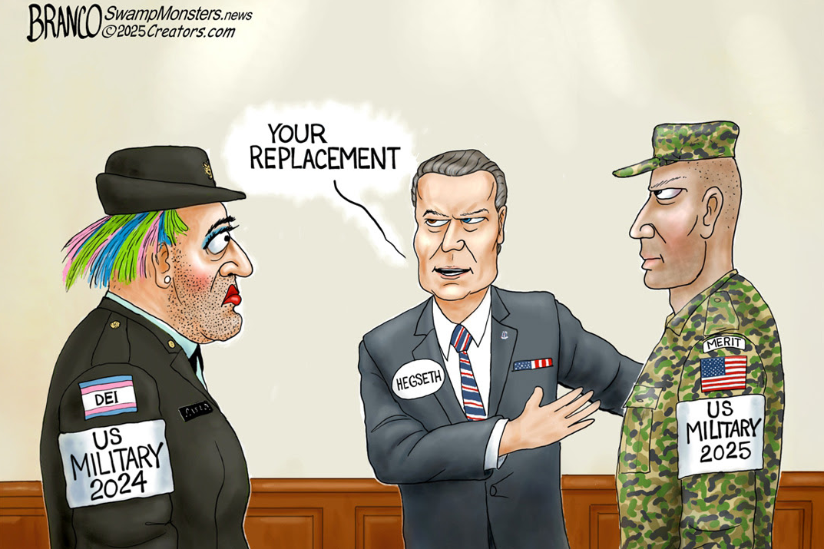
Notes:
Note
US military 2024
US military 2025
Enlistment is way UP!

Slide 101
^{Yaakov/James 1.19} Let every person be
quick to listen, slow to speak
Listening to G-d
Listening to people
When truth is utterly violated.
Rebuke

Slide 102
Do you KNOW Yeshua and the assurance of sins forgiven?
Are you hearing daily from His Word?
Are you listening to others?
How are you applying what you heard?
Are you asking this of another?

