Slide 1
e-handout
To have these notes
without taking notes
Go to OrHaOlam.com
Click on Messages tab,
2025 Messages

Slide 2

59
9

Slide 3
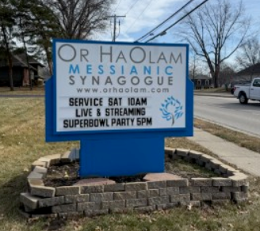
Notes:
We are hoping and praying many newbies will join us to share our hot wings, our pizza, and our Ruakh, His Ruakh.

Slide 4
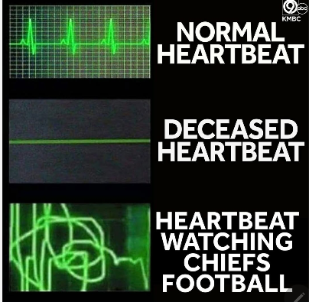

Slide 6
Notes:
Rukhel Fields

Slide 7
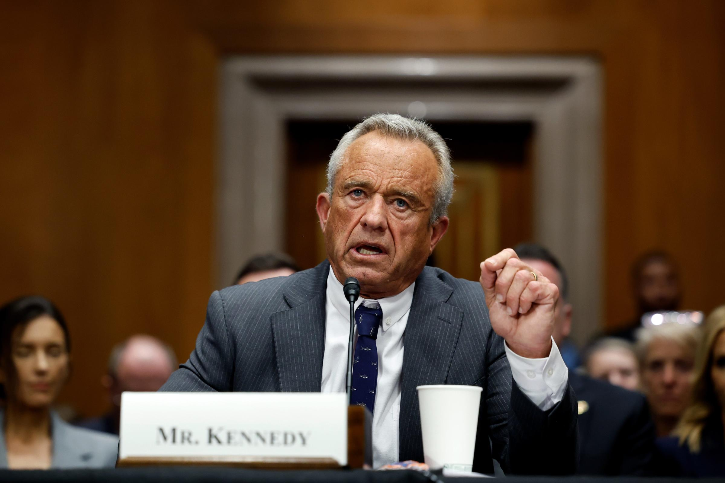
Robert F. Kennedy Jr.
Notes:
https://s.yimg.com/ny/api/res/1.2/UjqMutM8HV5dJxWihJPXyQ--/YXBwaWQ9aGlnaGxhbmRlcjt3PTI0MDA7aD0xNjAw/https://media.zenfs.com/en/cape-cod-times/fc52604314fed866cec09874e75d14a2

Slide 8
“Kellogg’s makes Fruit Loops for the United States alone that is loaded with red dye, blue dye, yellow dye, and many, many other ingredients,” Kennedy said Thursday. He noted, “They make the same product for Canada — it’s all vegetable dyes.”
Notes:
https://washingtonstand.com/news/top-4-takeaways-from-rfk-jrs-confirmation-hearings

Slide 9
Senator Roger Marshall (R-Kan.) told Kennedy Wednesday, “I believe for such a time as this, that you’re not just one of 300 million people, I think that you are the person to lead HHS to make America healthy again, that God has a divine purpose for you.”
Notes:
https://washingtonstand.com/news/top-4-takeaways-from-rfk-jrs-confirmation-hearings

Slide 10


Slide 11

​Every Knee will bow. Phil 2.10
My driving passion, fire in my belly.
What does it mean eternally?
What does it mean in this life?
Notes:
Why I get up in the morning, and keep working. Age 75: time sit with my feet up and do nothing?

Slide 12
​Every Knee will bow. Phil 2.10
My driving passion, fire in my belly.
What does it mean eternally?
What does it mean in this life?

Slide 13
^{Phil 2. 5-11} Let your attitude toward one another be governed by your being in union with the Messiah Yeshua: Though he was in the form of God, he did not regard equality with God something to be possessed by force.

Slide 14
^{Phil 2. 5-11} On the contrary, he emptied himself, in that he took the form of a slave by becoming like human beings are. And when he appeared as a human being, he humbled himself still more by becoming obedient even to death — death on a stake as a criminal!

Slide 15
^{Phil 2. 5-11} Therefore God raised him to the highest place and gave him the name above every name; that in honor of the name given Yeshua, every knee will bow — in heaven, on earth and under the earth — and every tongue will acknowledge that Yeshua the Messiah is Adoni — to the glory of God the Father.
Notes:
I am passionate that people, Jews and the Nations, will know Him, love Him, surrender to Him, worship Him

Slide 16
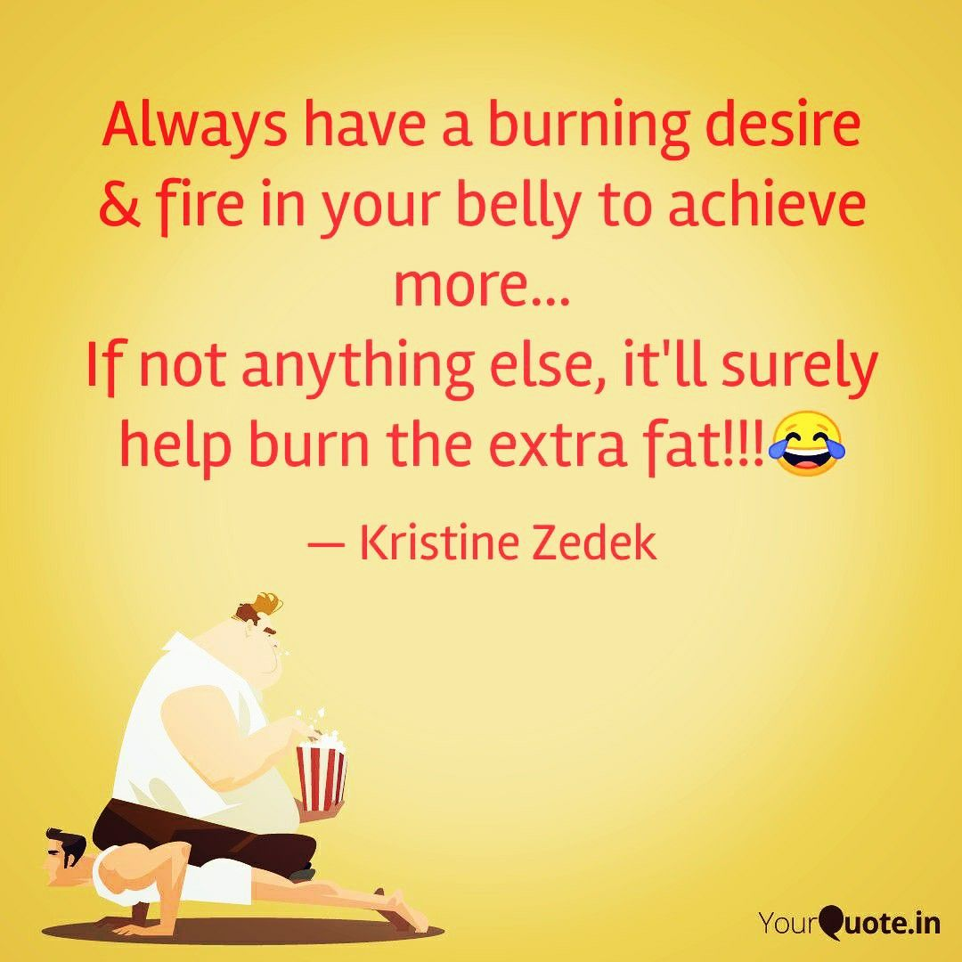
Notes:
https://i.pinimg.com/originals/42/7c/f9/427cf9bcb4ffd0ef1b207d2b94399af6.jpg

Slide 17
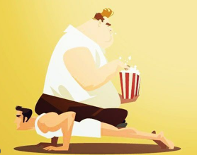
Which guy has a fire in his belly?

Slide 18
From OrHaOlam.com
The vision and purpose of Or HaOlam, as Rabbi Shmuel sees the חָזוֹן khazon vision , is working to bring Jewish people, and those grafted in, to their covenantal identity in Messiah.

Slide 19
From OrHaOlam.com
Implies: Salvation through the Atonement of the Messiah. Personal faith in the atoning death and resurrection of Yeshua. It’s all about the King.
Notes:
That’s why we have the Super Bowl notice on the marquee.
That’s why we appreciate the great work Angela Stobbe did to set up nursery care. Soon to be noticed on the marquee sign.

Slide 20
^{Ro 1.16} For I am not ashamed of the Good News, for it is the power of God for salvation to everyone who trusts—to the Jew first and also to the Greek.
Notes:
So where is the power? We’re seeking it.
Jew First?

Slide 21

Proton?

Slide 22
The adverb "próton" is used to denote priority in time, order, or importance. It often signifies the first in a sequence or the foremost in significance. In the New Testament, it is used to emphasize what should be considered or done before anything else, highlighting the primacy of certain actions or principles.
Notes:
https://biblehub.com/greek/4412.htm
Either or both: First in time, first in focus.
So to the Jewish people historically first, but still the first goal to reach.

Slide 23
^{Acts 4.12} There is salvation in no one else! For there is no other name under heaven given to mankind by whom we must be saved!”

Slide 24
^{Phil 2. 5-11} In honor of the name given Yeshua, every knee will bow — in heaven, on earth and under the earth — and every tongue will acknowledge that Yeshua the Messiah is Adoni — to the glory of God the Father.
Notes:
I am passionate that people will know Him, worship Him, love Him, rejoice in Him.

Slide 26
​Every Knee will bow. Phil 2.10
My driving passion, fire in my belly.
What does it mean eternally?
What does it mean in this life?

Slide 27
^{Rev 20.11-15} Next I saw a great white throne and the One sitting on it. Earth and heaven fled from his presence, and no place was found for them. And I saw the dead, both great and small, standing in front of the throne. Books were opened; and another book was opened, the Book of Life;
Notes:
Books, and another book, the Book of Life.

Slide 28
^{Rev 20.11-15} and the dead were judged from what was written in the books, according to what they had done. The sea gave up the dead in it; and Death and Sh’ol gave up the dead in them; and they were judged, each according to what he had done.
Notes:
Books in the plural has record of all our actions and history.

Slide 29
^{Rev 20.11-15} Then Death and Sh’ol were hurled into the lake of fire. This is the second death — the lake of fire. Anyone whose name was not found written in the Book of Life was hurled into the lake of fire.

Slide 30
The Books in the plural has record of all our actions and history.
The Book of Life seems to be just a name registry
If one is judged by The Books they appear to be intrinsically lost. No one is saved from the Lake of Fire by the record of their actions.

Slide 31
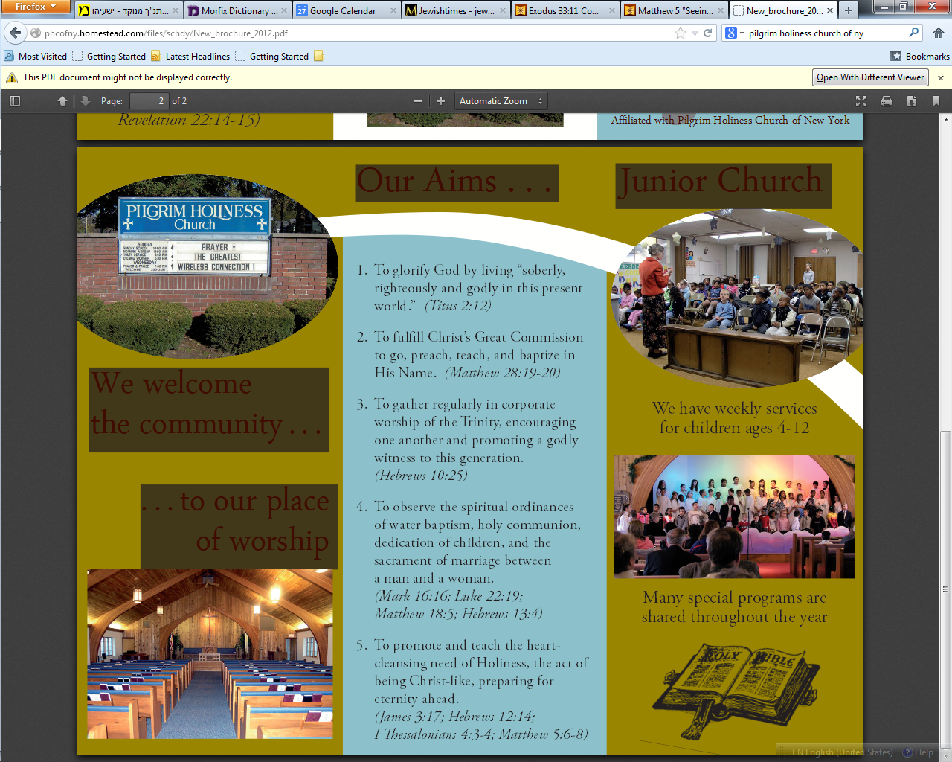
Pilgrim Holiness Church,
Schenectady, NY, April 13, 1969
Notes:
Golden glow up in the laminated rafters. “Cloud of liquid love.” April 13, 1969 I experienced New Birth. Joy all around me, and in my heart, and I knew that it was connected to the fact that my name was now written in the Book of Life. Many young people similarly seeking, finding. Jesus/Yeshua Revolution..
Went home few weeks later. “Mom, Dad, I’ve found the answer to life’s problems. It’s not in drugs, or revolution, but in the love of Jesus Christ.” No Messianic terminology to figure out then.
Sent me to psychiatrist.
“You’re worse than Hitler. He destroyed our bodies. You are destroying our souls.”

Slide 32
^{Yeshayahu/Is 6.1-4} In the year of King Uzziah’s death, I saw Adonai sitting on a throne, high and lifted up, and the train of His robe filled the Temple. Seraphim were standing above Him. Each had six wings: with two he covered his face and with two he covered his feet, and with two he flew.
Notes:
John 12.41

Slide 33
^{Yeshayahu/Is 6.1-4} One called out to another, and said: “Holy, holy, holy, is Adonai-Tzva’ot! The whole earth is full of His glory.” Then the posts of the door trembled at the voice of those who called, and the House was filled with smoke.
Notes:
John 12.41

Slide 34
קָדוֹשׁ קָדוֹשׁ קָדוֹשׁ
Ka-dosh, ka-dosh, ka-dosh,
יְיָ צְבָאוֹת,
Adoni ts'va-ot,
מְלֹא כָל הָאָֽרֶץ כְּבוֹדוֹ.
m'lo khawl ha-aretz k'vodo.

Slide 35
Holy, holy, holy,
Is the L-rd of the armies of heaven,
All the earth is filled with His glory.

Slide 36
^{Ro 1.14-15} I have an obligation to both Greeks and barbarians, to both the wise and the foolish. So I am eager to proclaim the Good News also to you who are in [Rome] Overland Park, Johnson County, Wyandotte, Greater KC, MO

Slide 37
^{Ro 1.16} For I am not ashamed of the Good News, for it is the power of God for salvation to everyone who trusts—to the Jew first and also to the Greek.
Notes:
Jew First?

Slide 38
What about those who have never heard, or saw so much Yeshua believer failure so as to undermine the credibility of the message of Messiah? No one goes to heaven without the Atoning Blood of the Lamb.
Holocaust survivors
Abuse survivors

Slide 39
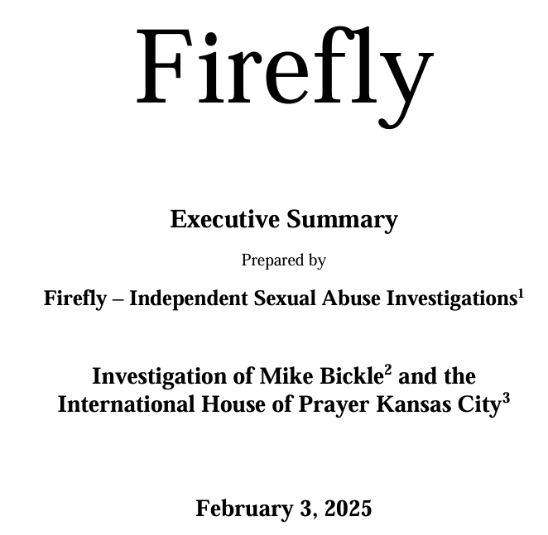
Notes:
Hired by Tikkun, Dan Juster. I have the 68 page full report. I’ll send it to you if you want it.

Slide 40
Mike Bickle committed sexual abuse or misconduct against 17 women — including minors — over decades, amid a thriving culture of systematic abuse and coverups, Firefly Independent Sexual Abuse Investigations has determined.
Notes:
Hired by Tikkun, Dan Juster.

Slide 41
^{Beresheet /Gen 18.23-25} Avraham approached and said, “Will you actually sweep away the righteous with the wicked? Maybe there are fifty righteous people in the city; will you actually sweep the place away, and not forgive it for the sake of the fifty righteous who are there?

Slide 42
^{Beresheet /Gen 18.23-25} Far be it from you to do such a thing — to kill the righteous along with the wicked, so that the righteous and the wicked are treated alike! Far be it from you! Shouldn’t the judge of all the earth do what is just?”

Slide 43
Matthew Schwartz’ father or friend’s father
Mtt 10.40 “Whoever receives you is receiving me, and whoever receives me is receiving the One who sent me.
Notes:
I heard this first person from Matt Schwartz, a powerful Messianic leader in the 1980s and 1990s. But I can’t remember if he was telling this story about himself or a Jewish friend.

Slide 44
Stewart Winograd’s father.
“Just say ‘Yes’”
Shouldn’t the judge of all the earth do what is just?”
He will!

Slide 45
^{Phil 2. 5-11} In honor of the name given Yeshua, every knee will bow — in heaven, on earth and under the earth — and every tongue will acknowledge that Yeshua the Messiah is Adoni — to the glory of God the Father.
Notes:
I am passionate that people will know Him, worship Him, love Him, rejoice in Him.

Slide 47
​Every Knee will bow. Phil 2.10
My driving passion, fire in my belly.
What does it mean eternally?
What does it mean in this life?

Slide 48
Being saved for eternity, out of the Lake of Fire was not my main passion, though obviously VERY important.
It doesn’t seem to be the main concern of Messiah Yeshua.

Slide 49
^{Mtt 5.1-10} Seeing the crowds, Yeshua walked up the hill. After he sat down, his talmidim came to him, and he began to speak. This is what he taught them:
“How blessed are the poor in spirit! for the Kingdom of Heaven is theirs.
Notes:
Blessed = joyful, happy, content
How He describes Himself: meek and lowly in heart.

Slide 50
^{Mtt 5.1-10} “How blessed are those who mourn! for they will be comforted.
Notes:
Easily see one’s own sins.
Why Jewish music in minor key?

Slide 51
^{Mtt 5.1-10} “How blessed are those who mourn! for they will be comforted.
“How blessed are the meek! for they will inherit the Land!
Notes:
Not a doormat. Stand for truth, but not with arrogance.

Slide 52
^{Mtt 5.1-10} “How blessed are those who hunger and thirst for righteousness! for they will be filled.
Notes:
Time with Him, His Word!

Slide 53
^{Mtt 5.1-10} “How blessed are those who hunger and thirst for righteousness! for they will be filled.
“How blessed are those who show mercy! for they will be shown mercy.

Slide 54
^{Mtt 5.1-10} “How blessed are the pure in heart! for they will see God.
Notes:
This is the bottom line re sexual sin. Inner repentance. T’shuvah!

Slide 55
^{Mtt 5.1-10} “How blessed are the pure in heart! for they will see God.
“How blessed are those who make peace! for they will be called sons of God.
Notes:
Mtt 18

Slide 56
^{Mtt 5.1-10} “How blessed are those who are persecuted because they pursue righteousness! for the Kingdom of Heaven is theirs.
Notes:
You would think that with all these good qualities or aspirations, such a person would be held in high esteem by the world. Rather…

Slide 57
^{Mtt 5.11-12} “How blessed you are when people insult you and persecute you and tell all kinds of vicious lies about you because you follow me! Rejoice, be glad, because your reward in heaven is great — they persecuted the prophets before you in the same way.

Slide 58
Messiah Yeshua seemed to stress HOW we live and walk in this life, here and now, in His Kingdom. It’s important to be prepared for the next life, by faith, but that’s not all.
The Kingdom of Heaven is now, and not yet.

Slide 59
^{Yn 14.1- 3} “Don’t let yourselves be disturbed. Trust in God and trust in me. In my Father’s house are many places to live. If there weren’t, I would have told you; because I am going there to prepare a place for you.

Slide 60
^{Yn 14.1- 3} Since I am going and preparing a place for you, I will return to take you with me; so that where I am, you may be also.
Notes:
Sounds like a focus on life after death.

Slide 61
^{Yn 14.15-21} “If you love me, you will keep my commands; and I will ask the Father, and he will give you another comforting Counselor like me, the Spirit of Truth, to be with you forever. The world cannot receive him, because it neither sees nor knows him.
Notes:
My commands…Mitzvot: just His words, or all of Hebrew scripture too?
Another comforting counselor…the Ruakh!
Imperceptible to the general population!

Slide 62
^{Yn 14.15-21} You know him, because he is staying with you and will be united with you. I will not leave you orphans — I am coming to you. In just a little while, the world will no longer see me; but you will see me. Because I live, you too will live.
Notes:
Staying with you.
United with each other, with Messiah
Not orphans: “Orphan spirit”
LIFE

Slide 63
^{Yn 14.15-21} When that day comes, you will know that I am united with my Father, and you with me, and I with you. Whoever has my commands and keeps them is the one who loves me, and the one who loves me will be loved by my Father, and I will love him and reveal myself to him.”
Notes:
Mitzvot and love! →
8. Love revelation of the Av and the Ben.

Slide 64
^{Mark 8 34-38} Then Yeshua called the crowd and his talmidim to him and told them, “If anyone wants to come after me, let him say ‘No’ to himself, take up his execution-stake, and keep following me.

Slide 65
^{Mark 8 34-38} For whoever wants to save his own life will destroy it, but whoever destroys his life for my sake and for the sake of the Good News will save it. Indeed, what will it benefit a person if he gains the whole world but forfeits his life?

Slide 66
^{Mark 8 34-38} What could a person give in exchange for his life? For if someone is ashamed of me and of what I say in this adulterous and sinful generation, the Son of Man also will be ashamed of him when he comes in his Father’s glory with the holy angels.
Notes:
Preparing for an eternity of great praise….

Slide 67
^{Rev 5.12-13} Then I looked, and I heard the sound of a vast number of angels — thousands and thousands, millions and millions! They were all around the throne, the living beings and the elders; and they shouted out,

Slide 68
^{Rev 5.12-13} “Worthy is the slaughtered Lamb to receive power, riches, wisdom, strength, honor, glory and praise!” And I heard every creature in heaven, on earth, under the earth and on the sea — yes, everything in them — saying,

Slide 69
^{Rev 5.12-13} “To the One sitting on the throne and to the Lamb belong praise, honor, glory and power forever and ever!”

Slide 70
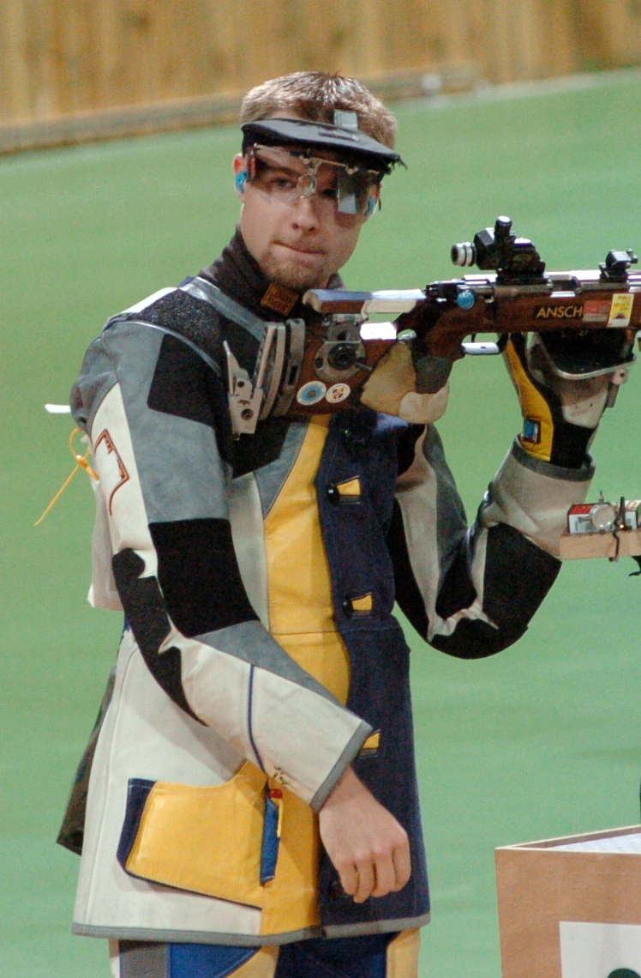
Matt Emmons, Olympic Gold Medalist sharpshooter

Slide 71
Matthew Emmons was the best sharpshooter. Fire between heartbeats. Breathe to slow down heartbeat. Bullseye in work target.

Slide 72
Matt Emmons was stunned. The year was 2004. He held a commanding lead in the 50-meter Olympic rifle final. Honing to dead center of the target, he gently squeezed the trigger. The bullet pierced the bull’s eye. He was sure he’d just won his second Olympic gold medal.
Notes:
https://hebfdn.org/portfolio/right-shot-wrong-target/

Slide 73
Then, wait a minute: No score appeared! Matt gestured to the officials. Was there some malfunction with the target? No, the judges said: No malfunction. Matt Emmons had aimed precisely and … hit the target one lane over. His score was zero.
Notes:
https://hebfdn.org/portfolio/right-shot-wrong-target/

Slide 74
Even Olympian skills fail the competitor who is focused on the wrong target.
Make sure you’re aiming for the right goals … in the high calling of our daily work.
Notes:
https://hebfdn.org/portfolio/right-shot-wrong-target/

Slide 75
“Aim for perfection, listen to my appeal, be of one mind, live in peace. And the God of love and peace will be with you.” ^{1 Cor 13.11}
Notes:
https://hebfdn.org/portfolio/right-shot-wrong-target/

Slide 76
Aim at the right target. Succeeding at things that don’t matter, according to DL Moody, is the greatest danger.
Succeeding at things don’t matter.
Shooting at wrong target.
Notes:
What target are we aiming for?
Should be kneeling before Him, worshiping Him, praising Him.
I attended a one hour Zoom talmidut/discipleship teaching.

Slide 77
63% US populaton identify as believers
25% according to Barna are practicing.
Notes:
Disciplemakingplaybook.com

Slide 78
Yeshua
Grace
Unity
Good works
Typical believer
Judgment
Division
Hypocrisy

Slide 79
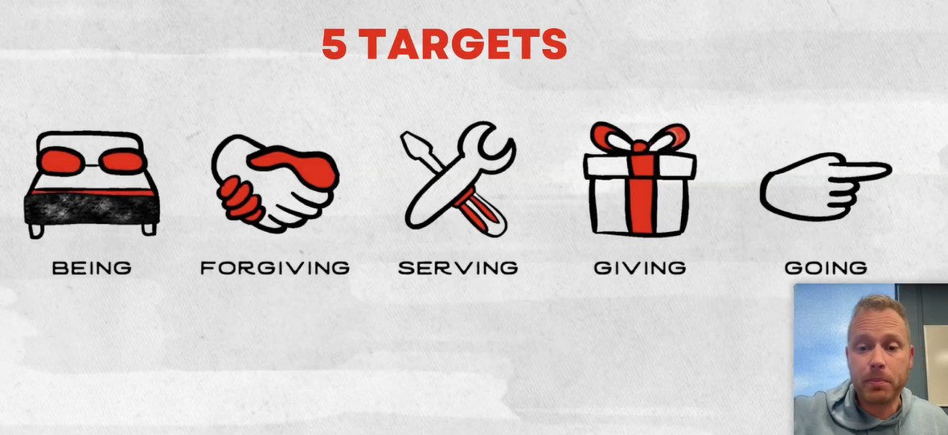
Notes:
Asks his sons how doing in these five Redletterassessment.com

Slide 80
Some encouraging trends…
Notes:
The world system is against us, but the Kingdom is making inroads.

Slide 81
Last Sunday was a big day for the YouVersion Bible app.
The faith-based app’s founder, Bobby Gruenewald, told The Christian Post the YouVersion team “saw 18.2 million people engage in the Bible and more than 798,000 installs” on Sunday Jan. 5.
Notes:
https://charismanews.com/news/record-shattered-amid-growing-fears-of-the-end-times/

Slide 82
“We tend to see a seasonal uptick in Bible engagement at the beginning of the year as people start new habits and are interested in reading the Bible for the first time,” he said. “What’s interesting to us is that this year’s increase is even higher than this same time last year, and it’s a trend we’re seeing globally.”
Notes:
https://charismanews.com/news/record-shattered-amid-growing-fears-of-the-end-times/

Slide 83
The hugely popular YouVersion Bible App was installed nearly 800,000 times on January 5 this year alone, the Christian Post reports. Launched in 2008 by the US-based Life.Church ministry, YouVersion is available in 2,100 languages and has been installed on 850 million devices worldwide.
Notes:
https://www.worthynews.com/101472-youversion-bible-app-saw-nearly-800000-installations-on-first-sunday-of-2025

Slide 84
^{Phil 2. 5-11} In honor of the name given Yeshua, every knee will bow — in heaven, on earth and under the earth — and every tongue will acknowledge that Yeshua the Messiah is Adoni — to the glory of God the Father.
Notes:
So, some are!

Slide 85
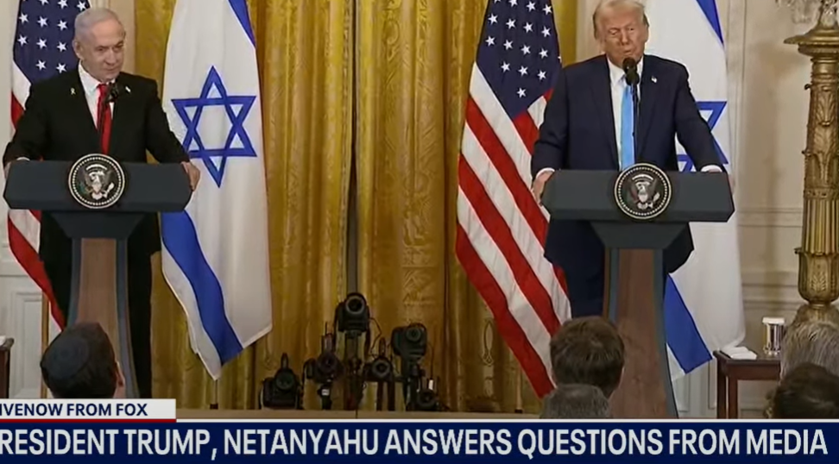

Slide 86
Netanyahu: “After this worst attack on Jews since the Holocaust, [Oct. 7] Iran and its henchmen in the Middle East were absolutely ecstatic. Haniyeh praised the massacre, Sinwar said Israel was finished, Nasrallah boasted that Israel was ‘as feeble as a spider’s web.’
Notes:
https://www.israeltoday.co.il/read/the-roar-of-the-lion-of-judah-is-heard-throughout-the-mideast/

Slide 87
“Well, Mr. President, Haniyeh is gone, Sinwar is gone, Nasrallah is gone, we’ve devastated Hamas, decimated Hezbollah, destroyed Assad’s remaining armaments and we crippled Iran’s air defenses. In doing this, we’ve defeated some of America’s worst enemies.
Notes:
https://www.israeltoday.co.il/read/the-roar-of-the-lion-of-judah-is-heard-throughout-the-mideast/

Slide 88
We took out terrorists who were wanted for decades for shedding rivers of American blood, including 241 Marines murdered in Beirut. We accomplished all this with the indomitable spirit of our people and the boundless courage of our soldiers. [and the help of G-d!]
Notes:
https://www.israeltoday.co.il/read/the-roar-of-the-lion-of-judah-is-heard-throughout-the-mideast/

Slide 89
“The Bible says that the people of Israel shall rise like lions and boy, did we rise. Today, the roar of the lion of Judah is heard loudly throughout the Middle East.
Notes:
https://www.israeltoday.co.il/read/the-roar-of-the-lion-of-judah-is-heard-throughout-the-mideast/

Slide 90
“Israel has never been stronger and the Iran terror axis has never been weaker. But as we discussed Mr. President, to secure our future and bring peace to our region, we have to finish the job.
Notes:
https://www.israeltoday.co.il/read/the-roar-of-the-lion-of-judah-is-heard-throughout-the-mideast/

Slide 91
“In Gaza, Israel has three goals: Destroy Hamas’s military and governing capabilities, secure the release of all our hostages and ensure that Gaza never again poses a threat to Israel.
Notes:
https://www.israeltoday.co.il/read/the-roar-of-the-lion-of-judah-is-heard-throughout-the-mideast/

Slide 92
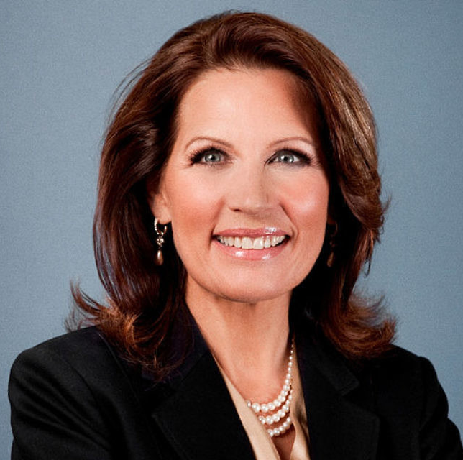
Congress-woman
Michele Bachman sees prophetic fulfillment:

Slide 93
^{Zeph 2.4-7} Seek Adonai, all you humble in the land, you who exercise his justice; seek righteousness, seek humility —you might be hidden on the day of Adonai’s anger. For ‘Azah [Gaza] will be abandoned, Ashkelon will be desolate, they will evacuate Ashdod at noon, and ‘Ekron will be uprooted.
Notes:
https://wellversedworld.org/media/spbcrbj/wpn-call-418-congresswoman-bachmann-gives-you-a-true-understanding-of-what-israel-faces

Slide 94
^{Zeph 2.4-7} Woe to the inhabitants of the seacoast, the nation of the K’reti [descendants of Crete]! The word of Adonai is against you, Kena‘an, land of the P’lishtim: “I will destroy you; no one will be left.” The seacoast will be reduced to pastures,
Notes:
https://wellversedworld.org/media/spbcrbj/wpn-call-418-congresswoman-bachmann-gives-you-a-true-understanding-of-what-israel-faces
the island of Crete; and that the Philistines came from thence into Palestine; and that the Cherethites are the ancient Cretians; the language, manners, arms, religion and gods, of the Cretians and Philistines, being much the same; though so they might be, as being a colony of the Philistines;

Slide 95
^{Zeph 2.4-7} meadows for shepherds, pens for sheep; and the coast will belong to the remnant of the house of Y’hudah. They will pasture their flocks there and in the evening lie down in the houses of Ashkelon. For Adonai their God will remember them and restore their fortunes.
Notes:
https://wellversedworld.org/media/spbcrbj/wpn-call-418-congresswoman-bachmann-gives-you-a-true-understanding-of-what-israel-faces

Slide 97
​Every Knee will bow. Phil 2.10
My driving passion, fire in my belly.
What does it mean eternally?
What does it mean in this life?

Slide 98
^{Phil 2. 5-11} In honor of the name given Yeshua, every knee will bow — in heaven, on earth and under the earth — and every tongue will acknowledge that Yeshua the Messiah is Adoni — to the glory of God the Father.
Notes:
We need to do it, and then share the glory of this with others.
If you need to surrender to Him, seek Him now.
If you feel you should commit to helping others to surrender to him, commit now!

