Slide 1
e-handout
To have these notes
without taking notes
Go to OrHaOlam.com
Click on Messages tab,
2025 Messages

Slide 2
KC Star Headline
Rising egg prices leave KC eateries scrambling

Slide 3
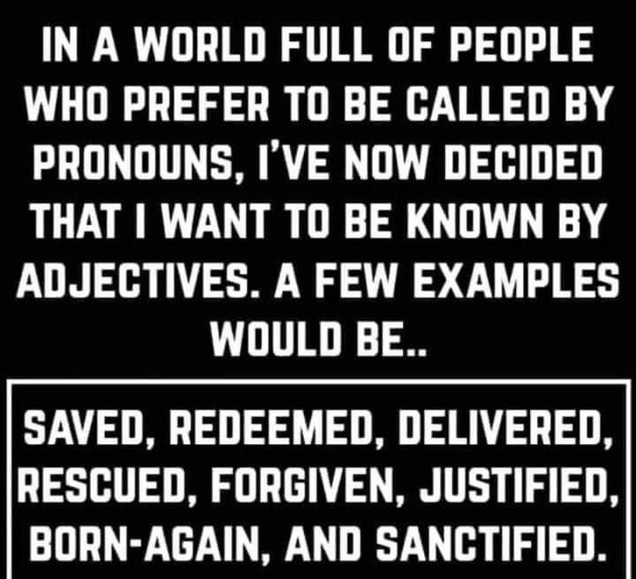

Slide 4
Notes:
Scott Hahn

Slide 5
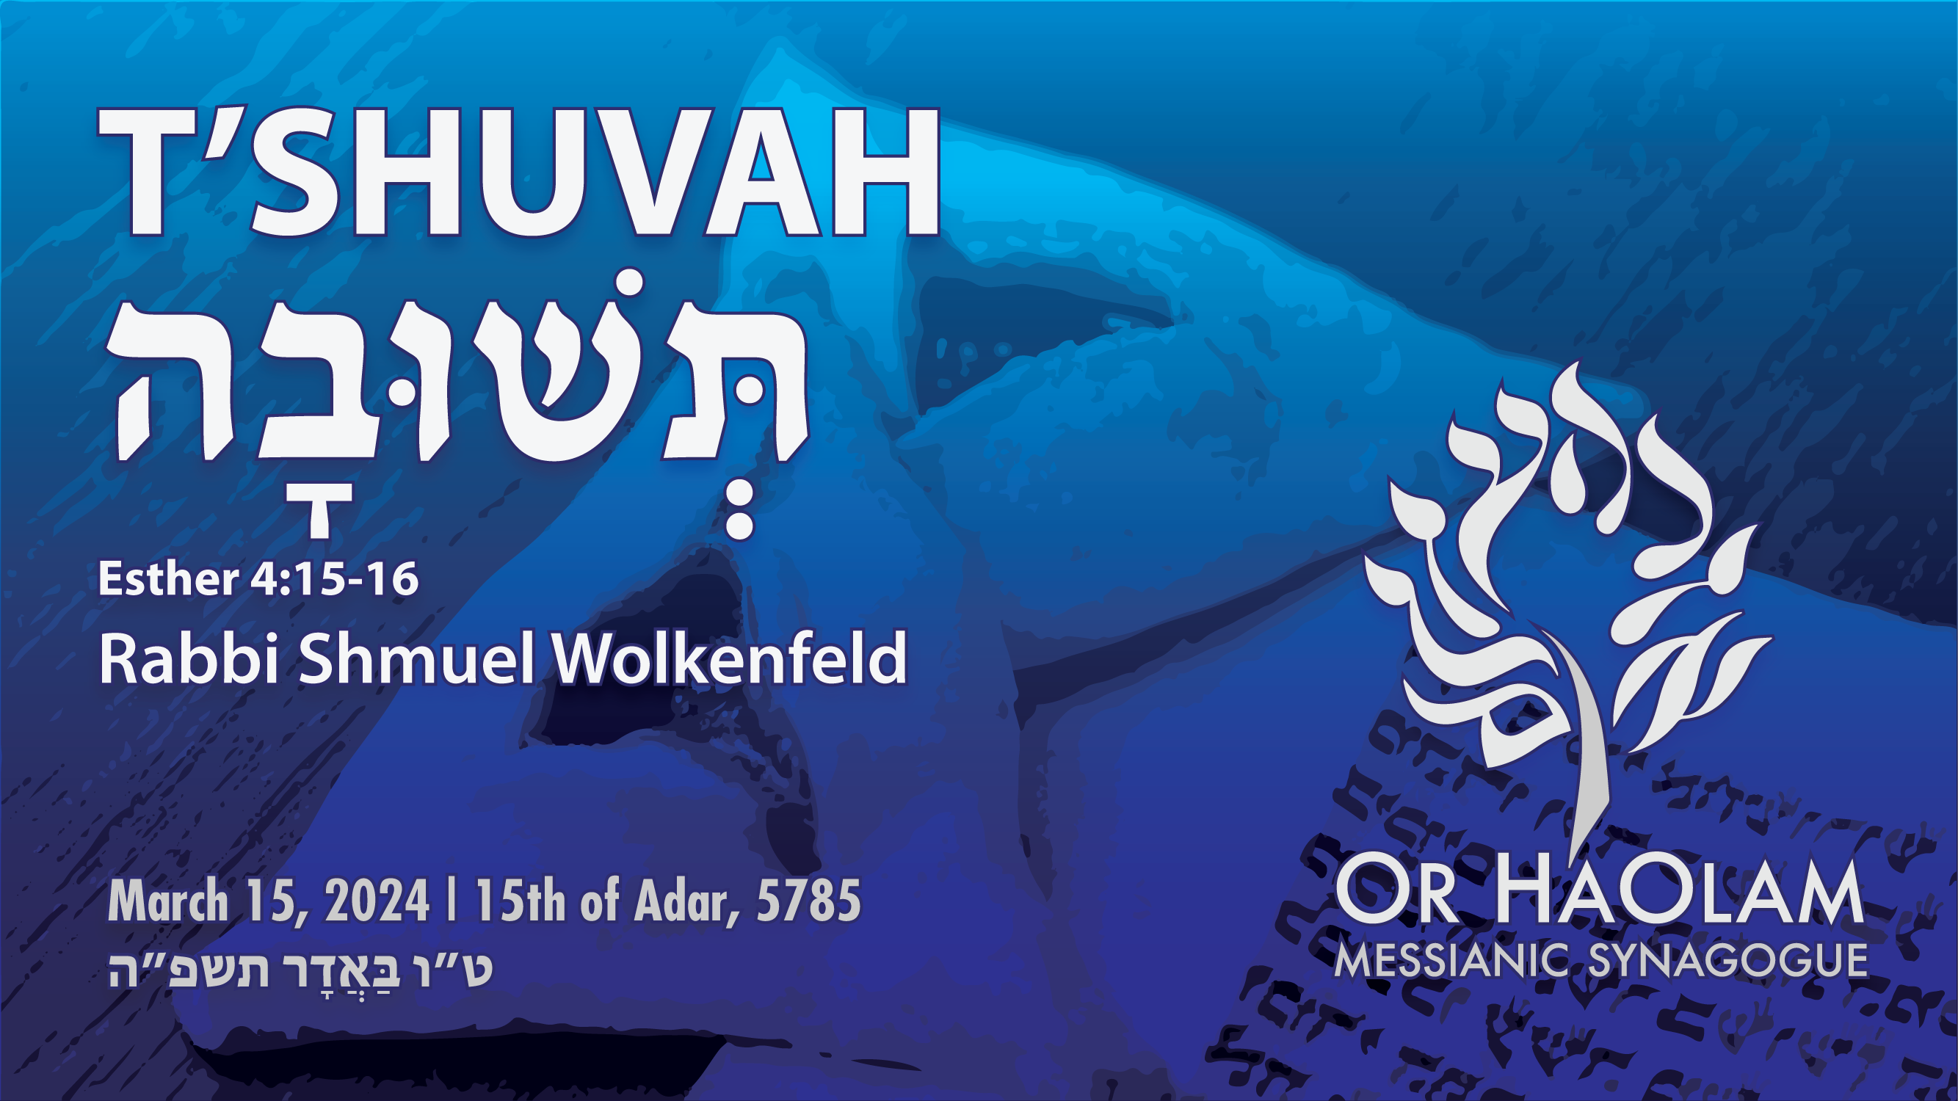
REPENTANCE

Slide 6
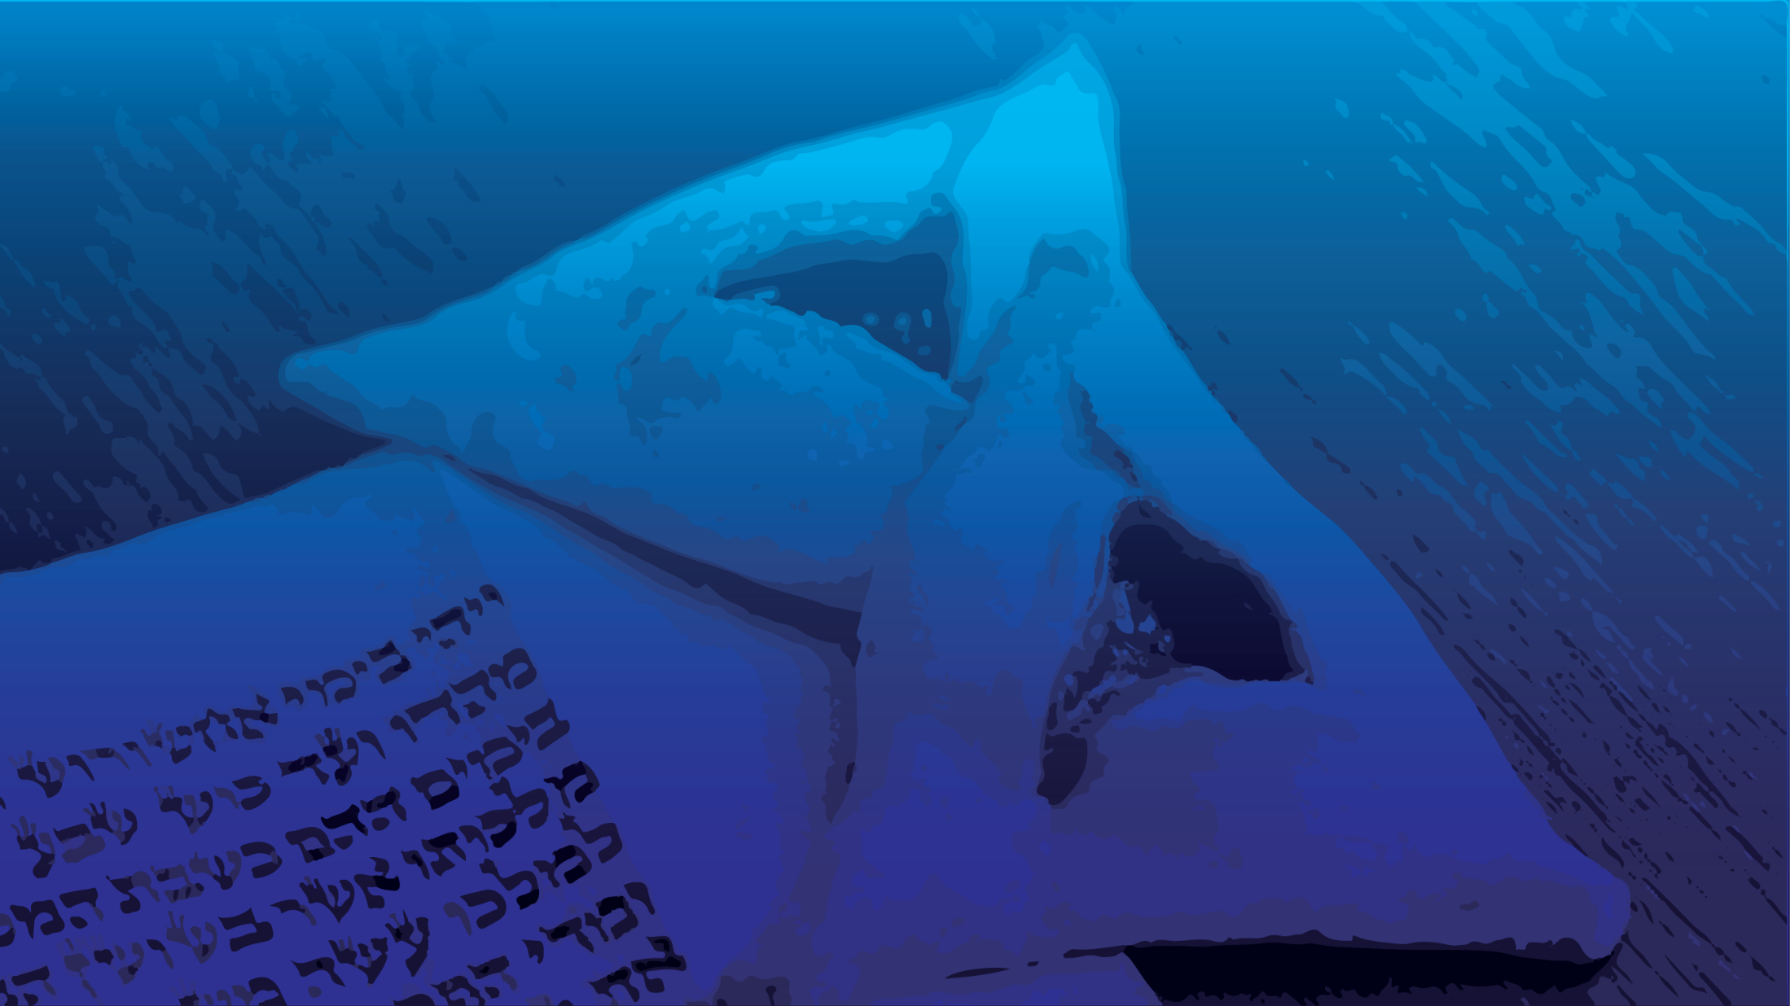
T'shuvah תְּשׁוּבָה Repentance
Ester 4.15-16
Primacy of repentance
Ester’s motivation to repent
Ongoing repentance in Messiah
Repentance in the wars of Israel
Deliverance

Slide 7
T'shuvah תְּשׁוּבָה Repentance
Ester 4.15-16
Primacy of repentance
Ester’s motivation to repent
Ongoing repentance in Messiah
Repentance in the wars of Israel
Deliverance

Slide 8
^{Ester 4.15-16} Ester had them return this answer to Mordekhi: “Go, assemble all the Jews to be found in Shushan, and have them fast for me, neither eating nor drinking for three days, night and day;

Slide 9
^{Ester 4.15-16} also I and the girls attending me will fast the same way. Then I will go in to the king, which is against the law; and if I perish, I perish.”

Slide 10
Why fast?
Why did Ester fast so intensely?
What was going on
for those three days?

Slide 11
Why fast?
Why did Ester fast so intensely?
T’shuvah
תְּשׁוּבָה
Repentance
Notes:
T’shuvah/ repentance may be the sweetest word / action to G-d’s ears.

Slide 12
Repentance is
the prime directive
of the Kingdom,
the starter core value.
Notes:
Star Trek

Slide 13
^{Mk 1.14-15} After Yokhanan had been arrested, Yeshua came into the Galil proclaiming the Good News from God: “The time has come,
God’s Kingdom is near!
Repent, Turn to God from your sins
and believe the Good News!”

Slide 14
^{1 Kefa 4.17} For the time has come for the judgment to begin. It begins with the household of God; and if it starts with us, what will the outcome be for those who are disobeying God’s Good News?
Notes:
That is, we believers repent first, then others may follow.

Slide 15
A repentant spirit is the access to all the aspects of the Kingdom…

Slide 16
^{Lk 18.9-14} Also, to some who were relying on their own righteousness and looking down on everyone else, he told this parable: “Two men went up to the Temple to pray, one a Parush and the other a tax-collector. The Parush stood and prayed to himself,

Slide 17
^{Lk 18.9-14} ‘O God! I thank you that I am not like the rest of humanity — greedy, dishonest, immoral, or like this tax-collector! I fast twice a week, I pay tithes on my entire income, . . . ’But the tax-collector, standing far off, would not even raise his eyes toward heaven,

Slide 18
^{Lk 18.9-14} but beat his breast and said, ‘God! Have mercy on me, sinner that I am!’ I tell you, this man went down to his home right with God rather than the other. For everyone who exalts himself will be humbled, but everyone who humbles himself will be exalted.”

Slide 19
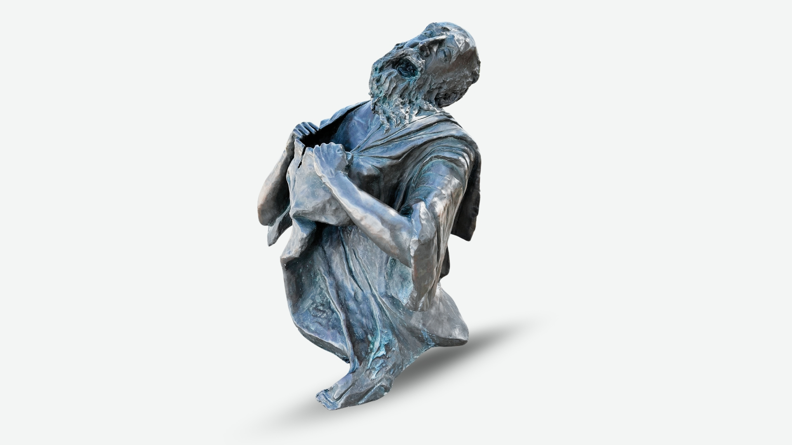

Slide 20
REPENTANCE

Slide 21
T'shuvah תְּשׁוּבָה Repentance
Ester 4.15-16
Primacy of repentance
Ester’s motivation to repent
Ongoing repentance in Messiah
Repentance in the wars of Israel
Deliverance

Slide 22
^{Ester 3.12,13} The king’s secretaries were summoned on the thirteenth day of the first month…Letters were sent by courier to all the royal provinces “to destroy, kill and exterminate all Jews, from young to old,

Slide 23
^{Ester 3.12,13} including small children and women, on a specific day, the thirteenth day of the twelfth month, the month of Adar, and to seize their goods as plunder.”
Notes:
Complete genocide. Ethnicity specific.

Slide 24
^{Ester 4.1,3} When Mordekhi learned everything that had been done, he tore his clothes, put on sackcloth and ashes and went out through the city, lamenting and crying bitterly…

Slide 25
^{Ester 4.1,3} In every province reached by the king’s order and decree, there was great mourning among the Jews, with fasting, weeping and wailing, as many lay down on sackcloth and ashes.
Notes:
Empire wide seeking of G-d by the Jews. But Ester…

Slide 26
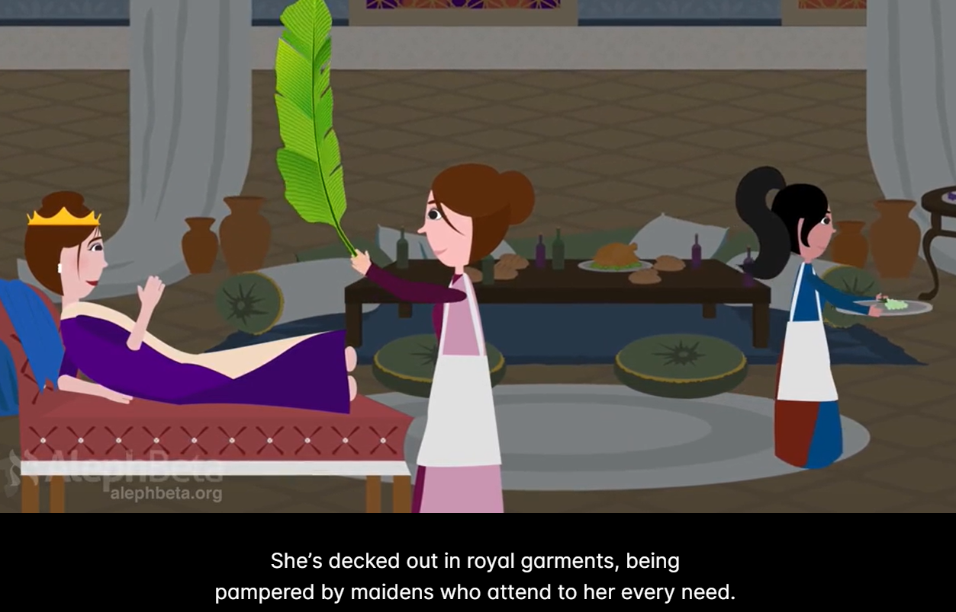
Notes:
https://members.alephbeta.org/playlist/taanit-esther-meaning

Slide 27
^{Ester 4.5-9} Ester summoned Hatakh, one of the king’s officials attending her, and instructed him to go to Mordekhi and find out what this was all about and why. Hatakh went out to Mordekhi in the open space in front of the King’s Gate, and Mordekhi told him everything that had happened to him

Slide 28
^{Ester 4.5-9} and exactly how much silver Haman had promised to put in the royal treasury for the destruction of the Jews. He also gave him a copy of the decree for their destruction issued in Shushan; so that he could show it to Ester,

Slide 29
^{Ester 4.5-9} explain it to her, and then instruct her to approach the king, intercede with him and implore his favor on behalf of her people. Hatakh returned and told Ester what Mordekhi had said.
Notes:
Ester said, “I can’t approach the King, as I’ve not been invited.” Instant death.

Slide 30
^{Ester 4.12-14} Mordekhi asked them to give Ester this answer: “Don’t suppose that merely because you happen to be in the royal palace you will escape any more than the other Jews. For if you fail to speak up now,

Slide 31
^{Ester 4.12-14} relief and deliverance will come to the Jews from a different direction; but you and your father’s family will perish. Who knows whether you didn’t come into your royal position precisely for such a time as this.”
Notes:
One of the greatest affirmations of FAITH in the Bible.
רֶוַח וְהַצָּלָה יַעֲמוֹד לַיְּהוּדִים
One of the greatest statements of calling in the Bible.

Slide 32
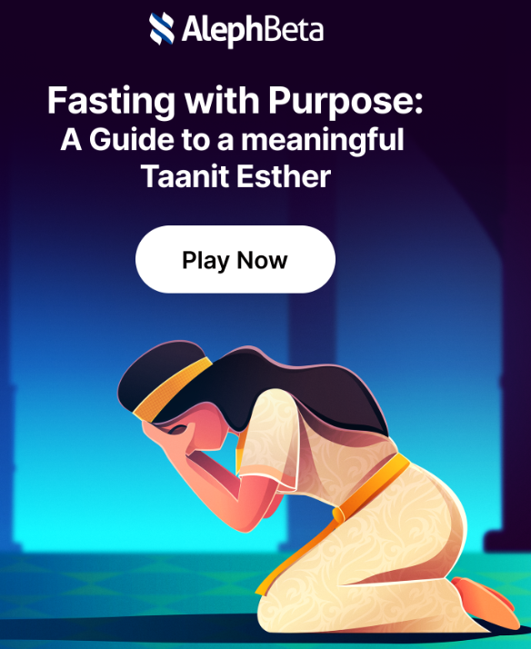
Notes:
She’s not separate from, above her people.

Slide 33
^{Ester 4.15-16} Ester had them return this answer to Mordekhi: “Go, assemble all the Jews to be found in Shushan, and have them fast for me, neither eating nor drinking for three days, night and day;
Notes:
Dramatic reversal of lifestyle.

Slide 34
^{Ester 4.15-16} also I and the girls attending me will fast the same way. Then I will go in to the king, which is against the law; and if I perish, I perish.”

Slide 35
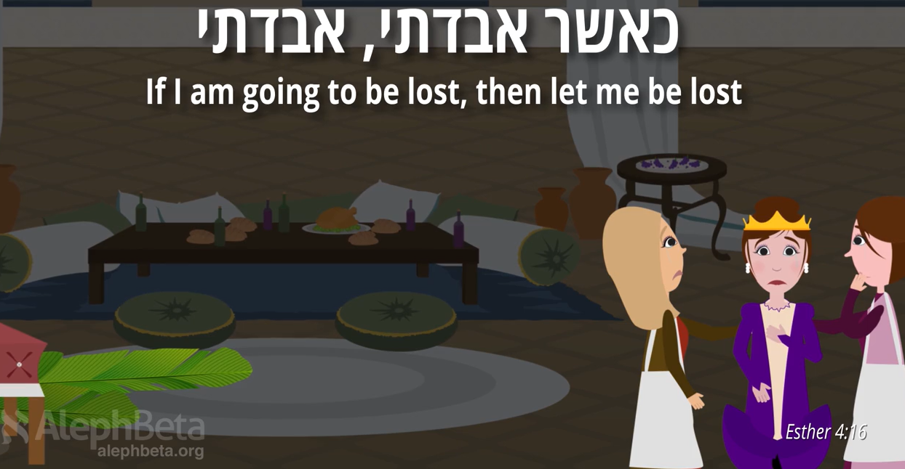

Slide 36
Why fast?
Why did Ester fast so intensely?
T’shuvah
תְּשׁוּבָה
Repentance

Slide 37
“neither eating nor drinking for three days”
Levels of fasting
Daniel fast: foregoing favorites
Juice fast: nothing else
Water fast: water only
Yom Kippur fast: NPO, “nils per os” or “nothing by mouth.”
Notes:
Ester did #4. Ouch.

Slide 38
Living in the prosperity and luxury of the Persian palace, maybe they grew to trust Persian policy
Return to the Land: Ezra
Rebuild the Temple
Security and luxury assumed.
Notes:
“luxury once enjoyed becomes a necessity”
“Each girl had her turn to appear before King Akhashverosh after she had undergone the full twelve-month preparation period prescribed for the women, consisting of a six-month treatment with oil of myrrh and six months with perfumes and other cosmetics for women.”

Slide 39
Spiritual humility: Fasting is a biblical way to humble yourself in the sight of God.
Self-reflection and transformation: Fasting enables the Holy Spirit to reveal your true spiritual condition, leading to brokenness, repentance, and transformation.

Slide 40
Quicken the Word of God: Fasting encourages the Holy Spirit to make God's truth more meaningful to you.
Deprivation for a greater good: Fasting involves giving up something good (like food or comforts) to make a decision for a greater spiritual purpose.
Notes:
She needed a strategy. If she just went to the King and requested reversal of the decree, may have lost. Strategy of double banquet piqued Akhashverosh’s interest.

Slide 41
^{Yoel 2.12-15} “Yet even now,” says Adoni, “turn to me with all your heart, with fasting, weeping and lamenting.” Tear your heart, not your garments; and turn to Adoni your God. For he is merciful and compassionate, slow to anger, rich in grace, and willing to change his mind about disaster.
Notes:
Fasting intensifies repentance.

Slide 42
^{Yoel 2.12-15} Who knows? He may turn, change his mind and leave a blessing behind him, [enough for] grain offerings and drink offerings to present to Adoni your God. “Blow the shofar in Tziyon! Proclaim a holy fast, call for a solemn assembly.”

Slide 43
Consider Daniel in Babylon
^{Dan 9.4-6} “I prayed to Adoni my God and confessed, saying: ‘O Lord, the great and awesome God, who keeps covenant and mercy with those who love Him and keep His mitzvot,
Notes:
Daniel saw Israel in distress, but a promise of redemption after 70 years captivity.

Slide 44
^{Dan 9.4-6} we have sinned; we have committed iniquity; we have acted wickedly; we have rebelled; we have turned away from Your mitzvot and from Your rulings.

Slide 45
^{Dan 9.4-6} We have not listened to Your servants the prophets, who spoke in Your name to our kings, our leaders and our fathers, and to all the people of the land.

Slide 46
^{Dan 9.11-14} Yes, all Isra’el flouted your Torah and turned away, unwilling to listen to your voice. Therefore, the curse and oath written in the Torah of Moshe the servant of God was poured out on us, because we sinned against him.

Slide 47
^{Dan 9.11-14} He carried out the threats he spoke against us and against our judges who judged us, by bringing upon us disaster so great that under all of heaven, nothing has been done like what has been done to Yerushalayim.

Slide 48
^{Dan 9.11-14} As written in the Torah of Moshe, this whole disaster came upon us. Yet we did not appease Adoni our God by renouncing our wrongdoing and discerning your truth.

Slide 49
^{Dan 9.11-14} So Adoni watched for the right moment to bring this disaster upon us, for Adoni our God was just in everything he did, yet we didn’t listen when he spoke.
Notes:
Our trust is NOT in Trump and Musk and Doge.

Slide 50
REPENTANCE

Slide 51
T'shuvah תְּשׁוּבָה Repentance
Ester 4.15-16
Primacy of repentance
Ester’s motivation to repent
Ongoing repentance in Messiah
Repentance in the wars of Israel
Deliverance

Slide 52
^{Mtt 6.9-13} ‘Our Father in heaven! May your Name be kept holy. May your Kingdom come; your will be done on earth as in heaven…

Slide 53
^{Mtt 6.9-13} ‘Forgive us what we have done wrong, as we too have forgiven those who have wronged us. And do not lead us into hard testing, but keep us safe from the Evil One.
Notes:
Assumes that we need daily to repent of failure.
Repentance never ends.
It doesn’t say, “Thank you that I’ve arrived”

Slide 54
A repentant spirit
is NOT a spirit of abject failure.
It IS a spirt of joyful dependence on the Blood of Atonement and the power of the Ruakh
It IS an easy heart to say “I was wrong.”

Slide 55
^{Mtt 5. 3-10} “How blessed are the poor in spirit! for the Kingdom of Heaven is theirs.
How blessed are those who mourn! for they will be comforted. How blessed are the meek! for they will inherit the Land!

Slide 56
^{Mtt 5. 3-10} How blessed are those who hunger and thirst for righteousness! for they will be filled.
How blessed are those who show mercy! for they will be shown mercy.
How blessed are the pure in heart! for they will see God.

Slide 57
^{Yn 17.13} But now, I am coming to you; and I say these things while I am still in the world so that they may have my joy made complete in themselves.
Notes:
His joy…dependent on Him.

Slide 58
^{Yn 17 24-26} “Father, I want those you have given me to be with me where I am; so that they may see my glory, which you have given me because you loved me before the creation of the world.
Notes:
Repent of self reliance, dependent on glory.

Slide 59
^{Yn 17 24-26} Righteous Father, the world has not known you, but I have known you, and these people have known that you sent me. I made your name known to them,
Notes:
Our dependence on Him!

Slide 60
^{Yn 17 24-26} and I will continue to make it known; so that the love with which you have loved me may be in them, and I myself may be united with them.”

Slide 61
REPENTANCE

Slide 62
T'shuvah תְּשׁוּבָה Repentance
Ester 4.15-16
Primacy of repentance
Ester’s motivation to repent
Ongoing repentance in Messiah
Repentance in the wars of Israel
Deliverance

Slide 63
^{Shoftim/Ju 6 12-13} The angel of Adoni appeared to him and said to him: “You valiant hero! Adoni is with you!” “Excuse me, sir,” answered Gid‘on, “but if Adoni is with us, then why is all this happening to us?”
Notes:
Gid’on saw idolatry of Israel as related to their subjugation by the Midianites.

Slide 64
^{Shoftim/Ju 6 12-13} And where are all his miracles our ancestors told us about when they said, ‘Didn’t Adoni bring us up from Egypt?’ For now, Adoni has abandoned us and handed us over to Midyan.”
Notes:
So, Gid’on tore down the idol and worshipped G-d.

Slide 65
Israel and America must NOT relay on secular strength primarily.

Slide 66
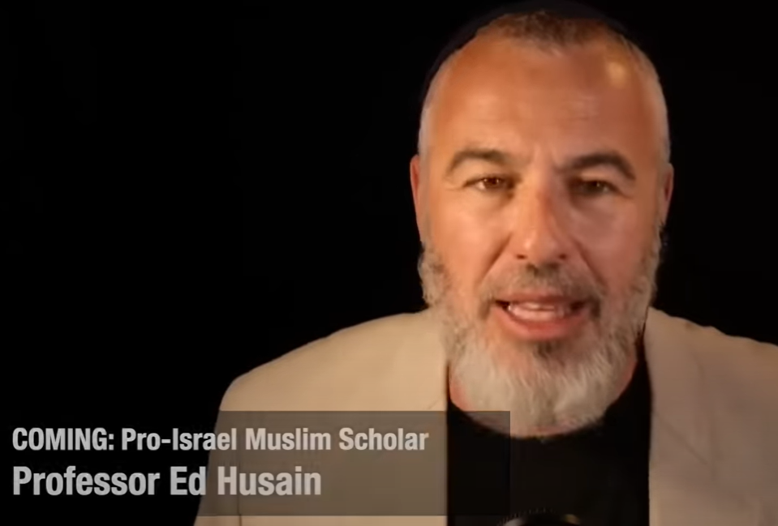
"Possibly the most
important video I’ve
ever seen!",
says Yishai Fleischer.

Slide 67
He is referring to the inspiring words of Professor Ed Husain, a Muslim scholar, author, teacher and a guide to understanding a path forward in the Abrahamic Region for Jews and Arabs to thrive and live side by side with mutual respect.

Slide 68
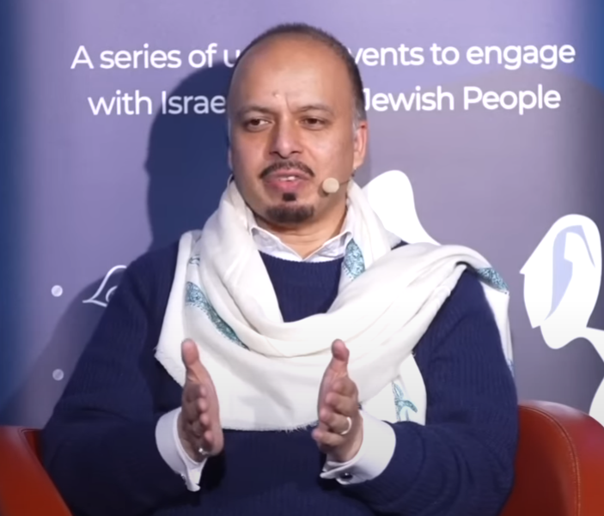
Notes:
https://youtu.be/wX4YXlQCjSo
From Russel Reitz

Slide 69
As Ronald Reagan famously said, “If we ever forget that we’re one nation under God, then we will be a nation gone under.”
Notes:
https://www.drjamesdobson.org/articles/the-attack-on-our-fundamental-liberties?utm_campaign=6458768-2025%20Public%20Policy&utm_medium=email&_hsenc=p2ANqtz--gXRuztA9EHOWAMzkif87oc1ArioGAwLhk2J-z1JSgH2TtYXocMKYcr5bYLckaGuFUCoXXy0LYwsXn2gAwOCr0a7XXbQ&_hsmi=348269053&utm_content=348269051&utm_source=hs_email

Slide 70
Purim is a time of celebration of victory, but it needs to be in the context of repentance. Three duties:

Slide 71
^{Ester 9.20-22} Mordekhi recorded these events and sent letters to all the Jews in all the provinces of King Achashverosh, both near and far, instructing them to observe the fourteenth day of the month of Adar and the fifteenth day, every year,

Slide 72
^{Ester 9.20-22} [to commemorate] the days on which the Jews obtained rest from their enemies and the month which for them was turned from sorrow into gladness and from mourning into a holiday; they were to make them days of celebrating and rejoicing, sending portions [of food] to each other and giving gifts to the poor.

Slide 73
^{Ester 9.20-22}
Celebrating and rejoicing Sunday afternoon
Sending portions: Saturday afternoon mishloakh manot משלוח מנות distribution

Slide 74
^{Ester 9.20-22}
Giving gifts to the poor: offering for Reach Initiative for Nova survivors. Both at the end of the Shabbat service and in the Sunday party

Slide 75
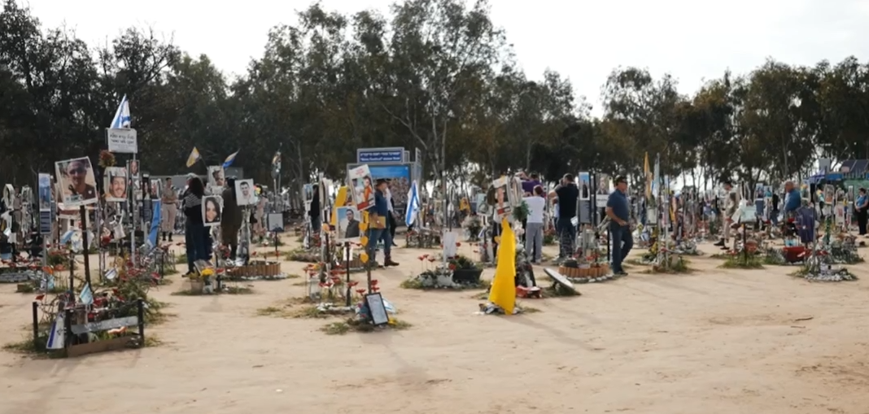
Nova Festival Site
Notes:
https://youtu.be/Z6oPXeEuUuA

Slide 76
REPENTANCE

Slide 77
T'shuvah תְּשׁוּבָה Repentance
Ester 4.15-16
Primacy of repentance
Ester’s motivation to repent
Ongoing repentance in Messiah
Repentance in the wars of Israel
Deliverance

Slide 78
^{Ester 9.1} The time approached for the king’s order and decree to be carried out, the day when the enemies of the Jews hoped to overpower them. But, as it turned out, the opposite took place — the Jews overpowered those who hated them.
Notes:
https://unitedwithisrael.org/the-miracle-behind-the-exploding-buses-is-much-larger-than-you-think/

Slide 79
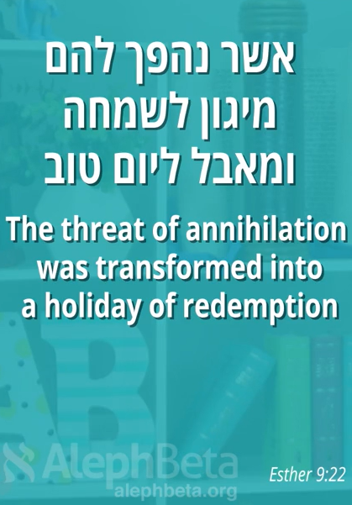

Slide 80
Another supernatural
Reversal / deliverance
Notes:
https://unitedwithisrael.org/the-miracle-behind-the-exploding-buses-is-much-larger-than-you-think/

Slide 81
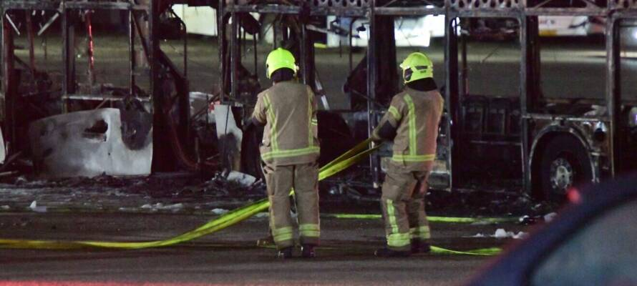
‘OPEN MIRACLE’: Palestinians Nearly Succeeded with Another October 7th
Notes:
https://unitedwithisrael.org/the-miracle-behind-the-exploding-buses-is-much-larger-than-you-think/

Slide 82
“This event might go down in history as one of the biggest miracles the Jewish people experienced since biblical times,” writes columnist Hillel Fuld.
Notes:
https://unitedwithisrael.org/the-miracle-behind-the-exploding-buses-is-much-larger-than-you-think/

Slide 83
Feb 23, 2025, a young lady noticed a suspicious object on a bus in the center of Israel. She reported it to the driver who pulled into a station, got everyone off the bus, at which point, the bus blew up and was completely destroyed.
Notes:
https://unitedwithisrael.org/the-miracle-behind-the-exploding-buses-is-much-larger-than-you-think/

Slide 84
Over the hours that followed, an additional four bombs were discovered on buses, some of them exploded, others were taken apart before exploding. Some malfunctioned.
Notes:
https://unitedwithisrael.org/the-miracle-behind-the-exploding-buses-is-much-larger-than-you-think/

Slide 85
SIX bombs were found in and around Bat Yam (Tel Aviv) with some already exploding in buses (non injured) and the rest set to go off tomorrow when the buses were to be crowded with people.
Notes:
Sally Shiff

Slide 86
According to my source, and this was news to me, a whopping 15 buses were supposed to explode this morning. According to reports, the terrorist set the timer for 9 PM instead of 9 AM.
Notes:
https://unitedwithisrael.org/the-miracle-behind-the-exploding-buses-is-much-larger-than-you-think/

Slide 87
In addition to the 15 buses, 5 suicide bombers were set to detonate bombs on the light rail at the same time, all in the center of Israel. My source says that as those buses and terrorists blew up, massive security and emergency forces were supposed to rush to the scene at which point,
Notes:
https://unitedwithisrael.org/the-miracle-behind-the-exploding-buses-is-much-larger-than-you-think/

Slide 88
there would be a massive breach of the security fence and many terrorists from Judea and Samaria would invade Israel and carry out a 10/7 2.0. Only this time it wouldn’t be from Gaza so it would be an invasion into basically every major city in Israel.
Notes:
https://unitedwithisrael.org/the-miracle-behind-the-exploding-buses-is-much-larger-than-you-think/

Slide 89
Effect of Deliverance
on Torah reading
Notes:
https://unitedwithisrael.org/the-miracle-behind-the-exploding-buses-is-much-larger-than-you-think/

Slide 90
It is interesting to note that the reading of “Zachor” [Dt 25.17-19] is the only Torah reading that we are obligated to hear by Torah law. The weekly Torah readings were instituted by the sages, while this reading – the Torah itself commands us to listen to.
Notes:
https://unitedwithisrael.org/remember-amalek/

Slide 91
^{Dvarim/Dt 25.17-19} “Remember what ‘Amalek did to you on the road as you were coming out of Egypt, how he met you by the road, attacked those in the rear, those who were exhausted and straggling behind when you were tired and weary.

Slide 92
^{Dvarim/Dt 25.17-19} He did not fear God. Therefore, when Adoni your God has given you rest from all your surrounding enemies in the land Adoni your God is giving you as your inheritance to possess, you are to blot out all memory of ‘Amalek from under heaven. Don’t forget!

Slide 93
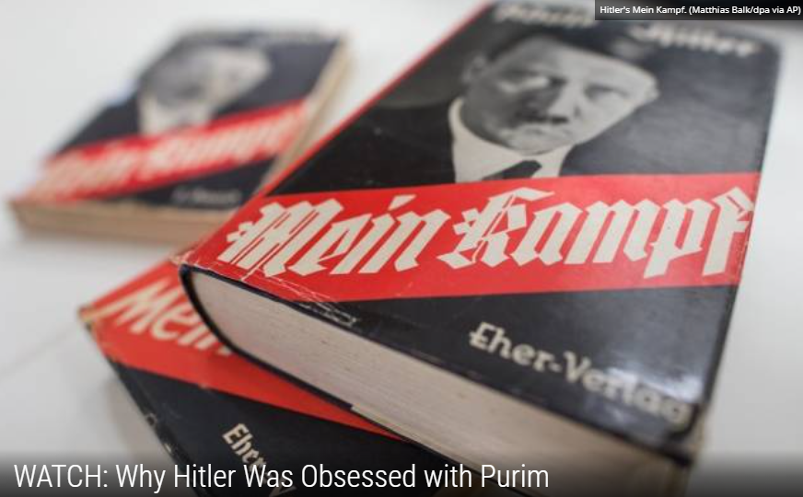
Hitler and Haman

Slide 94
The great Torah sage the Vilna Gaon explained that the Germans are also descendants of the nation of Amelek. Simon Dubnow, Arthur Szyk and Raul Hilberg also identified the Nazis,
Notes:
https://unitedwithisrael.org/strange-parallels-between-the-purim-story-and-the-nuremberg-trials/

Slide 95
who sought to eliminate the Jewish people, as being Amalekites. There are also Talmudic passages that mention a nation called Germania during the Roman Diaspora that seem prophetic in retrospect.
Notes:
https://unitedwithisrael.org/strange-parallels-between-the-purim-story-and-the-nuremberg-trials/

Slide 96
Fascinatingly, one finds in the Book of Esther that four of the Hebrew letters in Haman’s sons names utilize small instead of big characters. Jewish sages have taught throughout the generations that whenever there is a variation in the size of a letter or spelling of a word, it has a specific meaning.

Slide 97
If these four small Hebrew letters are used to represent the Jewish number for recording years, it states the year 5707 on the Jewish calendar. 5707 was the year on the Jewish calendar that the 10 Nazi war criminals were hung for committing genocide against the Jewish people.

Slide 98
As Dr. Moshe Katz proclaimed, “Since the trial was conducted by a military tribunal, the sentence handed down should have been death by firing squad, or by electric chair as practiced in the U.S.A. However, the court specifically prescribed hanging, exactly as in Esther’s original request: ‘…let Haman’s ten sons be hanged.’

Slide 99
Though doubts may linger about the connection between the Book of Esther and the Nazi war criminals, the condemned Julius Streicher certainly had none. Through some insight, Streicher appears to have grasped this link to Purim, as revealed by his final shout,

Slide 100
with the noose about his neck, mere seconds before he was hanged.” In fact, Julius Streicher, the Nazi editor of the anti-Semitic Der Stürmer newspaper, even proclaimed before he was hung, “Purim Fest 1946.”

Slide 101
REPENTANCE

Slide 102
T'shuvah תְּשׁוּבָה Repentance
Ester 4.15-16
Primacy of repentance
Ester’s motivation to repent
Ongoing repentance in Messiah
Repentance in the wars of Israel
Deliverance

Slide 103
Prayer points
A spirit of repentance: confession and forsaking
Anointing on the 300 Misloakh manot bags משלוח מנות
Elisheva Schork car accident, Ty Lewis surgery Monday
Israeli war weariness
Alliance Conf: China, Russia, Iran
Notes:
https://unitedwithisrael.org/the-miracle-behind-the-exploding-buses-is-much-larger-than-you-think/

Slide 104
Shalom. I am so thankful for Adoni's protection during my wreck, yesterday, & blessed by many prayers. A young man, 17 years, pulled out from a side street in front of me & didn't even look. I barely had time to stomp on my brakes before impact. I hit his driver's rear end full on. He was able to move his car out of the street but I was too traumatized to do anything.

Slide 105
I've never been in a wreck before. I had a ride in an ambulance to hospital. A policeman came there to get my info & tell me that he had to clear the street so had my car towed to the city impound lot. I don't even know the condition of my car. Francis is going to see about it today. I have substantial bruising from my seat belt & airbag. I have a fracture in my right wrist/arm so am in a cast. It's very difficult to text. Prayers are appreciated. Thanks.

Slide 106
Israeli war weariness
Notes:
https://unitedwithisrael.org/the-miracle-behind-the-exploding-buses-is-much-larger-than-you-think/

Slide 107
IDF Reserve Commanders, Recruiting Via WhatsApp, Say They’re Struggling to Fill Ranks
The problem of recruiting reservists comes amid weariness after more than 15 months of war and mounting anger among those who serve that they are a small minority shouldering the burden, a feeling exacerbated by the ongoing debate over the ultra-Orthodox draft
“In the second round [of call-ups], it went down to 90%, in the third to 70%. In the next one I don’t know if we’ll manage to get to 50% response.” “Every reservist has his reasons,” the commander explained.
“One doesn’t want to come because of the issue of the hostages, another because his business is falling apart. There are students who aren’t ready to give up on more studies, and in the majority of the cases it’s problems at home. People just can’t disappear again for a long period of time.” (TOI/VFI News)
Notes:
https://vfinews.com/news/hamas-agrees-to-release-one-alive-and-four-dead-ho/idf-reserve-commanders-recruiting-via-whatsapp-say?subscribed=true&utm_source=VFI+News+-+English&utm_campaign=ee75f0e9bc-EMAIL_CAMPAIGN_2025_03_14_06_00&utm_medium=email&utm_term=0_c414809724-ee75f0e9bc-148559991&mc_cid=ee75f0e9bc&mc_eid=UNIQID

Slide 108
The current situation in the world is more dangerous than in any of his best-selling novels, author and ALL ISRAEL NEWS Editor-in-Chief Joel Rosenberg warned in an interview on Fox News Radio’s "The Brian Kilmeade Show."
Speaking against the backdrop of what Rosenberg called the “Evil Empire Summit,” scheduled to be held on Friday, he warned against the budding alliance of the “three most dangerous nations on the planet – Communist China, Russia and Iran.”

