Slide 1
E-handout
To have these notes
without taking notes
go to orhaolam.com
Click on messages tab,
2025 messages

Slide 2
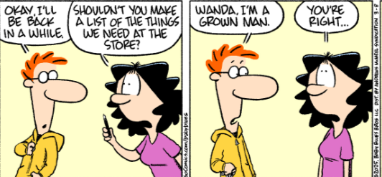

Slide 4
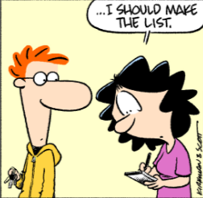

Slide 5

Notes:
https://twitter.com/i/status/1907991609251078185

Slide 6
Notes:
https://twitter.com/i/status/1907991609251078185

Slide 7
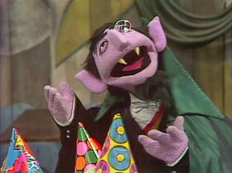
Count
von Count sings, “Counting is
Wonderful!”

Slide 8
^{Vayikra/ Lev 23.15-16} You are to count seven full weeks, until the day after the seventh week; you are to count fifty days.
We will count the Omer
by days and weeks,
from April 13 to May 31

Slide 9

Omer counter app
https://www.chabad.org/library/article_cdo/aid/2907734/jewish/Omer-Counter.htm

Slide 10

Notes:
We follow the traditional Rabbinic mode

Slide 11


Slide 12
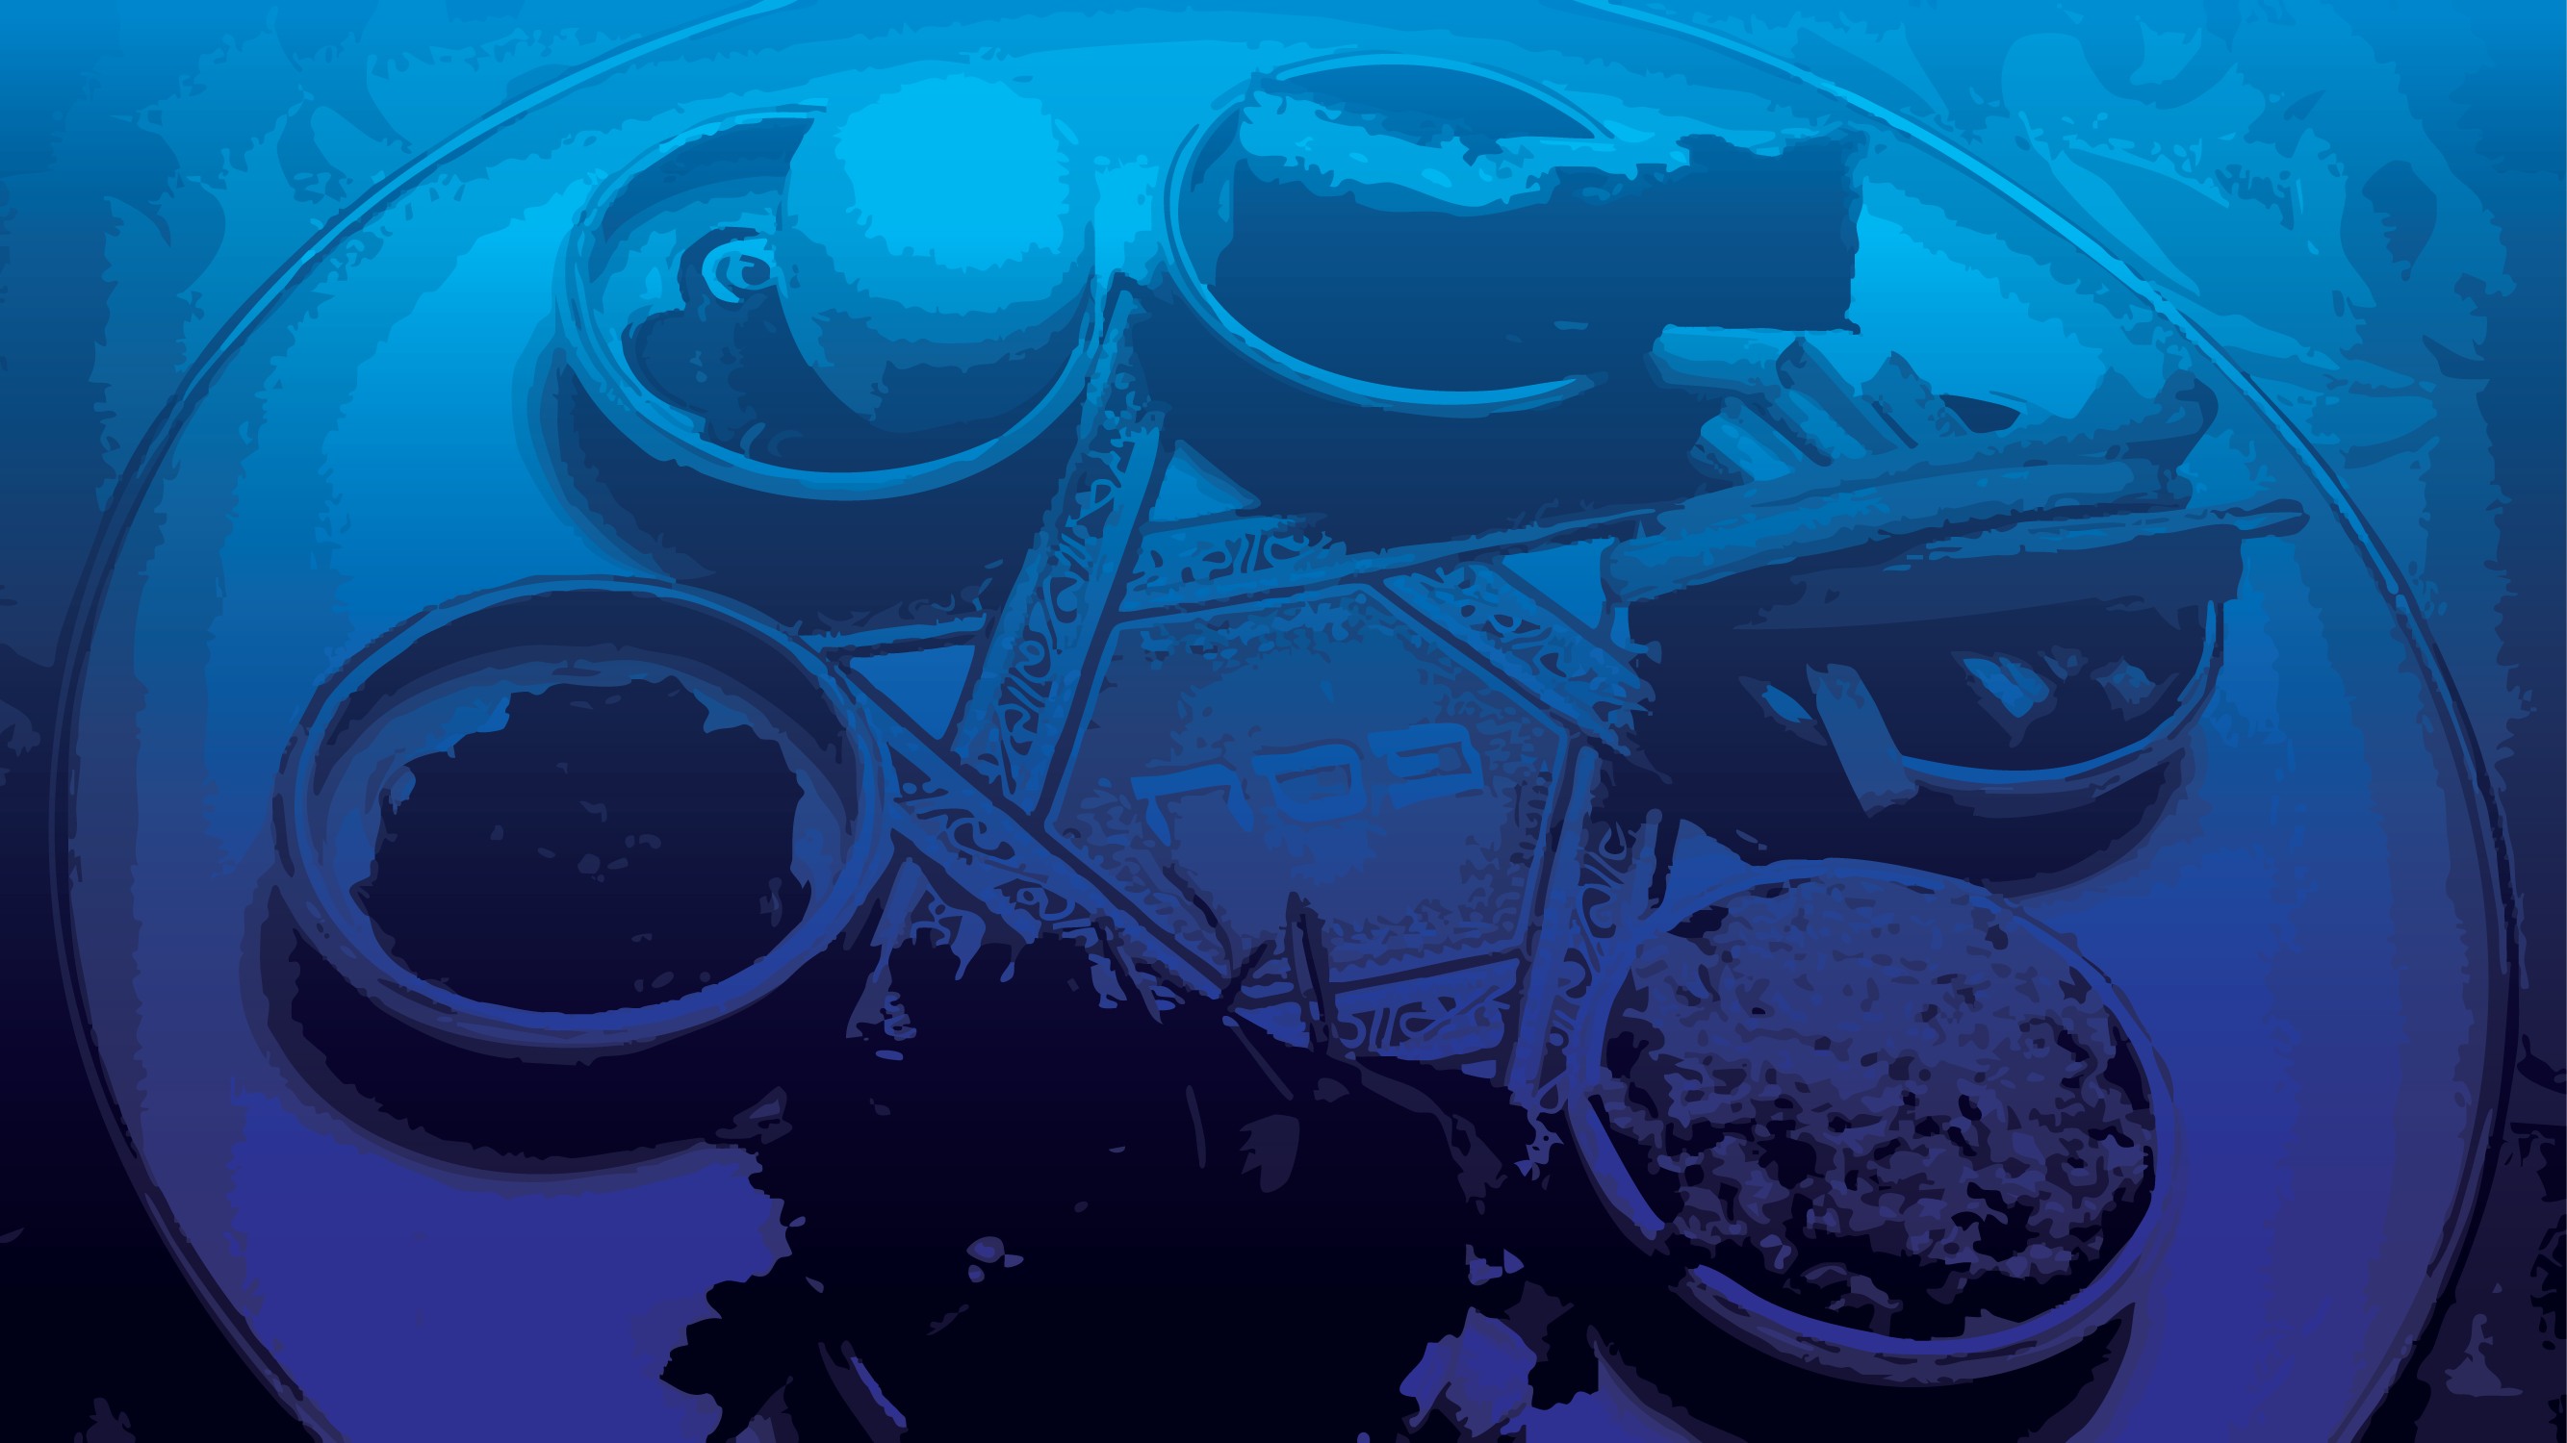
Passover Controversies
The importance of the challenge
Notes:
When I was a HS biology teacher, there was a unit on Creation vs Evolution. I got really disturbed by all the preachers who spoke about “stupid evolutionists.” Wrong, even corrupt, but NOT stupid. Kids would not be prepared for university. So I had the kids write two papers
Evidence based pro Evolution paper: 5 reasons. January. I wanted them to get nervous.
Evidence based rebuttal of the first paper in Feb.
At first I wondered if the parents would be up in arms, but did support.
Similar with apologetics. Studying Michael Browns Evidence gets boring. Agree, agree, yawn. Tovia Singer first. Nervous, then attentive

Slide 13
When I came faith in April of 1969, I can’t say that I had a detailed study of all the evidences for Yeshua. Just one evidence was convincing enough then: In the Bible, when the Jews were in right relationship to G-d, we were safe, secure, prosperous in our Land. We had been exiled for 2000 years, so we missed SOMETHING.
My mother sent me to a rabbi in Schenectady, then another in Cincinnati before I got married.

Slide 14
In about 1996, we had started Or HaOlam, and I received a phone call from Reuven Jacobs, who had been Roger Johnson, inviting Or HaOlam to attend a Tovia Singer lecture at BIAV.
Roger/ Reuven was the son of Robert Johnson, the pastor then of the Grandview Assembly. Reuven and his also PK bride had renounced Yeshua, and converted to Orthodox Judaism, and changed their names.

Slide 15
We couldn’t decline the offer, but nevertheless we were concerned what anti-Messianic arguments we would face.
One of our people, Steve Gelbart, had been given a complete set of Tovia Singers anti-Messiah presentation cassette tapes. So we divided them up, and listened to them, and researched our responses. I took Yeshayahu/ Isaiah 53. Some formidable statements.
Notes:
Exact same presentation, some comments and jokes.
It was a GREAT time, for I felt like we faced the worst, strongest objections to faith in Yeshua and found answers.
I think today I should share one of them with you.

Slide 16

Matt. 23.34
Notes:
Prophets are exciting, wise men are practical and comforting, scribes are the detail guys.

Slide 17
γραμματεῖς (grammateis)
sopher סוֹפֵר
Their role extended beyond mere copying; they were teachers, legal experts, and sometimes members of the Sanhedrin, the Jewish ruling council.
Notes:
So, this message is NOT to bless you, nor to comfort you, but to make you THINK!! about difficult things. I hope you get a bit nervous.

Slide 19
Passover Controversies
The importance of the challenge
The contents of the challenge

Slide 20
^{Lk 22.1,7-13} But the festival of Matzah, known as Pesakh, was approaching… Then came the day of matzah, on which the Passover lamb had to be killed. Yeshua sent Kefa and Yokhanan, instructing them, “Go and prepare our Seder, so we can eat.” They asked him, “Where do you want us to prepare it?” He told them, “As you’re going into the city, a man carrying a jar of water will meet you.
Notes:
Prepare = search for and clean out all leaven

Slide 21
^{Lk 22.7-13} Follow him into the house he enters, and say to its owner, ‘The Rabbi says to you, “Where is the guest room, where I am to eat the Pesakh meal with my talmidim?” ’ He will show you a large room upstairs already furnished; make the preparations there.” They went and found things just as Yeshua had told them they would be, and they prepared for the Seder.
Notes:
it is observed among the wonders and miracles done at Jerusalem, that though there were such multitudes at their feasts, yet “a man could never say to his friend, I have not found a fire to roast the Passover lambs in Jerusalem, nor I have not found a bed to sleep on in Jerusalem, nor the place is too strait for me to lodge in, in Jerusalem.”
They went and bought a lamb; they carried it to the temple to be slain in the court, where it was presented as a Passover lamb for such a number of persons; they had it flayed, cut up, the fat taken out, and burnt on the altar, and its blood sprinkled on the foot of it: they then brought it to the house where they were to eat it; here they roasted it, and provided matzah, and wine, and bitter herbs, and a sauce called “kharoseth", into which the herbs were dipped: and, in short, everything that was necessary.

Slide 22
^{Luke 22.14-16} When the time came, Yeshua and the emissaries reclined at the table and he said to them, "I have really wanted so much to celebrate this Seder with you before I die! For I tell you, it is certain that I will not celebrate it again until it is given its full meaning in the Kingdom of God."
Notes:
Full meaning is the Lamb of G-d taking away sins of the world.
Joy of Pesakh. How many had joy at Pesakh?
Joy of redemption IS difference Messianic faith and all other.

Slide 23
Was this last supper a Seder meal?

Slide 24
^{Yn 13.1-2} It was just before the festival of Pesakh, and Yeshua knew that the time had come for him to pass from this world to the Father. Having loved his own people in the world, he loved them to the end. They were at supper, and the Adversary had already put the desire to betray him into the heart of Y’hudah Ben-Shim‘on from K’riot…
Notes:
No mention of Seder yet

Slide 25
^{Yn 13.3-5} Yeshua was aware that the Father had put everything in his power, and that he had come from God and was returning to God. So he rose from the table, removed his outer garments and wrapped a towel around his waist. Then he poured some water into a basin and began to wash the feet of the talmidim and wipe them off with the towel wrapped around him.
Notes:
Not really a Seder activity, except that there are handwashing times.

Slide 26
^{Yn 13.21-26} After saying this, Yeshua, in deep anguish of spirit, declared, “Yes, indeed! I tell you that one of you will betray me.” The talmidim stared at one another, totally mystified — whom could he mean? One of his talmidim, the one Yeshua particularly loved, was reclining close beside him. So Shim‘on Kefa motioned to him and said, “Ask which one he’s talking about.”

Slide 27

^{Yn 13.21-26} Leaning against Yeshua’s chest, he asked Yeshua, “Lord, who is it?” Yeshua answered, “It’s the one to whom I give this piece of matzah after I dip it in the dish.” So he dipped the piece of matzah and gave it to Y’hudah Ben-Shim‘on from K’riot
Notes:
So this is like a Seder, Matzah and dipping.

Slide 28
The term "psómion" refers to a small piece or morsel of bread. In the New Testament, it is used to describe a piece of bread that is dipped and given as a sign of friendship or identification. It carries the connotation of a small, humble portion, often associated with sharing a meal.
Notes:
https://biblehub.com/greek/5596.htm

Slide 29
^{Yn 13.27-29} As soon as Y’hudah took the piece of matzah, the Adversary went into him. “What you are doing, do quickly!” Yeshua said to him. But no one at the table understood why he had said this to him. Some thought that since Y’hudah was in charge of the common purse, Yeshua was telling him, “Buy what we need for the festival,” or telling him to give something to the poor.
Notes:
If they were eating the Seder, why would they need to buy anything for it?
If it was the Seder meal, they shouldn’t buy and no one would sell.

Slide 30
Yn ch 14-16 Yeshua’s Spirit Life teaching
Yn ch 17 Yeshua’s greatest prayer

Slide 31
^{Yn 18.1, 12-13, 28} After Yeshua had said all this, he went out with his talmidim across the stream that flows in winter through the Vadi Kidron, to a spot where there was a grove of trees;

Slide 32
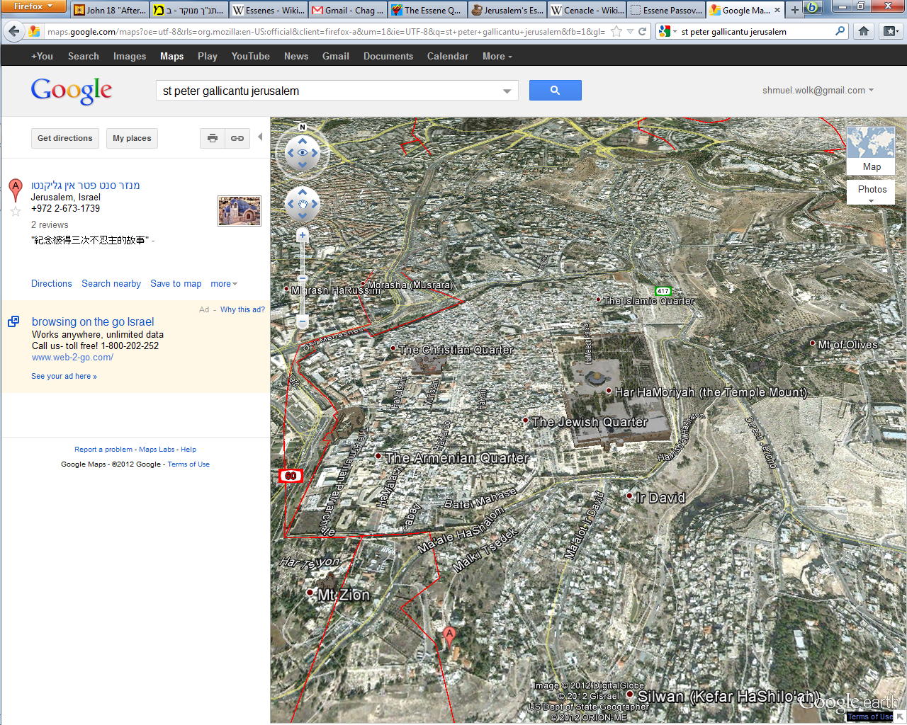
Notes:
Vadi Kidron,
Grove of Trees: Gat Shemene = Gethsemane גת = press שמן = oil
Gat Shemene = oil press

Slide 33
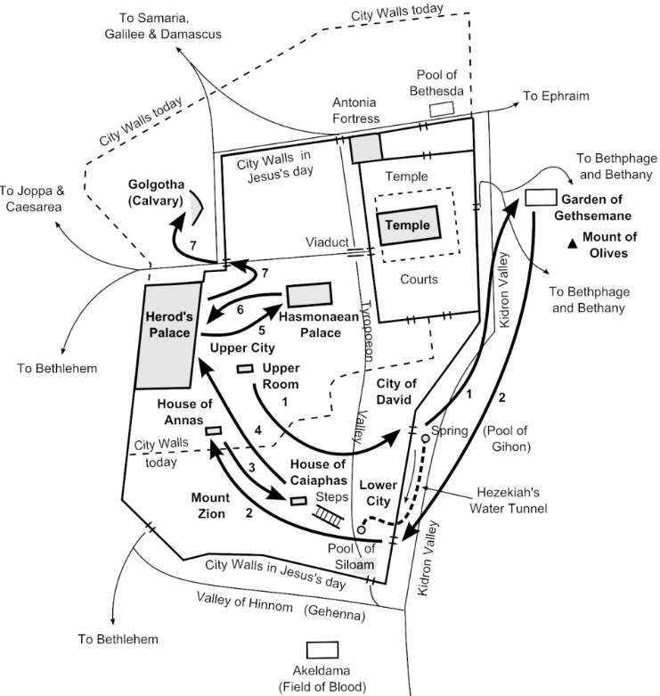
Notes:
Vadi Kidron,
Grove of Trees: Gat Shemene = Gethsemane גת = press שמן = oil
Gat Shemene = oil press
https://d3hgrlq6yacptf.cloudfront.net/5f43ec361fb8f/content/pages/uploaded_images/902.jpg

Slide 34
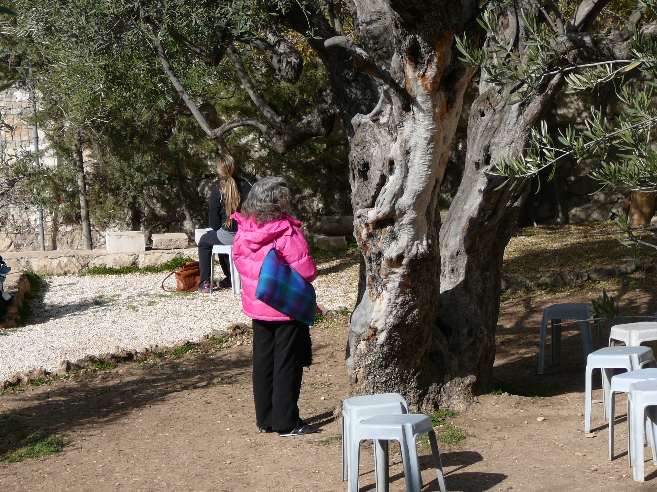

Slide 35
^{Yn 18.1, 12-13, 28} After Yeshua had said all this, he went out with his talmidim across the stream that flows in winter through the Vadi Kidron, to a spot where there was a grove of trees; and he and his talmidim went into it….So the detachment of Roman soldiers and their captain, together with the Temple guard of the Judeans, arrested Yeshua, tied him up,

Slide 36
^{Yn 18.1, 12-13, 28} and took him first to `Anan, the father-in-law of Kayafa, who was cohen gadol that fateful year…They led Yeshua from Kayafa to the governor's headquarters. By now it was early morning. They did not enter the headquarters building because they didn't want to become ritually defiled and thus unable to eat the Pesakh meal.

Slide 37
Notes:
Vadi Kidron,
Grove of Trees: Gat Shemene = Gethsemane גת = press שמן = oil
Gat Shemene = oil press
https://d3hgrlq6yacptf.cloudfront.net/5f43ec361fb8f/content/pages/uploaded_images/902.jpg

Slide 38
So, Yeshua’s last meal was a passover seder, but the cohenim the next day worried about being defiled and missing the Passover Seder.

Slide 39
^{Yn 19.12-14} On hearing this, Pilate tried to find a way to set him free; but the Judeans shouted, “If you set this man free, it means you’re not a ‘Friend of the Emperor’! Everyone who claims to be a king is opposing the Emperor!” When Pilate heard what they were saying, he brought Yeshua outside and sat down on the judge’s seat in the place called The Pavement (in Aramaic, Gabta); it was about noon on Preparation Day for Pesakh.

Slide 40
Do you see the conflict? Somebody had the wrong day, either Yeshua and followers, or Temple Cohenim/ priests and Rabbis.
Tovia Singer LOVES this “irreconcilable contradiction in the Messianic Scriptures/New Cov” Uses it to panic believers.

Slide 41
Summary of difficulties:
Yn 13.1 “just before the festival of Pesakh.”
Yn 13.26 “Buy what we need for the festival.
Yn 18.28 “unable to eat the Pesakh meal.”
Yn 19.14 “noon on Preparation Day for Pesakh.”

Slide 42
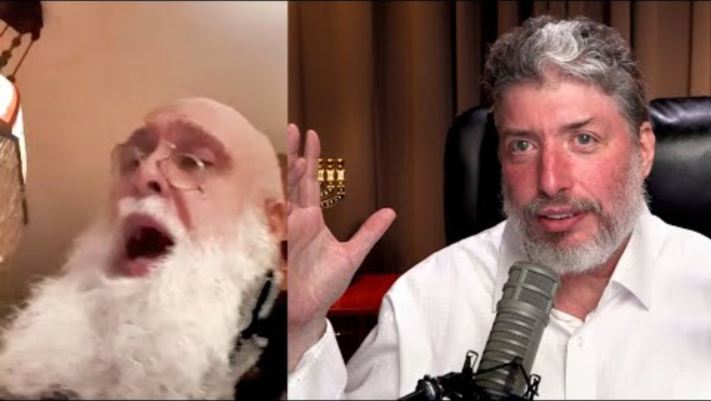
Yn 13.29
https://youtu.be/6xq9ul8P3mQ
Notes:
https://youtu.be/6xq9ul8P3mQ
1.47-5.25

Slide 43

doctrines they already held.
Notes:
.

Slide 45
Passover Controversies
The importance of the challenge
The contents of the challenge
The resolution of the challenge.

Slide 46
Summary of difficulties:
Yn 13.1 “just before the festival of Pesakh.”
Yn 13.26 “Buy what we need for the festival.
Yn 18.28 “unable to eat the Pesakh meal.”
Yn 19.14 “noon on Preparation Day for Pesakh.”

Slide 47
Yn 13.28 possible resolution

Slide 48
From David Stern’s New Testament Commentary
Yn 13.26 "Buy what we need for the festival." Following are three supporting arguments, along with points against them:
(1) Argument: Halakhah prohibits financial transactions on Shabbat and festivals. Against: The Oral Law as we know it today was not yet finalized in Yeshua's time.
Notes:
https://kifakz.github.io/eng/bible/stern/stern_yohanan_13.html

Slide 49
(2) Argument: Therefore the stores would be closed, so there would be no place to buy anything. Against: If argument (1) does not hold, neither does (2). According to С. Н. Lenski's commentary, St. John's Gospel, stores were shut on Nisan 13 (the day before Pesach) but open all night on Nisan 14, as preparations were made for the chagigah the following morning.
Notes:
https://kifakz.github.io/eng/bible/stern/stern_yohanan_13.html

Slide 50
(3) Argument: If it was already Erev-Pesach ("Passover eve"), it was too late to buy what was needed for it. Against: The directive may have been to buy for the rest of the seven-day festival, not for the Seder.
Notes:
https://kifakz.github.io/eng/bible/stern/stern_yohanan_13.html
This is the weakest of the defenses, that it was OK to buy on the Seder night.

Slide 51
Yn 18.28 and 19.14 possible resolution

Slide 52
Yn 18.28 literally, "unable to eat the Pesakh." Some scholars believe "the Pesakh" in this verse refers to other food eaten during Pesakh, specifically the khagigah (festival sacrifice), which was consumed with great joy and celebration on the afternoon following the Seder. This is the Pesakh meal which the Judeans gathered outside Pilate's palace would have been unable to eat had they entered, because their defilement would have lasted till sundown.
Notes:
Not another seder, but another big meal. Traditional innovation.

Slide 53
Yn 13.1 and Yn 19.14 possible resolution

Slide 54
From David Stern’s Jewish New Testament Commentary: Joseph Shulam has suggested that it [the Last Supper] may have been not the Seder but a se'udat-mitzvah, the celebratory "banquet accompanying performance of a commandment" such as a wedding or b'rit-milah.
Notes:
https://kifakz.github.io/eng/bible/stern/stern_matfey_26.html

Slide 55
Here is the background for his argument. When a rabbi and his students now finish studying a tractate of the Talmud, they celebrate with a se'udat-mitzvah (also called a se’udat-siyum, "banquet of completion," i.e., graduation).
Notes:
https://kifakz.github.io/eng/bible/stern/stern_matfey_26.html

Slide 56
Yeshua might have arranged to have himself and his talmidim finish reading a book of the Tanakh on Nisan 14. Or, since Yeshua knew he was to die, he may have regarded it as appropriate to complete his disciples' earthly "course of study" with a banquet. This solution would resolve the perceived conflict between Yochanan and the Synoptic Gospels over the timing of the Last Supper
Notes:
https://kifakz.github.io/eng/bible/stern/stern_matfey_26.html

Slide 57
^{Lk 22:15-16} "And He said to them: 'I have longingly desired [epithumia epethumesa] to eat this Passover with you before my suffering; however, I tell you that I shall not eat of it, until it can be administered in the Kingdom of God.'" (The Holy Bible in Modern English)

Slide 58
Total resolution

Slide 59
^{Luke 22.10} He told them, “As you’re going into the city, a man carrying a jar of water will meet you. Follow him into the house he enters,
Notes:
What’s wrong with this picture??
http://www.bible-history.com/links.php?cat=39&sub=453&cat_name=Manners+%26+Customs&subcat_name=Wells

Slide 60
It is the task of the women to go for the household water to the well or spring. And they do it today in many places in the East just like it was done when "the time of the evening, even the time that women go out to draw water" (Gen 24:11). The women are trained to do this from girlhood, for Saul and his servant "found young maidens going out to draw water" (I Samuel 9:11).
Notes:
http://www.bible-history.com/links.php?cat=39&sub=453&cat_name=Manners+%26+Customs&subcat_name=Wells

Slide 61
It has been customary for Syrian women to carry the pitcher of water on their shoulder, although sometimes it is carried on the hip. Most Arabs of Israel carry it upon their head. Rebekah carried her pitcher on her shoulder (Genesis 24:15). Carrying a pitcher of water was all but universally done by women… a picturesque sight to see them with the pitcher poised gracefully upon the head or shoulder.

Slide 62
When Yeshua instructed two of his disciples, "Go into the city, and there shall meet you a man bearing a pitcher of water: follow him" (Mark 14:13), that would be an easy way of identifying the person, for it is exceedingly uncommon to see a man carrying a pitcher of water, which is a woman's task.
Notes:
Was one major sect in First Century Judaism had no women. Very apocalyptic.

Slide 63
About 50 Essene kohanim lived in the Essene quarter of Jerusalem between 30 BC and 70 AD. Celibate, they had stricter purity laws than those of Jerusalem Temple priests.
Notes:
http://www.askwhy.co.uk/christianity/0160EsseneQ1.php
No female skeletons in Qumran graves from Essene period.
Hated Temple priests/cohanim כי not Aharonic descent. By bribing Roman rulers.
Cf The Jewish Gospels

Slide 64
Essenes were faithful servants who had suffered wrongly, and the suffering servant could be an Essene interpolation specifically of the experience of an Essene leader about thirty years before the crucifixion. Messianic hymns suggest that the Qumran community had identified the Jewish Messiah with G-d and with the suffering servant.
Notes:
http://www.askwhy.co.uk/christianity/0160EsseneQ1.php
Cf Boyarin Jewish gospels.
What was the Essene relation to women in community?
Celibate. Therefore a man would be carrying the water.

Slide 65
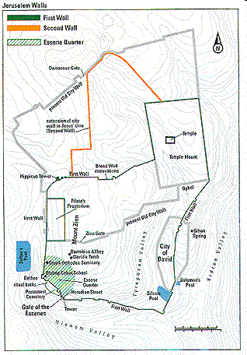
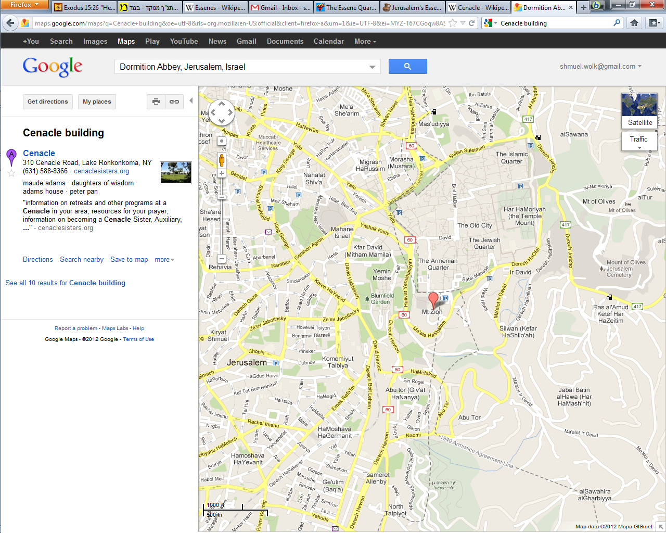
Notes:
Last meal Seder was in the Essene section of Jerusalem. Archeological evidence if google “Essene quarters in Jerusalem.”
http://www.askwhy.co.uk/christianity/0160EsseneQ1.php
http://www.centuryone.org/essene.html

Slide 66
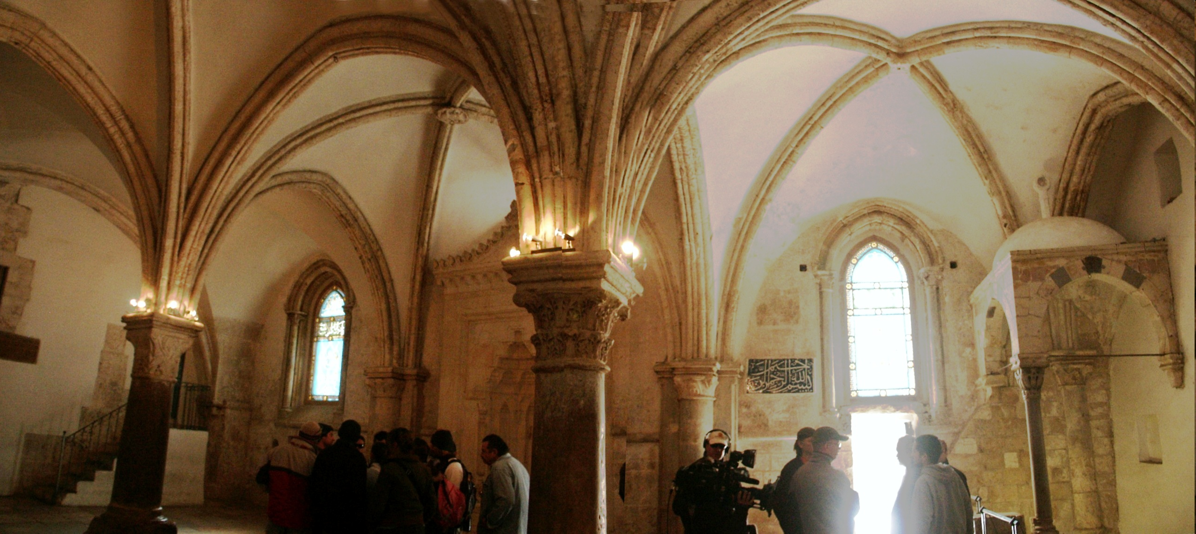

Slide 67
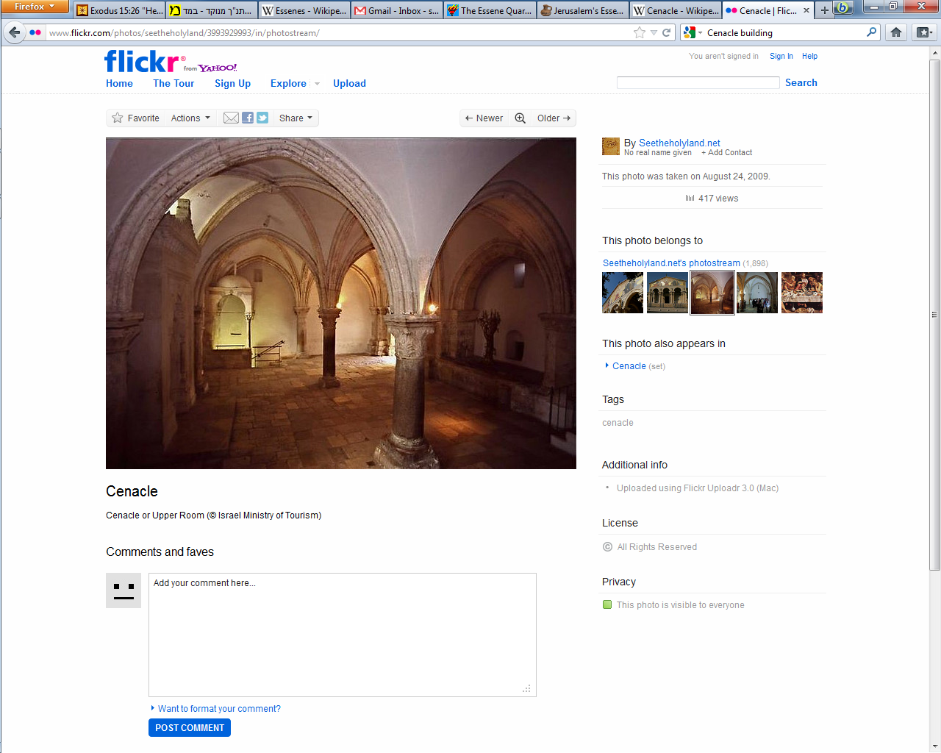
Notes:
Place of Last Meal Seder, Holy Spirit, knocking for Kefa. Not same room, rebuilt. But in same place.

Slide 68
The Essenes had a different calendar, and considered the calendar of the rabbis/Pharisees, and of the Temple/Sadducees to be corrupted.
Notes:
based on best fit of the date and upper room location, Yeshua and His disciples (and company) were likely hosted by Essenes when they observed Passover, and presumably it was an Essene observance of Passover according to Essene calendar keeping that Yeshua observed in the upper room with His disciples. The Essenes are also generally recognized as being the most pure and devout sect, whereas by contrast Yeshua characterized the Pharisees as a 'brood of vipers whose father was Satan' and the Sadducees were agitating for an unscriptural revision in Counting the Omer to the Feast of Weeks. So it is not unreasonable that Yeshua would observe an Essene dated Passover as opposed to that orchestrated by the Pharisees' power struggles against the Sadducees http://star.wind.mystarband.net/bib/essene_passover_dates.html

Slide 69
^{2 Kefa/Peter 1.12,16} Even though you know…and are firmly established in the truth… when we made known to you the power and the coming of our Lord Yeshua the Messiah, we did not rely on cunningly contrived myths.

Slide 70
^{Luke 24.12-27} Two of [His followers] were going toward a village about seven miles from Yerushalayim called Amma'us, and they were talking with each other about all the things that had happened. As they talked and discussed, Yeshua himself came up and walked along with them, but something kept them from recognizing him. He asked them, "What are you talking about with each other as you walk along?"

Slide 71
^{Luke 24.12-27} They stopped short, their faces downcast; and one of them, named Cleopas, answered him, "Are you the only person staying in Yerushalayim that doesn't know the things that have been going on there the last few days?" "What things?" he asked them. They said to him, "The things about Yeshua from Natzeret. He was a prophet and proved it by the things he did and said before God and all the people. Our head cohanim and our leaders handed him over,

Slide 72
^{Luke 24.12-27}, so that he could be sentenced to death and executed on a stake as a criminal. And we had hoped that he would be the one to liberate Isra'el! Besides all that, today is the third day since these things happened; and this morning, some of the women astounded us. They were at the tomb early and couldn't find his body, so they came back;

Slide 73
^{Luke 24.12-27} but they also reported that they had seen a vision of angels who say he's alive! Some of our friends went to the tomb and found it exactly as the women had said, but they didn't see him." He said to them, "Foolish people! So unwilling to put your trust in everything the prophets spoke! Didn't the Messiah have to die like this before entering his glory?"
Notes:
Resurrection is among the MOST evidence supported events in history.

Slide 74
Summary of difficulties:
Yn 13.1 “just before the festival of Pesakh.”
Yn 13.26 “Buy what we need for the festival.
Yn 18.28 “unable to eat the Pesakh meal.”
Yn 19.14 “noon on Preparation Day for Pesakh.”

Slide 76
Passover Controversies
The importance of the challenge
The contents of the challenge
The resolution of the challenge.
The victory over challenges.

Slide 77

Notes:
https://youtu.be/X--CsZtAl0o

Slide 78
Some Orthodox are losing faith. How could this happen?
Seculars, Nova survivors, searching
1967 2000 Jewish people believers in Messiah
Today about one million out of 16 million total
Highest percentage in history
Joel’s Orthodox Dad came to faith 1973 thought he was the only one! [me too]
1948, in Israel, 23 Jewish followers Messiah
Today ~30,000 of 8 million Jewish Israelis

Slide 79
China one million to 100 meg 40 years
Iran 500 believers 1979 → several million
People are processing faith in Israel, veil is melting

Slide 80
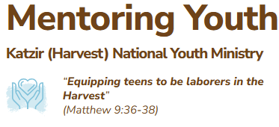
https://www.fieldsofwheat.org/
Notes:
https://www.fieldsofwheat.org/

Slide 81
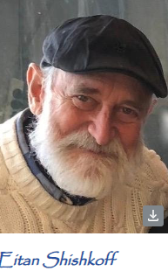
Here’s Ruth’s story, as she shared with the whole camp…
“My early education was in a religious Orthodox Jewish school in Jerusalem. I lived according to all the strict requirements expected of us. A radical change came when I began to believe in Yeshua. It happened through our family being deeply healed by the power of Yeshua’s forgiveness, after serious inner conflict.
“As a teen believer I served the Lord energetically. I was in different activities 5 days a week for Yeshua, but I still didn’t know Him.
Notes:
https://www.fieldsofwheat.org/

Slide 82
“In 2014 I came to the Katzir camp. I saw a fire inside my counselor. I wanted what she had! But I was embarrassed to ask for prayer, to humble myself. Finally, at one of the meetings, I began crying and came forward for prayer. She placed her hand on my shoulder, saying “I think the Lord wants you to kneel before Him, and He will receive you.” When I put aside my pride, left my comfort zone, and knelt before Him, I experienced the deep warmth of His love. Knowing Yeshua is the main thing in life!”
Notes:
https://www.fieldsofwheat.org/

Slide 83
^{2 Kefa/Peter 1.12,16} Even though you know…and are firmly established in the truth… when we made known to you the power and the coming of our lord yeshua the messiah, we did not rely on cunningly contrived myths.

Slide 85
Passover Controversies
The importance of the challenge
The contents of the challenge
The resolution of the challenge.
The victory over challenges.

