Slide 1
e-handout
To have these notes
without taking notes
Go to OrHaOlam.com
Click on Messages tab,
2025 Messages

Slide 2

Notes:
Patricia Henry

Slide 3
Three special issues today.

Slide 4
First issue of this day:
First fruits and barley waving

Slide 5
^{Lev 23.9-10} Adoni said to Moshe, "Tell the people of Isra'el, 'After you enter the land I am giving you and harvest its ripe crops, you are to bring a sheaf of the firstfruits of your harvest to the cohen.
Notes:
Barley is the first of the first fruits. We have barley, sort of, for all of you for today.

Slide 6
Lev 23.11-12 He is to wave the sheaf before Adoni, so that you will be accepted; the cohen is to wave it on the day after the Shabbat [Sunday eve, April 13].

Slide 7
We did our glorious community Seder on Wednesday, April 16 for functionality and convenience, so we are out of sync. Ideally Sat. evening April 12 Seder.
Firstfruits and Omer count start correctly eve Sunday April 13.
We will celebrate Firstfruits today!
Notes:
Dawn and I did a private Seder Sat. eve.
So we are up to the 6th day of the Omer count, and Commemorating First fruits 5 days late. Do you still think it’s acceptable to G-d? He knows our frame, and remembers that we are dust.

Slide 8
Second issue of this day: explaining the Omer count, which we counted earlier.
Notes:
Why did we do that?

Slide 9
^{Lev 23.9-10} Adoni said to Moshe, "Tell the people of Isra'el, 'After you enter the land I am giving you and harvest its ripe crops, you are to bring a sheaf of the firstfruits of your harvest to the cohen.

Slide 10
Lev 23.11-12 He is to wave the sheaf before Adonai, so that you will be accepted; the cohen is to wave it on the day after the Shabbat.

Slide 11
Lev 23.15-16 From the day after the day of rest — that is, from the day you bring the sheaf for waving — you are to count seven full weeks, until the day after the seventh week; you are to count fifty days; and then you are to present a new grain offering to Adonai .' "
Notes:
Count days, count weeks.

Slide 12

Acts 2.1 The festival of Shavu'ot arrived, and the believers all gathered together in one place.
The verb "sumpléroó"

Slide 13
The verb "sumpléroó" is used in the New Testament to convey the idea of something being completely filled or fulfilled. It often refers to the completion of time or the fulfillment of a specific event or prophecy.

Slide 14
The term implies a sense of fullness and completion, indicating that a particular period or event has reached its intended conclusion.
So apparently, the upper room group was counting the Omer.
Notes:
In the Seder room praying, interceding, confessing, seeking the Ruakh, in the context of counting the Omer. As you do this daily count for the next ~two months, focus on counting up to the purifying coming of the Ruakh HaKodesh, the Holy Spirit.

Slide 15
The Counting of the Omer begins on the second day of Passover (the 16th of Nisan) for Rabbinic Jews (Orthodox, Conservative, Reform),
but after the next weekly Shabbat during Passover for Karaite, Samaritan, Sadduccean Jews.
Notes:
https://en.wikipedia.org/wiki/Counting_of_the_Omer
The groups in the second paragraph are most non-existent, or very small population.

Slide 16
Ethiopian Jews traditionally had yet another practice: they interpreted the "day of rest" to be the last day of Passover, so April 20, 2025.
Notes:
https://en.wikipedia.org/wiki/Counting_of_the_Omer

Slide 17
The counting is preferably done at night, at the beginning of the Jewish day. If one realizes the next morning or afternoon that they have not yet counted, the count may still be made, but without a blessing.
Notes:
https://en.wikipedia.org/wiki/Counting_of_the_Omer

Slide 18
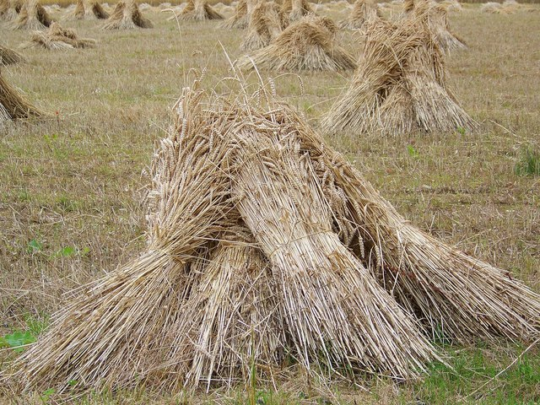
Modern day wheat sheaves.
Counting during the Omer gathering
Notes:
Not actually counting the Omer, although this is the terminology. Most of us don’t have any wheat to bundle into sheaves and count!

Slide 19


Omer counting app, available at the Google play store, iPhone App Store..
Notes:
Some screenshots from my phone.

Slide 20
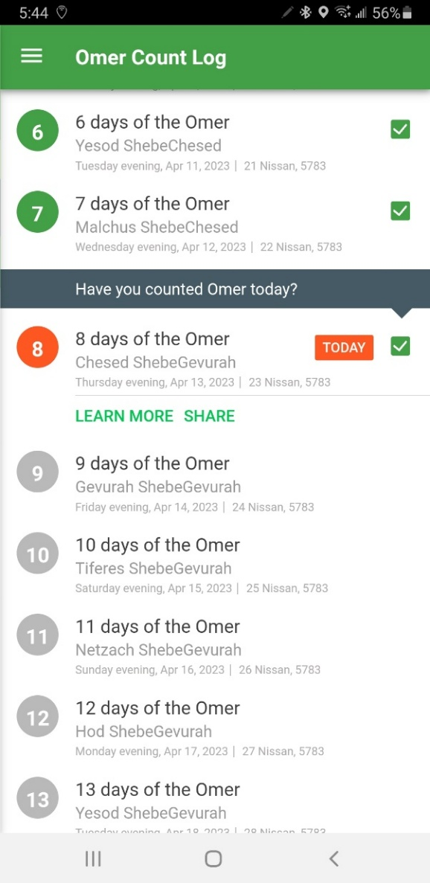


Slide 21
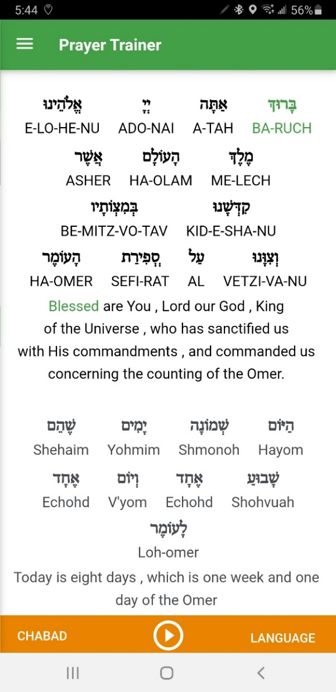
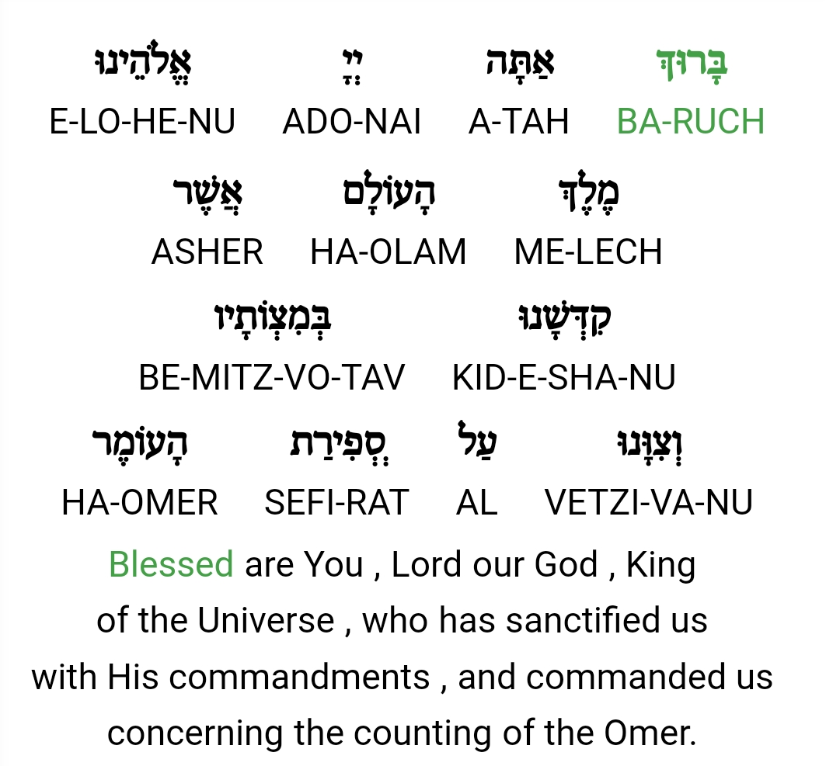

Slide 22
Third issue of this day:
Seventh day of Pesakh

Slide 23
In the first month…on the fifteenth day of the same month is the festival of matzah [eve April 12]; for seven days you are to eat matzah. On the first day you are to have a holy convocation; don’t do any kind of ordinary work…On the seventh day [April 19] is a holy convocation; do not do any kind of ordinary work.’” This is today!
Notes:
Right on time for this one.
So, it is Shabbat already, already a holy gathering. Sort of double holy. Some have considered it the day of the Reed Sea crossing. Pharoah’s destruction.

Slide 24
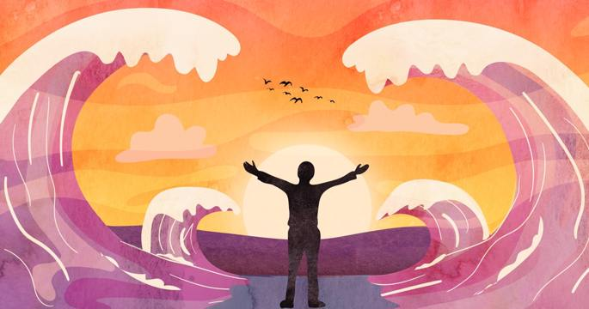

Slide 25
Some Sephardim gather in the synagogue at khatzot (midnight) and either recite אז ישיר Az Yashir (the Song of the Sea) verse by verse or sing and dance to its words. Others get up and recite it at dawn. Some even pour water on the floor during the dancing, commemorating the Splitting of the Sea.
Notes:
Shmot Ex 15

Slide 26
Three special issues today.
Belated First Fruits barley waving
Omer count explanation
Seventh day Reed Sea crossing

Slide 27
Most important of these is the First Fruits. This should be a premiere day for believers in Messiah!
There is no traditional synagogue liturgy for this day from Lev. 23.10-11.
Notes:
other than barley waving, which is not done traditionally. That is, this scriptural holy day is completely ignored in the traditional synagogue.

Slide 28
^{1 Cor 15.20-25} But the fact is that the Messiah has been raised from the dead, the firstfruits of those who have died. For since death came through a man, also the resurrection of the dead has come through a man.

Slide 29
Much liturgy for Shavuot exists, 50 days later for the wheat waving. In the Middle East, barley is up for harvesting at Passover, wheat not yet.

Slide 30
^{Shmot/Ex 9.31-32} The flax and barley were ruined, because the barley was ripe and the flax in bud. But the wheat and buckwheat were not ruined, because they come up later
Notes:
It seems that today’s message we should consider this feast of first fruits, and the Resurrection of Messiah

Slide 31
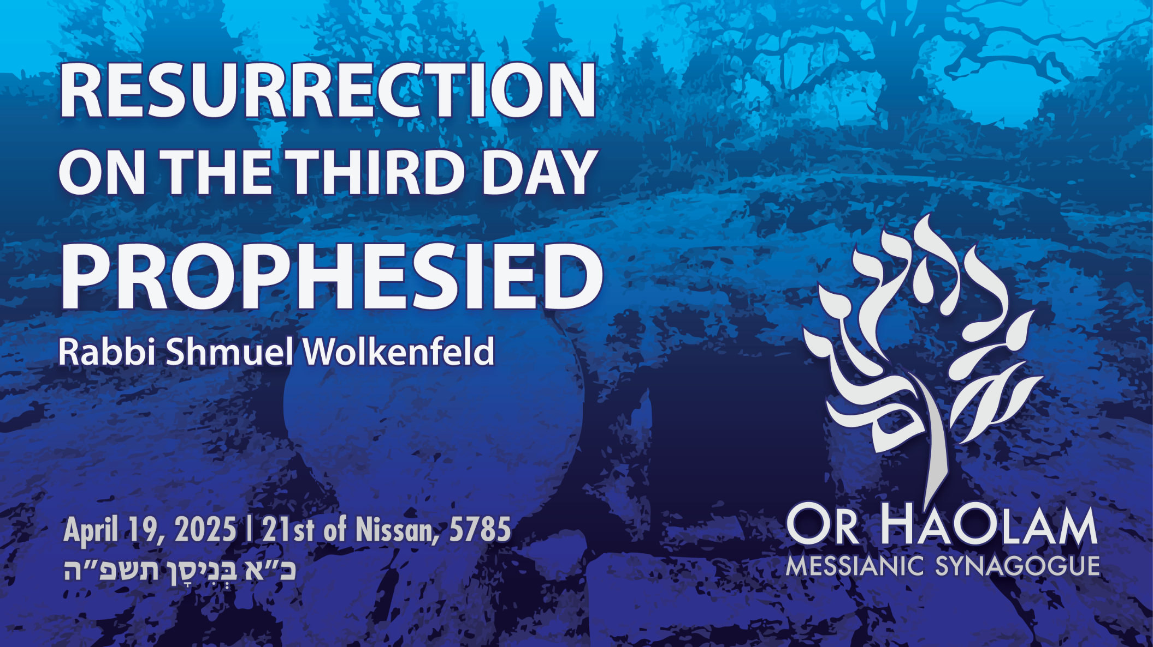

Slide 32
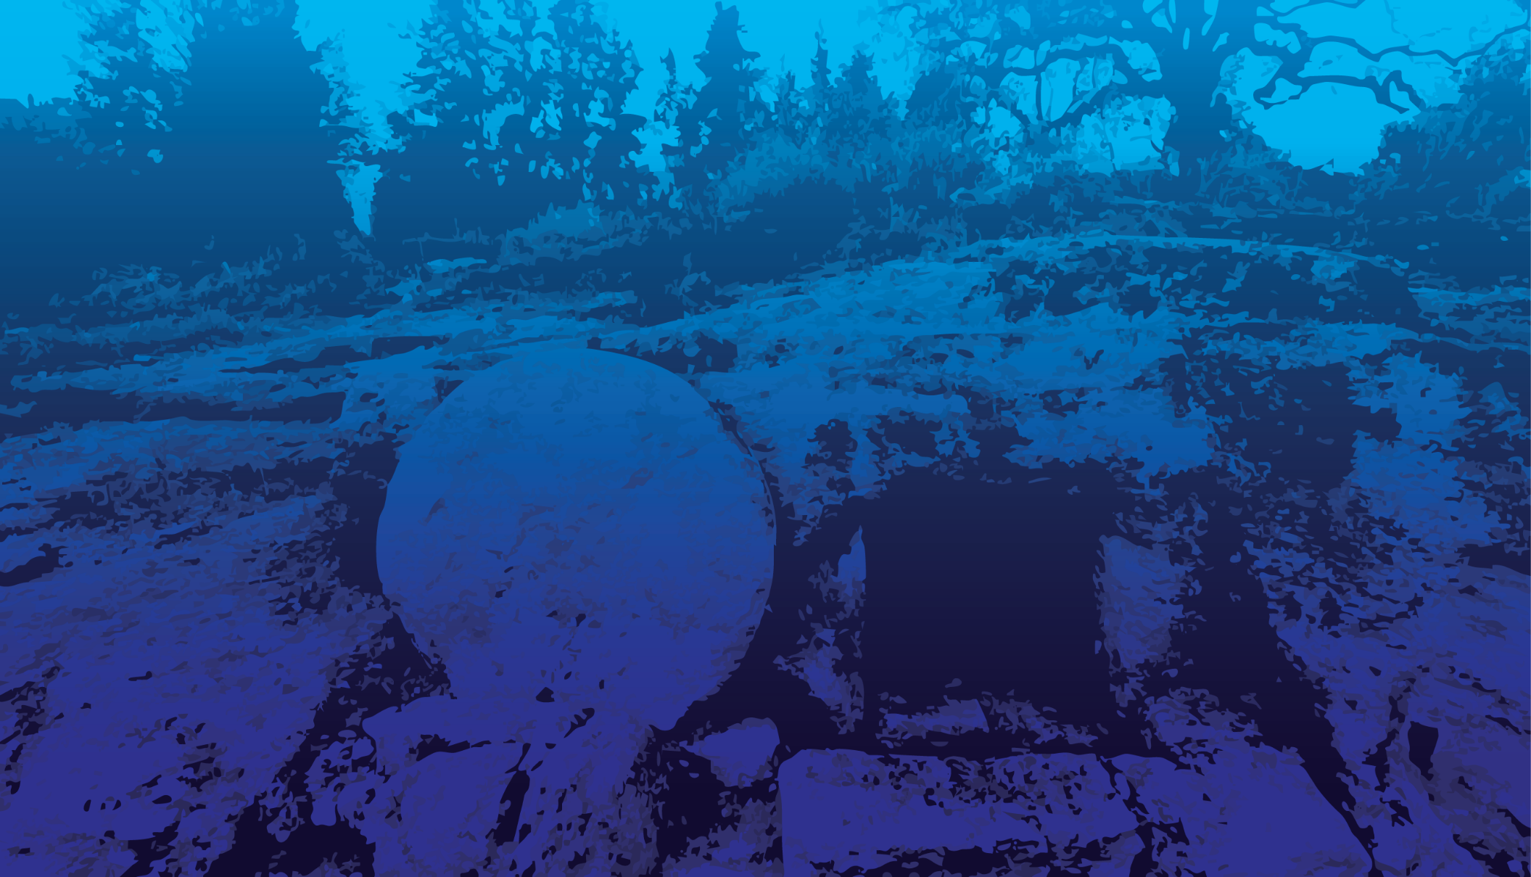
Resurrection on the Third Day
Third day uncertainty
Third day Tanakh mystery
Third day Yeshua explicitly
Resurrection generality
Conclusivity

Slide 33
Resurrection on the Third Day
Third day uncertainty
Third day Tanakh mystery
Third day Yeshua explicitly
Resurrection generality
Conclusivity

Slide 34
It has been said that a person can live about 40 days without food, about three days without water, about eight minutes without air, but only for a few seconds without hope. In Ezekiel 37, God’s people had raised the white flag of surrender, and admitted in verse 11: “Our hope is lost...”
Notes:
https://washingtonstand.com/commentary/hope-restored

Slide 35
^{Yekhezkael/Ezek 37.11} Then He said to me, “Son of man, these bones are the whole house of Israel. They are saying: ‘Our bones are dried up; our hope is lost; we are completely cut off.
אָבְדָה תִקְוָתֵנוּ av-da tik-va-tay-nu

Slide 36
^{Luke 24.12-27} Two of [His followers] were going toward a village about seven miles from Yerushalayim called Amma'us, and they were talking with each other about all the things that had happened... They stopped short, their faces downcast…

Slide 37
^{Luke 24.12-27} And we had hoped that he would be the one to liberate Isra'el! Besides all that, today is the third day since these things happened.
Notes:
The day of firstfruits has passed, beginning of the Omer, and no resurrection!!

Slide 38
^{Luke 24.12-27} and this morning, some of the women astounded us. They were at the tomb early and couldn't find his body, so they came back.

Slide 39
Why was the “three days” failure so important?

Slide 40
^{1 Cor. 15.1-2} Now, brothers, I must remind you of the Good News which I proclaimed to you, and which you received, and on which you have taken your stand,

Slide 41
^{1 Cor. 15.1-2} and by which you are being saved — provided you keep holding fast to the message I proclaimed to you. For if you don’t, your trust will have been in vain.
Notes:
These are the essential doctrines, concepts, life keys to eternal AND temporal salvation. This is the lifeboat from the Titanic that we are all on, or the directions to the lifeboat. There is NOT hope, not salvation without these issues of faith settled and functioning in our hearts.

Slide 42
^{1 Cor. 15.3-4} For I also passed on to you first of all what I also received— that Messiah died for our sins in accordance with what the Tanakh says ^{[a]},
Notes:
There is a footnote in Stern’s translation, because there is LOTS of substantiation at to that Messiah died according to the scriptures.

Slide 43
^{[a]} Isa. 53:8-10; “He was cut off”
Dan. 9:26 “Mashiach will be cut off and have nothing.”
Ps. 16:10-11; “For You will not abandon my soul to Sheol”
Ps. 22:15-16; “I am poured out like water”
Notes:
Actually, several verses in each context, some of them the whole chapter.

Slide 44
that He was raised on the third day according to according what the Tanakh says ^{[no footnote]},
Where does it say that?
Notes:
Did Paul Shaul misunderstand scripture?
Did those guys on the Emmaus road presume something unsound?

Slide 46
Resurrection on the Third Day
Third day uncertainty
Third day, Tanakh mystery
Third day Yeshua explicitly
Resurrection generality
Conclusivity

Slide 47
There was an ancient notice of the third day as a deliverance/ resurrection day
Beresheet Rabba, sect. 56. fol. 49. 3.
of the third day Abraham lift up his eyes,
of the third day of the tribes,
of the third day of the giving of the law,
of the third day of the spies,
Notes:
^{1 Cor 15.3-4} For among the first things I passed on to you was what I also received, namely this: the Messiah died for our sins, in accordance with what the Tanakh says; and he was buried; and he was raised on the third day, in accordance with what the Tanakh says

Slide 48
of the third day of Jonah,
of the third day of them that came out of the captivity,
of the third day of the resurrection of the dead, as it is written, "after two days will he revive us, in the third day he will raise us up, and we shall live in his sight".''
Notes:
Let’s look at these. Sense of scripture understanding in Yeshua ישוע's day

Slide 49
First ^{Ber/Gen22.1-5} After these things, God tested Avraham. He said to him, "Avraham!" and he answered, "Here I am." He said, "Take your son, your only son, whom you love, Yitz'chak; and go to the land of Moriyah.

Slide 50
First ^{Ber/Gen22.1-5} There you are to offer him as a burnt offering on a mountain that I will point out to you." Avraham got up early in the morning, saddled his donkey,

Slide 51
^{Ber/Gen22.1-5} and took two of his young men with him, together with Yitz'chak his son. He cut the wood for the burnt offering, departed and went toward the place God had told him about.

Slide 52
^{Ber/Gen22.1-5} On the third day, Avraham raised his eyes and saw the place in the distance. Avraham said to his young men,

Slide 53
^{Ber/Gen22.1-5} "Stay here with the donkey. I and the boy will go there, worship and return to you.“
וַאֲנִי וְהַנַּעַר, נֵלְכָה עַד-כֹּה; וְנִשְׁתַּחֲוֶה, וְנָשׁוּבָה אֲלֵיכֶם.
Letter nun is first person plural:
We will go
We will worship
We will return
Notes:
MJ/Heb 11.19 He reasoned that God was able to raise him up even from the dead—and in a sense, he did receive him back from there. So, for three days, Avraham considered Yitskhak dead.
Avraham was consigned that Yitskhak/Isaac would die and be resurrected, according to some. RW Dunn, at Bible School where I met Dawn. She was in my class. I did pay some attention to the class.
Three day resurrection, first teaching of it.

Slide 54
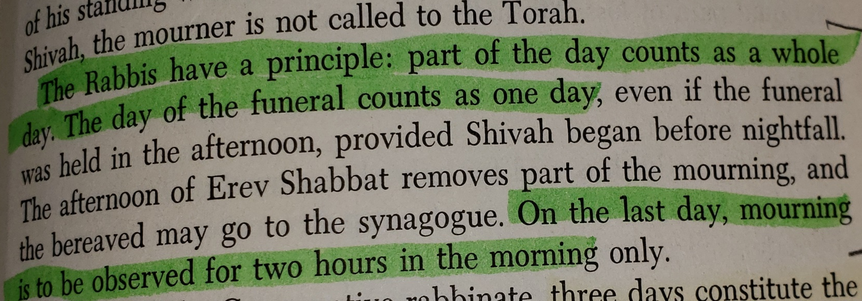
Leo Trepp The Complete Book of Jewish Observance
Notes:
Leo Trepp p. 335 from my Aunt Betty, Bat Mitzvahed at age 80 in NYC.

Slide 55
Second
^{Ber/Gen 42.17} Then he put all of them together in prison for three days. On the third day, Yosef said to them, "Do what I say, and stay alive, for I fear God. If you are upright men, let one of your brothers remain incarcerated

Slide 56
Second
^{Ber/Gen 42.17} in the prison you're being kept in, while you go and carry grain back to relieve the famine in your homes.
Notes:
third day as a deliverance/ resurrection day
Beresheet Rabba, sect. 56. fol. 49. 3.

Slide 57
Third ^{Shmot/Ex 19.14-16} Moshe went down from the mountain to the people and separated the people for God, and they washed their clothing. He said to the people, "Prepare for the third day; don't approach a woman."

Slide 58
Third ^{Shmot/Ex 19.14-16} On the morning of the third day, there was thunder, lightning and a thick cloud on the mountain. Then a shofar blast sounded so loudly that all the people in the camp trembled.
Notes:
Three days denial till covenantal revelation.

Slide 59
Fourth ^{Josh 2.14-16} The men replied to her, "Our lives are certainly worth yours, provided you don't betray our mission. So when ADONI gives us the land, we will treat you kindly and in good faith."

Slide 60
Fourth ^{Josh 2.14-16} Then she lowered them by a rope through the window; since her house abutted the city wall, indeed was actually built into it. She told them,

Slide 61
^{Josh 2.14-16} "Head for the hills, so that the pursuit party won't get their hands on you; and hide yourselves there for three days, until the pursuers have returned. After that, you can go on your way."

Slide 62
Fifth ^{Yonah 1.13-17} The men rowed hard, trying to reach the shore. But they couldn't, because the sea kept growing wilder against them. Finally they cried to ADONI, "Please, ADONI, please! Don't let us perish for causing the death of this man,

Slide 63
Fifth ^{Yonah 1.13-17} and don't hold us to account for shedding innocent blood…Then they picked up Yonah and threw him into the sea, and the sea stopped raging. Seized with great fear of ADONI,

Slide 64
^{Yonah 1.13-17} they offered a sacrifice to ADONI and made vows. ADONI prepared a huge fish to swallow Yonah; and Yonah was in the belly of the fish for three days and three nights.
Notes:
Yonah’s first converts. OK to say convert in the right sense. We who are Jewish and come to faith are completed Jews in our concepts, but Jews and all people equally need to be converted sinners. Rachmiel Fredland, the greatest Talmud scholar of the last generation, then WW II / great generation, noted that.
This one specifically quoted by Yeshua ישוע about resurrection

Slide 65
Sixth ^{Ezra 8.15, 21-23} I assembled them by the river that runs to Ahava, and we camped there three days…Then, there at the Ahava River, I proclaimed a fast; so that we could humble ourselves before our God and ask a safe journey of him for ourselves,

Slide 66
Sixth ^{Ezra 8.15, 21-23} our little ones and all our possessions. For I would have been ashamed to ask the king for a detachment of soldiers and horsemen to protect us from enemies along the road, since we had said to the king,

Slide 67
^{Ezra 8.15, 21-23} "The hand of our God is on all who seek him, for good; but his power and fury is against all who abandon him." So we fasted and asked our God for this, and he answered our prayer.
Notes:
Three days fasting and prayer till revelation of safe passage. Ester also three days.

Slide 68
Seventh ^{Hoshea 6.1-3} Come, let us return to ADONI; for he has torn, and he will heal us; he has struck, and he will bind our wounds. After two days, he will revive us; on the third day, he will raise us up;
Notes:
the Targum paraphrases the words thus,``he will quicken us in the days of consolation which are to come, and in the day of the resurrection of the dead he will raise us up;‘ 'where by days of consolation are meant the days of the Messiah

Slide 69
Seventh ^{Hoshea 6.1-3} and we will live in his presence. Let us know, let us strive to know ADONI. That he will come is as certain as morning; he will come to us like the rain, like the spring rains that water the earth.
Notes:
also used in the Talmud in connection with the End Times at Rosh Hashanah 31 a and Sanhedrin 97a)

Slide 70
There was an ancient notice of the third day as a deliverance/ resurrection day
Beresheet Rabba, sect. 56. fol. 49. 3.
of the third day Abraham lift up his eyes,
of the third day of the tribes,
of the third day of the giving of the law,
of the third day of the spies,
Notes:
^{1 Cor 15.3-4} For among the first things I passed on to you was what I also received, namely this: the Messiah died for our sins, in accordance with what the Tanakh says; and he was buried; and he was raised on the third day, in accordance with what the Tanakh says

Slide 71
of the third day of Jonah,
of the third day of them that came out of the captivity,
of the third day of the resurrection of the dead, as it is written, "after two days will he revive us, in the third day he will raise us up, and we shall live in his sight".''

Slide 73
Resurrection on the Third Day
Third day uncertainty
Third day, Tanakh mystery
Third day Yeshua explicitly
Resurrection generality
Conclusivity

Slide 74
^{Yn 2.18-22} The Judeans confronted him by asking him, "What miraculous sign can you show us to prove you have the right to do all this?" Yeshua answered them, "Destroy this temple, and in three days I will raise it up again."

Slide 75
^{Yn 2.18-22} But the "temple" he had spoken of was his body. Therefore, when he was raised from the dead, his talmidim remembered that he had said this, and they trusted in the Tanakh and in what Yeshua had said.
Notes:
27 CE Clarke

Slide 76
^{Mtt 12.1,9, 39-41} One Shabbat during that time, Yeshua was walking through some wheat fields … Going on from that place, he went into their synagogue…
Notes:
Hints of Galil, in the North

Slide 77
^{Mtt 12.39-41} No [sign] will be given to [this generation] but the sign of the prophet Yonah. For just as Yonah was three days and three nights in the belly of the sea-monster, so will the Son of Man be three days and three nights in the depths of the earth.

Slide 78
^{Mtt 12.1,9, 39-41} The people of Ninveh will stand up at the Judgment with this generation and condemn it, for they turned from their sins to God when Yonah preached, but what is here now is greater than Yonah.

Slide 79
^{Mk 8.27, 31} Yeshua and his talmidim went on to the towns of Caesarea Philippi…He began teaching them that the Son of Man had to endure much suffering and be rejected by the elders, the head cohanim and the Torah-teachers; and that he had to be put to death; but that after three days, he had to rise again.
Notes:
28 CE Clarke Way up North.

Slide 80
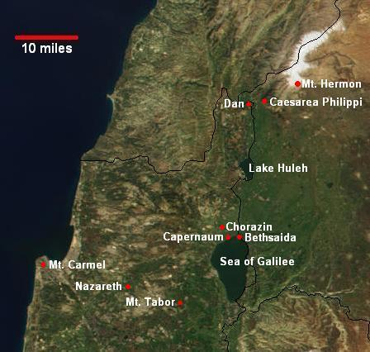
Notes:
Grain fields and synagogue, now way north

Slide 81
^{Mark 9.30-32} After leaving that place, they went on through the Galil. Yeshua didn't want anyone to know, because he was teaching his talmidim. He told them,

Slide 82
^{Mark 9.30-32 “}The Son of Man will be betrayed into the hands of men who will put him to death; but after he has been killed, three days later he will rise.” But they didn't understand what he meant, and they were afraid to ask him.

Slide 83
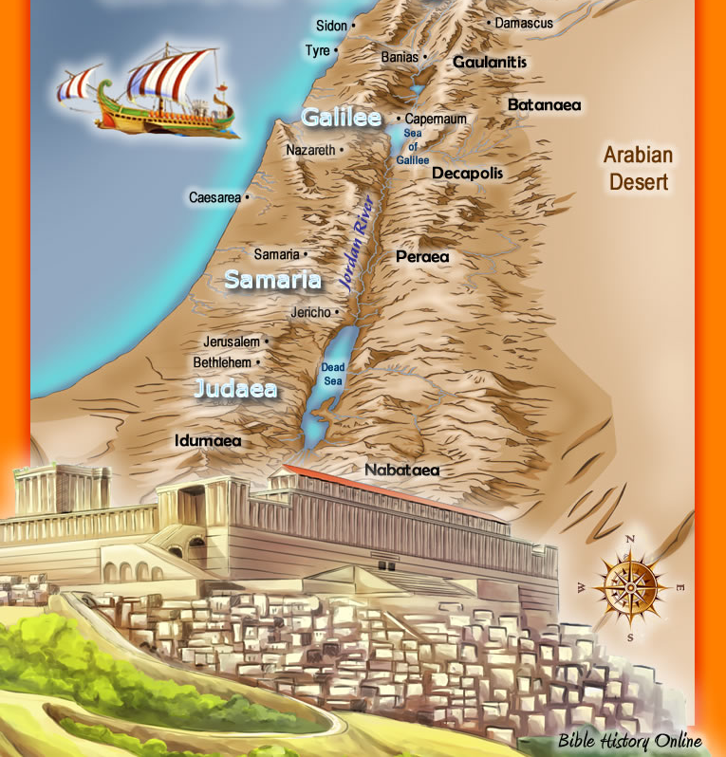
Banias = Place of Pan =
Caesarea Philippi
Notes:
Banias = Place of Pan = Caesarea Philipi
Abundant maps כי
Sense of varied repetition of this theme.
Sense of ownership of this history: NOT a spiritual story happened on some heavenly place like Jupiter and Mars. This is OUR land, our people, our King, our real story!!

Slide 84
^{Mark 10.1, 33-34} Then Yeshua left that place and went into the regions of Y'hudah and the territory beyond the Yarden…"We are now going up to Yerushalayim,

Slide 85
^{Mark 10.1, 33-34} where the Son of Man will be handed over to the head cohanim and the Torah-teachers. They will sentence him to death and turn him over to the Goyim, who will jeer at him, spit on him, beat him and kill him; but after three days, he will rise."

Slide 86
^{Mtt 27.63-64} Next day, after the preparation, the head cohanim and the P'rushim went together to Pilate and said, "Sir, we remember that that deceiver said while he was still alive,
Notes:
29 CE according to Clarke
Even His opponents and dissenters got the message.

Slide 87
^{Mtt 27.63-64} `After three days I will be raised.' Therefore, order that the grave be made secure till the third day; otherwise the talmidim may come, steal him away and say to the people,
Notes:
29 CE according to Clarke
Even His opponents and dissenters got the message.

Slide 88
^{Mtt 27.63-64 ‘}He was raised from the dead;’ and the last deception will be worse than the first.“
Notes:
Even His opponents and dissenters got the message.

Slide 90
Resurrection on the Third Day
Third day uncertainty
Third day, Tanakh mystery
Third day Yeshua explicitly
Resurrection generality
Conclusivity

Slide 91
^{Iyov/ Job 19.25-27} “But I know that my Redeemer lives, that in the end he will rise on the dust; so that after my skin has been thus destroyed, then even without my flesh, I will see God. I will see him for myself, my eyes, not someone else’s, will behold him.

Slide 92
^{2 K 20.5} “Go back, and tell Hizkiyahu the prince of my people, that this is what Adonai, the God of David your ancestor, says: ‘I have heard your prayer and seen your tears, and I will heal you. On the third day, you are to go up to the house of Adonai.

Slide 93
^{Yeshyahu/Isaiah 26:14} "Your dead [God's dead] will live, my dead body will rise";
^{Daniel 12:2}, "And many of those who sleep in the dust of the earth will awake, some to everlasting life,
and some to shame and everlasting contempt."

Slide 94

^{T’hillim 16.10} For You will not abandon my soul to Sheol nor let Your Holy One see
the Pit. You make
known to me the path
of life. Abundance of joys are in Your presence, eternal pleasures at Your right hand.[b]

Slide 96
Resurrection on the Third Day
Third day uncertainty
Third day Tanakh mystery
Third day Yeshua explicitly
Resurrection generality
Conclusivity

Slide 97
^{1 Cor 15.14} If Messiah has not been raised, then our proclaiming is meaningless and your faith also is meaningless.

Slide 98
^{1 Cor 15.16-19} For if the dead are not raised, not even Messiah has been raised. And if Messiah has not been raised, your faith is futile—you are still in your sins.

Slide 99
^{1 Cor 15.16-19} Then those also who have fallen asleep in Messiah have perished. If we have hoped in Messiah in this life alone, we are to be pitied more than all people.

Slide 100
^{1 Cor 15.20-25} But the fact is that the Messiah has been raised from the dead, the firstfruits of those who have died. For since death came through a man, also the resurrection of the dead has come through a man.

Slide 101
^{1 Cor 15.20-25} For just as in connection with Adam all die, so in connection with the Messiah all will be made alive.

Slide 102
^{1 Cor 15.20-25} But each in his own order: the Messiah is the firstfruits; then those who belong to the Messiah, at the time of his coming; then the culmination, when he hands over the Kingdom to God the Father, after having put an end to every rulership,

Slide 103
^{1 Cor 15.20-25} yes, to every authority and power. For he has to rule until he puts all his enemies under his feet. The last enemy to be done away with will be death

Slide 104
עוֹד לא אָבְדָה תִּקְוָתֵנוּ.
Od lo av-da tik-va-tay-nu.
Our ancient hope will not perish,

Slide 105
^{Lev 23.9-10} Adoni said to Moshe, "Tell the people of Isra'el, 'After you enter the land I am giving you and harvest its ripe crops, you are to bring a sheaf of the firstfruits of your harvest to the cohen.
Notes:
Barley is the first of the first fruits. We have barley, sort of, for all of you for today.

Slide 106
Lev 23.11-12 He is to wave the sheaf before Adoni, so that you will be accepted; the cohen is to wave it on the day after the Shabbat.

