Slide 1
From Jaedyn’s drash:
As the Prophet Malakhi said:
Who can endure the day of His coming? And who can stand when He appears? For He is like a refiner’s fire and like launderers’ soap.” ^{(Malakhi 3:2)}
Notes:
I was so touched and impressed, that I would like to build on her thoughts.

Slide 2
The fire is coming—not to destroy those who are His, but to refine them.
To burn away pride, selfishness, compromise.
To prepare a people who are ready to carry His light.
So today, we ask:
Are we the wheat—or are we still clinging to the chaff?

Slide 3
Have we submitted ourselves to the refining fire—or are we resisting it?
Are we willing to walk through our own baptism of obedience, even when it costs us something?

Slide 4
Let us not be afraid of the fire. Let us welcome it.
Because in the hands of a loving God, fire does not destroy—it purifies.

Slide 5
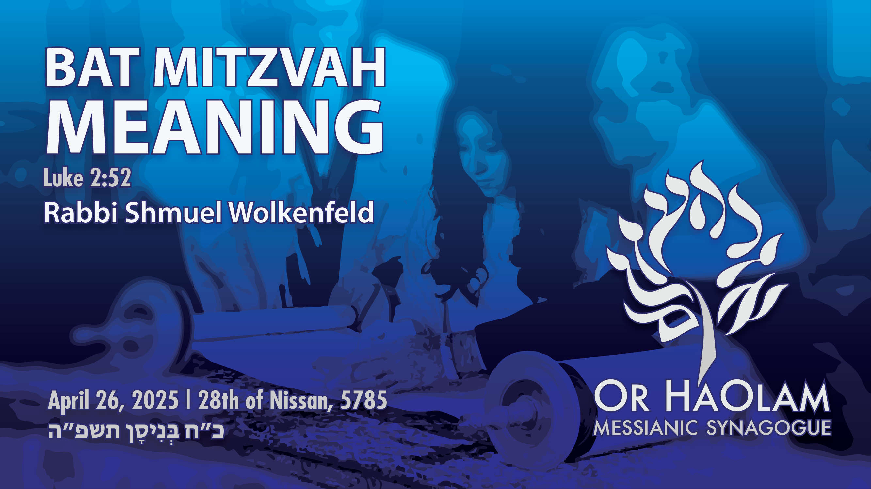

Slide 6

Bat Mitzvah meaning
Terminology: Torah and Covenant
Bat Mitzvah / covenant and growth
Bat Mitzvah / covenant is
allegiance to Israel and Torah.

Slide 7
Bat Mitzvah meaning
Terminology: Torah and Covenant
Bat Mitzvah / covenant and growth
Bat Mitzvah / covenant is
allegiance to Israel and Torah.

Slide 8
What is a Bat Mitzvah?
בַּת מִצְוָה
בַּת daughter
מִצְוָה (religion) commandment, precept; decree, edict; good deed, act of kindness
Notes:
“Daughter” and “commandment” seem opposite.
“Daughter” is the epitome of beloved and precious.
Commandment sound legal, military.
It’s being engaged, involved, enamored with the TRUTH of the Word. The daughterhood dimension is because the Word is a love letter of family identity. Covenantal family identity. Covenant is the key word.

Slide 9
^{Yermiyahu 31.31-33} “Listen! the days are coming,” says Adoni, “when I will make a new covenant with the house of Isra’el and with the house of Y’hudah…“For this is the covenant I will make with the house of Isra’el after those days,” says Adoni: “I will put my Torah within them and write it on their hearts;
Notes:
So, covenant and Torah are tied.
Torah is the expression of the covenant, but it is not the essence of the covenant.

Slide 10
^{Yermiyahu Jer 31.31-33} I will be their God, and they will be my people. No longer will any of them teach his fellow community member or his brother, ‘Know Adoni’; for all will know me, from the least of them to the greatest; because I will forgive their wickednesses and remember their sins no more.”
Notes:
Relationship to G-d and to other covenant members is the essence of the covenant. This is the chapter in Yermiyahu/Jer where we have our commission to dance “together.” That is why Messianic Jewish dance is in lines and circles. Together → community covenant.

Slide 11
The covenant is expressed in the Torah teachings and commandments.
Daughter of the Commandments =
[Bat Mitzvah בַּת מִצְוָה]
Daughter of the Covenant

Slide 12
Bat Mitzvah = entering into a covenantal relationship with G-d in Messiah, to be open to His instructions, His refining fire, His presence

Slide 13
Bat Mitzvah is entering into covenant loyalty with G-d in Messiah as manifest in the scriptures of Israel, the people, and the land,
Whether you are Jewish or grafted in of the Nations.

Slide 14
Have we submitted ourselves to the refining fire—or are we resisting it?
Are we willing to walk through our own baptism of obedience, even when it costs us something?

Slide 15
Let us not be afraid of the fire. Let us welcome it.
Because in the hands of a loving God, fire does not destroy—it purifies.

Slide 16
^{Mal 3.1} “Look! I am sending my messenger to clear the way before me; and the Lord, whom you seek,
will suddenly come to his temple.
Yes, the messenger of the covenant,
in whom you take such delight —
look! Here he comes,” says Adonai-Tzva’ot.
Notes:
This is the verse just before the one’s at Jaedyn’s powerful concluding exhortation.

Slide 17
The covenant is expressed in the Torah teachings and commandments.
Daughter of the Commandments =
[Bat Mitzvah בַּת מִצְוָה]
Daughter of the Covenant

Slide 18
God meets us at transition points,

Slide 19
בָּרוּךְ אַתָּה בְּבֹאֶךָ; וּבָרוּךְ אַתָּה בְּצֵאתֶךָ
Barukh atah b'voekha, barukh atah btseitkha
^{Dt. 28.6} “A blessing on you when you go out, and a blessing on you when you come in.”
Notes:
Most people, most cultures, call on the divine, on clergy at these points.

Slide 20
God meets us at transition points, so we have ceremonies.
Birth: Brit Milah/circumcision or dedication [G-d has a ceremony]
Puberty: Bar Bat Mitzvah
Marriage: Ceremony
Death: Funeral
Notes:
Birth: non existence before conception to earthly citizenship, flash of light Zn ions released
Puberty: Bar/Bat Mitzvah
Celebrate transitions: Honor the budding womanhood of Jaedyn Stobbe. [vote, DL, property ownership, not quite yet.] Don’t ask for the keys.
Marriage: singleness to oneness of spirit, soul, body
Death: earthly citizenship to eternal citizenship

Slide 21
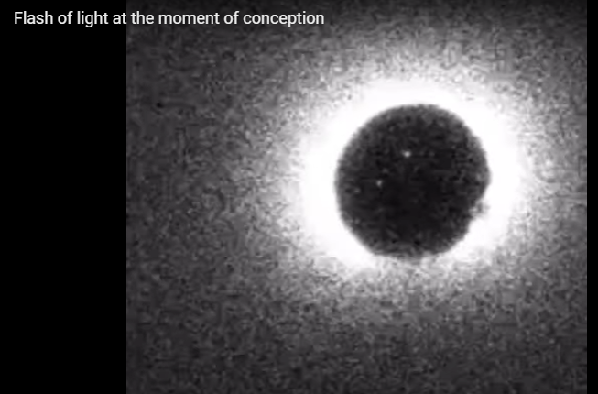
Notes:
Flash of light at the instant of the sperm entering egg. Zn ions released, wall goes up. No more sperm.
For the experiment, the team used a sperm enzyme to activate the egg (fertilising the egg with actual sperm for research purposes is illegal under US federal law) and watched as the event triggered calcium levels to rise inside the egg, which prompted the release of zinc.
"As the zinc shoots out, it binds to small molecules which emit a fluorescence which can be picked up by camera microscopes," Sarah Knapton explains for The Telegraph.
https://www.sciencealert.com/scientists-just-captured-the-actual-flash-of-light-that-sparks-when-sperm-meets-an-egg

Slide 22
The Bat Mitzvah blessing that will enact this reality

Slide 23
בָּרוּךְ שֶׁפְּטָרַנִי מֵעָנְשׁוֹ שֶׁלָזֹאת .
Ba-rukh sheh-p'ta-ra-nee
may-an-sho sheh-lah-zot.
Blessed is He Who has released
me from full responsibility [lit. punishment] for the character and deeds of this one, [my daughter].
Notes:
She will bear the full responsibility of her own actions, words, thoughts. Somewhat.
Her own entry into the covenant of Israel

Slide 25
Bat Mitzvah meaning
Terminology: Torah and Covenant
Bat Mitzvah / covenant and growth
Bat Mitzvah / covenant is
allegiance to Israel and Torah.

Slide 26
After Yeshua’s trip to the Jerusalem Temple with His mom and stepdad, at age 12, a sort of proto Bar Mitzvah, he stayed behind and was separated from his parents.

Slide 27
^{Lk 2.48} His mother said to Him, “Child, why did you do this to us? Look! Your [step]father and I were searching for You frantically!”

Slide 28
^{Luke 2.49-51} He said to them, “Why were you searching for Me? Didn’t you know that I must be about the things of My Father?” But they did not grasp the message He was telling them.

Slide 29
^{Luke 2.49-51} Then He went down with them to Natzeret and was obedient to them. But His mother treasured all these words in her heart.
Notes:
Still in the home.

Slide 30
^{Lk 2.52} And Yeshua grew both in wisdom and in stature, gaining favor both with other people and with God.

Slide 31
^{Lk 2.52} And Yeshua grew both in
wisdom
and in stature,
gaining favor both with other people
And [favor] with God.
He grew intellectually, physically, socially, and spiritually.
Notes:
You have been an amazing contributor to the community already, and today,
but growth now may be accelerated!!

Slide 33
Bat Mitzvah meaning
Terminology: Torah and Covenant
Bat Mitzvah / covenant and growth
Bat Mitzvah / covenant is
allegiance to Israel and Torah.

Slide 34
^{Rut 1.16} But Ruth said, “Don’t press me to leave you and stop following you; for wherever you go, I will go; and wherever you stay, I will stay. Your people will be my people and your God will be my God. Where you die, I will die; and there I will be buried.
Notes:
Ruth entered into covenant with the people AND the G-d of Israel, implying Torah.

Slide 35
It is possible to love Jewish things, and not love the Jewish people.

Slide 36
It is possible to love Jewish things, and not love the Jewish people.
“How odd of G-d to choose the Jews,

Slide 37
It is possible to love Jewish things, and not love the Jewish people.
“How odd of G-d to choose the Jews,
But not so odd as those who choose the Jewish G-d, and hate the Jews.”

Slide 38
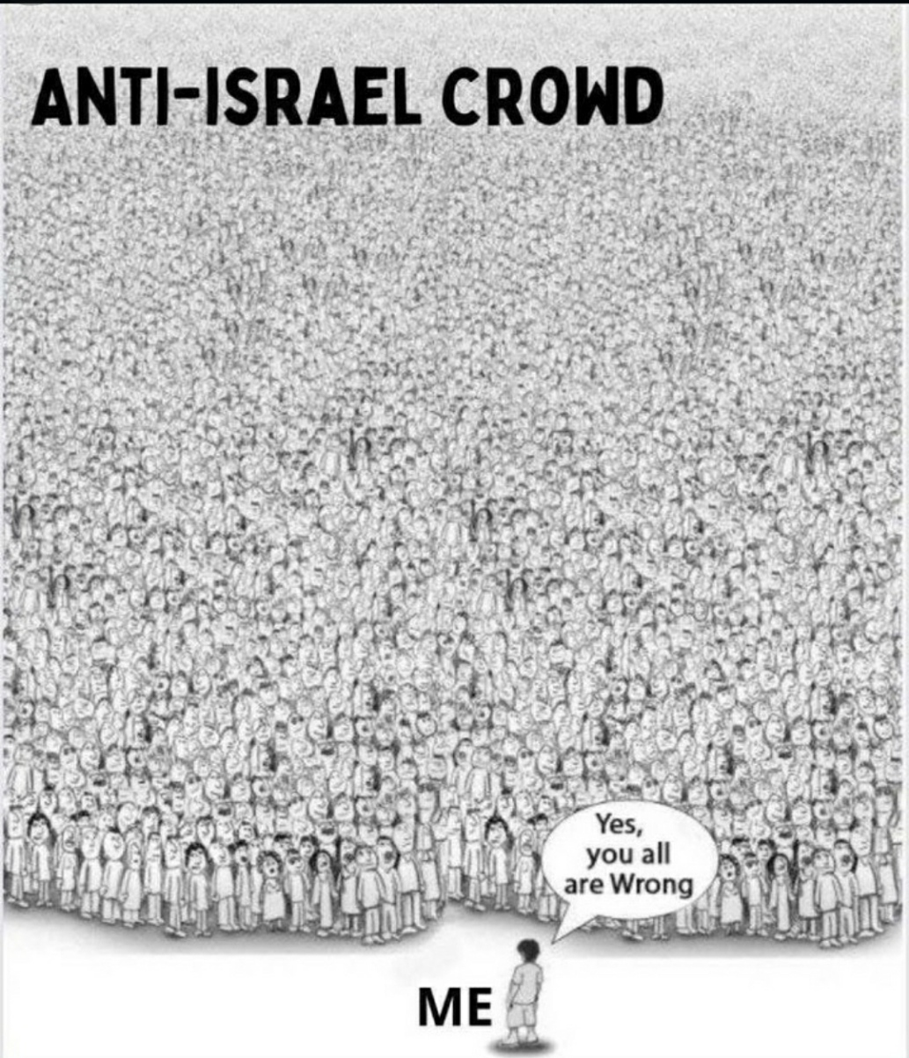

Slide 39
Summary of the
Hebrew roots movement

Slide 40
One-Law Rigidity – dogmatism around the idea that non-Jews must follow the Torah in the same way that Jews do
Two-House identity – which claims many or most non-Jews in the Messianic movement are actually descendants of the lost 10 tribes of Israel
Notes:
Discussed a LOT in the HaYesod class. Ro 11.12 difference
No second class citizenship. It’s OK to be Gentile. I understand that Angela has found Jewish ancestry. Cantor surname.

Slide 41
Sacred Name Only-ism – the idea that you must pronounce God’s divine name, יהוה YHVH and that you must never use circumlocutions like “Lord”, “God”, or even “Adoni” or “Elohim.”
Notes:
3. Yeshua didn’t, so we don’t

Slide 42
Divergent Calendars – Calendars that differ from the modern Jewish (Hillel II) calendar, resulting in dates of the Feasts differing from mainstream date

Slide 43
Bat Mitzvah is entering into covenant loyalty with G-d in Messiah as manifest in the scriptures of Israel, the people, and the land,
Whether you are Jewish or grafted in of the Nations.

Slide 44
So, it’s a big step, entering into covenantal identity.

Slide 45
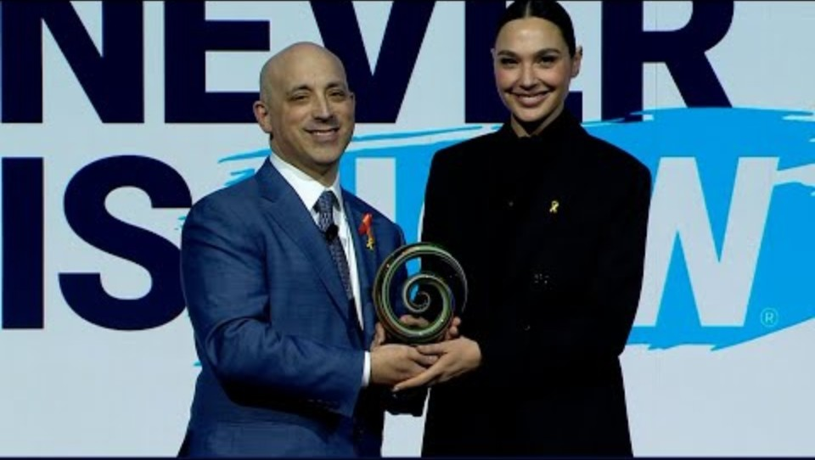
Notes:
https://youtu.be/xRQO48kvonQ

Slide 46
So you, our current Bat Mitzvah, and ALL our youth, have entered or will enter, into covenant loyalty with G-d in Messiah, as manifest in the scriptures of Israel, the people, and the land,
whether you are Jewish or grafted in of the Nations, by merit of His Blood and the power of His Ruakh fire!

Slide 48
Bat Mitzvah meaning
Terminology: Torah and Covenant
Bat Mitzvah / covenant and growth
Bat Mitzvah / covenant is
allegiance to Israel and Torah.

