Slide 1
e-handout
To have these notes
without taking notes
Go to OrHaOlam.com
Click on Messages tab,
2025 Messages

Slide 2
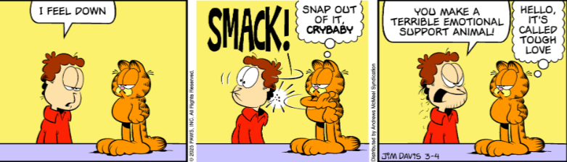

Slide 5
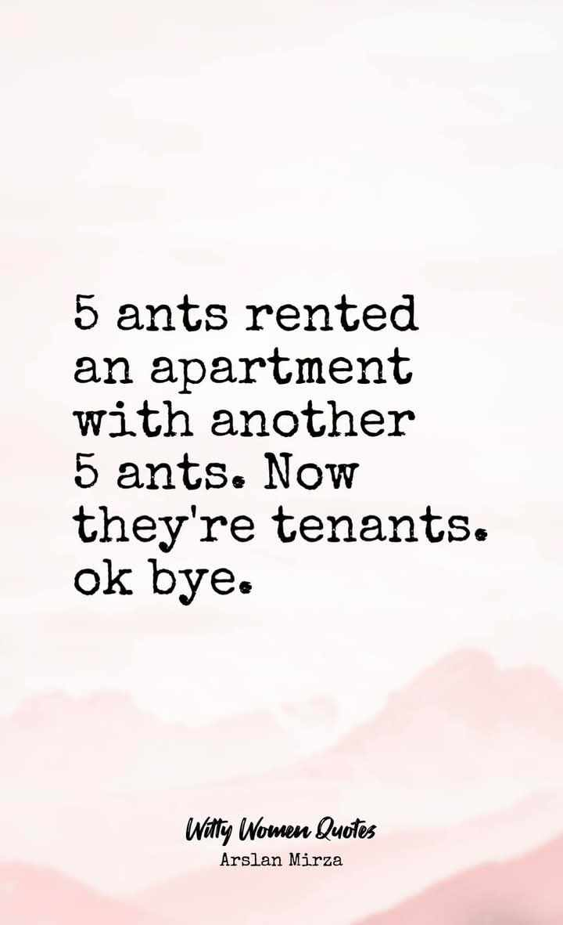

Slide 6
Notes:
Scott Hahn

Slide 7
West Wing
Children’s Dept
remodeling

Slide 8


Slide 9


Slide 10


Slide 11


Slide 12

Notes:
Appreciate to Angela Stobbe!!

Slide 13
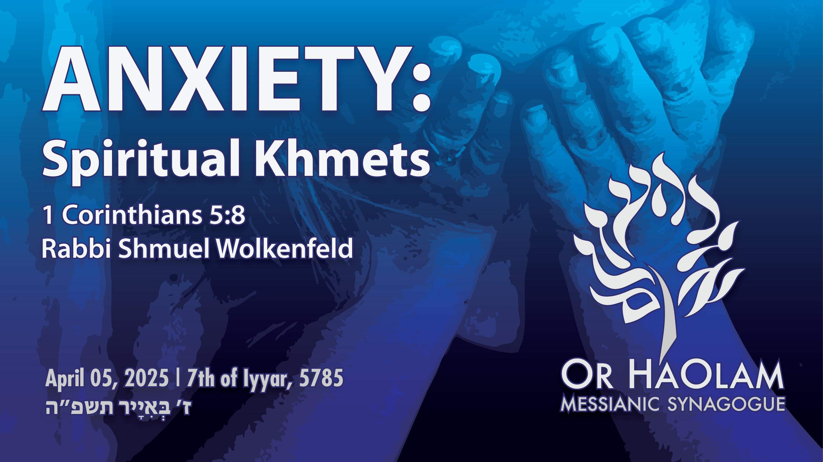

Slide 14

Anxiety: Spiritual Khametz חָמֵץ
What is Khametz חָמֵץ [leavened]
Epidemic of anxiety
Yeshua’s resolution of anxiety
Our calling: Working to bring
Jewish people, and those grafted in,
to their covenantal identity
in Messiah.

Slide 15
Anxiety: Spiritual Khametz חָמֵץ
What is Khametz חָמֵץ [leavened]
Epidemic of anxiety
Yeshua’s resolution of anxiety
Our calling: Working to bring
Jewish people, and those grafted in,
to their covenantal identity
in Messiah.

Slide 16
^{Shmot Ex 12. 18-20} During the first month in the evening of the fourteenth day of the month, you are to eat matzot, [April 12, 2025] until the evening of the twenty-first day of the month [April 19, 2025]. For seven days no hametz is to be found in your houses,

Slide 17
^{Shmot Ex 12. 18-20} for whoever eats hametz, that soul will be cut off from the congregation of Israel, whether he is an outsider or one who is born in the land. You are to eat no hametz; in all your houses you are to eat matzot.”
Notes:
Serious consequence.
Land based commandment. However, Jews everywhere practice it, from Brooklyn to Bangladesh. Non Jews as well.

Slide 18
^{Shmot Ex 12.15} For seven days you are to eat matzot, but on the first day you must remove hametz from your houses, for whoever eats hametz from the first day until the seventh day, that soul will be cut off from Israel.
Notes:
Serious consequences. Various interpretations.

Slide 19
What is all this, in plain English?

Slide 20
The five grains of Biblical Israel
חִטָּה Wheat Ḥittah
כֻּסְמִין Spelt Kusmin
שְׂעוֹרָה barley Se’orah
שִׁבֹּלֶת שׁוּעָל oats Shibbolet shual
שִׁיפוֹן rye sheefon
Notes:
https://en.wikipedia.org/wiki/Chametz
fox = שׁוּעָל
שִׁבֹּלֶת ear (of corn), stalk (of grain)=

Slide 21
שְׂאֹר leavening agents s’or
חָמֵץ leavened food khametz
Khametz is a product that is both made from one of five types of grain and has been combined with water and left to stand raw for longer than eighteen minutes and becomes leavened.
Notes:
https://en.wikipedia.org/wiki/Chametz
Two qualifications of the banned food for the week.
Definitions of Hebrew a bit fluid.

Slide 22
Note: Hebrew is subject to various schemes of transliteration
חָמֵץ leavened food khametz
Could be hametz, chametz, hamets, chamets, Ḥametz, etc.

Slide 23
Leavening agents, such as yeast or baking soda, are not themselves khametz.
Dry wheat grains are not khametz
Rather, it is these five grains when fermented. Thus yeast may be used in making wine, and kefir.
Notes:
https://en.wikipedia.org/wiki/Chametz

Slide 24
Jews from Europe, Ashkenazi Jews, have an additional restriction to the Biblical prohibitions of not eating anything that looks leavened, even if it doesn’t rise. Kitniyot…

Slide 25
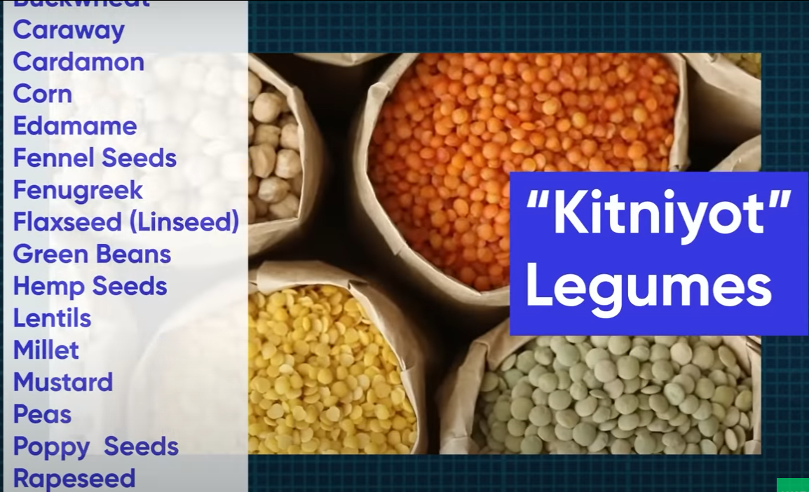
Notes:
https://youtu.be/M-TjGJ9bgKQ
Rice is a key one. It looks fermented, but just water.
Or HaOlam follows the Biblical and Sephardic interpretation. Rice is OK. Horchata is OK.

Slide 26
Jews from Europe, Ashkenazi Jews, have an additional day of unleavened bread…8 days.
Sephardic Jews, from Spain, Portugal, North Africa, have 7 days unleavened, then a bread fest on the eve of the 8th day.
Notes:
https://www.myjewishlearning.com/article/maimouna-a-post-passover-celebration/
I wondered about Memunah: Sephardic Jews have bread fest on the night of the 7th day. Ashkenaz still on matzah. How do they get the yeast so quickly?
A: they always had it.
Speaker of the Knesset MK Amir Ohana invites the public to a festive Mimouna event at the Knesset
on Wednesday night, April 12, 2023, after the Passover holiday ends, to celebrate the Mimouna here for the first time.
https://main.knesset.gov.il/EN/About/Pages/Mimouna5783.aspx
European, Ashkenaz Jews have extra day and extra food prohibitions.

Slide 27
What about gluten?

Slide 28

Notes:
https://video.search.yahoo.com/yhs/search;_ylt=Awr99r7qYfBn1hUpzTc2nIlQ?p=is+gluten+free+food+kosher+for+passover&hsimp=yhs-90&hspart=fc&type=fc_AC22890F0FA_s69_g_e_d_n1_c999&param1=7&param2=eJwtjstqwzAURH9FywQk5eptRys3TT6gdNWLFo6jOsJP%2FMClX19cwmyG4QycOj3Qh493AWCUUkhDjz4IpGHfkYYKfcjzHGlII%2FrgNM%2BAi0zyzCANdRzQh3VGGtYSfeiG39S25clwIIct9Y9hm0m%2FEAEcPNlSb7UnP1YfSTmObdzivUnLySjHlSWH5rl0LSVtaiKpY9UMR1I9p6GLJ6EMhz1kLr%2FLKb0uu9WcXqbrHKf%2Fbu1NWJ0Bg8vVMSFuwIpCOqbEtSiyN5u7i975aoclSMNAMZl%2FSnHW7iwNl8Z%2B%2FQFMwVD%2F&fr=yhs-fc-90&fr2=p%3As%2Cv%3Ai%2Cm%3Apivot#id=6&vid=21724b09f6e0b8fef7332a0fd12fff07&action=view

Slide 29
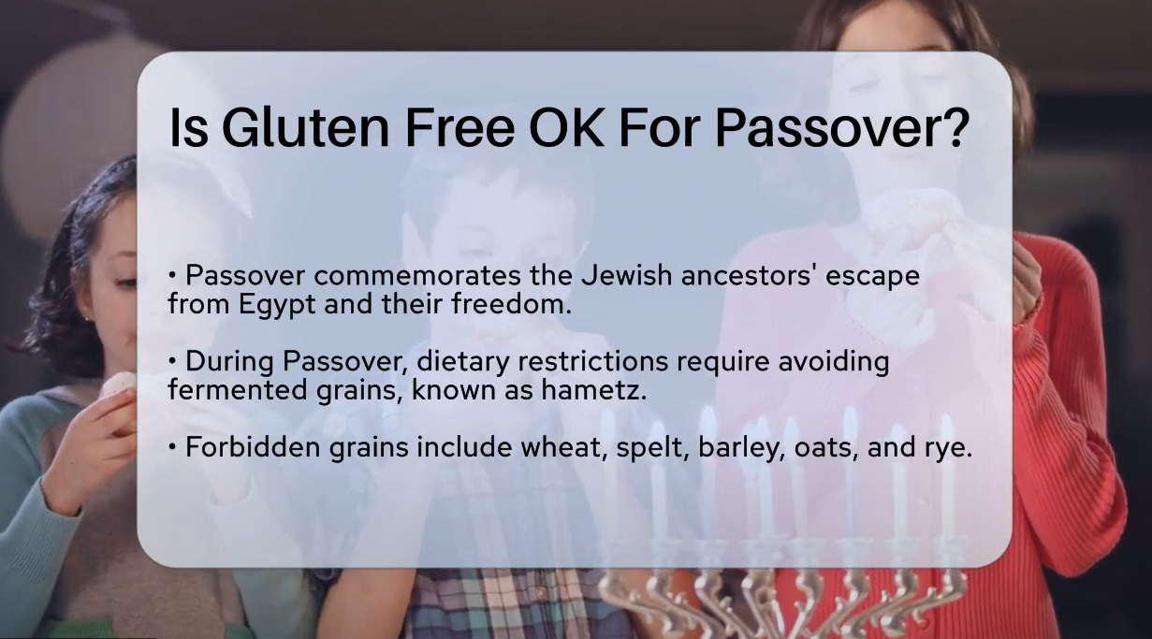
Notes:
https://video.search.yahoo.com/yhs/search;_ylt=Awr99r7qYfBn1hUpzTc2nIlQ?p=is+gluten+free+food+kosher+for+passover&hsimp=yhs-90&hspart=fc&type=fc_AC22890F0FA_s69_g_e_d_n1_c999&param1=7&param2=eJwtjstqwzAURH9FywQk5eptRys3TT6gdNWLFo6jOsJP%2FMClX19cwmyG4QycOj3Qh493AWCUUkhDjz4IpGHfkYYKfcjzHGlII%2FrgNM%2BAi0zyzCANdRzQh3VGGtYSfeiG39S25clwIIct9Y9hm0m%2FEAEcPNlSb7UnP1YfSTmObdzivUnLySjHlSWH5rl0LSVtaiKpY9UMR1I9p6GLJ6EMhz1kLr%2FLKb0uu9WcXqbrHKf%2Fbu1NWJ0Bg8vVMSFuwIpCOqbEtSiyN5u7i975aoclSMNAMZl%2FSnHW7iwNl8Z%2B%2FQFMwVD%2F&fr=yhs-fc-90&fr2=p%3As%2Cv%3Ai%2Cm%3Apivot#id=6&vid=21724b09f6e0b8fef7332a0fd12fff07&action=view

Slide 30
Gluten is a structural protein naturally found in certain cereal grains, and usually refers to the elastic network of a wheat grain's proteins, gliadin and glutenin primarily, that forms readily
Notes:
https://en.wikipedia.org/wiki/Gluten

Slide 31
with the addition of water and often kneading in the case of bread dough. The types of grains that contain gluten include all species of wheat, spelt, and barley, rye, and some varieties of oat
Notes:
https://en.wikipedia.org/wiki/Gluten

Slide 32
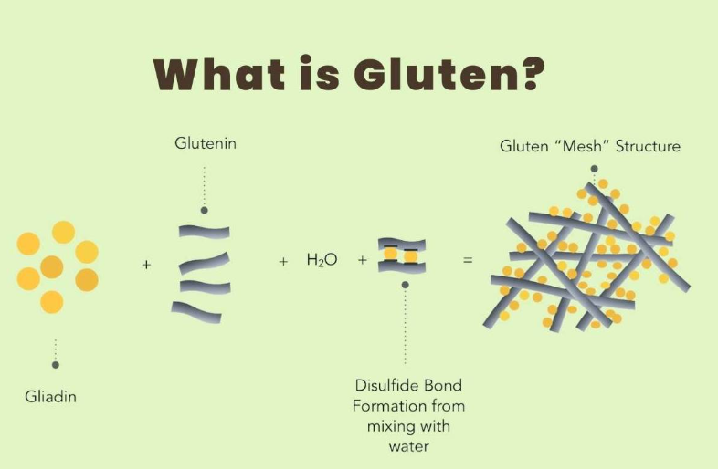

Slide 33
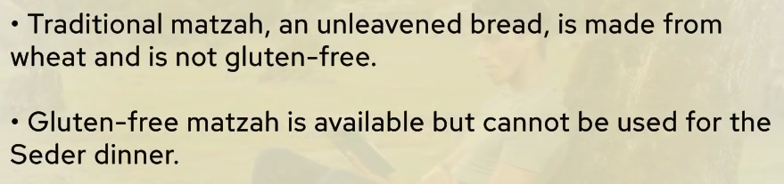
[According to this authority]
Notes:
https://video.search.yahoo.com/yhs/search;_ylt=Awr99r7qYfBn1hUpzTc2nIlQ?p=is+gluten+free+food+kosher+for+passover&hsimp=yhs-90&hspart=fc&type=fc_AC22890F0FA_s69_g_e_d_n1_c999&param1=7&param2=eJwtjstqwzAURH9FywQk5eptRys3TT6gdNWLFo6jOsJP%2FMClX19cwmyG4QycOj3Qh493AWCUUkhDjz4IpGHfkYYKfcjzHGlII%2FrgNM%2BAi0zyzCANdRzQh3VGGtYSfeiG39S25clwIIct9Y9hm0m%2FEAEcPNlSb7UnP1YfSTmObdzivUnLySjHlSWH5rl0LSVtaiKpY9UMR1I9p6GLJ6EMhz1kLr%2FLKb0uu9WcXqbrHKf%2Fbu1NWJ0Bg8vVMSFuwIpCOqbEtSiyN5u7i975aoclSMNAMZl%2FSnHW7iwNl8Z%2B%2FQFMwVD%2F&fr=yhs-fc-90&fr2=p%3As%2Cv%3Ai%2Cm%3Apivot#id=6&vid=21724b09f6e0b8fef7332a0fd12fff07&action=view

Slide 34
Can gluten-free products contain hametz?
No, gluten-free products should not contain hametz. However, sometimes manufacturers may use ingredients derived from hametz in gluten-free items, rendering them unsuitable for Passover.
Notes:
https://www.chefsresource.com/faq/are-gluten-free-foods-kosher-for-passover/

Slide 35
Conclusion if you are gluten
intolerant: avoid the five grains, or look for “Kosher for Passover AND “Gluten free”.
Conclusion otherwise
Eat khamets before Friday noon
Bring the remaining for a bonfire

Slide 36
So it’s a practice in observant Jewish homes to do a THOROUGH Spring cleaning! Get ALL the khametz out of every corner.
Burn the crumbs…bonfire.
And then a prayer of covering.
Notes:
Of course, the best is to eat it all before Passover!

Slide 37
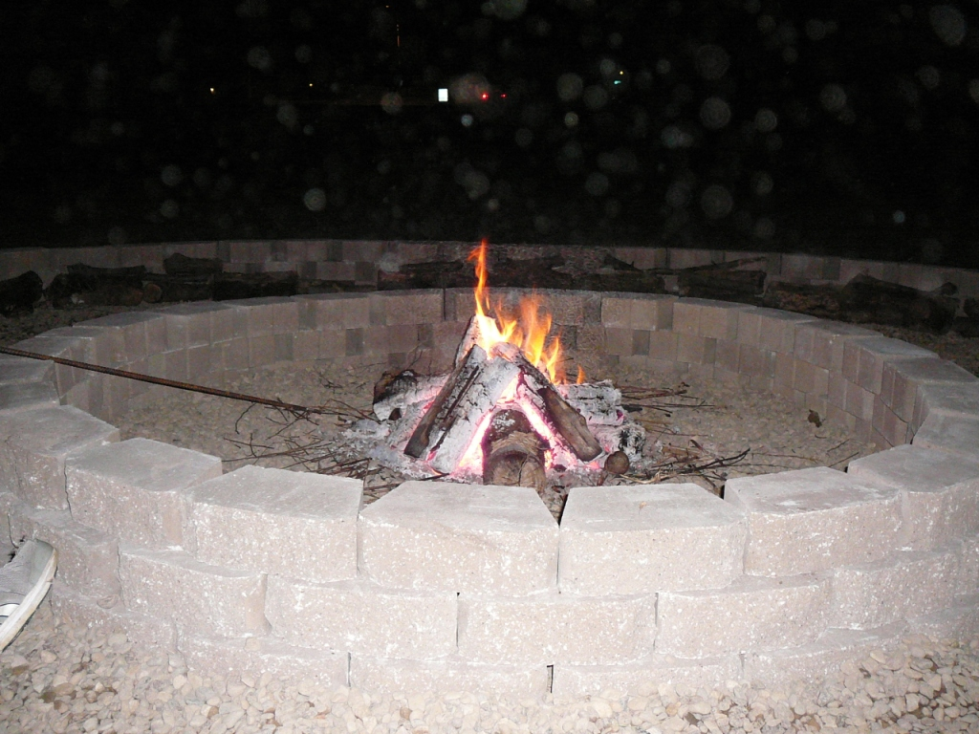
12 pm, noon, Friday,
April 11, 2025
Notes:
Evening photos.

Slide 38
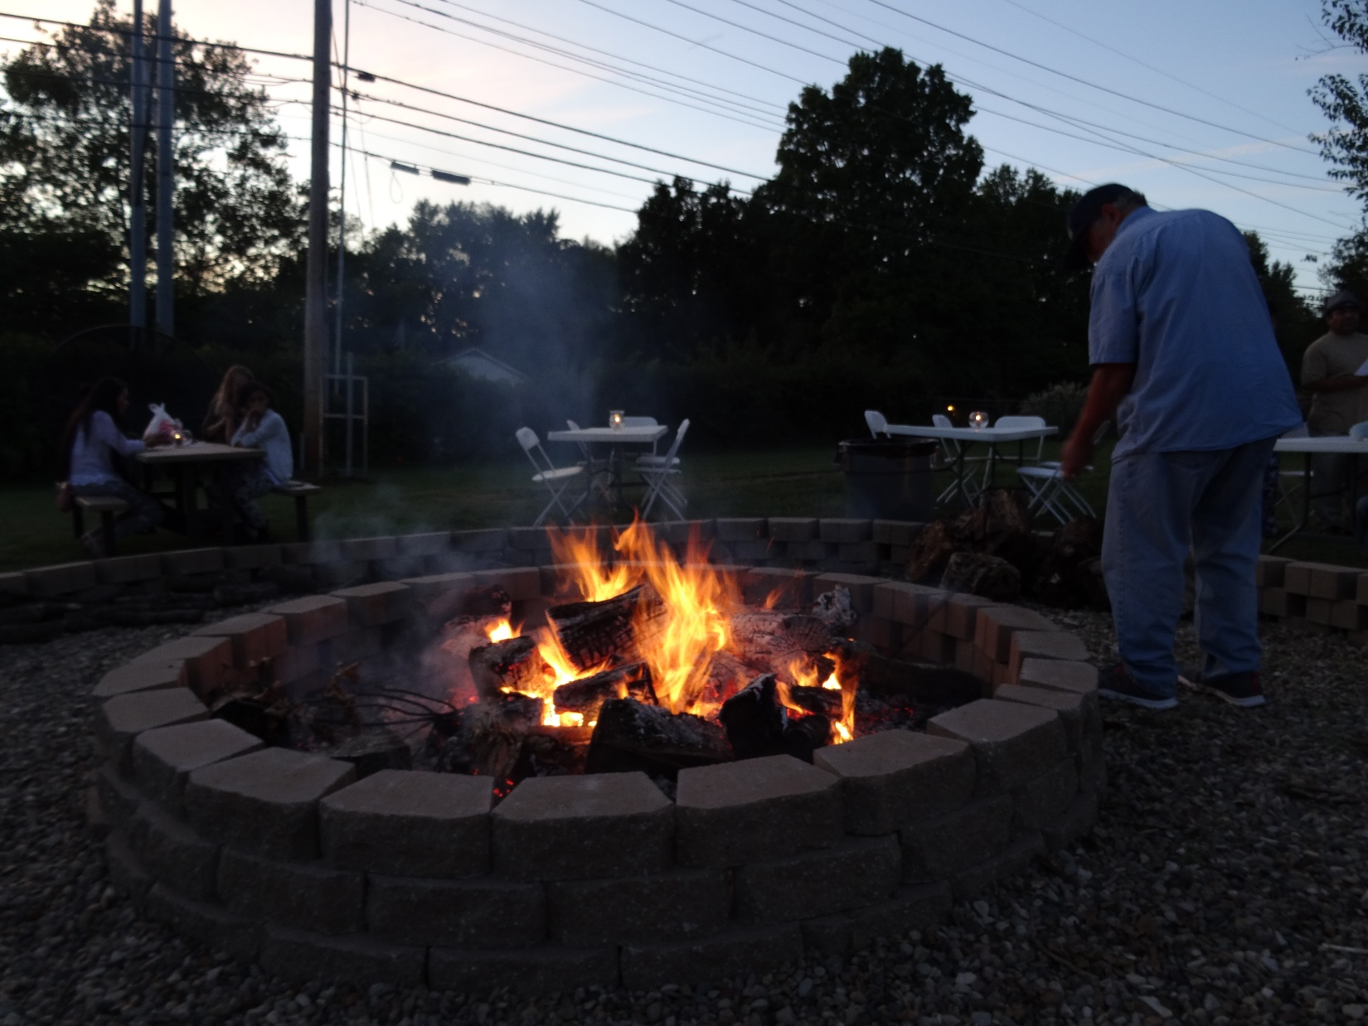
12 pm Friday, April 11, 2025

Slide 40
Anxiety: Spiritual Khametz חָמֵץ
What is Khametz חָמֵץ [leavened]
Epidemic of anxiety
Yeshua’s resolution of anxiety
Our calling: Working to bring
Jewish people, and those grafted in,
to their covenantal identity
in Messiah.

Slide 41
^{1 Cor 5.6-8} Your boasting is not good. Don’t you know the saying, “It takes only a little hametz to leaven a whole batch of dough?” Get rid of the old hametz, so that you can be a new batch of dough, because in reality you are unleavened.

Slide 42
^{1 Cor 5.6-8} For our Pesakh lamb, the Messiah, has been sacrificed. So let us celebrate the Seder not with leftover hametz, the hametz of wickedness and evil, but with the matzah of purity and truth.
Notes:
Anxiety is the spiritual khamets I think we should address.

Slide 43
The Bible app YouVersion has revealed its most popular verse of the year for 2024: “Do not be anxious about anything, but in every situation, by prayer and petition, with thanksgiving, present your requests to God” (Phil. 4:6 NIV).
Notes:
https://www.gbs.edu/wp-content/uploads/2025/02/Gods-Revivalist-2025-MARCH-web.pdf

Slide 44
According to YouVersion, that verse had “higher engagement than any other verse this year.”
Notes:
https://www.gbs.edu/wp-content/uploads/2025/02/Gods-Revivalist-2025-MARCH-web.pdf

Slide 45
Isaiah 41:10 was the most engaged verse on the app for 2023, 2022, 2020, and 2018. That verse reads, “So do not fear, for I am with you; do not be dismayed, for I am your God. I will strengthen you and help you; I will uphold you with my righteous right hand” ^{(NIV)}.
Notes:
https://www.gbs.edu/wp-content/uploads/2025/02/Gods-Revivalist-2025-MARCH-web.pdf

Slide 46
Most considered issues.
Anxiety in 2024
Fear in 2023, 2022, 2020, 2018

Slide 47
Anxiety and depression are two of the most common mental health conditions experienced by adults in the United States . In 2019, about 6% of adults had experienced moderate or severe symptoms of anxiety in the past 2 weeks,
Notes:
https://www.cdc.gov/nchs/data/nhsr/nhsr213.pdf

Slide 48
and 7% had experienced moderate or severe symptoms of depression in the past 2 weeks
Notes:
https://www.cdc.gov/nchs/data/nhsr/nhsr213.pdf

Slide 49
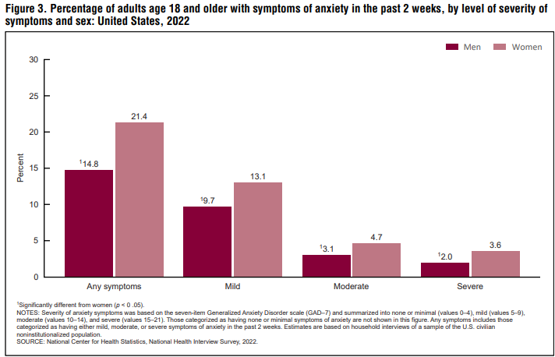
Notes:
https://www.cdc.gov/nchs/data/nhsr/nhsr213.pdf
Overview of the population 2022. ~18% US population had anxiety over the two weeks studied..
More women than men.

Slide 50
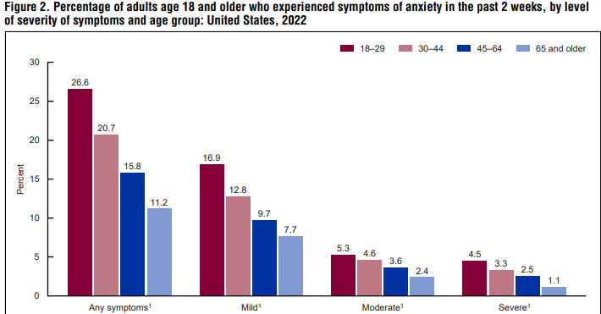
Notes:
https://www.cdc.gov/nchs/data/nhsr/nhsr213.pdf
Decreased with age group.

Slide 51
Issues that trigger anxiety

Slide 52
Issues that trigger anxiety
Most of us have our hearts and maybe relatives at risk in Israel.

Slide 53
Israel cannot continue this war indefinitely – even if there are endless excuses for it. 41 percent of reservists have been dismissed or had to give up their jobs.
Notes:
https://www.israeltoday.co.il/read/tachles-with-aviel-israels-reservists-are-losing-the-motivation-to-fight/#google_vignette

Slide 54
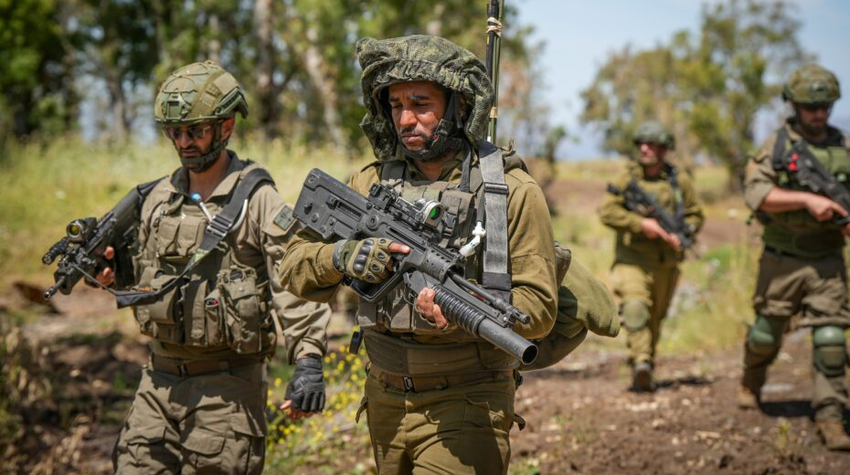
Israeli reserve soldiers during a military exercise in the Golan Heights in northern Israel on May 8, 2024.
Notes:
Photo: Ayal Margolin/Flash90
https://www.israeltoday.co.il/read/tachles-with-aviel-israels-reservists-are-losing-the-motivation-to-fight/#google_vignette

Slide 55
Israel’s reservists are losing the motivation to fight.
The willingness to fight is waning – I hear this more and more often in my circles and in the media.
By Aviel Schneider | Mar 30, 2025 at 12:00 pm
Notes:
https://www.israeltoday.co.il/read/tachles-with-aviel-israels-reservists-are-losing-the-motivation-to-fight/#google_vignette

Slide 56
A survey by Kantar Insights and Kan reveals that nearly a quarter of Israelis have contemplated leaving the country over the past year due to the ongoing multifront war.
Notes:
https://www.theyeshivaworld.com/news/israel-news/2321511/war-weary-1-in-4-israelis-considered-leaving-over-past-year-survey-reveals.html

Slide 57
A day after Hamas attacked Israel and sparked war on Oct. 7, Adi Hazan drove to a rallypoint in southern Israel and began what he thought would be one or two months of emergency military-reserve service.
Notes:
https://www.msn.com/en-us/news/world/everything-is-collapsing-israeli-reservists-confront-toll-of-protracted-war/ar-AA1ocwr1

Slide 58
Nearly 10 months later, the machine-gunner is still deployed—and the rest of his life is in shambles. His construction business is failing, he is sinking into debt, and his family relies on handouts from friends and charities. And he doesn’t see an end in sight.
Notes:
https://www.msn.com/en-us/news/world/everything-is-collapsing-israeli-reservists-confront-toll-of-protracted-war/ar-AA1ocwr1
Other wars: Ukraine, Taiwan threat

Slide 59
Anxiety from family issues

Slide 60

Barry & Cynthia Morehead
Notes:
Barry attends, from St. Joseph, from time to time, since about 2010. Came with me on the Israel trip when my son Ben was on. He and Cynthia have brought their children up in home school or Christian school. Best nurture in the L-rd they could. We’ve had lunch together from time to time. I eat lunch for a living.
Many of you heard Barry and Cythia make their presentation about a year ago.

Slide 61
In 2012 we lost our oldest son to estrangement. He married a woman who by the looks of things seemed to be a good match. A believer well educated, attractive, athletic, from a solid family. All things true of him as well. They had much in common. However, she wanted him to herself and wanted nothing to do with our family.

Slide 62
The first thing she did after they returned from their honeymoon was to cut off all communication between him and the entire extended family and then begin the process of turning him against us. Six years later our son’s high school and college friends began contacting us.

Slide 63
Apparently, she had not only cut off our family but also anyone who knew him prior to her entering his life. My grief was great those first three years. A sister in Messiah recommended a book to aid in my healing.

Slide 64
We had moved our youngest son to Columbia during the pandemic that he may begin his pursuit of his doctorate MU. He was single, lived alone, because of the pandemic he worked remotely and all his classes were being taught online. He would call us five times a week, sometimes alternating, calling his dad one day and me the next.

Slide 65
We were always in touch……until he went camping one time with his sister and her husband. Ever since then he has cut us out of his life as well. He communicated that officially in January of 2022. No explanation other than he is too busy right now to entertain phone calls, texts, or visits from us. That was the last time we heard from him.

Slide 66
Anxiety
Over life failure in general
Over deadly wars
Over estranged children and other painful family problems

Slide 68
Anxiety: Spiritual Khametz חָמֵץ
What is Khametz חָמֵץ [leavened]
Epidemic of anxiety
Yeshua’s resolution of anxiety
Our calling: Working to bring
Jewish people, and those grafted in,
to their covenantal identity
in Messiah.

Slide 69
^{Phil 4.4-9} Rejoice in union with the Lord always! I will say it again: rejoice! Let everyone see how reasonable and gentle you are. The Lord is near! Don’t worry about anything; on the contrary, make your requests known to God by prayer and petition, with thanksgiving.

Slide 70
^{Phil 4.4-9} Then God’s shalom, passing all understanding, will keep your hearts and minds safe in union with the Messiah Yeshua. In conclusion, brothers, focus your thoughts on what is true, noble, righteous, pure, lovable or admirable,

Slide 71
^{Phil 4.4-9} on some virtue or on something praiseworthy. Keep doing what you have learned and received from me, what you have heard and seen me doing; then the God who gives shalom will be with you.

Slide 72
Choose to Praise G-d
Notes:
G-d could turn my kids around. But if it brings more glory for him for me to walk joyfully in Him without their hearts yet turned, than for Him to turn them now, I will accept.
^{Yeshayahu Is 60.4} Lift up your eyes and look all around:
they all gather—they come to you—
your sons will come from far away,
your daughters carried on the hip.
^{Yeshayahu Is 60.26} I, Adoni, will hasten it in its time.

Slide 73
Choose to Praise G-d
G-d is near!
Notes:
Valley of the shadow of death…You are with me. Third person in the opening.

Slide 74
^{T’hillim / Ps 18.29} “For you, Adoni, light my lamp; Adoni, my God, lights up my darkness.
Notes:
He comes in the darkness!

Slide 75
^{2 Cor 12.9} He told me, “My grace is enough for you, for my power is brought to perfection in weakness.” Therefore, I am very happy to boast about my weaknesses, in order that the Messiah’s power will rest upon me.

Slide 76
Choose to Praise G-d
G-d is near!
Pray with thanksgiving!
Think about praiseworthy things!

Slide 77

Barry & Cynthia Morehead
and son Alex

Slide 78
Thank you for continuing to pray for restoration in our relationship with our children. This is my son Alex who recently reached out to us and said he wanted to connect. We just spent 2 1/2 hours catching up at lunch and going for a walk.

Slide 79
His sister had an influence on him. He has matured so much and has developed his own core values. We shared very deeply yesterday and I apologized for some mistakes I made in not giving him the space that Abba has given me in my faith development. He was very appreciative of my recognition of that.

Slide 80
Alex also shared how much he was THANKFUL for a couple of our core values we raised our kids with:
One being our strong example of community through family and friends and congregation. Second core value was the cultivation of learning and imagination. Cynthia instilled a love of learning and reading to all of our children.
Notes:
Yeshua Youth, Lo Kashish, Men’s Meeting, Ladies Havurah, contemplating others.

Slide 81
On a sidenote Alex should be graduating with his PhD in AI -machine learning from MU in the next couple of months.

Slide 82
I'm still walking around a little in shock for such a positive outcome yesterday!
All Praise goes to Abba through Yeshua our messiah.
Shalom to you and Dawn🙏❤️

Slide 83
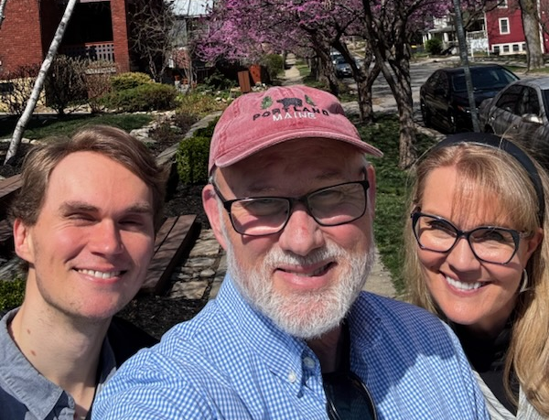

Slide 84

Amazing story of Rabbi Daniel Zion of Bulgaria

Slide 85
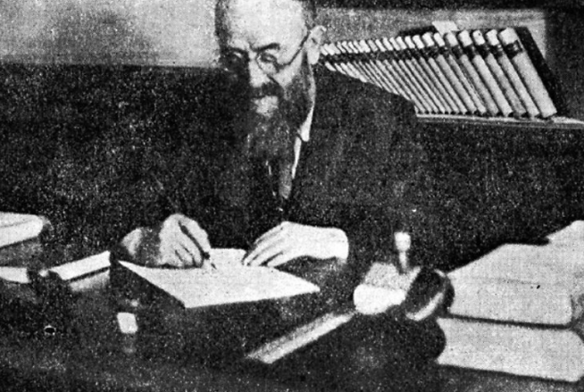

Slide 86
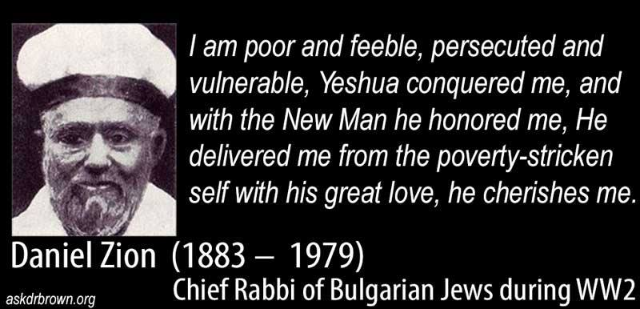
Notes:
https://youtu.be/lx0w61nRfxo

Slide 87
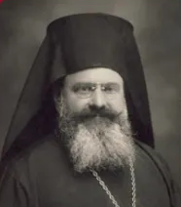
Metropolitan Stefan, head of the Bulgarian church, said he would lay on the tracks to stop deportation of Jews.
Notes:
p 49 salvation
P 96 Letter to Tsar
145-6 Camp 48,000 Bulgarian Jews never deported to Poland
Tsar met with Hitler, and said “No” to deporting the Jews. Trains sent to Bulgaria!
Nissim partisan
1948 Aliyah R Zion
Mom depressed → R. Zion gave her Mes Scrip. She and sister faith
232-234 קול ישראל broadcast
Avi in US came to faith

Slide 89
Anxiety: Spiritual Khametz חָמֵץ
What is Khametz חָמֵץ [leavened]
Epidemic of anxiety
Yeshua’s resolution of anxiety
Our calling: Working to bring
Jewish people, and those grafted in,
to their covenantal identity
in Messiah.

Slide 90

Notes:
https://youtu.be/VKGm2jWl1m4

Slide 91
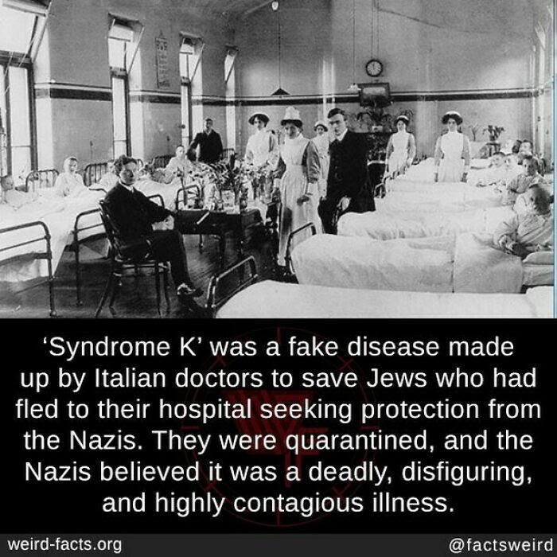
Notes:
Sent by Ted Alongi

Slide 92
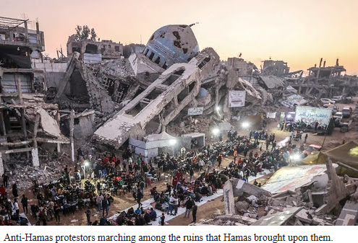
Notes:
https://www.danielpipes.org/22546/gazans-the-bravest-people-on-earth-confront-hamas

Slide 93
Starting on March 25, crowds of overwhelmingly young male Gazans have marched by the thousands through streets flanked by destroyed buildings, bellowing out slogans and carrying signs.
Notes:
https://www.danielpipes.org/22546/gazans-the-bravest-people-on-earth-confront-hamas

Slide 94
"Down with Hamas."
"Hamas does not represent us."
"Hamas get out."
"Hamas is terrorism."
"Hamas is terrorist"
"Hamas rule has destroyed us."
"Let Hamas go to hell."
"Out, out, out, Hamas get out."
Notes:
https://www.danielpipes.org/22546/gazans-the-bravest-people-on-earth-confront-hamas

Slide 96
Anxiety: Spiritual Khametz חָמֵץ
What is Khametz חָמֵץ [leavened]
Epidemic of anxiety
Yeshua’s resolution of anxiety
Our calling: Working to bring
Jewish people, and those grafted in,
to their covenantal identity
in Messiah.

Slide 97
^{1 Cor 5.6-8} For our Pesakh lamb, the Messiah, has been sacrificed. So let us celebrate the Seder not with leftover hametz, the hametz of wickedness and evil, but with the matzah of purity and truth.

Slide 98
^{Phil 4.4-9} Rejoice in union with the Lord always! I will say it again: rejoice! Let everyone see how reasonable and gentle you are. The Lord is near! Don’t worry about anything; on the contrary, make your requests known to God by prayer and petition, with thanksgiving.

Slide 99
^{Phil 4.4-9} Then God’s shalom, passing all understanding, will keep your hearts and minds safe in union with the Messiah Yeshua. In conclusion, brothers, focus your thoughts on what is true, noble, righteous, pure, lovable or admirable,

Slide 100
^{Phil 4.4-9} on some virtue or on something praiseworthy. Keep doing what you have learned and received from me, what you have heard and seen me doing; then the God who gives shalom will be with you.

