Slide 1
If you want to understand the base line thinking of Israeli strategy, consider…

Slide 2

Notes:
Let that sink in. There was an Auschwitz or similar camp survivor son as a pilot in the raid on the Osirak reactor in Iraq in 1981.
Now, from the sublime to the ridiculous…

Slide 3
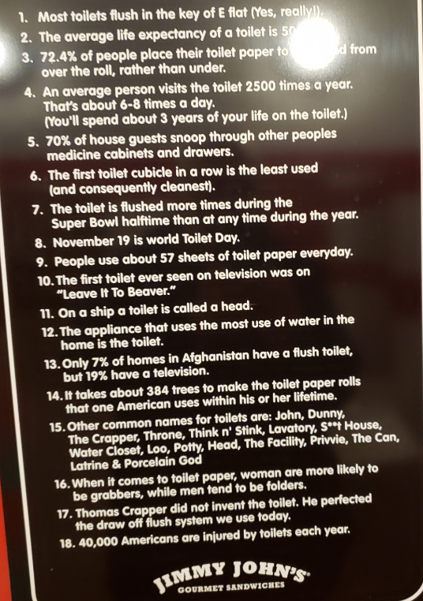
from Jimmy John’s restroom
Notes:
“Not me?”
Especially if faulty flapper.

Slide 4
from Jimmy John’s restroom
Notes:
When I was in Native Canadian, Indian ministry, I had some occasion to fly up to reserves [reservations] where people had no indorr plumbing, outhouses. But, they had satellite dish TVs.
Having established that, it’s Mother’s Day weekend…

Slide 5
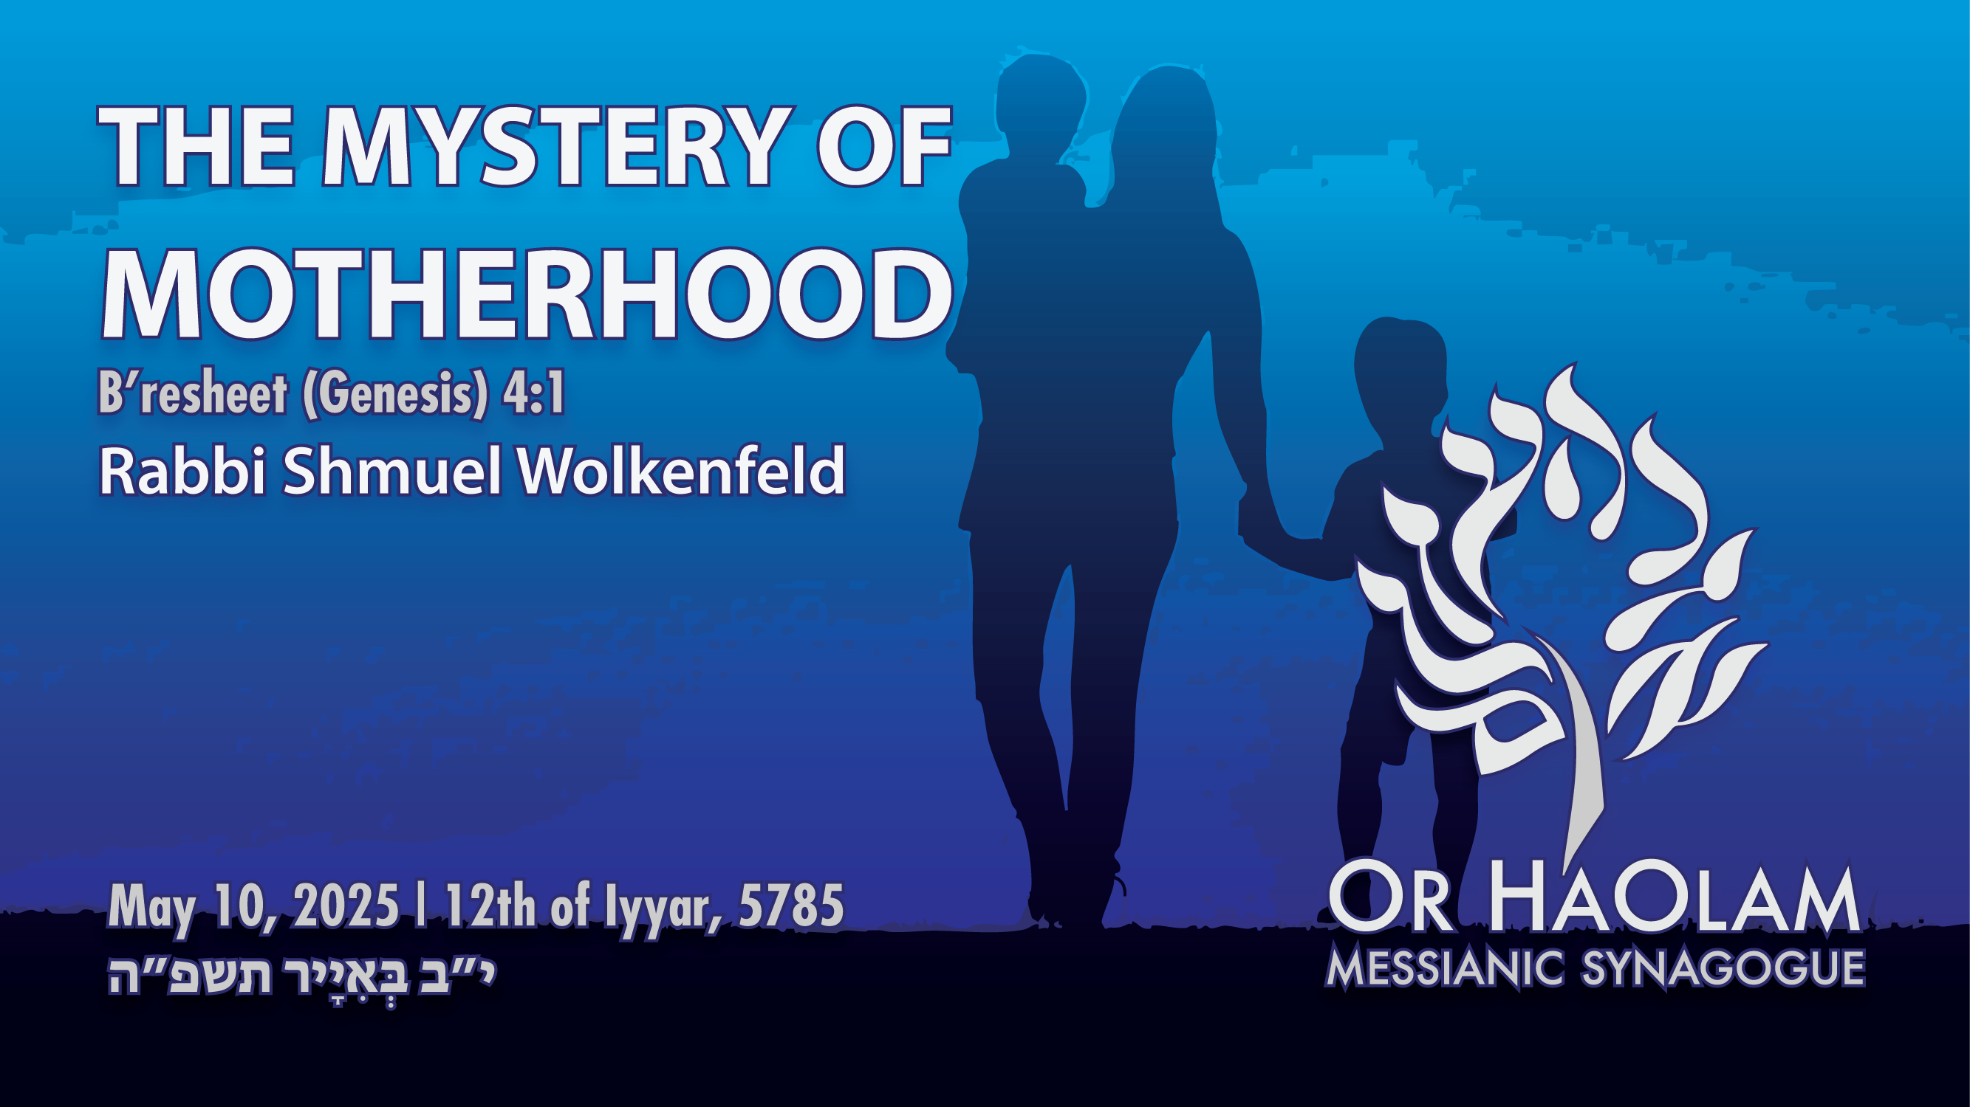

Slide 6

The Mystery of Motherhood Ber 4.1
Fears of overpopulation
Anti-natalism
Reverse fears
Fecundity and Fullness

Slide 7
The Mystery of Motherhood Ber 4.1
Fears of overpopulation
Anti-natalism
Reverse fears
Fecundity and Fullness

Slide 8
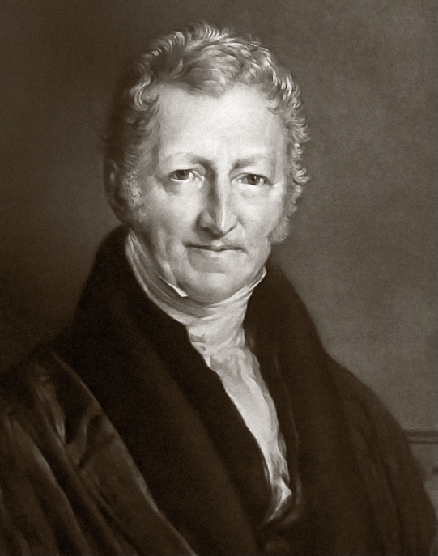
Reverend Thomas Robert Malthus laid out in his 1798 writings, An Essay on the Principle of Population, a theory called
Malthusianism.

Slide 9
Malthusianism is a theory that population growth is potentially exponential, according to the Malthusian growth model, while the growth of the food supply or other resources is linear,
Notes:
https://en.wikipedia.org/wiki/Malthusianism
It was commonly taught when I was in HS.

Slide 10
which eventually reduces living standards to the point of triggering a population decline. This event is called a Malthusian catastrophe.
Notes:
https://en.wikipedia.org/wiki/Malthusianism
It was commonly taught when I was in HS. Global overpopulation.
Similar book called “The Biological Time Bomb”

Slide 11
China's family planning policies began to be shaped by fears of overpopulation in the 1970s, and officials raised the age of marriage and called for fewer and more broadly spaced births. A near-universal one-child limit was imposed in 1980 and written into the country's constitution in 1982
Notes:
https://en.wikipedia.org/wiki/One-child_policy

Slide 12
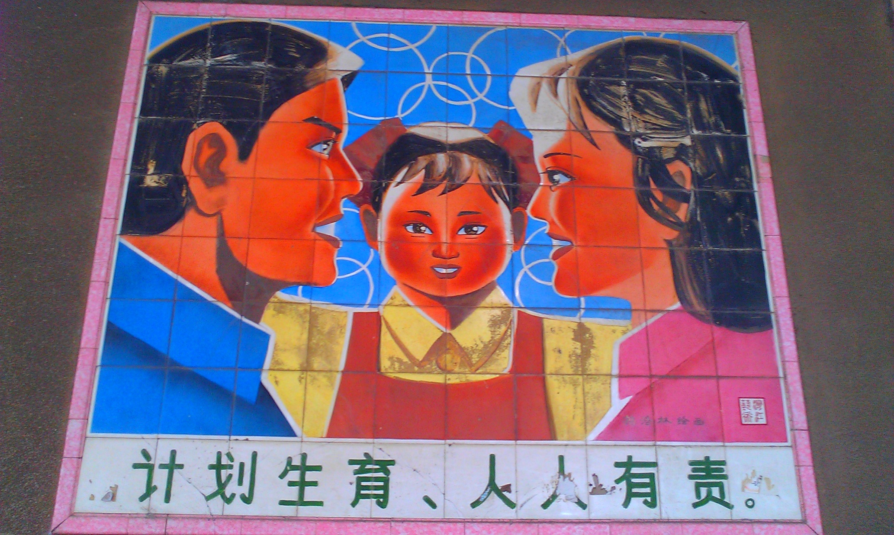
Notes:
A propaganda painting in Guangdong promotes the idea of a nuclear family with a single child. The text reads "Planned child birth is everyone's responsibility."

Slide 13
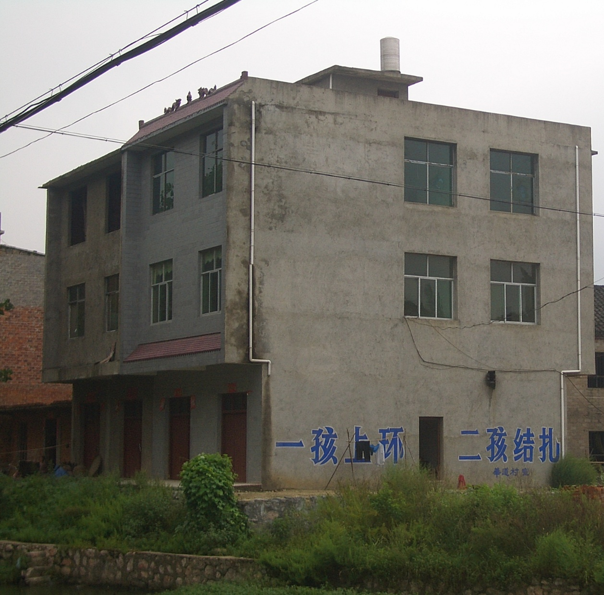
Propaganda slogan on a building at Yangxin County, Hubei, reading “an IUD after the first, tubal ligation after the second.”
Notes:
The CCP was actually quite brutal in enforcing this policy, with arrest seizures of unauthorized pregnant women and forced abortions.

Slide 14
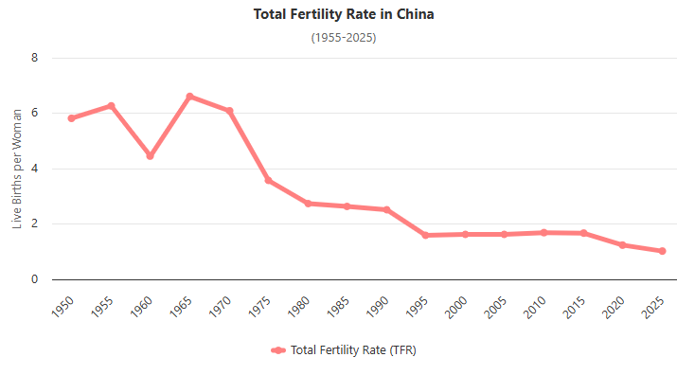
Notes:
https://www.worldometers.info/demographics/china-demographics/

Slide 16
The Mystery of Motherhood Ber 4.1
Fears of overpopulation
Anti-natalism
Reverse fears
Fecundity and Fullness

Slide 17
This fear of life grew worse, in a movement called Anti-natalism

Slide 18
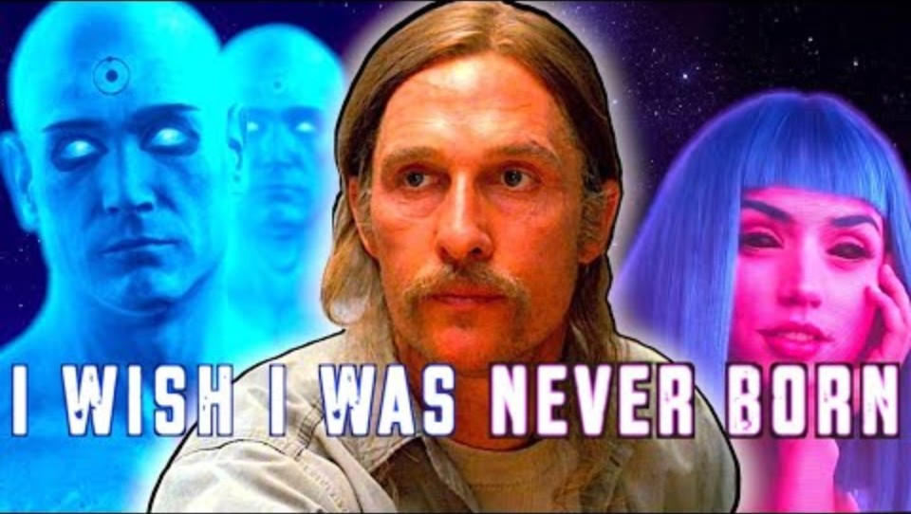
Notes:
https://youtu.be/yqMtAQEU2SA

Slide 19

Notes:
Yet, it didn’t begin with David Bentar in the 20th C.

Slide 20
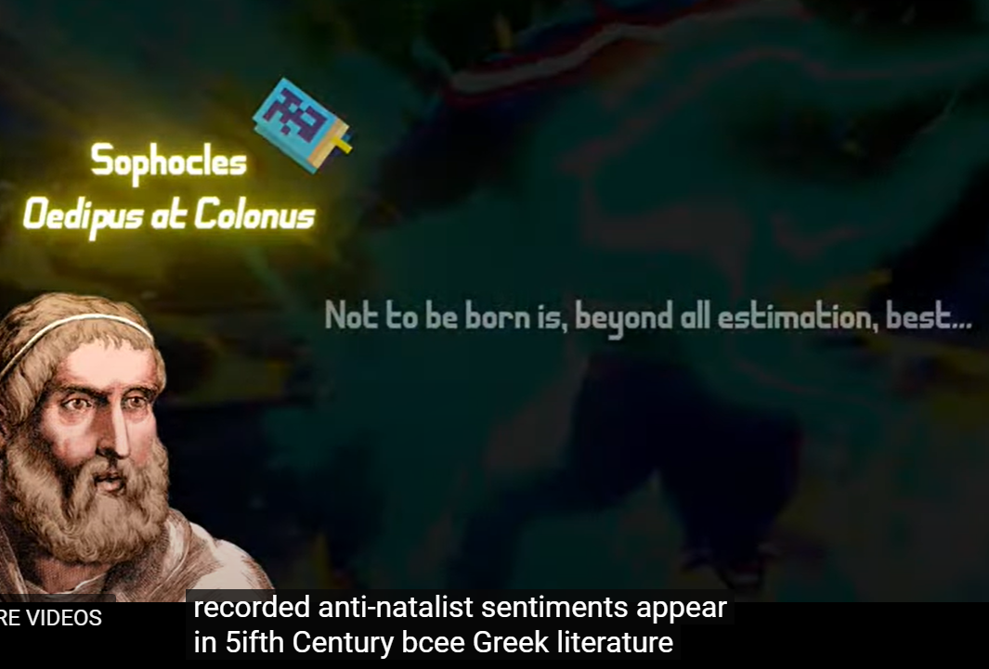

Slide 22
The Mystery of Motherhood Ber 4.1
Fears of overpopulation
Anti-natalism
Reverse fears
Fecundity and Fullness

Slide 23
In July 2021, the Chinese Communist government removed all limits, shortly after implementing financial incentives to encourage individuals to have additional children.
Notes:
https://en.wikipedia.org/wiki/One-child_policy

Slide 24
The rationale for the reversal / abolition was summarized by former Wall Street Journal reporter Mei Fong: "The reason China is doing this right now is because they have too many men, too many old people, and too few young people.
Notes:
https://en.wikipedia.org/wiki/One-child_policy

Slide 25
They have this huge crushing demographic crisis as a result of the one-child policy. And if people don't start having more children, they're going to have a vastly diminished workforce to support a huge aging population."
Notes:
https://en.wikipedia.org/wiki/One-child_policy
The CCP had tried to re-engineer the growth of the human race with restraining, and their plans woefully backfired on them.

Slide 26
A similar population issue,
but worse.

Slide 27
A landmark study published in the journal Human Reproduction Update analyzed data from over 40,000 men across North America, Europe, Australia, and New Zealand. The results were staggering – a 52.4% decline in sperm concentration between 1973 and 2011.
Notes:
https://holisticfertilityinstitute.com/fertilityarticles/the-truth-about-male-fertility-what-s-really-causing-the-global-decline#:~:text=Did%20you%20know%20that%20sperm%20counts%20have%20dropped,position%20doubles%20the%20risk%20of%20sperm%20DNA%20damage.

Slide 28
The authors warn that the mean sperm count has now dropped dangerously close to the threshold that makes conception more difficult, meaning couples around the world may encounter problems having a baby without medical assistance.
Notes:
https://www.euronews.com/health/2022/11/15/sperm-count-drop-is-accelerating-worldwide-and-threatens-the-future-of-mankind-study-warns

Slide 29
And the decline isn't slowing down. More recent data suggests the trend is continuing and possibly accelerating. But why? What's causing this dramatic shift in just a few decades?
Notes:
https://holisticfertilityinstitute.com/fertilityarticles/the-truth-about-male-fertility-what-s-really-causing-the-global-decline#:~:text=Did%20you%20know%20that%20sperm%20counts%20have%20dropped,position%20doubles%20the%20risk%20of%20sperm%20DNA%20damage.

Slide 30
The findings, published on Tuesday in the journal Human Reproduction Update, serve as "a canary in a coal mine," said Professor Hagai Levine, the study’s lead author from the Hebrew University of Jerusalem’s Hadassah Braun School of Public Health.
Notes:
https://www.euronews.com/health/2022/11/15/sperm-count-drop-is-accelerating-worldwide-and-threatens-the-future-of-mankind-study-warns

Slide 31
"We have a serious problem on our hands that, if not mitigated, could threaten mankind’s survival," he said in a statement.
Notes:
https://www.euronews.com/health/2022/11/15/sperm-count-drop-is-accelerating-worldwide-and-threatens-the-future-of-mankind-study-warns

Slide 32
The Sedentary Lifestyle Crisis
Environmental Toxins
Nutritional Deficiencies
Stress and Sleep Disruption
Electromagnetic Radiation
Some Prescription Medications
Notes:
https://holisticfertilityinstitute.com/fertilityarticles/the-truth-about-male-fertility-what-s-really-causing-the-global-decline#:~:text=Did%20you%20know%20that%20sperm%20counts%20have%20dropped,position%20doubles%20the%20risk%20of%20sperm%20DNA%20damage
Tight clothes
BPA and phtalates, pesticides, flame retardants
Food lots E, low nutrients: Zn
Cortisol
Laptop

Slide 33
The study, commissioned by the nonprofit organization The Club of Rome, predicts that if current trends continue, the world's population, which is currently 7.96 billion, will peak at 8.6 billion in the middle of the century before declining by nearly 2 billion before the century's end.
Notes:
https://www.livescience.com/worlds-population-could-plummet-to-six-billion-by-the-end-of-the-century-new-study-suggests

Slide 34
Japan’s population is projected to lose 18.7 million people between 2024 and 2050. The population is expected to shrink from 123.8 million to 105.1 million, a 15.1% decline. Japan’s population has been falling since 2011 due to very low fertility rates (1.42 births per woman) and an aging population.
Notes:
https://worldpopulationreview.com/country-rankings/countries-with-declining-population

Slide 35
The population of Greece is expected to shrink from 10 million to 8.8 million, a loss of more than 12%, over the next 26 years. Greece’s population began declining in 2011 when the first negative birth rate was recorded. Greece’s population could decline by up to 50% over the next 50 years if nothing is done to combat it.

Slide 36
So, the secular world
was panicked about overpopulation,
and is now panicked
about depopulation.

Slide 38
The Mystery of Motherhood Ber 4.1
Fears of overpopulation
Anti-natalism
Reverse fears
Fecundity and Fullness

Slide 39
^{Ber/Gen 1.26-28} Then God said, “Let us make humankind in our image, in the likeness of ourselves; and let them rule over the fish in the sea, the birds in the air, the animals, and over all the earth, and over every crawling creature that crawls on the earth.”

Slide 40
^{Ber/Gen 1.26-28} So God created humankind in his own image; in the image of God he created him: male and female he created them. God blessed them:

Slide 41
^{Ber/Gen 1.26-28} God said to them, “Be fruitful, multiply, fill the earth and subdue it. Rule over the fish in the sea, the birds in the air and every living creature that crawls on the earth.”

Slide 42
^{Ber. Gen 4.1} The man had sexual relations with Havah his wife; she conceived, gave birth to Kayin [acquisition] and said, “I have acquired a man from Adoni.”
Notes:
Let’s examine that line…

Slide 43

את Not typically translated; used as a direct object marker
Adoni
Adoni
Notes:
Hava thought she had created the G-d Man. She thought G-d had come to her.
There is something astonishing about the emergence of a baby, it elicits worship.

Slide 44
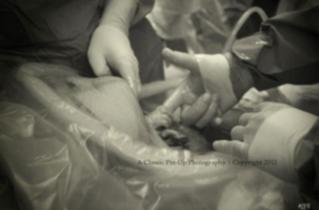
Notes:
https://i.pinimg.com/originals/8c/05/a3/8c05a3e148268d822d623a835e8ffc15.jpg
The surgeon who did this pre-natal surgery was interviewed on James Dobson Family Talk about the pre-natal surgery and said that the photog here was not a believer before he took this photo. This changed is view on G-d.

Slide 45
Natalism (also called pronatalism or the pro-birth position) is a policy paradigm or personal value that promotes the reproduction of human life as an important objective of humanity and therefore advocates a high birthrate.
Notes:
We are natalists, at Or HaOlam. At least I am. Dawn and I have four kids.

Slide 46

Notes:
https://upload.wikimedia.org/wikipedia/commons/6/6b/Parents_and_their_baby.jpg

Slide 47
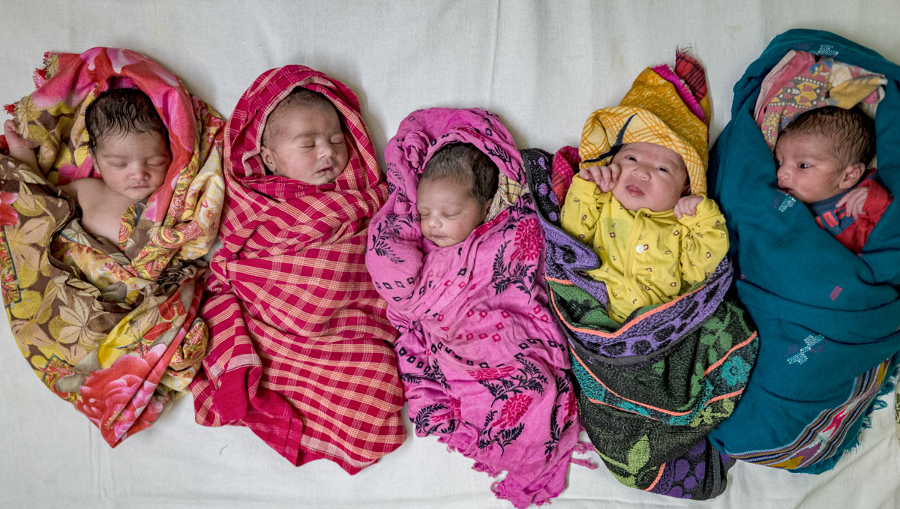
Notes:
https://www.science.org/do/10.1126/science.ze0x33r/full/_20240401_on_fertilityrate-1712071489863.jpg

Slide 48
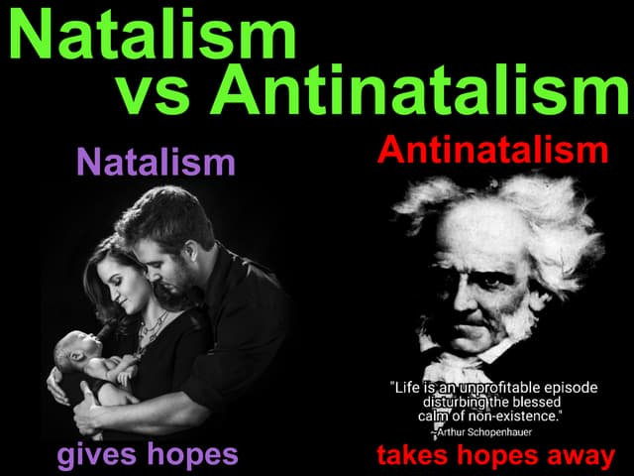
Notes:
https://cdn.slidesharecdn.com/ss_thumbnails/natalism-definition-part-3-childfree-pronatalism-teamnokids-natalist-principles-explanation-of-antin-170430175915-thumbnail.jpg?width=640&height=640&fit=bounds

Slide 49
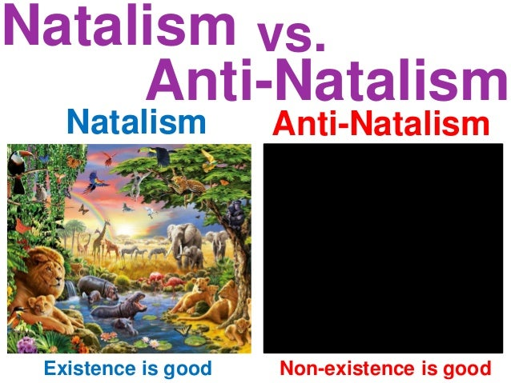
Notes:
https://image.slidesharecdn.com/antinatalism-principles-vs-natalism-foundation-of-childfree-vhemt-basics-efilism-rules-antinatalist--170217081028/95/antinatalism-vs-natalism-part-2-1-638.jpg?cb=1487319340

Slide 50
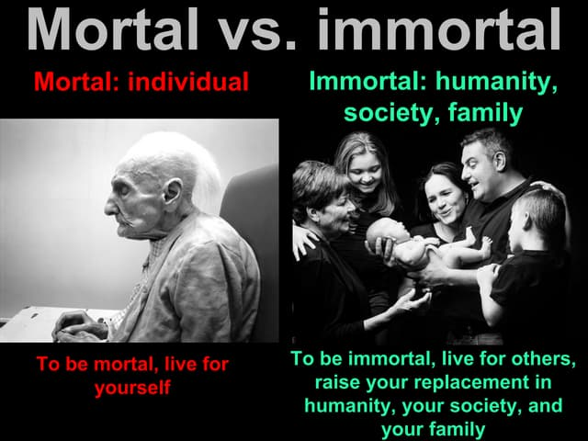
Notes:
https://cdn.slidesharecdn.com/ss_thumbnails/childfree-by-choice-mortal-ve-immortal-definition-of-antinatalism-vhemt-basics-efilism-rules-antinat-180409090743-thumbnail.jpg?cb=1523265071

Slide 51
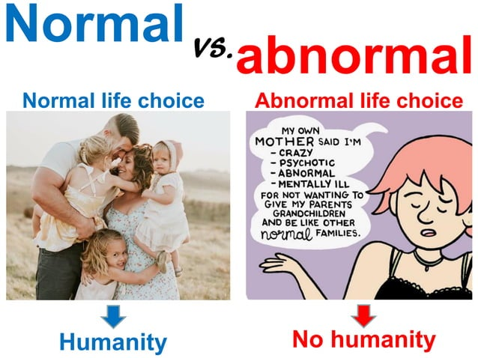

Slide 52
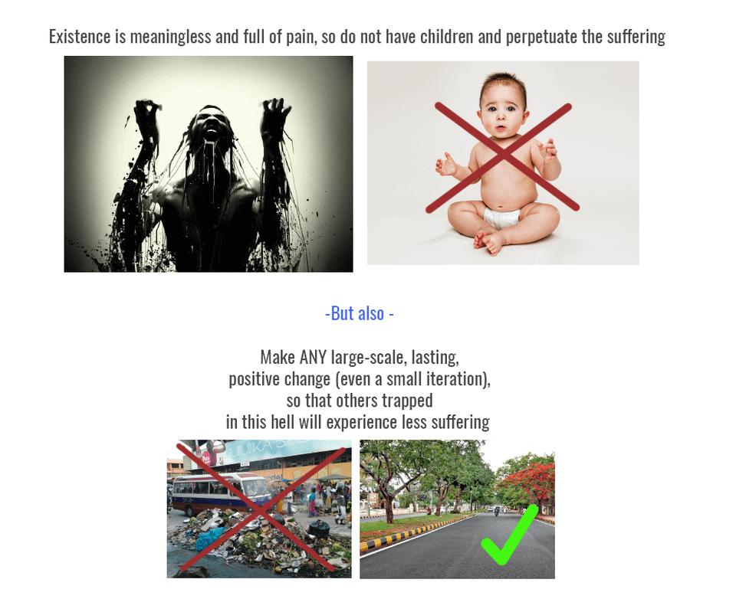
Notes:
https://preview.redd.it/rql8d576qgk21.png?width=960&crop=smart&auto=webp&s=424778fa1265a966ba5e7a2280d9c979862b29a0

Slide 53
Life is good, and hopeful,
because G-d in Yeshua is good, and gives HOPE even in darkness.

Slide 54
We want to express
our appreciation to the women who have experienced and accomplished the miracle of motherhood.

Slide 55

All the roles of fitness trainer, teacher, $ manager, hugger

Slide 56

Some particulars, from experts.

Slide 57
We women are blessed with oxytocin, the so-called “love hormone.” This little chemical messenger plays a big role in bonding with your baby and can influence your mood. It’s responsible for that rush of love you feel when you look at your little one, but it can also contribute to emotional intensity.
Notes:
https://neurolaunch.com/why-am-i-so-emotional-after-having-a-baby/

Slide 58
Let’s not forget that your body has just run the equivalent of an emotional and physical marathon. You’ve grown a whole human being and then brought them into the world – that’s no small feat!

Slide 59
Remember, you’ve already done the impossible – you’ve brought new life into this world. Now, as you nurture your little one, don’t forget to nurture yourself too. Your emotions, in all their messy, beautiful complexity, are part of what makes you the amazing mother you are.

Slide 60
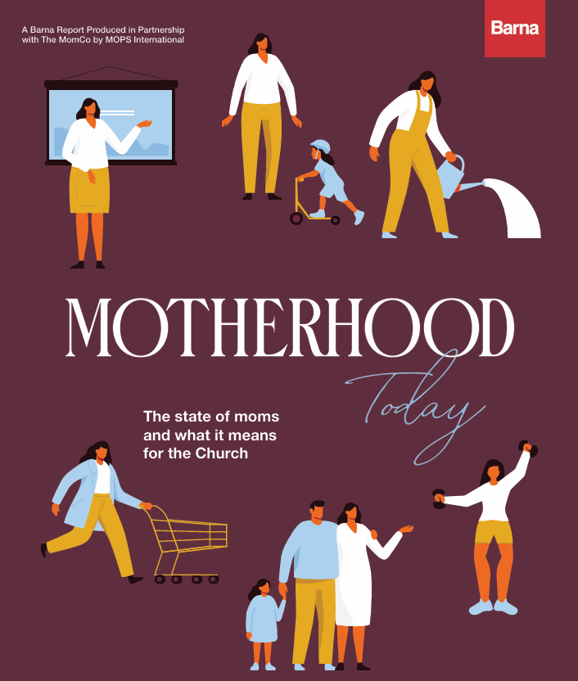
Some considerations from Barna

Slide 61
Mothers highly value their role as a mom, viewing motherhood as a large part of who they are. No matter a mom’s age, being or becoming a mother is what’s most important to her. And in spite of the various responsibilities and stressors that come with motherhood, most moms strongly agree “being a mother is rewarding.

Slide 62
A mother’s influence stretches into every sphere of life, but many moms fail to recognize their value or impact. Less than one in five moms (19%) says they regularly feel they are “able to contribute meaningfully to the world.

Slide 63
Along with gaps in community, anxiety and exhaustion are evident in the lives of most Moms. A strong majority of mothers says it is true “I usually find myself worrying about something” and “I feel tired most of the time.

Slide 64
Faith correlates with stronger emotional well-being among mothers. Compared to non-believing mothers, believing moms are more likely to say they regularly feel “satisfied with my life choices,” fully present,” “able to meaningfully contribute to the world” and
“confident in myself.

Slide 65
Yet ministry and resources specifically for mothers are limited in congregations. Just one in 10 U.S. leaders strongly agrees their congregation prioritizes mothers, and nearly half of moms say that their congregation “never” provides materials to help support them as a mother

Slide 66
Believing moms prioritize attendance and say they do so primarily to grow their personal faith. Though their child’s spiritual growth may be important to them, most moms are going to services for their own sake first

Slide 67

Stress of Motherhood
Notes:
https://www.drjamesdobson.org/hubfs/5-Tips-to-Help-Moms-Cope-with-Stress---Dr.-James-Dobson_1200x630.jpg

Slide 68

Becky Thompson
Is motherhood feeling more like a marathon than a blessing? On today’s edition of Family Talk

Slide 69
Roger Marsh continues his conversation with Becky Thompson about her new book, Healing Rest, which offers a lifeline to exhausted moms.

Slide 70
But the fact that you are finding that rest in God, and you have a great quote in this book, Healing Rest: An Invitation For Mommas Who Carry So Much to Lean Into the Arms of the One Who Holds It. It's a great quote about what you were just talking about where you said,
Notes:
http://cdn.bfldr.com/FK28HSHN/at/w9gchtbq4tvckfvfj73thshv/05092025HEALINGREST2.pdf

Slide 71
“We can't just one second Yeshua our way through all of our days.” I love that phrase. You really ought to copyright that or whatever because it's true, right? How many times do we pray that when we were kids it was the give me an A on the test prayer?
Notes:
http://cdn.bfldr.com/FK28HSHN/at/w9gchtbq4tvckfvfj73thshv/05092025HEALINGREST2.pdf

Slide 72
That's my time alone with God today. But the fact that if we are desperate for finished work in our lives, we have to find moments to spend at His feet. Talk about that.
Notes:
http://cdn.bfldr.com/FK28HSHN/at/w9gchtbq4tvckfvfj73thshv/05092025HEALINGREST2.pdf

Slide 73
The parts of Psalm 23 that we spend so much time on, "The Lord is my shepherd, I shall not want, he makes me lie down and green." Isn't that great? Green pastures. So wonderful and we forget, we just kind of run through the,

Slide 74
"Yea, though I walk through the valley of the shadow of death, I will fear no evil because you are with me.“ David says, look, we are going to walk through that valley. And the question isn’t so much do we have to, it's who is with you when you do?

Slide 75
The Beauty factor
Your Brain Craves Beauty,
Here’s Why

Slide 76
In a landmark 2004 experiment, researchers placed participants in brain scanners and showed them beautiful paintings. A specific brain region—the orbitofrontal cortex—lit up instantly. This dedicated neural real estate, sometimes dubbed “the beauty center,”

Slide 77
implies that beauty appreciation is hardwired into our cognitive architecture. Moreover, our brains recognize beauty in milliseconds, long before conscious thought has time to form. This instantaneous recognition hints that we simply know beauty when we see it.

Slide 78
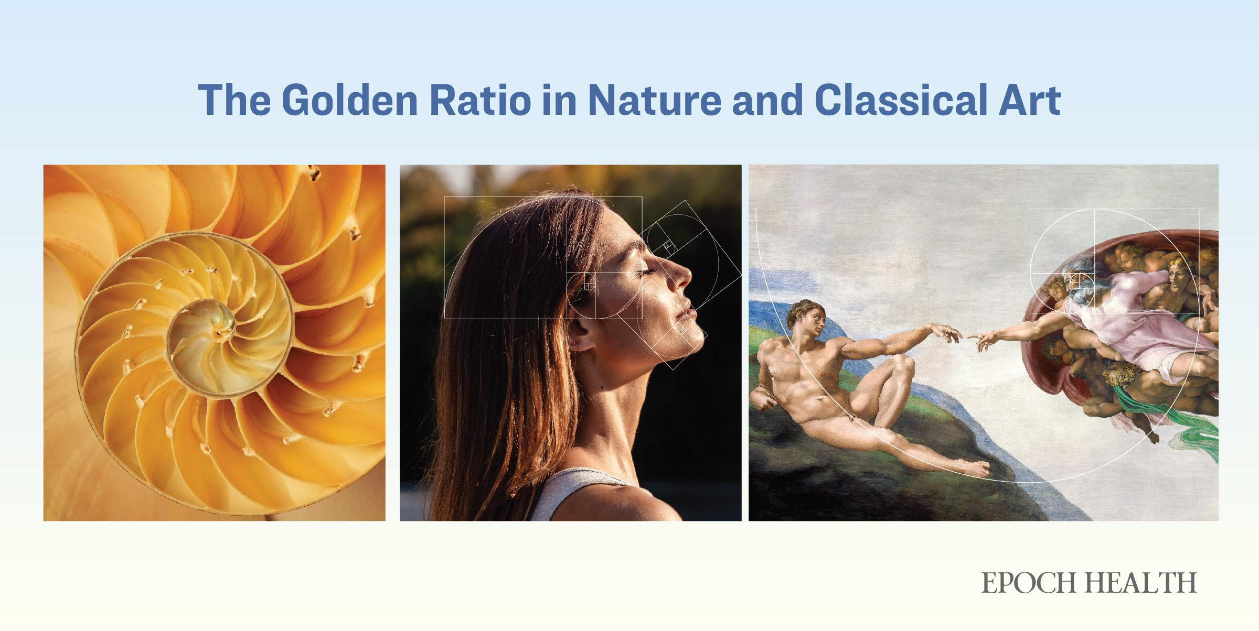
Notes:
https://www.theepochtimes.com/health/your-brain-craves-beauty-heres-why-5847092?utm_source=Morningbrief&src_src=Morningbrief&utm_campaign=mb-2025-05-04&src_cmp=mb-2025-05-04&utm_medium=email&est=6RmUYjAcok%2BIcrgYcAeQNRHc%2FwlaRRw3WqPnkP7pyEUMjLV2SBlQlaQocEDn5zsTFw%3D%3D

Slide 79
^{Mishlei/Prov 31.30-31} Charm can lie, beauty is futile, but a woman who fears Adoni should be praised. Give her a share in what she produces; let her works speak her praises at the city gates.
Notes:
Vanity, breath, vapor, futility, emptiness
Meaning: emptiness, vanity, transitory, unsatisfactory

Slide 80
Nevertheless, G-d in scripture notices and values beauty.

Slide 81
^{Iyov 42.13-15} He also had seven sons and three daughters. The first he named Y’mimah; the second, K’tzi‘ah; and the third, Keren-Hapukh. Nowhere in the land could women be found as beautiful as Iyov’s daughters; and their father gave them inheritances along with their brothers.

Slide 82
^{Beresheet/Gen 29.17} Rachel was good-looking, with beautiful features.
^{Ester 2.7} He had raised Hadassah, that is, Ester, his uncle’s daughter; because she had neither father nor mother. The girl was shapely and good-looking;

Slide 83
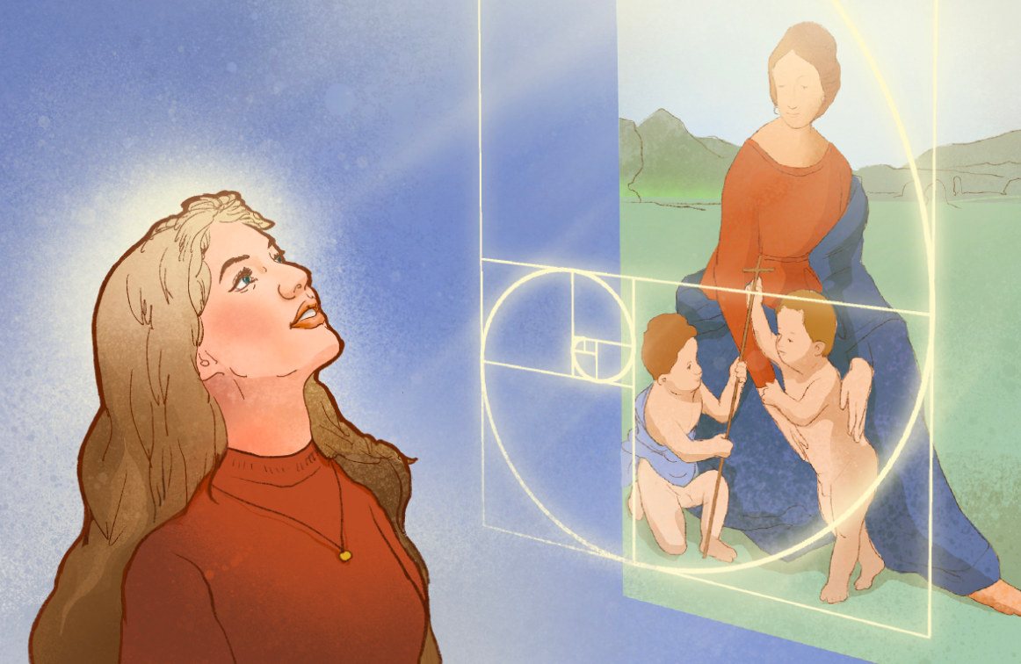
Notes:
https://img.theepochtimes.com/assets/uploads/2025/04/29/id5849492-Brain-Craves-Beauty-featured-image.jpg

Slide 84
^{T’hillim Ps 45.14-16} Inside [the palace], the king’s daughter looks splendid, attired in checker-work embroidered with gold. In brocade, she will be led to the king, to you, with the virgins in her retinue. They will be led in with gladness and joy, they will enter the king’s palace.

Slide 85
^{T’hillim Ps 45.2-3} My heart is stirred by a noble theme; I address my verses to the king; My tongue is the pen of an expert scribe. You are the most handsome of men; gracious speech flows from your lips. For God has blessed you forever.

Slide 86
^{T’hillim Ps 27.4} One thing have I asked of Adoni, that will I seek: to dwell in the House of Adoni all the days of my life, to behold the beauty of Adoni, and to meditate in His Temple.

Slide 87
So, ladies, mothers, be blessed and rejoice in the spiritual and physical beauty G-d gave you.
It is a Yeshua like quality.

Slide 88
Summary:
Mothers are the bedrock of all.
Roles: fitness trainer, teacher, manager, hugger
We don’t always attend to your needs.
Yeshua is there for you!
You are beautiful.

Slide 90
The Mystery of Motherhood Ber 4.1
Fears of overpopulation
Anti-natalism
Reverse fears
Fecundity and Fullness

