Slide 1
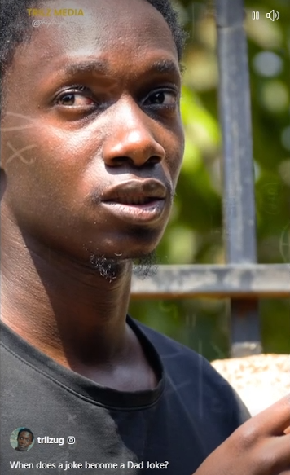
When does a joke become a Dad joke?
Notes:
from my daughter in law, Daniel’s wife Christina who was here for our Seder.
https://www.facebook.com/reel/988543155980045/

Slide 2
Dawn and I want to express our extreme gratefulness to all you servant hearted loving joyful mishpokha who have amazingly enriched our lives and made Or HaOlam possible.

Slide 3
from Lon Wiksell: We praise Adonai for His faithfulness to Or HaOlam over these past 30 years. May He continue to bless all of as you minister in Yeshua's Name!
With Blessings in Messiah Yeshua, Lon & Fran

Slide 4
From Teresa Hiatt: Happy anniversary to 30 years. God's hesed has brought you to this place. Marc Hiatt and I are thankful for the 16 years we had attending, serving, worshipping and staffing with the fine mishpocha at Or HaOlam. Sending greetings and love

Slide 5
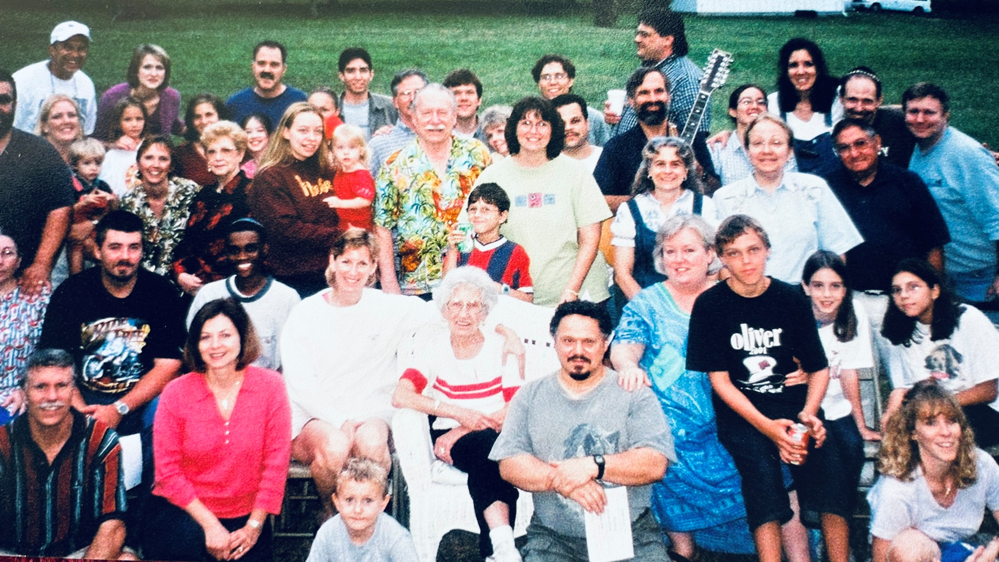

Slide 6
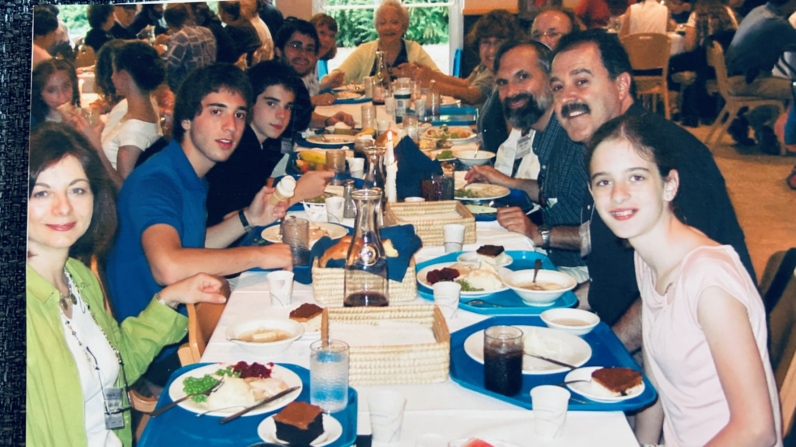

Slide 7
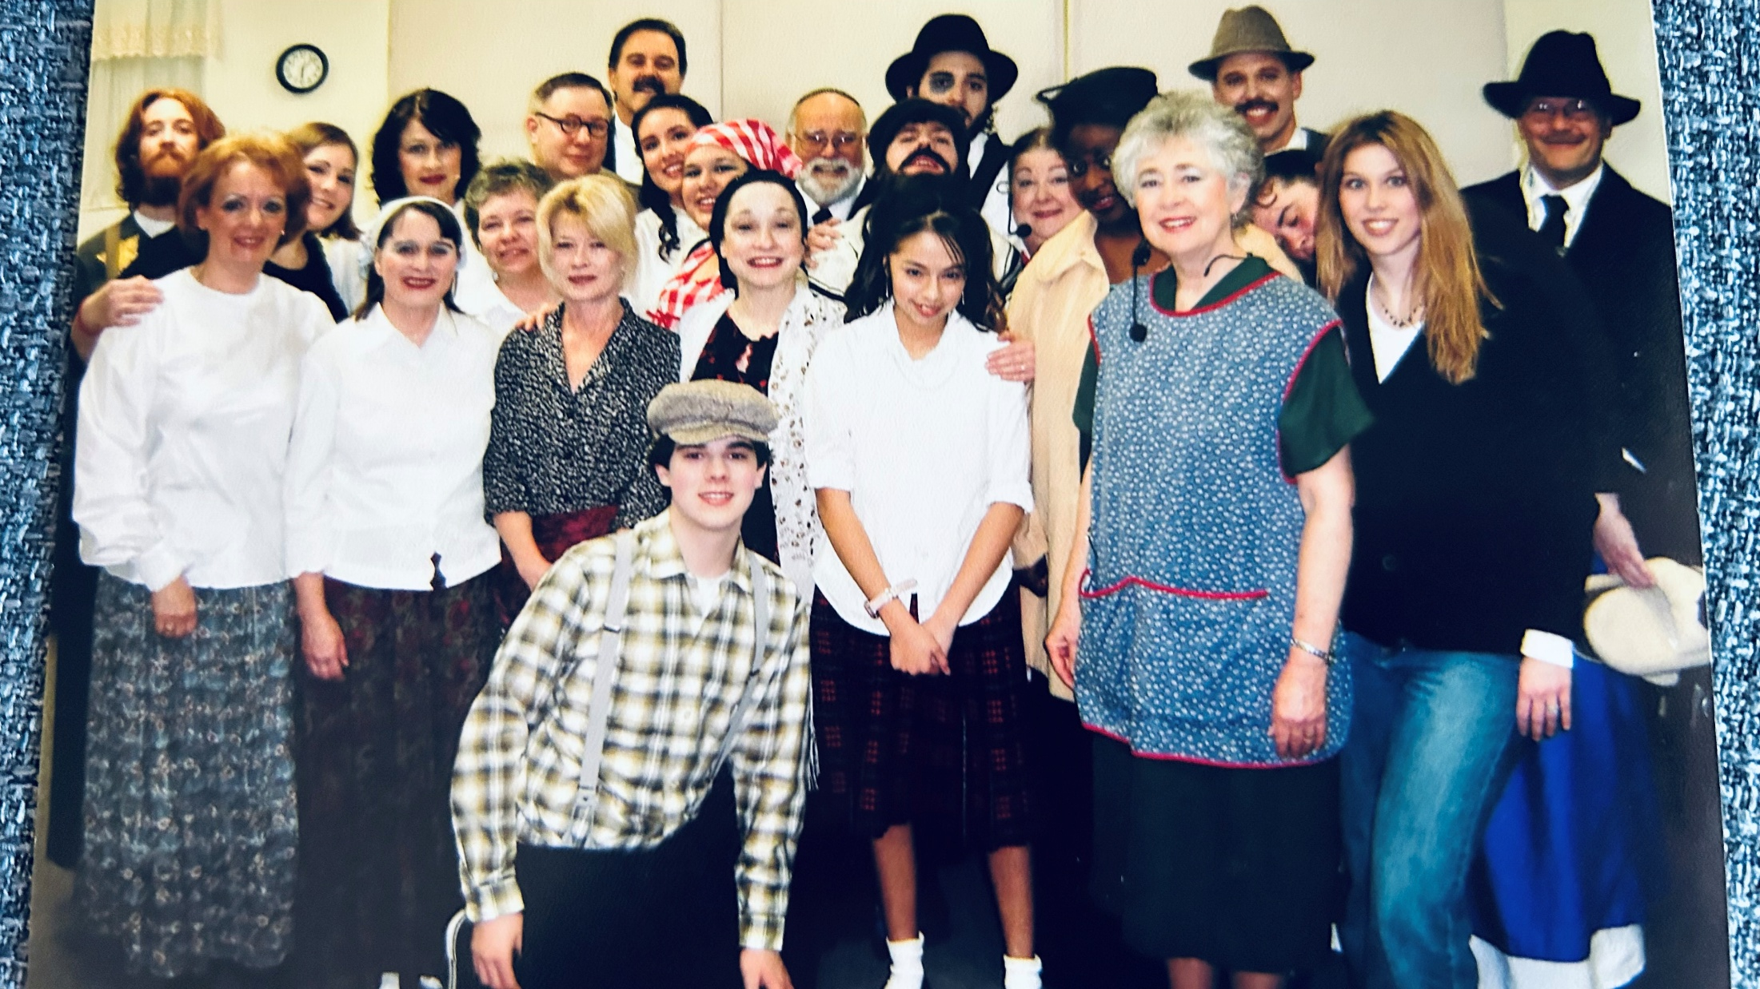

Slide 8
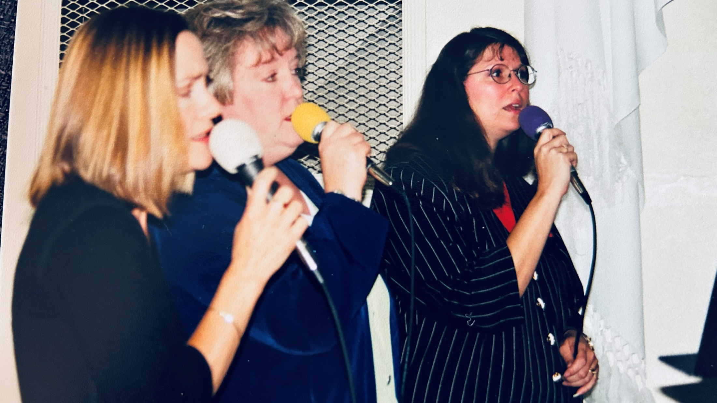

Slide 9
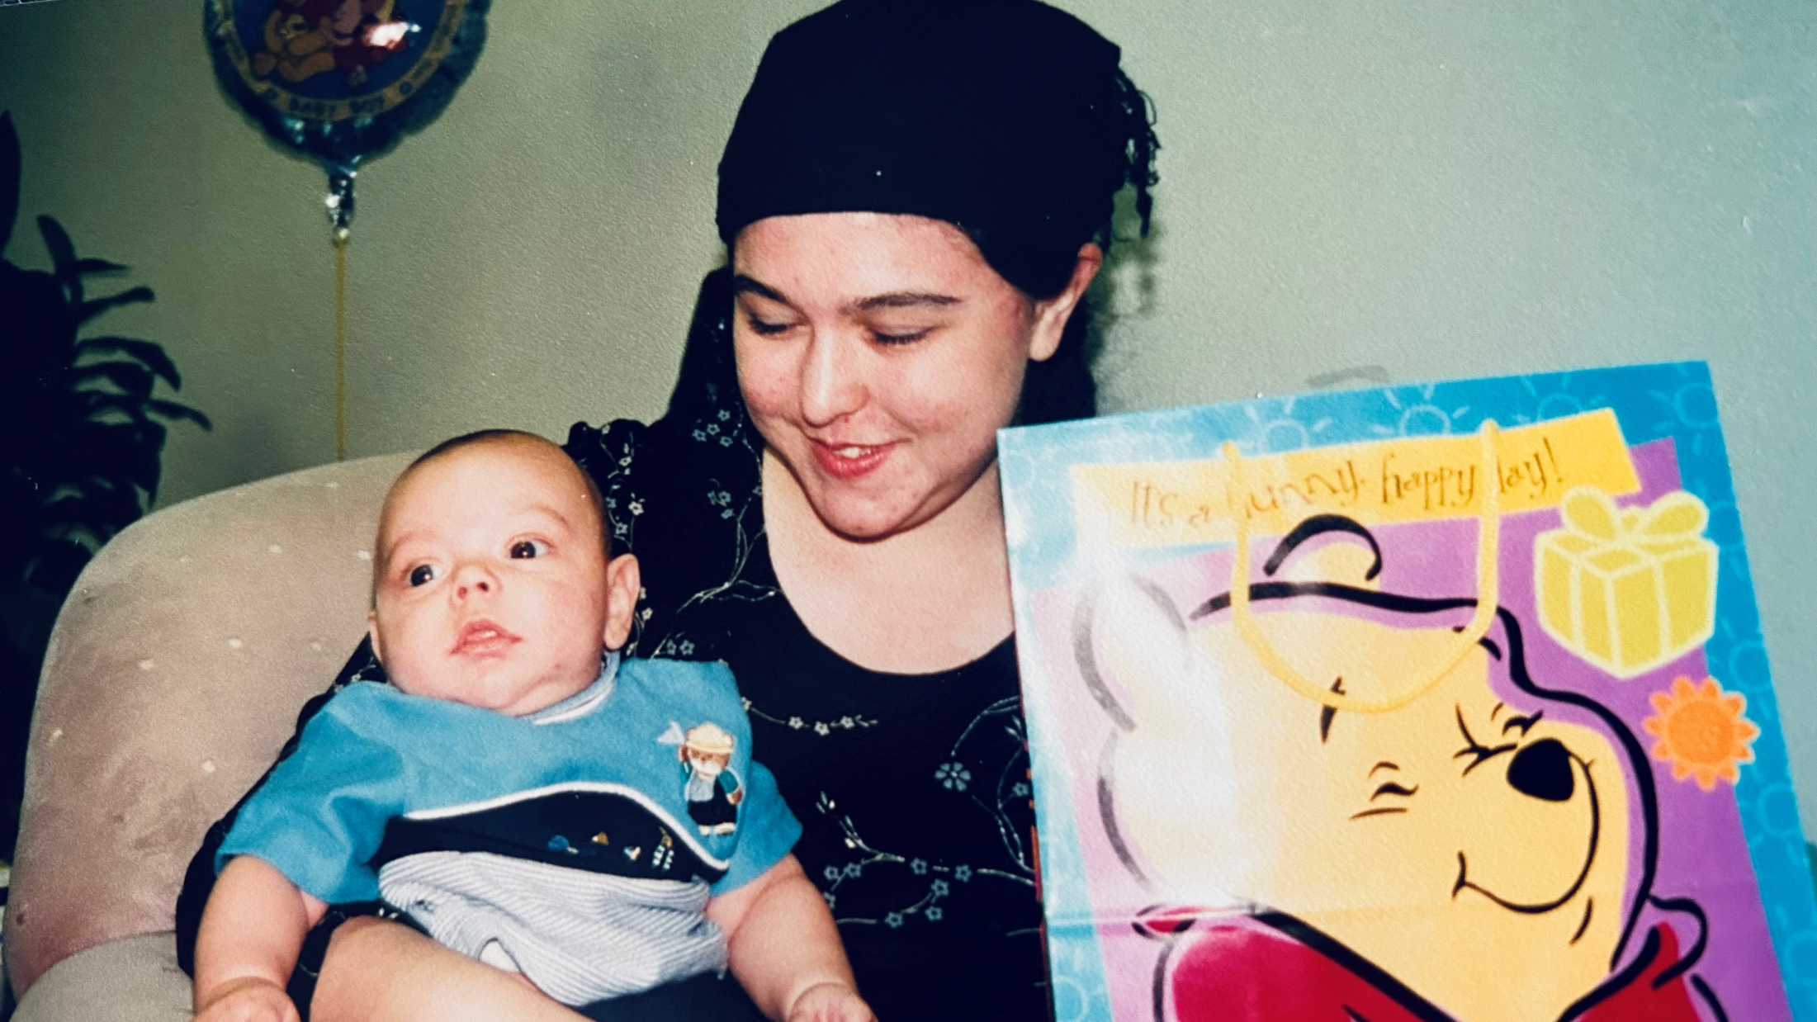

Slide 10
Why are we here?

Slide 11
Why are we here?
Because we’re not all there.

Slide 12
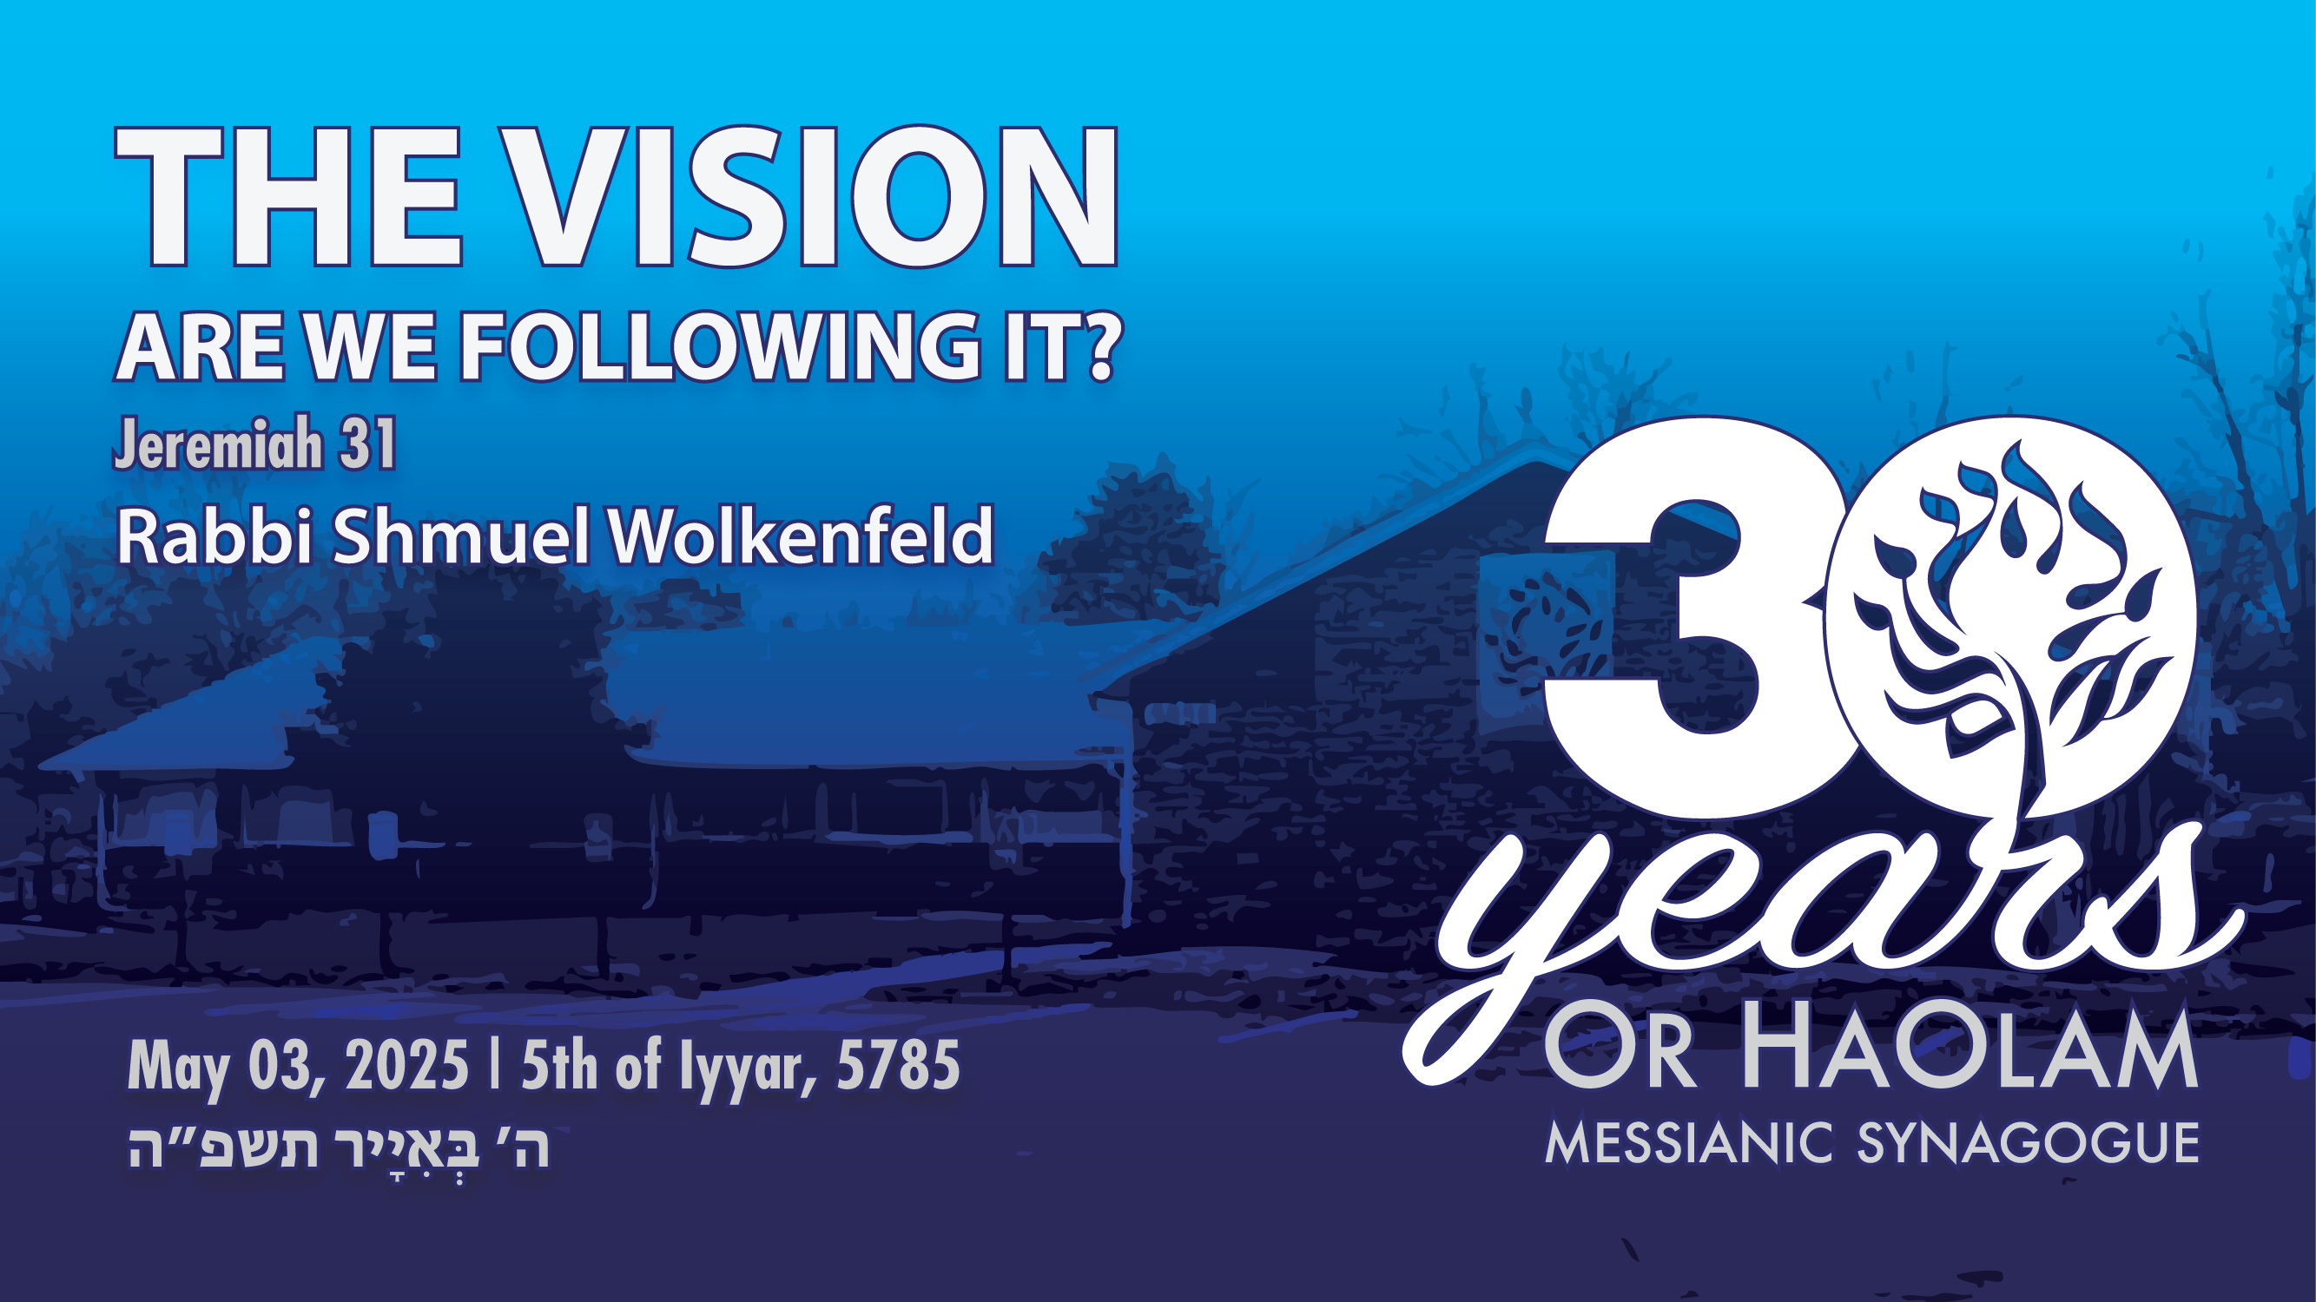

Slide 13
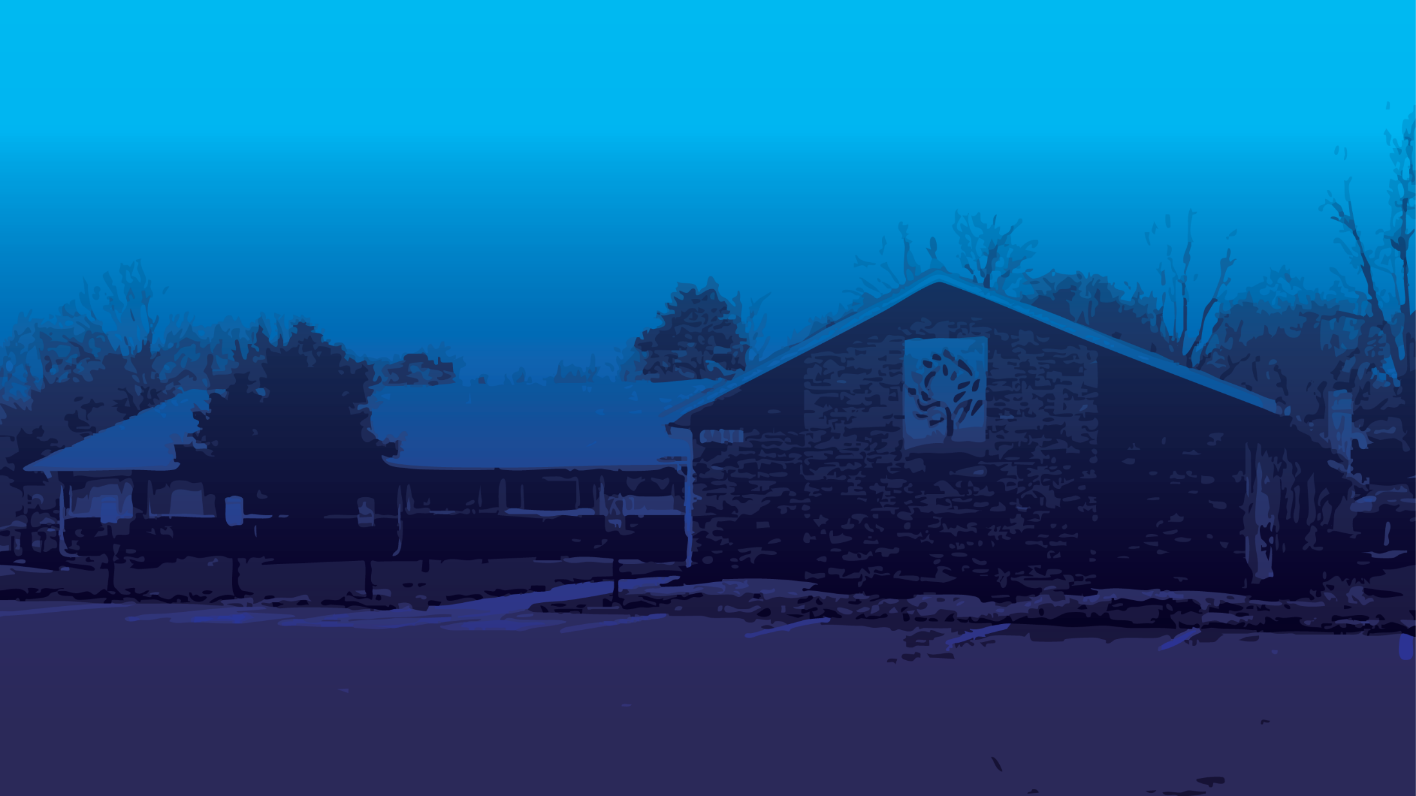
The vision, are we following it?
The power of a unified vision
The definition of our vision
Our fulfillment, or not.

Slide 14
The vision, are we following it?
The power of a unified vision
The definition of our vision
Our fulfillment, or not.

Slide 15
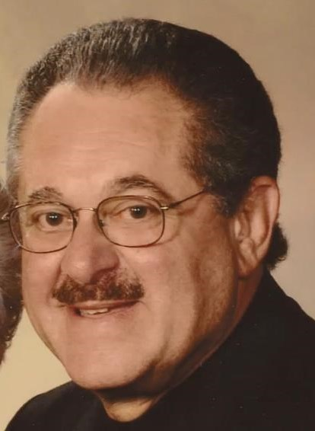
Rabbi Robert Solomon, Beth Hallel, Atlanta
1941-2025
If there is more than one vision,
There is division.
Notes:
Are we committed to unity in vision and in community?

Slide 16

^{Mishlei/Prov 29.18} Where there is no divine vision people cast off restraint, but blessed is the one who keeps Torah.
Notes:
And one of the words for cantor, prayer leader, is khazan, derived from khazon revelation.
What is G-d calling us to be and do, as a community?

Slide 17
para פָרַע
to loosen; by implication, to expose, dismiss; figuratively, absolve, begin -- avenge, avoid, bare, go back, let, (make) naked, set at nought, perish, refuse, uncover.

Slide 18
^{Mishlei/Prov 29.18} Where there is no divine vision people cast off restraint, but blessed is the one who keeps Torah.
Notes:
We need to have the same divinely inspired passion, or there is chaos.
What is G-d calling us to be and do, as a community?

Slide 20
The vision, are we following it?
The power of a unified vision
The definition of our vision
Our fulfillment, or not.

Slide 21
The Vision of Or HaOlam:
Working to bring Jewish people, and those grafted in, to their covenantal identity in Messiah. Implies:
1.) Salvation through the Atonement of the Messiah; personal faith in the atoning death and resurrection of Yeshua; it's all about the King.
Notes:
We are working, hoping, praying for Jewish people, and all people, all nations, to come to salvation in Messiah. Not exclusively Jewish, just inclusively Jewish.
^{Ro 1.16} For I am not ashamed of the Good News, for it is the power of God for salvation to everyone who trusts—to the Jew first and also to all Nations.
Most congregations which follow Messiah just despair to reach Jews. Too hard. Fugetaboutit.

Slide 22
Not exclusively or even majority Jewish
^{Zekh 8.23} Thus says Adoni-Tzva’ot, “In those days it will come to pass that ten men from every language of the nations will grasp the corner of the garment of a Jew [tsitsit] saying, ‘Let us go with you, for we have heard that God is with you.’”
Notes:
Ten to one ratio is about us.
Why wear tsitsit out, not tucked in.
J4J experience in outreach.

Slide 23
2.) Covenantal identity of Jewish people, not replacement
3.) Restoration to Torah lifestyle
Notes:
2. The Nations [better term than “Gentiles”] are grafted into the covenants of Israel.
3. Is Torah for everyone? Just wait a bit. FFOZ has a concept called distinction theology. I have a variant of it.

Slide 24
4.) Restoration/survival of the nation of Israel. (Covenantal identity, so Jewish believers don't assimilate.

Slide 25
Real distinction ^{Ro 11.12-15} Now if their transgression leads to riches for the world, and their loss riches for the Gentiles, then how much more their fullness!.... For if their rejection leads to the reconciliation of the world, what will their acceptance be but life from the dead?
Notes:
Riches for the Gentiles
Life from the Dead
Jewish salvations has a cosmic effect.

Slide 26
That is, when a Jew comes to Messiah, and lives Jewishly, in Torah, community, there is a cosmic multiplying effect.
When a Jew comes to faith and assimilates into the church, in a sense, Israel is not saved.
Notes:
Collision of Black Holes, radiation of power >> James E. Webb telescope can handle!

Slide 27
So, what is the difference between Jews and Gentiles in Torah observance?
Nothing, in practice, except circumcision.

Slide 28
^{1 Cor.7.18} Was anyone called when he already had been circumcised? Let him not make himself uncircumcised. Has anyone been called while uncircumcised? Let him not allow himself to be circumcised.

Slide 29
So, what is the difference between Jews and Gentiles in Torah observance?
Everything, in spiritual, cosmic, multiplying, world shaking effect.

Slide 30
There is GREAT power for Jewish people to serve the Messiah Jewishly.

Slide 31
There is GREAT power for Gentile people to serve the Messiah Jewishly.
^{Ro 11.11} Deliverance has come to the Gentiles, in order to provoke them to jealousy
Notes:
One of our people: “I’m not Jewish, but I practice Judaism.”
Dr. Michael Brown comment: 50 Jews in a Messianic Syn >> 500 Jews in the churches.

Slide 32
When a Jew lives for Messiah but NOT as a covenantal Jewish person, he is a bit like Simba in the Lion King.

Slide 34
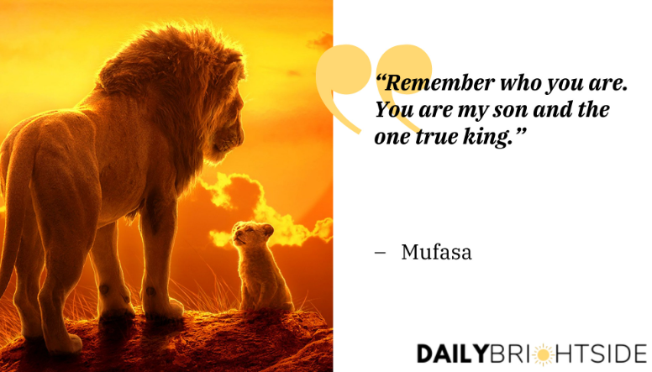
Notes:
https://dailybrightside.com/wp-content/uploads/2022/01/Mufasa.jpg

Slide 35

Notes:
http://25.media.tumblr.com/32c23e2c726f664cf56365f6e172e37e/tumblr_mvjg7nlESs1qe4dero1_500.jpg

Slide 36
^{Zekh 12.6} When that day comes, I will make the leaders of Y’hudah like a blazing fire pan in a pile of wood, like a fiery torch among sheaves of grain; they will devour all the surrounding peoples, on the right and on the left.
Yerushalayim will be inhabited in her own place, Yerushalayim.

Slide 37
^{Yeshayahu/Is 2.2-3} In the akharit-hayamim the mountain of Adoni’s house will be established as the most important mountain. It will be regarded more highly than the other hills, and all the Goyim will stream there.

Slide 38
^{Yeshayahu/Is 2.2-3} Many peoples will go and say, “Come, let’s go up to the mountain of Adoni, to the house of the God of Ya‘akov! He will teach us about his ways, and we will walk in his paths.” For out of Tziyon will go forth Torah, the word of Adoni from Yerushalayim.

Slide 39
Definitive scripture that the Gentiles are welcome keep Torah, but a gradual and individualized learning curve is expected.

Slide 40
^{Ro 14.1-5} The one who eats anything must not look down on the one who abstains; and the abstainer must not pass judgment on the one who eats anything, because God has accepted him — who are you to pass judgment on someone else’s servant?

Slide 41
^{Ro 14.1-5} It is before his own master that he will stand or fall; and the fact is that he will stand, because the Lord is able to make him stand. One person considers some days more holy than others, while someone else regards them as being all alike.

Slide 42
^{Ro 14.1-5} Now as for a person whose trust is weak, welcome him — but not to get into arguments over opinions. One person has the trust that will allow him to eat anything, while another whose trust is weak eats only vegetables.

Slide 43
^{Ro 11.11} It is by means of their [the Jewish people’s] stumbling that the deliverance has come to the Gentiles, in order to provoke them to jealousy.

Slide 45
The vision, are we following it?
The power of a unified vision
The definition of our vision
Our fulfillment, or not.

Slide 46
+In our 30 years 28 people have come to repentance and faith in Yeshua. Jewish and from the Nations.

Slide 47
+In our 30 years 28 people have come to repentance and faith in Yeshua.
+ Some of them are in eternity with G-d.

Slide 48
+In our 30 years 28 people have come to repentance and faith in Yeshua.
+ Some of them are in eternity with G-d.
- Some of them have gone back on Messiah.

Slide 49
There are MANY individuals and families who have been searching for spiritual depth, and found out that they head a genealogical as well as spiritual connection to Israel.
Roar Simba!

Slide 50
Will there be difficulties and challenges?

Slide 51
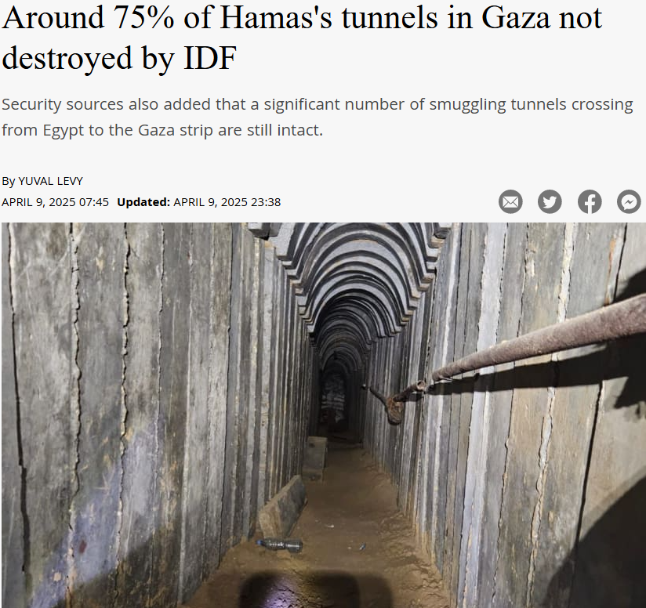
Notes:
https://www.jpost.com/breaking-news/article-849430?utm_source=ActiveCampaign&utm_medium=email&utm_content=REPORT%20%7C%2075%20%20of%20Hamas%20terror%20tunnels%20still%20standing%20%2A%20High%20Court%20freezes%20firing%20of%20Shin%20Bet%20chief%20Ronen%20Bar%2C%20Netanyahu%20%20puzzled%20%20by%20decision&utm_campaign=April%209%2C%202025

Slide 52
The military has destroyed approximately 25% of Hamas’s tunnels in Gaza, concentrating on those used for attacks, command, and weapons manufacturing, with many in these having been destroyed. The extensive tunnel network used for movement within the Strip, however, largely remains intact.
Notes:
https://www.worthynews.com/104101-israel-expands-buffer-zone-in-gaza-majority-of-hamas-tunnels-remain-intact

Slide 53
"This is what the Lord says, he who appoints the sun to shine by day, who decrees the moon and stars to shine by night, who stirs up the sea so that its waves roar— the Lord Almighty is his name: “Only if these decrees vanish from my sight,” declares the Lord, “will Israel ever cease being a nation before me.” ^{-Jeremiah 31: 35-36}

Slide 54
Our success metric is not just
the # of “salvations” nor # of people called to Torah,
It is those who walk in the covenant of Messiah’s salvation, Jewish or from the Nations.

Slide 55
^{Zekh 8.23} Thus says Adoni-Tzva’ot, “In those days it will come to pass that ten men from every language of the nations will grasp the corner of the garment of a Jew[tsitsit] saying, ‘Let us go with you, for we have heard that God is with you.’”

Slide 56
^{Yermiyahu 31.9-13} Nations, hear the word of Adonai! Proclaim it in the coastlands far away. Say: “He who scattered Isra’el is gathering him, guarding him like a shepherd his flock.” For Adoni has ransomed Ya‘akov, redeemed him from hands too strong for him.

Slide 57
^{Yermiyahu 31.9-13} They will come and sing on the heights of Tziyon, streaming to the goodness of Adoni, to the grain, the wine, the olive oil, and the young of the flock and the herd. They themselves will be like a well-watered garden, never to languish again.

Slide 58
^{Yermiyahu 31.9-13} “Then the virgin will dance for joy, young men and old men together; for I will turn their mourning into joy, comfort and gladden them after their sorrow. I will give the cohanim their fill of rich food, and my people will be satisfied with my bounty,” says Adoni.

Slide 60
The vision, are we following it?
The power of a unified vision
The definition of our vision
Our fulfillment, or not.

