Slide 1
Bringing up Baby
Boys Biblically

Slide 2
Bringing up Baby Boys Biblically
Circumcision on the 8th day
Redemption of the Firstborn on the 30th day or later
Purification of the mother on the 40th day
Notes:
Somewhat universal, Jews and Gentiles
Done in the Jewish community, I saw the coins for myself
No Temple sacrifices, not done

Slide 3
^{Shmot/Ex 13.12-13} You are to set apart for ADONI everything that is first from the womb. Every firstborn male animal will belong to ADONI. Every firstborn from a donkey, you are to redeem with a lamb; but if you choose not to redeem it, you must break its neck. But from people, you are to redeem every firstborn son.
So, until redeemed, Aharon belongs to ADONI through the Cohanim, the Levitical priests.

Slide 4
^{Shmot/Ex 13.14-15} So when your son asks you in times to come, ‘What is this?’ say to him, ‘By a strong hand Adoni brought us out from Egypt, the house of bondage, and when Pharaoh refused to let us go, Adoni slew all the firstborn in the land of Egypt, both men and animals. So I sacrifice to Adoni all firstborn males, but I redeem the firstborn of my sons.’

Slide 5
So the redemption of the firstborn is a
praise memorial to the sparing of the
firstborn sons of Israel
in Egypt at the first Passover

Slide 6
^{Bamidbar/Nu 3.12-13} ADONI said to Moshe, "I have taken the L'vi'im from among the people of Isra'el in lieu of every firstborn male that is first from the womb among the people of Isra'el; the L'vi'im are to be mine. All the firstborn males belong to me, because on the day that I killed all the firstborn males in the land of Egypt,

Slide 7
^{Bamidbar/Nu 3.12-13} I separated for myself all the firstborn males in Isra'el, both human and animal. They are mine; I am ADONI."

Slide 8
2. So the redemption of the
firstborn is a reminder of the
Levite / worship leader place of
Firstborn sons.

Slide 9
When and how to do this:
^{Bamidbar/Nu 18.15-16} "Everything that comes first out of the womb, of all living things which they offer to ADONI, whether human or animal, will be yours. However, the firstborn of a human being you must redeem, and the firstborn of an unclean beast you are to redeem. The sum to be paid for redeeming anyone a month old or over is to be five shekels of silver [two ounces]
Notes:
Ceremony for all except descendants of Aaron/Aharon to this day. I am a firstborn, done for me. Coins in my mother’s jewelry drawer.
Five Shekels. Govt of ישראל special coin.

Slide 10
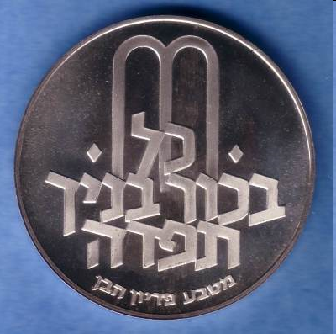
Notes:
מַטְבֵּעַ שֵם זו"נ
coin ; currency

Slide 11
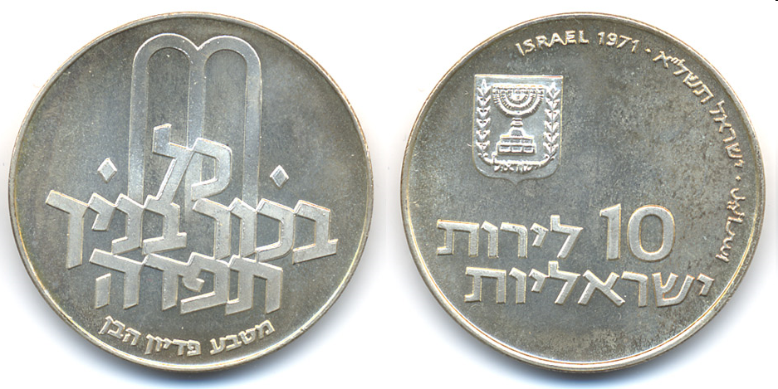
Notes:
I’m a firstborn. Mom had a jewelry draw with coins. Asked and told that my redemption coins. ???
When Mom died all jewelry → sister, but never found coins.

Slide 12
^{1 Kefa/Peter1.18-21} You should be aware that the ransom paid to free you…did not consist of anything perishable like silver or gold; on the contrary, it was the costly bloody sacrificial death of the Messiah, as of a lamb without defect or spot…Through him you trust in God, who raised him from the dead and gave him glory; so that your trust and hope are in God.

Slide 13
^{Luke 2.22-35} When the time came… according to the Torah of Moshe, they took him [Yeshua] up to Yerushalayim to present him [the baby Yeshua] to ADONI (as it is written in the Torah of ADONI, "Every firstborn male is to be consecrated to ADONI")…There was in Yerushalayim a man named Shim`on. This man was a tzaddik, he was devout, he waited eagerly for God to comfort Isra'el,
Notes:
Likely Shimon was the Cohen of the redemption, Pidyon HaBen
[Omitted 40 purification of Miriam @40 days
30 day redemption, they stayed in Yerushaliyam 10 more days]

Slide 14
^{Luke 2.22-35} and the Ruakh HaKodesh was upon him. It had been revealed to him by the Ruakh HaKodesh that he would not die before he had seen the Messiah of ADONI. Prompted by the Spirit, he went into the Temple courts; and when the parents brought in the child Yeshua to do for him what the Torah required,
Notes:
And Ruakh HaKodesh upon. Don’t think of it as big deal. Very Big Deal
400 years, RH been silent after 1500 years activity in Israel. Israel meant to live in the Ruakh HaKodesh [pronunciation]

Slide 15
^{Luke 2.22-35} Shim`on took him in his arms, made a b'rakhah to God, and said, "Now, ADONI, according to your word, your servant is at peace as you let him go; for I have seen with my own eyes your yeshu`ah, which you prepared in the presence of all peoples --a light that will bring revelation to the Goyim and glory to your people Isra'el." …
Notes:
Glory is back, Ruakh is back, Revelation is back
Firstborn is HERE
Association glory of Israel with revelation to Nations.

Slide 16
^{Luke 2.22-35} Shim`on blessed them and said to the child's mother, Miryam, "This child will cause many in Isra'el to fall and to rise, he will become a sign whom people will speak against; moreover, a sword will pierce your own heart too. All this will happen in order to reveal many people's inmost thoughts."
Notes:
Y is the Firstborn.
Firstborn of his mother Miriam.
Firstborn as the Great Cohen HaGadol, High Priest
Firstborn by sacrifice

Slide 17
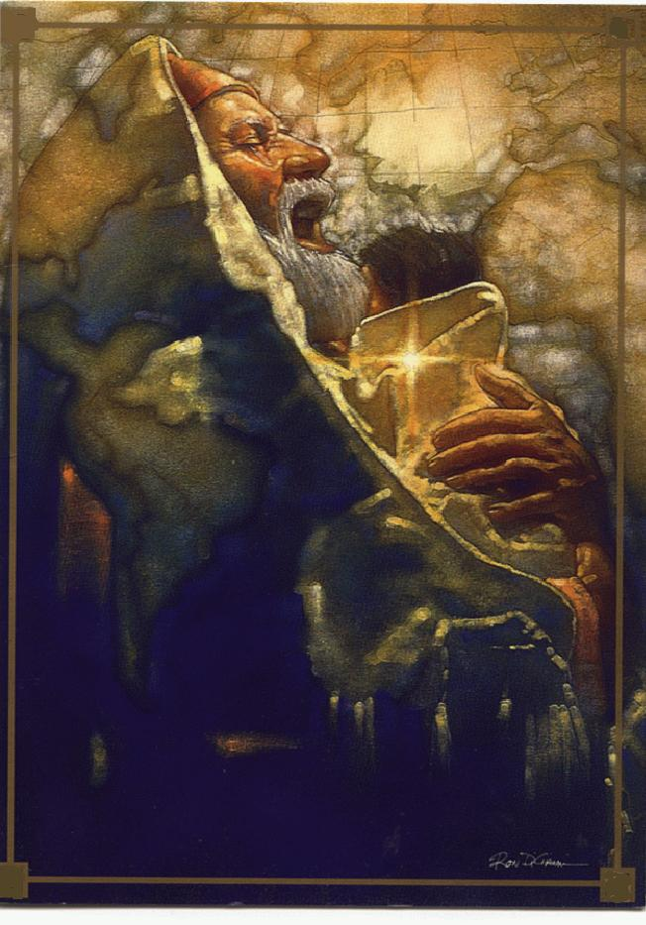
Notes:
See globe in background, South America, etc.?
G-d chose ישראל because He loves the Nations.
Jewish ID and covenant is not about us, it’s about world redemption. ישוע came only to Jews, כי we’re to be His instrument.

Slide 18
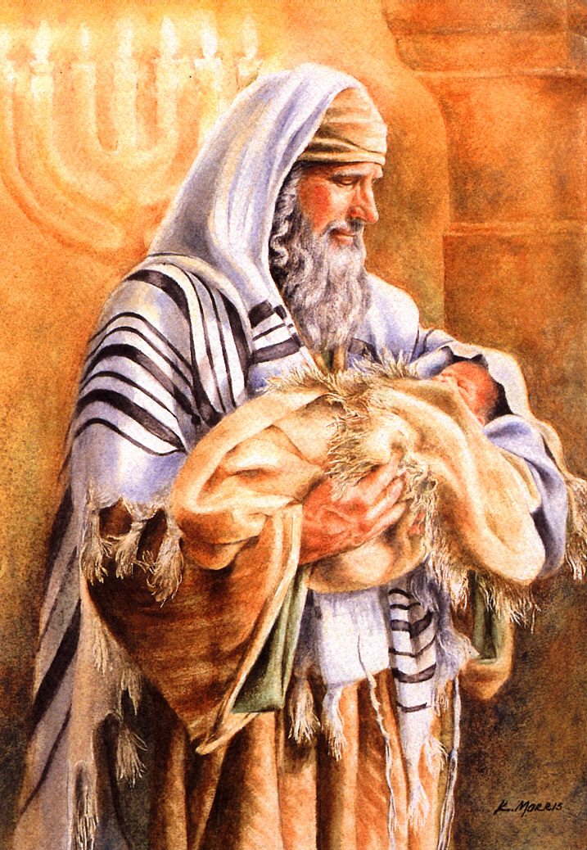
Notes:
The irony is that those appointed to "redeem him" as His kohanim according to the terms of the Mosiac covenant were the very ones who made Him our Redeemer! In other words, those who were appointed to represent Yeshua before God were the very ones who offered Him up as a sacrifice for our sins...

Slide 19
^{Col 1.18-19} He existed before all things, and he holds everything together. Also he is head of the Body, the Messianic Community - he is the beginning, the firstborn from the dead, so that he might hold first place in everything. For it pleased God to have his full being live in his Son
Notes:
Not created, BEFORE all things, even before time
the Logos, or Word, by Philo the Jew of Alexandria Philo Judaeus of Alexandria, contemporay of ישוע (20 BCE – 50 CE)

Slide 20
^{Rev. 1.4-5} From: Yochanan To: The seven Messianic communities … Grace and shalom to you from the One who is, who was and who is coming; from the sevenfold Spirit before his throne; and from Yeshua the Messiah, the faithful witness, the firstborn from the dead and the ruler of the earth's kings. To him, the one who loves us, who has freed us from our sins at the cost of his blood

Slide 21
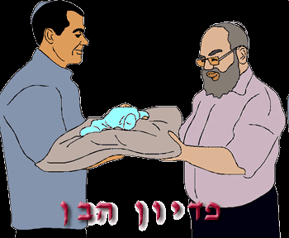
Notes:
So, Aharon belongs to the cohen, but you, Y’hoshua, can buy him back.
Give the cohen, descendent of Aharon, Aaron, the five shekels.
[Then get them back as memento.]

Slide 22
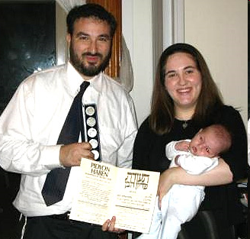

Slide 23
Father: My wife [not a cohen] has borne me this firstborn son.
Kohen: Which would you rather have—your firstborn son, or the five coins which you are obligated to give me for the redemption of this your firstborn son?
Father: I want this, my firstborn son, and here you have five coins which are required of me for the redemption.

Slide 24
Blessed are You, Adoni our G-d, King of the Universe, Who has sanctified us with His commandment, and has commanded us concerning the Redemption of the Firstborn.

Slide 25
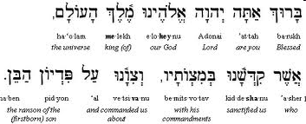
Notes:
Baruch atah Adoni, Eloheinu Melech ha'olam, asher kidshanu b'mitzvotav, ve'tzivanu al Pidyon haben ("Blessed are You, Lord our God, King of the Universe, Who sanctified us with His mitzvot, and instructed us regarding the redemption of a son").

Slide 26
Applications:
May Aharon ben Y’hoshua v Micah
אהרון בן יהושוע ומיכה
Be firstborn of many brothers and sisters
Walk in the power of Messiah’s redemption.
Walk as a beloved Son: a Levite, worshipper
Walk as an heir.

