Slide 1
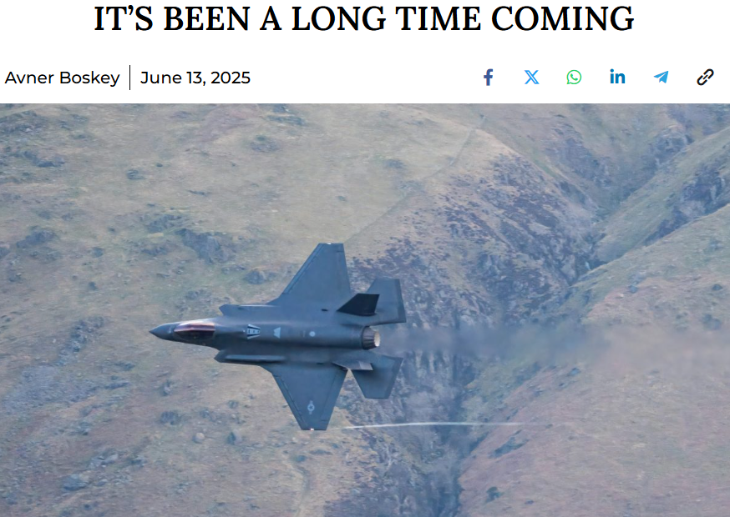

Slide 2
Natanz nuclear facility (Iran’s main uranium enrichment facility)
Arak, Parchin military nuclear complex,
Fordow underground uranium enrichment facility
Khorramabad underground nuclear development site and missile base
Tabriz (missile base and oil refineries)
Isfahan – the primary location for Iran’s secret nuclear weapon development program.
Notes:
https://davidstent.org/its-been-a-long-time-coming/
Plus six top leaders and 10 top nuclear scientists

Slide 3
Kermanshah (underground missile bases)
Qom (the spiritual center on Iran’s Ayatollahs and home to underground missile bases)
strategic sites in Tehran connected to IRGC, military and state leadership
Oil refineries
strategic Iranian radar installations
Notes:
https://davidstent.org/its-been-a-long-time-coming/

Slide 4
The Mossad established a secret drone base within Iranian territory. When the Israeli offensive began, the drones were launched to destroy surface-to-surface missile launchers (SSM) located at a base near Tehran, which was planned to be used to destroy strategic and civilian targets in Israel as part of the Iranian retaliation.
Notes:
https://allisraelnews.com/breathtaking-revelation-israels-mossad-operated-covert-drone-base-within-iran-struck-targets-from-inside-the-country?utm_source=convertkit&utm_medium=email&utm_campaign=ISRAEL%20LAUNCHES%20PREEMPTIVE%20STRIKES%20ON%20IRAN%20%E2%80%94%20Israeli%20DM%20declares%20%E2%80%98Extreme%20emergency%20alert%E2%80%99%20for%20all%20citizens%20to%20prepare%20for%20retaliatory%20attacks%20-%2017950371

Slide 5
In another operation, Mossad commando teams deployed operational systems of precision-guided munitions in open areas in central Iran, which had been smuggled into the country beforehand. The weapons were deployed near Iranian surface-to-air missile (SAM) systems, which could potentially threaten Israeli aircraft.
Notes:
https://allisraelnews.com/breathtaking-revelation-israels-mossad-operated-covert-drone-base-within-iran-struck-targets-from-inside-the-country?utm_source=convertkit&utm_medium=email&utm_campaign=ISRAEL%20LAUNCHES%20PREEMPTIVE%20STRIKES%20ON%20IRAN%20%E2%80%94%20Israeli%20DM%20declares%20%E2%80%98Extreme%20emergency%20alert%E2%80%99%20for%20all%20citizens%20to%20prepare%20for%20retaliatory%20attacks%20-%2017950371

Slide 6
Lastly, in another operation aiming to guarantee Israel’s freedom of action in Iranian skies, the Mossad deployed “sophisticated attack systems” and “vehicle-born technologies” which were used to destroy Iranian air defense systems.
Notes:
https://allisraelnews.com/breathtaking-revelation-israels-mossad-operated-covert-drone-base-within-iran-struck-targets-from-inside-the-country?utm_source=convertkit&utm_medium=email&utm_campaign=ISRAEL%20LAUNCHES%20PREEMPTIVE%20STRIKES%20ON%20IRAN%20%E2%80%94%20Israeli%20DM%20declares%20%E2%80%98Extreme%20emergency%20alert%E2%80%99%20for%20all%20citizens%20to%20prepare%20for%20retaliatory%20attacks%20-%2017950371

Slide 7
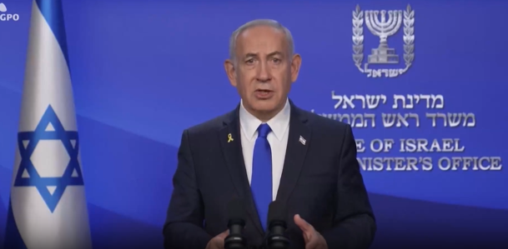
Mr Netanyahu said
“Operation Rising
Lion” had been
successfully
carried out to “
roll back
the Iranian threat
to Israel’s very survival”.
Notes:
https://www.yahoo.com/news/hour-hour-israel-three-pronged-143033789.html

Slide 8
הֶן־עָם כְּלָבִיא יָקוּם, וְכַאֲרִי יִתְנַשָּׂא;
^{Bamidbar/Nu 23.24} Behold, a people that rises like a lioness and raises itself like a lion.
מבצע עָם כְּלָבִיאMivtsa am k’lavi
Operation Nation Like a Lion
Operation 'Rising Lion':
Notes:
Pause to praise G-d for relief from existential threat.

Slide 9
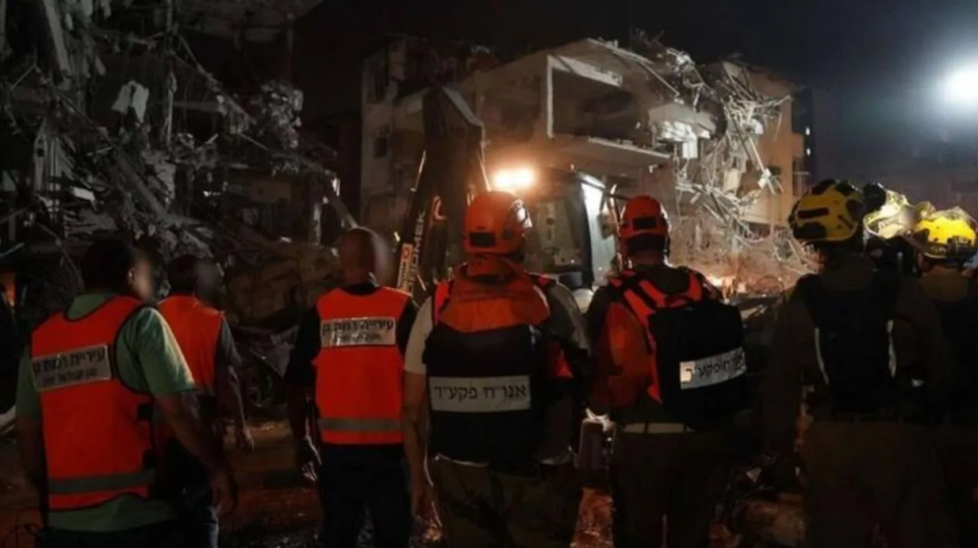
Emergency teams respond to an
Iranian missile attack in central Israel
on June 14, 2025. (photo credit: IDF SPOKESPERSON'S UNIT)
Notes:
One killed, 63 wounded after Iran fires multiple barrages of missiles at Israel
Blasts were heard in Tel Aviv and there are reports of trapped individuals in Tel Aviv and Ramat Gan.
Live Updates Jerusalem Post
Current time in Israel: June 14, 4:49 PM
Seven IDF soldiers wounded in Friday's missile attack, three killed, over 150 wounded from Iranian attacks

Slide 10
Our defense of Israel
in our own city

Slide 12


Slide 13
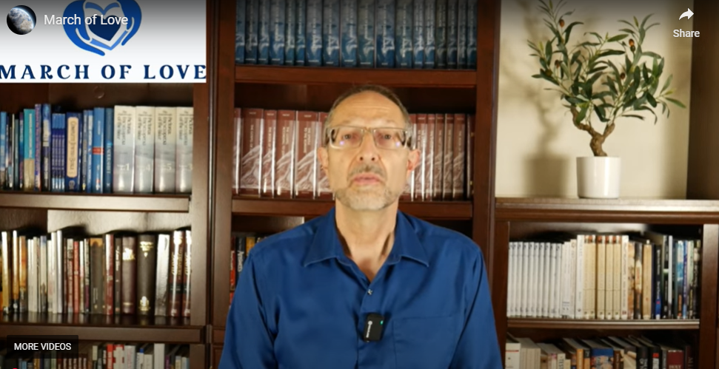
Notes:
https://youtu.be/ZdKEfKD_niM?list=TLGGnGkX2TlYuWExNDA2MjAyNQ
https://www.youtube.com/watch?v=ZdKEfKD_niM

Slide 14
Wednesday, June 18, 2025, 6 PM - 7:30 PM
Meeting Point: Hobby Lobby's parking lot at 119th and Metcalf, Overland Park.

Slide 15
Please use the parking spots farthest from the doors of the stores so customers can park near their entrances.
Dress code: Blue and white in honor of the Jewish community. Please avoid wearing other colors

Slide 16
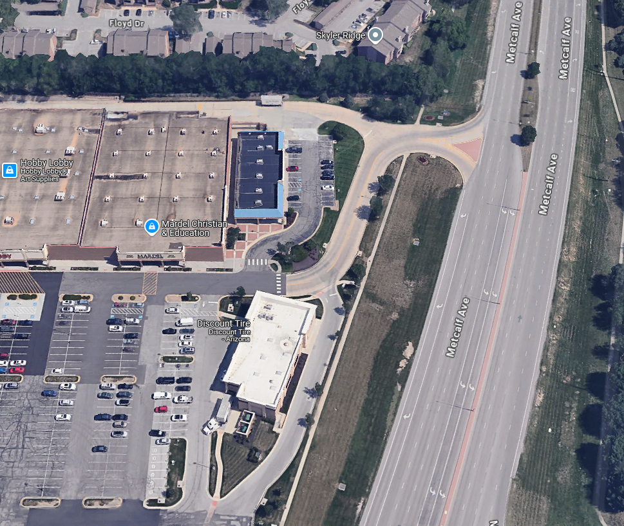
Mardell’s Metcalf just north of 119th St. west side

Slide 17
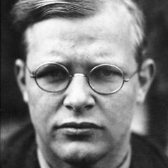
Dietrich Bonhoeffer 1906 – 9 April 1945, (executed just before Nazi defeat) was a German Lutheran pastor, neo-orthodox theologian and anti-Nazi dissident

Slide 18
Dietrich Bonhoeffer
Silence in the face of evil is evil itself.

Slide 19
Dietrich Bonhoeffer
Not to speak is to speak. Not to act is to act.

Slide 20
Dietrich Bonhoeffer
Salvation is free, but discipleship will cost you your life

Slide 21


Slide 22

The Father’s House: our homes
AND our synagogue community
A place of abundance of love
A place of abundance of Shalom
A place of abundance of resilience
A place of the father’s love & joy
A place where G-d is the perfect
father.

Slide 23
The Father’s House: our homes
AND our synagogue community
A place of abundance of love
A place of abundance of Shalom
A place of abundance of resilience
A place of the father’s love & joy
A place where G-d is the perfect
father.
Notes:
Considering both

Slide 24

^{Yn 10.10} The thief comes only to steal, slaughter, and destroy. I have come that they might have life, and have it abundantly!
From peri (in the sense of beyond); superabundant (in quantity) or superior (in quality); by implication, excessive

Slide 25
^{Eph 4.16} Under his control, the whole body is being fitted and held together by the support of every joint, with each part working to fulfill its function; this is how the body grows and builds itself up in love. But, how to do it?
Notes:
Congregation AND family
Look around. You ARE in a place of abundance. Gratefulness!?

Slide 26
^{Eph 4.2-4} Always be humble, gentle and patient, bearing with one another in love, and making every effort to preserve the unity the Spirit gives through the binding power of shalom. There is one body and one Spirit, just as when you were called you were called to one hope.

Slide 27
30 years solving problems
Solved all the problems?
No negatives. NEVER bashing denouncing other congregations Jewish or mixed, with other practices.
Notes:
Easy to monitor our tongue. If you say the name of a group or individual, other than yourself, speak well of them. Denounce practices if really needed.

Slide 28
Solve problems
Marriage
Emotional resilience
Safe place
^{Mt.16.18} I also tell you this: you are Kefa,” [which means ‘Rock,’] “and on this rock I will build my Community, and the gates of Sh’ol will not overcome it.
Notes:
Who builds it?

Slide 29

a stone (pebble), such as a small rock found along a pathway.

Slide 30

"a mass of connected rock," which is distinct from Pétros which is "a detached stone or boulder" (pétra) is a "solid or native rock, rising up through the earth"– a huge mass of rock (a boulder), such as a projecting cliff.
Notes:
https://biblehub.com/greek/4073.htm
He is our ROCK, our strength

Slide 31
Abundance of love in our marriages.
Notes:
Mentioned last week

Slide 32
בָּרוּךְ אַתָּה יְיָ אֱלֹהֵֽינוּ מֶֽלֶךְ הָעוֹלָם
Baruch ata Adonai, Eloheinu melech ha’olam,
Blessed are you, Lord our God, Ruler of the Universe,

Slide 33
אֲשֶׁר בָּרָא שָׂשׂוֹן וְשִׂמְחָה חָתָן וְכַלָּה.
asher bara sason v’simcha chatan v’chala.
Who created happiness and joy, groom and bride.
Notes:
Equivalent to each other. It doesn’t always work that way, but this is G-d’s paradigm

Slide 34
גִּילָה רִנָּה דִּיצָה וְחֶדְוָה אַהֲבָה וְאַחֲוָה וְשָׁלוֹם וְרֵעוּת.
Gila, rina, ditzah v’chedva, ahava v’achava v’shalom v’rei’ut.
Spinning with ecstasy, singing with delight, amusement, and pleasure, love and brotherhood, peace and friendship.
Notes:
Wives, make that so for your husbands!

Slide 35
מְהֵרָה יְיָ אֱלֹהֵֽינוּ יִשָּׁמַע בְּעָרֵי יְהוּדָה וּבְחֻצוֹת יְרוּשָׁלָםִ
M’heira Adonai Eloheinu yishama b’arei Yehuda u’vchutzot Yerushalayim,
Soon, Lord our God, may it be heard in the cities of Judah and the streets of Jerusalem
Notes:
After this picture, immediate segue into prayer for peace. NOT conquest. Shalom. More about this coming.

Slide 36
קוֹל שָׂשׂוֹן וְקוֹל שִׂמְחָה קוֹל חָתָן וְקוֹל כַּלָּה
kol sason v’kol simcha kol chatan v’kol kala,
The sound of happiness and the sound of joy and the voice of the groom and the voice of the bride
Notes:
So, happiness and joy = the voice of the bride and groom
Jews and Nations grafted in with us sing about joy and peace.

Slide 38
The Father’s House: our homes
AND our synagogue community
A place of abundance of love
A place of abundance of Shalom
A place of abundance of resilience
A place of the father’s love & joy
A place where G-d is the perfect
father.

Slide 39
Shalom שָׁלוֹם שֵם ז
peace ; Hello!, Goodbye; welfare, wellbeing, completeness, wholeness, health, safety, soundness, tranquility, prosperity, perfectness, fullness, rest, harmony, the absence of agitation or discord.
Notes:
Pay your bill.

Slide 40
וְהוּא מְחֹלָל מִפְּשָׁעֵנוּ, מְדֻכָּא מֵעֲו‍נתֵינוּ; מוּסַר שְׁלוֹמֵנוּ עָלָיו, וּבַחֲבֻרָתוֹ נִרְפָּא-לָנוּ.
^{Yeshayahu/Isaiah 53.} But he was wounded because of our crimes, crushed because of our sins; the disciplining that makes us whole fell on him, and by his bruises we are healed
Notes:
Come to Him, receive Shalom.
Come to Him, He’ll work out unity.
Come to Him, He’ll work out guarding you.
Come to Him, He’ll work out divine intimacy.

Slide 41
^{Yeshayahu/Isaiah 9.5} For to us a child is born, a son will be given to us, and the government will be upon His shoulder. His Name will be called Wonderful Counselor, Mighty God, My Father of Eternity, Prince of Peace.
Notes:
Yeshua is the Father, big Brother, Prince of Peace!!

Slide 42
^{Mtt 5.1,2, 9} Seeing the crowds, Yeshua walked up the hill. After he sat down, his talmidim came to him, and he began to speak. This is what he taught them…
How blessed are those who make peace! for they will be called sons of God.
Notes:
Fathers, are you peacemakers? Marriage, kids, community?

Slide 44
The Father’s House: our homes
AND our synagogue community
A place of abundance of love
A place of abundance of Shalom
A place of abundance of resilience
A place of the father’s love & joy
A place where G-d is the perfect
father.

Slide 45
Resilience
^{Eph 5.21-26} Submit to one another in fear of the Messiah…Just as the Messianic Community submits to the Messiah…As for husbands, love your wives, just as the Messiah loved the Messianic Community, indeed, gave himself up on its behalf, in order to set it apart for God, making it clean.
Notes:
The man should be the first to confess. If single parent...do your best.

Slide 46
^{1 Cor. 12.12-14} For just as the body is one but has many parts; and all the parts of the body, though many, constitute one body; so it is with the Messiah. For it was by one Spirit that we were all immersed into one body, whether Jews or Gentiles, slaves or free;

Slide 47
^{1 Cor. 12.12-14} and we were all given the one Spirit to drink. For indeed the body is not one part but many.

Slide 49
The Father’s House: our homes
AND our synagogue community
A place of abundance of love
A place of abundance of Shalom
A place of abundance of resilience
A place of the father’s love & joy
A place where G-d is the perfect
father.

Slide 50
Dad jokes are called dad jokes because they are stereotypically thought to be jokes a father or someone like a father would tell to a child
Notes:
https://en.wikipedia.org/wiki/Dad_joke

Slide 51
dad joke: a wholesome joke of the type said to be told by fathers with a punchline that is often an obvious or predictable pun or play on words and usually judged to be endearingly corny or unfunny
Notes:
No such thing as “Mom jokes”

Slide 52
What kind of shoes to frogs wear? Open-toad sandals.
I just built an ATM that only gives out coins. I don’t know why no one’s thought of it before: it just makes cents!

Slide 53
What happened when two slices of bread went on a date? It was loaf at first sight.
What's a shark's favorite saying? "Man overboard!"

Slide 54
Dads Are Meant to be the Fun Parent - It Is How They Bond
How do dads bond with their children?
Dads prefer to bond with their children through play. And not just any type of play.
Notes:
https://www.bornhappylivehappy.com/post/2019/07/30/why-dads-are-the-fun-parent

Slide 55
Children get the most stimulation in the reward centers of their brains when they engage in “rough and tumble play.” This means play that increases in intensity, involves contact, and focuses on the environment and not just on each other.
Notes:
https://www.bornhappylivehappy.com/post/2019/07/30/why-dads-are-the-fun-parent
Dad’s body changes with birth of kids: less testosterone, more oxytocin

Slide 56
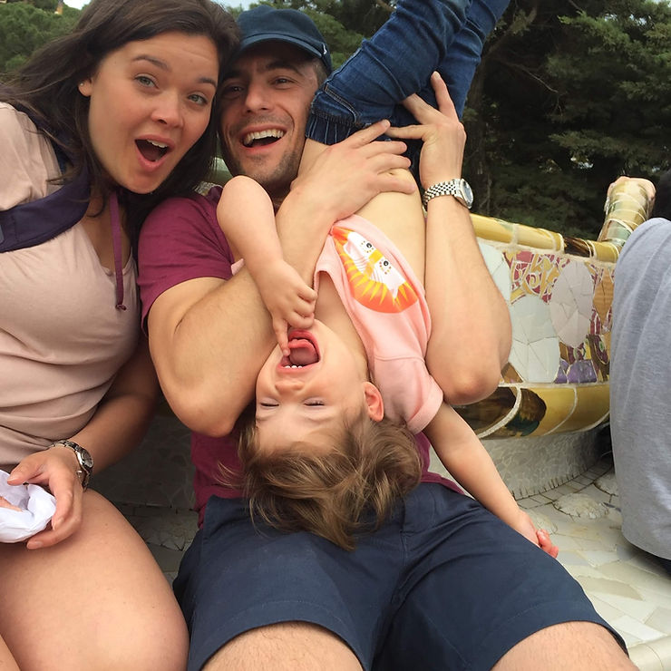
Notes:
https://www.bornhappylivehappy.com/post/2019/07/30/why-dads-are-the-fun-parent

Slide 57
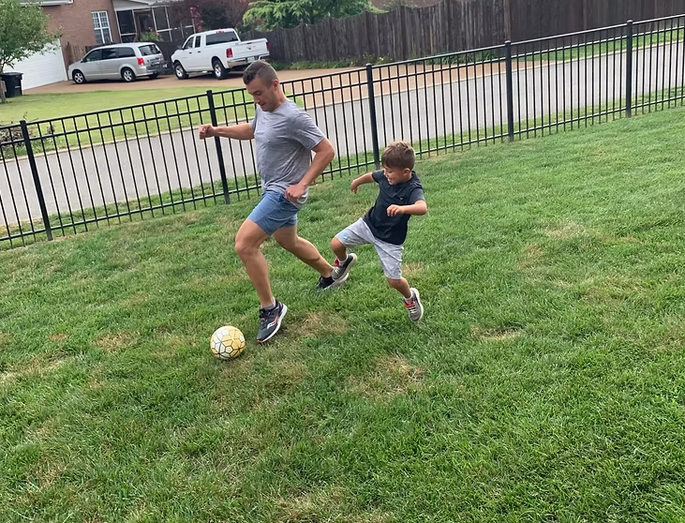
Notes:
I am not that athletic, but even my most estranged child says he can’t remember NOT knowing how to throw a frisbee. Emergency frisbee in the car always. Mr. Mouth.

Slide 58
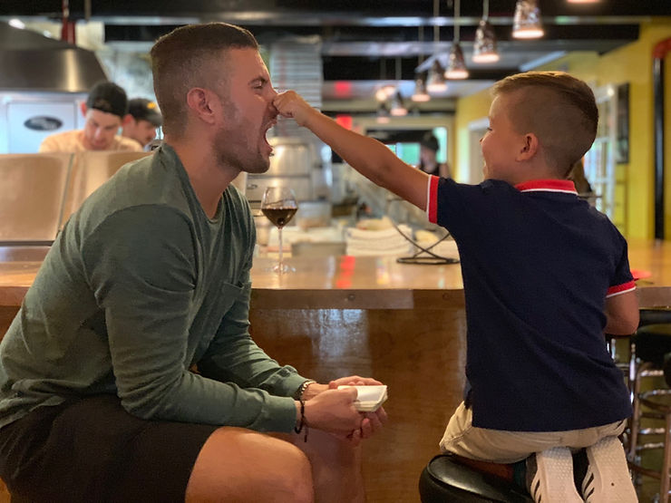
Notes:
Do you have fun with your kids?
Honey I shrunk the kids: Daddys are for play, Mommies mean business.

Slide 60
The Father’s House: our homes
AND our synagogue community
A place of abundance of love
A place of abundance of Shalom
A place of abundance of resilience
A place of the father’s love & joy
A place where G-d is the perfect
father.

Slide 61
Dads are ultimately responsible to lead devotions and prayer.

Slide 62
Dads are ultimately responsible to lead devotions and prayer.
Dads are ultimately responsible to address problems:
  Possum
  Predator
  Protector
Notes:
Nice guy vs good guy

Slide 63
But if Dad fails…

Slide 64
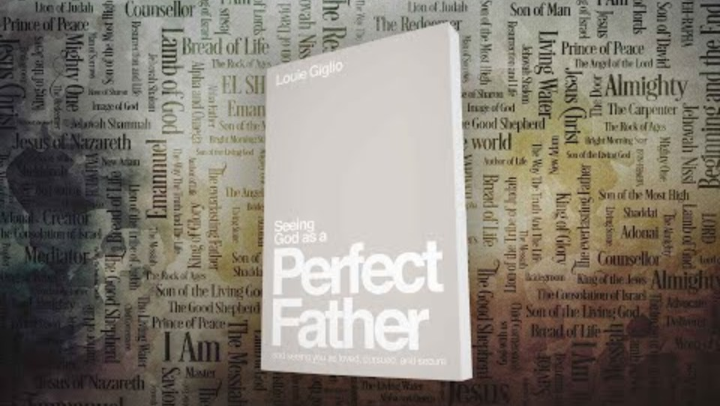
Notes:
https://youtu.be/Wys3-L7X8Io?si=gbBVfauXklf4iTcq

Slide 66
The Father’s House: our homes
AND our synagogue community
A place of abundance of love
A place of abundance of Shalom
A place of abundance of resilience
A place of the father’s love & joy
A place where G-d is the perfect
father.

Slide 67


