Slide 1

Sat., July 12, 7:30 pm
Sunday,
July 13, 2 pm
St. Joseph, MO
Notes:
They are also showing Friday night, but Or HaOlam is not promoting the erev Shabbat showing, only the Saturday evening 7.30
and Sunday matinee 2 p.m.

Slide 2
Two of our congregants, Robyn Custer and Cynthia Morehead, are playing in Fiddler
See Robyn for details, or sermon notes for the link, or future bulletins
Sat., July 12, 7:30 pm
Sunday,July 13, 2 pm
Notes:
https://rrtstjoe.org/production/fiddler-on-the-roof/#/productions-view

Slide 3

Wed., June 18,
6 -7.30 pm
Metcalf & 115th

Slide 4
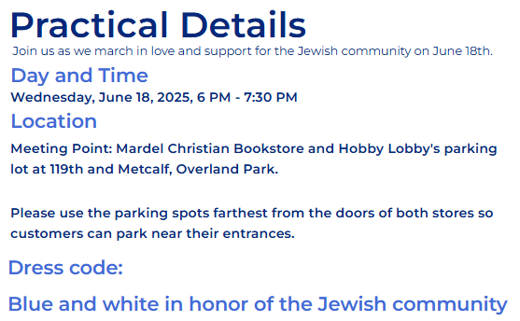
Notes:
We WILL have security.

Slide 5

Jihadi
Protests
Nixed an
Upcoming pro-Israel Summit in TX
Notes:
https://www.youtube.com/watch?v=lsBAae6njt8&t=2s
https://worthyinsights.com/american-jihadists-target-pro-israel-summit-in-texas-forcing-shutdown/

Slide 6
Naloxone (NARCAN) Training Course and Trainer Program
Learn how to recognize and respond to opioid overdoses with this in-person training.
See Ulises.

Slide 7
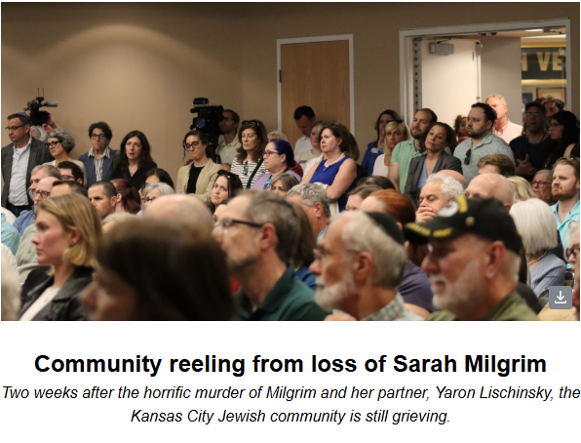
front page KC Jewish Chronicle
June 5, 2025
Notes:
Me, Paul Salavitch, Pierre and Laurence Benzencon

Slide 9
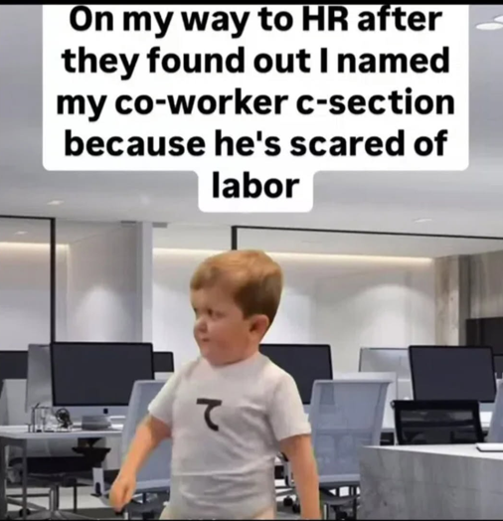

Slide 10
Notes:
That is, fired for politically incorrect speech
Scott Hahn

Slide 11

Notes:
https://babylonbee.com/news/elon-musk-leaves-job-of-making-government-more-efficient-for-much-easier-job-of-sending-humans-to-mars?utm_source=The%20Babylon%20Bee%20Newsletter&utm_medium=email

Slide 12
Mars, the fourth planet from the sun, is a barren wasteland with unbreathable air and a surface devoid of liquid water, experts agreed that dramatically altering the atmosphere and topography of Mars with technology that doesn't exist yet sounded much easier than permanently cutting government spending.
Notes:
https://babylonbee.com/news/elon-musk-leaves-job-of-making-government-more-efficient-for-much-easier-job-of-sending-humans-to-mars?utm_source=The%20Babylon%20Bee%20Newsletter&utm_medium=email

Slide 13


Slide 14

Encouragement, the Key to Caring
David’s reasons for discouragement
David’s recourse
Our reasons for discouragement
Our recourse

Slide 15
Encouragement, the Key to Caring
David’s reasons for discouragement
David’s recourse
Our reasons for discouragement
Our recourse

Slide 16
David was rejected in his birth family.
David was despised by his father-in-law and king.
He fled for his life and was pursued with royal authority and murderous intent.
Notes:
1. Not included in the muster when Navi Shmuel / Prophet Samuel visited. Are all your sons here?” Sh’mu’el asked Yishai. He replied, “There is still the youngest; he’s out there tending the sheep.” Sh’mu’el said to Yishai, “Send and bring him back, because we won’t sit down to eat until he gets here.” ¹² He sent and brought him in. With ruddy cheeks, red hair, and beautiful eyes, a handsome appearance.
Jeff Seif:
David could be another mother Ps 51
David’s sister Avigayil married Yeter the Yishmaeli 2 Sam 19.13 [355] Amasa nephew of David
1 Chron 2.17 [1152 cjb]
[2 Sam 17.25 complicates]
Camels 1 Chron 27.30 1181
3. Numerous hazardous but respectful attempts at reconciliation, all to no avail.

Slide 17
He became head of all the people in distress, in debt, or embittered, and he became their leader; there were about four hundred men with him.
Eventually he defected to the Nazis, sort of, Philistines. Lied continually to them to survive.
Notes:
4. How do you feed and provide housing and weapons for 400 men…and families? And bitterness, complaints, toxicity? Jeremy and I have to solve some bitter issues. Don’t always succees.

Slide 18
6. Plishtim / Philistine were about to have major battle with Saul. Plishtim nobles distrusted David, so rejected him.

Slide 19
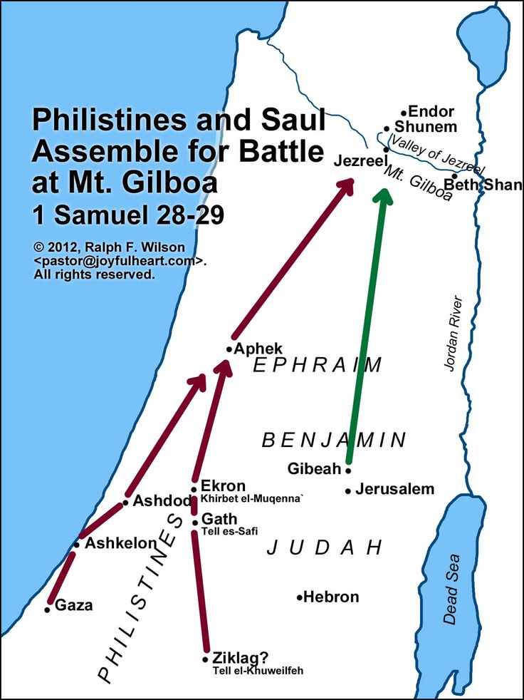
Notes:
https://i.pinimg.com/736x/15/b6/a3/15b6a3d04579576657bc6c2d824bfa93.jpg

Slide 20
^{1 Sam 30.1-6} Three days later, when David and his men arrived in Ziklag, they found that the ‘Amaleki had raided the Negev and Ziklag. They had sacked Ziklag and burned it down; and they had taken captive the women and everyone there, great and small.
Notes:
From as far north as modern Haifa to Gaza

Slide 21
^{1 Sam 30.1-6} They hadn’t killed anyone but had carried them off as they went on their way. So, when David and his men arrived at the city, there it was, burned down, with their wives, sons and daughters taken captive. Then David and the people with him cried aloud until they had no more power to cry.
Notes:
Soldiers, hand to hand knife combat, weeping to exhaustion.

Slide 22
^{1 Sam 30.1-6} David’s two wives had been taken captive — Akhino‘am from Yizre‘el and Avigayil the widow of Naval from Karmel. David was in serious trouble: the people were talking about stoning him to death, because all the people were in such deep grief, each man over his sons and daughters.

Slide 23
6. Plishtim / Philistine were about to have major battle with Saul. Plishtim nobles distrusted David, so rejected him.
Amalekite raiders had ransacked his camp and took all possession and family.
His own men about to mutiny. Failed leadership. Failed life.

Slide 24
Birth family rejection,
In law royalty murderous rejection,
Followers all distressed and bitter,
Defection to enemy,
Rejection by enemy,
Loss of all to another enemy,
Pending mutiny by his followers.

Slide 26
Encouragement, the Key to Caring
David’s reasons for discouragement
David’s recourse
Our reasons for discouragement
Our recourse

Slide 27
^{1 Shmu 30.6} But David strengthened himself in Adoni his God.
Notes:
What does that mean? How can we apply it?

Slide 28

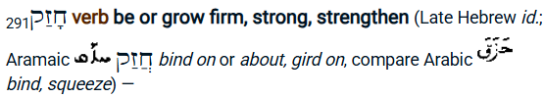
^{1 Shmu 30.6} But David strengthened himself in Adoni his God.
Notes:
Reflexive verb

Slide 29
^{NIV} David found strength in the L-rd his G-d.
^{KJV} David encouraged himself in the L-rd his G-d.
Became stronger, gathered strength, took courage

Slide 30
It seems to me that one can best, maybe only, get strength in crisis from Adoni if you are in the habit of receiving strength from Him in normal times.
Two sources:

Slide 31
Habitual strength from G-d directly
Community strength from G-d through people
Notes:
Habitual, community norms, culture

Slide 32
Habitual strength from G-d directly
Community strength from G-d through people
Notes:
David didn’t write all the Psalms, but apparently, he read them. This one from another rejected group, the descendants of Korakh

Slide 33
^{T’hillim 42.10-12} I say to God my Rock, “Why have you forgotten me? Why must I go about mourning, under pressure by the enemy? My adversaries’ taunts make me feel as if my bones were crushed, as they ask me all day long,

Slide 34
^{T’hillim 42.10-12} ‘Where is your God?’ ” My soul, why are you so downcast? Why are you groaning inside me? Hope in God, since I will yet praise for being my Savior and God.
Notes:
Spirit to soul inner conversation. “Yet praise Him.” Choice.

Slide 35
^{T’hillim 43.1-5} You are the God of my strength; why have you thrust me aside? Why must I go about mourning, under pressure by the enemy? Send out your light and your truth; let them be my guide; let them lead me to your holy mountain,

Slide 36

^{T’hillim 43.1-5} to the places where you live. Then I will go to the altar of God, to God, my joy and delight;
Notes:
Literally: the joy of my spinning

Slide 37
^{T’hillim 43.1-5} I will praise you on the lyre, God, my God. My soul, why are you so downcast? Why are you groaning inside me? Hope in God, since I will praise him again for being my Savior and God.
Notes:
Another inner conversation, soul and spirit

Slide 38
^{T’hillim / Ps 84 2-8} How deeply loved are your dwelling-places, Adoni-Tzva’ot! My soul yearns, yes, faints with longing for the courtyards of Adoni; my heart and body cry for joy to the living God. As the sparrow finds herself a homeand the swallow her nest,

Slide 39
^{T’hillim / Ps 84 2-8} where she lays her young, [so my resting-place is] by your altars, Adoni-Tzva’ot, my king and my God. How happy are those who live in your house; they never cease to praise you! (Selah) How happy the man whose strength is in you, in whose heart are [pilgrim] highways.

Slide 40
^{T’hillim / Ps 84 2-8} Passing through the [dry] Baka Valley, they make it a place of springs, and the early rain clothes it with blessings. They go from strength to strength and appear before God in Tziyon.

Slide 41
Habitual strength from G-d directly
Community strength from G-d through people

Slide 42
A healthy community, a healthy marriage, is in the practice of building & enhancing one another’s strength.

Slide 43

^{Mes Jews 10.25} Do not neglect our own meetings, as is the habit of some, but encourage one another—and all the more so as you see the Day approaching.

Slide 44
parakaléō
from pará, "from close-beside" and kaléō, "to call" – properly, "make a call" from being "close-up and personal."
Notes:
Getting up close and personal with each other in distress. Did David have any of his soldiers join him in that time of strengthening in G-d?

Slide 45
Revisit T’hillim 43.4 “God, my joy and delight;”
Notes:
Literally: the joy of my spinning
From this phrase some Hebrew liturgy.

Slide 46
I love the richness of Jewish liturgy, composed over thousands of years of meditation on the scriptures.
The Seven Wedding Blessings have some words of unparalleled encouragement & joy that should be in every marriage relationship.
Notes:
Maybe David had such joy, and remembered his abducted wives. [more than one?] Scripture mentions both by name, so they had a special role. Akhino‘am from Yizre‘el and Avigayil the widow of Naval from Karmel

Slide 47
Seven Jewish Wedding Blessings
Quoting the 7th
Notes:
We don’t know who wrote them, but maybe they are an amplification of what G-d said to them when G-d Himself introduced Hava / Eve to Adam, and He blessed them…

Slide 48
בָּרוּךְ אַתָּה יְיָ אֱלֹהֵֽינוּ מֶֽלֶךְ הָעוֹלָם
Baruch ata Adonai, Eloheinu melech ha’olam,
Blessed are you, Lord our God, Ruler of the Universe,

Slide 49
אֲשֶׁר בָּרָא שָׂשׂוֹן וְשִׂמְחָה חָתָן וְכַלָּה.
asher bara sason v’simcha chatan v’chala.
Who created happiness and joy, groom and bride.
Notes:
Equivalent to each other.

Slide 50
גִּילָה רִנָּה דִּיצָה וְחֶדְוָה אַהֲבָה וְאַחֲוָה וְשָׁלוֹם וְרֵעוּת.
Gila, rina, ditzah v’chedva, ahava v’achava v’shalom v’rei’ut.
Spinning with ecstasy, singing with delight, amusement, and pleasure, love and brotherhood, peace and friendship.

Slide 51
מְהֵרָה יְיָ אֱלֹהֵֽינוּ יִשָּׁמַע בְּעָרֵי יְהוּדָה וּבְחֻצוֹת יְרוּשָׁלָםִ
M’heira Adonai Eloheinu yishama b’arei Yehuda u’vchutzot Yerushalayim,
Soon, Lord our God, may it be heard in the cities of Judah and the streets of Jerusalem

Slide 52
קוֹל שָׂשׂוֹן וְקוֹל שִׂמְחָה קוֹל חָתָן וְקוֹל כַּלָּה
kol sason v’kol simcha kol chatan v’kol kala,
The sound of happiness and the sound of joy and the voice of the groom and the voice of the bride
Notes:
So, happiness and joy = the voice of the bride and groom

Slide 53
קוֹל מִצְהֲלוֹת חֲתָנִים מֵחֻפָּתָם וּנְעָרִים מִמִּשְׁתֵּה נְגִינָתָם.
kol mitzhalot chatanim mei-chupatam u’n’arim mimishtei n’ginatam.
— the rejoicing of grooms from their huppahs and youths from their singing banquets.
Notes:
Singing banquets = Havdalah dance parties

Slide 54
בָּרוּךְ אַתָּה יְיָ מְשַׂמֵּֽחַ חָתָן עִם הַכַּלָּה׃
Baruch ata Adonai m’sameiach chatan im ha’kala.
Blessed are you Lord who makes the groom rejoice with the bride.

Slide 55
David had an accumulated reservoir of strength, courage, joy from time with Elohim.
Do we have such from time with Elohim Yeshua?
Do we have such from time with our spouse?

Slide 56
^{Rev 21.8} But as for the cowardly, the untrustworthy, the vile, the murderers, the sexually immoral, those involved with the occult and with drugs, idol-worshippers, and all liars — their destiny is the lake burning with fire and sulfur, the second death.”

Slide 57
^{1 Yn 1.18} There is no fear in love. On the contrary, love that has achieved its goal gets rid of fear, because fear has to do with punishment; the person who keeps fearing has not been brought to maturity in regard to love.

Slide 58
^{1 Shmu 17. 33-37} Sha’ul said to David, “You can’t go to fight this P’lishti — you’re just a boy, and he has been a warrior from his youth!” David answered Sha’ul, “Your servant used to guard his father’s sheep. When a lion or a bear would come and grab a lamb from the flock,

Slide 59
^{1 Shmu 17. 33-37} I would go after it, hit it, and snatch the lamb from its mouth; and if it turned on me, I would catch it by the jaw, smack it and kill it. Your servant has defeated both lions and bears, and this uncircumcised P’lishti will be like one of them,

Slide 60
^{1 Shmu 17. 33-37} because he has challenged the armies of the living God.” Then David said, “Adoni, who rescued me from the paw of the lion and from the paw of the bear, will rescue me from the paw of this P’lishti!” Sha’ul said to David, “Go; may Adoni be with you.”
Notes:
Reservoir of strength

Slide 61
Back to our story of discouragement at Ziklag,
After spiritual strengthening

Slide 62
^{1 Shmu 30.7-9} David said to Avyatar the cohen, the son of Achimelekh, “Please bring the ritual vest here to me.” Avyatar brought the vest to David. Then David consulted Adoni. He asked, “Should I go in pursuit of these raiders? Will I catch up with them?”

Slide 63
^{1 Shmu 30.7-9} And [Adoni] answered him, “Go in pursuit, because you will overtake them and recover everyone and everything.” So David went, he and the six hundred men with him.

Slide 64
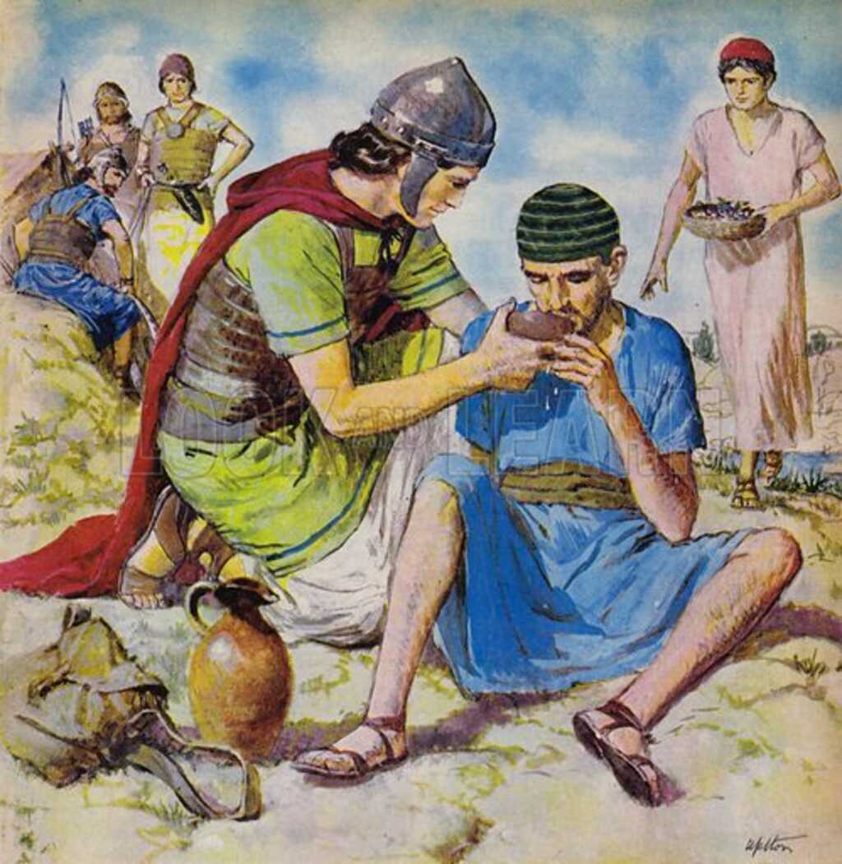
Their way was facilitated by finding an abandoned slave for intel.

Slide 66
Encouragement, the Key to Caring
David’s reasons for discouragement
David’s recourse
Our reasons for discouragement
Our recourse

Slide 67
Our reasons for discouragement
Conflicts and rejection
Financial setbacks
Health issues
Israel issues
Political concerns
Notes:
Too many to list.

Slide 69
Encouragement, the Key to Caring
David’s reasons for discouragement
David’s recourse
Our reasons for discouragement
Our recourse

Slide 70
Our way will be facilitated once we are in the practice of
Habitual strength from G-d in Messiah Yeshua directly
Community strength from G-d through people and to people

Slide 71
^{Prov 18.21} Death and life are in the power of the tongue.
^{Prov 12.25} Anxiety in a person’s heart weighs him down, but a kind word cheers him up.

Slide 72
^{Prov 15.4} A soothing tongue is a tree of life, but when it twists things, it breaks the spirit.
^{Prov 16.24} Pleasant words are like a honeycomb, sweet to the taste and healing for the body.

Slide 73
Have we sought daily words of encouragement from Adoni Yeshua?
Have we given words of encouragement to others?

Slide 74
^{Mes Jews 10.25} Do not neglect our own meetings, as is the habit of some, but encourage one another—and all the more so as you see the Day approaching.

Slide 76
Encouragement, the Key to Caring
David’s reasons for discouragement
David’s recourse
Our reasons for discouragement
Our recourse

