Slide 1
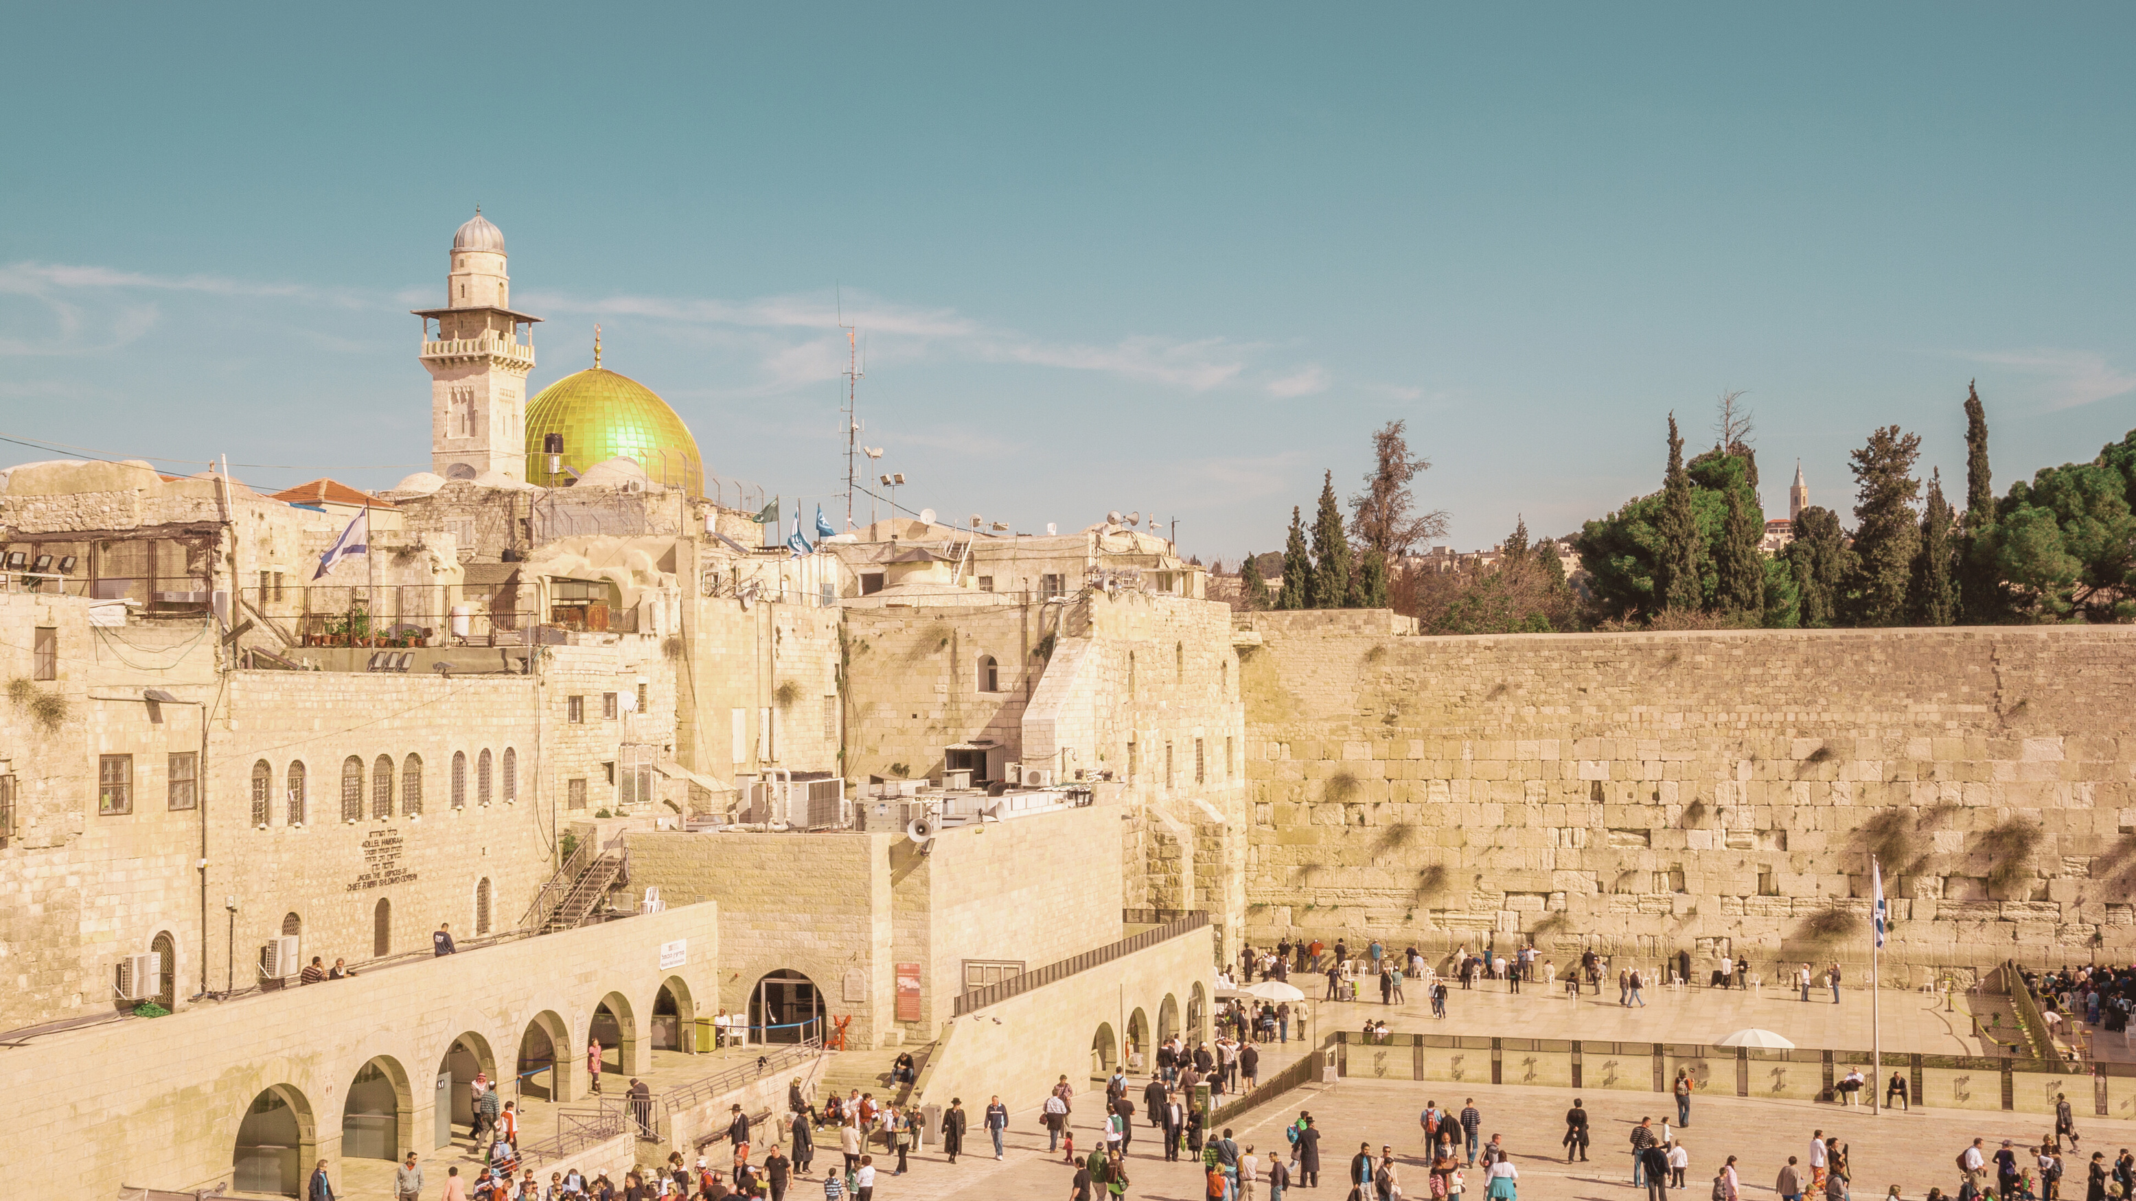


Rabbi Stewart & Chantal Winograd
WWW.REACHII.ORG

Slide 2
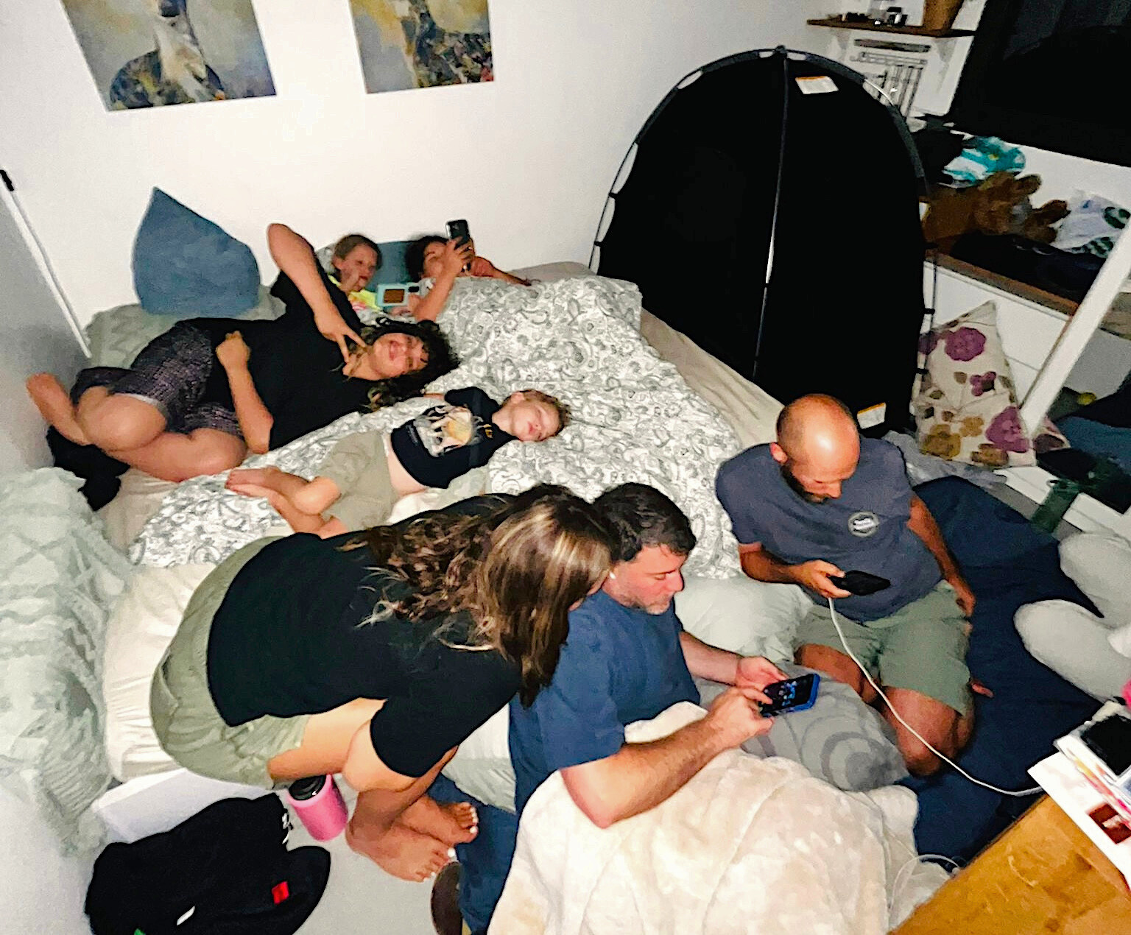
In the Bomb Shelter
WWW.REACHII.ORG

Slide 3
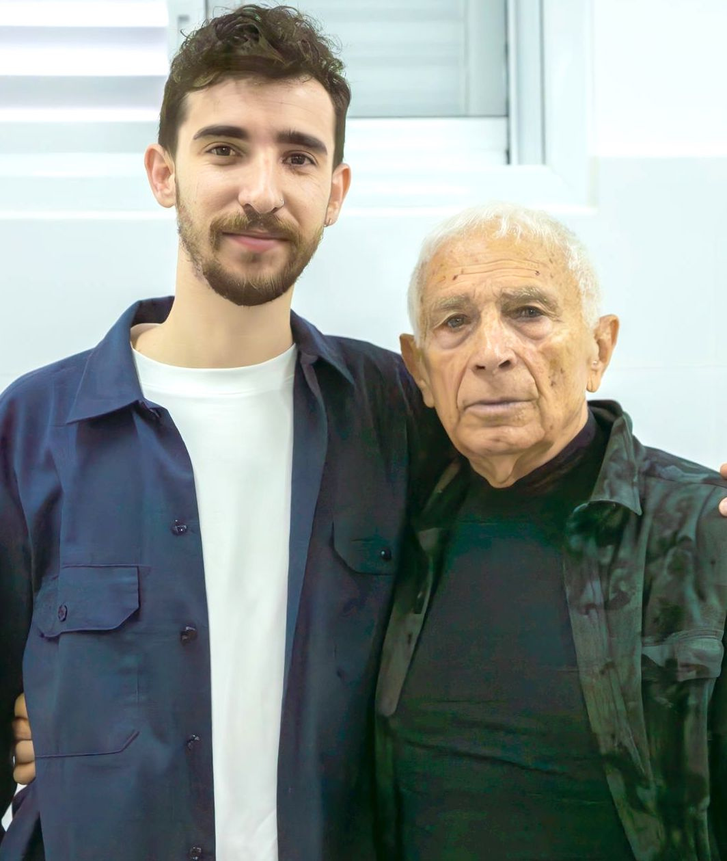
Two Generations of Survivors - Itai and Boris
WWW.REACHII.ORG

Slide 4
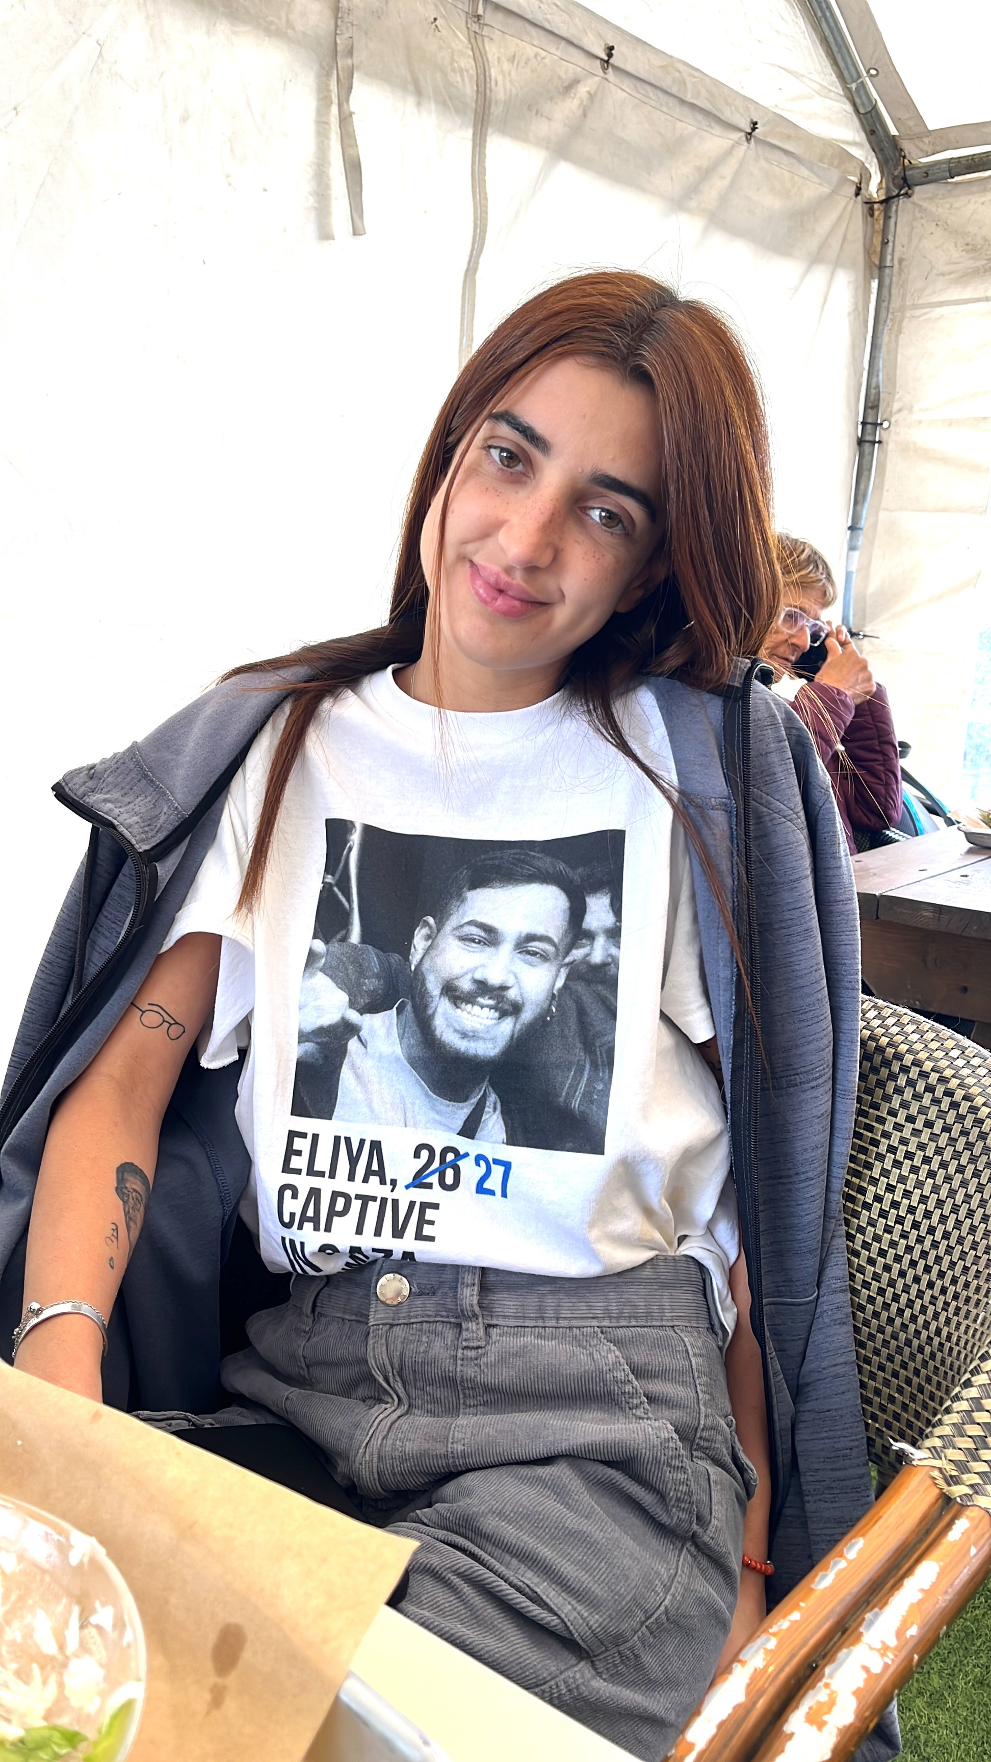
October 7
Survivor - Ziv
WWW.REACHII.ORG

Slide 5
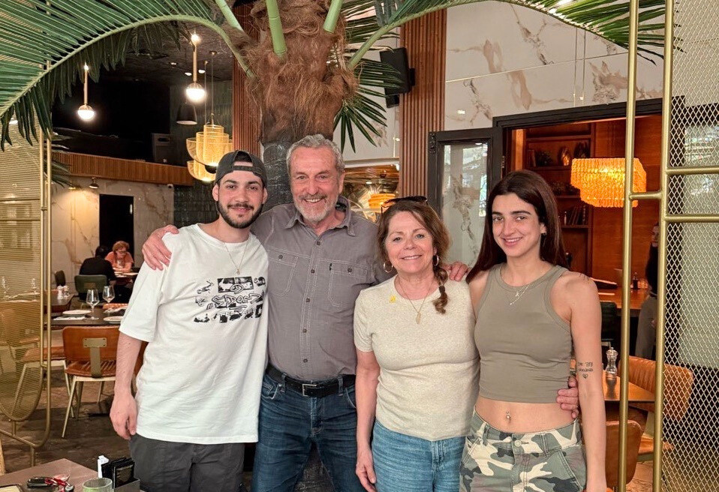
Eliya - Recently Released Hostage
WWW.REACHII.ORG

Slide 6
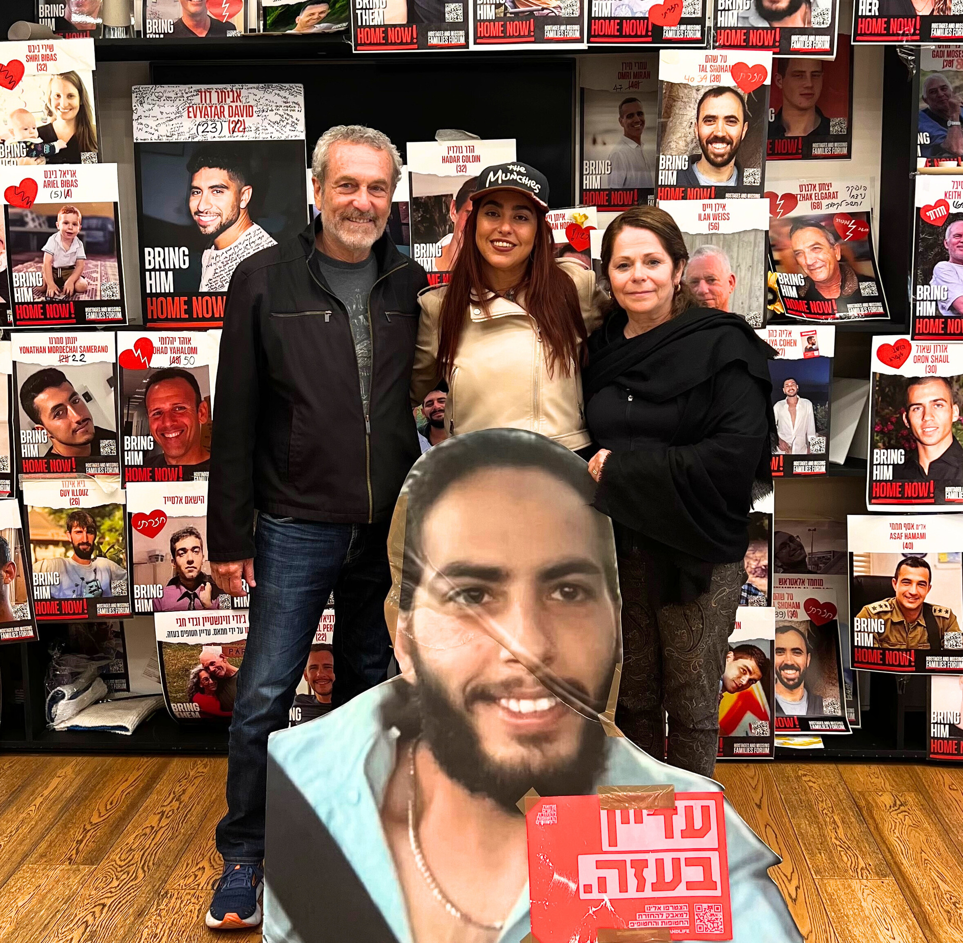
Freed from Gaza - Ilana
WWW.REACHII.ORG

Slide 7
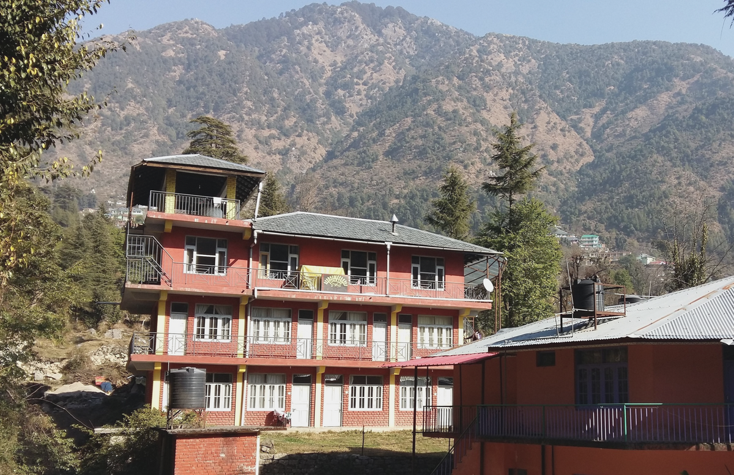
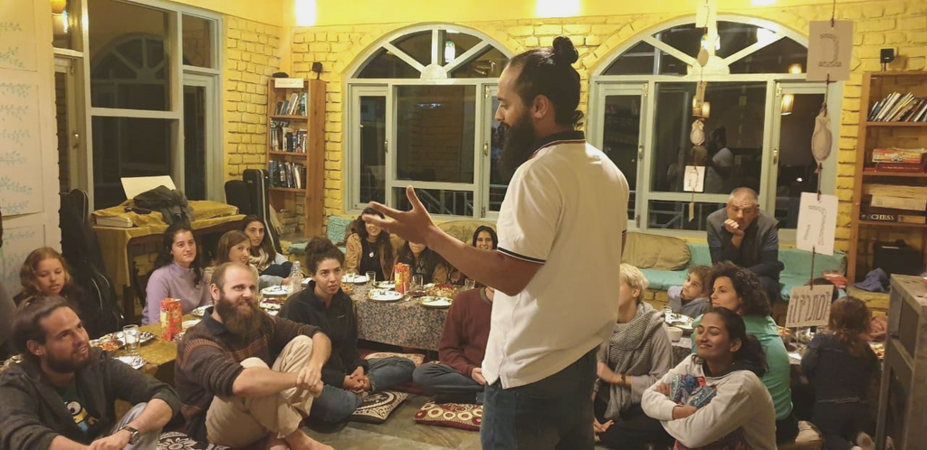
SunRise in the Himalayas
Hundreds of Israelis are hearing the Good News of Yeshua for the first time in their lives! Many are receiving comfort and healing for their wounded souls.
WWW.REACHII.ORG

