Slide 1

Notes:
Lori

Slide 2
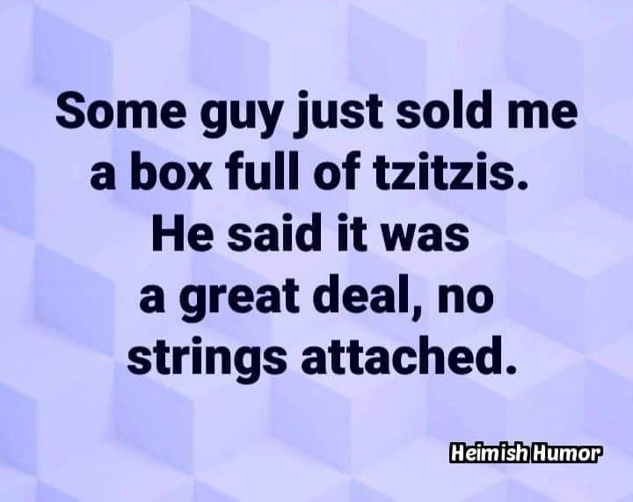
Notes:
Tzitzis Ashkenazi Jewish pronunciation. We usually say Tzitzit
Lori

Slide 3

Notes:
Doves cooing and snuggling

Slide 4

Elul Intimacy:
The word “Elul”
with G-d, Slikhot forgiveness
with family: parents, wife, kids,
siblings
With people believers and not
With G-d’s heart for Israel
Notes:
#4 [Greatest common offense in Messianic]

Slide 5
Elul Intimacy:
The word “Elul”
with G, Slikhot forgiveness
with family: parents, wife, kids,
siblings
With people believers and not
With G-d’s heart for Israel

Slide 6
The name of the month Elul, like the names of the rest of the Hebrew calendar months, was brought from the Babylonian captivity, and originated from the Akkadian word for “harvest.”
Notes:
https://en.wikipedia.org/wiki/Elul
However, the rabbis saw an acronym.

Slide 7
Jewish sources from the 14th century and on, write that the Hebrew word "Elul" can be understood to be an acronym for the phrase "Ani L'dodi V'dodi Li" – "I am my beloved's and my beloved is mine"
Notes:
Hebrew alphabet acronym
In English looks like ALVL But Hebrew letters work differently.

Slide 8
אֲנִי לְדוֹדִי וְדוֹדִי לִי ← אלול ← אֱלוּל
Anee l’dodi, v’dodi li
I am my beloved’s and he is mine.
Notes:
Like the name Teerosh. Consonants make an acronym, and we put the vowels to make the word.

Slide 9
Elul אֱלוּל Beloved
Song of Songs 6.3
I belong to the man I love, and he belongs to me.
אֲנִי לְדוֹדִי וְדוֹדִי לִי ← אלול ← אֱלוּל
Anee l’dodi, v’dodi li
Notes:
TLV: I am my beloved’s and my beloved is mine. Passion for G-d and His Glory!

Slide 10

אֲנִי לְדוֹדִי
Ani l’dodi

Slide 11
In Jewish tradition, the month of Elul is a time of loving repentance in preparation for the High Holy Days of Rosh Hashanah and Yom Kippur. Of preparing to approach the Sh’khinah, the Beloved.
Notes:
Loving repentance.
Not dreaded repentance? That too. We can love and fear/respect parents, authorities.

Slide 13
Elul Intimacy:
The word “Elul”
with G-d, Slikhot forgiveness
with family: parents, wife, kids,
siblings
With people believers and not
With G-d’s heart for Israel
Notes:
[Greatest common offense in Messianic]

Slide 14
It is customary to blow the shofar every morning. The blasts are meant to awaken one's spirits and inspire him to begin the soul searching which will prepare him for the High Holy Days.

Slide 15
As part of this preparation, Elul is the time to begin the sometimes-difficult process of granting and asking for forgiveness. Slikhot prayers. It is also customary to recite Psalm 27 every day from Rosh Hodesh Elul through Hoshanah Rabbah on Sukkot.
Notes:
חשבון נפש Kheshbon nefesh…accounting of the soul
I forgive you for…
Can’t always get full reconciliation, but pray that offender will say:
Will you forgive me for…
I will show a video in the Torah class about slikhot practice in Jerusalem.

Slide 16
Selikhot סְלִיחוֹת plural
singular: סליחה, are Jewish penitential poems and prayers, especially those said in the period leading up to the High Holidays, and on fast days. The Thirteen Attributes of Mercy are a central theme throughout these prayers.

Slide 17
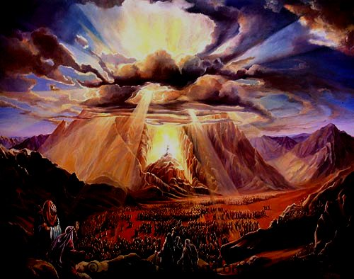
The Thirteen Attributes of ADONI
[Sh’mot (Exodus) 34: 6-7]
Notes:
You can consider these as you examine your life. Basis of G-d’s mercy in Messiah.

Slide 18
ADONI, ADONI is G-d, merciful and compassionate, slow to anger and rich in grace and truth, showing grace to the thousandth generation, forgiving offenses, crimes, and sins, yet not exonerating the guilty.
Notes:
Therefore Yeshua came.

Slide 19
יְיָ יְיָ אֵל רַחוּם וְחַנּוּן
Adoni, Adoni, Ayl ra-khoom v'kha-noon
אֶֽרֶךְ אַפַּֽיִם, וְרַב חֶֽסֶד וְאֶמֶת
Eh-rekh a-pi-yeem, v'rav
khe-sed v'eh-met

Slide 20
נֹצֵר חֶֽסֶד לָאֲלָפִים,
נֹשֵׂא עָוֹן וָפֶֽשַׁע וְחַטָּאָה
No-tsayr khe-sed la-ah-la-feem, no-say ah-von v'feh-shah v'kha-ta-ah
וְנַקֵּה לֹא יְנַקֶּה
V'nah-kay lo y'nah-keh

Slide 21
Pray into Psalm 27.
How does it apply to yourself?
Pray the scriptures:

Slide 22
^{T’hillim 27} Just one thing have I asked of Adoni; only this will I seek:
to live in the house of Adoni
all the days of my life,
to see the beauty of Adoni
and visit in his temple.
Notes:
Do we really want Him? Messiah’s fellowship above all?

Slide 23
Your face, Adoni, I will seek.
Do not hide your face from me,
don’t turn your servant away in anger.
You are my help; don’t abandon me;
don’t leave me, God my savior.
Even though my father and mother have left me, Adoni will care for me.
Notes:
Change anything I should change!!
Healing from parental wounds, abandonment, toxicity.

Slide 24
Teach me your way, Adoni;
lead me on a level path
because of my enemies —

Slide 25
Surely, I trust that I will see the goodness of Adoni in the land of the living.
Wait for Adoni. Be strong, let Your heart take courage, and wait for Adoni.
Notes:
Trust in Him!!
Wait on Yeshua!!

Slide 26
I would challenge us to enter into an Elul seeking of the Bridegroom in fasting. Suggested by Stewart Winograd, from Rosh HaShannah Tishri 1 until Yom Kippur, Tishri 10.
Sept. 24- Oct. 1

Slide 27
From Stewart:
The focus I have been given from the Lord is this:
Passionate intercession for an awakening (revival) in the body of Messiah, for all believers in Yeshua, starting with our own hearts.

Slide 28
A desperate cry for a great outpouring of the Ruakh Ha Kodesh. (Like we saw in the Book of Acts and in various times and places in history.) The purpose and desired result of the above leads us to:

Slide 29
Urgent, compassion-filled prayer for the lost. For the good news of Yeshua's salvation to go viral through His revived body; for a great harvest of thousands, even tens of thousands, of Jews and Gentiles in the coming year.
Add: End of the current war!

Slide 30
“Is not this the fast I choose: to release the bonds of wickedness, to untie the cords of the yoke, to let the oppressed go free, and to tear off every yoke?" ^{Isaiah 58:6}

Slide 31
Remember the purpose of fasting is to make yourself less sensitive to the things that satisfy your flesh and more sensitive to the things of God's Spirit and to give more time to focused prayer.

Slide 32
We set aside the time we would be preparing meals and eating; to pray, read the Bible, and worship. We are hungry for God and to see His breakthroughs.

Slide 33
Dawn and I have fasted these 10 days for years. The Daniel version.

Slide 34
Levels of Fasting:

Slide 35
Ester fast: all food and drink. YK
Fast from solid foods. [liquids OK]
Fast from solid foods at a specific time each day (i.e. 10 am-7 pm, sunup to sundown, etc.).
Fast from solid food one meal per day or eat only one meal of solid food per day.

Slide 36
Daniel Fast, fast from prepared foods and wine (alcohol).... eat fruits, vegetables, nuts, and liquids.
You can also mix and match these fasts, perhaps doing a different fast each week of the 40 days.

Slide 37
In addition to the food-based fasts above, consider adding a fast from your favorite TV show, internet browsing, games, social media, and/or some other pleasures.

Slide 39
Elul Intimacy:
The word “Elul”
with G, Slikhot forgiveness
with family: parents, wife, kids,
siblings
With people believers and not
With G-d’s heart for Israel

Slide 40
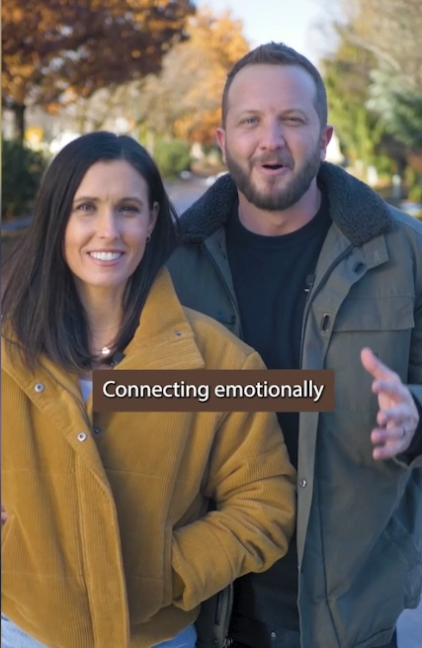
Brenen and Morgan Beeler on Dobson’s Family Talk.
Notes:
https://www.drjamesdobson.org/marriage-parenting/3-powerful-ways-to-deepen-emotional-connection-in-marriage/?utm_campaign=19399251-Evergreen%20-%20M%2FP%20Series%20%235&utm_medium=email&_hsenc=p2ANqtz-9WPHbN0XgHE0HtYQ_KdTw4paPxYNuSPoFd9pYlpMPZfOYBuehefi0l5oDyslgeLQrSqz6NbLP3d7xBrUUwDK1P0BHBUA&_hsmi=379727143&utm_content=379727143&utm_source=hs_email

Slide 41
Spend time together, year-round.
Pray together daily.
Play together. Laugh
Listen.

Slide 42
Elul Intimacy:
The word “Elul”
with G, Slikhot forgiveness
with family: parents, wife, kids,
siblings
With people, believers and not
With G-d’s heart for Israel

Slide 43
Worship on Shabbat and stay for Oneg
Youth group 13-18
Lo Kashish לא קשיש [not elderly] ~18→~30
Zeitim זיתים [olives] ~30→~45
Ladies’ Havurah,
Men’s Havurah
Grandparents [in formation]
Notes:
We have a lot of stuff organized, but personal: Shabbat dinners, friendship. We are too much of a destination congregation. Bonding takes time.

Slide 44
Ingathering / Outreach
^{Mtt. 28.18-20} Yeshua came and talked with them. He said, “All authority in heaven and on earth has been given to me. Therefore, go and make people from all nations into talmidim,

Slide 45
Ingathering / Outreach
^{Mtt. 28.18-20} immersing them into the reality of the Father, the Son and the Ruach HaKodesh, and teaching them to obey everything that I have commanded you. And remember! I will be with you always, yes, even until the end of the age.”

Slide 46
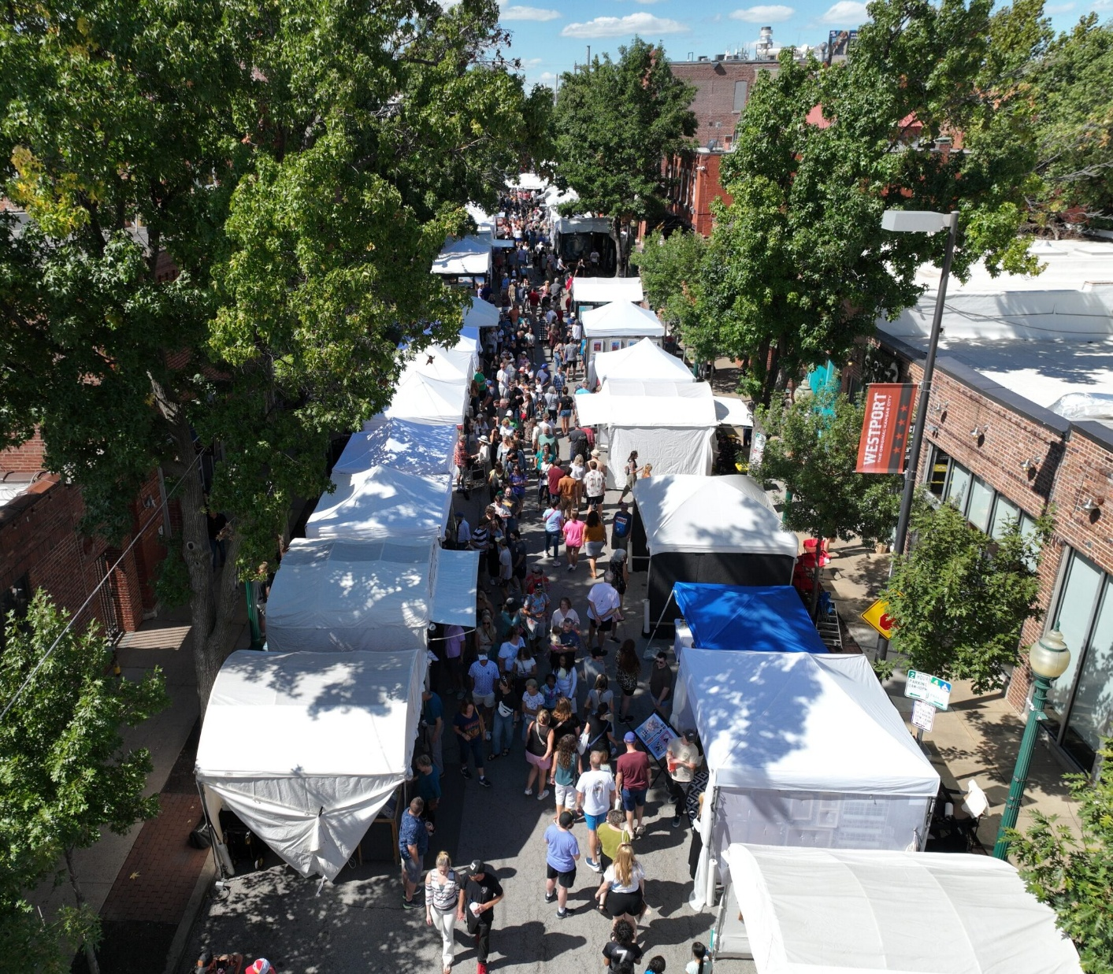
46th Annual Art Westport, happened September 11-13th, 2026
We did “walk through” Ingathering.
Much joy!

Slide 47

Notes:
Considering…

Slide 48
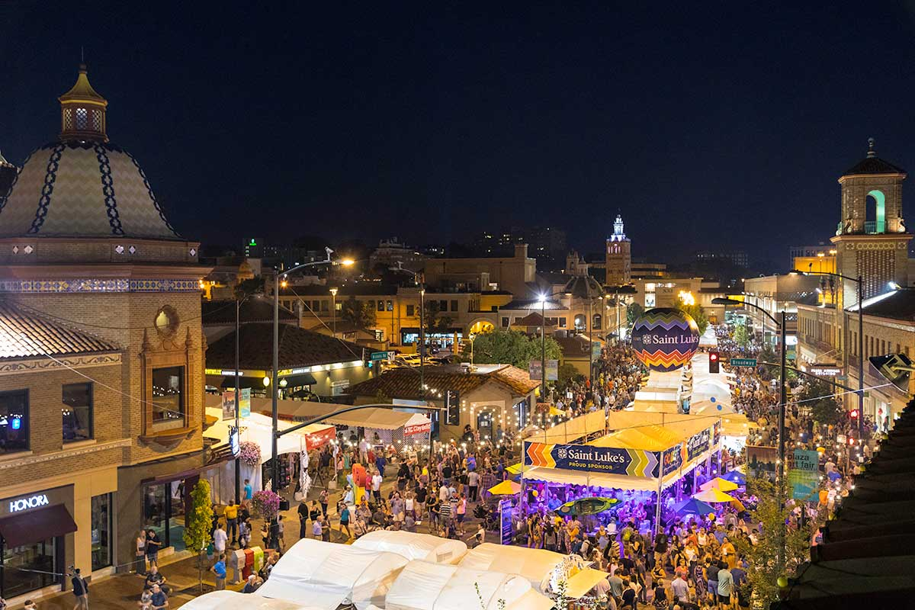
Notes:
Really short notice, but really no prep for the walk through. Sat., Sept 20 maybe

Slide 49
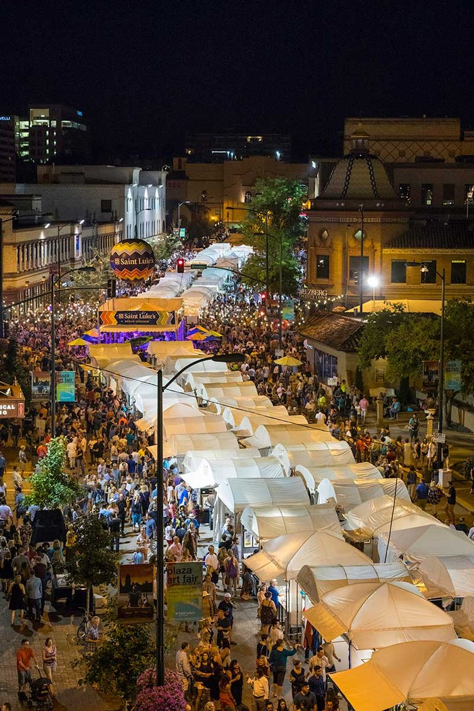

Slide 50
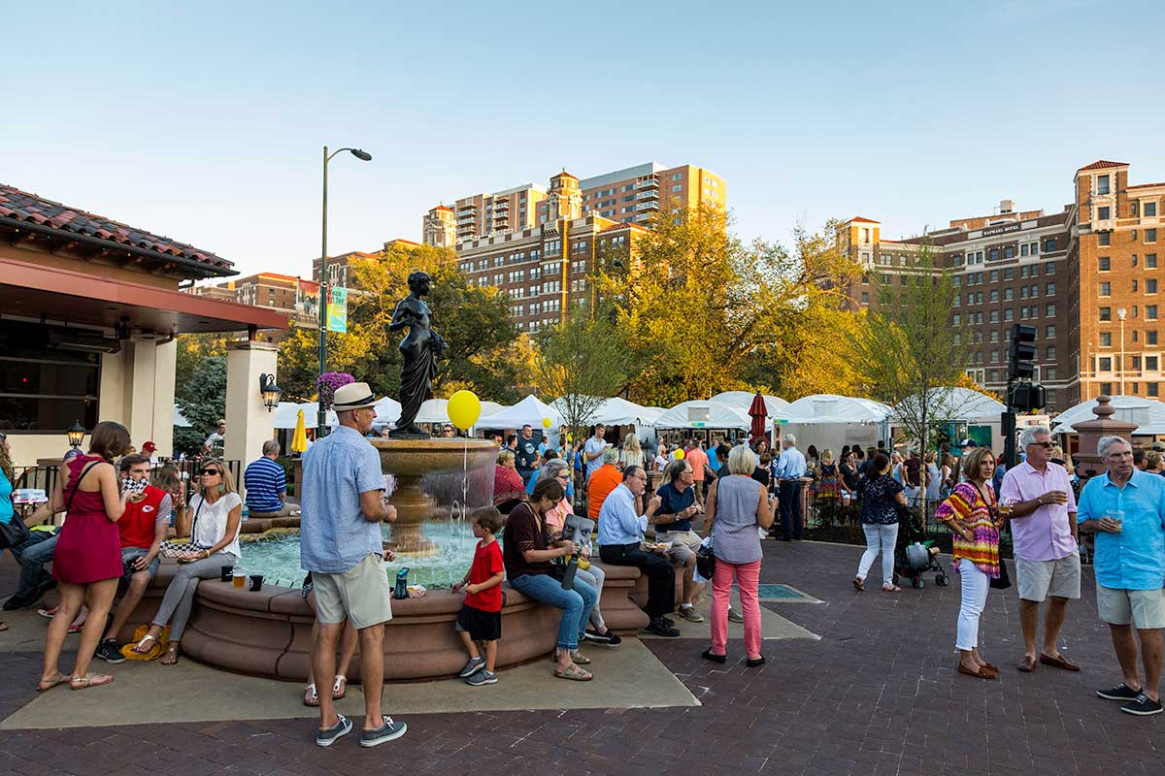

Slide 52
Elul Intimacy:
The word “Elul”
with G-d, Slikhot forgiveness
with family: parents, wife, kids,
siblings
With people believers and not
With G-d’s heart for Israel
Notes:
[#4 Greatest common offense in Messianic world. Why big deal about the Jews? ]

Slide 53
This is a main passion and raison d’être, reason for existence, of Or HaOlam.
This concept can also be a main source of offense.
Notes:
[Offense is more common in the US, while offence is more common outside of the US.]

Slide 54
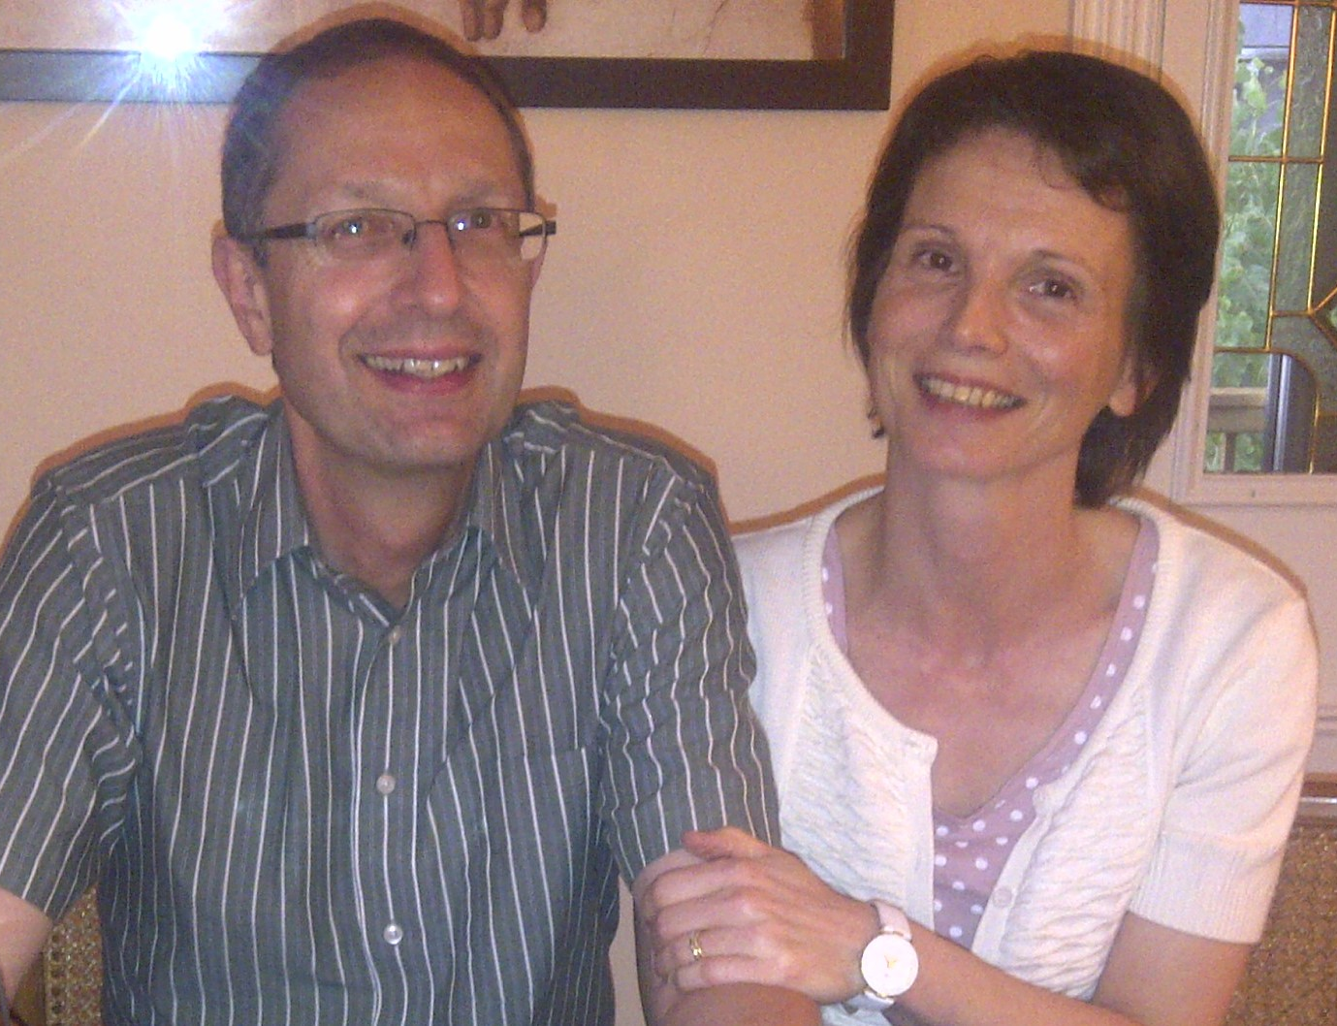
Pierre Laurence Bezencon
Notes:
Dear friends since ~2010

Slide 55
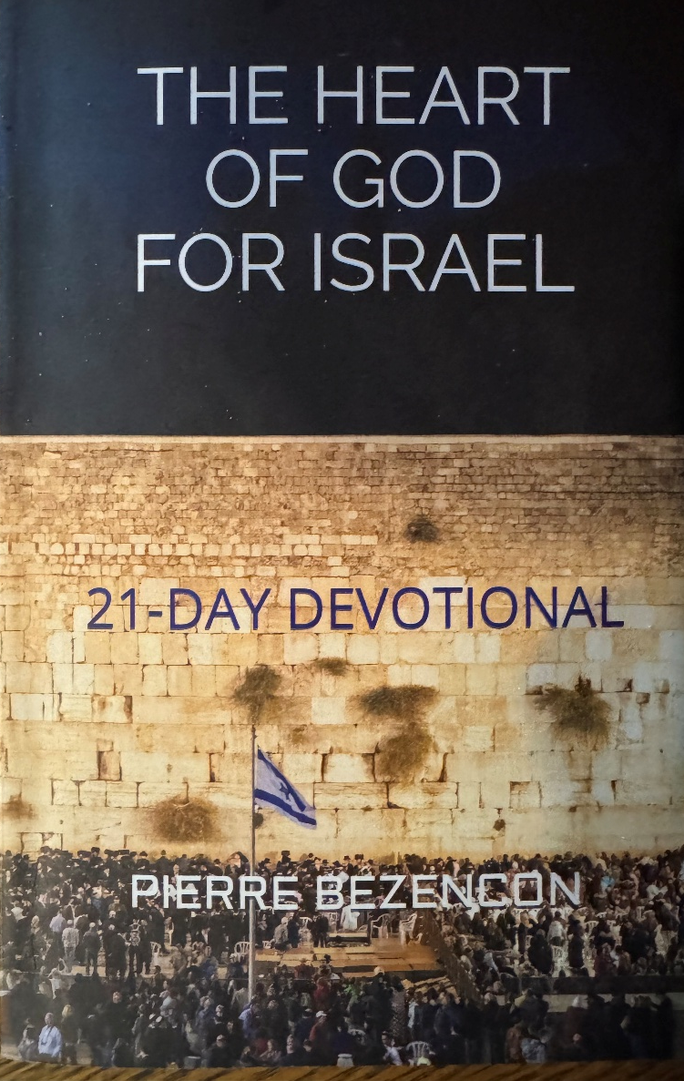
Pierre’s Book
Notes:
Collection of scriptures and brief commentary about G-d’s Heart for Israel. G-d’s heart not just for Messianics, not just for ancient prophets, priests, scribes, warriors. G-d’s heart, Yeshua’s heart for Israel, Jews. Lox and dill pickle and humus loving Jews. Stock brokers, doctors, scientists, lawyers, dentist,s those PEOPLE

Slide 56
^{Yeshayahu 54.5-8} For your husband is your Maker, Adoni-Tzva’ot is his name. The Holy One of Isra’el is your Redeemer. He will be called the God of all the earth. For Adoni has called you back like a wife abandoned and grief-stricken; “A wife married in her youth cannot be rejected,”
Notes:
Strongest human language. Why, covenant G-d made.

Slide 57
^{Hoshea 2.19-20} I will betroth you to Me forever— yes, I will betroth you to Me with righteousness, justice, covenant loyalty and compassion. I will betroth you to Me with faithfulness, and you will know Adoni.
Notes:
Excitement of a fiance
Said to Hoshea’s wife in deep adultery, street woman. Said to Israel in degraded idolatry.
Does it make sense to prioritize one people group?
No in terms of fairness. Yes in terms of showing G-d’s unfailing love!

Slide 58
^{Yeshayahu/Is 49.14-16} “But Tziyon says, ‘Adoni has abandoned me, Adoni has forgotten me.’ Can a woman forget her child at the breast, not show pity on the child from her womb? Even if these were to forget, I would not forget you. I have engraved you on the palms of my hands, your walls are always before me.”
Notes:
Nursing mother.
Western wall? Hand? Yeshua’s!!

Slide 59
^{Shmot/Ex 4.22-23} You are to tell Pharaoh: ‘Adoni says, “Isra’el is my firstborn son. I have told you to let my son go in order to worship me, but you have refused to let him go. Well, then, I will kill your firstborn son!”
Notes:
Firstborn, yet ornery slave mentality.
Father protects from neighborhood bully.

Slide 60
^{Dvarim/ Dt 1.30-33} Adoni your God, who is going ahead of you, will fight on your behalf, just as he accomplished all those things for you in Egypt before your eyes, and likewise in the desert, where you saw how Adoni your God carried you, like a man carries his child,

Slide 61
^{Dvarim/ Dt 1.30-33} along the entire way you traveled until you arrived at this place. Yet in this matter you don’t trust Adoni your God, even though he went ahead of you, seeking out places for you to pitch your tents and showing you which way to go, by fire at night and by a cloud during the day.’

Slide 62
^{Yeshayahu 54.5-8} Thus says your God. “Briefly I abandoned you, but with great compassion I am taking you back. I was angry for a moment and hid my face from you; but with everlasting grace I will have compassion on you,” says Adoni your Redeemer.

Slide 63
^{Dvarim / Dt 32.9-12} But Adoni’s portion is His people — Yaakov/ Jacob is the share of His inheritance. He found him in the wilderness land, in the void of a howling waste. He surrounded him, cared for him, guarded him as the pupil of His eye.
Notes:
Israel is G-d’s portion? G-d has EVERYTHING

Slide 64
^{Dvarim / Dt 32.9-12} As an eagle stirs up its nest, hovers over its young, He spreads His wings, catches him, lifts him up on His wings. Adoni alone guided him— there was no foreign god with him.
Notes:
De-nesting procedure of eagles.

Slide 65
^{Beresheet / Gen 17.7} “I am establishing my covenant between me and you, along with your descendants after you, generation after generation, as an everlasting covenant, to be God for you and for your descendants after you.
Notes:
Covenant key to this congregation.

Slide 66
^{Beresheet / Gen 17.19} God answered, “No, but Sarah your wife will bear you a son, and you are to call him Yitz’khak [laughter]. I will establish my covenant with him as an everlasting covenant for his descendants after him.

Slide 67
^{Shmot/ Ex 3.13-15} But Moshe said to God, “Suppose I go to Bnei-Yisrael and say to them, ‘The God of your fathers has sent me to you,’ and they ask me, ‘What is His Name?’ What should I say to them?”God answered Moshe, “I AM WHO I AM.”

Slide 68
^{Shmot/ Ex 3.13-15} Then He said, “You are to say to Bnei-Yisrael, ‘I AM’ has sent me to you.” God also said to Moshe: “You are to say to Bnei-Yisrael, Adoni, the God of your fathers, the God of Avraham, Yitskhak, Yaakov, has sent me to you. This is My Name forever, and the Name by which I should be remembered from generation to generation.
Notes:
G-d in heaven and eternity deigns to name Himself by this family.

Slide 69
^{Yer/Jer 33.14-17} “Here, the days are coming,” says Adoni, “when I will fulfill this good promise which I have proclaimed for the house of Isra’el and the house of Y’hudah. When those days come, at that time, I will cause to spring up for David a Branch of Righteousness. He will do what is just and right in the land.

Slide 70
^{Yer/Jer 33.14-17} When those days come, Y’hudah will be saved, Yerushalayim will live in safety, and the name given to her will be Adoni Tzidkenu [Adoni our Righteousness].” For this is what Adoni says: “There will never be cut off from David a man to occupy the throne of the house of Isra’el.

Slide 71
^{Yer/Jer 33.31-34} “Here, the days are coming,” says Adoni, “when I will make a new covenant with the house of Isra’el and with the house of Y’hudah. It will not be like the covenant I made with their fathers on the day I took them by their hand and brought them out of the land of Egypt;

Slide 72
^{Yer/Jer 33.31-34} because they, for their part, violated my covenant, even though I, for my part, was a husband to them,” says Adoni. “For this is the covenant I will make with the house of Isra’el after those days,” says Adoni: “I will put my Torah within them and write it on their hearts;

Slide 73
^{Yer/Jer 33.31-34} I will be their God, and they will be my people. No longer will any of them teach his fellow community member or his brother, ‘Know Adoni’; for all will know me, from the least of them to the greatest; because I will forgive their wickednesses and remember their sins no more

Slide 74
^{Ro 11.26-29} All Israel will be saved, as it is written, “The Deliverer shall come out of Zion. He shall turn away ungodliness from Yaakov Jacob. And this is My covenant with them, when I take away their sins.” Concerning the Good News,
Notes:
Do we have a part in this??

Slide 75
^{Ro 11.26-29} they are hostile for your sake; but concerning chosenness, they are loved on account of the fathers, for the gifts and the calling of God are irrevocable.

Slide 76
^{T’hillim / Ps 132.11-14} Adoni swore an oath to David, an oath he will not break: “One of the sons from your own body I will set on your throne. If your sons keep my covenant and my instruction, which I will teach them, then their descendants too, forever, will sit on your throne.”

Slide 77
^{T’hillim / Ps 132.11-14} For Adoni has chosen Tziyon, he has wanted it as his home. “This is my resting-place forever, I will live here because I so much want to.
Notes:
G-d’s resting place? When you go there, there is a sense of rest, shalom, joy, AND warfare.

Slide 78
^{Yeshayahu / Is 62.6-7} I have posted watchmen on your walls, Yerushalayim; they will never fall silent, neither by day nor by night. You who call on Adoni, give yourselves no rest; and give him no rest till he restores Yerushalayim and makes it a praise on earth.
Notes:
G-d posted angelic watchmen? We enter into that in Teerosh. Watchman

Slide 79
^{Yeshayahu/Is 60.1-3} “Arise, shine [Yerushalayim], for your light has come, the glory of Adoni has risen over you. For although darkness covers the earth and thick darkness the peoples;

Slide 80
^{Yeshayahu/Is 60.1-3} on you Adoni will rise; over you will be seen his glory. Nations will go toward your light and kings toward your shining splendor.

Slide 81
^{Mt. 23 37-39} “Yerushalayim! Yerushalayim! You kill the prophets! You stone those who are sent to you! How often I wanted to gather your children, just as a hen gathers her chickens under her wings, but you refused! Look! God is abandoning your house to you, leaving it desolate.

Slide 82
^{Mt. 23 37-39} For I tell you, from now on, you will not see me again until you say, ‘Blessed is he who comes in the name of Adoni.’”
Barukh ha-ba b’shem Adoni.
בשם יי ברוך הבא

Slide 83
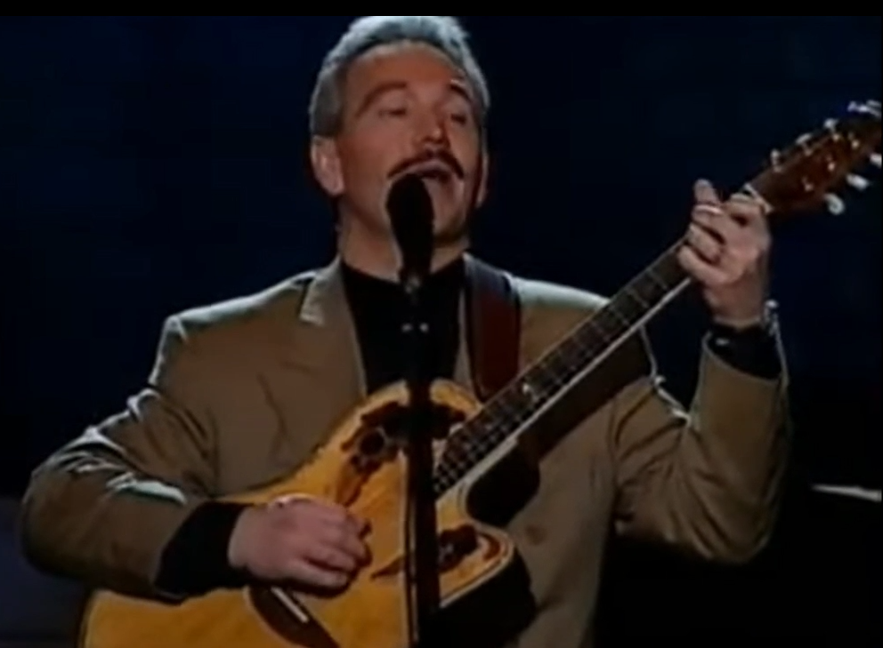
Paul Wilbur Jerusalem concert
Dec. 12, 2010
Notes:
https://www.youtube.com/watch?v=FtPTI0dnWTk&list=RDFtPTI0dnWTk&start_radio=1
I believe this is in the Jerusalem Coliseum, Binyanei HaUma בניני האומה
Seemed like Yeshua would return in the singing of this.

Slide 85
Elul Intimacy:
The word “Elul”
with G-d, Slikhot forgiveness
with family: parents, wife, kids,
siblings
With people believers and not
With G-d’s heart for Israel
Notes:
[#4 Greatest common offense in Messianic world. Why big deal about the Jews? ]

Slide 86
Do you KNOW Yeshua and the assurance of sins forgiven?
Are you hearing daily from His Word?
How are you applying what you heard?
Are you asking this of another?
Notes:
Who are you discipling, building up?4

