Slide 1
The importance of unambiguous, clear communication…

Slide 2
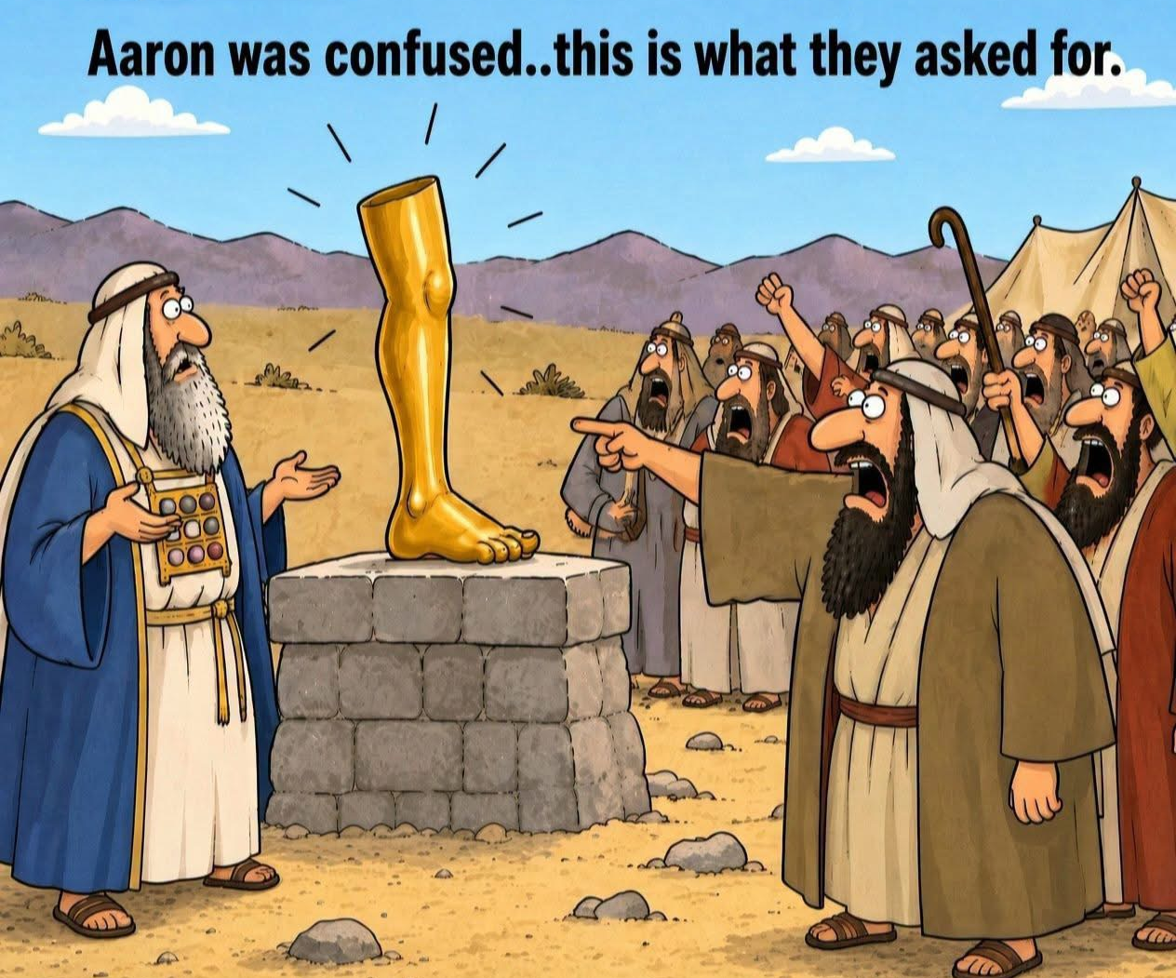
Notes:
Golden calf…Yes?
From Grady Merritt
Next one is very politically incorrect

Slide 3
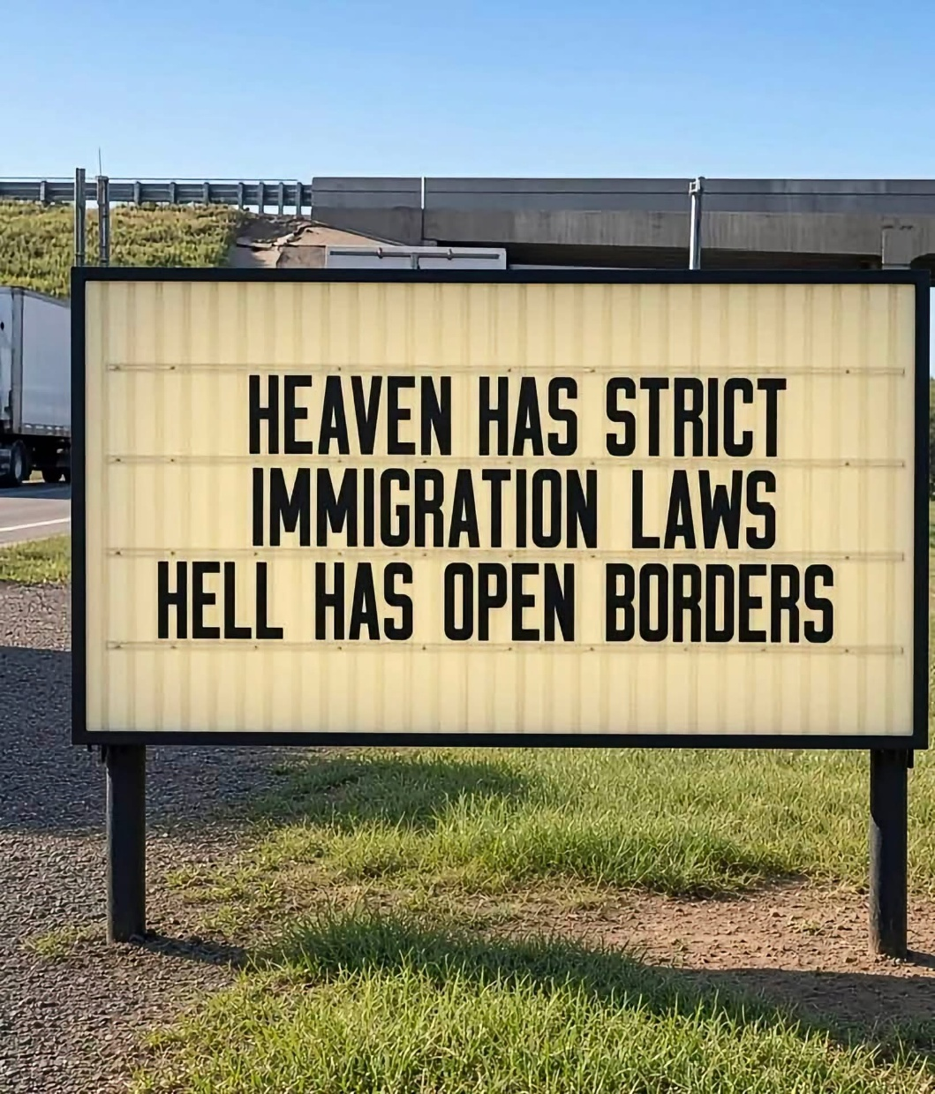
Notes:
From Tabitha Dotson

Slide 4
Notes:
From Tabitha Dotson

Slide 5
We had a blessed Sukkot campout in spite of more rain than ever in 32 years of Sukkot celebration!
Nevertheless, sweet fellowship…

Slide 6
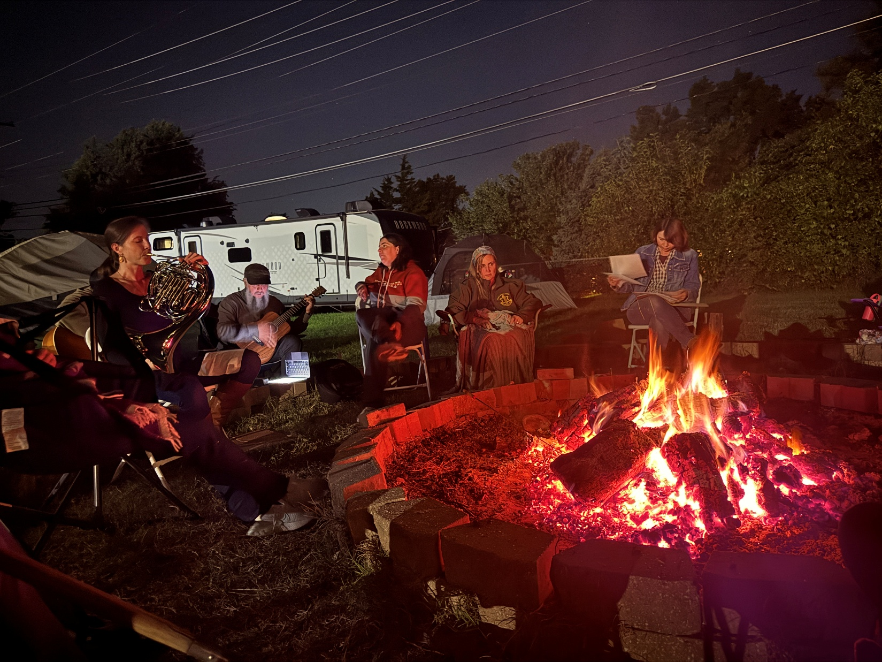
Notes:
Simps is a great fire meister.

Slide 7

Notes:
So good that some stayed camping till Wednesday after Sukkot!

Slide 8
Today we are celebrating the birth of Yeshua as the Messiah and King of Israel and all the world.
In October?

Slide 9
יוֹם הֻלֶּדֶת מְשִׁיחִי שָׂמֵחַ
Yom Huledet M’shikhee Sa-me-akh
Happy Messiah’s Birthday!

Slide 10
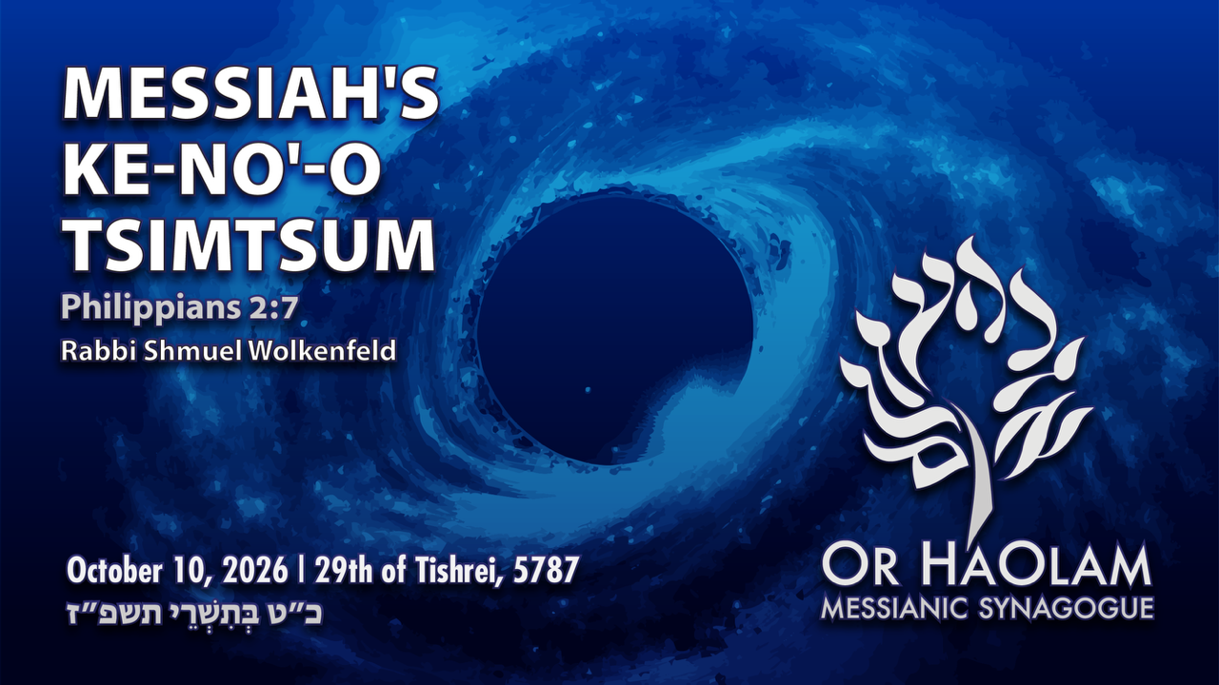

Slide 11

Messiah’s Birthday Phil. 2.7
Keno-o / Tsimtsum
Is it Biblical to celebrate birthdays?
Why celebrate it now, in Oct.?
What does His birth mean?
Application to our lives
Notes:
Some Greek and Hebrew terms.

Slide 12
Messiah’s Birthday Phil. 2.7
Keno-o / Tsimtsum
Is it Biblical to celebrate birthdays?
Why celebrate it now, in Oct.?
What does His birth mean?
Application to our lives

Slide 13
Is it legitimate to celebrate birthdays?
^{Ber./Gen 40.20} On the third day, which was Pharaoh’s birthday, he gave a party for all his officials, and he lifted up the head of the chief cupbearer and the head of the chief baker among his officials.
Notes:
Implied recognition that this was normal and celebratory.

Slide 14
^{Iyov/Job 1.4} It was the custom of his sons to give banquets, each on his set day in his own house; and they would invite their three sisters to eat and drink with them.
^{Mt.14.6} However, at Herod’s birthday celebration, Herodias’ daughter danced before the company.

Slide 15
Jewish authorities: The Lubavitch Hasidim [my ancestry] encourage celebration, plus Bar/Bat Mitzvahs.
Church father: Origen of Alexandria [c 185 – 253], major originator of replacement theology, was opposed with disgust to birthdays.
Notes:
So if Origen was opposed, it’s probably a good thing.

Slide 16
Celebrating birthdays
is scriptural and legitimate
and an affirmation of people whom we love!

Slide 18
Messiah’s Birthday Phil. 2.7
Keno-o / Tsimtsum
Is it Biblical to celebrate birthdays?
Why celebrate it now, in Oct.?
What does His birth mean?
Application to our lives

Slide 19
The Cohen [priestly] Rotation History
Zekhariah of the course of Aviyah ^{Lk 1.5} In the days of Herod, King of Y’hudah, there was a cohen named Z’kharyah who belonged to the Aviyah division. His wife was a descendant of Aharon, and her name was Elisheva
Notes:
Partially from http://www.kolsimcha.org/messages/2008/101808M.pdf

Slide 20
^{1Chr 24:3-4} There were sixteen divisions of the descendants of El’azar, headed by clan leaders, and eight divisions of the descendants of Itamar, according to their clans.”

Slide 21
^{1 Chr 24:7-10} The first lot drawn was for Y’hoyariv, the second for Y’da’yah, the third for Harim, the fourth for S’orim, the fifth for Malkiyah, the sixth for Miyamin, the seventhfor Hakotz, the eighth for Aviyah”

Slide 22
There were 24 divisions in the Temple and each was to serve two weeks at a time throughout the year. Eighth division = 16 weeks after start of cycle.
If rotation cycle started at Pesakh, then 16 weeks later, Zekhariah served. So June

Slide 23
^{Luke 1.24-27} Elisheva his wife conceived, and she remained five months in seclusion, saying, “Adoni has done this for me; he has shown me favor at this time, so as to remove my public disgrace.”

Slide 24
^{Luke 1.24-27} In the sixth month, the angel Gavri’el was sent by God to a city in the Galil called Natzeret, to a virgin engaged to a man named Yosef, of the house of David; the virgin’s name was Miryam.

Slide 25
Announcement of Yokhanan’s conception. 6 months plus 9 month’s Miriam’s pregnancy. Therefore Fall time of birth.
Yeshua born 15 month after announcement to Zekharyah: 6 months of Elisheva [Elizabeth’s] pregnancy, announcement to Miriam 6 + 9 = 15 months from Passover to Sukkot

Slide 26
Some uncertainty in start of count. Count could start count at end of Sukkot, and two separate one week times of Temple service. Same conclusion. [Two possible start dates, and two ways to count service times.]

Slide 27
Shepherds in the Field
^{Luke 2:8} “Now there were shepherds in the same region, living out in the fields and guarding their flock at night.” ^{(TLV)}
Shepherd facts
Shepherds were watching their flocks by night -only when lambs are being born in the spring or autumn.
Notes:
[BlaineRobinson.com]

Slide 28
The flocks would not be in the fields in the spring because they would trample the new crops.
Flocks were only allowed in the fields in the autumn to graze the stubble and for the fall lambing season.
Notes:
[BlaineRobinson.com]

Slide 29
Two other reasons for ~Sukkot Birthday
The conjunction of the planets.
The history of Roman taxation.
Notes:
[BlaineRobinson.com]

Slide 31
Messiah’s Birthday Phil. 2.7
Keno-o / Tsimtsum
Is it Biblical to celebrate birthdays?
Why celebrate it now, in Oct.?
What does His birth mean?
Application to our lives

Slide 32
^{Phil 2.5-8} Let your attitude toward one another be governed by your being in union with the Messiah Yeshua: Though he was in the form of God,
Let’s explore that concept:
Notes:
In eternity past, He was in the form of G-d

Slide 33
^{Dan 7.2,9-10} “I had a vision at night…“As I watched, thrones were set in place; and the Ancient One took his seat. His clothing was white as snow, the hair on his head was like pure wool.
Notes:
Vision of G-d

Slide 34
^{Dan 7.2,9-10} His throne was fiery flames, with wheels of burning fire. A stream of fire flowed from his presence; thousands and thousands ministered to him, millions and millions stood before him. Then the court was convened, and the books were opened.

Slide 35
^{Dan 7.13-14}“I kept watching the night visions, when I saw, coming with the clouds of heaven, someone like a son of man. He approached the Ancient One and was led into his presence.
Notes:
Clouds of heaven is terminology of G-d: Psalm 18.11, Dt 32.10

Slide 36
^{Dan 7.13-14}“To him was given rulership, glory and a kingdom, so that all peoples, nations and languages should serve him. His rulership is an eternal rulership that will not pass away; and his kingdom is one that will never be destroyed.

Slide 37
Two divine beings here.
Yeshua was and is the
Son of man.
Divine title.
A surprising reinforcement:

Slide 38
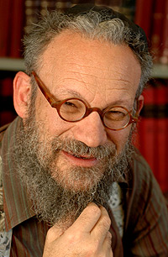
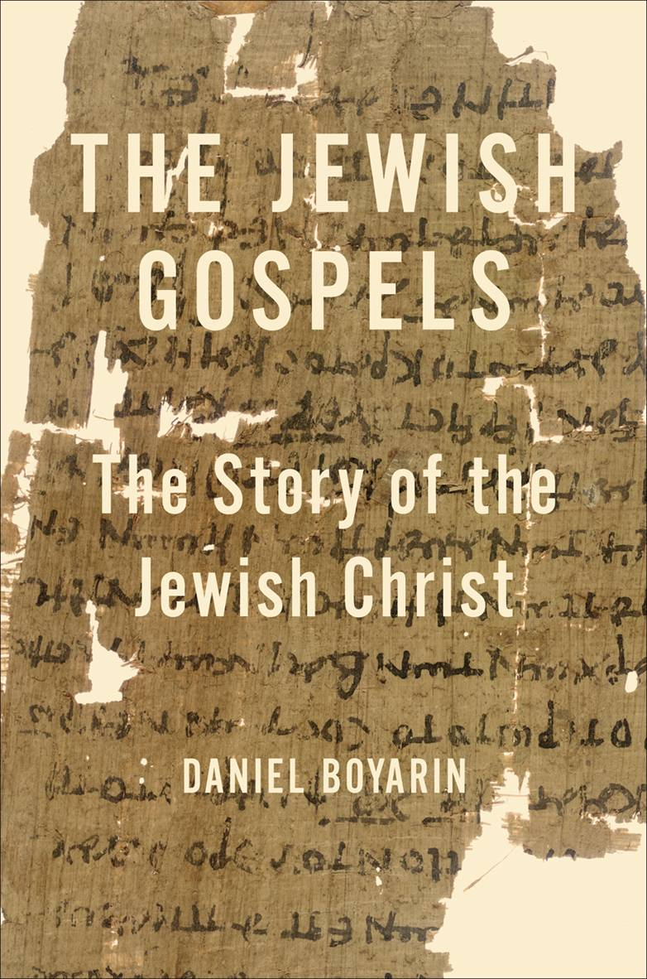
Daniel Boyarin

Slide 39
Daniel Boyarin (born 1946) is a historian of religion. Born in Asbury Park, New Jersey, he holds dual United States and Israeli citizenship. Trained as a Talmudic scholar, in 1990 he was appointed Professor of Talmudic Culture, Departments of Near Eastern Studies and Rhetoric, University of California, Berkeley, a post which he still holds
Notes:
UC Berkeley, a bastion of G-dly thinking. Yes??

Slide 40

Daniel Boyarin, professor of Talmudic Culture at the University of California Berkeley, may be the most influential scholar of ancient Judaism today.
Notes:
Daniel Boyarin The Jewish Gospels p31-32, 132

Slide 41
Messiah = Son of G-d in Jewish concepts, but not what you think.
^{1 Shmu 10.1} Then Sh'mu'el took a flask of oil he had prepared and poured it on Sha'ul's head. He kissed him and said, "ADONI has anointed you to be prince over his inheritance.”
משחך M’shakhekha

Slide 42
^{T’hillim 2.6-7} "I myself have installed my king on Tziyon, my holy mountain." "I will proclaim the decree: ADONI said to me, 'You are my son; today I became your father.
Notes:
Later got to have secondary meanings, but at first, simply son of G-d as royal king with divinely appointed authority.

Slide 43
All the kings, priests anointed for service. No hint of deity ~ Pharoah.
^{1 Chron 7. 11-14} When your days come to an end and you go to be with your ancestors, I will establish one of your descendants to succeed you, one of your own sons; and I will set up his rulership. He will build me a house, and I will establish his throne forever.

Slide 44
^{1 Chron 7. 11-14} I will be a father for him, and he will be a son for me; I will not take my grace away from him, as I took it away from your predecessor. Rather, I will maintain him in my house and in my kingdom forever; and his throne will be set up forever.'"
The king is special to G-d, a son in authority, but very human.

Slide 45
After the exile, prayer was for a restoration of the Davidic kingdom.
^{Lk 1.31-32} Look! You will become pregnant, you will give birth to a son, and you are to name him Yeshua.
Notes:
Reversal: Son of G-d = divinely appointed king.

Slide 46
He will be great, he will be called Son of Ha`Elyon. ADONI, God, will give him the throne of his forefather David
Focus here primarily Davidic throne
Notes:
Reversal: Son of G-d = divinely appointed king.

Slide 47
^{Daniel 7.13-14} "I kept watching the night visions, when I saw, coming with the clouds of heaven, someone like a son of man. He approached the Ancient One and was led into his presence. To him was given rulership, glory and a kingdom, so that all peoples, nations and languages should serve him. His rulership is an eternal rulership that will not pass away; and his kingdom is one that will never be destroyed.
Notes:
Coming with clouds Ps 18, and about 70 passages picture of G
In my distress I called to ADONAI; I cried out to my God. Out of his temple he heard my voice; my cry reached his ears. 7 "Then the earth quaked and shook, the foundations of the mountains trembled. They were shaken because he was angry. 8 Smoke arose in his nostrils; out of his mouth came devouring fire; sparks blazed forth from him. 9 He lowered heaven and came down with thick darkness under his feet. 10 He rode on a keruv; he flew, swooping down on the wings of the wind.

Slide 48
Boyarin, Jewish Gospels, p 33
Daniel’s vision of Messiah, son of man
He is divine
He is in human form
He may very well be portrayed as a younger appearing divinity
He will be enthroned on high
He is given power on earth.
Notes:
Exonerate Paul

Slide 49
Two concepts of
anointed king, Son of God,
divine deliverer, Son of Man
began to merge
Notes:
Total reversal of traditional Christian teaching.

Slide 50
^{Mark 2. 5-11} Seeing their trust, Yeshua said to the paralyzed man, "Son, your sins are forgiven." Some Torah-teachers sitting there thought to themselves, "How can this fellow say such a thing? He is blaspheming! Who can forgive sins except God?" But immediately Yeshua, perceiving in his spirit what they were thinking, said to them,

Slide 51
^{Mark 2. 5-11} "Why are you thinking these things? Which is easier to say to the paralyzed man? `Your sins are forgiven'? or `Get up, pick up your stretcher and walk'? But look! I will prove to you that the Son of Man has authority on earth to forgive sins."
Notes:
Yeshua cites two sources of authority: fact of healing, and Daniel title, quoting Dan 7

Slide 52
^{Mark 2. 5-11} He then said to the paralytic, "I say to you: get up, pick up your stretcher and go home!" Dan 7… “To him was given rulership” שלטן
Notes:
Yeshua cites two sources of authority: fact of healing, and Daniel title, quoting Dan 7

Slide 53
^{Mk 2.23-28} One Shabbat Yeshua was passing through some wheat fields; and as they went along, his talmidim began picking heads of grain. The P'rushim said to him, "Look! Why are they violating Shabbat?" He said to them, "Haven't you ever read what David did when he and those with him were hungry and needed food?
Notes:
Was Rabbinic context to interpret Shabbat laws Boyarin 63

Slide 54
^{Mk 2.23-28} He entered the House of God when Evyatar was cohen gadol and ate the Bread of the Presence," -- which is forbidden for anyone to eat but the cohanim -- "and even gave some to his companions." Then he said to them, "Shabbat was made for mankind, not mankind for Shabbat; So the Son of Man is Lord even of Shabbat."

Slide 55
^{1 Yn 1.1- 2} The Word, which gives life! He existed from the beginning. We have heard him, we have seen him with our eyes, we have contemplated him, we have touched him with our hands! The life appeared, and we have seen it. We are testifying to it and announcing it to you - eternal life! He was with the Father, and he appeared to us.
Notes:
Here is the point, G-d came to be seen. Ivov/Jobs prayer in distress.

Slide 56
Yeshua, was the eternal divine Son of Man, Bar Enosh

Slide 57
^{Phil 2.5-8} he did not regard equality with God something to be possessed by force.

Slide 58
^{Phil 2.5-8} On the contrary, he emptied himself, in that he took the form of a slave by becoming like human beings are. And when he appeared as a human being, he humbled himself still more by becoming obedient even to death — death on a stake as a criminal!
Notes:
This is what Messiah’s Birthday celebrates.

Slide 59

Here κενόω anchors the classic “Kenosis Hymn.” The eternal Son does not relinquish deity but voluntarily sets aside the prerogatives of divine glory to assume true humanity.
Notes:
https://biblehub.com/greek/2758.htm
This is what Messiah’s Birthday celebrates. Divine Kenosis.

Slide 60
The action is purposive: He “emptied Himself” in order to be “obedient to death—even death on an execution stake” ^{Phil 2:8}. This text safeguards both Messiah’s full divinity and full humanity while urging believers to adopt His mindset of self-sacrificing humility (Philippians 2:5).
Notes:
https://biblehub.com/greek/2758.htm

Slide 61
Historically, orthodox evangelical theology has treated this verse as a touchstone for understanding incarnation—rejecting notions that Messiah Yeshua ceased to be God, yet affirming the profound depth of His condescension.
Notes:
https://biblehub.com/greek/2758.htm

Slide 62
We can draw from this passage to model servant leadership and to ground ethical exhortations in Messiah’s redemptive example.
Notes:
https://biblehub.com/greek/2758.htm

Slide 63
He was fully G-d, and fully man.

Slide 64
What about chromosomes?
Humans have 46 chromosomes, 23 paternal, 23 maternal.

Slide 65
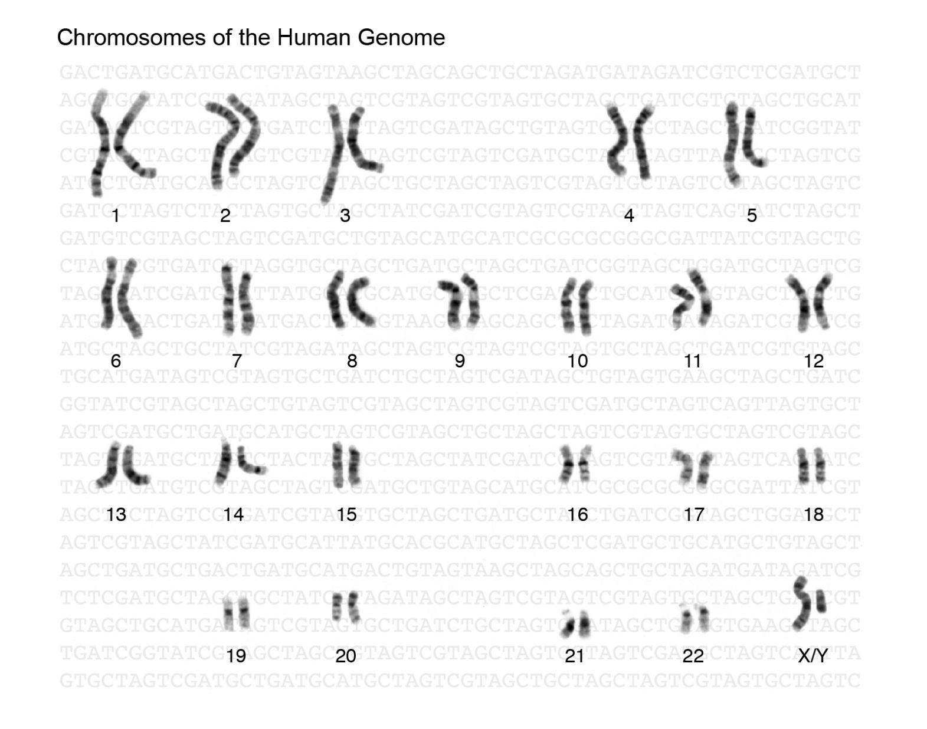
Male
Female XX
Notes:
https://www.genome.gov/sites/default/files/tg/en/illustration/genome.jpg
I just congratulated a friend whose wife bore him a son, after three daughters. So, you are not solely an X man. Also a Y man.

Slide 66
Recent large-scale analyses estimate that an average adult male has about 36 trillion human cells, an adult female about 28 trillion, and a 10‑year‑old child roughly 17 trillion
You are male or female this many times. Gender change?
Notes:
https://www.sciencetimes.com/articles/46097/20230920/human-body-number-cells-massive-new-analysis-reveals-many-person.htm

Slide 67
My theory: 23 from Miriam, 23 supernaturally by the Ruakh.

Slide 68

There is a concept in Jewish mystical writings that is somewhat like
Keno-o emptying.
However, I am NOT endorsing Kaballah.

Slide 69
The Hebrew word צִמְצוּם can mean "contraction," "retraction," "demarcation," "restraint," and "concentration." The term tsimtsum originates in the Kabbalah and refers to God’s contraction of himself before the creation of the world,
Notes:
https://en.wikipedia.org/wiki/Tzimtzum

Slide 70
and for the purpose of creating the world. To put it another way, the omnipresent God, אור אין סוף Ohr Ein Sof (infinite light) of the Godhead, who exists beyond time and space before creation, withdraws a part of his infinite presence into himself.
Notes:
https://en.wikipedia.org/wiki/Tzimtzum

Slide 71
Therefore, in some Jewish writings, the idea exists of G-d reducing Himself for the blessing of humanity!
Yeshua, the Son of Man, could be viewed as Tsimtsum צִמְצוּם to be human among us.
Notes:
Tsakhi p 267

Slide 73
Messiah’s Birthday Phil. 2.7
Keno-o / Tsimtsum
Is it Biblical to celebrate birthdays?
Why celebrate it now, in Oct.?
What does His birth mean?
Application to our lives

Slide 74
^{Mes Jews/Heb 4.15, 5.8} For we do not have a cohen gadol unable to empathize with our weaknesses; since in every respect he was tempted just as we are, the only difference being that he did not sin…Even though he was the Son, he learned obedience through his sufferings.
Notes:
Learned??? Experience it. What are you called to suffer, and learn??

Slide 75
^{MJ / Heb 7.24-25} Because he lives forever, his position as cohen does not pass on to someone else; and consequently, he is totally able to deliver those who approach God through him; since he is alive forever and thus forever able to intercede on their behalf.
Notes:
Divine Son of Man, Bar Enosh Aramaic, Ben Adam Hebrew

Slide 76
^{MJ / Heb 7.24-25} ^{NKJV} Therefore, He is also able to save to the uttermost those who come to God through Him, since He always lives to make intercession for them.

Slide 77
G-d in Messiah reaches us where we are and how we are, and completely understands, from the inside, our struggles, with divine power!
He can deliver us!
Salvation is a gift for you to receive! Then further receive.

Slide 78
So, what are we struggling with?
Hurts, resentments, anger
Frustration, failures
Passions, pornography
Jealousy, rejection, loneliness [epidemic of loneliness and AI]
Notes:
Matt Walsh

Slide 79
^{MJ / Heb 7.24-25} Because he lives forever, his position as cohen does not pass on to someone else; and consequently, he is totally able to deliver those who approach God through him; since he is alive forever and thus forever able to intercede on their behalf.

Slide 80
So, the song of Miriam when visiting her relative Elisheva
^{Lk 1.46-55} “My soul magnifies Adoni; and my spirit rejoices in God, my Savior, who has taken notice of his servant-girl in her humble position. For — imagine it! — from now on, all generations will call me blessed!
Notes:
Miriam, not Mary.

Slide 81
^{Lk 1.46-55} “The Mighty One has done great things for me! Indeed, his name is holy; and in every generation he has mercy on those who fear him. “He has performed mighty deeds with his arm, routed the secretly proud,
Notes:
Arm of the L-rd over Pharoah

Slide 82
^{Lk 1.46-55} brought down rulers from their thrones, raised up the humble, filled the hungry with good things, but sent the rich away empty. “He has taken the part of his servant Isra’el, mindful of the mercy which he promised to our fathers, to Avraham and his seed forever.”
Notes:
Avraham’s seed forever! Danger of Jewish extermination then…Haman.
Victory by His coming to earth!!

Slide 83
Zekharyah, husband of Elisheva, had this expression of praise at the birth of his son, Yokhanan,
^{Lk 1.68-79}“Praised be Adoni, the God of Isra’el, because he has visited and made a ransom to liberate his people by raising up for us a mighty Deliverer who is a descendant of his servant David.
Notes:
liberate

Slide 84
It is just as he has spoken through the mouth of the prophets from the very beginning — that we should be delivered from our enemies and from the power of all who hate us. “This has happened so that he might show the mercy promised to our fathers — that he would remember his holy covenant,
Notes:
Enemies and covenant

Slide 85
the oath he swore before Avraham Avinu to grant us that we, freed from our enemies, would serve him without fear, in holiness and righteousness before him all our days. You, child, will be called a prophet of Ha‘Elyon;
Notes:
Enemies, fear.

Slide 86
you will go before the Lord to prepare his way by spreading the knowledge among his people that deliverance comes by having sins forgiven through our God’s most tender mercy, which causes the Sunrise to visit us from Heaven, to shine on those in darkness, living in the shadow of death, and to guide our feet into the paths of peace.”
Notes:
Go before the L-rd!!
Deliverance comes….
Sunrise to visit us from heaven, the keno-o

Slide 87
G-d in Messiah reaches us where we are and how we are, and completely understands, from the inside, our struggles.
He can deliver us!
Salvation is a gift for you to receive! Then pass along.

Slide 88
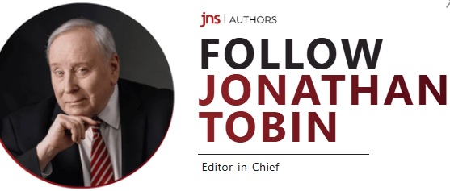
Notes:
https://www.jns.org/opinion/column/jonathan-s-tobin/the-vacation-from-jewish-history-is-over-for-americans

Slide 89
“The post-Holocaust vacation from Jewish history may be over, but the Jewish story is still unfolding. And those who have the courage to stand up and stay strong, rather than to join their enemies or to hide,
Notes:
https://www.jns.org/opinion/column/jonathan-s-tobin/the-vacation-from-jewish-history-is-over-for-americans
Post Holocaust vacation from Jewish history? Safe and accepted in America. NYC. NYU used to be NY Jew.

Slide 90
will ride out this dismal chapter of the saga of their people with the same honor and ultimate success as those who went before them.”
G-d is calling us to fight.
Jews and Gentiles FIGHT for the salvation of Israel and the Nations.
Notes:
https://www.jns.org/opinion/column/jonathan-s-tobin/the-vacation-from-jewish-history-is-over-for-americans

Slide 91
Concerning sharing the gift of Yeshua’s salvation, note that Nov. 14 we will host Emmanuel Mebasser. He is a 5th‑generation Jewish believer in Yeshua and the leader of the Online Evangelism Team at Jews for Jesus, based in Los Angeles, California.
Notes:
Fighting the enemy.

Slide 92
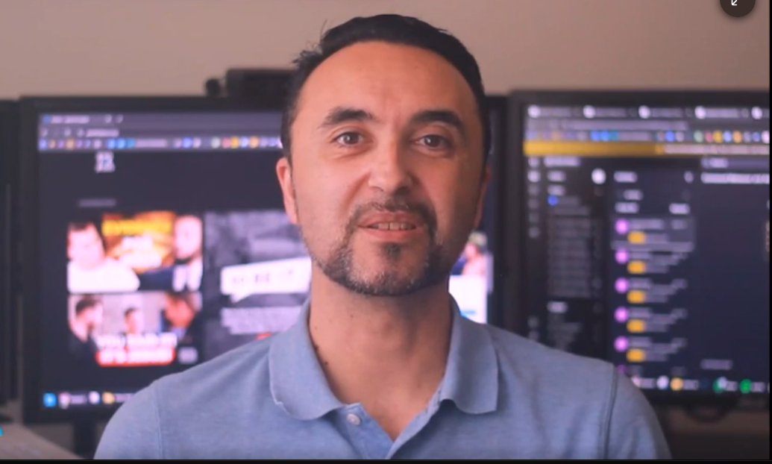

Slide 93
Incredibly, every single Democratic senator voted no to giving newborn survivors medical care in 2025. In fact, all but one Democrat in the entire Congress — Rep. Henry Cuellar (D-Texas) — refused to agree that a child crying on the table deserves to live.
Senator James Lankford (R-Okla.) could barely contain his emotion after one of these votes. “This is literally if an abortion is carried out. But the abortion, instead of destroying the child in the womb, the child is actually delivered. What do you do in that case where a child is actually delivered? They’re literally crying and breathing on the table in front of you. Now you have a fully delivered child in front of you. Do they get medical care or not? This seems like a no-brainer.” And yet, “painfully,” he continued, “Democrats said no. … I think that’s abhorrent.”
Notes:
https://washingtonstand.com/article/christa-pike-and-the-lefts-incoherent-argument-against-human-cruelty

Slide 95
Messiah’s Birthday Phil. 2.7
Keno-o / Tsimtsum
Is it Biblical to celebrate birthdays?
Why celebrate it now, in Oct.?
What does His birth mean?
Application to our lives

