Slide 1
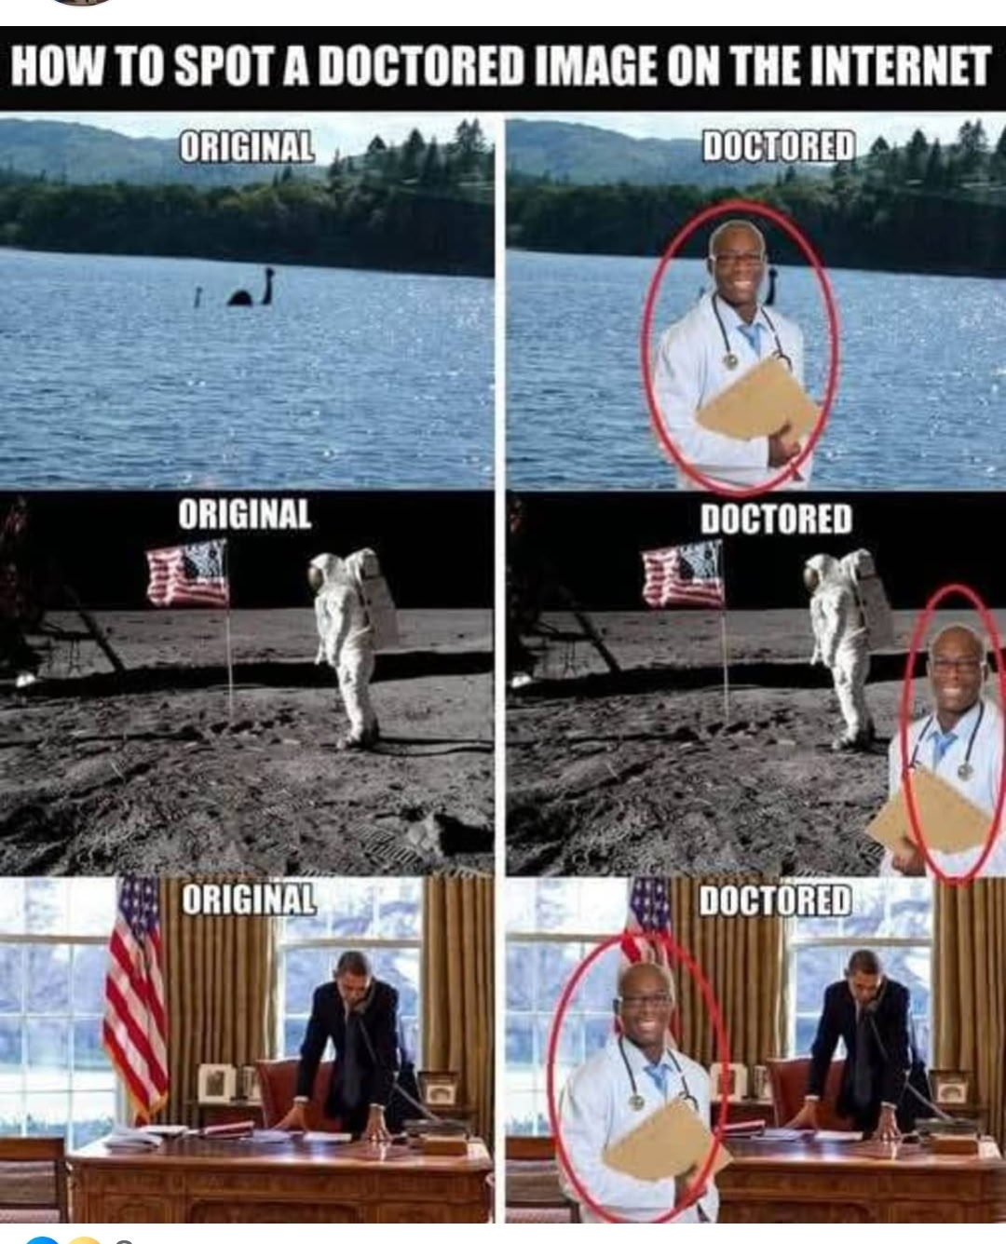

Slide 2
Notes:
Loch Ness monster? Nessie?

Slide 7
Notes:
Grady

Slide 8


Slide 9
Nov. 3, 2026 is the
mid-term election day.

Slide 10

Give to Caesar What Belongs to Ceasar,
Give to G-d What Belongs to G-d
We are in a civilizational /spiritual war
Should we avoid politics?
Should we pursue politics
How else to fight?

Slide 11
Give to Caesar What Belongs to Ceasar,
Give to G-d What Belongs to G-d
We are in a civilizational /spiritual war
Should we avoid politics?
Should we pursue politics
How else to fight?
Notes:
So what? Blood of martyrs seed of faith. We could live or die that way. NOT so.
Often, monotone pagan. Islamic Middle East.

Slide 12
First Democrat Senate candidate James Talarico says he is “a Christian who hates Christianity.” He told the Texas House that God’s gender is "nonbinary." The majority of the members of the “church” he attends are “atheists or agnostic.”
Notes:
https://lcaction.org/detail/261023-talarico-calls-god-prochoice-and-nonbinary

Slide 13
On Joe Rogan's show, Talarico argued that the Bible demands a "pro-choice" stance on abortion. His platform calls for federal legislation to codify Roe v. Wade to make abortion permanent nationwide. Talarico also said, "our trans community needs abortion care too."
Notes:
https://lcaction.org/detail/261023-talarico-calls-god-prochoice-and-nonbinary

Slide 14
Talarico even outrageously claimed that abortion and marriage are "two issues that Messiah never talked about."
He described orthodox Christian institutions as oppressive while championing radical class warfare and the redistribution of wealth.
Notes:
https://lcaction.org/detail/261023-talarico-calls-god-prochoice-and-nonbinary

Slide 15
His rhetoric sets out an alarming socialist vision for America's future.
In his speeches, Talarico targets the free market, calling capitalism an “oppressive system” that must be “dismantled.”
Notes:
https://lcaction.org/detail/261023-talarico-calls-god-prochoice-and-nonbinary
This may be the future of America. Easy to live and share about Yeshua?

Slide 16
^{1 Tim 2.1-5} First of all, then, I counsel that petitions, prayers, intercessions and thanksgivings be made for all human beings, including kings and all in positions of prominence; so that we may lead quiet and peaceful lives, being godly and upright in everything.

Slide 17
^{1 Tim 2.1-5} This is what God, our Deliverer, regards as good; this is what meets his approval. He wants all humanity to be delivered and come to full knowledge of the truth. For God is one;[a] and there is but one Mediator between God and humanity, Yeshua the Messiah

Slide 18
Second Senator James Lankford (R-Okla.) could barely contain his emotion after one of these votes. “This is literally if an abortion is carried out. But the abortion, instead of destroying the child in the womb, the child is actually delivered. What do you do in that case where a child is actually delivered?
Notes:
https://washingtonstand.com/article/christa-pike-and-the-lefts-incoherent-argument-against-human-cruelty
Evidence of civilizational/spiritual war

Slide 19
They’re literally crying and breathing on the table in front of you. Now you have a fully delivered child in front of you. Do they get medical care or not? This seems like a no-brainer.” And yet, “painfully,” he continued, “Democrats said no. … I think that’s abhorrent.”
Notes:
https://washingtonstand.com/article/christa-pike-and-the-lefts-incoherent-argument-against-human-cruelty

Slide 20
Incredibly, every single Democratic senator voted no to giving newborn survivors medical care in 2025. In fact, all but one Democrat in the entire Congress — Rep. Henry Cuellar (D-Texas) — refused to agree that a child crying on the table deserves to live.
Notes:
https://washingtonstand.com/article/christa-pike-and-the-lefts-incoherent-argument-against-human-cruelty

Slide 21
Third French President Emmanuel Macron called Israeli Prime Minister Benjamin Netanyahu on Oct. 7, 2023, to push for an immediate ceasefire while Hamas terrorists were still inside Israeli communities, Netanyahu told Israel’s Channel 14 television in an interview set for full release on Tuesday.
Notes:
https://unitedwithisrael.org/macron-urged-ceasefire-on-oct-7-says-netanyahu/

Slide 22
Macron told him the deadliest single-day massacre of Jews since the Holocaust should be stopped “by diplomacy,” Netanyahu said.
Notes:
https://unitedwithisrael.org/macron-urged-ceasefire-on-oct-7-says-netanyahu/

Slide 23
“No, Emmanuel. It’s not going to be solved by diplomacy,” he said he replied. “These are monsters. These are neo-Nazis.” Netanyahu said he told the French leader at the time that Hamas is “even worse than ISIS” and warned: “If we don’t stop Hamas here, you’ll see them on the streets of Paris.”
Notes:
https://unitedwithisrael.org/macron-urged-ceasefire-on-oct-7-says-netanyahu/

Slide 24

Notes:
https://allisraelnews.com/blog/macron-you-asked-for-it-you-got-it-a-palestinian-state

Slide 25
Demonstrators holding Palestinian and Algerian flags on the monument at Place de la Nation. Tens of thousand of people went in the streets in Paris on October 17 2026 to protest against President Emmanuel Macron policy and his Government. (Photo: Polyvios Anemoyannis / Hans Lucas via Reuters)
Notes:
https://allisraelnews.com/blog/macron-you-asked-for-it-you-got-it-a-palestinian-state

Slide 26
Fourth A new report from the Office of the Comptroller of the Currency found that America's nine largest banks maintained policies that restricted financial services based on customers' religious beliefs, political views, or otherwise lawful activities.
Notes:
FRC Action
801 G Street NW, Washington, D.C. 20001
1-877/372-2808 | Contact FRC Action

Slide 27
Even more troubling, banks referenced designations from the Southern Poverty Law Center (SPLC), an organization that has labeled Christian and conservative organizations as hate groups.
Notes:
FRC Action
801 G Street NW, Washington, D.C. 20001
1-877/372-2808 | Contact FRC Action

Slide 29
Give to Caesar What Belongs to Ceasar,
Give to G-d What Belongs to G-d
We are in a civilizational war
Should we avoid politics?
Should we pursue politics
How else to fight?

Slide 30
^{Mt 26.52-54} Yeshua said to him, “Put your sword back where it belongs, for everyone who uses the sword will die by the sword. Don’t you know that I can ask my Father, and he will instantly provide more than a dozen legions [1 legion = 6000 soldiers = 72,000] of angels to help me?

Slide 31
^{2 Cor 10.4-5} For the weapons of our warfare are not fleshly but powerful through God for the tearing down of strongholds. We are tearing down false arguments and every high-minded thing that exalts itself

Slide 32
^{2 Cor 10.4-5} against the knowledge of God. We are taking every thought captive to the obedience of Messiah.

Slide 33
Politics =
poly [many]
tics [blood suckers]
Really?

Slide 34
Nov. 3, 2026 is the
mid-term election day.

Slide 36
Give to Caesar What Belongs to Ceasar,
Give to G-d What Belongs to G-d
We are in a civilizational war
Should we avoid politics?
Should we pursue politics
How else to fight?

Slide 37
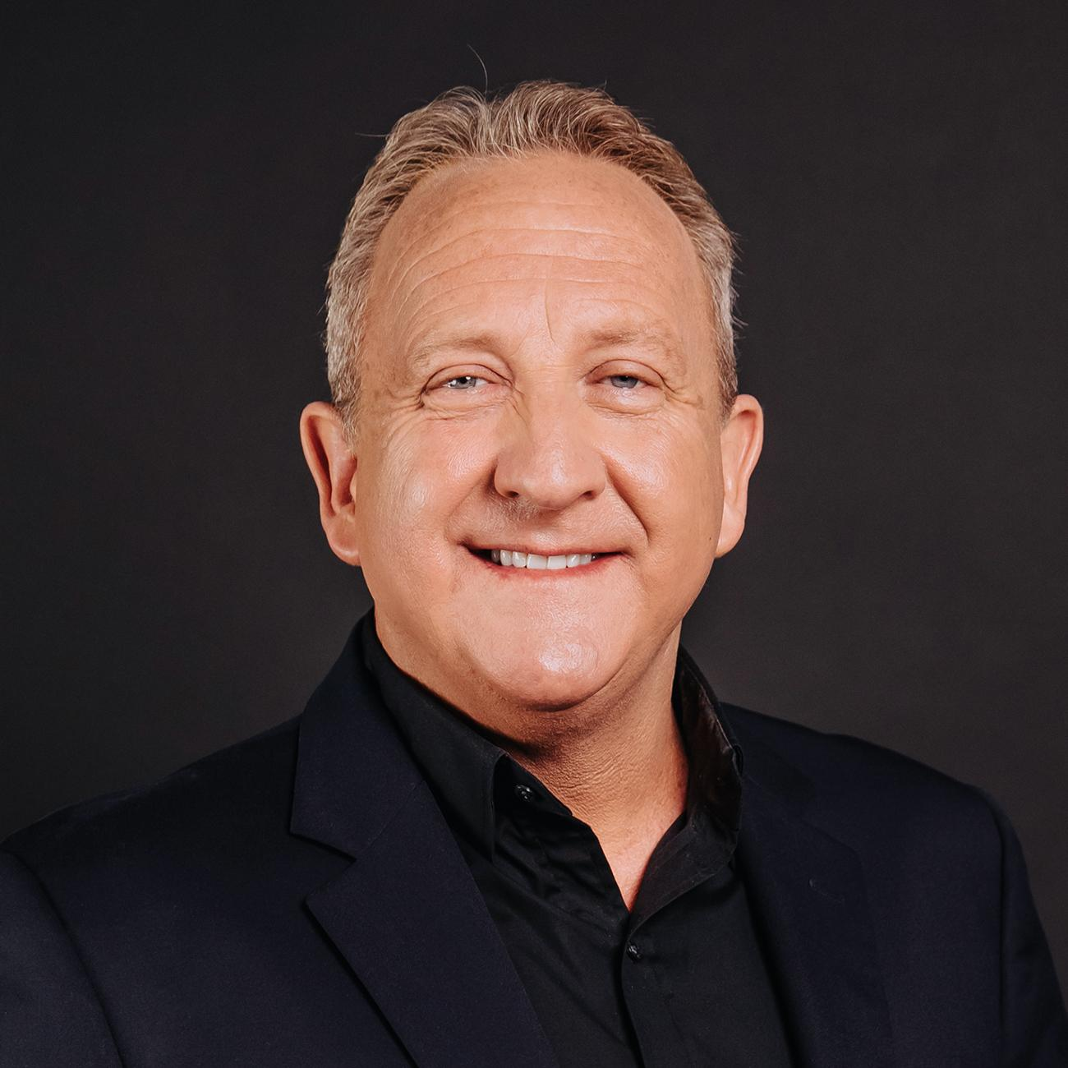
Rob McCoy was senior pastor at Godspeak Calvary Chapel in Thousand Oaks, CA for more than twenty-five years.
Notes:
He holds a B.A. in history from California State University, Fresno, and pastoral training from Mennonite Brethren Biblical Seminary. McCoy previously worked in management roles at Unilever before entering ministry.
Much of the following from:
https://www.prageru.com/videos/christians-have-a-responsibility-to-vote-pastor-rob-mccoy

Slide 38
He has also served on the Thousand Oaks City Council and was mayor from 2018 to 2019.
He was Charlie Kirk’s pastor, officiated at Charlie’s and Erika’s wedding
Notes:
Story of his and Charlie’s meeting:
I didn’t know there was anyone like you: pastor and politician,
I didn’t know there was anyone like you: young and conservative.
Play two movies.

Slide 39
Politics = poly [many] tics
or
Politics = literally means "the things concerning the πόλις (polis)“ the city, the community, Politics is the highest form of community

Slide 40
^{Yermiyahu/Jer 29.7} Seek the shalom / welfare of the city where I took you as captives in exile, and pray to Adoni for it—for in its shalom will you have shalom.”

Slide 41

https://kfl.org/

Slide 42

https://missourilife.org/

Slide 43
In 1692 in Salem, Massachusetts 19 women were convicted of witchcraft and burned of drowned.
Spectral evidence: dream
Increase Mather stopped it with the scriptural mandate: ^{Dvarim/Dt 17.6} The death sentence is to be carried out only if there was testimony

Slide 44
from two or three witnesses; he may not be sentenced to death on the testimony of only one witness.
Notes:
Pastor Mathers reformed politics with scripture!

Slide 45
Today there is much condemnation of people by social media reports. Not substantiated witnesses.
Notes:
Social media slander of Erika Kirk, Charlie’s murder conspiracies, Pastor Rob McCoy himself, Jewish people.

Slide 46
The United States is a nation built on the Torah, the Decalogue.
How many can recite all 10 in order?
Revival vs awakening.
  Whitefield, Jonathn Edwards published sermons on civic duty. Ground work for Am. Revolution.

Slide 47
20 years before the Revolution in 1776, Rev. Thomas Hooker was teaching John Locke’s principles. John Locke believed in natural rights, emphasizing that individuals possess inherent rights to life, liberty, and property.

Slide 48
Locke argued that governments are formed through the consent of the governed to protect these rights, and if they fail, citizens have the right to revolt against them.
^{Yeshayahu/ Is 33.22} For Adoni is our judge, Adoni is our lawgiver, Adoni is our king. He will save us.

Slide 49
The believing community is NOT head of the government, nor slave to it, but the conscience of the government.
The separation of powers: executive, legislative, judicial, came after 3 days of fasting and prayer. Bi-cameral legislature.
Notes:
Ideas formed out of preaching on Locke and civic duties.

Slide 50
The term “Black Robe Regiment” referred to the influential clergymen who promoted American independence and supported the military struggle against Britain.
Abolition of slavery was a clergy inspired movement

Slide 51
Until 1870’s revival associated with Sabbath keeping, honesty in words and business, coveting
In the 20thC more focus on evangelism than transformation
Jesus Revolution 1970’s coincided with sexual revolution. No society wide transformation / awakening!
Notes:
80% of Christian women who had abortions did so after making a decision for Messiah

Slide 52
What about Romans 13?

Slide 53
^{Ro 13.1-3} Everyone is to obey the governing authorities. For there is no authority that is not from God, and the existing authorities have been placed where they are by God. Therefore, whoever resists the authorities is resisting what God has instituted;

Slide 54
^{Ro 13.1-3} and those who resist will bring judgment on themselves. For rulers are no terror to good conduct, but to bad. Would you like to be unafraid of the person in authority? Then simply do what is good, and you will win his approval;
Notes:
We are to submit to authorities that do good!

Slide 55
Is it good to give hormone blockers to minors, and that without parental knowledge?
Is it good to allow the irreversible mutilation of 15-year-olds such as Chloe Cole? [then suicidal]
Is it good to allow Riley Gaines to lose her swim meet?
Notes:
And most congregations will NOT allow Chloe Cole or Riley Gaines to speak!

Slide 56

Is it loving your neighbor to allow
the above plus loss of bathroom
privacy, plus distribution of
abortifacient medicines?

Slide 57
^{Mt 16.5-7} The talmidim, in crossing to the other side of the lake, had forgotten to bring any bread. So when Yeshua said to them, “Watch out! Guard yourselves against the hametz of the P’rushim and Tz’dukim,” they thought he said it because they hadn’t brought bread

Slide 58
^{Mt 16.11-12} How can you possibly think I was talking to you about bread? Guard yourselves from the hametz of the P’rushim and Tz’dukim!” Then they understood — they were to guard themselves not from yeast for bread but from the teaching of the P’rushim and Tz’dukim.

Slide 59
^{Mt 16.13,18} When Yeshua came into the territory around Caesarea Philippi, he asked his talmidim, “Who are people saying the Son of Man is?”… I also tell you this: you are Kefa,” [which means ‘Rock,’] “and on this rock I will build my Community, and the gates of Sh’ol will not overcome it.
Notes:
Beautiful place, headwaters of Yarden/Jordan, Bacchus, nudity,

Slide 60




Slide 61
NOT “build my church.” Tyndale first to correctly translate it and hung for it.
“On this rock I’ll build my City Hall, my polis, my kehilah.”
Notes:
King James was head of the Anglican Church, and wanted his authority over the church enforced. This translation says that the believers are the conscience to the building of the City.

Slide 62
^{Mt 10.34-36} Don’t suppose that I have come to bring peace to the Land. It is not peace I have come to bring, but a sword! For I have come to set6 a man against his father, a daughter against her mother, a daughter-in-law against her mother-in-law, so that a man’s enemies will be the members of his own household.

Slide 63
^{2 Cor 10.4-5} the weapons we use to wage war are not worldly. On the contrary, they have God’s power for demolishing strongholds. We demolish arguments and every arrogance that raises itself up against the knowledge of God; we take every thought captive and make it obey the Messiah.

Slide 64
If we don’t use words now to assert righteousness, we will pay.
You can vote socialism in, but you have to shoot your way out.

Slide 65
After WW II, North and South Korea both impoverished. North of 38th parallel rich farmland. South had rocky coast, and FREEDOM. Now 8th highest GDP. Guns of N. Korea pointed at own people more than at the South.

Slide 66
Before the Japanese conquest, missionaries brought to Korea medicine, principles of sanitation, seminaries.
Korean pastors stood up to Japanese, so revival after liberation, 1948 independence.

Slide 67
Former House Speaker Newt Gingrich expressed outrage on Fox News: "We are watching our ally in South Korea, which is headed up [now] by basically a pro-communist government, literally and methodically destroying Christianity. It is an astonishing assault."
Notes:
https://en.koreaportal.com/articles/54239/20260125/south-koreas-religious-freedom-crisis-president-lee-jae-myung-faces.htm

Slide 68
South Korean President Lee Jae-myung is facing mounting international pressure over what critics describe as an unprecedented assault on religious freedom, with conservative Christian leaders detained, churches raided, and proposals to dissolve religious organizations that engage in political activity.
Notes:
https://en.koreaportal.com/articles/54239/20260125/south-koreas-religious-freedom-crisis-president-lee-jae-myung-faces.htm

Slide 69
Lee's administration targets conservative religious groups, it has remained silent regarding left-leaning Catholic and Protestant organizations that held "emergency prayer meetings" and issued declarations calling for former President Yoon Suk-yeol's resignation and impeachment.
Notes:
https://en.koreaportal.com/articles/54239/20260125/south-koreas-religious-freedom-crisis-president-lee-jae-myung-faces.htm

Slide 70
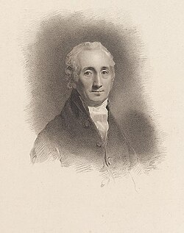
Alexander Fraser Tytler, Lord Woodhouselee FRSE 1747 –1813) was a Scottish advocate, judge, writer, and historian who was a Professor of Universal History and of Greek and Roman Antiquities at the University of Edinburgh.
Notes:
https://en.wikipedia.org/wiki/Alexander_Fraser_Tytler,_Lord_Woodhouselee

Slide 71
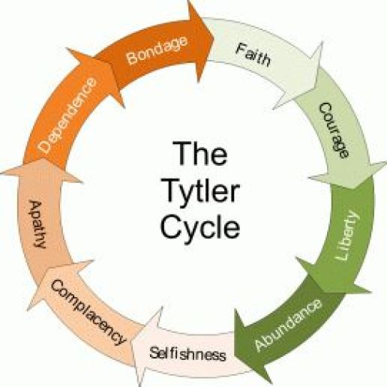

Slide 72
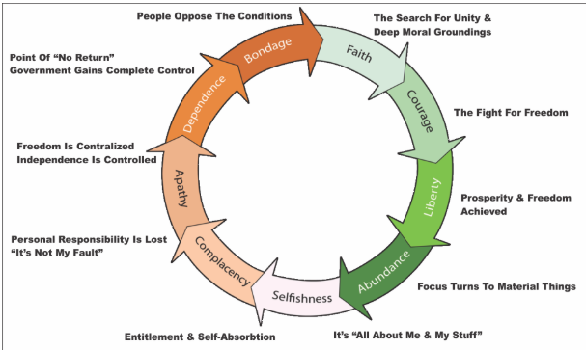

Slide 73
Faith virtue freedom can break the Tytler cycle. Revival AND awakening.

Slide 74
Avoiding politics = avoiding loving your neighbor in a difficult manner.

Slide 75
^{Rev 21.7-8} He who wins the victory will receive these things, and I will be his God, and he will be my son. But as for the cowardly, the untrustworthy, the vile, the murderers, the sexually immoral, those involved with the occult and with drugs, idol-worshippers, and all liars — their destiny is the lake burning with fire and sulfur, the second death.”

Slide 78
Give to Caesar What Belongs to Ceasar,
Give to G-d What Belongs to G-d
Should we avoid politics?
Should we pursue politics
Should we pursue politics
How else to fight?

Slide 79
Nov. 14 we will host Emmanuel Mebasser. He is a 5th‑generation Jewish believer in Yeshua and the leader of the Online Evangelism Team at Jews for Jesus, Yehudim for Yeshua, based in Los Angeles, California.
Notes:
Fighting the enemy.

Slide 80
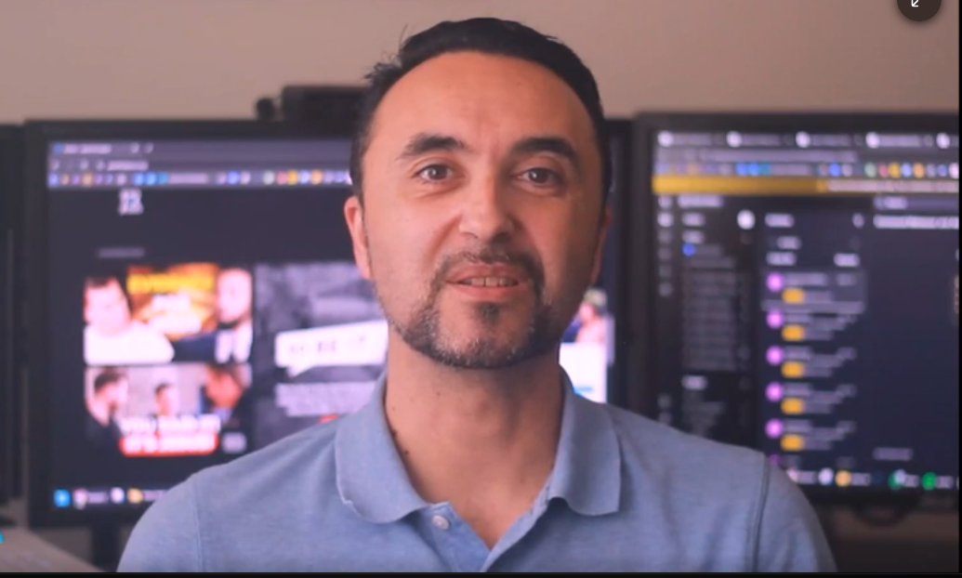

Slide 81
Marissa: What advice you give a young man wanting spiritual awakening. Starfish Lead follow get out of the way. Moses one man plus G-d is a majority.

Slide 82
Story of two boys optimist and pessimist Room full of toys crying. Room full of manure, laughting Pony here somewhere.
You are immortal till g-d done 3 people said Charlie died w smile on his face. Stephen said Y stood to weldomce him.

Slide 84
Give to Caesar What Belongs to Ceasar,
Give to G-d What Belongs to G-d
Should we avoid politics?
Should we pursue politics
Should we pursue politics
How else to fight?

