Slide 1
Special Oneg Lunch announcement:
Food will be served in the Bring & Share room, NOT outside.
Feel free to eat outside in the Sukkah or the picnic tables.

Slide 2
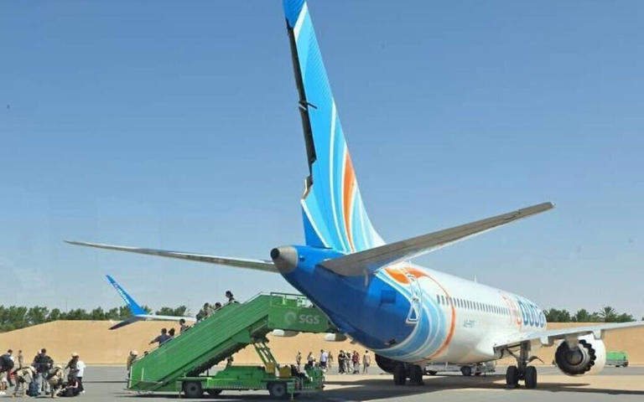
The flydubai
flight that
landed at
Tabuk Airport
in Saudi Arabia
Notes:
https://img-s-msn-com.akamaized.net/tenant/amp/entityid/AA2dfZrv.img?w=768&h=480&m=6
Note tail ripped off because of near Mach 1 supersonic speed in descent. Any faster and plane would have damaged further, uncontrollabl

Slide 3

Notes:
An undated photo of Captain Smit Machchhar, captain of a flydubai flight from Dubai to Tel Aviv that suffered an emergency, mid-air, with the copilot subdued after stabbing Machchhar in an alleged attempt to crash the plane full of Israelis, September 30, 2026. (Danny Danon via X)

Slide 4
For Netanyahu, the remarkable convergence of events — a wounded captain managing to open the cockpit, passengers willing to charge toward danger, people aboard capable of treating the wounded,
Notes:
https://www.worthynews.com/117932-netanyahu-calls-flydubai-rescue-a-chain-of-miracles-with-divine-assistance

Slide 5
additional pilots available to take control and an aircraft surviving its violent descent — amounted to something beyond human courage alone.
“What happened yesterday,” Netanyahu said, “is a chain of miracles with divine assistance.”
Notes:
https://www.worthynews.com/117932-netanyahu-calls-flydubai-rescue-a-chain-of-miracles-with-divine-assistance

Slide 6
With the aircraft hurtling downward, Yaniv Hayun managed to breach the cockpit with a crew member's help thanks to the Captain opening the door. Inside, chaos unfolded. Realizing a physical threat was actively compromising the flight,
Notes:
Rita Slobodkin’s Facebook

Slide 7
Yaniv did what had to be done: he fought the co-pilot, locked him in a chokehold, and dragged him out of the cockpit.
With nobody at the controls and seconds ticking away, Yaniv went back in and grabbed the yoke and pulled back to help level the aircraft.
Notes:
Rita Slobodkin’s Facebook

Slide 8
His professional aviation experience? Zero. His qualifications? "I had seen Air Crash Investigation on TV."
Another qualified off duty pilot eventually stepped in to bring the aircraft down safely, but Yaniv's split-second bravery and iron-willed intervention stopped a catastrophe.
Notes:
Rita Slobodkin’s Facebook

Slide 9


Slide 10
Israel was not founded so that the world could better mourn Jewish victims. Israel was founded so that there would be fewer Jewish victims to mourn. From Masada to the Warsaw Ghetto to the founding of the state, a single idea runs through Jewish memory:

Slide 11
we cannot count on others to save us in time. Golda Meir distilled this experience into a formulation that has lost none of its edge to this day: better to be alive and criticized than dead and honored...
Notes:
Pause to thank G-d in Messiah for this deliverance. Time of the year of 9/11, Oct. 7 and 8.
עם ישראל חי Am Yisrael Khi!!

Slide 12
Since we are talking about heroism
Built from the shoresh (root) ג-ב-ר
Creates a family of related words:
Notes:
I get an email from the Rosen school of Hebrew.
https://lp.rosenhebrewschool.com/lp-rosen-modern-hebrew-drip_ret_rosen_www_gever-en.html?cid=111444&adGroupId=-1&utm_source=Email_Marketing&utm_medium=Drip_RET_Rosen+-+WWW+Gever+03&utm_campaign=HEB_EN_EML_Drip_RET_Rosen+-+WWW+Gever_2025-02-26_111444&commChannel=1&stid=12345&hash=c8bdb8daf0b0d1714a86c5e5852b3c389fbf96e1edf4f29d20910a154fff15a3

Slide 13
מה קורה גבר → Ma koreh gever - What's up man?
גבר גבר → Gever gever - Great guy/Good man (expression of praise), "macho"
Notes:
https://lp.rosenhebrewschool.com/lp-rosen-modern-hebrew-drip_ret_rosen_www_gever-en.html?cid=111444&adGroupId=-1&utm_source=Email_Marketing&utm_medium=Drip_RET_Rosen+-+WWW+Gever+03&utm_campaign=HEB_EN_EML_Drip_RET_Rosen+-+WWW+Gever_2025-02-26_111444&commChannel=1&stid=12345&hash=c8bdb8daf0b0d1714a86c5e5852b3c389fbf96e1edf4f29d20910a154fff15a3

Slide 14
אתה גבר → Ata gever - You're the man
תהיה גבר → Tihye gever - Be a man (encouragement)
Notes:
https://lp.rosenhebrewschool.com/lp-rosen-modern-hebrew-drip_ret_rosen_www_gever-en.html?cid=111444&adGroupId=-1&utm_source=Email_Marketing&utm_medium=Drip_RET_Rosen+-+WWW+Gever+03&utm_campaign=HEB_EN_EML_Drip_RET_Rosen+-+WWW+Gever_2025-02-26_111444&commChannel=1&stid=12345&hash=c8bdb8daf0b0d1714a86c5e5852b3c389fbf96e1edf4f29d20910a154fff15a3

Slide 15
איזה גבר → Eizeh gever - What a guy! (compliment)
להסגביר → Lehasgbir – to mansplain (להסביר + גבר)
Notes:
https://lp.rosenhebrewschool.com/lp-rosen-modern-hebrew-drip_ret_rosen_www_gever-en.html?cid=111444&adGroupId=-1&utm_source=Email_Marketing&utm_medium=Drip_RET_Rosen+-+WWW+Gever+03&utm_campaign=HEB_EN_EML_Drip_RET_Rosen+-+WWW+Gever_2025-02-26_111444&commChannel=1&stid=12345&hash=c8bdb8daf0b0d1714a86c5e5852b3c389fbf96e1edf4f29d20910a154fff15a3

Slide 16


Slide 17

G-d’s Infinite Resources
Some inventory
Notes:
I’m going to do something unique in 32 years. Rukhel elegantly read and drashed on the weekly parasha. I’m going to comment on the same verses, but in a whole different direction. I’ll just read the English.
View the following from a business perspective. My Dad’s business huge task counting every buff, brush, tweezer…every December.

Slide 18
D’varim (Deuteronomy) 33:24 CJB
וּלְאָשֵׁ֣ר אָמַ֔ר בָּר֥וּךְ מִבָּנִ֖ים אָשֵׁ֑ר יְהִ֤י רְצוּי֙ אֶחָ֔יו וְטֹבֵ֥ל בַּשֶּׁ֖מֶן רַגְלֽוֹ׃
Of Asher he said:
“May Asher be most blessed of sons,
may he be the favorite among his brothers and bathe his feet in oil.

Slide 19
D’varim (Deuteronomy) 33:25 CJB
בַּרְזֶ֥ל וּנְחֹ֖שֶׁת מִנְעָלֶ֑ךָ וּכְיָמֶ֖יךָ דׇּבְאֶֽךָ׃
“May your bolts be of iron and bronze
and your strength last as long as you live.

Slide 20
B’resheet (Genesis) 1:21 CJB
וַיִּבְרָ֣א אֱלֹהִ֔ים אֶת־הַתַּנִּינִ֖ם הַגְּדֹלִ֑ים וְאֵ֣ת כׇּל־נֶ֣פֶשׁ הַֽחַיָּ֣ה הָֽרֹמֶ֡שֶׂת אֲשֶׁר֩ שָׁרְצ֨וּ הַמַּ֜יִם לְמִֽינֵהֶ֗ם וְאֵ֨ת כׇּל־ע֤וֹף כָּנָף֙ לְמִינֵ֔הוּ וַיַּ֥רְא אֱלֹהִ֖ים כִּי־טֽוֹב׃
God created the great sea creatures and every living thing that creeps, so that the water swarmed with all kinds of them, and there was every kind of winged bird; and God saw that it was good.

Slide 21
B’resheet (Genesis) 1:22 CJB
וַיְבָ֧רֶךְ אֹתָ֛ם אֱלֹהִ֖ים לֵאמֹ֑ר פְּר֣וּ וּרְב֗וּ וּמִלְא֤וּ אֶת־הַמַּ֙יִם֙ בַּיַּמִּ֔ים וְהָע֖וֹף יִ֥רֶב בָּאָֽרֶץ׃
Then God blessed them, saying, “Be fruitful, multiply and fill the water of the seas, and let birds multiply on the earth.”

Slide 22
B’resheet (Genesis) 1:23 CJB
וַֽיְהִי־עֶ֥רֶב וַֽיְהִי־בֹ֖קֶר י֥וֹם חֲמִישִֽׁי׃
So there was evening, and there was morning, a fifth day.

Slide 23
B’resheet (Genesis) 1:24 CJB
וַיֹּ֣אמֶר אֱלֹהִ֗ים תּוֹצֵ֨א הָאָ֜רֶץ נֶ֤פֶשׁ חַיָּה֙ לְמִינָ֔הּ בְּהֵמָ֥ה וָרֶ֛מֶשׂ וְחַֽיְתוֹ־אֶ֖רֶץ לְמִינָ֑הּ וַֽיְהִי־כֵֽן׃
God said, “Let the earth bring forth each kind of living creature — each kind of livestock, crawling animal and wild beast”; and that is how it was.

Slide 24
B’resheet (Genesis) 1:24 CJB
וַיֹּ֣אמֶר אֱלֹהִ֗ים תּוֹצֵ֨א הָאָ֜רֶץ נֶ֤פֶשׁ חַיָּה֙ לְמִינָ֔הּ בְּהֵמָ֥ה וָרֶ֛מֶשׂ וְחַֽיְתוֹ־אֶ֖רֶץ לְמִינָ֑הּ וַֽיְהִי־כֵֽן׃
God said, “Let the earth bring forth each kind of living creature — each kind of livestock, crawling animal and wild beast”; and that is how it was.

Slide 25
A plethora of wealth!!

Slide 27
G-d’s Infinite Resources
Some inventory
Hyper-literal?

Slide 28
D’varim (Deuteronomy) 33:24 CJB
וּלְאָשֵׁ֣ר אָמַ֔ר בָּר֥וּךְ מִבָּנִ֖ים אָשֵׁ֑ר יְהִ֤י רְצוּי֙ אֶחָ֔יו וְטֹבֵ֥ל בַּשֶּׁ֖מֶן רַגְלֽוֹ׃
Of Asher he said:
“May Asher be most blessed of sons,
may he be the favorite among his brothers and bathe his feet in oil.

Slide 29
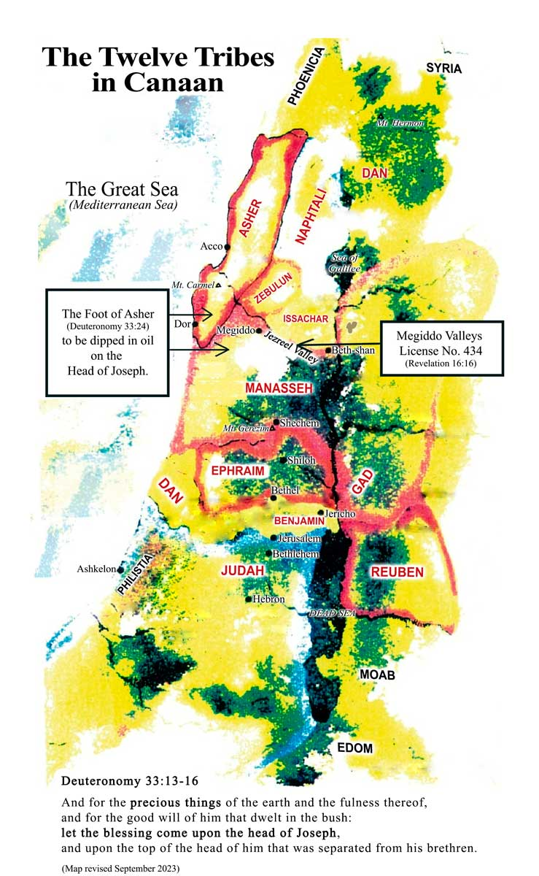
Notes:
https://www.zionoil.com/

Slide 30
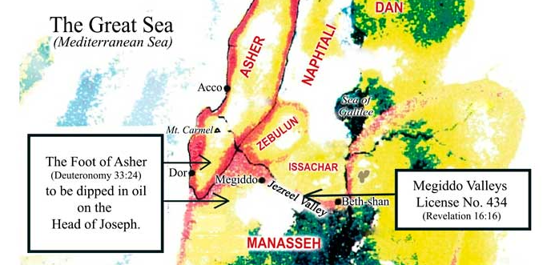
Notes:
https://www.zionoil.com/

Slide 31
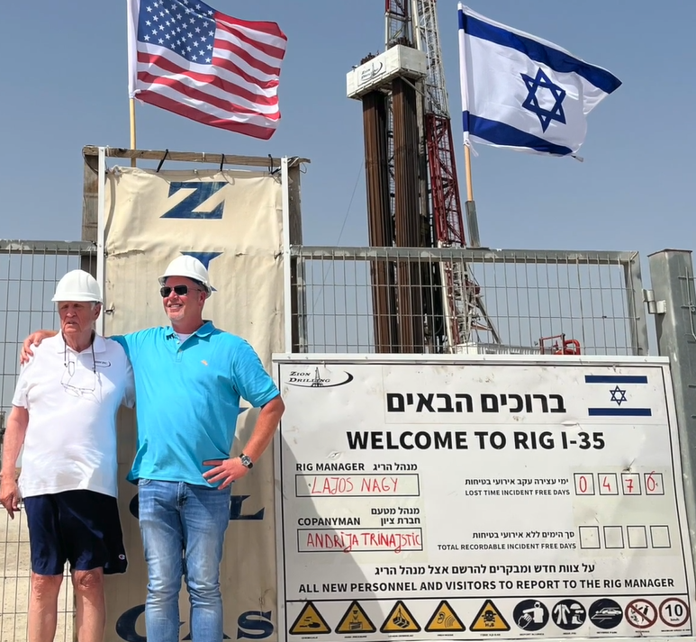
God called me full time to pursue the vision for the oil in December 1985 (Acts 22:14-15). So, by faith, I resigned my position at Valeron and moved to Houston, Texas to write the Vision Book (Habakkuk 2:1-3).
Notes:
https://www.zionoil.com/vision/vision-statement/founders-page/

Slide 32
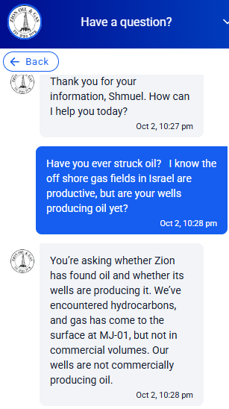

Slide 33
You’re asking whether Zion has found oil and whether its wells are producing it. We’ve encountered hydrocarbons, and gas has come to the surface at MJ-01, but not in commercial volumes. Our wells are not commercially producing oil.
Notes:
Some have scoffed at the survivability of Israel. A ridiculous dream. Many Israelis are leaving the country, declining to go on a tour!

Slide 35
G-d’s Infinite Resources
Some inventory
Hyper-literal?
Abundant riches

Slide 36

https://www.wisemoneyisrael.com/iltv-feature-inside-israels-economic-resilience/

Slide 37
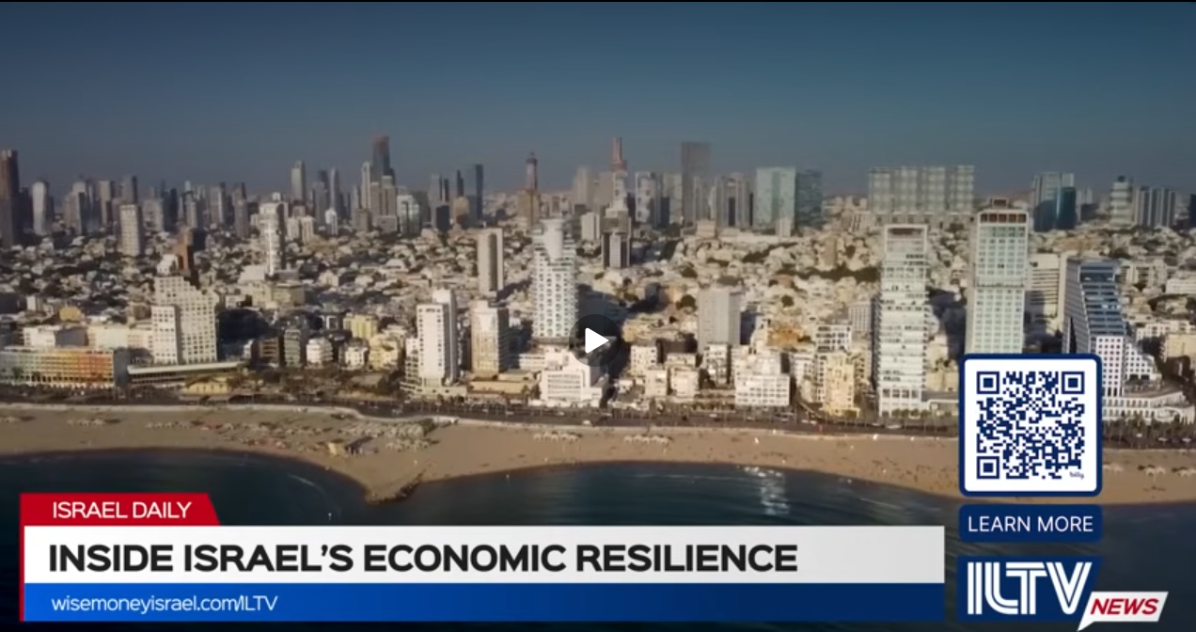
Notes:
When I was in Israel in 1973 there was ONE Jewish skyscraper: Shalom Tower. Now you can barely find it.

Slide 39
G-d’s Infinite Resources
Some inventory
Hyper-literal?
Abundant riches
Our GREATEST riches

Slide 40
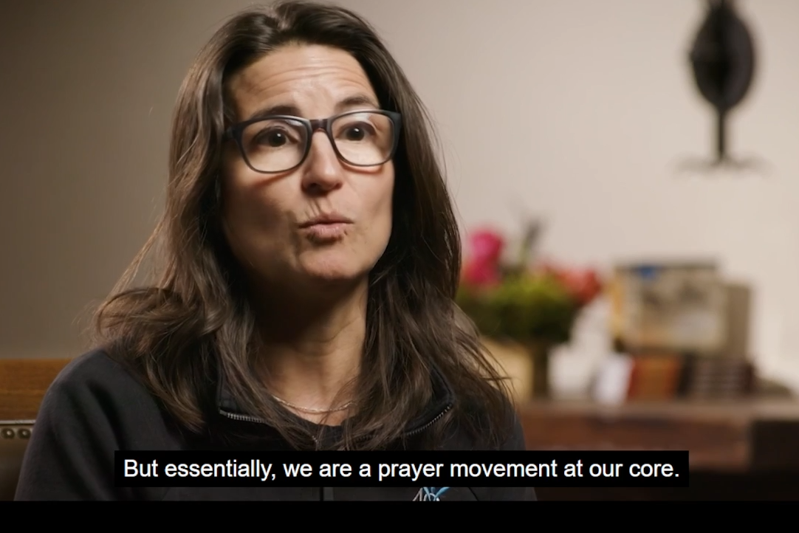
Notes:
https://vimeo.com/1225394168?fl=pl&fe=vl

Slide 41
Tuesday, Oct. 13, from 7 a.m.
to 7 p.m. will be Or HaOlam’s day to peacefully protest and pray on the sidewalk near the Overland Park abortion clinic

Slide 42
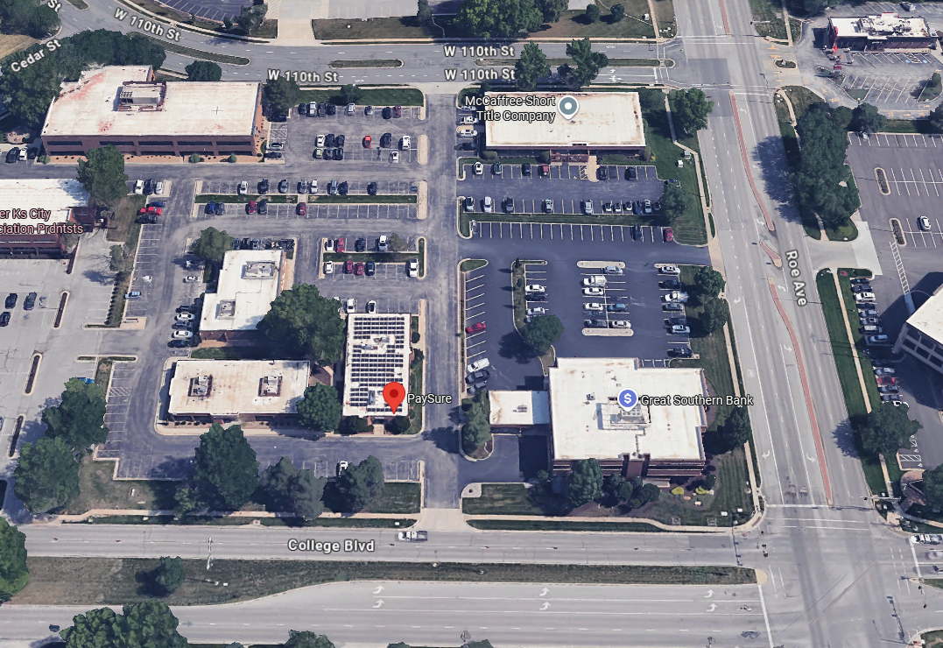
Notes:
Near the NW corner of College Blvd and Roe Ave

Slide 43
Notes:
So is Or HaOlam.
Like the heroes of Flydubai Flight 1073, we have heroic servant hearted people doing the planning and prep for the music, the tech, the Torah, the teaching. But the bottom line is the prayer.
Private prayer 10-10-10 or MUCH more.
Teerosh, particularly last Tuesday Ulises lead a powerful prayer time. PLEASE prioritize!

Slide 44

One in three young adults say they’re attending services more often than a year ago—and it’s not happening evenly across every group.
Prayer tops the list of reasons young adults give for showing up, ahead of every other spiritual reason surveyed.
Notes:
https://www.barna.com/research/young-adults-spiritual-reasons-church/?utm_campaign=37192504-Weekly%20Roundup&utm_medium=email&_hsenc=p2ANqtz-9LGyCjDjxxfWLKvzBaE86M6fq_DOu45XNjjlmbTZEDRaFea2l4ZaQ3QjF4u8p4lx4tnr10w5ldg6OdmfSP69nQgQjs_g&_hsmi=442298177&utm_content=442298177&utm_source=hs_email

Slide 45
The more interesting question isn’t just who’s returning to congregation, but what they’re finding there—or hoping to find. Nearly half of young adults (45%) say prayer is a reason they attend services, the single most-selected spiritual reason on the list. Worshiping Messiah alongside other people follows at 38 percent.
Notes:
https://www.barna.com/research/young-adults-spiritual-reasons-church/?utm_campaign=37192504-Weekly%20Roundup&utm_medium=email&_hsenc=p2ANqtz-9LGyCjDjxxfWLKvzBaE86M6fq_DOu45XNjjlmbTZEDRaFea2l4ZaQ3QjF4u8p4lx4tnr10w5ldg6OdmfSP69nQgQjs_g&_hsmi=442298177&utm_content=442298177&utm_source=hs_email

Slide 46
^{Yn 7 37-46} Now on the last day of the festival, Hoshana Rabbah, Yeshua stood and cried out, “If anyone is thirsty, let him keep coming to me and drinking! Whoever puts his trust in me, as the Scripture says, rivers of living water will flow from his inmost being!” (Now he said this about the Spirit, whom those who trusted in him were to receive later — the Spirit had not yet been given,

Slide 47
^{Yn 7 37-46} because Yeshua had not yet been glorified.) On hearing his words, some people in the crowd said, “Surely this man is ‘the prophet’”; others said, “This is the Messiah.” But others said, “How can the Messiah come from the Galil? Doesn’t the Tanakh say that the Messiah is from the seed of David and comes from Beit-Lekhem, the village where David lived?”

Slide 48
^{Yn 7 37-46} So the people were divided because of him. Some wanted to arrest him, but no one laid a hand on him. The guards came back to the head cohanim and the P’rushim, who asked them, “Why didn’t you bring him in?” The guards replied, “No one ever spoke the way this man speaks!
Notes:
There are no words like the scripture. No joy like the Spirit!
Have you received Him?
Are you actively walking with Him in His Word and Spirit by prayer?

Slide 50
G-d’s Infinite Resources
Some inventory
Hyper-literal?
Abundant riches
Our GREATEST riches

