Slide 1
A new definition of couch potato

Slide 2

Notes:
From Ben Troyer

Slide 3
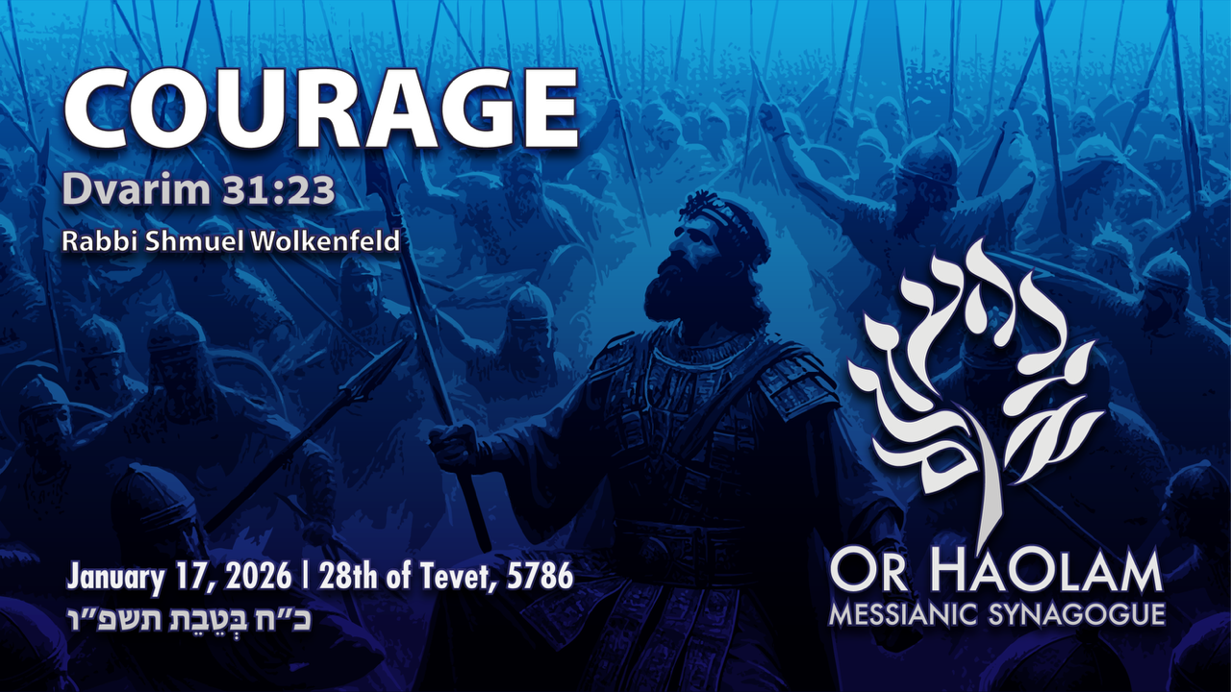
Notes:
Think of what you are afraid of

Slide 4
^{Dvarim 31.23} Adoni also commissioned Y’hoshua the son of Nun with these words: “Be strong and full of courage; for you are to bring the people of Isra’el into the land about which I swore to them; and I will be with you.”
Notes:
NOT a retirement message. That timing is not yet determined. The issue will be addressed a bit.

Slide 5
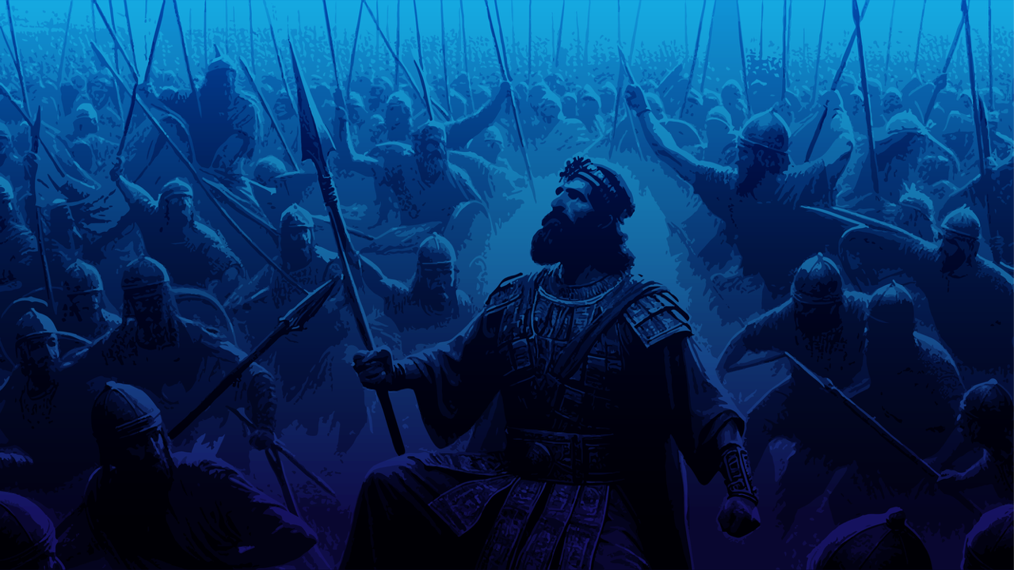
Courage: Dvarim/ Dt 31.23
Word study on courage
Context in Dvarim ch 31
Other comments on courage
Actions that require courage

Slide 6
Courage: Dvarim/ Dt 31.23
Word study on courage
Context in Dvarim
Other comments on courage
Actions that require courage

Slide 7
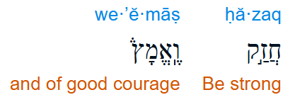
חֲזַק וֶאֱמָץ khazak v’emaz
Imperative verbs
Notes:
https://biblehub.com/hebrew/2388.htm

Slide 8
חָזַק khazaq: To be strong, to strengthen, to harden, to prevail, to take hold of, tough, hardy; powerful
Original Word: חָזַק
Part of Speech: Verb

Slide 9
אָמַץ amats: To be strong, to be courageous, to be firm, to strengthen, to take courage
Original Word: אָמַץ
Part of Speech: Verb

Slide 10
Courage: the ability to do something that frightens one:
"she called on all her courage to face the ordeal"
▪strength in the face of pain or grief: "he fought his illness with great courage"
Notes:
https://search.yahoo.com/yhs/search?p=courage&hspart=fc&hsimp=yhs-5918_1&type=fc_A2EFA035EF5_s69_g_e_d111225_n141297_c999&param1=7&param2=eJwtj8tqwzAURH9FywRk%2BV69HEWrpnY%2BoHRVoYXjqI7wE9vBpV9fFMpsBuYMzLTx7qz%2FKBFAyUI46kdnPUrkpnDUpxAROVeO%2BsZZb4xx1MfZWc%2BRMwTONDIUCW7D5Kx%2Fro76Z%2B2sH6bf2Pd1rhiQwx7H%2B7SvZNwIAgNL9jhqacmPlkdSz3Mf9nDr4pYrUTChyaF7bENPSR%2B7QNrQdNORNI9lGkKOUjJIImv9XS%2Fxv5J2ra87acAalpevhFJSXSC7ChQZ4hWyNy1l9n4R1akUwMvqlPgmwRy4zgAz1J9ozlKd0TAuxdcfTIVTfA%3D%3D

Slide 11
Courage noun
mental or moral strength to venture, persevere, and withstand danger, fear, or difficulty
Notes:
https://www.merriam-webster.com/dictionary/courage

Slide 13
Courage: Dvarim/ Dt 31.23
Word study on courage
Context in Dvarim ch 31
Other comments on courage
Actions that require courage

Slide 14
^{Dvarim Dt 31.1} Moshe went and spoke the following words to all Isra’el: “I am 120 years old today. I can’t get around any longer; moreover, Adoni has said to me, ‘You will not cross this Yarden.’
Losing their leader
Notes:
This is NOT a retirement message. I did 113 pushups this morning.

Slide 15
^{Dvarim Dt 31.3} Y’hoshua — he will cross over ahead of you, as Adoni has said. Adoni will do to them what he did to Sichon and ‘Og, the kings of the Emori, and to their land — he destroyed them. Adoni will defeat them ahead of you.
Huge, powerful enemies pending

Slide 16
^{Dvarim Dt 31.6} To Yehoshua“Be strong, be bold.”
^{Dvarim Dt 31.8} Adoni — it is he who will go ahead of you. He will be with you. He will neither fail you nor abandon you, so don’t be afraid or downhearted.”
Notes:
Previously to all Israel.
Negative form of the same exhortation

Slide 17
^{Dvarim Dt 31.9-12} Then Moshe wrote down this Torah… At the end of every seven years, during the festival of Sukkot in the year of sh’mittah…you are to read this Torah before all Isra’el, so that they can hear it. Assemble the people — the men, the women, the little ones and the foreigners.
Notes:
Grand Bible study. No books, no iPhones, etc., just scrolls, just hearing, at least Sukkot, maybe whole Sabbatical year

Slide 18
^{Dvarim Dt 31.15} Adoni appeared in the tent in a column of cloud;
^{Dvarim Dt 31.16} But this people will get up and offer themselves as prostitutes to the foreign gods of the land where they are going.
Notes:
Presence
Future failure and disaster

Slide 19
^{Dvarim Dt 31.19} Therefore, write this song for yourselves, and teach it to the people of Isra’el. Have them learn it by heart.
Notes:
Memorize and sing scripture.

Slide 20
Summary of Dvarim 31 context: Moshe old, great enemies, strong and bold, don’t fear and dread, study Word, assemble, Presence, future failure, sing scripture…

Slide 21
^{Dvarim 31.23} Adoni also commissioned Y’hoshua the son of Nun with these words: “Be strong and full of courage; for you are to bring the people of Isra’el into the land about which I swore to them; and I will be with you.”
Notes:
You will do it successfully, in spite of all this.

Slide 23
Courage: Dvarim/ Dt 31.23
Word study on courage
Context in Dvarim
Other comments on courage
Actions that require courage

Slide 24
^{Yeshayahu/Is 50.5-7} Adoni Elohim has opened my ear, and I neither rebelled nor turned away. I offered my back to those who struck me, my cheeks to those who plucked out my beard; I did not hide my face from insult and spitting.
Notes:
A prophetic picture of Yeshua.

Slide 25
^{Yeshayahu/Is 50.5-7} For Adoni Elohim will help. This is why no insult can wound me. This is why I have set my face like flint, knowing I will not be put to shame.
Notes:
A prophetic picture of Yeshua.

Slide 26
^{Lk 9.51} As the time approached for him to be taken up to heaven, Yeshua resolutely set out for Yerushalayim.

Slide 27
^{Yn 16:33} “I have said these things to you so that, united with me, you may have shalom. In the world, you have tsuris. But be brave! I have conquered the world!”

Slide 28
^{Acts 14.21-22} After proclaiming the Good News in that city and making many people into talmidim, they returned to Lystra, Iconium and Antioch, strengthening the talmidim, encouraging them to remain true to the faith, and reminding them
Notes:
This is sooooo hard!
So?

Slide 29
^{Acts 14.22} It is through many hardships that we must enter the Kingdom of God.
Notes:
My life is hard. This situation is difficult. True.

Slide 30
^{Ro 8.17} If we are children, then we are also heirs, heirs of God and joint-heirs with the Messiah — provided we are suffering with him in order also to be glorified with him.
Notes:
What are you suffering? Do it with courage and love. That is your pathway to the kingdom of Messiah!!

Slide 31
Aristotle: 'Courage is the first of human qualities because it is the quality which guarantees the others.'
Notes:
https://www.socratic-method.com/philosophy-quote-meanings/aristotle-courage-is-the-first-of-human-qualities-because-it-is-the-quality-which-guarantees-the-others

Slide 32

Notes:
https://quotefancy.com/quote/1372410/Dennis-Prager-Courage-is-the-rarest-of-all-good-traits

Slide 33
“I am convinced courage is the rarest of all good traits. There are far more kind and honest people than there are courageous people. Unfortunately, however, in the battle against evil, all the good traits in the world amount to little when not accompanied by courage.”
― Dennis Prager, The Rational Bible: Exodus
Notes:
https://www.facebook.com/DennisPrager/posts/1410038703812915/

Slide 34
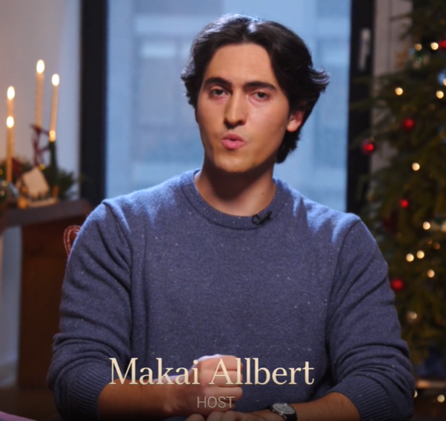
Notes:
https://www.theepochtimes.com/epochtv/how-courage-changes-your-brain-and-your-life-5966832?utm_source=Goodevening&src_src=Goodevening&utm_campaign=gv-2026-01-07&src_cmp=gv-2026-01-07&utm_medium=email&est=FGVQwkWiabkokEiL7kb2LUE4p%2FujWMRIHAJCAUQixlXJV6qEdpoHoettG14cMBo04A%3D%3D&utm_campaign=socialshare_email&utm_source=email

Slide 35

Courage challenges us to move beyond our comfort zone.
Notes:
https://www.theepochtimes.com/epochtv/how-courage-changes-your-brain-and-your-life-5966832?utm_source=Goodevening&src_src=Goodevening&utm_campaign=gv-2026-01-07&src_cmp=gv-2026-01-07&utm_medium=email&est=FGVQwkWiabkokEiL7kb2LUE4p%2FujWMRIHAJCAUQixlXJV6qEdpoHoettG14cMBo04A%3D%3D&utm_campaign=socialshare_email&utm_source=email

Slide 36

Stand by our principles
Embark on a new path.
Notes:
https://www.theepochtimes.com/epochtv/how-courage-changes-your-brain-and-your-life-5966832?utm_source=Goodevening&src_src=Goodevening&utm_campaign=gv-2026-01-07&src_cmp=gv-2026-01-07&utm_medium=email&est=FGVQwkWiabkokEiL7kb2LUE4p%2FujWMRIHAJCAUQixlXJV6qEdpoHoettG14cMBo04A%3D%3D&utm_campaign=socialshare_email&utm_source=email

Slide 37
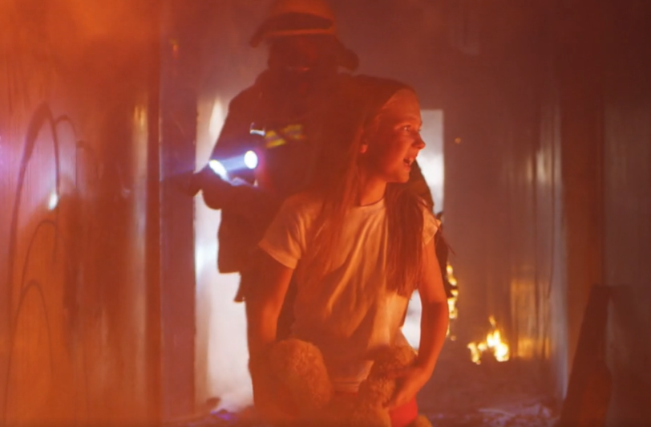
Intention: deliberate choice
Noble meaningful goal
Real risk
Notes:
https://www.theepochtimes.com/epochtv/how-courage-changes-your-brain-and-your-life-5966832?utm_source=Goodevening&src_src=Goodevening&utm_campaign=gv-2026-01-07&src_cmp=gv-2026-01-07&utm_medium=email&est=FGVQwkWiabkokEiL7kb2LUE4p%2FujWMRIHAJCAUQixlXJV6qEdpoHoettG14cMBo04A%3D%3D&utm_campaign=socialshare_email&utm_source=email

Slide 38
General: military
Moral: stand up in a progressive university
Personal: overcome a phobia
Notes:
Israelis facing rockets, protracted war. PTSD ~30 years after YK 1973 war

Slide 39
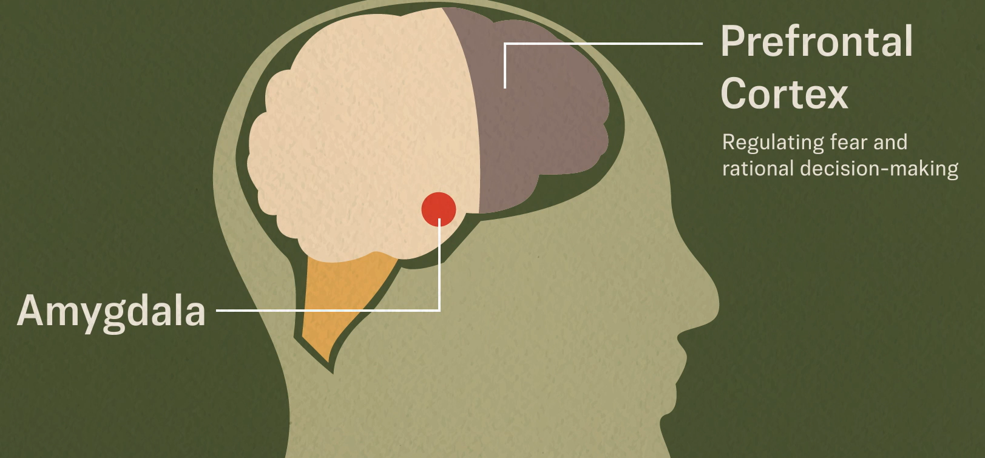
Courage gap: what you fear and what you can become.
Notes:
Amygdala overrides prefrontal cortex. Your brain changes when you practice courage, making it easier over time. Overriding rational signals for safety.

Slide 40
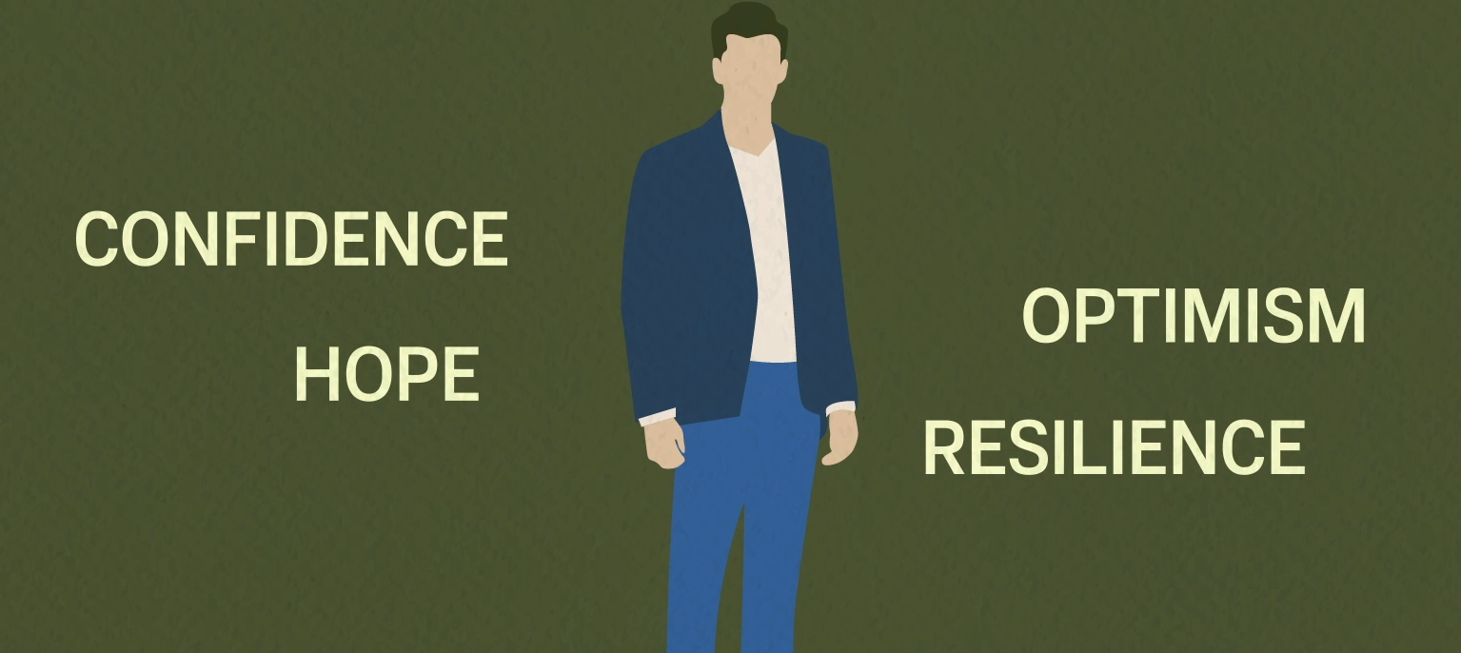

Slide 41

Notes:
One study connected courage with greater academic performance
https://www.theepochtimes.com/epochtv/how-courage-changes-your-brain-and-your-life-5966832?utm_source=Goodevening&src_src=Goodevening&utm_campaign=gv-2026-01-07&src_cmp=gv-2026-01-07&utm_medium=email&est=FGVQwkWiabkokEiL7kb2LUE4p%2FujWMRIHAJCAUQixlXJV6qEdpoHoettG14cMBo04A%3D%3D&utm_campaign=socialshare_email&utm_source=email

Slide 42
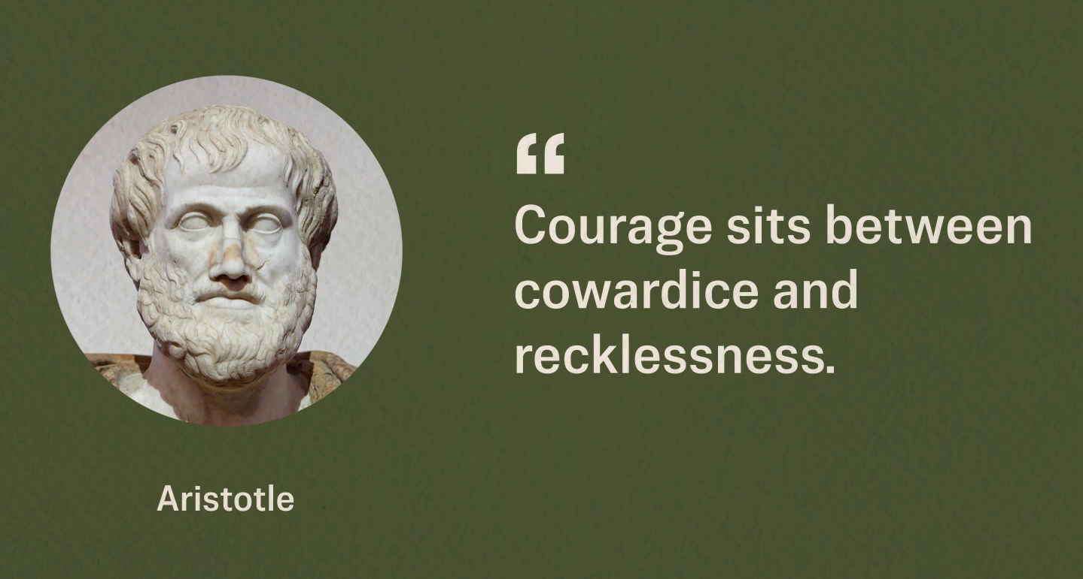
Notes:
Change the story you tell yourself
Your life will improve as you are willing to take a risk.
Every time you make a decision to act against fear, courage grows.
You will fail. Not a shut down. Space X failures
Israeli startup culture. Failure is NOT the end.
https://www.theepochtimes.com/epochtv/how-courage-changes-your-brain-and-your-life-5966832?utm_source=Goodevening&src_src=Goodevening&utm_campaign=gv-2026-01-07&src_cmp=gv-2026-01-07&utm_medium=email&est=FGVQwkWiabkokEiL7kb2LUE4p%2FujWMRIHAJCAUQixlXJV6qEdpoHoettG14cMBo04A%3D%3D&utm_campaign=socialshare_email&utm_source=email

Slide 43
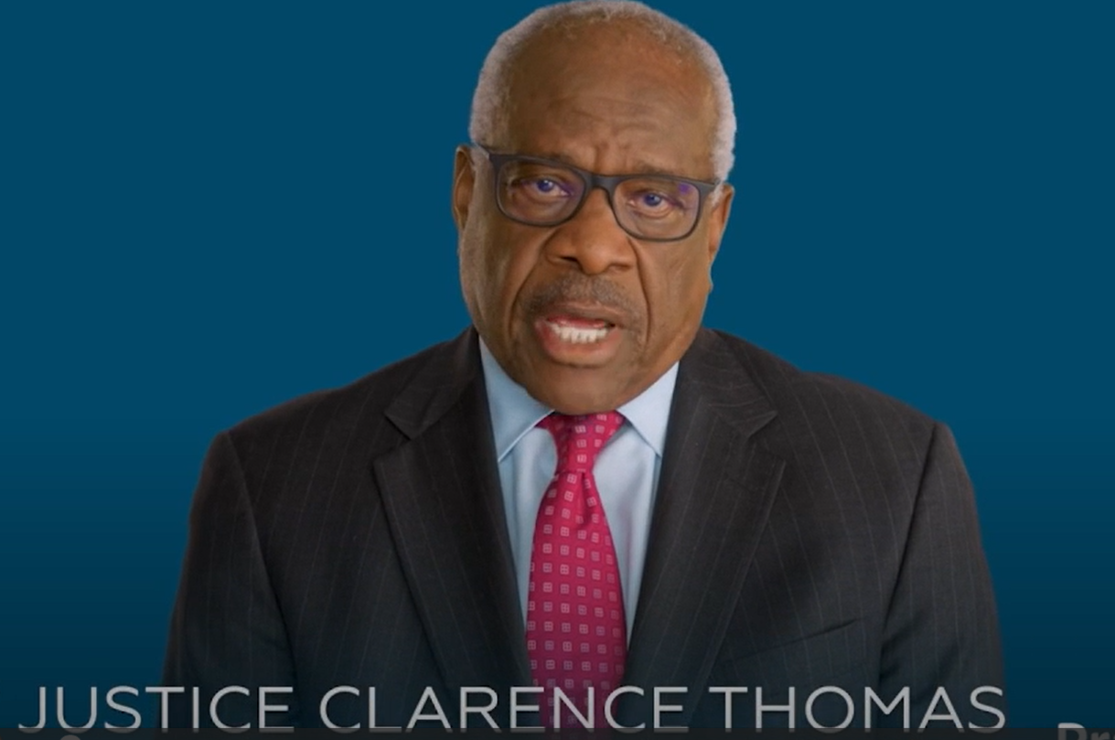

Slide 45
Courage: Dvarim/ Dt 31.23
Word study on courage
Context in Dvarim
Other comments on courage
Actions that require courage

Slide 46
Confessing sin and failure

Slide 47
^{Matt 5.23-24} So if you are offering your gift at the Temple altar and you remember there that your brother has something against you, leave your gift where it is by the altar, and go, make peace with your brother. Then come back and offer your gift.
Notes:
About a month ago, we made a serious mistake.
I have permission to use her name. We asked Rachel to leave the community. It was an ignorant decision. I apologize and ask your forgiveness.

Slide 48
Confronting someone in love.
Notes:
Not talking about it to anyone. When you say someone’s name, unless it’s positive, you are likely sinning.
Not giving a piece of your mind.

Slide 49
Yeshua's teaching on Matt. 18
Step 1:
18:15 “Moreover, if your brother commits a sin against you, go and show him his fault — but privately, just between the two of you. If he listens to you, you have won back your brother.

Slide 50
^{Gal 6.1-2} Brothers and sisters, if someone is caught doing something wrong, you who are directed by the Ruach, restore such a person in a spirit of gentleness—

Slide 51
^{Gal 6.1-2} looking closely at yourself so you are not tempted also. Bear one another’s burdens, and in this way you fulfill the Torah of Messiah.

Slide 52
Step 2:
18:16 If he doesn’t listen, take one or two others with you so that every accusation can be supported by the testimony of two or three witnesses.
Note: be careful who the one or two others are. Make sure they won't engage in lashon hara

Slide 53
Step 3:
18:17 If he refuses to hear them, tell the congregation; and if he refuses to listen even to the congregation, treat him as you would a pagan or a tax-collector.

Slide 54
Refraining from speaking negatively about another person is not covering up their actions. It's protecting yourself because there's coming a Day when we will all have to give an account to the Judge of all the earth for Every word we have spoken (or texted).

Slide 55
Courage to
stand with the Jews
visit Israel
Notes:
Wear my kippah

Slide 56

Notes:
Travelers at Ben-Gurion International Airport, May 13, 2025. Photo by Nati Shohat/Flash90.

Slide 57
(Dec. 31, 2025 / JNS) 1.3 million tourists visited Israel this year, even as war raged in the region, the Israeli Tourism Ministry announced on Wednesday.
A whopping 88% of tourists polled said they were very satisfied with their visit, while 83% said they would recommend travel to Israel.

Slide 58
If we expect the Jewish Israelis to live there permanently, to fulfill their prophesied covenant destiny, can we not go there for ~12 days?

Slide 59
Face the future

Slide 60
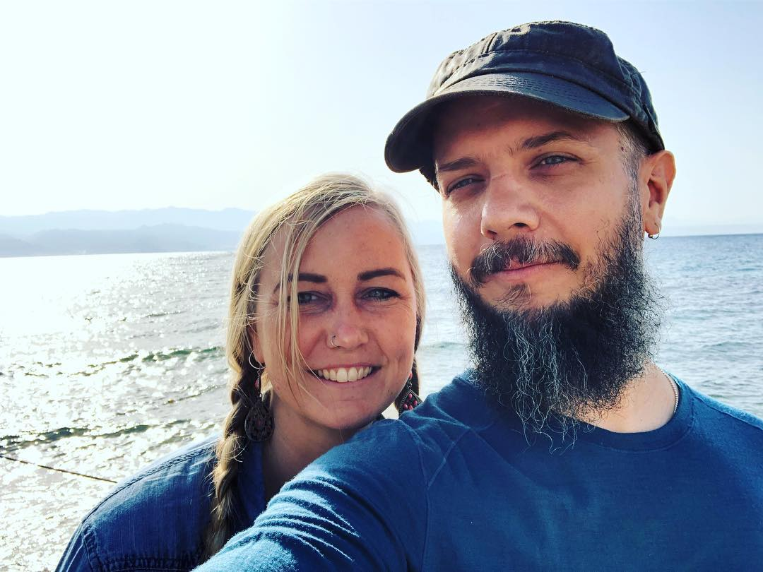
Notes:
Endorse Jeremy and Amber. Jeremy testimony
Feel about Oral Torah
IAMCS procedure.
Diffuse doubt or hidden agenda
Afternoon Q&A ask the Rabbi

