Slide 1
Presidential humor

Slide 2
Faced with crises at home and abroad, presidents found that levity and wit could lighten the weightiest office in the nation.
Notes:
https://www.rd.com/list/the-funniest-joke-told-by-presidents/

Slide 3
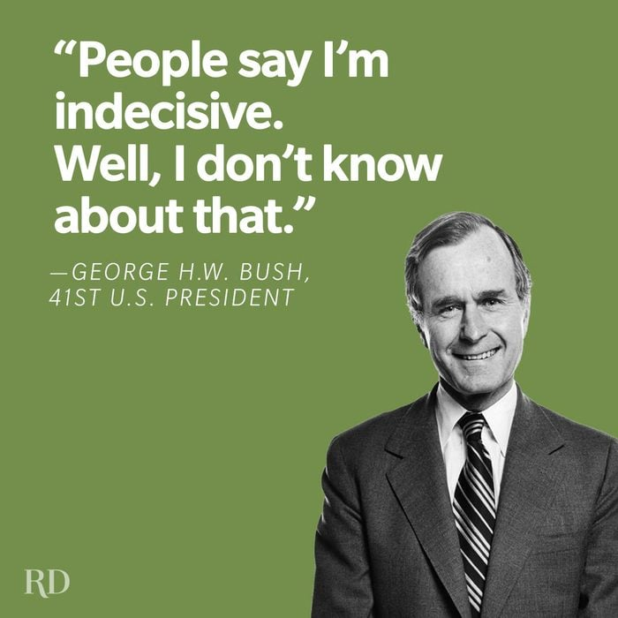
Notes:
https://www.rd.com/list/the-funniest-joke-told-by-presidents/

Slide 4
“Blessed are the young, for they shall inherit the National Debt.” —Herbert Hoover, 31st U.S. president
Notes:
https://www.rd.com/list/the-funniest-joke-told-by-presidents/

Slide 5
“I’ve laid down the law, though, to everyone there from now on about anything that happens, that no matter what time it is, wake me, even if it’s in the middle of a Cabinet meeting.”—Ronald Reagan, 40th U.S. president
Notes:
https://www.rd.com/list/the-funniest-joke-told-by-presidents/

Slide 6
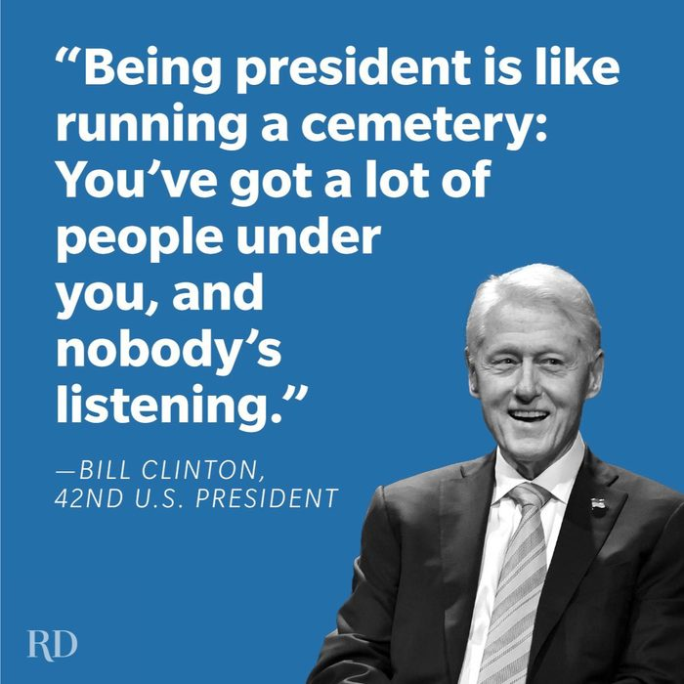

Slide 7
“Recession is when your neighbor loses his job.
Depression is when you lose yours.
And recovery is when Jimmy Carter loses his.”
—Ronald Reagan, 40th U.S. president
Notes:
https://www.rd.com/list/the-funniest-joke-told-by-presidents/

Slide 8
Not without reason was Ronald Reagan known as “The Great Communicator.” He often deployed stories to amuse his audience and to make a point. His one about Cuban leader Fidel Castro did both:
Notes:
https://www.rd.com/list/the-funniest-joke-told-by-presidents/

Slide 9
“It is said that Castro was making a speech to a large assembly. And he was going on at great length and then a voice out in the crowd said, ‘Peanuts, popcorn, crackerjacks.’
Notes:
https://www.rd.com/list/the-funniest-joke-told-by-presidents/

Slide 10
“And he went on speaking,
and again the voice said, ‘Peanuts, popcorn, crackerjacks.’ ... And about the fourth time this happened, he stopped in his regular speech and he said, ‘The next time,’ he said, ‘I’m going to find out who that is and kick him all the way to Miami.’
Notes:
https://www.rd.com/list/the-funniest-joke-told-by-presidents/

Slide 11
And everybody in the crowd said, ‘Peanuts, popcorn, crackerjacks.’”
Notes:
https://www.rd.com/list/the-funniest-joke-told-by-presidents/

Slide 12
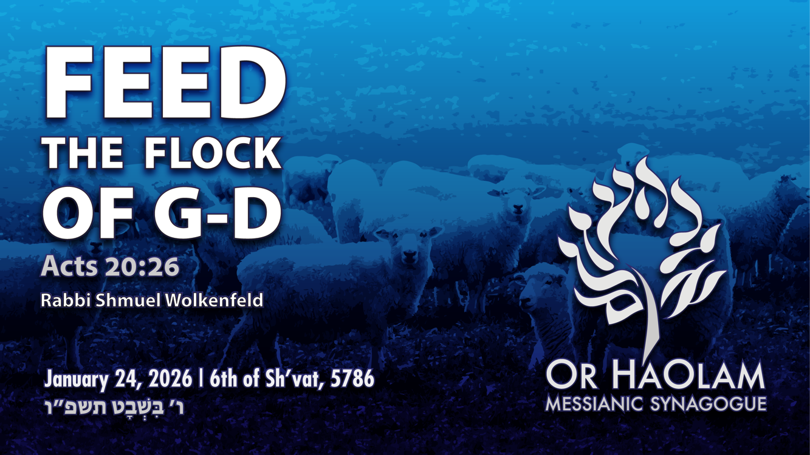

Slide 13
^{Acts 20.28} “Watch out for yourselves, and for all the flock in which the Ruakh HaKodesh has placed you as leaders, to shepherd God’s Messianic community, which he won for himself at the cost of his own Son’s blood.
Notes:
https://biblehub.com/greek/4165.htm

Slide 14
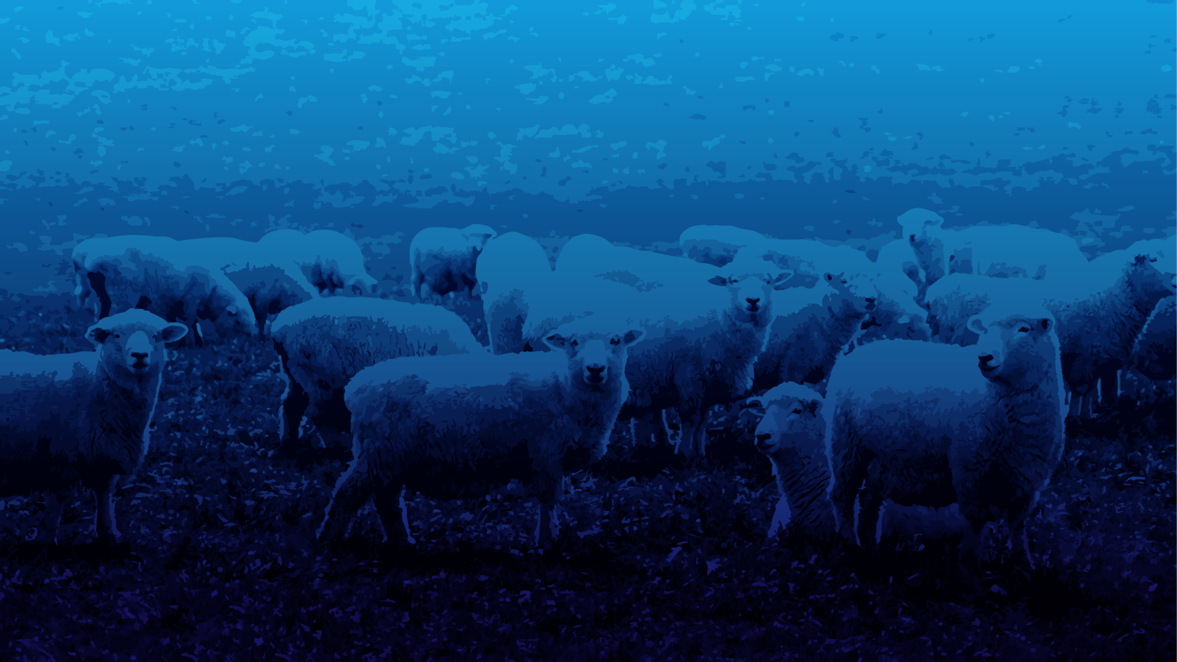
Feed the Flock of G-d Acts 20.28
Word study on “Feed”

Slide 15

Notes:
https://biblehub.com/greek/4165.htm

Slide 16
poimainó: To shepherd, to tend, to feed, to guide
the Sept. forרָעָה ra-ah to feed, to tend a flock, keep sheep;
Notes:
https://biblehub.com/greek/4165.htm
“Feed” is only one of the meanings, but maybe the most promoted.

Slide 17
Rev 7:17 proclaims, “For the Lamb in the center of the throne will be their Shepherd. He will lead them to springs of living water, and God will wipe away every tear from their eyes”
Notes:
A key task of the Lamb, as shepherd, will be to quench the thirst of his people.
https://biblehub.com/greek/4165.htm

Slide 18
^{1 Kefa/Pet 5.1} Shepherd the flock of God that is in your care, exercising oversight not out of constraint, but willingly, as God wants; and not out of a desire for dishonest gain, but with enthusiasm.
Notes:
https://biblehub.com/greek/4165.htm

Slide 19
The verb demands more than teaching; it includes guarding, guiding, and willingly sacrificing for the welfare of believers.

Slide 20
The Messianic Scriptures employ this vivid verb to unite themes of nurture, oversight, and royal authority. The Good Shepherd who laid down His life now calls His under-shepherds to guard His blood-bought flock.
Notes:
https://biblehub.com/greek/4165.htm

Slide 21
^{KJ21} Feed the congregation of God which He hath purchased with His own blood.
^{AMP} Shepherd (tend, feed, guide) the congregation of God
Notes:
https://www.biblegateway.com/verse/en/Acts%2020%3A28
I am going to focus on this aspect of the word: feed.

Slide 22
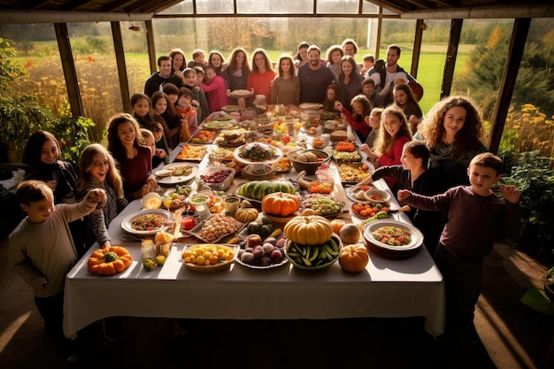
Thanksgiving family meal
Notes:
https://img.freepik.com/premium-photo/big-family-thanksgiving-celebration-dinner-around-table-with-food_960396-489982.jpg

Slide 23
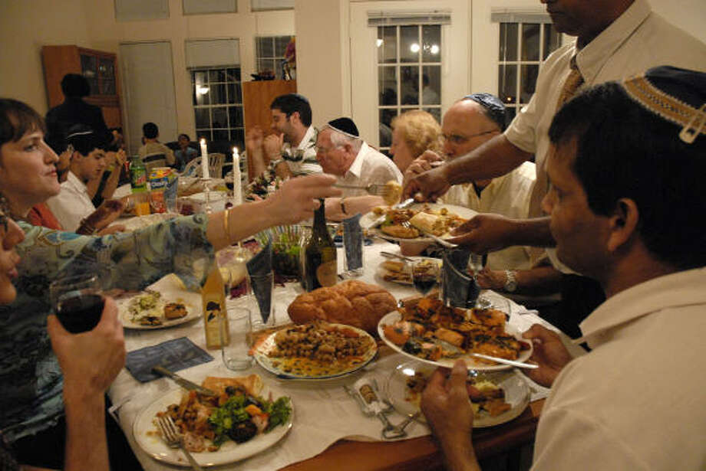
Shabbat family meal
Notes:
https://s.hdnux.com/photos/04/23/43/1128652/3/920x920.jpg

Slide 24
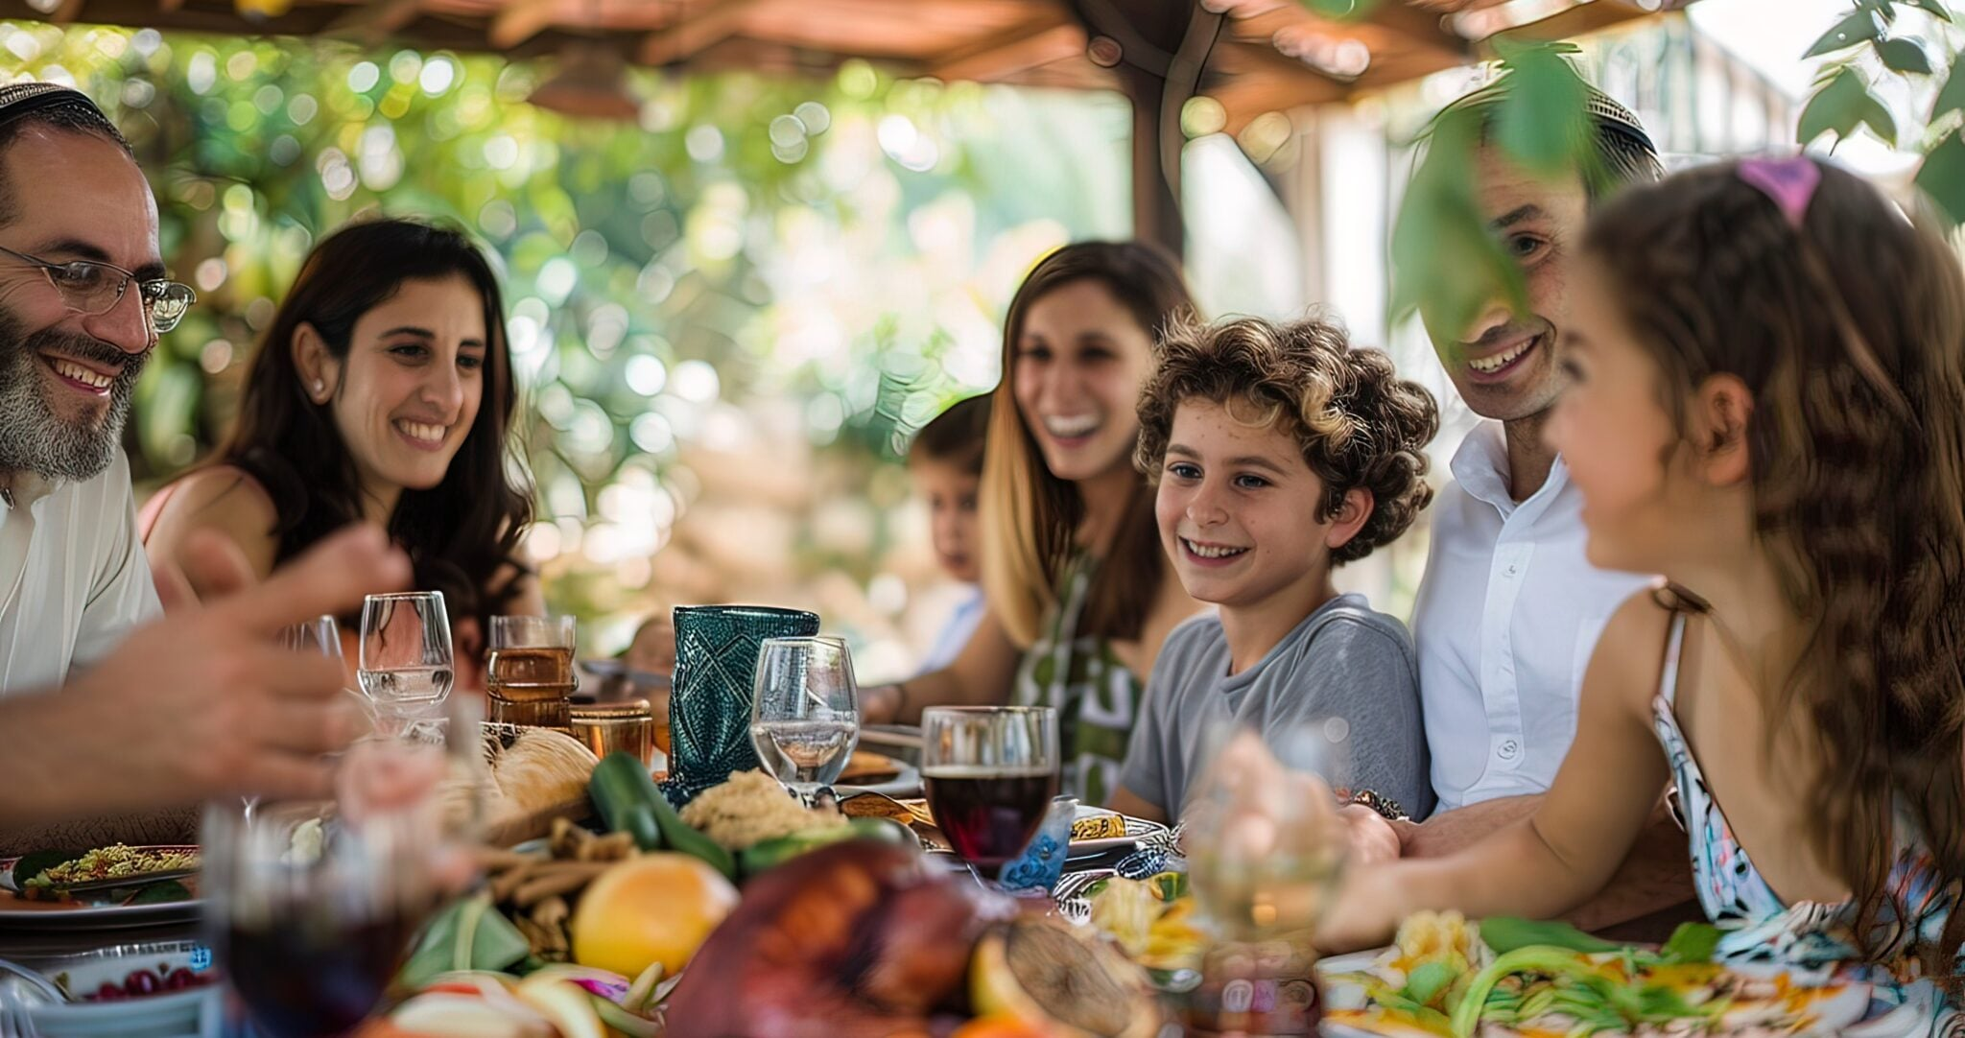
Sukkot family meal
Notes:
https://blog.judaicawebstore.com/wp-content/uploads/2024/10/AdobeStock_938924365-2048x1082.jpeg

Slide 25
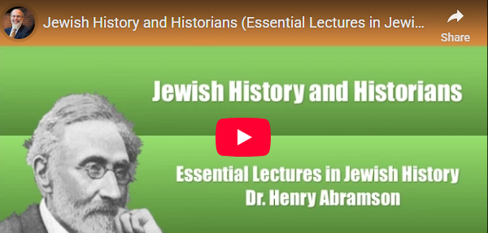
Notes:
https://henryabramson.com/2013/08/02/jewish-history-1-1-they-tried-to-kill-us-we-survived-lets-eat/

Slide 26
Excerpt from
The Jewish Diaspora: A Brief History Henry Abramson
What is Jewish History?
“They tried to kill us, we survived, let’s eat.”
Notes:
Personally, I like to render it as “They tried to kill us, G-d saved us and we survived, let’s eat.”

Slide 28
Feed the Flock of G-d Acts 20.28
Word study on “Feed”
So, are we a well-fed
well-shepherded flock?

Slide 29
A well fed, well shepherded flock will have:
Spiritual Ruakh food sustaining life. [loving G-d]
Relational joy. [loving one another]
Knowledge and wisdom
Character development [holiness]
Notes:
Love G-d in Yeshua with all your heart, mind, soul, and strength
Love your neighbor as yourself
^{Mislei/Prov 3.13} Happy the person who finds wisdom,
the person who acquires understanding.
Of scripture,
of life,
of the meaning of end times of Israel and the Nations
You shall be holy

Slide 30
A 23rd psalm picture of a well shepherded flock. We can assess our flock by this standard.

Slide 31
A well fed, well shepherded flock will have:
Spiritual Ruakh food sustaining life. [loving G-d]
Notes:
Love G-d in Yeshua with all your heart, mind, soul, and strength

Slide 32
1. Spiritual Ruakh food sustaining life. [loving G-d]
^{T’hillim 23.1a} Adoni is my shepherd
He is the shepherd. Pharaoh Ex 5.2 Creator. Father.
^{Yn 10.14} Gives His life for his sheep
Notes:
Do we have a sense of Who our shepherd is?? Key to FEELING well tended.
Milky Way 100k ly across, 200 billion stars
Andromeda nearest galaxy (2.5 million light-years) from Earth.
Alpha Centuri nearest star ~4 ly 24 trillion miles.
One shepherd tells of neighbor sheep look across the fence.
Shepherd marks them on the day he buys. Are you marked as His? Enjoying being part of His flock. Renouncing the world.

Slide 33
^{T’hillim/Ps 23.1b} I lack nothing.
^{Yn 16.33} “I have said these things to you so that, united with me, you may have shalom. In the world, you have tsuris. But be brave! I have conquered the world!”
Notes:
When I was in Life Ins sales, they said, “Sell the sizzle, not the steak.” Security kids, peace of mind, promise. Restaurants set vents. “I must have.” I need. “Needy guy” One kid: “That’s all I want.”
^{2 Cor 2.16-17} For to God we are the aroma of the Messiah, both among those being saved and among those being lost; to the latter, we are the smell of death leading only to more death; but to the former, we are the sweet smell of life leading to more life. Who is equal to such a task?” Our sizzle.
David wrote this as a shepherd, then 8 years fleeing Shaul, 2 times Shaul admitted. 1 yr fleeing Avshalom
G-d is making you as rich as He dares to.

Slide 34
^{Yn 14.8-10} Philip said to him, “Lord, show us the Father, and it will be enough for us.” Yeshua replied to him, “Have I been with you so long without your knowing me, Philip? Whoever has seen me has seen the Father; so how can you say, ‘Show us the Father’? Don’t you believe that I am united with the Father, and the Father united with me

Slide 35
^{T’hillim/Ps 16.11} You make known to me the path of life; you will fill me with joy in your presence, with eternal pleasures at your right hand.

Slide 36
^{Phil 4. 10-13} In union with the Lord I greatly rejoice that now, after this long time, you have let your concern for me express itself again. Of course, you were concerned for me all along, but you had no opportunity to express it. Not that I am saying this to call attention to any need of mine; since, as far as I am concerned,

Slide 37
^{Phil 4. 10-13} I have learned to be content regardless of circumstances. I know what it is to be in want, and I know what it is to have more than enough — in everything and in every way I have learned the secret of being full and being hungry, of having abundance and being in need. I can do all things through him who gives me power.

Slide 38
^{T’hillim/Ps 23.2a} He has me lie down in grassy pastures
Four things keep sheep from sleeping
Fear
Friction with others
Parasites
Hunger
Notes:
Fear: easily panicked. One Pkinese pup 23b

Slide 39
A well fed, well shepherded flock will have:
Spiritual Ruakh food sustaining life. [loving G-d]
Relational joy. [loving one another]
Notes:
Love G-d in Yeshua with all your heart, mind, soul, and strength
Tension wi flock
Q&A at membership meeting
Love your neighbor as yourself 23B.1 23c

Slide 40
^{Gal 5. 14-16} For the whole of the Torah is summed up in this one sentence: “Love your neighbor as yourself”; but if you go on snapping at each other and tearing each other to pieces, watch out, or you will be destroyed by each other! What I am saying is this: run your lives by the Spirit. Then you will not do what your old nature wants.
Notes:
Members meeting Feb 8, Q&A

Slide 41
^{T’hillim/Ps 23.2b} He leads me beside still waters.
^{T’hillim/Ps 23.3a} He restores my soul.
Notes:
23c.1
^{T’hillim/Ps 43.2b-5} Why do I go about gloomy because of the oppression of the enemy? Send forth Your light and Your truth— let them guide me. Let them bring me to Your holy mountain and to Your dwelling places. Then I will come to the altar of God, to the God of my exceeding joy, and praise You upon the harp —O God, my God. My soul, why are you so downcast? Why are you murmuring within me?
Hope in God, for I will yet praise Him, the salvation of my countenance.
Cast sheep 23d.1

Slide 42
^{T’hillim/Ps 23.3b} He guides me along the right paths for his name’s sake.
Path of integrity, fruitfulness
Path to Israel
Notes:
Outreach Ingathering. Mishloakh Manot End Feb

Slide 43
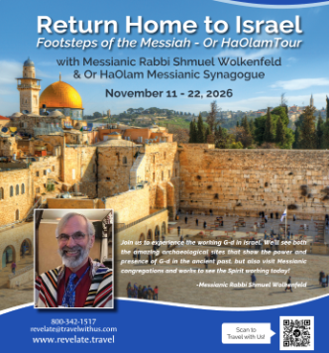

Slide 44
Dates: 11/11/2026 – 11/22/2026
Even included an overnight at the Dead Sea!
$4799 from NYC, or $5197 from MCI includes air, most meals, 1st rate hotels and buses, and awesome guide and driver.
Deposit only $300 to secure spot.

Slide 45
Friday night erev Shabbat with Chaim Malespin at Aliyah Return Center
Shabbat worship Kehilat HaCarmel Karen Davis
Lunch in Jericho with Khader Ghanim Hope for Ishmael

Slide 46
Immersion either Yardanit, or Qasr al Yahud
New southern tunnel
Joshua’s altar
Serve with Joseph Project warehouse and the Gaza envelope

Slide 47
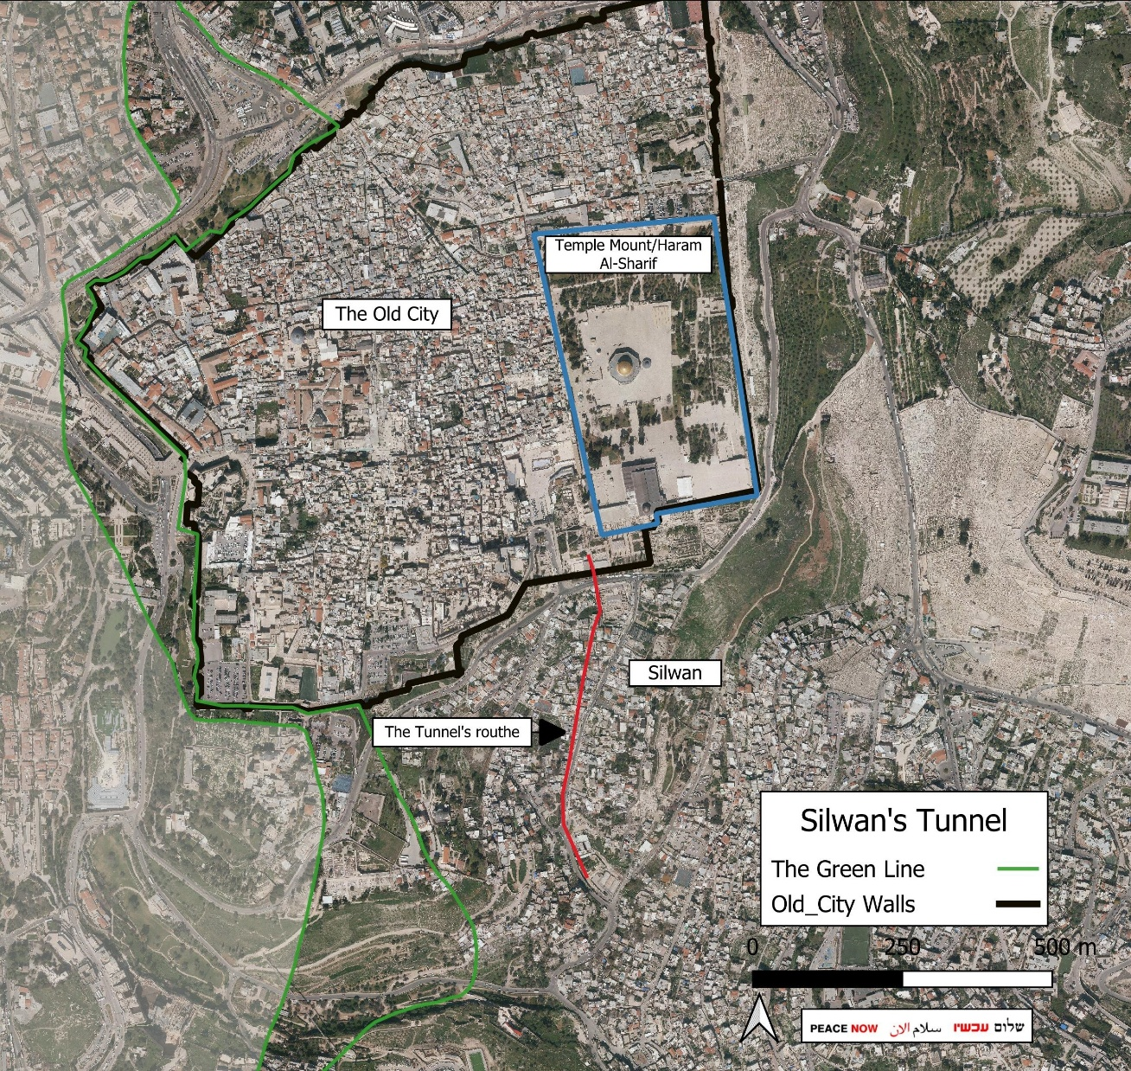
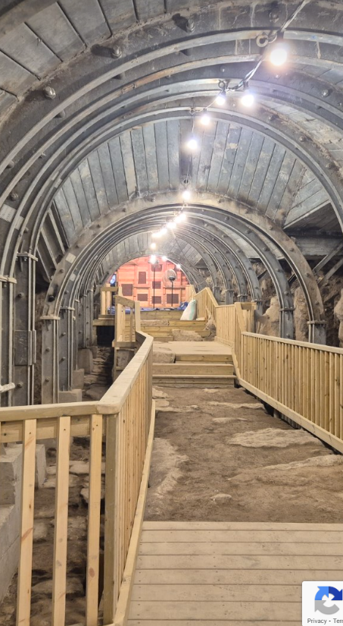
Notes:
https://peacenow.org.il/wp-content/uploads/2025/09/Silwan-tunnel-1536x1454.jpeg

Slide 48
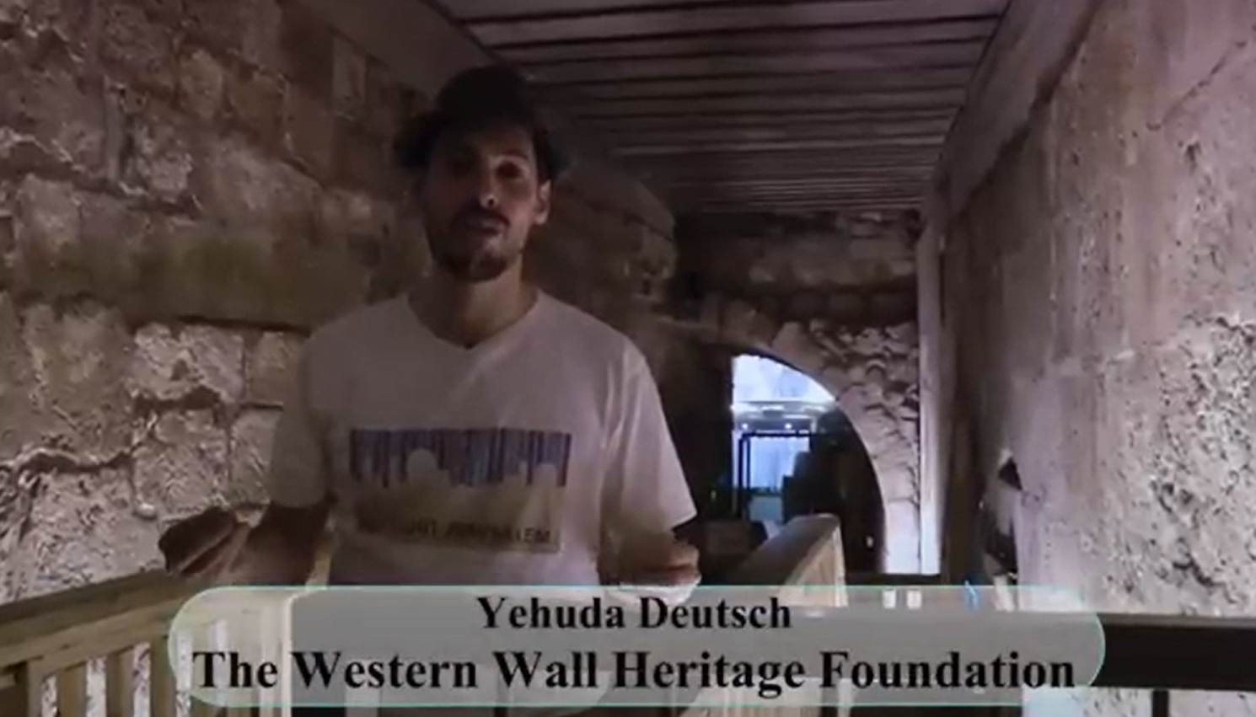
Notes:
North part of the W Wall tunnel.

Slide 49
^{T’hillim/Ps 23.4} Even if I pass through death-dark ravines, I will fear no disaster; for you are with me; your rod and staff reassure me.
Notes:
עם ישראל חי Am Yisrael Khi The people of Israel live.
23f
23h

Slide 50

Notes:
https://mailchi.mp/jij/2324-9202520?e=5b00c6e90f

Slide 51
Since October 7, 2023, 76 IDF soldiers have died by suicide. More than 300 others have attempted suicide. These soldiers survived Gaza. They survived Lebanon. They survived combat. But they couldn't survive what they brought home with them.
Notes:
https://mailchi.mp/jij/2324-9202520?e=5b00c6e90f

Slide 52
"My friends died."
"My nervous system is shattered."
"I saw horrible things."
This is moral injury. The deep psychological wounds from trauma, loss, and the horrors of war. The trauma and PTSD these soldiers carry are just as real as any physical wound.
Notes:
https://mailchi.mp/jij/2324-9202520?e=5b00c6e90f

Slide 53
A well fed, well shepherded flock will have:
Spiritual Ruakh food sustaining life. [loving G-d]
Relational joy. [loving one another]
Knowledge and wisdom
Notes:
Love G-d in Yeshua with all your heart, mind, soul, and strength
Love your neighbor as yourself
^{Mislei/Prov 3.13} Happy the person who finds wisdom,
the person who acquires understanding.
Of scripture,
of life,
of the meaning of end times of Israel and the Nations

Slide 54
^{T’hillim/Ps 23.5} You prepare a table before me in the presence of my enemies. You anoint my head with oil; my cup overflows.
Notes:
The bottom line to our being well shepherded is if we have the discipline to feast at His table, daily! Receive His anointing.
Eric Carlson: keep learning Teddy Roosevelt died in sleep w ~6 books
Fortune 500 1956 and 2026 only 49 in common
Oil at Ein Gedi
23k and k.1

Slide 55
A well fed, well shepherded flock will have:
Spiritual Ruakh food sustaining life. [loving G-d]
Relational joy. [loving one another]
Knowledge and wisdom
Character development [holiness]
Notes:
Love G-d in Yeshua with all your heart, mind, soul, and strength
Love your neighbor as yourself
^{Mislei/Prov 3.13} Happy the person who finds wisdom,
the person who acquires understanding.
Of scripture,
of life,
of the meaning of end times of Israel and the Nations
You shall be holy

Slide 56
^{T’hillim/Ps 23.6} Surely your goodness and love will follow me all the days of my life, and I will dwell in the house of the Lord forever.
Notes:
Eternal values

Slide 58
https://washingtonstand.com/article/foundation-of-lies-how-deception-underpins-youth-trans-procedures--and-echoes-the-nature-of-sin

Slide 60
https://www.theepochtimes.com/health/how-suppressed-emotions-chronic-stress-fuel-autoimmune-disease-what-you-can-do-5960626

