Slide 1
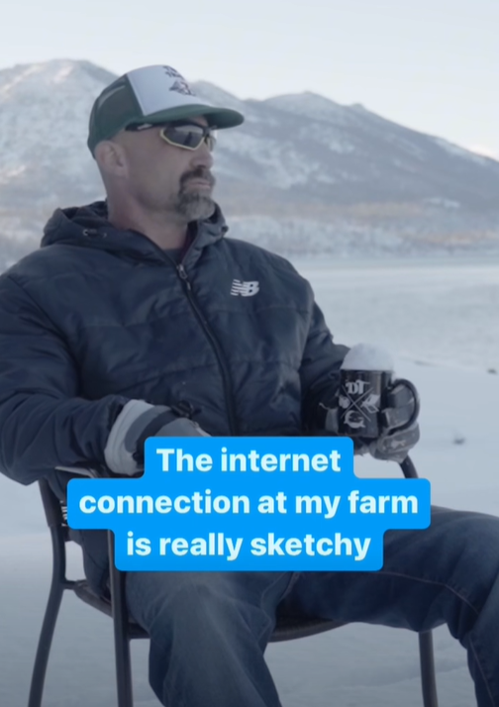
Notes:
https://www.facebook.com/reel/643335811420484

Slide 2
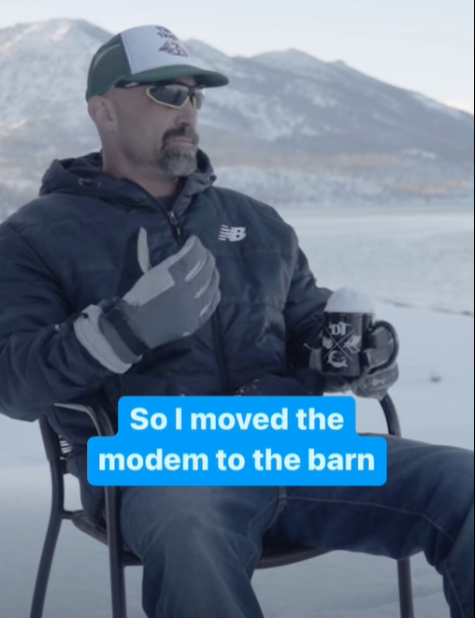

Slide 3
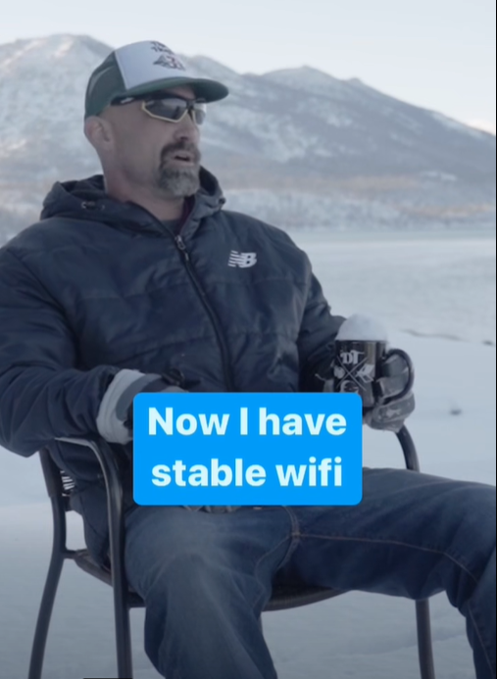
Notes:
https://www.facebook.com/reel/643335811420484

Slide 4

Notes:
https://www.facebook.com/reel/643335811420484

Slide 5

Notes:
https://www.facebook.com/reel/643335811420484

Slide 6

Notes:
https://www.facebook.com/reel/643335811420484

Slide 7
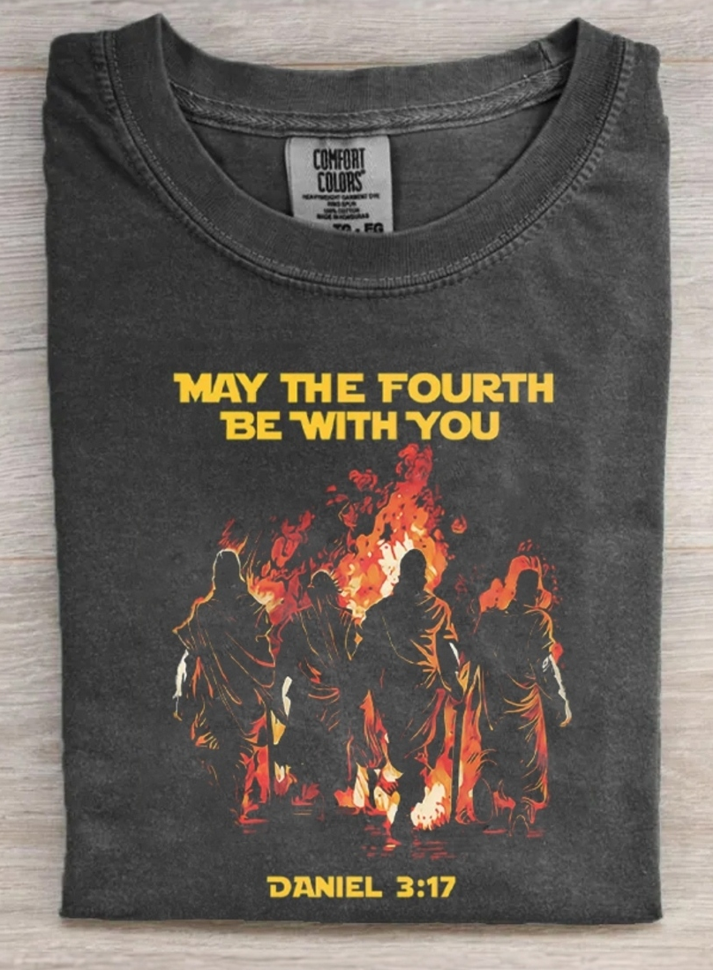
^{Daniel 3.24-25} Then King Nebuchadnezzar was astonished and leapt to his feet. He asked his ministers, “Didn’t we cast three men bound into the middle of the fire?”
Notes:
Cosycutome.com

Slide 8
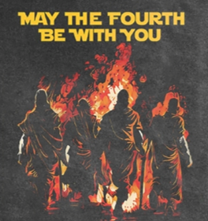
^{Daniel 3.24-25} They replied to the king, “Surely, O king.” But he answered saying, “Look! I see four men walking about unbound and unharmed in the middle of the fire, and the fourth has the appearance like a son of the gods!”
Notes:
Cosycutome.com
I’m NOT endorsing Star Wars mysticism. Just a Dad joke.
From Ben Troyer tree trimmer
But here, G-d changed the outcome of an event…

Slide 9
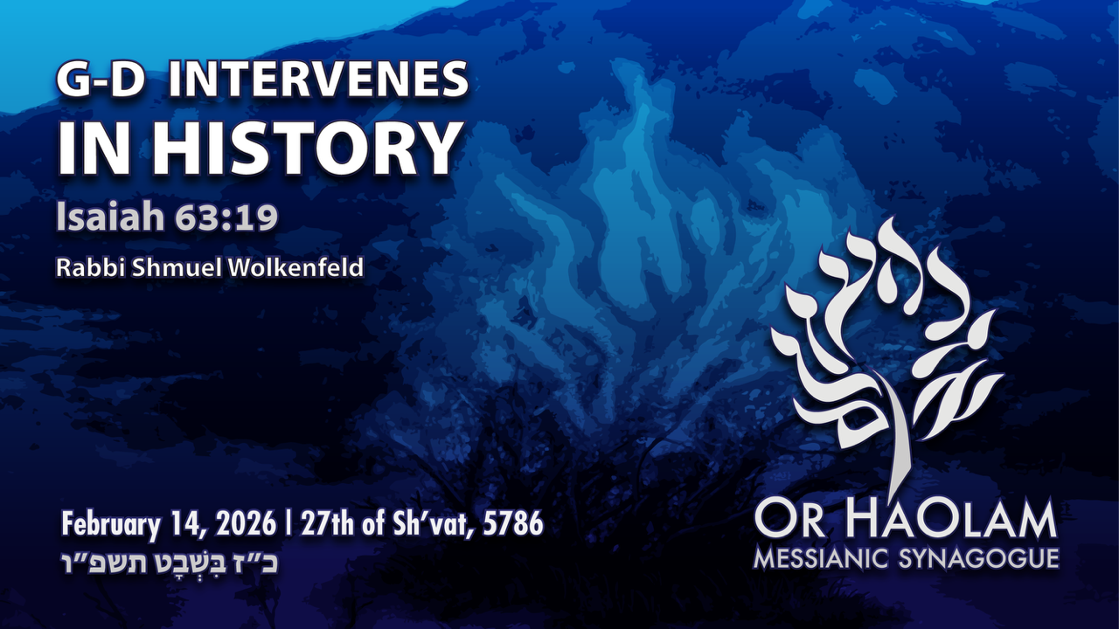

Slide 10

G-d Intervenes in History
Theological basis: to make us
holy through faith in covenantal
promise, and prayer.
2. Illustration: Avraham in Gerar
3. Illustration: Pharoah
4. Illustration: Purim
5. Illustration: Return of the Jews

Slide 11
Yeshayahu / Is 63.19.-64.3 [64.1-4] We wish you would tear open heaven and come down, so the mountains would shake at your presence! It would be like fire kindling the brush, and the fire then makes the water boil. Then your enemies would know your name, the nations would tremble before you!

Slide 12
Yeshayahu / Is 63.19.-64.3 [64.1-4] When you did tremendous things that we were not expecting, we wished that you would come down,

Slide 13
Yeshayahu / Is 63.19.-64.3 [64.1-4] so that the mountains would shake at your presence! No one has ever heard, no ear perceived, no eye seen, any God but you. You work for him who waits for you.
Notes:
Pray for G-d’s intervention in our hearts, families, community, nation, Israel, the world

Slide 14
G-d Intervenes in History
Theological basis: to make us
holy through faith in covenantal
promise, and prayer.
2. Illustration: Avraham in Gerar
3. Illustration: Pharoah
4. Illustration: Purim
5. Illustration: Return of the Jews

Slide 15
From Britannica.com:
History is the discipline that studies the chronological record of events, usually attempting, on the basis of a critical examination of source materials, to explain events.
Notes:
https://www.britannica.com/topic/history
Sometimes called historicity.

Slide 16
^{Eph.1.4-6} God and Father of our Lord Yeshua the Messiah…chose us in the Messiah before the foundation of the world, to be holy and blameless before Him in love.
Notes:
This is the purpose of history. G-d’s choice. You and me to be holy and blameless in love.
How?

Slide 17
^{Eph.1.4-6} He predestined us for adoption as sons through Messiah Yeshua, in keeping with the good pleasure of His will— to the glorious praise of His grace, with which He favored us through the One He loves!
Notes:
Through Yeshua
Predestined can be understood in two ways:
G-d predestined the means of salvation
G-d predestined the individuals who would receive salvation
I understand the first option. This theology, called Arminianism, is compatible with the Messianic Jewish view of G-d, according to David Stern, author of CJB.
Review G-d predestined purpose.

Slide 18
History = His story
Notes:
His story of bringing men and women with free will to acknowledge and repent of their sins, and accept His salvation. Overcome historical corruption through covenantal faith and prayer.

Slide 19
^{Ro 9.14-18} There is no injustice with God, is there? May it never be! For to Moshe He says, “I will have mercy on whom I have mercy, and I will have compassion on whom I have compassion.” So, then it does not depend on the one who wills or the one who strives,
Notes:
Can also be understood two ways. Mercy on whom G-d choses, or mercy in the WAY G-d choses.
Mercy is available to anyone, but on G-d’s terms.

Slide 20
^{Ro 9.14-18} but on God who shows mercy. For the Scripture says to Pharaoh, “For this very purpose I raised you up—to demonstrate My power in you, so My name might be proclaimed in all the earth.” So, then He has mercy on whom He wills, and He hardens whom He wills.
Notes:
This is the purpose of history. G-d’s choice. You and me to be holy and blameless in love. Pharoah chose repeatedly against G-d’s purpose for him and for Egypt.
Mercy in His manner of obeying.
There is One plan of salvation, through the atonement of the Jewish Messiah, the Jewish scriptures.

Slide 21
^{Yn 1.12-14} To as many as did receive him, to those who put their trust in his person and power, he gave the right to become children of God, not because of bloodline, physical impulse, or human intention but because of God.
Notes:
Commonly quoted verse. Let’s expound it.

Slide 22
^{Yn 1.12-14} To as many as did receive him, to those who put their trust in his person and power, he gave the right to become children of God, not because of
bloodline, [Hebew ancestry]
physical impulse [will to obey]
or human intention [other religions],
but because of God.

Slide 23
^{Yn 1.12-14} The Word became a human being and lived with us, and we saw his Sh’khinah, the Sh’khinah of the Father’s only Son, full of grace and truth.
Notes:
Like my “liquid love” story.

Slide 25
G-d Intervenes in History
Theological basis: to make us
holy through faith in covenantal
promise, and prayer.
2. Illustration: Avraham in Gerar
3. Illustration: Pharoah
4. Illustration: Purim
5. Illustration: Return of the Jews

Slide 26
The name Beersheba (בְּאֵר שֶׁבַע Be’er Sheva) carries deep meaning. The word be’er means “well,” and sheva means “seven,” but it is also closely connected to the Hebrew word for an oath or covenant. Beersheba is therefore known as the “Well of Seven” or the “Well of the Oath.” It is a place marked by covenant.
Notes:
https://www.youtube.com/watch?v=eaUSQaouqz0

Slide 27
In Genesis, Avraham had a serious dispute with Avimelech, the king of Gerar, over wells of water. In that region, wells were not a small matter. They were the difference between survival and loss. Tension had developed between them, and there was potential for ongoing conflict.
Notes:
https://www.youtube.com/watch?v=eaUSQaouqz0

Slide 28
Yet instead of allowing hostility to define the relationship, they chose to resolve it through covenant. Avraham set apart seven lambs as a witness to their oath, and peace was established between them.
Notes:
https://www.youtube.com/watch?v=eaUSQaouqz0

Slide 29
The sequence is important. First, covenant. Then, provision. The desert did not disappear. The climate did not change overnight. But after peace was made and covenant established, life-giving water came forth. Abraham chose trust over control. He chose reconciliation instead of escalation.
Notes:
https://www.youtube.com/watch?v=eaUSQaouqz0

Slide 30
He placed his future in God’s hands rather than securing it by force. And in that posture, God provided what was necessary for life. The ancient well in Beersheba is still there today, deep and steady. Generations have come and gone, kingdoms have risen and fallen, yet the well remains.
Notes:
https://www.youtube.com/watch?v=eaUSQaouqz0

Slide 31
It is a simple but powerful picture of God’s enduring faithfulness. When He establishes something, it is not temporary.
So, faith in covenant, based on G-d’s covenant, and prayer?
Notes:
https://www.youtube.com/watch?v=eaUSQaouqz0

Slide 32
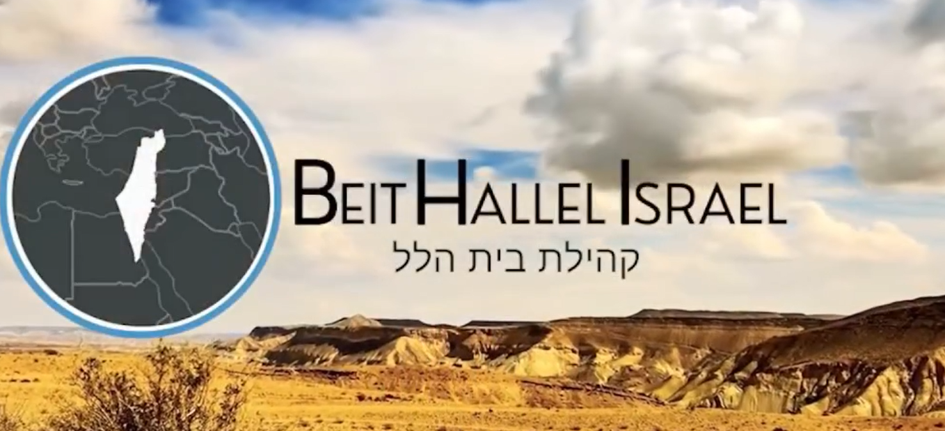
Notes:
https://youtu.be/eaUSQaouqz0

Slide 33
^{2 Chronicles 7:14-15} If my people, which are called by my name, shall humble themselves, and pray, and seek my face, and turn from their wicked ways; then will I hear from heaven, and will forgive their sin, and will heal their land.

Slide 35
G-d Intervenes in History
Theological basis: to make us
holy through faith in covenantal
promise, and prayer.
2. Illustration: Avraham in Gerar
3. Illustration: Pharoah
4. Illustration: Purim
5. Illustration: Return of the Jews
Notes:
Slaughter of 7 sheep analogous to prayer?

Slide 36
^{Shmot/Ex 2.23-25} Sometime during those many years the king of Egypt died, but the people of Isra’el still groaned under the yoke of slavery, and they cried out, and their cry for rescue from slavery came up to God. God heard their groaning,
Notes:
Prayer was the precipitator of the Passover story.
Would G-d have rescued Israel without this prayer?

Slide 37
^{Shmot/Ex 2.23-25} and God remembered his covenant with Avraham, Yitz’chak and Ya‘akov. God saw the people of Isra’el, and God acknowledged them.
Notes:
Prayer and covenantal promise. G-d changed history.

Slide 38
^{Ro 9.14-18} For the Scripture says to Pharaoh, “For this very purpose I raised you up—to demonstrate My power in you, so My name might be proclaimed in all the earth.”
Notes:
This is the purpose of history. G-d’s choice. You and me to be holy and blameless in love. Pharoah chose repeatedly against G-d’s purpose for him and for Egypt.
If Pharoah had said yes…
Mercy in His manner of obeying.
There is One plan of salvation, through the atonement of the Jewish Messiah, the Jewish scriptures.

Slide 40
G-d Intervenes in History
Theological basis: make us
holy through faith in covenantal
promise, and prayer.
2. Illustration: Avraham in Gerar
3. Illustration: Pharoah
4. Illustration: Purim
5. Illustration: Return of the Jews

Slide 41
^{Est 4.5-14} Ester summoned Hatakh, one of the king’s officials [סריס Saris eunuchs] attending her, and instructed him to go to Mordekhi and find out what this was all about and why. Hatakh went out to Mordekhi in the open space in front of the King’s Gate, and Mordekhi told him everything that had happened to him

Slide 42
^{Est 4.5-14} and exactly how much silver Haman had promised to put in the royal treasury for the destruction of the Jews. He also gave him a copy of the decree for their destruction issued in Shushan; so that he could show it to Ester, explain it to her, and then instruct her to approach the king,

Slide 43
^{Est 4.5-14} intercede with him and implore his favor on behalf of her people. Hatakh returned and told Ester what Mordekhi had said. Then Ester spoke to Hatakh and gave him this message for Mordekhi: “All the king’s officials, as well as the people in the royal provinces,

Slide 44
^{Est 4.5-14} know that if anyone, man or woman, approaches the king in the inner courtyard without being summoned, there is just one law — he must be put to death — unless the king holds out the gold scepter for him to remain alive; and I haven’t been summoned to the king for the past thirty days.”

Slide 45
^{Est 4.5-14} Upon being told what Ester had said, Mordekhi asked them to give Ester this answer: “Don’t suppose that merely because you happen to be in the royal palace you will escape any more than the other Jews. For if you fail to speak up now,

Slide 46
^{Est 4.5-14} relief and deliverance will come to the Jews from a different direction; but you and your father’s family will perish. Who knows whether you didn’t come into your royal position precisely for such a time as this.”
Notes:
G-d had a covenantal promise to the Jewish people, and was purposing to work through history, intervene in history, keep covenant.

Slide 47
^{Est 4.15-17} Ester had them return this answer to Mordekhi: “Go, assemble all the Jews to be found in Shushan, and have them fast for me, neither eating nor drinking for three days,[prayer implied!?] night and day; also I and the girls attending me will fast the same way. Then I will go in to the king, which is against the law; and if I perish, I perish.”
Notes:
Prayer implied
Result…

Slide 48
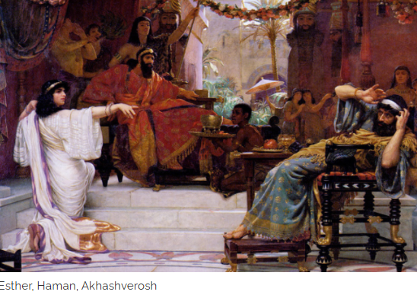

Slide 50
G-d Intervenes in History
Theological basis: make us
holy through faith in covenantal
promise, and prayer.
2. Illustration: Avraham in Gerar
3. Illustration: Pharoah
4. Illustration: Purim
5. Illustration: Return of the Jews

Slide 51
^{Yeshayahu/Is 62.6-7} I have posted watchmen on your walls, Yerushalayim; they will never fall silent, neither by day nor by night. You who call on Adoni, give yourselves no rest; and give him no rest till he restores Yerushalayim and makes it a praise on earth.
Notes:
Prayer!! By many over the millennia!

Slide 52
^{Yeshayahu / Is 11.11-12} On that day Adoni will raise his hand again, a second time, to reclaim the remnant of his people who remain from Ashur, Egypt, Patros, Ethiopia, ‘Eilam, Shin‘ar, Hamat and the islands in the sea.
Notes:
Keep the covenant

Slide 53
^{Yeshayahu / Is 11.11-12} He will hoist a banner for the Goyim, assemble the dispersed of Isra’el, and gather the scattered of Y’hudah from the four corners of the earth.

Slide 54
Let me take you back to 1947: a Bedouin named Mohammed ed-dib discovers ancient scrolls in a cave near Qumran. After this initial find, even more scrolls are discovered and in November of 1947 some of the scrolls are sold to Professor Eliezer Sukenik, a professor of archaeology at Hebrew University.
Notes:
George Whitten resurrection of the nation

Slide 55
The significance of the timing of these events should not be overlooked. Professor Sukenik writes in his journal: “While I was examining these precious documents in my study, the late news on the radio announced that the United Nations would be voting on the resolution that night—whether or not Israel would be allowed to become a nation…
Notes:
George Whitten resurrection of the nation

Slide 56
It was past midnight when the decision was announced while I was engrossed in a particularly absorbing passage in one of the scrolls, and my son rushed in with the shout that the vote on the Jewish State had passed.
Notes:
George Whitten resurrection of the nation

Slide 57
The very day the first Dead Sea scrolls were being read, the UN General Assembly was casting votes to decide whether Israel would become a modern nation, and decided in its favor.
Notes:
George Whitten resurrection of the nation

Slide 58
As God providentially unveiled the documentation of Israel's ancient history through the discovery of the scrolls, the very words of those scriptures were being fulfilled concerning the nation's future rebirth!
Notes:
George Whitten resurrection of the nation

Slide 59
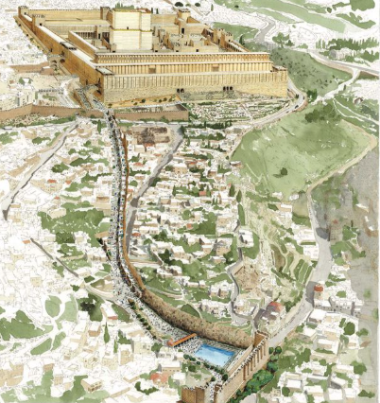
Pilgrim road from the Temple Mount to the mikveh pool of Siloam in the time of Yeshua
Notes:
https://cdn.mos.cms.futurecdn.net/N24U8hNqSmy2C8MyFRQsKC-1200-80.jpg
Zoom in…

Slide 60
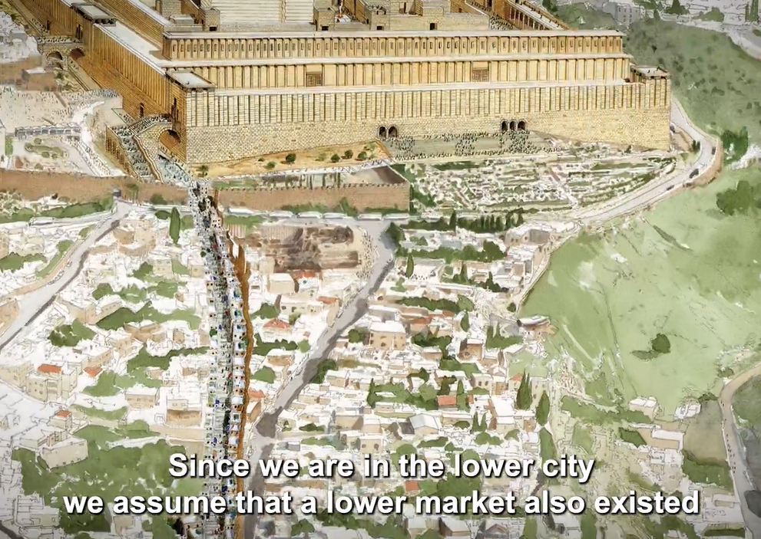
Notes:
https://www.livescience.com/archaeology/2000-year-old-stone-receipt-discovered-in-jerusalem

Slide 61
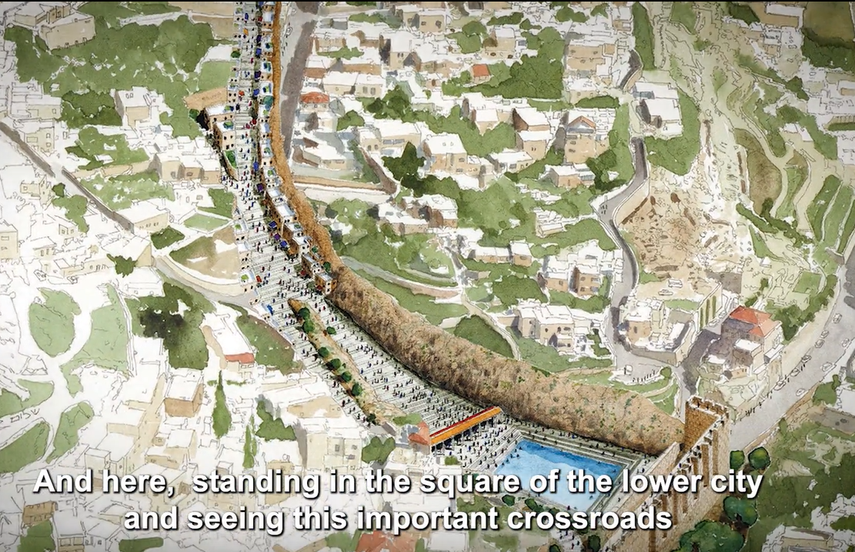
Notes:
https://www.livescience.com/archaeology/2000-year-old-stone-receipt-discovered-in-jerusalem
Road covered over, but excavated as a tunnel. Was open air in Yeshua’s time.
Another tunnel to Siloam pool goes east, Hezekiah’s tunnel

Slide 62
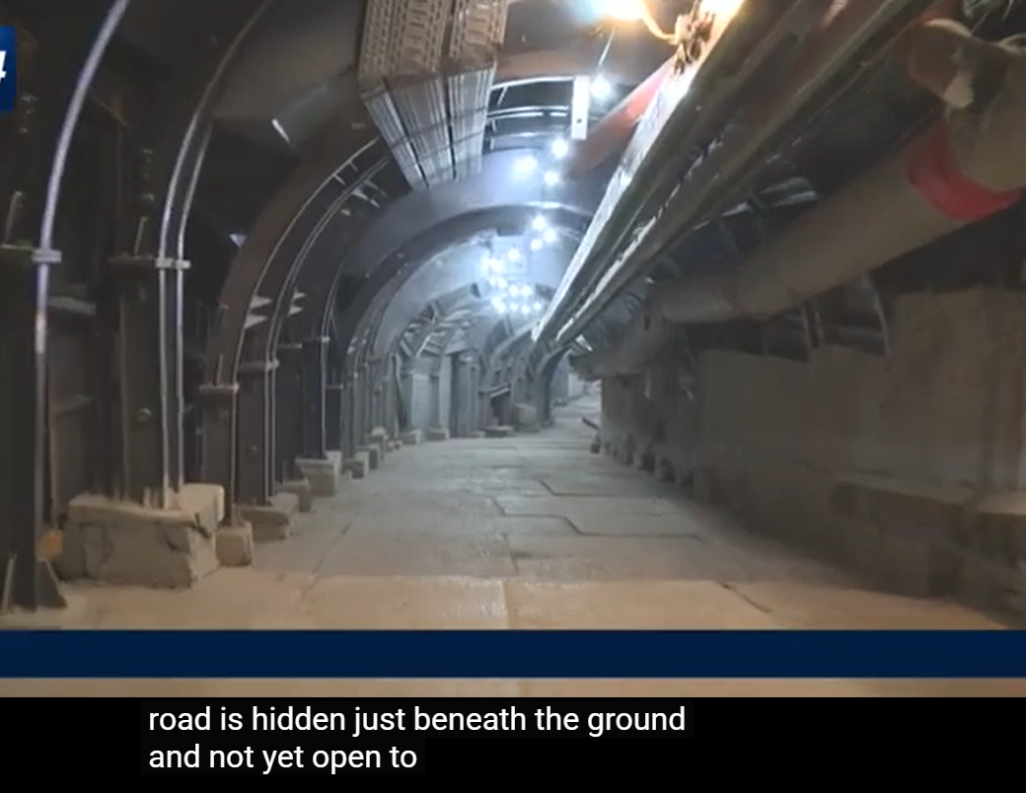
Notes:
https://youtu.be/K-ov-VCS6j4
We will go there. Newly opened Pilgrim Road

Slide 63
How can YOU seek G-d
to change your history?
Notes:
Faith in covenantal promises, and prayer

Slide 65
G-d Intervenes in History
Theological basis: make us
holy through faith in covenantal
promise, and prayer.
2. Illustration: Avraham in Gerar
3. Illustration: Pharoah
4. Illustration: Purim
5. Illustration: Return of the Jews

Slide 66
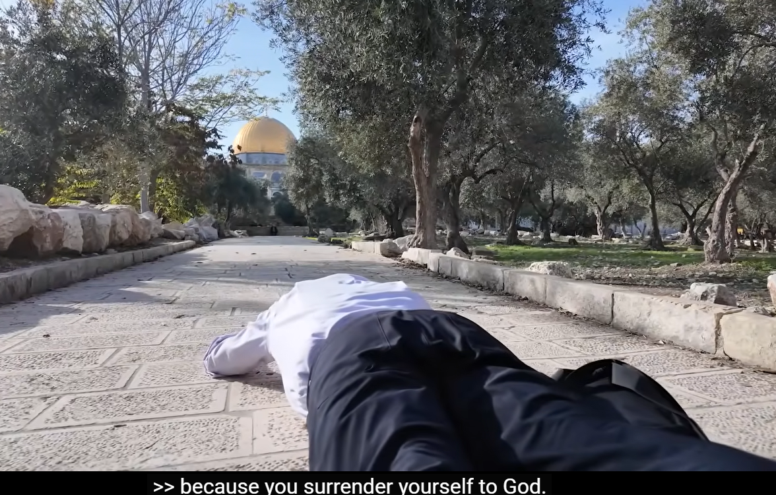
Notes:
https://www.youtube.com/live/7n9vZRC2r5U
What is it about your life you don’t like? Surrender it to G-d!!

Slide 67
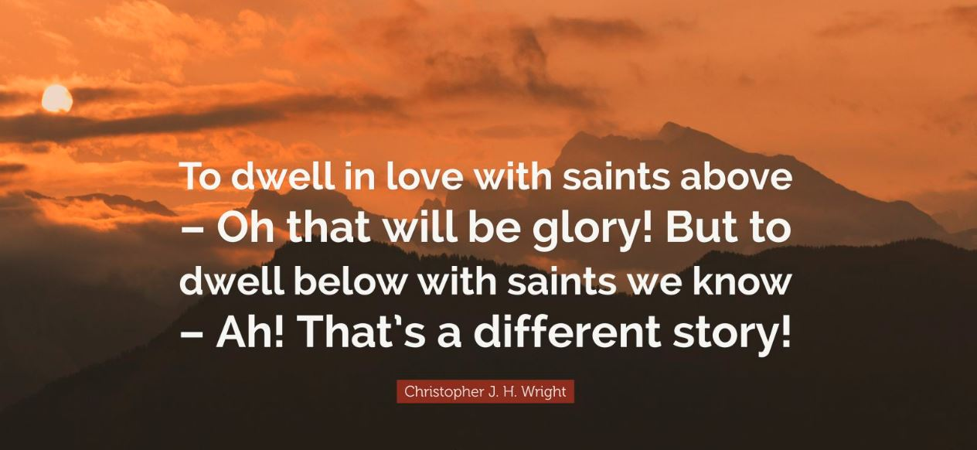

Slide 69
^{Yn 17.22-23} The glory which you have given to me, I have given to them; so that they may be one, just as we are one — I united with them and you with me, so that they may be completely one, and the world thus realize that you sent me, and that you have loved them just as you have loved me.
Notes:
Covenantal unity changes the world.

Slide 70
How can YOU seek G-d
to change your history?

Slide 72
G-d Intervenes in History
Theological basis: make us
holy through faith in covenantal
promise, and prayer.
2. Illustration: Avraham in Gerar
3. Illustration: Pharoah
4. Illustration: Purim
5. Illustration: Return of the Jews

