Slide 1
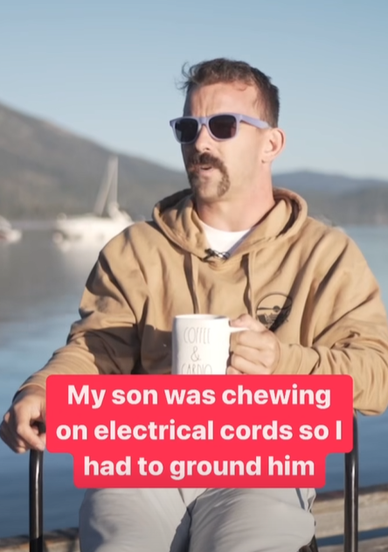

Slide 2
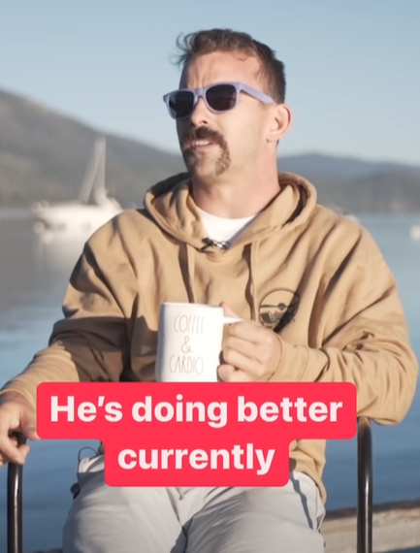

Slide 3
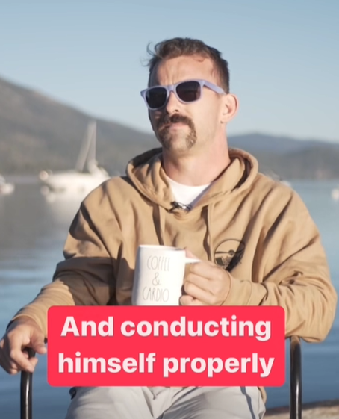
Notes:
Facebook Dad jokes

Slide 4
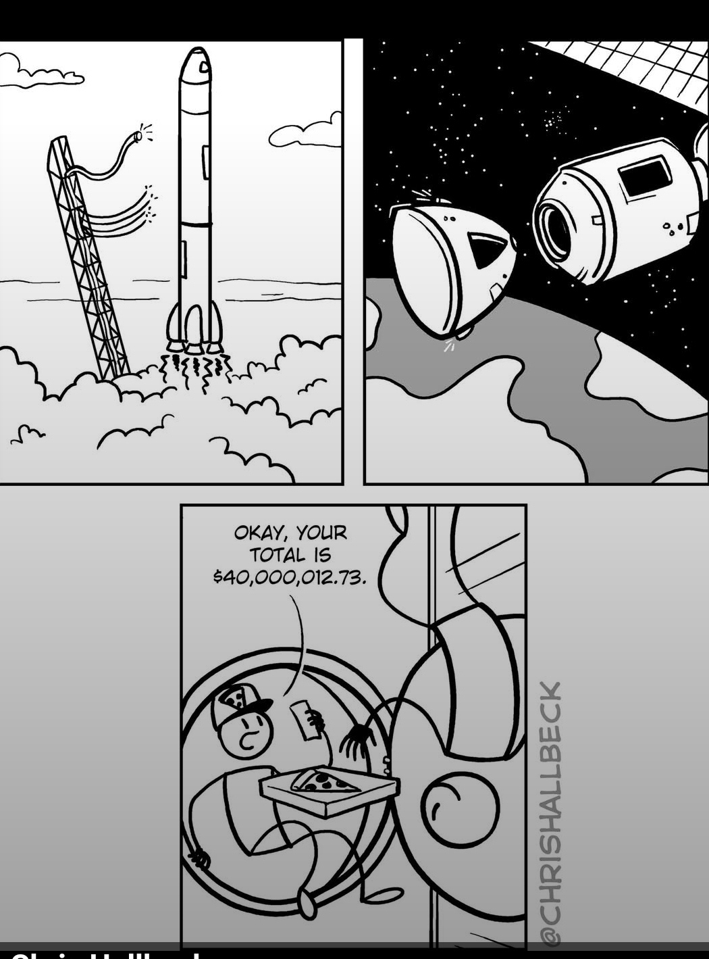
Notes:
I am a frustrated astronaut.

Slide 6
Notes:
Ben Troyer

Slide 7
The Babylon Bee:
“Make them laugh, and while their mouths are open, pour truth in.” — Harold Clurman
Notes:
https://cl.babylonbee.com/m/1/93403970/02-b26037-d610b7de962f4244801650ef24c71247/427/894/a8d3a6e4-ee61-4760-b7f7-7e2fa1aaf518

Slide 8
Messianic Judaism =
The Presence of Messiah +
The Covenantal Jewish Context
So, Or HaOlam has steered down a narrow path that has deep and dangerous ditches on either side - one titled Crazy Charismatic Chaos and the other Rigid Rabbinical Righteousness.
Notes:
Major crises on both sides
Too IHOPy → lost congregants
Too Jewish → lost congregants

Slide 9
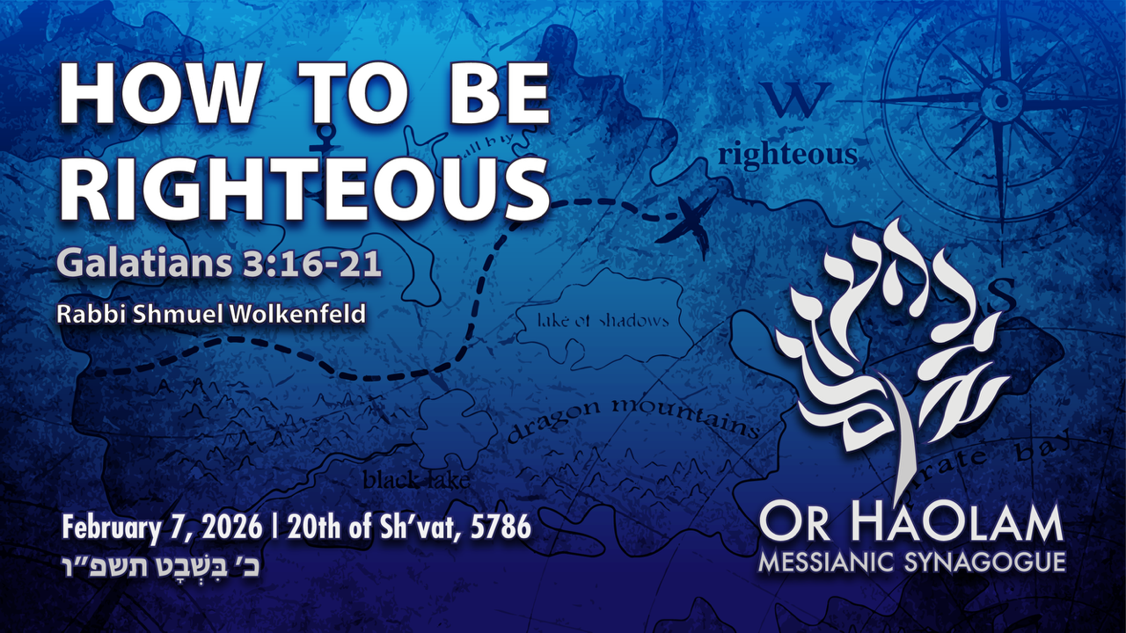

Slide 10
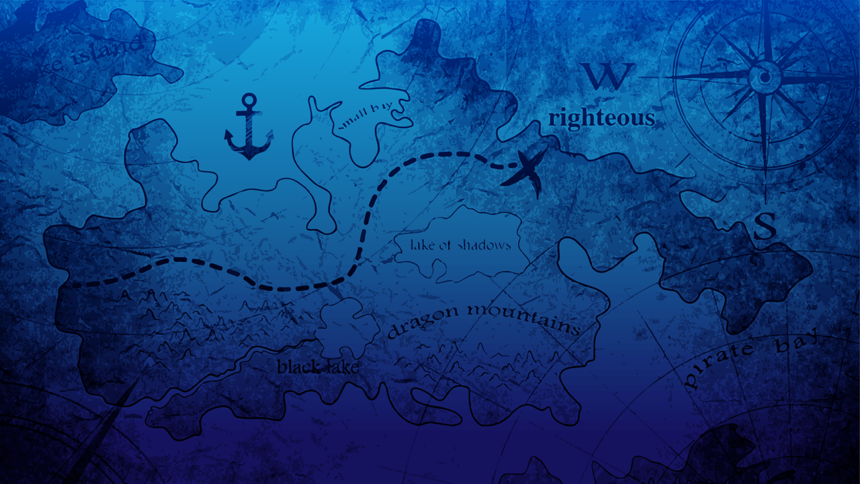
How to be righteous: Messianic + Judaism
Galatians grid
Yeshua’s Jewish Joy
Cernan systematic
Applications: tithing, outreach,
talebearing, visit Israel
Notes:
NOT Yeshua plus anything. We are walking with the Jewish people BECAUSE of Yeshua.
There is a bit of different level of joy in Messianic Jewish worship: Covenantal unity

Slide 11
How to be righteous: Messianic + Judaism
Galatians grid
Yeshua’s Jewish Joy
Cernan systematic
Applications: tithing, outreach,
talebearing, visit Israel

Slide 12
^{Gal 3.16-21} Now the promises were made to Avraham and to his seed. It doesn’t say, “and to seeds,” as if to many; on the contrary, it speaks of one — “and to your seed” — and this “one” is the Messiah.
Notes:
Genesis 12:7; 13:15; 17:7; 24:7

Slide 13
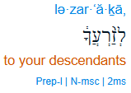
Preposition ל “to”
Noun Masc sing
זֶרעַ
Possessive 2nd person ms ךָ
Plural זרָעֶיךָ

Slide 14
David Stern’s drash:
(1) Israel is God's son.
(2) The Messiah is God's Son.
(3) Israel is descended from Avraham, is Avraham's seed, the children of Avraham.
(4) The true children of Avraham are those who trust.

Slide 15
(5) Those who trust in Yeshua are united with him by that trust — they are part of his Body, one with him, one, singular.
(6) In the thinking of the Tanakh, a king represents his people to the point of being one with them; and the king of Israel is treated as representing Israel, standing for them, being one with them.

Slide 16
(7) The Messiah Yeshua is the King of Israel, the promised Son of David, one with Israel.
(8) By trusting. Gentiles become identified with and in some sense a part of Israel.
(9) All of God's promises reach their culmination and fulfillment in the Messiah, who is Avraham's "seed."
Notes:
So, many possible interp of “your seed” Only one primary, all others dependent.
All about Yeshua

Slide 17
^{Gal 3.16-21} Here is what I am saying: the legal part of the Torah, which came into being 430 years later,

Slide 18
The legal part of the Torah came into being in the days of Moshe, 430 years later than Avraham.
In Judaism, the word "Torah" usually means one of the following:
Notes:
Quote about “your seed” to Avraham.

Slide 19
(1) the Humash (Pentateuch, Five Books of Moses),
(2) the Tanakh (the Hebrew Scriptures),
(3) the Tanakh (Written Law) together with the Oral Law, or
(4) all true religious teaching (see Mt 5:17N). In any of these senses the Torah includes the promises to Avraham.

Slide 20
But here "the Torah" means none of these. Shaul means its specifically legal portions, from the elements which existed previously. He is contrasting the Torah's commandments with its promises.
Notes:
to use Jewish language from a couple of centuries later, contrasting halakhah (what to do, how to live) with aggadah (narrative).

Slide 21
Therefore, even if the legal part of the Torah had required legalistic obedience without trust, it could not nullify an oath sworn or: "a covenant established"; earlier by God, so as to abolish the promise to Avraham, which says that Gentiles will be blessed through Avraham without having to become Jews.

Slide 22
^{Gal 3.16-21} Here is what I am saying: the legal part of the Torah, which came into being 430 years later,

Slide 23
^{Gal 3.16-21} does not nullify an oath sworn by God, so as to abolish the promise. For if the inheritance comes from the legal part of the Torah, it no longer comes from a promise. But God gave it to Avraham through a promise. So then, why the legal part of the Torah?

Slide 24
If the inheritance comes by legalism, that is, by meeting the condition of legalistically following the Torah's prescriptions, then it no longer comes from an unconditional promise. The very promise referred to is set forth in the Torah itself, in the book of Genesis. ﻿

Slide 25
^{Gal 3.16-21} It was added in order to create transgressions, until the coming of the seed about whom the promise had been made. Moreover, it was handed down through angels and a mediator. Now a mediator implies more than one, but God is one.

Slide 26
A key purpose of the commandments was to make Jewish people ever aware of their sin — not that Jews were more sinful than Gentiles, but that, like Gentiles, Jews too "fall short of earning God's praise" (Ro 3:23). The Torah "creates" transgressions by containing commandments which people break,
Notes:
Jewish guilt
Also RC guilt.

Slide 27
At least in some cases the guilt they feel causes them to despair of ever earning God's praise by their own works, so that they come to God in all humility to repent, seek his forgiveness, and trust him

Slide 28
Until the coming of the "seed," Yeshua about whom the promise had been made. From the time of Moshe until the coming of Yeshua, the Torah had this "consciousness-raising" role. The Torah still exists, and for those who have not yet come to trust in Yeshua it still has this function.

Slide 29
^{Gal 3.16-21} Does this mean that the legal part of the Torah stands in opposition to God’s promises? Heaven forbid! For if the legal part of the Torah which God gave had had in itself the power to give life, then righteousness really would have come by legalistically following such a Torah.

Slide 30
^{Gal 3.22-29} But the Scripture has locked up the whole world under sin, so that the promise based on trust in Messiah Yeshua might be given to those who trust. Now before faith came, we were being guarded under Torah—bound together until the coming faith would be revealed.
Notes:
Torah is still with us, drawing us to Messiah, living FOR Messiah, according to the mitzvot.

Slide 32
How to be righteous: Messianic + Judaism
Galatians grid
Yeshua’s Jewish Joy
Cernan systematic
Applications: tithing, outreach,
talebearing, visit Israel
Notes:
NOT Yeshua plus anything. We are walking with the Jewish people BECAUSE of Yeshua.
There is a bit of different joy in Messianic Jewish worship: Covenantal unity

Slide 33
^{Gal 3.22-29} Therefore, the Torah became our guardian to lead us to Messiah, so that we might be made right based on trusting. But now that faith has come, we are no longer under a guardian. For you are all sons of God through trusting in Messiah Yeshua. For all of you who were immersed in Messiah have clothed yourselves with Messiah.
Notes:
It all gets sort of mystical

Slide 34
^{Gal 3.22-29} There is neither Jew nor Greek, there is neither slave nor free, there is neither male nor female—for you are all one in Messiah Yeshua. And if you belong to Messiah, then you are Abraham’s seed—heirs according to the promise
Notes:
Don’t go woke on me. There is still male and female, so there is still a covenantal difference between Jews and Gentiles. Basically, referring to the Land of Israel promises.

Slide 35
^{Yermiyahu 31.9-11}Hear the word of Adoni, O nations, and declare it in the distant islands, and say: ‘He who scattered Israel will gather and watch over him, as a shepherd does his flock.’

Slide 36
^{Yermiyahu 31.9-11} For Adoni has ransomed Jacob. He redeemed him from the hand of one stronger than he. They will come and sing on Zion’s height, radiant over the bounty of Adoni—

Slide 37
Then will the virgin rejoice in the dance, both young men and old men together. For I will turn their mourning into joy, and I will comfort them, and make them rejoice out of their sorrow.
Notes:
Jewish joy bc redemption after unimaginable suffering!

Slide 39
How to be righteous: Messianic + Judaism
Galatians grid
Yeshua’s Jewish Joy
Cernan systematic
Applications: tithing, outreach,
talebearing, visit Israel
Notes:
NOT Yeshua plus anything. We are walking with the Jewish people BECAUSE of Yeshua.

Slide 40

Eugene Andrew Cernan 1934–2017) American astronaut, naval aviator, electrical engineer, aeronautical engineer, and fighter pilot.
Notes:
https://en.wikipedia.org/wiki/Gene_Cernan

Slide 41

Cernan aboard Gemini 9A

Slide 43
How to be righteous: Messianic + Judaism
Galatians grid
Yeshua’s Jewish Joy
Cernan systematic
Applications: tithing, outreach,
talebearing

Slide 44
My understanding of tithing was not made clear enough previously. I just assumed it was. So if you entered into membership of Or HaOlam with a varying concept, consider yourself “grandfathered.” But this is what I think the scripture means.

Slide 45
Regardless of what financial distress or pressure one is in, the first 10%, 1/10, one out of 10 dollars you get in your paycheck or other income increase, you give to the local congregation without designation. That makes the tithe both the first fruit and given to the storehouse.
That’s what I do with every dollar.
Notes:
Dawn and I do. Then we give offerings.

Slide 46
^{Vayikra/Lev 27.30-31} “‘All the tenth given from the land, whether from planted seed or fruit from trees, belongs to Adoni; it is holy to Adoni. If someone wants to redeem any of his tenth, he must add to it one-fifth.
Notes:
I’ve heard it said that you haven’t given anything when you tithe, it belongs to Adoni, just entrusted to you.

Slide 47
^{Malakhi 3.10} Bring the whole tenth into the storehouse, so that there will be food in my house, and put me to the test,” says Adoni-Tzva’ot. “See if I won’t open for you the floodgates of heaven and pour out for you a blessing far beyond your needs.
Notes:
So, without designation.
What about the Messianic Scriptures? Torah for Gentiles?

Slide 48
^{1 Cor 9.13-14} Don’t you know that those who work in the Temple get their food from the Temple, and those who serve at the altar get a share of the sacrifices offered there? So also, the Lord directed that those who proclaim the Good News should get their living from the Good News.

Slide 49

hoútō – like this . . .; in this manner, in this way (fashion), in accordance with this description (i.e. corresponding to what follows); in keeping with; along this line, in the manner spoken.

Slide 50
^{1 Cor 9.13-14} Don’t you know that those who work in the Temple get their food from the Temple, and those who serve at the altar get a share of the sacrifices offered there? So also, the Lord directed that those who proclaim the Good News should get their living from the Good News.

Slide 52
How to be righteous: Messianic + Judaism
Galatians grid
Yeshua’s Jewish Joy
Cernan systematic
Applications: tithing, outreach,
Talebearing, visit Israel

Slide 53
^{Ester 9.20-22} Mordekhi recorded these events and sent letters to all the Jews in all the provinces of King Achashverosh, both near and far, instructing them to observe the fourteenth day of the month of Adar and the fifteenth day, every year, [to commemorate] the days

Slide 54
^{Ester 9.20-22} on which the Jews obtained rest from their enemies and the month which for them was turned from sorrow into gladness and from mourning into a holiday; they were to make them days of celebrating and rejoicing, sending portions [of food] to each other and giving gifts to the poor.
Notes:
Portions of food, Mishloakh manot

Slide 55
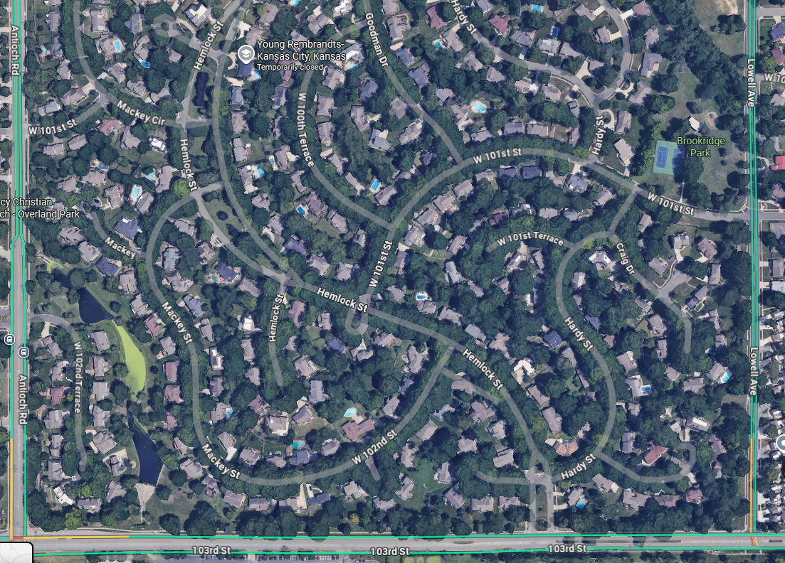
Mish-loakh Manot
Feb 28, 2026

Slide 56

Notes:
https://victory-beyond-the-cup-community.mn.co/

Slide 57
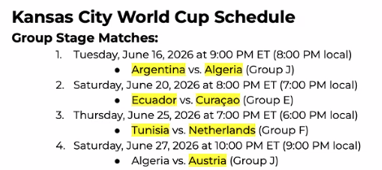
Notes:
At Arrowhead

Slide 58


Slide 59
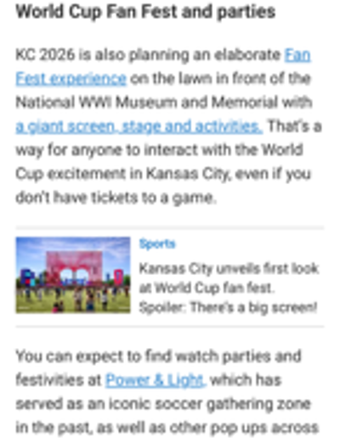

Slide 60
JCC Maccabi 2026
JCC Maccabi 2026 Is Going to Kansas City and Toronto!

Slide 61
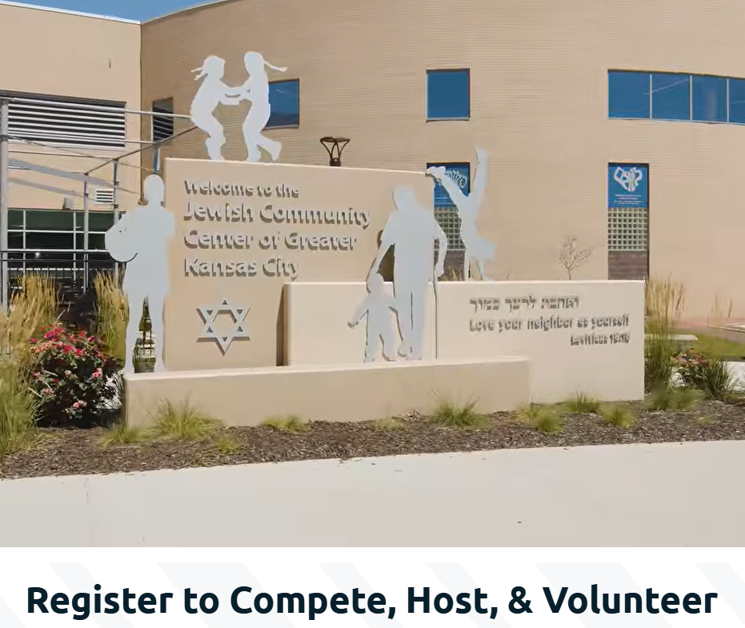

Slide 62


Slide 63
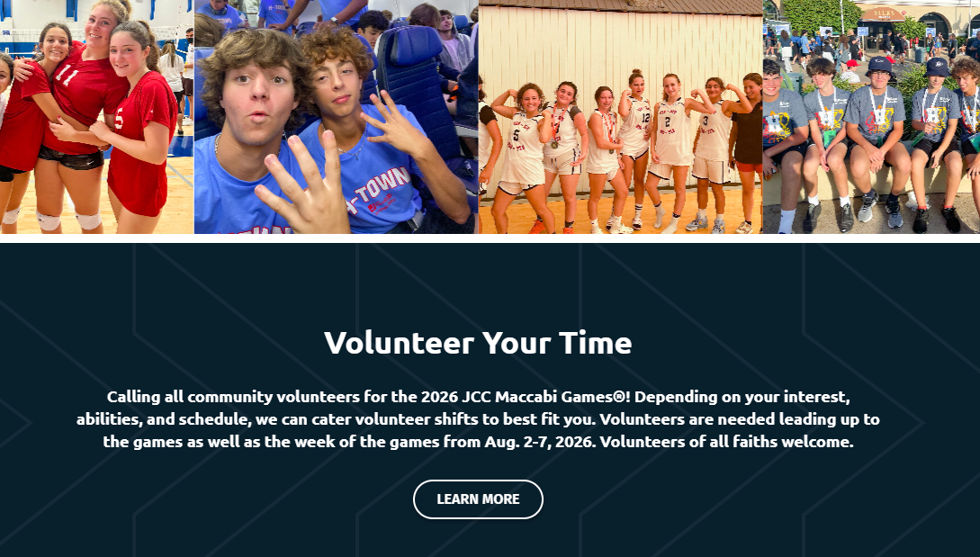

Slide 64
https://jcckcmaccabi.org/

Slide 66
How to be righteous: Messianic + Judaism
Galatians grid
Yeshua’s Jewish Joy
Cernan systematic
Applications: tithing, outreach,
Talebearing, visit Israel

Slide 67
^{Mishlei Prov 26.17-28} Like someone who grabs a dog by the ears is a passer-by who mixes in a fight not his own.
If there’s no wood, the fire goes out; if nobody gossips, contention stops.
As coals are to embers and wood to fire is a quarrelsome person to kindling strife.
Notes:
My guideline is that if you say anyone’s name, you are on dangerous ground. Either positive or helpful. If negative, likely sinning. Just talk to people, not about them.
https://www.youtube.com/live/ObIjqpf55pA Tale bearer

Slide 68
A slanderer’s words are tasty morsels; they slide right down into the belly. Like silver slag overlaid on a clay pot are lips that burn [with friendship] over a hating heart. A lying tongue hates its victims, and a flattering mouth causes ruin.

Slide 69
He may speak pleasantly, but don’t trust him; for seven abominations are in his heart. His hatred may be concealed by deceit, but his wickedness will be revealed in the assembly. Whoever digs a pit will fall into it, and a stone will come back on the one who starts it rolling. A lying tongue hates its victims, and a flattering mouth causes ruin.

Slide 71
How to be righteous: Messianic + Judaism
Galatians grid
Yeshua’s Jewish Joy
Cernan systematic
Applications: tithing, outreach,
Talebearing, visit Israel

Slide 72
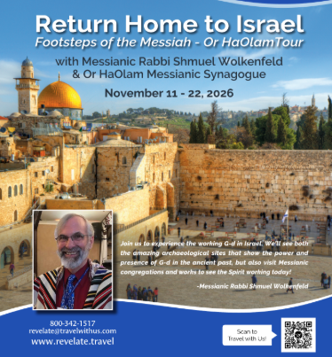
https://orhaolam.com/
index.php/israel-tour-2026
Notes:
Our first erev Shabbat with Chaim Malespin

Slide 73
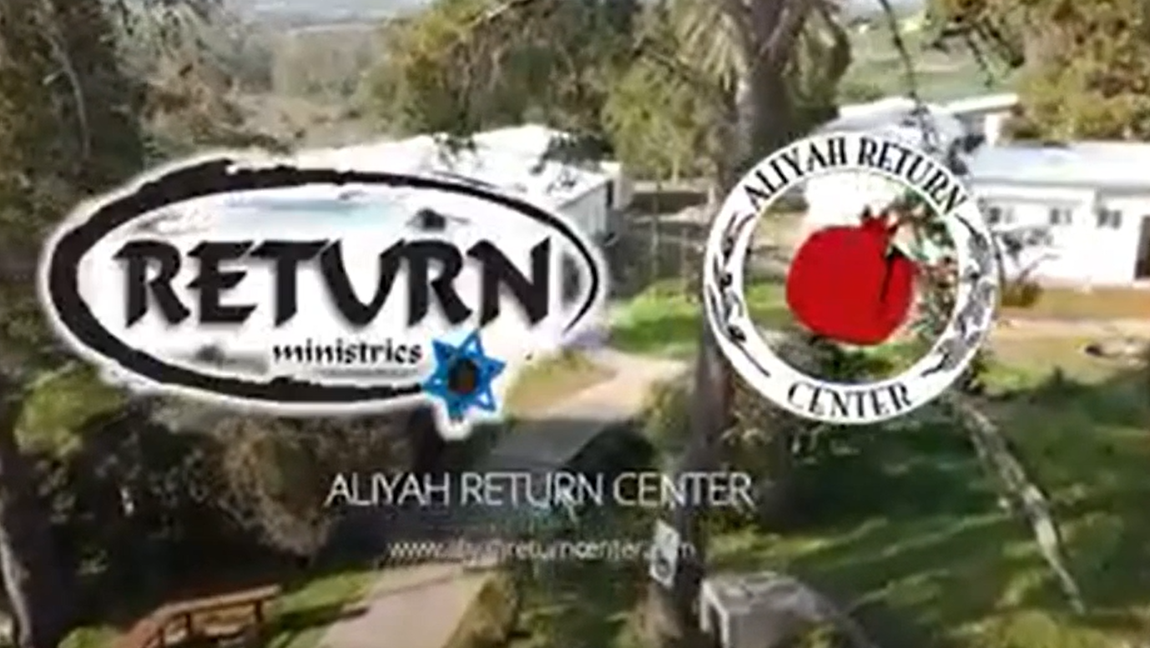
Notes:
https://aliyahreturncenter.com/about-us/

Slide 75
How to be righteous: Messianic + Judaism
Galatians grid
Yeshua’s Jewish Joy
Cernan systematic
Applications: tithing, outreach,
Talebearing, visit Israel
Notes:
NOT Yeshua plus anything. We are walking with the Jewish people BECAUSE of Yeshua.
There is a bit of different joy in Messianic Jewish worship: Covenantal unity

