Slide 1
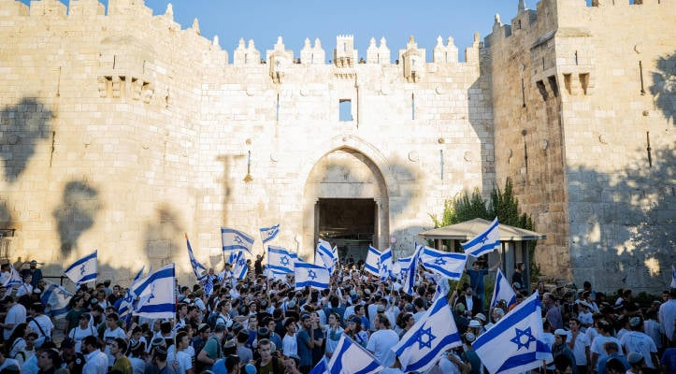
Israel 8th Happiest Country for
Second Year, Despite War
Notes:
https://unitedwithisrael.org/israel-8th-happiest-country-for-second-year-despite-war/

Slide 2
For the second consecutive year, Israel placed eighth in the 2026 World Happiness Report, even as society continues to grapple with prolonged war.
“These figures suggest that even under the strain of prolonged war, the deeper sources of Israeli resilience —
Notes:
https://unitedwithisrael.org/israel-8th-happiest-country-for-second-year-despite-war/

Slide 3
— family ties, community, faith, a sense of belonging, and strong social bonds — are helping large parts of society remain well above the global average,” said Anat Panti, a researcher in happiness policy at Bar-Ilan University.
Notes:
https://unitedwithisrael.org/israel-8th-happiest-country-for-second-year-despite-war/

Slide 4
Those under the age of 25 rank as the happiest age group within the country and place third worldwide in their category.
Notes:
https://unitedwithisrael.org/israel-8th-happiest-country-for-second-year-despite-war/
SW comment: This considering the VERY high reports of national PTSD.
Warfare and joy in the covenantal calling, destiny, purpose of Israel, Jewish JOY available for all nations grafted in, is the source. Am Yisrael Khi. עם ישראל חי
Go there with us in November!!

Slide 5

Kippat Barzel
כפת ברזל
Iron Dome Interception

Slide 6
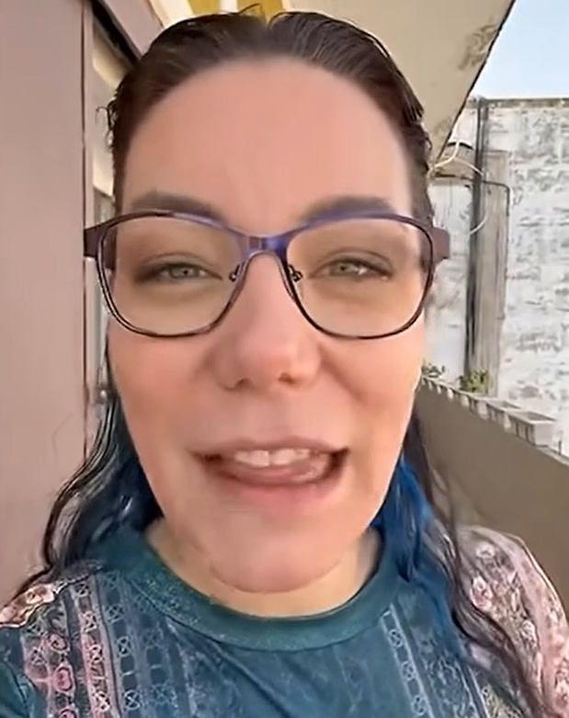
Shani Ferguson,
Daughter of Ari and Shira Sorko-Ram of Maoz Ministries,
Recording artist
Notes:
She and husband Kobi Israeli been in our home for a Shabbat dinner when invited by our son.

Slide 7
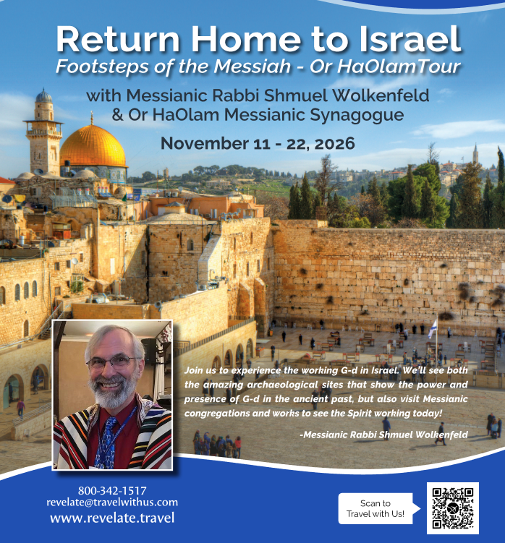

Slide 8
Pesakh Particulars

Slide 9
^{Shmot Ex 12. 18-20} During the first month in the evening of the fourteenth day of the month, you are to eat matzot, [April 1, 2026] until the evening of the twenty-first day of the month [April 8, 2026]. For seven days no hametz is to be found in your houses,
Notes:
Khametz avoidance is just temporary, but it represents something VERY deadly

Slide 10
^{Shmot Ex 12. 18-20} for whoever eats hametz, that soul will be cut off from the congregation of Israel, whether he is an outsider or one who is born in the land. You are to eat no hametz; in all your houses you are to eat matzot.”
Notes:
Serious consequence.
Land based commandment. However, Jews everywhere practice it, from Brooklyn to Bangladesh. Non Jews as well.

Slide 11
^{Shmot Ex 12.15} For seven days you are to eat matzot, but on the first day you must remove hametz from your houses, for whoever eats hametz from the first day until the seventh day, that soul will be cut off from Israel.
Notes:
Serious consequences. Various interpretations.

Slide 12
What is all this, in plain English?

Slide 13
שְׂאֹר leavening agents s’or
חָמֵץ leavened food khametz
Khametz is a product that is both made from one of five types of grain and has been combined with water and left to stand raw for longer than eighteen minutes and becomes leavened.
Notes:
https://en.wikipedia.org/wiki/Chametz
Definitions of Hebrew a bit fluid.

Slide 14
Note: Hebrew is subject to various schemes of transliteration
חָמֵץ leavened food khametz
Could be hametz, chametz, hamets, chamets, Ḥametz, etc.

Slide 15
The five grains of Biblical Israel
חִטָּה Wheat Ḥittah
כֻּסְמִין Spelt Kusmin
שְׂעוֹרָה barley Se’orah
שִׁבֹּלֶת שׁוּעָל oats Shibbolet shual
שִׁיפוֹן rye sheefon
Notes:
https://en.wikipedia.org/wiki/Chametz
שִׁבֹּלֶת ear (of corn), stalk (of grain)=
fox = שׁוּעָל

Slide 16
Leavening agents, such as yeast or baking soda, are not themselves khametz. Rather, it is these five fermented grains. Thus yeast may be used in making wine, and kefir.
Notes:
https://en.wikipedia.org/wiki/Chametz
Wine IS fermented, but not of the 5 grains.
Kefir similar

Slide 17
Jews from Europe, Ashkenazi Jews, have an additional restriction to the Biblical prohibitions of not eating anything that looks leavened, even if it doesn’t rise. Kitniyot…

Slide 18
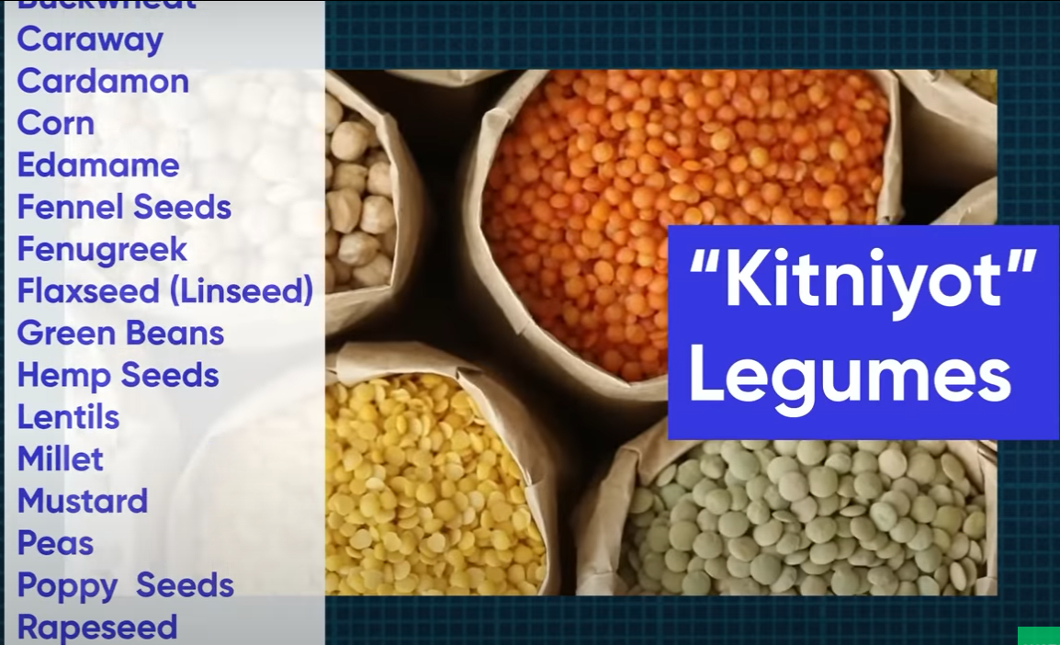
Notes:
https://youtu.be/M-TjGJ9bgKQ
Rice is a key one. It looks fermented, but just water.
Or HaOlam follows the Biblical and Sephardic interpretation. Rice is OK. Horchata is OK.

Slide 19
So it’s a practice in observant Jewish homes to do a THOROUGH Spring cleaning! Get ALL the khametz out of every corner.
Burn the crumbs…bonfire.
And then a prayer of covering.
Notes:
Of course, the best is to eat it all before Passover!

Slide 20
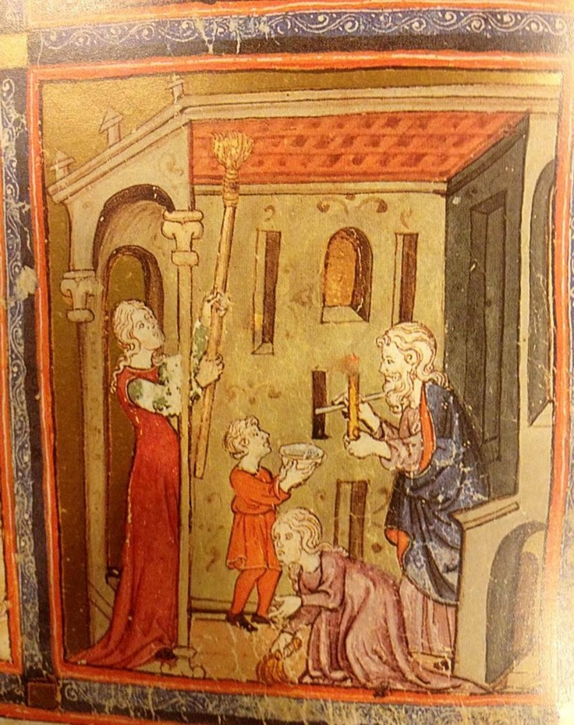
Medieval Jewish family searching for leaven
Notes:
https://i.pinimg.com/736x/f0/f9/43/f0f9431fb1624df18215a92f3cb2153d.jpg

Slide 21
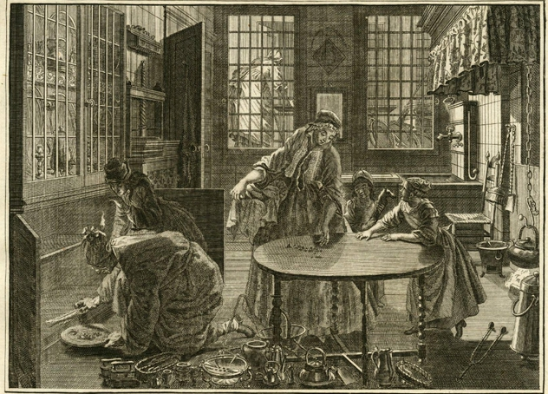
Notes:
https://www.lbi.org/media/images/Passover_LExamen_du_levain.height-515.jpg

Slide 22
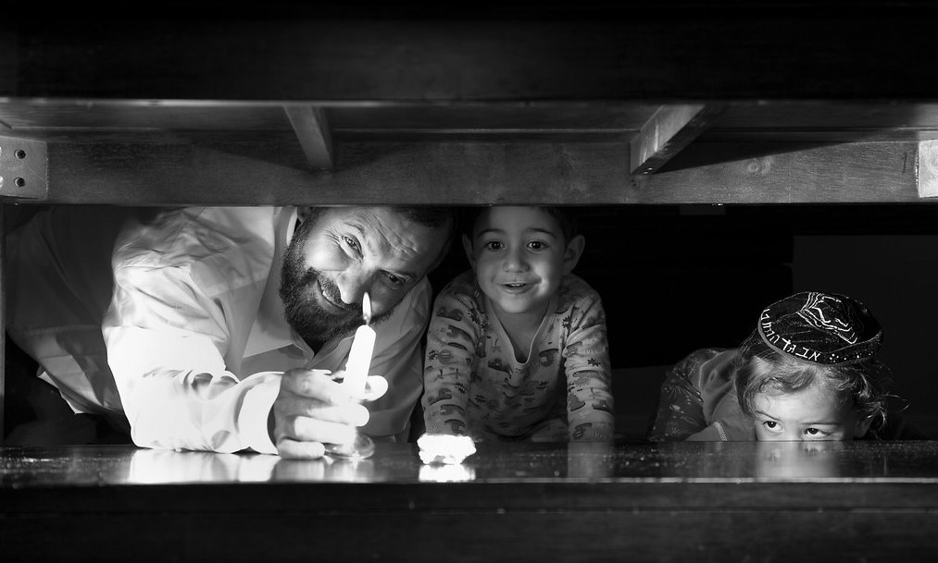
Notes:
https://mybethany.com/wp-content/uploads/2020/04/Leaven.jpg

Slide 23
To prepare for Passover, we will have a khamets burning at noon, Wednesday, here at the shul firepit. You are invited to bring and burn any excess leavened bread and crackers, etc. I recommend that you eat all khamets before Passover, but the next best option is to burn it.

Slide 24
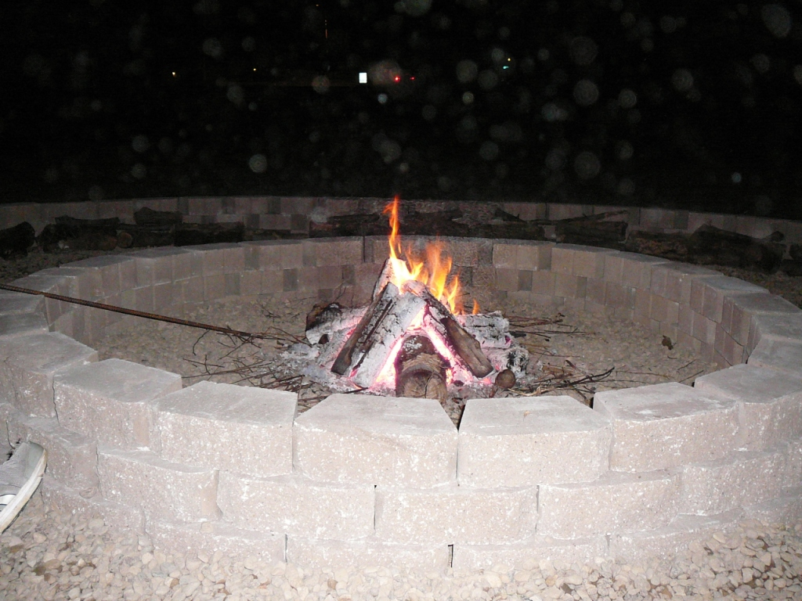
Wednesday, April 1, 2026, noon
Notes:
Evening photos.

Slide 25
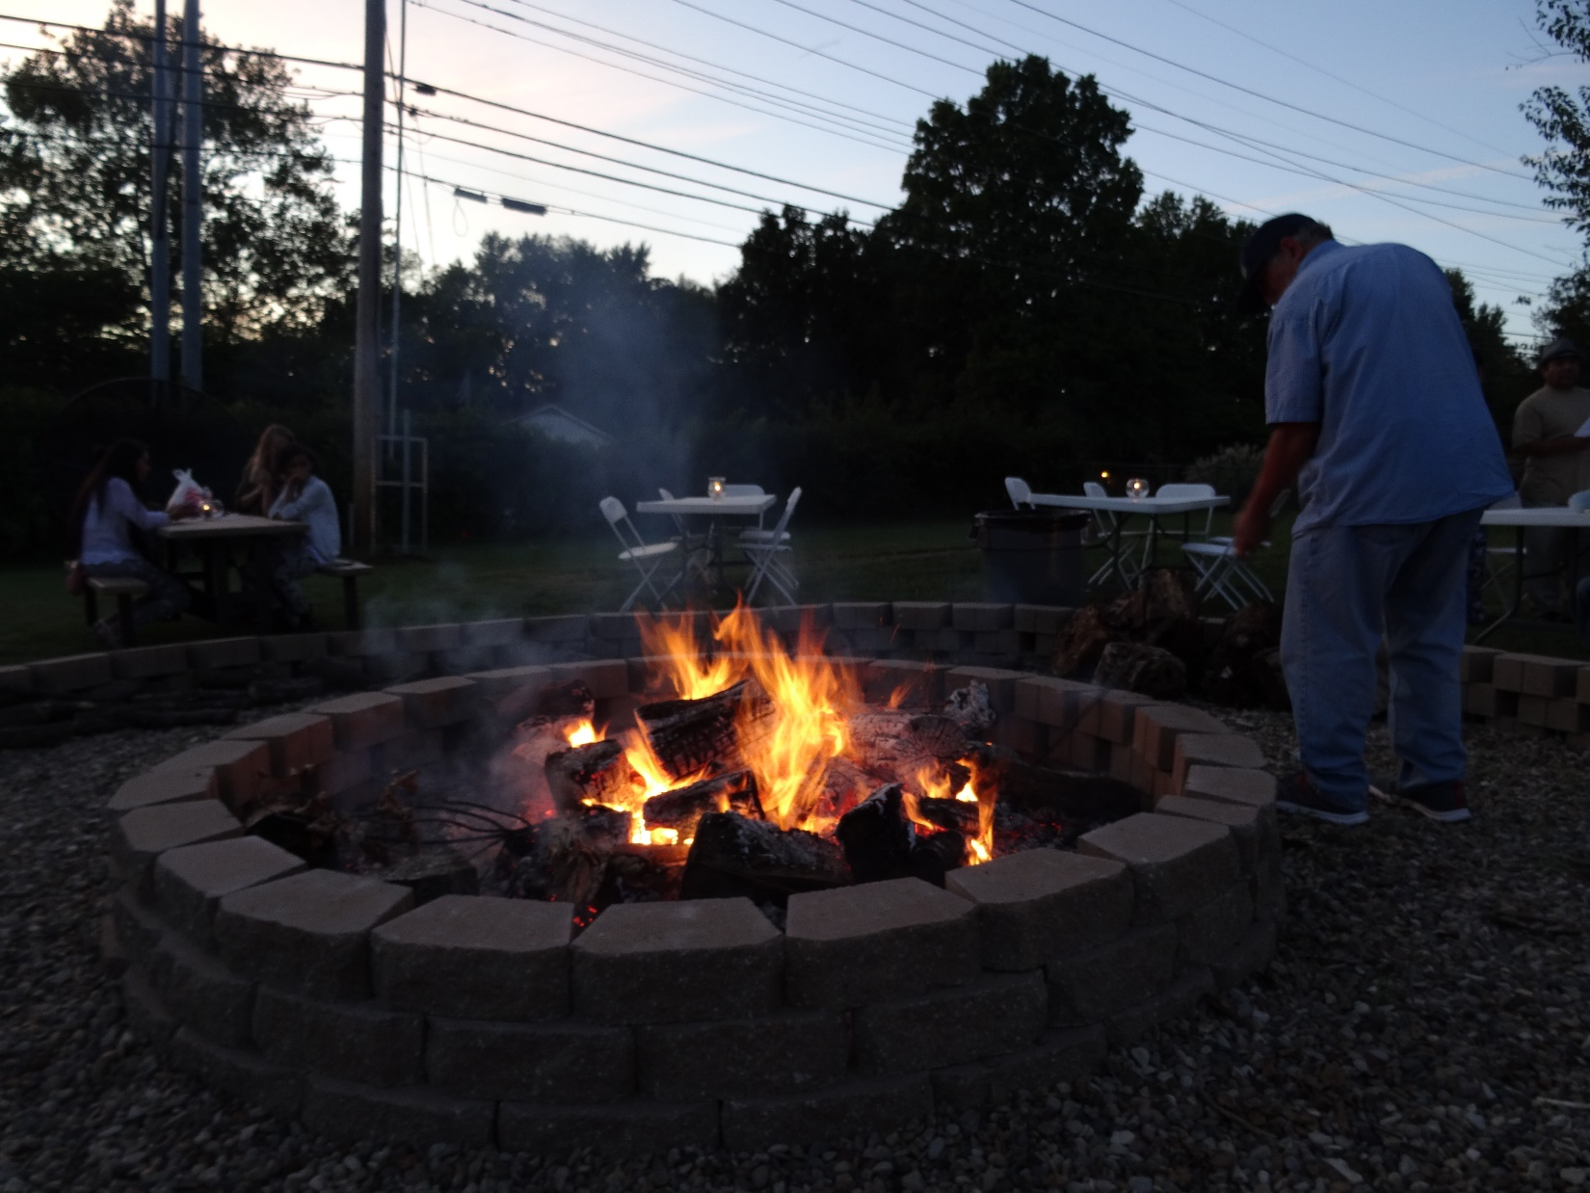

Slide 26
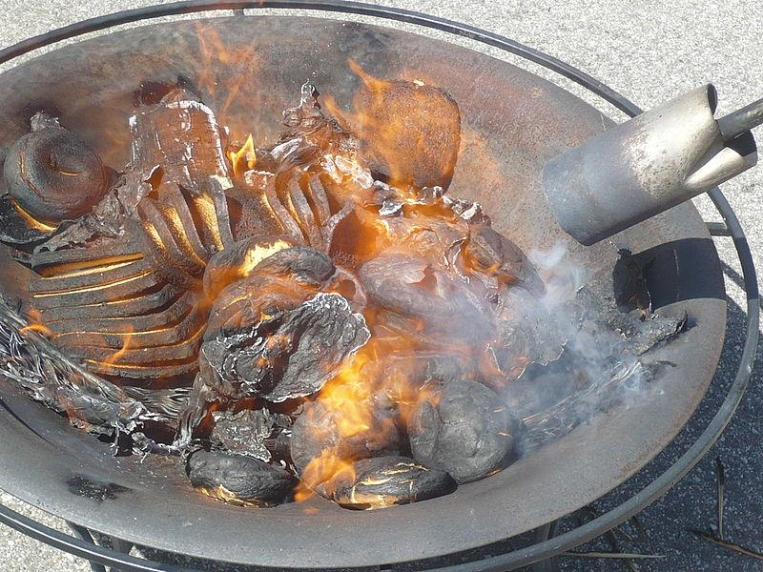

Slide 27
Jews from Europe, Ashkenazi Jews, have an additional day of unleavened bread…8 days.
Sephardic Jews, from Spain, Portugal, North Africa, have 7 days unleavened, then a bread fest on the eve of the 8th day.
Notes:
https://www.myjewishlearning.com/article/maimouna-a-post-passover-celebration/
I wondered about Memunah: Sephardic Jews have bread fest on the night of the 7th day. Ashkenaz still on matzah. How do they get the yeast so quickly?
A: they always had it.
Speaker of the Knesset MK Amir Ohana invited the public to a festive Mimouna event at the Knesset
on Wednesday night, April 12, 2023, after the Passover holiday ends, to celebrate the Mimouna here for the first time.
https://main.knesset.gov.il/EN/About/Pages/Mimouna5783.aspx
European, Ashkenaz Jews have extra day and extra food prohibitions.

Slide 28
^{1 Cor 5.7-8} Get rid of the old hametz, so that you can be a new batch of dough, because in reality you are unleavened. For our Pesakh lamb, the Messiah, has been sacrificed. So let us celebrate the Seder not with leftover hametz, the hametz of wickedness and evil, but with the matzah of purity and truth.
Notes:
Physical and spiritual, inspection, housecleaning…

Slide 29
^{T’hillim / Ps 139.23-24} Search me, O God, and know my heart.
Examine me, and know my anxious thoughts, and see if there be any offensive way within me,
and lead me in the way everlasting.
Notes:
And khamets in my soul.

Slide 30

Notes:
Get rid of khamets

Slide 31

Accountability 2 Cor. 8.21
Accountability to G-d
Accountability to People
Or HaOlam Finances
IAMCS membership
Rabbinic leadership
Marriage leadership
Community Practices

Slide 32
Accountability 2 Cor. 8.21
Accountability to G-d
Accountability to People
Or HaOlam Finances
IAMCS membership
Rabbinic leadership
Marriage leadership
Community Practices

Slide 33
^{2 Cor 8 21} For we take pains to do what is right not only in the sight of God but also in the sight of other people.
Notes:
.

Slide 34
^{Mtt 12.36-37} I tell you this: on the Day of Judgment people will have to give account for every careless word they have spoken; for by your own words you will be acquitted, and by your own words you will be condemned.”

Slide 35
What? I thought we are saved by faith?!
^{Mtt 12.33} “If you make a tree good, its fruit will be good; and if you make a tree bad, its fruit will be bad; for a tree is known by its fruit.

Slide 36
^{Lk 12.47-48} Now the servant who knew what his master wanted but didn’t prepare or act according to his will, will be whipped with many lashes; however, the one who did what deserves a beating, but didn’t know, will receive few lashes.
Notes:
Various degrees of eternal punishment.

Slide 37
^{Lk 12.47-48} From him who has been given much, much will be demanded — from someone to whom people entrust much, they ask still more.
Notes:
Given, is the key.

Slide 38
^{Ro 14.11-12} it is written in the Tanakh, “As I live, says Adoni, every knee will bend before me, and every tongue will publicly acknowledge God.” ^{Yeshayahu 45.23} So then, every one of us will have to give an account of himself to God.

Slide 39
^{1 Kefa / Peter 4.3-4} For the time that has passed was sufficient for you to carry out the desire of the pagans—living in indecency, lusts, drunken binges, orgies, wild parties, and lawless idolatries.

Slide 40
^{1 Kefa / Peter 4.3-5} They are surprised that you do not run with them into the same riot of recklessness, and they vilify you. But they will have to give an account to the One who stands ready to judge the living and the dead.

Slide 41
^{1Cor 3.13-15} But each one’s work will be shown for what it is; the Day will disclose it, because it will be revealed by fire — the fire will test the quality of each one’s work. If the work someone has built on the foundation survives,

Slide 42
^{1Cor 3.13-15} he will receive a reward; if it is burned up, he will have to bear the loss: he will still escape with his life, but it will be like escaping through a fire.
Notes:
So, apparently, saved people can “lose their reward”

Slide 43
^{Rev 22.12-15} “Pay attention!” [says Yeshua,] “I am coming soon, and my rewards are with me to give to each person according to what he has done. I am the ‘A’ and the ‘Z,’ the First and the Last, the Beginning and the End.”
How blessed are those who wash their robes,

Slide 44
^{Rev 22.12-15} so that they have the right to eat from the Tree of Life and go through the gates into the city! Outside are the homosexuals, those involved with the occult and with drugs, the sexually immoral, murderers, idol-worshippers, and everyone who loves and practices falsehood.

Slide 45
^{1 Cor 4.4-5} I am not aware of anything against me, but this does not make me innocent. The one who is evaluating me is the Lord. So don’t pronounce judgment prematurely, before the Lord comes;
Notes:
I am not aware…Ruakh search.

Slide 46
^{1 Cor 4.4-5} for he will bring to light what is now hidden in darkness; he will expose the motives of people’s hearts; and then each will receive from God whatever praise he deserves.

Slide 47

My family business
116 W. 29th St.,
New York, NY

Slide 48
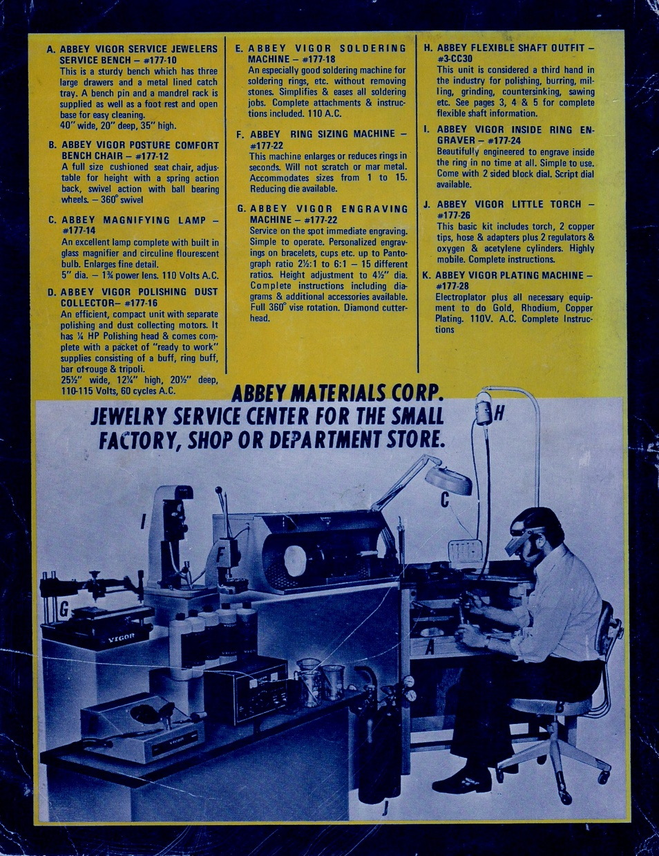

Slide 49
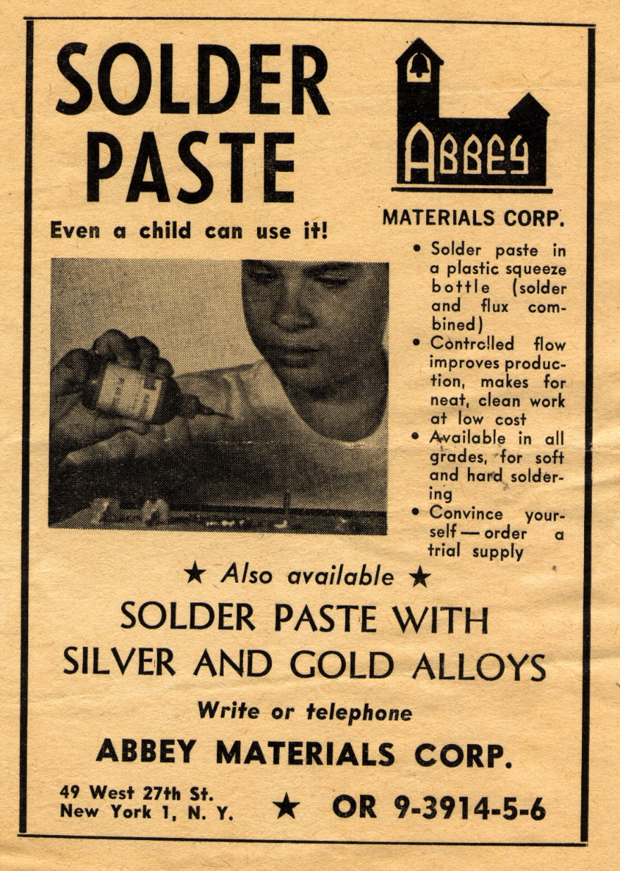

Slide 50
~Dec 27 everything STOPPED for inventory. Physically count every tool, every file, every buff, brush, bottle of flux, solder spool…
Notes:
Giving account of our sins, inventory, seems dreadful, HOWEVER

Slide 51
However, despite
the great count of sins…

Slide 52
^{Ro 5.20-21} Where sin proliferated, grace proliferated even more. All this happened so that just as sin ruled by means of death, so also grace might rule through causing people to be considered righteous, so that they might have eternal life, through Yeshua the Messiah, our Lord.

Slide 54
Accountability 2 Cor. 8.21
Accountability to G-d
Accountability to People
Or HaOlam Finances
IAMCS membership
Rabbinic leadership
Marriage leadership
Community Practices

Slide 55
^{2 Cor 8 21} For we take pains to do what is right not only in the sight of God but also in the sight of other people.
Notes:
^{2 Cor 8.18-20} We are sending along with him the brother whose fame in connection with the Good News has spread throughout all of Messiah’s communities. Not only that, but he has also been appointed by the communities as our travel companion with this gracious gift, which is administered by us for the glory of the Lord Himself and to show our eagerness to help. We are taking this precaution, so that no one will blame us in regard to the way we administer this generous gift.
To Jerusalem, and double checking.

Slide 56
^{Mishlei/Prov 3.3-4} Do not let grace and truth leave you — bind them around your neck; write them on the tablet of your heart. Then you will win favor and esteem
in the sight of God and of people.

Slide 57


Slide 58
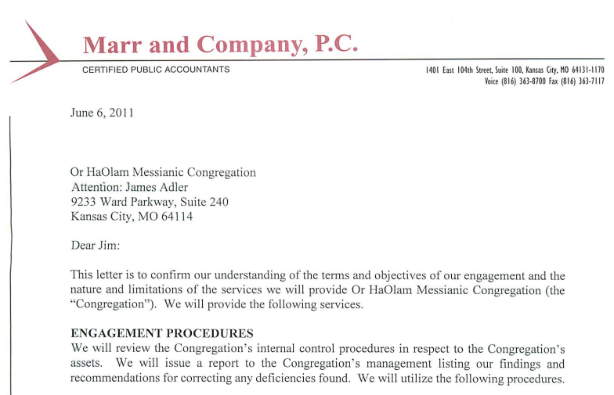

Slide 59
Or HaOlam has strict
finance handling procedures
set up by an accounting firm.
Notes:
Police background check on all $ handlers
Two people count $,
Check writer is NOT check signer,
two signatures on checks,
detailed reports available on requests.

Slide 60
^{2 Cor 8 21} For we take pains to do what is right not only in the sight of God but also in the sight of other people.

Slide 61
Accountability 2 Cor. 8.21
Accountability to G-d
Accountability to People
Or HaOlam Finances
IAMCS membership
Rabbinic leadership
Marriage leadership
Community Practices
Notes:
This is parallel to our own membership renewal. Reinforced a practice that I had neglected, gotten some resistance, but just did. I really treasure your responses, and plan to respond to your great comments.

Slide 62
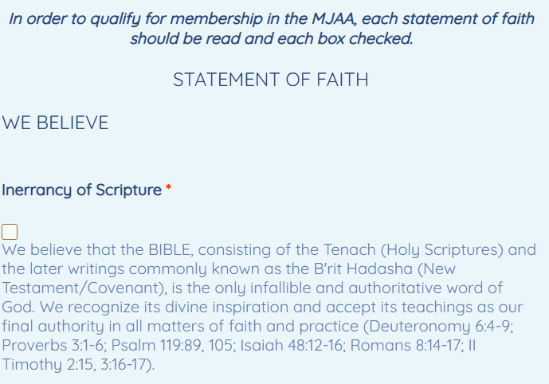
Notes:
I have to fill this out yearly, as do all here and around the country and the world who are IAMCS members. Our renewal is parallel to this.
In addition, Jeremy and I have an accountability form as leaders about our synagogue practice of Shabbat, holidays, liturgy

Slide 63
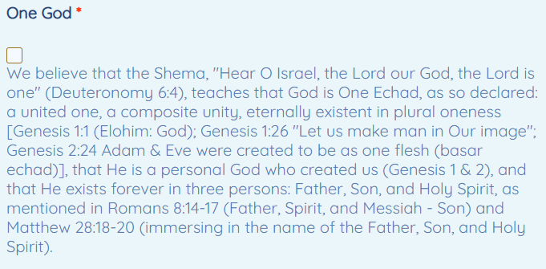

Slide 64
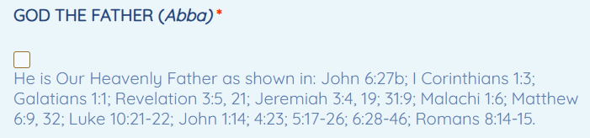

Slide 65
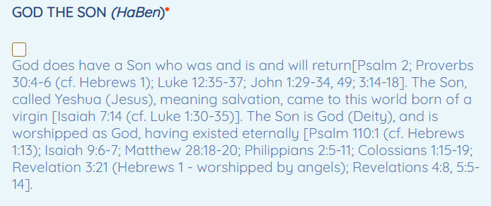

Slide 66
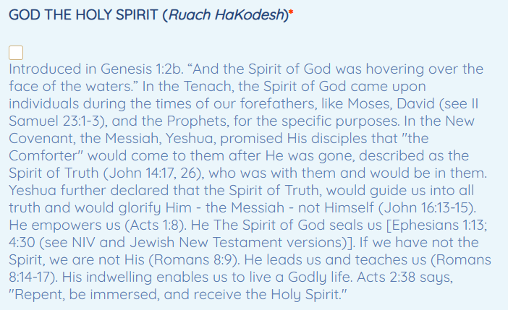
Notes:
It DOESN’T say yes or no about speaking in tongues, glossolalia, unknown languages.
Many think that doing so is a heavenly prayer language, many think that is false and an expression of Satan. “enables us to live a G-dly life” key

Slide 67
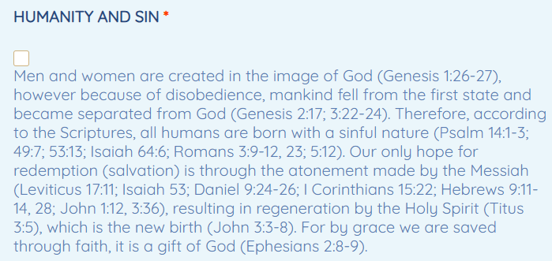

Slide 68
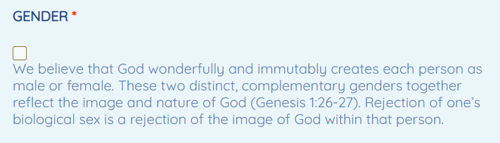

Slide 69
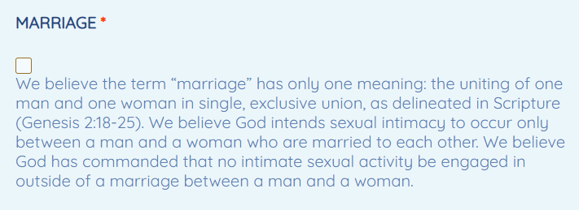

Slide 70
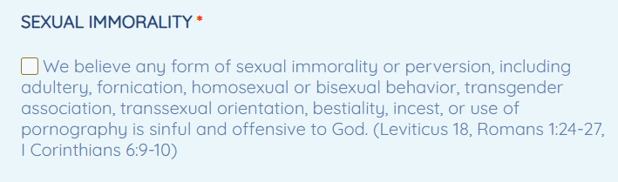

Slide 71
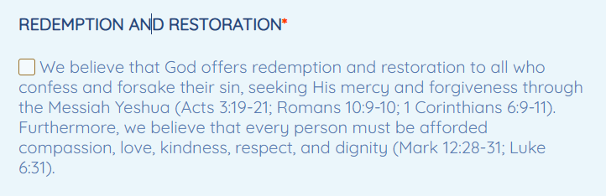

Slide 72
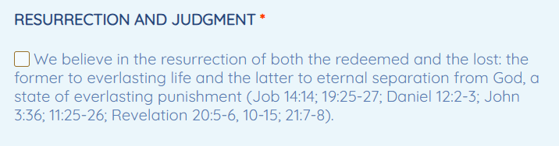

Slide 73
^{Rev 20.15, 10} Anyone whose name was not found written in the Book of Life was hurled into the lake of fire…and they will be tormented day and night forever and ever.

Slide 74
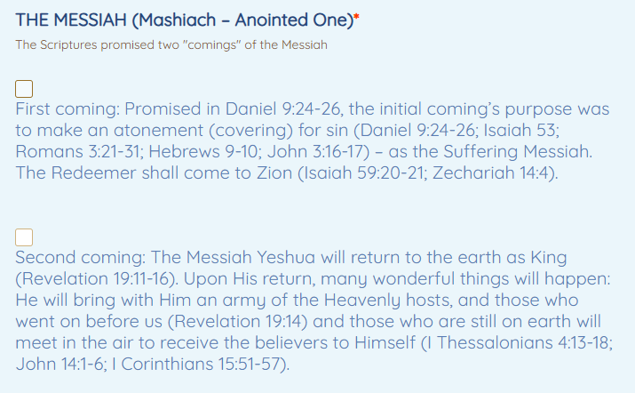
Notes:
No specific statement on the Rapture, pre-Trib, mid-Trib, post Trib

Slide 75
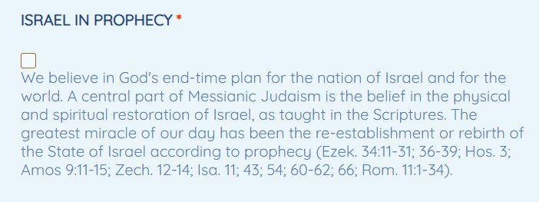

Slide 76
Accountability 2 Cor. 8.21
Accountability to G-d
Accountability to People
Or HaOlam Finances
IAMCS membership
Rabbinic leadership
Marriage leadership
Community Practices
Notes:
I have an ordination renewal questionnaire even more detailed about my practices. PLUS

Slide 77
Leadership is subject to accountability. If there is an issue with me or Jeremy, come to us according to Mt 18.
If you do not get a good hearing…

Slide 78
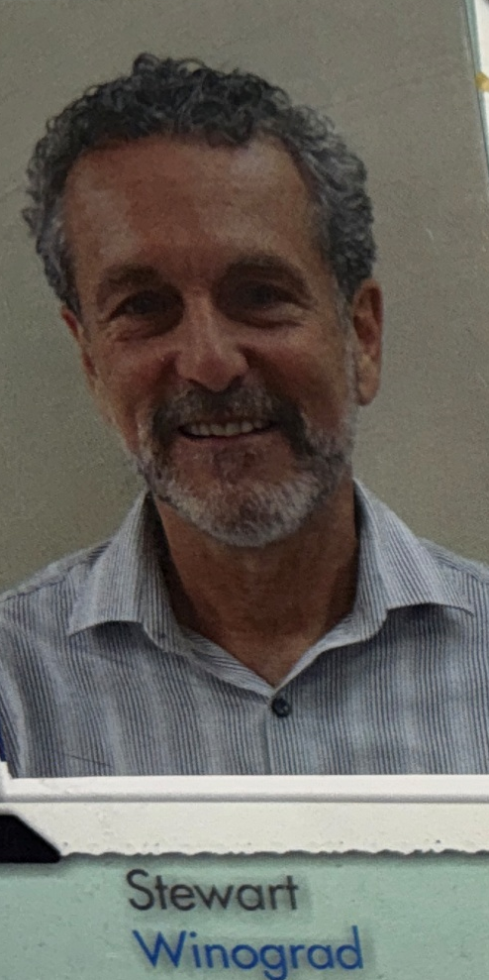
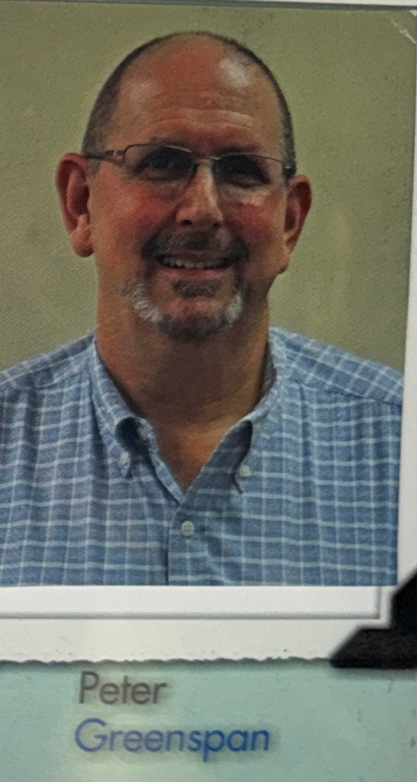
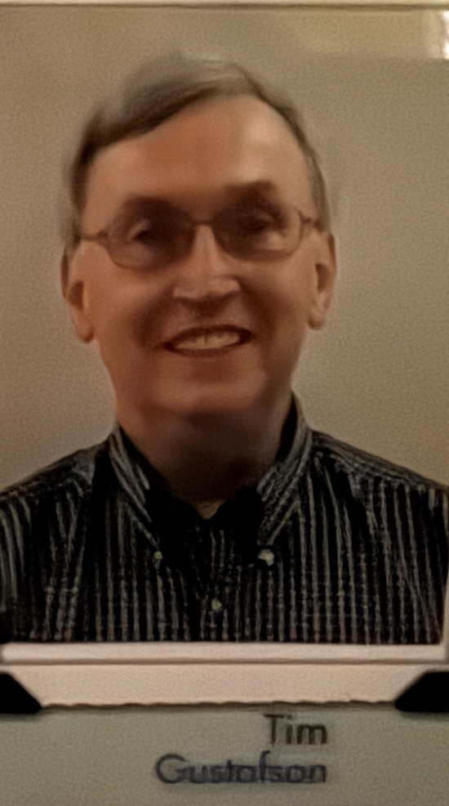
The Corporate Directors

Slide 79
Board ofמְנַהלים
M’nahaleem / Directors

Slide 80
From the Or HaOlam ByLays:
The M’nahaleem/Directors shall have authority, by unanimous vote [excluding the Rabbi’s and his wife’s vote], to remove the Rabbi from office, or mandate a short term of leave, or administer discipline or correction, in the event of moral turpitude, fraud,

Slide 81
apostasy (as defined by the Covenant), misconduct, [1 Cor. 5.11–13, 1 Tim. 5.1, 19], physical or mental disability. Any of the M’nahaleem / Directors may call a meeting of the Directors for a judicial review of the Rabbi, and such review can continue with consent of the majority.

Slide 82
To communicate with
any of the Directors,
please email Admin@OrHaOlam.com
Notes:
Someone asked me, how do we access these guys. We’ve never made it accessible, and we wanted to do so without giving their private information.

Slide 83
Accountability 2 Cor. 8.21
Accountability to G-d
Accountability to People
Or HaOlam Finances
IAMCS membership
Rabbinic leadership
Marriage leadership
Community Practices
Notes:
I have an ordination renewal questionnaire even more detailed about my practices. PLUS

Slide 84
^{Ber/Gen 3.6} Now the woman saw that the tree was good for food, and that it was a thing of lust for the eyes, and that the tree was desirable for imparting wisdom. So, she took of its fruit and she ate. She also gave to her husband who was with her and he ate.
Notes:
“Yes dear.” He didn’t challenge her. What if Adam intervened?

Slide 85
^{Ber/Gen 3.9} Then Adoni Elohim called to the man and He said to him, “Where are you?”
Notes:
Held Adam first in responsibility. Accountability for his wife. Mutual?

Slide 86
^{Bmidbar/Nu 30.4, 8-9} “When a woman makes a vow to Adoni…and her husband hears but holds his peace with her on the day he learns of it, then her vows and obligations she has bound herself to will stand. But if her husband expresses his disapproval on the day he hears it, he will void the vow.
Notes:
Take the leadership: family prayer, attending services, home worship

Slide 87
Accountability 2 Cor. 8.21
Accountability to G-d
Accountability to People
Or HaOlam Finances
IAMCS membership
Rabbinic leadership
Marriage leadership
Community Practices
Notes:
I have an ordination renewal questionnaire even more detailed about my practices. PLUS

Slide 88
Don’t struggle with pornography alone: accountability partner
Never be alone with the opposite gender.
Even for prayer
Cc all emails and texts
Have SOMEONE available in contingency

Slide 89
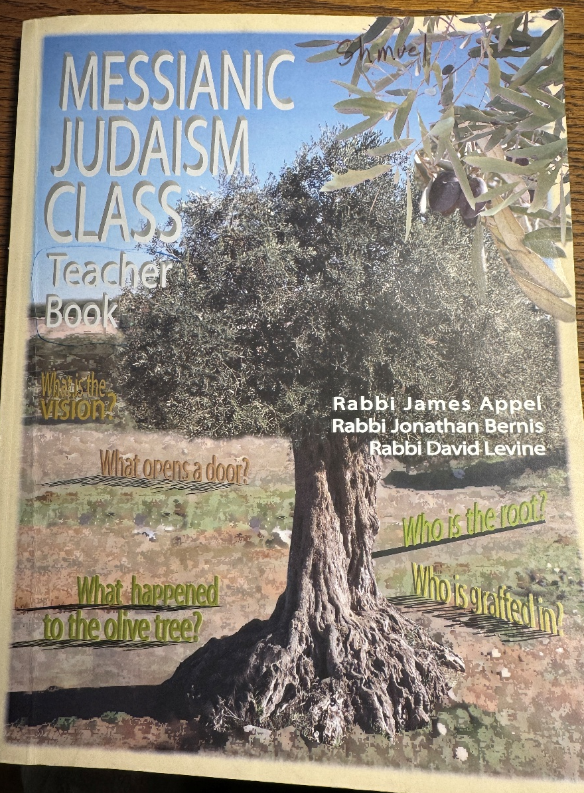
Messianic Judaism
Talmidut
Discipleship
Class

Slide 90
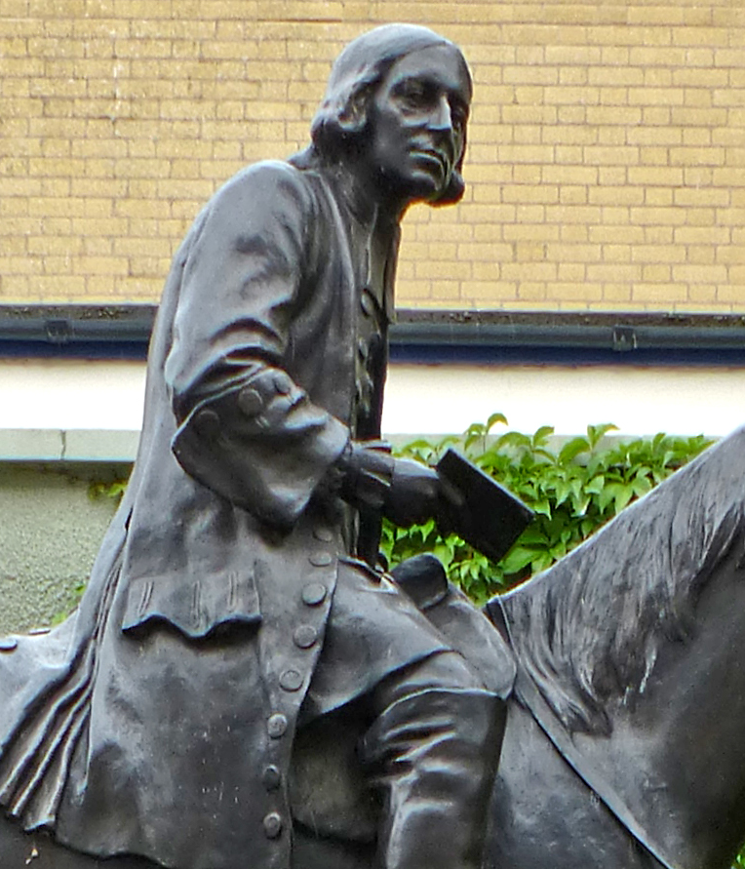
John Wesley (1703-1791)
Notes:
https://www.wesleysheritage.org.uk/os/wp-content/uploads/2020/04/LNE_WCMM_LDWMM_1993_1619-Wesley-by-Westley.jpg

Slide 91
Each week Methodists would meet together in groups of three to five people of the same gender (known as bands), and ask each person the following four questions:

Slide 92
What known sins have you committed since our last meeting?
What temptations have you met with?
How were you delivered?
What have you thought, said, or done, of which you doubt whether it be sin or not?

Slide 93
They also had a series of questions asked regularly at the weekly class meetings (essentially bible study groups of 12 people meeting together). Some of these included:

Slide 94
Am I self-conscious, self-pitying or self-justifying?
Did the Bible live in me today?
Am I enjoying prayer?
Do I pray about the money I spend?
Am I a slave to dress, friends, work or habits?
Do I get to bed on time and get up on time?

Slide 95
^{Mt 7.21-23} “Not everyone who says to me, ‘Lord, Lord!’ will enter the Kingdom of Heaven, only those who do what my Father in heaven wants. On that Day, many will say to me, ‘Lord, Lord! Didn’t we prophesy in your name?

Slide 96
^{Mt 7.21-23} Didn’t we expel demons in your name? Didn’t we perform many miracles in your name?’ Then I will tell them to their faces, ‘I never knew you! Get away from me, you workers of lawlessness!’
Notes:
This verse is both about performance AND intimacy. Knowing G-d in Messiah Yeshua.

Slide 97
^{Yn 17.1-3} After Yeshua had said these things, he looked up toward heaven and said, “Father, the time has come. Glorify your Son, so that the Son may glorify you — just as you gave him authority over all mankind,
Notes:
His basic purpose!

Slide 98
^{Yn 17.1-3} so that he might give eternal life to all those whom you have given him. And eternal life is this: to know you, the one true God, and him whom you sent, Yeshua the Messiah.
Notes:
In your spirit, close your eyes, or not, and talk to Him!!

Slide 99
Accountability 2 Cor. 8.21
Accountability to G-d
Accountability to People
Or HaOlam Finances
IAMCS membership
Rabbinic leadership
Marriage leadership
Community Practices
Notes:
I have an ordination renewal questionnaire even more detailed about my practices. PLUS

Slide 100
^{2 Cor 8 21} For we take pains to do what is right not only in the sight of God but also in the sight of other people.

